Slide 1
Random Variables
CSE 312 Spring 24
Lecture 10

Slide 2
Random Variables

Slide 3
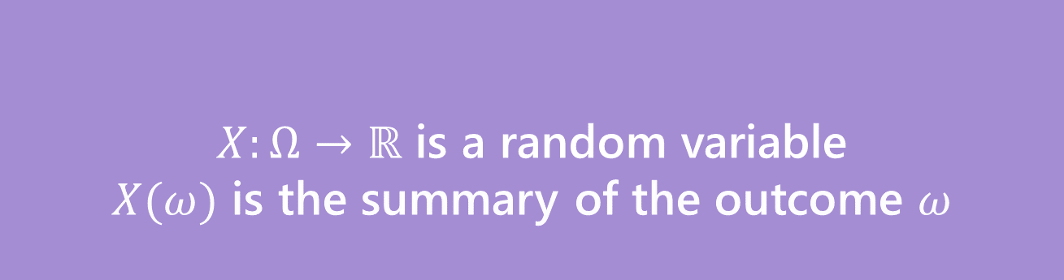
Random Variable
What’s a random variable?
Formally
Informally: A random variable is a way to summarize the important (numerical) information from your outcome.
$X:Ω→ℝ$ is a random variable
$X(ω)$ is the summary of the outcome $ω$
Random Variable

Slide 4

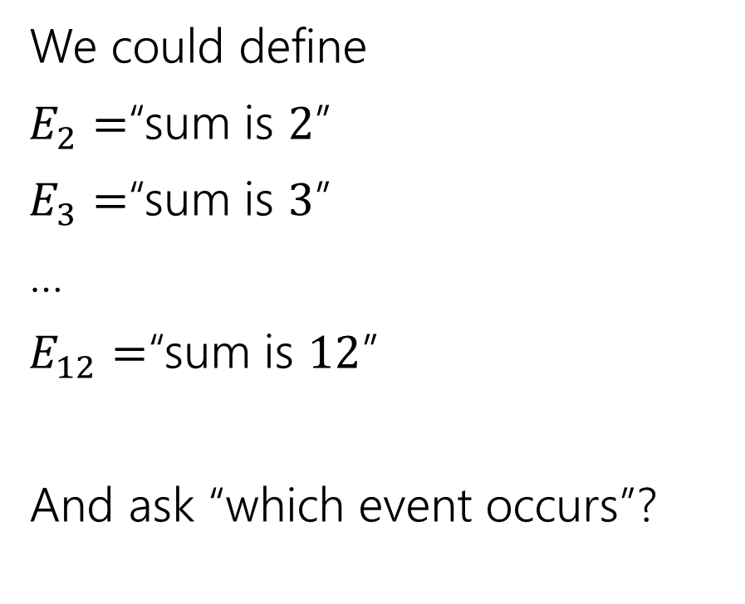
The sum of two dice
Events
Random variable
We could define
$E_{2}=$“sum is $2$”
$E_{3}=$“sum is $3$”
…
$E_{12}=$“sum is $12$”
And ask “which event occurs”?
$X:Ω→ℝ$
$X$is the sum of the two dice.

Slide 5
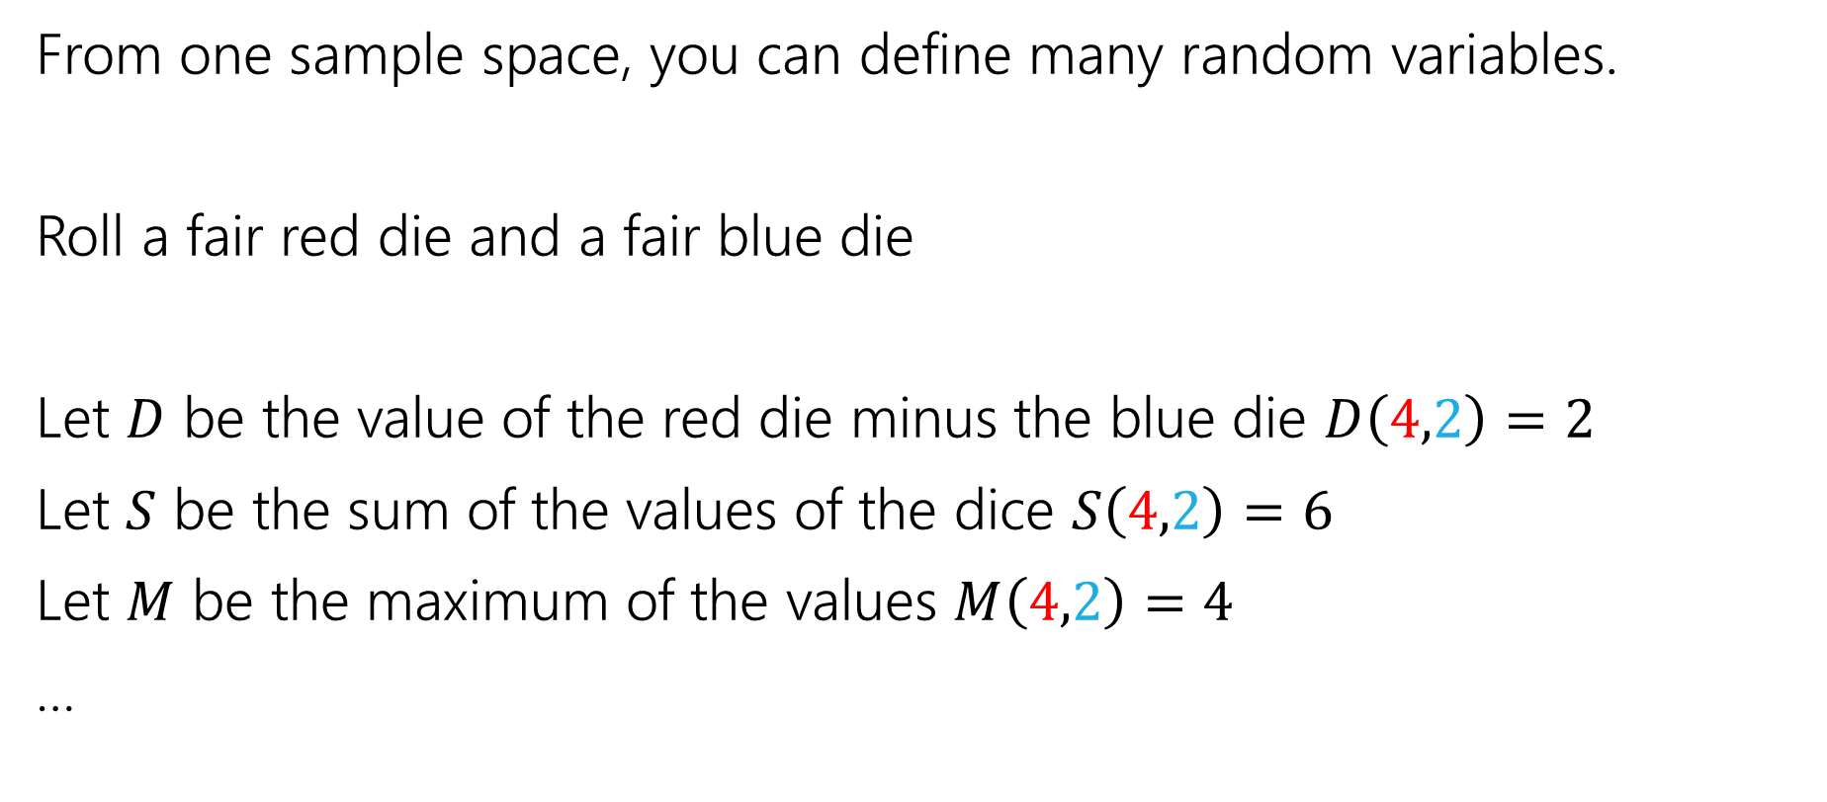
More random variables
From one sample space, you can define many random variables.
Roll a fair red die and a fair blue die
Let $D$ be the value of the red die minus the blue die $D\left(4,2\right)=2$
Let $S$ be the sum of the values of the dice $S\left(4,2\right)=6$
Let $M$ be the maximum of the values $M\left(4,2\right)=4$
…
Notes:
Give ~15 seconds for maximum.

Slide 6
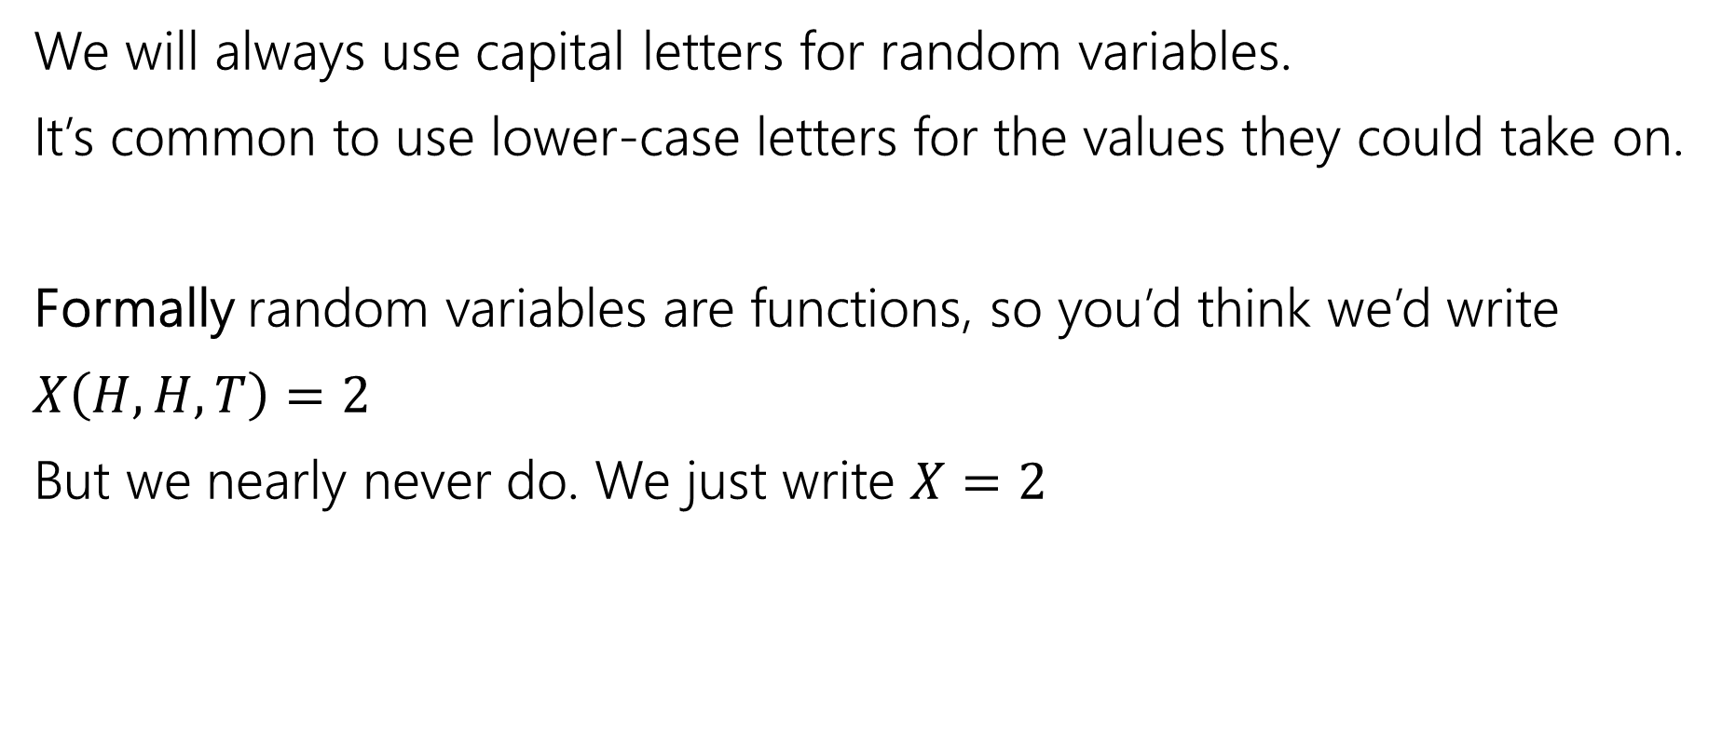
Notational Notes
We will always use capital letters for random variables.
It’s common to use lower-case letters for the values they could take on.
Formally random variables are functions, so you’d think we’d write
$X\left(H,H,T\right)=2$
But we nearly never do. We just write $X=2$

Slide 7

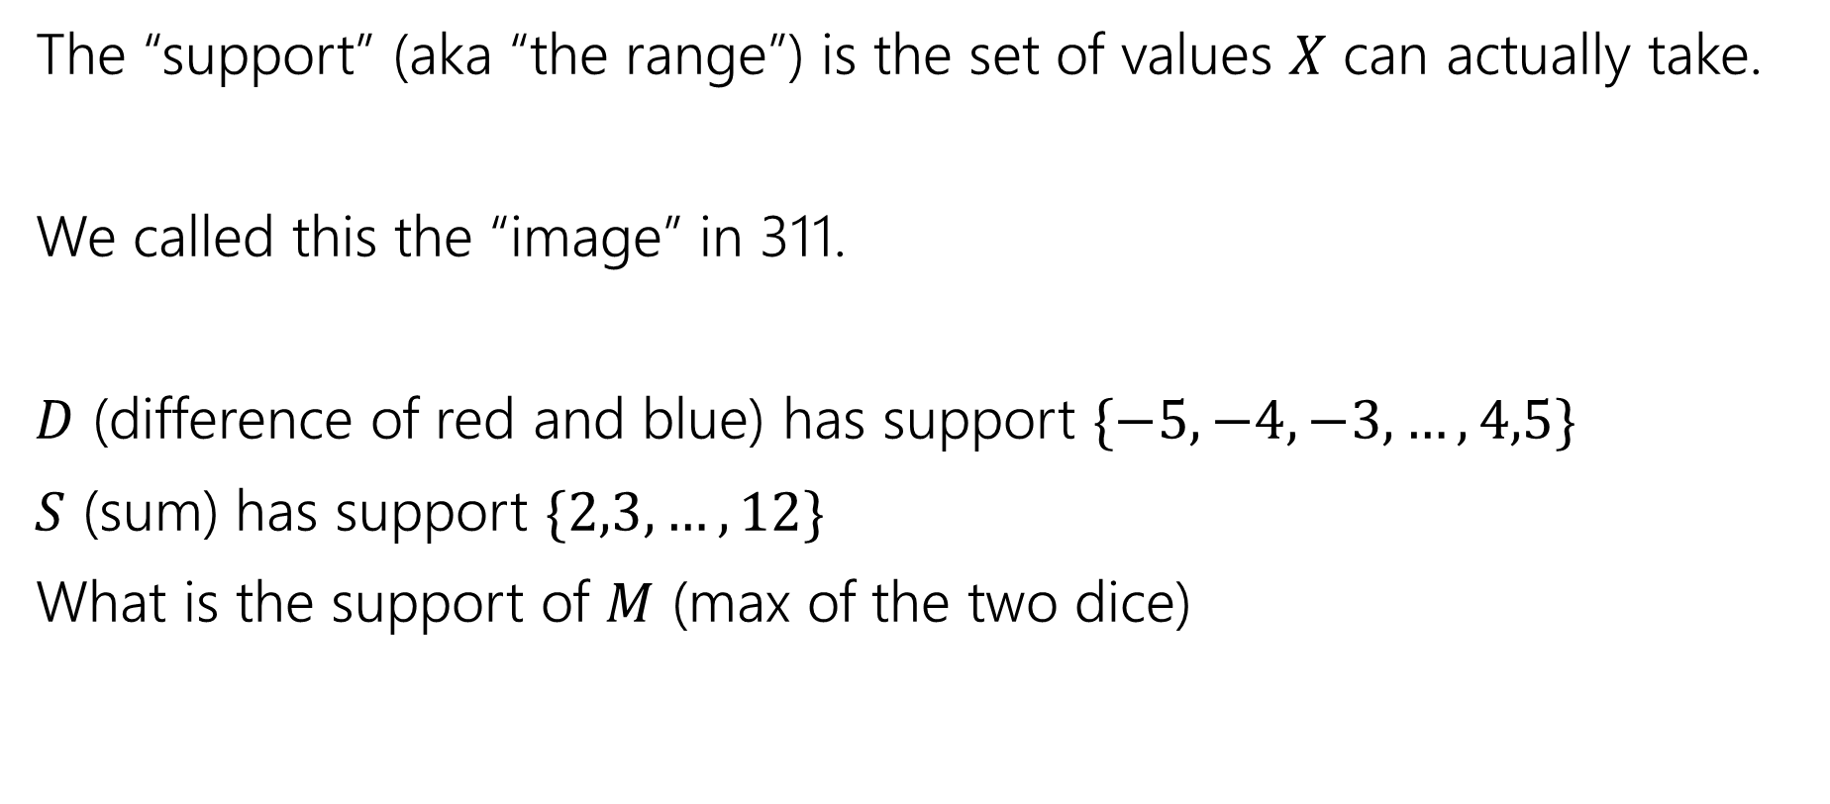
Support ($Ω_{X})$
The “support” (aka “the range”) is the set of values $X$ can actually take.
We called this the “image” in 311.
$D$ (difference of red and blue) has support $\{−5,−4,−3,…,4,5\}$
$S$ (sum) has support $\{2,3,…,12\}$
What is the support of $M$ (max of the two dice)
Notes:
Give ~15sec

Slide 8
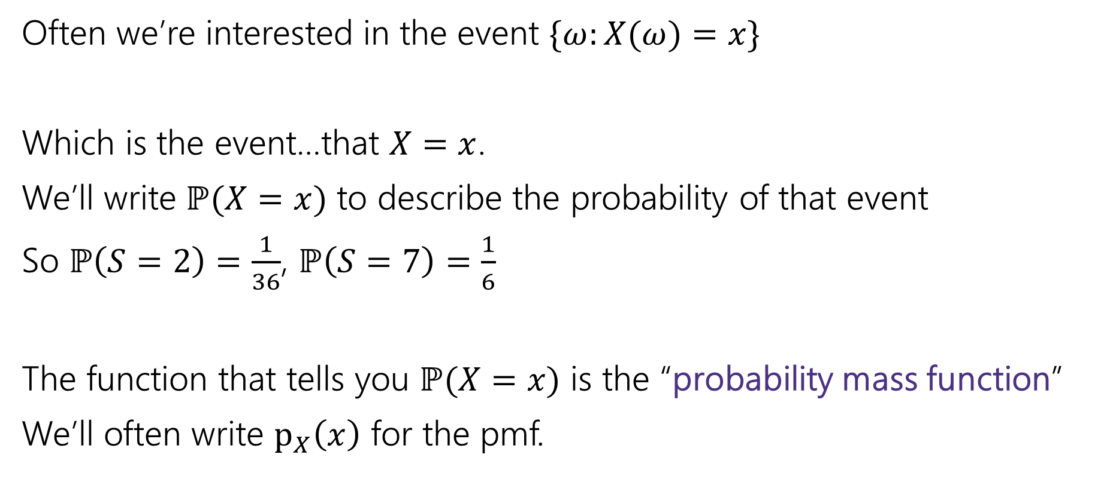
Probability Mass Function
Often we’re interested in the event $\{ω:X(ω)=x\}$
Which is the event…that $X=x$.
We’ll write $ℙ(X=x)$ to describe the probability of that event
So $ℙ\left(S=2\right)=\frac{1}{36}$, $ℙ\left(S=7\right)=\frac{1}{6}$
The function that tells you $ℙ(X=x)$ is the “probability mass function”
We’ll often write $p_{X}\left(x\right)$ for the pmf.
Notes:
TIME CHECK: 7.5 minutes
It is pretty standard to use lower-case x to describe the possible value of random variable upper-case-x.
This can be confusing if your handwriting doesn’t differentiate, it can also be confusing out loud (“what’s the probability X = x”) but it’s so standard we’ll do it most of the time. It’s just a convention though, so you can use a different letter if you prefer.

Slide 9
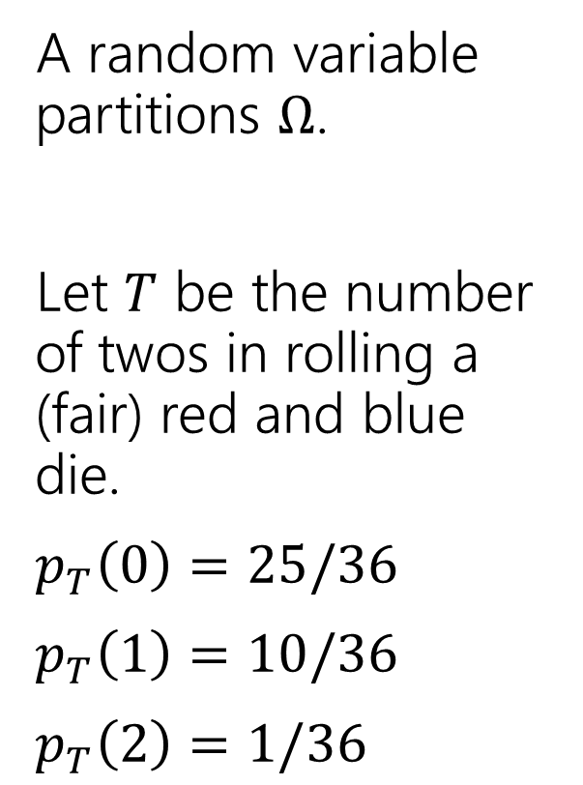
Partition
A random variable partitions $Ω$.
Let $T$ be the number of twos in rolling a (fair) red and blue die.
$p_{T}\left(0\right)=25/36$
$p_{T}\left(1\right)=10/36$
$p_{T}\left(2\right)=1/36$
 | D2=1 | D2=2 | D2=3 | D2=4 | D2=5 | D2=6
D1=1 | (1,1) | (1,2) | (1,3) | (1,4) | (1,5) | (1.6)
D1=2 | (2,1) | (2,2) | (2,3) | (2,4) | (2,5) | (2,6)
D1=3 | (3,1) | (3,2) | (3,3) | (3,4) | (3,5) | (3,6)
D1=4 | (4,1) | (4,2) | (4,3) | (4,4) | (4,5) | (4,6)
D1=5 | (5,1) | (5,2) | (5,3) | (5,4) | (5,5) | (5,6)
D1=6 | (6,1) | (6,2) | (6,3) | (6,4) | (6,5) | (6,6)
Notes:
Partition based on events T = t (set of outcomes that give T that specific value) for all t in the support

Slide 10
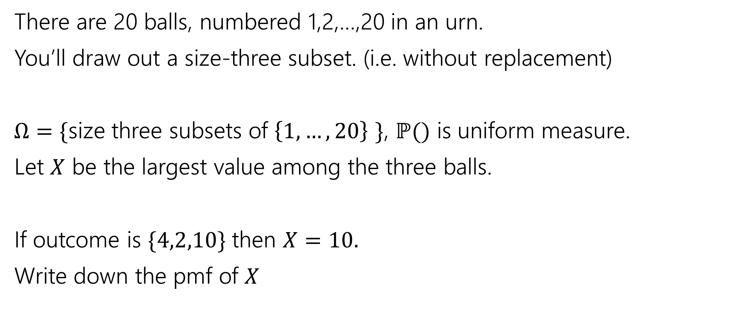
Try It Yourself
There are 20 balls, numbered 1,2,…,20 in an urn.
You’ll draw out a size-three subset. (i.e. without replacement)
$Ω=\{$size three subsets of $\left\{1,…,20\right\}$ $\}$, $ℙ()$ is uniform measure.
Let $X$ be the largest value among the three balls.
If outcome is $\{4,2,10\}$ then $X=10.$
Write down the pmf of $X$
Notes:
TIME CHECK: 13.5 minutes
Since uniform measure, boils down to counting problem.
Consider the case where x = 3: (1,2)
Consider the case where x = 4: (1,2), (2,3), (1,3)
=> Number of size three subsets with largest value x: x-1 choose 2 (all pairs of lower values)

Slide 11
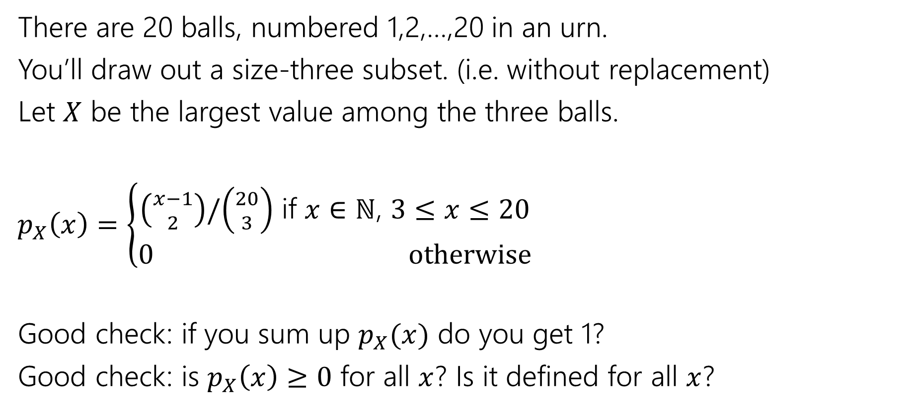
Try It Yourself
There are 20 balls, numbered 1,2,…,20 in an urn.
You’ll draw out a size-three subset. (i.e. without replacement)
Let $X$ be the largest value among the three balls.
$p_{X}\left(x\right)=\left\{\begin{aligned}\left({x−1 \atop 2}\right)/\left({20 \atop 3}\right) \text{if} x∈ℕ\text{, }3≤x≤20 \\ 0 otherwise\end{aligned}\right.$
Good check: if you sum up $p_{X}(x)$ do you get 1?
Good check: is $p_{X}\left(x\right)≥0$ for all $x$? Is it defined for all $x$?
Notes:
IMPORTANT: 0 otherwise
PAUSE FOR QUESTIONS

Slide 12

Random Variable
Support $Ω_{X}$
the set of values $X$ can take.
Probability Mass Function
(pmf $p_{X}(x)$)
on input $x,$tells you $ℙ\left(X=x\right).$
What’s a random variable?
Formally
Informally: A random variable is a way to summarize the important (numerical) information from your outcome.
$X:Ω→ℝ$ is a random variable
$X(ω)$ is the summary of the outcome $ω$
Random Variable
Notes:
Quick review of concepts before CDF – skip if low on time

Slide 13
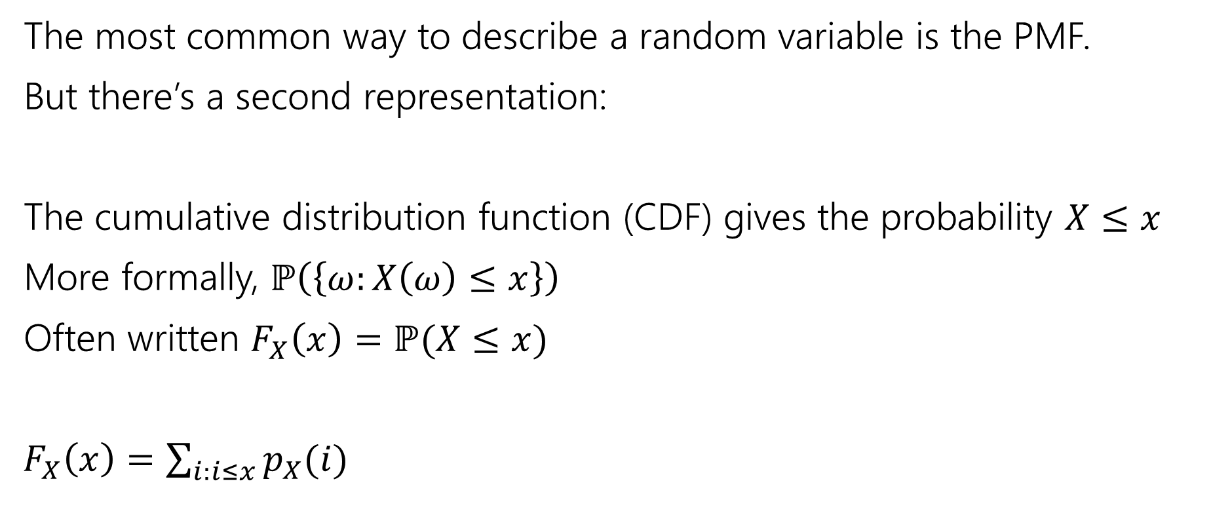
Describing a Random Variable
The most common way to describe a random variable is the PMF.
But there’s a second representation:
The cumulative distribution function (CDF) gives the probability $X≤x$
More formally, $ℙ\left(\left\{ω:X\left(ω\right)≤x\right\}\right)$
Often written $F_{X}\left(x\right)=ℙ(X≤x)$
$F_{X}\left(x\right)=\sum_{i:i≤x}{p_{X}(i)}$
Notes:
Summation notation – summing PMF for all values of RV less than or equal to x
“Cumulative” ⬄ cumulative exam – covers all things we know so far
Similarly, we are summing up all the probabilities less than this value

Slide 14

Try it yourself
What is the CDF of $X$ where
$X$ be the largest value among the three balls. (Drawing 3 of the 20 without replacement)
Notes:
TIME CHECK: 23 minutes
Take 1 minute
Same counting problem – number of ways to pick size-3 subset with largest value AT MOST x
=> All size three subsets from the set 1,2,…,x

Slide 15
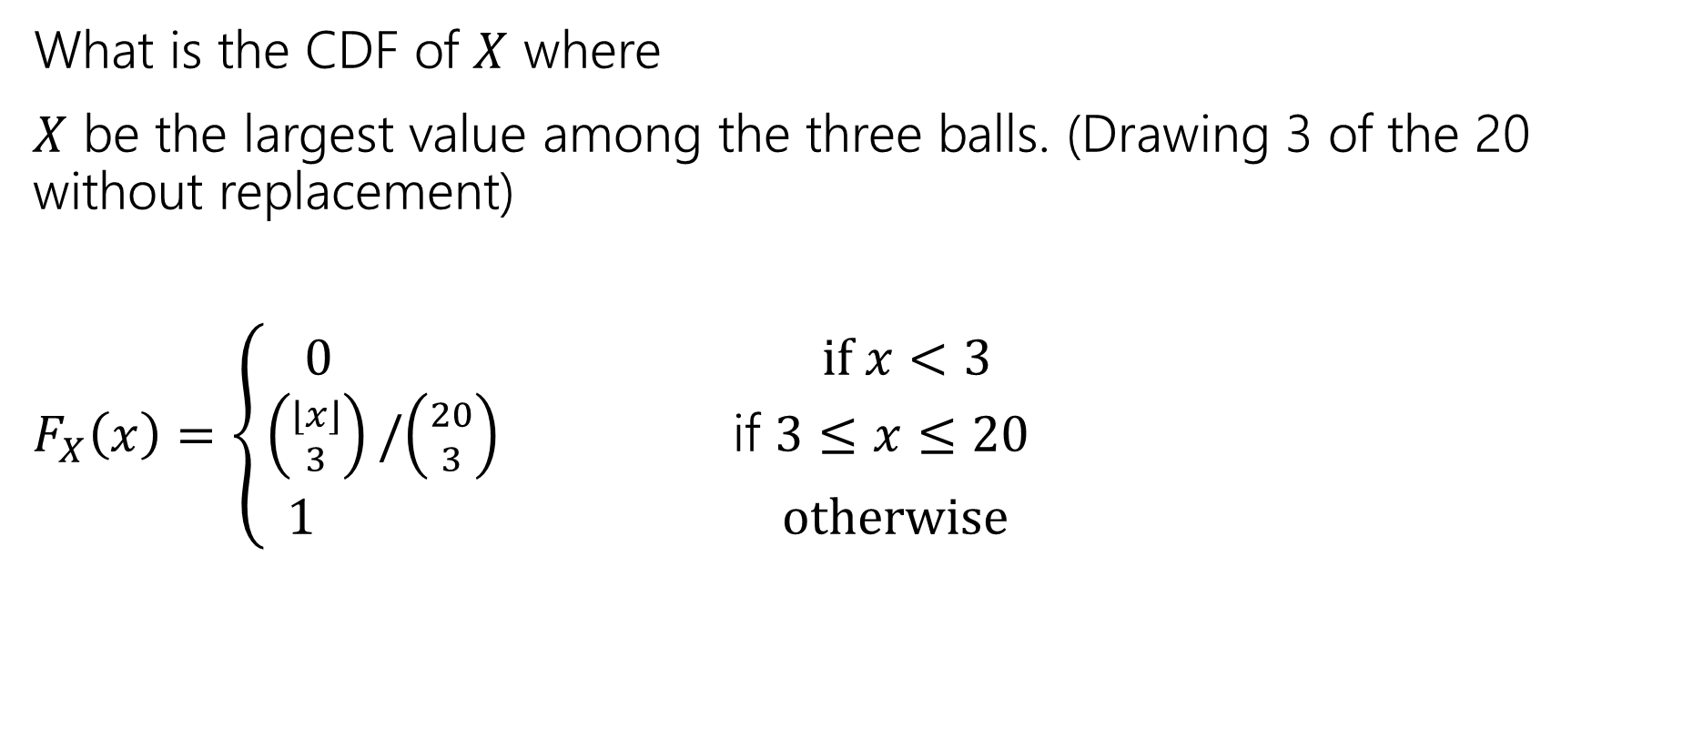
Try it yourself
What is the CDF of $X$ where
$X$ be the largest value among the three balls. (Drawing 3 of the 20 without replacement)
$F_{X}\left(x\right)=\left\{\begin{aligned}\begin{aligned}0 if x<3 \\ \left({⌊x⌋ \atop 3}\right)/\left({20 \atop 3}\right) \text{if} 3≤x≤20\end{aligned} \\ 1 otherwise\end{aligned}\right.$
Notes:
Start with main case
Explain edge cases
PAUSE FOR QUESTIONS

Slide 16
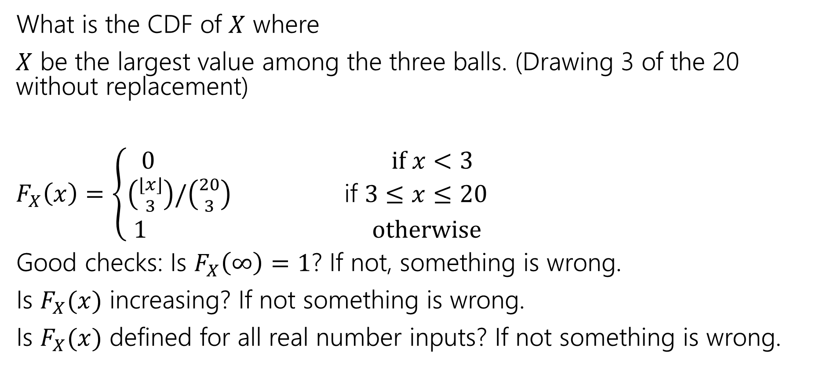
Try it yourself
What is the CDF of $X$ where
$X$ be the largest value among the three balls. (Drawing 3 of the 20 without replacement)
$F_{X}\left(x\right)=\left\{\begin{aligned}\begin{aligned}0 if x<3 \\ \left({⌊x⌋ \atop 3}\right)/\left({20 \atop 3}\right) \text{if} 3≤x≤20\end{aligned} \\ 1 otherwise\end{aligned}\right.$
Good checks: Is $F_{X}\left(∞\right)=1$? If not, something is wrong.
Is $F_{X}(x)$ increasing? If not something is wrong.
Is $F_{X}(x)$ defined for all real number inputs? If not something is wrong.

Slide 17
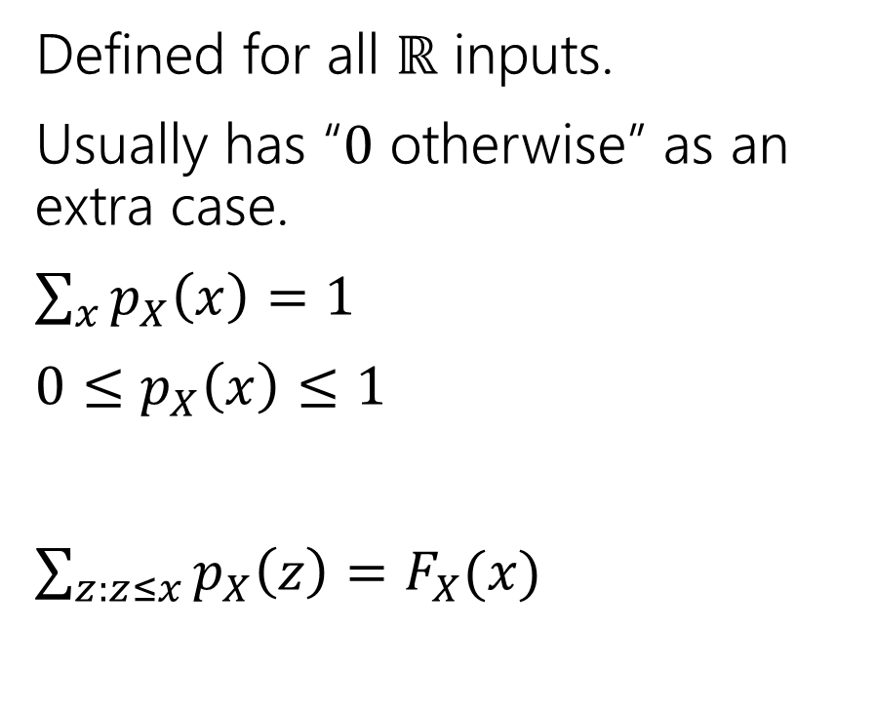
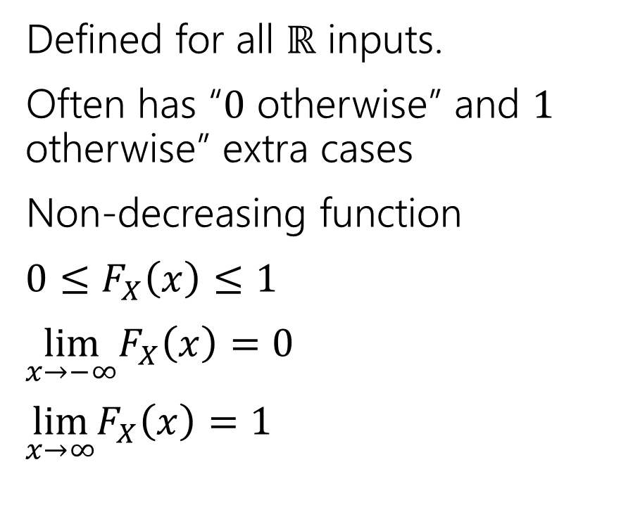
Two descriptions
Probability mass function
Cumulative Distribution function
Defined for all $ℝ$ inputs.
Usually has “$0$ otherwise” as an extra case.
$\sum_{x}{p_{X}\left(x\right)=1}$
$0≤p_{X}\left(x\right)≤1$
$\sum_{z:z≤x}{p_{X}\left(z\right)=F_{X}(x)}$
Defined for all $ℝ$ inputs.
Often has “$0$ otherwise” and $1$ otherwise” extra cases
Non-decreasing function
$0≤F_{X}\left(x\right)≤1$
$\lim_{x→−∞}F_{X}\left(x\right)=0$
$\lim_{x→∞}F_{X}\left(x\right)=1⁡$
Notes:
TIME CHECK: 30 minutes

Slide 18

More Random Variable Practice
Roll a fair die $n$ times. Let $Z$ be the number of rolls that are $5s$ or $6s$.
What is the pmf?
Don’t try to write the CDF…it’s a mess…
Or try for a few minutes to realize it isn’t nice.
Notes:
Take 1 minute
Same uniform distribution => counting problem
Sequential process: If we see z,
Choose order of rolls for 5/6,
Multiply by prob of seeing that many 5/6,
Multiply by prob of seeing others

Slide 19
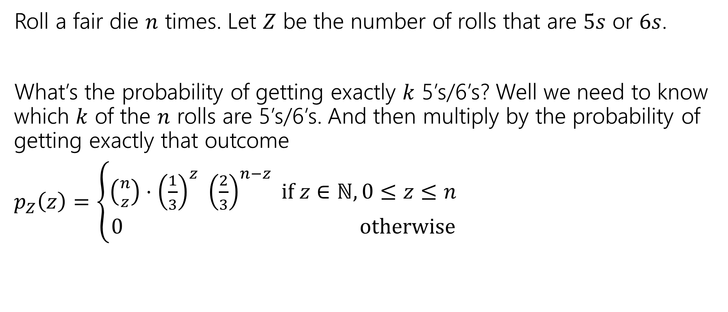
More Random Variable Practice
Roll a fair die $n$ times. Let $Z$ be the number of rolls that are $5s$ or $6s$.
What’s the probability of getting exactly $k$ 5’s/6’s? Well we need to know which $k$ of the $n$ rolls are 5’s/6’s. And then multiply by the probability of getting exactly that outcome
$p_{Z}\left(z\right)=\left\{\begin{aligned}\left({n \atop z}\right)⋅{\left(\frac{1}{3}\right)}^{z} {\left(\frac{2}{3}\right)}^{n−z} if z∈ℕ,0≤z≤n \\ 0 otherwise\end{aligned}\right.$

Slide 20
Expectation

Slide 21
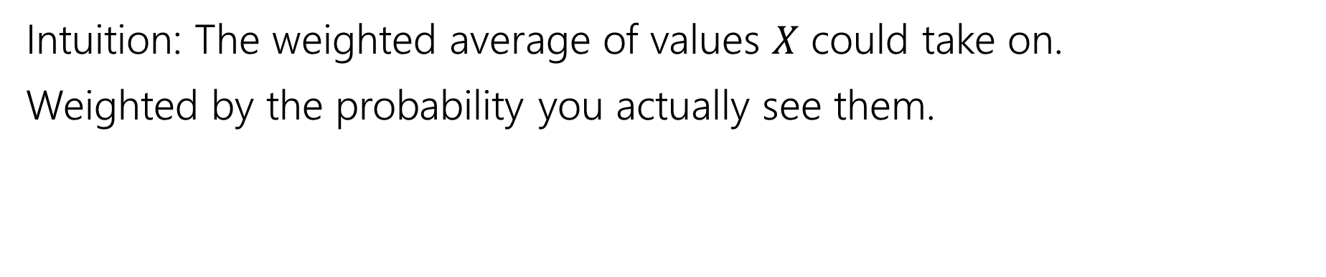
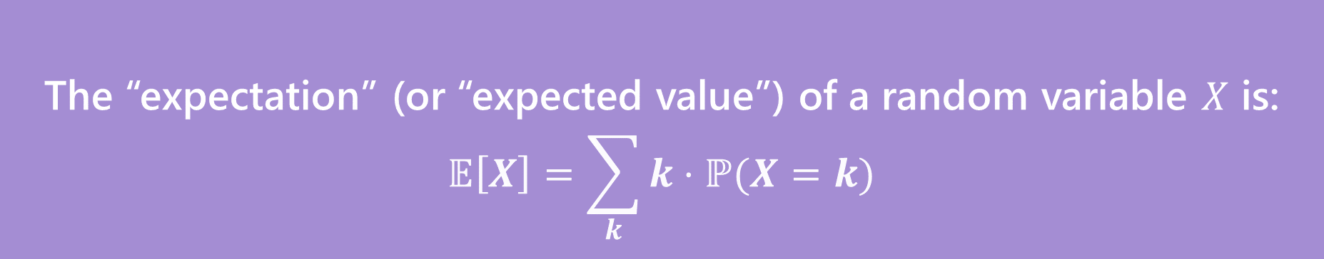
Expectation
The “expectation” (or “expected value”) of a random variable $X$ is:
$$𝔼\left[X\right]=\sum_{k}{k⋅ℙ(X=k)}$$
Expectation
Intuition: The weighted average of values $X$ could take on.
Weighted by the probability you actually see them.
Notes:
TIME CHECK: 34 minutes
Alternative intuition: If you ran the experiment generating X over and over, what would the value be on average?

Slide 22

Example 1
Flip a fair coin twice (independently)
Let $X$be the number of heads.
$Ω=\{TT,TH,HT,HH\}$, $ℙ()$ is uniform measure.
$𝔼\left[X\right]=\frac{1}{4}⋅0+\frac{1}{2}⋅1+\frac{1}{4}⋅2=0+\frac{1}{2}+\frac{1}{2}=1$.

Slide 23
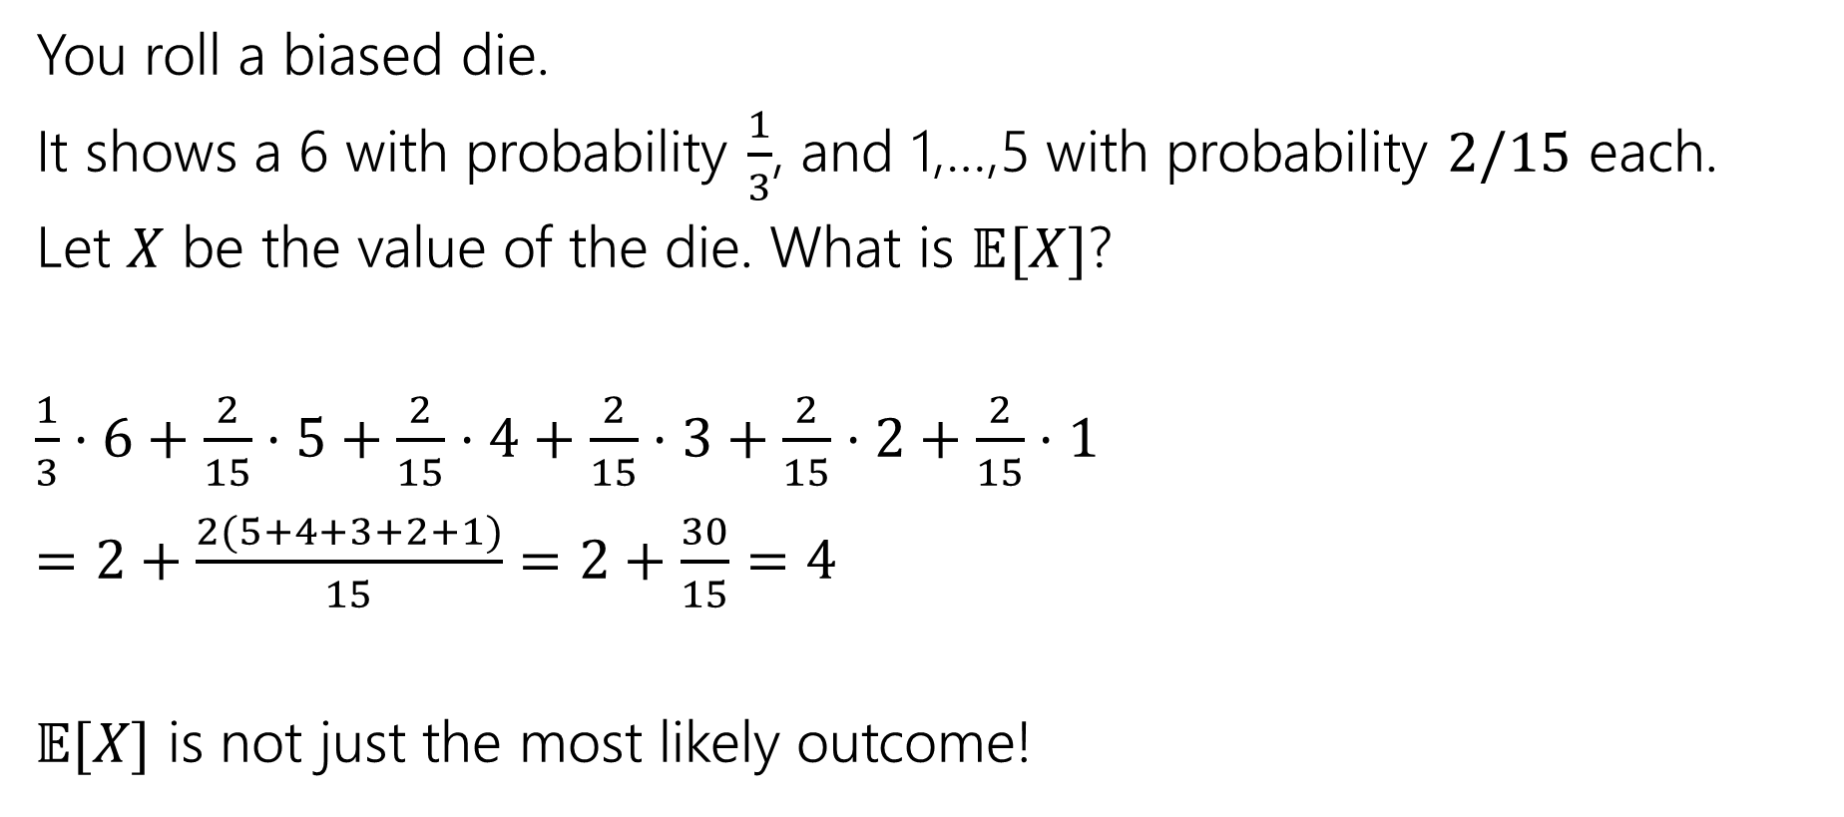
Example 2
You roll a biased die.
It shows a 6 with probability $\frac{1}{3}$, and 1,…,5 with probability $2/15$ each.
Let $X$ be the value of the die. What is $𝔼[X]$?
$\frac{1}{3}⋅6+\frac{2}{15}⋅5+\frac{2}{15}⋅4+\frac{2}{15}⋅3+\frac{2}{15}⋅2+\frac{2}{15}⋅1$
$=2+\frac{2(5+4+3+2+1)}{15}=2+\frac{30}{15}=4$
$𝔼[X]$ is not just the most likely outcome!

Slide 24

Try it yourself
Let $X$ be the result shown on a fair die. What is $𝔼[X]$?
Let $Y$ be the sum of two (independent) fair die rolls. What is $𝔼[Y]$?
Notes:
Take 1 minute

Slide 25

Try it yourself
Let $X$ be the result shown on a fair die. What is $𝔼[X]$
$6⋅\frac{1}{6}+5⋅\frac{1}{6}+4⋅\frac{1}{6}+3⋅\frac{1}{6}+2⋅\frac{1}{6}+1⋅\frac{1}{6}$
$=\frac{21}{6}=3.5$
$𝔼[X]$ is not necessarily a possible outcome!
That’s ok, it’s an average!

Slide 26

Try it yourself
$𝔼\left[Y\right]=$
$\frac{1}{36}⋅2+\frac{2}{36}⋅3+\frac{3}{36}⋅4+\frac{4}{36}⋅5+\frac{5}{36}⋅6+\frac{6}{36}⋅7+\frac{5}{36}⋅8+\frac{4}{36}⋅9+\frac{3}{36}⋅10+\frac{2}{36}⋅11+\frac{1}{36}⋅12$
$=7$
$𝔼\left[Y\right]=2𝔼[X]$. That’s not a coincidence…we’ll talk about why on Friday.
Notes:
This is a general pattern – we will develop the tools to discuss it mathematically on Friday

Slide 27

Subtle but Important
$X$ is random. You don’t know what it is (at least until you run the experiment).
$𝔼[X]$ is not random. It’s a number.
You don’t need to run the experiment to know what it is.
Notes:
Even after running experiment, expectation is the same
WHY DO WE CARE? Helps us as computer scientists quantify the general behavior of random processes.
PAUSE FOR QUESTIONS

Slide 28
More Independence

Slide 29
Independence of Random Variables
That’s for events…what about random variables?
$X$ and $Y$ are independent if for all $k,ℓ$
$$ℙ\left(X=k, Y=ℓ\right)=ℙ\left(X=k\right)ℙ(Y=ℓ)$$
Independence (of random variables)
We’ll often use commas instead of $∩$ symbol.
Notes:
IMPORTANT: for all k,l
Analogous to events otherwise, but must be true for all events w.r.t RVs (X=k is an event)

Slide 30

Independence of Random Variables
The “for all values” is important.
We say that the event “the sum is 7” is independent of “the red die is 5”
What about $S=$“the sum of two dice” and $R=$“the value of the red die”

Slide 31
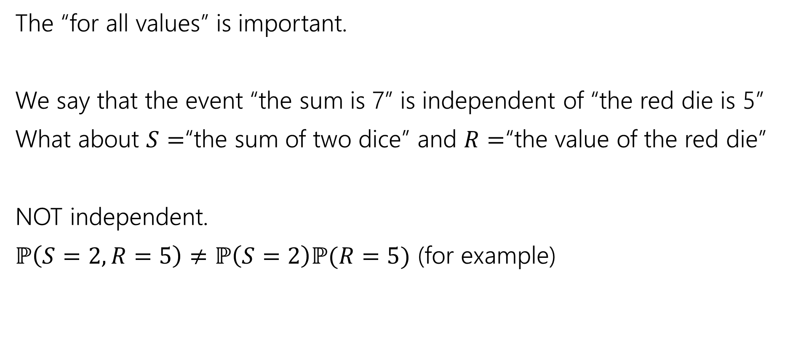
Independence of Random Variables
The “for all values” is important.
We say that the event “the sum is 7” is independent of “the red die is 5”
What about $S=$“the sum of two dice” and $R=$“the value of the red die”
NOT independent.
$ℙ\left(S=2, R=5\right)≠ℙ\left(S=2\right)ℙ(R=5)$ (for example)
Notes:
Left side 0, right side 1/36 * 1/6

Slide 32

Independence of Random Variables
Flip a coin independently $2n$ times.
Let $X$ be “the number of heads in the first $n$ flips.”
Let $Y$ be “the number of heads in the last $n$ flips.”
$X$ and $Y$ are independent.
Notes:
The events X=x, Y=y are always independent since they are describing functionally different experiments (two sets of n flips)
Probability we see x heads in the first n flips does not affect the probability of seeing y heads in the next n flips

Slide 33

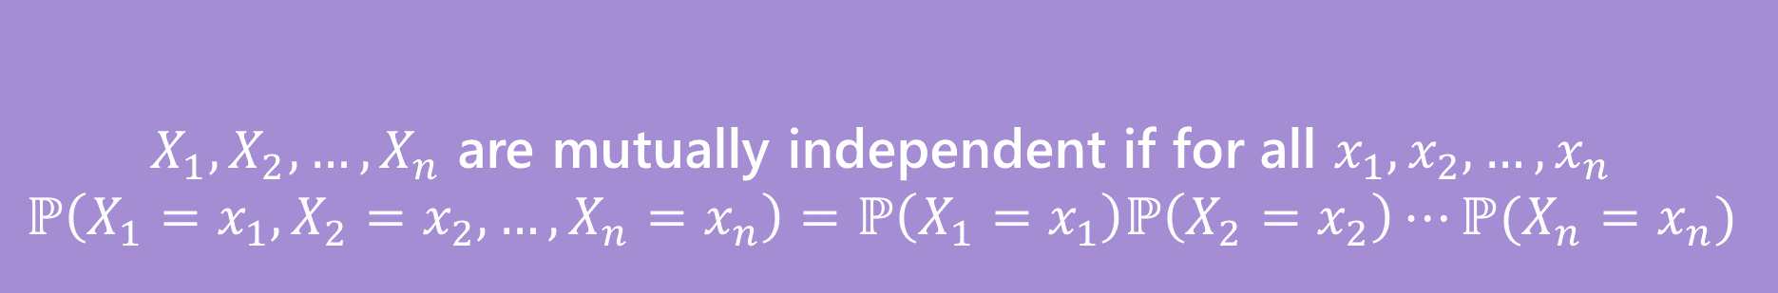
Mutual Independence for RVs
A little simpler to write down than for events
DON’T need to check all subsets for random variables…
But you do need to check all values (all possible $x_{i}$) still.
$X_{1},X_{2},…,X_{n}$ are mutually independent if for all $x_{1},x_{2},…,x_{n}$
$$ℙ\left(X_{1}=x_{1}, X_{2}=x_{2},…,X_{n}=x_{n}\right)=ℙ\left(X_{1}=x_{1}\right)ℙ\left(X_{2}=x_{2}\right)⋯ℙ(X_{n}=x_{n})$$
Mutual Independence (of random variables)
Notes:
For events, we need to check that this condition holds for all subsets (not just the full group)

Slide 34

What does Independence give you?
$𝔼\left[XY\right]=𝔼\left[X\right]⋅𝔼[Y]$
$Var\left(X+Y\right)=Var\left(X\right)+Var(Y)$
Notes:
Looking forward- useful tools

Slide 35
More Practice: Infinite sequential processes
Notes:
TIME CHECK: Stop if <5 minutes

Slide 36
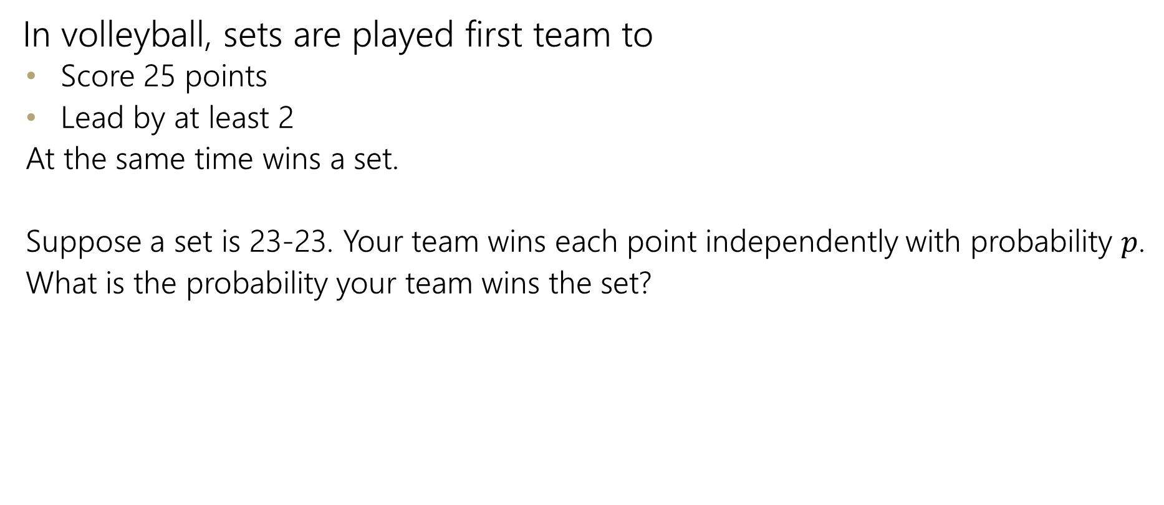
Infinite sequential process
In volleyball, sets are played first team to
  Score 25 points
  Lead by at least 2
  At the same time wins a set.
  Suppose a set is 23-23. Your team wins each point independently with probability $p$.
  What is the probability your team wins the set?

Slide 37
Sequential Process
0
$$ℙ\left(win from even\right)=p^{2}+2p\left(1−p\right)ℙ(win from even)$$
+
-
W
0
L
+
-
W
0
L
+
-
…
Notes:
Either win with 2 in a row (first term) or start from even again (second term)
Solve using algebra

Slide 38
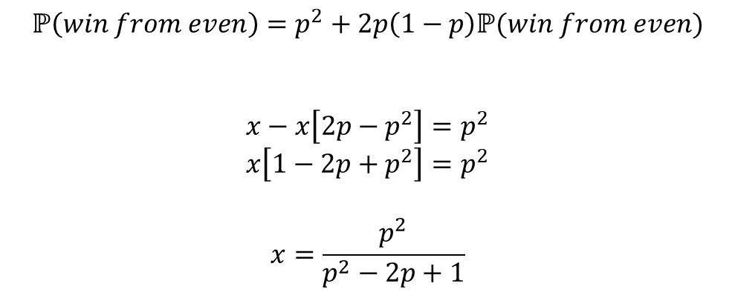
Sequential Process
0
$$ℙ\left(win from even\right)=p^{2}+2p\left(1−p\right)ℙ(win from even)$$
$$x−x\left[2p−p^{2}\right]=p^{2}$$
$$x\left[1−2p+p^{2}\right]=p^{2}$$
$$x=\frac{p^{2}}{p^{2}−2p+1}$$
+
-
W
0
L
+
-
W
0
L
+
-
…

