Slide 1
Independence
CSE 312 Winter 25
Lecture 7

Slide 2
Announcements
HW2 due tonight
HW3 out this evening.
HW3 includes a programming problem – using Bayes rule to do some machine learning – detecting whether emails are spam or “ham” (legitimate emails).
Longer than the programming on HW1 – please get started early!
Extra resources will be available!

Slide 3
Today
Outline:
Independence
Chain Rule
Conditional Independence

Slide 4
Definition of Independence
We’ve calculated conditional probabilities.
Sometimes conditioning – getting some partial information about the outcome – doesn’t actually change the probability.
We already saw an example like this…

Slide 5
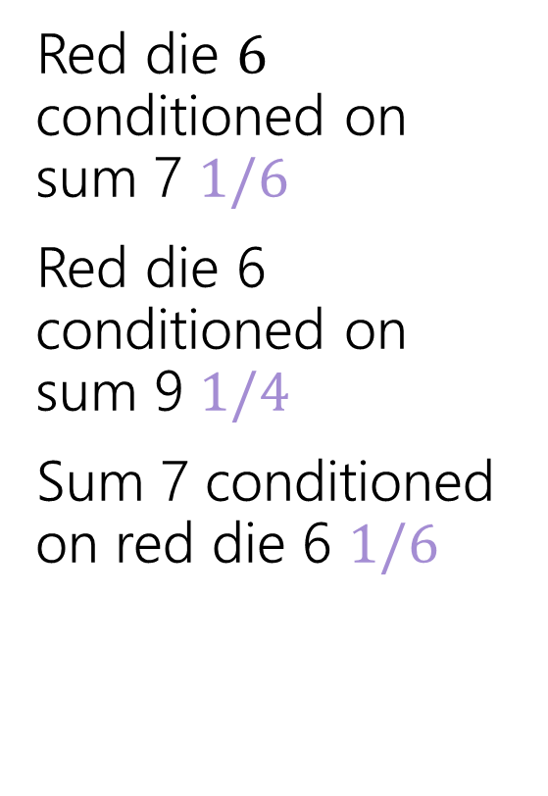
Conditioning Practice
Red die $6$ conditioned on sum 7 $1/6$
Red die 6 conditioned on sum 9 $1/4$
Sum 7 conditioned on red die 6 $1/6$
 | D2=1 | D2=2 | D2=3 | D2=4 | D2=5 | D2=6
D1=1 | (1,1) | (1,2) | (1,3) | (1,4) | (1,5) | (1.6)
D1=2 | (2,1) | (2,2) | (2,3) | (2,4) | (2,5) | (2,6)
D1=3 | (3,1) | (3,2) | (3,3) | (3,4) | (3,5) | (3,6)
D1=4 | (4,1) | (4,2) | (4,3) | (4,4) | (4,5) | (4,6)
D1=5 | (5,1) | (5,2) | (5,3) | (5,4) | (5,5) | (5,6)
D1=6 | (6,1) | (6,2) | (6,3) | (6,4) | (6,5) | (6,6)
Red die 6 has probability 1/6 before or after conditioning on sum 7.

Slide 6
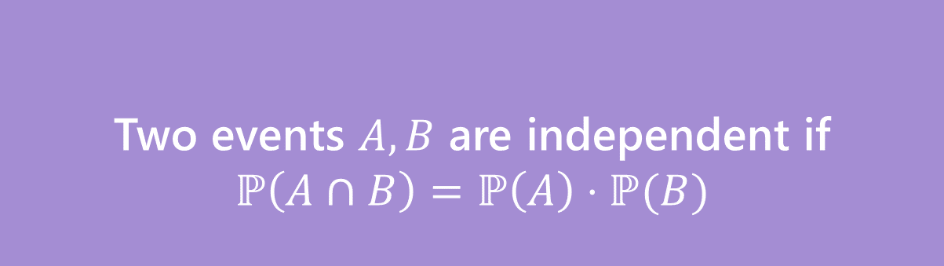
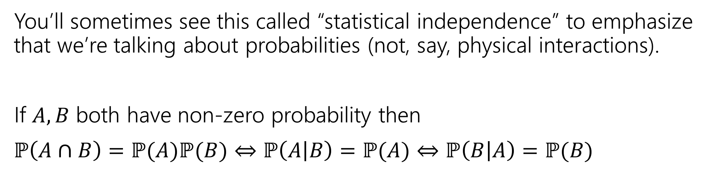
Independence
Two events $A,B$ are independent if
$$ℙ\left(A∩B\right)=ℙ\left(A\right)⋅ℙ(B)$$
Independence
You’ll sometimes see this called “statistical independence” to emphasize that we’re talking about probabilities (not, say, physical interactions).
If $A,B$ both have non-zero probability then
$ℙ\left(A∩B\right)=ℙ(A)ℙ(B)$ $⇔$ $ℙ\left(A | B\right)=ℙ(A)$ $⇔ℙ\left(B | A\right)=ℙ(B)$

Slide 7
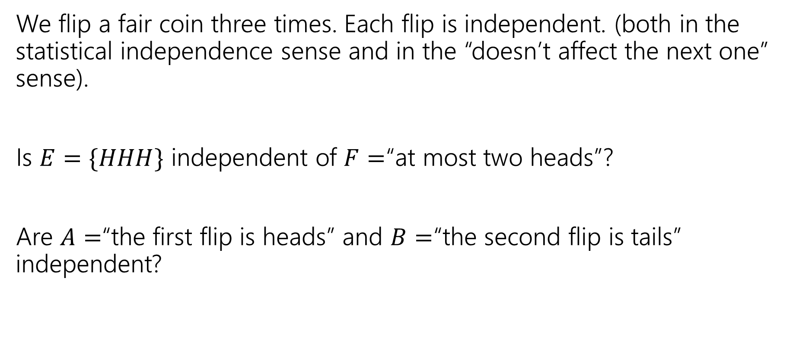
Examples
We flip a fair coin three times. Each flip is independent. (both in the statistical independence sense and in the “doesn’t affect the next one” sense).
Is $E=\{HHH\}$ independent of $F=$“at most two heads”?
Are $A=$“the first flip is heads” and $B=$“the second flip is tails” independent?

Slide 8
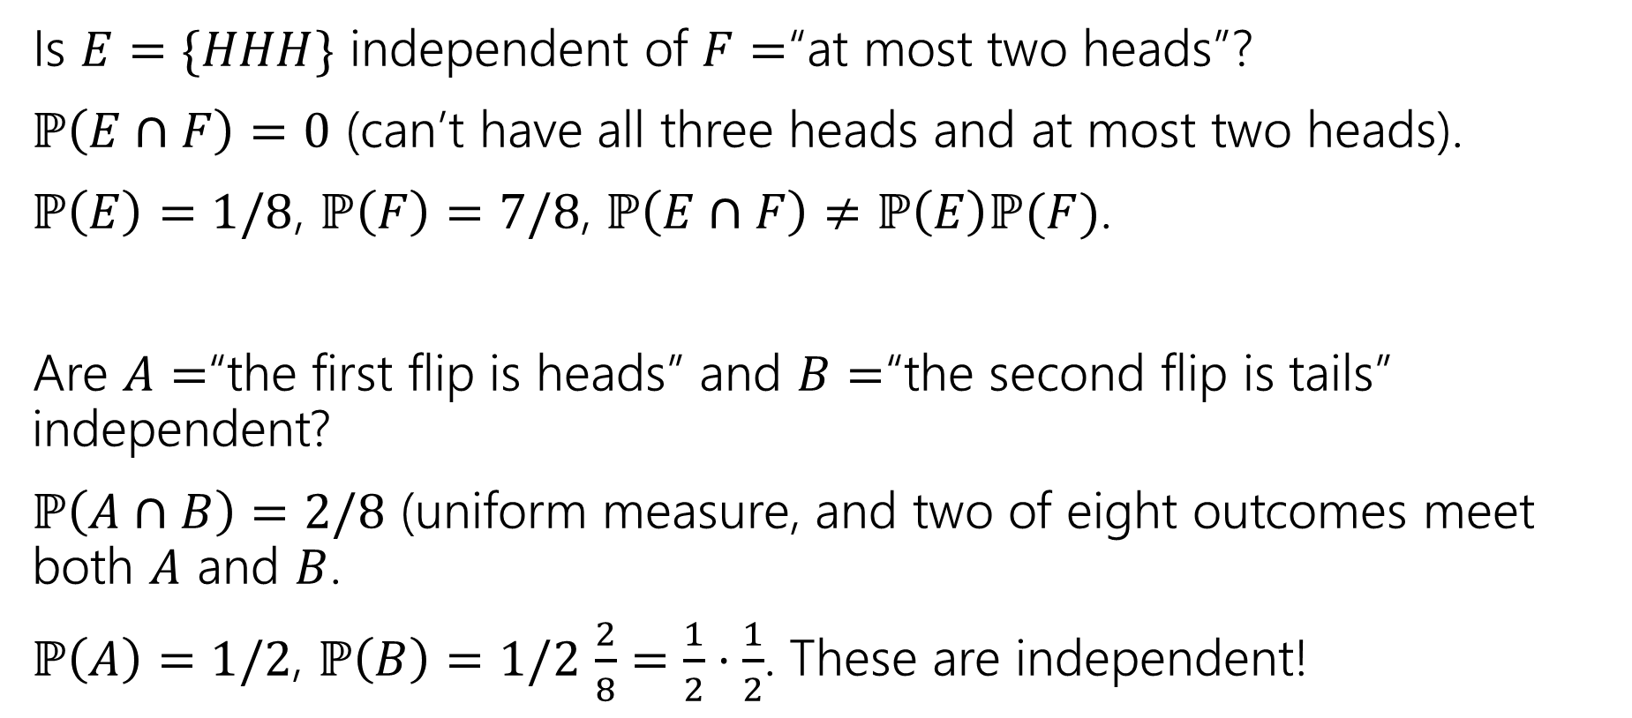
Examples
Is $E=\{HHH\}$ independent of $F=$“at most two heads”?
$ℙ\left(E∩F\right)=0$ (can’t have all three heads and at most two heads).
$ℙ\left(E\right)=1/8$, $ℙ\left(F\right)=7/8$, $ℙ\left(E∩F\right)≠ℙ\left(E\right)ℙ(F)$.
Are $A=$“the first flip is heads” and $B=$“the second flip is tails” independent?
$ℙ\left(A∩B\right)=2/8$ (uniform measure, and two of eight outcomes meet both $A$ and $B$.
$ℙ\left(A\right)=1/2$, $ℙ\left(B\right)=1/2$ $\frac{2}{8}=\frac{1}{2}⋅\frac{1}{2}$. These are independent!

Slide 9
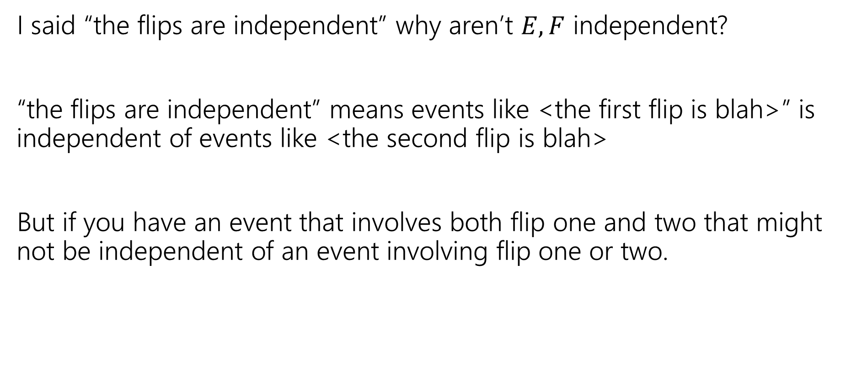
Hey Wait
I said “the flips are independent” why aren’t $E,F$ independent?
“the flips are independent” means events like <the first flip is blah>” is independent of events like <the second flip is blah>
But if you have an event that involves both flip one and two that might not be independent of an event involving flip one or two.

Slide 10
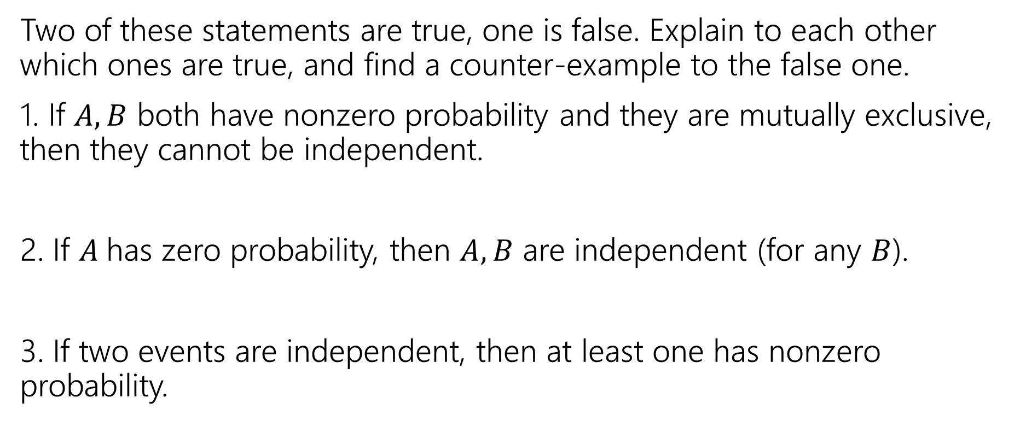
Mutual Exclusion and independence
Two of these statements are true, one is false. Explain to each other which ones are true, and find a counter-example to the false one.
1. If $A,B$ both have nonzero probability and they are mutually exclusive, then they cannot be independent.
2. If $A$has zero probability, then $A,B$ are independent (for any $B$).
3. If two events are independent, then at least one has nonzero probability.
Fill out the poll everywhere so Robbie knows how long to explain
Go to pollev.com/robbie

Slide 11
Mutual Exclusion and independence
Two of these statements are true, one is false. Explain to each other which ones are true, and find a counter-example to the false one.
1. If $A,B$ both have nonzero probability and they are mutually exclusive, then they cannot be independent.
2. If $A$has zero probability, then $A,B$ are independent (for any $B$).
3. If two events are independent, then at least one has nonzero probability.
Notes:
1. True (P(B|A) = 0 in this case).
2. True (P(A cap B) <= P(A) = 0; P(A)P(B) = 0*P(B)=0
3. False. For A, B events with 0 probability P(A cap B)=0=0*0=P(A)P(B), so they are independent.

Slide 12
Chain Rule

Slide 13
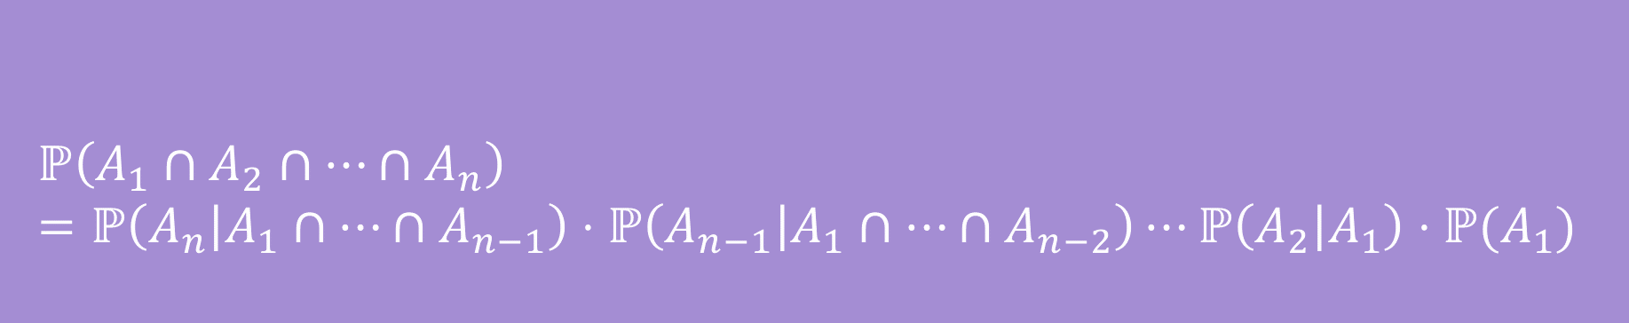

Chain Rule
We defined conditional probability as: $ℙ\left(A | B\right)=\frac{ℙ\left(A∩B\right)}{ℙ\left(B\right)}$
Which means $ℙ\left(A∩B\right)=ℙ(A|B)ℙ(B)$
$$ℙ\left(A_{1}∩A_{2}∩…∩A_{n}\right)=ℙ\left(A_{n} | A_{1}∩…∩A_{n−1}\right)⋅ℙ\left(A_{n−1} | A_{1}∩…∩A_{n−2}\right)⋯ℙ\left(A_{2} | A_{1}\right)⋅ℙ(A_{1})$$
Chain Rule

Slide 14
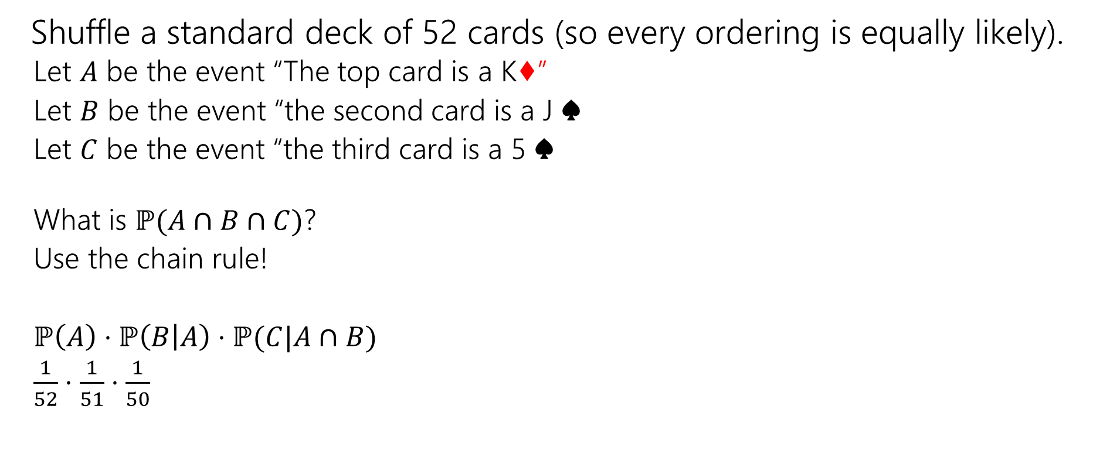
Chain Rule Example
Shuffle a standard deck of 52 cards (so every ordering is equally likely).
  Let $A$ be the event “The top card is a K♦”
  Let $B$ be the event “the second card is a J ♠️
  Let $C$ be the event “the third card is a 5 ♠️
  What is $ℙ(A∩B∩C)$?
  Use the chain rule!
  $ℙ\left(A\right)⋅ℙ\left(B | A\right)⋅ℙ(C|A∩B)$
  $\frac{1}{52}⋅\frac{1}{51}⋅\frac{1}{50}$

Slide 15
Conditional Independence

Slide 16

Conditional Independence
We say $A$ and $B$ are conditionally independent on $C$ if
$ℙ\left(A∩B | C\right)=ℙ\left(A | C\right)⋅ℙ(B|C)$
i.e. if you condition on $C$, they are independent.

Slide 17
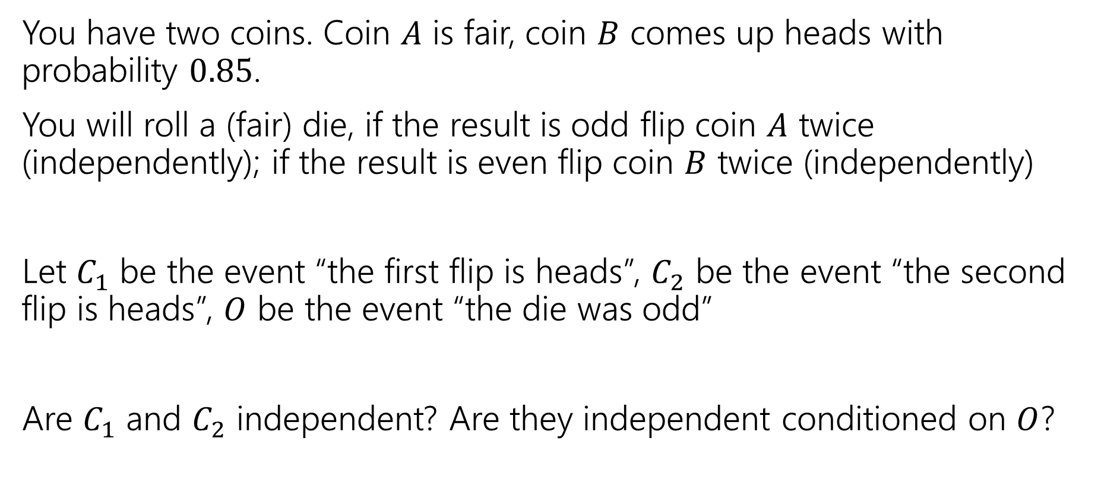
Conditional Independence Example
You have two coins. Coin $A$ is fair, coin $B$ comes up heads with probability $0.85$.
You will roll a (fair) die, if the result is odd flip coin $A$ twice (independently); if the result is even flip coin $B$ twice (independently)
Let $C_{1}$ be the event “the first flip is heads”, $C_{2}$ be the event “the second flip is heads”, $O$ be the event “the die was odd”
Are $C_{1}$ and $C_{2}$ independent? Are they independent conditioned on $O$?

Slide 18
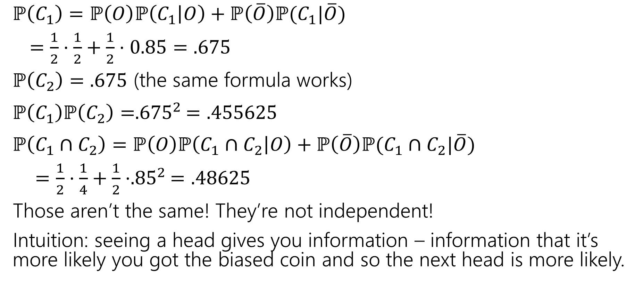
(Unconditioned) Independence
$ℙ\left(C_{1}\right)=ℙ\left(O\right)ℙ\left(C_{1} | O\right)+ℙ\left(\overline{O}\right)ℙ(C_{1}|\overline{O})$
$=\frac{1}{2}⋅\frac{1}{2}+\frac{1}{2}⋅0.85=.675$
$ℙ\left(C_{2}\right)=.675$ (the same formula works)
$ℙ\left(C_{1}\right)ℙ\left(C_{2}\right)={.675}^{2}=.455625$
$ℙ\left(C_{1}∩C_{2}\right)=ℙ\left(O\right)ℙ\left(C_{1}∩C_{2} | O\right)+ℙ\left(\overline{O}\right)ℙ(C_{1}∩C_{2}|\overline{O})$
$=\frac{1}{2}⋅\frac{1}{4}+\frac{1}{2}⋅{.85}^{2}=.48625$
Those aren’t the same! They’re not independent!
Intuition: seeing a head gives you information – information that it’s more likely you got the biased coin and so the next head is more likely.

Slide 19

Conditional Independence
$ℙ\left(C_{1} | O\right)=1/2$
$ℙ\left(C_{2} | O\right)=1/2$
$ℙ\left(C_{1}∩C_{2} | O\right)=\frac{1}{2}⋅\frac{1}{2}=1/4$
$ℙ\left(C_{1} | O\right)ℙ\left(C_{2} | O\right)=ℙ(C_{1}∩C_{2}|O)$
Yes! $C_{1}$ and $C_{2}$ are conditionally independent, conditioned on $O$.

Slide 20
Takeaway
Read a problem carefully – when we say “these steps are independent of each other” about some part of a sequential process, it’s usually “conditioned on all prior steps, these steps are conditionally independent of each other.”
Those conditional steps are usually dependent (without conditioning) because they might give you information about which branch you took.

Slide 21
More Bayes Practice

Slide 22
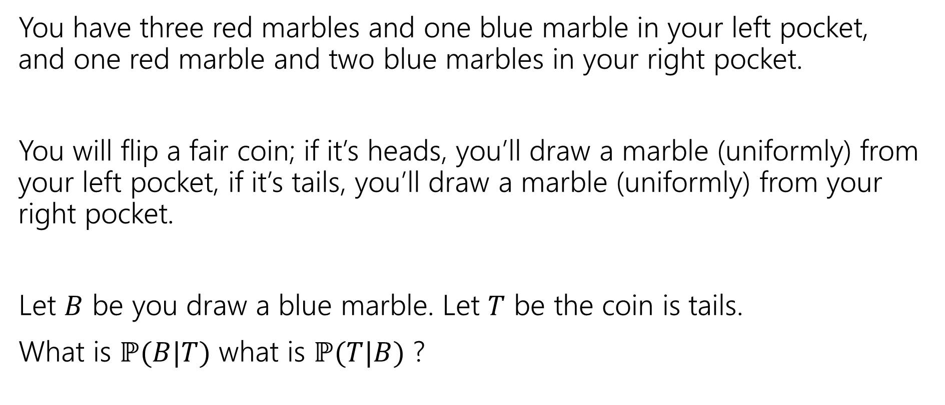
A contrived example
You have three red marbles and one blue marble in your left pocket, and one red marble and two blue marbles in your right pocket.
You will flip a fair coin; if it’s heads, you’ll draw a marble (uniformly) from your left pocket, if it’s tails, you’ll draw a marble (uniformly) from your right pocket.
Let $B$ be you draw a blue marble. Let $T$ be the coin is tails.
What is $ℙ(B|T)$ what is $ℙ(T|B)$ ?

Slide 23

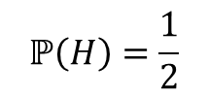







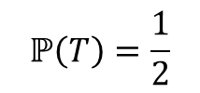

Updated Sequential Processes
You have three red marbles and one blue marble in your left pocket, and one red marble and two blue marbles in your right pocket.
if it’s heads, you’ll draw a marble (uniformly) from your left pocket,
if it’s tails, you’ll draw a marble (uniformly) from your right pocket.
$$ℙ\left(H\right)=\frac{1}{2}$$
$$ℙ\left(T\right)=\frac{1}{2}$$
H
T
For sequential processes with probability, at each step multiply by $ℙ\left(next step \right|all∩prior∩steps)$
$$ℙ\left(R|H\right)=\frac{3}{4}$$
$$ℙ\left(R|T\right)=\frac{1}{3}$$
$$ℙ\left(B|T\right)=\frac{2}{3}$$
$$ℙ\left(B|H\right)=\frac{1}{4}$$
$$ℙ\left(R∩H\right)=3/8$$
$$ℙ\left(R∩T\right)=1/6$$
$$ℙ\left(B∩H\right)=1/8$$
$$ℙ\left(B∩T\right)=1/3$$

Slide 24
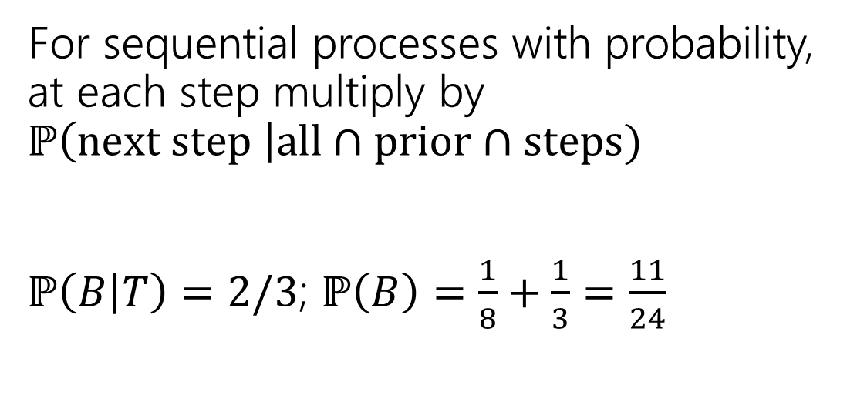
Updated Sequential Processes
You have three red marbles and one blue marble in your left pocket, and one red marble and two blue marbles in your right pocket.
if it’s heads, you’ll draw a marble (uniformly) from your left pocket,
if it’s tails, you’ll draw a marble (uniformly) from your right pocket.
$$ℙ\left(H\right)=\frac{1}{2}$$
$$ℙ\left(T\right)=\frac{1}{2}$$
H
T
For sequential processes with probability, at each step multiply by $ℙ\left(next step \right|all∩prior∩steps)$
$ℙ\left(B | T\right)=2/3$; $ℙ\left(B\right)=\frac{1}{8}+\frac{1}{3}=\frac{11}{24}$
$$ℙ\left(R|H\right)=\frac{3}{4}$$
$$ℙ\left(R|T\right)=\frac{1}{3}$$
$$ℙ\left(B|T\right)=\frac{2}{3}$$
$$ℙ\left(B|H\right)=\frac{1}{4}$$
$$ℙ\left(R∩H\right)=3/8$$
$$ℙ\left(R∩T\right)=1/6$$
$$ℙ\left(B∩H\right)=1/8$$
$$ℙ\left(B∩T\right)=1/3$$

Slide 25

Flipping the conditioning
You have three red marbles and one blue marble in your left pocket, and one red marble and two blue marbles in your right pocket.
if it’s heads, you’ll draw a marble (uniformly) from your left pocket,
if it’s tails, you’ll draw a marble (uniformly) from your right pocket.
What about $ℙ(T|B)$?
Pause, what’s your intuition?
Is this probability
A. less than $½$
B. equal to $½$
C. greater than $½$

Slide 26
Flipping the conditioning
You have three red marbles and one blue marble in your left pocket, and one red marble and two blue marbles in your right pocket.
if it’s heads, you’ll draw a marble (uniformly) from your left pocket,
if it’s tails, you’ll draw a marble (uniformly) from your right pocket.
What about $ℙ(T|B)$?
Pause, what’s your intuition?
Is this probability
A. less than $½$
B. equal to $½$
C. greater than $½$
The right (tails) pocket is far more likely to produce a blue marble if picked than the left (heads) pocket is. Seems like $ℙ(T|B)$ should be greater than ½.

Slide 27

Flipping the conditioning
You have three red marbles and one blue marble in your left pocket, and one red marble and two blue marbles in your right pocket.
if it’s heads, you’ll draw a marble (uniformly) from your left pocket,
if it’s tails, you’ll draw a marble (uniformly) from your right pocket.
What about $ℙ(T|B)$?
Bayes’ Rule says:
$ℙ\left(T | B\right)=\frac{ℙ(B|T)ℙ\left(T\right)}{ℙ\left(B\right)}$
$=\frac{\frac{2}{3}⋅\frac{1}{2}}{11/24}=8/11$

Slide 28
The Technical Stuff

Slide 29
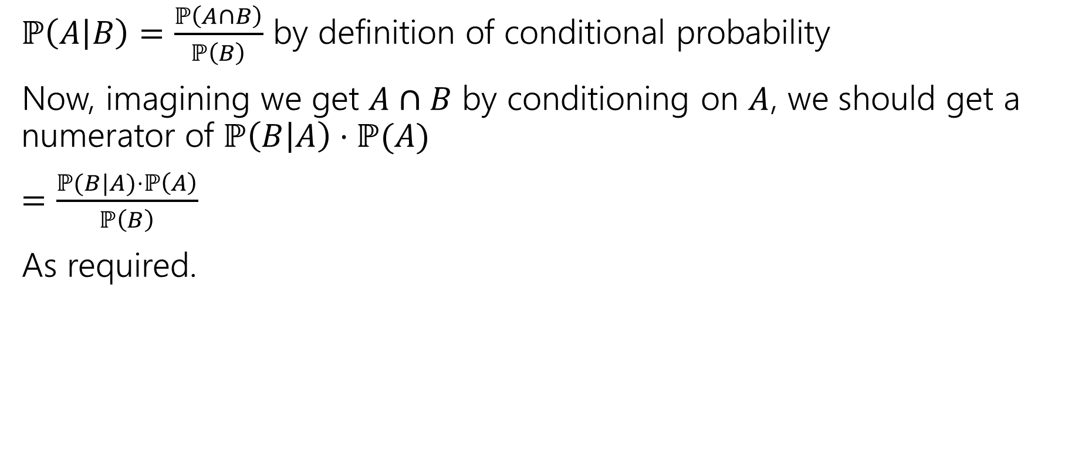
Proof of Bayes’ Rule
$ℙ\left(A | B\right)=\frac{ℙ\left(A∩B\right)}{ℙ\left(B\right)}$ by definition of conditional probability
Now, imagining we get $A∩B$ by conditioning on $A$, we should get a numerator of $ℙ\left(B | A\right)⋅ℙ(A)$
$=\frac{ℙ(B|A)⋅ℙ\left(A\right)}{ℙ\left(B\right)}$
As required.

Slide 30
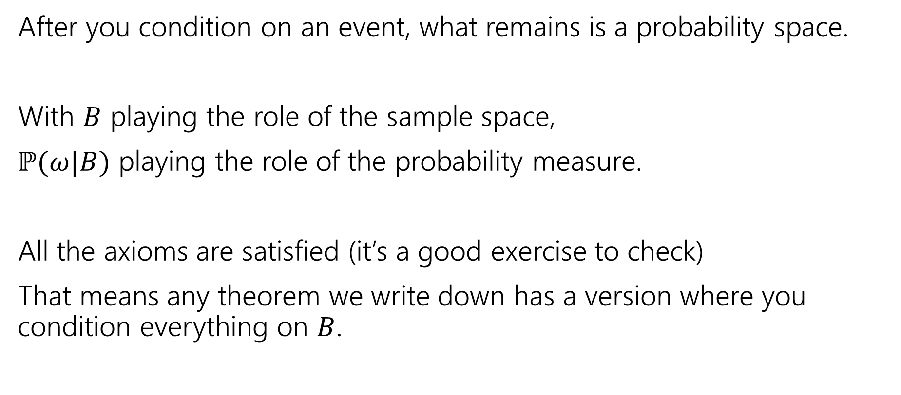
A Technical Note
After you condition on an event, what remains is a probability space.
With $B$ playing the role of the sample space,
$ℙ(ω|B)$ playing the role of the probability measure.
All the axioms are satisfied (it’s a good exercise to check)
That means any theorem we write down has a version where you condition everything on $B$.

Slide 31

An Example
Bayes Theorem still works in a probability space where we’ve already conditioned on $S.$
$ℙ\left(A | [B∩S]\right)=\frac{ℙ\left(B | [A∩S]\right)⋅ℙ\left(A | S\right)}{ℙ(B|S)}$

Slide 32
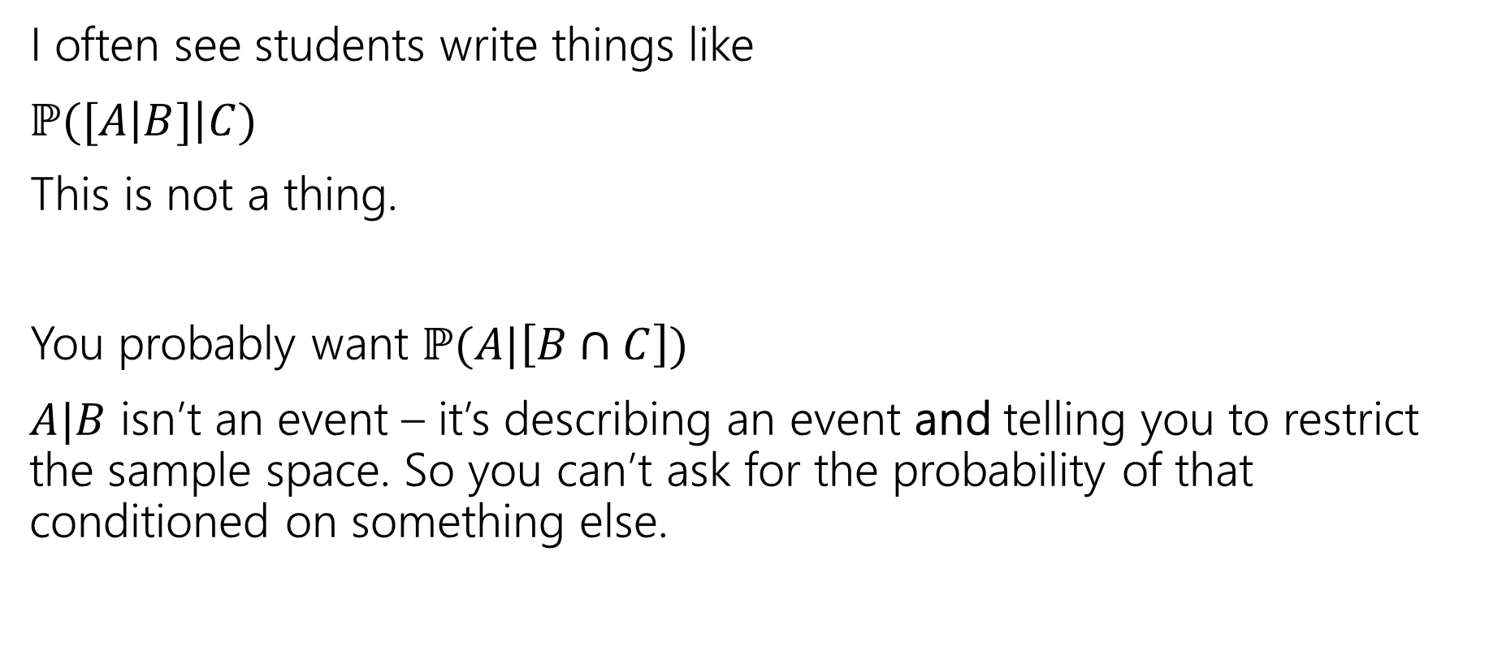
A Quick Technical Remark
I often see students write things like
$ℙ([A\left|B]\right|C)$
This is not a thing.
You probably want $ℙ(A|\left[B∩C\right])$
$A|B$ isn’t an event – it’s describing an event and telling you to restrict the sample space. So you can’t ask for the probability of that conditioned on something else.

Slide 33
Setting the stage: Random Variables

Slide 34
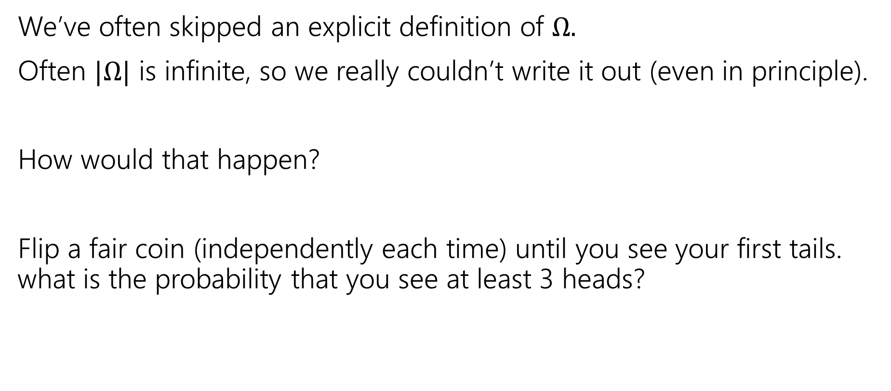

Implicitly defining $Ω$
We’ve often skipped an explicit definition of $Ω.$
Often $|Ω|$ is infinite, so we really couldn’t write it out (even in principle).
How would that happen?
Flip a fair coin (independently each time) until you see your first tails. what is the probability that you see at least 3 heads?

Slide 35

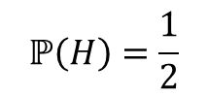

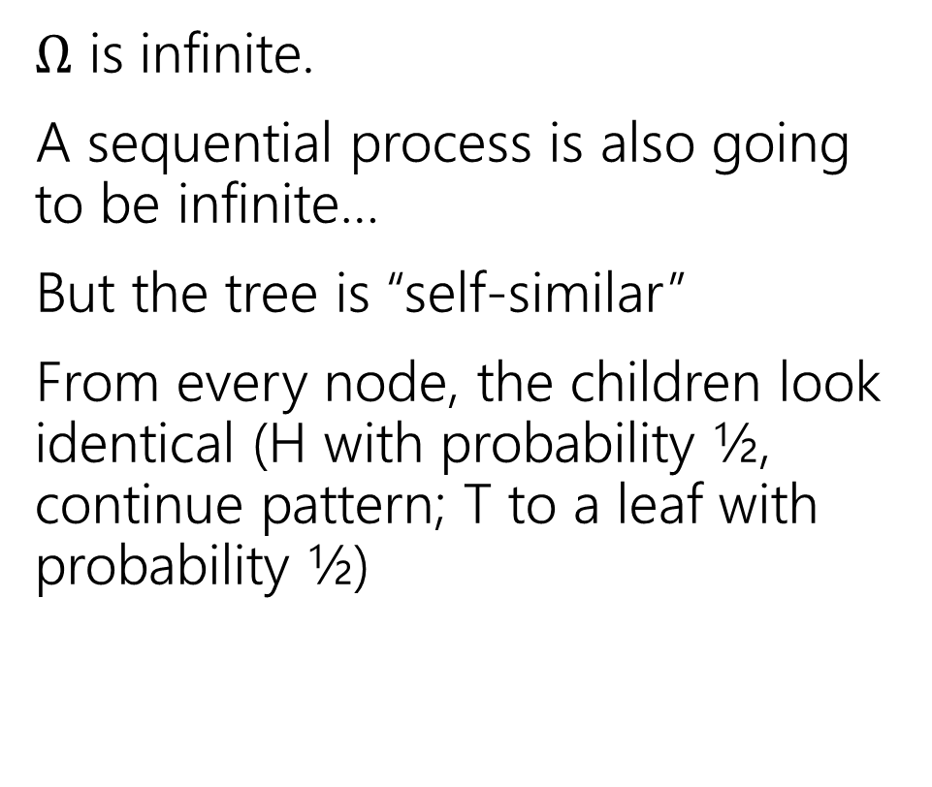




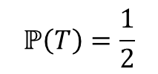

An infinite process.
$Ω$ is infinite.
A sequential process is also going to be infinite…
But the tree is “self-similar”
From every node, the children look identical (H with probability ½, continue pattern; T to a leaf with probability ½)
$$ℙ\left(H\right)=\frac{1}{2}$$
$$ℙ\left(T\right)=\frac{1}{2}$$
H
$$ℙ\left(T\right)=1/2$$
$$ℙ\left(HH|H\right)=\frac{1}{2}$$
$$ℙ\left(HT|H\right)=\frac{1}{2}$$
H
$$ℙ\left(HT\right)=1/4$$
$$ℙ\left(HHH|HH\right)=\frac{1}{2}$$
$$ℙ\left(HHT|HH\right)=\frac{1}{2}$$
H
$$ℙ\left(HHT\right)=1/8$$
…

Slide 36
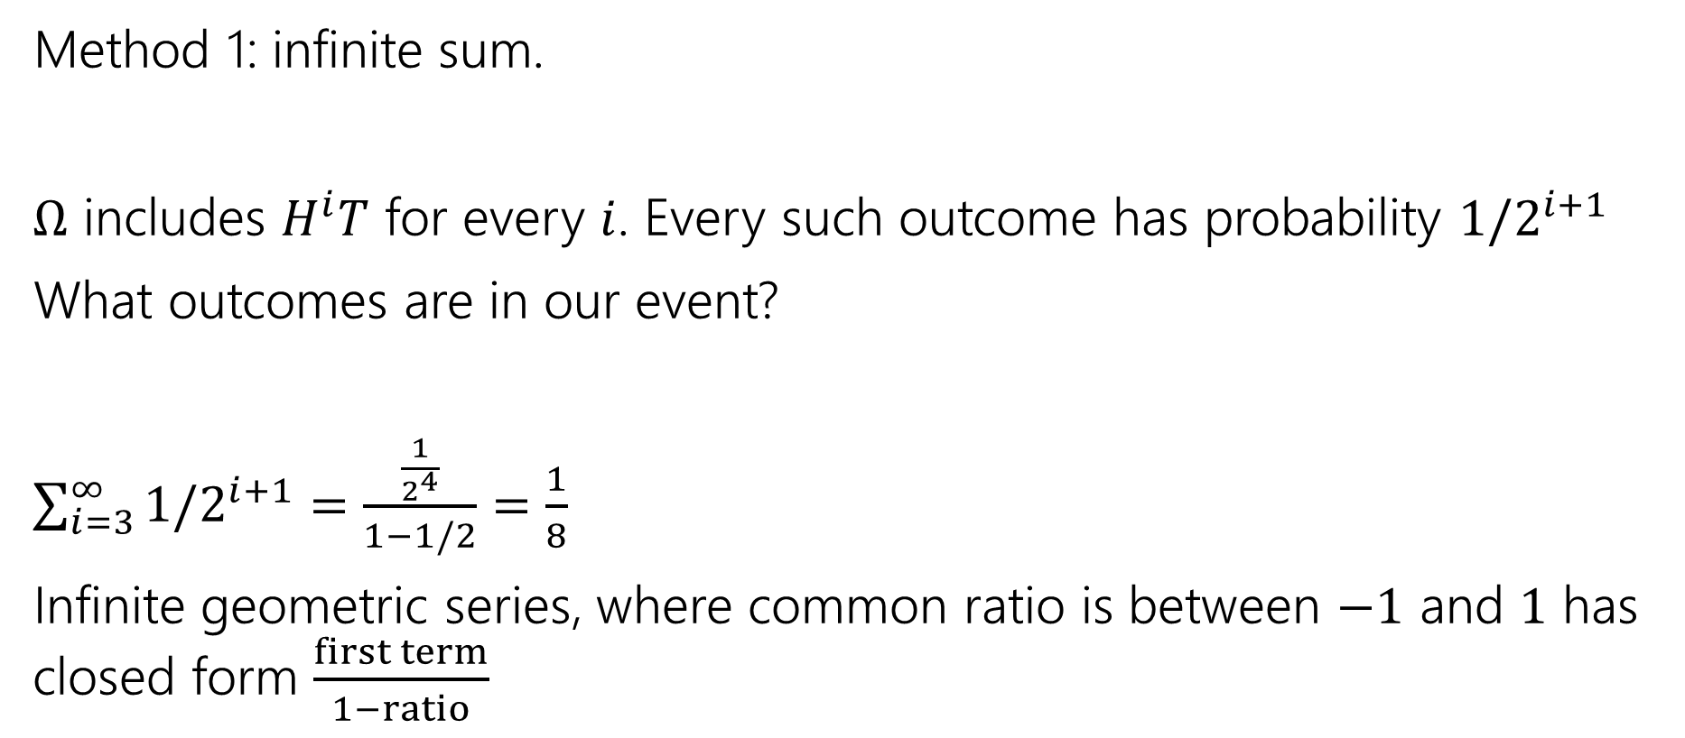

Finding $ℙ($at least $3$ heads)
Method 1: infinite sum.
$Ω$ includes $H^{i}T$ for every $i$. Every such outcome has probability $1/2^{i+1}$
What outcomes are in our event?
$\sum_{i=3}^{∞}{1/2^{i+1}}=$ $\frac{\frac{1}{2^{4}}}{1−1/2}=\frac{1}{8}$
Infinite geometric series, where common ratio is between $−1$ and $1$ has closed form $\frac{first term}{1−ratio}$

Slide 37

Finding $ℙ($at least $3$ heads)
Method 2:
Calculate the complement
$ℙ($at most 2 heads) = $\frac{1}{2}+\frac{1}{4}+\frac{1}{8}$
$ℙ($at least 3 heads)= $1−\left(\frac{1}{2}+\frac{1}{4}+\frac{1}{8}\right)=\frac{1}{8}$

Slide 38
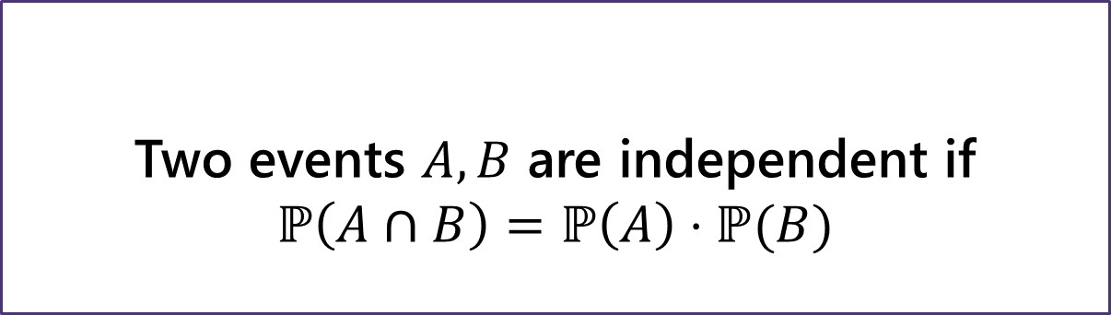
Independence
Two events $A,B$ are independent if
$$ℙ\left(A∩B\right)=ℙ\left(A\right)⋅ℙ(B)$$
Independence
You’ll sometimes see this called “statistical independence” to emphasize that we’re talking about probabilities (not, say, physical interactions).
If $A,B$ both have non-zero probability then
$ℙ\left(A∩B\right)=ℙ(A)ℙ(B)$ $⇔$ $ℙ\left(A | B\right)=ℙ(A)$ $⇔ℙ\left(B | A\right)=ℙ(B)$

Slide 39
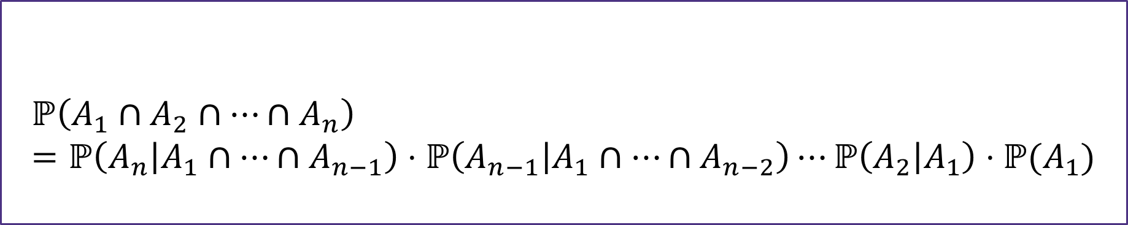
Chain Rule
We defined conditional probability as: $ℙ\left(A | B\right)=\frac{ℙ\left(A∩B\right)}{ℙ\left(B\right)}$
Which means $ℙ\left(A∩B\right)=ℙ(A|B)ℙ(B)$
$$ℙ\left(A_{1}∩A_{2}∩…∩A_{n}\right)=ℙ\left(A_{n} | A_{1}∩…∩A_{n−1}\right)⋅ℙ\left(A_{n−1} | A_{1}∩…∩A_{n−2}\right)⋯ℙ\left(A_{2} | A_{1}\right)⋅ℙ(A_{1})$$
Chain Rule

