Slide 1
More Bayes’ Rule and Independence
CSE 312 Winter 25
Lecture 6

Slide 2
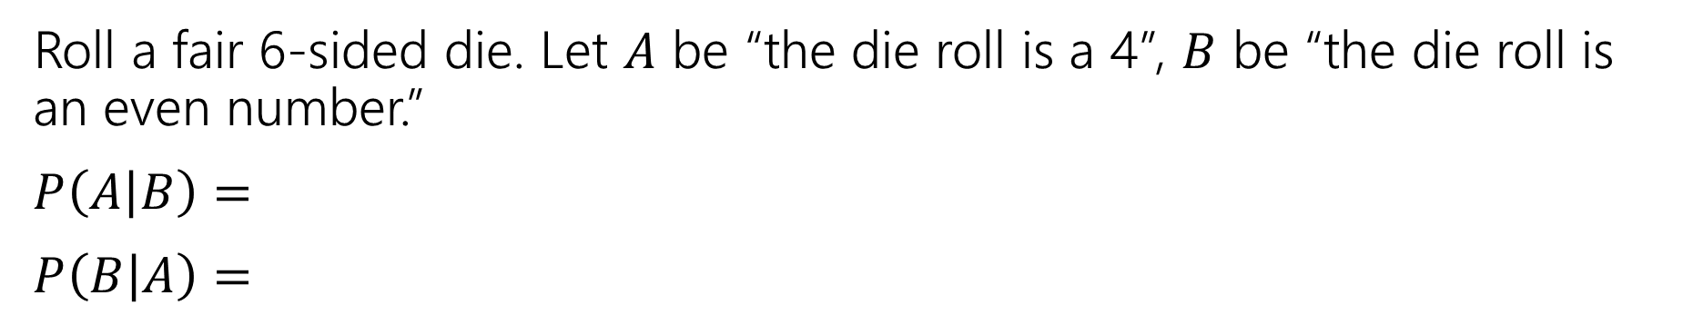

Last Time
For an event $B$, with $ℙ\left(B\right)>0,$
$t$he “Probability of $A$ conditioned on $B$” is
$$ℙ\left(A | B\right)=\frac{ℙ\left(A∩B\right)}{ℙ\left(B\right)}$$
Conditional Probability
Roll a fair 6-sided die. Let $A$ be “the die roll is a 4”, $B$ be “the die roll is an even number.”
$P\left(A | B\right)=$
$P\left(B | A\right)=$
Notes:
What we condition on is “the new (restricted) sample space”

Slide 3
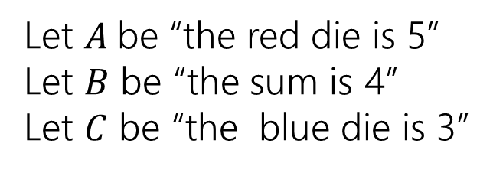
Conditioning…
 | D2=1 | D2=2 | D2=3 | D2=4 | D2=5 | D2=6
D1=1 | (1,1) | (1,2) | (1,3) | (1,4) | (1,5) | (1.6)
D1=2 | (2,1) | (2,2) | (2,3) | (2,4) | (2,5) | (2,6)
D1=3 | (3,1) | (3,2) | (3,3) | (3,4) | (3,5) | (3,6)
D1=4 | (4,1) | (4,2) | (4,3) | (4,4) | (4,5) | (4,6)
D1=5 | (5,1) | (5,2) | (5,3) | (5,4) | (5,5) | (5,6)
D1=6 | (6,1) | (6,2) | (6,3) | (6,4) | (6,5) | (6,6)
Let $A$be “the red die is 5”
Let $B$ be “the sum is 4”
Let $C$ be “the blue die is 3”

Slide 4
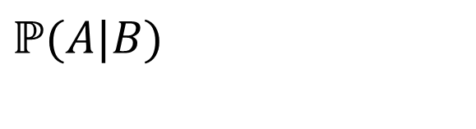
Conditioning…
 | D2=1 | D2=2 | D2=3 | D2=4 | D2=5 | D2=6
D1=1 | (1,1) | (1,2) | (1,3) | (1,4) | (1,5) | (1.6)
D1=2 | (2,1) | (2,2) | (2,3) | (2,4) | (2,5) | (2,6)
D1=3 | (3,1) | (3,2) | (3,3) | (3,4) | (3,5) | (3,6)
D1=4 | (4,1) | (4,2) | (4,3) | (4,4) | (4,5) | (4,6)
D1=5 | (5,1) | (5,2) | (5,3) | (5,4) | (5,5) | (5,6)
D1=6 | (6,1) | (6,2) | (6,3) | (6,4) | (6,5) | (6,6)
Let $A$be “the red die is 5”
Let $B$ be “the sum is 4”
Let $C$ be “the blue die is 3”
$$ℙ(A|B)$$

Slide 5
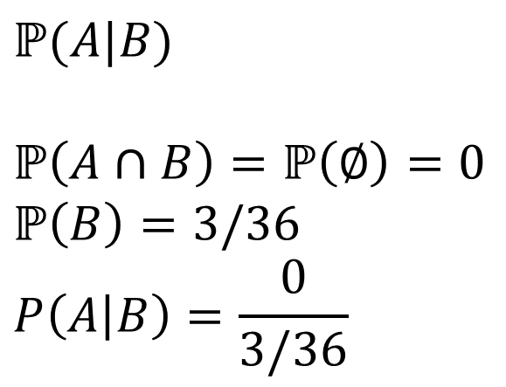
Conditioning…
 | D2=1 | D2=2 | D2=3 | D2=4 | D2=5 | D2=6
D1=1 | (1,1) | (1,2) | (1,3) | (1,4) | (1,5) | (1.6)
D1=2 | (2,1) | (2,2) | (2,3) | (2,4) | (2,5) | (2,6)
D1=3 | (3,1) | (3,2) | (3,3) | (3,4) | (3,5) | (3,6)
D1=4 | (4,1) | (4,2) | (4,3) | (4,4) | (4,5) | (4,6)
D1=5 | (5,1) | (5,2) | (5,3) | (5,4) | (5,5) | (5,6)
D1=6 | (6,1) | (6,2) | (6,3) | (6,4) | (6,5) | (6,6)
Let $A$be “the red die is 5”
Let $B$ be “the sum is 4”
Let $C$ be “the blue die is 3”
$$ℙ(A|B)$$
$$ℙ\left(A∩B\right)=ℙ\left(∅\right)=0$$
$$ℙ\left(B\right)=3/36$$
$$P\left(A | B\right)=\frac{0}{3/36}$$

Slide 6
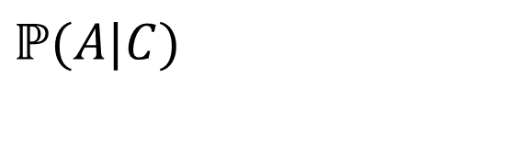
Conditioning…
 | D2=1 | D2=2 | D2=3 | D2=4 | D2=5 | D2=6
D1=1 | (1,1) | (1,2) | (1,3) | (1,4) | (1,5) | (1.6)
D1=2 | (2,1) | (2,2) | (2,3) | (2,4) | (2,5) | (2,6)
D1=3 | (3,1) | (3,2) | (3,3) | (3,4) | (3,5) | (3,6)
D1=4 | (4,1) | (4,2) | (4,3) | (4,4) | (4,5) | (4,6)
D1=5 | (5,1) | (5,2) | (5,3) | (5,4) | (5,5) | (5,6)
D1=6 | (6,1) | (6,2) | (6,3) | (6,4) | (6,5) | (6,6)
Let $A$be “the red die is 5”
Let $B$ be “the sum is 4”
Let $C$ be “the blue die is 3”
$$ℙ(A|C)$$

Slide 7
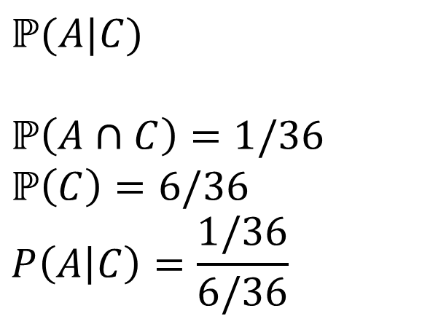
Conditioning…
 | D2=1 | D2=2 | D2=3 | D2=4 | D2=5 | D2=6
D1=1 | (1,1) | (1,2) | (1,3) | (1,4) | (1,5) | (1.6)
D1=2 | (2,1) | (2,2) | (2,3) | (2,4) | (2,5) | (2,6)
D1=3 | (3,1) | (3,2) | (3,3) | (3,4) | (3,5) | (3,6)
D1=4 | (4,1) | (4,2) | (4,3) | (4,4) | (4,5) | (4,6)
D1=5 | (5,1) | (5,2) | (5,3) | (5,4) | (5,5) | (5,6)
D1=6 | (6,1) | (6,2) | (6,3) | (6,4) | (6,5) | (6,6)
Let $A$be “the red die is 5”
Let $B$ be “the sum is 4”
Let $C$ be “the blue die is 3”
$$ℙ(A|C)$$
$$ℙ\left(A∩C\right)=1/36$$
$$ℙ\left(C\right)=6/36$$
$$P\left(A | C\right)=\frac{1/36}{6/36}$$

Slide 8
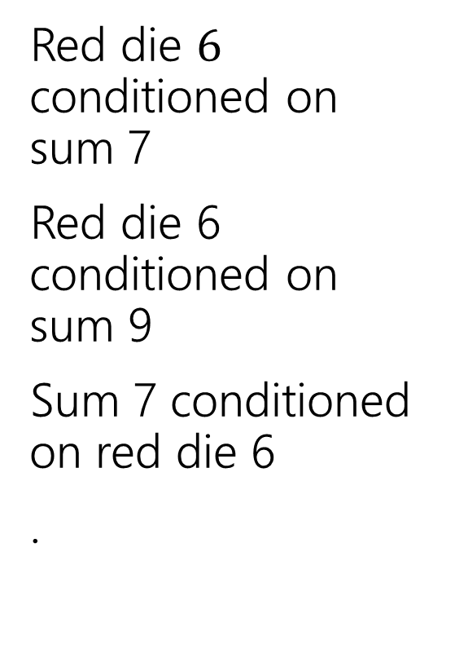
Conditioning Practice
Red die $6$ conditioned on sum 7
Red die 6 conditioned on sum 9
Sum 7 conditioned on red die 6
.
 | D2=1 | D2=2 | D2=3 | D2=4 | D2=5 | D2=6
D1=1 | (1,1) | (1,2) | (1,3) | (1,4) | (1,5) | (1.6)
D1=2 | (2,1) | (2,2) | (2,3) | (2,4) | (2,5) | (2,6)
D1=3 | (3,1) | (3,2) | (3,3) | (3,4) | (3,5) | (3,6)
D1=4 | (4,1) | (4,2) | (4,3) | (4,4) | (4,5) | (4,6)
D1=5 | (5,1) | (5,2) | (5,3) | (5,4) | (5,5) | (5,6)
D1=6 | (6,1) | (6,2) | (6,3) | (6,4) | (6,5) | (6,6)
Take a few minutes to work on this with the people around you! (also on your handout)

Slide 9
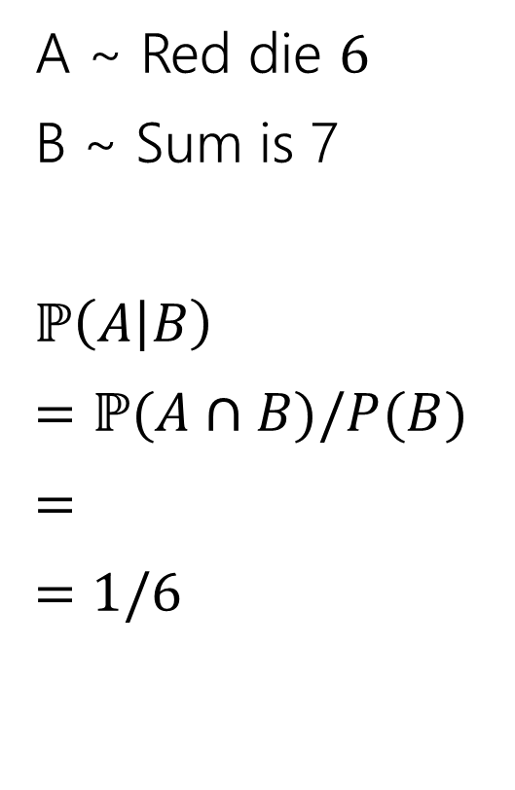
Conditioning Practice
A ~ Red die $6$
B ~ Sum is 7
$ℙ\left(A | B\right)$
$=ℙ(A∩B)/P(B)$
$=$
$=$ $1/6$
 | D2=1 | D2=2 | D2=3 | D2=4 | D2=5 | D2=6
D1=1 | (1,1) | (1,2) | (1,3) | (1,4) | (1,5) | (1.6)
D1=2 | (2,1) | (2,2) | (2,3) | (2,4) | (2,5) | (2,6)
D1=3 | (3,1) | (3,2) | (3,3) | (3,4) | (3,5) | (3,6)
D1=4 | (4,1) | (4,2) | (4,3) | (4,4) | (4,5) | (4,6)
D1=5 | (5,1) | (5,2) | (5,3) | (5,4) | (5,5) | (5,6)
D1=6 | (6,1) | (6,2) | (6,3) | (6,4) | (6,5) | (6,6)

Slide 10
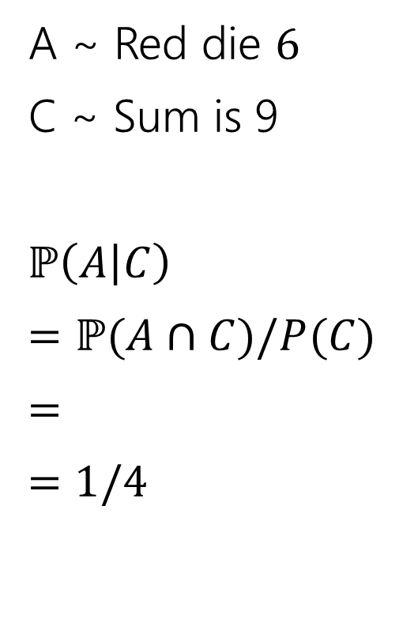
Conditioning Practice
A ~ Red die $6$
C ~ Sum is 9
$ℙ\left(A | C\right)$
$=ℙ(A∩C)/P(C)$
$=$
$=$ $1/4$
 | D2=1 | D2=2 | D2=3 | D2=4 | D2=5 | D2=6
D1=1 | (1,1) | (1,2) | (1,3) | (1,4) | (1,5) | (1.6)
D1=2 | (2,1) | (2,2) | (2,3) | (2,4) | (2,5) | (2,6)
D1=3 | (3,1) | (3,2) | (3,3) | (3,4) | (3,5) | (3,6)
D1=4 | (4,1) | (4,2) | (4,3) | (4,4) | (4,5) | (4,6)
D1=5 | (5,1) | (5,2) | (5,3) | (5,4) | (5,5) | (5,6)
D1=6 | (6,1) | (6,2) | (6,3) | (6,4) | (6,5) | (6,6)

Slide 11
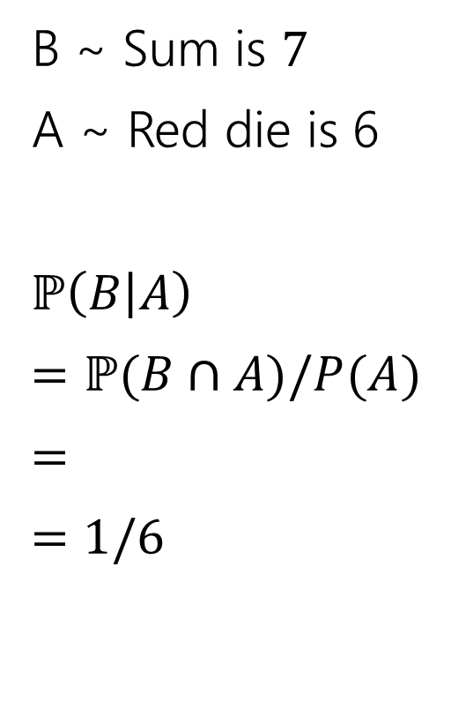
Conditioning Practice
B ~ Sum is $7$
A ~ Red die is 6
$ℙ\left(B | A\right)$
$=ℙ(B∩A)/P(A)$
$=$
$=$ $1/6$
 | D2=1 | D2=2 | D2=3 | D2=4 | D2=5 | D2=6
D1=1 | (1,1) | (1,2) | (1,3) | (1,4) | (1,5) | (1.6)
D1=2 | (2,1) | (2,2) | (2,3) | (2,4) | (2,5) | (2,6)
D1=3 | (3,1) | (3,2) | (3,3) | (3,4) | (3,5) | (3,6)
D1=4 | (4,1) | (4,2) | (4,3) | (4,4) | (4,5) | (4,6)
D1=5 | (5,1) | (5,2) | (5,3) | (5,4) | (5,5) | (5,6)
D1=6 | (6,1) | (6,2) | (6,3) | (6,4) | (6,5) | (6,6)

Slide 12
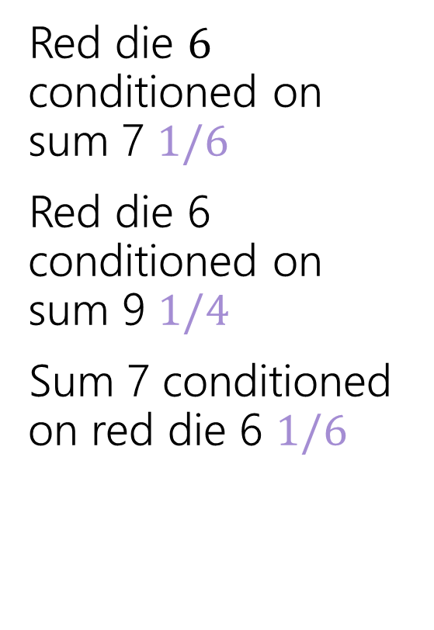
Conditioning Practice
Red die $6$ conditioned on sum 7 $1/6$
Red die 6 conditioned on sum 9 $1/4$
Sum 7 conditioned on red die 6 $1/6$
 | D2=1 | D2=2 | D2=3 | D2=4 | D2=5 | D2=6
D1=1 | (1,1) | (1,2) | (1,3) | (1,4) | (1,5) | (1.6)
D1=2 | (2,1) | (2,2) | (2,3) | (2,4) | (2,5) | (2,6)
D1=3 | (3,1) | (3,2) | (3,3) | (3,4) | (3,5) | (3,6)
D1=4 | (4,1) | (4,2) | (4,3) | (4,4) | (4,5) | (4,6)
D1=5 | (5,1) | (5,2) | (5,3) | (5,4) | (5,5) | (5,6)
D1=6 | (6,1) | (6,2) | (6,3) | (6,4) | (6,5) | (6,6)

Slide 13

Direction Matters
Are $ℙ(A|B)$ and $ℙ(B|A)$ the same?

Slide 14
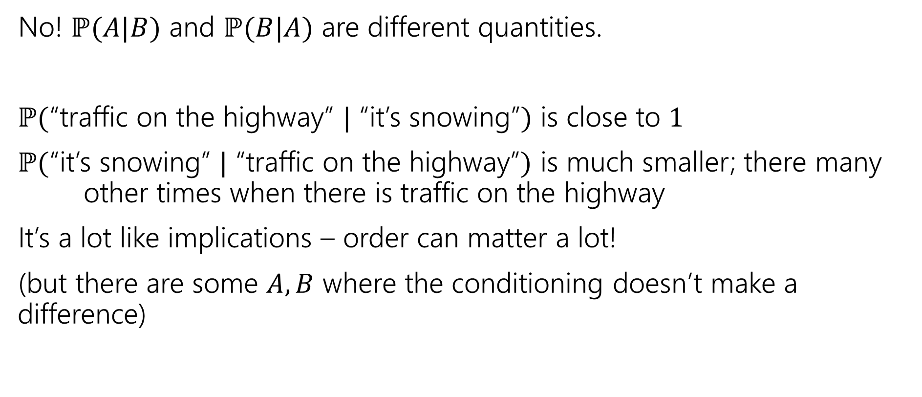
Direction Matters
No! $ℙ(A|B)$ and $ℙ(B|A)$ are different quantities.
$ℙ($“traffic on the highway” $|$ “it’s snowing”$)$ is close to $1$
$ℙ($“it’s snowing” $|$ “traffic on the highway”$)$ is much smaller; there many other times when there is traffic on the highway
It’s a lot like implications – order can matter a lot!
(but there are some $A,B$ where the conditioning doesn’t make a difference)

Slide 15
Bayes’ Rule

Slide 16
Wonka Bars
Willy Wonka has placed golden tickets on 0.1% of his Wonka Bars.
You want to get a golden ticket. You could buy a 1000-or-so of the bars until you find one, but that’s expensive…you’ve got a better idea!
You have a test – a very precise scale you’ve bought.
  If the bar you weigh does have a golden ticket, the scale will alert you 99.9% of the time.
  If the bar you weigh does not have a golden ticket, the scale will (falsely) alert you only 1% of the time.
If you pick up a bar and it alerts, what is the probability you have a golden ticket?

Slide 17
Willy Wonka
Fill out the poll everywhere so Robbie knows how long to explain
Go to pollev.com/robbie
  Willy Wonka has placed golden tickets on 0.1% of his Wonka Bars.
  If the bar you weigh does have a golden ticket, the scale will alert you 99.9% of the time.
  If the bar you weigh does not have a golden ticket, the scale will (falsely) alert you only 1% of the time.
You pick up a bar and it alerts, what is the probability you have a golden ticket?
Which of these is closest to the right answer?
0.1%
10%
50%
90%
99%
99.9%

Slide 18
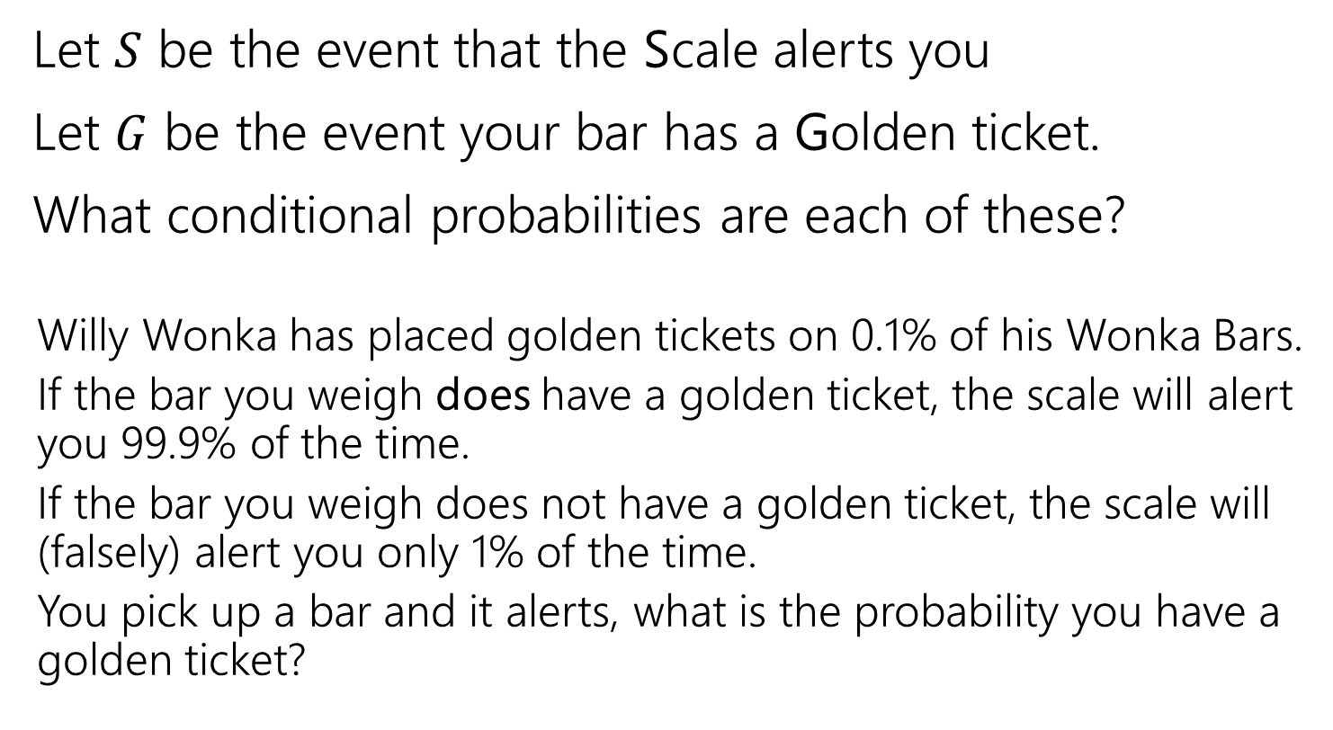
Conditioning
Let $S$ be the event that the Scale alerts you
Let $G$ be the event your bar has a Golden ticket.
What conditional probabilities are each of these?
  Willy Wonka has placed golden tickets on 0.1% of his Wonka Bars.
  If the bar you weigh does have a golden ticket, the scale will alert you 99.9% of the time.
  If the bar you weigh does not have a golden ticket, the scale will (falsely) alert you only 1% of the time.
  You pick up a bar and it alerts, what is the probability you have a golden ticket?

Slide 19




Conditioning
Let $S$ be the event that the Scale alerts you
Let $G$ be the event your bar has a Golden ticket.
What conditional probabilities are each of these?
  Willy Wonka has placed golden tickets on 0.1% of his Wonka Bars.
  If the bar you weigh does have a golden ticket, the scale will alert you 99.9% of the time.
  If the bar you weigh does not have a golden ticket, the scale will (falsely) alert you only 1% of the time.
  You pick up a bar and it alerts, what is the probability you have a golden ticket?
$$ℙ(G)$$
$$ℙ(S|G)$$
$$ℙ\left(S | \overline{G}\right)$$
$$ℙ(G|S)$$

Slide 20
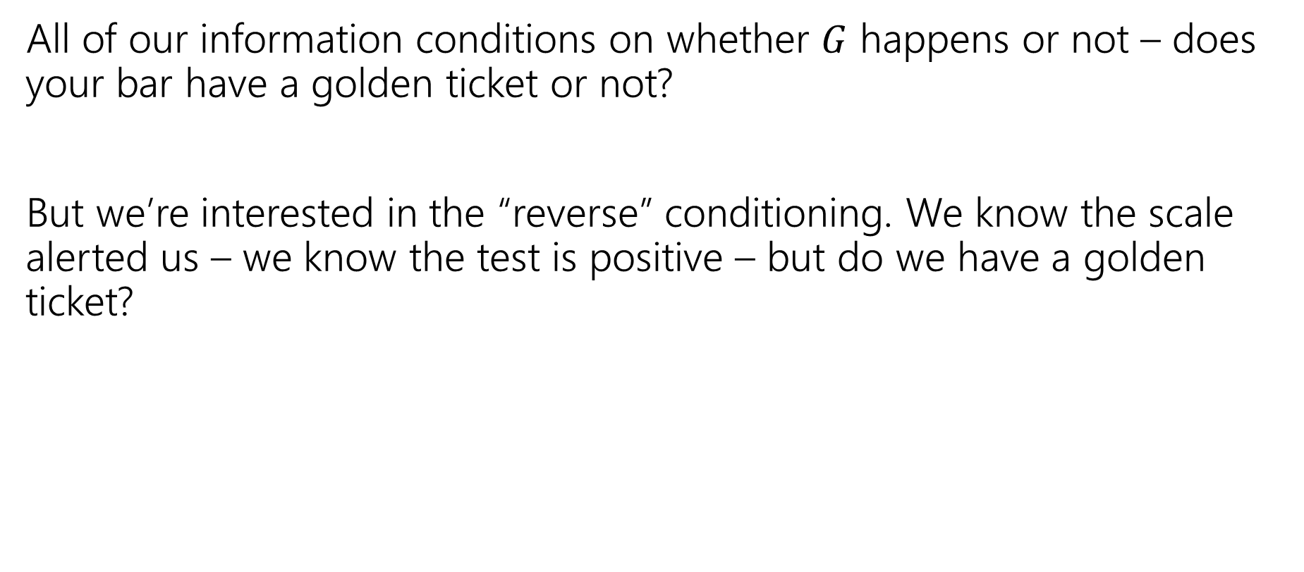
Reversing the Conditioning
All of our information conditions on whether $G$ happens or not – does your bar have a golden ticket or not?
But we’re interested in the “reverse” conditioning. We know the scale alerted us – we know the test is positive – but do we have a golden ticket?

Slide 21

Bayes’ Rule
$$ℙ\left(A | B\right)=\frac{ℙ(B|A)ℙ\left(A\right)}{ℙ\left(B\right)}$$
Bayes’ Rule

Slide 22

Bayes’ Rule
$$ℙ\left(A | B\right)=\frac{ℙ(B|A)ℙ\left(A\right)}{ℙ\left(B\right)}$$
Bayes’ Rule
What do we know about Wonka Bars?
$$ℙ(G|S)=\frac{ℙ\left(S | G\right)⋅ℙ(G)}{ℙ(S)}$$

Slide 23

Bayes’ Rule
$$ℙ\left(A | B\right)=\frac{ℙ(B|A)ℙ\left(A\right)}{ℙ\left(B\right)}$$
Bayes’ Rule
What do we know about Wonka Bars?
$$ℙ(G|S)=\frac{.999⋅.001}{ℙ(S)}$$

Slide 24

Filling In
What’s $ℙ(S)$?
We’ll use a trick called “the law of total probability”:
$ℙ\left(S\right)=ℙ\left(S | G\right)⋅ℙ\left(G\right)+ℙ\left(S | \overline{G}\right)⋅ℙ\left(\overline{G}\right)$
$=0.999⋅.001+.01⋅.999$
$=.010989$

Slide 25
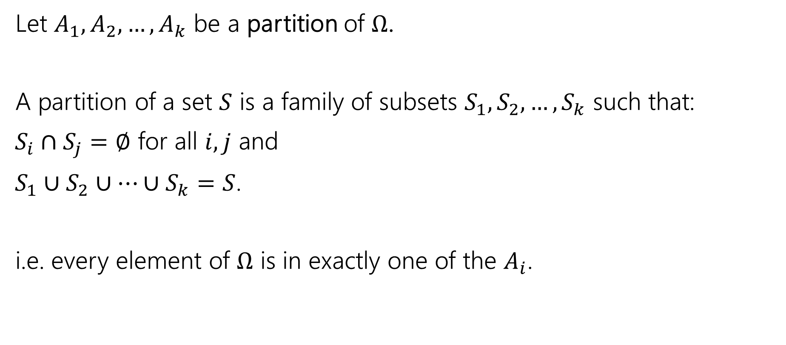
Law of Total Probability
Let $A_{1},A_{2},…,A_{k}$ be a partition of $Ω$.
A partition of a set $S$ is a family of subsets $S_{1},S_{2},…,S_{k}$ such that:
$S_{i}∩S_{j}=∅$ for all $i,j$ and
$S_{1}∪S_{2}∪…∪S_{k}=S$.
i.e. every element of $Ω$ is in exactly one of the $A_{i}$.

Slide 26

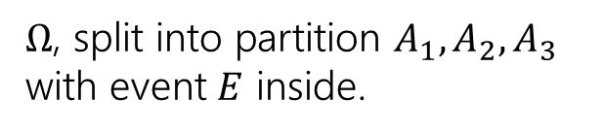




Law of Total Probability
Let $A_{1},A_{2},…,A_{k}$ be a partition of $Ω$.
For any event $E$,
$$ℙ\left(E\right)= \sum_{all i}{ℙ\left(E|A_{i}\right)ℙ(A_{i})}$$
Law of Total Probability
$Ω$, split into partition $A_{1},A_{2},A_{3}$ with event $E$ inside.
$$E$$
$$A_{1}$$
$$A_{2}$$
$$A_{3}$$

Slide 27

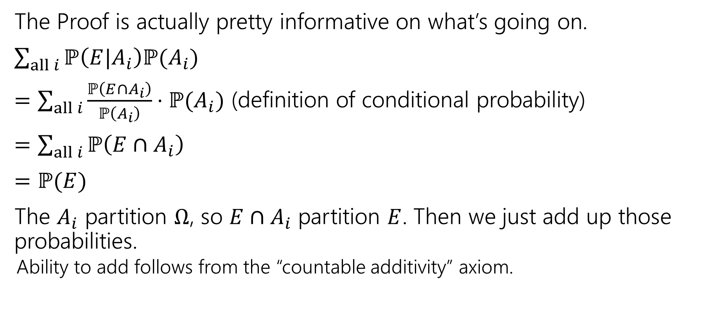



Why?
$$E$$
$$A_{1}$$
$$A_{2}$$
$$A_{3}$$
The Proof is actually pretty informative on what’s going on.
$\sum_{all i}{ℙ\left(E|A_{i}\right)ℙ(A_{i})}$
$=\sum_{all i}{\frac{ℙ\left(E∩A_{i}\right)}{ℙ\left(A_{i}\right)}⋅ℙ(A_{i})}$ (definition of conditional probability)
$=\sum_{all i}{ℙ\left(E∩A_{i}\right)}$
$=ℙ(E)$
The $A_{i}$ partition $Ω$, so $E∩A_{i}$ partition $E$. Then we just add up those probabilities.
  Ability to add follows from the “countable additivity” axiom.

Slide 28
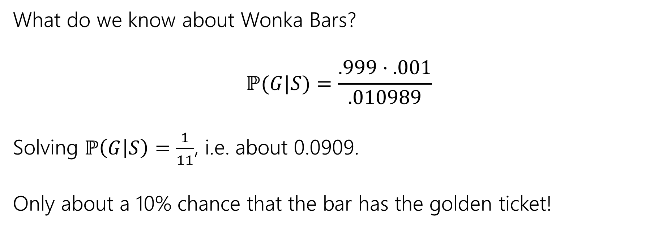
Bayes Rule
What do we know about Wonka Bars?
$$ℙ(G|S)=\frac{.999⋅.001}{.010989}$$
Solving $ℙ\left(G | S\right)=\frac{1}{11}$, i.e. about 0.0909.
Only about a 10% chance that the bar has the golden ticket!

Slide 29
Wait a minute…
  Willy Wonka has placed golden tickets on 0.1% of his Wonka Bars.
  If the bar you weigh does have a golden ticket, the scale will alert you 99.9% of the time.
  If the bar you weigh does not have a golden ticket, the scale will (falsely) alert you only 1% of the time.
That doesn’t fit with many of our guesses. What’s going on?
Instead of saying “we tested one and got a positive” imagine we tested 1000. ABOUT how many bars of each type are there?
(about) 1 with a golden ticket 999 without. Let’s say those are exactly right.
Let’s just say that one golden is truly found.
(about) 1% of the 999 without would be a positive. Let’s say it’s exactly 10.

Slide 30
Visually
Gold bar is the one (true) golden ticket bar.
Purple bars don’t have a ticket and tested negative.
Red bars don’t have a ticket, but tested positive.
The test is, in a sense, doing really well.
It’s almost always right.
The problem is it’s also the case that the correct answer is almost always “no.”

Slide 31

Updating Your Intuition
Take 1: The test is actually good and has VASTLY increased our belief that there IS a golden ticket when you get a positive result.
If we told you “your job is to find a Wonka Bar with a golden ticket” without the test, you have 1/1000 chance, with the test, you have (about) a 1/11 chance. That’s (almost) 100 times better!
This is actually a huge improvement!

Slide 32
Updating Your Intuition
Take 2: Humans are really bad at intuitively understanding very large or very small numbers.
When I hear “99% chance”, “99.9% chance”, “99.99% chance” they all go into my brain as “well that’s basically guaranteed” And then I forget how many 9’s there actually were.
But the number of 9s matters because they end up “cancelling” with the “number of 9’s” in the population that’s truly negative. We’ll talk about this a little more on Friday in the applications.

Slide 33
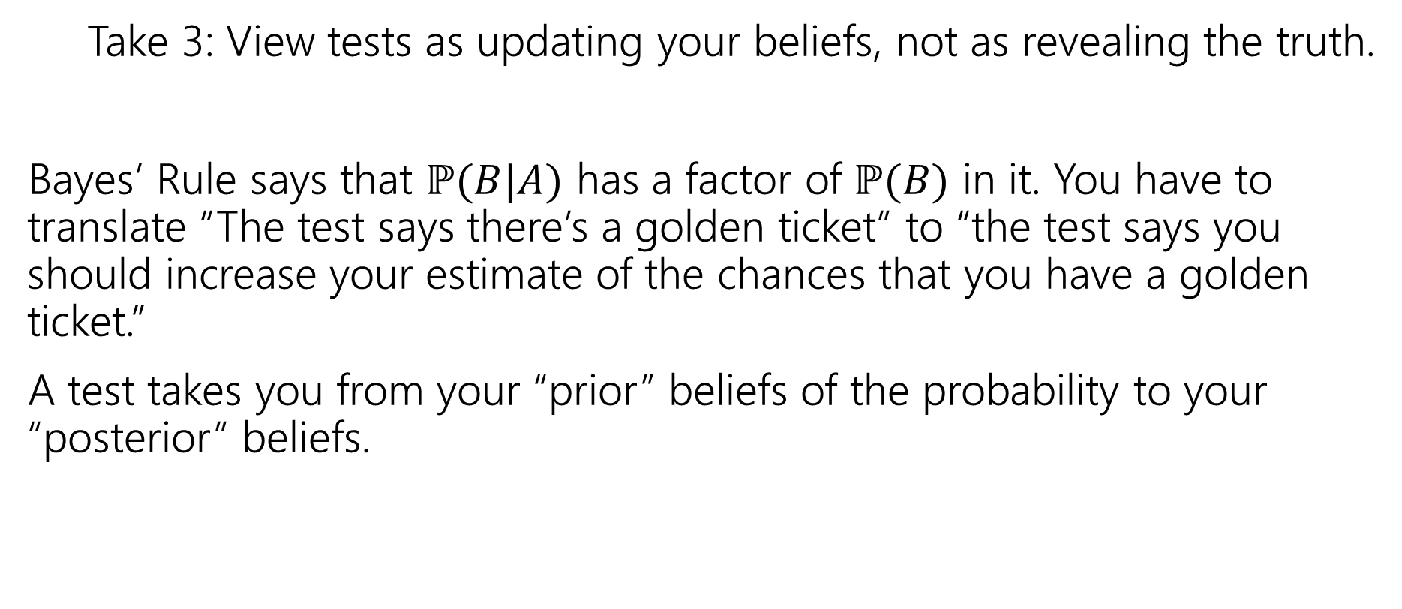
Updating Your Intuition
Take 3: View tests as updating your beliefs, not as revealing the truth.
Bayes’ Rule says that $ℙ(B|A)$ has a factor of $ℙ(B)$ in it. You have to translate “The test says there’s a golden ticket” to “the test says you should increase your estimate of the chances that you have a golden ticket.”
A test takes you from your “prior” beliefs of the probability to your “posterior” beliefs.

Slide 34
More Bayes Practice

Slide 35
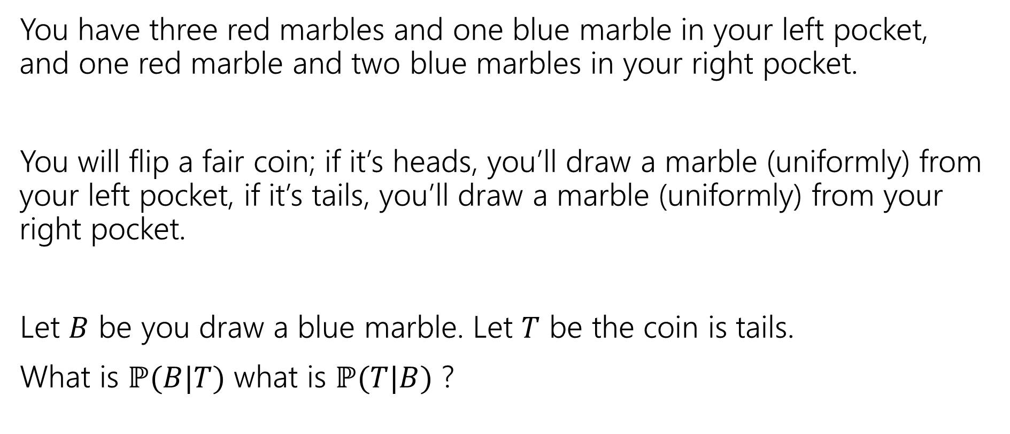
A contrived example
You have three red marbles and one blue marble in your left pocket, and one red marble and two blue marbles in your right pocket.
You will flip a fair coin; if it’s heads, you’ll draw a marble (uniformly) from your left pocket, if it’s tails, you’ll draw a marble (uniformly) from your right pocket.
Let $B$ be you draw a blue marble. Let $T$ be the coin is tails.
What is $ℙ(B|T)$ what is $ℙ(T|B)$ ?

Slide 36

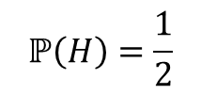







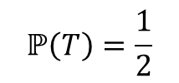

Updated Sequential Processes
You have three red marbles and one blue marble in your left pocket, and one red marble and two blue marbles in your right pocket.
if it’s heads, you’ll draw a marble (uniformly) from your left pocket,
if it’s tails, you’ll draw a marble (uniformly) from your right pocket.
$$ℙ\left(H\right)=\frac{1}{2}$$
$$ℙ\left(T\right)=\frac{1}{2}$$
H
T
For sequential processes with probability, at each step multiply by $ℙ\left(next step \right|all∩prior∩steps)$
$$ℙ\left(R|H\right)=\frac{3}{4}$$
$$ℙ\left(R|T\right)=\frac{1}{3}$$
$$ℙ\left(B|T\right)=\frac{2}{3}$$
$$ℙ\left(B|H\right)=\frac{1}{4}$$
$$ℙ\left(R∩H\right)=3/8$$
$$ℙ\left(R∩T\right)=1/6$$
$$ℙ\left(B∩H\right)=1/8$$
$$ℙ\left(B∩T\right)=1/3$$

Slide 37
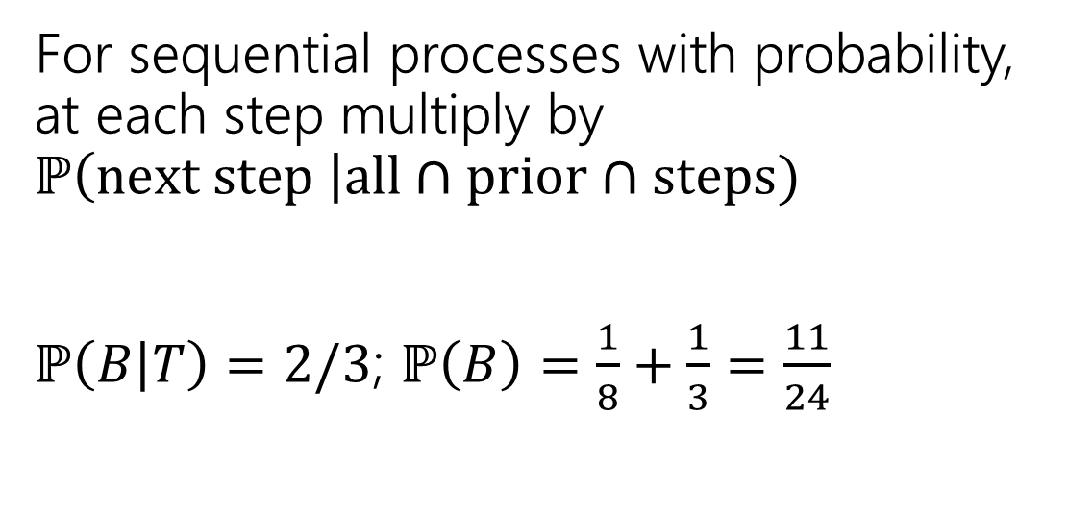
Updated Sequential Processes
You have three red marbles and one blue marble in your left pocket, and one red marble and two blue marbles in your right pocket.
if it’s heads, you’ll draw a marble (uniformly) from your left pocket,
if it’s tails, you’ll draw a marble (uniformly) from your right pocket.
$$ℙ\left(H\right)=\frac{1}{2}$$
$$ℙ\left(T\right)=\frac{1}{2}$$
H
T
For sequential processes with probability, at each step multiply by $ℙ\left(next step \right|all∩prior∩steps)$
$ℙ\left(B | T\right)=2/3$; $ℙ\left(B\right)=\frac{1}{8}+\frac{1}{3}=\frac{11}{24}$
$$ℙ\left(R|H\right)=\frac{3}{4}$$
$$ℙ\left(R|T\right)=\frac{1}{3}$$
$$ℙ\left(B|T\right)=\frac{2}{3}$$
$$ℙ\left(B|H\right)=\frac{1}{4}$$
$$ℙ\left(R∩H\right)=3/8$$
$$ℙ\left(R∩T\right)=1/6$$
$$ℙ\left(B∩H\right)=1/8$$
$$ℙ\left(B∩T\right)=1/3$$

Slide 38

Flipping the conditioning
You have three red marbles and one blue marble in your left pocket, and one red marble and two blue marbles in your right pocket.
if it’s heads, you’ll draw a marble (uniformly) from your left pocket,
if it’s tails, you’ll draw a marble (uniformly) from your right pocket.
What about $ℙ(T|B)$?
Pause, what’s your intuition?
Is this probability
A. less than $½$
B. equal to $½$
C. greater than $½$

Slide 39
Flipping the conditioning
You have three red marbles and one blue marble in your left pocket, and one red marble and two blue marbles in your right pocket.
if it’s heads, you’ll draw a marble (uniformly) from your left pocket,
if it’s tails, you’ll draw a marble (uniformly) from your right pocket.
What about $ℙ(T|B)$?
Pause, what’s your intuition?
Is this probability
A. less than $½$
B. equal to $½$
C. greater than $½$
The right (tails) pocket is far more likely to produce a blue marble if picked than the left (heads) pocket is. Seems like $ℙ(T|B)$ should be greater than ½.

Slide 40

Flipping the conditioning
You have three red marbles and one blue marble in your left pocket, and one red marble and two blue marbles in your right pocket.
if it’s heads, you’ll draw a marble (uniformly) from your left pocket,
if it’s tails, you’ll draw a marble (uniformly) from your right pocket.
What about $ℙ(T|B)$?
Bayes’ Rule says:
$ℙ\left(T | B\right)=\frac{ℙ(B|T)ℙ\left(T\right)}{ℙ\left(B\right)}$
$=\frac{\frac{2}{3}⋅\frac{1}{2}}{11/24}=8/11$

Slide 41
The Technical Stuff

Slide 42
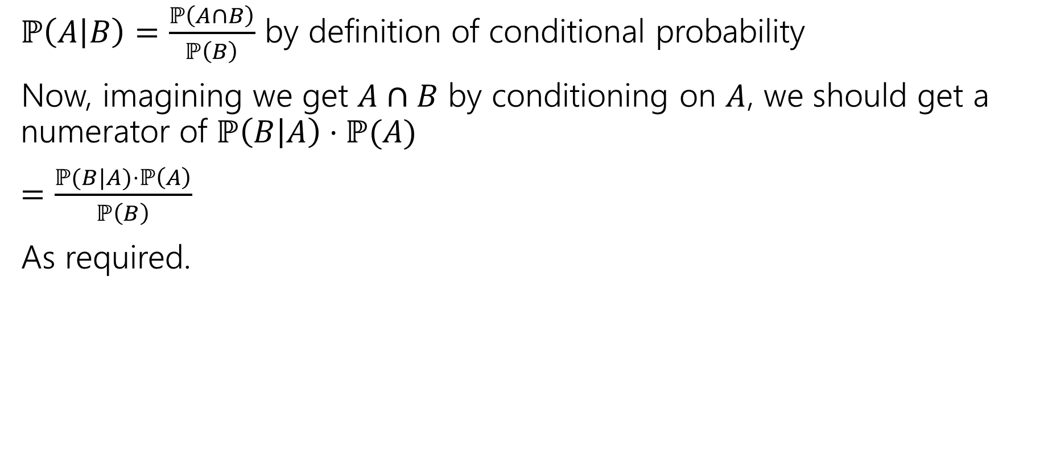
Proof of Bayes’ Rule
$ℙ\left(A | B\right)=\frac{ℙ\left(A∩B\right)}{ℙ\left(B\right)}$ by definition of conditional probability
Now, imagining we get $A∩B$ by conditioning on $A$, we should get a numerator of $ℙ\left(B | A\right)⋅ℙ(A)$
$=\frac{ℙ(B|A)⋅ℙ\left(A\right)}{ℙ\left(B\right)}$
As required.

Slide 43
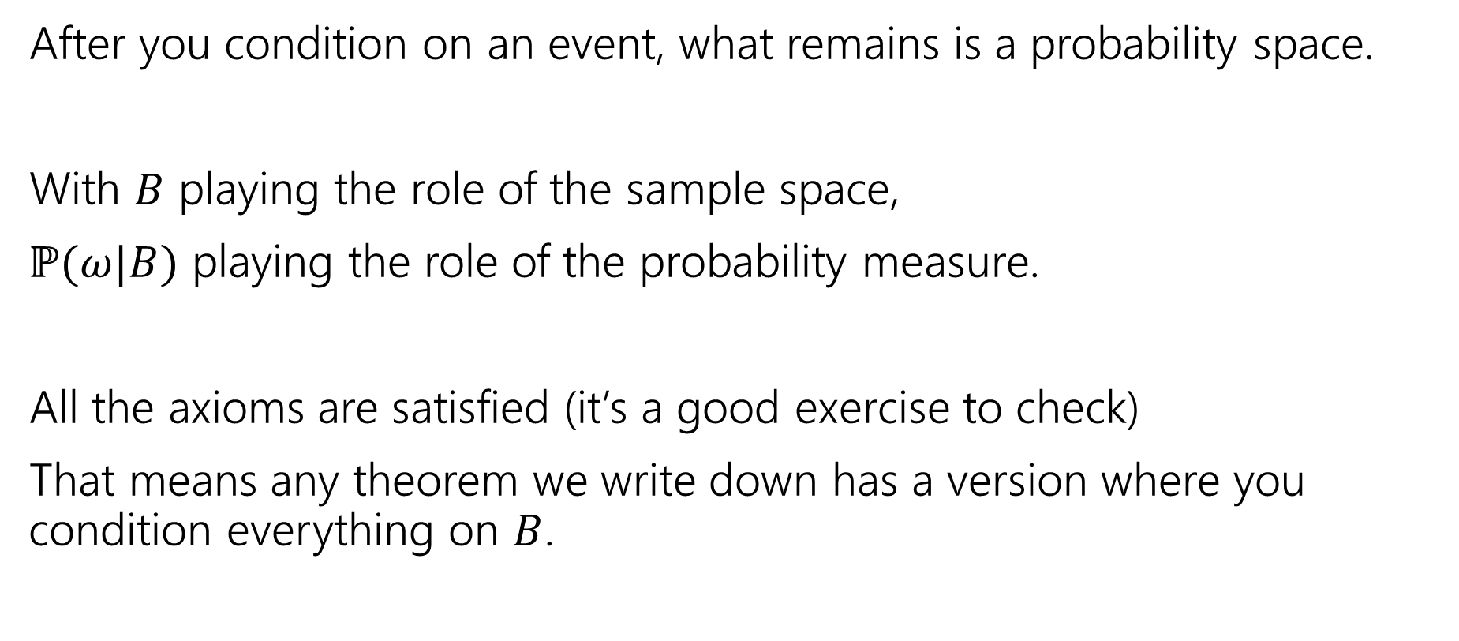
A Technical Note
After you condition on an event, what remains is a probability space.
With $B$ playing the role of the sample space,
$ℙ(ω|B)$ playing the role of the probability measure.
All the axioms are satisfied (it’s a good exercise to check)
That means any theorem we write down has a version where you condition everything on $B$.

Slide 44

An Example
Bayes Theorem still works in a probability space where we’ve already conditioned on $S.$
$ℙ\left(A | [B∩S]\right)=\frac{ℙ\left(B | [A∩S]\right)⋅ℙ\left(A | S\right)}{ℙ(B|S)}$

Slide 45
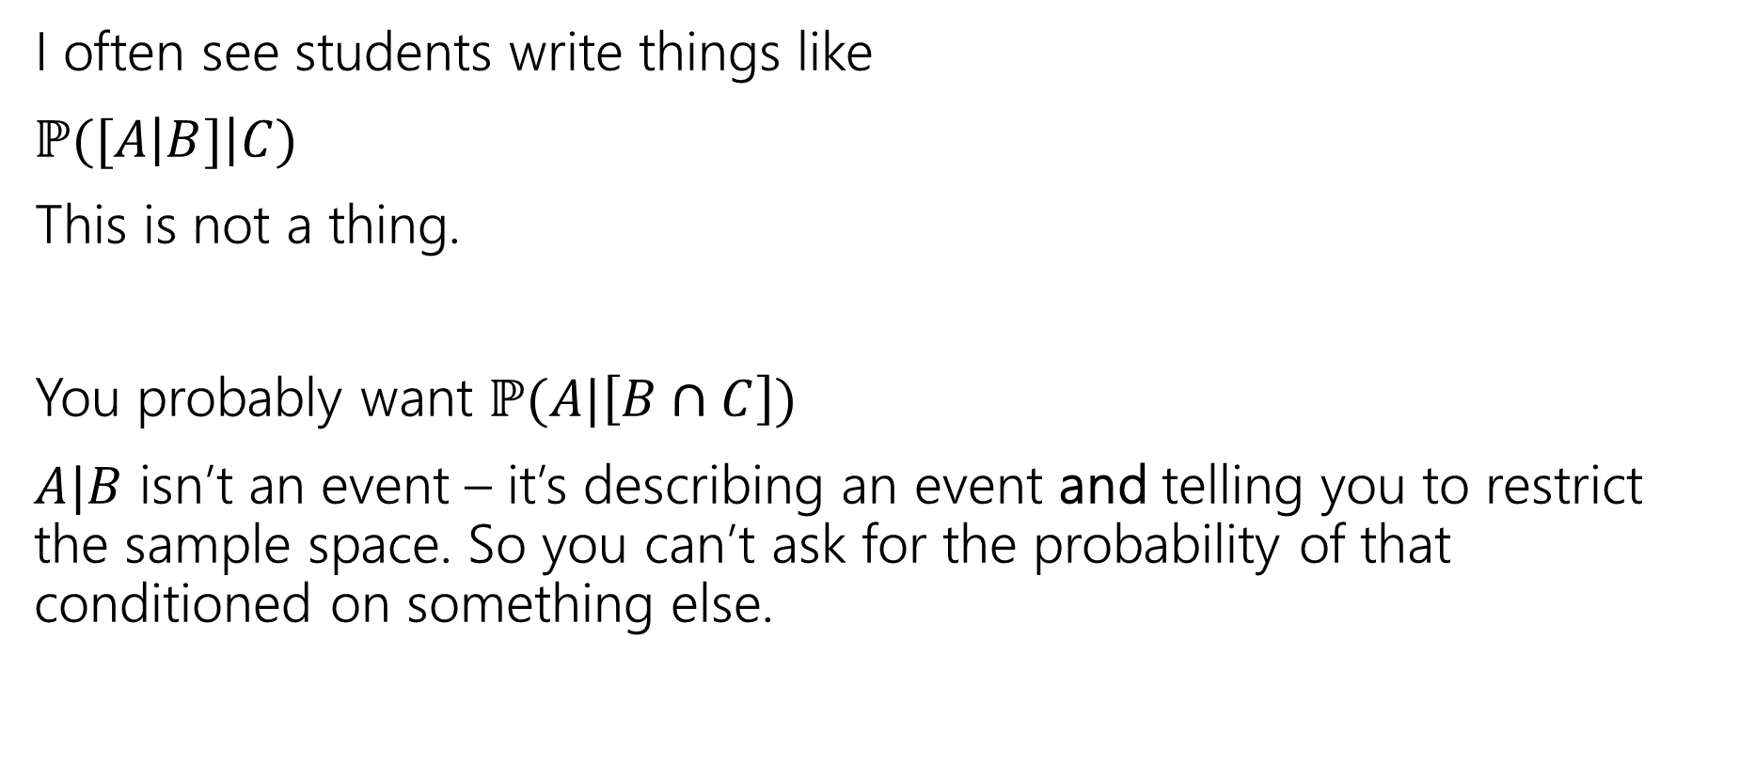
A Quick Technical Remark
I often see students write things like
$ℙ([A\left|B]\right|C)$
This is not a thing.
You probably want $ℙ(A|\left[B∩C\right])$
$A|B$ isn’t an event – it’s describing an event and telling you to restrict the sample space. So you can’t ask for the probability of that conditioned on something else.

Slide 46

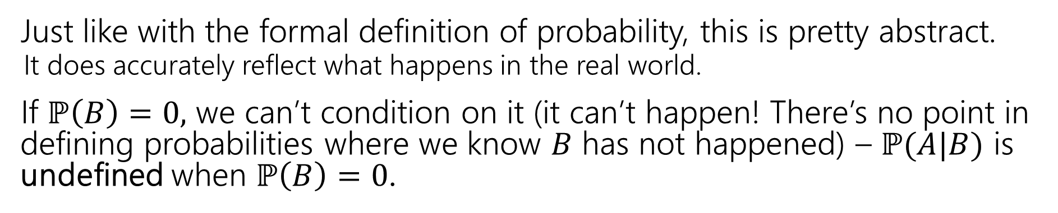
Conditional Probability
For an event $B$, with $ℙ\left(B\right)>0,$
$t$he “Probability of $A$ conditioned on $B$” is
$$ℙ\left(A | B\right)=\frac{ℙ\left(A∩B\right)}{ℙ\left(B\right)}$$
Conditional Probability
Just like with the formal definition of probability, this is pretty abstract.
  It does accurately reflect what happens in the real world.
If $ℙ\left(B\right)=0,$ we can’t condition on it (it can’t happen! There’s no point in defining probabilities where we know $B$ has not happened) – $ℙ(A|B)$ is undefined when $ℙ\left(B\right)=0$.

Slide 47
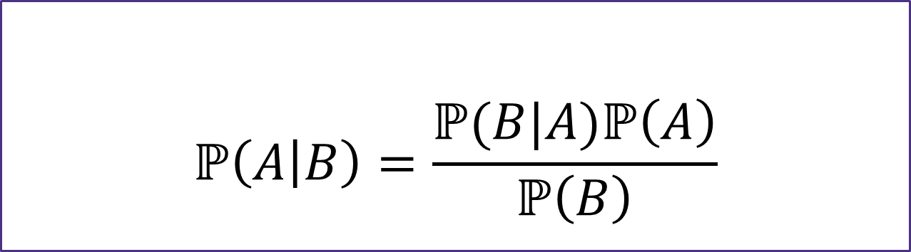

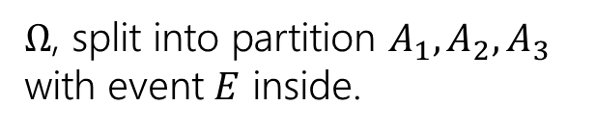
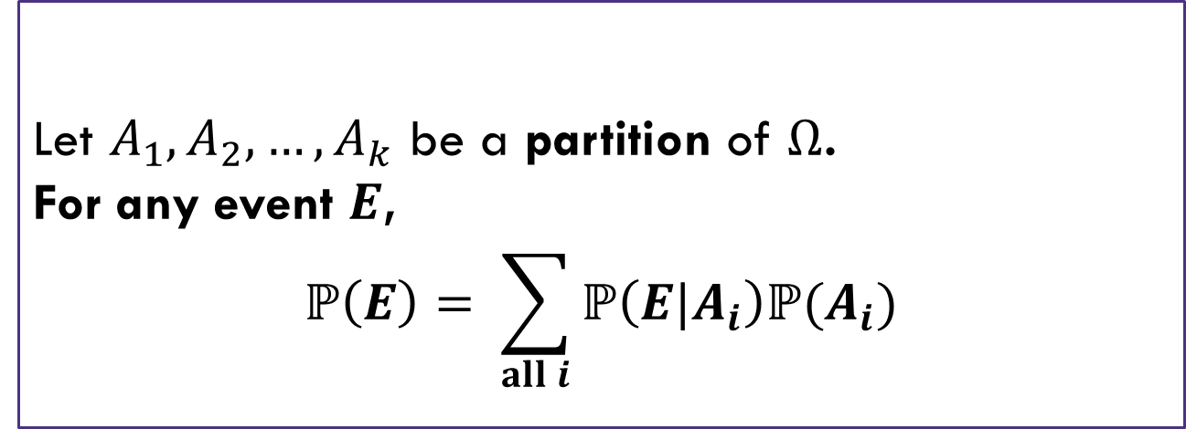



LTP and Bayes
Let $A_{1},A_{2},…,A_{k}$ be a partition of $Ω$.
For any event $E$,
$$ℙ\left(E\right)= \sum_{all i}{ℙ\left(E|A_{i}\right)ℙ(A_{i})}$$
$Ω$, split into partition $A_{1},A_{2},A_{3}$ with event $E$ inside.
Law of Total Probability
$$E$$
$$A_{1}$$
$$A_{2}$$
$$A_{3}$$
$$ℙ\left(A | B\right)=\frac{ℙ(B|A)ℙ\left(A\right)}{ℙ\left(B\right)}$$
Bayes’ Rule

