Slide 1
Conditional Probability
CSE 312 Winter 25
Lecture 5

Slide 2


Last Time
A sample space $Ω$ is the set of all possible outcomes of an experiment.
Sample Space
An event $E⊆Ω$ is a subset of possible outcomes (i.e. a subset of $Ω$)
Event
A probability is a number between 0 and 1 describing how likely a particular outcome is.
Probability

Slide 3

Probability Space
Probability Space
A (discrete) probability space is a pair $(Ω,ℙ)$ where:
$Ω$ is the sample space
$ℙ:Ω→[0,1]$ is the probability measure.
$ℙ$ satisfies:
$ℙ\left(x\right)≥0$ for all $x$
$\sum_{x∈Ω}{ℙ(x)} =1$
If $E,F⊆Ω$ and $E∩F=∅$then $ℙ\left(E∪F\right)=ℙ\left(E\right)+ℙ(F)$

Slide 4
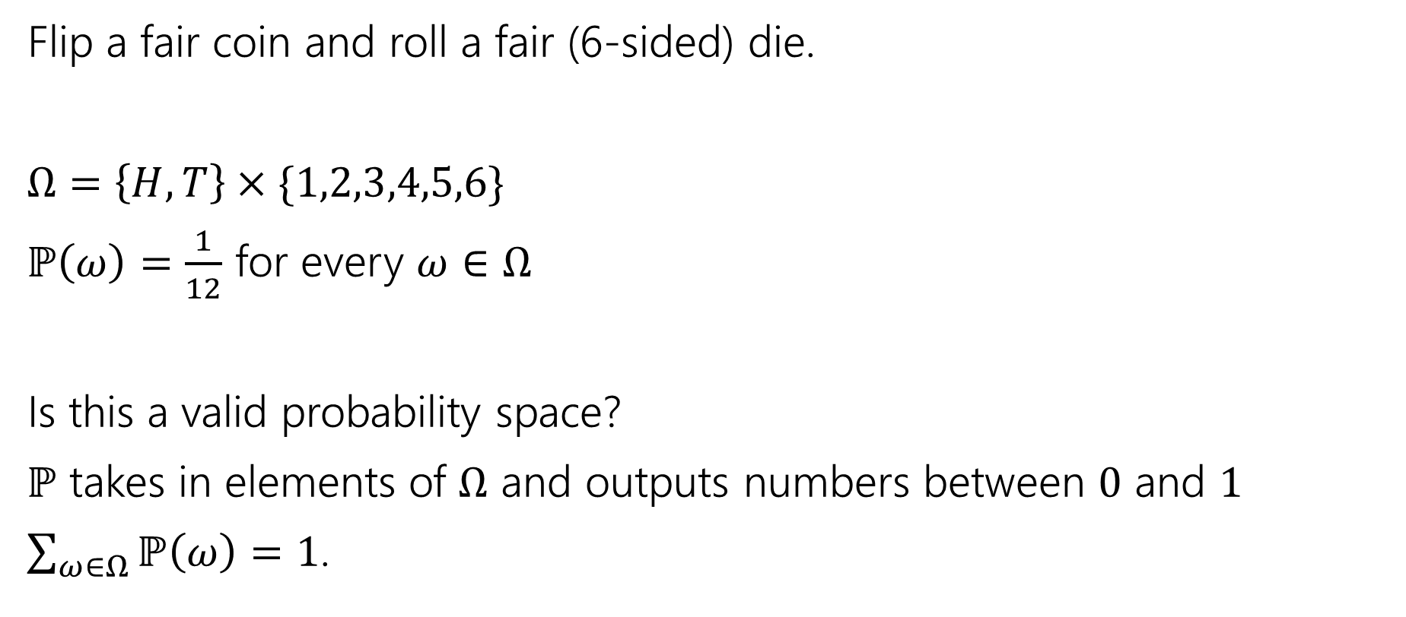
Probability Space
Flip a fair coin and roll a fair (6-sided) die.
$Ω=\left\{H,T\right\}×\{1,2,3,4,5,6\}$
$ℙ\left(ω\right)=\frac{1}{12}$ for every $ω∈Ω$
Is this a valid probability space?
$ℙ$ takes in elements of $Ω$ and outputs numbers between $0$ and $1$
$\sum_{ω∈Ω}{ℙ\left(ω\right)}=1$.

Slide 5

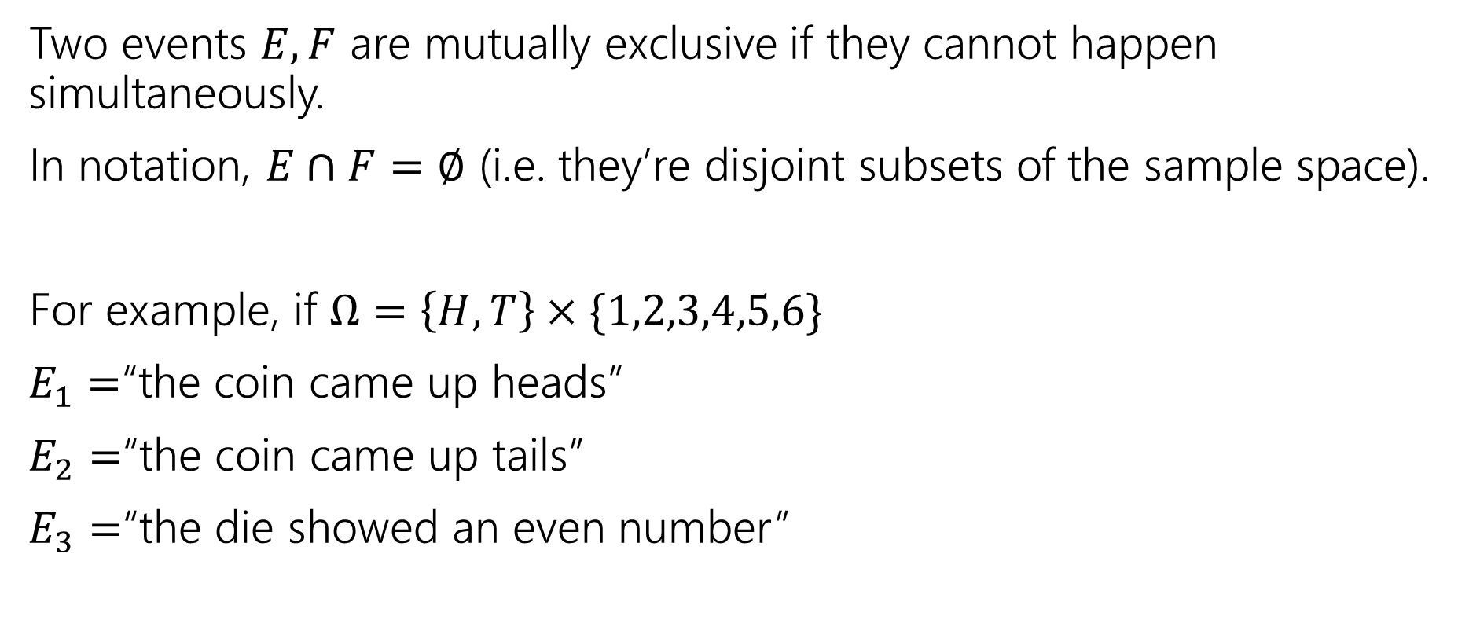
Mutually Exclusive Events
Two events $E,F$ are mutually exclusive if they cannot happen simultaneously.
In notation, $E∩F=∅$ (i.e. they’re disjoint subsets of the sample space).
For example, if $Ω=\left\{H,T\right\}×\{1,2,3,4,5,6\}$
$E_{1}=$“the coin came up heads”
$E_{2}=$“the coin came up tails”
$E_{3}=$“the die showed an even number”
$E_{1}$ and $E_{2}$ are mutually exclusive.
$E_{1}$ and $E_{3}$ are not mutually exclusive.

Slide 6
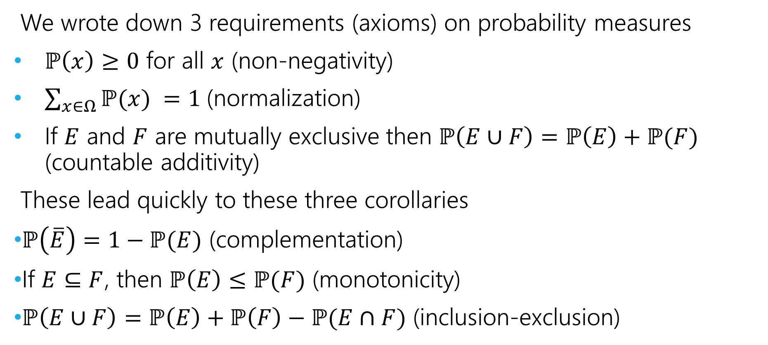
Axioms and Consequences
We wrote down 3 requirements (axioms) on probability measures
$ℙ\left(x\right)≥0$ for all $x$ (non-negativity)
$\sum_{x∈Ω}{ℙ(x)} =1$(normalization)
If $E$ and $F$ are mutually exclusive then $ℙ\left(E∪F\right)=ℙ\left(E\right)+ℙ(F)$ (countable additivity)
These lead quickly to these three corollaries
$ℙ\left(\overline{E}\right)=1−ℙ(E)$ (complementation)
If $E⊆F$, then $ℙ\left(E\right)≤ℙ(F)$ (monotonicity)
$ℙ\left(E∪F\right)=ℙ\left(E\right)+ℙ\left(F\right)−ℙ(E∩F)$ (inclusion-exclusion)

Slide 7
Examples

Slide 8
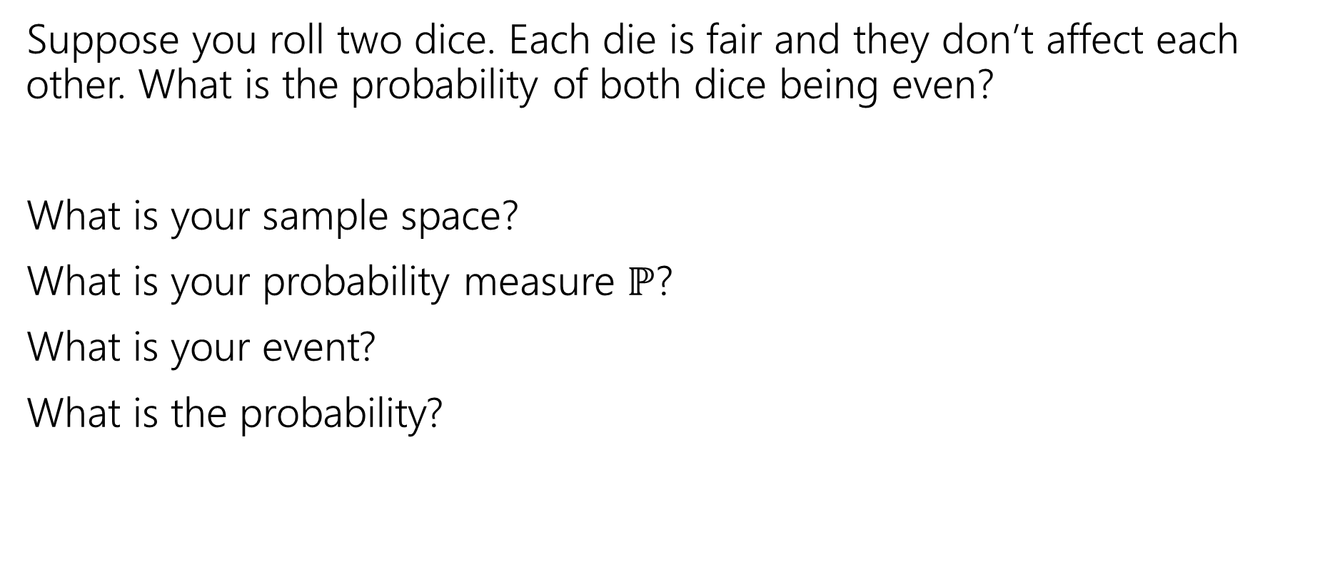
More Examples!
Suppose you roll two dice. Each die is fair and they don’t affect each other. What is the probability of both dice being even?
What is your sample space?
What is your probability measure $ℙ$?
What is your event?
What is the probability?

Slide 9
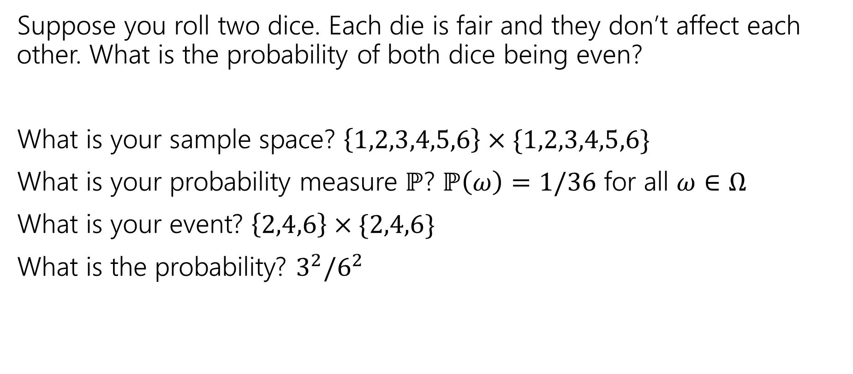
More Examples!
Suppose you roll two dice. Each die is fair and they don’t affect each other. What is the probability of both dice being even?
What is your sample space? $\left\{1,2,3,4,5,6\right\}×\{1,2,3,4,5,6\}$
What is your probability measure $ℙ$? $ℙ\left(ω\right)=1/36$ for all $ω∈Ω$
What is your event? $\left\{2,4,6\right\}×\{2,4,6\}$
What is the probability? $3^{2}/6^{2}$

Slide 10
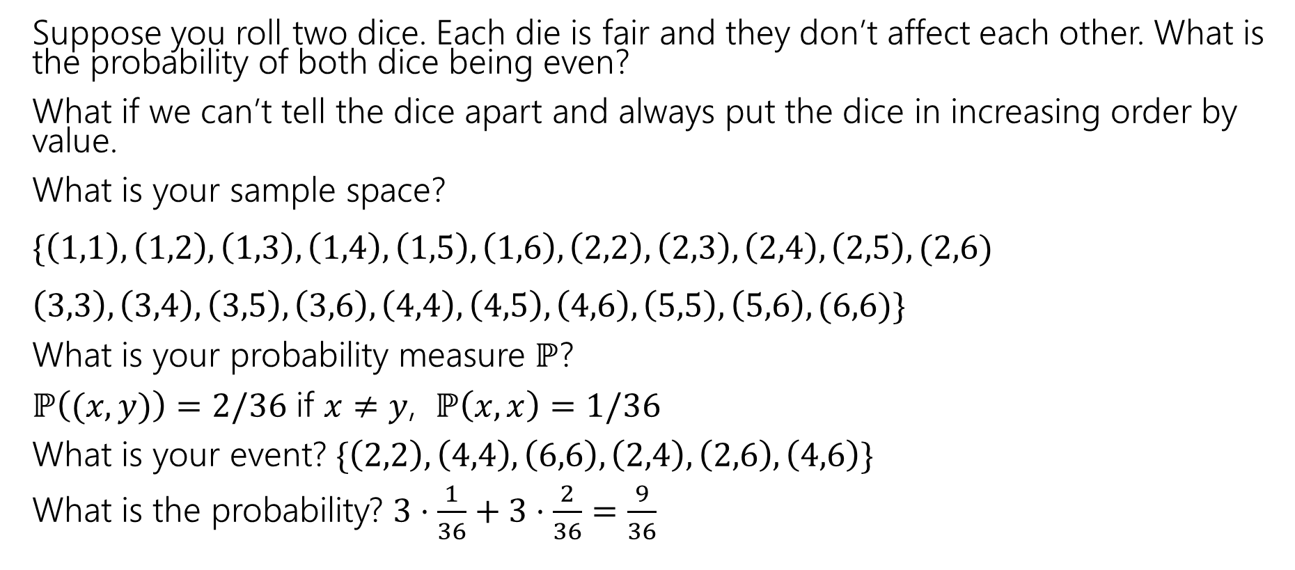
More Examples!
Suppose you roll two dice. Each die is fair and they don’t affect each other. What is the probability of both dice being even?
What if we can’t tell the dice apart and always put the dice in increasing order by value.
What is your sample space?
$\{\left(1,1\right),\left(1,2\right),\left(1,3\right),\left(1,4\right),\left(1,5\right),\left(1,6\right), \left(2,2\right),\left(2,3\right), \left(2,4\right),\left(2,5\right), (2,6)$
$\left(3,3\right),\left(3,4\right),\left(3,5\right),\left(3,6\right),\left(4,4\right),\left(4,5\right),\left(4,6\right),\left(5,5\right),\left(5,6\right), (6,6)\}$
What is your probability measure $ℙ$?
$ℙ\left((x,y)\right)=2/36$ if $x≠y$, $ℙ\left(x,x\right)=1/36$
What is your event? $\{\left(2,2\right),\left(4,4\right),\left(6,6\right), \left(2,4\right),\left(2,6\right),\left(4,6\right)\}$
What is the probability? $3⋅\frac{1}{36}+3⋅\frac{2}{36}=\frac{9}{36}$

Slide 11
Takeaways
There is often more than one sample space possible! But one is probably easier than the others.
Finding a sample space that will make the uniform measure correct will usually make finding the probabilities easier to calculate.

Slide 12
Another Example
Suppose you shuffle a deck of cards so any arrangement is equally likely. What is the probability that the top two cards have the same value?
Sample Space
Probability Measure
Event
Probability

Slide 13
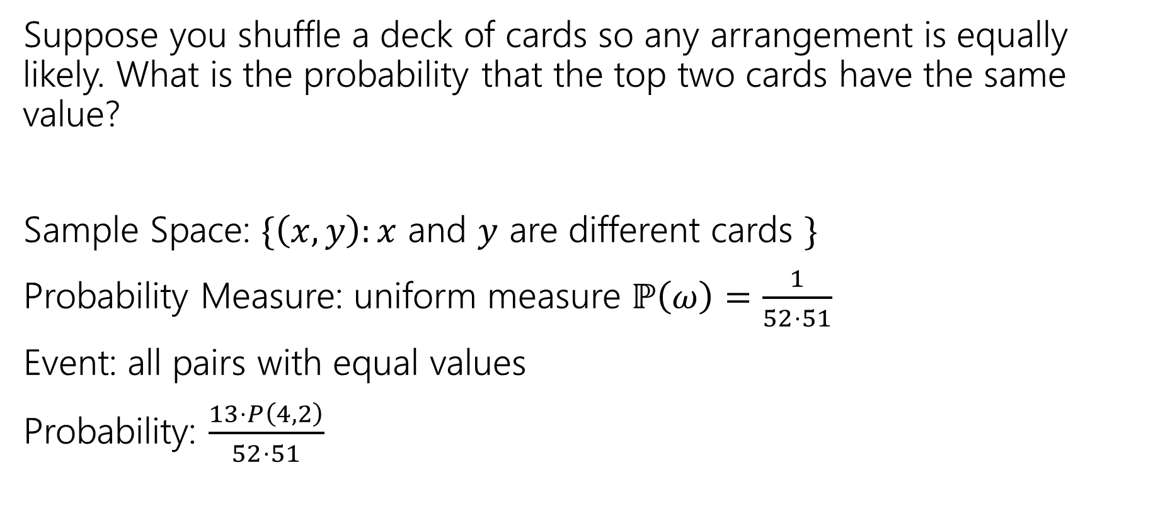
Another Example
Suppose you shuffle a deck of cards so any arrangement is equally likely. What is the probability that the top two cards have the same value?
Sample Space: $\{\left(x,y\right):x$ and $y$ are different cards $\}$
Probability Measure: uniform measure $ℙ\left(ω\right)=\frac{1}{52⋅51}$
Event: all pairs with equal values
Probability: $\frac{13⋅P\left(4,2\right)}{52⋅51}$

Slide 14
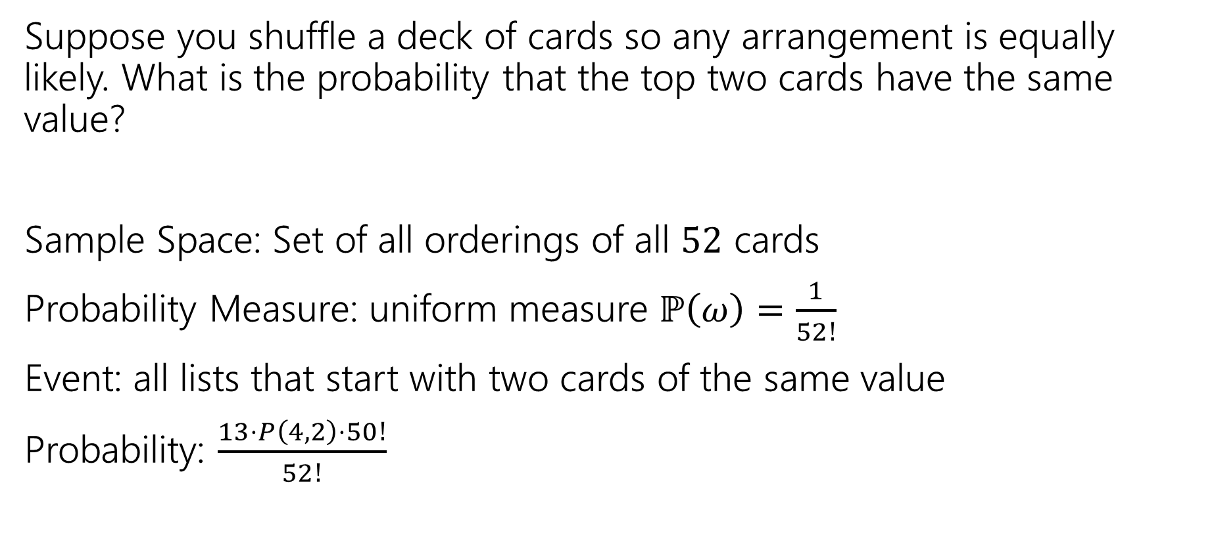
Another Example
Suppose you shuffle a deck of cards so any arrangement is equally likely. What is the probability that the top two cards have the same value?
Sample Space: Set of all orderings of all $52$ cards
Probability Measure: uniform measure $ℙ\left(ω\right)=\frac{1}{52!}$
Event: all lists that start with two cards of the same value
Probability: $\frac{13⋅P\left(4,2\right)⋅50!}{52!}$

Slide 15
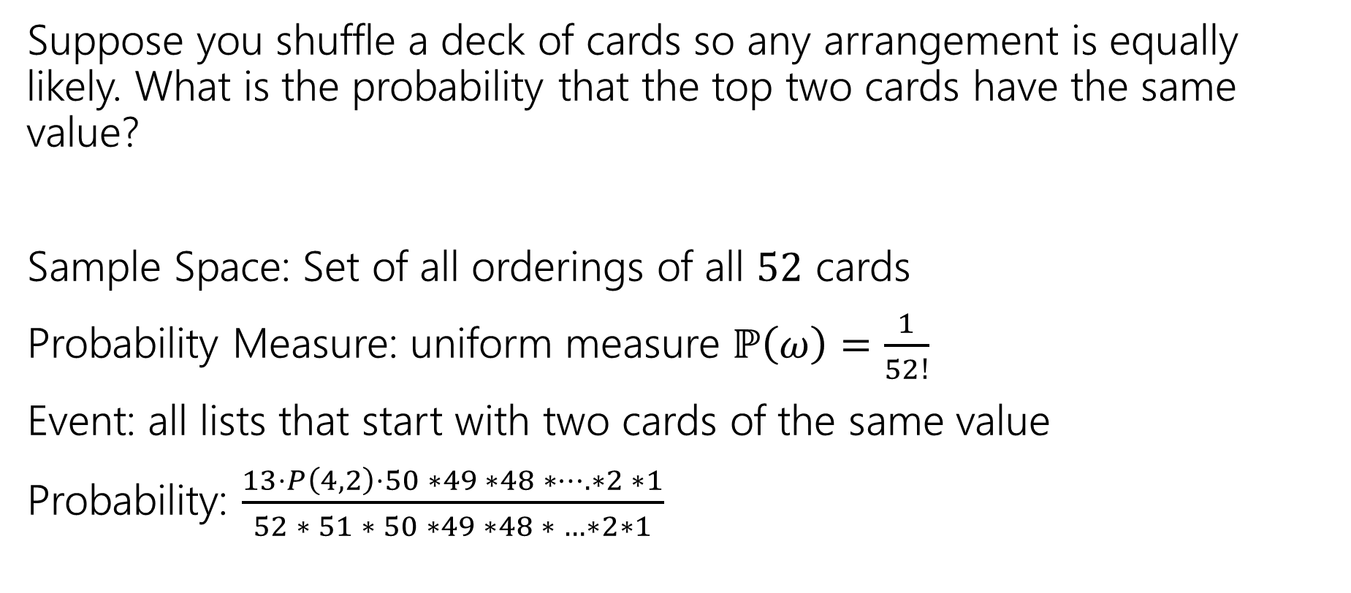
Another Example
Suppose you shuffle a deck of cards so any arrangement is equally likely. What is the probability that the top two cards have the same value?
Sample Space: Set of all orderings of all $52$ cards
Probability Measure: uniform measure $ℙ\left(ω\right)=\frac{1}{52!}$
Event: all lists that start with two cards of the same value
Probability: $\frac{13⋅P\left(4,2\right)⋅50 ∗49 ∗48 ∗…. ∗2 ∗1}{52 ∗ 51 ∗ 50 ∗49 ∗48 ∗ …∗2∗1}$

Slide 16
Takeaway
There’s often information you “don’t need” in your sample space.
It won’t give you the wrong answer.
But it sometimes makes for extra work/a harder counting problem,
Good indication: you cancelled A LOT of stuff that was common in the numerator and denominator.

Slide 17
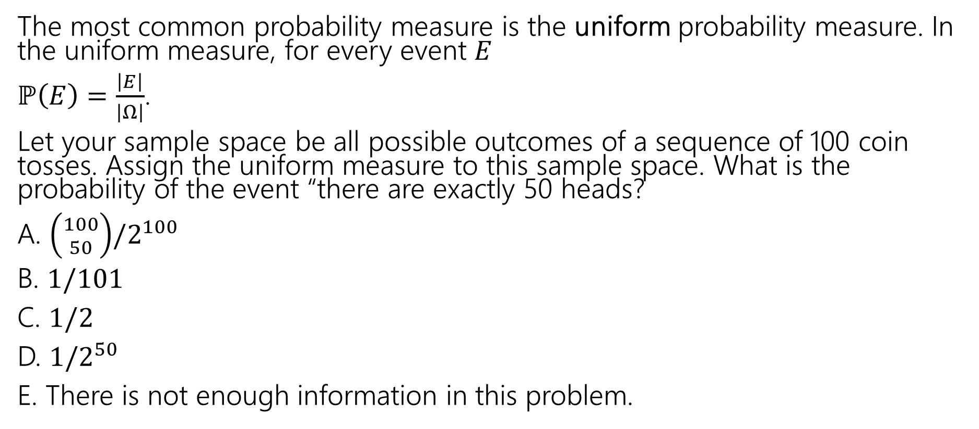
Uniform Probability Space
The most common probability measure is the uniform probability measure. In the uniform measure, for every event $E$
$ℙ\left(E\right)=\frac{\left|E\right|}{\left|Ω\right|}$.
Let your sample space be all possible outcomes of a sequence of 100 coin tosses. Assign the uniform measure to this sample space. What is the probability of the event “there are exactly 50 heads?
A. $\left({100 \atop 50}\right)/2^{100}$
B. $1/101$
C. $1/2$
D. $1/2^{50}$
E. There is not enough information in this problem.

Slide 18
Few notes about events and samples spaces
If you’re dealing with a situation where you may be able to use a uniform probability space, make sure to set up the sample space in a way that every outcome is equally likely.
Try not overcomplicate the sample space – only include the information that you need in it.
When you define an event, make sure it is a subset of the sample space!

Slide 19

Some Quick Observations
For discrete probability spaces (the kind we’ve seen so far)
$ℙ\left(E\right)=0$ if and only if ?
$ℙ\left(E\right)=1$ if and only if ?

Slide 20

Some Quick Observations
For discrete probability spaces (the kind we’ve seen so far)
$ℙ\left(E\right)=0$ if and only if an event can’t happen.
$ℙ\left(E\right)=1$ if and only if an event is guaranteed (every outcome outside $E$has probability $0$).

Slide 21
Conditional Probabilities

Slide 22
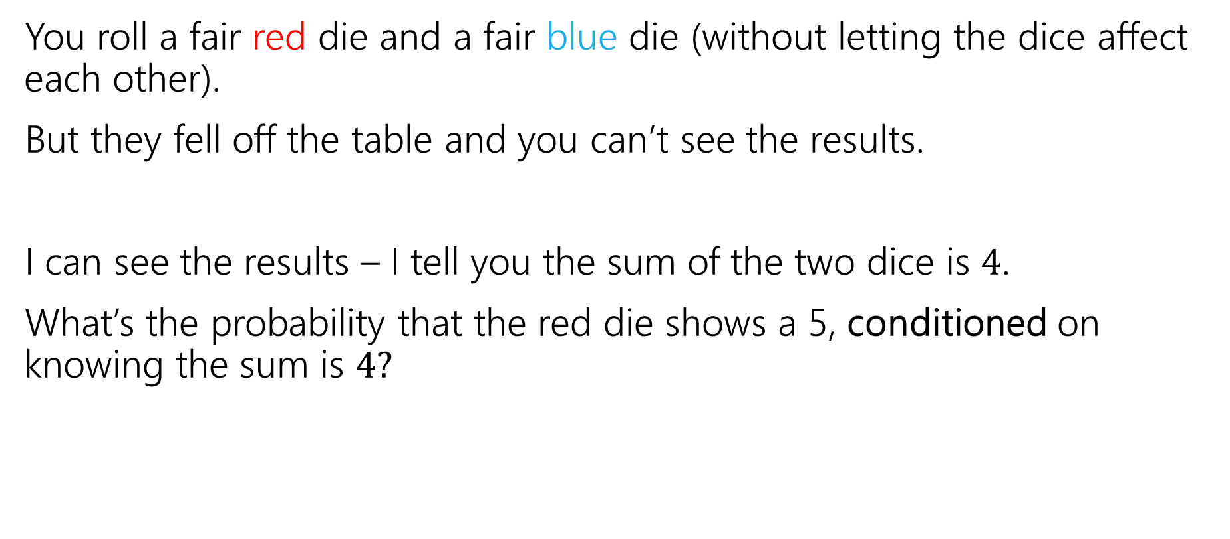
Conditioning
You roll a fair red die and a fair blue die (without letting the dice affect each other).
But they fell off the table and you can’t see the results.
I can see the results – I tell you the sum of the two dice is $4$.
What’s the probability that the red die shows a 5, conditioned on knowing the sum is $4?$

Slide 23
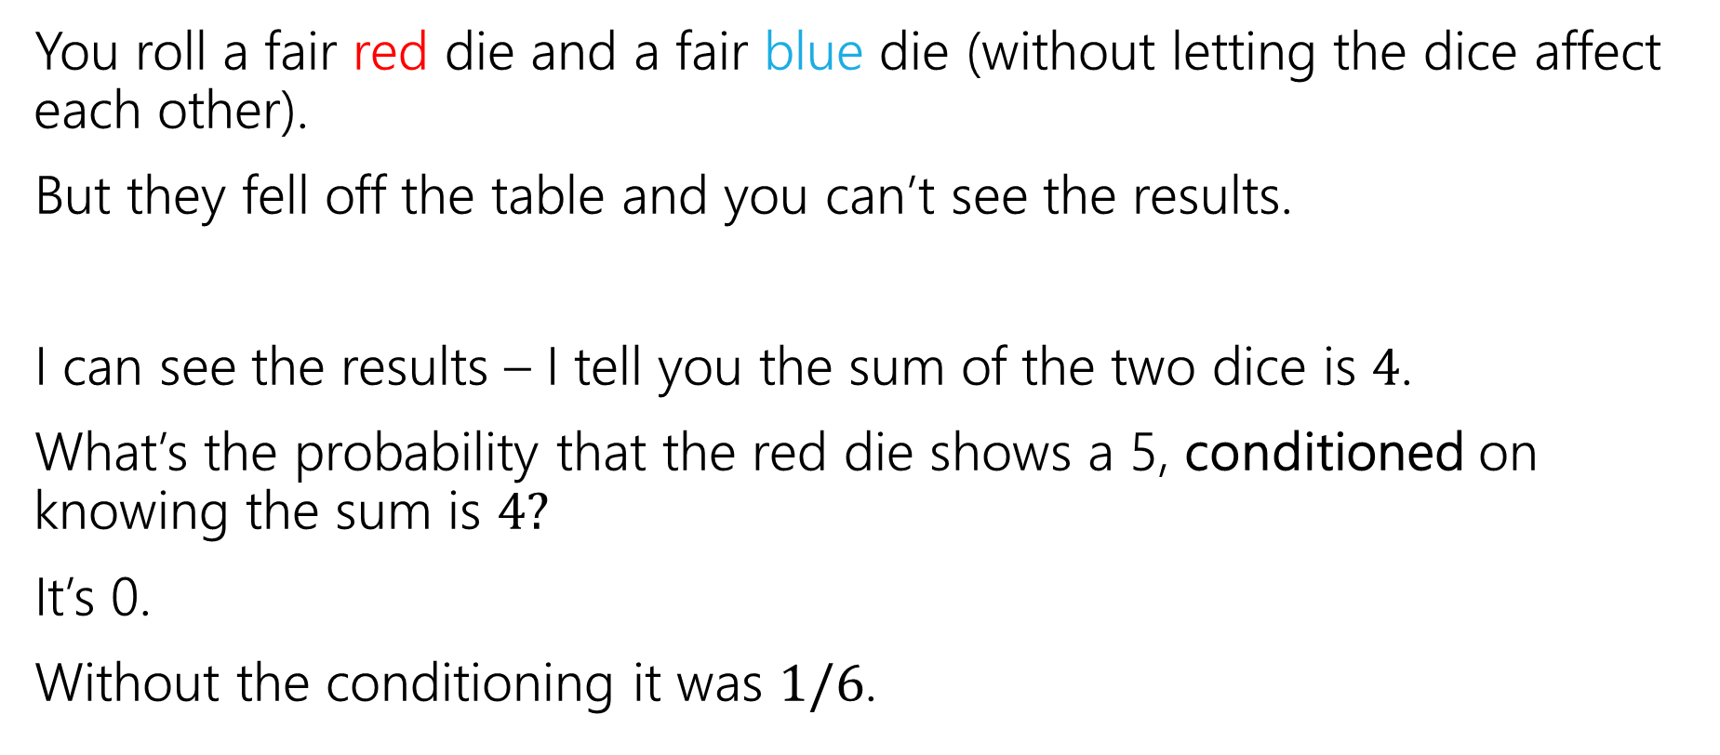
Conditioning
You roll a fair red die and a fair blue die (without letting the dice affect each other).
But they fell off the table and you can’t see the results.
I can see the results – I tell you the sum of the two dice is $4$.
What’s the probability that the red die shows a 5, conditioned on knowing the sum is $4?$
It’s 0.
Without the conditioning it was $1/6$.

Slide 24
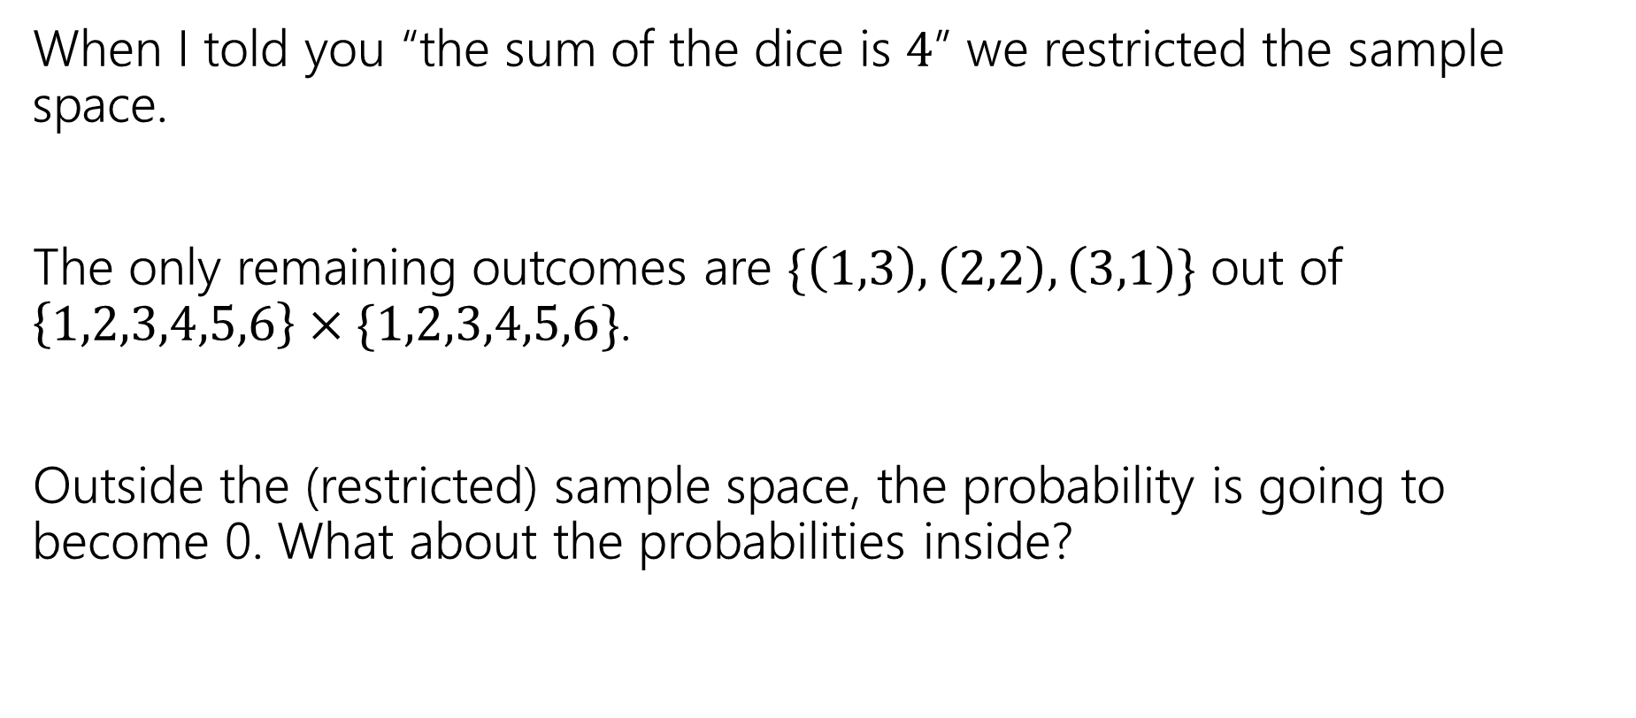
Conditioning
When I told you “the sum of the dice is $4$” we restricted the sample space.
The only remaining outcomes are $\{\left(1,3\right), \left(2,2\right), \left(3,1\right)\}$ out of $\left\{1,2,3,4,5,6\right\}×\{1,2,3,4,5,6\}$.
Outside the (restricted) sample space, the probability is going to become 0. What about the probabilities inside?

Slide 25

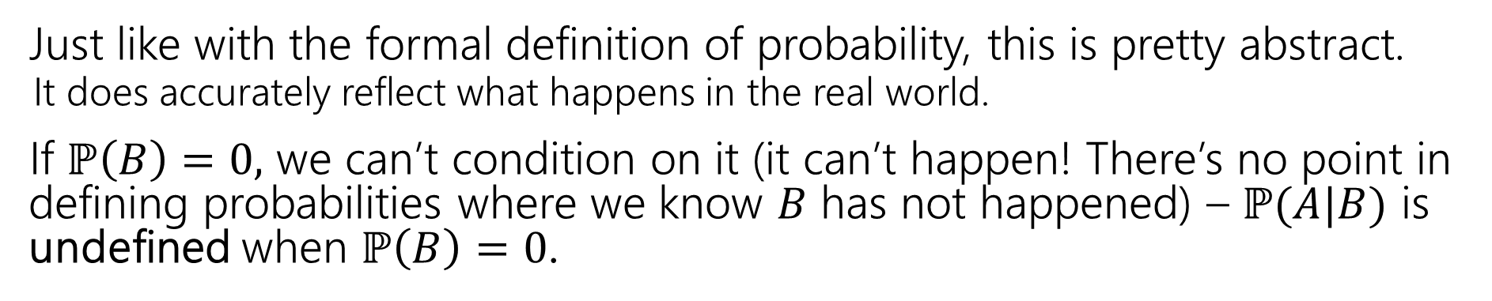
Conditional Probability
For an event $B$, with $ℙ\left(B\right)>0,$
$t$he “Probability of $A$ conditioned on $B$” is
$$ℙ\left(A | B\right)=\frac{ℙ\left(A∩B\right)}{ℙ\left(B\right)}$$
Conditional Probability
Just like with the formal definition of probability, this is pretty abstract.
  It does accurately reflect what happens in the real world.
If $ℙ\left(B\right)=0,$ we can’t condition on it (it can’t happen! There’s no point in defining probabilities where we know $B$ has not happened) – $ℙ(A|B)$ is undefined when $ℙ\left(B\right)=0$.

Slide 26
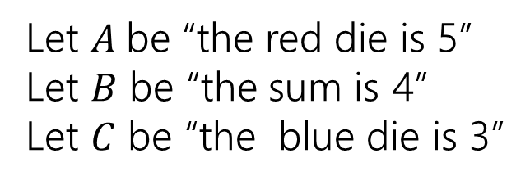
Conditioning…
 | D2=1 | D2=2 | D2=3 | D2=4 | D2=5 | D2=6
D1=1 | (1,1) | (1,2) | (1,3) | (1,4) | (1,5) | (1.6)
D1=2 | (2,1) | (2,2) | (2,3) | (2,4) | (2,5) | (2,6)
D1=3 | (3,1) | (3,2) | (3,3) | (3,4) | (3,5) | (3,6)
D1=4 | (4,1) | (4,2) | (4,3) | (4,4) | (4,5) | (4,6)
D1=5 | (5,1) | (5,2) | (5,3) | (5,4) | (5,5) | (5,6)
D1=6 | (6,1) | (6,2) | (6,3) | (6,4) | (6,5) | (6,6)
Let $A$be “the red die is 5”
Let $B$ be “the sum is 4”
Let $C$ be “the blue die is 3”

Slide 27
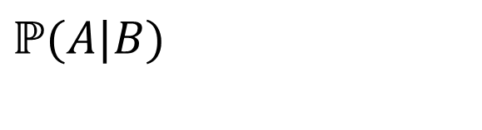
Conditioning…
 | D2=1 | D2=2 | D2=3 | D2=4 | D2=5 | D2=6
D1=1 | (1,1) | (1,2) | (1,3) | (1,4) | (1,5) | (1.6)
D1=2 | (2,1) | (2,2) | (2,3) | (2,4) | (2,5) | (2,6)
D1=3 | (3,1) | (3,2) | (3,3) | (3,4) | (3,5) | (3,6)
D1=4 | (4,1) | (4,2) | (4,3) | (4,4) | (4,5) | (4,6)
D1=5 | (5,1) | (5,2) | (5,3) | (5,4) | (5,5) | (5,6)
D1=6 | (6,1) | (6,2) | (6,3) | (6,4) | (6,5) | (6,6)
Let $A$be “the red die is 5”
Let $B$ be “the sum is 4”
Let $C$ be “the blue die is 3”
$$ℙ(A|B)$$

Slide 28
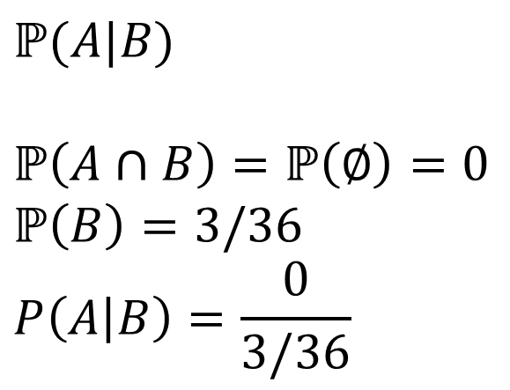
Conditioning…
 | D2=1 | D2=2 | D2=3 | D2=4 | D2=5 | D2=6
D1=1 | (1,1) | (1,2) | (1,3) | (1,4) | (1,5) | (1.6)
D1=2 | (2,1) | (2,2) | (2,3) | (2,4) | (2,5) | (2,6)
D1=3 | (3,1) | (3,2) | (3,3) | (3,4) | (3,5) | (3,6)
D1=4 | (4,1) | (4,2) | (4,3) | (4,4) | (4,5) | (4,6)
D1=5 | (5,1) | (5,2) | (5,3) | (5,4) | (5,5) | (5,6)
D1=6 | (6,1) | (6,2) | (6,3) | (6,4) | (6,5) | (6,6)
Let $A$be “the red die is 5”
Let $B$ be “the sum is 4”
Let $C$ be “the blue die is 3”
$$ℙ(A|B)$$
$$ℙ\left(A∩B\right)=ℙ\left(∅\right)=0$$
$$ℙ\left(B\right)=3/36$$
$$P\left(A | B\right)=\frac{0}{3/36}$$

Slide 29
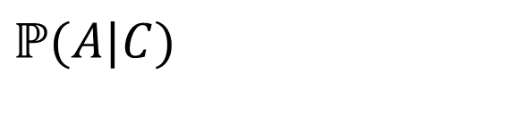
Conditioning…
 | D2=1 | D2=2 | D2=3 | D2=4 | D2=5 | D2=6
D1=1 | (1,1) | (1,2) | (1,3) | (1,4) | (1,5) | (1.6)
D1=2 | (2,1) | (2,2) | (2,3) | (2,4) | (2,5) | (2,6)
D1=3 | (3,1) | (3,2) | (3,3) | (3,4) | (3,5) | (3,6)
D1=4 | (4,1) | (4,2) | (4,3) | (4,4) | (4,5) | (4,6)
D1=5 | (5,1) | (5,2) | (5,3) | (5,4) | (5,5) | (5,6)
D1=6 | (6,1) | (6,2) | (6,3) | (6,4) | (6,5) | (6,6)
Let $A$be “the red die is 5”
Let $B$ be “the sum is 4”
Let $C$ be “the blue die is 3”
$$ℙ(A|C)$$

Slide 30
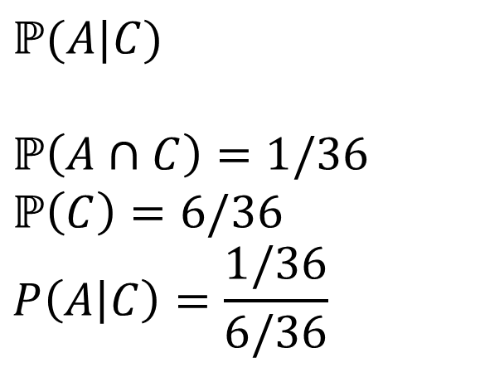
Conditioning…
 | D2=1 | D2=2 | D2=3 | D2=4 | D2=5 | D2=6
D1=1 | (1,1) | (1,2) | (1,3) | (1,4) | (1,5) | (1.6)
D1=2 | (2,1) | (2,2) | (2,3) | (2,4) | (2,5) | (2,6)
D1=3 | (3,1) | (3,2) | (3,3) | (3,4) | (3,5) | (3,6)
D1=4 | (4,1) | (4,2) | (4,3) | (4,4) | (4,5) | (4,6)
D1=5 | (5,1) | (5,2) | (5,3) | (5,4) | (5,5) | (5,6)
D1=6 | (6,1) | (6,2) | (6,3) | (6,4) | (6,5) | (6,6)
Let $A$be “the red die is 5”
Let $B$ be “the sum is 4”
Let $C$ be “the blue die is 3”
$$ℙ(A|C)$$
$$ℙ\left(A∩C\right)=1/36$$
$$ℙ\left(C\right)=6/36$$
$$P\left(A | C\right)=\frac{1/36}{6/36}$$

Slide 31
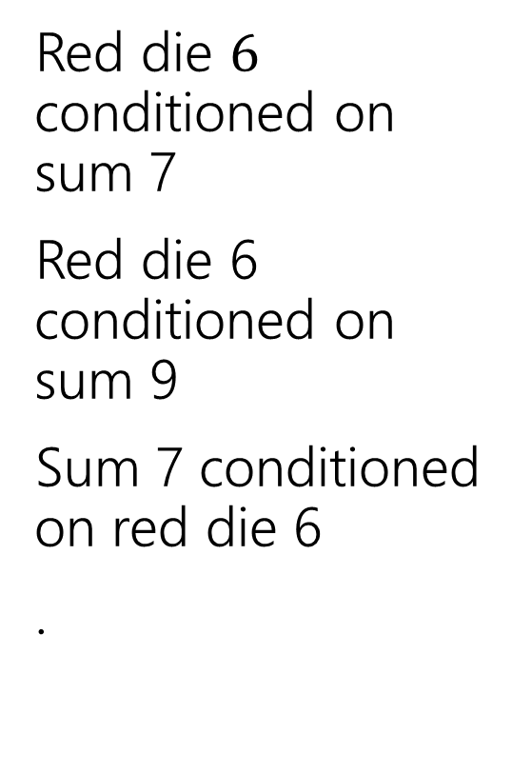
Conditioning Practice
Red die $6$ conditioned on sum 7
Red die 6 conditioned on sum 9
Sum 7 conditioned on red die 6
.
 | D2=1 | D2=2 | D2=3 | D2=4 | D2=5 | D2=6
D1=1 | (1,1) | (1,2) | (1,3) | (1,4) | (1,5) | (1.6)
D1=2 | (2,1) | (2,2) | (2,3) | (2,4) | (2,5) | (2,6)
D1=3 | (3,1) | (3,2) | (3,3) | (3,4) | (3,5) | (3,6)
D1=4 | (4,1) | (4,2) | (4,3) | (4,4) | (4,5) | (4,6)
D1=5 | (5,1) | (5,2) | (5,3) | (5,4) | (5,5) | (5,6)
D1=6 | (6,1) | (6,2) | (6,3) | (6,4) | (6,5) | (6,6)
Take a few minutes to work on this with the people around you! (also on your handout)

Slide 32
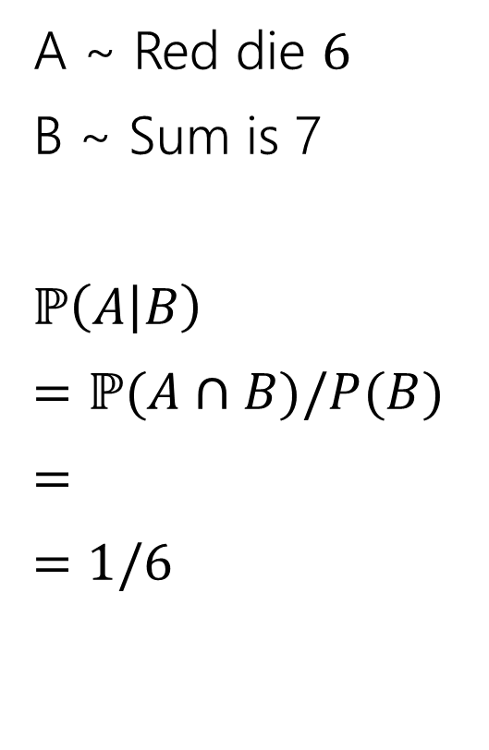
Conditioning Practice
A ~ Red die $6$
B ~ Sum is 7
$ℙ\left(A | B\right)$
$=ℙ(A∩B)/P(B)$
$=$
$=$ $1/6$
 | D2=1 | D2=2 | D2=3 | D2=4 | D2=5 | D2=6
D1=1 | (1,1) | (1,2) | (1,3) | (1,4) | (1,5) | (1.6)
D1=2 | (2,1) | (2,2) | (2,3) | (2,4) | (2,5) | (2,6)
D1=3 | (3,1) | (3,2) | (3,3) | (3,4) | (3,5) | (3,6)
D1=4 | (4,1) | (4,2) | (4,3) | (4,4) | (4,5) | (4,6)
D1=5 | (5,1) | (5,2) | (5,3) | (5,4) | (5,5) | (5,6)
D1=6 | (6,1) | (6,2) | (6,3) | (6,4) | (6,5) | (6,6)

Slide 33
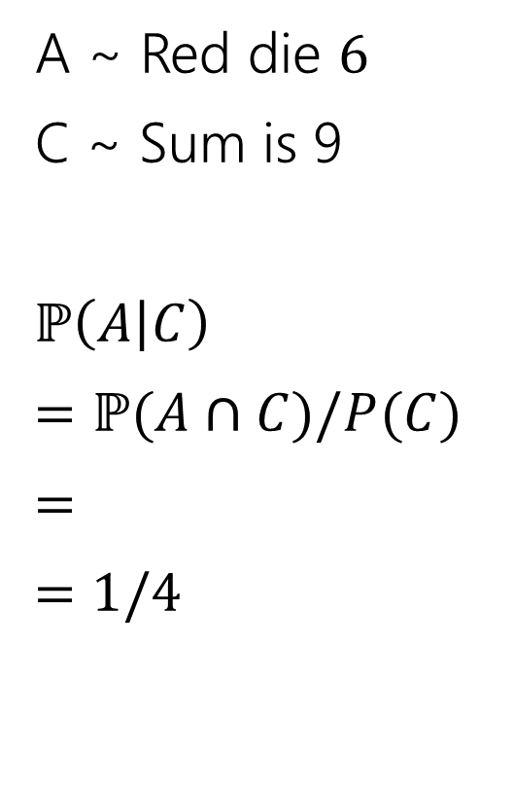
Conditioning Practice
A ~ Red die $6$
C ~ Sum is 9
$ℙ\left(A | C\right)$
$=ℙ(A∩C)/P(C)$
$=$
$=$ $1/4$
 | D2=1 | D2=2 | D2=3 | D2=4 | D2=5 | D2=6
D1=1 | (1,1) | (1,2) | (1,3) | (1,4) | (1,5) | (1.6)
D1=2 | (2,1) | (2,2) | (2,3) | (2,4) | (2,5) | (2,6)
D1=3 | (3,1) | (3,2) | (3,3) | (3,4) | (3,5) | (3,6)
D1=4 | (4,1) | (4,2) | (4,3) | (4,4) | (4,5) | (4,6)
D1=5 | (5,1) | (5,2) | (5,3) | (5,4) | (5,5) | (5,6)
D1=6 | (6,1) | (6,2) | (6,3) | (6,4) | (6,5) | (6,6)

Slide 34
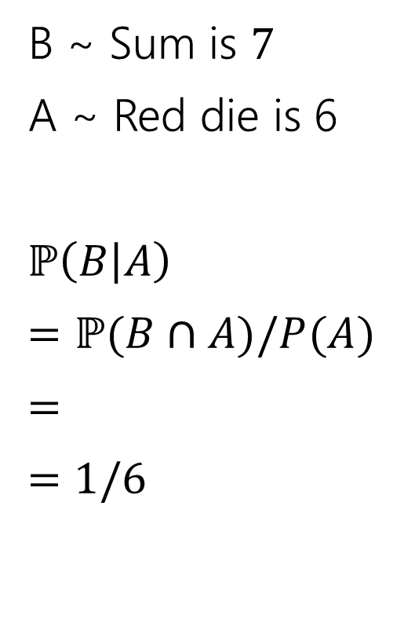
Conditioning Practice
B ~ Sum is $7$
A ~ Red die is 6
$ℙ\left(B | A\right)$
$=ℙ(B∩A)/P(A)$
$=$
$=$ $1/6$
 | D2=1 | D2=2 | D2=3 | D2=4 | D2=5 | D2=6
D1=1 | (1,1) | (1,2) | (1,3) | (1,4) | (1,5) | (1.6)
D1=2 | (2,1) | (2,2) | (2,3) | (2,4) | (2,5) | (2,6)
D1=3 | (3,1) | (3,2) | (3,3) | (3,4) | (3,5) | (3,6)
D1=4 | (4,1) | (4,2) | (4,3) | (4,4) | (4,5) | (4,6)
D1=5 | (5,1) | (5,2) | (5,3) | (5,4) | (5,5) | (5,6)
D1=6 | (6,1) | (6,2) | (6,3) | (6,4) | (6,5) | (6,6)

Slide 35
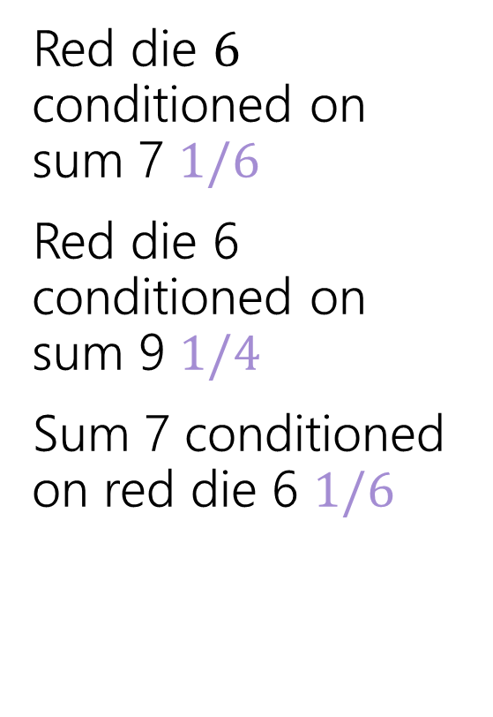
Conditioning Practice
Red die $6$ conditioned on sum 7 $1/6$
Red die 6 conditioned on sum 9 $1/4$
Sum 7 conditioned on red die 6 $1/6$
 | D2=1 | D2=2 | D2=3 | D2=4 | D2=5 | D2=6
D1=1 | (1,1) | (1,2) | (1,3) | (1,4) | (1,5) | (1.6)
D1=2 | (2,1) | (2,2) | (2,3) | (2,4) | (2,5) | (2,6)
D1=3 | (3,1) | (3,2) | (3,3) | (3,4) | (3,5) | (3,6)
D1=4 | (4,1) | (4,2) | (4,3) | (4,4) | (4,5) | (4,6)
D1=5 | (5,1) | (5,2) | (5,3) | (5,4) | (5,5) | (5,6)
D1=6 | (6,1) | (6,2) | (6,3) | (6,4) | (6,5) | (6,6)

Slide 36

Direction Matters
Are $ℙ(A|B)$ and $ℙ(B|A)$ the same?

Slide 37
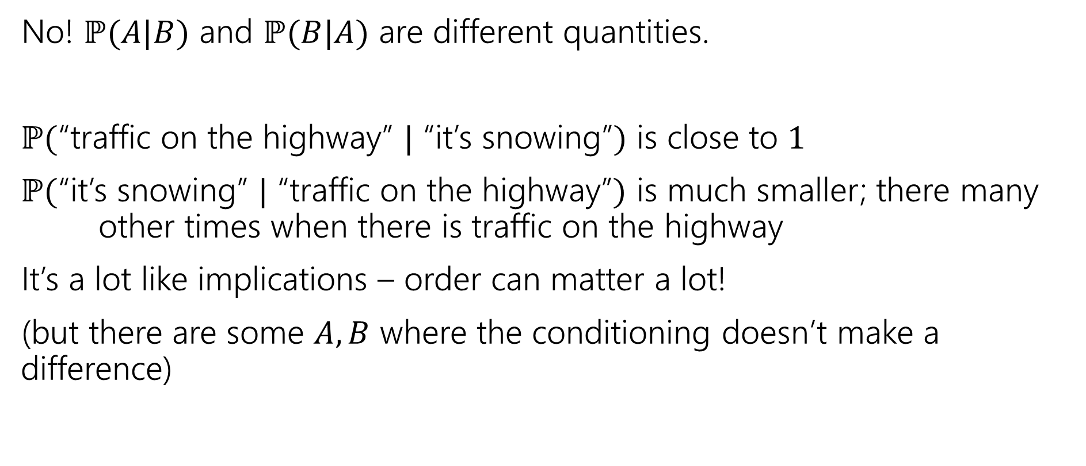
Direction Matters
No! $ℙ(A|B)$ and $ℙ(B|A)$ are different quantities.
$ℙ($“traffic on the highway” $|$ “it’s snowing”$)$ is close to $1$
$ℙ($“it’s snowing” $|$ “traffic on the highway”$)$ is much smaller; there many other times when there is traffic on the highway
It’s a lot like implications – order can matter a lot!
(but there are some $A,B$ where the conditioning doesn’t make a difference)

Slide 38

Conditional Probability
For an event $B$, with $ℙ\left(B\right)>0,$
$t$he “Probability of $A$ conditioned on $B$” is
$$ℙ\left(A | B\right)=\frac{ℙ\left(A∩B\right)}{ℙ\left(B\right)}$$
Conditional Probability
Just like with the formal definition of probability, this is pretty abstract.
  It does accurately reflect what happens in the real world.
If $ℙ\left(B\right)=0,$ we can’t condition on it (it can’t happen! There’s no point in defining probabilities where we know $B$ has not happened) – $ℙ(A|B)$ is undefined when $ℙ\left(B\right)=0$.

