Slide 1
More MLE
CSE 312 Summer 25
Lecture 22

Slide 2

Biased
One property we might want from an estimator is for it to be unbiased.
The expectation is taken over the randomness in the samples we drew.
  The formula is fixed, the data we draw to evaluate the formula becomes the source of the randomness.
So we’re not consistently overestimating or underestimating.
If an estimator isn’t unbiased then it’s biased.
An estimator $\hat{θ}$is “unbiased” if
$$𝔼\left[\hat{θ}\right]=θ$$

Slide 3
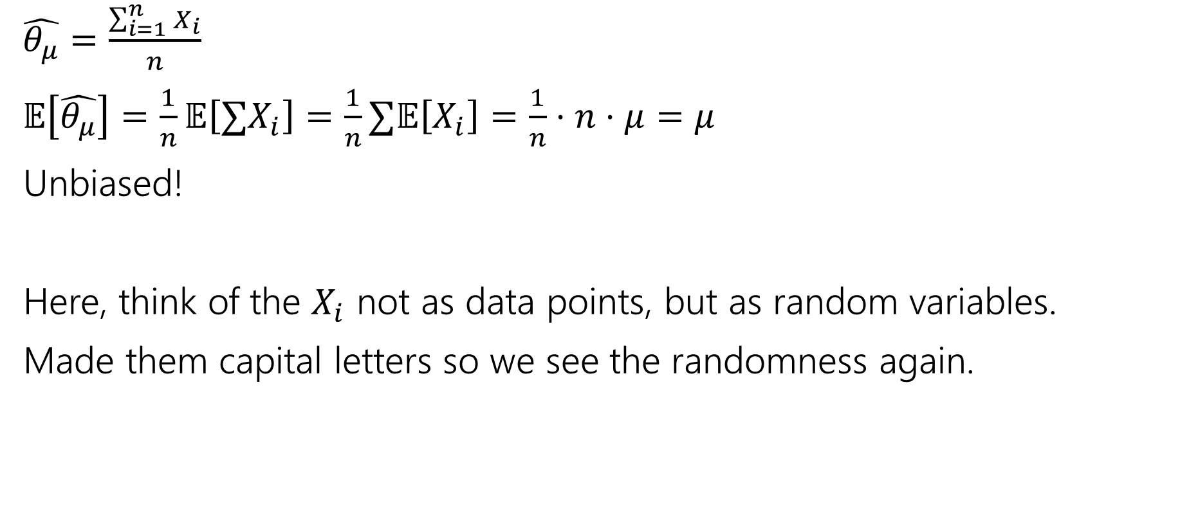
Are our MLEs unbiased?
$\hat{θ_{μ}}=\frac{\sum_{i=1}^{n}{X_{i}}}{n}$
$𝔼\left[\hat{θ_{μ}}\right]=\frac{1}{n}𝔼\left[∑X_{i}\right]=\frac{1}{n}∑𝔼\left[X_{i}\right]=\frac{1}{n}⋅n⋅μ=μ$
Unbiased!
Here, think of the $X_{i}$ not as data points, but as random variables.
Made them capital letters so we see the randomness again.
Notes:
Want to

Slide 4

Are our MLEs biased?
Our estimate for the coin-flips (if we generalized a bit) would be
  $$\frac{num heads}{total flips}$$
Is this biased or unbiased?
Notes:
This number of heads is a binomial with parameters n, theta

Slide 5
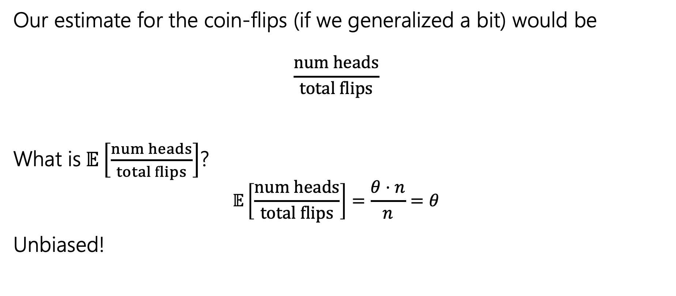
Are our MLEs biased?
Our estimate for the coin-flips (if we generalized a bit) would be
  $$\frac{num heads}{total flips}$$
$\text{What} \text{is} 𝔼\left[\frac{num heads}{total flips}\right]$?
  $$𝔼\left[\frac{num heads}{total flips}\right]=\frac{θ⋅n}{n}=θ$$
Unbiased!
Notes:
This number of heads is a binomial with parameters n, theta

Slide 6
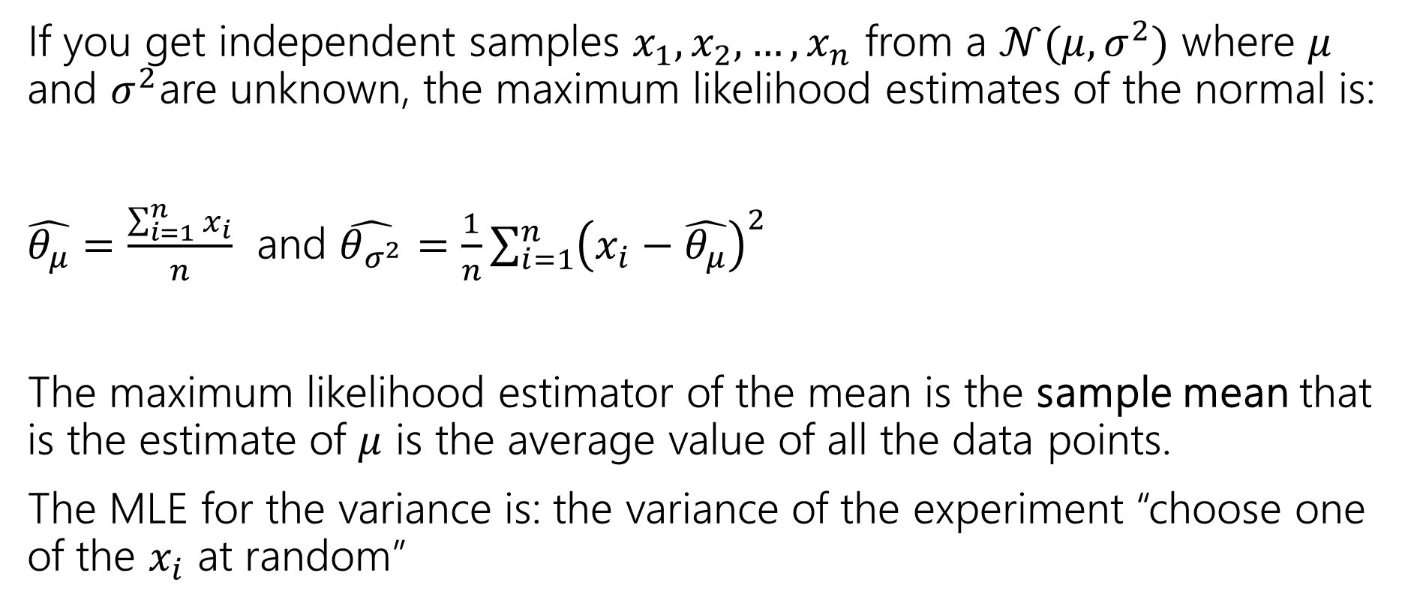
Summary
If you get independent samples $x_{1},x_{2},…,x_{n}$ from a $𝒩(μ,σ^{2})$ where $μ$ and $σ^{2}$are unknown, the maximum likelihood estimates of the normal is:
$\hat{θ_{μ}}=\frac{\sum_{i=1}^{n}{x_{i}}}{n}$ and $\hat{θ_{σ^{2}}}=\frac{1}{n}\sum_{i=1}^{n}{{\left(x_{i}−\hat{θ_{μ}}\right)}^{2}}$
The maximum likelihood estimator of the mean is the sample mean that is the estimate of $μ$ is the average value of all the data points.
The MLE for the variance is: the variance of the experiment “choose one of the $x_{i}$ at random”

Slide 7
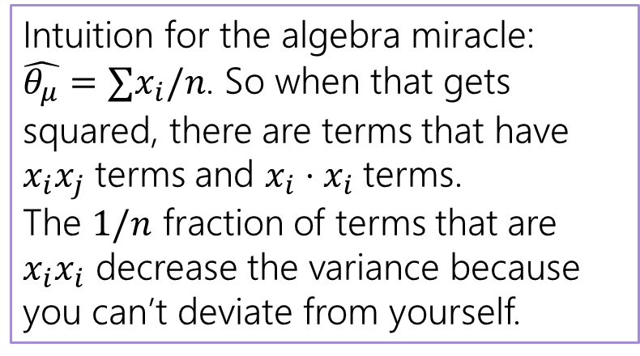

Unbiased?
$𝔼\left[θ_{σ^{2}}\right]=𝔼[\frac{1}{n}\sum_{i=1}^{n}{{\left(x_{i}−\hat{θ_{μ}}\right)}^{2}]}$
$=\frac{1}{n}𝔼\left[{∑\left(x_{i}−\hat{θ_{μ}}\right)}^{2}\right]$
$=\frac{1}{n}𝔼\left[∑x_{i}^{2}−2x_{i}\hat{θ_{μ}}+{\hat{θ_{μ}}}^{2}\right]$
$…$
Then an algebraic miracle occurs…
$=\frac{n−1}{n}⋅σ^{2}$ where $σ^{2}=𝔼\left[{(x}_{i}−𝔼\left[x_{i}\right])^2\right]$
Intuition for the algebra miracle:
$\hat{θ_{μ}}=∑x_{i}/n$. So when that gets squared, there are terms that have $x_{i}x_{j}$ terms and $x_{i}⋅x_{i}$terms.
The $1/n$ fraction of terms that are $x_{i}x_{i}$ decrease the variance because you can’t deviate from yourself.

Slide 8
Optional: Algebra
Showing MLE of Variance is biased

Slide 9
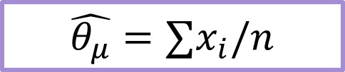
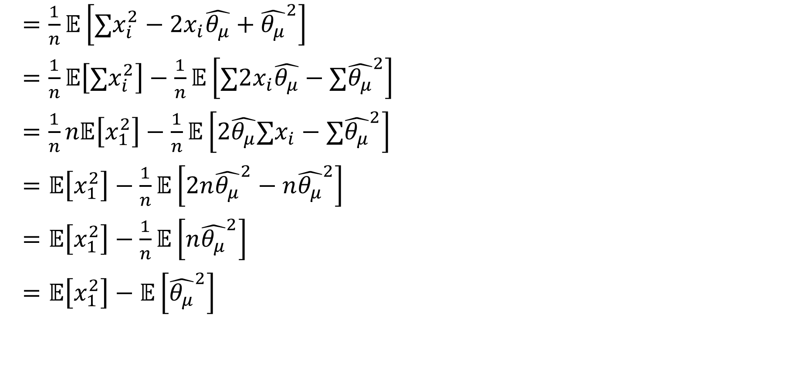
That Algebraic Miracle
$=\frac{1}{n}𝔼\left[∑x_{i}^{2}−2x_{i}\hat{θ_{μ}}+{\hat{θ_{μ}}}^{2}\right]$
$=\frac{1}{n}𝔼\left[∑x_{i}^{2}\right]−\frac{1}{n}𝔼\left[∑2x_{i}\hat{θ_{μ}}−{∑\hat{θ_{μ}}}^{2}\right]$
$=\frac{1}{n}n𝔼\left[x_{1}^{2}\right]−\frac{1}{n}𝔼\left[2\hat{θ_{μ}}∑x_{i}−{∑\hat{θ_{μ}}}^{2}\right]$
$=𝔼\left[x_{1}^{2}\right]−\frac{1}{n}𝔼\left[2n{\hat{θ_{μ}}}^{2}−n{\hat{θ_{μ}}}^{2}\right]$
$=𝔼\left[x_{1}^{2}\right]−\frac{1}{n}𝔼\left[n{\hat{θ_{μ}}}^{2}\right]$
$=𝔼\left[x_{1}^{2}\right]−𝔼\left[{\hat{θ_{μ}}}^{2}\right]$
$$\hat{θ_{μ}}=∑x_{i}/n$$

Slide 10
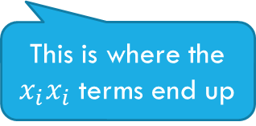
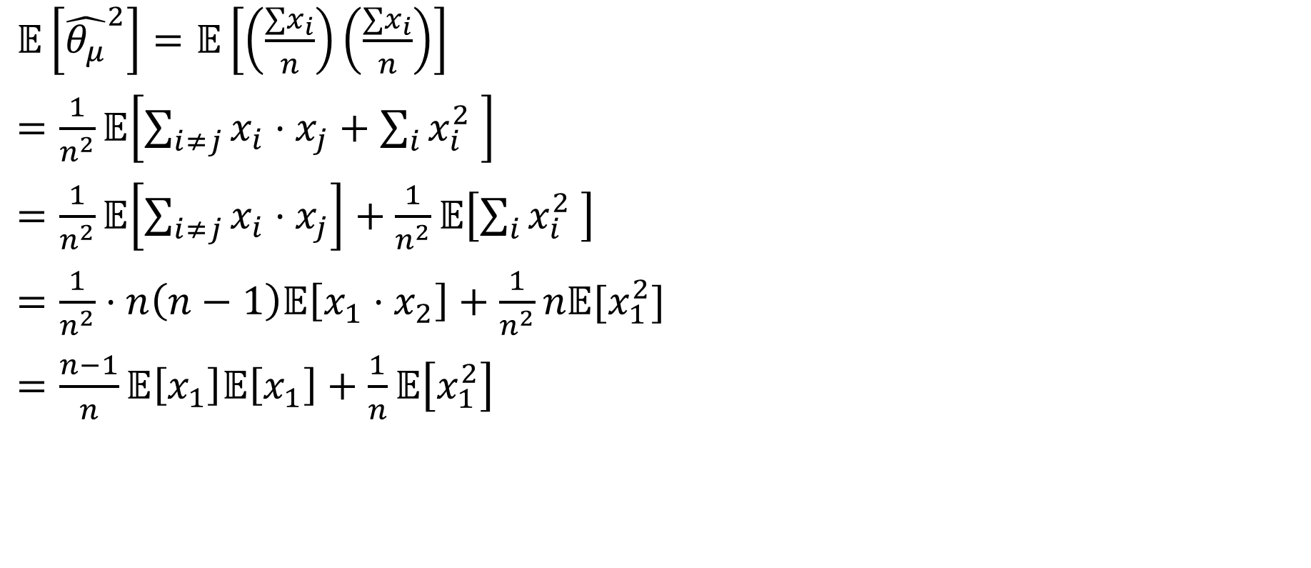
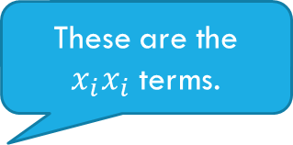
More of That Algebraic Miracle
$𝔼\left[{\hat{θ_{μ}}}^{2}\right]=𝔼\left[\left(\frac{∑x_{i}}{n}\right)\left(\frac{∑x_{i}}{n}\right)\right]$
$=\frac{1}{n^{2}}𝔼\left[\sum_{i≠j}{x_{i}⋅x_{j}}+\sum_{i}{x_{i}^{2} }\right]$
$=\frac{1}{n^{2}}𝔼\left[\sum_{i≠j}{x_{i}⋅x_{j}}\right]+\frac{1}{n^{2}}𝔼\left[\sum_{i}{x_{i}^{2} }\right]$
$=\frac{1}{n^{2}}⋅n\left(n−1\right)𝔼\left[x_{1}⋅x_{2}\right]+\frac{1}{n^{2}}n𝔼[x_{1}^{2}]$
$=\frac{n−1}{n}𝔼\left[x_{1}\right]𝔼\left[x_{1}\right]+\frac{1}{n}𝔼\left[x_{1}^{2}\right]$
These are the $x_{i}x_{i}$ terms.
This is where the $x_{i}x_{i}$ terms end up

Slide 11
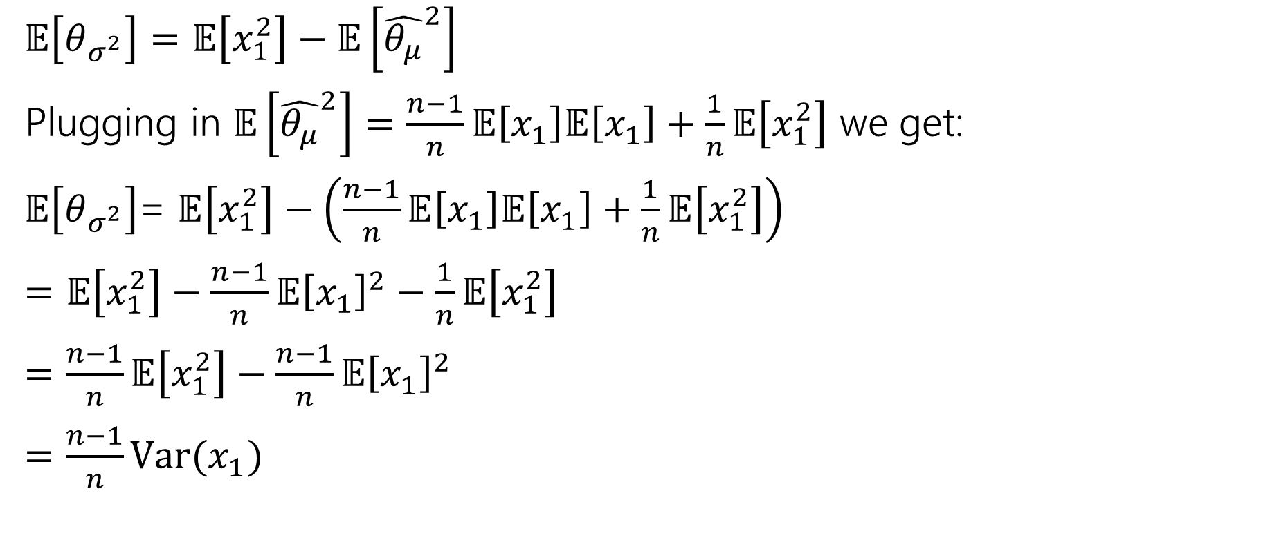
Wrapping Up the Algebraic Miracle
$𝔼\left[θ_{σ^{2}}\right]=𝔼\left[x_{1}^{2}\right]−𝔼\left[{\hat{θ_{μ}}}^{2}\right]$
Plugging in $𝔼\left[{\hat{θ_{μ}}}^{2}\right]=\frac{n−1}{n}𝔼\left[x_{1}\right]𝔼\left[x_{1}\right]+\frac{1}{n}𝔼\left[x_{1}^{2}\right]$ we get:
$𝔼\left[θ_{σ^{2}}\right]$= $𝔼\left[x_{1}^{2}\right]−\left(\frac{n−1}{n}𝔼\left[x_{1}\right]𝔼\left[x_{1}\right]+\frac{1}{n}𝔼\left[x_{1}^{2}\right]\right)$
$=𝔼\left[x_{1}^{2}\right]−\frac{n−1}{n}𝔼{\left[x_{1}\right]}^{2}−\frac{1}{n}𝔼\left[x_{1}^{2}\right]$
$=\frac{n−1}{n}𝔼\left[x_{1}^{2}\right]−\frac{n−1}{n}𝔼{\left[x_{1}\right]}^{2}$
$=\frac{n−1}{n}Var(x_{1})$

Slide 12
Non-optional Takeaways

Slide 13
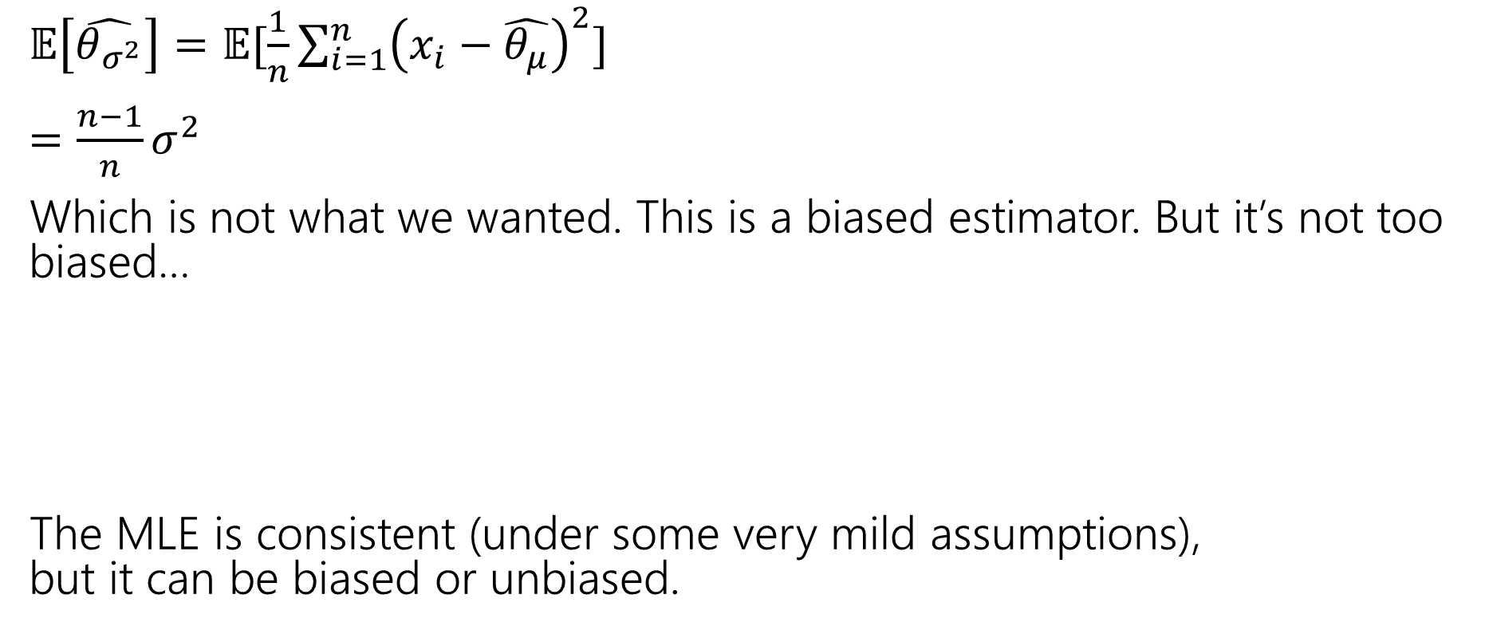

Not Unbiased
$𝔼\left[\hat{θ_{σ^{2}}}\right]=𝔼[\frac{1}{n}\sum_{i=1}^{n}{{\left(x_{i}−\hat{θ_{μ}}\right)}^{2}]}$
$=\frac{n−1}{n}σ^{2}$
Which is not what we wanted. This is a biased estimator. But it’s not too biased…
The MLE is consistent (under some very mild assumptions),
but it can be biased or unbiased.
An estimator $\hat{θ}$is “consistent” if
$$\lim_{n→∞}{𝔼\left[\hat{θ}\right]}=θ$$
Notes:
See, e.g., https://stats.stackexchange.com/questions/323873/assumptions-of-mle

Slide 14
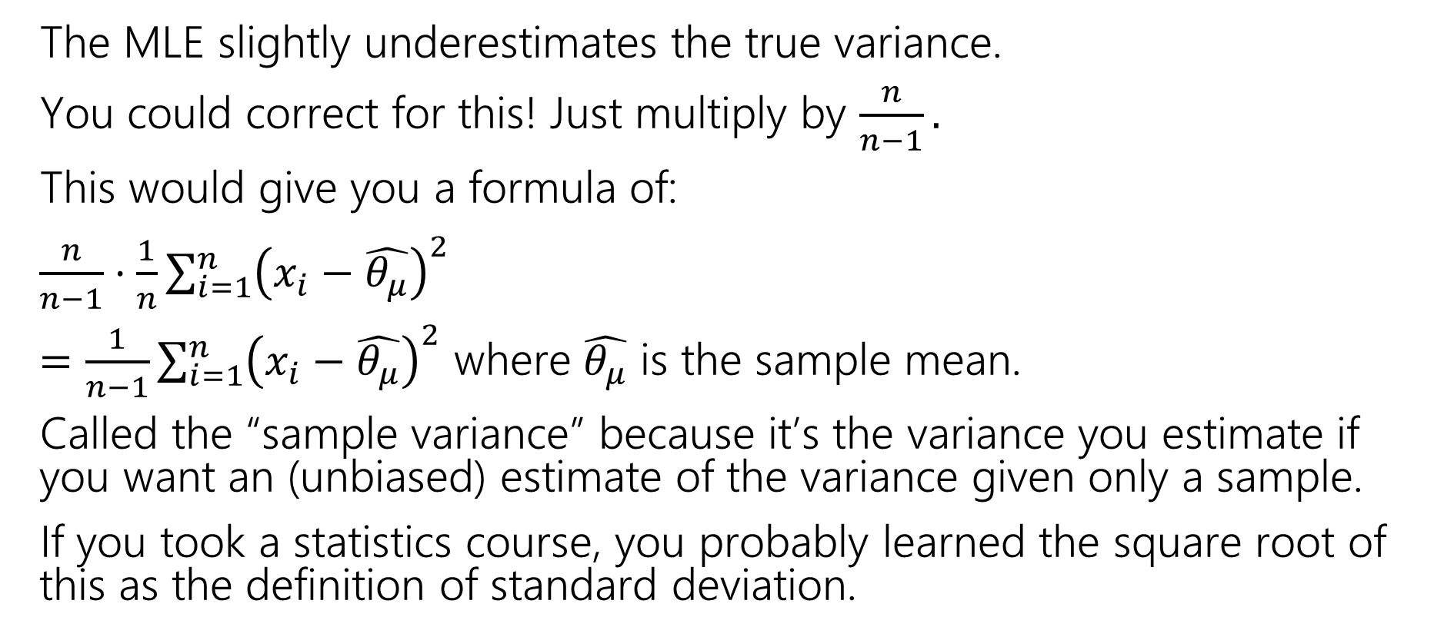
Correction
The MLE slightly underestimates the true variance.
You could correct for this! Just multiply by $\frac{n}{n−1}.$
This would give you a formula of:
$\frac{n}{n−1}⋅\frac{1}{n}\sum_{i=1}^{n}{{\left(x_{i}−\hat{θ_{μ}}\right)}^{2}}$
$=\frac{1}{n−1}\sum_{i=1}^{n}{{\left(x_{i}−\hat{θ_{μ}}\right)}^{2}}$ where $\hat{θ_{μ}}$ is the sample mean.
Called the “sample variance” because it’s the variance you estimate if you want an (unbiased) estimate of the variance given only a sample.
If you took a statistics course, you probably learned the square root of this as the definition of standard deviation.
Notes:
This would no longer be an MLE estimator, it is a different estimator.
Do other estimator exist? Yes! Maximum a posteriori probability estimation (MAP)

Slide 15
Are our MLE’s accurate?

Slide 16
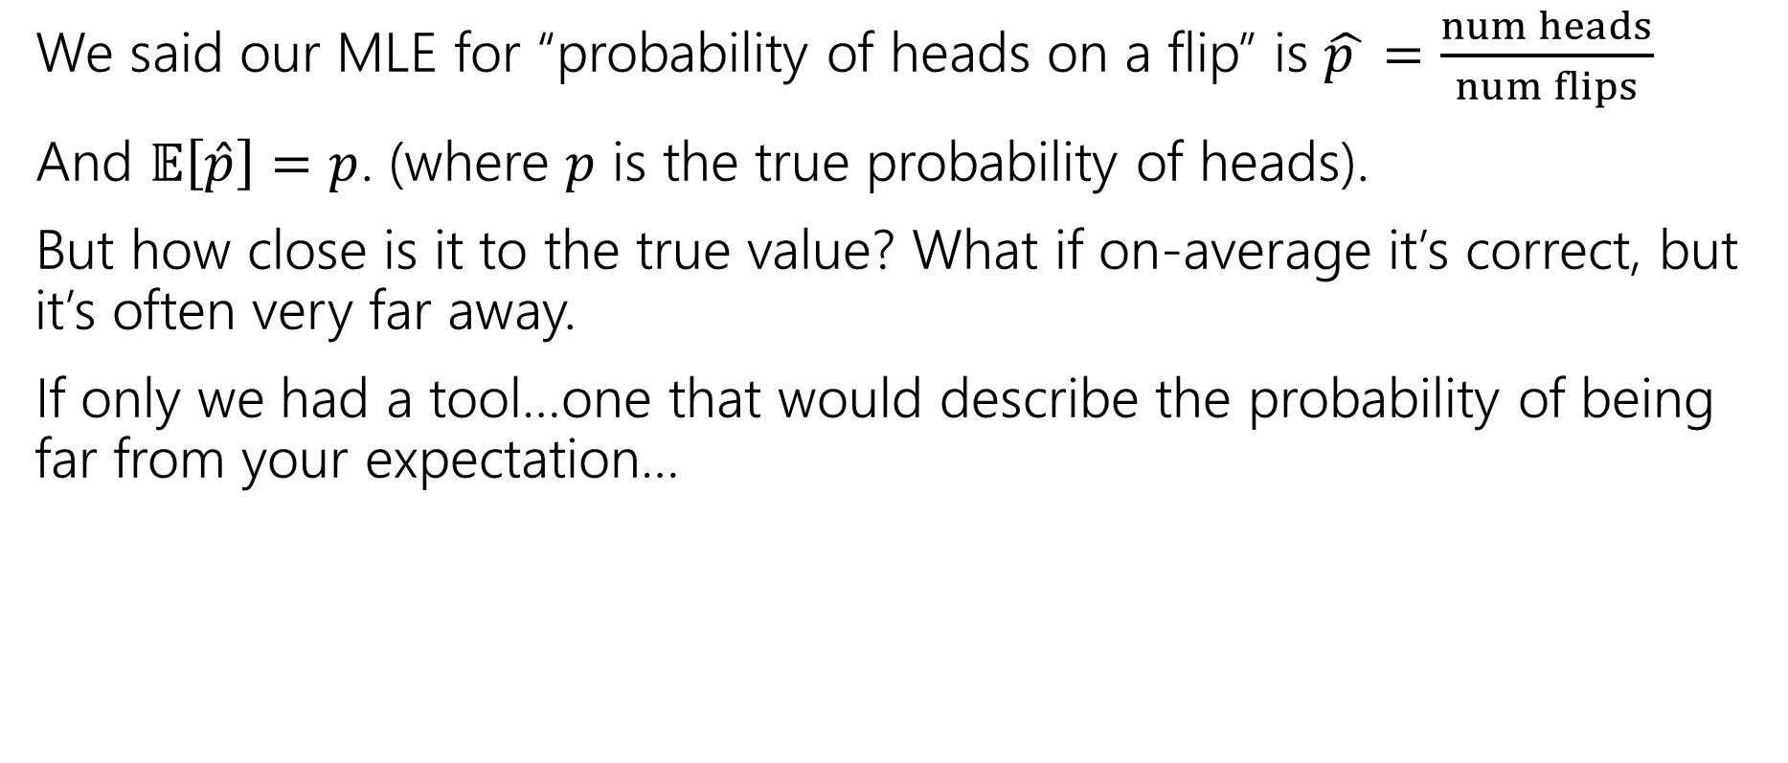
Confidence for MLEs
We said our MLE for “probability of heads on a flip” is $\hat{p }=\frac{num heads}{num flips}$
And $𝔼\left[\hat{p}\right]=p$. (where $p$ is the true probability of heads).
But how close is it to the true value? What if on-average it’s correct, but it’s often very far away.
If only we had a tool…one that would describe the probability of being far from your expectation…

