Slide 1
Maximum Likelihood Estimation
CSE 312 Summer 25
Lecture 21

Slide 2
Asking The Opposite Question
So far:
  Given rules for an experiment.
  Given the event/outcome we’re interested in.
  You calculate/estimate/bound what the probability is.
Today:
  Given some of the rules of the experiment.
  Given what happened.
  You estimate what the rest of the rules of the experiment were.

Slide 3
Example
Suppose you flip a coin independently 10 times, and you see
HTTTHHTHHH
What is your estimate of the probability the coin comes up heads?

Slide 4
Maximum Likelihood Estimation
Idea: we got the results we got.
High probability events happen more often than low probability events.
So, guess the rules that maximize the probability of the events we saw (relative to other choices of the rules).
Since that event happened, might as well guess the set of rules for which that event was a ‘high probability event’.
Notes:
If the coin was 50/50 what is P of seeing this result, if it was 55/45 …

Slide 5
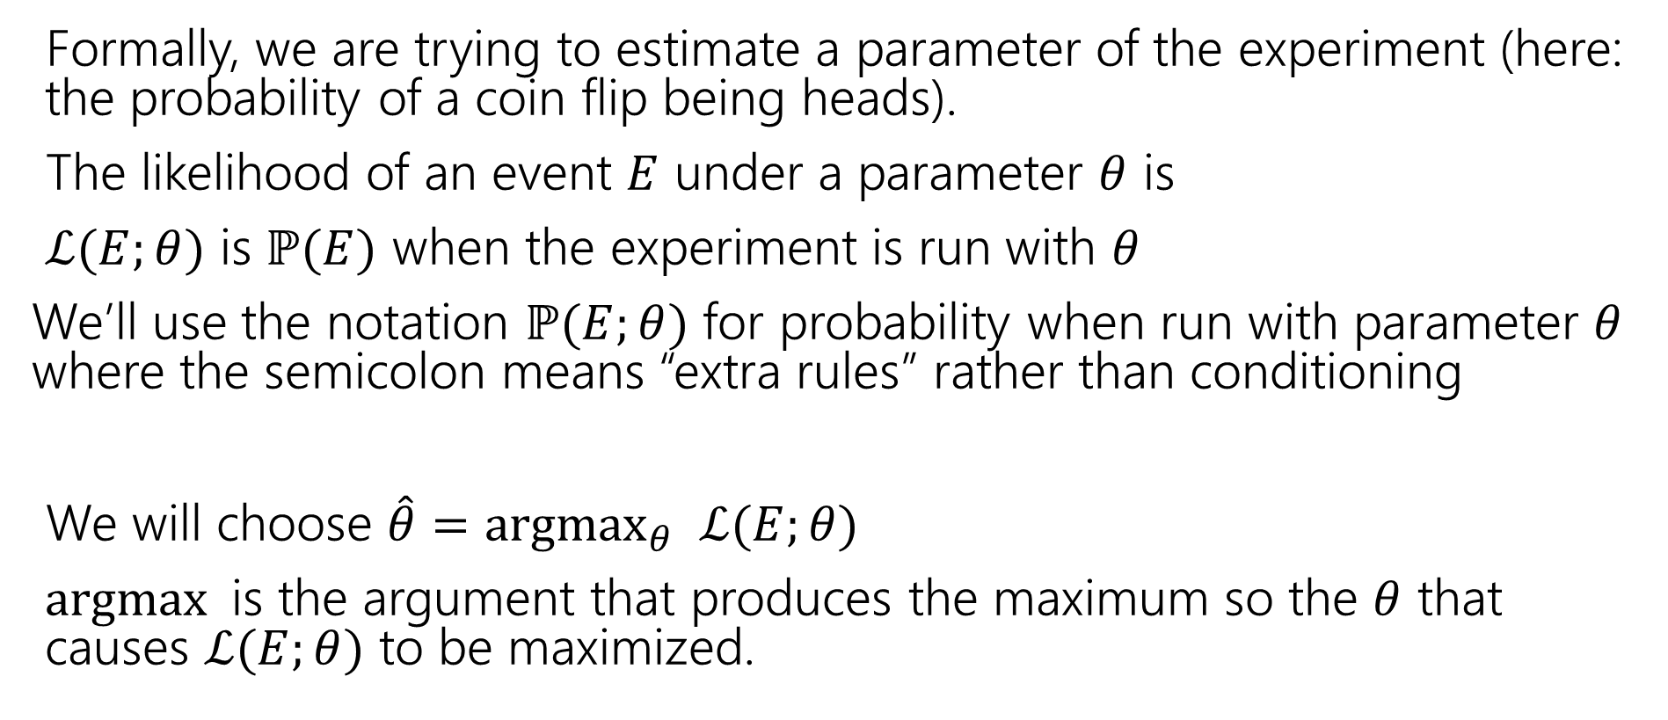
Maximum Likelihood Estimation
Formally, we are trying to estimate a parameter of the experiment (here: the probability of a coin flip being heads).
The likelihood of an event $E$ under a parameter $θ$ is
$ℒ(E;θ)$ is $ℙ(E)$ when the experiment is run with $θ$
We’ll use the notation $ℙ(E;θ)$ for probability when run with parameter $θ$ where the semicolon means “extra rules” rather than conditioning
We will choose $\hat{θ}={argmax}_{θ} ℒ(E;θ)$
$argmax$is the argument that produces the maximum so the $θ$ that causes $ℒ(E;θ)$ to be maximized.
Notes:
L(E|Theta) and P(E|Theta) are also very common notation, so expect to see that elsewhere.

Slide 6
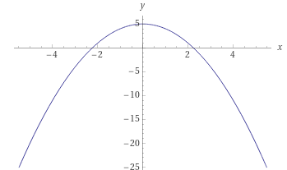

Argmax?
For example
${argmax}_{x} \left(5−x^{2}\right)=0$
$\max_{x}\left(5−x^{2}\right)=5$, the input (argument) which produces $5$ is $0$, so the argmax is 0

Slide 7
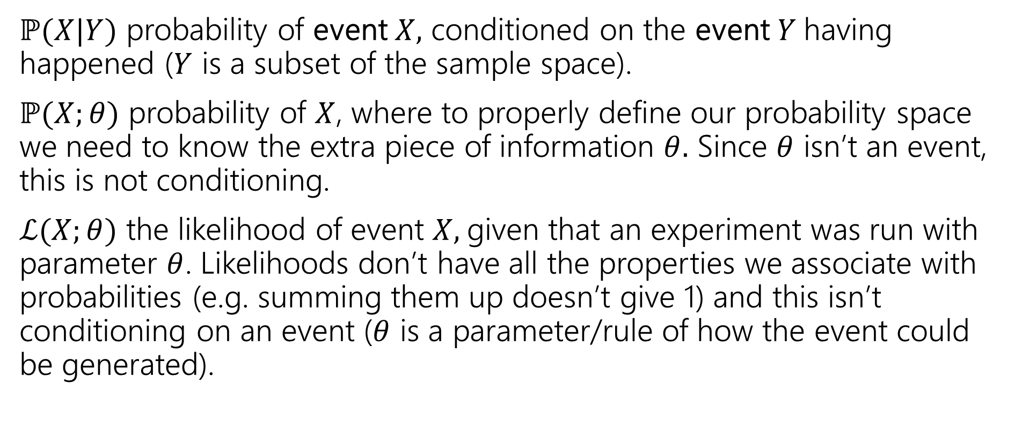
Notation comparison
$ℙ(X|Y)$ probability of event $X,$ conditioned on the event $Y$having happened ($Y$ is a subset of the sample space).
$ℙ(X;θ)$ probability of $X$, where to properly define our probability space we need to know the extra piece of information $θ.$ Since $θ$ isn’t an event, this is not conditioning.
$ℒ(X;θ)$ the likelihood of event $X,$given that an experiment was run with parameter $θ$. Likelihoods don’t have all the properties we associate with probabilities (e.g. summing them up doesn’t give 1) and this isn’t conditioning on an event ($θ$ is a parameter/rule of how the event could be generated).
Notes:
If X is changing probably want P(X;Theta) if X is fixed but Theta is changing probably want L(X; Theta)
It will be uncommon for us to write P(X;Theta) *except* when giving a formula for the likelihood.

Slide 8


MLE
The maximum likelihood estimator of the parameter $θ$ is:
$$\hat{θ}={argmax}_{θ} ℒ(E;θ)$$
Maximum Likelihood Estimator
$θ$ is a variable, $\hat{θ}$is a number (or formula given the event).
We’ll also use the notation ${\hat{θ}}_{MLE}$ if we want to emphasize how we found this estimator.

Slide 9
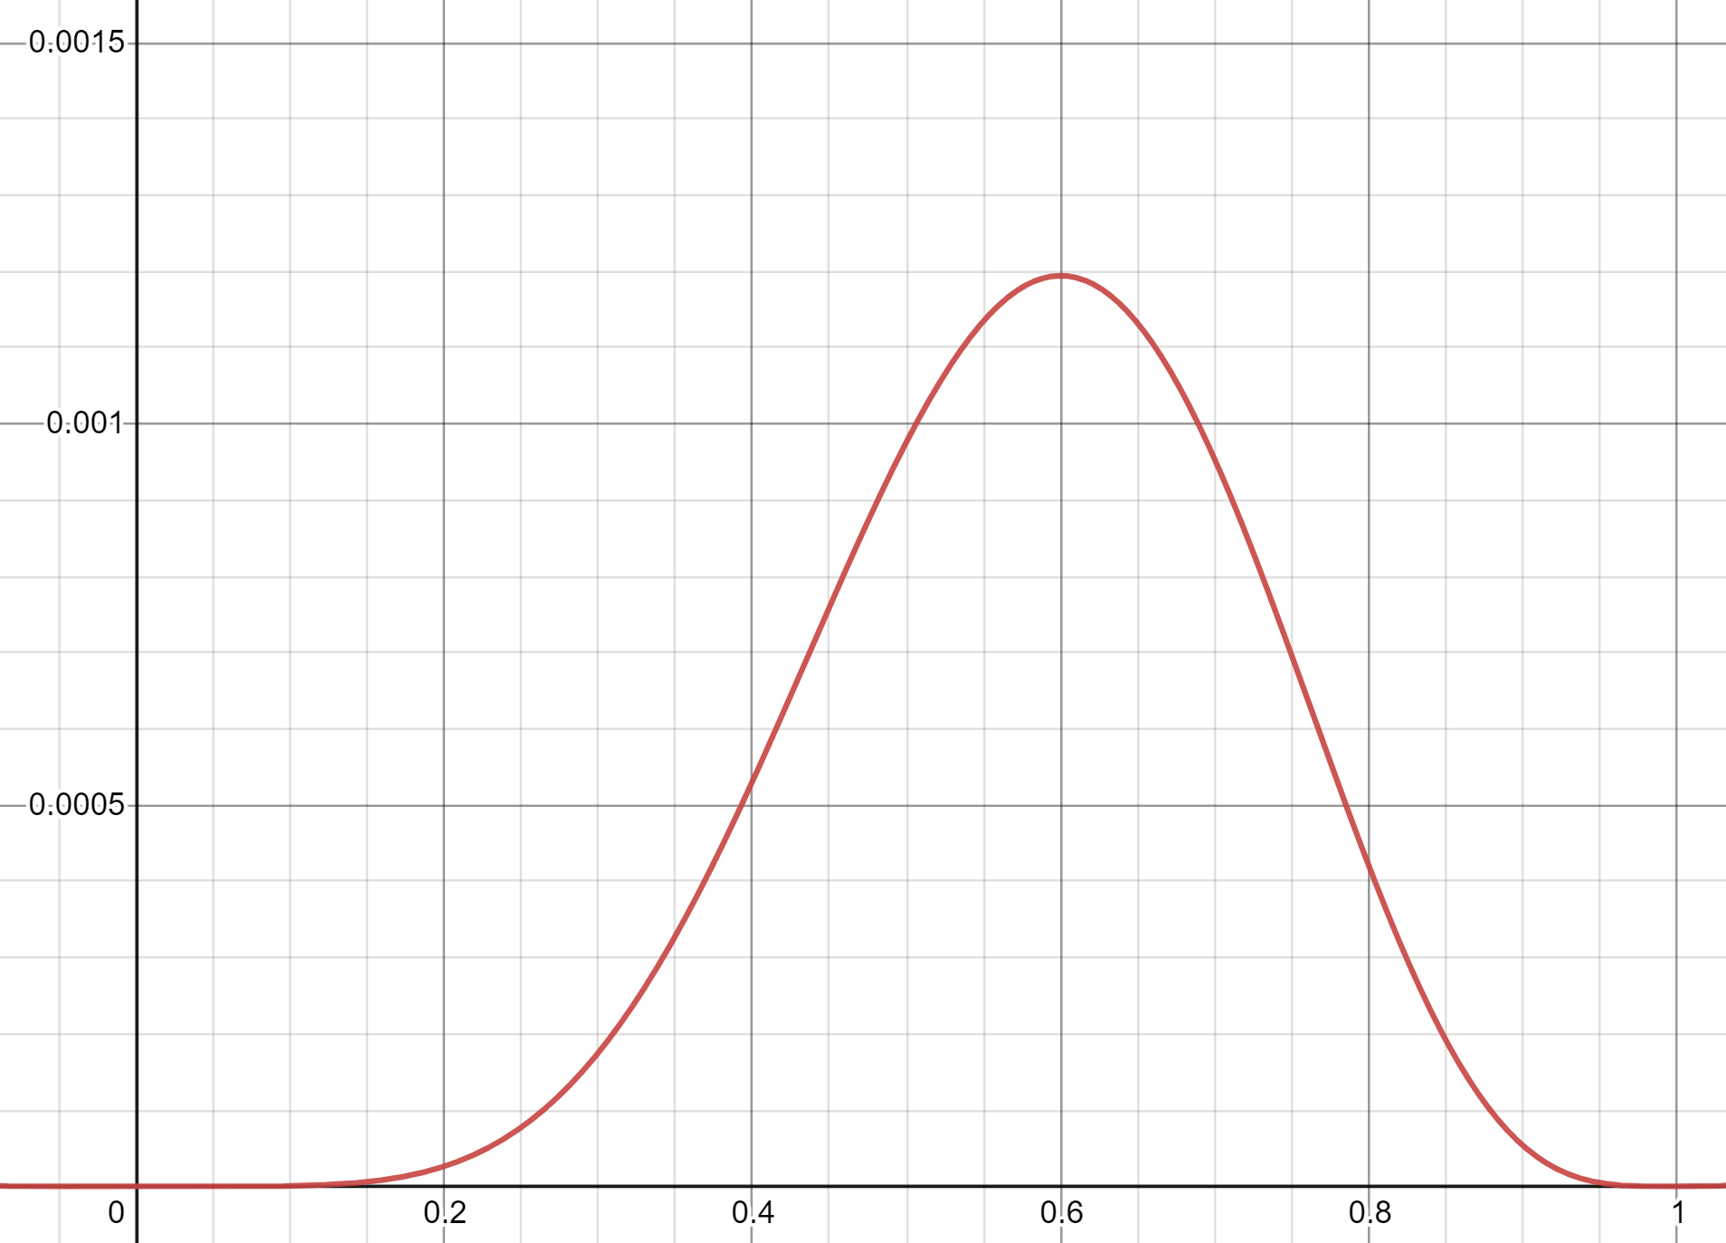
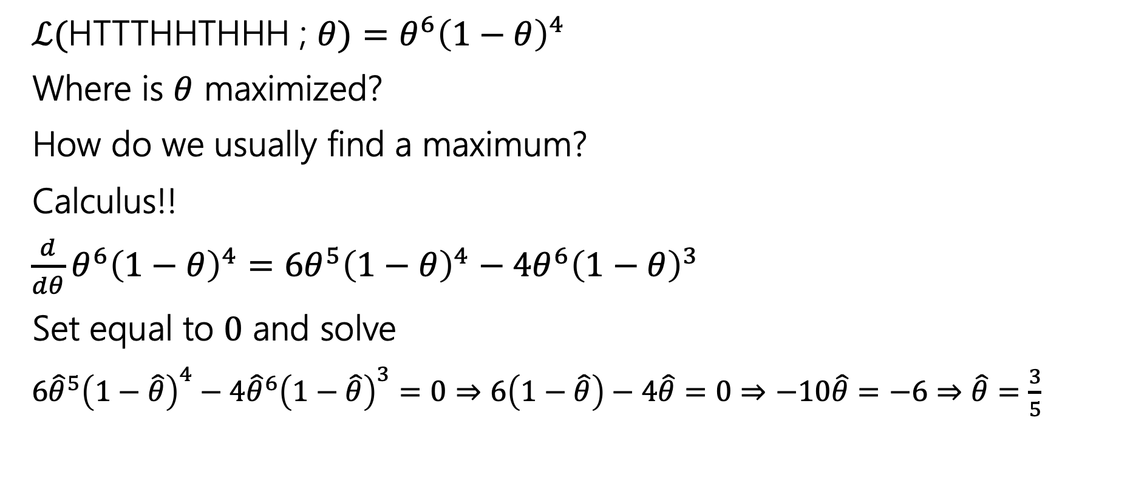


The Coin Example
$$ℒ(E;Θ)$$
$ℒ(\text{HTTTHHTHHH}$ ; $θ)=θ^{6}{\left(1−θ\right)}^{4}$
Where is $θ$ maximized?
How do we usually find a maximum?
Calculus!!
$\frac{d}{dθ}θ^{6}{\left(1−θ\right)}^{4}=6θ^{5}{\left(1−θ\right)}^{4}−{4θ}^{6}{\left(1−θ\right)}^{3}$
Set equal to $0$ and solve
$6{\hat{θ}}^{5}{\left(1−\hat{θ}\right)}^{4}−{4\hat{θ}}^{6}{\left(1−\hat{θ}\right)}^{3}=0⇒6\left(1−\hat{θ}\right)−4\hat{θ}=0⇒−10\hat{θ}=−6⇒\hat{θ}=\frac{3}{5}$
$$Θ$$
Notes:
(fg)’ = f’g + fg’

Slide 10
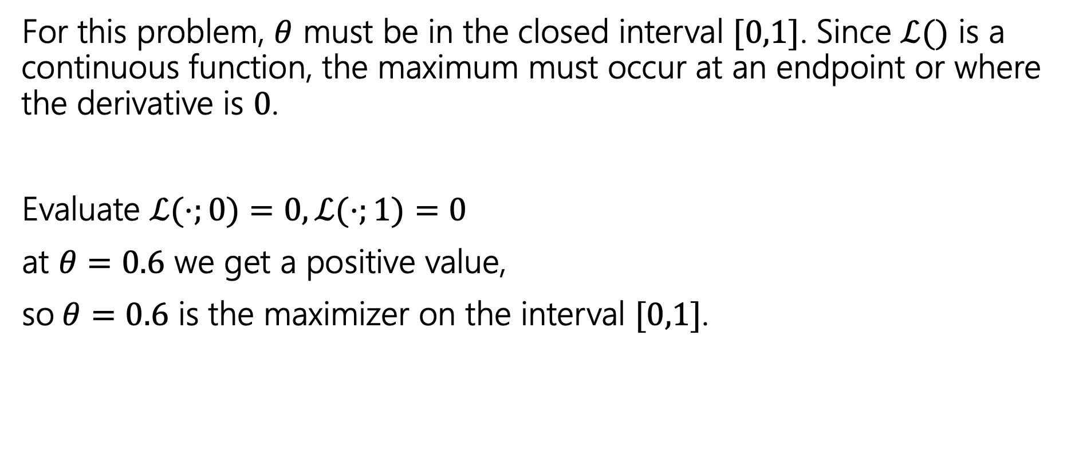
The Coin Example
For this problem, $θ$ must be in the closed interval $[0,1]$. Since $ℒ()$ is a continuous function, the maximum must occur at an endpoint or where the derivative is $0$.
Evaluate $ℒ(⋅;0)=0, ℒ(⋅;1)=0$
at $θ=0.6$ we get a positive value,
so$θ=0.6$ is the maximizer on the interval $[0,1]$.
Notes:
Could also use second derivative test, but that’s definitely more annoying.

Slide 11
Maximizing a Function
Closed intervals
Second derivative test
Set derivative equal to 0 and solve.
Evaluate likelihood at endpoints and any critical points.
Maximum value must be maximum on that interval.
Set derivative equal to 0 and solve.
Take the second derivative. If negative everywhere, then the critical point is the maximizer.

Slide 12
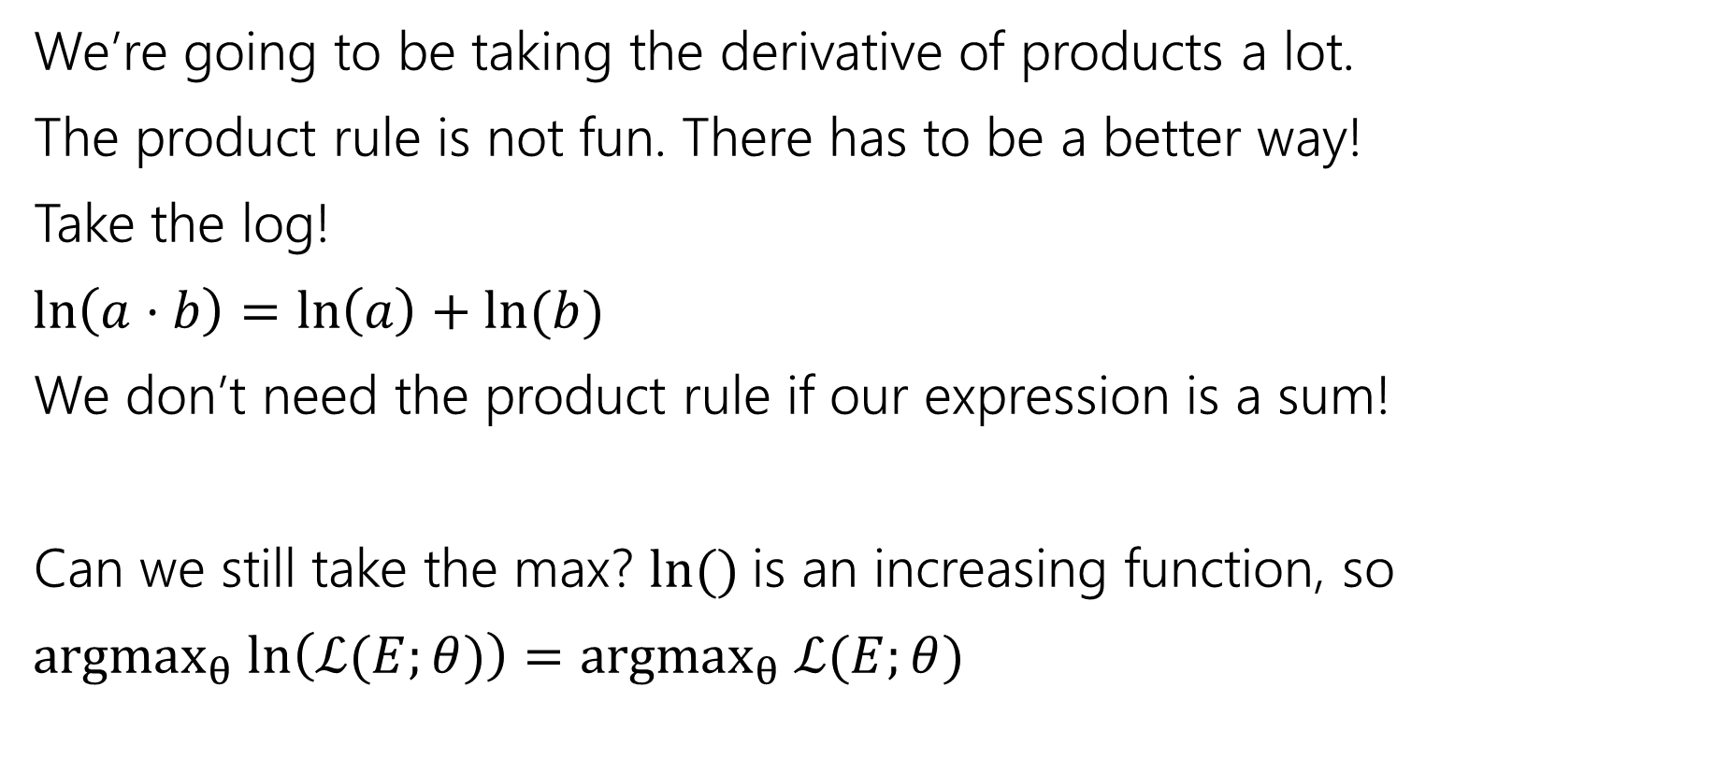
A Math Trick
We’re going to be taking the derivative of products a lot.
The product rule is not fun. There has to be a better way!
Take the log!
$\ln\left(a⋅b\right)=\ln\left(a\right)+\ln{(b)}$
We don’t need the product rule if our expression is a sum!
Can we still take the max? $\ln{()}$is an increasing function, so
$argmax_{θ} ln\left(ℒ(E;θ)\right)=argmax_{θ} ℒ(E;θ)$

Slide 13

Coin flips is easier
$ℒ($HTTTHHTHHH$;θ)=θ^{6}{\left(1−θ\right)}^{4}$
$\ln{(ℒ(\text{HTTTHHTHHH};θ)}= ?$

Slide 14
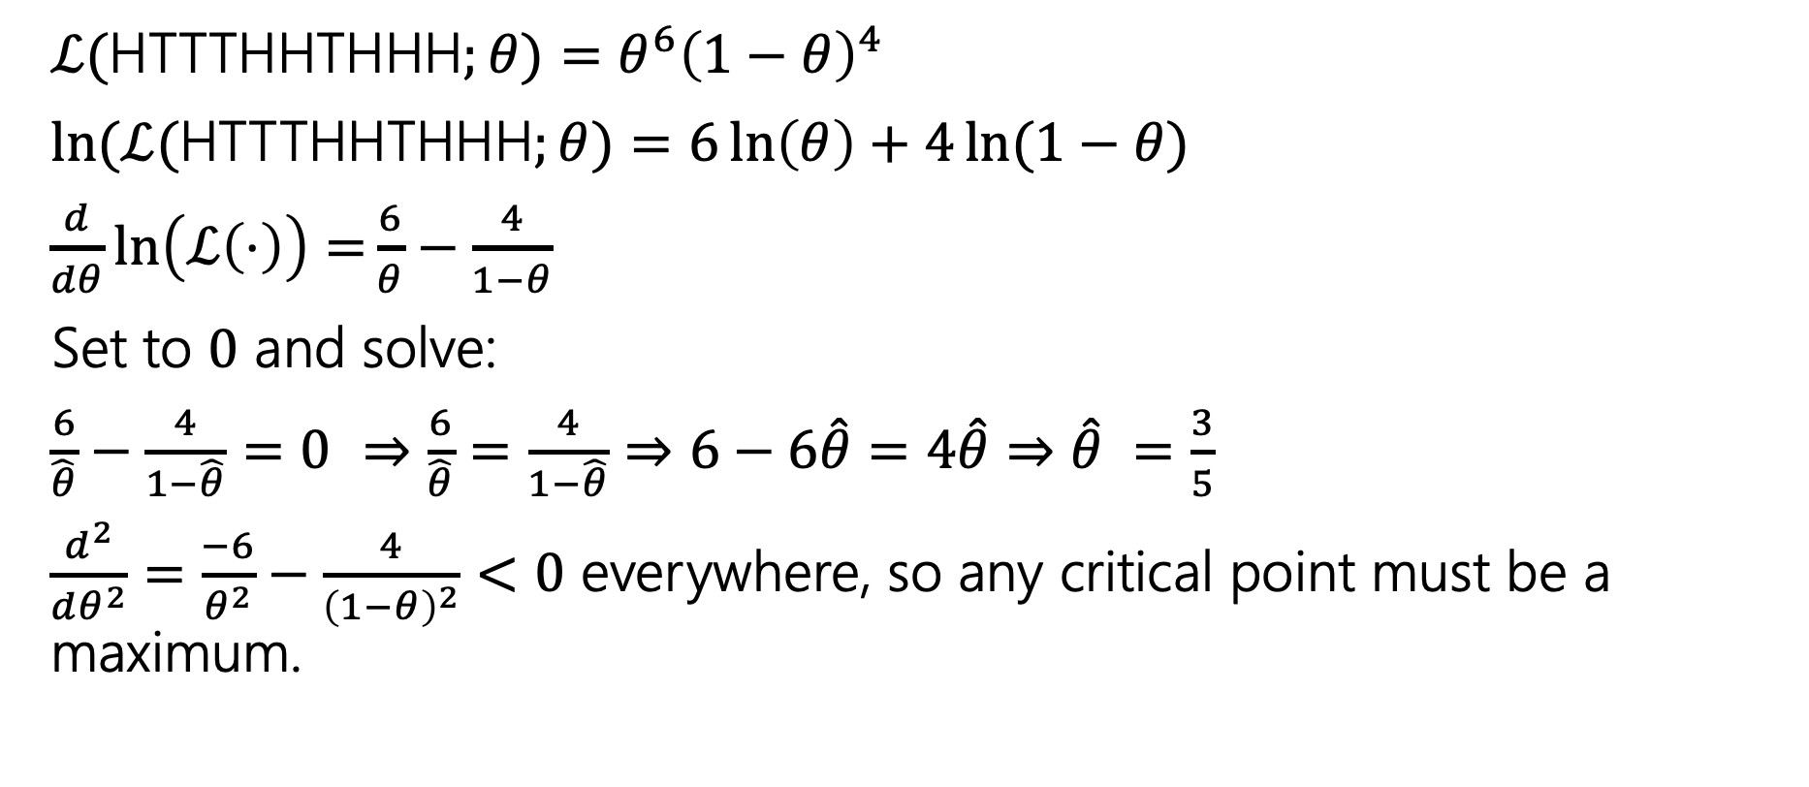
Coin flips is easier
$ℒ($HTTTHHTHHH$;θ)=θ^{6}{\left(1−θ\right)}^{4}$
$\ln{(ℒ(\text{HTTTHHTHHH};θ)}=6\ln\left(θ\right)+4\ln{(1−θ)}$
$\frac{d}{dθ}\ln\left(ℒ\left(⋅\right)\right)=\frac{6}{θ}−\frac{4}{1−θ}$
Set to $0$ and solve:
$\frac{6}{\hat{θ}}−\frac{4}{1−\hat{θ}}=0$ $⇒$ $\frac{6}{\hat{θ}}=\frac{4}{1−\hat{θ}}$ $⇒$ $6−6\hat{θ}=4\hat{θ}⇒$ $\hat{θ} =\frac{3}{5}$
$\frac{d^{2}}{dθ^{2}}=\frac{−6}{θ^{2}}−\frac{4}{{\left(1−θ\right)}^{2}}<0$ everywhere, so any critical point must be a maximum.

Slide 15
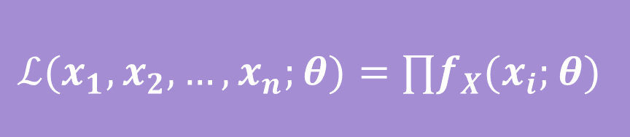
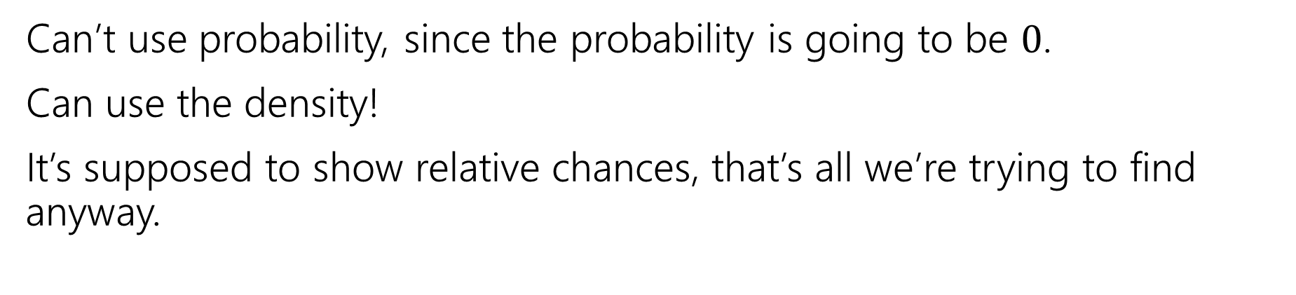
What about continuous random variables?
Can’t use probability, since the probability is going to be $0$.
Can use the density!
It’s supposed to show relative chances, that’s all we’re trying to find anyway.
$$ℒ(x_{1},x_{2},…,x_{n};θ)=∏f_{X}(x_{i};θ)$$

Slide 16
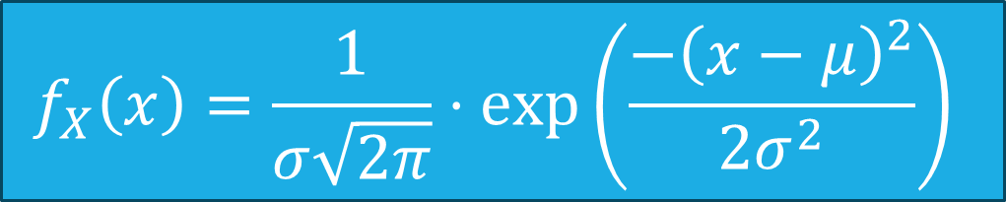
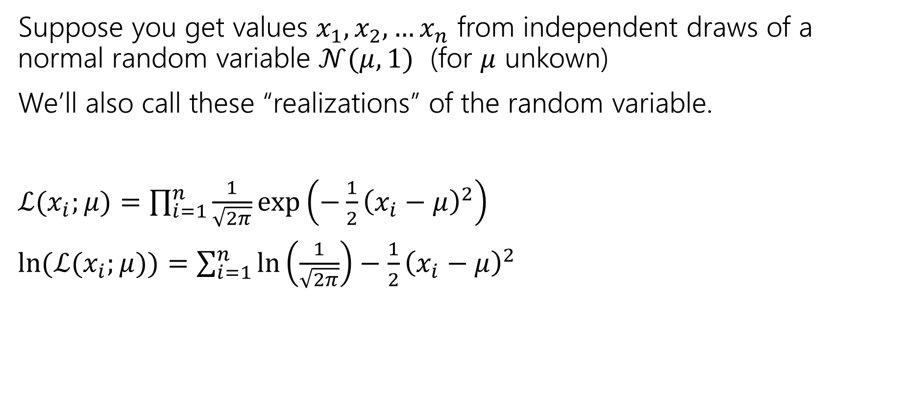
Continuous Example
Suppose you get values $x_{1},x_{2},…x_{n}$ from independent draws of a normal random variable $𝒩(μ,1)$ (for $μ$ unkown)
We’ll also call these “realizations” of the random variable.
$ℒ(x_{i};μ)=\prod_{i=1}^{n}{\frac{1}{\sqrt{2π}}\exp\left(−\frac{1}{2}{\left(x_{i}−μ\right)}^{2}\right)}$
$\ln{(ℒ(x_{i};μ))=\sum_{i=1}^{n}{\ln\left(\frac{1}{\sqrt{2π}}\right)−\frac{1}{2}{\left(x_{i}−μ\right)}^{2}}}$
$$f_{X}\left(x\right)=\frac{1}{σ\sqrt{2π}}⋅\exp\left(\frac{−{\left(x−μ\right)}^{2}}{2σ^{2}}\right)$$

Slide 17
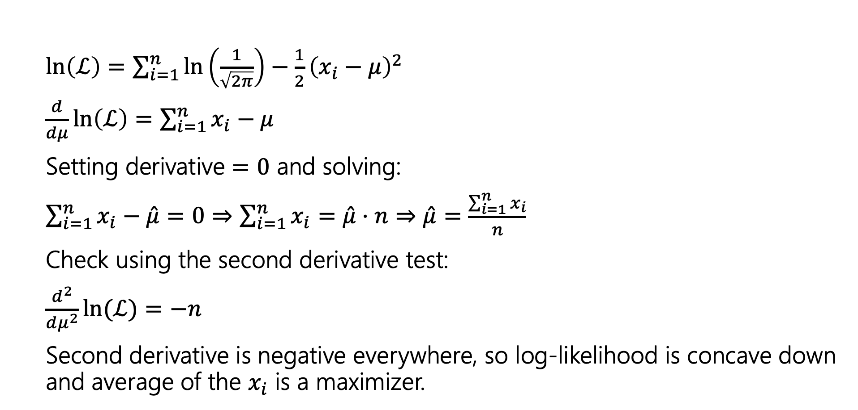

Finding $\hat{μ}$
$\ln\left(ℒ\right)=\sum_{i=1}^{n}{\ln\left(\frac{1}{\sqrt{2π}}\right)−\frac{1}{2}{\left(x_{i}−μ\right)}^{2}}$
$\frac{d}{dμ}\ln\left(ℒ\right)=\sum_{i=1}^{n}{x_{i}−μ}$
Setting derivative $=0$ and solving:
$\sum_{i=1}^{n}{x_{i}−\hat{μ}}=0⇒\sum_{i=1}^{n}{x_{i}}=\hat{μ}⋅n⇒\hat{μ}=\frac{\sum_{i=1}^{n}{x_{i}}}{n}$
Check using the second derivative test:
$\frac{d^{2}}{dμ^{2}}\ln{(ℒ)}=−n$
Second derivative is negative everywhere, so log-likelihood is concave down and average of the $x_{i}$ is a maximizer.

Slide 18
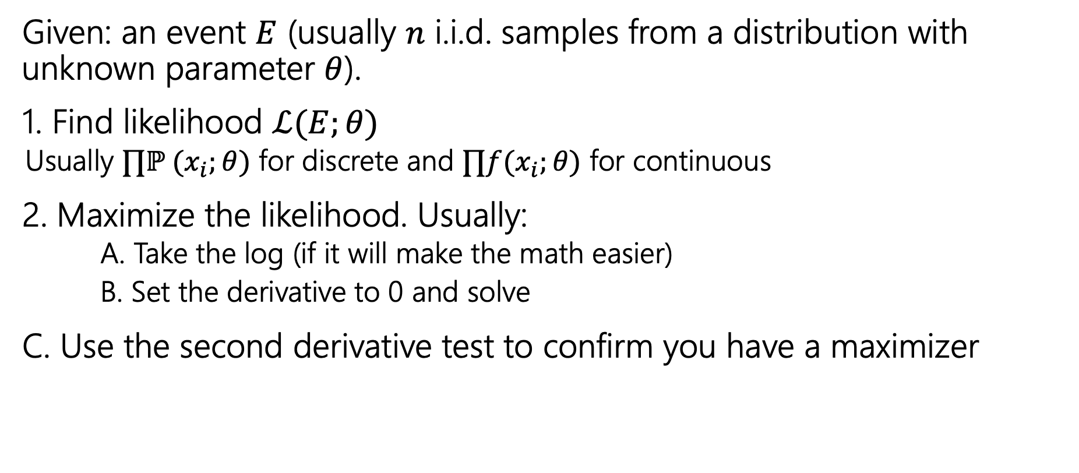
Summary
Given: an event $E$ (usually $n$ i.i.d. samples from a distribution with unknown parameter $θ$).
1. Find likelihood $ℒ(E;θ)$
  Usually $∏ℙ (x_{i};θ)$ for discrete and $∏f(x_{i};θ)$ for continuous
2. Maximize the likelihood. Usually:
  A. Take the log (if it will make the math easier)
  B. Set the derivative to 0 and solve
C. Use the second derivative test to confirm you have a maximizer

Slide 19

Generalizing Normals
We just saw to estimate $μ$ for $𝒩(μ,1)$ we get:
$\hat{μ}=∑x_{i}/n$
Now what happens if we know our data is $𝒩()$ but both the mean and the variance are unknown.?

Slide 20
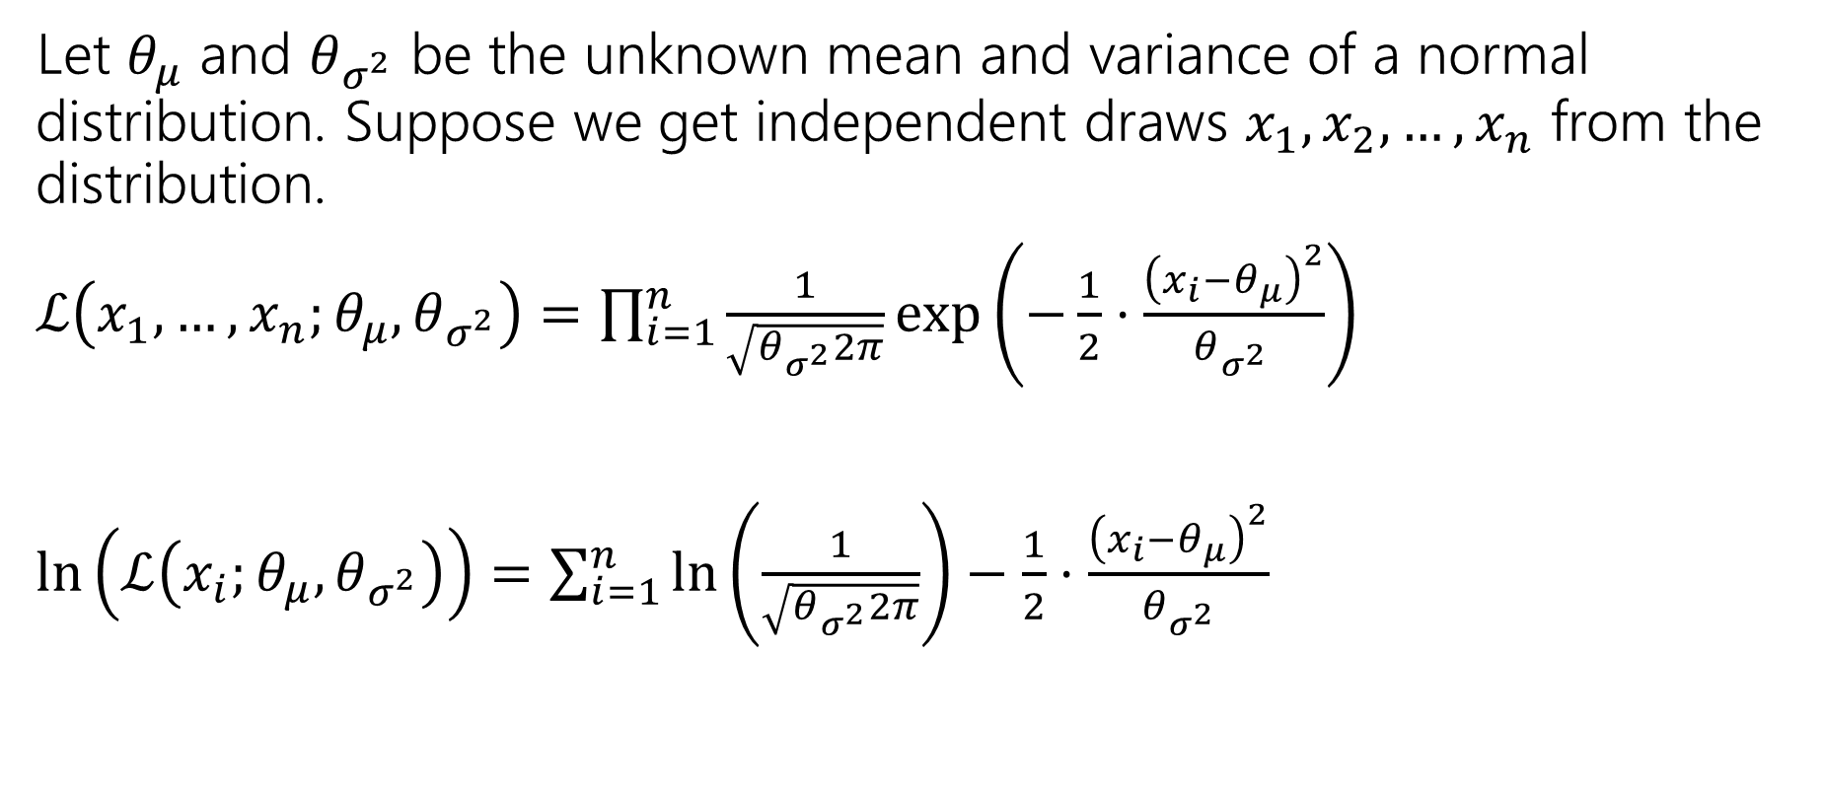
Log-likelihood
Let $θ_{μ}$ and $θ_{σ^{2}}$ be the unknown mean and variance of a normal distribution. Suppose we get independent draws $x_{1},x_{2},…, x_{n}$ from the distribution.
$ℒ\left(x_{1},…,x_{n};θ_{μ},θ_{σ^{2}}\right)=\prod_{i=1}^{n}{\frac{1}{\sqrt{θ_{σ^{2}}2π}}\exp\left(−\frac{1}{2}⋅\frac{{\left(x_{i}−θ_{μ}\right)}^{2}}{θ_{σ^{2} }}\right)}$
$\ln\left(ℒ\left(x_{i};θ_{μ},θ_{σ^{2}}\right)\right)=\sum_{i=1}^{n}{\ln\left(\frac{1}{\sqrt{θ_{σ^{2}}2π}}\right)−\frac{1}{2}⋅\frac{{\left(x_{i}−θ_{μ}\right)}^{2}}{θ_{σ^{2}}} }$
With multiple parameters, take partial derivatives to find maxima.

Slide 21

Expectation
$\ln\left(ℒ\left(x_{i};θ_{μ},θ_{σ^{2}}\right)\right)=\sum_{i=1}^{n}{\ln\left(\frac{1}{\sqrt{θ_{σ^{2}}2π}}\right)−\frac{1}{2}⋅\frac{{\left(x_{i}−θ_{μ}\right)}^{2}}{θ_{σ^{2}}} }$
$\frac{∂}{∂θ_{μ}}\ln\left(ℒ\right)=$
Setting equal to $0$ and solving

Slide 22
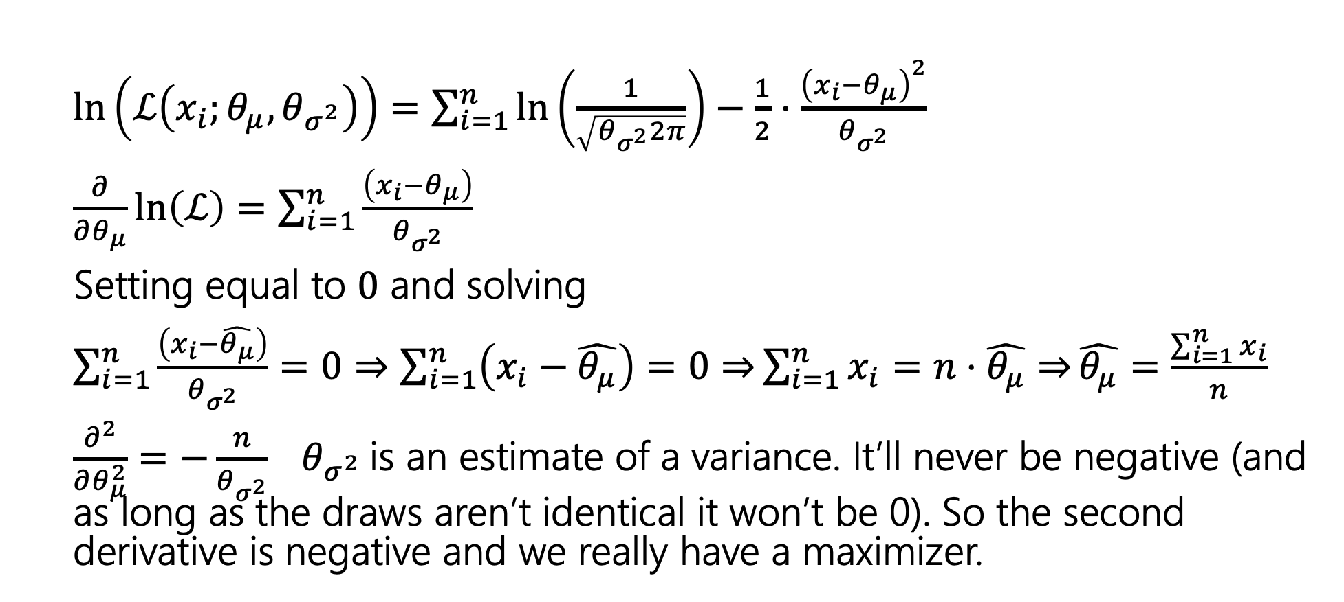
Expectation
Arithmetic is nearly identical to known variance case.
$\ln\left(ℒ\left(x_{i};θ_{μ},θ_{σ^{2}}\right)\right)=\sum_{i=1}^{n}{\ln\left(\frac{1}{\sqrt{θ_{σ^{2}}2π}}\right)−\frac{1}{2}⋅\frac{{\left(x_{i}−θ_{μ}\right)}^{2}}{θ_{σ^{2}}} }$
$\frac{∂}{∂θ_{μ}}\ln\left(ℒ\right)=\sum_{i=1}^{n}{\frac{\left(x_{i}−θ_{μ}\right)}{θ_{σ^{2}}}}$
Setting equal to $0$ and solving
$\sum_{i=1}^{n}{\frac{\left(x_{i}−\hat{θ_{μ}}\right)}{θ_{σ^{2}}}}=0⇒\sum_{i=1}^{n}{\left(x_{i}−\hat{θ_{μ}}\right)=0⇒}\sum_{i=1}^{n}{x_{i}=n⋅\hat{θ_{μ}}⇒}\hat{θ_{μ}}=\frac{\sum_{i=1}^{n}{x_{i}}}{n}$
$\frac{∂^{2}}{∂θ_{μ}^{2}}=−\frac{n}{θ_{σ^{2}}}$ $θ_{σ^{2}}$is an estimate of a variance. It’ll never be negative (and as long as the draws aren’t identical it won’t be 0). So the second derivative is negative and we really have a maximizer.

Slide 23
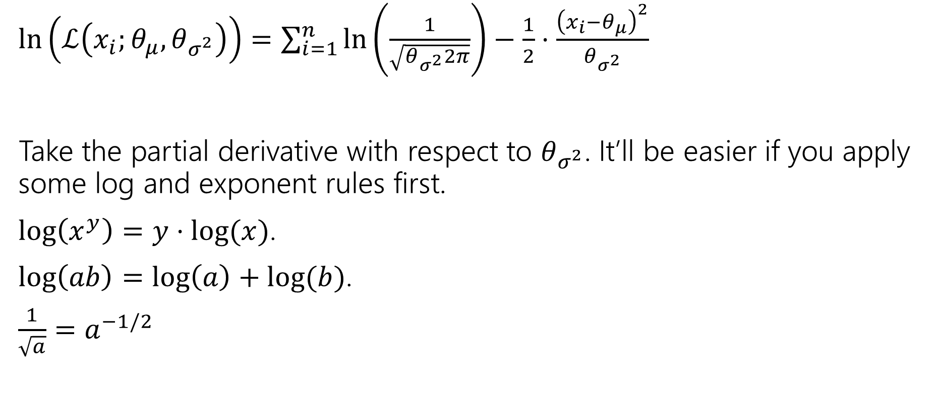
Variance
$\ln\left(ℒ\left(x_{i};θ_{μ},θ_{σ^{2}}\right)\right)=\sum_{i=1}^{n}{\ln\left(\frac{1}{\sqrt{θ_{σ^{2}}2π}}\right)−\frac{1}{2}⋅\frac{{\left(x_{i}−θ_{μ}\right)}^{2}}{θ_{σ^{2}}} }$
Take the partial derivative with respect to $θ_{σ^{2}}$. It’ll be easier if you apply some log and exponent rules first.
$\log\left(x^{y}\right)=y⋅\log{(x)}$.
$\log\left(ab\right)=\log\left(a\right)+log⁡(b)$.
$\frac{1}{\sqrt{a}}=a^{−1/2}$

Slide 24
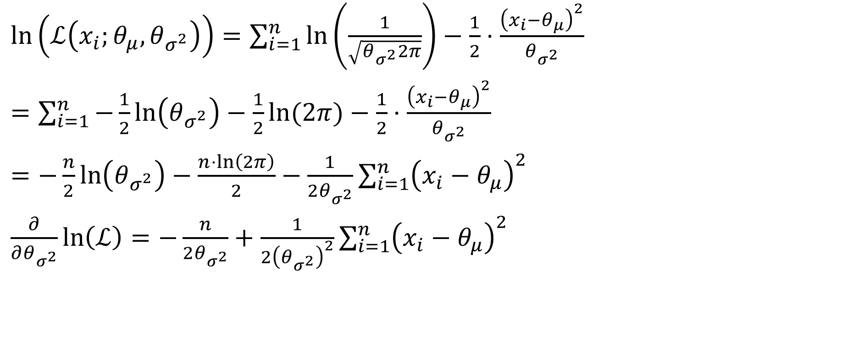
Variance
$\ln\left(ℒ\left(x_{i};θ_{μ},θ_{σ^{2}}\right)\right)=\sum_{i=1}^{n}{\ln\left(\frac{1}{\sqrt{θ_{σ^{2}}2π}}\right)−\frac{1}{2}⋅\frac{{\left(x_{i}−θ_{μ}\right)}^{2}}{θ_{σ^{2}}} }$
$=\sum_{i=1}^{n}{−\frac{1}{2}\ln\left(θ_{σ^{2}}\right)−\frac{1}{2}\ln{(2π)}}−\frac{1}{2}⋅\frac{{\left(x_{i}−θ_{μ}\right)}^{2}}{θ_{σ^{2}}}$
$=−\frac{n}{2}\ln\left(θ_{σ^{2}}\right)−\frac{n⋅\ln\left(2π\right)}{2}−\frac{1}{2θ_{σ^{2}}}\sum_{i=1}^{n}{{\left(x_{i}−θ_{μ}\right)}^{2}}$
$\frac{∂}{∂θ_{σ^{2}}}\ln\left(ℒ\right)=−\frac{n}{2θ_{σ^{2}}}+\frac{1}{2{\left(θ_{σ^{2}}\right)}^{2}}\sum_{i=1}^{n}{{\left(x_{i}−θ_{μ}\right)}^{2}}$

Slide 25
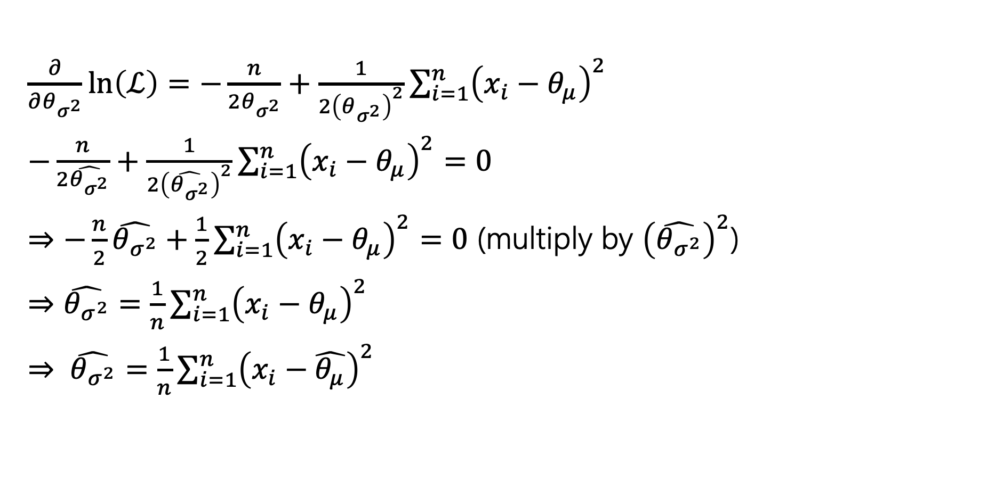
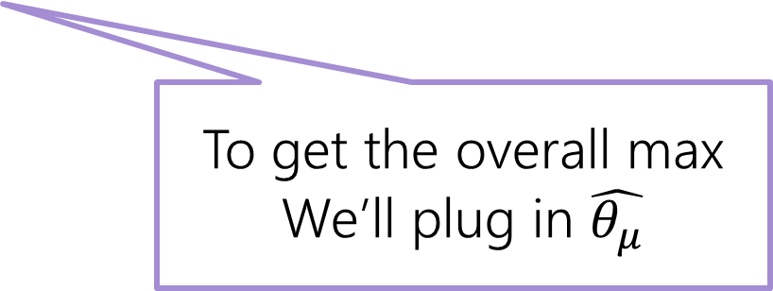
Variance part 2
$\frac{∂}{∂θ_{σ^{2}}}\ln\left(ℒ\right)=−\frac{n}{2θ_{σ^{2}}}+\frac{1}{2{\left(θ_{σ^{2}}\right)}^{2}}\sum_{i=1}^{n}{{\left(x_{i}−θ_{μ}\right)}^{2}}$
$−\frac{n}{2\hat{θ_{σ^{2}}}}+\frac{1}{2{\left(\hat{θ_{σ^{2}}}\right)}^{2}}\sum_{i=1}^{n}{{\left(x_{i}−θ_{μ}\right)}^{2}}=0$
$⇒−\frac{n}{2}\hat{θ_{σ^{2}}}+\frac{1}{2}\sum_{i=1}^{n}{{\left(x_{i}−θ_{μ}\right)}^{2}}=0$ (multiply by ${\left(\hat{θ_{σ^{2}}}\right)}^{2}$)
$⇒\hat{θ_{σ^{2}}}=\frac{1}{n}\sum_{i=1}^{n}{{\left(x_{i}−θ_{μ}\right)}^{2}}$
$⇒ \hat{θ_{σ^{2}}}=\frac{1}{n}\sum_{i=1}^{n}{{\left(x_{i}−\hat{θ_{μ}}\right)}^{2}}$
To get the overall max
We’ll plug in $\hat{θ_{μ}}$
Notes:
Regardless of the value of $θ_{σ^{2}}$ that’s selected, the likelihood is maximized by setting $θ_{μ}$ to the value of $\hat{θ_{μ}}$ . So we should pick $θ_{μ}$ first (it’s without loss of generality to do so), then we can plug in the value and realize that the likelihood is overall maximized when $\hat{θ_{σ^{2}}}$ is selected as in the slide.

Slide 26
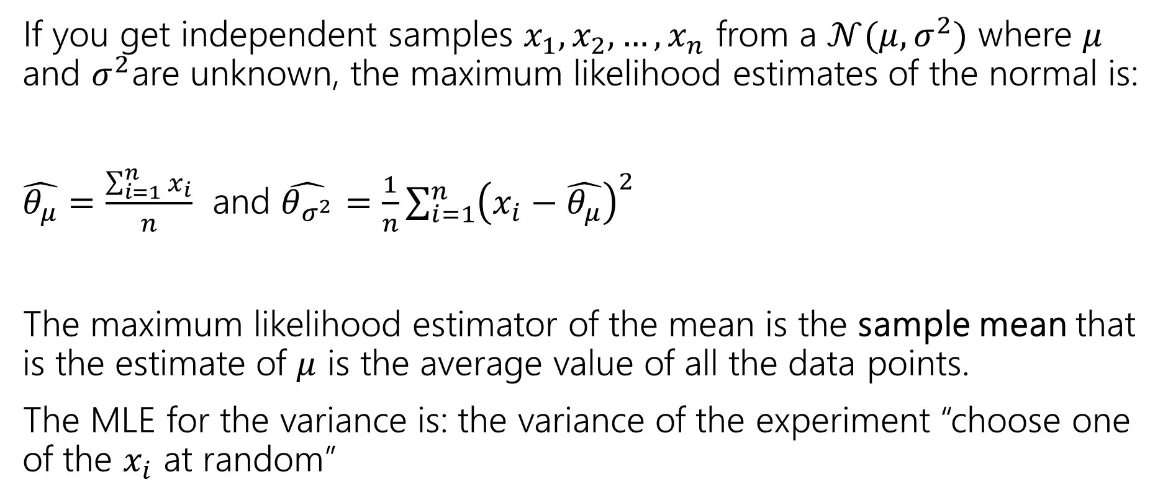
Summary
If you get independent samples $x_{1},x_{2},…,x_{n}$ from a $𝒩(μ,σ^{2})$ where $μ$ and $σ^{2}$are unknown, the maximum likelihood estimates of the normal is:
$\hat{θ_{μ}}=\frac{\sum_{i=1}^{n}{x_{i}}}{n}$ and $\hat{θ_{σ^{2}}}=\frac{1}{n}\sum_{i=1}^{n}{{\left(x_{i}−\hat{θ_{μ}}\right)}^{2}}$
The maximum likelihood estimator of the mean is the sample mean that is the estimate of $μ$ is the average value of all the data points.
The MLE for the variance is: the variance of the experiment “choose one of the $x_{i}$ at random”

