Slide 1
More Tail Bounds
CSE 312 Summer 25
Lecture 20

Slide 2
Announcements
Homework 5 Solutions available at the front + outside Allen 206
Homework 6 will be due on Wednesday
Homework 7 will be out on Wednesday and due Monday at 11:59pm with a late deadline on Tuesday at 11:59pm
Quiz 7 on Friday

Slide 3
Midterm Retake Opportunity
Monday August 18th at 12pm in DEM 104.
You will have 60 minutes.
Same point value and similar difficulty.
The same reference sheet will be provided.
The score will be capped at 75% or 61.5/82 points.
We will take the max of the two scores.
Midterm score update will only be incorporated after grade breaks are set (like extra credit).

Slide 4
Looking ahead at next week
Monday: Midterm Retake + HW7 Due
Wednesday: Final Review
Thursday: Final Part 1 (hopefully in DEM 104)
Friday: Final Part 2

Slide 5

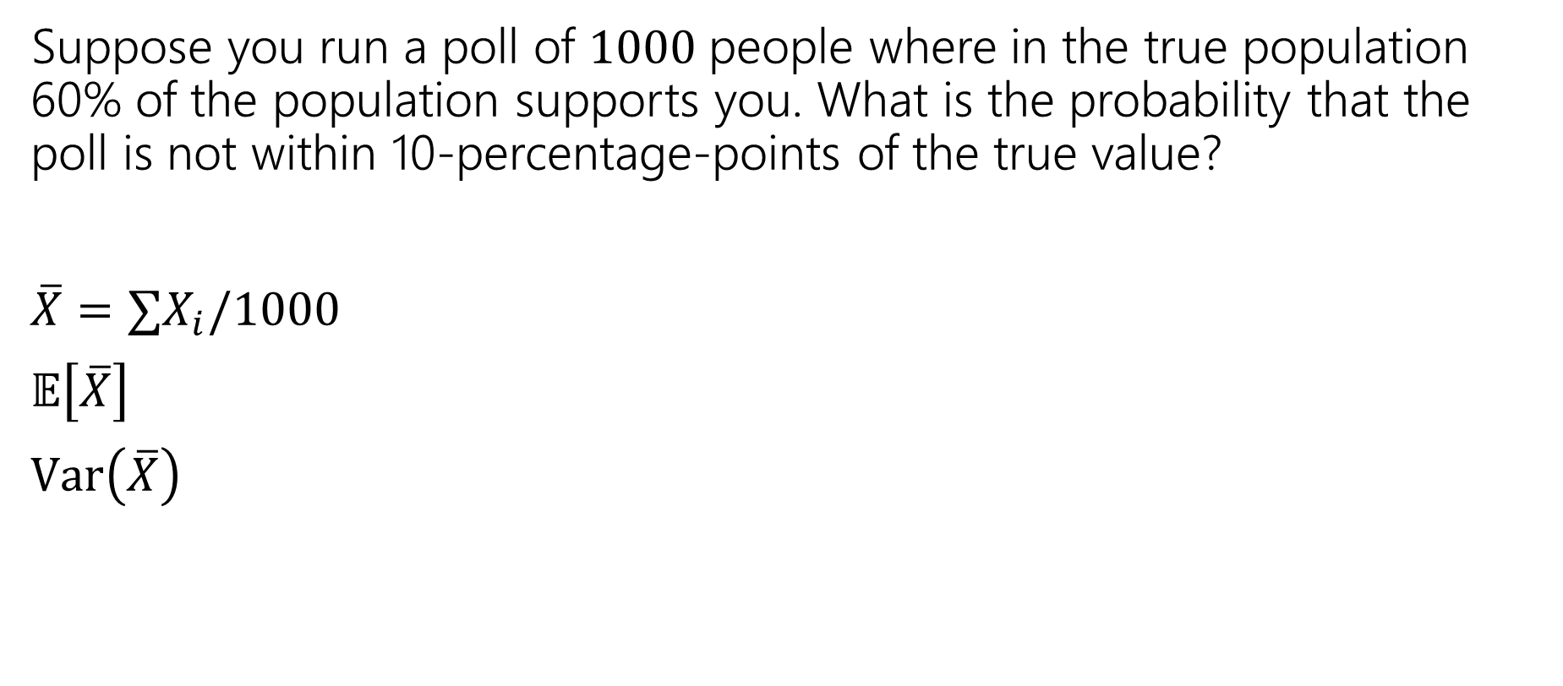
Near the mean
Suppose you run a poll of $1000$people where in the true population 60% of the population supports you. What is the probability that the poll is not within 10-percentage-points of the true value?
$\overline{X}=∑X_{i}/1000$
$𝔼\left[\overline{X}\right]$
$Var\left(\overline{X}\right)$
Let $X$ be a random variable. For any $t>0$
$$ℙ\left(\left|X−𝔼\left[X\right]\right|≥t\right)≤\frac{Var(X)}{t^{2}}$$
Chebyshev’s Inequality
Chebyshev’s Inequality

Slide 6
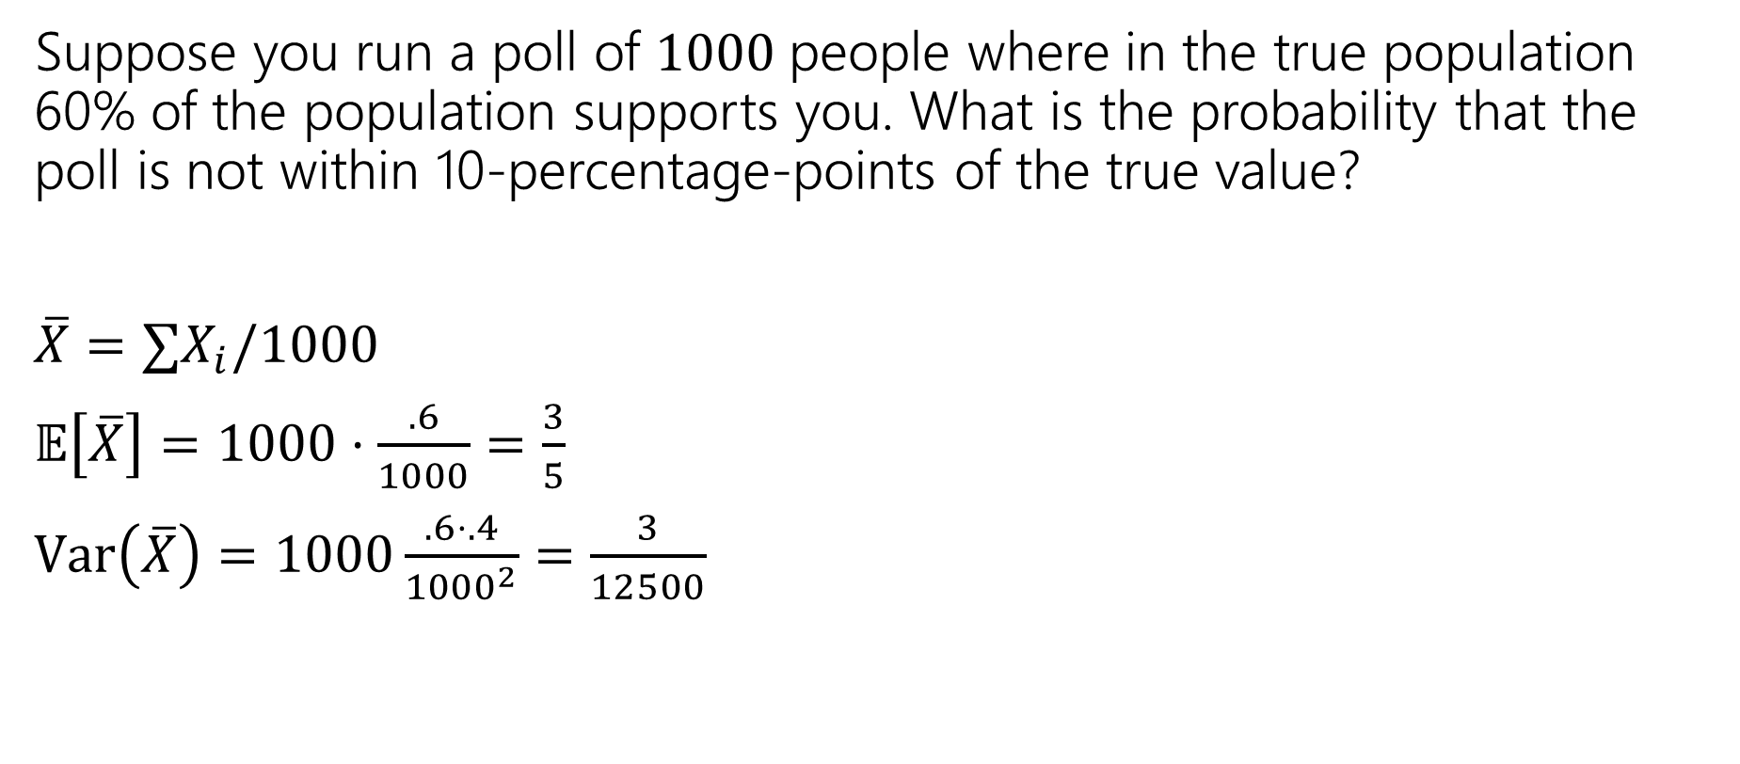
Near the mean
Suppose you run a poll of $1000$people where in the true population 60% of the population supports you. What is the probability that the poll is not within 10-percentage-points of the true value?
$\overline{X}=∑X_{i}/1000$
$𝔼\left[\overline{X}\right]=1000⋅\frac{.6}{1000}=\frac{3}{5}$
$Var\left(\overline{X}\right)=1000\frac{.6⋅.4}{{1000}^{2}}=\frac{3}{12500}$
Let $X$ be a random variable. For any $t>0$
$$ℙ\left(\left|X−𝔼\left[X\right]\right|≥t\right)≤\frac{Var(X)}{t^{2}}$$
Chebyshev’s Inequality
Chebyshev’s Inequality

Slide 7
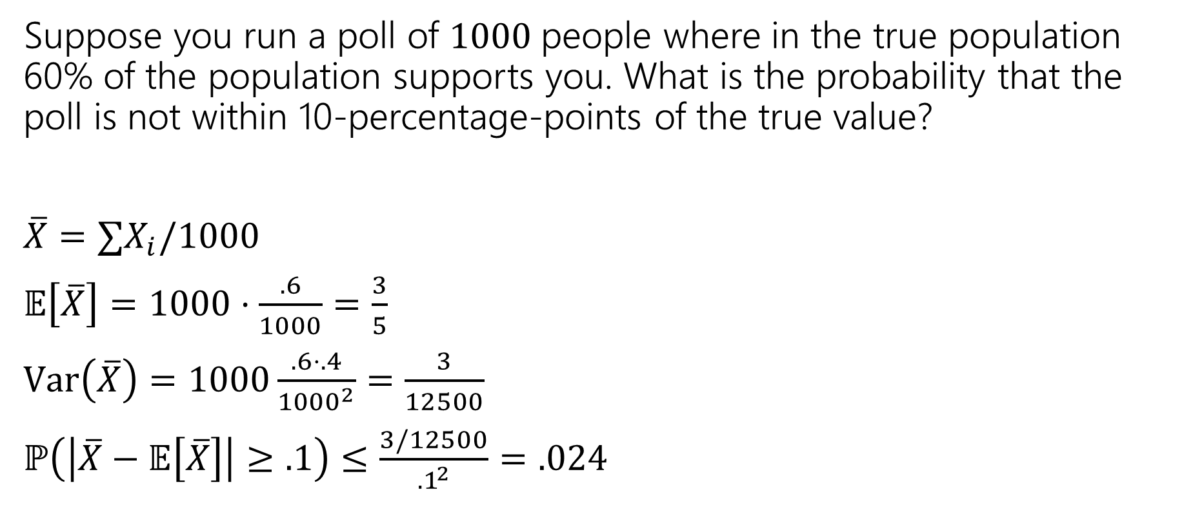
Near the mean
Suppose you run a poll of $1000$people where in the true population 60% of the population supports you. What is the probability that the poll is not within 10-percentage-points of the true value?
$\overline{X}=∑X_{i}/1000$
$𝔼\left[\overline{X}\right]=1000⋅\frac{.6}{1000}=\frac{3}{5}$
$Var\left(\overline{X}\right)=1000\frac{.6⋅.4}{{1000}^{2}}=\frac{3}{12500}$
$ℙ\left(\left|\overline{X}−𝔼\left[\overline{X}\right]\right|≥.1\right)≤\frac{3/12500}{{.1}^{2}}$ $=.024$
Let $X$ be a random variable. For any $t>0$
$$ℙ\left(\left|X−𝔼\left[X\right]\right|≥t\right)≤\frac{Var(X)}{t^{2}}$$
Chebyshev’s Inequality
Chebyshev’s Inequality

Slide 8

Chebyshev’s – Repeated Experiments
How many coin flips (each head with probability $p$) are needed until you get $n$ heads.
Let $X$ be the number necessary. What is probability $X≥2n/p$?
Markov
Chebyshev

Slide 9
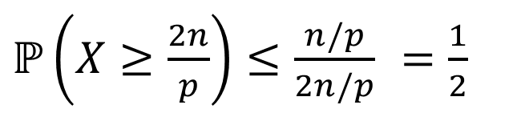
Chebyshev’s – Repeated Experiments
How many coin flips (each head with probability $p$) are needed until you get $n$ heads.
Let $X$ be the number necessary. What is probability $X≥2n/p$?
Markov
Chebyshev
$ℙ\left(X≥\frac{2n}{p}\right)≤\frac{n/p}{2n/p}$ $=\frac{1}{2}$
$ℙ\left(X≥\frac{2n}{p}\right)≤ℙ\left(\left|X−\frac{n}{p}\right|≥\frac{n}{p}\right)≤\frac{Var(X)}{n^{2}/p^{2}}$ $=\frac{n(1−p)/p^{2}}{n^{2}/p^{2}}$ $=\frac{1−p}{n}$

Slide 10
Takeaway
Chebyshev gets more powerful as the variance shrinks.
Repeated experiments are a great way to cause that to happen.

Slide 11
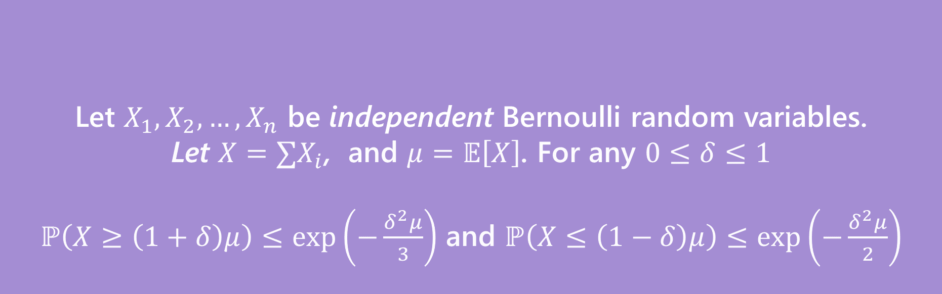
More Assumptions → Better Guarantee
Let $X_{1},X_{2},…,X_{n}$ be independent Bernoulli random variables.
Let $X=∑X_{i}$, and $μ=𝔼\left[X\right]$. For any $0≤δ≤1$
$ℙ\left(X≥\left(1+δ\right)μ\right)≤\exp\left(−\frac{δ^{2}μ}{3}\right)$ and $ℙ\left(X≤\left(1−δ\right)μ\right)≤\exp\left(−\frac{δ^{2}μ}{2}\right)$
(Multiplicative) Chernoff Bound
Notes:
Section 6.2 in the textbook

Slide 12
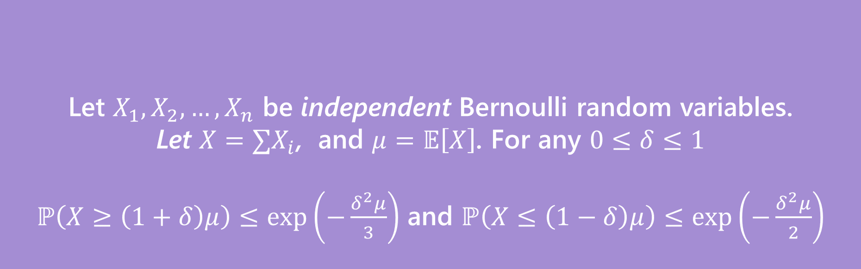

Same Problem, New Solution
Suppose you run a poll of $1000$people where in the true population 60% of the population supports you. What is the probability that the poll is not within 10-percentage-points of the true value?
Let $X_{1},X_{2},…,X_{n}$ be independent Bernoulli random variables.
Let $X=∑X_{i}$, and $μ=𝔼\left[X\right]$. For any $0≤δ≤1$
$ℙ\left(X≥\left(1+δ\right)μ\right)≤\exp\left(−\frac{δ^{2}μ}{3}\right)$ and $ℙ\left(X≤\left(1−δ\right)μ\right)≤\exp\left(−\frac{δ^{2}μ}{2}\right)$
(Multiplicative) Chernoff Bound

Slide 13


Right Tail
Suppose you run a poll of $1000$people where in the true population 60% of the population supports you. What is the probability that the poll is not within 10-percentage-points of the true value?
Want $ℙ\left(\frac{X}{1000}≥.7\right)$
Let $X_{1},X_{2},…,X_{n}$ be independent Bernoulli random variables.
Let $X=∑X_{i}$, and $μ=𝔼\left[X\right]$. For any $0≤δ≤1$
$ℙ\left(X≥\left(1+δ\right)μ\right)≤\exp\left(−\frac{δ^{2}μ}{3}\right)$
Chernoff Bound (right tail)
Notes:
Need X=sum X_i
So P(X >= 700)
Now, we need to rewrite 700 = (1+delta)mu mu is E[X] (NOT E[X-bar]) E[X] is 600 (1+delta)*600 = 700 (1+delta) = 7/6 delta = 1/6

Slide 14

Right Tail
Suppose you run a poll of $1000$people where in the true population 60% of the population supports you. What is the probability that the poll is not within 10-percentage-points of the true value?
Want $ℙ\left(\frac{X}{1000}≥.7\right)=ℙ(X≥.7⋅1000)$
$=ℙ\left(X≥\left(1+.1/.6\right)⋅(.6⋅1000)\right)$
So $δ=\frac{1}{6}$ and $μ=.6⋅1000$
$ℙ\left(X≥700\right)≤\exp\left(−\frac{\frac{1}{6^{2}}⋅.6⋅1000}{3}\right)$
$≤0.0039$
Let $X_{1},X_{2},…,X_{n}$ be independent Bernoulli random variables.
Let $X=∑X_{i}$, and $μ=𝔼\left[X\right]$. For any $0≤δ≤1$
$ℙ\left(X≥\left(1+δ\right)μ\right)≤\exp\left(−\frac{δ^{2}μ}{3}\right)$
Chernoff Bound (right tail)

Slide 15


Left Tail
Suppose you run a poll of $1000$people where in the true population 60% of the population supports you. What is the probability that the poll is not within 10-percentage-points of the true value?
Want $ℙ\left(\frac{X}{1000}≤.5\right)=ℙ(X≤.5⋅1000)$
Let $X_{1},X_{2},…,X_{n}$ be independent Bernoulli random variables.
Let $X=∑X_{i}$, and $μ=𝔼\left[X\right]$. For any $0≤δ≤1$
$ℙ\left(X≤\left(1−δ\right)μ\right)≤\exp\left(−\frac{δ^{2}μ}{2}\right)$
Chernoff Bound (left tail)

Slide 16

Left Tail
Suppose you run a poll of $1000$people where in the true population 60% of the population supports you. What is the probability that the poll is not within 10-percentage-points of the true value?
Want $ℙ\left(\frac{X}{1000}≤.5\right)=ℙ(X≤.5⋅1000)$
$=ℙ\left(X≤\left(1−.1/.6\right)⋅(.6⋅1000)\right)$
So $δ=\frac{1}{6}$ and $μ=.6⋅1000$
$ℙ\left(X≤500\right)≤\exp\left(−\frac{\frac{1}{6^{2}}⋅.6⋅1000}{2}\right)$
$≤0.0003$
Let $X_{1},X_{2},…,X_{n}$ be independent Bernoulli random variables.
Let $X=∑X_{i}$, and $μ=𝔼\left[X\right]$. For any $0≤δ≤1$
$ℙ\left(X≤\left(1−δ\right)μ\right)≤\exp\left(−\frac{δ^{2}μ}{2}\right)$
Chernoff Bound (left tail)

Slide 17
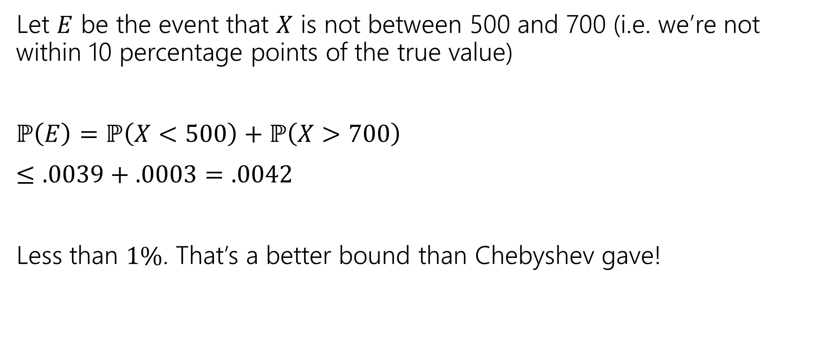
Both Tails
Let $E$ be the event that $X$ is not between 500 and 700 (i.e. we’re not within 10 percentage points of the true value)
$ℙ\left(E\right)=ℙ\left(X<500\right)+ℙ\left(X>700\right)$
$≤.0039+.0003=.0042$
Less than $1\%$. That’s a better bound than Chebyshev gave!

Slide 18
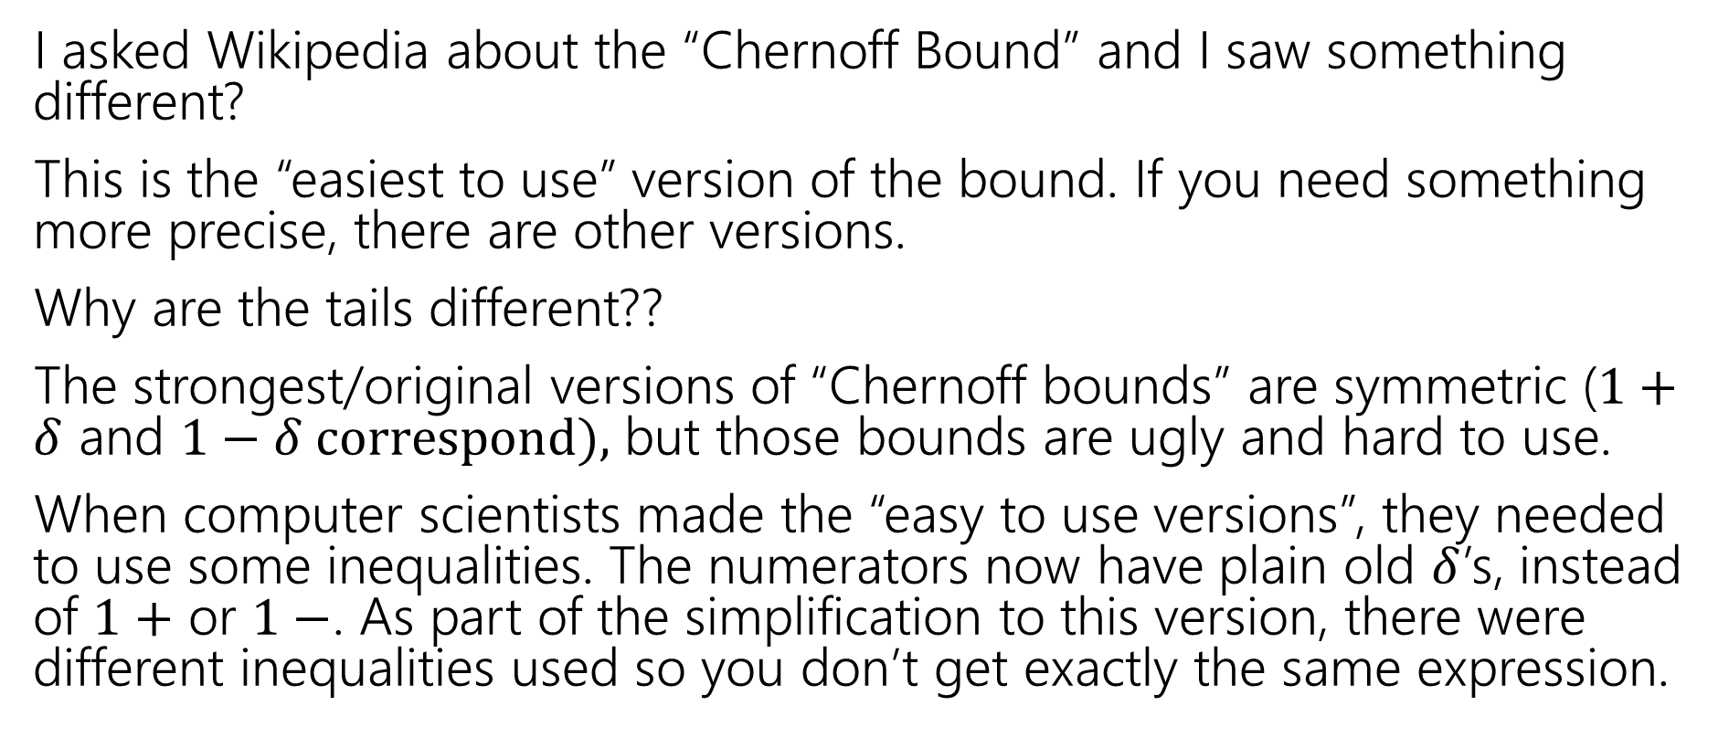
Wait a Minute
I asked Wikipedia about the “Chernoff Bound” and I saw something different?
This is the “easiest to use” version of the bound. If you need something more precise, there are other versions.
Why are the tails different??
The strongest/original versions of “Chernoff bounds” are symmetric ($1+δ$ and $1−δ correspond),$ but those bounds are ugly and hard to use.
When computer scientists made the “easy to use versions”, they needed to use some inequalities. The numerators now have plain old $δ$’s, instead of $1+$ or $1−$. As part of the simplification to this version, there were different inequalities used so you don’t get exactly the same expression.

Slide 19
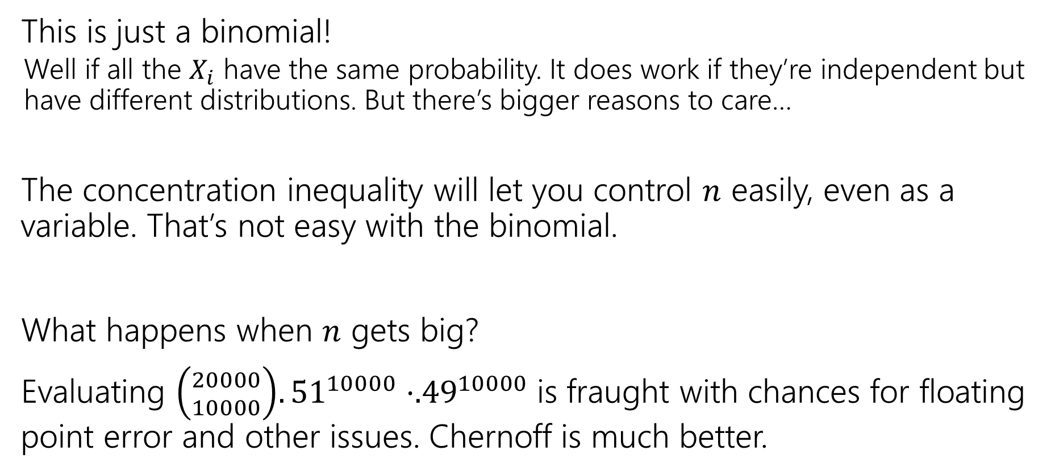
Wait a Minute
This is just a binomial!
Well if all the $X_{i}$ have the same probability. It does work if they’re independent but have different distributions. But there’s bigger reasons to care…
The concentration inequality will let you control $n$ easily, even as a variable. That’s not easy with the binomial.
What happens when $n$ gets big?
Evaluating ${\left({20000 \atop 10000}\right).51}^{10000}⋅{.49}^{10000}$is fraught with chances for floating point error and other issues. Chernoff is much better.

Slide 20
But Wait! There’s More
For this class, please limit yourself to: Markov, Chebyshev, and Chernoff, as stated in these slides…
But for your information. There’s more.
Trying to apply Chebyshev, but only want a “one-sided” bound (and tired of losing that almost-factor-of-two)Try Cantelli’s Inequality
In a position to use Chernoff, but want additive distance to the mean instead of multiplicative? They got one of those.
Have a sum of independent random variables that aren’t indicators, but are bounded, you better believe Wikipedia’s got one
Have a sum of random matrices instead of a sum of random numbers. Not only is that a thing you can do, but the eigenvalue of the matrix concentrates
There’s a whole book of these!

Slide 21
One More Bound

Slide 22
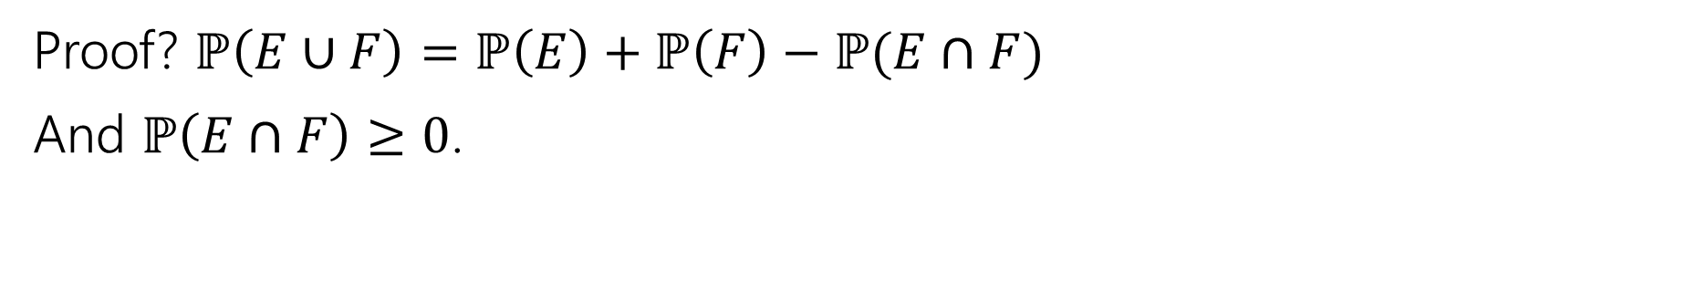

One More Bound
The Union bound
For any events $E,F$
$$ℙ\left(E∪F\right)≤ℙ\left(E\right)+ℙ(F)$$
Union Bound
Proof? $ℙ\left(E∪F\right)=ℙ\left(E\right)+ℙ\left(F\right)−ℙ(E∩F)$
And $ℙ\left(E∩F\right)≥0$.

Slide 23
Concentration Applications
A common pattern:
Figure out “what could possibly go wrong” – often these are dependent.
Use a concentration inequality for each of the things that could go wrong.
Union bound over everything that could go wrong.

Slide 24
Frogs
There are 20 frogs on each location in a 5x5 grid. Each frog will independently jump to the left, right, up, down, or stay where it is with equal probability. A frog at an edge of the grid magically warps to the corresponding edge (pac-man-style).
Bound the probability that at least one square ends up with at least 36 frogs.

Slide 25
Frogs
There are 20 frogs on each location in a 5x5 grid. Each frog will independently jump to the left, right, up, down, or stay where it is with equal probability. A frog at an edge of the grid magically warps to the corresponding edge (pac-man-style).
Bound the probability that at least one square ends up with at least 36 frogs.
These events are dependent – adjacent squares affect each other!

Slide 26
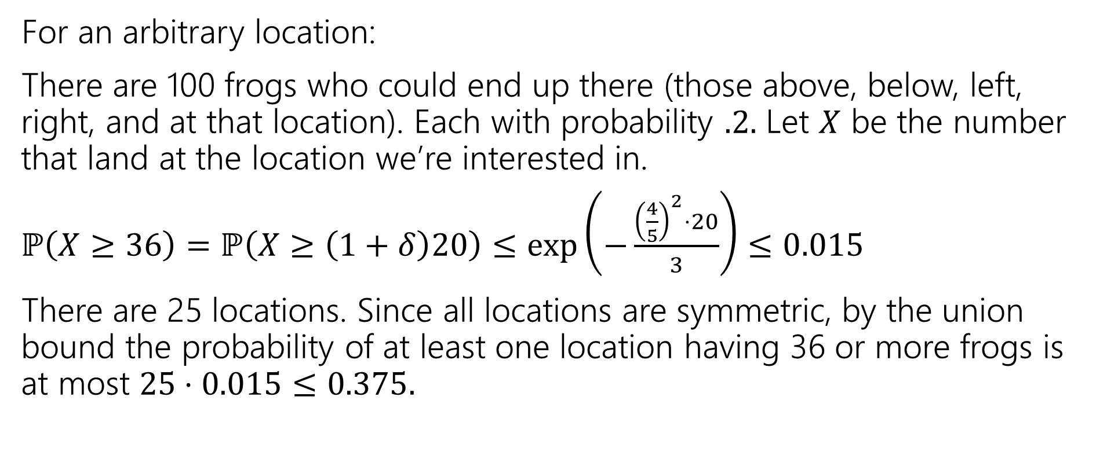
Frogs
For an arbitrary location:
There are 100 frogs who could end up there (those above, below, left, right, and at that location). Each with probability $.2.$ Let $X$ be the number that land at the location we’re interested in.
$ℙ\left(X≥36\right)=ℙ\left(X≥\left(1+δ\right)20\right)≤\exp\left(−\frac{{\left(\frac{4}{5}\right)}^{2}⋅20}{3}\right)≤0.015$
There are 25 locations. Since all locations are symmetric, by the union bound the probability of at least one location having 36 or more frogs is at most $25⋅0.015≤0.375.$

Slide 27
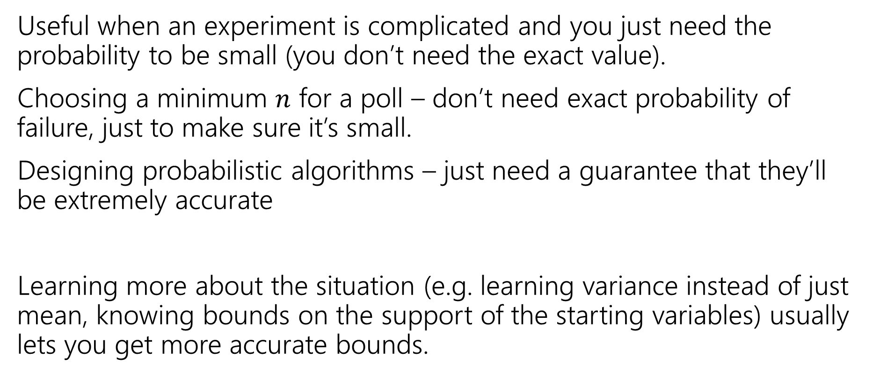
Tail Bounds – Takeaways
Useful when an experiment is complicated and you just need the probability to be small (you don’t need the exact value).
Choosing a minimum $n$ for a poll – don’t need exact probability of failure, just to make sure it’s small.
Designing probabilistic algorithms – just need a guarantee that they’ll be extremely accurate
Learning more about the situation (e.g. learning variance instead of just mean, knowing bounds on the support of the starting variables) usually lets you get more accurate bounds.

Slide 28
Applications

Slide 29
Privacy Preservation
A real-world example (adapted from The Ethical Algorithm by Kearns and Roth; based on protocol by Warner [1965]).
And gives a sense of how randomness is actually used to protect privacy.

Slide 30
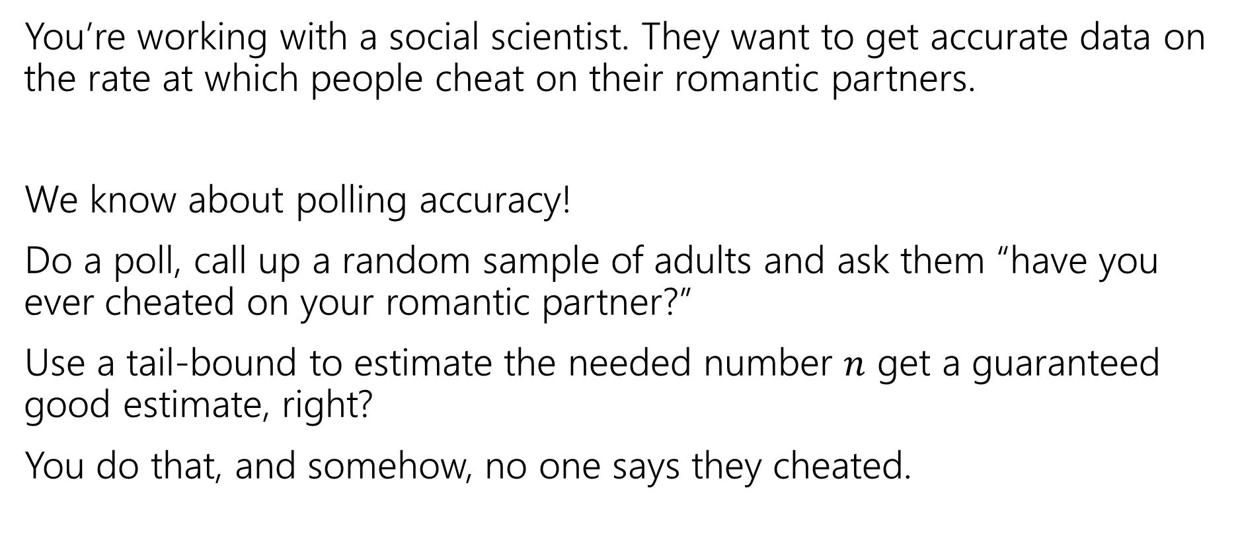
Privacy Preservation with Randomness
You’re working with a social scientist. They want to get accurate data on the rate at which people cheat on their romantic partners.
We know about polling accuracy!
Do a poll, call up a random sample of adults and ask them “have you ever cheated on your romantic partner?”
Use a tail-bound to estimate the needed number $n$ get a guaranteed good estimate, right?
You do that, and somehow, no one says they cheated.

Slide 31
What’s the problem?
People lie.
Or they might be concerned about you keeping this data.
Databases can be leaked (or infiltrated. Or subpoenaed).
You don’t want to hold this data, and the people you’re calling don’t want you to hold this data.

Slide 32
Doing Better With Randomness
You don’t really need to know who was cheating. Just how many people were.
Here’s a protocol:
Please flip a coin.
If the coin is heads, or you have ever cheated, please tell me “heads”
If the coin is tails and you have not ever cheated, please tell me “tails”

Slide 33
Will it be private?
If you are someone who has cheated, and you report heads can that be used against you? Not substantially – just say “no the coin came up heads!”
You discover your partner said heads, what’s the probability that they cheated?

Slide 34
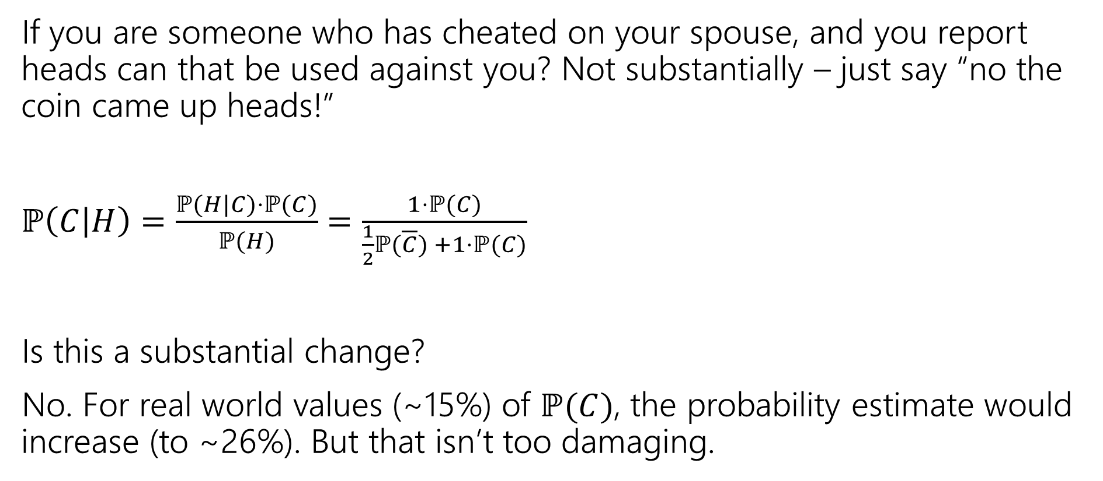
Will it be private?
If you are someone who has cheated on your spouse, and you report heads can that be used against you? Not substantially – just say “no the coin came up heads!”
$ℙ\left(C | H\right)=\frac{ℙ(H|C)⋅ℙ(C)}{ℙ(H)}$ $=\frac{1⋅ℙ(C)}{\frac{1}{2}ℙ(\overline{C}) +1⋅ℙ(C)}$
Is this a substantial change?
No. For real world values (~15%) of $ℙ(C)$, the probability estimate would increase (to ~26%). But that isn’t too damaging.
Notes:
Largest absolute increase is between .15 and .2, happens at P(C)approx. .4. Plot x-x/(.5(1-x)+.5)

Slide 35
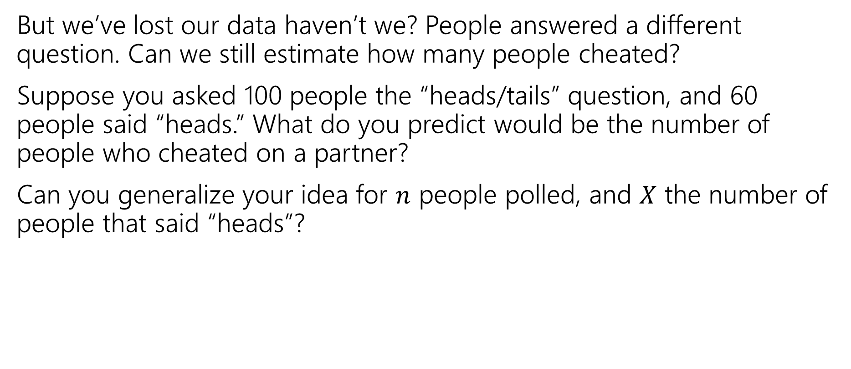
But will it be accurate?
But we’ve lost our data haven’t we? People answered a different question. Can we still estimate how many people cheated?
Suppose you asked 100 people the “heads/tails” question, and 60 people said “heads.” What do you predict would be the number of people who cheated on a partner?
Can you generalize your idea for $n$ people polled, and $X$ the number of people that said “heads”?
Notes:
This is actually dubious logic. We’ve found *an* unbiased estimator, but we should really use a more justified method. Tune in next week for MLEs, this is actually also the MLE.

Slide 36
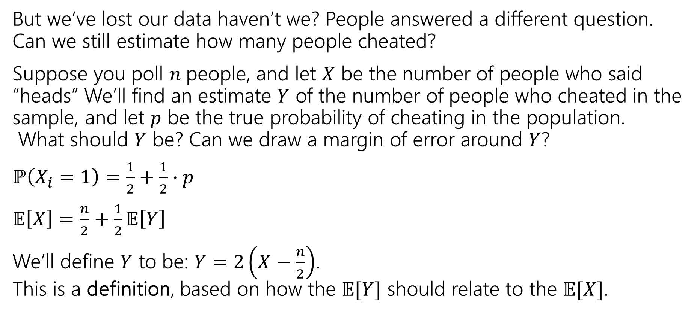
But will it be accurate?
But we’ve lost our data haven’t we? People answered a different question. Can we still estimate how many people cheated?
Suppose you poll $n$people, and let $X$ be the number of people who said “heads” We’ll find an estimate $Y$ of the number of people who cheated in the sample, and let $p$ be the true probability of cheating in the population. What should $Y$ be? Can we draw a margin of error around $Y$?
$ℙ\left(X_{i}=1\right)=\frac{1}{2}+\frac{1}{2}⋅p$
$𝔼\left[X\right]=\frac{n}{2}+\frac{1}{2}𝔼\left[Y\right]$
We’ll define $Y$ to be: $Y=2\left(X−\frac{n}{2}\right)$. This is a definition, based on how the $𝔼[Y]$ should relate to the $𝔼[X]$.
Notes:
This is actually dubious logic. We’ve found *an* unbiased estimator, but we should really use a more justified method. Tune in next week for MLEs, this is actually also the MLE.

Slide 37
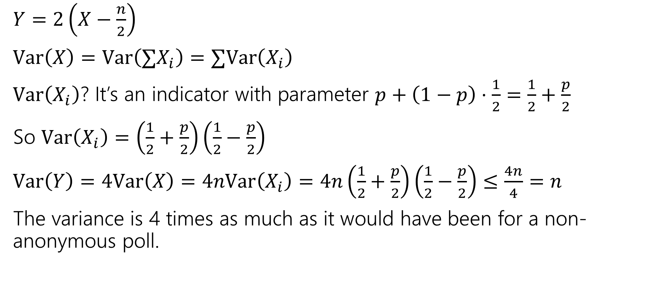
But will it be accurate?
$Y=2\left(X−\frac{n}{2}\right)$
$Var\left(X\right)=Var\left(∑X_{i}\right)=∑Var\left(X_{i}\right)$
$Var\left(X_{i}\right)$? It’s an indicator with parameter $p+\left(1−p\right)⋅\frac{1}{2}=\frac{1}{2}+\frac{p}{2}$
So $Var\left(X_{i}\right)=\left(\frac{1}{2}+\frac{p}{2}\right)\left(\frac{1}{2}−\frac{p}{2}\right)$
$Var\left(Y\right)=4Var\left(X\right)=4nVar\left(X_{i}\right)=4n\left(\frac{1}{2}+\frac{p}{2}\right)\left(\frac{1}{2}−\frac{p}{2}\right)≤\frac{4n}{4}=n$
The variance is 4 times as much as it would have been for a non-anonymous poll.

Slide 38
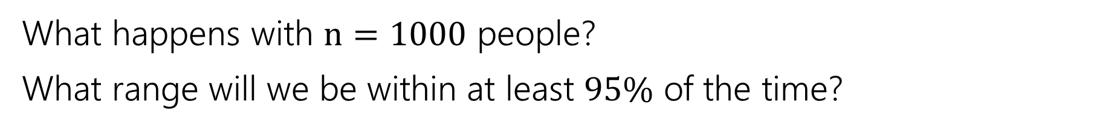
Can we use Chernoff?
Let $X_{1},X_{2},…,X_{n}$ be independent Bernoulli random variables.
Let $X=∑X_{i}$, and $μ=𝔼\left[X\right]$. For any $0≤δ≤1$
$ℙ\left(X≥\left(1+δ\right)μ\right)≤\exp\left(−\frac{δ^{2}μ}{3}\right)$ and $ℙ\left(X≤\left(1−δ\right)μ\right)≤\exp\left(−\frac{δ^{2}μ}{2}\right)$
(Multiplicative) Chernoff Bound
What happens with $n=1000$ people?
What range will we be within at least $95\%$ of the time?

Slide 39
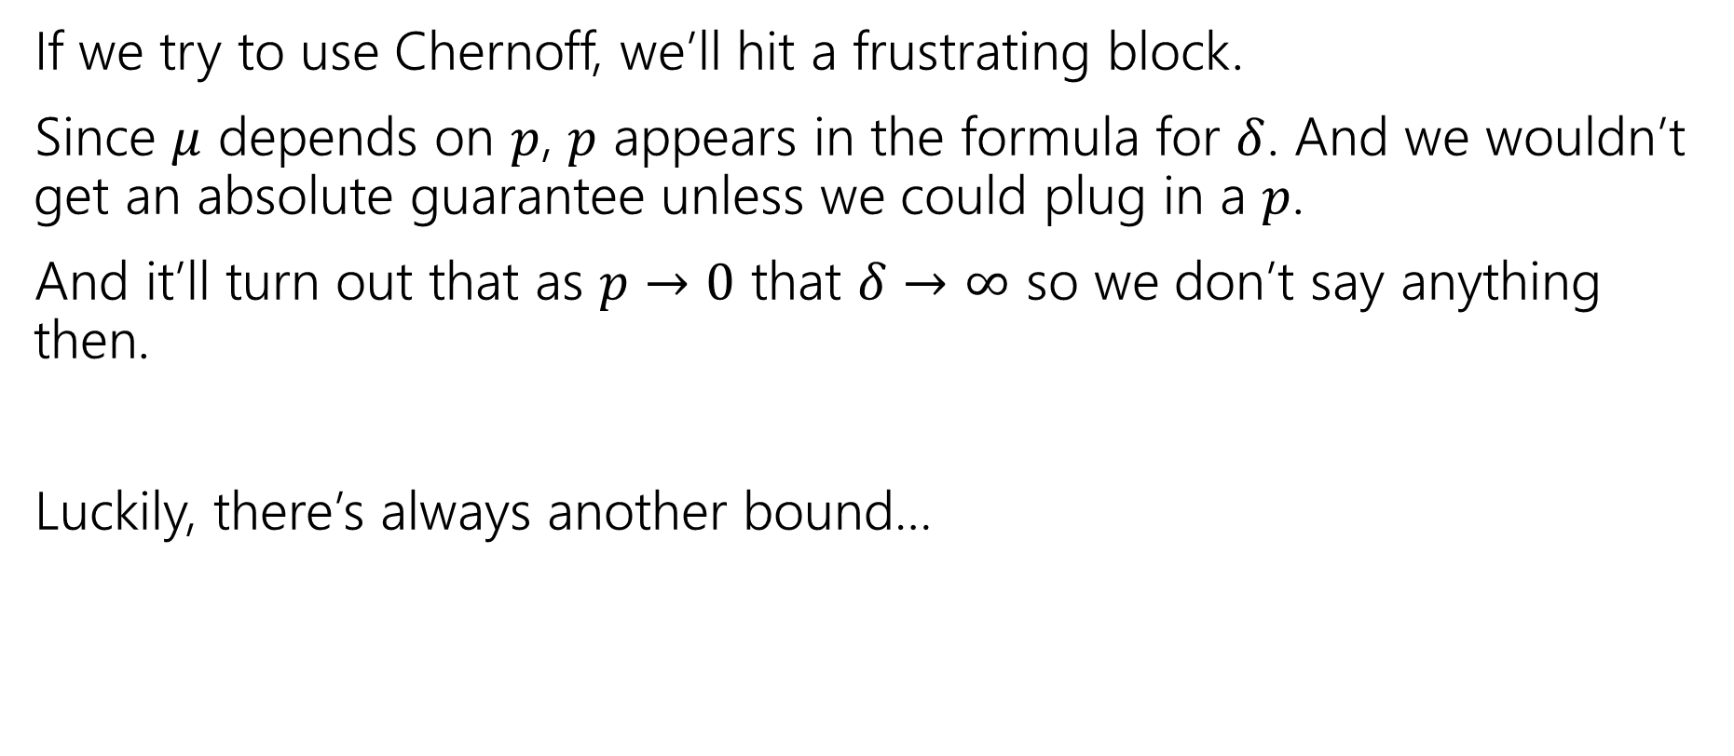
A different inequality
If we try to use Chernoff, we’ll hit a frustrating block.
Since $μ$ depends on $p$, $p$ appears in the formula for $δ$. And we wouldn’t get an absolute guarantee unless we could plug in a $p$.
And it’ll turn out that as $p→0$ that $δ→∞$ so we don’t say anything then.
Luckily, there’s always another bound…

Slide 40
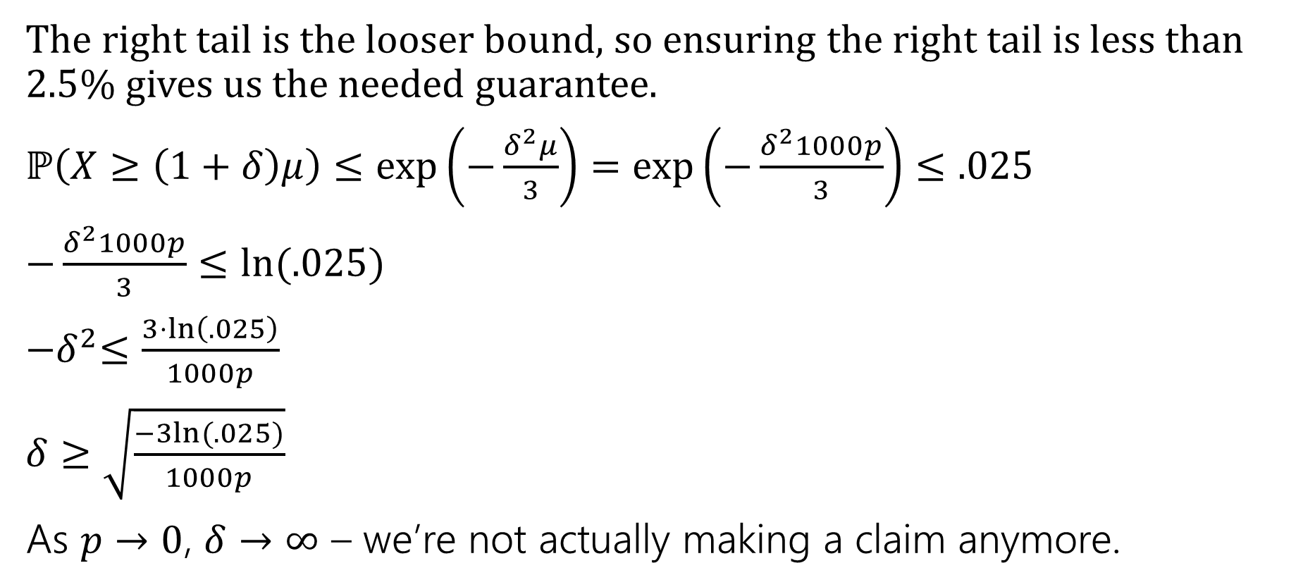
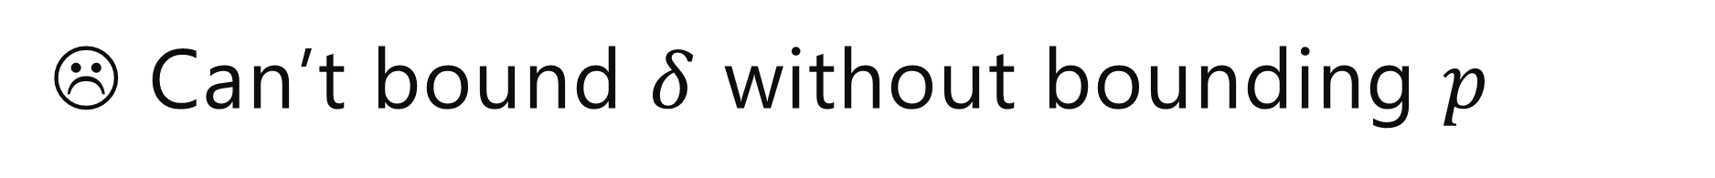
☹ Can’t bound $δ$ without bounding $p$
The right tail is the looser bound, so ensuring the right tail is less than $2.5$% gives us the needed guarantee.
$ℙ\left(X≥\left(1+δ\right)μ\right)≤\exp\left(−\frac{δ^{2}μ}{3}\right)=\exp\left(−\frac{δ^{2}1000p}{3}\right)≤.025$
$−\frac{δ^{2}1000p}{3}≤ln⁡(.025)$
${−δ}^{2}≤\frac{3⋅\ln\left(.025\right)}{1000p}$
$δ≥\sqrt{\frac{−3ln⁡(.025)}{1000p}}$
As $p→0$, $δ→∞$ – we’re not actually making a claim anymore.

Slide 41
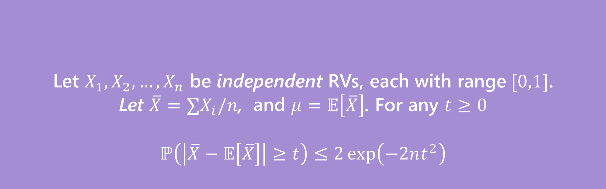
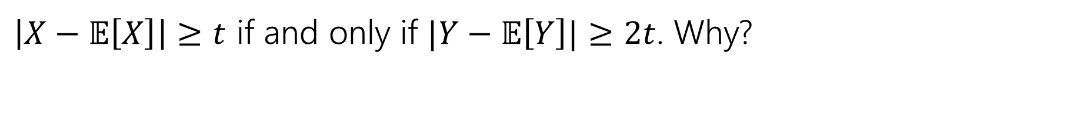
Hoeffding’s Inequality
Let $X_{1},X_{2},…,X_{n}$ be independent RVs, each with range$[0,1]$.
Let $\overline{X}=∑X_{i}/n$, and $μ=𝔼\left[\overline{X}\right]$. For any $t≥0$
$$ℙ\left(\left|\overline{X}−𝔼\left[\overline{X}\right]\right|≥t\right)≤2\exp\left(−2nt^{2}\right)$$
Hoeffding’s Inequality
$\left|X−𝔼\left[X\right]\right|≥t$ if and only if $|Y−𝔼\left[Y\right]|≥2t$. Why?

Slide 42

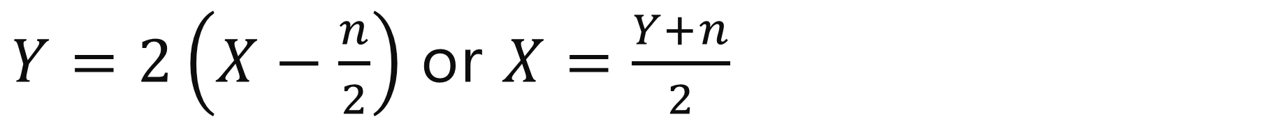
$Y=2\left(X−\frac{n}{2}\right)$ or $X=\frac{Y+n}{2}$
$\left|X−𝔼\left[X\right]\right|$
$=\left|\frac{Y+n}{2}−𝔼\left[\frac{Y+n}{2}\right]\right|$
$=\left|\frac{Y+n}{2}−𝔼\left[\frac{Y}{2}\right]−\frac{n}{2}\right|$
$=\left|\frac{Y}{2}−𝔼\left[\frac{Y}{2}\right]\right|$
$=\frac{1}{2}\left|Y−𝔼\left[Y\right]\right|$
So $\left|X−𝔼\left[X\right]\right|≥t$ if and only if $\frac{1}{2}\left|Y−𝔼\left[Y\right]\right|≥t$ iff $\left|Y−𝔼\left[Y\right]\right|≥2t$.

Slide 43
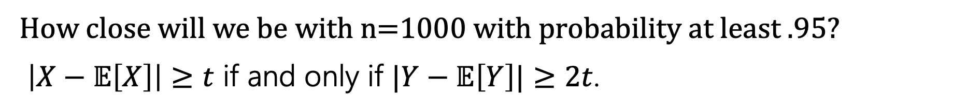
Hoeffding’s Inequality
Let $X_{1},X_{2},…,X_{n}$ be independent RVs, each with range$[0,1]$.
Let $\overline{X}=∑X_{i}/n$, and $μ=𝔼\left[\overline{X}\right]$. For any $t≥0$
$$ℙ\left(\left|\overline{X}−𝔼\left[\overline{X}\right]\right|≥t\right)≤2\exp\left(−2nt^{2}\right)$$
Hoeffding’s Inequality
How close will we be with n=1000 with probability at least $.95$?
$\left|X−𝔼\left[X\right]\right|≥t$ if and only if $|Y−𝔼\left[Y\right]|≥2t$.

Slide 44
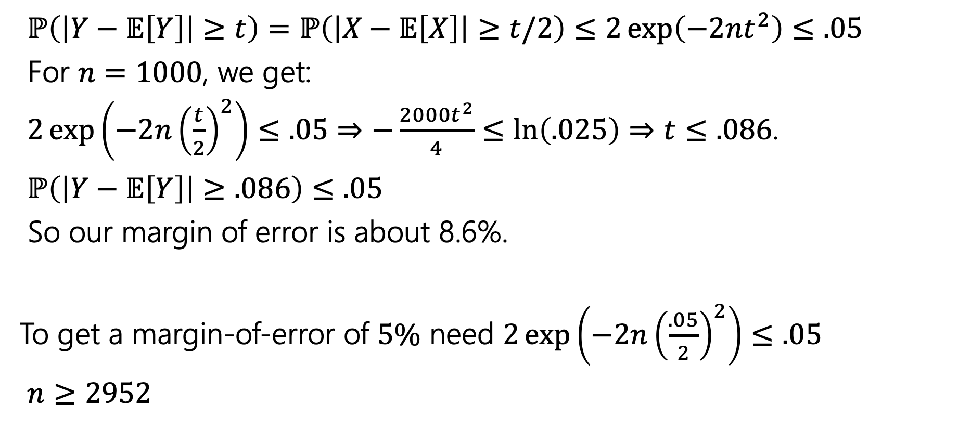
Margin of Error
$ℙ\left(\left|Y−𝔼\left[Y\right]\right|≥t\right)=ℙ\left(\left|X−𝔼\left[X\right]\right|≥t/2\right)≤2\exp\left(−2nt^{2}\right)≤.05$
For $n=1000$, we get:
$2\exp\left(−2n{\left(\frac{t}{2}\right)}^{2}\right)≤.05$ $⇒−\frac{2000t^{2}}{4}≤\ln\left(.025\right)⇒t≤.086$.
$ℙ\left(\left|Y−𝔼\left[Y\right]\right|≥.086\right)≤.05$
So our margin of error is about 8.6%.
To get a margin-of-error of $5\%$ need $2\exp\left(−2n{\left(\frac{.05}{2}\right)}^{2}\right)≤.05$
$n≥2952$

Slide 45
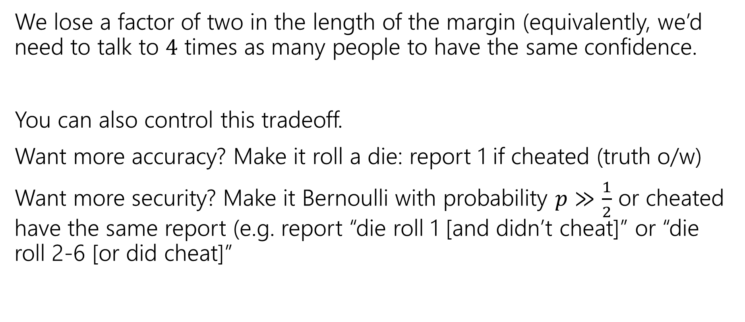
How much do we lose?
We lose a factor of two in the length of the margin (equivalently, we’d need to talk to $4$ times as many people to have the same confidence.
You can also control this tradeoff.
Want more accuracy? Make it roll a die: report 1 if cheated (truth o/w)
Want more security? Make it Bernoulli with probability $p≫\frac{1}{2}$ or cheated have the same report (e.g. report “die roll 1 [and didn’t cheat]” or “die roll 2-6 [or did cheat]”

Slide 46
In The Real World
Injecting randomness to preserve privacy is a real thing.
Instead of having everyone flip a coin, “random noise” can be inserted after all the data has been collected.
Differential privacy is being used to protect the 2020 Census data.
The overall count of people in each state is exact (well, exactly the data they collected). But the data per block or per city will be randomized to protect against revealing who lives where.
This video nicely explains what’s involved. Notice that the accuracy guarantees come in the same “inside-margin-of-error-with-probability” guarantees we’ve been giving for our randomness (just much stronger).

Slide 47

One More Bound
The Union bound
For any events $E,F$
$$ℙ\left(E∪F\right)≤ℙ\left(E\right)+ℙ(F)$$
Union Bound
Proof? $ℙ\left(E∪F\right)=ℙ\left(E\right)+ℙ\left(F\right)−ℙ(E∩F)$
And $ℙ\left(E∩F\right)≥0$.

