Slide 1
Joint Distributions
CSE 312 Summer 25
Lecture 18

Slide 2
Announcements
Homework 4 solutions available outside Allen 206
Homework 5 due tonight
Homework 6 will release later today
Quiz 6 on Friday

Slide 3
Multiple Random Variables

Slide 4
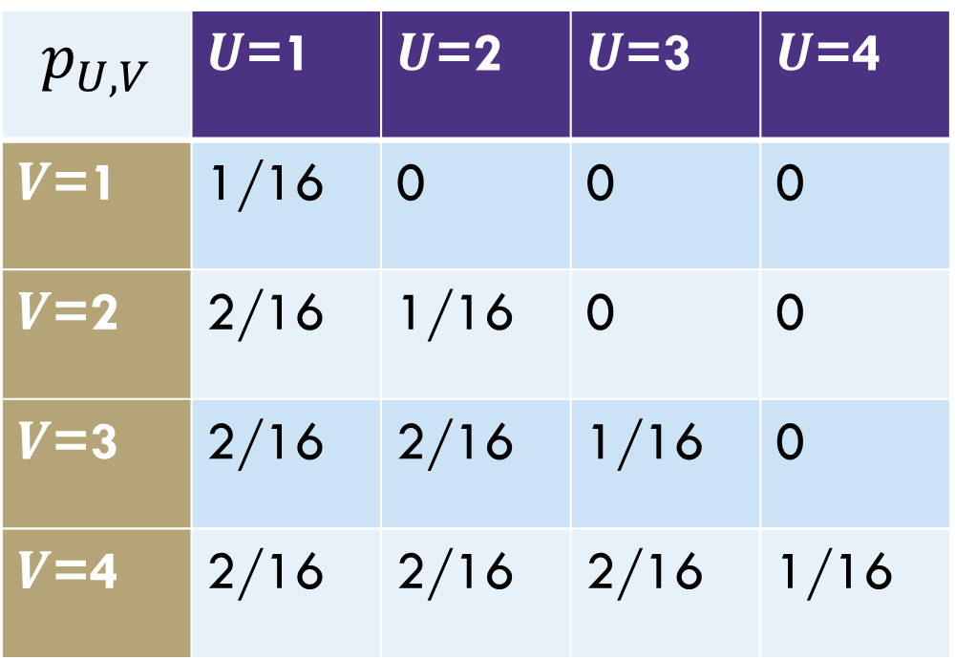
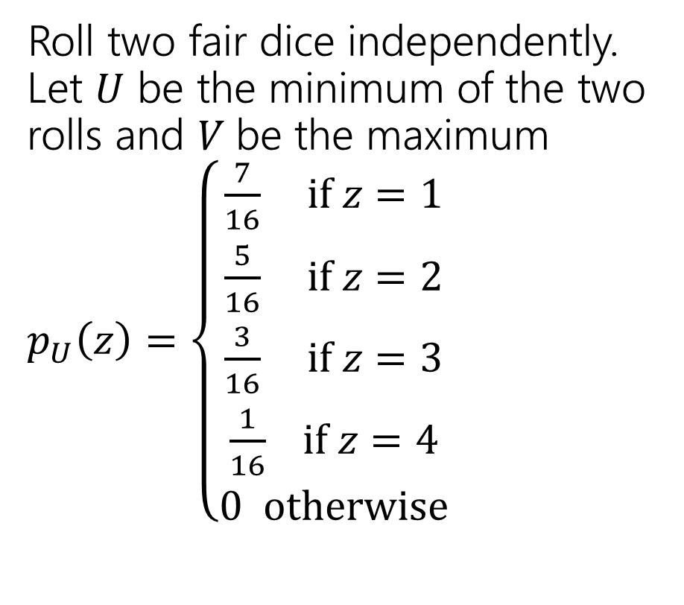
Different dice
Roll two fair dice independently. Let $U$ be the minimum of the two rolls and $V$be the maximum
$p_{U}\left(z\right)=\left\{\begin{aligned}\frac{7}{16} if z=1 \\ \frac{5}{16} if z=2 \\ \frac{3}{16} if z=3 \\ \frac{1}{16} if z=4 \\ 0 otherwise\end{aligned}\right.$
$$p_{U,V}$$ | $U$=1 | $U$=2 | $U$=3 | $U$=4
$V$=1 | 1/16 | 0 | 0 | 0
$V$=2 | 2/16 | 1/16 | 0 | 0
$V$=3 | 2/16 | 2/16 | 1/16 | 0
$V$=4 | 2/16 | 2/16 | 2/16 | 1/16

Slide 5

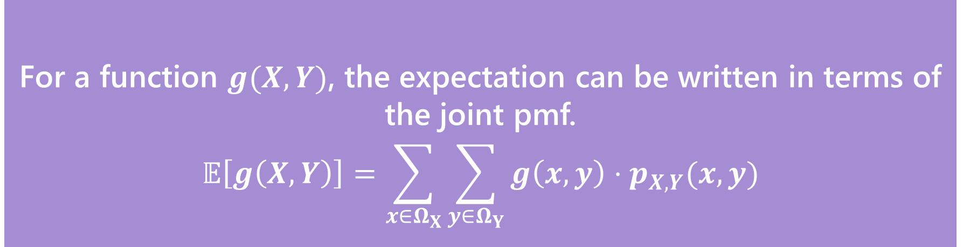
Joint Expectation
For a function $g(X,Y)$, the expectation can be written in terms of the joint pmf.
$$𝔼\left[g\left(X,Y\right)\right]=\sum_{x∈Ω_{X}}{\sum_{y∈Ω_{Y}}{g\left(x,y\right)⋅p_{X,Y}(x,y)}}$$
Expectations of joint functions
This definition hopefully isn’t surprising at this point (it’s the value of $g$ times the probability $g$ takes on that value), but it’s good to see.
Notes:
When we have multiple random variables we tend to want to define a new R.V. like X+Y or X*Y or X^2 + 7Y and we often want to find the expectation of this new RV

Slide 6

Expectation of a function of two RVs
What’s $𝔼[UV]$ for $U,V$ from the last slide?

Slide 7
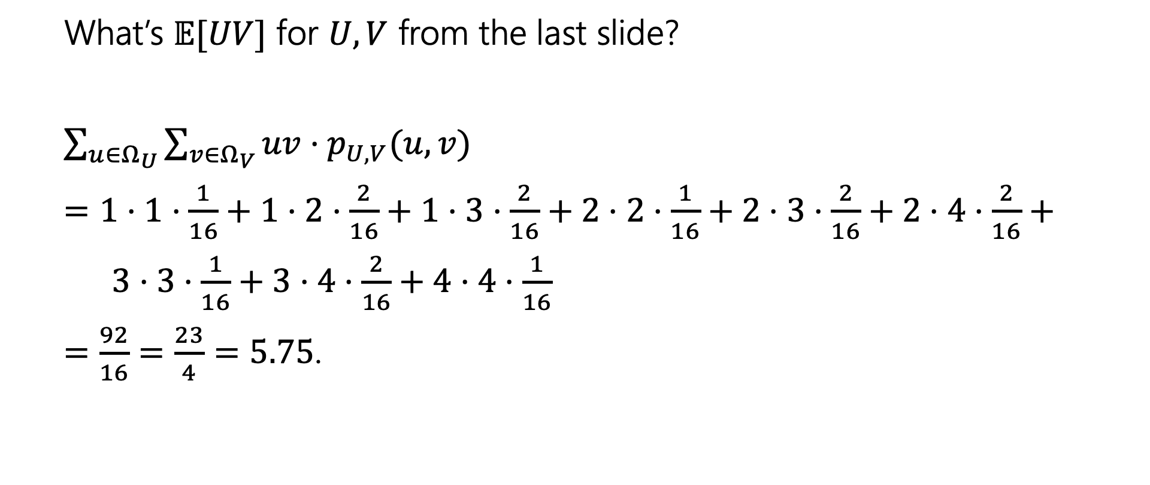
Expectation of a function of two RVs
What’s $𝔼[UV]$ for $U,V$ from the last slide?
$\sum_{u∈Ω_{U}}{\sum_{v∈Ω_{V}}{uv⋅p_{U,V}(u,v)}}$
$=1⋅1⋅\frac{1}{16}+1⋅2⋅\frac{2}{16}+1⋅3⋅\frac{2}{16}+2⋅2⋅\frac{1}{16}+2⋅3⋅\frac{2}{16}+2⋅4⋅\frac{2}{16}+$
$3⋅3⋅\frac{1}{16}+3⋅4⋅\frac{2}{16}+4⋅4⋅\frac{1}{16}$
$=\frac{92}{16}=\frac{23}{4}=5.75$.

Slide 8


Conditional Expectation
Waaaaaay back when, we said conditioning on an event creates a new probability space, with all the laws holding.
So we can define things like “conditional expectations” which is the expectation of a random variable in that new probability space.
$$𝔼\left[X | E\right]=\sum_{x∈Ω_{X}}{x⋅ℙ(X=x|E)}$$
$$𝔼\left[X | Y=y\right]=\sum_{x∈Ω_{X}}{x⋅ℙ\left(X=x | Y=y\right)}$$
Notes:
Give example with die

Slide 9

Conditional Expectations
All your favorite theorems are still true.
For example, linearity of expectation still holds
$$𝔼\left[(aX+bY+c) \right|E]=a𝔼\left[X | E\right]+b𝔼\left[Y | E\right]+c$$

Slide 10


Law of Total Expectation
Let $A_{1},A_{2},…,A_{k}$ be a partition of the sample space, then
$$𝔼[X]=\sum_{i=1}^{n}{𝔼\left[X | A_{i}\right]ℙ(A_{i})}$$
Let $X,Y$be discrete random variables, then
$$𝔼[X]=\sum_{y∈Ω_{Y}}{𝔼\left[X | Y=y\right]ℙ(Y=y)}$$
Similar in form to law of total probability, and the proof goes that way as well.

Slide 11

LTE
You will flip $2$ (independent, fair coins). Call the number of heads $X$. Then (independently of the coin flips) draw an exponential random variable $Y$from the distribution $Exp(X+1)$.
What is $𝔼[Y]$?
Notes:
Y has a very strange distribution! We can find it in principle, but if we just want the expectation, we can avoid that work.
We can partition on the values that X takes on.

Slide 12
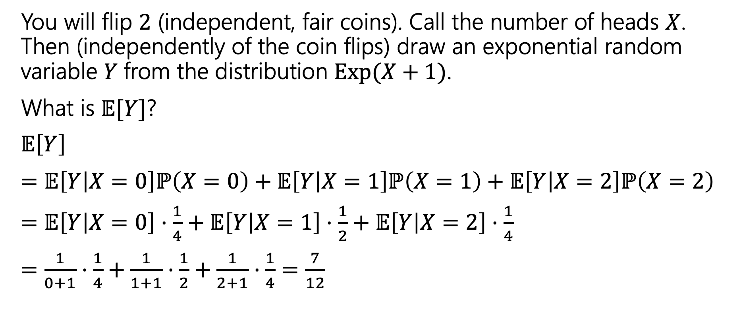
LTE
You will flip $2$ (independent, fair coins). Call the number of heads $X$. Then (independently of the coin flips) draw an exponential random variable $Y$from the distribution $Exp(X+1)$.
What is $𝔼[Y]$?
$𝔼\left[Y\right]$
$=𝔼\left[Y | X=0\right]ℙ\left(X=0\right)+𝔼\left[Y | X=1\right]ℙ\left(X=1\right)+𝔼\left[Y | X=2\right]ℙ\left(X=2\right)$
$=𝔼\left[Y | X=0\right]⋅\frac{1}{4}+𝔼\left[Y | X=1\right]⋅\frac{1}{2}+𝔼\left[Y | X=2\right]⋅\frac{1}{4}$
$=\frac{1}{0+1}⋅\frac{1}{4}+\frac{1}{1+1}⋅\frac{1}{2}+\frac{1}{2+1}⋅\frac{1}{4}=\frac{7}{12}$

Slide 13
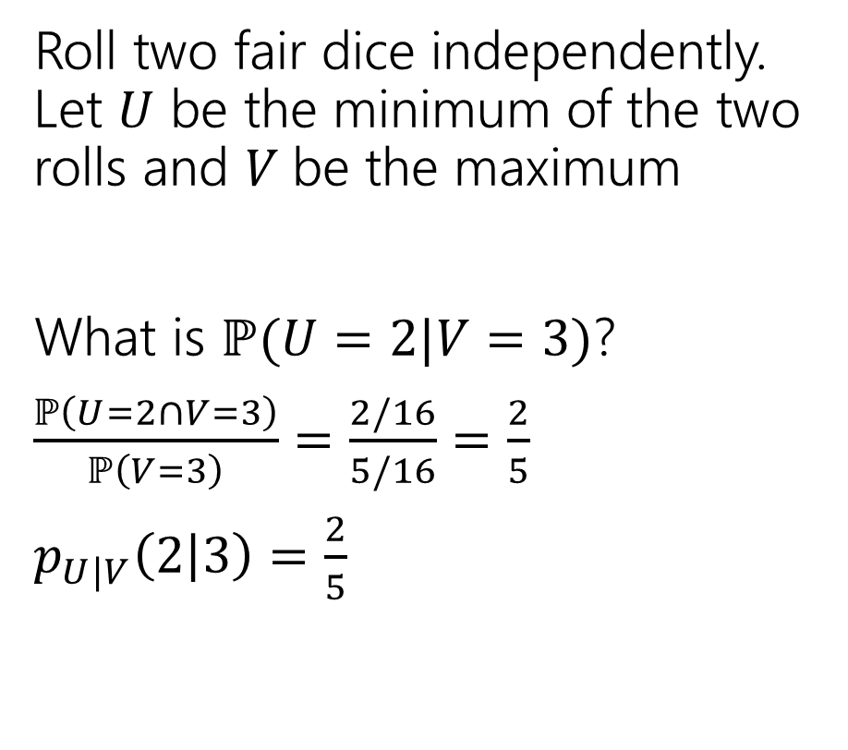
Different dice
Roll two fair dice independently. Let $U$ be the minimum of the two rolls and $V$be the maximum
What is $ℙ(U=2|V=3)$?
$\frac{ℙ\left(U=2∩V=3\right)}{ℙ\left(V=3\right)}=\frac{2/16}{5/16}=\frac{2}{5}$
$p_{U|V}\left(2 | 3\right)=\frac{2}{5}$
$$p_{U,V}$$ | $U$=1 | $U$=2 | $U$=3 | $U$=4
$V$=1 | 1/16 | 0 | 0 | 0
$V$=2 | 2/16 | 1/16 | 0 | 0
$V$=3 | 2/16 | 2/16 | 1/16 | 0
$V$=4 | 2/16 | 2/16 | 2/16 | 1/16
Notes:
Sometimes you’ll want to look at a lot of these values, so we will define a conditional PMF. This is the notation that we will use, so we don’t forget that we are conditioning.

Slide 14

Different dice
Find these values
$p_{V|U}\left(2|1\right)=$
$p_{U|V}\left(1 | 2\right)=$
$p_{U|V}\left(4 | 1\right)=$
$$p_{U,V}$$ | $U$=1 | $U$=2 | $U$=3 | $U$=4
$V$=1 | 1/16 | 0 | 0 | 0
$V$=2 | 2/16 | 1/16 | 0 | 0
$V$=3 | 2/16 | 2/16 | 1/16 | 0
$V$=4 | 2/16 | 2/16 | 2/16 | 1/16

Slide 15
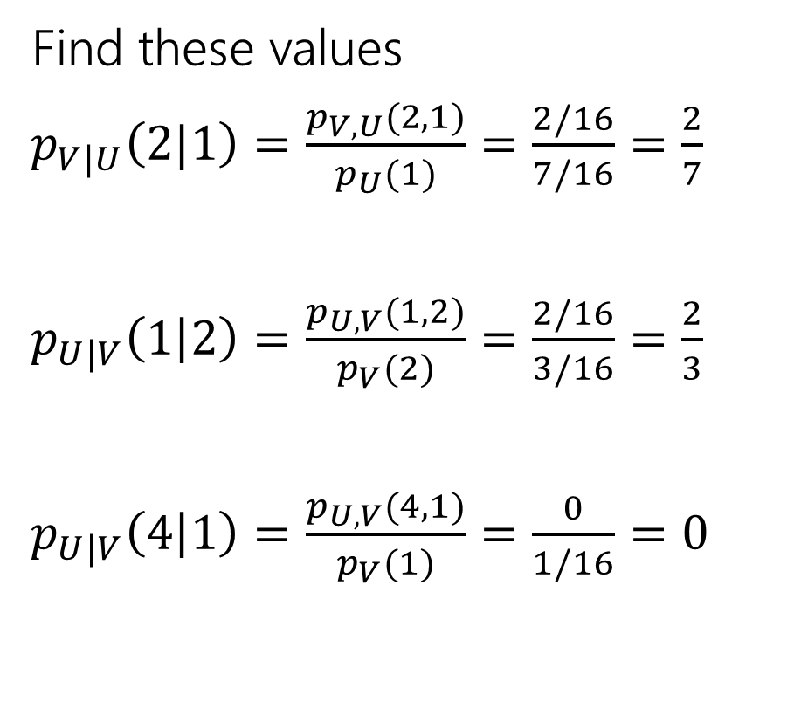
Different dice
Find these values
$p_{V|U}\left(2|1\right)=\frac{p_{V,U}(2,1)}{p_{U}(1)}=\frac{2/16}{7/16}=\frac{2}{7}$
$p_{U|V}\left(1 | 2\right)=\frac{p_{U,V}(1,2)}{p_{V}(2)}=\frac{2/16}{3/16}=\frac{2}{3}$
$p_{U|V}\left(4 | 1\right)=\frac{p_{U,V}(4,1)}{p_{V}(1)}=\frac{0}{1/16}=0$
$$p_{U,V}$$ | $U$=1 | $U$=2 | $U$=3 | $U$=4
$V$=1 | 1/16 | 0 | 0 | 0
$V$=2 | 2/16 | 1/16 | 0 | 0
$V$=3 | 2/16 | 2/16 | 1/16 | 0
$V$=4 | 2/16 | 2/16 | 2/16 | 1/16
Notes:
With conditioning order really matters.

Slide 16
Continuous Joint Distributions

Slide 17
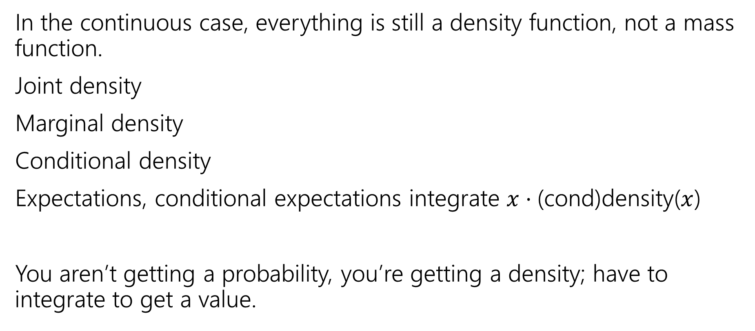
What about the continuous versions?
In the continuous case, everything is still a density function, not a mass function.
Joint density
Marginal density
Conditional density
Expectations, conditional expectations integrate $x⋅$(cond)density($x$)
You aren’t getting a probability, you’re getting a density; have to integrate to get a value.

Slide 18
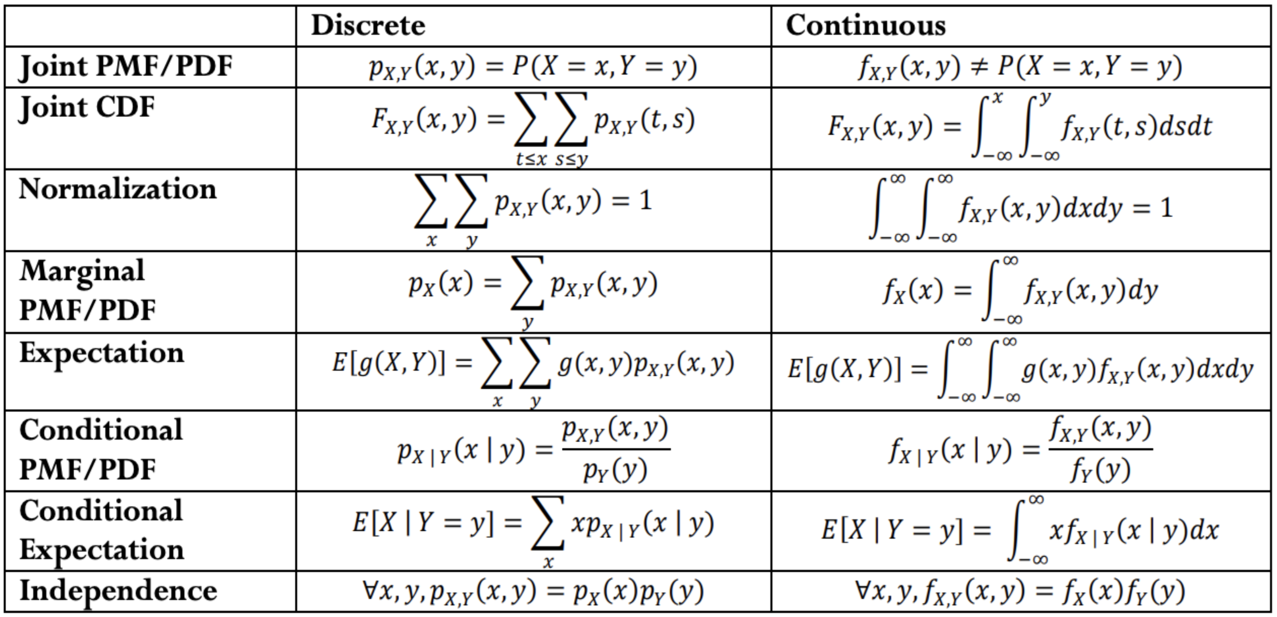
Analogues for continuous
Everything we saw today has a continuous version.
There are “no surprises”– replace pmf with pdf and sums with integrals.

Slide 19
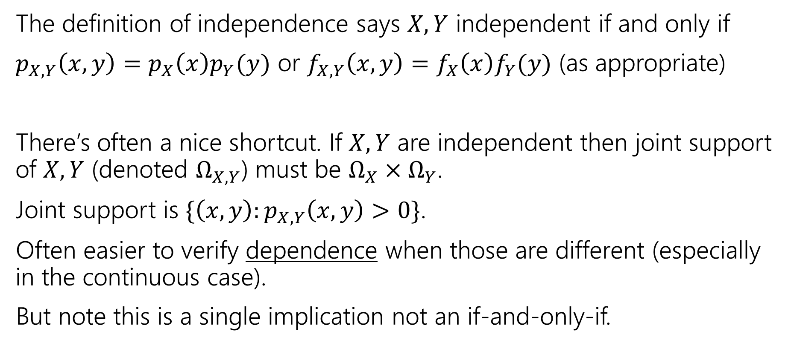
A note on independence
The definition of independence says $X,Y$ independent if and only if
$p_{X,Y}\left(x,y\right)=p_{X}\left(x\right)p_{Y}(y)$ or $f_{X,Y}\left(x,y\right)=f_{X}\left(x\right)f_{Y}(y)$ (as appropriate)
There’s often a nice shortcut. If $X,Y$ are independent then joint support of $X,Y$ (denoted $Ω_{X,Y}$) must be $Ω_{X}×Ω_{Y}$.
Joint support is $\{\left(x,y\right):p_{X,Y}\left(x,y\right)>0\}$.
Often easier to verify dependence when those are different (especially in the continuous case).
But note this is a single implication not an if-and-only-if.
Notes:
$U,V$ from last example can have their dependence verified this way.
Step 1: check the support
Step 2: go through the math to check for independence

Slide 20
Covariance
Notes:
When we have two random variables that are dependent, we want to answer when how dependent are they. Does knowing the value Y took on tell up a lot about what value X would take on or not that much. Covariance is out way of measuring this exact thing.

Slide 21

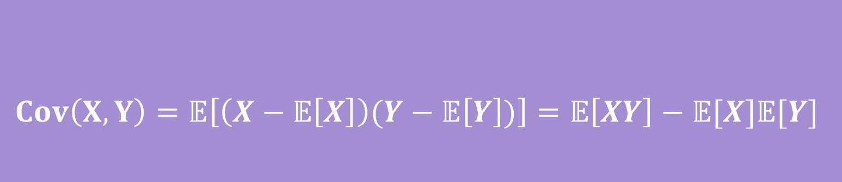
Covariance
We sometimes want to measure how “intertwined” $X$ and $Y$ are – how much knowing about one of them will affect the other.
If $X$ turns out “big” how likely is it that $Y$ will be “big” how much do they “vary together”
$$Cov\left(X,Y\right)=𝔼\left[\left(X−𝔼\left[X\right]\right)(Y−𝔼\left[Y\right])\right]=𝔼\left[XY\right]−𝔼[X]𝔼[Y]$$
Covariance
Notes:
By big, I mean larger than the expectation.
Covariance can be positive or negative!
Positive covariance means (linearly) vary together---X bigger than expectation predicts Y bigger than expectation If covariance is negative than X bigger than expectation predicts Y less than expectation
Add note about independent rvs

Slide 22


$$Cov\left(X,Y\right)=𝔼\left[\left(X−𝔼\left[X\right]\right)(Y−𝔼\left[Y\right])\right]=𝔼\left[XY\right]−𝔼[X]𝔼[Y]$$
Covariance
If $X,Y$ go in the same direction
If $X,Y$ go in the opposite directions

Slide 23

Covariance
$Var\left(X+Y\right)=Var\left(X\right)+Var\left(Y\right)+2Cov(X,Y)$
That’s consistent with our previous knowledge for independent variables. (for $X,Y$independent, $𝔼\left[XY\right]=𝔼\left[X\right]𝔼[Y]$).

Slide 24
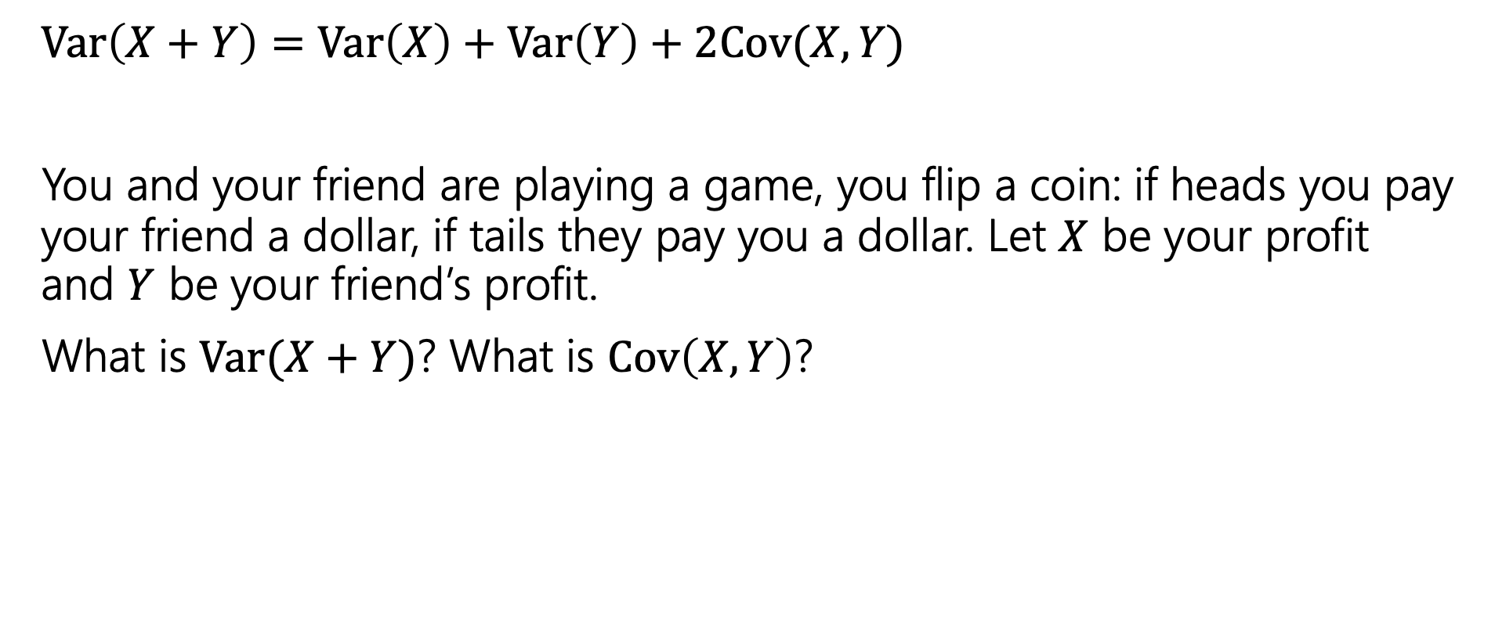
Covariance
$Var\left(X+Y\right)=Var\left(X\right)+Var\left(Y\right)+2Cov(X,Y)$
You and your friend are playing a game, you flip a coin: if heads you pay your friend a dollar, if tails they pay you a dollar. Let $X$ be your profit and $Y$ be your friend’s profit.
What is $Var(X+Y)$? What is $Cov\left(X,Y\right)$?
Before you calculate, make a prediction. What should it be?

Slide 25
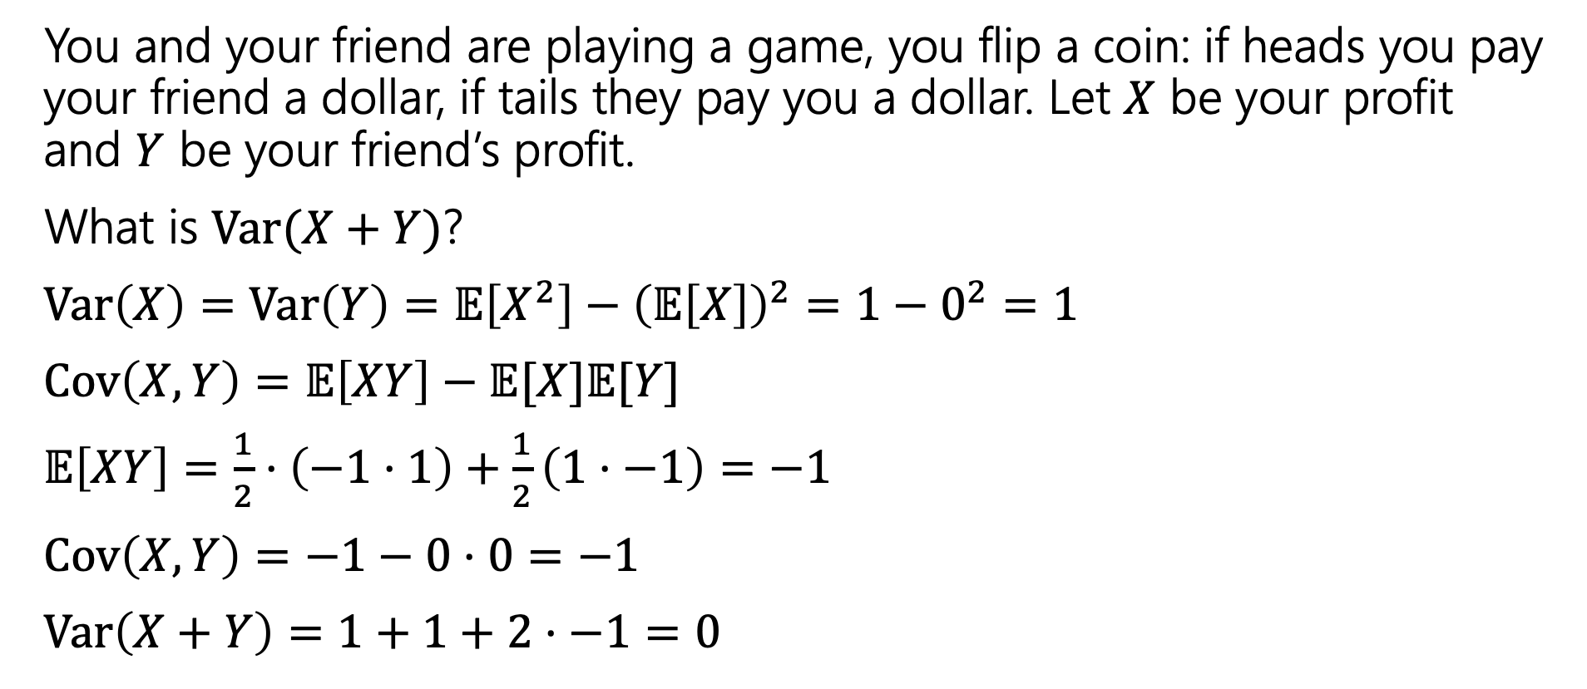
Covariance
You and your friend are playing a game, you flip a coin: if heads you pay your friend a dollar, if tails they pay you a dollar. Let $X$ be your profit and $Y$ be your friend’s profit.
What is $Var(X+Y)$?
$Var\left(X\right)=Var\left(Y\right)=𝔼\left[X^{2}\right]−{\left(𝔼\left[X\right]\right)}^{2}=1−0^{2}=1$
$Cov\left(X,Y\right)=𝔼\left[XY\right]−𝔼[X]𝔼[Y]$
$𝔼\left[XY\right]=\frac{1}{2}⋅\left(−1⋅1\right)+\frac{1}{2}\left(1⋅−1\right)=−1$
$Cov\left(X,Y\right)=−1−0⋅0=−1$
$Var\left(X+Y\right)=1+1+2⋅−1=0$

Slide 26
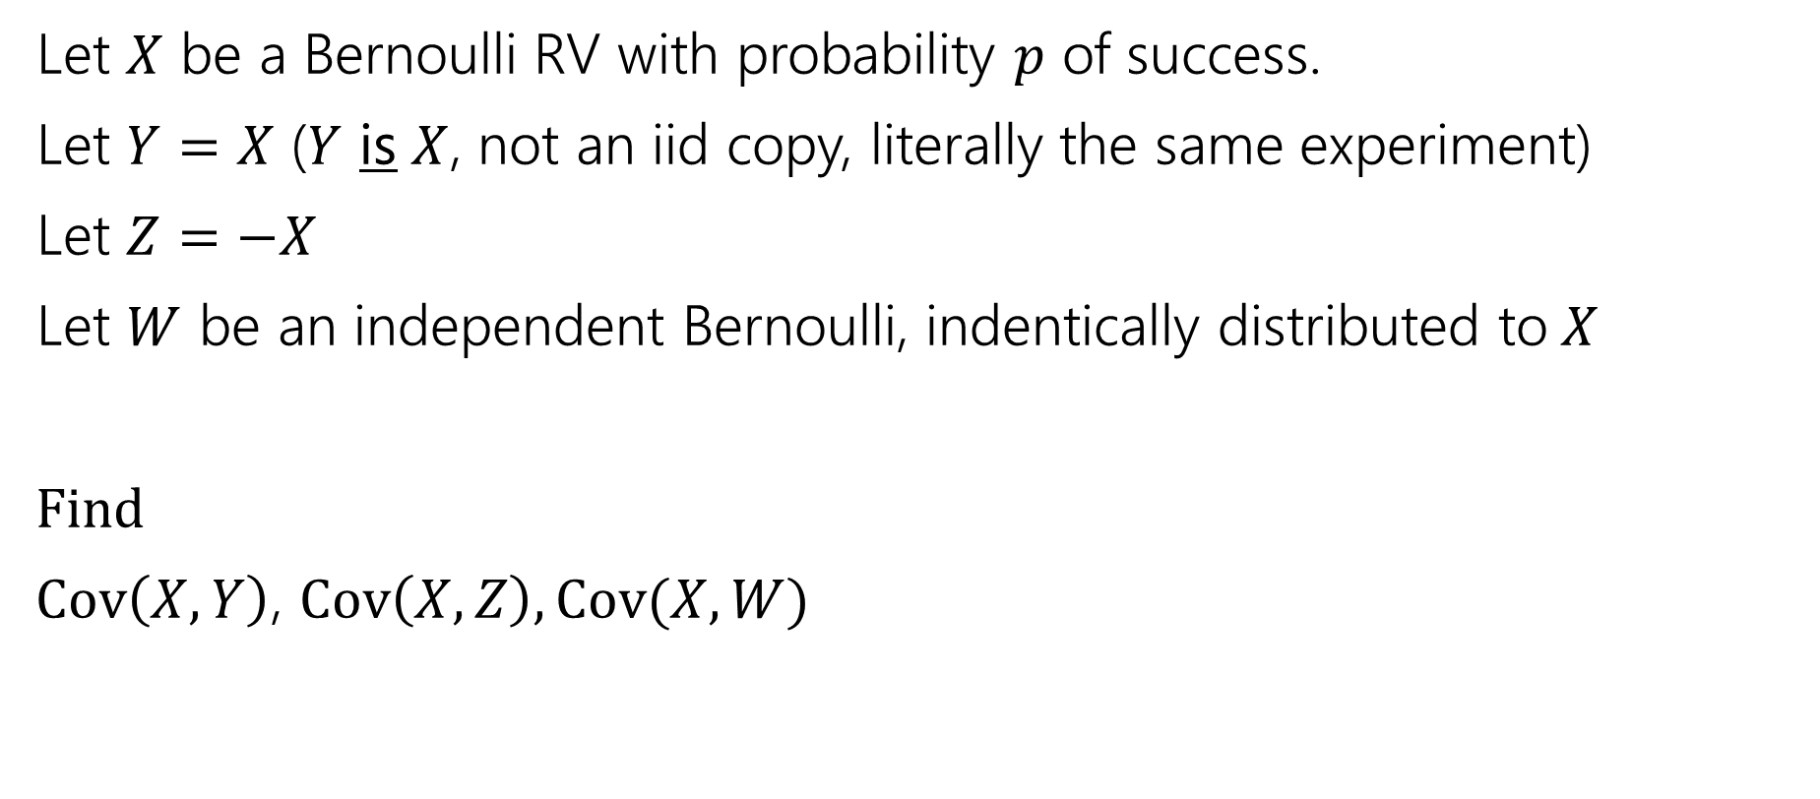
Covariance, Another example
Let $X$ be a Bernoulli RV with probability $p$ of success.
Let $Y=X$ ($Y$ is $X$, not an iid copy, literally the same experiment)
Let $Z=−X$
Let $W$ be an independent Bernoulli, indentically distributed to$X$
Find
$Cov\left(X,Y\right)$, $Cov\left(X,Z\right), Cov(X,W)$

Slide 27
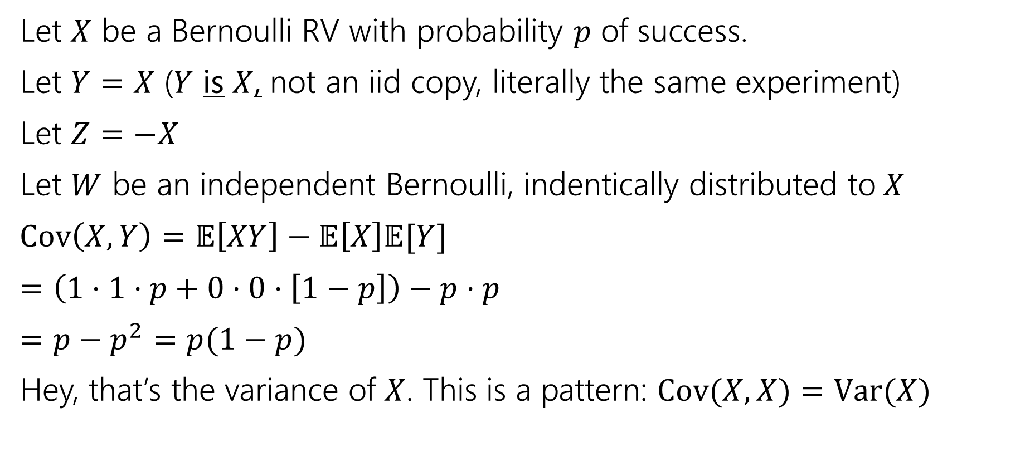
Covariance, Another example
Let $X$ be a Bernoulli RV with probability $p$ of success.
Let $Y=X$ ($Y$ is $X$, not an iid copy, literally the same experiment)
Let $Z=−X$
Let $W$ be an independent Bernoulli, indentically distributed to$X$
$Cov\left(X,Y\right)=𝔼\left[XY\right]−𝔼\left[X\right]𝔼[Y]$
$=\left(1⋅1⋅p+0⋅0⋅\left[1−p\right]\right)−p⋅p$
$=p−p^{2}=p(1−p)$
Hey, that’s the variance of $X$. This is a pattern: $Cov(X,X)=Var(X)$

Slide 28
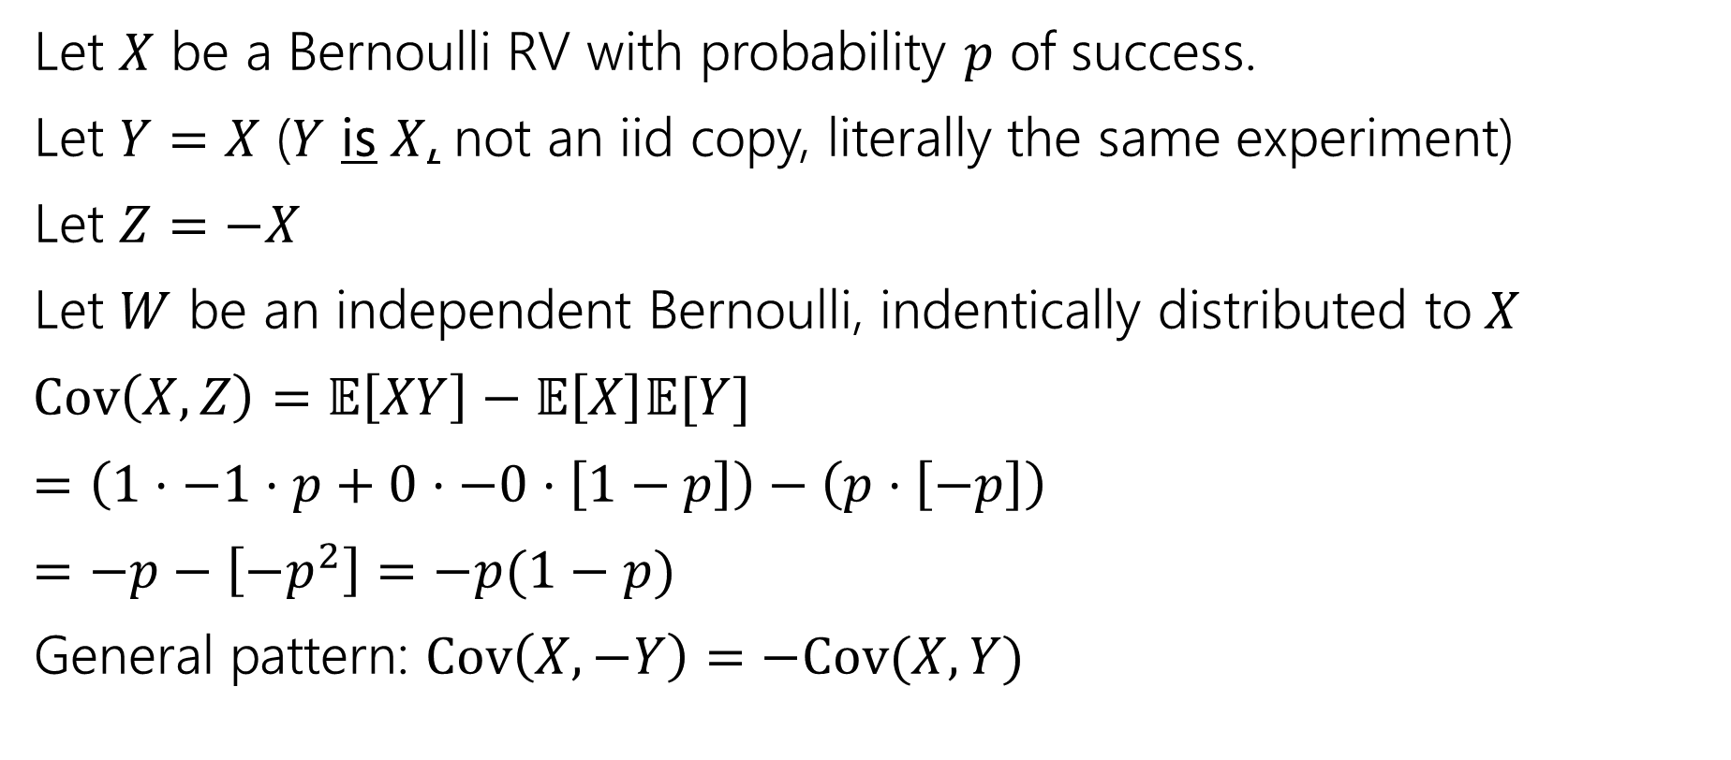
Covariance, Another example
Let $X$ be a Bernoulli RV with probability $p$ of success.
Let $Y=X$ ($Y$ is $X$, not an iid copy, literally the same experiment)
Let $Z=−X$
Let $W$ be an independent Bernoulli, indentically distributed to$X$
$Cov\left(X,Z\right)=𝔼\left[XY\right]−𝔼\left[X\right]𝔼[Y]$
$=\left(1⋅−1⋅p+0⋅−0⋅\left[1−p\right]\right)−\left(p⋅\left[−p\right]\right)$
$=−p−\left[−p^{2}\right]=−p(1−p)$
General pattern: $Cov\left(X,−Y\right)=−Cov(X,Y)$
Notes:
Cov(aX,Y)=aCov(X,Y) in general

Slide 29
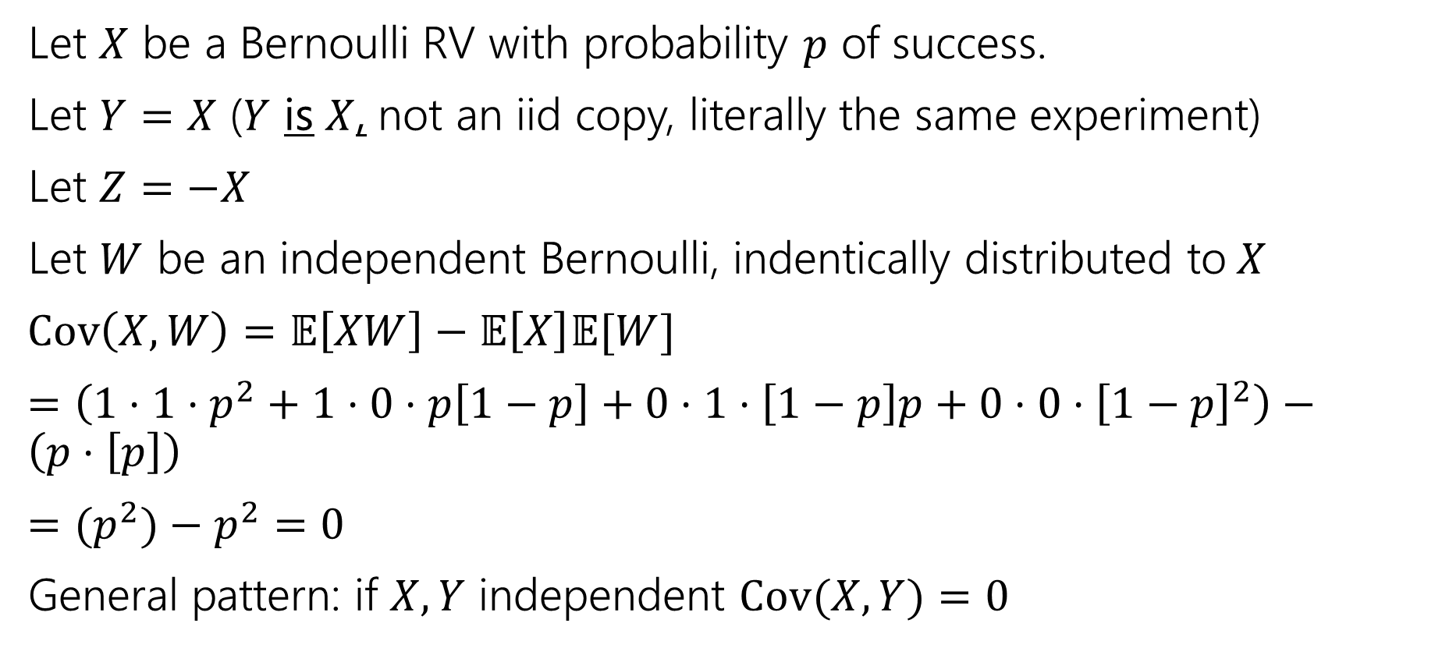
Covariance, Another example
Let $X$ be a Bernoulli RV with probability $p$ of success.
Let $Y=X$ ($Y$ is $X$, not an iid copy, literally the same experiment)
Let $Z=−X$
Let $W$ be an independent Bernoulli, indentically distributed to$X$
$Cov\left(X,W\right)=𝔼\left[XW\right]−𝔼\left[X\right]𝔼[W]$
$=\left(1⋅1⋅p^{2}+1⋅0⋅p\left[1−p\right]+0⋅1⋅\left[1−p\right]p+0⋅0⋅{\left[1−p\right]}^{2}\right)−\left(p⋅\left[p\right]\right)$
$={(p}^{2})−p^{2}=0$
General pattern: if $X,Y$ independent $Cov(X,Y)=0$
Notes:
Converse is not a general pattern; there are “uncorrelated” random variables which are dependent but have covariance 0.
Covariance only measures “linear” relationship; sometimes higher dimensional relationships are hidden. Taking $X\sim N\left(0,1\right), Y=X^2$ is a standard example, but not worth the effort to compute here.

Slide 30
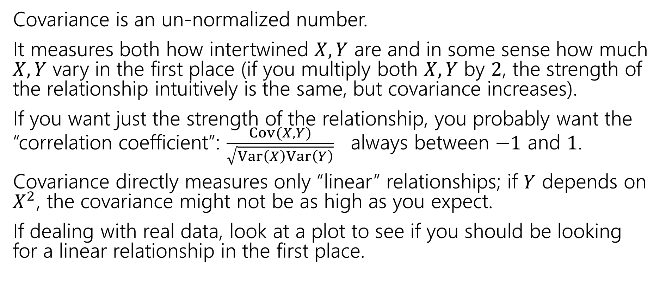
A Few Notes
Covariance is an un-normalized number.
It measures both how intertwined $X,Y$ are and in some sense how much $X,Y$ vary in the first place (if you multiply both $X,Y$ by $2$, the strength of the relationship intuitively is the same, but covariance increases).
If you want just the strength of the relationship, you probably want the “correlation coefficient”: $\frac{Cov(X,Y)}{\sqrt{Var\left(X\right)Var\left(Y\right)}}$ always between $−1$ and $1$.
Covariance directly measures only “linear” relationships; if $Y$ depends on $X^{2}$, the covariance might not be as high as you expect.
If dealing with real data, look at a plot to see if you should be looking for a linear relationship in the first place.

