Slide 1
Confidence Intervals & Joint Distributions
CSE 312 Summer 25
Lecture 17

Slide 2
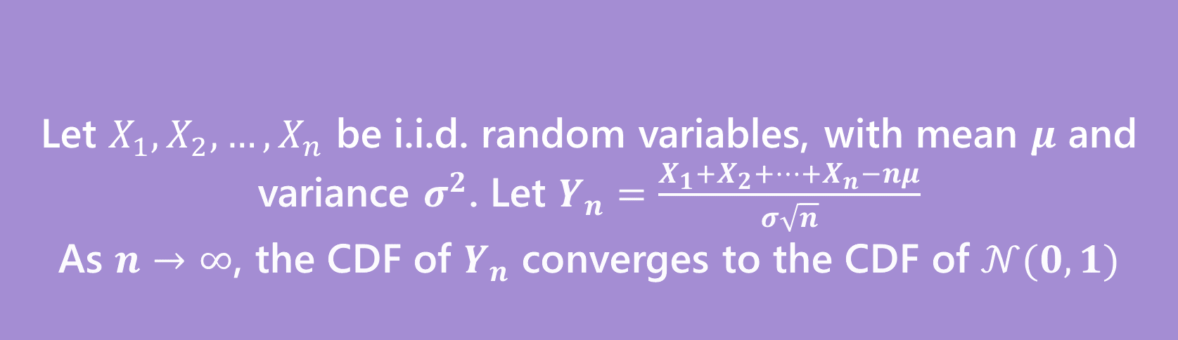
Why Learn Normals?
When we add together independent normal random variables, you get another normal random variable.
The sum of any independent random variables approaches a normal distribution.
Let $X_{1},X_{2},…,X_{n}$ be i.i.d. random variables, with mean $μ$ and variance $σ^{2}$. Let $Y_{n}=\frac{X_{1}+X_{2}+…+X_{n}−nμ}{σ\sqrt{n}}$
As $n→∞$, the CDF of $Y_{n}$ converges to the CDF of $𝒩(0,1)$
Central Limit Theorem
Notes:
This allows use to approximate distributions that would be too difficult to calculate otherwise.
Intuitively what this means is that when we sum any independent random variables that distribution starts looking like a normal distribution.

Slide 3
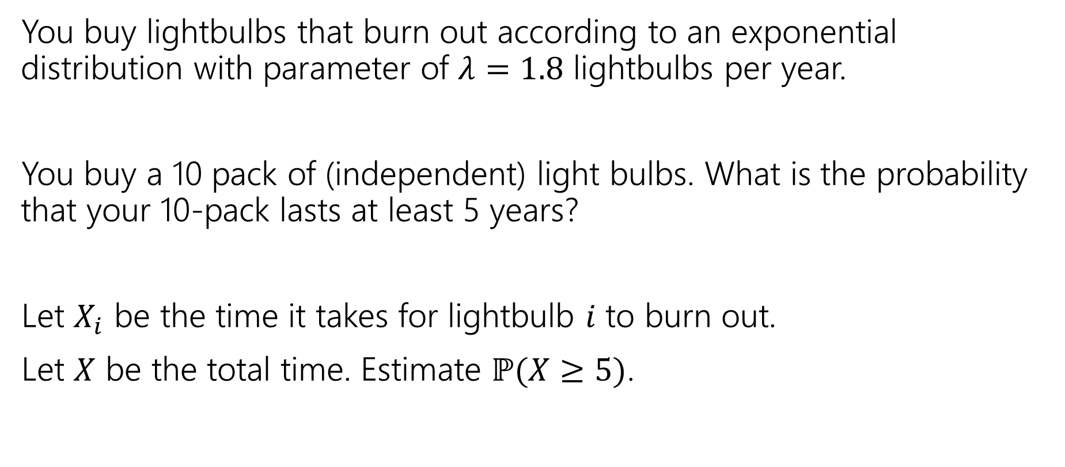
Approximating a continuous distribution
You buy lightbulbs that burn out according to an exponential distribution with parameter of $λ=1.8$ lightbulbs per year.
You buy a 10 pack of (independent) light bulbs. What is the probability that your 10-pack lasts at least 5 years?
Let $X_{i}$ be the time it takes for lightbulb $i$ to burn out.
Let $X$ be the total time. Estimate $ℙ(X≥5)$.

Slide 4
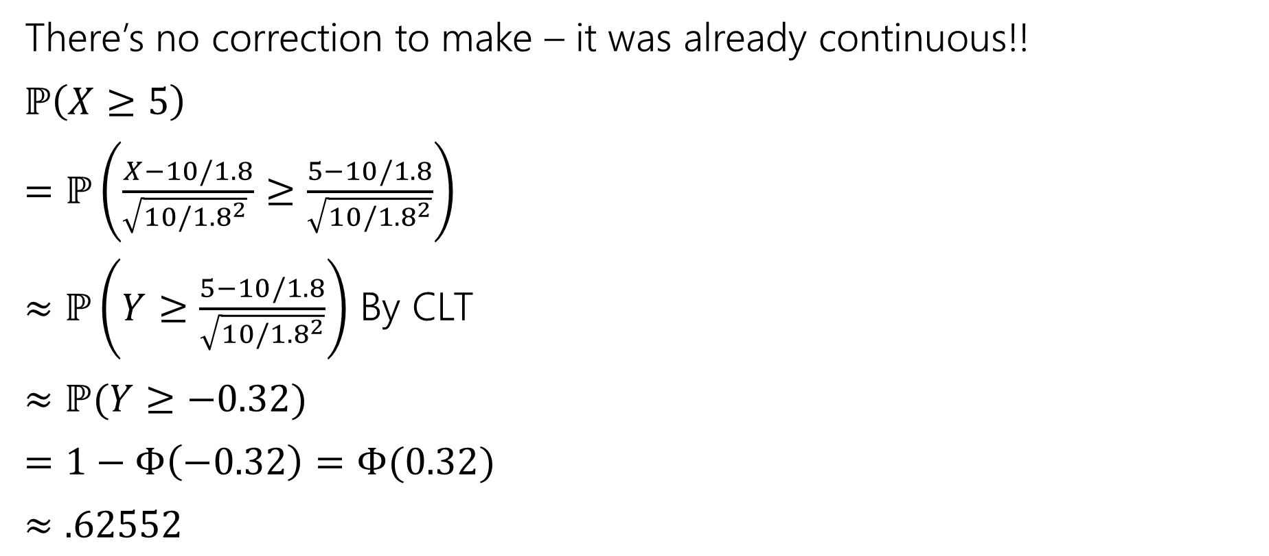
Where’s the continuity correction?
There’s no correction to make – it was already continuous!!
$ℙ\left(X≥5\right)$
$=ℙ\left(\frac{X−10/1.8}{\sqrt{10/{1.8}^{2}} }≥\frac{5−10/1.8}{\sqrt{10/{1.8}^{2}}}\right)$
$≈ℙ\left(Y≥\frac{5−10/1.8}{\sqrt{10/{1.8}^{2}}}\right)$ By CLT
$≈ℙ(Y≥−0.32)$
$=1−Φ\left(−0.32\right)=Φ(0.32)$
$≈.62552$
True value (needs a distribution not in our zoo) is $≈0.58741$
Notes:
Sum of n IID exponentials with parameter lambda is a Gamma distribution with paramaters n, 1/lambda https://en.wikipedia.org/wiki/Gamma_distribution

Slide 5
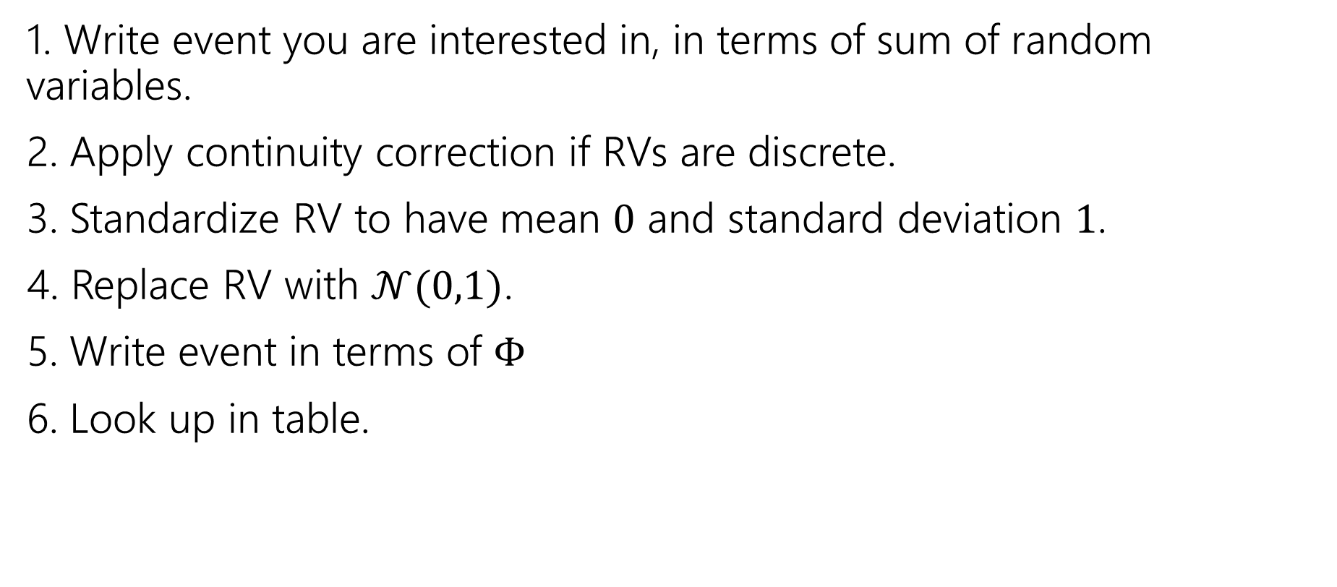
Outline of CLT steps
1. Write event you are interested in, in terms of sum of random variables.
2. Apply continuity correction if RVs are discrete.
3. Standardize RV to have mean $0$ and standard deviation $1$.
4. Replace RV with $𝒩(0,1)$.
5. Write event in terms of $Φ$
6. Look up in table.

Slide 6
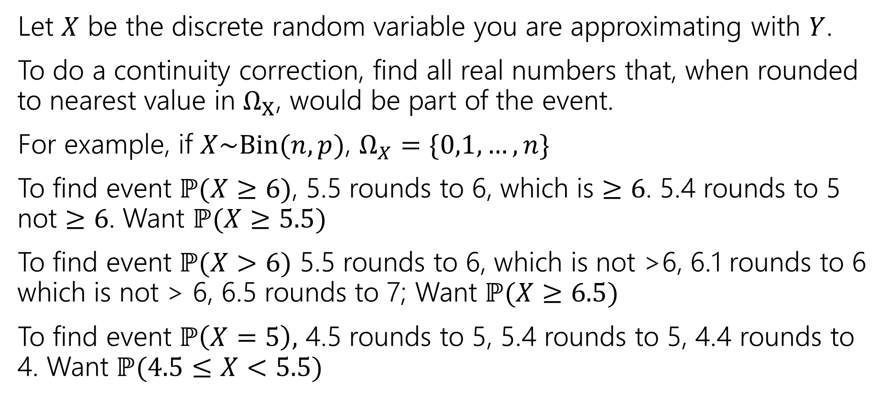
Process For Continuity Correction
Let $X$ be the discrete random variable you are approximating with $Y$.
To do a continuity correction, find all real numbers that, when rounded to nearest value in $Ω_{X}$, would be part of the event.
For example, if $X\sim Bin(n,p)$, $Ω_{X}=\{0,1,…,n\}$
To find event $ℙ(X≥6)$, 5.5 rounds to 6, which is $≥6$. 5.4 rounds to 5 not $≥6$. Want $ℙ(X≥5.5)$
To find event $ℙ(X>6)$ 5.5 rounds to 6, which is not >6, 6.1 rounds to 6 which is not > 6, 6.5 rounds to 7; Want $ℙ(X≥6.5)$
To find event $ℙ\left(X=5\right),$ 4.5 rounds to 5, 5.4 rounds to 5, 4.4 rounds to 4. Want $ℙ(4.5≤X<5.5)$

Slide 7
Confidence Intervals

Slide 8
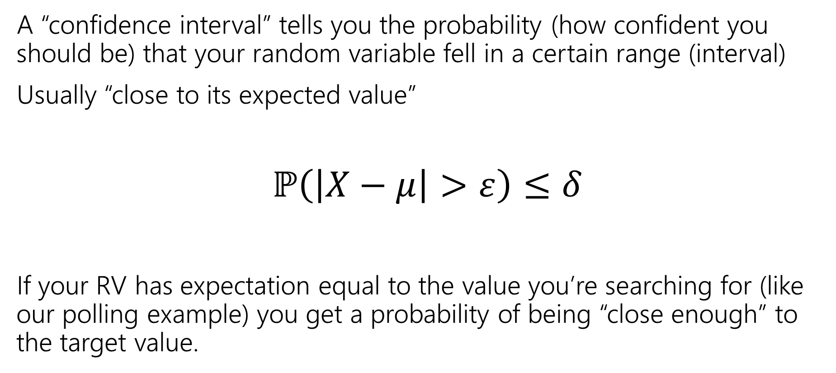
Confidence Intervals
A “confidence interval” tells you the probability (how confident you should be) that your random variable fell in a certain range (interval)
Usually “close to its expected value”
$ℙ\left(\left|X−μ\right|>ε\right)≤δ$
If your RV has expectation equal to the value you’re searching for (like our polling example) you get a probability of being “close enough” to the target value.

Slide 9
$ℙ\left(\left|X−μ\right|>ε\right)≤δ$
Notes:
Draw picture

Slide 10
Confidence Intervals
Using the CLT, we estimated the probability of “missing low”
There’s a few drawbacks though
1. Using the CLT we get an estimate, not a guarantee---what if the CLT estimate is underestimating the probability of failure?
2. We needed to know the true value to do that computation---if we knew the true value, we wouldn’t run the poll!
Some algebra tricks can handle problem 2, but 1 really asks for a new tool; we’ll see concentration inequalities later this week.

Slide 11
Application: Idealized Polling

Slide 12
Polling
Our end goal is to answer the question “how many people do I need to poll to get an accurate sense of how the population is going to vote?”
That’s a weird question (it’ll require “going backwards” in the algebra) so first we’ll “go forwards” (given the poll size how accurate will we be?) to see what’s happening more clearly.

Slide 13
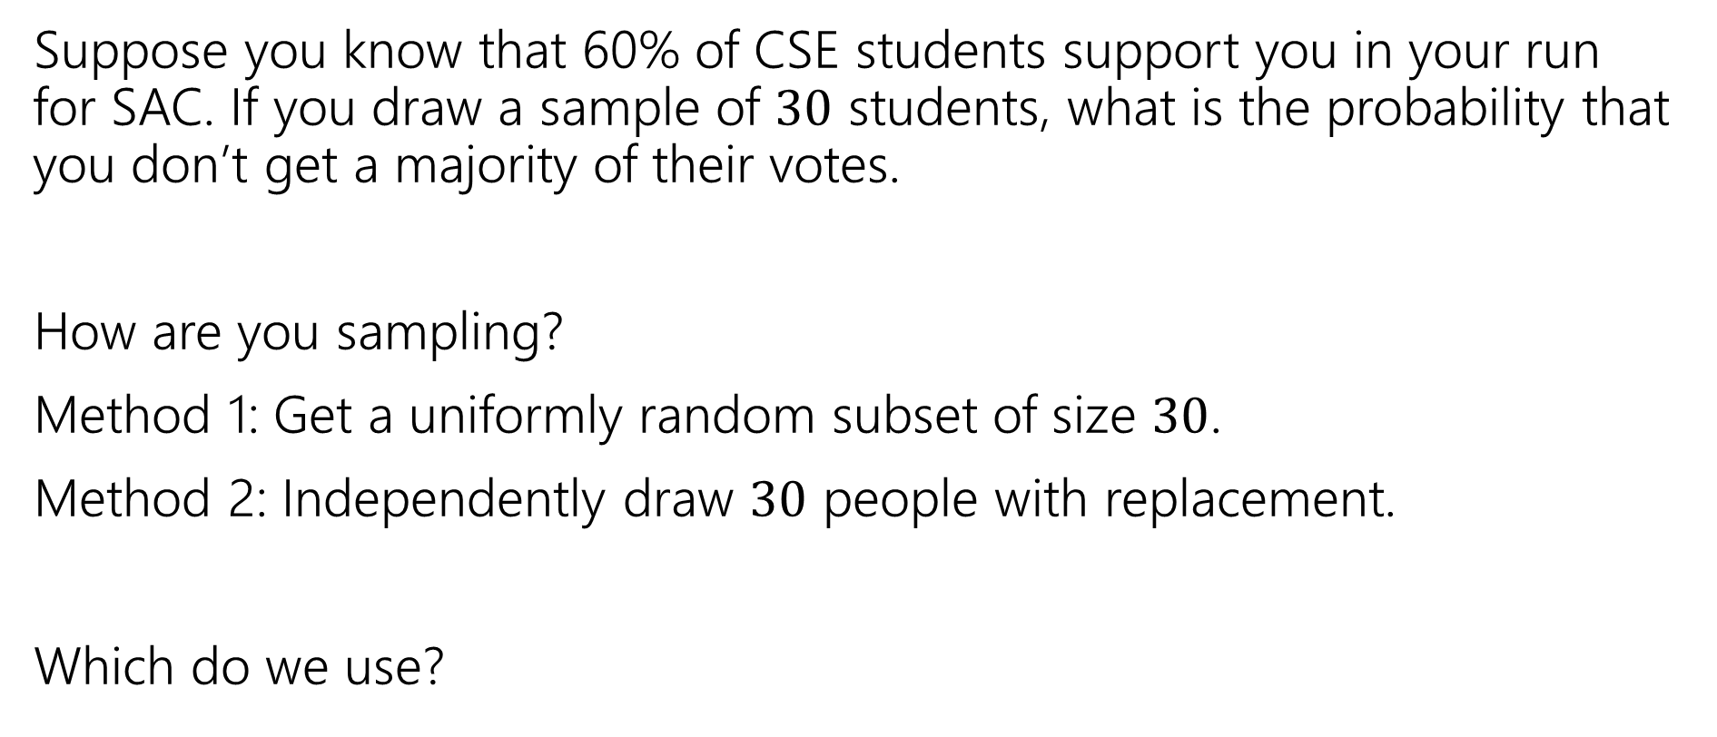
Polling
Suppose you know that 60% of CSE students support you in your run for SAC. If you draw a sample of $30$ students, what is the probability that you don’t get a majority of their votes.
How are you sampling?
Method 1: Get a uniformly random subset of size $30$.
Method 2: Independently draw $30$ people with replacement.
Which do we use?
Notes:
Method 1 is what’s accurate to what is actually done but we’re going to use the math from Method 2. This is because it makes our life way easier and CLT is already an approximation so this inaccuracy isn’t a deal breaker.

Slide 14
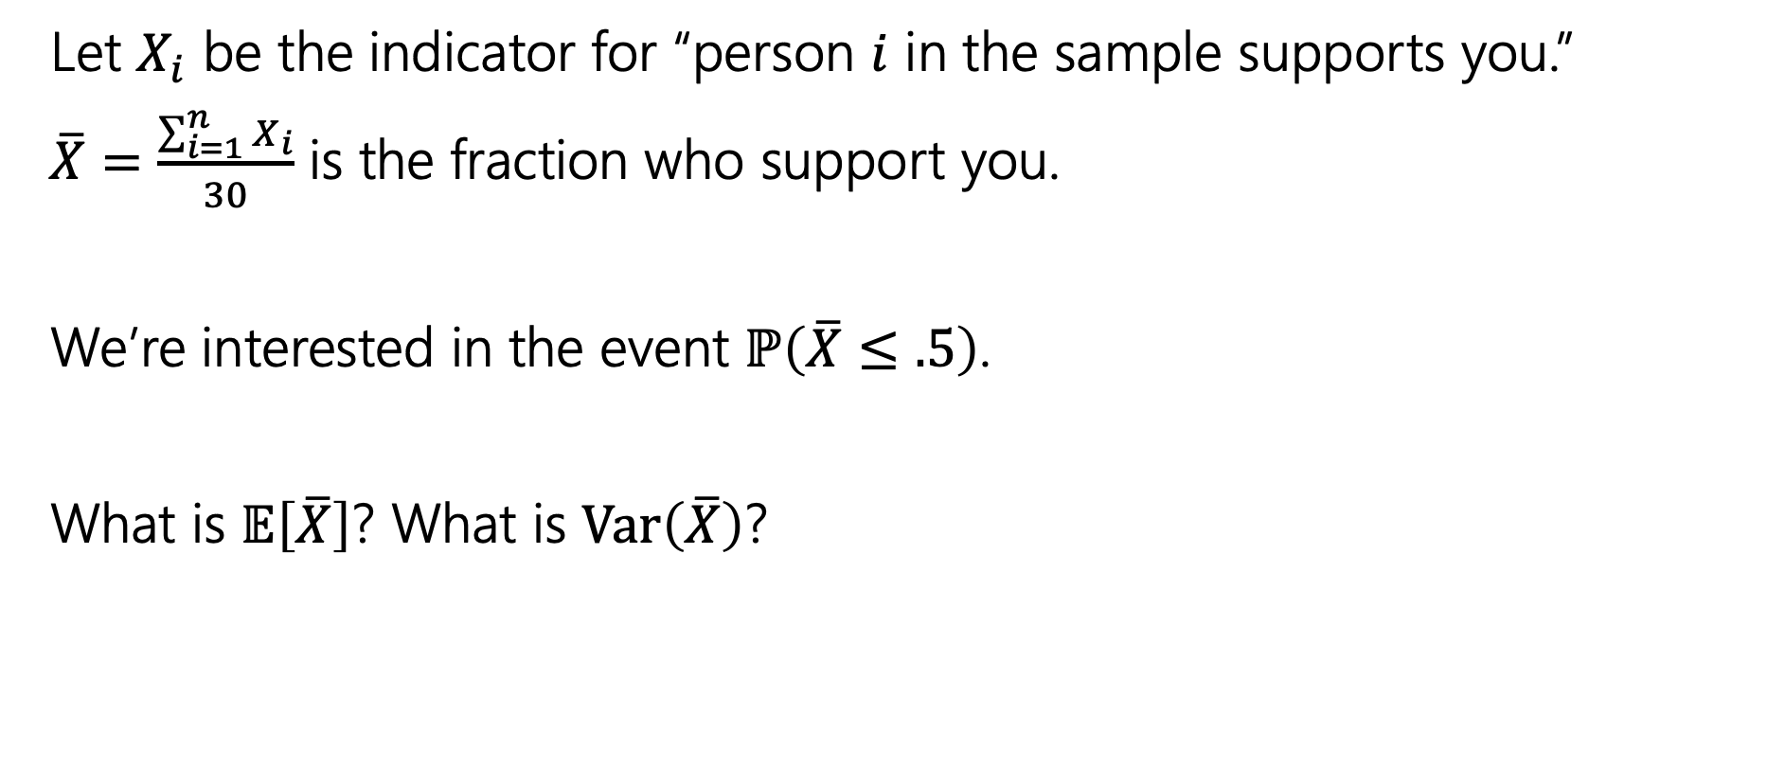
Polling
Let $X_{i}$ be the indicator for “person $i$ in the sample supports you.”
$\overline{X}=\frac{\sum_{i=1}^{n}{X_{i}}}{30}$ is the fraction who support you.
We’re interested in the event $ℙ\left(\overline{X}≤.5\right)$.
What is $𝔼\left[\overline{X}\right]$? What is $Var\left(\overline{X}\right)$?

Slide 15
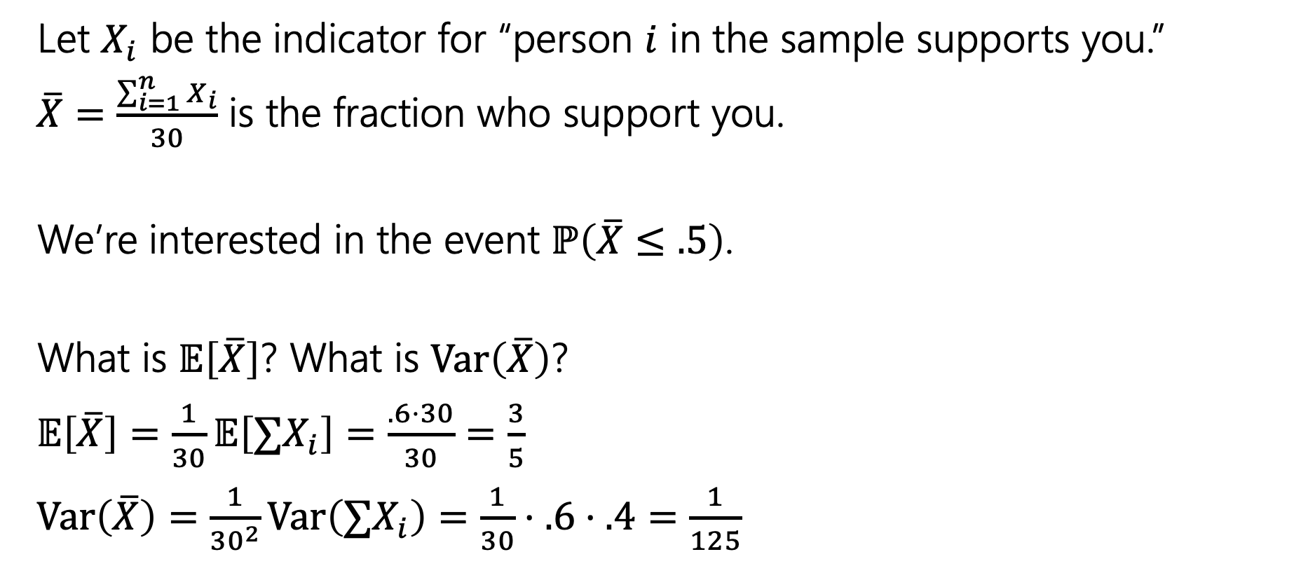
Polling
Let $X_{i}$ be the indicator for “person $i$ in the sample supports you.”
$\overline{X}=\frac{\sum_{i=1}^{n}{X_{i}}}{30}$ is the fraction who support you.
We’re interested in the event $ℙ\left(\overline{X}≤.5\right)$.
What is $𝔼\left[\overline{X}\right]$? What is $Var\left(\overline{X}\right)$?
$𝔼\left[\overline{X}\right]=\frac{1}{30}𝔼\left[{∑X}_{i}\right]=\frac{.6⋅30}{30}=\frac{3}{5}$
$Var\left(\overline{X}\right)=\frac{1}{{30}^{2}}Var\left(∑X_{i}\right)=\frac{1}{30}⋅.6⋅.4=\frac{1}{125}$

Slide 16

Using the CLT
$ℙ\left(\overline{X}≤.5\right)$
$=ℙ\left(\frac{\overline{X}−.6}{1/\sqrt{125}}≤\frac{.5−.6}{1/\sqrt{125}}\right)$
$≈ℙ\left(Y≤\frac{.5−.6}{1/\sqrt{125}}\right)$ where $Y\sim 𝒩(0,1)$
$≈ℙ(Y≤−1.12)$
$=Φ\left(−1.12\right)=1−Φ\left(1.12\right)≈1−0.86864=0.13136$

Slide 17
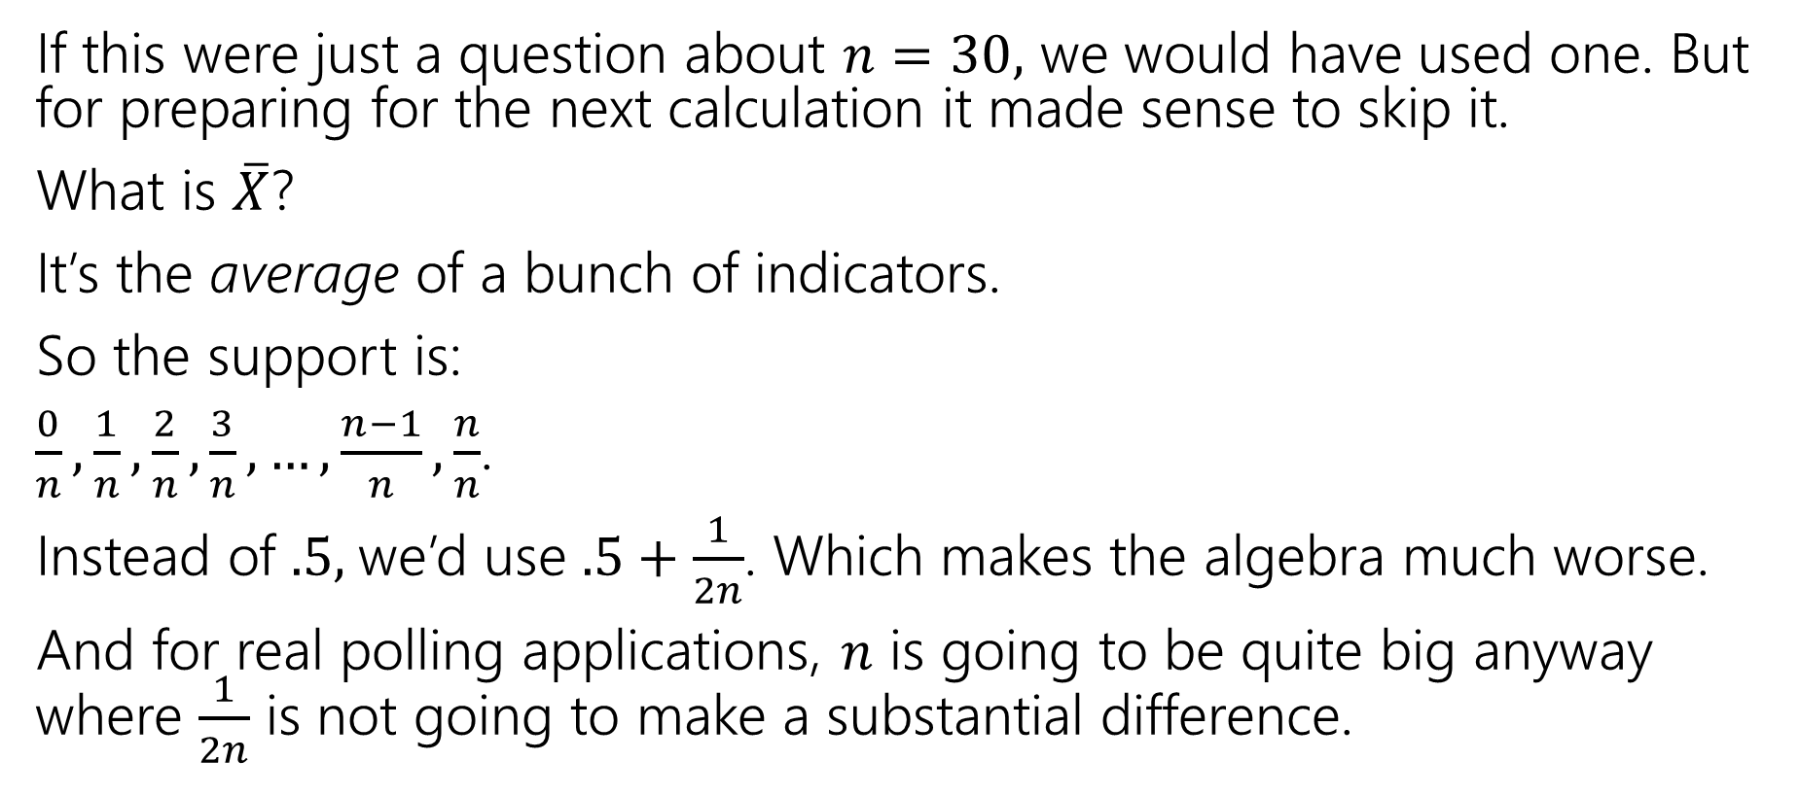
Hey! Where’s the continuity correction?
If this were just a question about $n=30,$ we would have used one. But for preparing for the next calculation it made sense to skip it.
What is $\overline{X}$?
It’s the average of a bunch of indicators.
So the support is:
$\frac{0}{n},\frac{1}{n},\frac{2}{n},\frac{3}{n},…,\frac{n−1}{n},\frac{n}{n}$.
Instead of $.5,$we’d use $.5+\frac{1}{2n}$. Which makes the algebra much worse.
And for real polling applications, $n$ is going to be quite big anyway where $\frac{1}{2n}$ is not going to make a substantial difference.

Slide 18
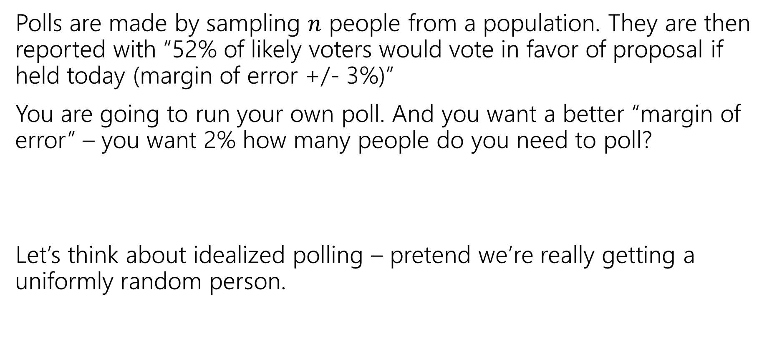
The Reverse Question
Polls are made by sampling $n$ people from a population. They are then reported with “52% of likely voters would vote in favor of proposal if held today (margin of error +/- 3%)”
You are going to run your own poll. And you want a better “margin of error” – you want 2% how many people do you need to poll?
Let’s think about idealized polling – pretend we’re really getting a uniformly random person.

Slide 19
Margin of Error
Wait…what’s a “margin of error”
The result of the poll is a random variable – it has a distribution.
You’d like to know something about its variance (Did you poll everyone in the entire country? Just 3 people? How much variance is there in the poll?)
A “margin of error” is an intuitive measurement of the variance of the poll. “If I performed this poll repeatedly, 95% of the time, we’re within true +/- the margin of error.”

Slide 20

Our Goal
Set a target – I want my margin of error to be $2\%$. That is, at least $95\%$ of the time, your poll’s estimate of the fraction of people in favor will be within $2$ percentage points of the true value.
So…how many people are you going to need to interview?

Slide 21
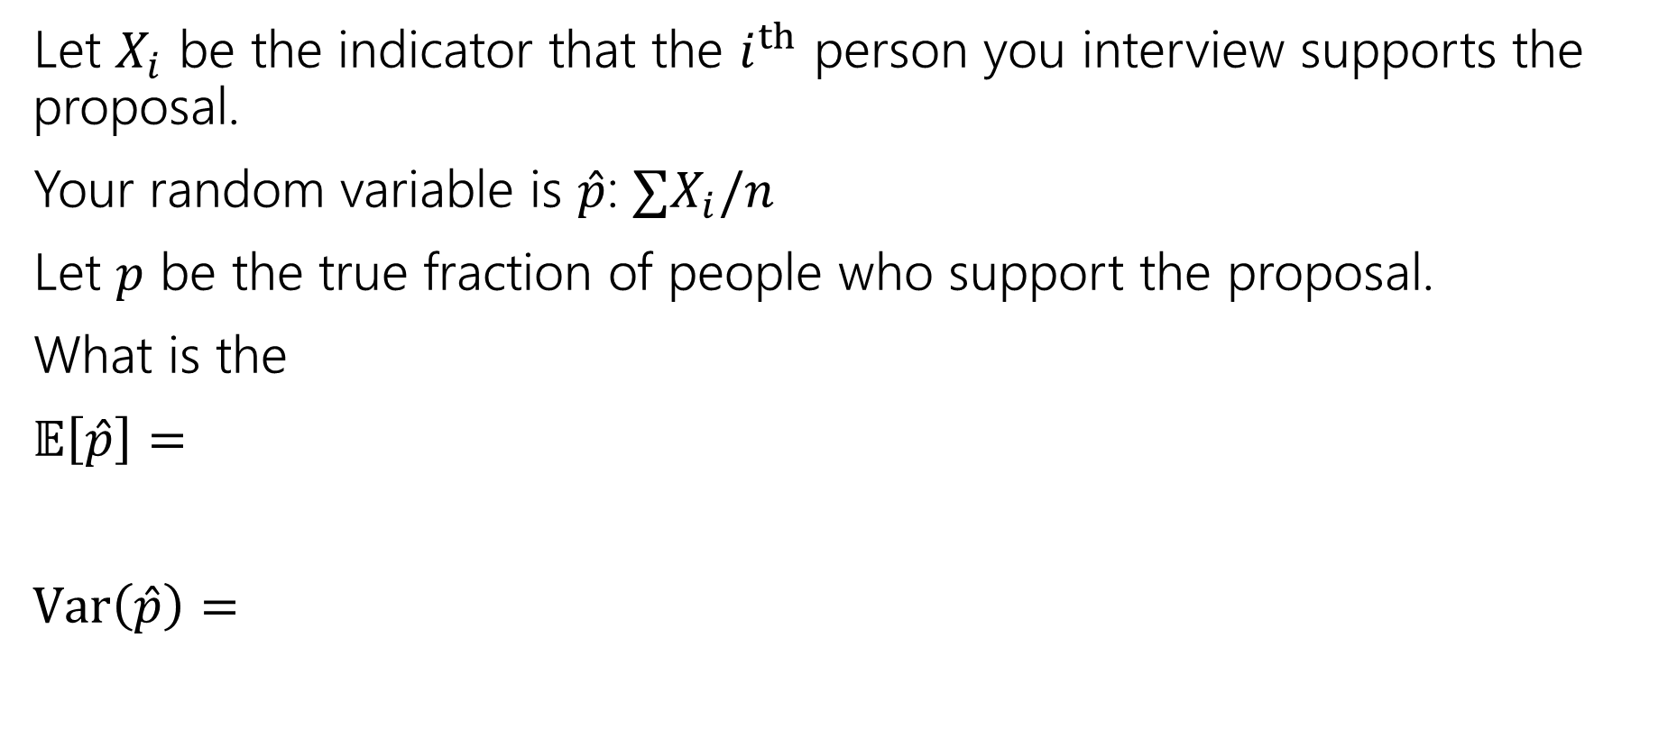
Poll Setup
Let $X_{i}$ be the indicator that the $i^{th}$ person you interview supports the proposal.
Your random variable is $\hat{p}$: $∑X_{i}/n$
Let $p$ be the true fraction of people who support the proposal.
What is the
$𝔼\left[\hat{p}\right]=$
$Var\left(\hat{p}\right)=$

Slide 22
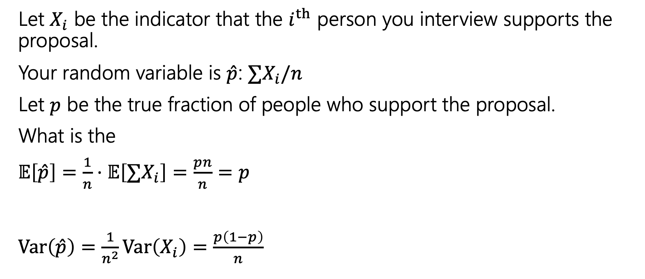
Poll Setup
Let $X_{i}$ be the indicator that the $i^{th}$ person you interview supports the proposal.
Your random variable is $\hat{p}$: $∑X_{i}/n$
Let $p$ be the true fraction of people who support the proposal.
What is the
$𝔼\left[\hat{p}\right]=\frac{1}{n}⋅𝔼\left[∑X_{i}\right]=\frac{pn}{n}=p$
$Var\left(\hat{p}\right)=\frac{1}{n^{2}}Var\left(X_{i}\right)=\frac{p\left(1−p\right)}{n}$

Slide 23
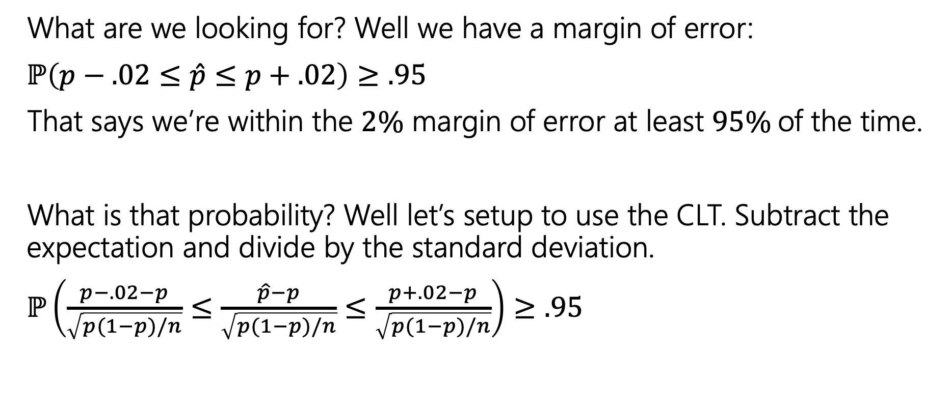
Using the CLT
What are we looking for? Well we have a margin of error:
$ℙ\left(p−.02≤\hat{p}≤p+.02\right)≥.95$
That says we’re within the $2\%$ margin of error at least $95\%$of the time.
What is that probability? Well let’s setup to use the CLT. Subtract the expectation and divide by the standard deviation.
$ℙ\left(\frac{p−.02−p}{\sqrt{p(1−p)/n}}≤\frac{\hat{p}−p}{\sqrt{p(1−p)/n}}≤\frac{p+.02−p}{\sqrt{p(1−p)/n}}\right)≥.95$

Slide 24
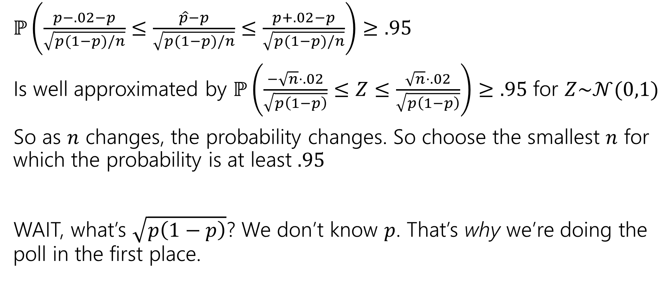
Apply the CLT
$ℙ\left(\frac{p−.02−p}{\sqrt{p(1−p)/n}}≤\frac{\hat{p}−p}{\sqrt{p(1−p)/n}}≤\frac{p+.02−p}{\sqrt{p(1−p)/n}}\right)≥.95$
Is well approximated by $ℙ\left(\frac{−\sqrt{n}⋅.02}{\sqrt{p\left(1−p\right)}}≤Z≤\frac{\sqrt{n}⋅.02}{\sqrt{p\left(1−p\right)}}\right)≥.95$ for $Z\sim 𝒩(0,1)$
So as $n$ changes, the probability changes. So choose the smallest $n$ for which the probability is at least $.95$
WAIT, what’s $\sqrt{p\left(1−p\right)}$? We don’t know $p$. That’s why we’re doing the poll in the first place.

Slide 25
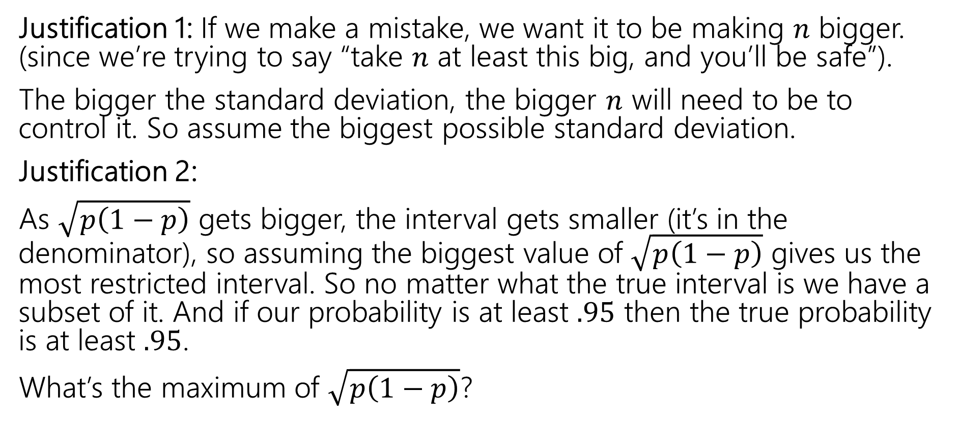

Handling $\sqrt{p\left(1−p\right)}$
Justification 1: If we make a mistake, we want it to be making $n$ bigger. (since we’re trying to say “take $n$ at least this big, and you’ll be safe”).
The bigger the standard deviation, the bigger $n$ will need to be to control it. So assume the biggest possible standard deviation.
Justification 2:
As $\sqrt{p\left(1−p\right)}$ gets bigger, the interval gets smaller (it’s in the denominator), so assuming the biggest value of $\sqrt{p\left(1−p\right)}$ gives us the most restricted interval. So no matter what the true interval is we have a subset of it. And if our probability is at least $.95$ then the true probability is at least $.95$.
What’s the maximum of $\sqrt{p\left(1−p\right)}$?

Slide 26
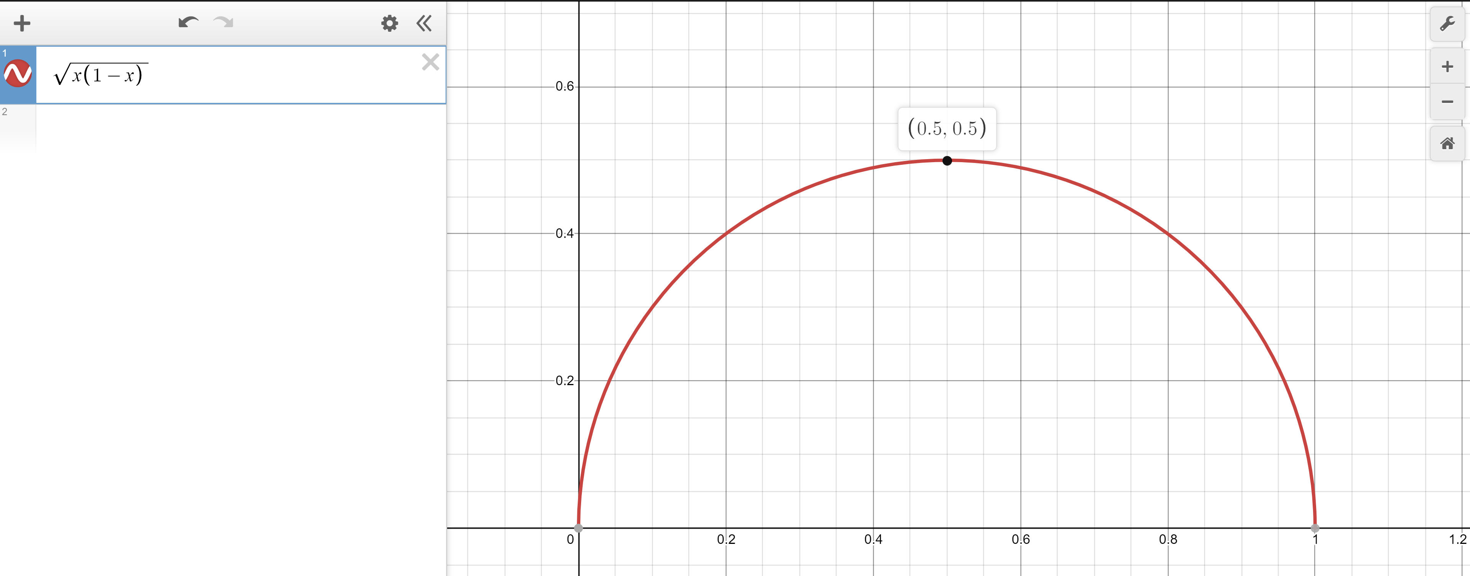
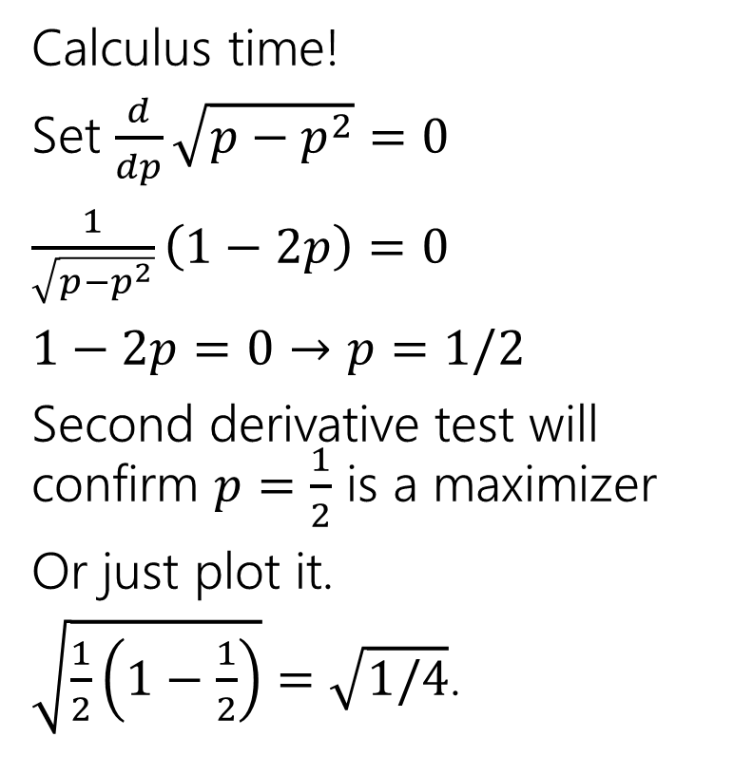

Worst value of $p$
Calculus time!
Set $\frac{d}{dp}\sqrt{p−p^{2}}=0$
$\frac{1}{\sqrt{p−p^{2}}}\left(1−2p\right)=0$
$1−2p=0$ $→p=1/2$
Second derivative test will confirm $p=\frac{1}{2}$ is a maximizer
Or just plot it.
$\sqrt{\frac{1}{2}\left(1−\frac{1}{2}\right)}=\sqrt{1/4}$.

Slide 27
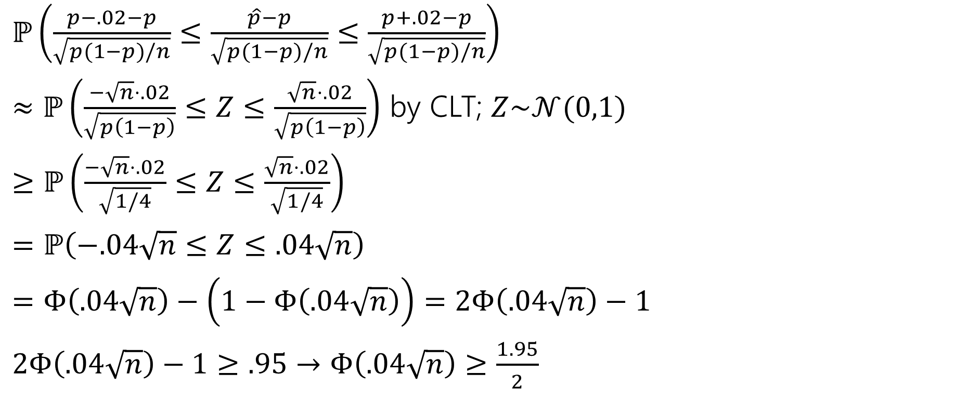
Doing the algebra
$ℙ\left(\frac{p−.02−p}{\sqrt{p(1−p)/n}}≤\frac{\hat{p}−p}{\sqrt{p(1−p)/n}}≤\frac{p+.02−p}{\sqrt{p(1−p)/n}}\right)$
$≈ℙ\left(\frac{−\sqrt{n}⋅.02}{\sqrt{p\left(1−p\right)}}≤Z≤\frac{\sqrt{n}⋅.02}{\sqrt{p\left(1−p\right)}}\right)$ by CLT; $Z\sim 𝒩(0,1)$
$≥ℙ\left(\frac{−\sqrt{n}⋅.02}{\sqrt{1/4}}≤Z≤\frac{\sqrt{n}⋅.02}{\sqrt{1/4}}\right)$
$=ℙ\left(−.04\sqrt{n}≤Z≤.04\sqrt{n}\right)$
$=Φ\left(.04\sqrt{n}\right)−\left(1−Φ\left(.04\sqrt{n}\right)\right)=2Φ\left(.04\sqrt{n}\right)−1$
$2Φ\left(.04\sqrt{n}\right)−1≥.95$ $→$ $Φ\left(.04\sqrt{n}\right)≥\frac{1.95}{2}$

Slide 28
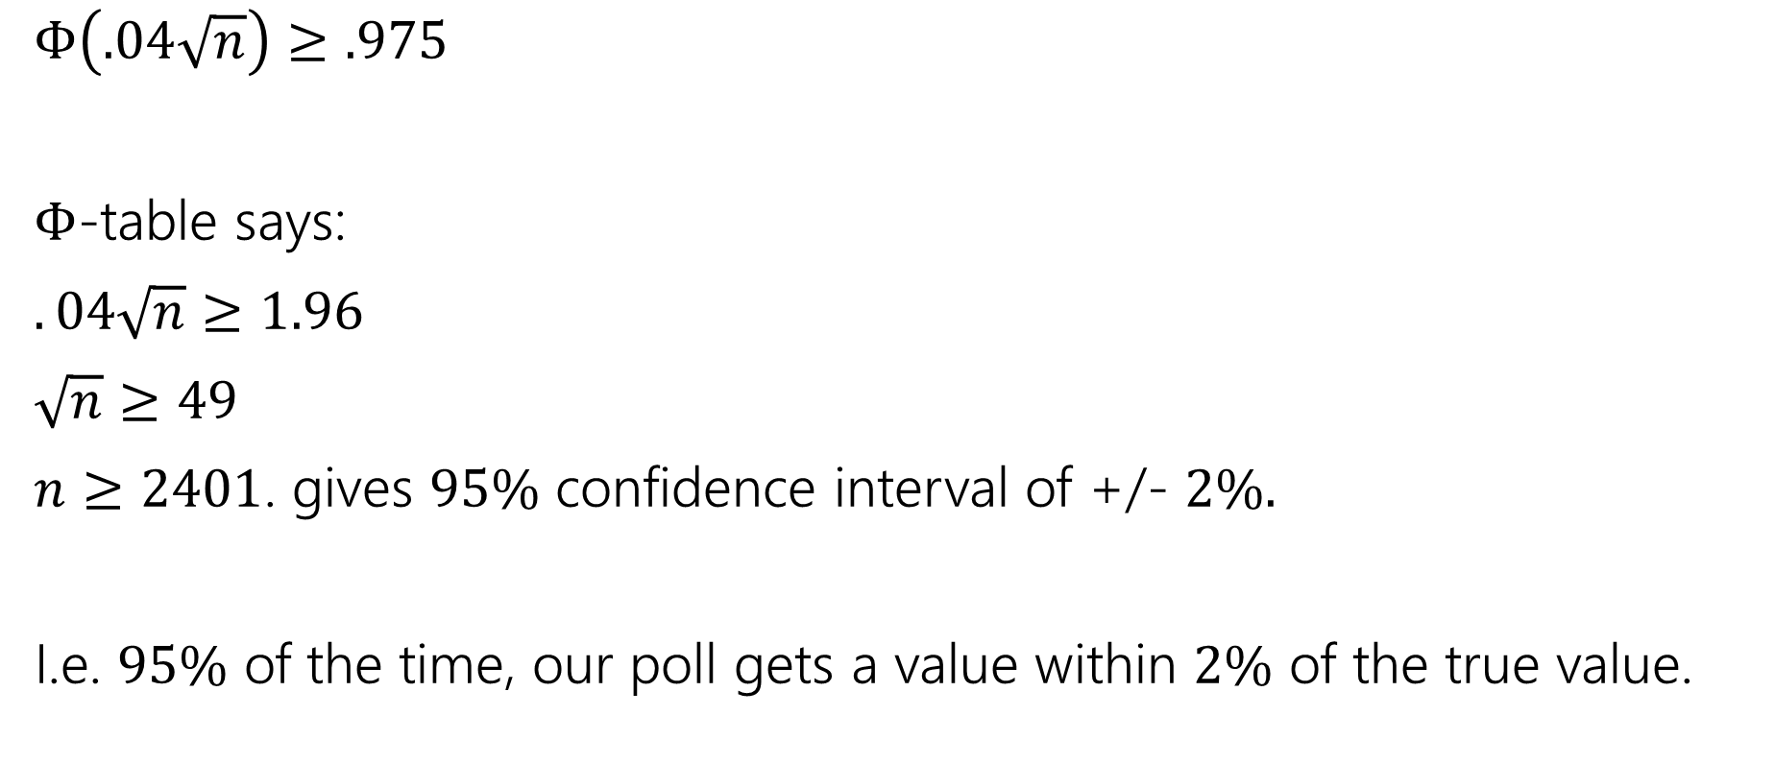

Using the $Φ$-table
$Φ\left(.04\sqrt{n}\right)≥.975$
$Φ$-table says:
$.04\sqrt{n}≥1.96$
$\sqrt{n}≥49$
$n≥2401$. gives $95\%$ confidence interval of +/- $2\%.$
I.e. $95\%$ of the time, our poll gets a value within $2\%$ of the true value.

Slide 29
Multiple Random Variables

Slide 30
This part of lecture and next lecture
Somewhat out-of-place content.
When we introduced multiple random variables, we’ve always had them be independent.
Because it’s hard to deal with non-independent random variables.
Today and Wednesday are a crash-course in the toolkit for when you have multiple random variables and they aren’t independent.
Going to focus on discrete RVs, we’ll talk about continuous at the end.

Slide 31

Joint PMF, support
For two (discrete) random variables $X,Y$their joint pmf
$p_{X,Y}\left(x,y\right)=ℙ(X=x∩Y=y)$
When $X,Y$ are independent then $p_{X,Y}\left(x,y\right)=p_{X}\left(x\right)p_{Y}(y)$.

Slide 32
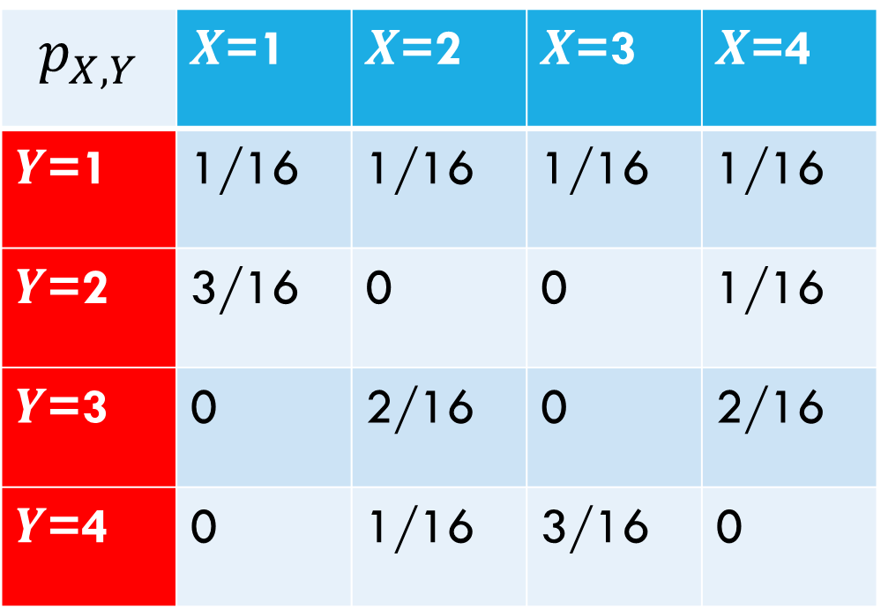
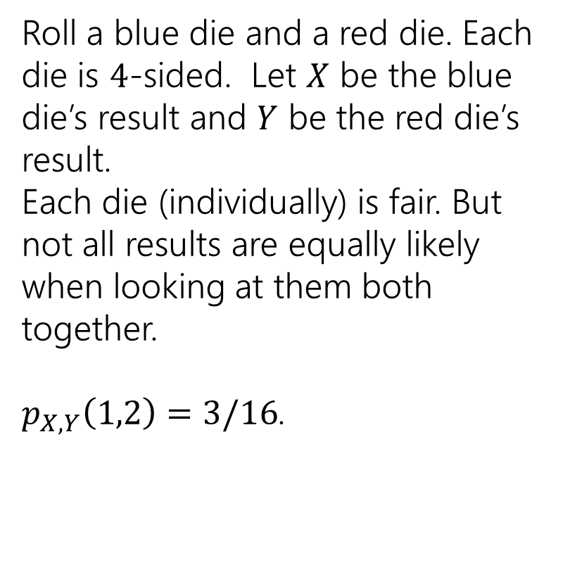
Examples
$$p_{X,Y}$$ | $X$=1 | $X$=2 | $X$=3 | $X$=4
$Y$=1 | 1/16 | 1/16 | 1/16 | 1/16
$Y$=2 | 3/16 | 0 | 0 | 1/16
$Y$=3 | 0 | 2/16 | 0 | 2/16
$Y$=4 | 0 | 1/16 | 3/16 | 0
Roll a blue die and a red die. Each die is $4$-sided. Let $X$ be the blue die’s result and $Y$ be the red die’s result.
Each die (individually) is fair. But not all results are equally likely when looking at them both together.
$p_{X,Y}\left(1,2\right)=3/16$.
Notes:
This is the join pmf in table form
If we want to just talk about X we would have to think about X and Y together to figure that out. So if we wanted to find the probability that X takes on the value 2, that would be the sum of the column. These are disjoint events, so we can just add them. This gives us the marginal distribution of X, this is the same as was we’ve been calling the regular PMF of X, but its called marginal because people would write it in the margins of these column and it reminds us that we derived it from a joint distribution.

Slide 33
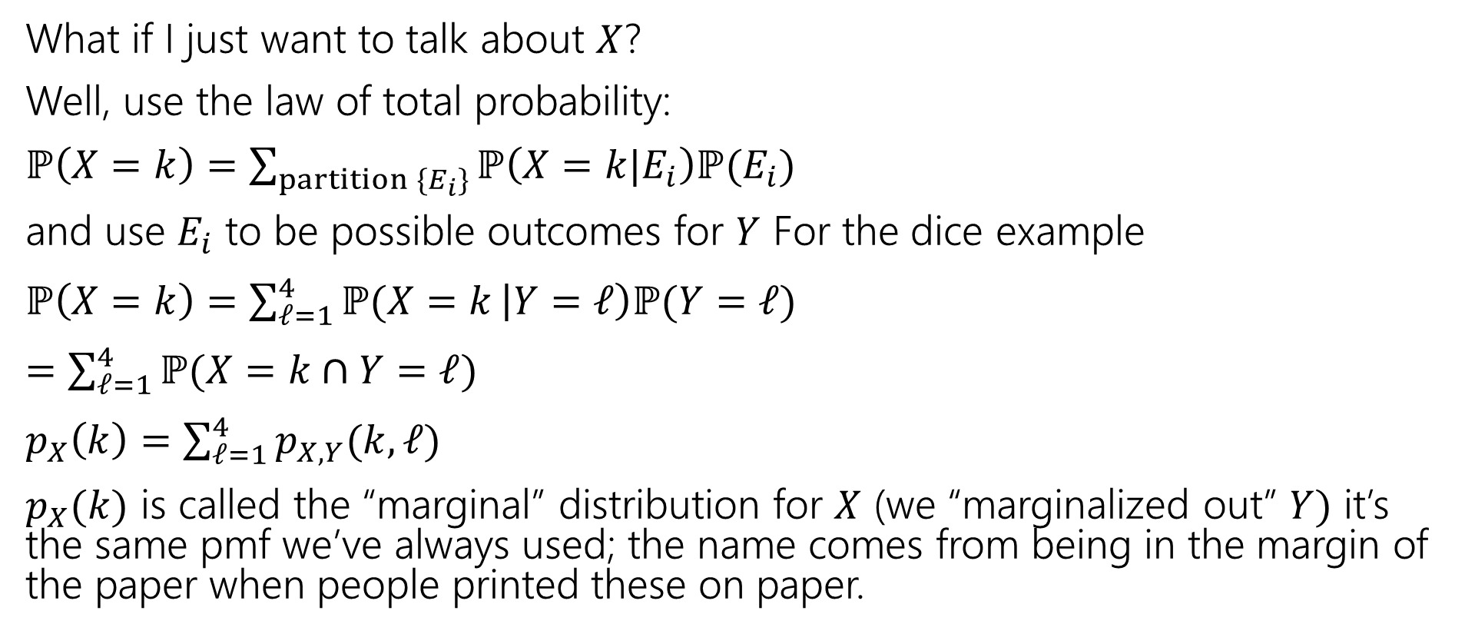
Marginals
What if I just want to talk about $X$?
Well, use the law of total probability:
$ℙ\left(X=k\right)=\sum_{partition \{E_{i}\}}{ℙ\left(X=k|E_{i}\right)ℙ(E_{i})}$
and use $E_{i}$ to be possible outcomes for $Y$ For the dice example
$ℙ\left(X=k\right)=\sum_{ℓ=1}^{4}{ℙ(X=k}\left|Y=ℓ\right)ℙ(Y=ℓ)$
$=\sum_{ℓ=1}^{4}{ℙ(X=k}∩Y=ℓ)$
$p_{X}\left(k\right)=\sum_{ℓ=1}^{4}{p_{X,Y}(k,ℓ)}$
$p_{X}(k)$ is called the “marginal” distribution for $X$ (we “marginalized out” $Y)$ it’s the same pmf we’ve always used; the name comes from being in the margin of the paper when people printed these on paper.

Slide 34
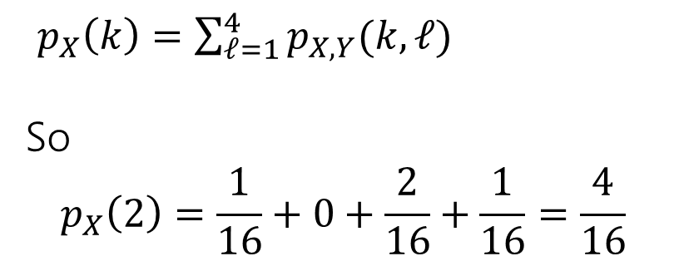
Marginals
$$p_{X,Y}$$ | $X$=1 | $X$=2 | $X$=3 | $X$=4
$Y$=1 | 1/16 | 1/16 | 1/16 | 1/16
$Y$=2 | 3/16 | 0 | 0 | 1/16
$Y$=3 | 0 | 2/16 | 0 | 2/16
$Y$=4 | 0 | 1/16 | 3/16 | 0
$p_{X}\left(k\right)=\sum_{ℓ=1}^{4}{p_{X,Y}(k,ℓ)}$
So
$$p_{X}\left(2\right)=\frac{1}{16}+0+\frac{2}{16}+\frac{1}{16}=\frac{4}{16}$$

Slide 35
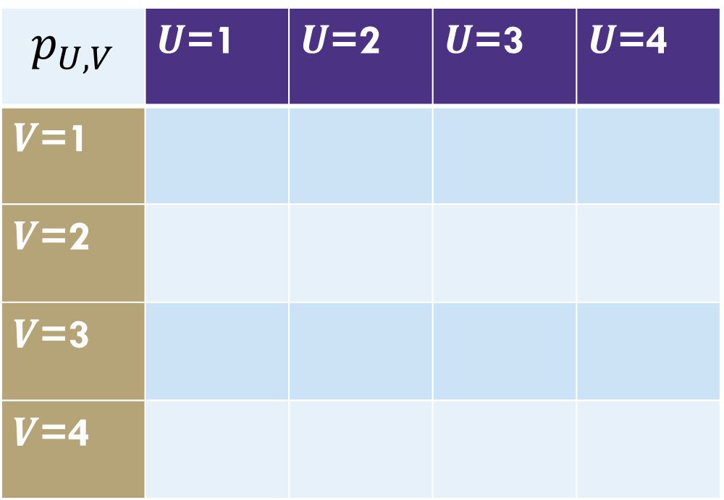
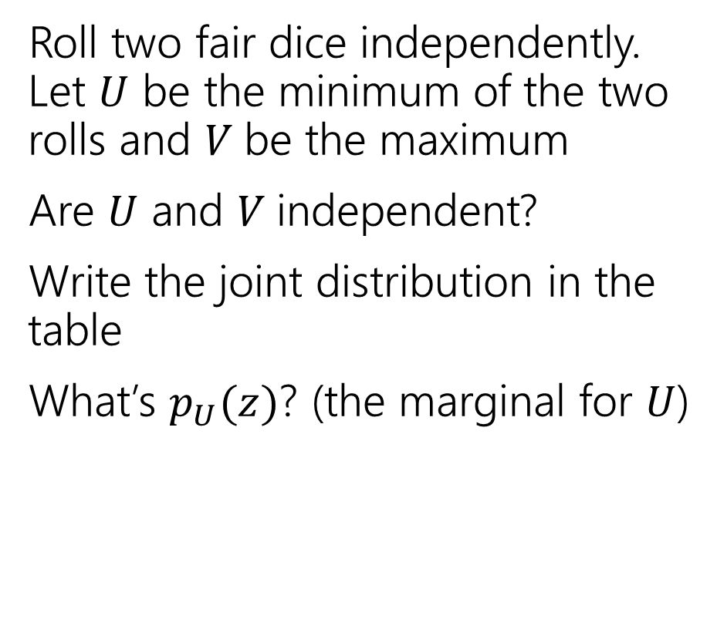
Different dice
Roll two fair dice independently. Let $U$ be the minimum of the two rolls and $V$be the maximum
Are $U$ and $V$independent?
Write the joint distribution in the table
What’s $p_{U}(z)$? (the marginal for $U$)
$$p_{U,V}$$ | $U$=1 | $U$=2 | $U$=3 | $U$=4
$V$=1
$V$=2
$V$=3
$V$=4

Slide 36
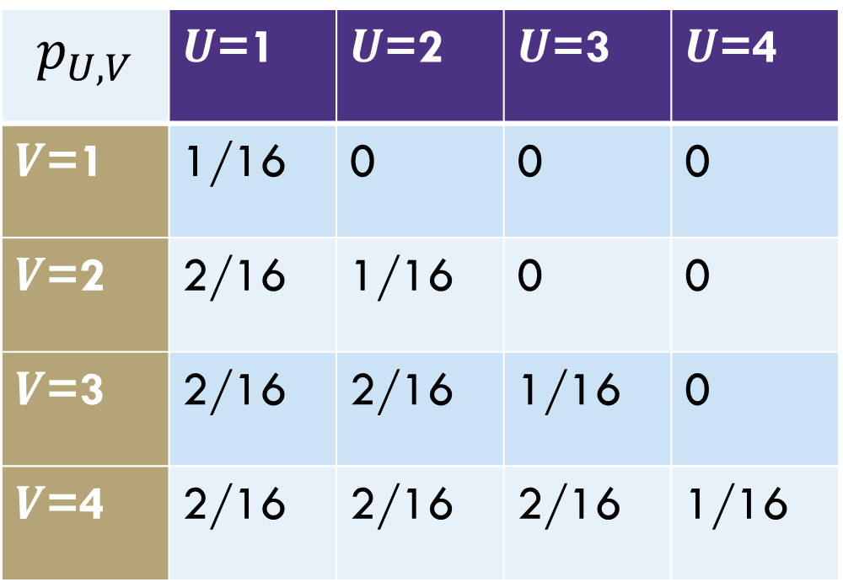
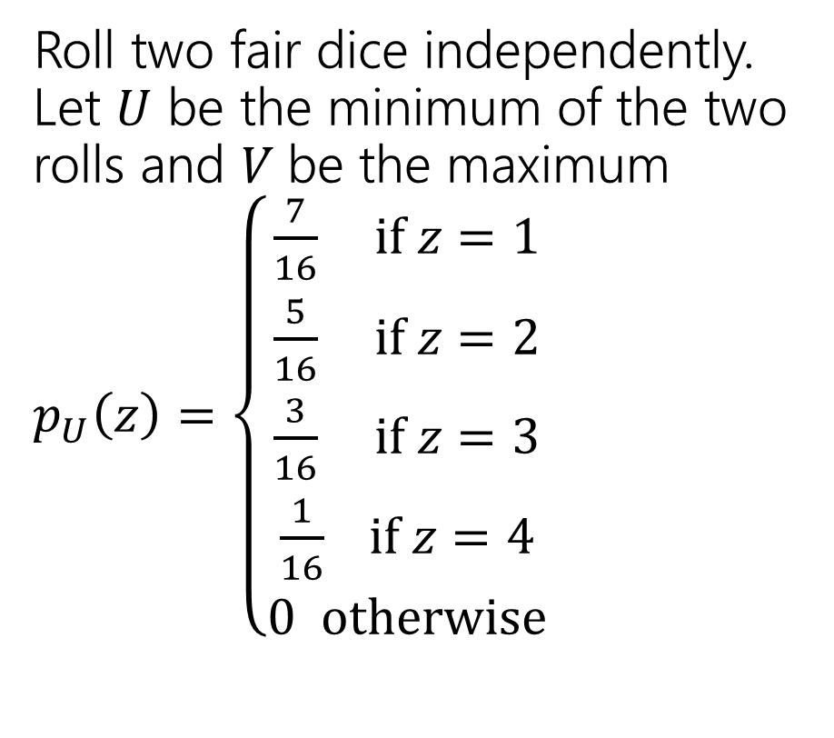
Different dice
Roll two fair dice independently. Let $U$ be the minimum of the two rolls and $V$be the maximum
$p_{U}\left(z\right)=\left\{\begin{aligned}\frac{7}{16} if z=1 \\ \frac{5}{16} if z=2 \\ \frac{3}{16} if z=3 \\ \frac{1}{16} if z=4 \\ 0 otherwise\end{aligned}\right.$
$$p_{U,V}$$ | $U$=1 | $U$=2 | $U$=3 | $U$=4
$V$=1 | 1/16 | 0 | 0 | 0
$V$=2 | 2/16 | 1/16 | 0 | 0
$V$=3 | 2/16 | 2/16 | 1/16 | 0
$V$=4 | 2/16 | 2/16 | 2/16 | 1/16

Slide 37
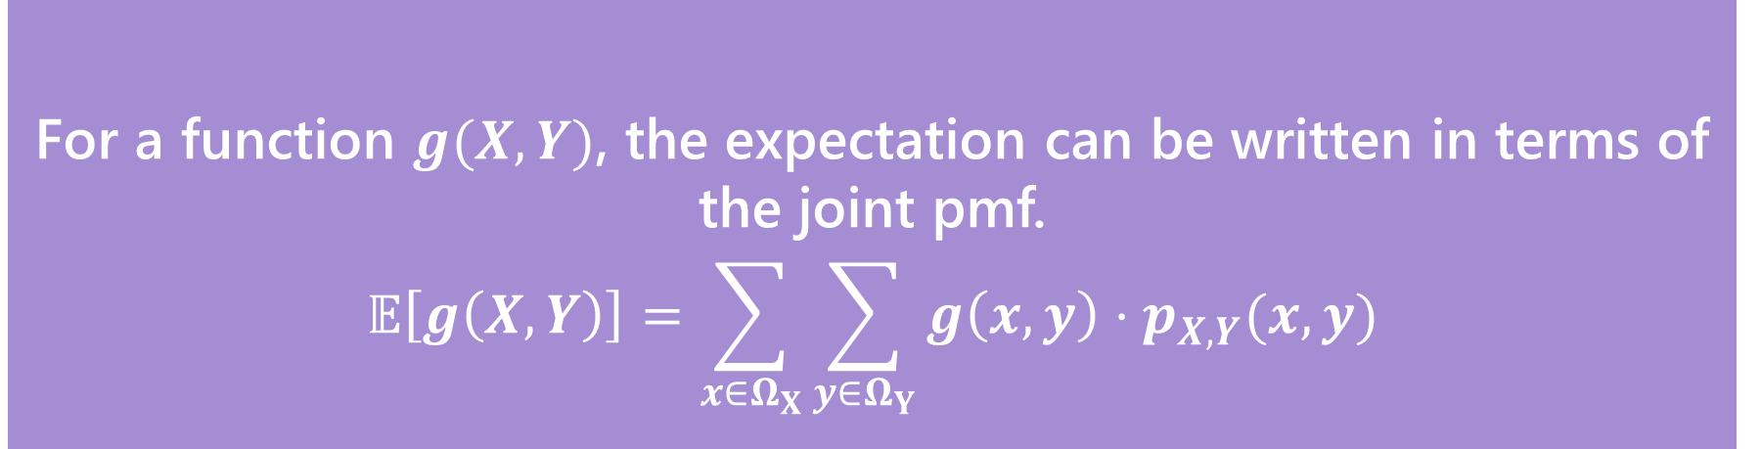

Joint Expectation
For a function $g(X,Y)$, the expectation can be written in terms of the joint pmf.
$$𝔼\left[g\left(X,Y\right)\right]=\sum_{x∈Ω_{X}}{\sum_{y∈Ω_{Y}}{g\left(x,y\right)⋅p_{X,Y}(x,y)}}$$
Expectations of joint functions
This definition hopefully isn’t surprising at this point (it’s the value of $g$ times the probability $g$ takes on that value), but it’s good to see.

Slide 38

Expectation of a function of two RVs
What’s $𝔼[UV]$ for $U,V$ from the last slide?

Slide 39
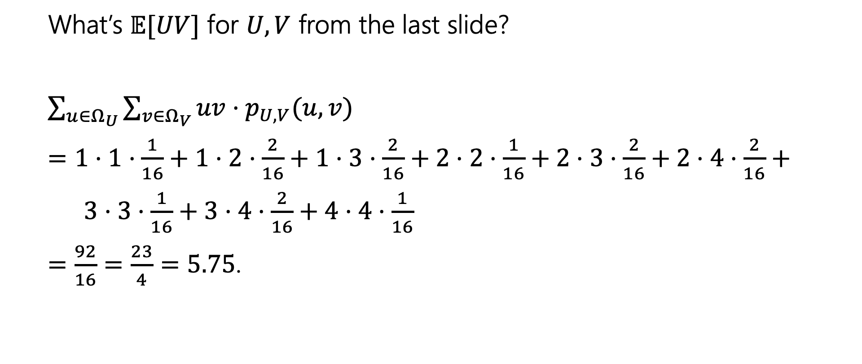
Expectation of a function of two RVs
What’s $𝔼[UV]$ for $U,V$ from the last slide?
$\sum_{u∈Ω_{U}}{\sum_{v∈Ω_{V}}{uv⋅p_{U,V}(u,v)}}$
$=1⋅1⋅\frac{1}{16}+1⋅2⋅\frac{2}{16}+1⋅3⋅\frac{2}{16}+2⋅2⋅\frac{1}{16}+2⋅3⋅\frac{2}{16}+2⋅4⋅\frac{2}{16}+$
$3⋅3⋅\frac{1}{16}+3⋅4⋅\frac{2}{16}+4⋅4⋅\frac{1}{16}$
$=\frac{92}{16}=\frac{23}{4}=5.75$.

