Slide 1
Normal RVs
CSE 312 Summer 25
Lecture 15

Slide 2
Announcements
Homework 4 due today
Homework 5 out today
Midterm overview at 1:15pm tomorrow in Gates 371
One-on-one office hours
Quiz 5 on Friday

Slide 3
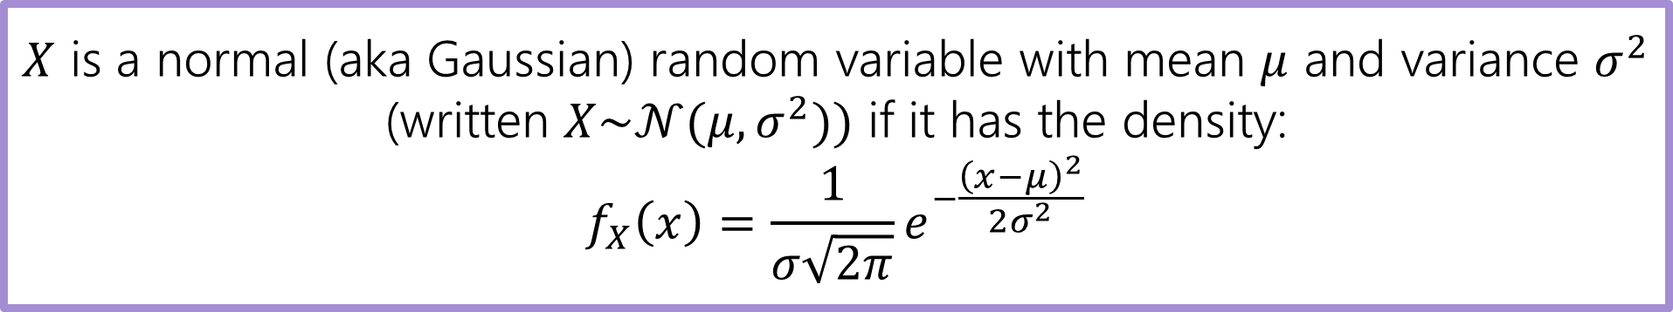
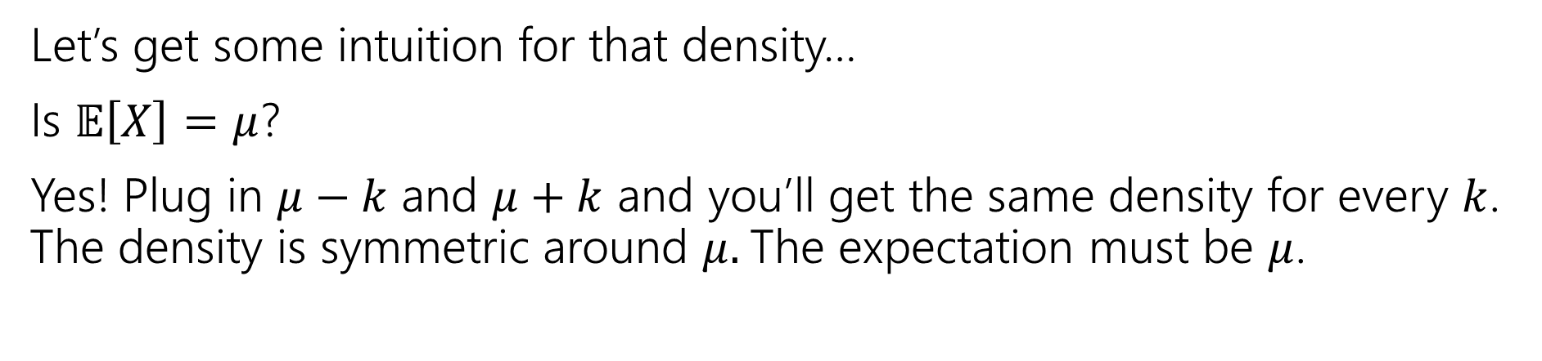
Normal Random Variable
$X$ is a normal (aka Gaussian) random variable with mean $μ$ and variance $σ^{2}$ (written $X\sim 𝒩(μ,σ^{2}))$ if it has the density:
$$f_{X}\left(x\right)=\frac{1}{σ\sqrt{2π}}e^{−\frac{{\left(x−μ\right)}^{2}}{2σ^{2}}}$$
Let’s get some intuition for that density…
Is $𝔼\left[X\right]=μ$?
Yes! Plug in $μ−k$ and $μ+k$ and you’ll get the same density for every $k$. The density is symmetric around $μ.$The expectation must be $μ$.

Slide 4
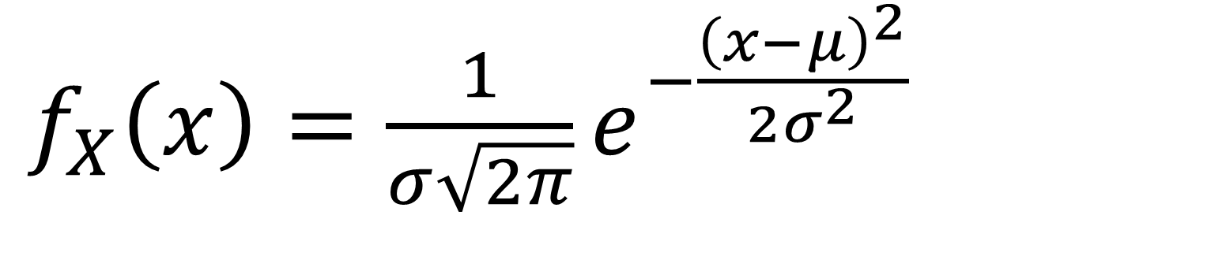
Breaking down the density
$f_{X}\left(x\right)=\frac{1}{σ\sqrt{2π}}e^{−\frac{{\left(x−μ\right)}^{2}}{2σ^{2}}}$
Notes:
Constant 1 / sigma sqrt(2 pi) makes sure when we integrate we get 1
e to the negative power, means we expect exponential decay
x minus mu squared says exponential decay is fast as you move away from the mean, and in either direction
/2 sigma squared controls the rate at which decay occurs (if variance is larger, you decay slower)

Slide 5
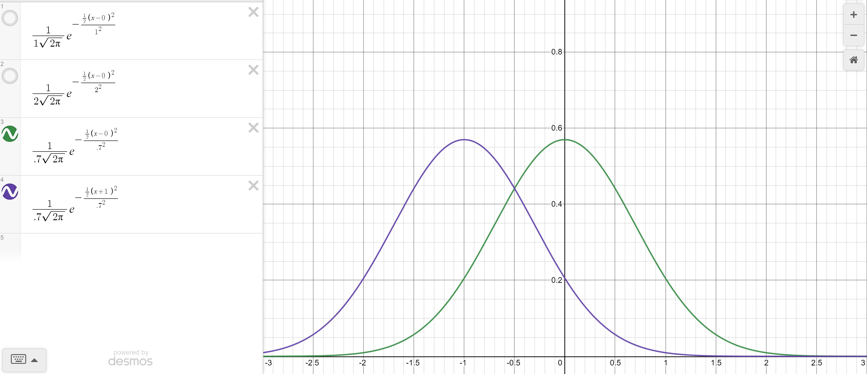

Changing the mean
Green: $σ^{2}=.7, μ=0$
Purple $σ^{2}=.7, μ=−1$

Slide 6
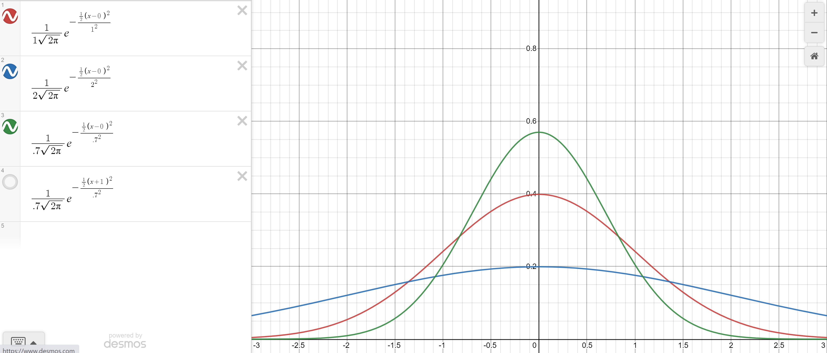

Changing the variance
Green: $σ^{2}=.7$
Red $σ^{2}=1$
Blue: $σ^{2}=2$

Slide 7
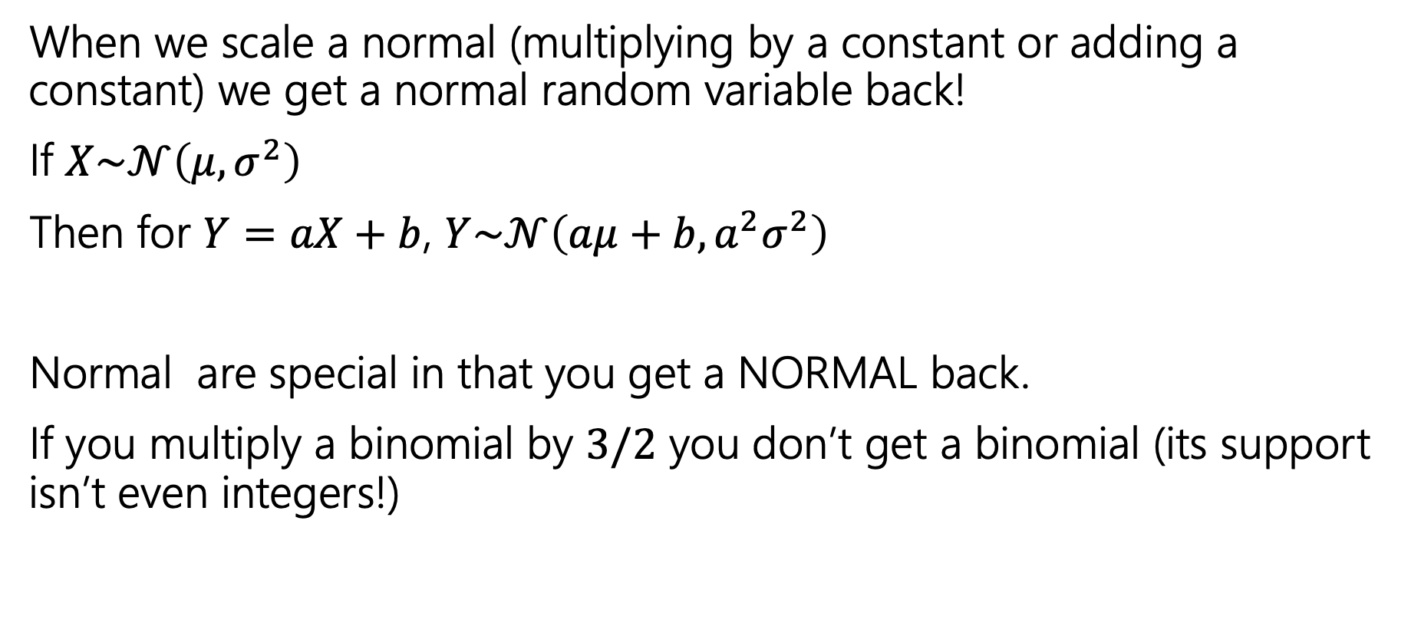
Scaling Normal Random Variables
When we scale a normal (multiplying by a constant or adding a constant) we get a normal random variable back!
If $X\sim 𝒩\left(μ,σ^{2}\right)$
Then for $Y=aX+b$, $Y\sim 𝒩\left(aμ+b, a^{2}σ^{2}\right)$
Normal are special in that you get a NORMAL back.
If you multiply a binomial by $3/2$ you don’t get a binomial (its support isn’t even integers!)

Slide 8
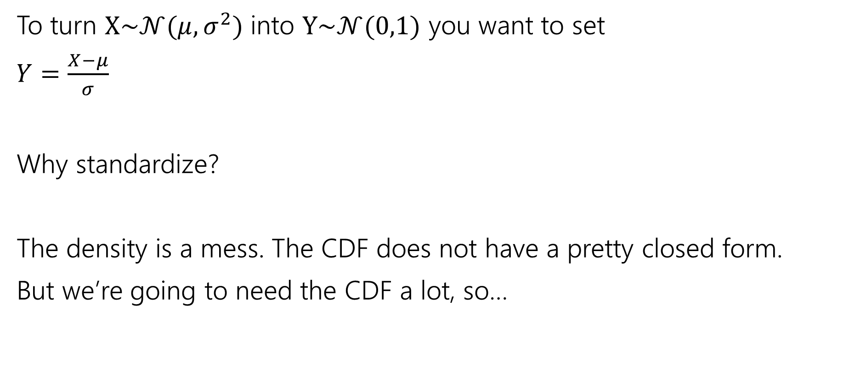
Standardize
To turn $X\sim 𝒩(μ,σ^{2})$ into $Y\sim 𝒩(0,1)$ you want to set
$Y=\frac{X−μ}{σ}$
Why standardize?
The density is a mess. The CDF does not have a pretty closed form.
But we’re going to need the CDF a lot, so…
Notes:
You’ll be tempted to say “normalize” because normal means….normal. But we really want to say “standardize” the “standard” one has mean 0 variance 1.
Walk through the expectation and variance of Y. Explain sigma vs sigma squared

Slide 9
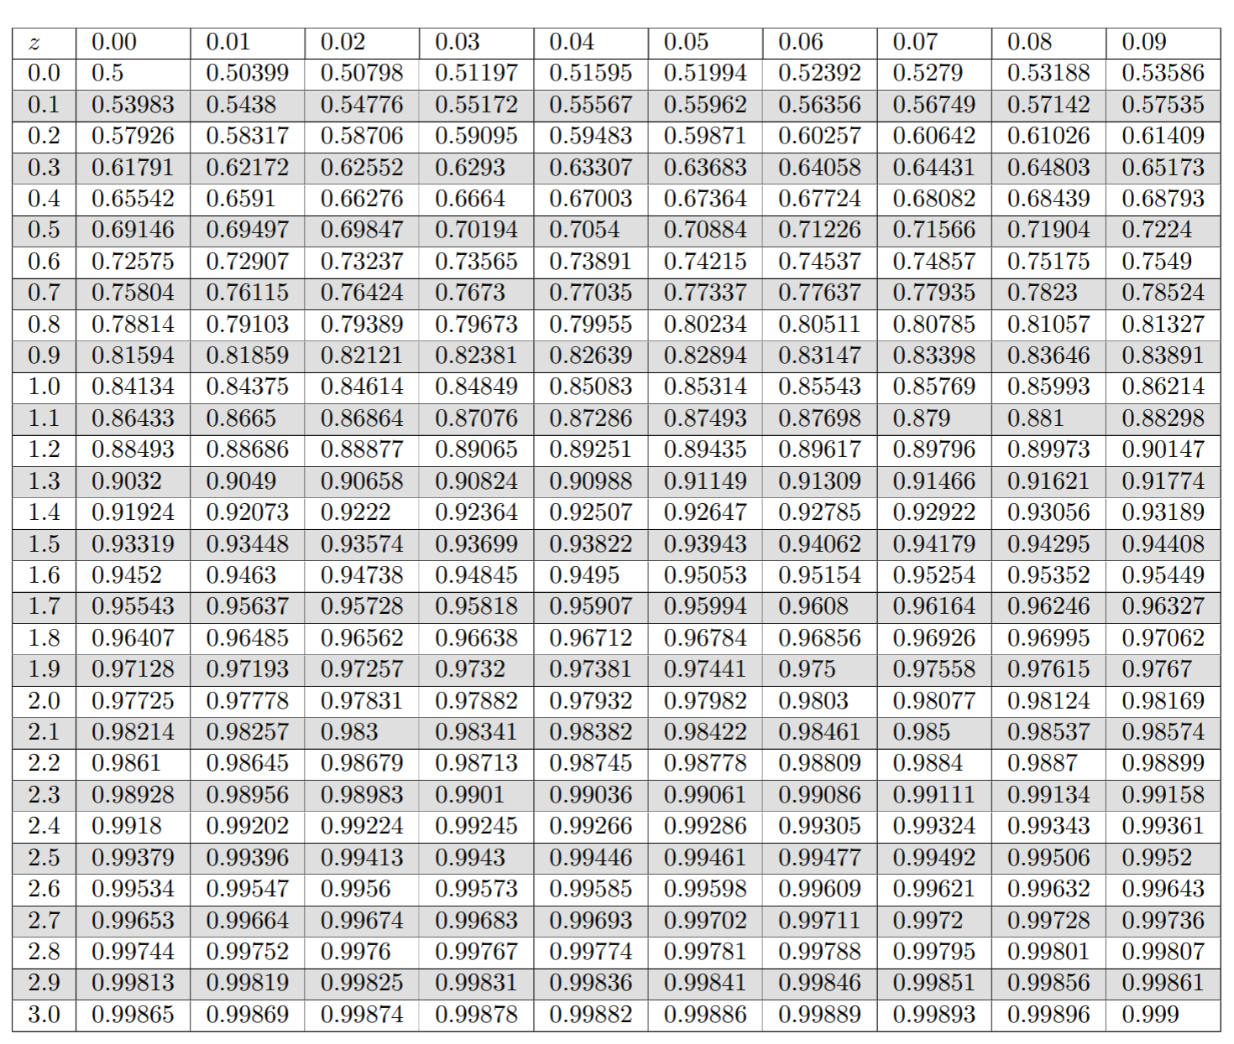
Table of Standard Normal CDF
The way we’ll evaluate the CDF of a normal is to:
1. convert to a standard normal
2. Round the “z-score” to the hundredths place.
3. Look up the value in the table.
It’s 2025, we’re using a table?
The table makes sure we have consistent rounding rules (makes it easier for us to debug with you).
You can’t evaluate this by hand – the “z-score” can give you intuition right away.

Slide 10
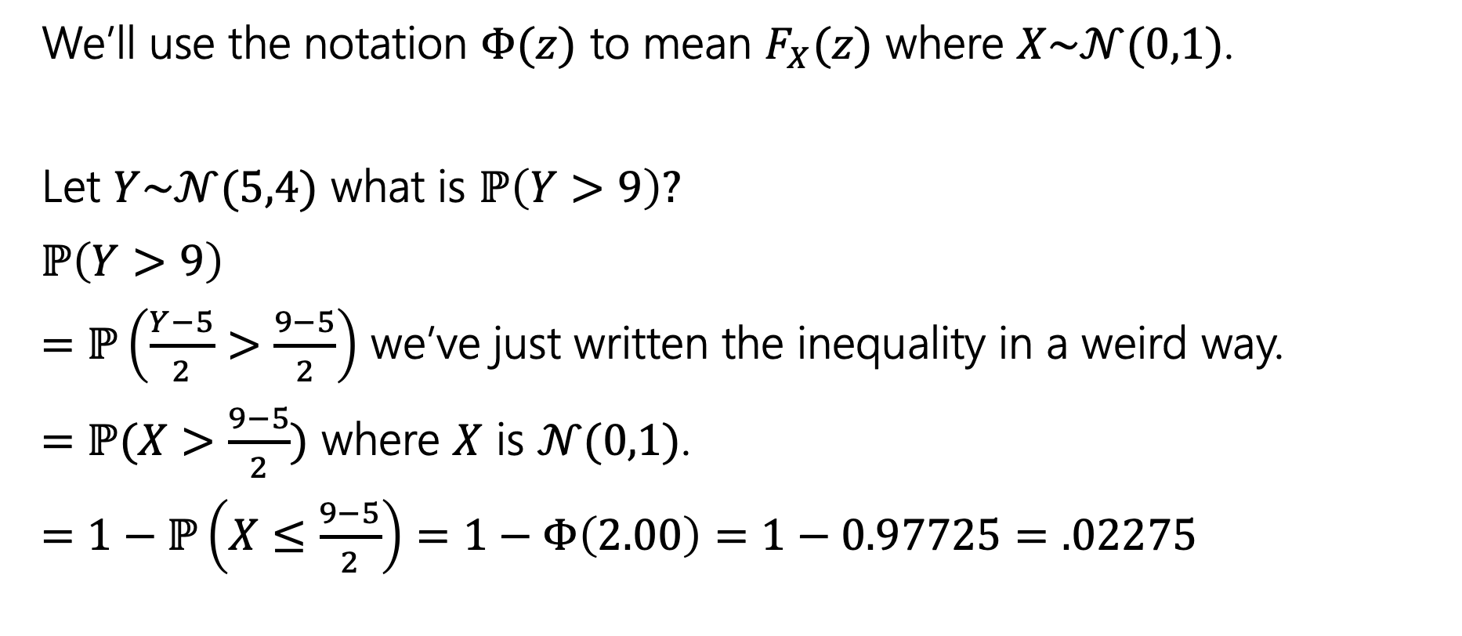
Use the table!
We’ll use the notation $Φ(z)$ to mean $F_{X}(z)$ where $X\sim 𝒩(0,1)$.
Let $Y\sim 𝒩(5,4)$ what is $ℙ\left(Y>9\right)?$
$ℙ\left(Y>9\right)$
$=ℙ\left(\frac{Y−5}{2}>\frac{9−5}{2}\right)$ we’ve just written the inequality in a weird way.
$=ℙ(X>\frac{9−5}{2})$ where $X$ is $𝒩(0,1)$.
$=1−ℙ\left(X≤\frac{9−5}{2}\right)=1−Φ\left(2.00\right)=1−0.97725=.02275$

Slide 11
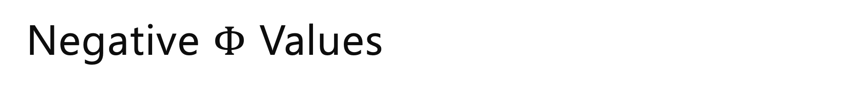
Negative $Φ$ Values
Notes:
Draw picture
Phi(-x) = 1 – phi(x)

Slide 12
$ℙ\left(a≤X≤b\right)$
Notes:
Draw picture

Slide 13

Normal (aka Guassian)
$X\sim 𝒩(μ,σ^{2})$
Parameter $μ$ is the expectation; $σ^{2}$ is the variance.
$f_{X}\left(x\right)=\frac{1}{σ\sqrt{2π}}e^{−\frac{{\left(x−μ\right)}^{2}}{2σ^{2}}}$
$F_{X}\left(k\right)$ has no nice closed form. Use the table.
$𝔼\left[X\right]=μ$
$Var\left(X\right)=σ^{2}$

Slide 14

More practice
Let $X\sim 𝒩(3, 2)$.
What is the probability that $1≤X≤4$

Slide 15
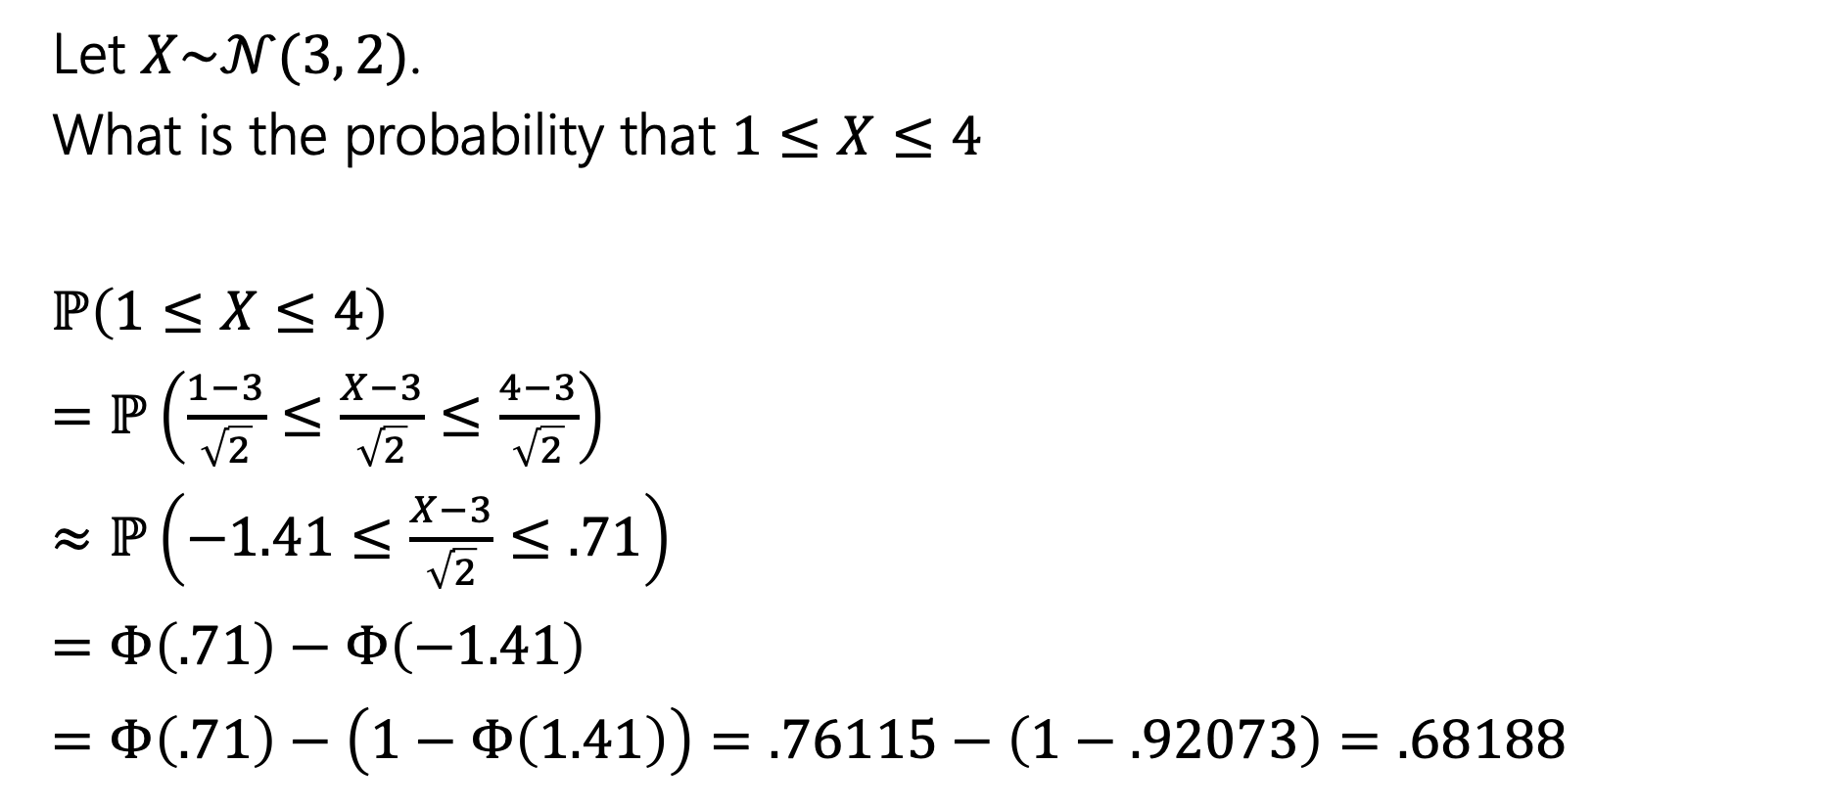
More practice
Let $X\sim 𝒩(3, 2)$.
What is the probability that $1≤X≤4$
$ℙ\left(1≤X≤4\right)$
$=ℙ\left(\frac{1−3}{\sqrt{2}}≤\frac{X−3}{\sqrt{2}}≤\frac{4−3}{\sqrt{2}}\right)$
$≈ℙ\left(−1.41≤\frac{X−3}{\sqrt{2}}≤.71\right)$
$=Φ\left(.71\right)−Φ\left(−1.41\right)$
$=Φ\left(.71\right)−\left(1−Φ\left(1.41\right)\right)=.76115−\left(1−.92073\right)=.68188$

Slide 16
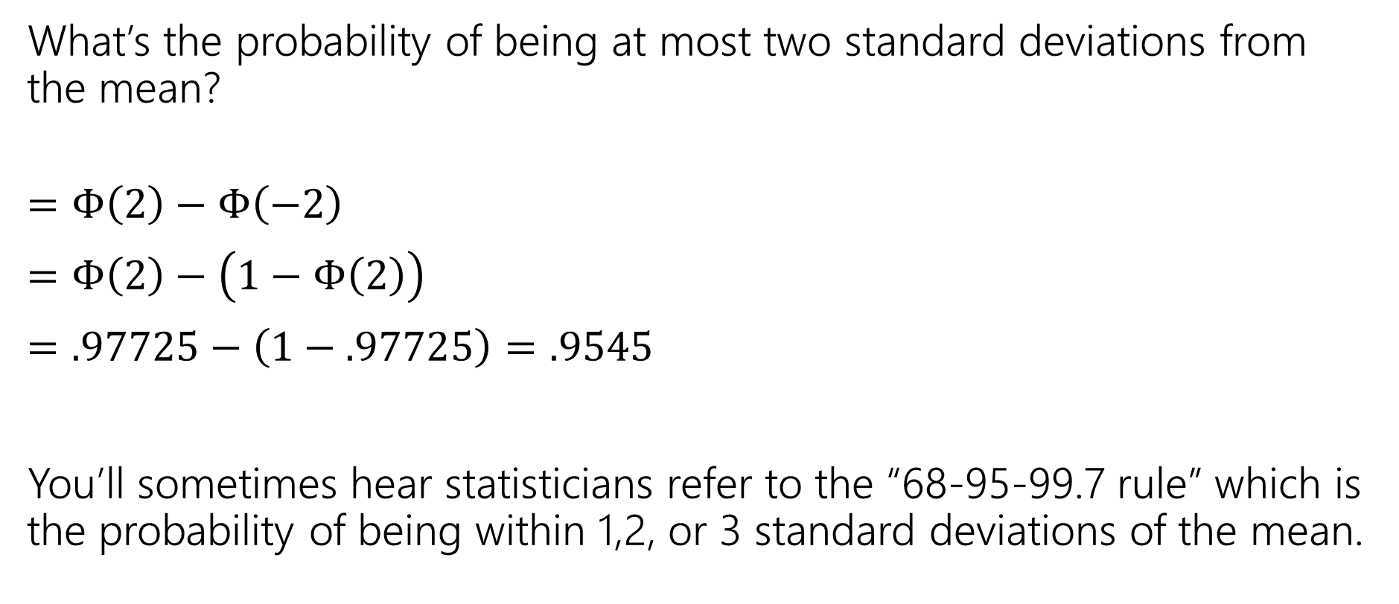
In real life
What’s the probability of being at most two standard deviations from the mean?
$=Φ\left(2\right)−Φ\left(−2\right)$
$=Φ\left(2\right)−\left(1−Φ\left(2\right)\right)$
$=.97725−\left(1−.97725\right)=.9545$
You’ll sometimes hear statisticians refer to the “68-95-99.7 rule” which is the probability of being within 1,2, or 3 standard deviations of the mean.

Slide 17
One last (unrelated) thing

Slide 18
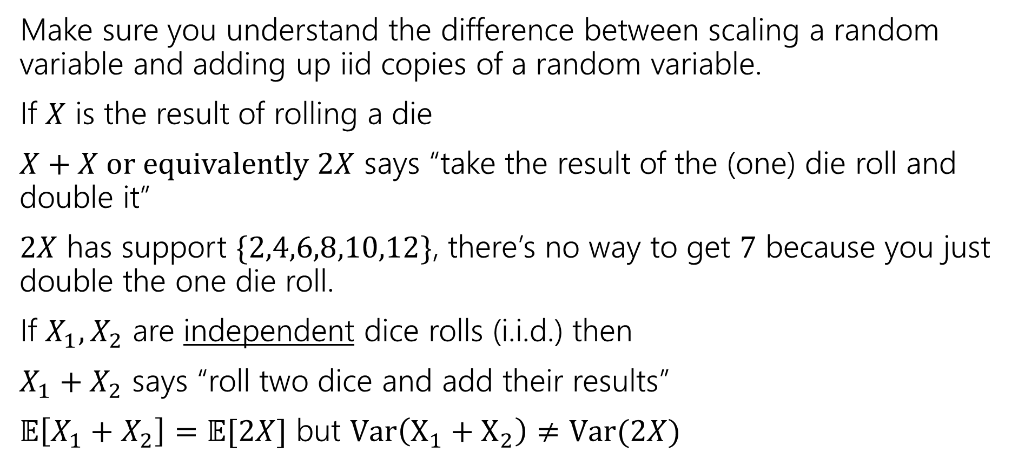
A Side Note
Make sure you understand the difference between scaling a random variable and adding up iid copies of a random variable.
If $X$ is the result of rolling a die
$X+X or equivalently 2X$ says “take the result of the (one) die roll and double it”
$2X$ has support $\{2,4,6,8,10,12\}$, there’s no way to get $7$ because you just double the one die roll.
If $X_{1},X_{2}$ are independent dice rolls (i.i.d.) then
$X_{1}+X_{2}$ says “roll two dice and add their results”
$𝔼\left[X_{1}+X_{2}\right]=𝔼[2X]$ but $Var\left(X_{1}+X_{2}\right)≠Var(2X)$

Slide 19


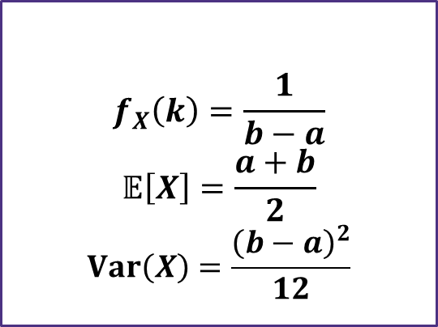
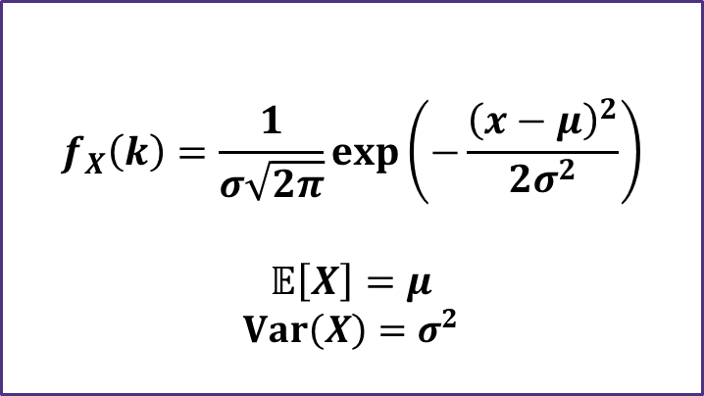

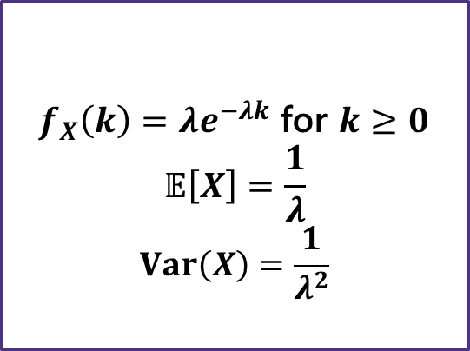
Continuous Zoo
$$X\sim Unif(a,b)$$
$$X\sim Exp(λ)$$
$$X\sim 𝒩(μ,σ^{2})$$
$$f_{X}\left(k\right)=\frac{1}{b−a}$$
$$𝔼\left[X\right]=\frac{a+b}{2}$$
$$Var\left(X\right)=\frac{{\left(b−a\right)}^{2}}{12}$$
$f_{X}\left(k\right)=λe^{−λk}$ for $k≥0$
$$𝔼\left[X\right]=\frac{1}{λ}$$
$$Var\left(X\right)=\frac{1}{λ^{2}}$$
$$f_{X}\left(k\right)=\frac{1}{σ\sqrt{2π}}exp\left(−\frac{{\left(x−μ\right)}^{2}}{2σ^{2}}\right)$$
$$𝔼\left[X\right]=μ$$
$$Var\left(X\right)=σ^{2}$$
It’s a smaller zoo, but it’s just as much fun!

