Slide 1
Continuous Zoo
CSE 312 Summer 25
Lecture 14

Slide 2
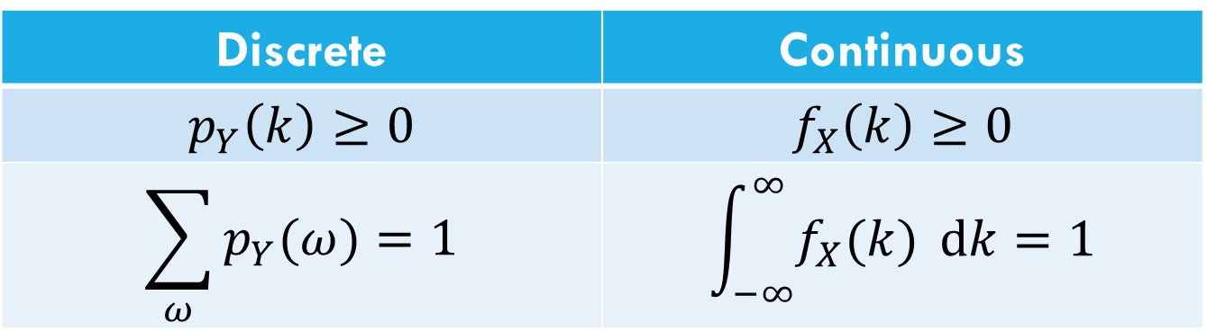
Let’s start with the pmf
For discrete random variables, we defined the pmf: $p_{Y}\left(k\right)=ℙ(Y=k)$.
We can’t have a pmf quite like we did for discrete random variables. Let $X$be a random real number between $0$ and $1$.
$ℙ\left(X=.1\right)=\frac{1}{∞}$??
Let’s try to maintain as many rules as we can…
Discrete | Continuous
$$p_{Y}\left(k\right)≥0$$ | $$f_{X}\left(k\right)≥0$$
$$\sum_{ω}{p_{Y}(ω)}=1$$ | $$\int_{−∞}^{∞}{f_{X}(k)} dk=1$$
Use $f_{X}$ instead of $p_{X}$ to remember it’s different .
Notes:
Last week wend we started to talk about continuous random variables we realized that things would be a little different now, specifically because the probability of a single outcome for a continuous RV is 0.
So instead of using a PMF we defined a PDF, so that when we integrate over some range of the PDF we would get back a probability.

Slide 3
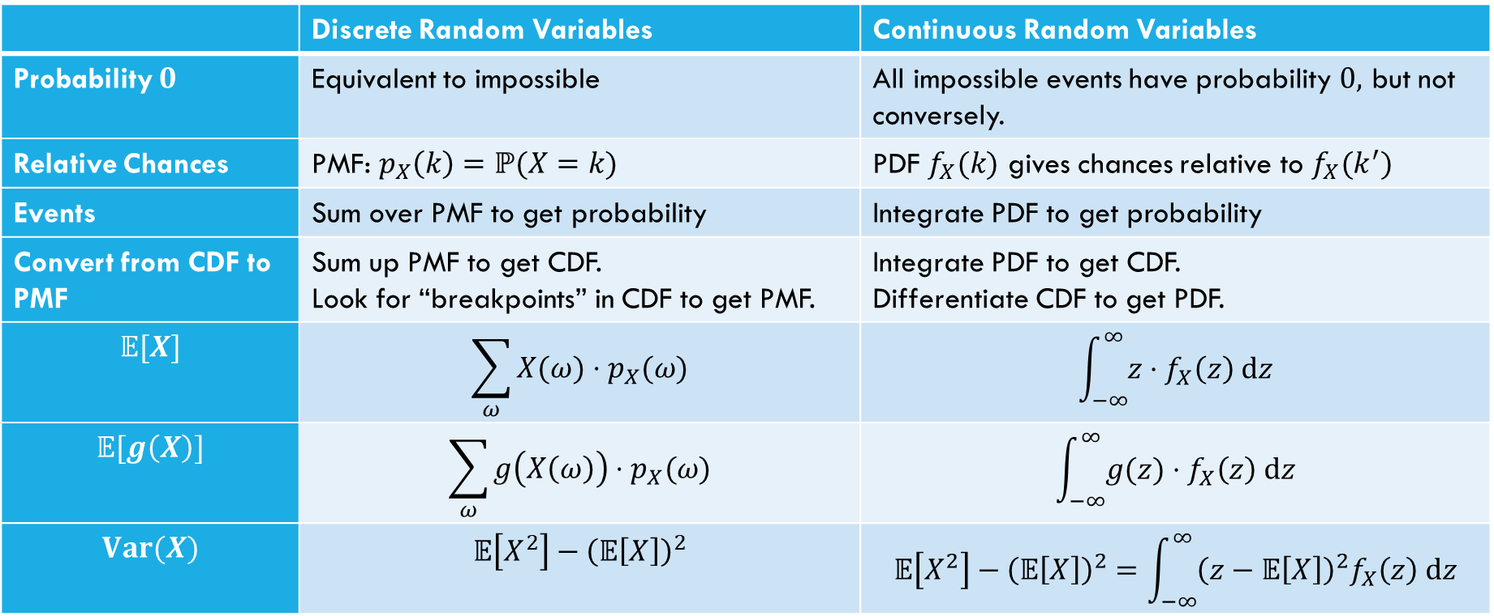
Comparing Discrete and Continuous
 | Discrete Random Variables | Continuous Random Variables
Probability $0$ | Equivalent to impossible | All impossible events have probability $0,$ but not conversely.
Relative Chances | PMF: $p_{X}\left(k\right)=ℙ(X=k)$ | PDF $f_{X}(k)$ gives chances relative to $f_{X}(k^{′})$
Events | Sum over PMF to get probability | Integrate PDF to get probability
Convert from CDF to PMF | Sum up PMF to get CDF. Look for “breakpoints” in CDF to get PMF. | Integrate PDF to get CDF. Differentiate CDF to get PDF.
$$𝔼[X]$$ | $$\sum_{ω}{X(ω)⋅p_{X}(ω)}$$ | $$\int_{−∞}^{∞}{z⋅f_{X}\left(z\right) dz}$$
$$𝔼[g\left(X\right)]$$ | $$\sum_{ω}{g\left(X\left(ω\right)\right)⋅p_{X}(ω)}$$ | $$\int_{−∞}^{∞}{g(z)⋅f_{X}\left(z\right) dz}$$
$$Var(X)$$ | $$𝔼\left[X^{2}\right]−{\left(𝔼\left[X\right]\right)}^{2}$$ | $$𝔼\left[X^{2}\right]−{\left(𝔼\left[X\right]\right)}^{2}=\int_{−∞}^{∞}{{\left(z−𝔼\left[X\right]\right)}^{2}f_{X}\left(z\right) dz}$$

Slide 4
What about expectation?
For a random variable $X$, we define:
$𝔼\left[X\right]=\int_{−∞}^{∞}{{X(z)⋅f}_{X}\left(z\right) dz}$
Just replace summing over the pmf with integrating the pdf.
It still represents the average value of $X$.

Slide 5
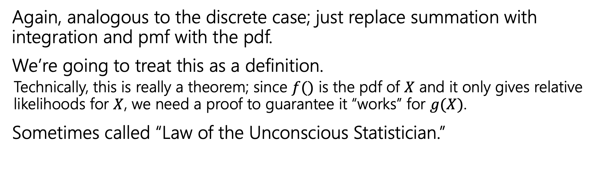
Expectation of a function
For any function $g$ and any continuous random variable, $X:$
$𝔼\left[g\left(X\right)\right]=\int_{−∞}^{∞}{g\left(X(z)\right)⋅f_{X}\left(z\right) dz}$
Again, analogous to the discrete case; just replace summation with integration and pmf with the pdf.
We’re going to treat this as a definition.
  Technically, this is really a theorem; since $f()$ is the pdf of $X$ and it only gives relative likelihoods for $X$, we need a proof to guarantee it “works” for $g(X)$.
Sometimes called “Law of the Unconscious Statistician.”
Notes:
We saw the equivalent version for discrete cases, it was the third form that we saw

Slide 6
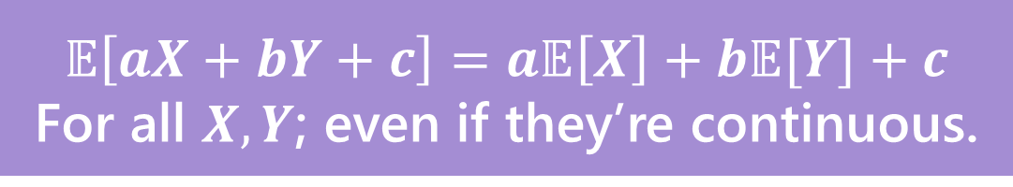
Linearity of Expectation
Still true!
Won’t show you the proof – for just $𝔼[aX+b]$, it’s
$𝔼\left[aX+b\right]=\int_{−∞}^{∞}{\left[aX\left(k\right)+b\right]f_{X}(k) dk}$
$=\int_{−∞}^{∞}{aX\left(k\right)f_{X}\left(k\right)dk}+\int_{−∞}^{∞}{bf_{X}\left(k\right)dk}$
$=a\int_{−∞}^{∞}{X\left(k\right)f_{X}\left(k\right)dk}+b\int_{−∞}^{∞}{f_{X}\left(k\right)dk}$
$=a𝔼\left[X\right]+b$
$$𝔼\left[aX+bY+c\right]=a𝔼\left[X\right]+b𝔼[Y]+c$$
For all $X,Y$; even if they’re continuous.
Notes:
Variance property holds if independent

Slide 7
Variance
No surprises here
$$Var\left(X\right)=𝔼\left[X^{2}\right]−{\left(𝔼\left[X\right]\right)}^{2}=\int_{−∞}^{∞}{{f_{X}(k)\left(X\left(k\right)−𝔼\left[X\right]\right)}^{2} dk}$$

Slide 8


Let’s calculate an expectation
$$f_{X}\left(z\right)=\left\{\begin{aligned}\frac{1}{b−a} if a≤z≤b \\ 0 otherwise\end{aligned}\right.$$
Let $X$ be a uniform random number between $a$ and$b$.
$𝔼\left[X\right]=\int_{−∞}^{∞}{z⋅f_{X}\left(z\right) dz}$
Notes:
Draw picture

Slide 9
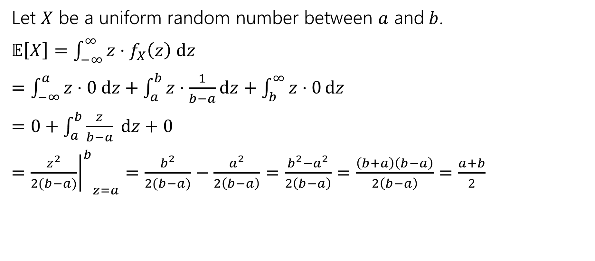
Let’s calculate an expectation
$$f_{X}\left(z\right)=\left\{\begin{aligned}\frac{1}{b−a} if a≤z≤b \\ 0 otherwise\end{aligned}\right.$$
Let $X$ be a uniform random number between $a$ and$b$.
$𝔼\left[X\right]=\int_{−∞}^{∞}{z⋅f_{X}\left(z\right) dz}$
$=\int_{−∞}^{a}{z⋅0 dz}+\int_{a}^{b}{z⋅\frac{1}{b−a}dz}+\int_{b}^{∞}{z⋅0}dz$
$=0+\int_{a}^{b}{\frac{z}{b−a} dz+0}$
$={{\left.\frac{z^{2}}{2(b−a)}\right|}^{b}}_{z=a}=\frac{b^{2}}{2(b−a)}−\frac{a^{2}}{2\left(b−a\right)}=\frac{b^{2}−a^{2}}{2\left(b−a\right)}=\frac{\left(b+a\right)\left(b−a\right)}{2\left(b−a\right)}=\frac{a+b}{2}$
Notes:
Density will usually be piecewise so evaluating integrals is usually piecewise

Slide 10
What about $𝔼\left[g\left(X\right)\right]$
Let $X\sim Unif(a,b)$, what about $𝔼\left[X^{2}\right]$?
$𝔼\left[X^{2}\right]=\int_{−∞}^{∞}{z^{2}f_{X}\left(z\right)dz}$
$=\int_{−∞}^{a}{z^{2}⋅0 dz+\int_{a}^{b}{z^{2}⋅\frac{1}{b−a}dz}+\int_{b}^{∞}{z^{2}⋅0 dz}}$
$=0+\int_{a}^{b}{z^{2}⋅\frac{1}{b−a}dz}+0$
$=\frac{1}{b−a}⋅{{\left.\frac{z^{3}}{3}\right|}^{b}}_{z=a}=\frac{1}{b−a}\left(\frac{b^{3}}{3}−\frac{a^{3}}{3}\right)=\frac{1}{3\left(b−a\right)}⋅\left(b−a\right)\left(a^{2}+ab+b^{2}\right)$
$=\frac{a^{2}+ab+b^{2}}{3}$
Notes:
If we were finding the expectation of X^3 + 5, then we would have …

Slide 11
Let’s assemble the variance
$Var\left(X\right)=𝔼\left[X^{2}\right]−{\left(𝔼\left[X\right]\right)}^{2}$
$=\frac{a^{2}+ab+b^{2}}{3}−{\left(\frac{a+b}{2}\right)}^{2}$
$=\frac{4(a^{2}+ab+b^{2})}{12}−\frac{{3(a}^{2}+2ab+b^{2})}{12}$
$=\frac{a^{2}−2ab+b^{2}}{12}$
$=\frac{{\left(a−b\right)}^{2}}{12}$

Slide 12
Continuous Uniform Distribution
$X\sim Unif(a,b)$ (uniform real number between $a$ and $b$)
PDF: $f_{X}\left(k\right)=\left\{\begin{aligned}\frac{1}{b−a} if a≤k≤b \\ 0 otherwise\end{aligned}\right.$
CDF: $F_{X}\left(k\right)=\left\{\begin{aligned}0 if k<a \\ \frac{k−a}{b−a} if a≤k≤b \\ 1 if k≥b\end{aligned}\right.$
$𝔼\left[X\right]=\frac{a+b}{2}$
$Var\left(X\right)=\frac{{\left(b−a\right)}^{2}}{12}$

Slide 13
Continuous Zoo
$$X\sim Unif(a,b)$$
$$X\sim Exp(λ)$$
$$X\sim 𝒩(μ,σ^{2})$$
$$f_{X}\left(k\right)=\frac{1}{b−a}$$
$$𝔼\left[X\right]=\frac{a+b}{2}$$
$$Var\left(X\right)=\frac{{\left(b−a\right)}^{2}}{12}$$
$f_{X}\left(k\right)=λe^{−λk}$ for $k≥0$
$$𝔼\left[X\right]=\frac{1}{λ}$$
$$Var\left(X\right)=\frac{1}{λ^{2}}$$
$$f_{X}\left(k\right)=\frac{1}{σ\sqrt{2π}}exp\left(−\frac{{\left(x−μ\right)}^{2}}{2σ^{2}}\right)$$
$$𝔼\left[X\right]=μ$$
$$Var\left(X\right)=σ^{2}$$
It’s a smaller zoo, but it’s just as much fun!

Slide 14
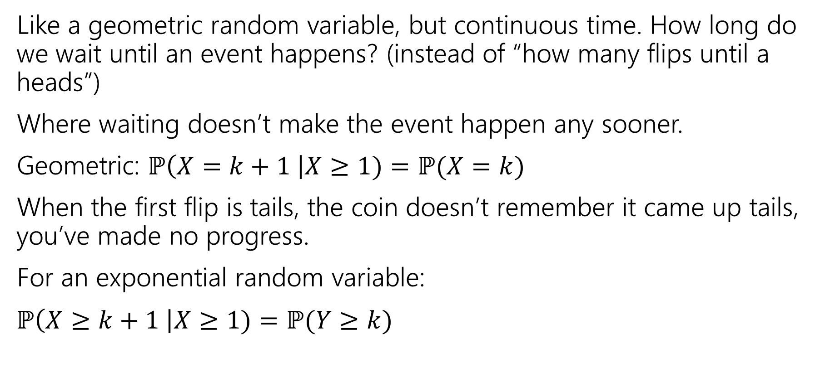
Exponential Random Variable
Like a geometric random variable, but continuous time. How long do we wait until an event happens? (instead of “how many flips until a heads”)
Where waiting doesn’t make the event happen any sooner.
Geometric: $ℙ\left(X=k+1 \right|X≥1)=ℙ(X=k)$
When the first flip is tails, the coin doesn’t remember it came up tails, you’ve made no progress.
For an exponential random variable:
$ℙ\left(X≥k+1 \right|X≥1)=ℙ(Y≥k)$

Slide 15
Are these memoryless?
You arrive to a bus stop at a (uniformly) random time, to a bus that arrives every 10 minutes. How long until the bus arrives? How long conditioned on you’ve already waited 8 minutes?
You put everyone in class into a random order. You’ll iterate through that list. What is the probability of being next? Probability of being next conditioned on not selected yet AND half the class has gone?
You flip a coin (independently) until you see a heads. How many flips do you need? How many additional flips after seeing 4 tails?

Slide 16
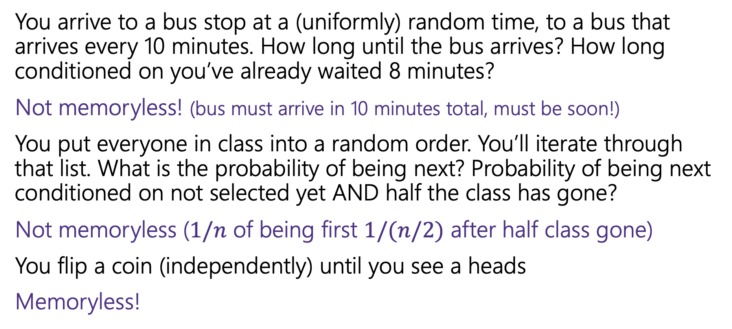
Are these memoryless?
You arrive to a bus stop at a (uniformly) random time, to a bus that arrives every 10 minutes. How long until the bus arrives? How long conditioned on you’ve already waited 8 minutes?
Not memoryless! (bus must arrive in 10 minutes total, must be soon!)
You put everyone in class into a random order. You’ll iterate through that list. What is the probability of being next? Probability of being next conditioned on not selected yet AND half the class has gone?
Not memoryless ($1/n$ of being first $1/(n/2)$ after half class gone)
You flip a coin (independently) until you see a heads
Memoryless!
Notes:
You need some sort of independence for a memoryless process

Slide 17
A continuous memoryless RV?
Poisson random variables come from a memoryless-type process.
Number of earthquakes (people in bakery, car accidents in Seattle) would be memoryless under assumption that events are independent of each other!
Same experiments, but now ask a different question:
Poisson: how many incidents occur in fixed interval?
Exponential: how long do I have to wait to see the next incident?
Notes:
We made the assumption that each car getting into a car accident is independent of the other.
Now for each of these types of experiments we can ask a different question, how much time until we see the first occurrence of the incident. Since we are dealing with time, it is a continuous R.V.

Slide 18
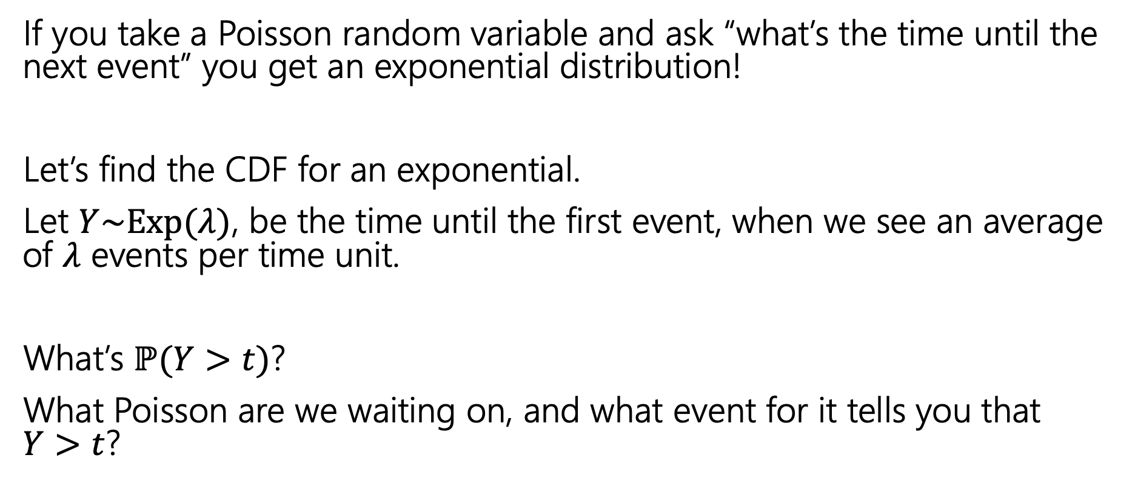
Exponential random variable
If you take a Poisson random variable and ask “what’s the time until the next event” you get an exponential distribution!
Let’s find the CDF for an exponential.
Let $Y\sim Exp(λ)$, be the time until the first event, when we see an average of $λ$ events per time unit.
What’s $ℙ(Y>t)$?
What Poisson are we waiting on, and what event for it tells you that $Y>t$?
Notes:
Since these come from the same experiment we can use the Poisson R.V. to derive the exponential R.V.
We will compute the compliment of the CDF to get our CDF and then from there we can get our PDF.
In the time interval T we saw no people
The probability that this Poisson took on the value 0 is equal to the probability that the exponential R.V. takes on a value larger than t.

Slide 19
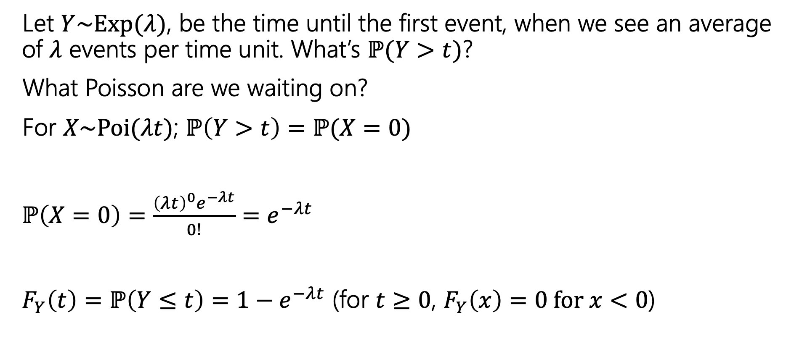
Exponential random variable
Let $Y\sim Exp(λ)$, be the time until the first event, when we see an average of $λ$ events per time unit. What’s $ℙ(Y>t)$?
What Poisson are we waiting on?
For $X\sim Poi(λt)$; $ℙ\left(Y>t\right)=ℙ(X=0)$
$ℙ\left(X=0\right)=\frac{{\left(λt\right)}^{0}e^{−λt}}{0!}=e^{−λt}$
$F_{Y}\left(t\right)=ℙ\left(Y≤t\right)=1−e^{−λt}$ (for $t≥0$, $F_{Y}\left(x\right)=0 for x<0$)

Slide 20
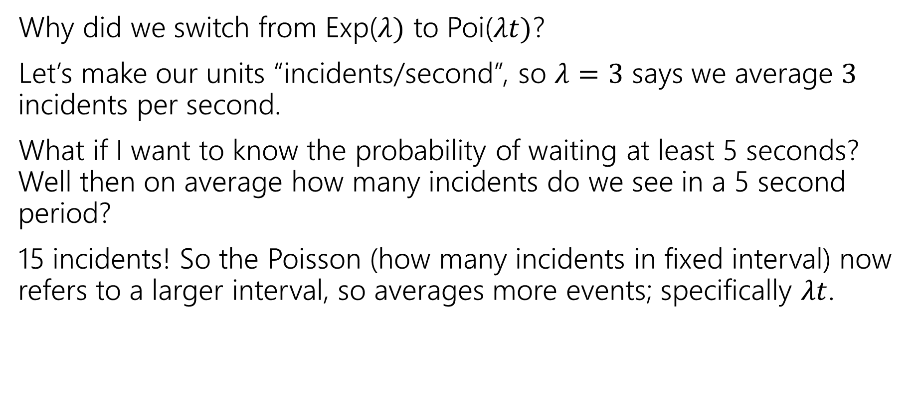

Where did the $t$ come from?
Why did we switch from Exp($λ)$ to Poi($λt)$?
Let’s make our units “incidents/second”, so $λ=3$ says we average $3$ incidents per second.
What if I want to know the probability of waiting at least 5 seconds? Well then on average how many incidents do we see in a 5 second period?
15 incidents! So the Poisson (how many incidents in fixed interval) now refers to a larger interval, so averages more events; specifically $λt$.

Slide 21
Find the density
We know the CDF, $F_{Y}\left(t\right)=ℙ\left(Y≤t\right)=1−e^{−λt}$
What’s the density?
$f_{Y}\left(t\right)=$

Slide 22
Find the density
We know the CDF, $F_{Y}\left(t\right)=ℙ\left(Y≤t\right)=1−e^{−λt}$
What’s the density?
$f_{Y}\left(t\right)=\frac{d}{dt}\left(1−e^{−λt}\right)=0−\frac{d}{dt}\left(e^{−λt}\right)=λe^{−λt}$.
For $t≥0$ it’s that expression
For $t<0$ it’s just $0.$

Slide 23
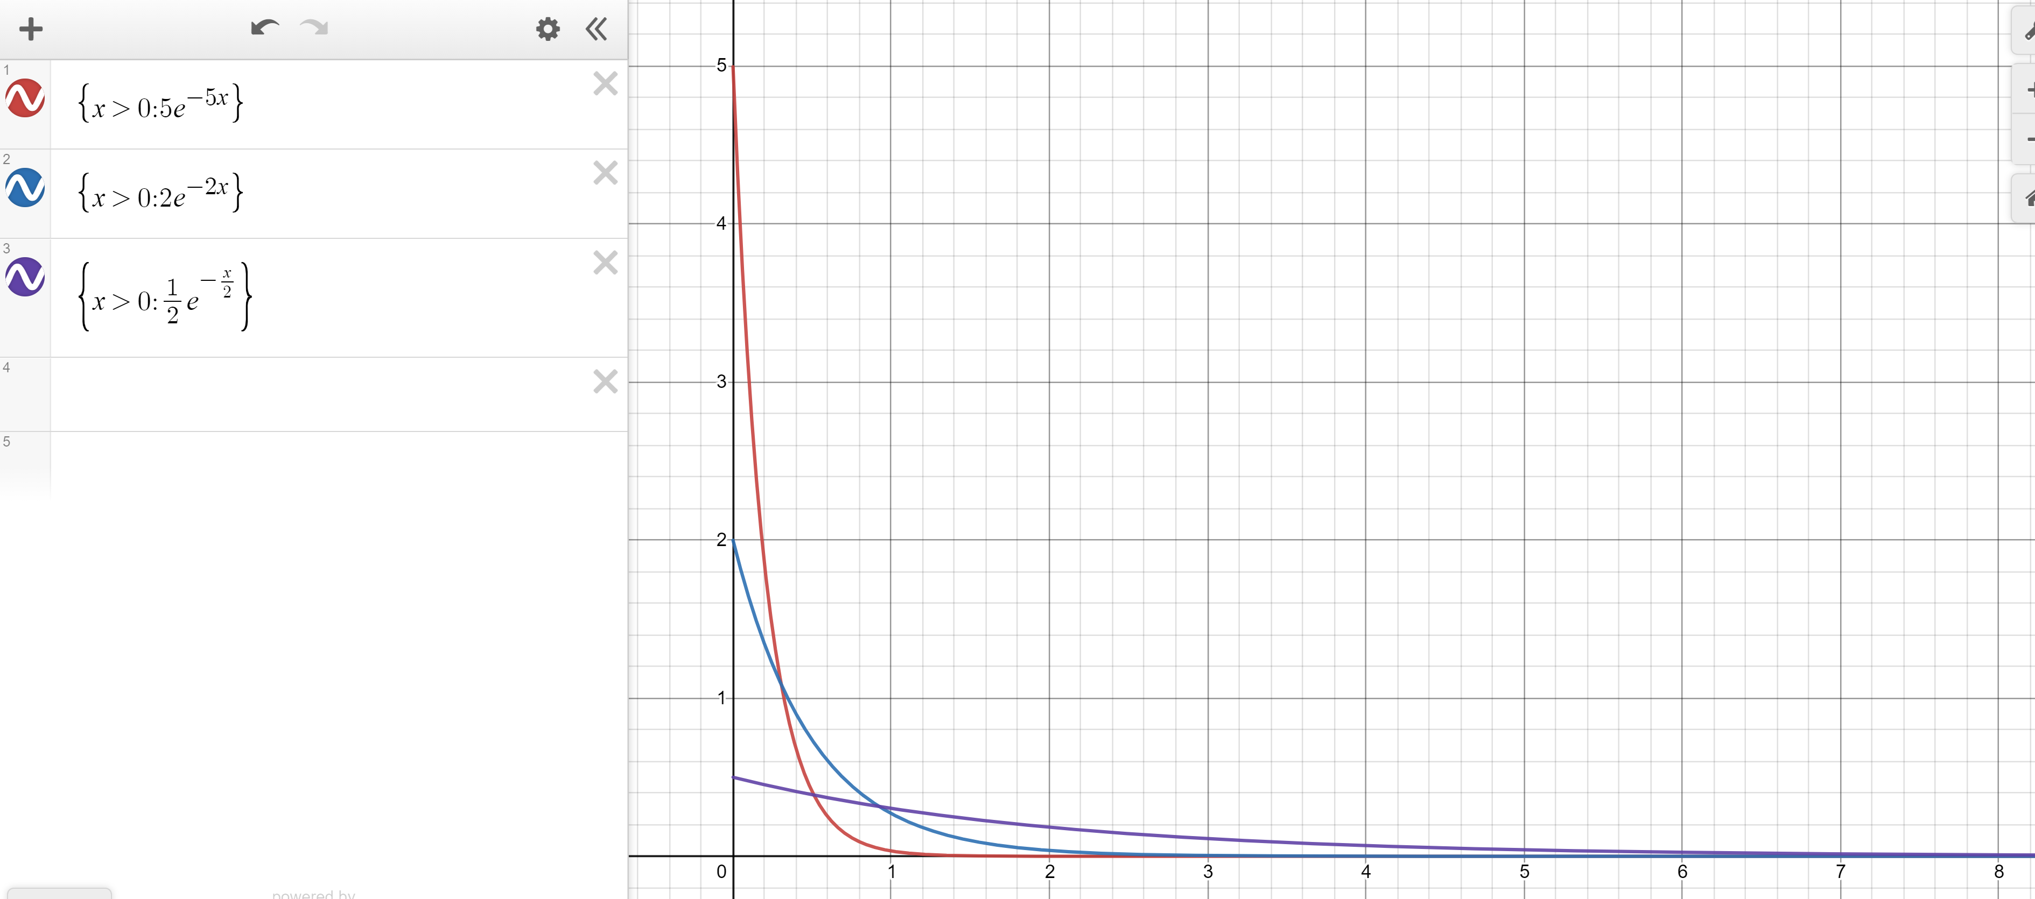
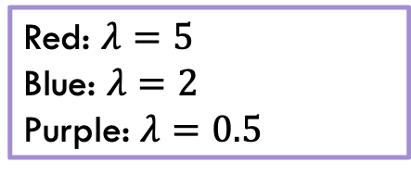
Exponential PDF
Red: $λ=5$
Blue: $λ=2$
Purple: $λ=0.5$
Notes:
If lambda is larger we should expect to not wait to long to see our first incident, so we should have more area or a larger probability closer to 0, but if lambda is smaller, it would be flatter.
All are examples of exponential decay

Slide 24
Exponential
$X\sim Exp(λ)$
Parameter $λ≥0$ is the average number of events in a unit of time.
$f_{X}\left(k\right)=\left\{\begin{aligned}λe^{−λk} if k≥0 \\ 0 otherwise\end{aligned}\right.$
$F_{X}\left(k\right)=\left\{\begin{aligned}1−e^{−λk} if k≥0 \\ 0 otherwise\end{aligned}\right.$
$𝔼\left[X\right]=\frac{1}{λ}$
$Var\left(X\right)=\frac{1}{λ^{2}}$

Slide 25
Expectation of an exponential
Don’t worry about the derivation (it’s here if you’re interested; you’re not responsible for the derivation. Just the value.
Let $X\sim Exp(λ)$
$𝔼\left[X\right]=\int_{−∞}^{∞}{{z⋅f}_{X}\left(z\right)dz}$
$=\int_{0}^{∞}{z⋅λe^{−λz}}dz$
Let $u=z; dv=λe^{−λz}dz$ ($v=−e^{−λz}$)
Integrate by parts:$−ze^{−λz}−\int{−e^{−λz}}dz=−ze^{−λz}−\frac{1}{λ}e^{−λz}$
Definite Integral:$−ze^{−λz}−\frac{1}{λ}e^{−λz}{\left.​\right|}_{z=0}^{∞}=(\lim_{z→∞}{−ze^{−λz}−\frac{1}{λ}e^{−λz}) −(0−\frac{1}{λ})}$
By L’Hopital’s Rule $(\lim_{z→∞}{−\frac{z}{e^{λz}}−\frac{1}{λe^{λz}}) −(0−\frac{1}{λ})}=\left(\lim_{z→∞}−\frac{1}{λe^{λz}}\right)+\frac{1}{λ}=\frac{1}{λ}$

Slide 26
Variance of an exponential
If $X\sim Exp\left(λ\right)then Var\left(X\right)=\frac{1}{λ^{2}}$
Similar calculus tricks will get you there.

Slide 27
Memorylessness
$ℙ\left(X≥k+1 | X≥1\right)=\frac{ℙ(X≥k+1∩X≥1)}{ℙ(X≥1)}=\frac{ℙ(X≥k+1)}{1−(1−e^{−λ⋅1})}$
$=\frac{e^{−λ(k+1)}}{e^{−λ}}=e^{−λk}$
What about $ℙ(X≥k)$ (without conditioning on the first step)?
${1−(1−e}^{−λk})=e^{−λk}$
It’s the same!!!
More generally, for an exponential rv $X,$ $ℙ\left(X≥s+t | X≥s\right)=ℙ(X≥t)$

Slide 28
Side note
I hid a trick in that algebra,
$ℙ\left(X≥1\right)=1−ℙ\left(X<1\right)=1−ℙ(X≤1)$
The first step is the complementary law.
The second step is using that $\int_{1}^{1}{f_{X}\left(z\right)dz}=0$
In general, for continuous random variables we can switch out $≤$ and $<$without anything changing.
  We can’t make those switches for discrete random variables.

Slide 29


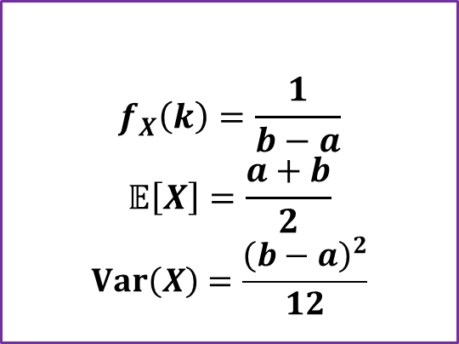
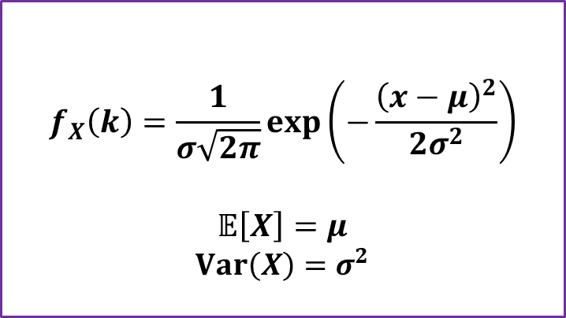

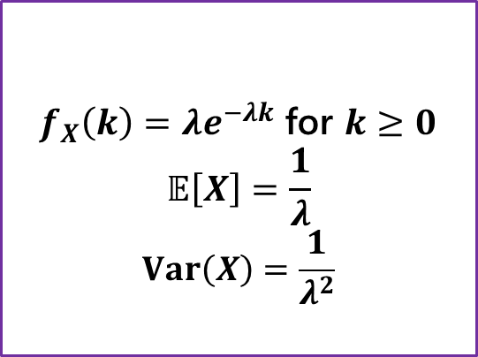
Continuous Zoo
$$X\sim Unif(a,b)$$
$$X\sim Exp(λ)$$
$$X\sim 𝒩(μ,σ^{2})$$
$$f_{X}\left(k\right)=\frac{1}{b−a}$$
$$𝔼\left[X\right]=\frac{a+b}{2}$$
$$Var\left(X\right)=\frac{{\left(b−a\right)}^{2}}{12}$$
$f_{X}\left(k\right)=λe^{−λk}$ for $k≥0$
$$𝔼\left[X\right]=\frac{1}{λ}$$
$$Var\left(X\right)=\frac{1}{λ^{2}}$$
$$f_{X}\left(k\right)=\frac{1}{σ\sqrt{2π}}exp\left(−\frac{{\left(x−μ\right)}^{2}}{2σ^{2}}\right)$$
$$𝔼\left[X\right]=μ$$
$$Var\left(X\right)=σ^{2}$$
It’s a smaller zoo, but it’s just as much fun!

