Slide 1
Continuous Probability
CSE 312 Summer 25
Lecture 13

Slide 2
Where Are We?

Slide 3
What have we done over the past 5 weeks?
Counting
  Combinations, permutations, indistinguishable elements, starts and bars, inclusion-exclusion…
  Probability foundations
  Events, sample space, axioms of probability, expectation, variance
  Conditional probability
  Conditioning, independence, Bayes’ Rule
  Refined our intuition
  Especially around Bayes’ Rule

Slide 4
What’s next?
Continuous random variables.
  So far our sample spaces have been countable. What happens if we want to choose a random real number?
  How do expectation, variance, conditioning, etc. change in this new context?
  Mostly analogous to discrete cases, but with integrals instead of sums.
  Analysis when it’s inconvenient (or impossible) to exactly calculate probabilities.
  Central Limit Theorem (approximating discrete distributions with continuous ones)
  Tail Bounds/Concentration (arguing it’s unlikely that a random variable is far from its expectation)
  A first taste of making predictions from data (i.e., a bit of ML)

Slide 5
Today
Continuous Probability
  Probability Density Function
  Cumulative Distribution Function
Goal for today is to get intuition on what’s different in the continuous case. Your goal today is to start building up a gut-feeling of what’s happening.
ASK QUESTIONS, (always, but today especially).

Slide 6
Continuous Random Variables

Slide 7
Continuous Random Variables
We’ll need continuous probability spaces and continuous random variables to describe experiments that have uncountably-infinite sample spaces.
  e.g. all real numbers
How long until the next bus shows up?
What location does a dart land?

Slide 8
Continuous Random Variables
Wait, we’re computer scientists. Computers don’t do real numbers, why should we?
Continuous random variables will be a useful model for enormous sample spaces. The math will be easier.
Example: polling a large population. The sample space is actually discrete. But we’re going to round the result anyway. Make it continuous first for easier math, then round.

Slide 9
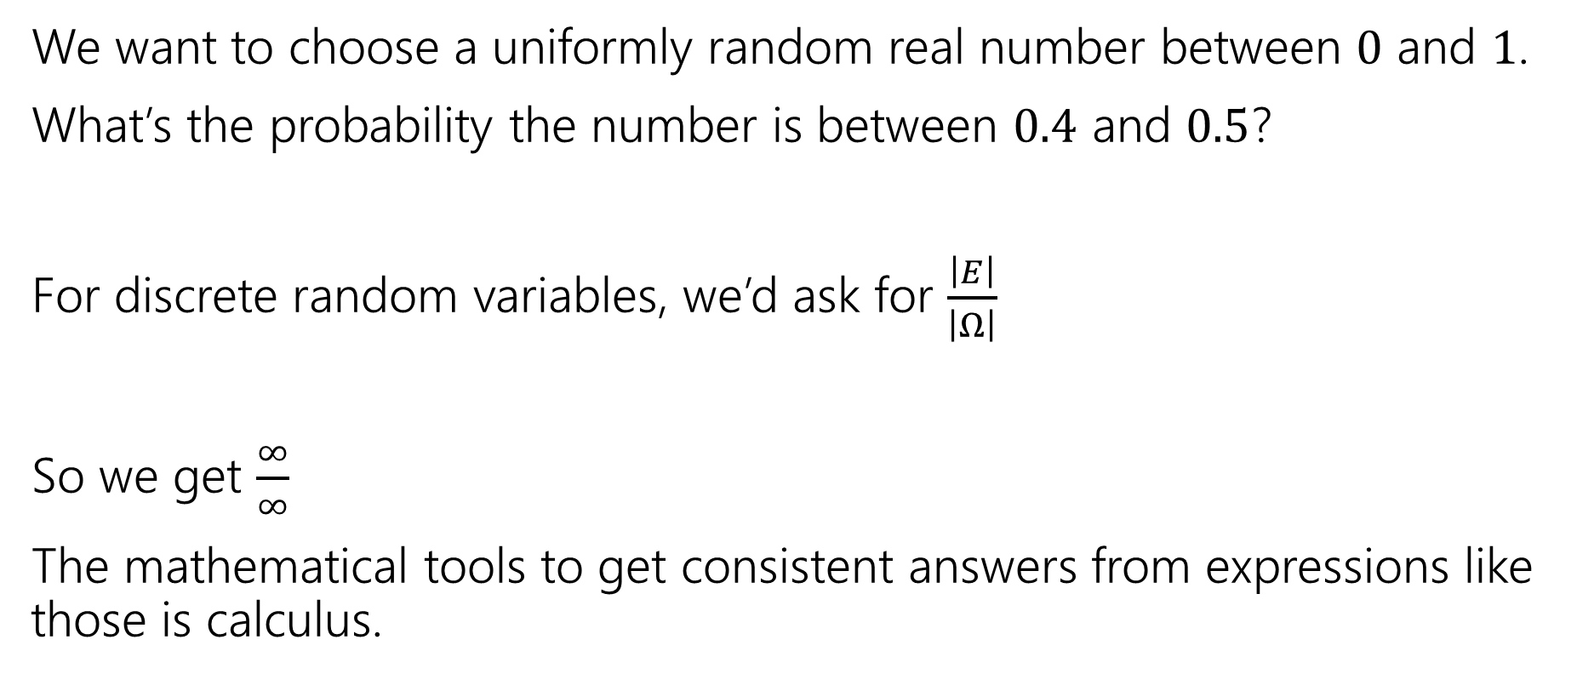
Why Need New Rules?
We want to choose a uniformly random real number between $0$ and $1$.
What’s the probability the number is between $0.4$ and $0.5$?
For discrete random variables, we’d ask for $\frac{\left|E\right|}{\left|Ω\right|}$
So we get $\frac{∞}{∞}$
The mathematical tools to get consistent answers from expressions like those is calculus.
Notes:
This is the experiment that we will talk about for the rest of the lecture.
What should this value be?

Slide 10

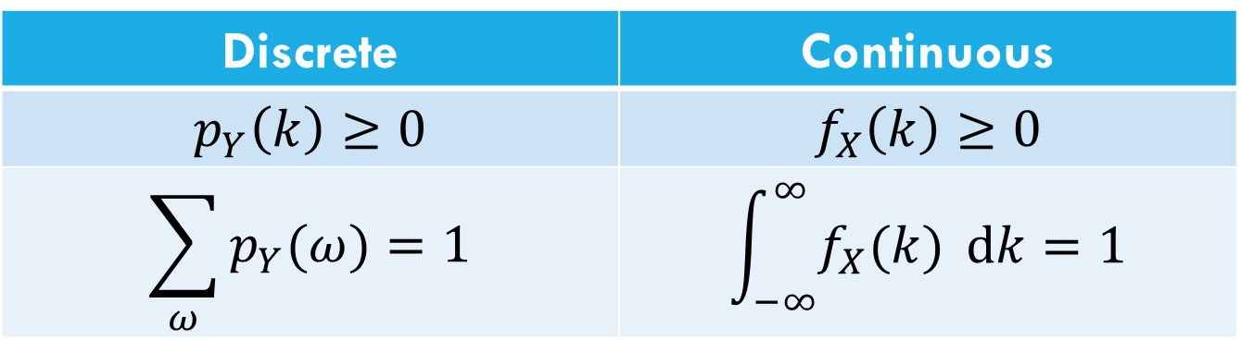
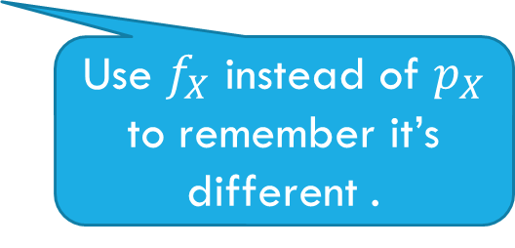
Let’s start with the pmf
For discrete random variables, we defined the pmf: $p_{Y}\left(k\right)=ℙ(Y=k)$.
We can’t have a pmf quite like we did for discrete random variables. Let $X$be a random real number between $0$ and $1$.
$ℙ\left(X=.1\right)=\frac{1}{∞}$??
Let’s try to maintain as many rules as we can…
Discrete | Continuous
$$p_{Y}\left(k\right)≥0$$ | $$f_{X}\left(k\right)≥0$$
$$\sum_{ω}{p_{Y}(ω)}=1$$ | $$\int_{−∞}^{∞}{f_{X}(k)} dk=1$$
Use $f_{X}$ instead of $p_{X}$ to remember it’s different .
Notes:
If we define a PMF for a continuous rv it would always output 0 which isn’t useful for anything
This is the PDF

Slide 11

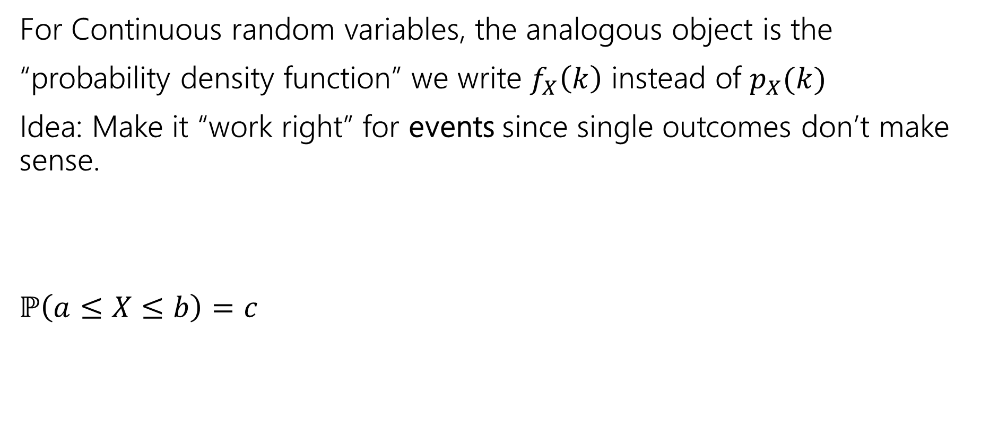
The probability density function
For Continuous random variables, the analogous object is the
“probability density function” we write $f_{X}\left(k\right)$ instead of $p_{X}(k)$
Idea: Make it “work right” for events since single outcomes don’t make sense.
$ℙ\left(a≤X≤b\right)=c$
$$\int_{a}^{b}{f_{X}\left(z\right) dz}=c$$
integrating is analogous to sum.

Slide 12

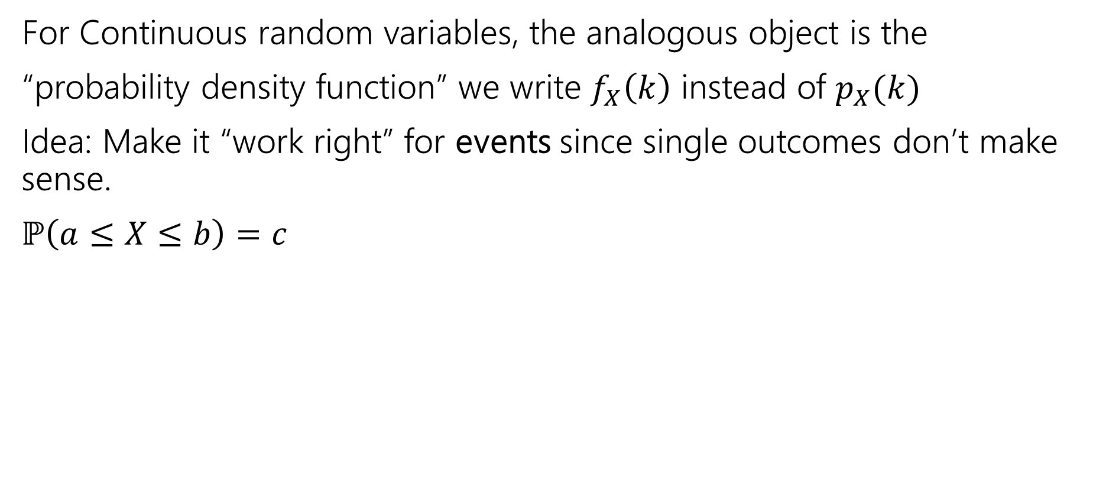
The probability density function
For Continuous random variables, the analogous object is the
“probability density function” we write $f_{X}\left(k\right)$ instead of $p_{X}(k)$
Idea: Make it “work right” for events since single outcomes don’t make sense.
$ℙ\left(a≤X≤b\right)=c$
$$\int_{a}^{b}{f_{X}\left(z\right) dz}=c$$
integrating is analogous to sum.
Let’s derive an example PDF together!
For a uniform random real number in [0,1]

Slide 13
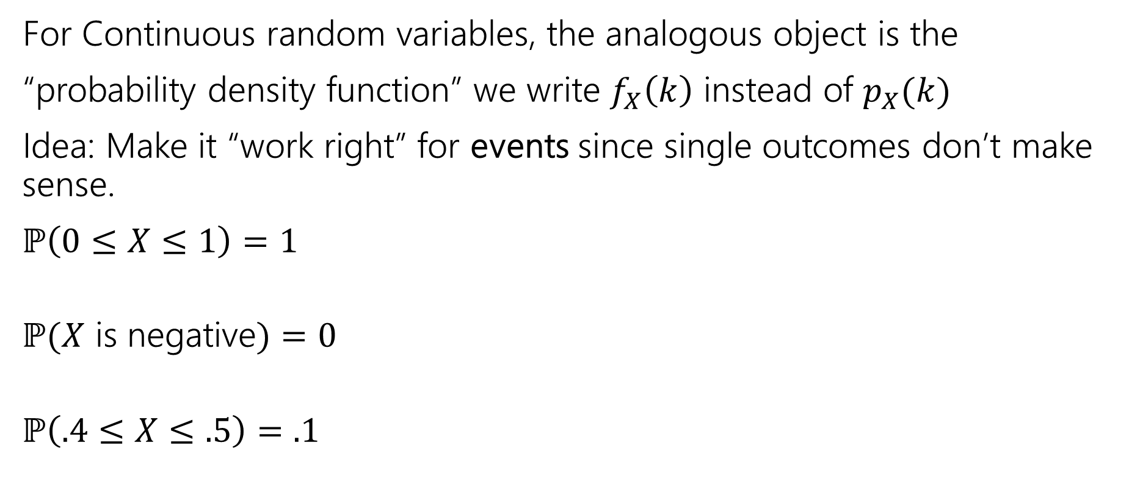
The probability density function
For Continuous random variables, the analogous object is the
“probability density function” we write $f_{X}\left(k\right)$ instead of $p_{X}(k)$
Idea: Make it “work right” for events since single outcomes don’t make sense.
$ℙ\left(0≤X≤1\right)=1$
$ℙ(X$ is negative$)=0$
$ℙ\left(.4≤X≤.5\right)=.1$
integrating is analogous to sum.
Notes:
Try writing out the integrals for what we are trying to find, and see if you can figure out what our PDF should be

Slide 14
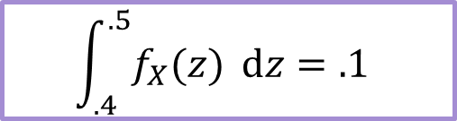
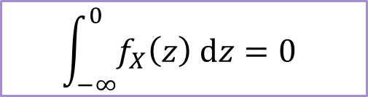
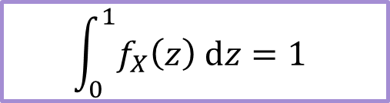
The probability density function
For Continuous random variables, the analogous object is the
“probability density function” we write $f_{X}\left(k\right)$ instead of $p_{X}(k)$
Idea: Make it “work right” for events since single outcomes don’t make sense.
$ℙ\left(0≤X≤1\right)=1$
$ℙ(X$ is negative$)=0$
$ℙ\left(.4≤X≤.5\right)=.1$
$$\int_{0}^{1}{f_{X}\left(z\right) dz}=1$$
integrating is analogous to sum.
$$\int_{−∞}^{0}{f_{X}\left(z\right) dz=0}$$
$$\int_{.4}^{.5}{f_{X}(z)} dz=.1$$
Notes:
Does this mapping conversion make sense?

Slide 15

PDF for uniform
Let $X$ be a uniform real number between $0$ and $1$.
What should $f_{X}(k)$ be to make all those events integrate to the right values?
$f_{X}\left(k\right)=\left\{\begin{aligned}0 if k<0 or k>1 \\ 1 if 0≤k≤1\end{aligned}\right.$
Notes:
Draw picture

Slide 16


Probability Density Function
So $ℙ\left(X=.1\right)=??$
$f_{X}\left(.1\right)=1$
The number that best represents $ℙ(X=.1)$ is $0$.
This is different from $f_{X}(x)$
So…what is $f_{X}(x)$???
For continuous probability spaces:
Impossible events have probability $0$,
but some probability $0$ events might be possible.
Notes:
The PDF is designed for events, to be integrated over a range, not for single values. It does not tell you the probability, it is telling you something a little different

Slide 17
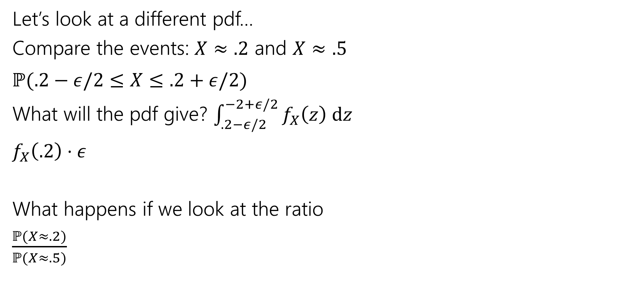
Using the PDF
Let’s look at a different pdf…
Compare the events: $X≈.2$ and $X≈.5$
$ℙ(.2−ε/2≤X≤.2+ε/2)$
What will the pdf give? $\int_{.2−ε/2}^{−2+ε/2}{f_{X}\left(z\right) dz}$
$f_{X}\left(.2\right)⋅ε$
What happens if we look at the ratio
$\frac{ℙ(X≈.2)}{ℙ(X≈.5)}$
.2
.5

Slide 18
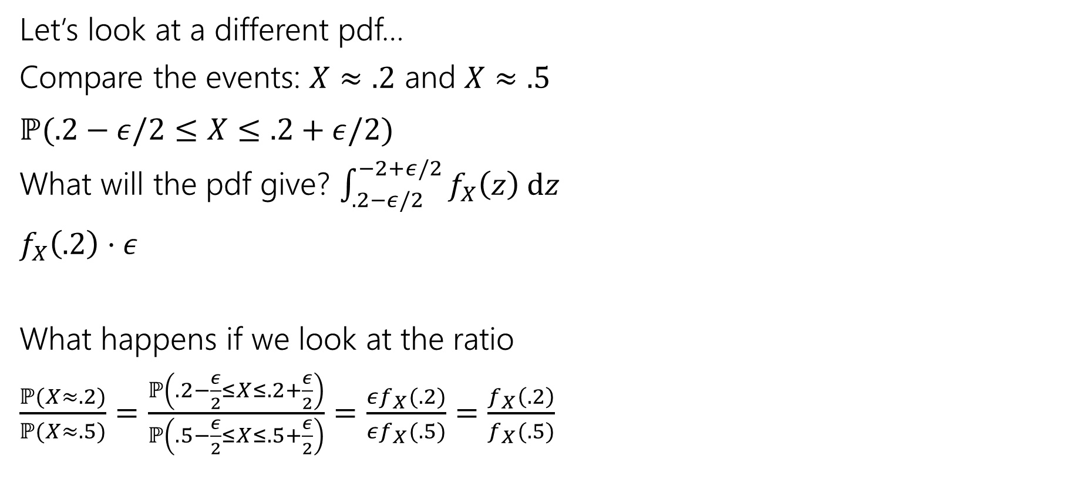
Using the PDF
Let’s look at a different pdf…
Compare the events: $X≈.2$ and $X≈.5$
$ℙ(.2−ε/2≤X≤.2+ε/2)$
What will the pdf give? $\int_{.2−ε/2}^{−2+ε/2}{f_{X}\left(z\right) dz}$
$f_{X}\left(.2\right)⋅ε$
What happens if we look at the ratio
$\frac{ℙ(X≈.2)}{ℙ(X≈.5)}=\frac{ℙ\left(.2−\frac{ε}{2}≤X≤.2+\frac{ε}{2}\right)}{ℙ\left(.5−\frac{ε}{2}≤X≤.5+\frac{ε}{2}\right)}=\frac{εf_{X}(.2)}{εf_{X}(.5)}=\frac{f_{X}\left(.2\right)}{f_{X}(.5)}$
.2
.5
Notes:
The PDF tells you if you are more likely to be near .2 or near .5 How dense is the probability in that area

Slide 19
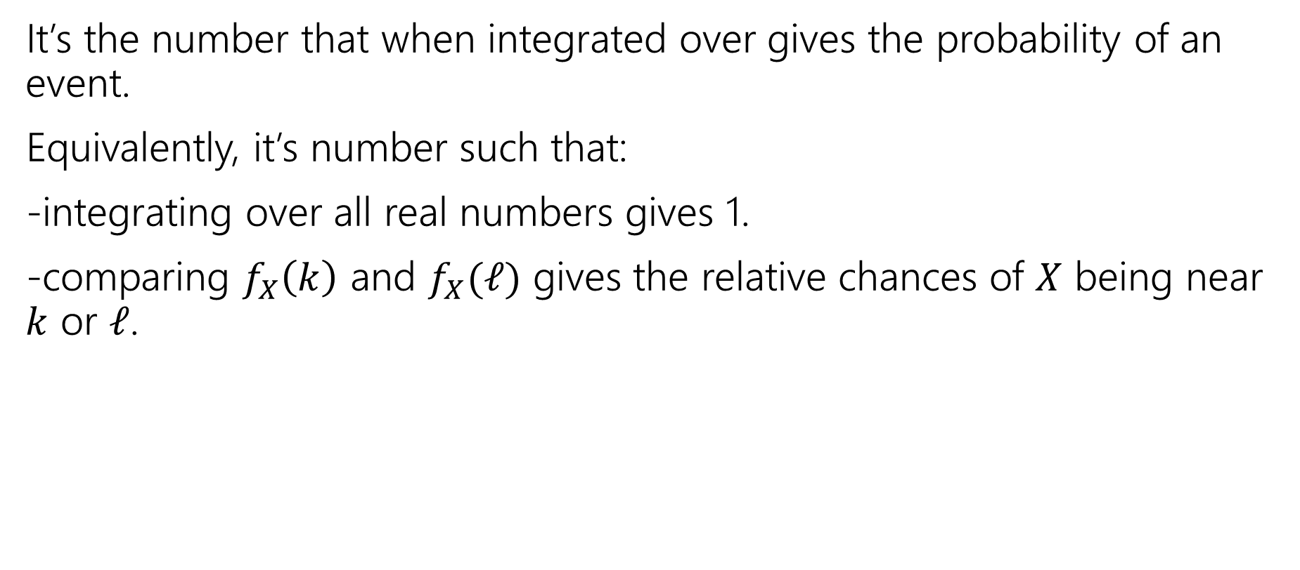
So what’s the pdf?
It’s the number that when integrated over gives the probability of an event.
Equivalently, it’s number such that:
-integrating over all real numbers gives 1.
-comparing $f_{X}\left(k\right)$ and $f_{X}(ℓ)$ gives the relative chances of $X$ being near $k$ or $ℓ$.

Slide 20
CDFs

Slide 21

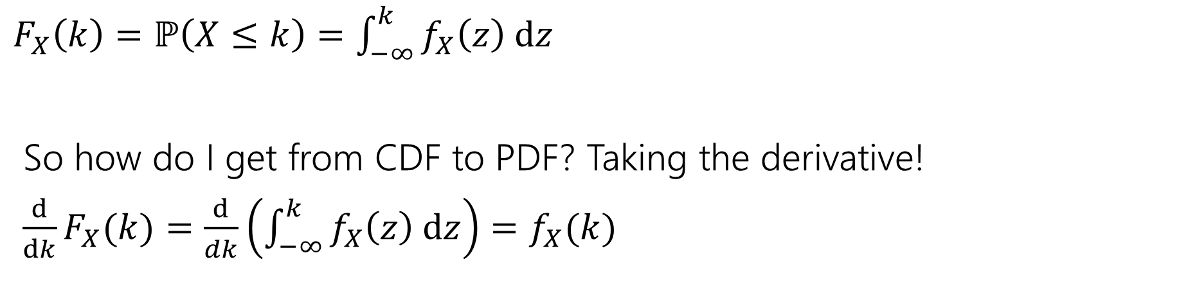
What’s a CDF?
The Cumulative Distribution Function $F_{X}\left(k\right)=ℙ(X≤k)$
analogous to the CDF for discrete variables.
$F_{X}\left(k\right)=ℙ\left(X≤k\right)=\int_{−∞}^{k}{f_{X}\left(z\right) dz}$
So how do I get from CDF to PDF? Taking the derivative!
$\frac{d}{dk}F_{X}(k)=\frac{d}{dk}\left(\int_{−∞}^{k}{f_{X}\left(z\right) dz}\right)=f_{X}(k)$

Slide 22
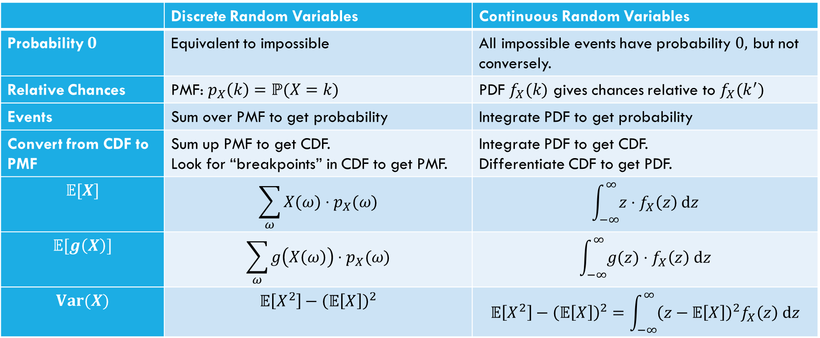
Comparing Discrete and Continuous
 | Discrete Random Variables | Continuous Random Variables
Probability $0$ | Equivalent to impossible | All impossible events have probability $0,$ but not conversely.
Relative Chances | PMF: $p_{X}\left(k\right)=ℙ(X=k)$ | PDF $f_{X}(k)$ gives chances relative to $f_{X}(k^{′})$
Events | Sum over PMF to get probability | Integrate PDF to get probability
Convert from CDF to PMF | Sum up PMF to get CDF. Look for “breakpoints” in CDF to get PMF. | Integrate PDF to get CDF. Differentiate CDF to get PDF.
$$𝔼[X]$$ | $$\sum_{ω}{X(ω)⋅p_{X}(ω)}$$ | $$\int_{−∞}^{∞}{z⋅f_{X}\left(z\right) dz}$$
$$𝔼[g\left(X\right)]$$ | $$\sum_{ω}{g\left(X\left(ω\right)\right)⋅p_{X}(ω)}$$ | $$\int_{−∞}^{∞}{g(z)⋅f_{X}\left(z\right) dz}$$
$$Var(X)$$ | $$𝔼\left[X^{2}\right]−{\left(𝔼\left[X\right]\right)}^{2}$$ | $$𝔼\left[X^{2}\right]−{\left(𝔼\left[X\right]\right)}^{2}=\int_{−∞}^{∞}{{\left(z−𝔼\left[X\right]\right)}^{2}f_{X}\left(z\right) dz}$$

Slide 23

What about expectation?
For a random variable $X$, we define:
$𝔼\left[X\right]=\int_{−∞}^{∞}{{X(z)⋅f}_{X}\left(z\right) dz}$
Just replace summing over the pmf with integrating the pdf.
It still represents the average value of $X$.

Slide 24

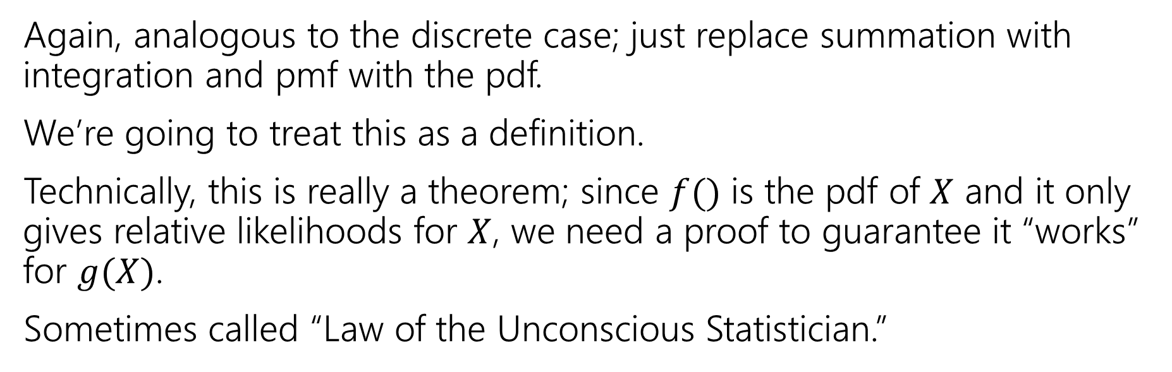
Expectation of a function
For any function $g$ and any continuous random variable, $X:$
$𝔼\left[g\left(X\right)\right]=\int_{−∞}^{∞}{g\left(X(z)\right)⋅f_{X}\left(z\right) dz}$
Again, analogous to the discrete case; just replace summation with integration and pmf with the pdf.
We’re going to treat this as a definition.
Technically, this is really a theorem; since $f()$ is the pdf of $X$ and it only gives relative likelihoods for $X$, we need a proof to guarantee it “works” for $g(X)$.
Sometimes called “Law of the Unconscious Statistician.”

Slide 25
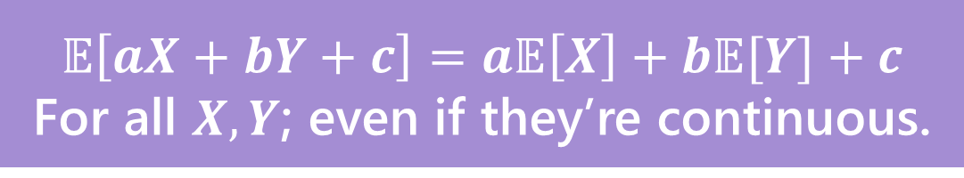
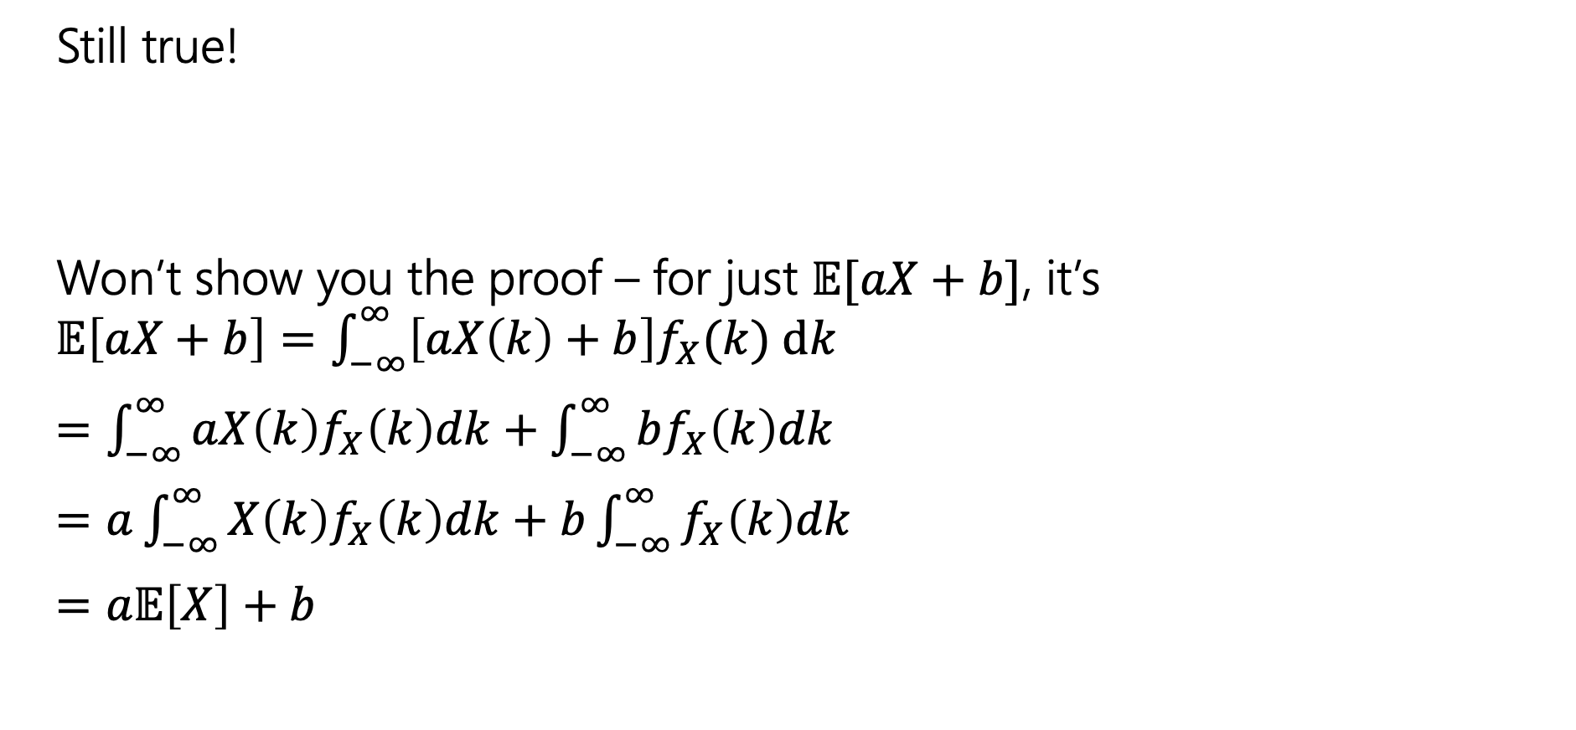
Linearity of Expectation
Still true!
Won’t show you the proof – for just $𝔼[aX+b]$, it’s
$𝔼\left[aX+b\right]=\int_{−∞}^{∞}{\left[aX\left(k\right)+b\right]f_{X}(k) dk}$
$=\int_{−∞}^{∞}{aX\left(k\right)f_{X}\left(k\right)dk}+\int_{−∞}^{∞}{bf_{X}\left(k\right)dk}$
$=a\int_{−∞}^{∞}{X\left(k\right)f_{X}\left(k\right)dk}+b\int_{−∞}^{∞}{f_{X}\left(k\right)dk}$
$=a𝔼\left[X\right]+b$
$$𝔼\left[aX+bY+c\right]=a𝔼\left[X\right]+b𝔼[Y]+c$$
For all $X,Y$; even if they’re continuous.

Slide 26
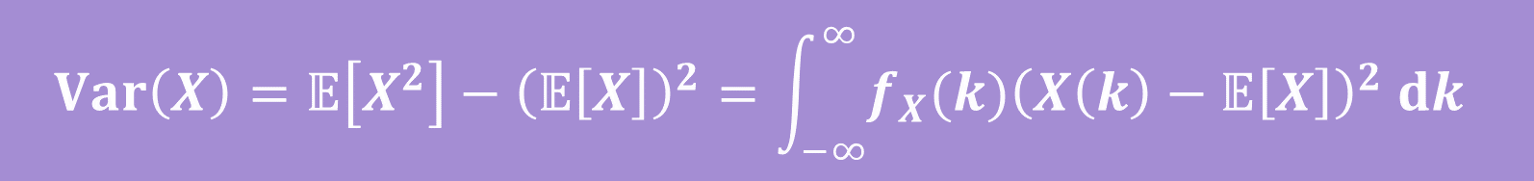
Variance
No surprises here
$$Var\left(X\right)=𝔼\left[X^{2}\right]−{\left(𝔼\left[X\right]\right)}^{2}=\int_{−∞}^{∞}{{f_{X}(k)\left(X\left(k\right)−𝔼\left[X\right]\right)}^{2} dk}$$

Slide 27


Let’s calculate an expectation
$$f_{X}\left(z\right)=\left\{\begin{aligned}\frac{1}{b−a} if a≤z≤b \\ 0 otherwise\end{aligned}\right.$$
Let $X$ be a uniform random number between $a$ and$b$.
$𝔼\left[X\right]=\int_{−∞}^{∞}{z⋅f_{X}\left(z\right) dz}$

Slide 28
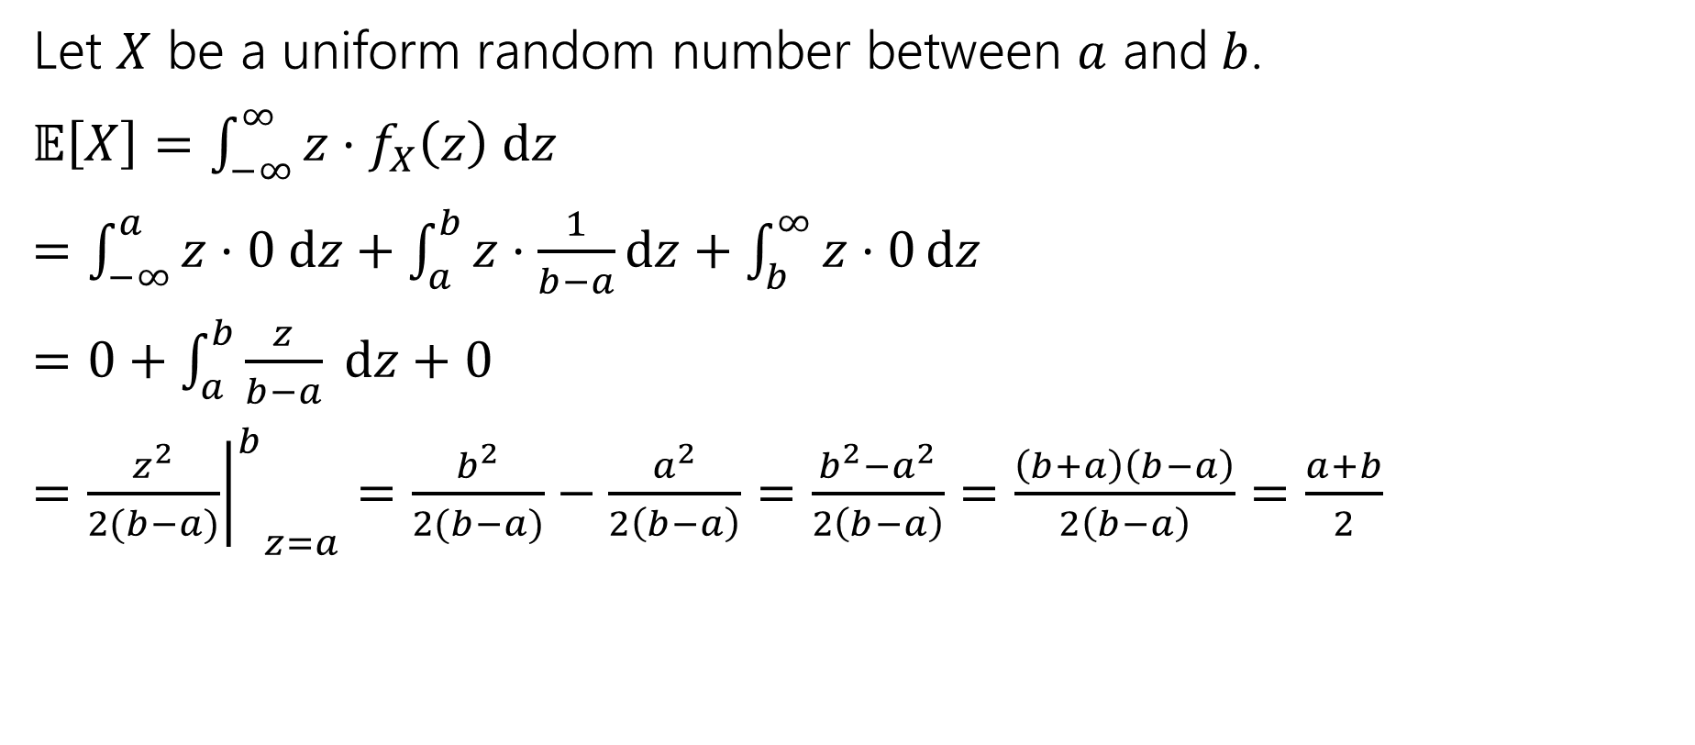
Let’s calculate an expectation
Let $X$ be a uniform random number between $a$ and$b$.
$𝔼\left[X\right]=\int_{−∞}^{∞}{z⋅f_{X}\left(z\right) dz}$
$=\int_{−∞}^{a}{z⋅0 dz}+\int_{a}^{b}{z⋅\frac{1}{b−a}dz}+\int_{b}^{∞}{z⋅0}dz$
$=0+\int_{a}^{b}{\frac{z}{b−a} dz+0}$
$={{\left.\frac{z^{2}}{2(b−a)}\right|}^{b}}_{z=a}=\frac{b^{2}}{2(b−a)}−\frac{a^{2}}{2\left(b−a\right)}=\frac{b^{2}−a^{2}}{2\left(b−a\right)}=\frac{\left(b+a\right)\left(b−a\right)}{2\left(b−a\right)}=\frac{a+b}{2}$

Slide 29
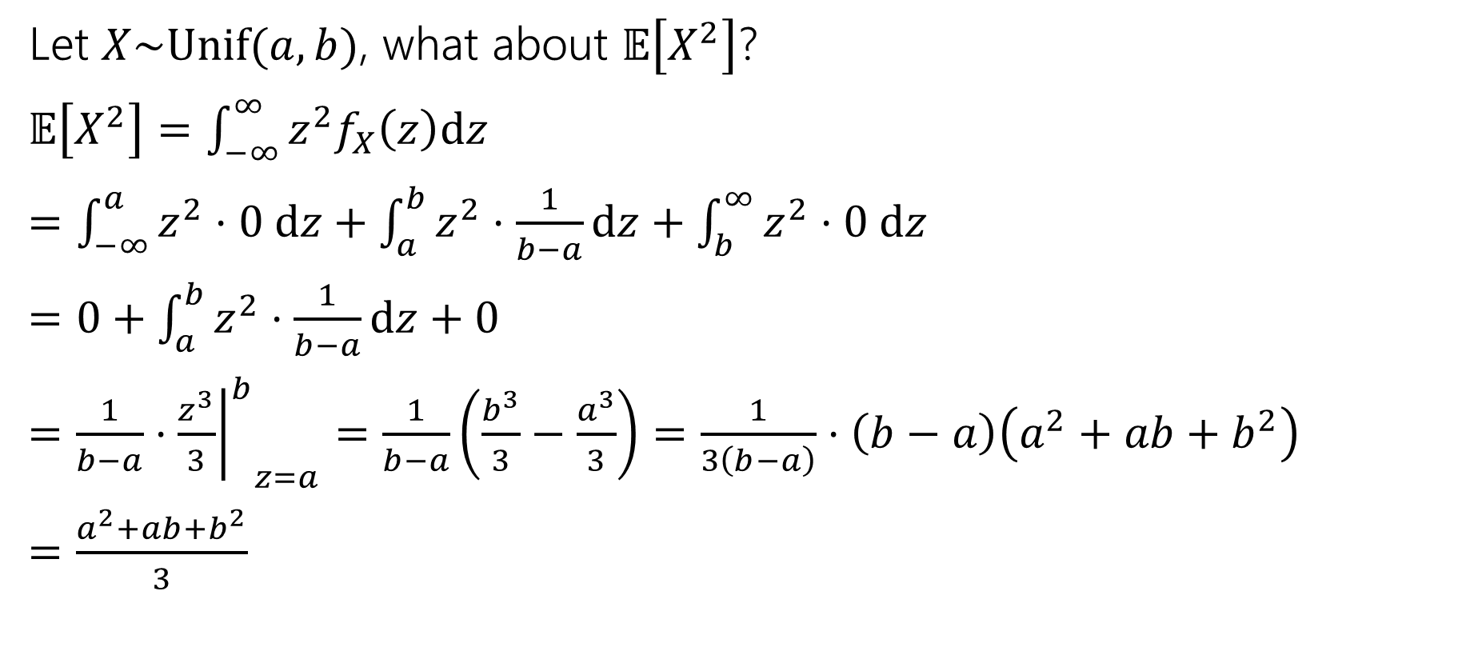

What about $𝔼\left[g\left(X\right)\right]$
Let $X\sim Unif(a,b)$, what about $𝔼\left[X^{2}\right]$?
$𝔼\left[X^{2}\right]=\int_{−∞}^{∞}{z^{2}f_{X}\left(z\right)dz}$
$=\int_{−∞}^{a}{z^{2}⋅0 dz+\int_{a}^{b}{z^{2}⋅\frac{1}{b−a}dz}+\int_{b}^{∞}{z^{2}⋅0 dz}}$
$=0+\int_{a}^{b}{z^{2}⋅\frac{1}{b−a}dz}+0$
$=\frac{1}{b−a}⋅{{\left.\frac{z^{3}}{3}\right|}^{b}}_{z=a}=\frac{1}{b−a}\left(\frac{b^{3}}{3}−\frac{a^{3}}{3}\right)=\frac{1}{3\left(b−a\right)}⋅\left(b−a\right)\left(a^{2}+ab+b^{2}\right)$
$=\frac{a^{2}+ab+b^{2}}{3}$

Slide 30

Let’s assemble the variance
$Var\left(X\right)=𝔼\left[X^{2}\right]−{\left(𝔼\left[X\right]\right)}^{2}$
$=\frac{a^{2}+ab+b^{2}}{3}−{\left(\frac{a+b}{2}\right)}^{2}$
$=\frac{4(a^{2}+ab+b^{2})}{12}−\frac{{3(a}^{2}+2ab+b^{2})}{12}$
$=\frac{a^{2}−2ab+b^{2}}{12}$
$=\frac{{\left(a−b\right)}^{2}}{12}$

Slide 31
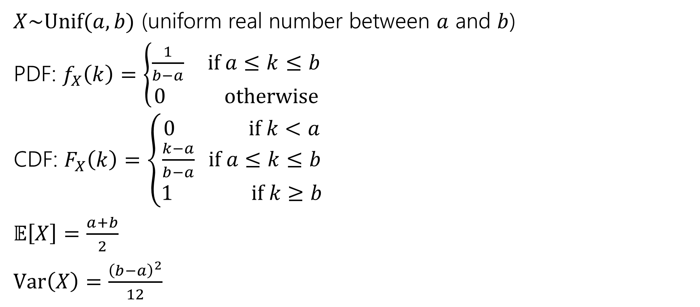
Continuous Uniform Distribution
$X\sim Unif(a,b)$ (uniform real number between $a$ and $b$)
PDF: $f_{X}\left(k\right)=\left\{\begin{aligned}\frac{1}{b−a} if a≤k≤b \\ 0 otherwise\end{aligned}\right.$
CDF: $F_{X}\left(k\right)=\left\{\begin{aligned}0 if k<a \\ \frac{k−a}{b−a} if a≤k≤b \\ 1 if k≥b\end{aligned}\right.$
$𝔼\left[X\right]=\frac{a+b}{2}$
$Var\left(X\right)=\frac{{\left(b−a\right)}^{2}}{12}$

Slide 32
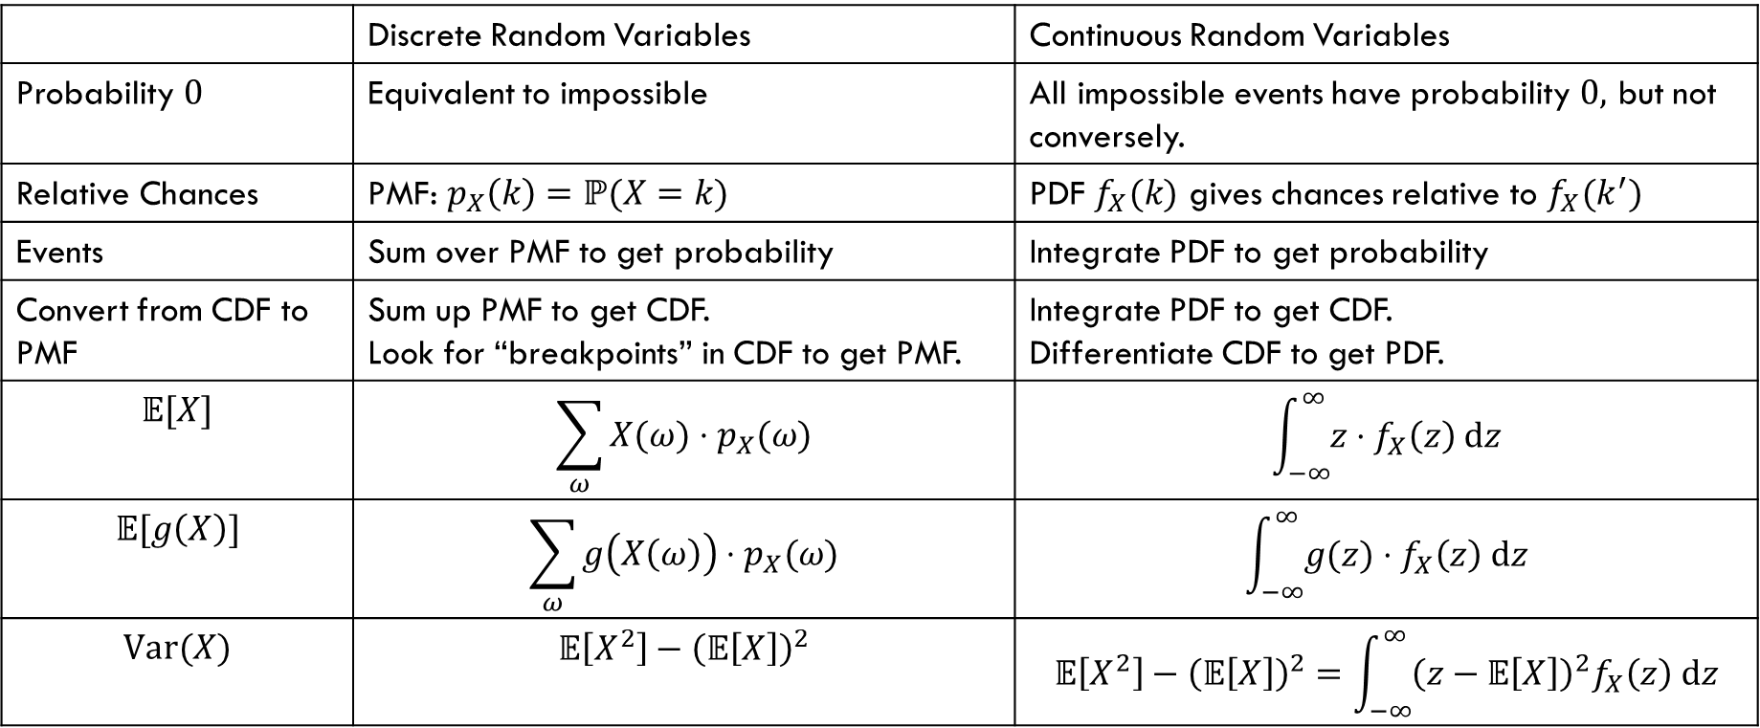
Comparing Discrete and Continuous
 | Discrete Random Variables | Continuous Random Variables
Probability $0$ | Equivalent to impossible | All impossible events have probability $0,$ but not conversely.
Relative Chances | PMF: $p_{X}\left(k\right)=ℙ(X=k)$ | PDF $f_{X}(k)$ gives chances relative to $f_{X}(k^{′})$
Events | Sum over PMF to get probability | Integrate PDF to get probability
Convert from CDF to PMF | Sum up PMF to get CDF. Look for “breakpoints” in CDF to get PMF. | Integrate PDF to get CDF. Differentiate CDF to get PDF.
$$𝔼[X]$$ | $$\sum_{ω}{X(ω)⋅p_{X}(ω)}$$ | $$\int_{−∞}^{∞}{z⋅f_{X}\left(z\right) dz}$$
$$𝔼[g\left(X\right)]$$ | $$\sum_{ω}{g\left(X\left(ω\right)\right)⋅p_{X}(ω)}$$ | $$\int_{−∞}^{∞}{g(z)⋅f_{X}\left(z\right) dz}$$
$$Var(X)$$ | $$𝔼\left[X^{2}\right]−{\left(𝔼\left[X\right]\right)}^{2}$$ | $$𝔼\left[X^{2}\right]−{\left(𝔼\left[X\right]\right)}^{2}=\int_{−∞}^{∞}{{\left(z−𝔼\left[X\right]\right)}^{2}f_{X}\left(z\right) dz}$$

