Slide 1
Discrete RV Zoo
Part 2
CSE 312 Summer 25
Lecture 12

Slide 2












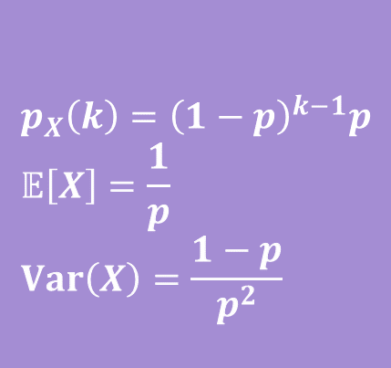
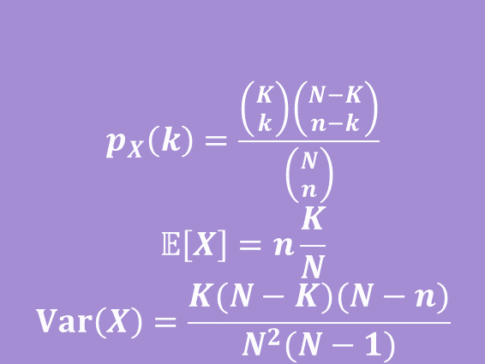
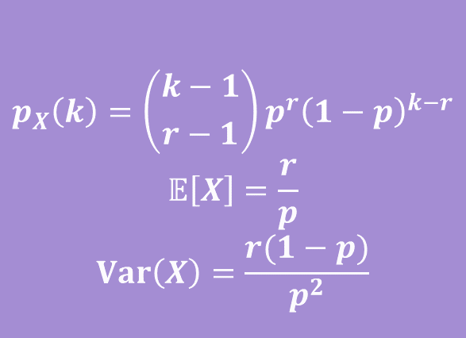


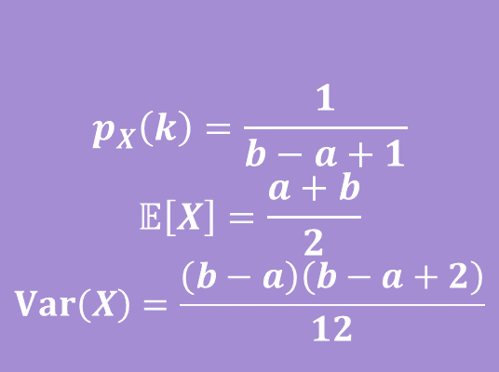


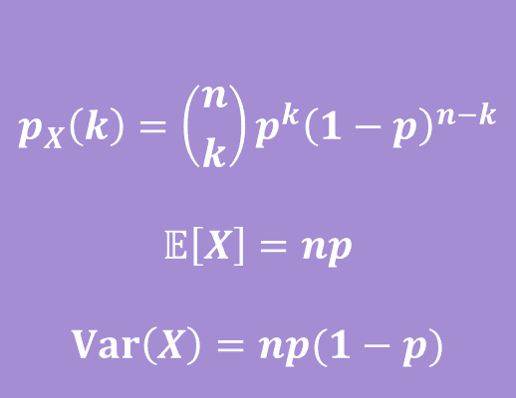
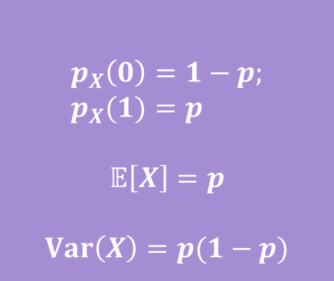

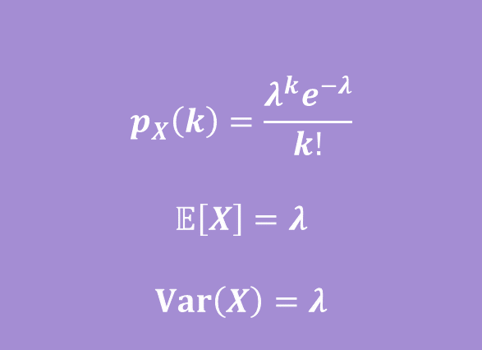
Zoo!
$$X\sim Geo(p)$$
$$X\sim Unif(a,b)$$
$$p_{X}\left(k\right)={\left(1−p\right)}^{k−1}p \\ 𝔼\left[X\right]=\frac{1}{p} \\ Var\left(X\right)=\frac{1−p}{p^{2}}$$
$$p_{X}\left(k\right)=\frac{1}{b−a+1}$$
$$𝔼\left[X\right]=\frac{a+b}{2}$$
$$Var\left(X\right)=\frac{\left(b−a\right)\left(b−a+2\right)}{12}$$
$$X\sim Ber(p)$$
$$X\sim Bin(n,p)$$
$$p_{X}\left(0\right)=1−p; \\ p_{X}(1)=p$$
$$𝔼\left[X\right]=p$$
$$Var\left(X\right)=p(1−p)$$
$$p_{X}\left(k\right)=\left({n \atop k}\right)p^{k}{\left(1−p\right)}^{n−k}$$
$$𝔼\left[X\right]=np$$
$$Var\left(X\right)=np(1−p)$$
$$X\sim Poi(λ)$$
$$X\sim NegBin(r,p)$$
$$p_{X}\left(k\right)=\frac{λ^{k}e^{−λ}}{k!}$$
$$𝔼\left[X\right]=λ$$
$$Var\left(X\right)=λ$$
$$p_{X}\left(k\right)=\left({k−1 \atop r−1}\right)p^{r}{\left(1−p\right)}^{k−r}$$
$$𝔼\left[X\right]=\frac{r}{p}$$
$$Var\left(X\right)=\frac{r(1−p)}{p^{2}}$$
$$X\sim HypGeo(N,K,n)$$
$$p_{X}\left(k\right)=\frac{\left({K \atop k}\right)\left({N−K \atop n−k}\right)}{\left({N \atop n}\right)}$$
$$𝔼\left[X\right]=n\frac{K}{N}$$
$$Var\left(X\right)=\frac{K(N−K)(N−n)}{N^{2}(N−1)}$$
Notes:
We will try to get through as many as we can, but you will have these slides for reference to see more details about these.

Slide 3
Some More Familiar Variables

Slide 4

Situation: Geometric
You flip a coin (which comes up heads with probability $p$) until you get a heads. How many flips did you need?
More generally: how many independent trials are needed until the first success?
Notes:
What would the probability mass function look like?

Slide 5
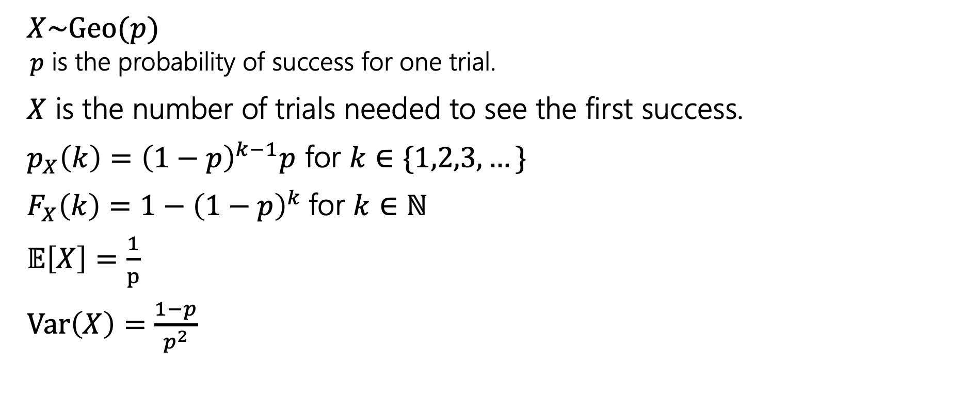
Geometric Distribution
$X\sim Geo(p)$
  $p$ is the probability of success for one trial.
$X$ is the number of trials needed to see the first success.
$p_{X}\left(k\right)={\left(1−p\right)}^{k−1}p$ for $k∈\{1,2,3,…\}$
$F_{X}\left(k\right)=1−{\left(1−p\right)}^{k}$for $k∈ℕ$
$𝔼\left[X\right]=\frac{1}{p}$
$Var\left(X\right)=\frac{1−p}{p^{2}}$
Some other uses:
How many bits can we write before one is incorrect?
How many questions do you have to answer until you get one right?
How many times can you run an experiment until it fails for the first time?

Slide 6
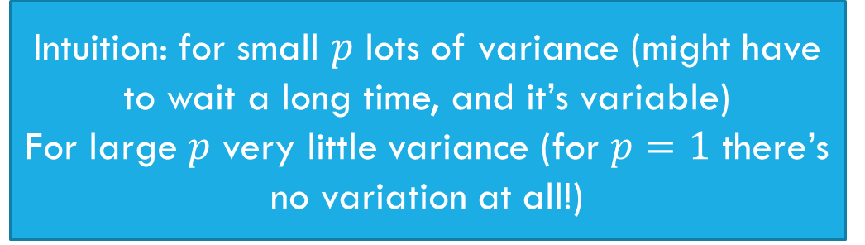


Geometric: Expectation
$𝔼\left[X\right]=\sum_{k=1}^{∞}{k{\left(1−p\right)}^{k−1}p}$
$=p\sum_{k=1}^{∞}{k{\left(1−p\right)}^{k−1}}=p⋅\frac{1}{p^{2}}=\frac{1}{p}$.
$Var\left(X\right)=𝔼\left[X^{2}\right]−{\left(𝔼\left[X\right]\right)}^{2}$
$=\frac{2−p}{p^{2}}−\frac{1}{p^{2}}=\frac{1−p}{p^{2}}$
Intuition: Smaller $p$ means longer wait
Intuition: for small $p$ lots of variance (might have to wait a long time, and it’s variable)
For large $p$ very little variance (for $p=1$ there’s no variation at all!)

Slide 7
Geometric Property
Geometric random variables are called “memoryless”
Suppose you’re flipping coins (independently) until you see a heads.
The first two came up tails.
How many flips are left until you see the first heads?
It’s another independent copy of the original!
The coin “forgot” it already came up tails 2 times.

Slide 8

Formally…
Let $X$ be the total number of flips needed, $Y$ be the flips after the second.
$ℙ\left(Y=k\right|X≥3)=?$
…
Which is $p_{X}(k)$.

Slide 9
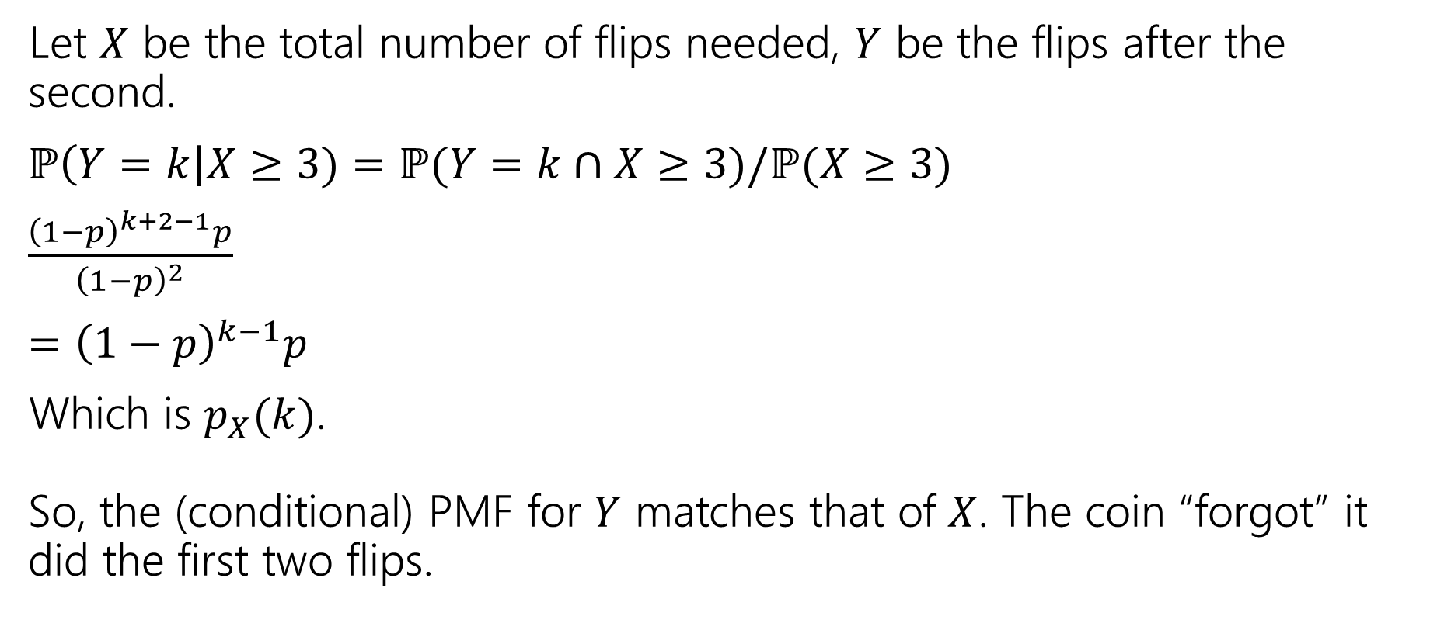
Formally…
Let $X$ be the total number of flips needed, $Y$ be the flips after the second.
$ℙ\left(Y=k\right|X≥3)=ℙ(Y=k∩X≥3)/ℙ(X≥3)$
$\frac{{\left(1−p\right)}^{k+2−1}p}{{\left(1−p\right)}^{2}}$
$={\left(1−p\right)}^{k−1}p$
Which is $p_{X}(k)$.
So, the (conditional) PMF for $Y$ matches that of $X$. The coin “forgot” it did the first two flips.
Notes:
If Y = k, X = k + 2
If we choose a positive k, then it will hold that X >= 3
Y = k is the same probability that X = k + 2, so how do we get that X = k + 2?
P(X >= 3) is saying that the first 2 flips were tails and then we don’t know what happens after that
We’ll learn about another random variable later on that also had this memoryless property

Slide 10
Scenario: Uniform
You Roll a Fair Die (or draw a random integer from 1,…,n).
More generally: you want an integer in some range, with each equally likely.

Slide 11
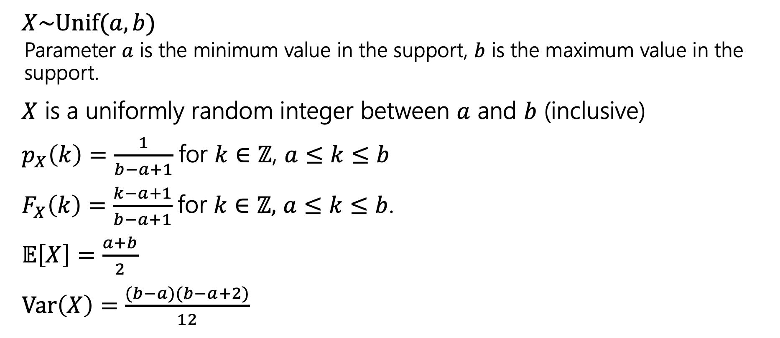
Discrete Uniform Distribution
$X\sim Unif(a,b)$
  Parameter $a$ is the minimum value in the support, $b$ is the maximum value in the support.
$X$ is a uniformly random integer between $a$ and $b$ (inclusive)
$p_{X}\left(k\right)=\frac{1}{b−a+1}$for $k∈ℤ$, $a≤k≤b$
$F_{X}\left(k\right)=\frac{k−a+1}{b−a+1}$for $k∈ℤ,$ $a≤k≤b$.
$𝔼\left[X\right]=\frac{a+b}{2}$
$Var\left(X\right)=\frac{(b−a)(b−a+2)}{12}$
Notes:
Fair die roll is unif(1,6)

Slide 12
Some Less Familiar Distributions

Slide 13
The Poisson Distribution
A new kind of random variable.
We use a Poisson distribution when:
We’re trying to count the number of times something happens in some interval of time.
We know the average number that happen (i.e. the expectation)
Each occurrence is independent of the others.
There are a VERY large number of “potential sources” for those events, few of which happen.
Notes:
Simeon Davis Poisson was a French mathematician
So far we’ve been talking about using the random variable zoo to look at an experiment and identity what random variable from our zoo fits best, the Poisson distribution is a little different
This last point is a bit vague, so lets look at some examples

Slide 14
The Poisson Distribution
Classic applications:
  How many traffic accidents occur in Seattle in a day?
  How many major earthquakes occur in a year (not including aftershocks)?
  How many customers visit a bakery in an hour?
Why not just use counting coin flips?
What are the flips…the number of cars? Every person who might visit the bakery? There are way too many of these to count exactly or think about dependency between.
But a Poisson might accurately model what’s happening.

Slide 15
It’s a model
By modeling choice, we mean that we’re choosing math that we think represents the real world as best as possible
Is every traffic accident really independent?
Not really, one causes congestion, which causes angrier drivers. Or both might be caused by bad weather/more cars on the road.
But we assume they are (because the dependence is so weak that the model is useful).
Notes:
Using a passion distribution is always a modeling choice. It’s a choice that we are making when doing the analysis, because we believe this will be the best representation we can find, because we cant perfectly describe the experiment for example with a binomial distribution that describes the number of successes in some n trials
When occurrences aren’t actually independent, we will tell you that we would like you to still use a Poisson distribution to model the situation.

Slide 16
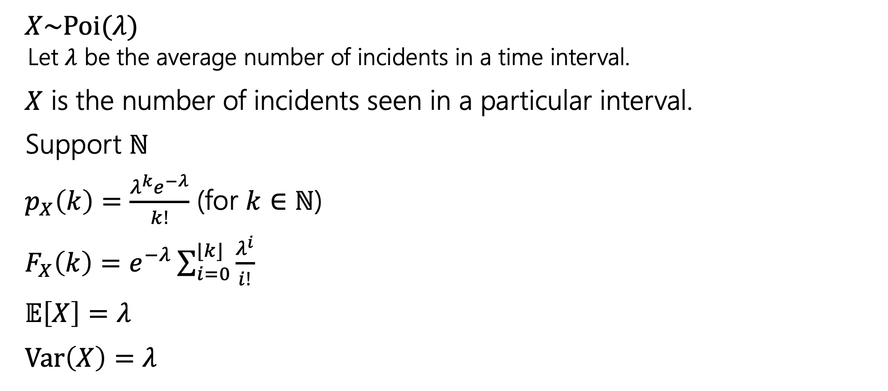
Poisson Distribution
$X\sim Poi(λ)$
  Let $λ$ be the average number of incidents in a time interval.
$X$ is the number of incidents seen in a particular interval.
Support $ℕ$
$p_{X}\left(k\right)=\frac{λ^{k}e^{−λ}}{k!}$ (for $k∈ℕ$)
$F_{X}\left(k\right)=e^{−λ}\sum_{i=0}^{⌊k⌋}{\frac{λ^{i}}{i!}}$
$𝔼\left[X\right]=λ$
$Var\left(X\right)=λ$
Notes:
These time interval need to be the same
Every natural number will have a non zero probability, starting from 0 to large numbers, the probability will get smaller for larger values, but it wont be zero

Slide 17
Some Sample PMFs
…
…
0
5
10
0
5
10

Slide 18


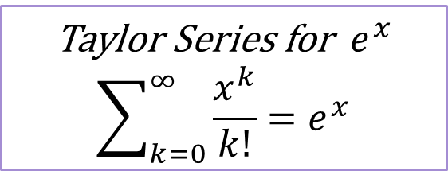
Let’s take a closer look at that pmf
$p_{X}\left(k\right)=\frac{λ^{k}e^{−λ}}{k!}$ (for $k∈ℕ$)
If this is a real PMF, it should sum to $1$.
Let’s check that to understand the PMF a little better.
$\sum_{k=0}^{∞}{\frac{λ^{k}e^{−λ}}{k!}}$
$=e^{−λ}\sum_{k=0}^{∞}{\frac{λ^{k}}{k!}}$
Taylor Series for $e^{x}$
$$\sum_{k=0}^{∞}{\frac{x^{k}}{k!}}=e^{x}$$
$$=e^{−λ}e^{λ}=e^{0}=1$$
Notes:
The goal for this isn’t to try to remember taylor series, but to understand where the piece of this formula come from.
So this e^-lambda is what we would call a normalizing constant, we know that our summation needs to add up to 1, so if our summation is e^lambda we can add this e^-lambda constant to normalize everything.
The core part of this formula is the lambda^k/k! which is giving us an exponential type function which give us this very quick drop off

Slide 19
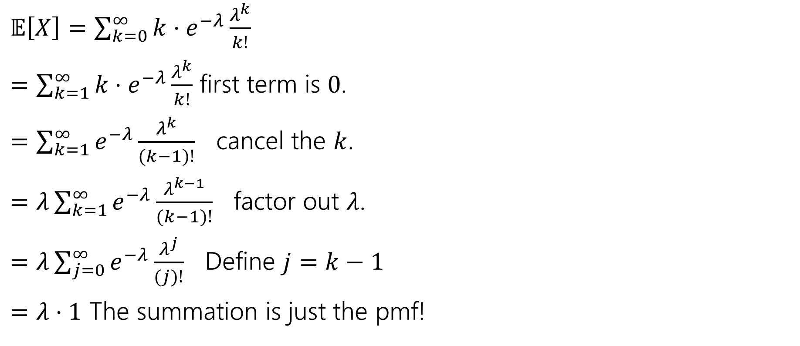
Let’s check something…the expectation
$𝔼\left[X\right]=\sum_{k=0}^{∞}{k⋅e^{−λ}\frac{λ^{k}}{k!}}$
$=\sum_{k=1}^{∞}{k⋅e^{−λ}\frac{λ^{k}}{k!}}$ first term is $0$.
$=\sum_{k=1}^{∞}{e^{−λ}\frac{λ^{k}}{(k−1)!}}$ cancel the $k$.
$=λ\sum_{k=1}^{∞}{e^{−λ}\frac{λ^{k−1}}{(k−1)!}}$ factor out $λ$.
$=λ\sum_{j=0}^{∞}{e^{−λ}\frac{λ^{j}}{(j)!}}$ Define $j=k−1$
$=λ⋅1$ The summation is just the pmf!
Notes:
We wont go over this, but if you’re interested feel free to try it out

Slide 20
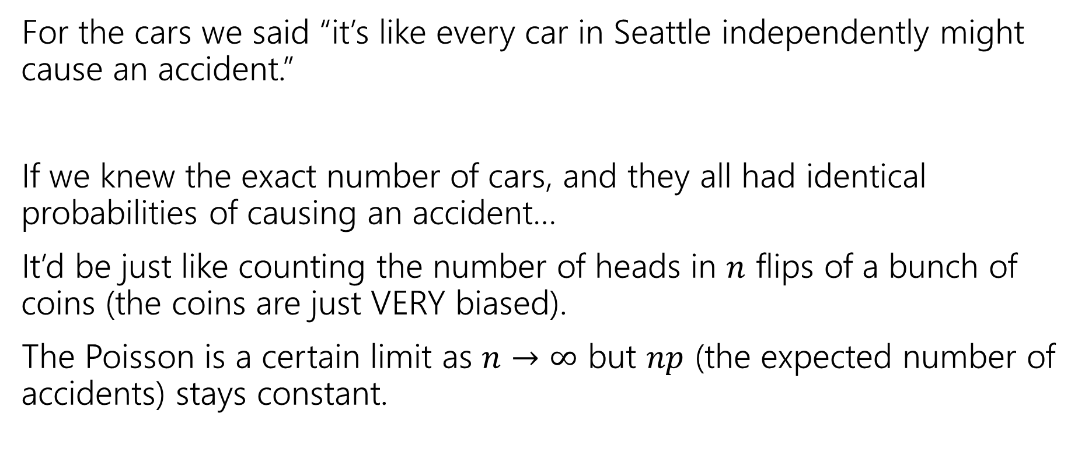
Where did this expression come from?
For the cars we said “it’s like every car in Seattle independently might cause an accident.”
If we knew the exact number of cars, and they all had identical probabilities of causing an accident…
It’d be just like counting the number of heads in $n$ flips of a bunch of coins (the coins are just VERY biased).
The Poisson is a certain limit as $n→∞$ but $np$ (the expected number of accidents) stays constant.
Notes:
The Poisson distribution was derived from a binomial distribution when n goes off to infinity, but the expected number of occurrences stays constant. If you’re interested in more of the details I would recommend taking a look at section 3.6.1 in our optional textbook on the course website.
Poisson to approximate a binomial distribution when n gets really big.

Slide 21

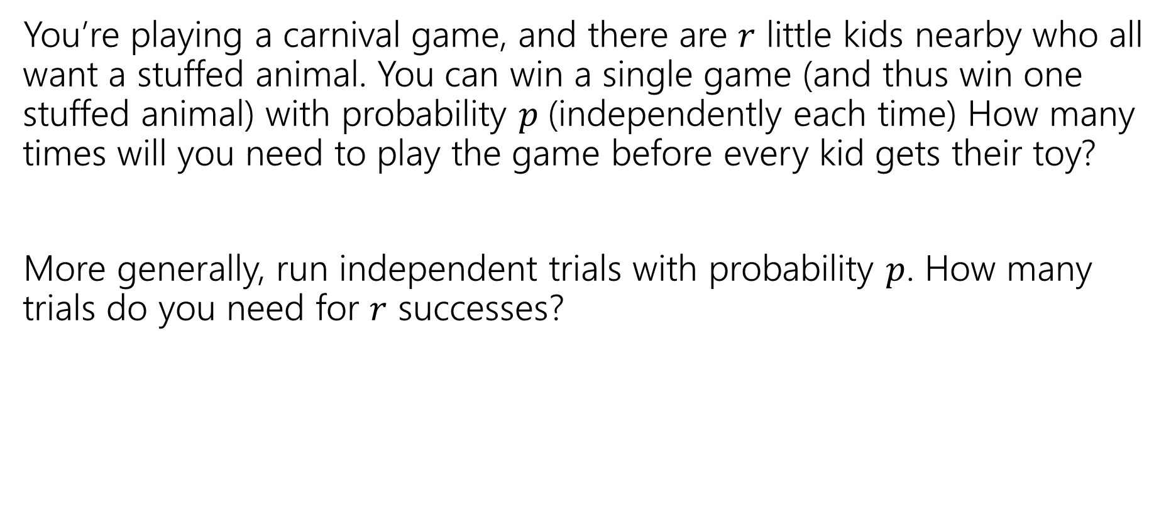
Scenario: Negative Binomial
You’re playing a carnival game, and there are $r$ little kids nearby who all want a stuffed animal. You can win a single game (and thus win one stuffed animal) with probability $p$(independently each time) How many times will you need to play the game before every kid gets their toy?
More generally, run independent trials with probability $p$. How many trials do you need for $r$ successes?

Slide 22
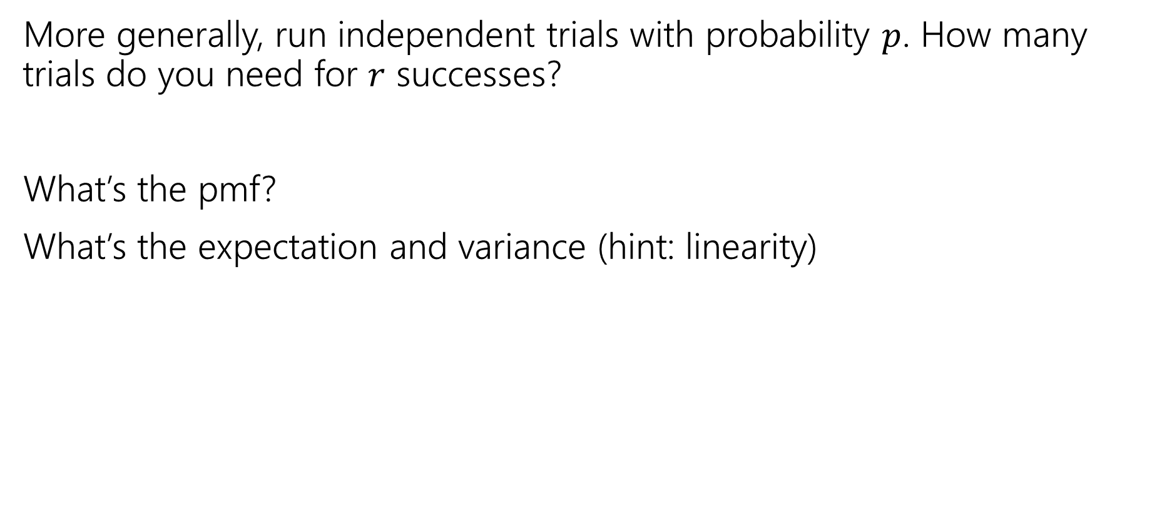
Try it
More generally, run independent trials with probability $p$. How many trials do you need for $r$ successes?
What’s the pmf?
What’s the expectation and variance (hint: linearity)
Notes:
Try setting these variables to particular values.

Slide 23
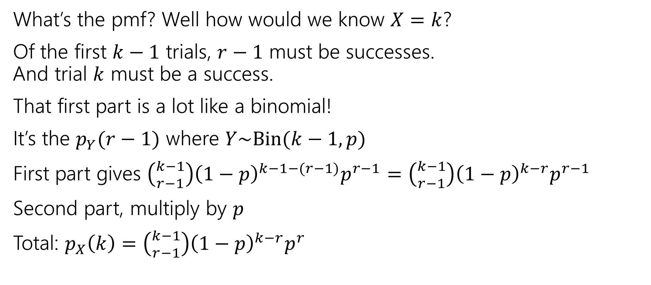
Negative Binomial Analysis
What’s the pmf? Well how would we know $X=k$?
Of the first $k−1$ trials, $r−1$ must be successes.
And trial $k$ must be a success.
That first part is a lot like a binomial!
It’s the $p_{Y}(r−1)$ where $Y\sim Bin(k−1, p)$
First part gives $\left({k−1 \atop r−1}\right){\left(1−p\right)}^{k−1−(r−1)}p^{r−1}=\left({k−1 \atop r−1}\right){\left(1−p\right)}^{k−r}p^{r−1}$
Second part, multiply by $p$
Total: $p_{X}\left(k\right)=\left({k−1 \atop r−1}\right){\left(1−p\right)}^{k−r}p^{r}$

Slide 24
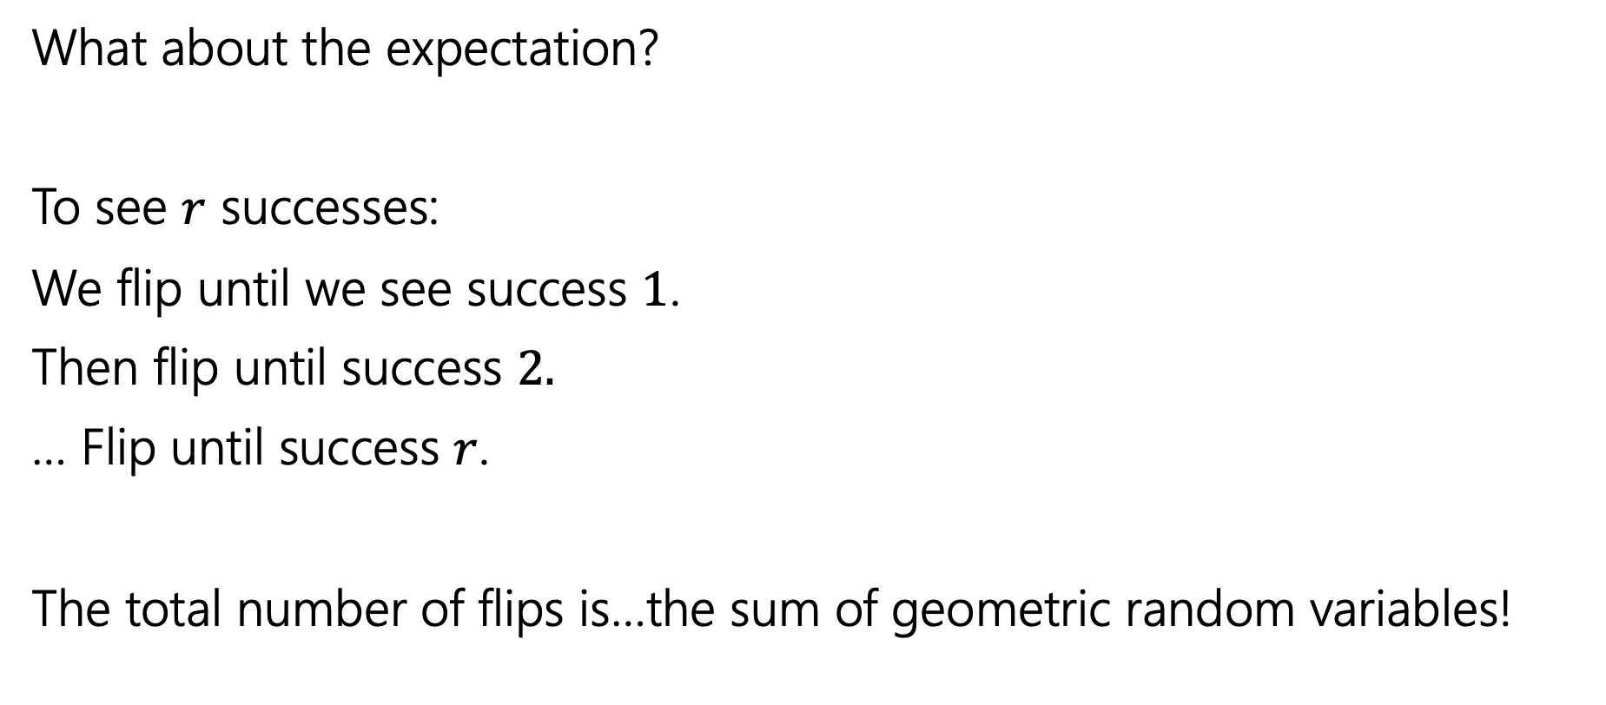
Negative Binomial Analysis
What about the expectation?
To see $r$ successes:
We flip until we see success $1$.
Then flip until success $2.$
… Flip until success $r$.
The total number of flips is…the sum of geometric random variables!

Slide 25
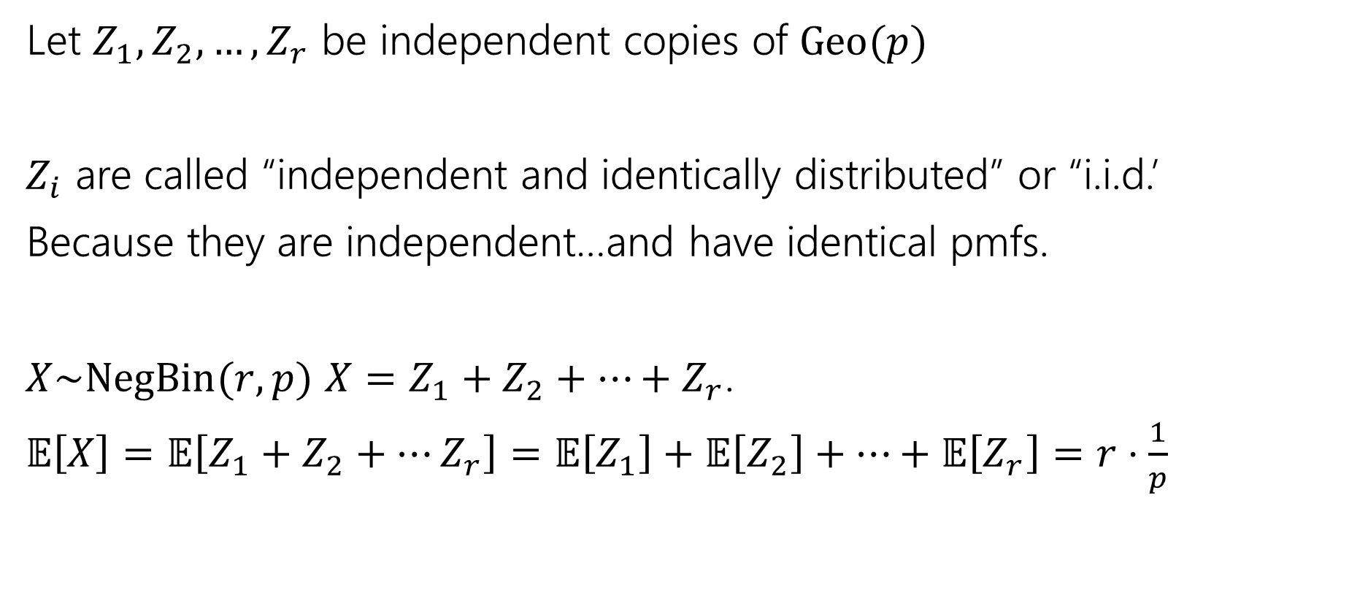
Negative Binomial Analysis
Let $Z_{1},Z_{2},…,Z_{r}$ be independent copies of $Geo(p)$
$Z_{i}$ are called “independent and identically distributed” or “i.i.d.’
Because they are independent…and have identical pmfs.
$X\sim NegBin(r,p)$ $X=Z_{1}+Z_{2}+…+Z_{r}$.
$𝔼\left[X\right]=𝔼\left[Z_{1}+Z_{2}+…Z_{r}\right]=𝔼\left[Z_{1}\right]+𝔼\left[Z_{2}\right]+…+𝔼\left[Z_{r}\right]=r⋅\frac{1}{p}$

Slide 26
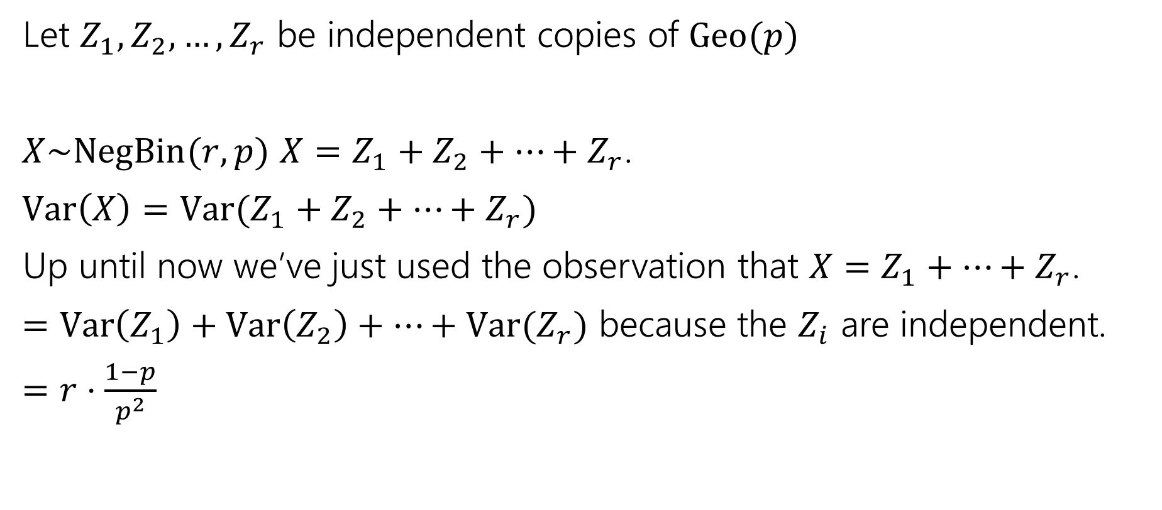
Negative Binomial Analysis
Let $Z_{1},Z_{2},…,Z_{r}$ be independent copies of $Geo(p)$
$X\sim NegBin(r,p)$ $X=Z_{1}+Z_{2}+…+Z_{r}$.
$Var\left(X\right)=Var(Z_{1}+Z_{2}+…+Z_{r})$
Up until now we’ve just used the observation that $X=Z_{1}+…+Z_{r}$.
$=Var\left(Z_{1}\right)+Var\left(Z_{2}\right)+…+Var(Z_{r})$ because the $Z_{i}$ are independent.
$=r⋅\frac{1−p}{p^{2}}$

Slide 27
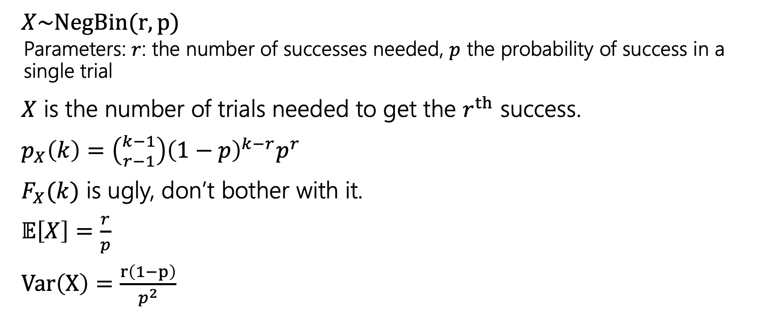
Negative Binomial
$X\sim NegBin(r,p)$
  Parameters: $r$: the number of successes needed, $p$ the probability of success in a single trial
$X$ is the number of trials needed to get the $r^{th}$ success.
$p_{X}\left(k\right)=\left({k−1 \atop r−1}\right){\left(1−p\right)}^{k−r}p^{r}$
$F_{X}(k)$ is ugly, don’t bother with it.
$𝔼\left[X\right]=\frac{r}{p}$
$Var\left(X\right)=\frac{r\left(1−p\right)}{p^{2}}$

Slide 28

Scenario: Hypergeometric
You have an urn with $N$ balls, of which $K$ are purple. You are going to draw balls out of the urn without replacement.
If you draw out $n$ balls, what is the probability you see $k$ purple ones?

Slide 29
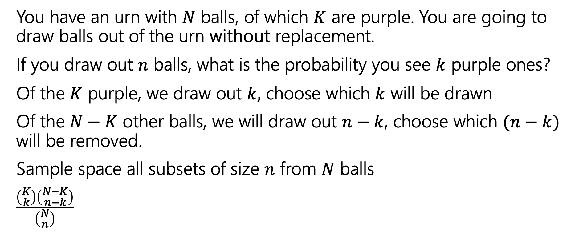
Hypergeometric: Analysis
You have an urn with $N$ balls, of which $K$ are purple. You are going to draw balls out of the urn without replacement.
If you draw out $n$ balls, what is the probability you see $k$ purple ones?
Of the $K$ purple, we draw out $k,$ choose which $k$ will be drawn
Of the $N−K$ other balls, we will draw out $n−k$, choose which $(n−k)$ will be removed.
Sample space all subsets of size $n$ from $N$ balls
$\frac{\left({K \atop k}\right)\left({N−K \atop n−k}\right)}{\left({N \atop n}\right)}$

Slide 30
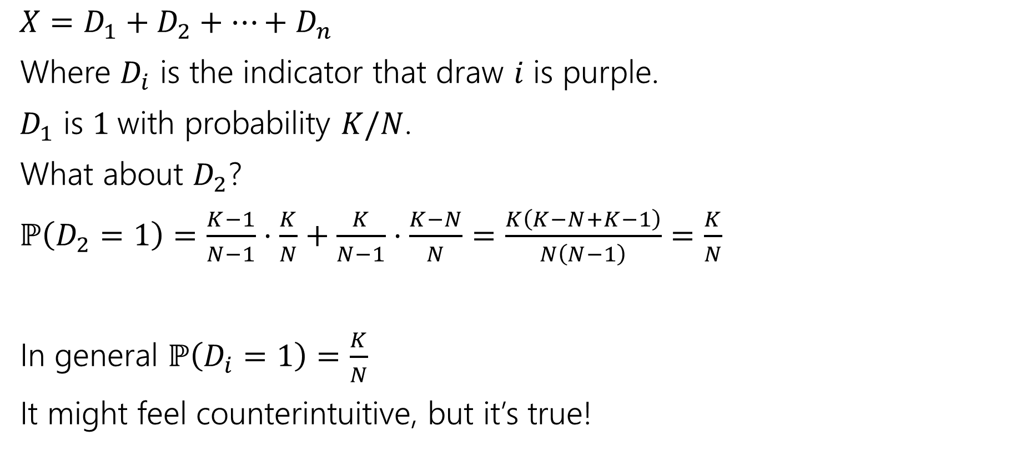
Hypergeometric: Analysis
$X=D_{1}+D_{2}+…+D_{n}$
Where $D_{i}$ is the indicator that draw $i$ is purple.
$D_{1}$ is $1$with probability $K/N$.
What about $D_{2}$?
$ℙ\left(D_{2}=1\right)=\frac{K−1}{N−1}⋅\frac{K}{N}+\frac{K}{N−1}⋅\frac{K−N}{N}=\frac{K\left(K−N+K−1\right)}{N\left(N−1\right)}=\frac{K}{N}$
In general $ℙ\left(D_{i}=1\right)=\frac{K}{N}$
It might feel counterintuitive, but it’s true!

Slide 31

Hypergeometric: Analysis
$𝔼[X]$
$=𝔼\left[D_{1}+…D_{n}\right]=𝔼\left[D_{1}\right]+…+𝔼\left[D_{n}\right]=n⋅\frac{K}{N}$
Can we do the same for variance?
No! The $D_{i}$ are dependent. Even if they have the same probability.

Slide 32
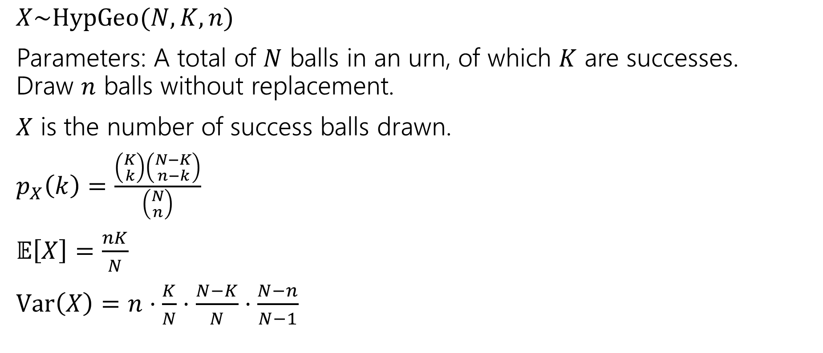
Hypergeometric Random Variable
$X\sim HypGeo(N,K,n)$
Parameters: A total of $N$ balls in an urn, of which $K$ are successes.
Draw $n$ balls without replacement.
$X$ is the number of success balls drawn.
$p_{X}\left(k\right)=\frac{\left({K \atop k}\right)\left({N−K \atop n−k}\right)}{\left({N \atop n}\right)}$
$𝔼\left[X\right]=\frac{nK}{N}$
$Var\left(X\right)=n⋅\frac{K}{N}⋅\frac{N−K}{N}⋅\frac{N−n}{N−1}$

Slide 33
Zoo!
$$X\sim Geo(p)$$
$$X\sim Unif(a,b)$$
$$p_{X}\left(k\right)={\left(1−p\right)}^{k−1}p \\ 𝔼\left[X\right]=\frac{1}{p} \\ Var\left(X\right)=\frac{1−p}{p^{2}}$$
$$p_{X}\left(k\right)=\frac{1}{b−a+1}$$
$$𝔼\left[X\right]=\frac{a+b}{2}$$
$$Var\left(X\right)=\frac{\left(b−a\right)\left(b−a+2\right)}{12}$$
$$X\sim Ber(p)$$
$$X\sim Bin(n,p)$$
$$p_{X}\left(0\right)=1−p; \\ p_{X}(1)=p$$
$$𝔼\left[X\right]=p$$
$$Var\left(X\right)=p(1−p)$$
$$p_{X}\left(k\right)=\left({n \atop k}\right)p^{k}{\left(1−p\right)}^{n−k}$$
$$𝔼\left[X\right]=np$$
$$Var\left(X\right)=np(1−p)$$
$$X\sim Poi(λ)$$
$$X\sim NegBin(r,p)$$
$$p_{X}\left(k\right)=\frac{λ^{k}e^{−λ}}{k!}$$
$$𝔼\left[X\right]=λ$$
$$Var\left(X\right)=λ$$
$$p_{X}\left(k\right)=\left({k−1 \atop r−1}\right)p^{r}{\left(1−p\right)}^{k−r}$$
$$𝔼\left[X\right]=\frac{r}{p}$$
$$Var\left(X\right)=\frac{r(1−p)}{p^{2}}$$
$$X\sim HypGeo(N,K,n)$$
$$p_{X}\left(k\right)=\frac{\left({K \atop k}\right)\left({N−K \atop n−k}\right)}{\left({N \atop n}\right)}$$
$$𝔼\left[X\right]=n\frac{K}{N}$$
$$Var\left(X\right)=\frac{K(N−K)(N−n)}{N^{2}(N−1)}$$
Notes:
Note about geo and hypgeo naming

Slide 34
Zoo Takeaways
You can do relatively complicated counting/probability calculations much more quickly than you could week 1!
You can now explain why your problem is a zoo variable and save explanation on homework (and save yourself calculations in the future).
Don’t spend extra effort memorizing…but be careful when looking up Wikipedia articles.
  The exact definitions of the parameters can differ (is a geometric random variable the number of failures before the first success, or the total number of trials including the success?)

Slide 35
Practice Problem: Poisson
Seattle averages 3 days with snowfall per year.
Suppose that the number of days with snow follows a Poisson distribution. What is the probability of getting exactly 5 days of snow?
According to the Poisson model, what is the probability of getting 367 days of snow?

Slide 36
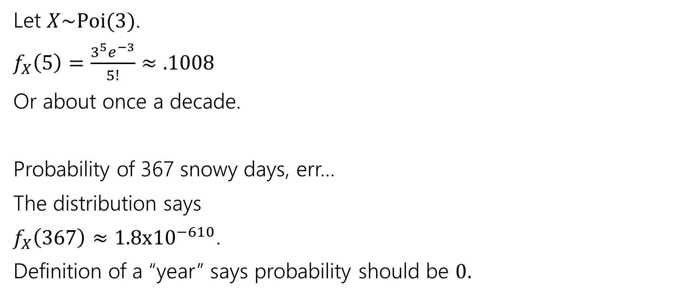
Practice: Poisson
Let $X\sim Poi(3)$.
$f_{X}\left(5\right)=\frac{3^{5}e^{−3}}{5!}≈.1008$
Or about once a decade.
Probability of 367 snowy days, err…
The distribution says
$f_{X}\left(367\right)≈1.8x{10}^{−610}$.
Definition of a “year” says probability should be $0.$

Slide 37
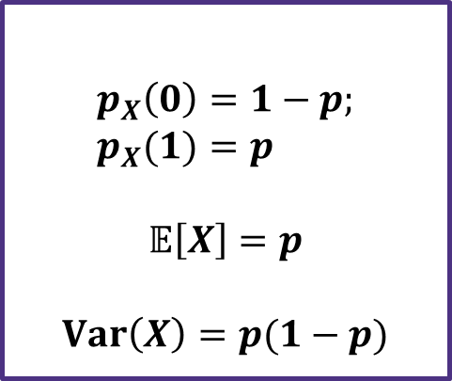
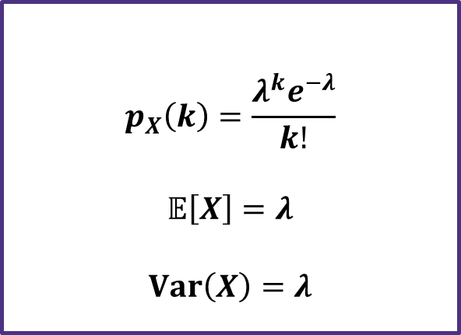



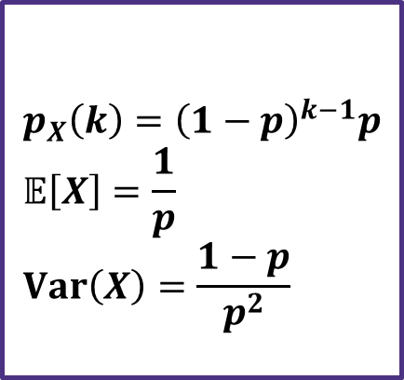
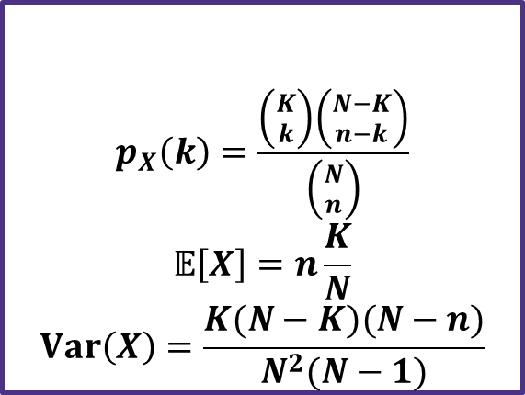

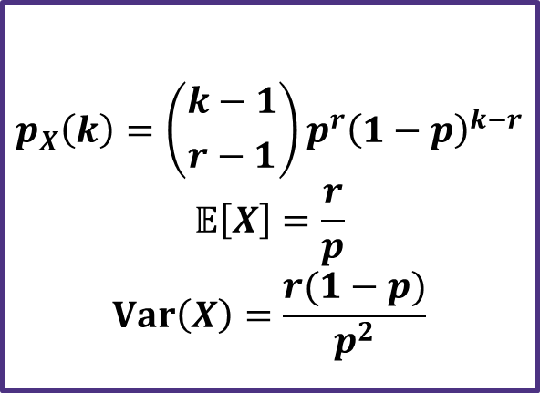

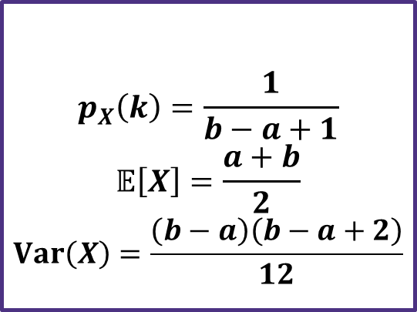

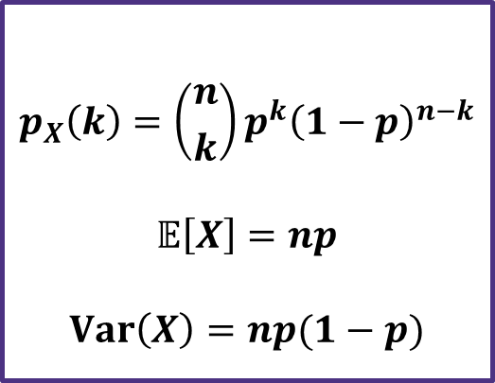

Zoo!
$$X\sim Geo(p)$$
$$X\sim Unif(a,b)$$
$$p_{X}\left(k\right)={\left(1−p\right)}^{k−1}p \\ 𝔼\left[X\right]=\frac{1}{p} \\ Var\left(X\right)=\frac{1−p}{p^{2}}$$
$$p_{X}\left(k\right)=\frac{1}{b−a+1}$$
$$𝔼\left[X\right]=\frac{a+b}{2}$$
$$Var\left(X\right)=\frac{\left(b−a\right)\left(b−a+2\right)}{12}$$
$$X\sim Ber(p)$$
$$X\sim Bin(n,p)$$
$$p_{X}\left(0\right)=1−p; \\ p_{X}(1)=p$$
$$𝔼\left[X\right]=p$$
$$Var\left(X\right)=p(1−p)$$
$$p_{X}\left(k\right)=\left({n \atop k}\right)p^{k}{\left(1−p\right)}^{n−k}$$
$$𝔼\left[X\right]=np$$
$$Var\left(X\right)=np(1−p)$$
$$X\sim Poi(λ)$$
$$X\sim NegBin(r,p)$$
$$p_{X}\left(k\right)=\frac{λ^{k}e^{−λ}}{k!}$$
$$𝔼\left[X\right]=λ$$
$$Var\left(X\right)=λ$$
$$p_{X}\left(k\right)=\left({k−1 \atop r−1}\right)p^{r}{\left(1−p\right)}^{k−r}$$
$$𝔼\left[X\right]=\frac{r}{p}$$
$$Var\left(X\right)=\frac{r(1−p)}{p^{2}}$$
$$X\sim HypGeo(N,K,n)$$
$$p_{X}\left(k\right)=\frac{\left({K \atop k}\right)\left({N−K \atop n−k}\right)}{\left({N \atop n}\right)}$$
$$𝔼\left[X\right]=n\frac{K}{N}$$
$$Var\left(X\right)=\frac{K(N−K)(N−n)}{N^{2}(N−1)}$$

