Slide 1
Linearity of Expectation
CSE 312 Summer 25
Lecture 10
Notes:
Last lecture that is fair game for the midterm

Slide 2
Announcements
Quiz 3 on Friday
Midterm next Wednesday July 23rd
Details on course website
No homework this week, use the time to study for quiz and midterm

Slide 3
Variance

Slide 4
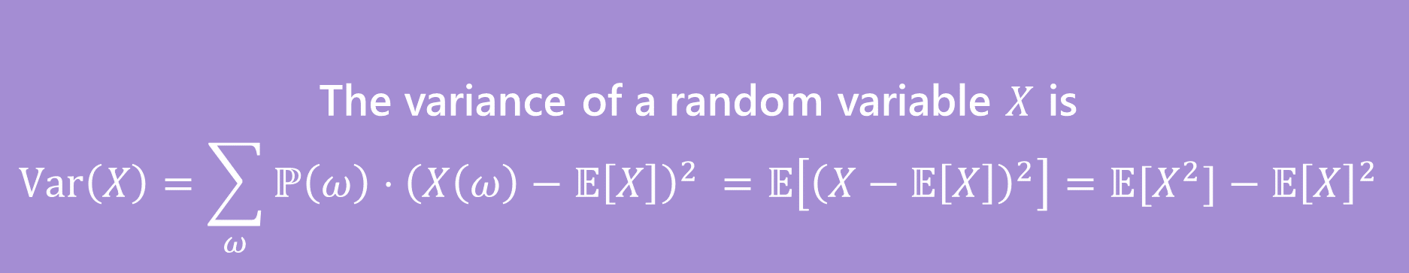
Variance
The first two forms are the definition. The last one is an algebra trick.
The variance of a random variable $X$ is
$$Var\left(X\right)=\sum_{ω}{ℙ\left(ω\right)⋅{\left(X\left(ω\right)−𝔼\left[X\right]\right)}^{2} }=𝔼\left[{\left(X−𝔼\left[X\right]\right)}^{2}\right]=𝔼[X^{2}]−𝔼{\left[X\right]}^{2}$$
Variance
Notes:
In this class you’ll mostly be using this algebra trick version of variance

Slide 5
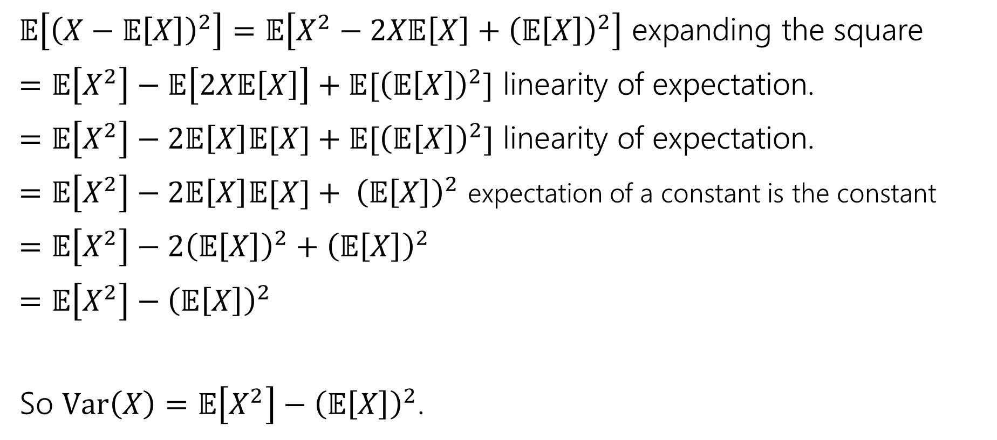
Proof of Calculation Trick
$𝔼\left[{\left(X−𝔼\left[X\right]\right)}^{2}\right]=𝔼\left[X^{2}−2X𝔼\left[X\right]+{\left(𝔼\left[X\right]\right)}^{2}\right]$ expanding the square
$=𝔼\left[X^{2}\right]−𝔼\left[2X𝔼\left[X\right]\right]+𝔼[{\left(𝔼\left[X\right]\right)}^{2}]$ linearity of expectation.
$=𝔼\left[X^{2}\right]−2𝔼\left[X\right]𝔼[X]+𝔼[{\left(𝔼\left[X\right]\right)}^{2}]$ linearity of expectation.
$=𝔼\left[X^{2}\right]−2𝔼\left[X\right]𝔼[X]+ {\left(𝔼\left[X\right]\right)}^{2}$ expectation of a constant is the constant
$=𝔼\left[X^{2}\right]−2{\left(𝔼\left[X\right]\right)}^{2}+{\left(𝔼\left[X\right]\right)}^{2}$
$=𝔼\left[X^{2}\right]−{\left(𝔼\left[X\right]\right)}^{2}$
So $Var\left(X\right)=𝔼\left[X^{2}\right]−{\left(𝔼\left[X\right]\right)}^{2}$.

Slide 6
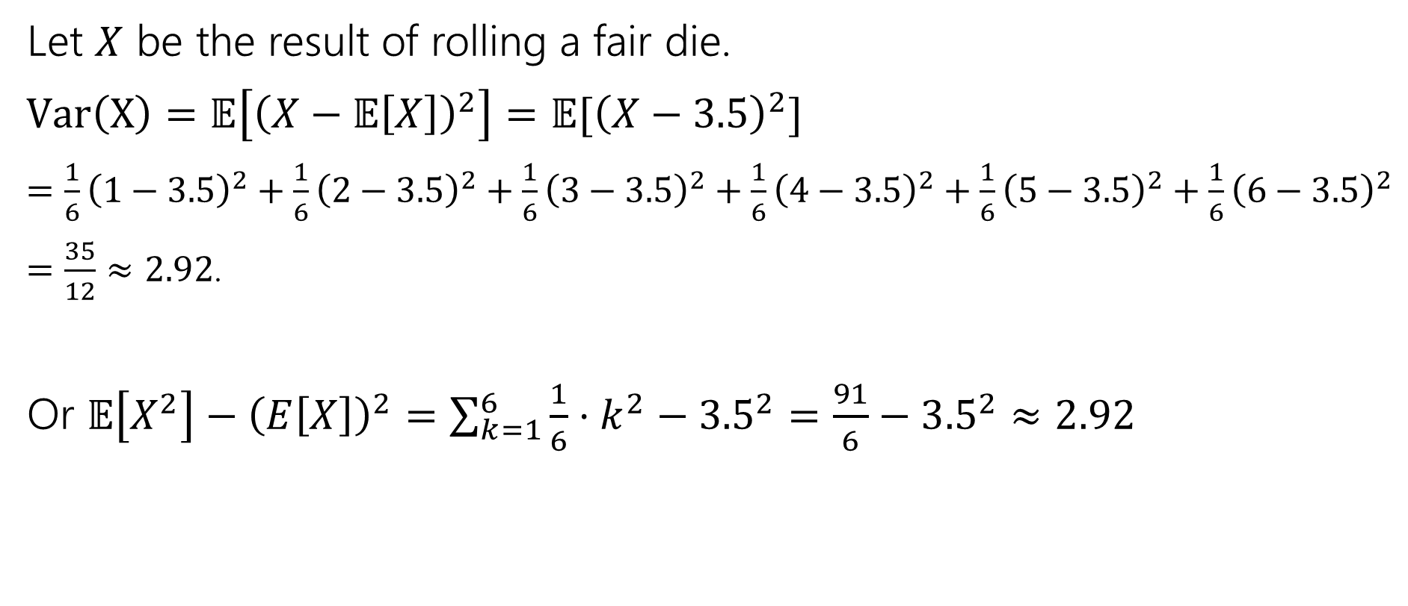
Variance of a die
Let $X$ be the result of rolling a fair die.
$Var\left(X\right)=𝔼\left[{\left(X−𝔼\left[X\right]\right)}^{2}\right]=𝔼[{\left(X−3.5\right)}^{2}]$
$=\frac{1}{6}{\left(1−3.5\right)}^{2}+\frac{1}{6}{\left(2−3.5\right)}^{2}+\frac{1}{6}{\left(3−3.5\right)}^{2}+\frac{1}{6}{\left(4−3.5\right)}^{2}+\frac{1}{6}{\left(5−3.5\right)}^{2}+\frac{1}{6}{\left(6−3.5\right)}^{2}$
$=\frac{35}{12}≈2.92$.
Or $𝔼\left[X^{2}\right]−{\left(E\left[X\right]\right)}^{2}=\sum_{k=1}^{6}{\frac{1}{6}⋅k^{2}−{3.5}^{2}}=\frac{91}{6}−{3.5}^{2}≈2.92$

Slide 7
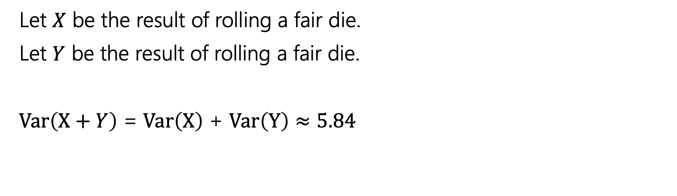

Variance
If $X$ and $Y$ are independent then
$$Var\left(X+Y\right)=Var\left(X\right)+Var(Y)$$
Let $X$ be the result of rolling a fair die.
Let $Y$ be the result of rolling a fair die.
$Var\left(X+Y\right)$ = $Var\left(X\right)$ + $Var\left(Y\right)$ $≈5.84$
Notes:
Note about example at the end

Slide 8
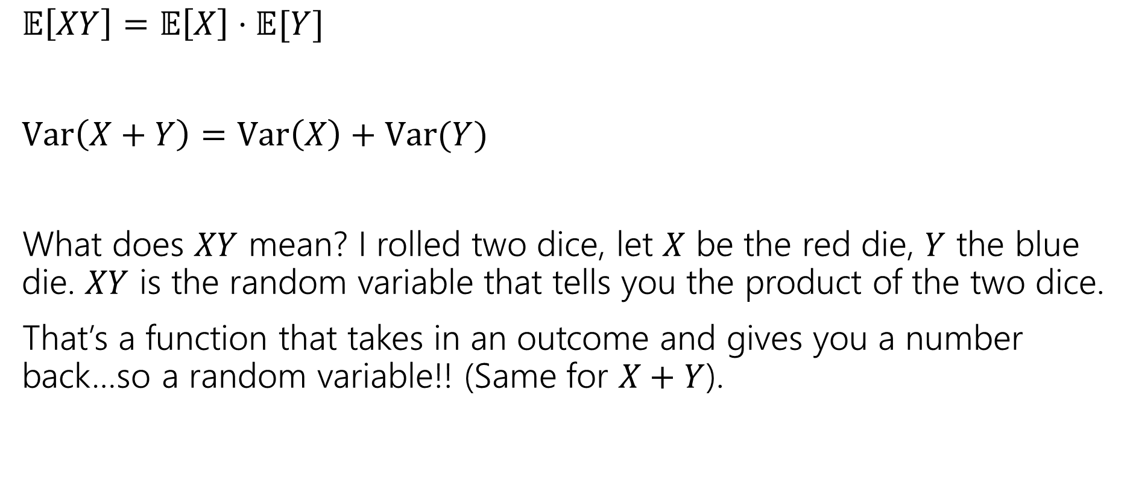
What does Independence give you?
$𝔼\left[XY\right]=𝔼\left[X\right]⋅𝔼[Y]$
$Var\left(X+Y\right)=Var\left(X\right)+Var(Y)$
What does $XY$ mean? I rolled two dice, let $X$ be the red die, $Y$ the blue die. $XY$ is the random variable that tells you the product of the two dice.
That’s a function that takes in an outcome and gives you a number back…so a random variable!! (Same for $X+Y$).

Slide 9
Useful Variance Facts

Slide 10
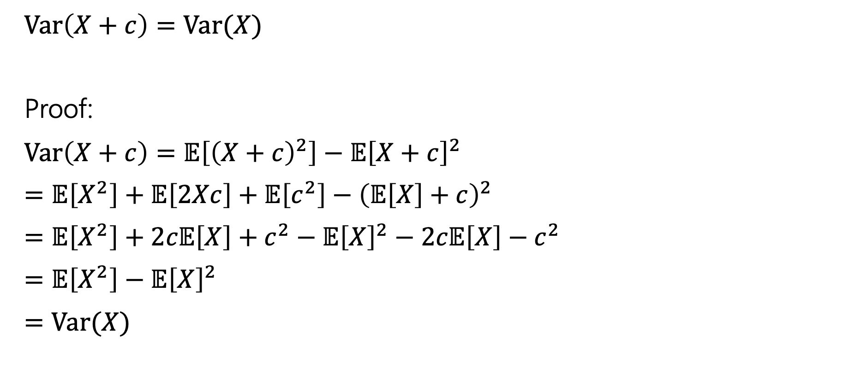
Facts About Variance
$Var\left(X+c\right)=Var(X)$
Proof:
$Var\left(X+c\right)=𝔼\left[{\left(X+c\right)}^{2}\right]−𝔼{\left[X+c\right]}^{2}$
$=𝔼\left[X^{2}\right]+𝔼\left[2Xc\right]+𝔼\left[c^{2}\right]−{\left(𝔼\left[X\right]+c\right)}^{2}$
$=𝔼\left[X^{2}\right]+2c𝔼\left[X\right]+c^{2}−𝔼{\left[X\right]}^{2}−2c𝔼\left[X\right]−c^{2}$
$=𝔼\left[X^{2}\right]−𝔼{\left[X\right]}^{2}$
$=Var(X)$

Slide 11

Facts about Variance
$Var\left(aX\right)=a^{2}Var(X)$
Proof:
$Var\left(aX\right)=𝔼\left[{\left(aX\right)}^{2}\right]−(𝔼{\left[aX\right])}^{2}$
$=a^{2}𝔼\left[X^{2}\right]−{\left(a𝔼\left[X\right]\right)}^{2}$
$=a^{2}𝔼\left[X^{2}\right]−a^{2}𝔼{\left[X\right]}^{2}$
$=a^{2}\left(𝔼\left[X^{2}\right]−𝔼{\left[X\right]}^{2}\right)$
Notes:
Show that var(X-Y) is not Var(X) – Var(Y)

Slide 12
Expectation and Variance aren’t everything
Alright, so expectation and variance is everything right?
No!
A PMF or CDF *does* fully describe a random variable.
Flip a fair coin 3 times indep. Count heads.
Flip a biased coin (prob heads=2/3) until heads. Count flips.
…

Slide 13
Linearity of Expectation

Slide 14
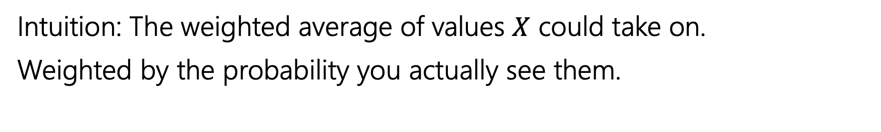
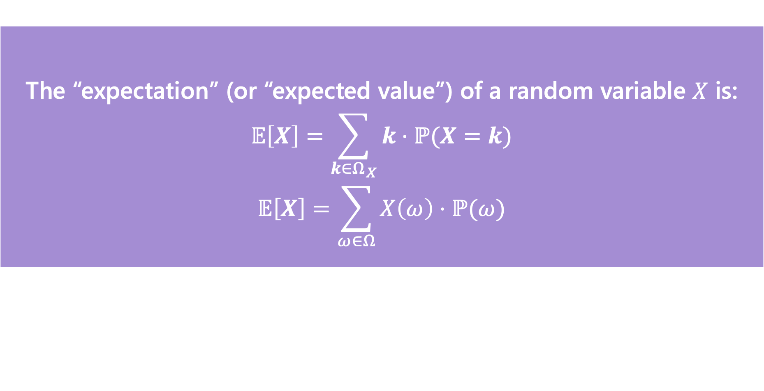
Expectation
The “expectation” (or “expected value”) of a random variable $X$ is:
$$𝔼\left[X\right]=\sum_{k∈Ω_{X}}{k⋅ℙ(X=k)}$$
$$𝔼\left[X\right]=\sum_{ω∈Ω}{X\left(ω\right)⋅ℙ(ω)}$$
Expectation
Intuition: The weighted average of values $X$ could take on.
Weighted by the probability you actually see them.

Slide 15

Linearity of Expectation
For any two random variables $X$ and $Y$:
$$𝔼\left[X+Y\right]=𝔼\left[X\right]+𝔼[Y]$$
Note: $X$ and $Y$ do not have to be independent
Linearity of Expectation

Slide 16
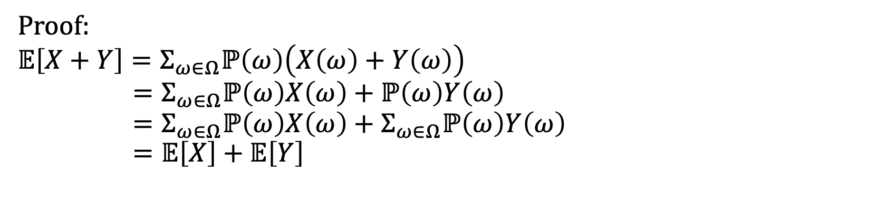

Linearity of Expectation - Proof
For any two random variables $X$ and $Y$:
$$𝔼\left[X+Y\right]=𝔼\left[X\right]+𝔼[Y]$$
Note: $X$ and $Y$ do not have to be independent
Linearity of Expectation
Proof:
$$𝔼\left[X+Y\right]=Σ_{ω∈Ω}ℙ\left(ω\right)\left(X\left(ω\right)+Y\left(ω\right)\right)$$
$$=Σ_{ω∈Ω}ℙ\left(ω\right)X\left(ω\right)+ℙ\left(ω\right)Y\left(ω\right) \\ =Σ_{ω∈Ω}ℙ\left(ω\right)X\left(ω\right)+Σ_{ω∈Ω}ℙ\left(ω\right)Y\left(ω\right)=𝔼\left[X\right]+𝔼\left[Y\right]$$

Slide 17
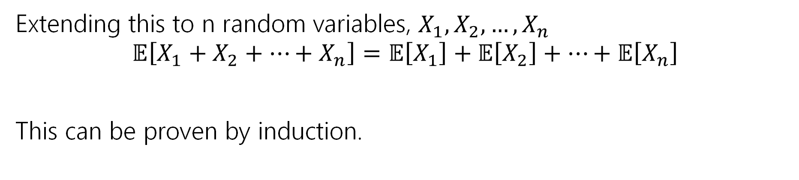
Linearity of Expectation
For any two random variables $X$ and $Y$:
$$𝔼\left[X+Y\right]=𝔼\left[X\right]+𝔼[Y]$$
Note: $X$ and $Y$ do not have to be independent
Linearity of Expectation
Extending this to n random variables, $X_{1},X_{2},…,X_{n}$
$$𝔼\left[X_{1}+X_{2}+…+X_{n}\right]=𝔼\left[X_{1}\right]+𝔼\left[X_{2}\right]+…+𝔼\left[X_{n}\right]$$
This can be proven by induction.

Slide 18
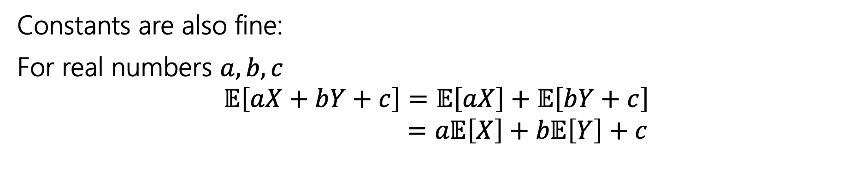
Linearity of Expectation
For any two random variables $X$ and $Y$:
$$𝔼\left[X+Y\right]=𝔼\left[X\right]+𝔼[Y]$$
Note: $X$ and $Y$ do not have to be independent
Linearity of Expectation
Constants are also fine:
For real numbers $a,b,c$
$$𝔼\left[aX+bY+c\right]=𝔼\left[aX\right]+𝔼\left[bY+c\right]$$
$$=a𝔼\left[X\right]+b𝔼\left[Y\right]+c$$

Slide 19
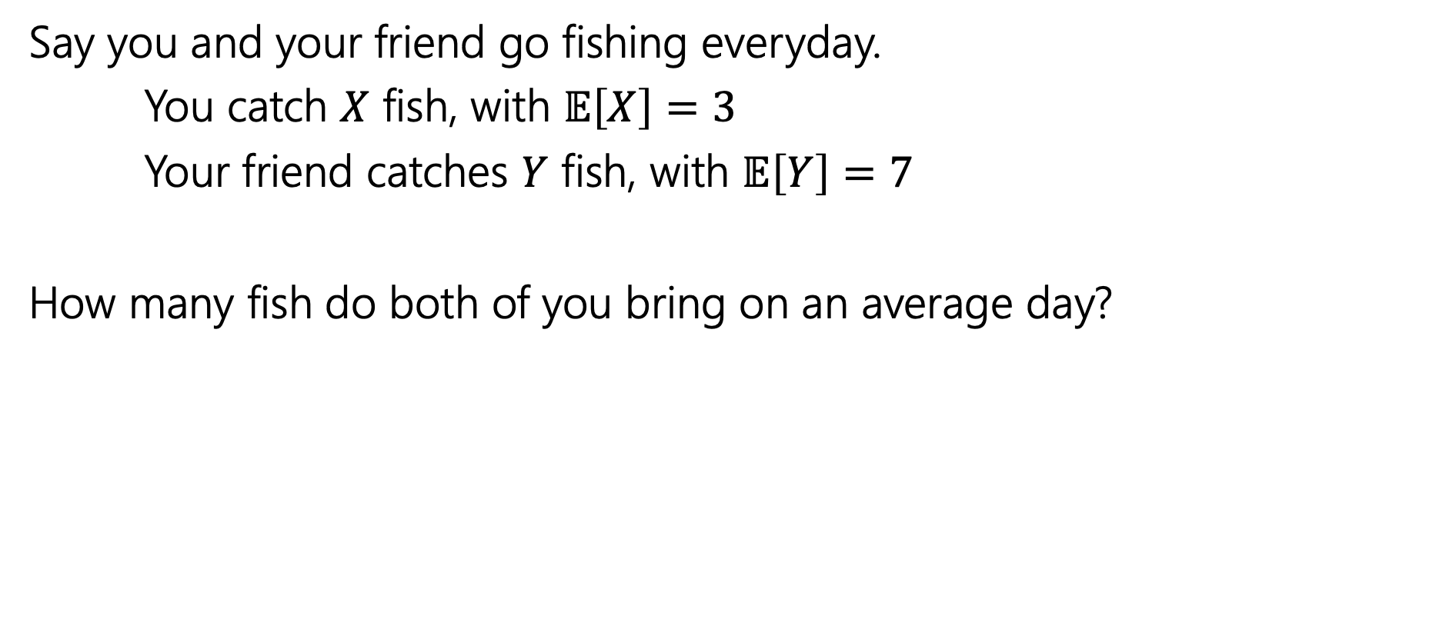
Fishy Business
Say you and your friend go fishing everyday.
You catch $X$ fish, with $𝔼\left[X\right]=3$
Your friend catches $Y$ fish, with $𝔼\left[Y\right]=7$
How many fish do both of you bring on an average day?

Slide 20
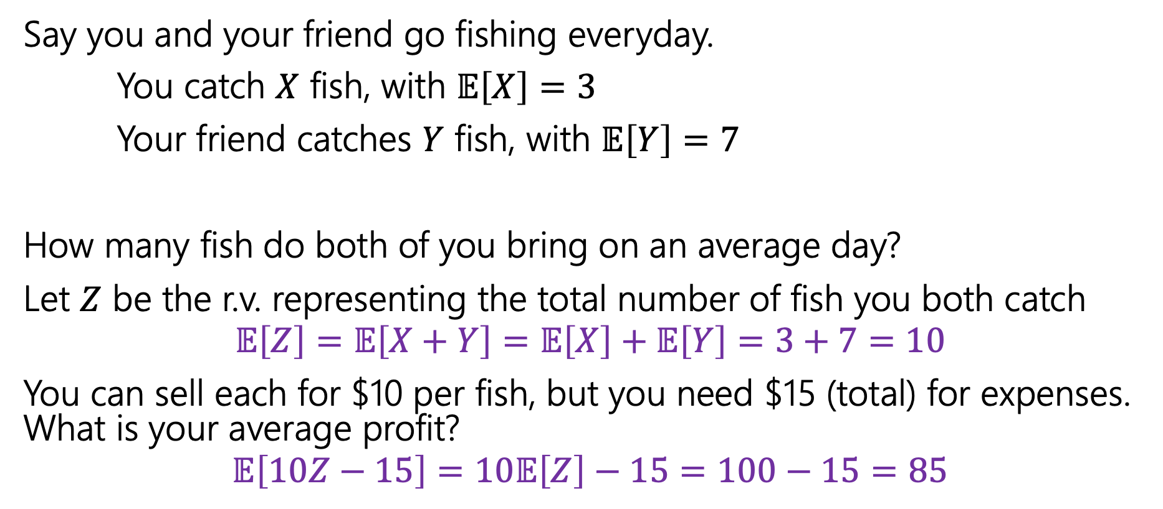
Fishy Business
Say you and your friend go fishing everyday.
You catch $X$ fish, with $𝔼\left[X\right]=3$
Your friend catches $Y$ fish, with $𝔼\left[Y\right]=7$
How many fish do both of you bring on an average day?
Let $Z$ be the r.v. representing the total number of fish you both catch
$$𝔼\left[Z\right]=𝔼\left[X+Y\right]=𝔼\left[X\right]+𝔼\left[Y\right]=3+7=10$$
You can sell each for $10 per fish, but you need $15 (total) for expenses. What is your average profit?
$$𝔼\left[10Z−15\right]=10𝔼\left[Z\right]−15=100−15=85$$
Notes:
Something to notice here is we do not have enough information in this problem to calculate the expectation using the PMF. We don’t know what the distribution or the PMF of X and Y are, we also don’t know how they relate to each other. Maybe you and your friend fish in the same spot so you haven’t a good fishing day means your friend will have a good fishing day, meaning they are dependent. None the less given the expectation of X and Y we were able to solve the problem just with linearity of expectation. Linearity of expectation allows us to solve problems that we wouldn't be able to solve otherwise.

Slide 21
Coin Tosses
If we flip a coin twice, what is the expected number of heads that come up?

Slide 22
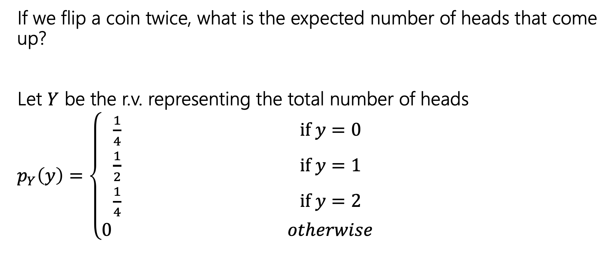
Coin Tosses
If we flip a coin twice, what is the expected number of heads that come up?
Let $Y$ be the r.v. representing the total number of heads
$p_{Y}\left(y\right)=\left\{\begin{aligned}\frac{1}{4} if y=0 \\ \frac{1}{2} if y=1 \\ \frac{1}{4} if y=2 \\ 0 otherwise\end{aligned}\right.$

Slide 23
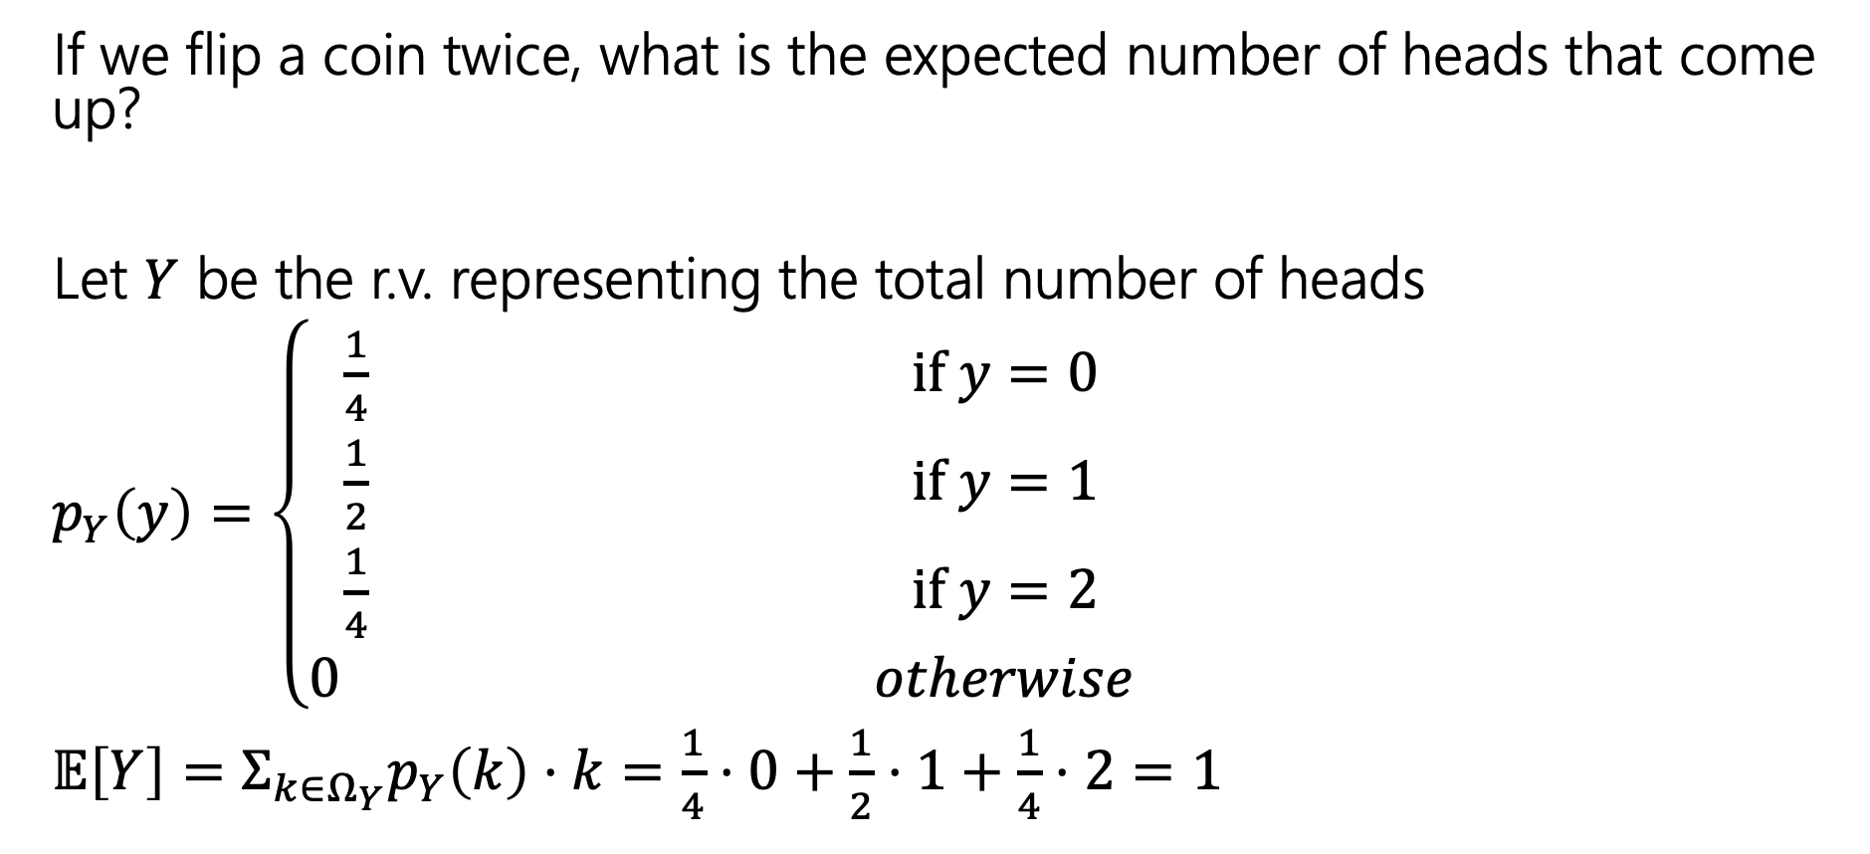
Coin Tosses
If we flip a coin twice, what is the expected number of heads that come up?
Let $Y$ be the r.v. representing the total number of heads
$p_{Y}\left(y\right)=\left\{\begin{aligned}\frac{1}{4} if y=0 \\ \frac{1}{2} if y=1 \\ \frac{1}{4} if y=2 \\ 0 otherwise\end{aligned}\right.$
$𝔼\left[Y\right]=Σ_{k∈Ω_{Y}}p_{Y}\left(k\right)⋅k=\frac{1}{4}⋅0+\frac{1}{2}⋅1+\frac{1}{4}⋅2=1$

Slide 24


Repeated Coin Tosses
Now what if the probability of flipping a head was $p$ and that we wanted to find the total number of heads flipped when we flip the coin $n$ times?
Let $X$ be the r.v. representing the total number of heads.
Make a prediction --- what should $𝔼[X]$ be?
Notes:
Now lets look at a generalized case.
Were going to solve this in two different ways, first using the definition of expectation and then using linearity of expectation.

Slide 25
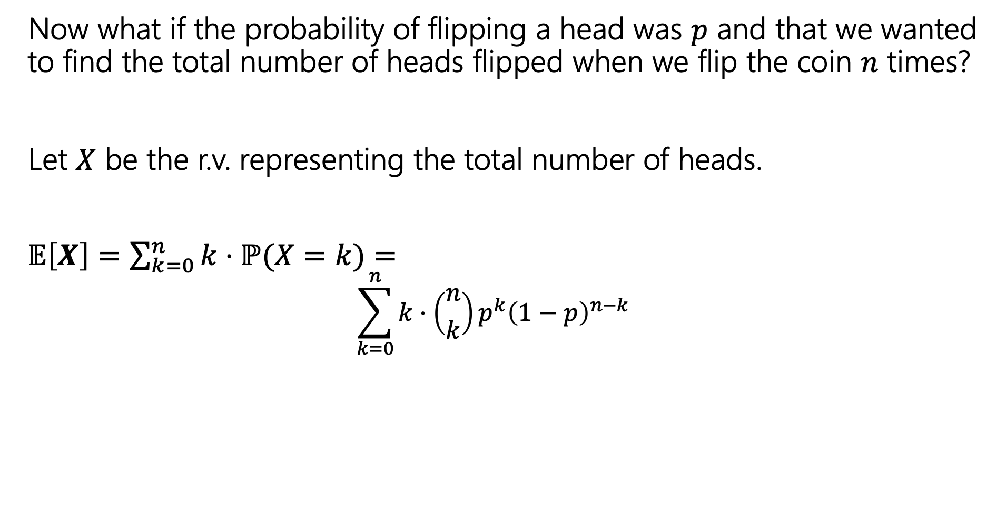
Repeated Coin Tosses
Now what if the probability of flipping a head was $p$ and that we wanted to find the total number of heads flipped when we flip the coin $n$ times?
Let $X$ be the r.v. representing the total number of heads.
$𝔼\left[X\right]=\sum_{k=0}^{n}{k⋅ℙ(X=k)}=$
$$\sum_{k=0}^{n}{k⋅\left({n \atop k}\right)p^{k}{\left(1−p\right)}^{n−k}}$$
Ok, but what actually is it?
I don’t have intuition for this formula.

Slide 26
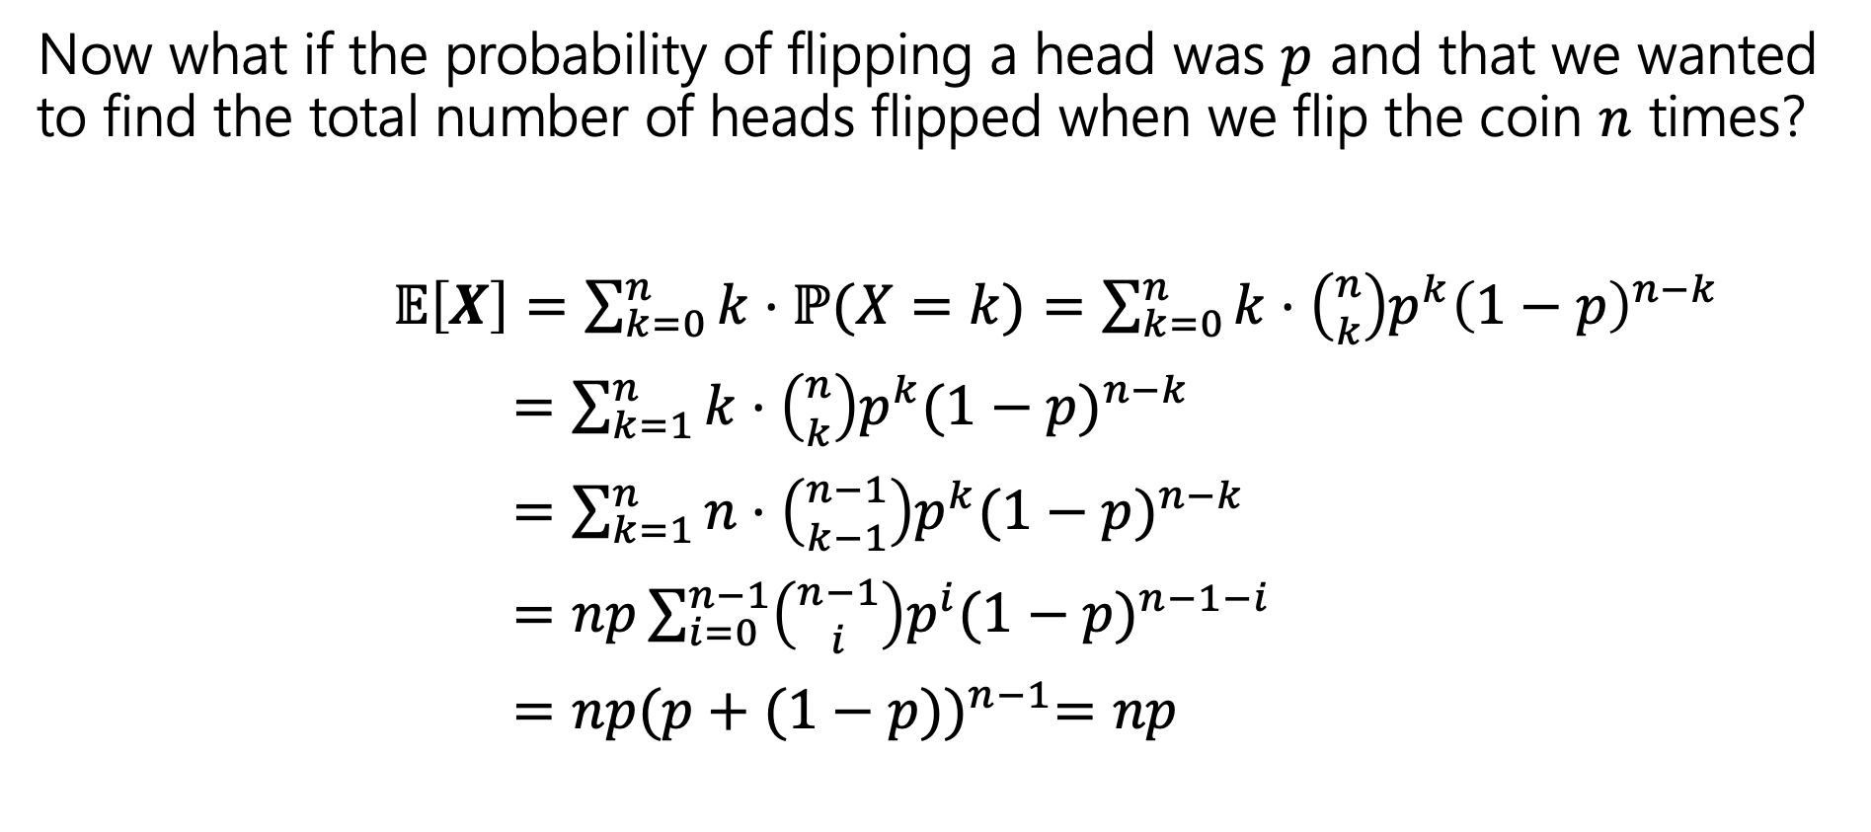
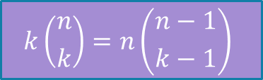
Repeated Coin Tosses
Now what if the probability of flipping a head was $p$ and that we wanted to find the total number of heads flipped when we flip the coin $n$ times?
$𝔼\left[X\right]=\sum_{k=0}^{n}{k⋅ℙ(X=k)}=\sum_{k=0}^{n}{k⋅\left({n \atop k}\right)p^{k}{\left(1−p\right)}^{n−k}}$
$=\sum_{k=1}^{n}{k⋅\left({n \atop k}\right)p^{k}{(1−p)}^{n−k}}$
$=\sum_{k=1}^{n}{n⋅\left({n−1 \atop k−1}\right)p^{k}{(1−p)}^{n−k}}$
$=np\sum_{i=0}^{n−1}{\left({n−1 \atop i}\right)p^{i}{(1−p)}^{n−1−i}}$
$=np{(p+(1−p))}^{n−1}=np$
$$k\left({n \atop k}\right)=n\left({n−1 \atop k−1}\right)$$
Binomial Theorem!
We did it! And all it took was a clever application of the binomial theorem, setup by a very non-obvious application of an obscure combinatorial identity. Ezpz.
Notes:
Don't worry, we won't ask you to do a proof like this. It requires the use of an obscure identity (week 2 section problem) and a clever application of the binomial theorem.

Slide 27

Repeated Coin Tosses
Now what if the probability of flipping a head was $p$ and that we wanted to find the total number of heads flipped when we flip the coin $n$ times?
$𝔼\left[X\right]=\sum_{k=0}^{n}{k⋅ℙ(Y=k)}=\sum_{k=0}^{n}{k⋅\left({n \atop k}\right)p^{k}{\left(1−p\right)}^{n−k}}$
$=\sum_{k=1}^{n}{k⋅\left({n \atop k}\right)p^{k}{(1−p)}^{n−k}}$
$=\sum_{k=1}^{n}{n⋅\left({n−1 \atop k−1}\right)p^{k}{(1−p)}^{n−k}}$
$=np\sum_{i=0}^{n−1}{\left({n−1 \atop i}\right)p^{i}{(1−p)}^{n−1−i}}$
$=np{(p+(1−p))}^{n−1}=np$
No one wants to do proofs like this every time!
$$k\left({n \atop k}\right)=n\left({n−1 \atop k−1}\right)$$
Binomial Theorem!
We did it! And all it took was a clever application of the binomial theorem, setup by a very non-obvious application of an obscure combinatorial identity. Ezpz.

Slide 28
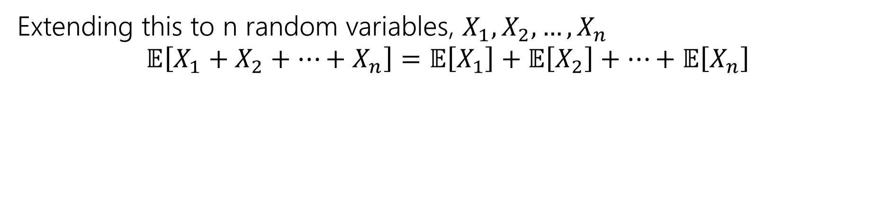
Linearity of Expectation
For any two random variables $X$ and $Y$:
$$𝔼\left[X+Y\right]=𝔼\left[X\right]+𝔼[Y]$$
Note: $X$ and $Y$ do not have to be independent
Linearity of Expectation
Extending this to n random variables, $X_{1},X_{2},…,X_{n}$
$$𝔼\left[X_{1}+X_{2}+…+X_{n}\right]=𝔼\left[X_{1}\right]+𝔼\left[X_{2}\right]+…+𝔼\left[X_{n}\right]$$
Notes:
We are going to design random variables in a way that would allow us to break the problem down in such a way that we are adding up random variable, where each random variables’ expectation is simple to compute., and they add up to the random variable X that were interested in.

Slide 29









Indicator Random Variables
For any event $A$, we can define the indicator random variable $1[A]$ for $A$
$1[A]=\left\{\begin{aligned} 1 if event A occurs \\ 0 otherwise\end{aligned}\right.$
You’ll also see notation like:
$$ℙ\left(X=1\right)=ℙ\left(A\right)$$
$$ℙ\left(X=0\right)=1−ℙ(A)$$
$$p_{X}\left(x\right)=\left\{\begin{aligned}ℙ\left(A\right) if x=1 \\ 1−ℙ\left(A\right) if x=0 \\ 0 otherwise\end{aligned}\right.$$
$$𝔼 \left[X\right]=1⋅p_{X}\left(1\right)+0⋅p_{X}(0)=p_{X}\left(1\right)=ℙ(A)$$
Notes:
Its support is {0,1} and if it is 1, then it indicates that the event happened. Its like a Boolean that we cast to an int, so we can add it up.

Slide 30

Repeated Coin Tosses (Again)
The probability of flipping a head is $p$ and we want to find the total number of heads flipped when we flip the coin $n$ times?
Let $X$ be the total number of heads
What indicators can we define? What ‘Booleans’ have enough information to combine (add) and solve the problem?

Slide 31
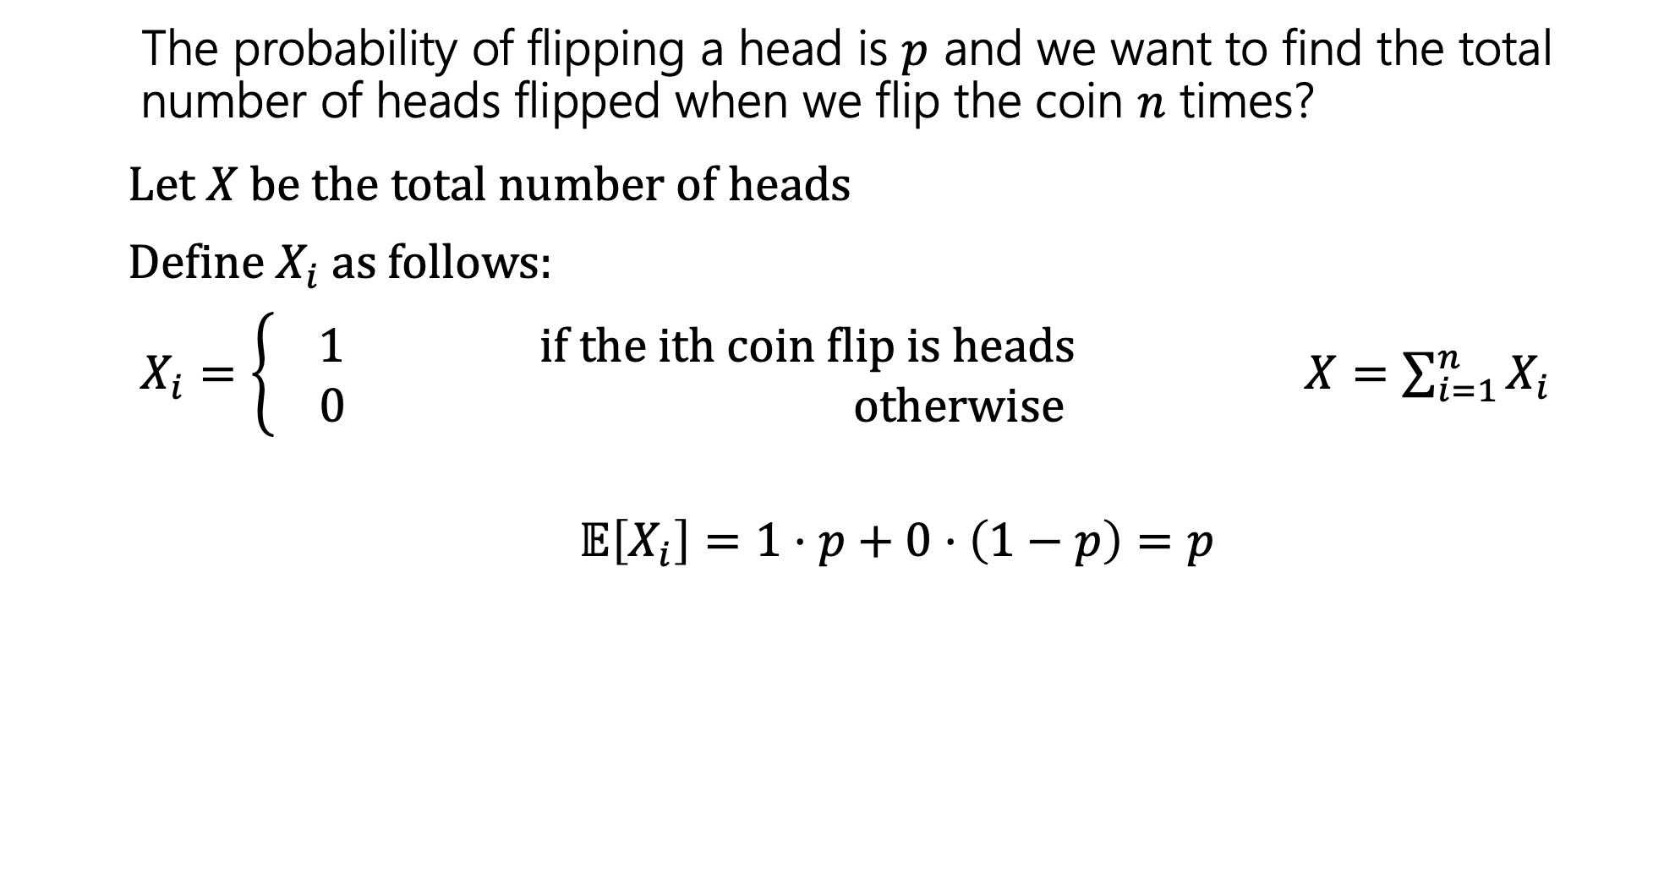
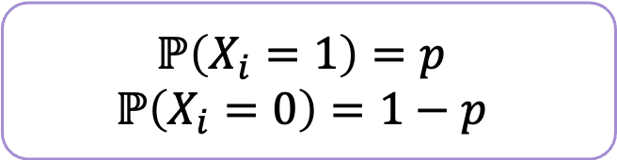
Repeated Coin Tosses (Again)
The probability of flipping a head is $p$ and we want to find the total number of heads flipped when we flip the coin $n$ times?
Let $X$ be the total number of heads
Define $X_{i}$as follows:
$X_{i}=\left\{\begin{aligned} 1 if the ith coin flip is heads \\ 0 otherwise\end{aligned}\right.$ $X=\sum_{i=1}^{n}{X_{i}}$
$$𝔼\left[X_{i}\right]=1⋅p+0⋅\left(1−p\right)=p$$
$$ℙ\left(X_{i}=1\right)=p$$
$$ℙ\left(X_{i}=0\right)=1−p$$

Slide 32
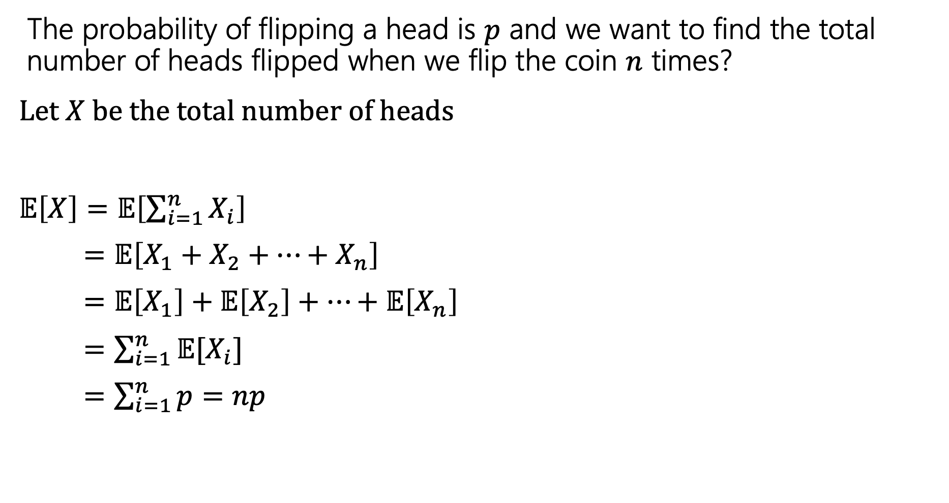
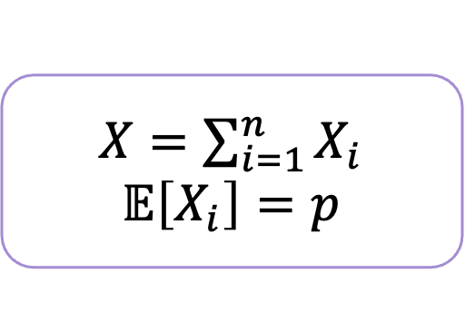
Repeated Coin Tosses (Again)
The probability of flipping a head is $p$ and we want to find the total number of heads flipped when we flip the coin $n$ times?
Let $X$ be the total number of heads
$𝔼\left[X\right]=𝔼\left[\sum_{i=1}^{n}{X_{i}}\right]$
$=𝔼\left[X_{1}+X_{2}+…+X_{n}\right]$
= $𝔼\left[X_{1}\right]+𝔼\left[X_{2}\right]+…+𝔼\left[X_{n}\right]$
$=\sum_{i=1}^{n}{𝔼[X_{i}]}$
$=\sum_{i=1}^{n}{p}=np$
$X=\sum_{i=1}^{n}{X_{i}}$
$$𝔼\left[X_{i}\right]=p$$
Notes:
The hardest steps in this process is coming up with a cleaver way to define your indicator random variable and figuring out the probability of the event occurring. Then LOE handles the heavy lifting.

Slide 33
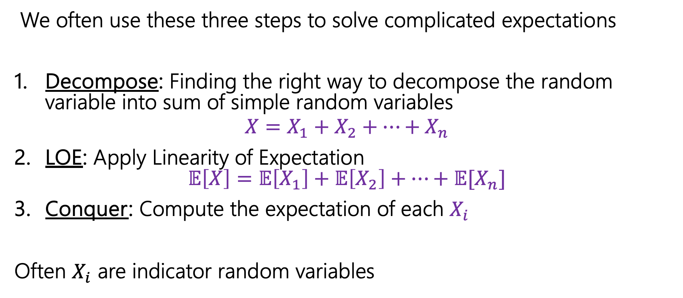
Computing complicated expectations
We often use these three steps to solve complicated expectations
Decompose: Finding the right way to decompose the random variable into sum of simple random variables
$$X=X_{1}+X_{2}+…+X_{n}$$
LOE: Apply Linearity of Expectation $𝔼\left[X\right]=𝔼\left[X_{1}\right]+𝔼\left[X_{2}\right]+…+𝔼[X_{n}]$
Conquer: Compute the expectation of each $X_{i}$
Often $X_{i}$ are indicator random variables

Slide 34

Pairs with the same birthday
In a class of $m$ students, on average how many pairs of people have the same birthday?
Decompose:
LOE:
Conquer:
Notes:
Solving this problem without LOE is possible, but again very messy and frustrating

Slide 35
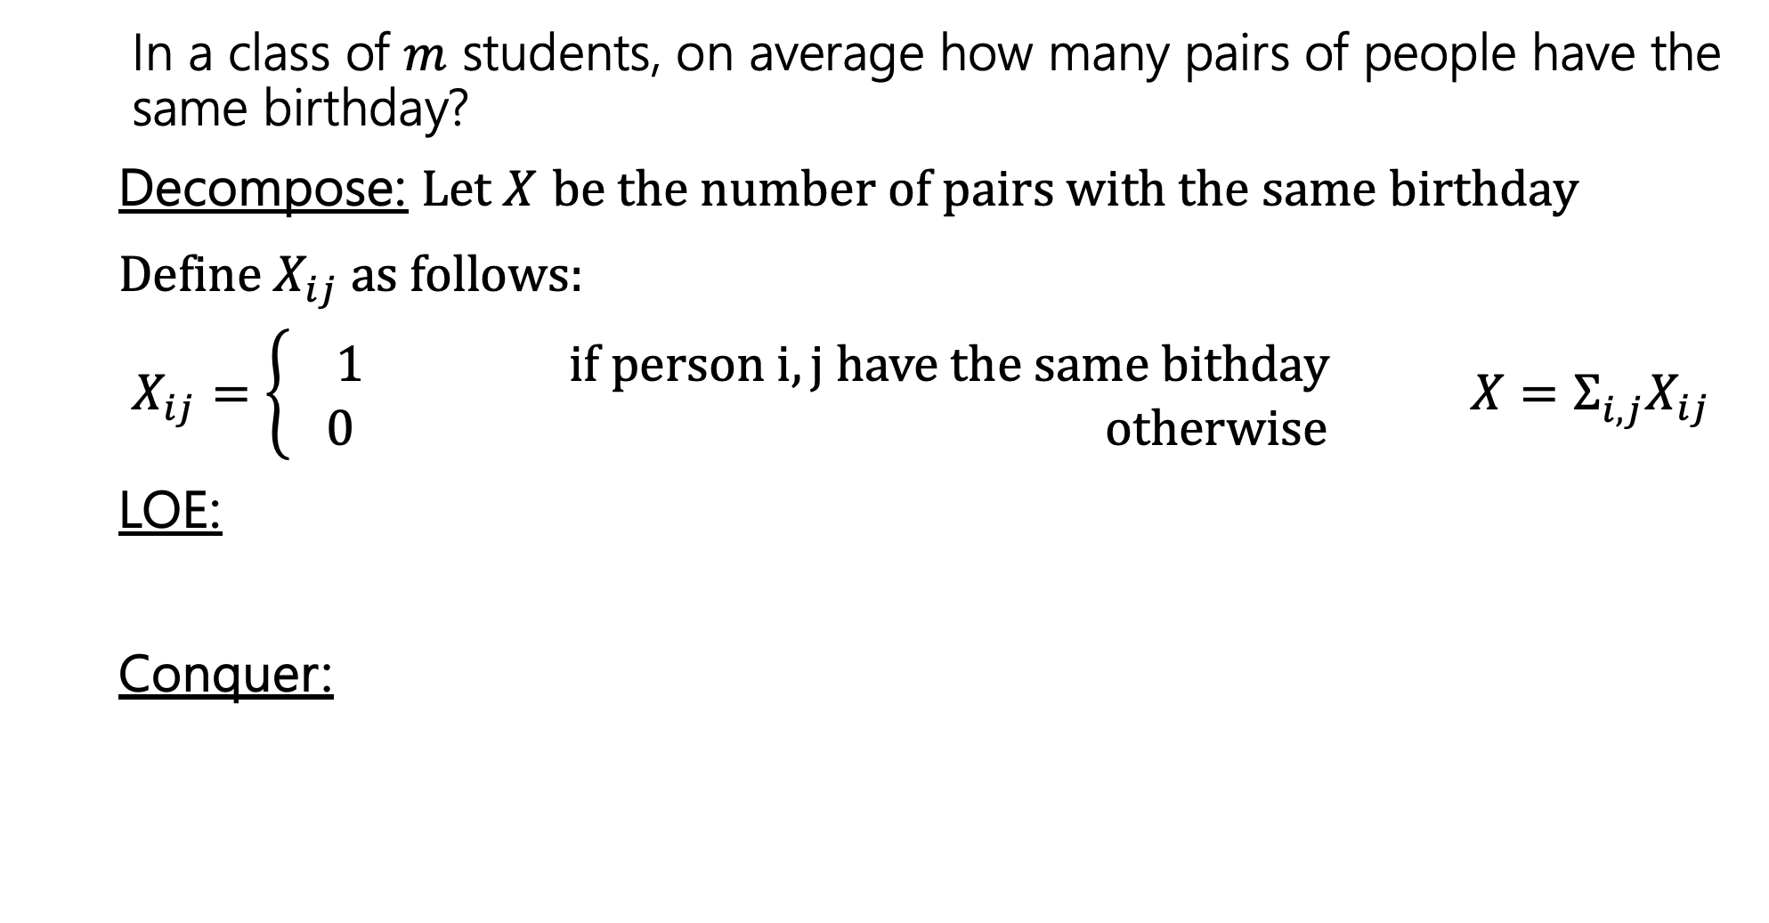
Pairs with the same birthday
In a class of $m$ students, on average how many pairs of people have the same birthday?
Decompose: Let $X$ be the number of pairs with the same birthday
Define $X_{ij}$as follows:
$X_{ij}=\left\{\begin{aligned} 1 if person i,j have the same bithday \\ 0 otherwise\end{aligned}\right.$ ${X=Σ_{i,j}^{}X}_{ij}$
LOE:
Conquer:
Notes:
Compare pairs with coin flips.

Slide 36
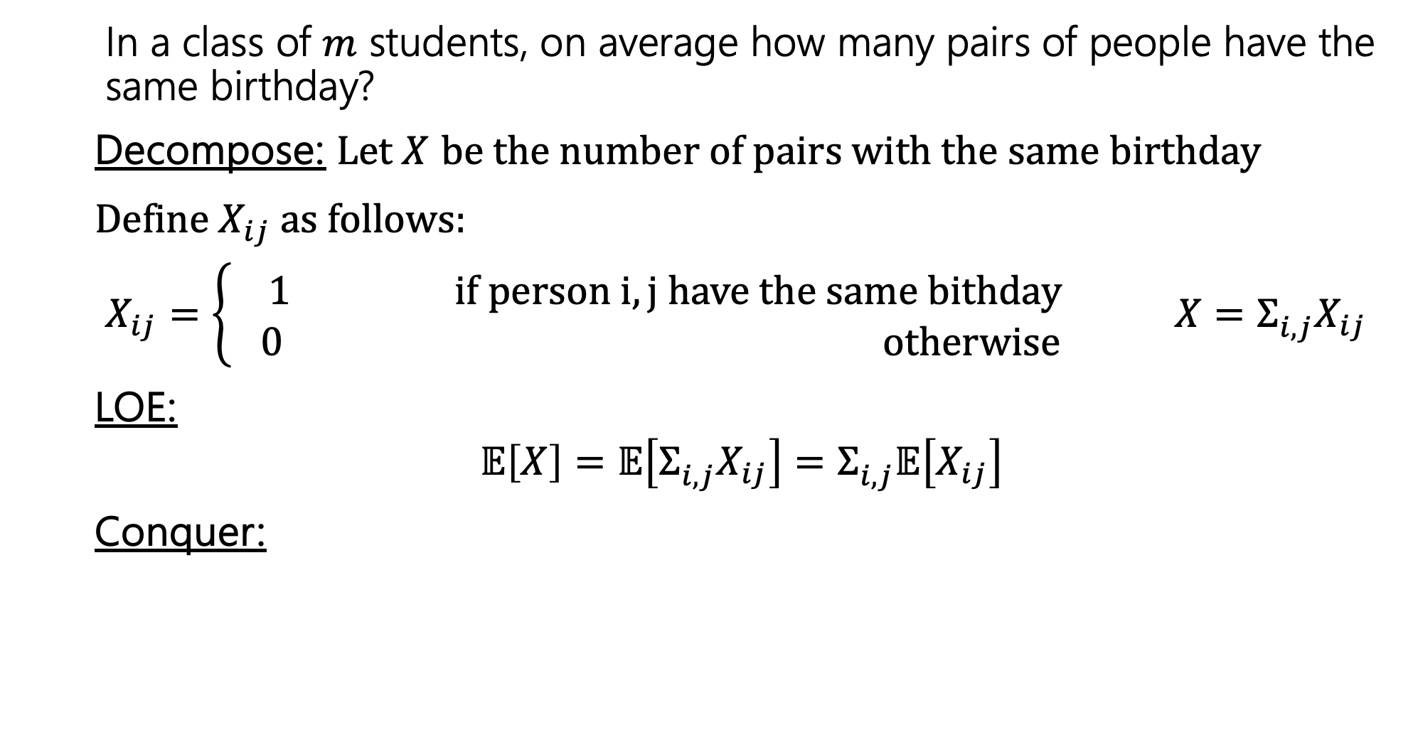
Pairs with the same birthday
In a class of $m$ students, on average how many pairs of people have the same birthday?
Decompose: Let $X$ be the number of pairs with the same birthday
Define $X_{ij}$as follows:
$X_{ij}=\left\{\begin{aligned} 1 if person i,j have the same bithday \\ 0 otherwise\end{aligned}\right.$ ${X=Σ_{i,j}^{}X}_{ij}$
LOE:
$$𝔼\left[X\right]=𝔼\left[Σ_{i,j}^{}X_{ij}\right]=Σ_{i,j}^{}𝔼\left[X_{ij}\right]$$
Conquer:
Notes:
We are going to assume that there are 365 days in the year and each day is equally likely

Slide 37
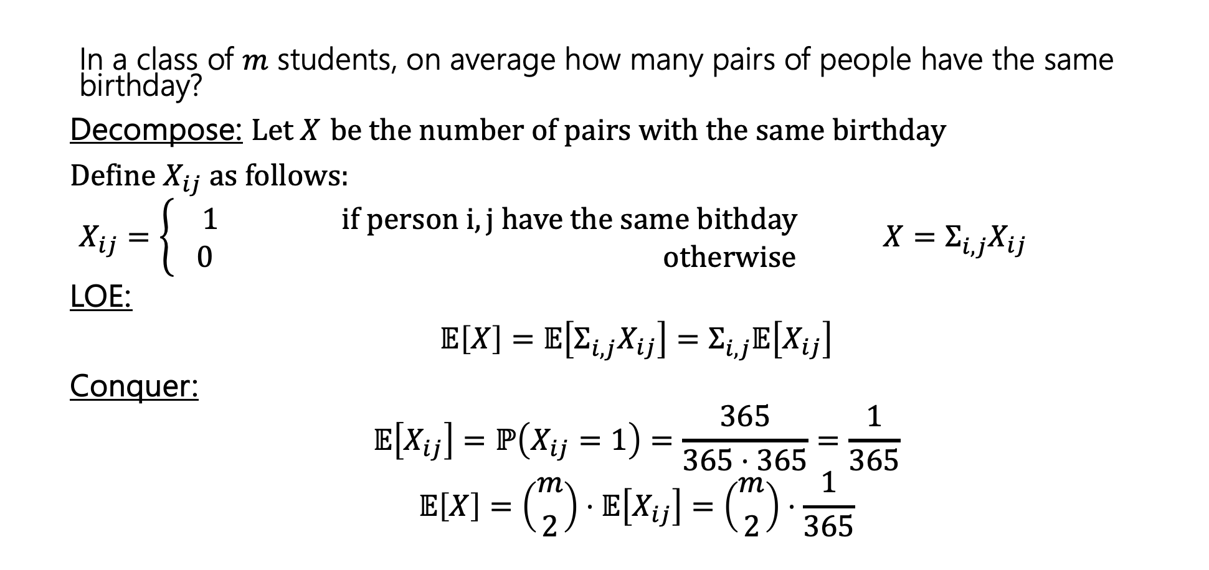
Pairs with the same birthday
In a class of $m$ students, on average how many pairs of people have the same birthday?
Decompose: Let $X$ be the number of pairs with the same birthday
Define $X_{ij}$as follows:
$X_{ij}=\left\{\begin{aligned} 1 if person i,j have the same bithday \\ 0 otherwise\end{aligned}\right.$ ${X=Σ_{i,j}^{}X}_{ij}$
LOE:
$$𝔼\left[X\right]=𝔼\left[Σ_{i,j}^{}X_{ij}\right]=Σ_{i,j}^{}𝔼\left[X_{ij}\right]$$
Conquer:
$$𝔼\left[X_{ij}\right]=ℙ\left(X_{ij}=1\right)=\frac{365}{365⋅365}=\frac{1}{365}$$
$$𝔼\left[X\right]=\left({m \atop 2}\right)⋅𝔼\left[X_{ij}\right]=\left({m \atop 2}\right)⋅\frac{1}{365}$$
Notes:
These indicator random variables are not independent, but that is okay. We wouldn’t be able to calculate the variance, but we can calculate the expectation

Slide 38
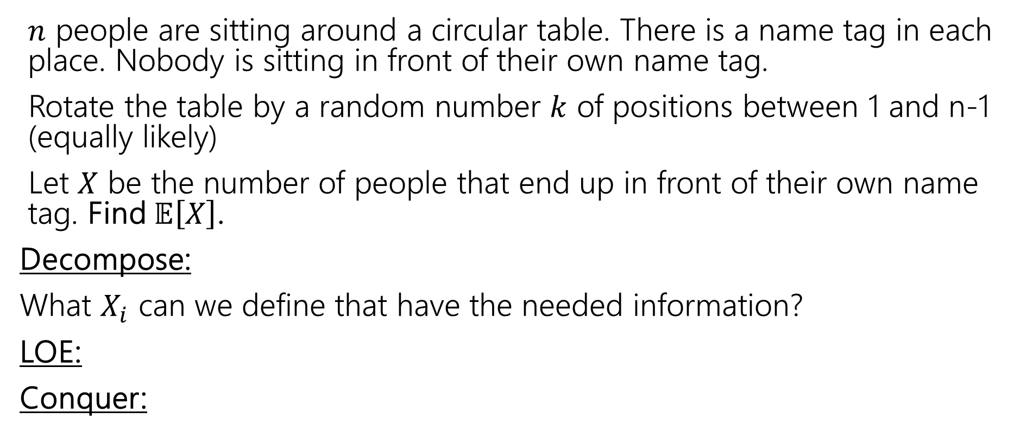
Rotating the table
$n$ people are sitting around a circular table. There is a name tag in each place. Nobody is sitting in front of their own name tag.
Rotate the table by a random number $k$ of positions between 1 and n-1 (equally likely)
Let $X$ be the number of people that end up in front of their own name tag. Find $𝔼\left[X\right]$.
Decompose:
What $X_{i}$ can we define that have the needed information?
LOE:
Conquer:
Notes:
Imagine this scenario. We have a round table where there are n seats and n name tags placed in front of every seat. Your group of n friends come in and all sit down. Everyone sits in the wrong seat, which means no one has their nametag in front of them. Now instead of all standing up and moving around you decide to just spin the table some k positions so that the table doesn't come back to where it started. This means that there are 1 to n-1 positions that are all equally likely.
You want to know after this rotation, how many people will have their nametag in front of them?

Slide 39
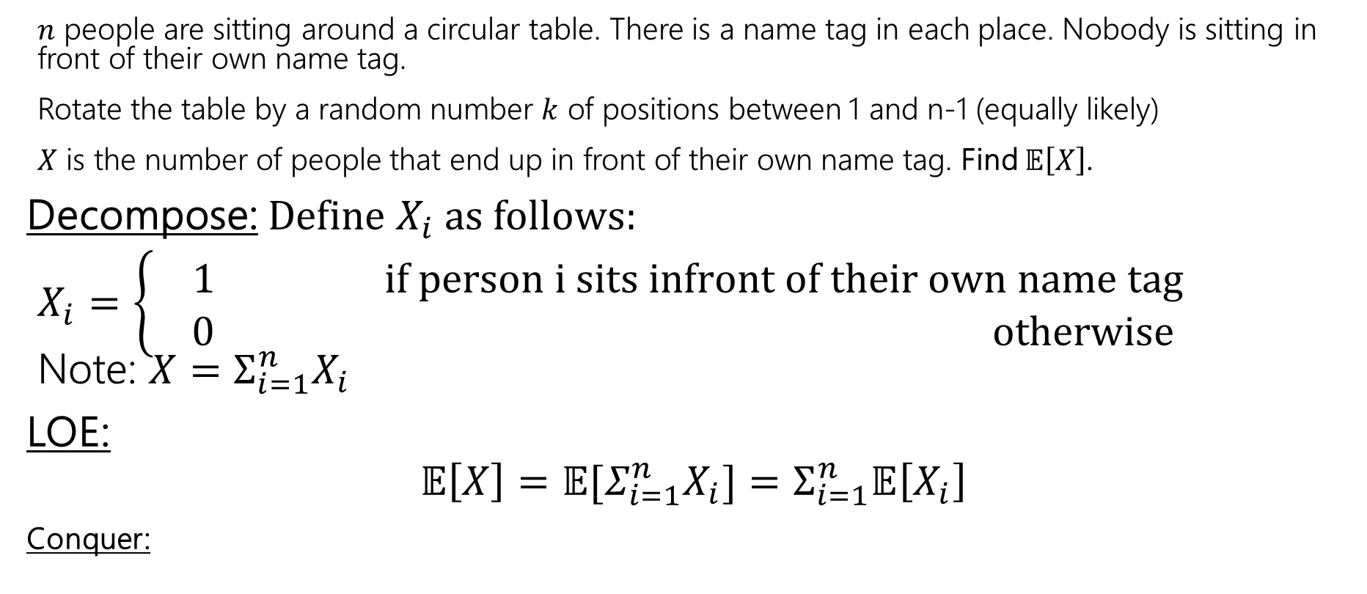

Rotating the table
$n$ people are sitting around a circular table. There is a name tag in each place. Nobody is sitting in front of their own name tag.
Rotate the table by a random number $k$ of positions between 1 and n-1 (equally likely)
$X$ is the number of people that end up in front of their own name tag. Find $𝔼\left[X\right]$.
Decompose: Define $X_{i}$as follows:
$X_{i}=\left\{\begin{aligned} 1 if person i sits infront of their own name tag \\ 0 otherwise\end{aligned}\right.$ Note: ${X=Σ_{i=1}^{n}X}_{i}$
LOE:
$$𝔼\left[X\right]=𝔼[Σ_{i=1}^{n}X_{i}]=Σ_{i=1}^{n}𝔼\left[X_{i}\right]$$
Conquer:
These $X_{i}$ are not independent!
That’s ok!!

Slide 40
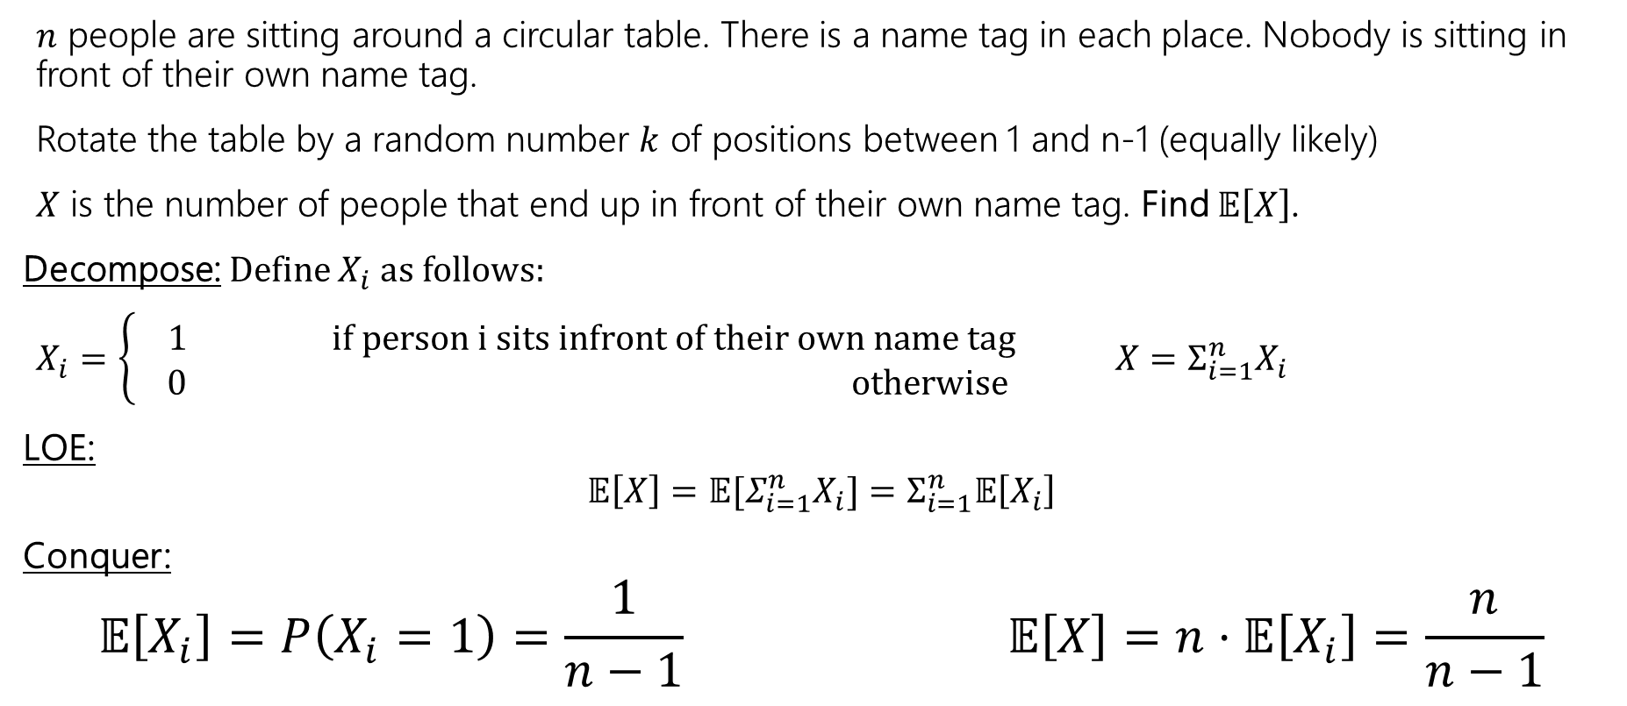
Rotating the table
$n$ people are sitting around a circular table. There is a name tag in each place. Nobody is sitting in front of their own name tag.
Rotate the table by a random number $k$ of positions between 1 and n-1 (equally likely)
$X$ is the number of people that end up in front of their own name tag. Find $𝔼\left[X\right]$.
Decompose: Define $X_{i}$as follows:
$X_{i}=\left\{\begin{aligned} 1 if person i sits infront of their own name tag \\ 0 otherwise\end{aligned}\right.$ ${X=Σ_{i=1}^{n}X}_{i}$
LOE:
$$𝔼\left[X\right]=𝔼[Σ_{i=1}^{n}X_{i}]=Σ_{i=1}^{n}𝔼\left[X_{i}\right]$$
Conquer:
$$𝔼\left[X_{i}\right]=P\left(X_{i}=1\right)=\frac{1}{n−1} 𝔼\left[X\right]=n⋅𝔼\left[X_{i}\right]=\frac{n}{n−1}$$
Notes:
This is approximately 1, so spinning the table is probably not the best option if you are trying to have everyone sit in front of their name tag since on average, after a spin we can expect approximately one person to be in front of their nametag.
Now we have one more some example at the end of this slide dec for you to take a look.
Thank you for coming to lecture and I hope you have a wonderful weekend.

Slide 41
Variance Example

Slide 42
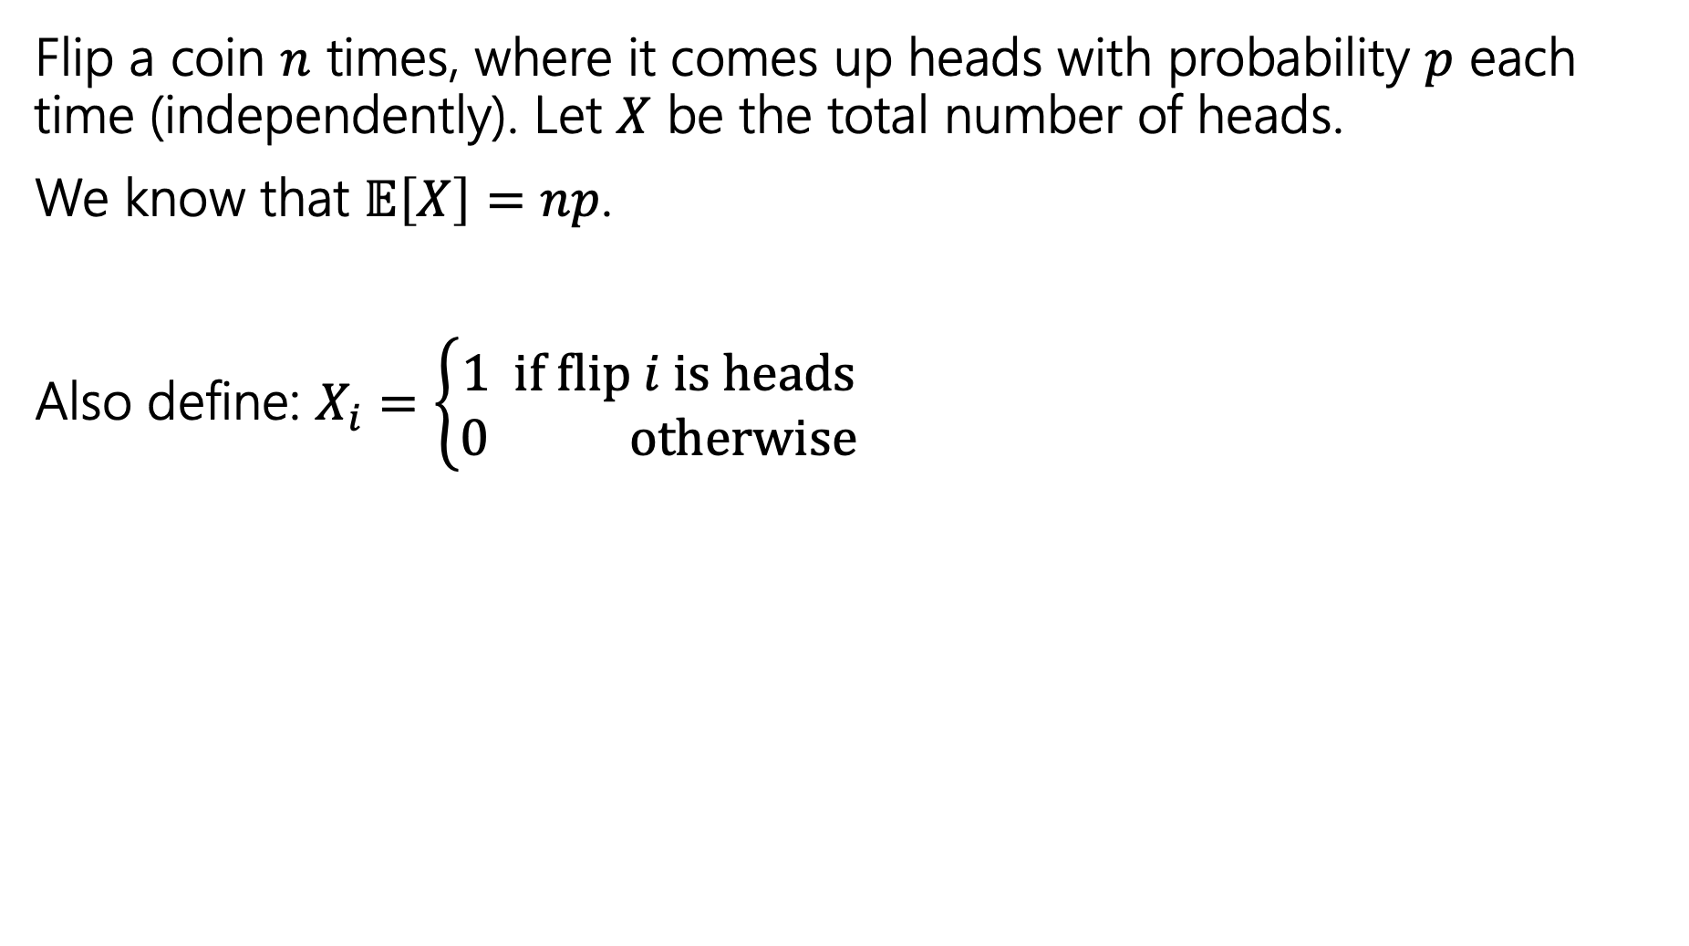

Variance of $n$ Coin Flips
Flip a coin $n$ times, where it comes up heads with probability $p$ each time (independently). Let $X$ be the total number of heads.
We know that $𝔼\left[X\right]=np$.
Also define: $X_{i}=\left\{\begin{aligned}1 if flip i is heads \\ 0 otherwise\end{aligned}\right.$

Slide 43
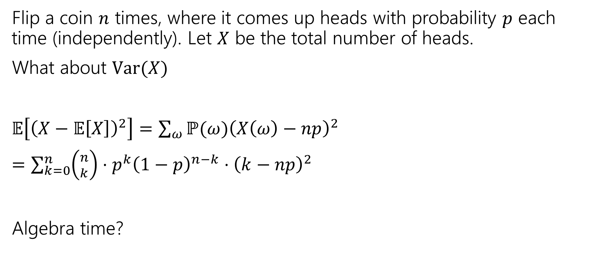
Variance of $n$ Coin Flips
Flip a coin $n$ times, where it comes up heads with probability $p$ each time (independently). Let $X$ be the total number of heads.
What about $Var(X)$
$𝔼\left[{\left(X−𝔼\left[X\right]\right)}^{2}\right]=\sum_{ω}{ℙ(ω){\left(X\left(ω\right)−np\right)}^{2}}$
$=\sum_{k=0}^{n}{\left({n \atop k}\right)⋅p^{k}{\left(1−p\right)}^{n−k}⋅{\left(k−np\right)}^{2}}$
Algebra time?

Slide 44
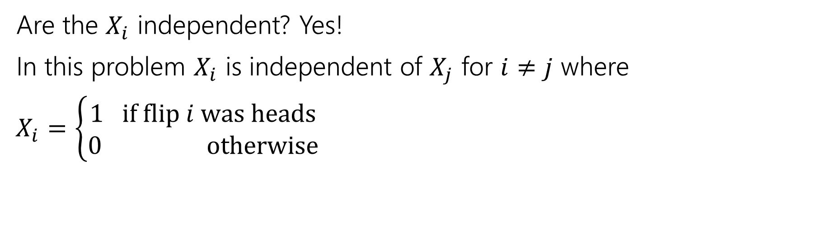
Variance
If $X$ and $Y$ are independent then
$$Var\left(X+Y\right)=Var\left(X\right)+Var(Y)$$
Are the $X_{i}$ independent? Yes!
In this problem $X_{i}$ is independent of $X_{j}$ for $i≠j$ where
$X_{i}=\left\{\begin{aligned}1 if flip i was heads \\ 0 otherwise\end{aligned}\right.$

Slide 45
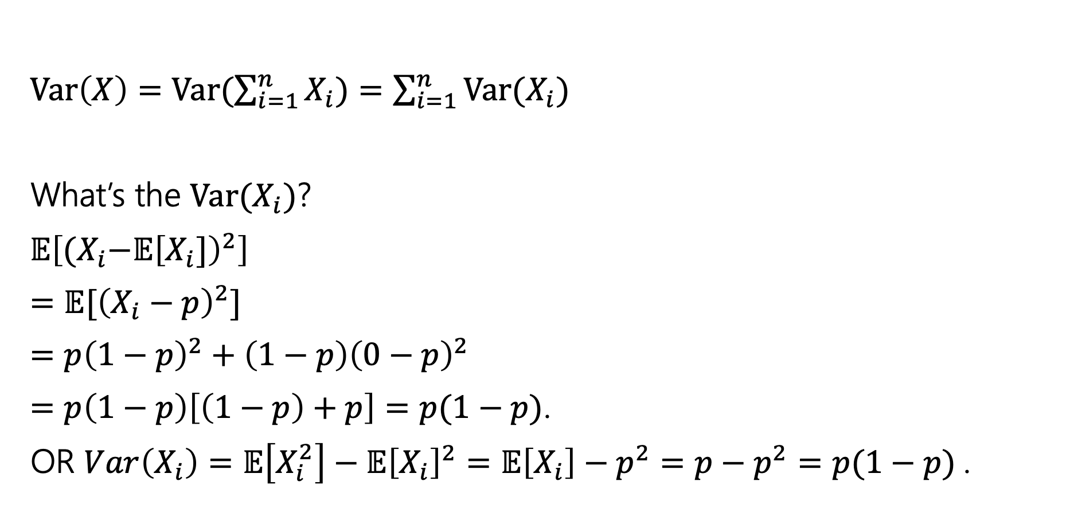
Variance
$Var\left(X\right)=Var(\sum_{i=1}^{n}{X_{i})=\sum_{i=1}^{n}{Var(X_{i})}}$
What’s the $Var(X_{i})$?
$𝔼\left[{(X}_{i}−𝔼{\left[X_{i}]\right)}^{2}\right]$
$=𝔼[{\left(X_{i}−p\right)}^{2}]$
$=p{\left(1−p\right)}^{2}+\left(1−p\right){\left(0−p\right)}^{2}$
$=p\left(1−p\right)\left[\left(1−p\right)+p\right]=p(1−p)$.
OR $Var\left(X_{i}\right)=𝔼\left[X_{i}^{2}\right]−𝔼{\left[X_{i}\right]}^{2}=𝔼\left[X_{i}\right]−p^{2}=p−p^{2}=p(1−p)$.

Slide 46

Plugging In
$Var\left(X\right)=Var(\sum_{i=1}^{n}{X_{i})=\sum_{i=1}^{n}{Var(X_{i})}}$
What’s the $Var(X_{i})$?
$p(1−p)$.
$Var\left(X\right)=\sum_{i=1}^{n}{p\left(1−p\right)=}np(1−p)$.

Slide 47
Extra Practice

Slide 48


Frogger
A frog starts on a 1-dimensional number line at 0.
Each second, independently, the frog takes a unit step right with probability $p_{1}$, to the left with probability $p_{2}$, and doesn't move with probability $p_{3}$, where ${p_{1}+p}_{2}+p_{3}=1$.
After 2 seconds, let $X$ be the location of the frog. Find $𝔼\left[X\right]$.

Slide 49
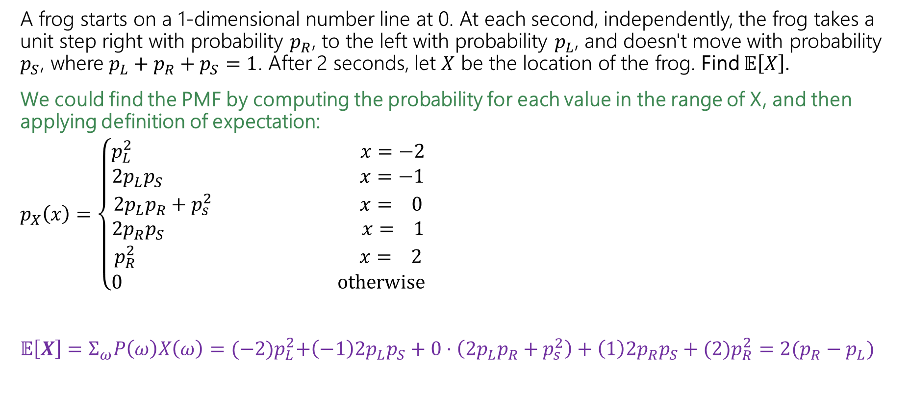
Frogger – Brute Force
A frog starts on a 1-dimensional number line at 0. At each second, independently, the frog takes a unit step right with probability $p_{R}$, to the left with probability $p_{L}$, and doesn't move with probability $p_{S}$, where ${p_{L}+p}_{R}+p_{S}=1$. After 2 seconds, let $X$ be the location of the frog. Find $𝔼\left[X\right]$.
We could find the PMF by computing the probability for each value in the range of X, and then applying definition of expectation:
$p_{X}\left(x\right)=\left\{\begin{aligned}p_{L}^{2} x=−2 \\ {2p}_{L}p_{S} x=−1 \\ {2p}_{L}p_{R}+p_{s}^{2} x= 0 \\ {2p}_{R}p_{S} x= 1 \\ p_{R}^{2} x= 2 \\ 0 otherwise\end{aligned}\right.$
$𝔼\left[X\right]=Σ_{ω}P\left(ω\right)X\left(ω\right)={(−2)p}_{L}^{2}+\left(−1\right){2p}_{L}p_{S}+0⋅\left({2p}_{L}p_{R}+p_{s}^{2}\right)+\left(1\right){2p}_{R}p_{S}+(2)p_{R}^{2}=2(p_{R}−p_{L})$
We think about the outcomes that correspond to each value of X and compute the probability of that. For example, X=0 happens when the frog is at the same position after 2 sec – this means it either moved left and then right, or right and then left, or did not move both seconds.

Slide 50
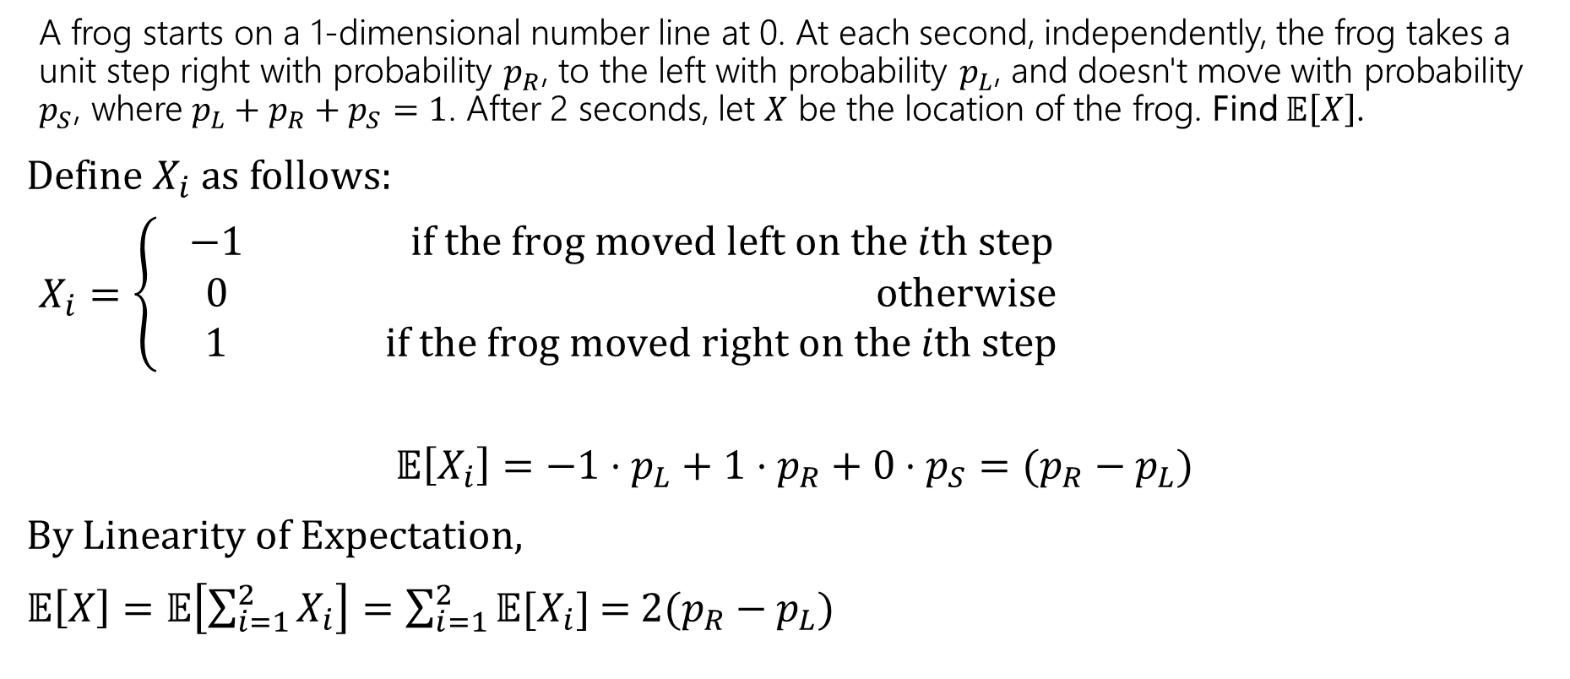
Frogger – LOE
Or we can apply LoE!
A frog starts on a 1-dimensional number line at 0. At each second, independently, the frog takes a unit step right with probability $p_{R}$, to the left with probability $p_{L}$, and doesn't move with probability $p_{S}$, where ${p_{L}+p}_{R}+p_{S}=1$. After 2 seconds, let $X$ be the location of the frog. Find $𝔼\left[X\right]$.
Define $X_{i}$as follows:
$X_{i}=\left\{\begin{aligned} −1 if the frog moved left on the ith step \\ 0 otherwise \\ 1 if the frog moved right on the ith step\end{aligned}\right.$
$$𝔼\left[X_{i}\right]={−1⋅p_{L}+1⋅p}_{R}+0⋅p_{S}=(p_{R}−p_{L})$$
By Linearity of Expectation,
$𝔼\left[X\right]=𝔼\left[\sum_{i=1}^{2}{X_{i}}\right]=\sum_{i=1}^{2}{𝔼[X_{i}]}$ =$2(p_{R}−p_{L})$

Slide 51
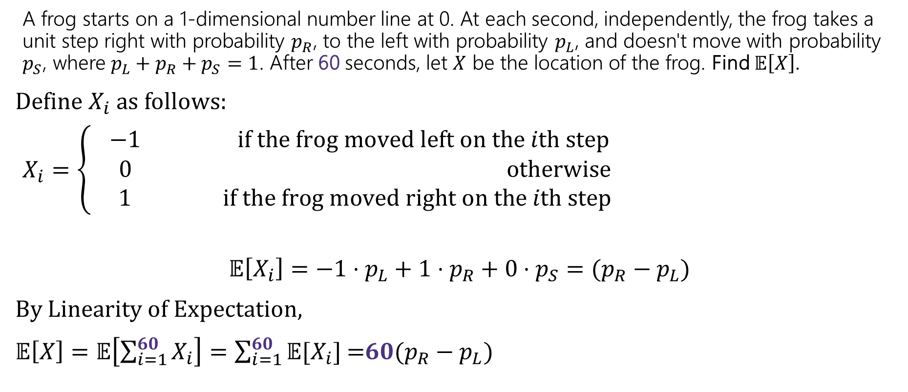
Frogger – LOE
If we interested in a whole minute (60 sec), the first approach would be awful because we would need to compute many probabilities or deal with a gnarly summation! Instead, we can use LoE!
A frog starts on a 1-dimensional number line at 0. At each second, independently, the frog takes a unit step right with probability $p_{R}$, to the left with probability $p_{L}$, and doesn't move with probability $p_{S}$, where ${p_{L}+p}_{R}+p_{S}=1$. After 60 seconds, let $X$ be the location of the frog. Find $𝔼\left[X\right]$.
Define $X_{i}$as follows:
$X_{i}=\left\{\begin{aligned} −1 if the frog moved left on the ith step \\ 0 otherwise \\ 1 if the frog moved right on the ith step\end{aligned}\right.$
$$𝔼\left[X_{i}\right]={−1⋅p_{L}+1⋅p}_{R}+0⋅p_{S}=(p_{R}−p_{L})$$
By Linearity of Expectation,
$𝔼\left[X\right]=𝔼\left[\sum_{i=1}^{60}{X_{i}}\right]=\sum_{i=1}^{60}{𝔼[X_{i}]}$ =$60(p_{R}−p_{L})$

Slide 52
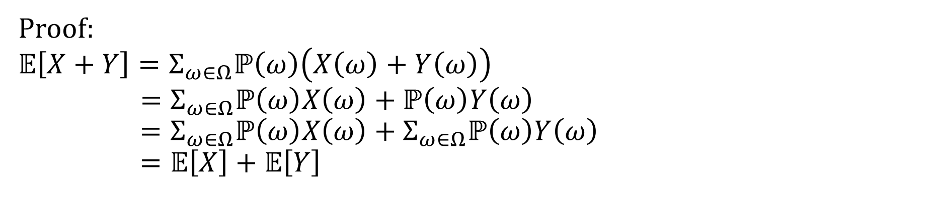

Linearity of Expectation - Proof
For any two random variables $X$ and $Y$:
$$𝔼\left[X+Y\right]=𝔼\left[X\right]+𝔼[Y]$$
Note: $X$ and $Y$ do not have to be independent
Linearity of Expectation
Proof:
$$𝔼\left[X+Y\right]=Σ_{ω∈Ω}ℙ\left(ω\right)\left(X\left(ω\right)+Y\left(ω\right)\right)$$
$$=Σ_{ω∈Ω}ℙ\left(ω\right)X\left(ω\right)+ℙ\left(ω\right)Y\left(ω\right) \\ =Σ_{ω∈Ω}ℙ\left(ω\right)X\left(ω\right)+Σ_{ω∈Ω}ℙ\left(ω\right)Y\left(ω\right)=𝔼\left[X\right]+𝔼\left[Y\right]$$

