Slide 1
Expectation and Variance
CSE 312 Summer 25
Lecture 9

Slide 2
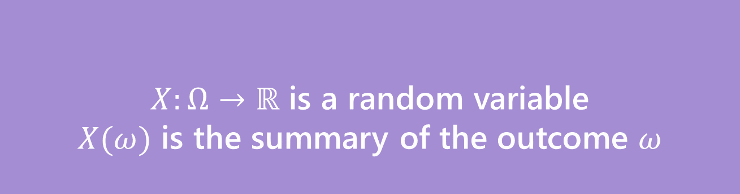

Random Variable
Support $Ω_{X}$
the set of values $X$ can take.
Probability Mass Function
(pmf $p_{X}(x)$)
on input $x,$tells you $ℙ\left(X=x\right).$
What’s a random variable?
Formally
Informally: A random variable is a way to summarize the important (numerical) information from your outcome.
$X:Ω→ℝ$ is a random variable
$X(ω)$ is the summary of the outcome $ω$
Random Variable
Notes:
Quick review of concepts before CDF – skip if low on time

Slide 3
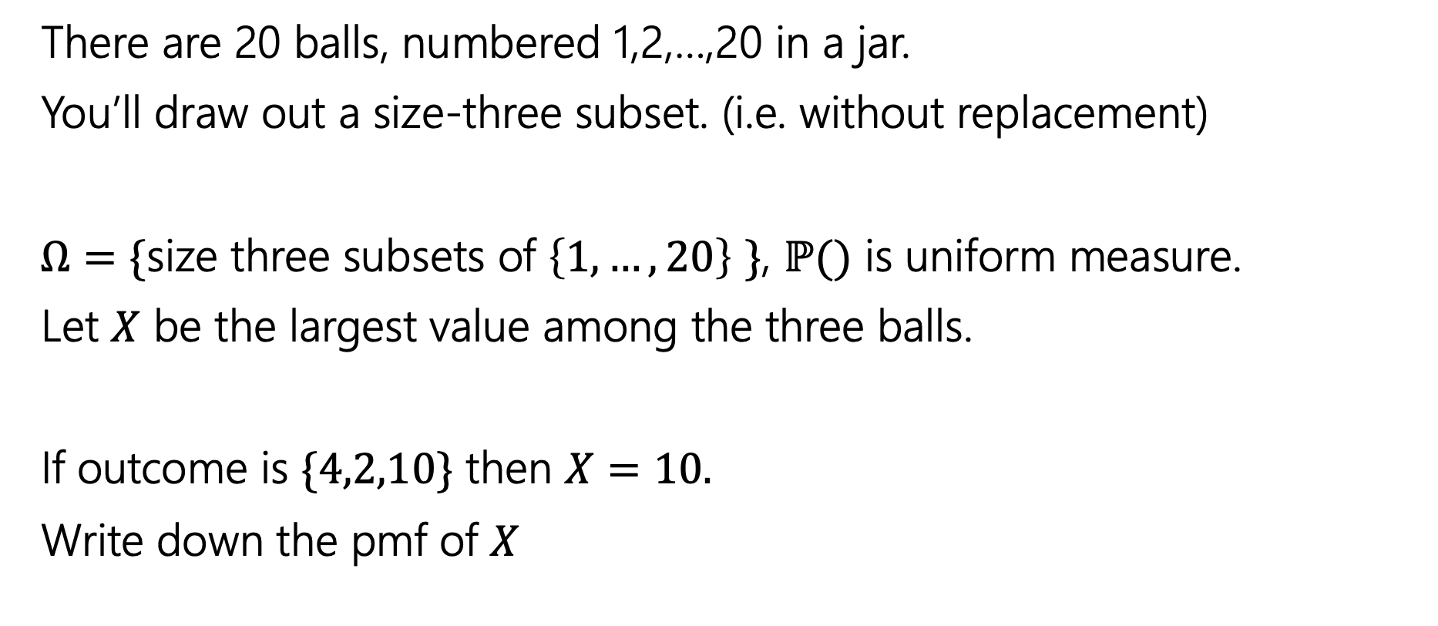
Try It Yourself
There are 20 balls, numbered 1,2,…,20 in a jar.
You’ll draw out a size-three subset. (i.e. without replacement)
$Ω=\{$size three subsets of $\left\{1,…,20\right\}$ $\}$, $ℙ()$ is uniform measure.
Let $X$ be the largest value among the three balls.
If outcome is $\{4,2,10\}$ then $X=10.$
Write down the pmf of $X$
Notes:
Does everyone understand the experiment that we have set up?
Since uniform measure, boils down to counting problem.
Consider the case where x = 3: (1,2)
Consider the case where x = 4: (1,2), (2,3), (1,3)
Number of size three subsets with largest value x: x-1 choose 2 (all pairs of lower values)

Slide 4
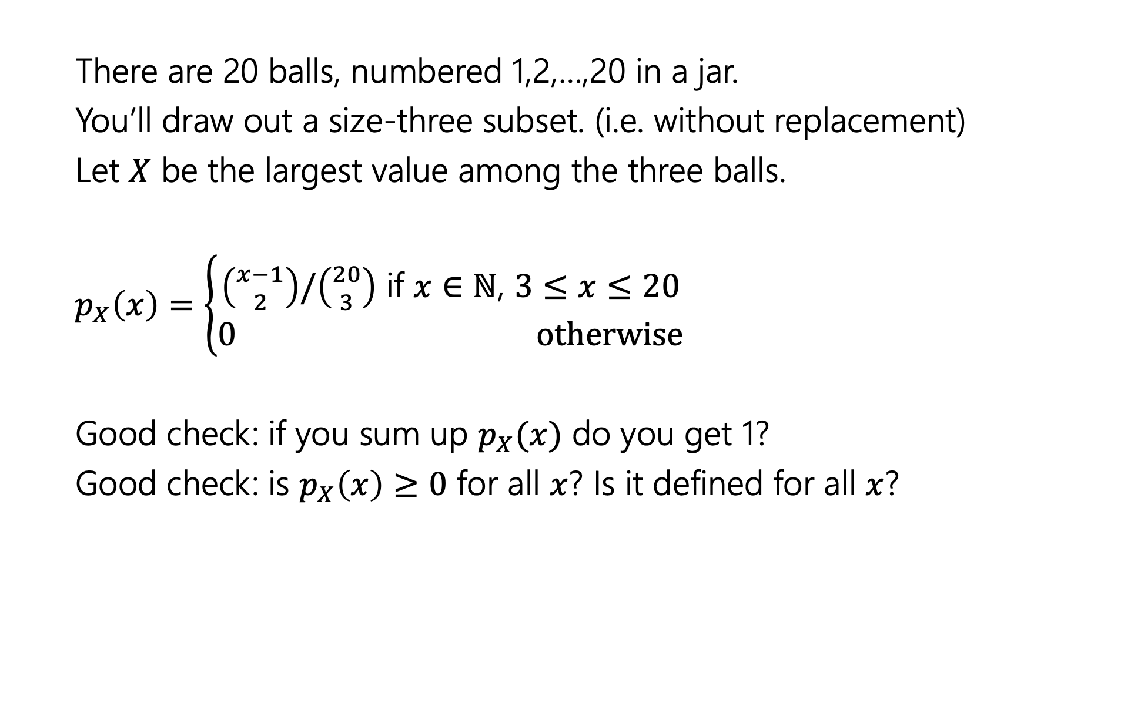
Try It Yourself
There are 20 balls, numbered 1,2,…,20 in a jar.
You’ll draw out a size-three subset. (i.e. without replacement)
Let $X$ be the largest value among the three balls.
$p_{X}\left(x\right)=\left\{\begin{aligned}\left({x−1 \atop 2}\right)/\left({20 \atop 3}\right) \text{if} x∈ℕ\text{, }3≤x≤20 \\ 0 otherwise\end{aligned}\right.$
Good check: if you sum up $p_{X}(x)$ do you get 1?
Good check: is $p_{X}\left(x\right)≥0$ for all $x$? Is it defined for all $x$?
Notes:
Since the random variable partitions the sample space, if we add up the probabilities for all values in the range we better get one.
IMPORTANT: 0 otherwise
Pause for questions

Slide 5
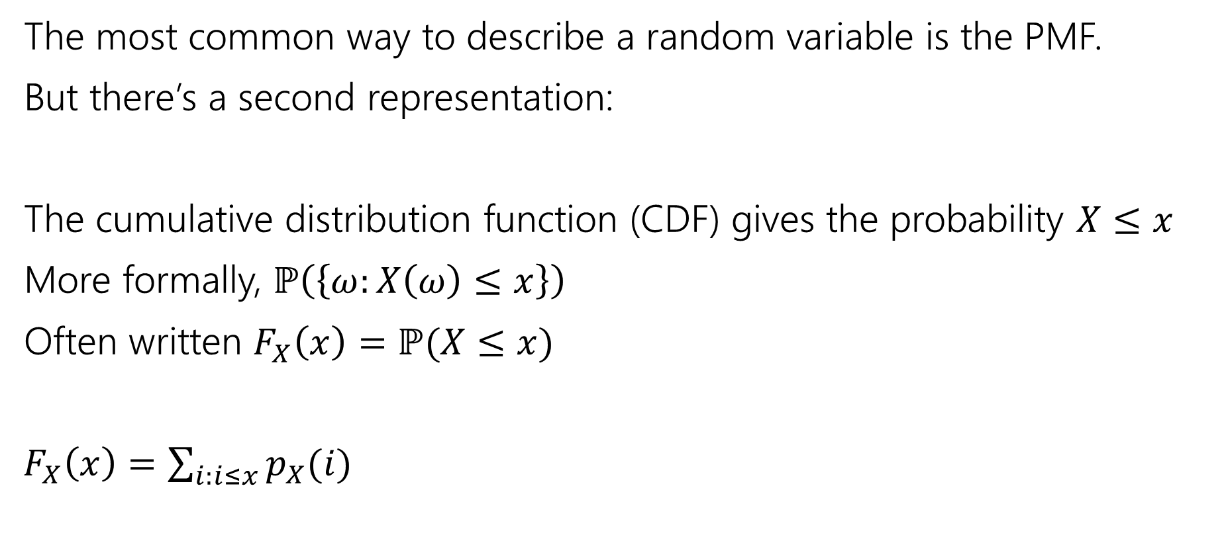
Describing a Random Variable
The most common way to describe a random variable is the PMF.
But there’s a second representation:
The cumulative distribution function (CDF) gives the probability $X≤x$
More formally, $ℙ\left(\left\{ω:X\left(ω\right)≤x\right\}\right)$
Often written $F_{X}\left(x\right)=ℙ(X≤x)$
$F_{X}\left(x\right)=\sum_{i:i≤x}{p_{X}(i)}$
Notes:
Summation notation – summing PMF for all values of RV less than or equal to x
“Cumulative” ⬄ cumulative exam – covers all things we know so far
Similarly, we are summing up all the probabilities less than this value

Slide 6

Try it yourself
What is the CDF of $X$ where
$X$ be the largest value among the three balls. (Drawing 3 of the 20 without replacement)
Notes:
TIME CHECK: 23 minutes
Take 1 minute
Same counting problem – number of ways to pick size-3 subset with largest value AT MOST x
=> All size three subsets from the set 1,2,…,x

Slide 7
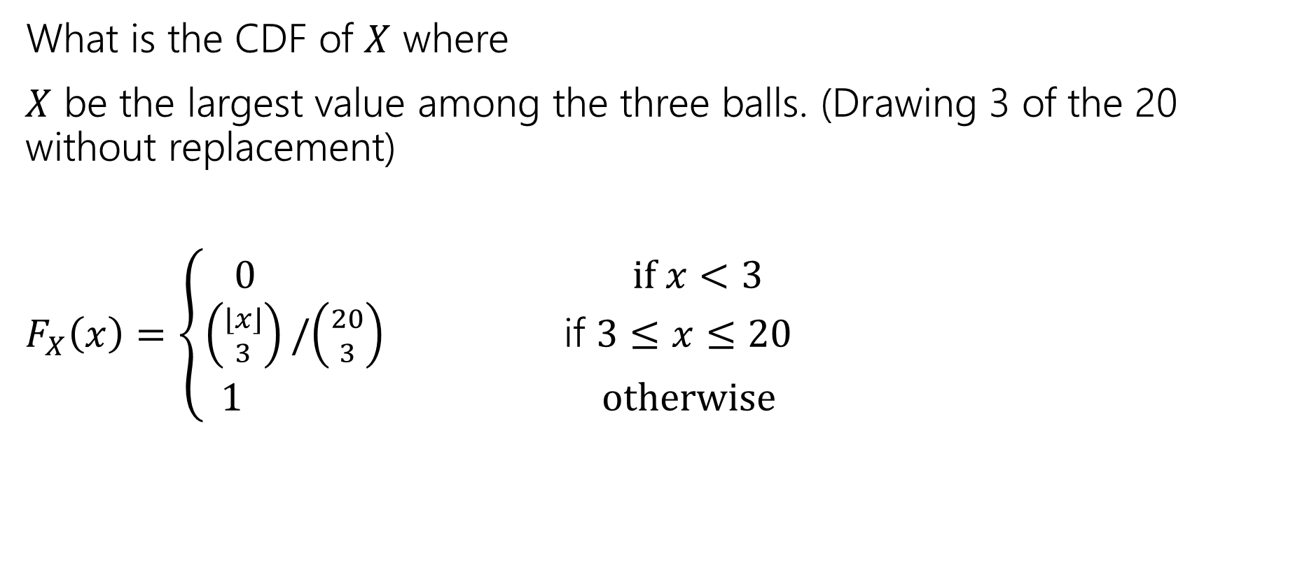
Try it yourself
What is the CDF of $X$ where
$X$ be the largest value among the three balls. (Drawing 3 of the 20 without replacement)
$F_{X}\left(x\right)=\left\{\begin{aligned}\begin{aligned}0 if x<3 \\ \left({⌊x⌋ \atop 3}\right)/\left({20 \atop 3}\right) \text{if} 3≤x≤20\end{aligned} \\ 1 otherwise\end{aligned}\right.$
Notes:
Start with main case
Explain edge cases
When we were defining the PMF, if someone gave us a non
PAUSE FOR QUESTIONS

Slide 8
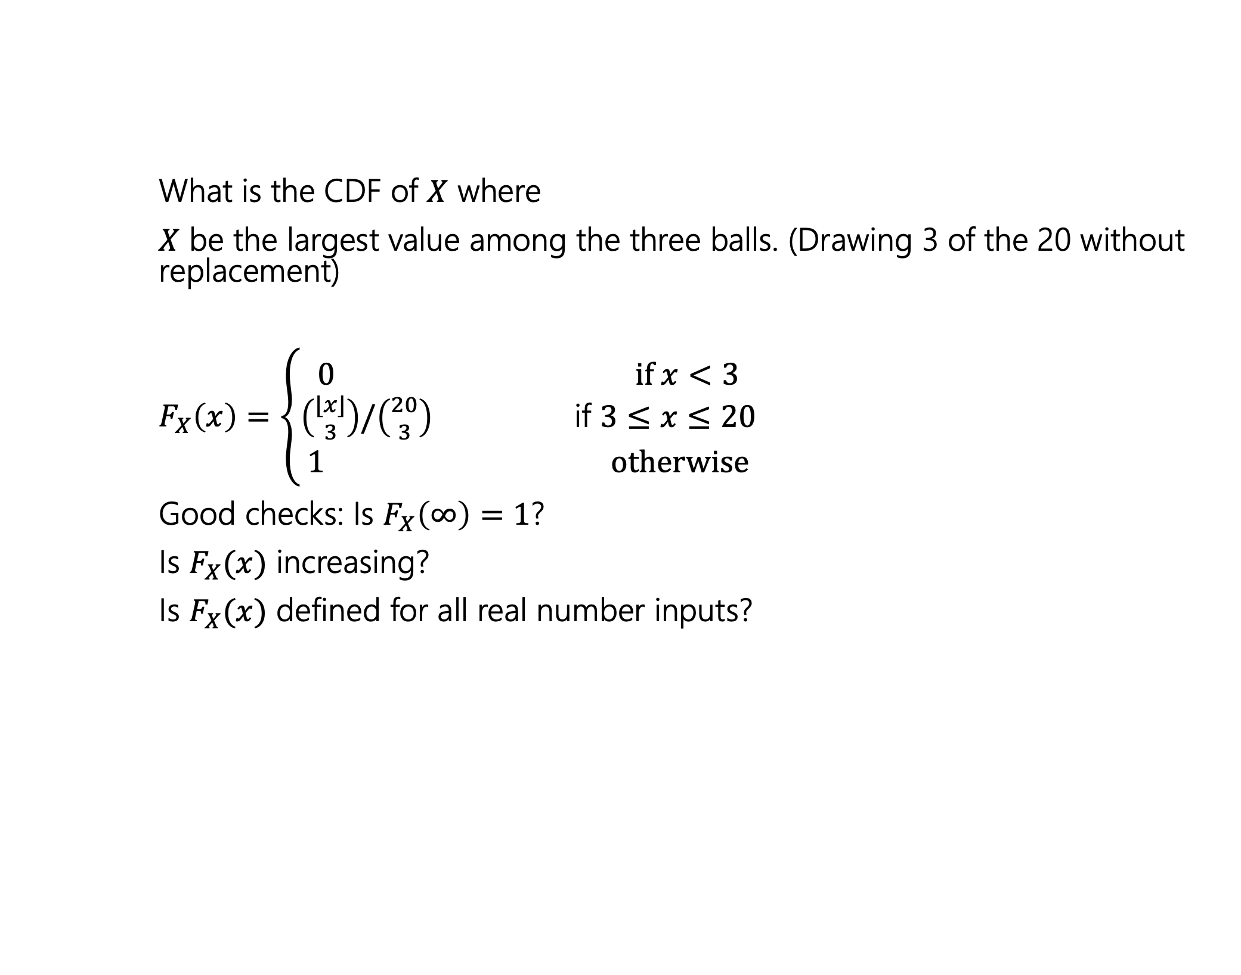
Try it yourself
What is the CDF of $X$ where
$X$ be the largest value among the three balls. (Drawing 3 of the 20 without replacement)
$F_{X}\left(x\right)=\left\{\begin{aligned}\begin{aligned}0 if x<3 \\ \left({⌊x⌋ \atop 3}\right)/\left({20 \atop 3}\right) \text{if} 3≤x≤20\end{aligned} \\ 1 otherwise\end{aligned}\right.$
Good checks: Is $F_{X}\left(∞\right)=1$?
Is $F_{X}(x)$ increasing?
Is $F_{X}(x)$ defined for all real number inputs?

Slide 9
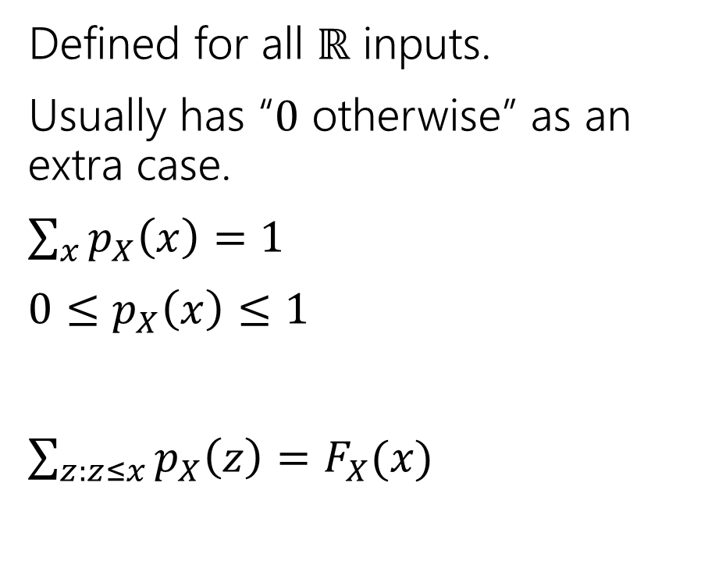
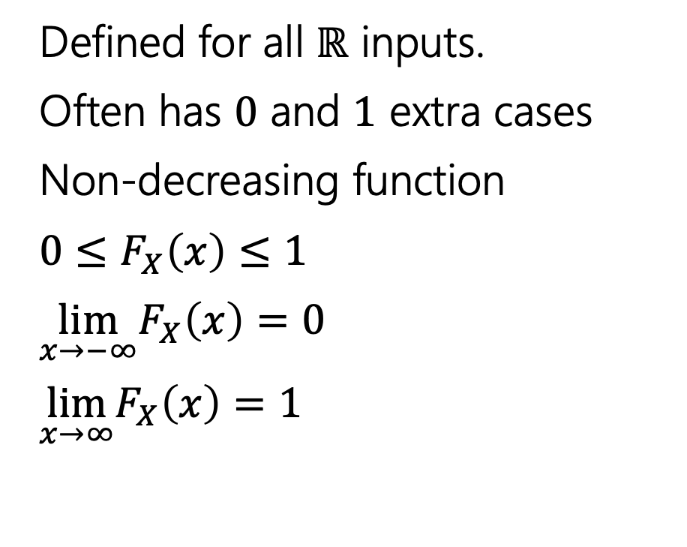
Two descriptions
Probability mass function
Cumulative Distribution function
Defined for all $ℝ$ inputs.
Usually has “$0$ otherwise” as an extra case.
$\sum_{x}{p_{X}\left(x\right)=1}$
$0≤p_{X}\left(x\right)≤1$
$\sum_{z:z≤x}{p_{X}\left(z\right)=F_{X}(x)}$
Defined for all $ℝ$ inputs.
Often has $0$ and $1$ extra cases
Non-decreasing function
$0≤F_{X}\left(x\right)≤1$
$\lim_{x→−∞}F_{X}\left(x\right)=0$
$\lim_{x→∞}F_{X}\left(x\right)=1⁡$
Notes:
TIME CHECK: 30 minutes

Slide 10
More Independence

Slide 11
Independence of Random Variables
$X$ and $Y$ are independent if for all $k,ℓ$
$$ℙ\left(X=k, Y=ℓ\right)=ℙ\left(X=k\right)ℙ(Y=ℓ)$$
Independence (of random variables)
We’ll often use commas instead of $∩$ symbol.
Notes:
IMPORTANT: for all k,l
Analogous to events otherwise, but must be true for all events w.r.t RVs (X=k is an event)

Slide 12

Independence of Random Variables
The “for all values” is important.
We say that the event “the sum is 7” is independent of “the red die is 5”
What about $S=$“the sum of two dice” and $R=$“the value of the red die”
Notes:
We can define two events that are independent, but their corresponding RVs might not be.

Slide 13
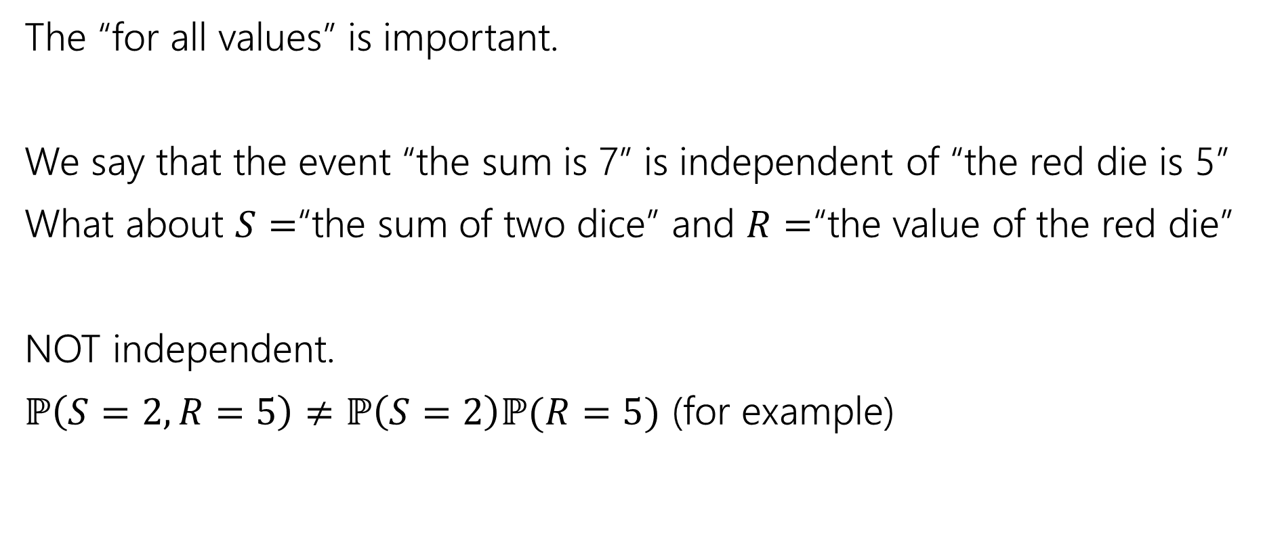
Independence of Random Variables
The “for all values” is important.
We say that the event “the sum is 7” is independent of “the red die is 5”
What about $S=$“the sum of two dice” and $R=$“the value of the red die”
NOT independent.
$ℙ\left(S=2, R=5\right)≠ℙ\left(S=2\right)ℙ(R=5)$ (for example)
Notes:
Left side 0, right side 1/36 * 1/6

Slide 14

Independence of Random Variables
Flip a coin independently $2n$ times.
Let $X$ be “the number of heads in the first $n$ flips.”
Let $Y$ be “the number of heads in the last $n$ flips.”
$X$ and $Y$ are independent.
Notes:
The events X=x, Y=y are always independent since they are describing functionally different experiments (two sets of n flips)
Probability we see x heads in the first n flips does not affect the probability of seeing y heads in the next n flips

Slide 15

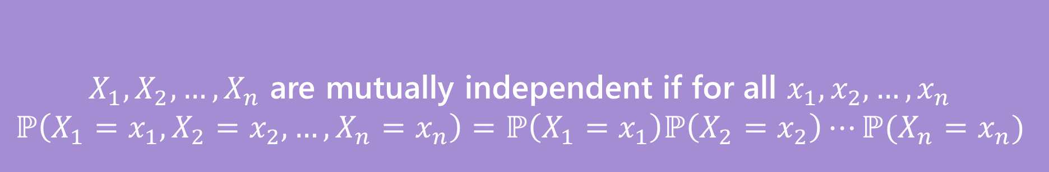
Mutual Independence for RVs
A little simpler to write down than for events
DON’T need to check all subsets for random variables…
But you do need to check all values (all possible $x_{i}$) still.
$X_{1},X_{2},…,X_{n}$ are mutually independent if for all $x_{1},x_{2},…,x_{n}$
$$ℙ\left(X_{1}=x_{1}, X_{2}=x_{2},…,X_{n}=x_{n}\right)=ℙ\left(X_{1}=x_{1}\right)ℙ\left(X_{2}=x_{2}\right)⋯ℙ(X_{n}=x_{n})$$
Mutual Independence (of random variables)
Notes:
For events, we need to check that this condition holds for all subsets (not just the full group)
Wait but why don’t we need different kinds of independence? It turns out for RVs that it doesn’t make a difference. The intuition here is that it comes from the “for all x_i” condition. Any random variable that *isn’t* mentioned just “factors out” when you evaluate either the left or right hand-side. That’s because you must handle *all* values, the same doesn’t happen for events.

Slide 16
Expectation

Slide 17


Expectation
The “expectation” (or “expected value”) of a random variable $X$ is:
$$𝔼\left[X\right]=\sum_{k}{k⋅ℙ(X=k)}$$
Expectation
Intuition: The weighted average of values $X$ could take on.
Weighted by the probability you actually see them.
Notes:
Our expected value is a one number summary of our random variable.
K in the support of the random variable
Alternative intuition: If you ran the experiment generating X over and over, what would the value be on average?

Slide 18

Example 1
Flip a fair coin twice (independently)
Let $X$be the number of heads.
$Ω=\{TT,TH,HT,HH\}$, $ℙ()$ is uniform measure.
$𝔼\left[X\right]=\frac{1}{4}⋅0+\frac{1}{2}⋅1+\frac{1}{4}⋅2=0+\frac{1}{2}+\frac{1}{2}=1$.
Notes:
Write the support

Slide 19
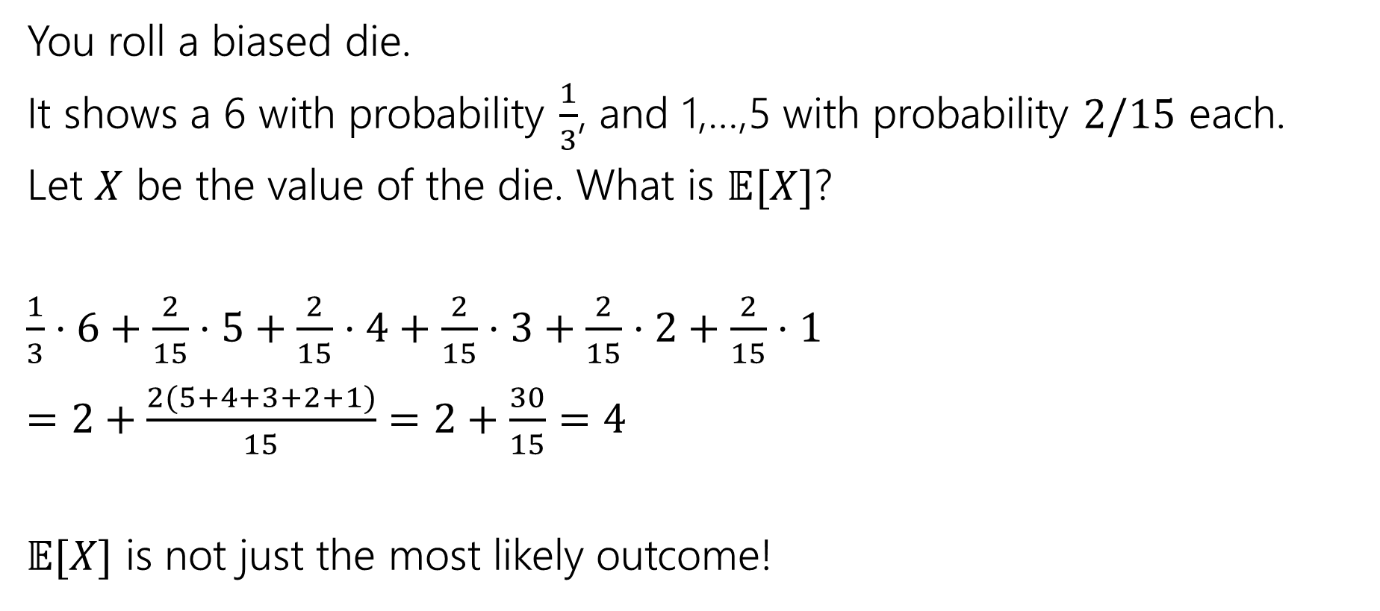
Example 2
You roll a biased die.
It shows a 6 with probability $\frac{1}{3}$, and 1,…,5 with probability $2/15$ each.
Let $X$ be the value of the die. What is $𝔼[X]$?
$\frac{1}{3}⋅6+\frac{2}{15}⋅5+\frac{2}{15}⋅4+\frac{2}{15}⋅3+\frac{2}{15}⋅2+\frac{2}{15}⋅1$
$=2+\frac{2(5+4+3+2+1)}{15}=2+\frac{30}{15}=4$
$𝔼[X]$ is not just the most likely outcome!

Slide 20

Try it yourself
Let $X$ be the result shown on a fair die. What is $𝔼[X]$?
Let $Y$ be the sum of two (independent) fair die rolls. What is $𝔼[Y]$?
Notes:
Take 1 minute

Slide 21

Try it yourself
Let $X$ be the result shown on a fair die. What is $𝔼[X]$
$6⋅\frac{1}{6}+5⋅\frac{1}{6}+4⋅\frac{1}{6}+3⋅\frac{1}{6}+2⋅\frac{1}{6}+1⋅\frac{1}{6}$
$=\frac{21}{6}=3.5$
$𝔼[X]$ is not necessarily a possible outcome!
That’s ok, it’s an average!

Slide 22
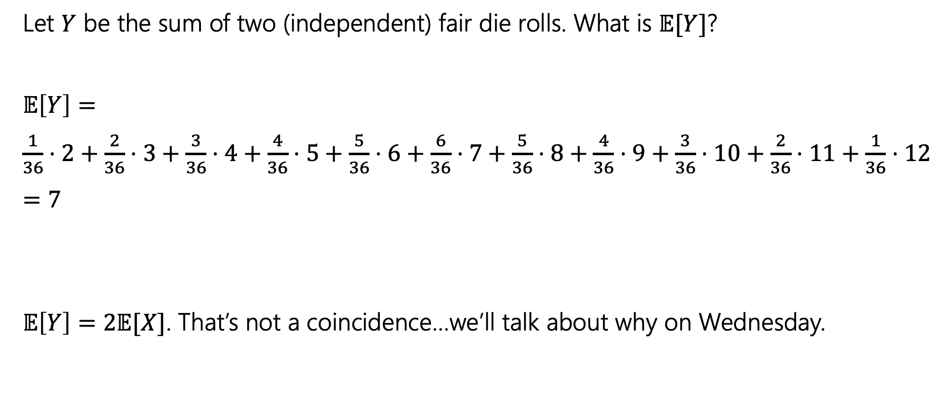
Try it yourself
Let $Y$ be the sum of two (independent) fair die rolls. What is $𝔼[Y]$?
$𝔼\left[Y\right]=$
$\frac{1}{36}⋅2+\frac{2}{36}⋅3+\frac{3}{36}⋅4+\frac{4}{36}⋅5+\frac{5}{36}⋅6+\frac{6}{36}⋅7+\frac{5}{36}⋅8+\frac{4}{36}⋅9+\frac{3}{36}⋅10+\frac{2}{36}⋅11+\frac{1}{36}⋅12$
$=7$
$𝔼\left[Y\right]=2𝔼[X]$. That’s not a coincidence…we’ll talk about why on Wednesday.
Notes:
This is a general pattern – we will develop the tools to discuss it mathematically on Friday

Slide 23

Subtle but Important
$X$ is random. You don’t know what it is (at least until you run the experiment).
$𝔼[X]$ is not random. It’s a number.
You don’t need to run the experiment to know what it is.
Notes:
Even after running experiment, expectation is the same
WHY DO WE CARE? Helps us as computer scientists quantify the general behavior of random processes.
PAUSE FOR QUESTIONS

Slide 24
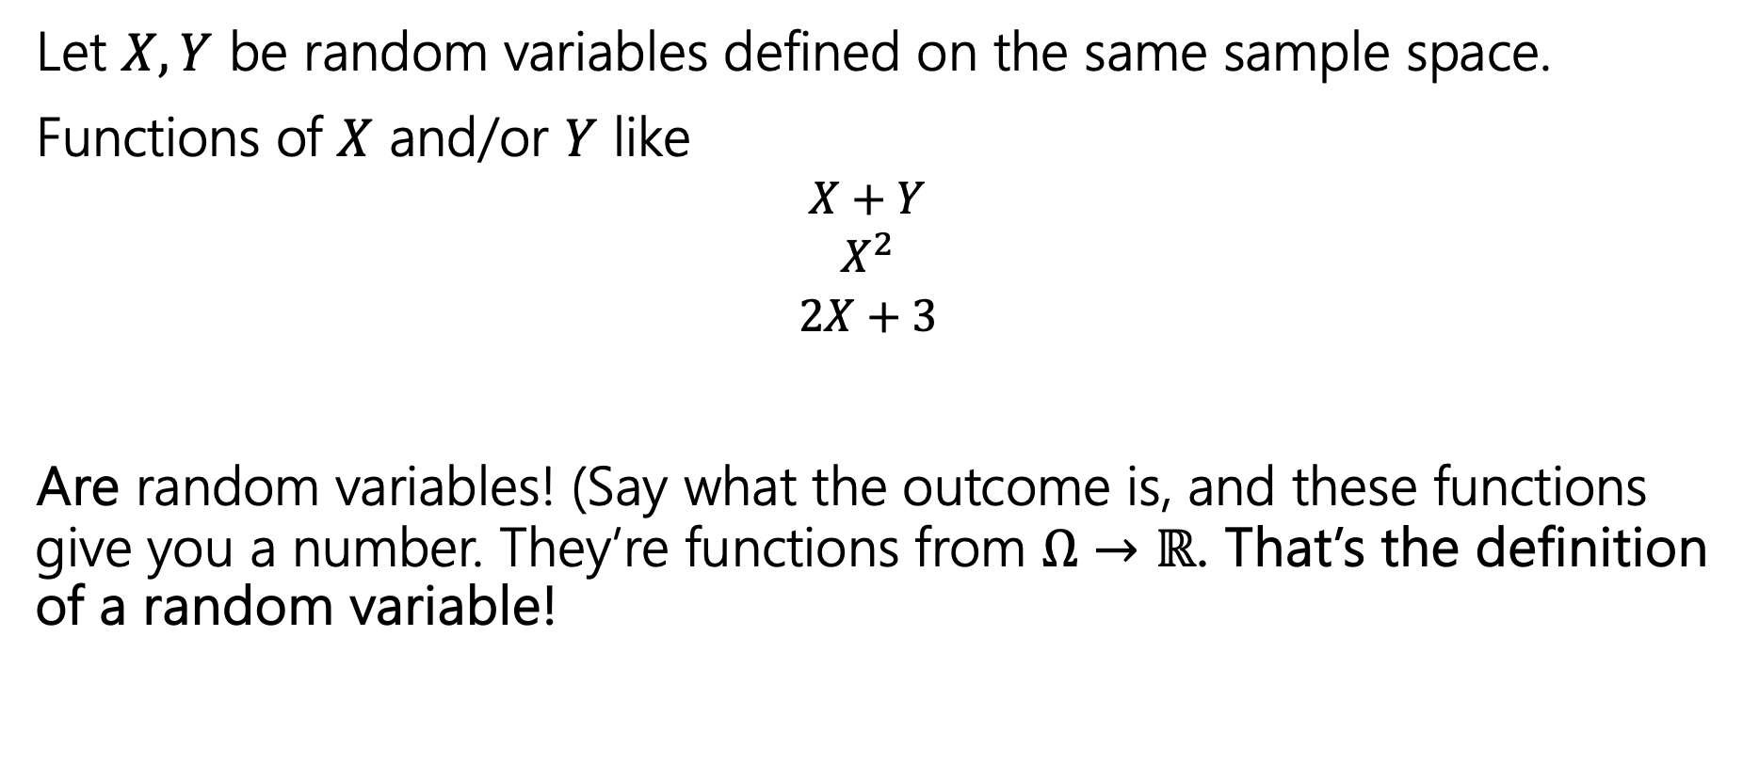
Functions of a random variable
Let $X,Y$ be random variables defined on the same sample space.
Functions of $X$ and/or $Y$ like
  $$X+Y$$
  $$X^{2}$$
  $$2X+3$$
Are random variables! (Say what the outcome is, and these functions give you a number. They’re functions from $Ω→ℝ$. That’s the definition of a random variable!

Slide 25
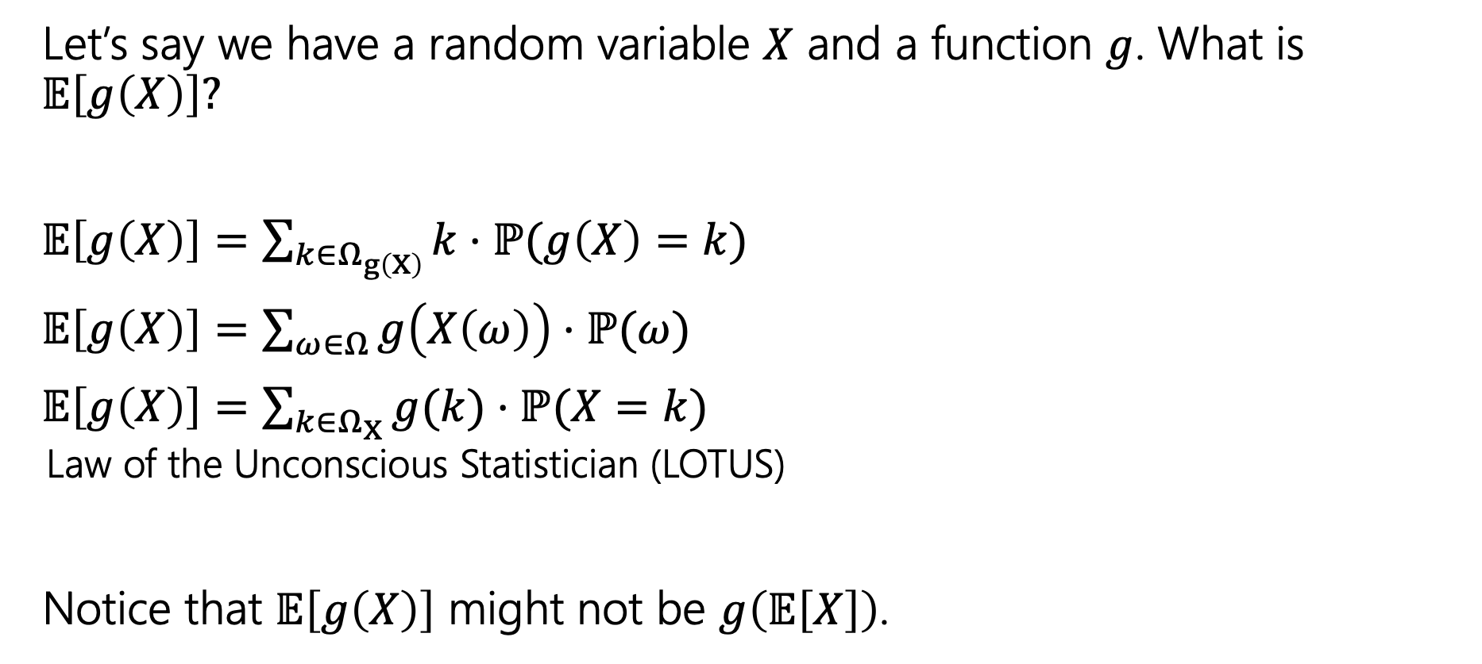
Expectations of functions of random variables
Let’s say we have a random variable $X$ and a function $g$. What is $𝔼\left[g\left(X\right)\right]?$
$𝔼\left[g\left(X\right)\right]=\sum_{k∈Ω_{g\left(X\right)}}{k⋅ℙ(g\left(X\right)=k)}$
$𝔼\left[g\left(X\right)\right]=\sum_{ω∈Ω}{g\left(X\left(ω\right)\right)⋅ℙ(ω)}$
$𝔼\left[g\left(X\right)\right]=\sum_{k∈Ω_{X}}{g(k)⋅ℙ(X=k)}$
  Law of the Unconscious Statistician (LOTUS)
Notice that $𝔼\left[g\left(X\right)\right]$ might not be $g\left(𝔼\left[X\right]\right)$.
Notes:
Show in the context of X^2
Cant take the shortcut
Mention that E[X*Y] = E[X] * E[Y] only if X and Y are independent

Slide 26
Variance

Slide 27
Where are we?
A random variable is a way to summarize what outcome you saw.
The Expectation of a random variable is its average value.
A way to summarize a random variable

Slide 28
Variance
Another one number summary of a random variable.
But wait, we already have expectation, what’s this for?
Notes:
We’re going to see an example where two different random variables that have the same expectation, but have very different behavior

Slide 29
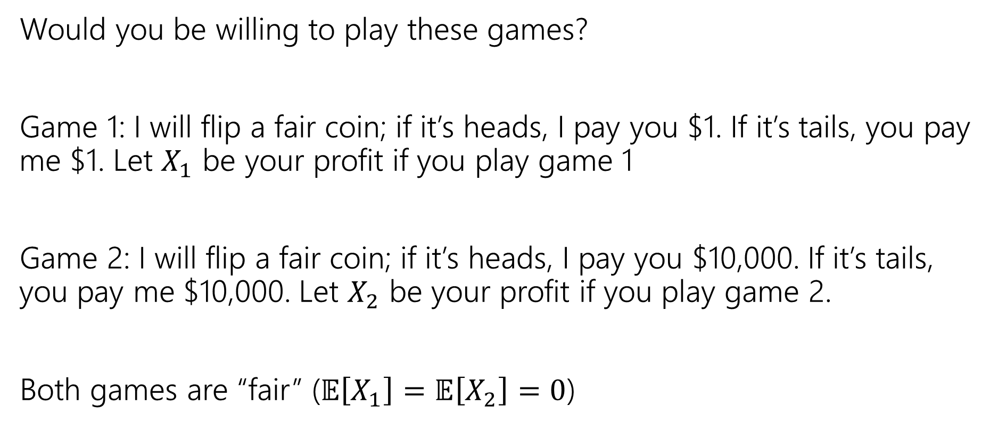
Consider these two games
Would you be willing to play these games?
Game 1: I will flip a fair coin; if it’s heads, I pay you $1. If it’s tails, you pay me $1. Let $X_{1}$ be your profit if you play game 1
Game 2: I will flip a fair coin; if it’s heads, I pay you $10,000. If it’s tails, you pay me $10,000. Let $X_{2}$ be your profit if you play game 2.
Both games are “fair” ($𝔼\left[X_{1}\right]=𝔼\left[X_{2}\right]=0$)

Slide 30
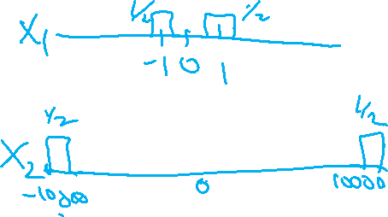
Consider these two games
Would you be willing to play these games?
Game 1: I will flip a fair coin; if it’s heads, I pay you $1. If it’s tails, you pay me $1. Let $X_{1}$ be your profit if you play game 1
Game 2: I will flip a fair coin; if it’s heads, I pay you $10,000. If it’s tails, you pay me $10,000. Let $X_{2}$ be your profit if you play game 2.
Both games are “fair” ($𝔼\left[X_{1}\right]=𝔼\left[X_{2}\right]=0$)
Notes:
What would the probability mass functions look like?

Slide 31
What’s the difference
Expectation tells you what the average will be…
But it doesn’t tell you how “extreme” your results could be.
Nor how likely those extreme results are.
Game 2 has many (well, only) very extreme results.
In expectation they “cancel out” but if you can only play once…
…it would be nice to measure that.

Slide 32
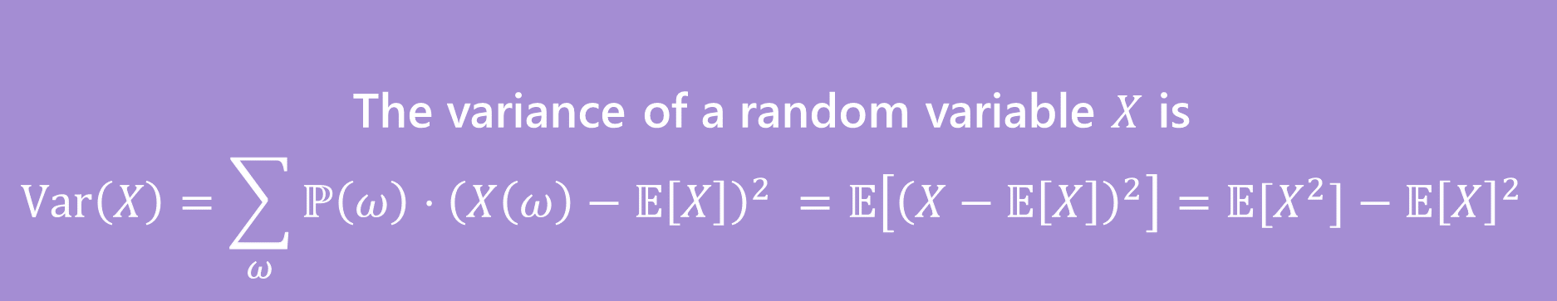
Variance
The first two forms are the definition. The last one is an algebra trick.
The variance of a random variable $X$ is
$$Var\left(X\right)=\sum_{ω}{ℙ\left(ω\right)⋅{\left(X\left(ω\right)−𝔼\left[X\right]\right)}^{2} }=𝔼\left[{\left(X−𝔼\left[X\right]\right)}^{2}\right]=𝔼[X^{2}]−𝔼{\left[X\right]}^{2}$$
Variance
Notes:
In this class you’ll mostly be using this algebra trick version of variance

Slide 33
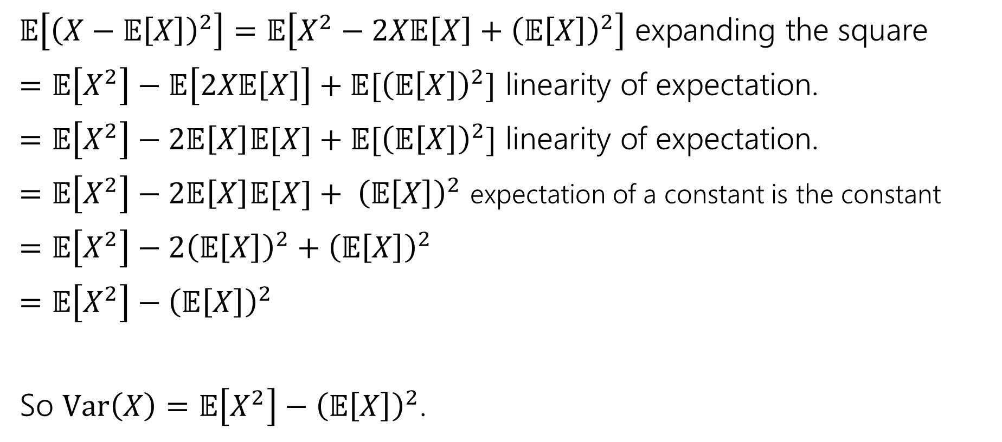
Proof of Calculation Trick
$𝔼\left[{\left(X−𝔼\left[X\right]\right)}^{2}\right]=𝔼\left[X^{2}−2X𝔼\left[X\right]+{\left(𝔼\left[X\right]\right)}^{2}\right]$ expanding the square
$=𝔼\left[X^{2}\right]−𝔼\left[2X𝔼\left[X\right]\right]+𝔼[{\left(𝔼\left[X\right]\right)}^{2}]$ linearity of expectation.
$=𝔼\left[X^{2}\right]−2𝔼\left[X\right]𝔼[X]+𝔼[{\left(𝔼\left[X\right]\right)}^{2}]$ linearity of expectation.
$=𝔼\left[X^{2}\right]−2𝔼\left[X\right]𝔼[X]+ {\left(𝔼\left[X\right]\right)}^{2}$ expectation of a constant is the constant
$=𝔼\left[X^{2}\right]−2{\left(𝔼\left[X\right]\right)}^{2}+{\left(𝔼\left[X\right]\right)}^{2}$
$=𝔼\left[X^{2}\right]−{\left(𝔼\left[X\right]\right)}^{2}$
So $Var\left(X\right)=𝔼\left[X^{2}\right]−{\left(𝔼\left[X\right]\right)}^{2}$.

Slide 34
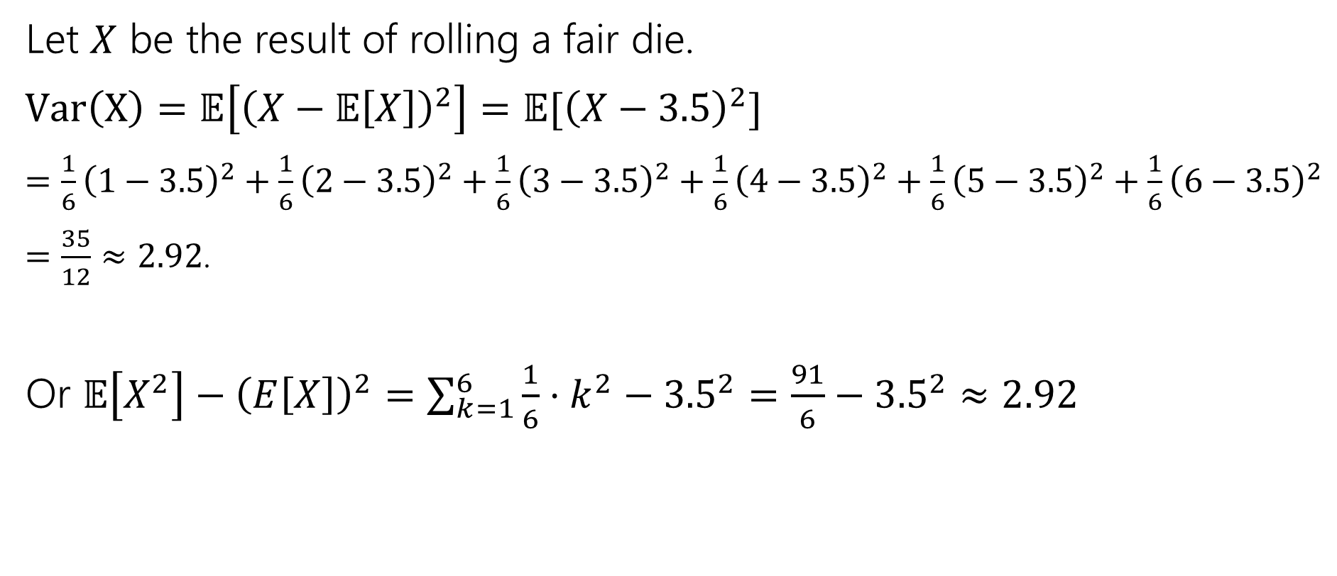
Variance of a die
Let $X$ be the result of rolling a fair die.
$Var\left(X\right)=𝔼\left[{\left(X−𝔼\left[X\right]\right)}^{2}\right]=𝔼[{\left(X−3.5\right)}^{2}]$
$=\frac{1}{6}{\left(1−3.5\right)}^{2}+\frac{1}{6}{\left(2−3.5\right)}^{2}+\frac{1}{6}{\left(3−3.5\right)}^{2}+\frac{1}{6}{\left(4−3.5\right)}^{2}+\frac{1}{6}{\left(5−3.5\right)}^{2}+\frac{1}{6}{\left(6−3.5\right)}^{2}$
$=\frac{35}{12}≈2.92$.
Or $𝔼\left[X^{2}\right]−{\left(E\left[X\right]\right)}^{2}=\sum_{k=1}^{6}{\frac{1}{6}⋅k^{2}−{3.5}^{2}}=\frac{91}{6}−{3.5}^{2}≈2.92$

Slide 35

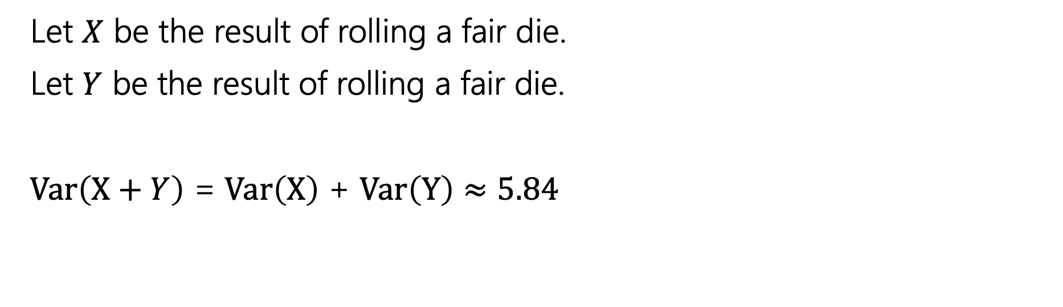
Variance
If $X$ and $Y$ are independent then
$$Var\left(X+Y\right)=Var\left(X\right)+Var(Y)$$
Let $X$ be the result of rolling a fair die.
Let $Y$ be the result of rolling a fair die.
$Var\left(X+Y\right)$ = $Var\left(X\right)$ + $Var\left(Y\right)$ $≈5.84$

Slide 36
Useful Facts

Slide 37
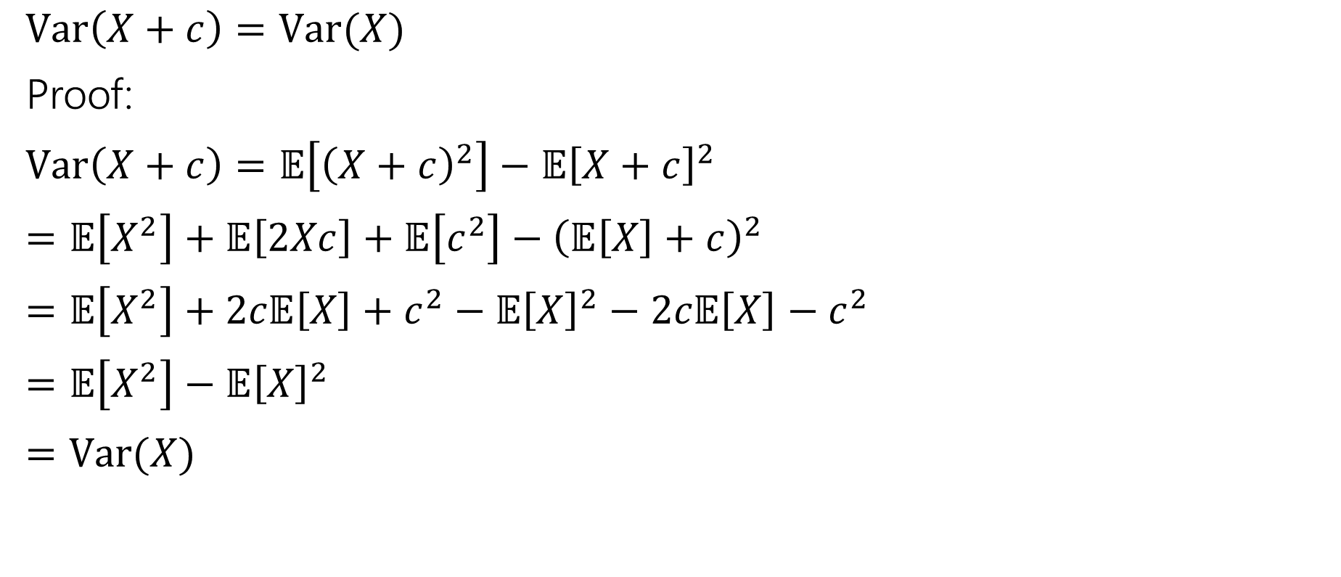
Facts About Variance
$Var\left(X+c\right)=Var(X)$
Proof:
$Var\left(X+c\right)=𝔼\left[{\left(X+c\right)}^{2}\right]−𝔼{\left[X+c\right]}^{2}$
$=𝔼\left[X^{2}\right]+𝔼\left[2Xc\right]+𝔼\left[c^{2}\right]−{\left(𝔼\left[X\right]+c\right)}^{2}$
$=𝔼\left[X^{2}\right]+2c𝔼\left[X\right]+c^{2}−𝔼{\left[X\right]}^{2}−2c𝔼\left[X\right]−c^{2}$
$=𝔼\left[X^{2}\right]−𝔼{\left[X\right]}^{2}$
$=Var(X)$

Slide 38

Facts about Variance
$Var\left(aX\right)=a^{2}Var(X)$
$=𝔼\left[{\left(aX\right)}^{2}\right]−(𝔼{\left[aX\right])}^{2}$
$=a^{2}𝔼\left[X^{2}\right]−{\left(a𝔼\left[X\right]\right)}^{2}$
$=a^{2}𝔼\left[X^{2}\right]−a^{2}𝔼{\left[X\right]}^{2}$
$=a^{2}\left(𝔼\left[X^{2}\right]−𝔼{\left[X\right]}^{2}\right)$
Notes:
Show that var(X-Y) is not Var(X) – Var(Y)

Slide 39
Expectation and Variance aren’t everything
Alright, so expectation and variance is everything right?
No!
A PMF or CDF *does* fully describe a random variable.
Flip a fair coin 3 times indep. Count heads.
Flip a biased coin (prob heads=2/3) until heads. Count flips.
…

Slide 40
Extra Practice

Slide 41

More Practice
Suppose you flip a coin until you see a heads for the first time.
Let $X$ be the number of trials (including the heads)
What is the pmf of $X$?
The cdf of $X$?
$𝔼[X]$?

Slide 42
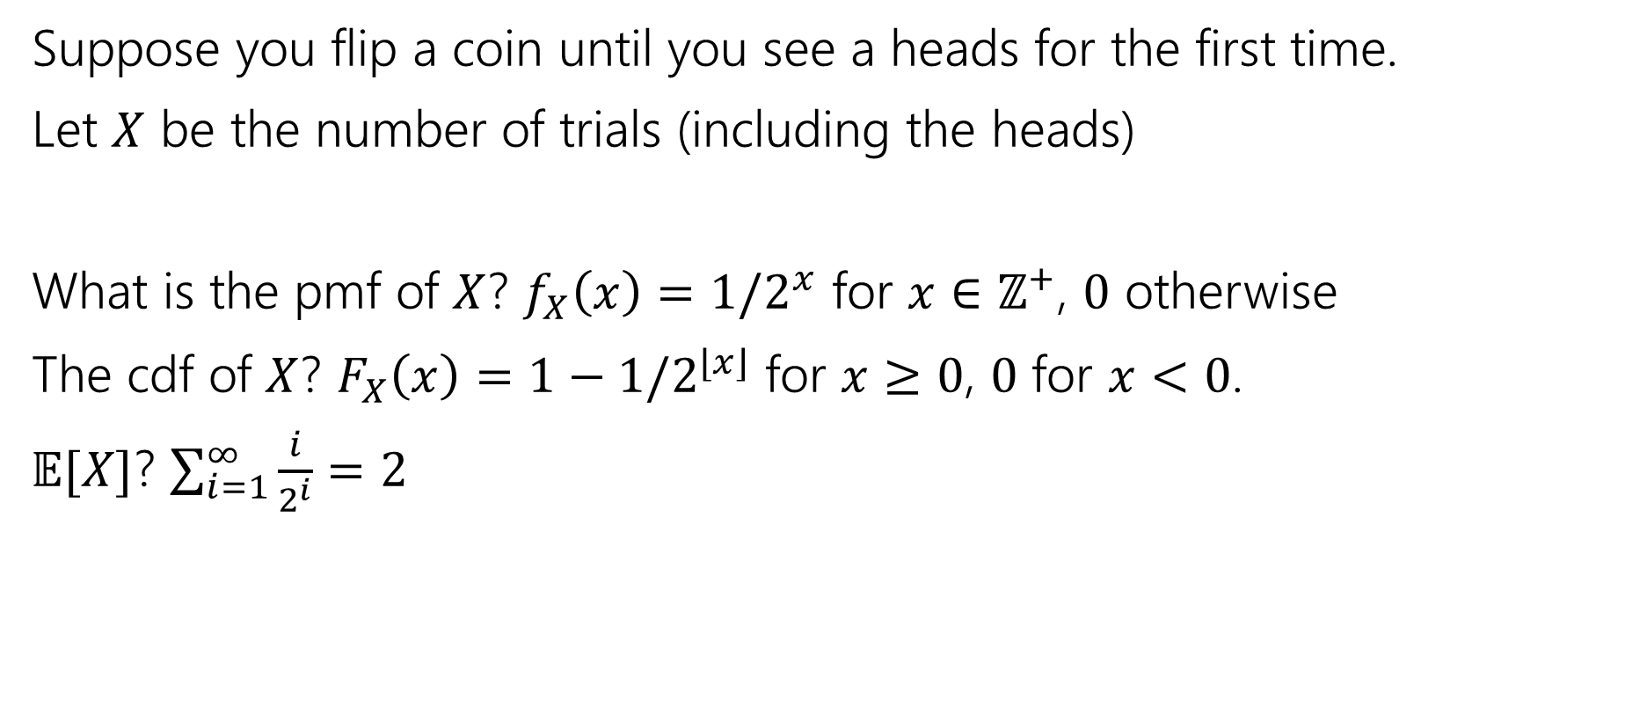
More Practice
Suppose you flip a coin until you see a heads for the first time.
Let $X$ be the number of trials (including the heads)
What is the pmf of $X$? $f_{X}\left(x\right)=1/2^{x}$ for $x∈ℤ^{+}$, $0$ otherwise
The cdf of $X$? $F_{X}\left(x\right)=1−1/2^{⌊x⌋}$ for $x≥0$, $0$ for $x<0$.
$𝔼[X]$? $\sum_{i=1}^{∞}{\frac{i}{2^{i}}}=2$

Slide 43
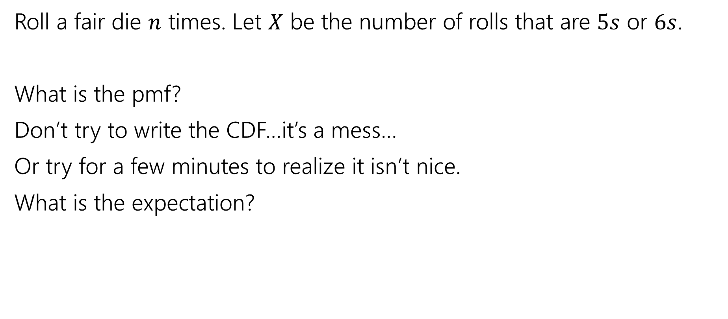
More Random Variable Practice
Roll a fair die $n$ times. Let $X$ be the number of rolls that are $5s$ or $6s$.
What is the pmf?
Don’t try to write the CDF…it’s a mess…
Or try for a few minutes to realize it isn’t nice.
What is the expectation?

Slide 44
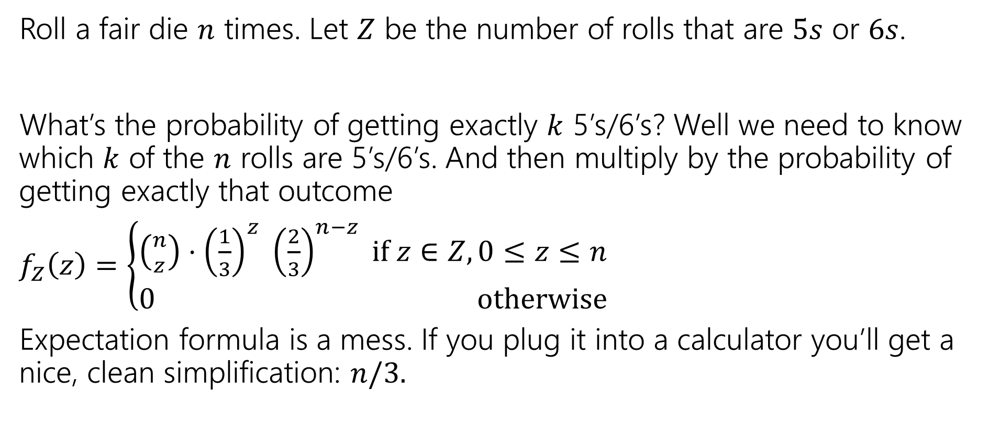
More Random Variable Practice
Roll a fair die $n$ times. Let $Z$ be the number of rolls that are $5s$ or $6s$.
What’s the probability of getting exactly $k$ 5’s/6’s? Well we need to know which $k$ of the $n$ rolls are 5’s/6’s. And then multiply by the probability of getting exactly that outcome
$f_{Z}\left(z\right)=\left\{\begin{aligned}\left({n \atop z}\right)⋅{\left(\frac{1}{3}\right)}^{z} {\left(\frac{2}{3}\right)}^{n−z} if z∈Z,0≤z≤n \\ 0 otherwise\end{aligned}\right.$
Expectation formula is a mess. If you plug it into a calculator you’ll get a nice, clean simplification: $n/3.$

