Slide 1
Random Variables
CSE 312 Summer 25
Lecture 8

Slide 2
Quiz 2 – Probability

Slide 3
Setting the stage: Random Variables
Notes:
Lets talk about what happens when our sample space is infinite.

Slide 4

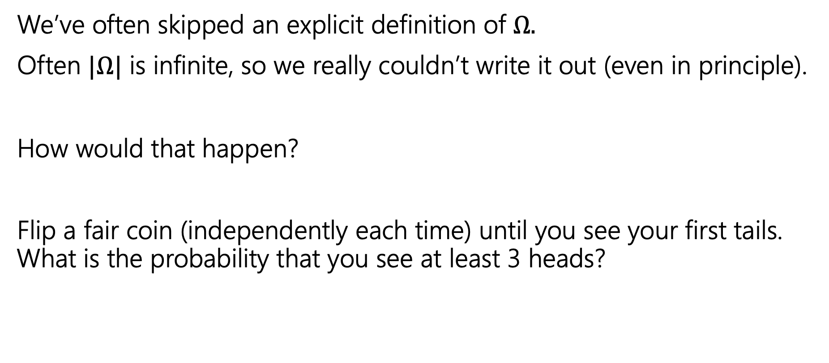
Implicitly defining $Ω$
We’ve often skipped an explicit definition of $Ω.$
Often $|Ω|$ is infinite, so we really couldn’t write it out (even in principle).
How would that happen?
Flip a fair coin (independently each time) until you see your first tails. What is the probability that you see at least 3 heads?
Notes:
We haven’t talked about it before, at least not explicitly, but its actually going to come up a lot. You might be wondering, how could we even have an infinite sample space.
If we have an experiment like this, it’s a bit weird to define a sample space. This is because, at least in principle, we can see any number of heads before the first tails.

Slide 5

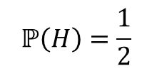

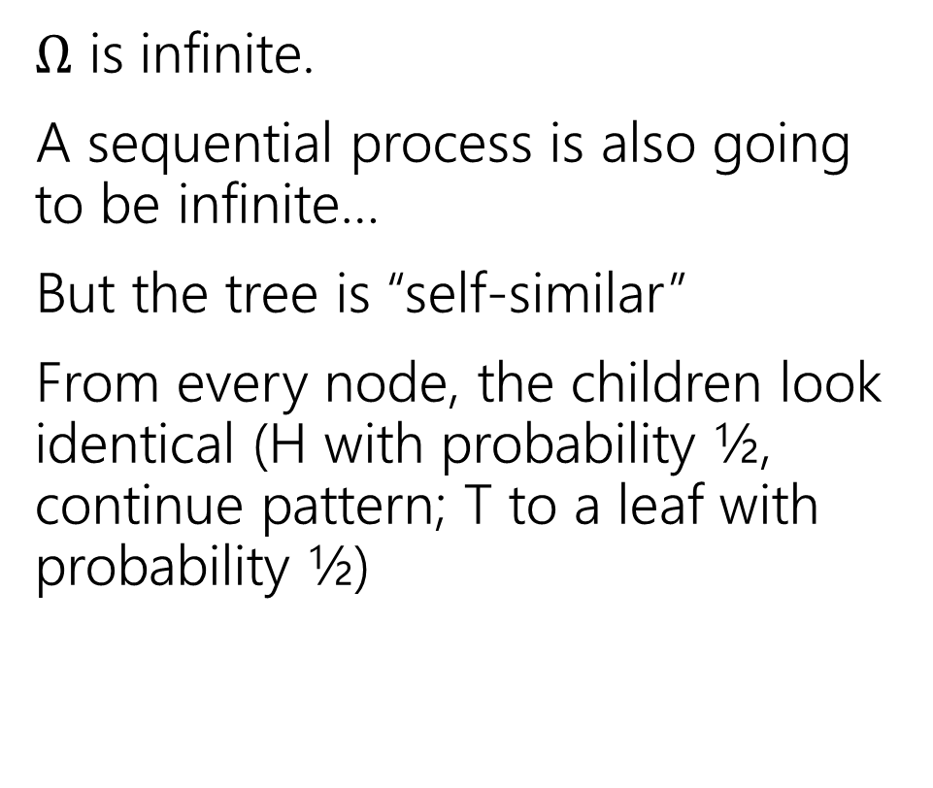




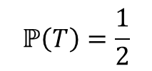

An infinite process.
$Ω$ is infinite.
A sequential process is also going to be infinite…
But the tree is “self-similar”
From every node, the children look identical (H with probability ½, continue pattern; T to a leaf with probability ½)
$$ℙ\left(H\right)=\frac{1}{2}$$
$$ℙ\left(T\right)=\frac{1}{2}$$
H
$$ℙ\left(T\right)=1/2$$
$$ℙ\left(HH|H\right)=\frac{1}{2}$$
$$ℙ\left(HT|H\right)=\frac{1}{2}$$
H
$$ℙ\left(HT\right)=1/4$$
$$ℙ\left(HHH|HH\right)=\frac{1}{2}$$
$$ℙ\left(HHT|HH\right)=\frac{1}{2}$$
H
$$ℙ\left(HHT\right)=1/8$$
…

Slide 6

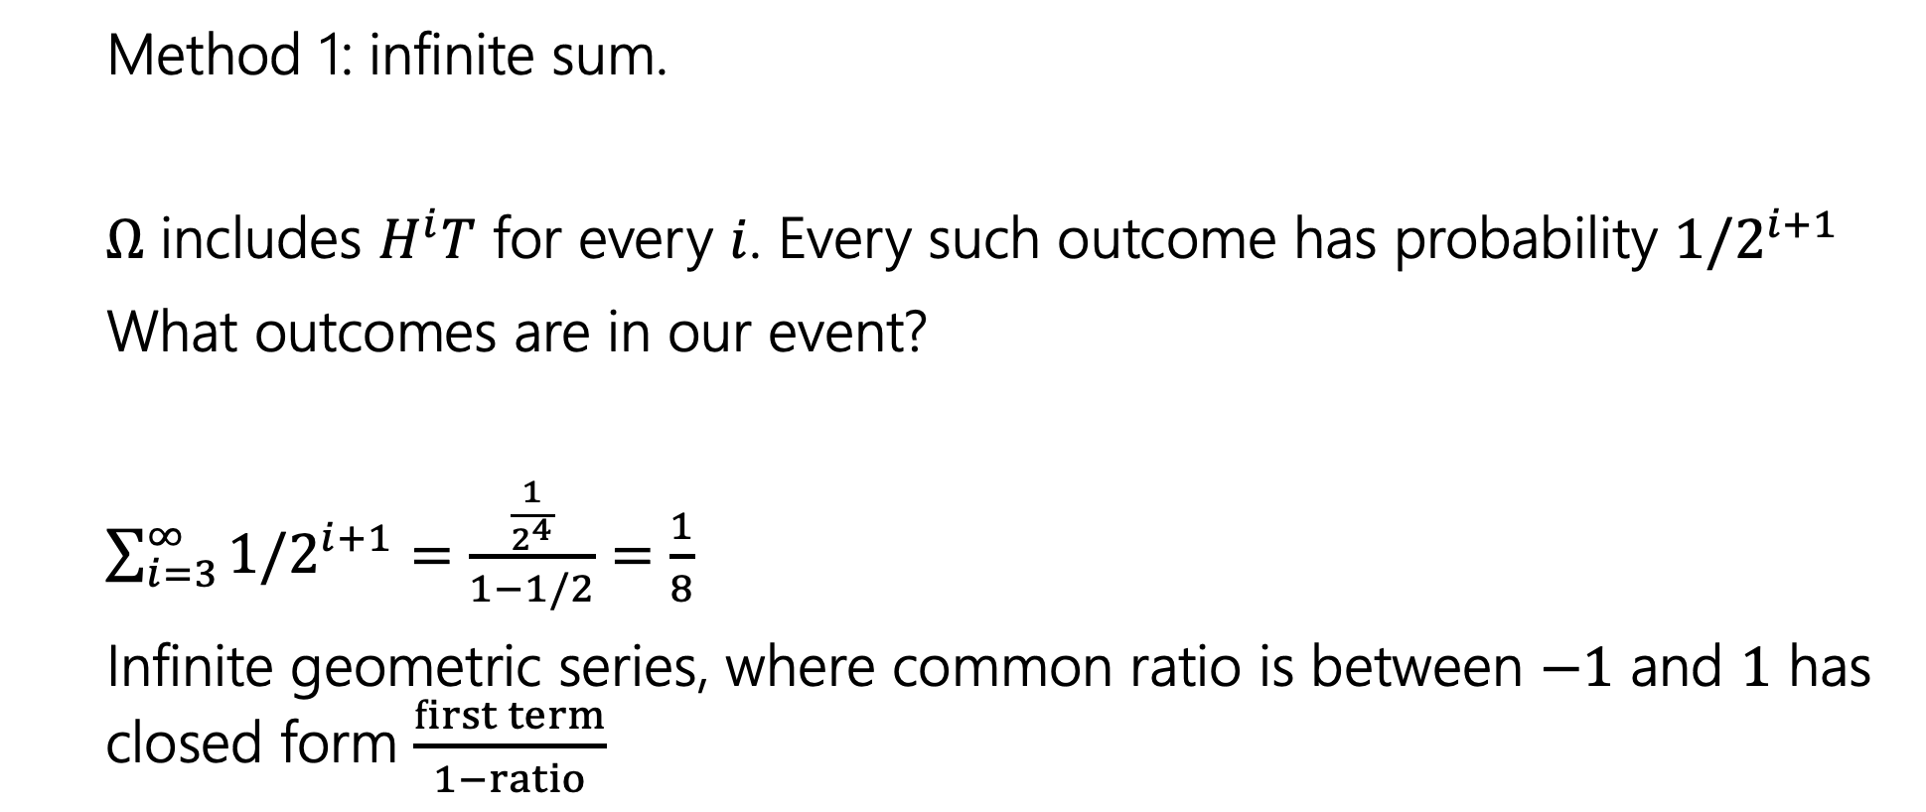
Finding $ℙ($at least $3$ heads)
Method 1: infinite sum.
$Ω$ includes $H^{i}T$ for every $i$. Every such outcome has probability $1/2^{i+1}$
What outcomes are in our event?
$\sum_{i=3}^{∞}{1/2^{i+1}}=$ $\frac{\frac{1}{2^{4}}}{1−1/2}=\frac{1}{8}$
Infinite geometric series, where common ratio is between $−1$ and $1$ has closed form $\frac{first term}{1−ratio}$
Notes:
We can write this as an infinite summation.

Slide 7

Finding $ℙ($at least $3$ heads)
Method 2: Calculate the complement
$ℙ($at most 2 heads) = $\frac{1}{2}+\frac{1}{4}+\frac{1}{8}$
$ℙ($at least 3 heads)= $1−\left(\frac{1}{2}+\frac{1}{4}+\frac{1}{8}\right)=\frac{1}{8}$

Slide 8
Random Variables
Notes:
The idea for a RV is to summarize the information in an outcome, or in our sample space. We don’t always need all the information, just some key pieces. For example, if you're playing a board game and rolling two dice, you're usually just interested in the sum of the dice, not what they exact roll was.
What I've noticed in the past is that this is a bit of a jump for students from what we’ve seen in the past. There is a bit of new notation, but with some practice it will be come familiar and easier for you to express ideas in this way.

Slide 9
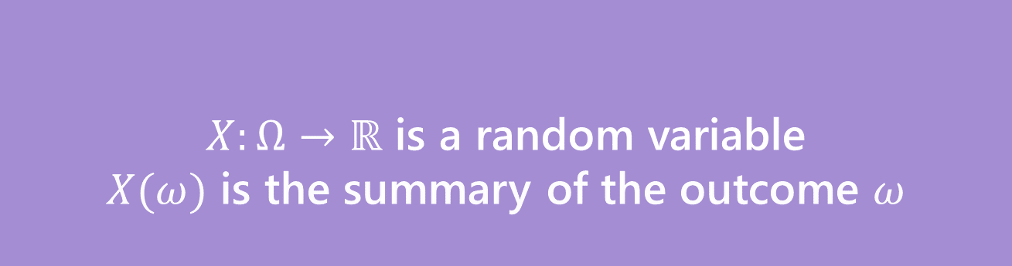
Random Variable
Formally
Informally: A random variable is a way to summarize the important (numerical) information from your outcome.
$X:Ω→ℝ$ is a random variable
$X(ω)$ is the summary of the outcome $ω$
Random Variable
Notes:
Formally a random variable is a function whole domain is the sample space, so it takes in particular outcomes and returns a real number, which is the important numerical summary that we were interested in.

Slide 10
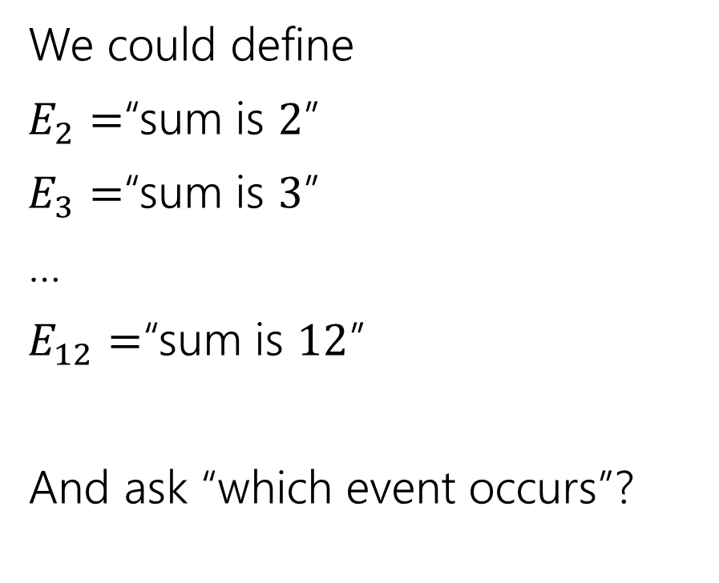

The sum of two dice
Events
Random variable
We could define
$E_{2}=$“sum is $2$”
$E_{3}=$“sum is $3$”
…
$E_{12}=$“sum is $12$”
And ask “which event occurs”?
$X:Ω→ℝ$
$X$is the sum of the two dice.
Notes:
We could define all these events and for an outcome find what event its in to determine the sum or we could have this function that maps outcome to the sum.

Slide 11
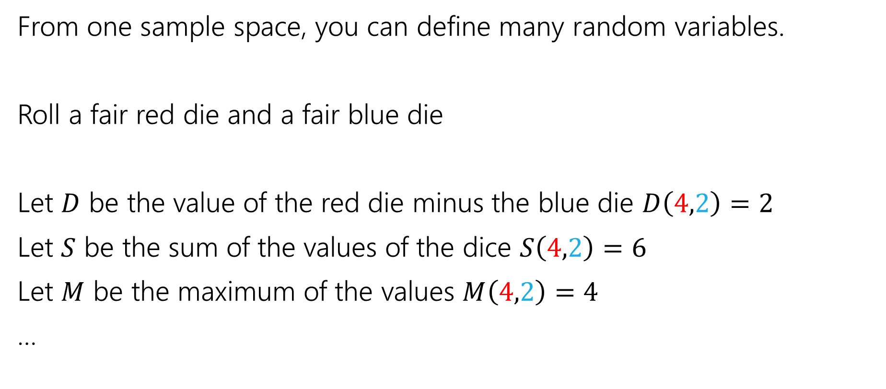
More random variables
From one sample space, you can define many random variables.
Roll a fair red die and a fair blue die
Let $D$ be the value of the red die minus the blue die $D\left(4,2\right)=2$
Let $S$ be the sum of the values of the dice $S\left(4,2\right)=6$
Let $M$ be the maximum of the values $M\left(4,2\right)=4$
…
Notes:
Whatever information I might want.

Slide 12
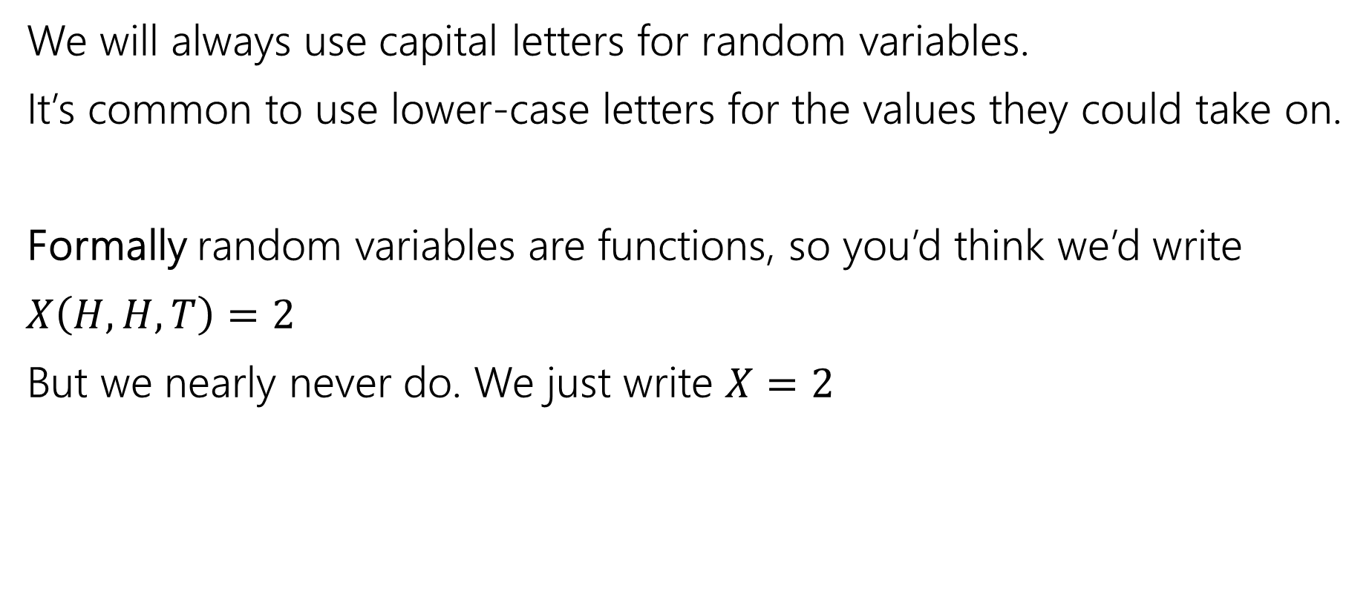
Notational Notes
We will always use capital letters for random variables.
It’s common to use lower-case letters for the values they could take on.
Formally random variables are functions, so you’d think we’d write
$X\left(H,H,T\right)=2$
But we nearly never do. We just write $X=2$

Slide 13

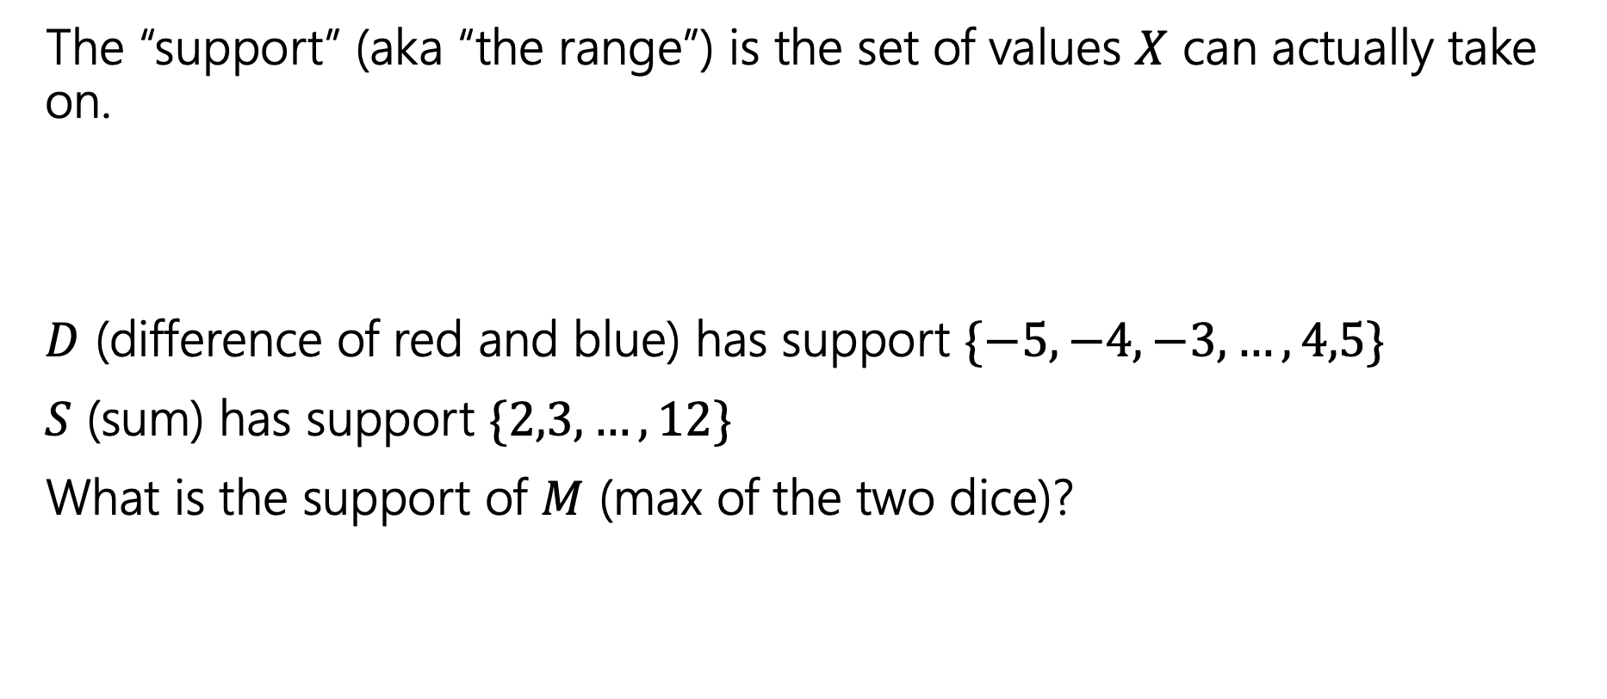
Support ($Ω_{X})$
The “support” (aka “the range”) is the set of values $X$ can actually take on.
$D$ (difference of red and blue) has support $\{−5,−4,−3,…,4,5\}$
$S$ (sum) has support $\{2,3,…,12\}$
What is the support of $M$ (max of the two dice)?
Notes:
Give ~15sec

Slide 14
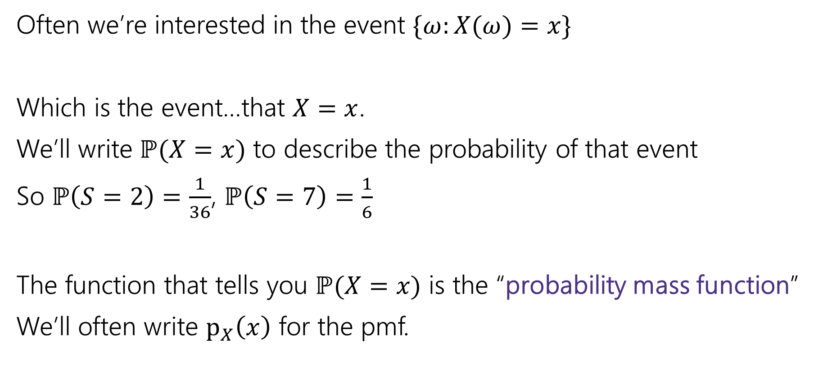
Probability Mass Function
Often we’re interested in the event $\{ω:X(ω)=x\}$
Which is the event…that $X=x$.
We’ll write $ℙ(X=x)$ to describe the probability of that event
So $ℙ\left(S=2\right)=\frac{1}{36}$, $ℙ\left(S=7\right)=\frac{1}{6}$
The function that tells you $ℙ(X=x)$ is the “probability mass function”
We’ll often write $p_{X}\left(x\right)$ for the pmf.
Notes:
One of the most common ways to interact with a random variable is with something that we call the probability mass function.
It is pretty standard to use lower-case x to describe the possible value of random variable upper-case-x. This can be confusing if your handwriting doesn’t differentiate, it can also be confusing out loud (“what’s the probability X = x”) but it’s so standard we’ll do it most of the time. It’s just a convention though, so you can use a different letter if you prefer.

Slide 15
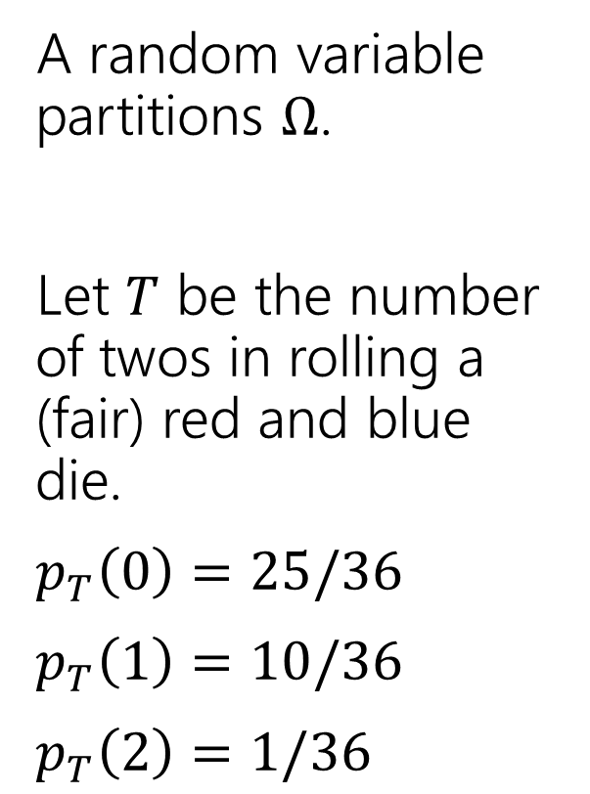
Partition
A random variable partitions $Ω$.
Let $T$ be the number of twos in rolling a (fair) red and blue die.
$p_{T}\left(0\right)=25/36$
$p_{T}\left(1\right)=10/36$
$p_{T}\left(2\right)=1/36$
 | D2=1 | D2=2 | D2=3 | D2=4 | D2=5 | D2=6
D1=1 | (1,1) | (1,2) | (1,3) | (1,4) | (1,5) | (1.6)
D1=2 | (2,1) | (2,2) | (2,3) | (2,4) | (2,5) | (2,6)
D1=3 | (3,1) | (3,2) | (3,3) | (3,4) | (3,5) | (3,6)
D1=4 | (4,1) | (4,2) | (4,3) | (4,4) | (4,5) | (4,6)
D1=5 | (5,1) | (5,2) | (5,3) | (5,4) | (5,5) | (5,6)
D1=6 | (6,1) | (6,2) | (6,3) | (6,4) | (6,5) | (6,6)
Notes:
Partition based on events T = t (set of outcomes that give T that specific value) for all t in the support

Slide 16
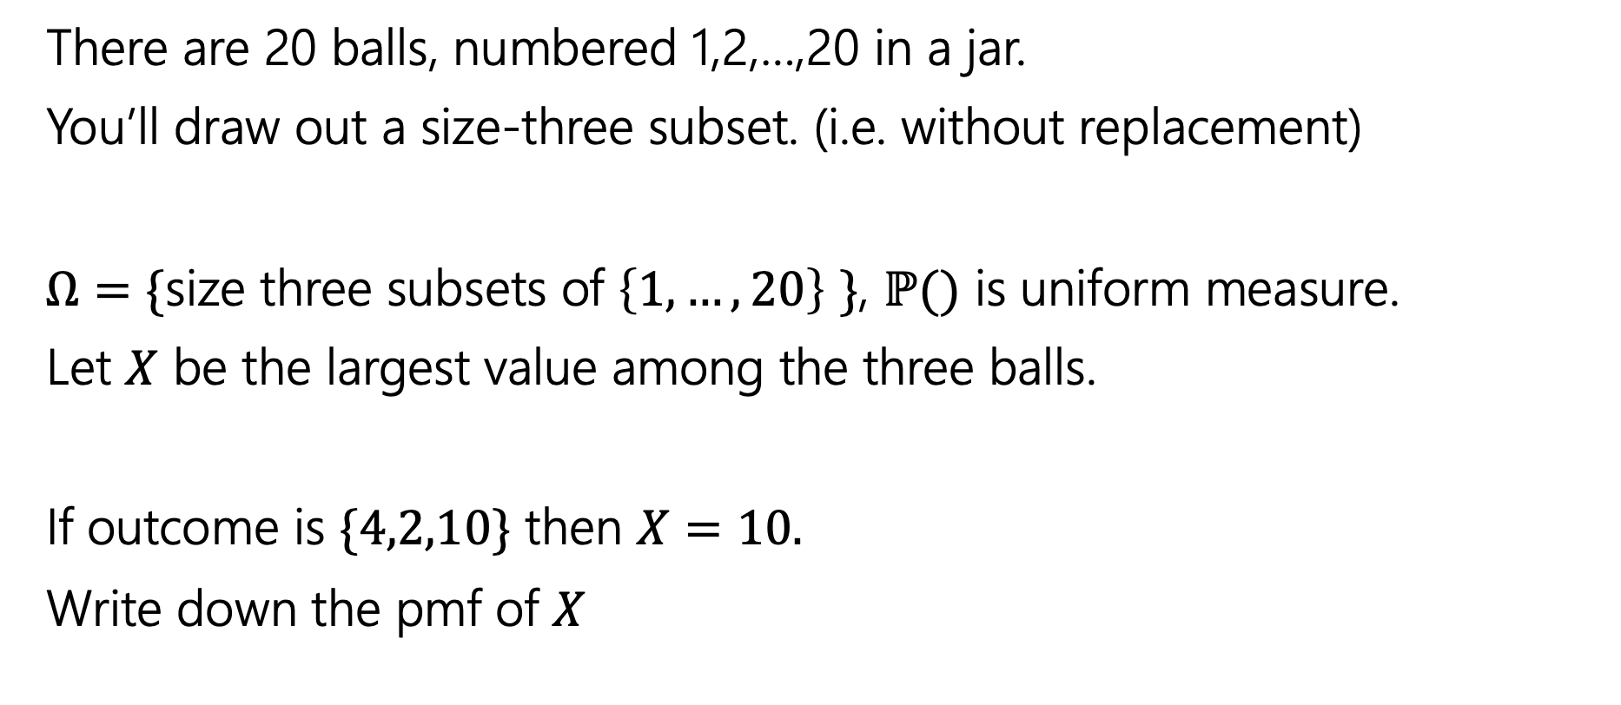
Try It Yourself
There are 20 balls, numbered 1,2,…,20 in a jar.
You’ll draw out a size-three subset. (i.e. without replacement)
$Ω=\{$size three subsets of $\left\{1,…,20\right\}$ $\}$, $ℙ()$ is uniform measure.
Let $X$ be the largest value among the three balls.
If outcome is $\{4,2,10\}$ then $X=10.$
Write down the pmf of $X$
Notes:
Does everyone understand the experiment that we have set up?
Since uniform measure, boils down to counting problem.
Consider the case where x = 3: (1,2)
Consider the case where x = 4: (1,2), (2,3), (1,3)
Number of size three subsets with largest value x: x-1 choose 2 (all pairs of lower values)

Slide 17
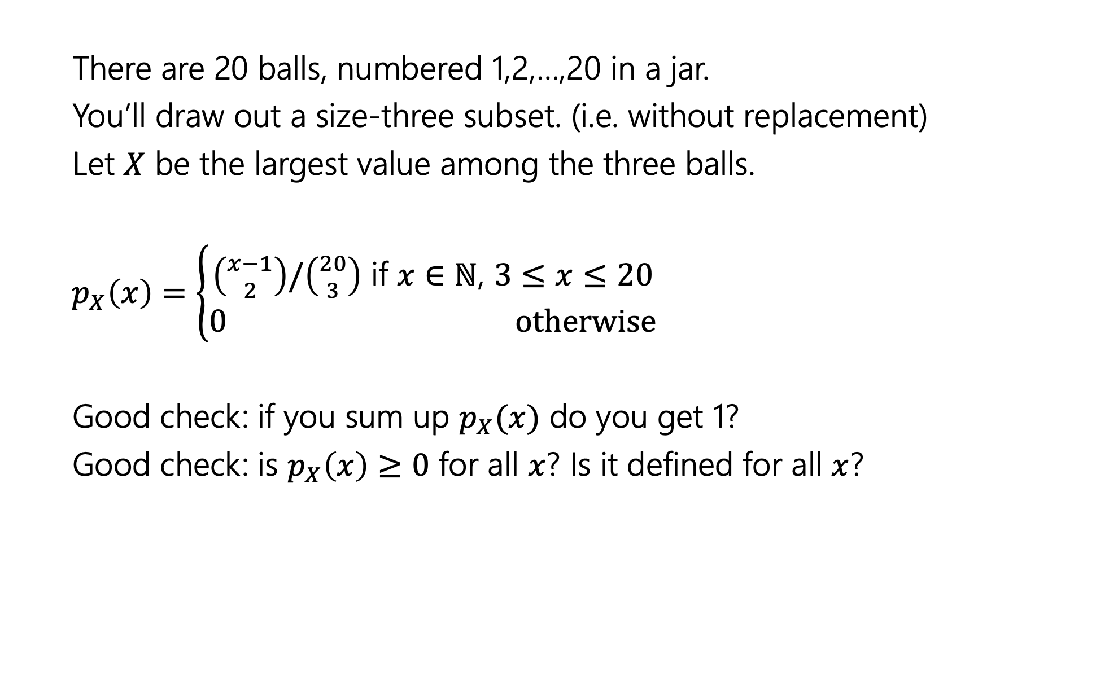
Try It Yourself
There are 20 balls, numbered 1,2,…,20 in a jar.
You’ll draw out a size-three subset. (i.e. without replacement)
Let $X$ be the largest value among the three balls.
$p_{X}\left(x\right)=\left\{\begin{aligned}\left({x−1 \atop 2}\right)/\left({20 \atop 3}\right) \text{if} x∈ℕ\text{, }3≤x≤20 \\ 0 otherwise\end{aligned}\right.$
Good check: if you sum up $p_{X}(x)$ do you get 1?
Good check: is $p_{X}\left(x\right)≥0$ for all $x$? Is it defined for all $x$?
Notes:
Since the random variable partitions the sample space, if we add up the probabilities for all values in the range we better get one.
IMPORTANT: 0 otherwise
Pause for questions

Slide 18

Random Variable
Support $Ω_{X}$ the set of values $X$ can take.
Probability Mass Function (pmf $p_{X}(x)$) on input $x,$tells you $ℙ\left(X=x\right).$
What’s a random variable?
Formally
Informally: A random variable is a way to summarize the important (numerical) information from your outcome.
$X:Ω→ℝ$ is a random variable
$X(ω)$ is the summary of the outcome $ω$
Random Variable
Notes:
Quick review of concepts before CDF – skip if low on time

Slide 19
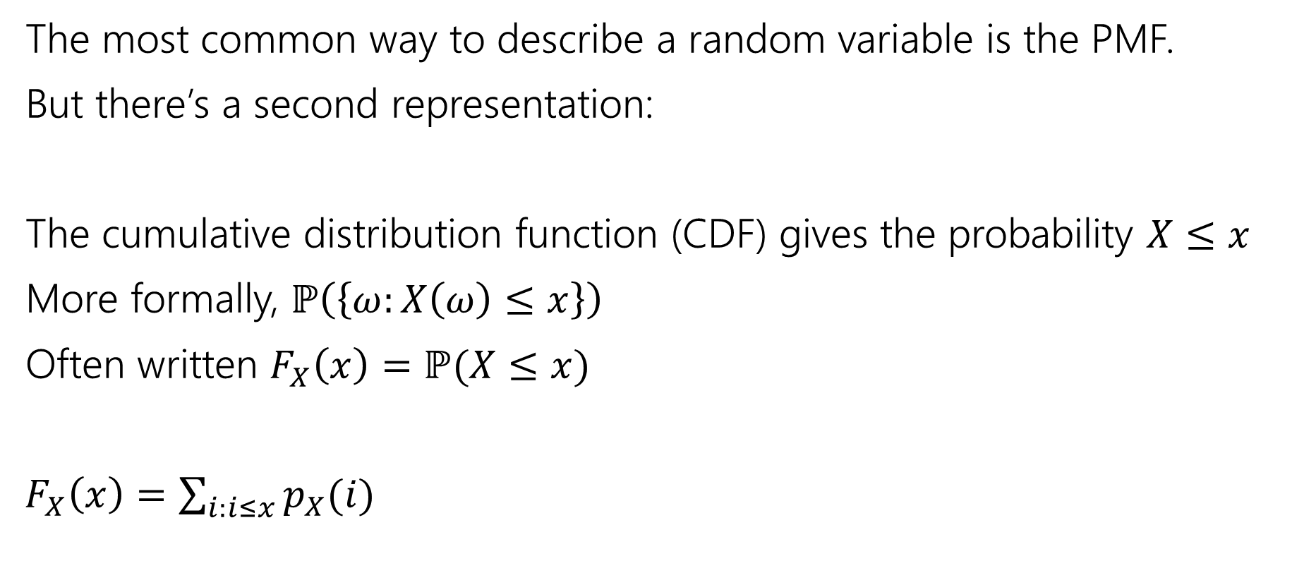
Describing a Random Variable
The most common way to describe a random variable is the PMF.
But there’s a second representation:
The cumulative distribution function (CDF) gives the probability $X≤x$
More formally, $ℙ\left(\left\{ω:X\left(ω\right)≤x\right\}\right)$
Often written $F_{X}\left(x\right)=ℙ(X≤x)$
$F_{X}\left(x\right)=\sum_{i:i≤x}{p_{X}(i)}$
Notes:
Summation notation – summing PMF for all values of RV less than or equal to x
“Cumulative” ⬄ cumulative exam – covers all things we know so far
Similarly, we are summing up all the probabilities less than this value

Slide 20

Try it yourself
What is the CDF of $X$ where
$X$ be the largest value among the three balls. (Drawing 3 of the 20 without replacement)
Notes:
TIME CHECK: 23 minutes
Take 1 minute
Same counting problem – number of ways to pick size-3 subset with largest value AT MOST x
=> All size three subsets from the set 1,2,…,x

Slide 21
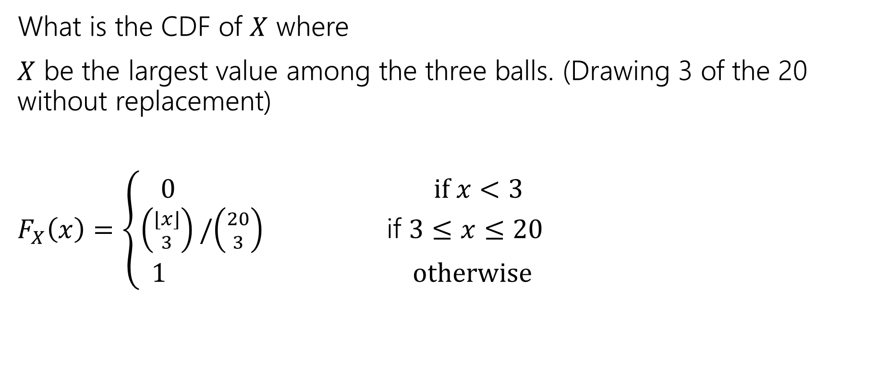
Try it yourself
What is the CDF of $X$ where
$X$ be the largest value among the three balls. (Drawing 3 of the 20 without replacement)
$F_{X}\left(x\right)=\left\{\begin{aligned}\begin{aligned}0 if x<3 \\ \left({⌊x⌋ \atop 3}\right)/\left({20 \atop 3}\right) \text{if} 3≤x≤20\end{aligned} \\ 1 otherwise\end{aligned}\right.$
Notes:
Start with main case
Explain edge cases
When we were defining the PMF, if someone gave us a non
PAUSE FOR QUESTIONS

Slide 22
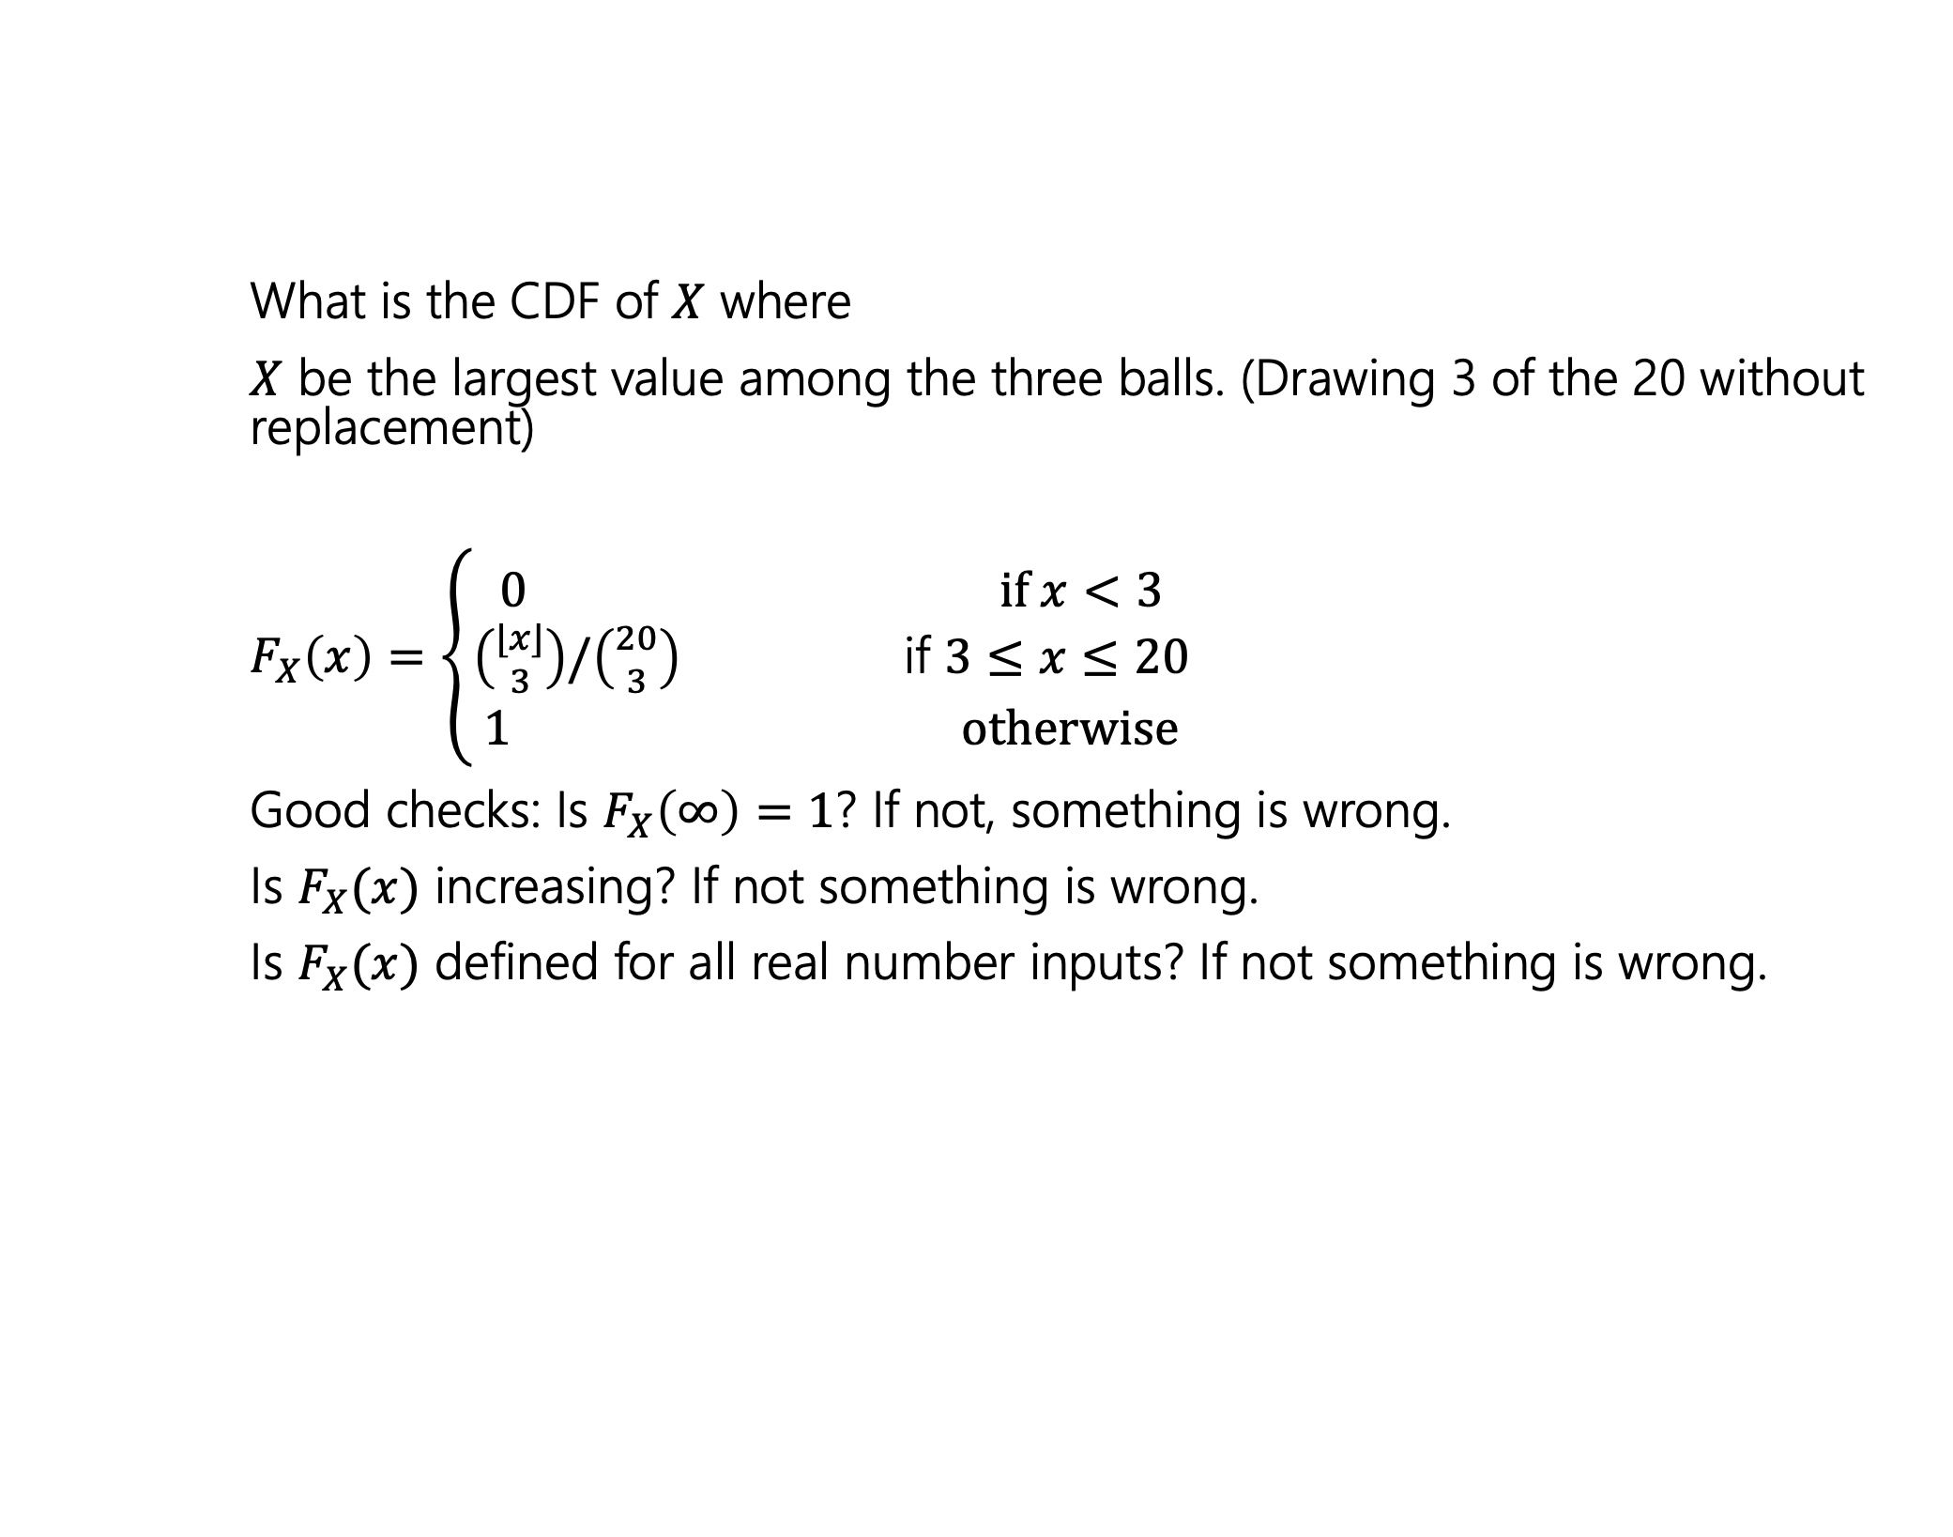
Try it yourself
What is the CDF of $X$ where
$X$ be the largest value among the three balls. (Drawing 3 of the 20 without replacement)
$F_{X}\left(x\right)=\left\{\begin{aligned}\begin{aligned}0 if x<3 \\ \left({⌊x⌋ \atop 3}\right)/\left({20 \atop 3}\right) \text{if} 3≤x≤20\end{aligned} \\ 1 otherwise\end{aligned}\right.$
Good checks: Is $F_{X}\left(∞\right)=1$? If not, something is wrong.
Is $F_{X}(x)$ increasing? If not something is wrong.
Is $F_{X}(x)$ defined for all real number inputs? If not something is wrong.

Slide 23
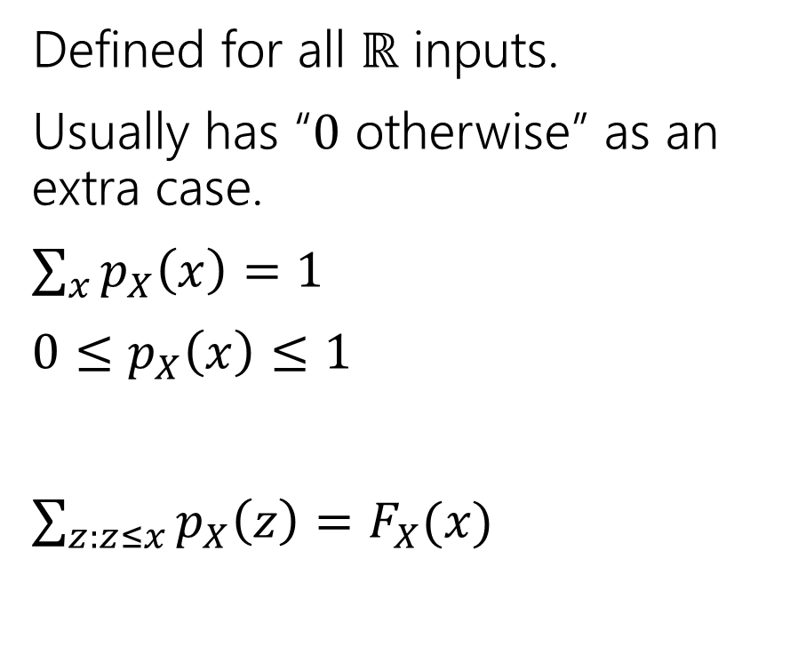
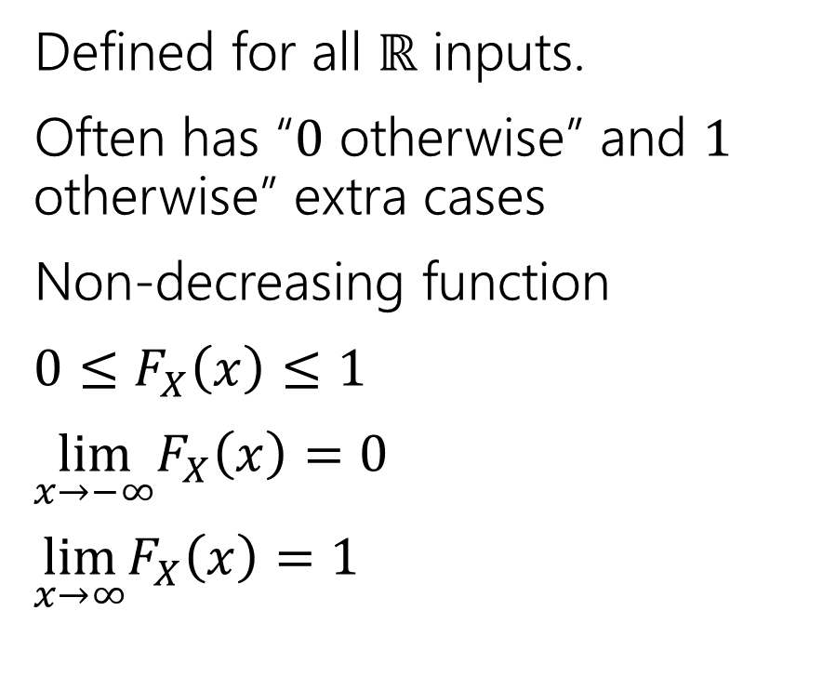
Two descriptions
Probability mass function
Cumulative Distribution function
Defined for all $ℝ$ inputs.
Usually has “$0$ otherwise” as an extra case.
$\sum_{x}{p_{X}\left(x\right)=1}$
$0≤p_{X}\left(x\right)≤1$
$\sum_{z:z≤x}{p_{X}\left(z\right)=F_{X}(x)}$
Defined for all $ℝ$ inputs.
Often has “$0$ otherwise” and $1$ otherwise” extra cases
Non-decreasing function
$0≤F_{X}\left(x\right)≤1$
$\lim_{x→−∞}F_{X}\left(x\right)=0$
$\lim_{x→∞}F_{X}\left(x\right)=1⁡$
Notes:
TIME CHECK: 30 minutes

Slide 24

More Random Variable Practice
Roll a fair die $n$ times. Let $Z$ be the number of rolls that are $5s$ or $6s$.
What is the pmf?
Don’t try to write the CDF…it’s a mess…
Or try for a few minutes to realize it isn’t nice.
Notes:
Take 1 minute
Same uniform distribution => counting problem
Sequential process: If we see z,
Choose order of rolls for 5/6,
Multiply by prob of seeing that many 5/6,
Multiply by prob of seeing others

Slide 25
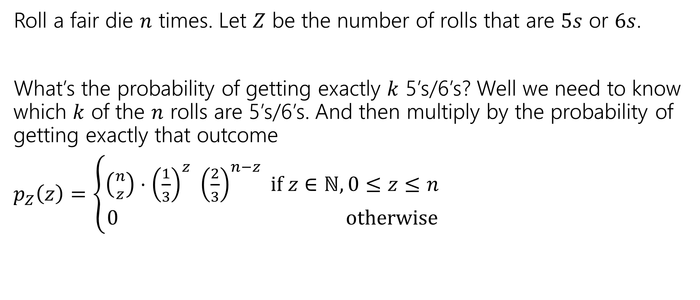
More Random Variable Practice
Roll a fair die $n$ times. Let $Z$ be the number of rolls that are $5s$ or $6s$.
What’s the probability of getting exactly $k$ 5’s/6’s? Well we need to know which $k$ of the $n$ rolls are 5’s/6’s. And then multiply by the probability of getting exactly that outcome
$p_{Z}\left(z\right)=\left\{\begin{aligned}\left({n \atop z}\right)⋅{\left(\frac{1}{3}\right)}^{z} {\left(\frac{2}{3}\right)}^{n−z} if z∈ℕ,0≤z≤n \\ 0 otherwise\end{aligned}\right.$

Slide 26
More Independence

Slide 27
Independence of Random Variables
That’s for events…what about random variables?
$X$ and $Y$ are independent if for all $k,ℓ$
$$ℙ\left(X=k, Y=ℓ\right)=ℙ\left(X=k\right)ℙ(Y=ℓ)$$
Independence (of random variables)
We’ll often use commas instead of $∩$ symbol.
Notes:
IMPORTANT: for all k,l
Analogous to events otherwise, but must be true for all events w.r.t RVs (X=k is an event)

Slide 28

Independence of Random Variables
The “for all values” is important.
We say that the event “the sum is 7” is independent of “the red die is 5”
What about $S=$“the sum of two dice” and $R=$“the value of the red die”

Slide 29
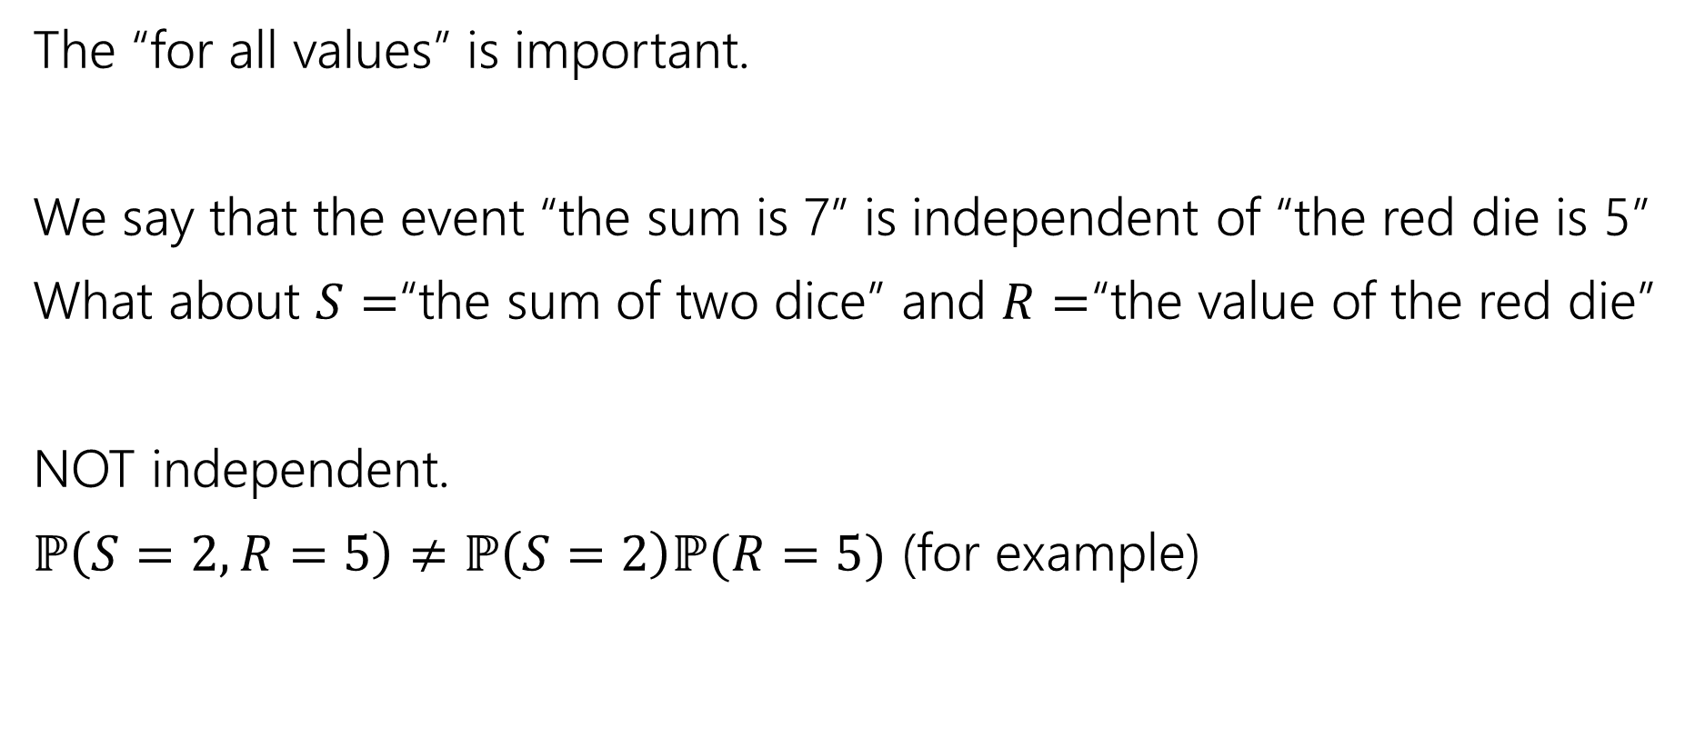
Independence of Random Variables
The “for all values” is important.
We say that the event “the sum is 7” is independent of “the red die is 5”
What about $S=$“the sum of two dice” and $R=$“the value of the red die”
NOT independent.
$ℙ\left(S=2, R=5\right)≠ℙ\left(S=2\right)ℙ(R=5)$ (for example)
Notes:
Left side 0, right side 1/36 * 1/6

Slide 30

Independence of Random Variables
Flip a coin independently $2n$ times.
Let $X$ be “the number of heads in the first $n$ flips.”
Let $Y$ be “the number of heads in the last $n$ flips.”
$X$ and $Y$ are independent.
Notes:
The events X=x, Y=y are always independent since they are describing functionally different experiments (two sets of n flips)
Probability we see x heads in the first n flips does not affect the probability of seeing y heads in the next n flips

Slide 31

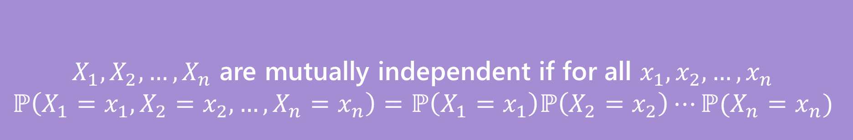
Mutual Independence for RVs
A little simpler to write down than for events
DON’T need to check all subsets for random variables…
But you do need to check all values (all possible $x_{i}$) still.
$X_{1},X_{2},…,X_{n}$ are mutually independent if for all $x_{1},x_{2},…,x_{n}$
$$ℙ\left(X_{1}=x_{1}, X_{2}=x_{2},…,X_{n}=x_{n}\right)=ℙ\left(X_{1}=x_{1}\right)ℙ\left(X_{2}=x_{2}\right)⋯ℙ(X_{n}=x_{n})$$
Mutual Independence (of random variables)
Notes:
For events, we need to check that this condition holds for all subsets (not just the full group)
Wait but why don’t we need different kinds of independence? It turns out for RVs that it doesn’t make a difference. The intuition here is that it comes from the “for all x_i” condition. Any random variable that *isn’t* mentioned just “factors out” when you evaluate either the left or right hand-side. That’s because you must handle *all* values, the same doesn’t happen for events.

Slide 32

What does Independence give you?
$𝔼\left[XY\right]=𝔼\left[X\right]⋅𝔼[Y]$
$Var\left(X+Y\right)=Var\left(X\right)+Var(Y)$
Notes:
Looking forward- useful tools

