Slide 1
Independence
CSE 312 Summer 25
Lecture 7

Slide 2
Announcements
HW2 due tonight
Penalty free late days require a meaningful attempt by the original deadline.
HW3 out this evening.
HW3 includes a programming problem – using Bayes rule to do some machine learning – detecting whether emails are spam or “ham” (legitimate emails).
Longer than the programming on HW1 – please get started early!
Extra resources will be available!

Slide 3
The Technical Stuff

Slide 4
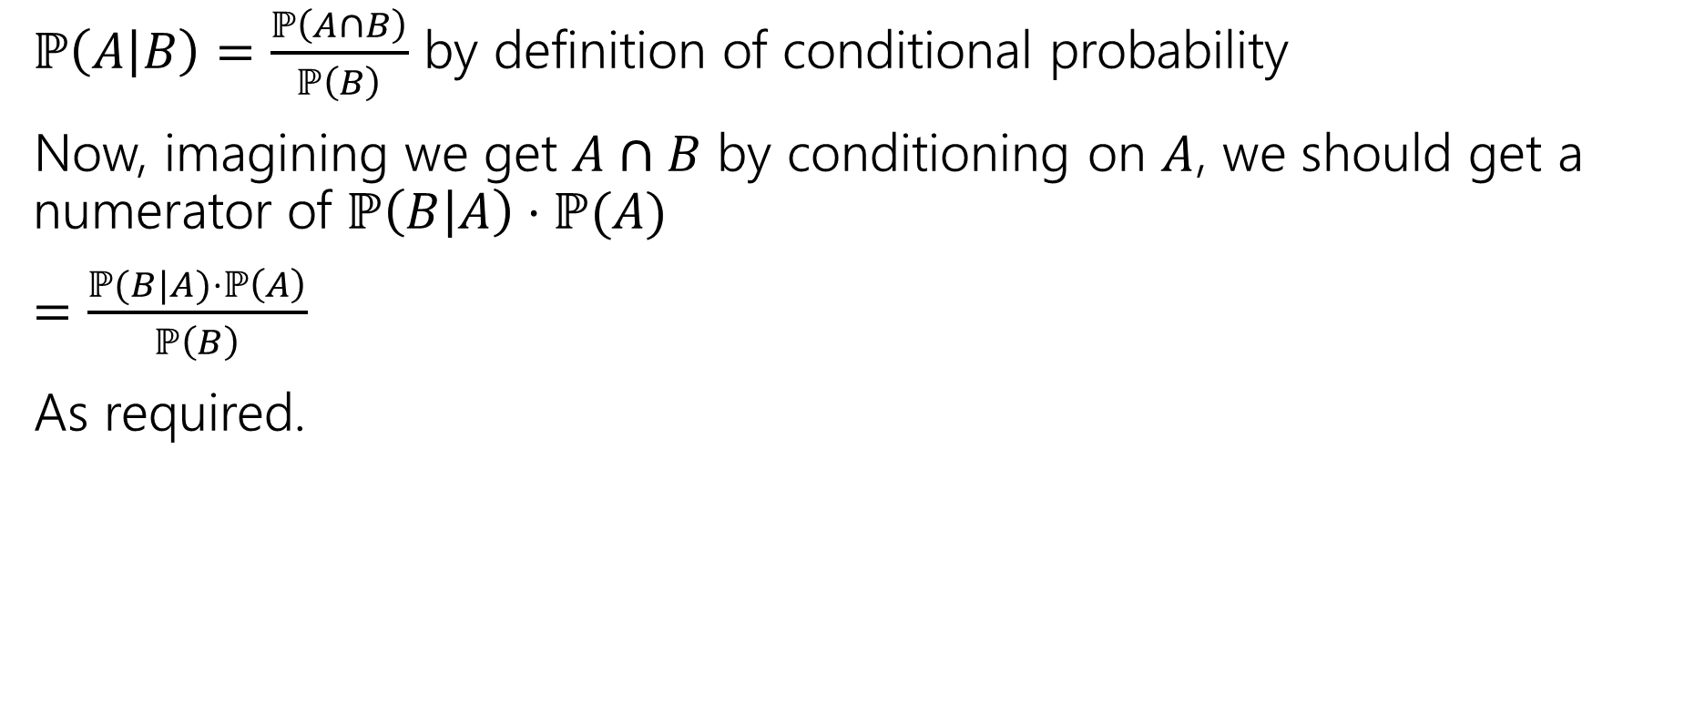
Proof of Bayes’ Rule
$ℙ\left(A | B\right)=\frac{ℙ\left(A∩B\right)}{ℙ\left(B\right)}$ by definition of conditional probability
Now, imagining we get $A∩B$ by conditioning on $A$, we should get a numerator of $ℙ\left(B | A\right)⋅ℙ(A)$
$=\frac{ℙ(B|A)⋅ℙ\left(A\right)}{ℙ\left(B\right)}$
As required.

Slide 5
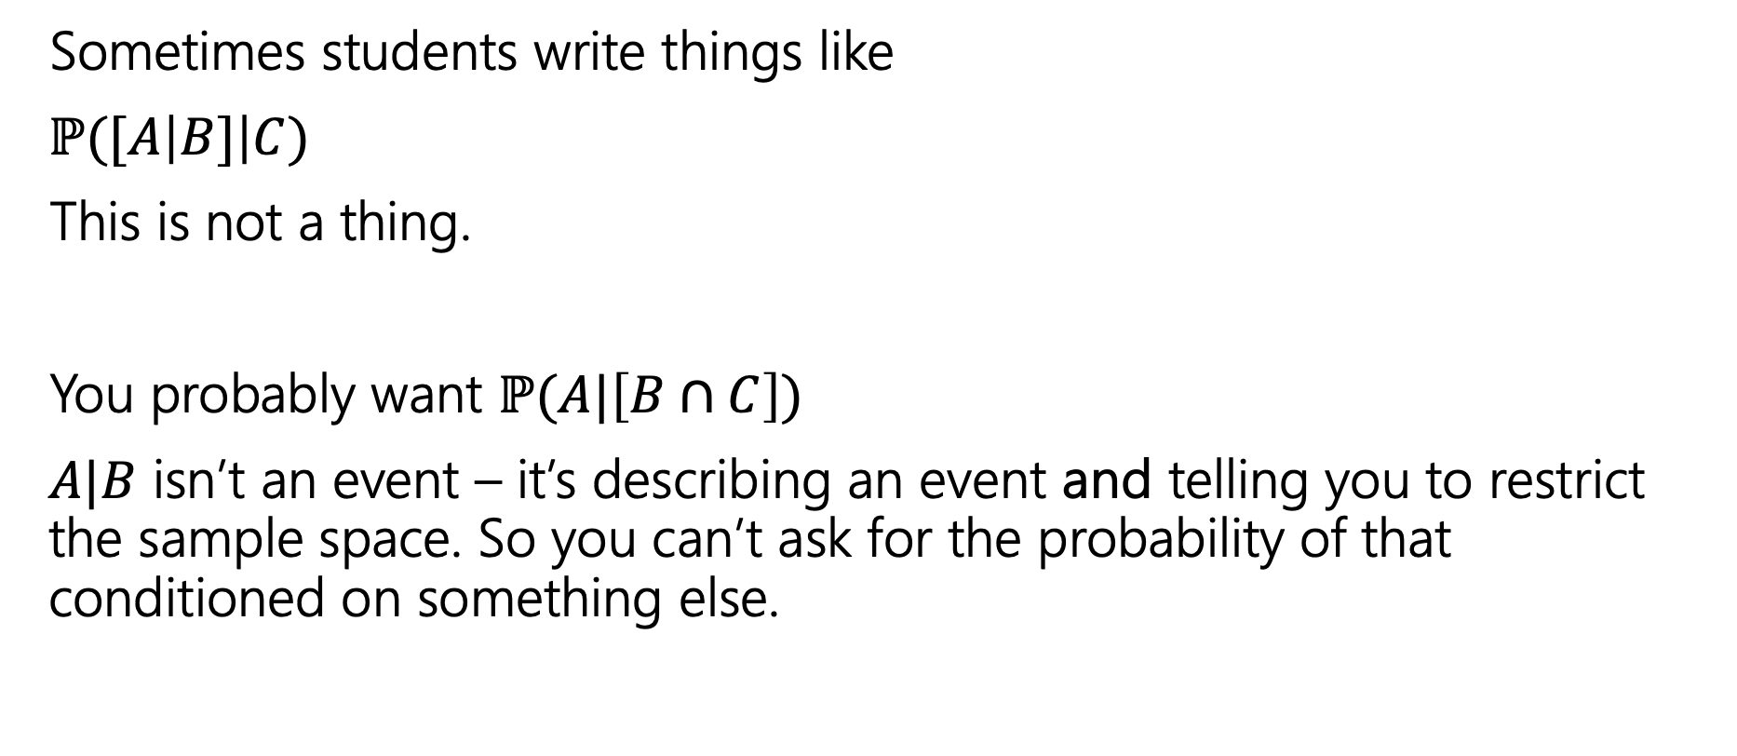
A Quick Technical Remark
Sometimes students write things like
$ℙ([A\left|B]\right|C)$
This is not a thing.
You probably want $ℙ(A|\left[B∩C\right])$
$A|B$ isn’t an event – it’s describing an event and telling you to restrict the sample space. So you can’t ask for the probability of that conditioned on something else.

Slide 6
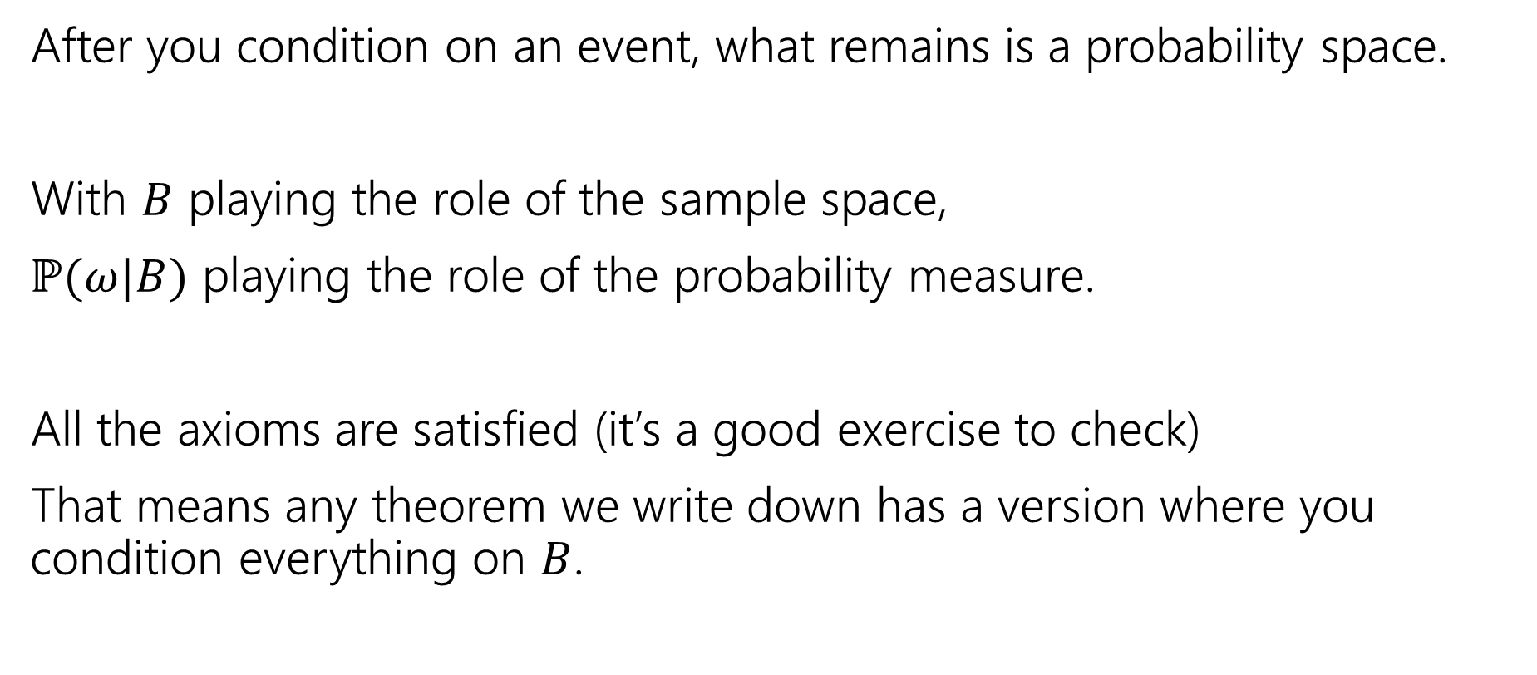
A Technical Note
After you condition on an event, what remains is a probability space.
With $B$ playing the role of the sample space,
$ℙ(ω|B)$ playing the role of the probability measure.
All the axioms are satisfied (it’s a good exercise to check)
That means any theorem we write down has a version where you condition everything on $B$.

Slide 7
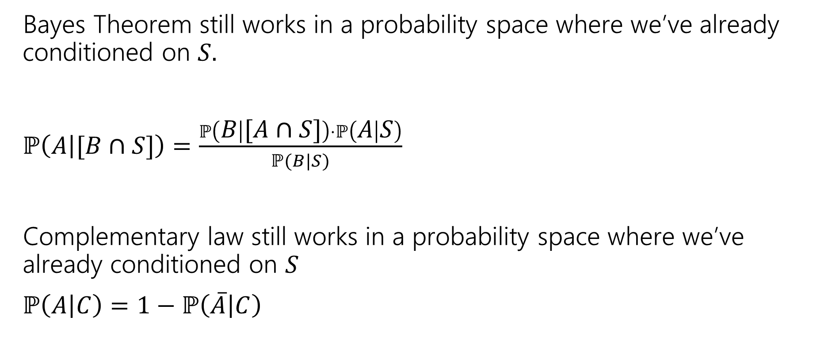
An Example
Bayes Theorem still works in a probability space where we’ve already conditioned on $S.$
$ℙ\left(A | [B∩S]\right)=\frac{ℙ\left(B | [A∩S]\right)⋅ℙ\left(A | S\right)}{ℙ(B|S)}$
Complementary law still works in a probability space where we’ve already conditioned on $S$
$ℙ\left(A | C\right)=1−ℙ\left(\overline{A} | C\right)$
Notes:
These are just examples. EVERY theorem we have that mentions events works this way.

Slide 8
Independence

Slide 9
Definition of Independence
We’ve calculated conditional probabilities.
Sometimes conditioning – getting some partial information about the outcome – doesn’t actually change the probability.
We already saw an example like this…
Notes:
This is a new technical term, but its been in the background of what we have been doing so far.
When we were going conditional probabilities the past few lectures what we were doing was say hey I’ve not this new information let me update my probabilities or my estimates of the event that I’m interested in.

Slide 10
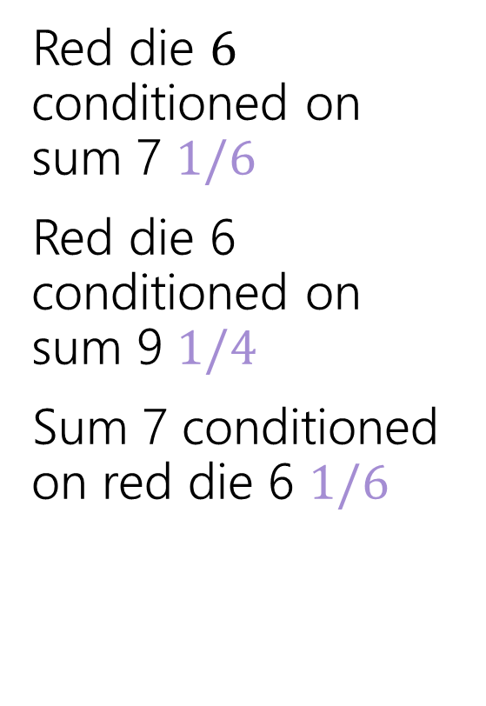
Conditioning Practice
Red die $6$ conditioned on sum 7 $1/6$
Red die 6 conditioned on sum 9 $1/4$
Sum 7 conditioned on red die 6 $1/6$
 | D2=1 | D2=2 | D2=3 | D2=4 | D2=5 | D2=6
D1=1 | (1,1) | (1,2) | (1,3) | (1,4) | (1,5) | (1.6)
D1=2 | (2,1) | (2,2) | (2,3) | (2,4) | (2,5) | (2,6)
D1=3 | (3,1) | (3,2) | (3,3) | (3,4) | (3,5) | (3,6)
D1=4 | (4,1) | (4,2) | (4,3) | (4,4) | (4,5) | (4,6)
D1=5 | (5,1) | (5,2) | (5,3) | (5,4) | (5,5) | (5,6)
D1=6 | (6,1) | (6,2) | (6,3) | (6,4) | (6,5) | (6,6)
Red die 6 has probability 1/6 before or after conditioning on sum 7.
Notes:
The conditioning didn’t make a difference and there for they didn’t affect each other. It did affect out sample space and the outcomes we were looking about, but it didn’t affect the number itself.

Slide 11
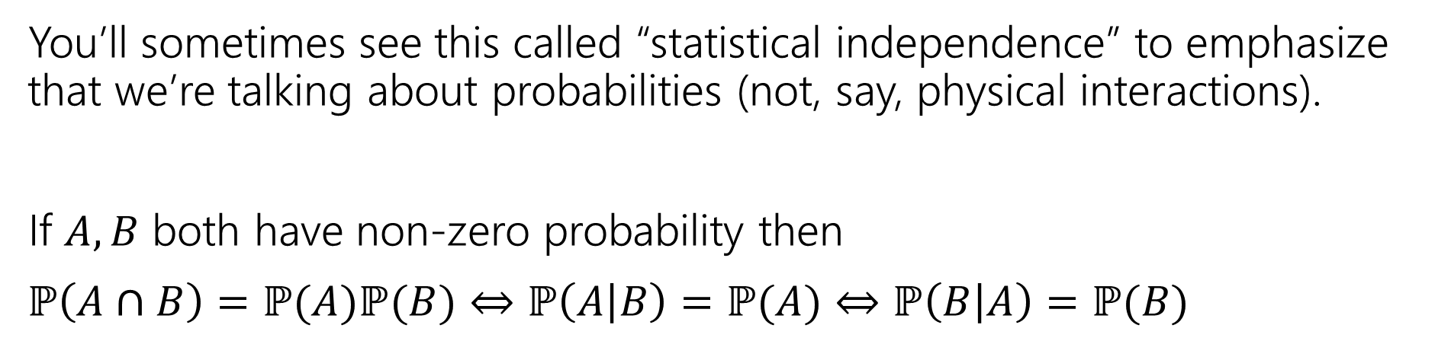
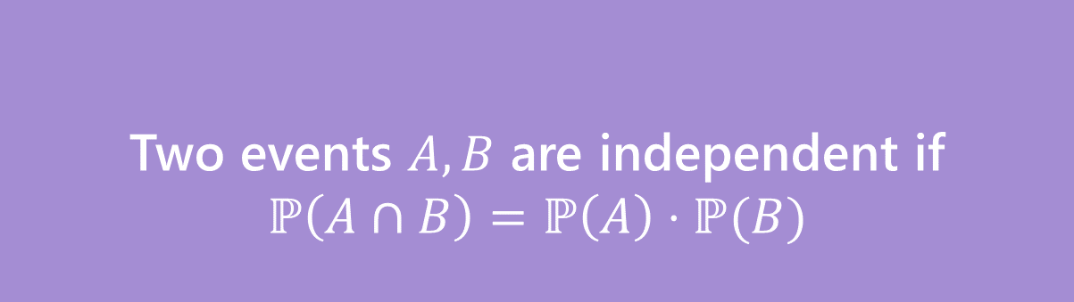
Independence
Two events $A,B$ are independent if
$$ℙ\left(A∩B\right)=ℙ\left(A\right)⋅ℙ(B)$$
Independence
You’ll sometimes see this called “statistical independence” to emphasize that we’re talking about probabilities (not, say, physical interactions).
If $A,B$ both have non-zero probability then
$ℙ\left(A∩B\right)=ℙ(A)ℙ(B)$ $⇔$ $ℙ\left(A | B\right)=ℙ(A)$ $⇔ℙ\left(B | A\right)=ℙ(B)$
Notes:
Intuition is that conditioning doesn’t make a difference. Explain why the edge case in conditional probabilities lead to this being the definition. How do you check for independence? Well you can calculate the three probabilities and see if this equality holds. If you know that the conditional probabilities are defined you can jump to the other forms to check for independence.

Slide 12
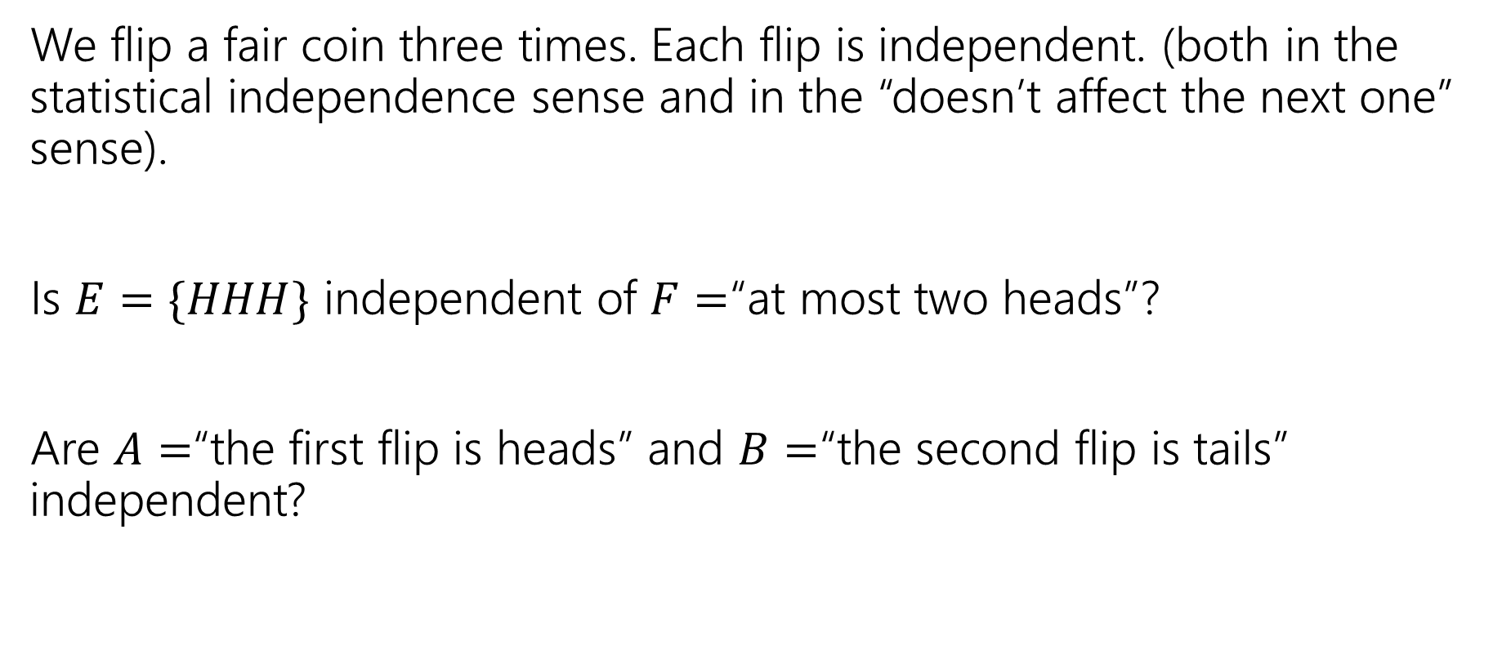
Examples
We flip a fair coin three times. Each flip is independent. (both in the statistical independence sense and in the “doesn’t affect the next one” sense).
Is $E=\{HHH\}$ independent of $F=$“at most two heads”?
Are $A=$“the first flip is heads” and $B=$“the second flip is tails” independent?

Slide 13
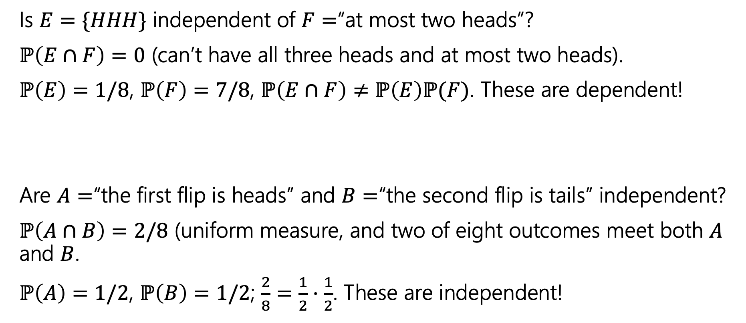
Examples
Is $E=\{HHH\}$ independent of $F=$“at most two heads”?
$ℙ\left(E∩F\right)=0$ (can’t have all three heads and at most two heads).
$ℙ\left(E\right)=1/8$, $ℙ\left(F\right)=7/8$, $ℙ\left(E∩F\right)≠ℙ\left(E\right)ℙ(F)$. These are dependent!
Are $A=$“the first flip is heads” and $B=$“the second flip is tails” independent?
$ℙ\left(A∩B\right)=2/8$ (uniform measure, and two of eight outcomes meet both $A$ and $B$.
$ℙ\left(A\right)=1/2$, $ℙ\left(B\right)=1/2$; $\frac{2}{8}=\frac{1}{2}⋅\frac{1}{2}$. These are independent!

Slide 14
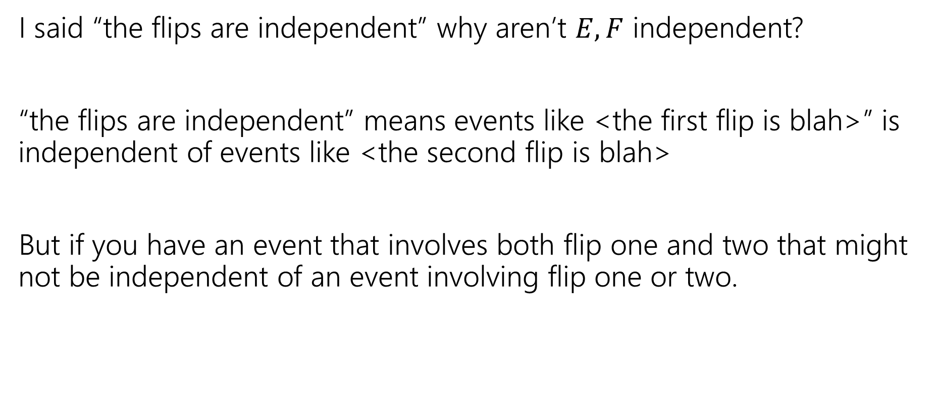
Hey Wait
I said “the flips are independent” why aren’t $E,F$ independent?
“the flips are independent” means events like <the first flip is blah>” is independent of events like <the second flip is blah>
But if you have an event that involves both flip one and two that might not be independent of an event involving flip one or two.
Notes:
Just because a problem statement mentions independence doesn’t mean the events that you define will be independent.

Slide 15
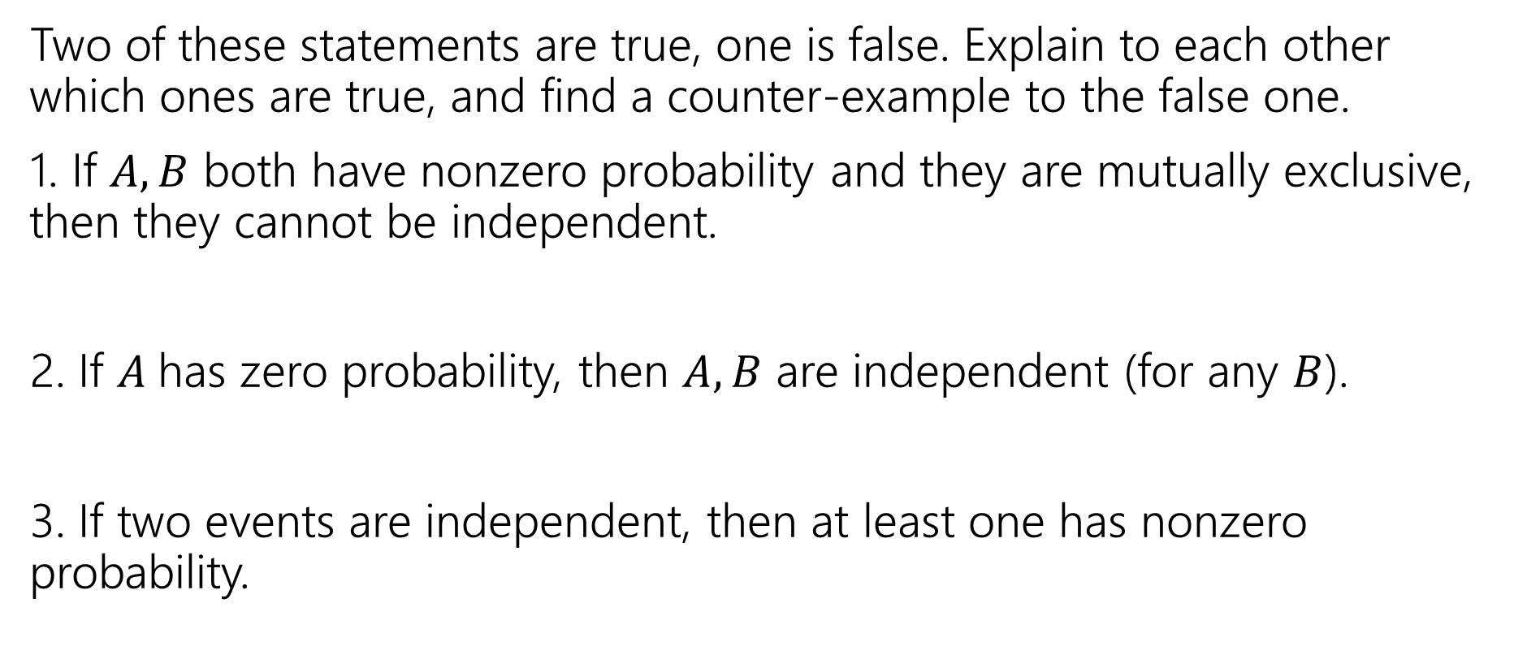
Mutual Exclusion and independence
Two of these statements are true, one is false. Explain to each other which ones are true, and find a counter-example to the false one.
1. If $A,B$ both have nonzero probability and they are mutually exclusive, then they cannot be independent.
2. If $A$has zero probability, then $A,B$ are independent (for any $B$).
3. If two events are independent, then at least one has nonzero probability.
Fill out the poll everywhere so Robbie knows how long to explain
Go to pollev.com/avk5

Slide 16
Mutual Exclusion and independence
Two of these statements are true, one is false. Explain to each other which ones are true, and find a counter-example to the false one.
1. If $A,B$ both have nonzero probability and they are mutually exclusive, then they cannot be independent.
2. If $A$has zero probability, then $A,B$ are independent (for any $B$).
3. If two events are independent, then at least one has nonzero probability.
Notes:
1. True (P(B|A) = 0 in this case). 2. True (P(A cap B) <= P(A) = 0; P(A)P(B) = 0*P(B)=0 3. False. For A, B events with 0 probability P(A cap B)=0=0*0=P(A)P(B), so they are independent.

Slide 17
Chain Rule

Slide 18

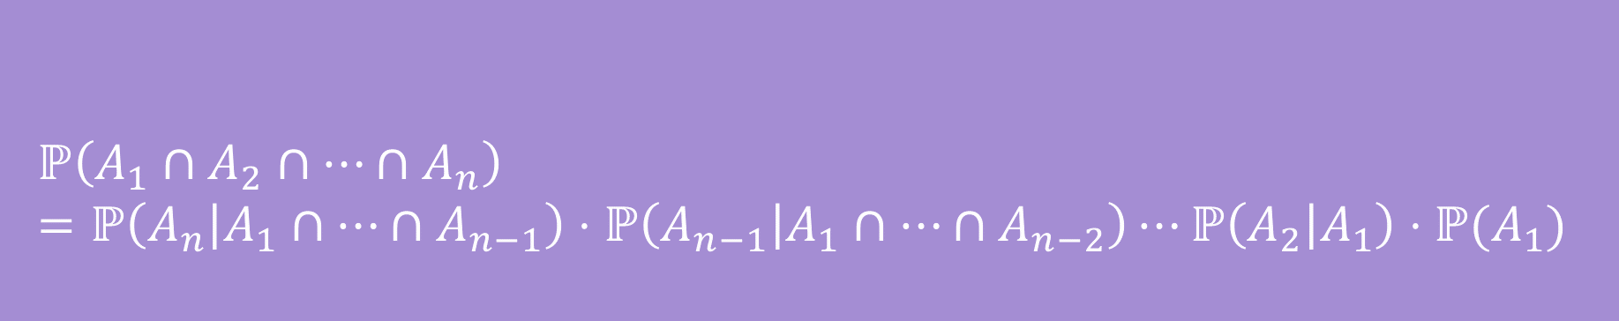
Chain Rule
We defined conditional probability as: $ℙ\left(A | B\right)=\frac{ℙ\left(A∩B\right)}{ℙ\left(B\right)}$
Which means $ℙ\left(A∩B\right)=ℙ(A|B)ℙ(B)$
$$ℙ\left(A_{1}∩A_{2}∩…∩A_{n}\right)=ℙ\left(A_{n} | A_{1}∩…∩A_{n−1}\right)⋅ℙ\left(A_{n−1} | A_{1}∩…∩A_{n−2}\right)⋯ℙ\left(A_{2} | A_{1}\right)⋅ℙ(A_{1})$$
Chain Rule
Notes:
This allows you to analyze the event of A intersect B step by step.

Slide 19
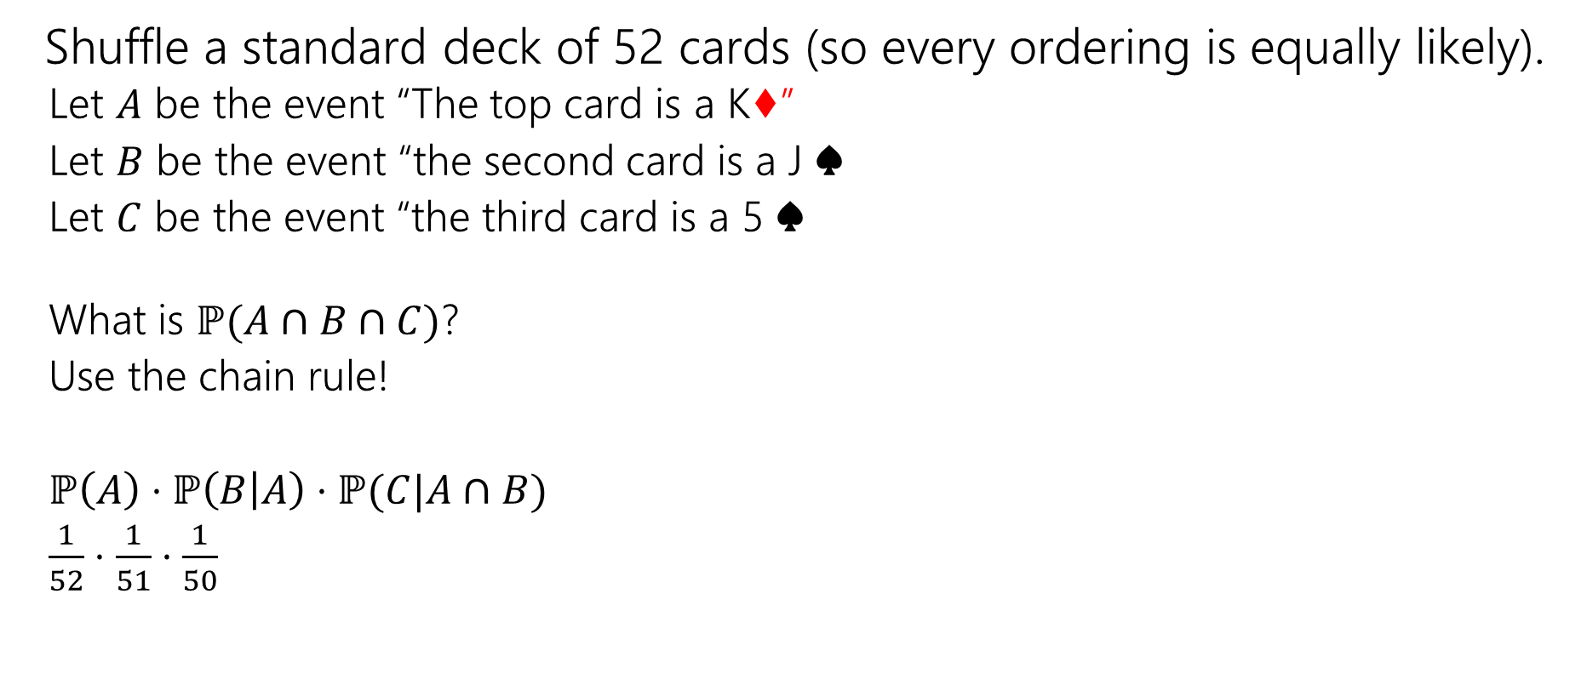
Chain Rule Example
Shuffle a standard deck of 52 cards (so every ordering is equally likely).
Let $A$ be the event “The top card is a K♦”
Let $B$ be the event “the second card is a J ♠️
Let $C$ be the event “the third card is a 5 ♠️
What is $ℙ(A∩B∩C)$?
Use the chain rule!
$ℙ\left(A\right)⋅ℙ\left(B | A\right)⋅ℙ(C|A∩B)$
$\frac{1}{52}⋅\frac{1}{51}⋅\frac{1}{50}$
Notes:
We could have solved this by defining our sample space or we can use the chain rule. We condition on all steps that came before me.

Slide 20
Conditional Independence

Slide 21
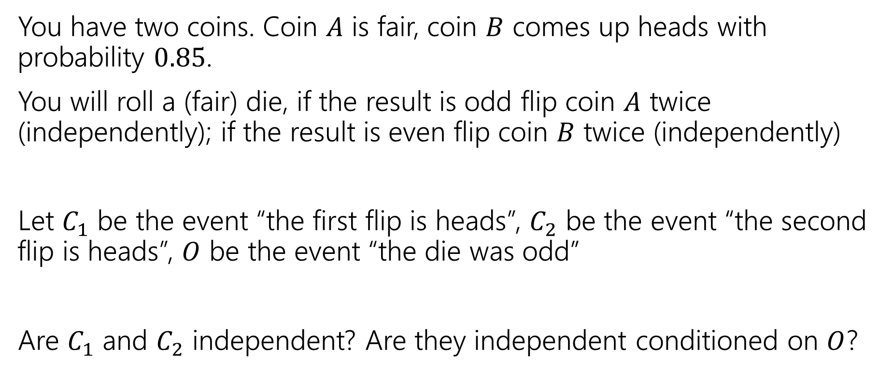
Conditional Independence Example
You have two coins. Coin $A$ is fair, coin $B$ comes up heads with probability $0.85$.
You will roll a (fair) die, if the result is odd flip coin $A$ twice (independently); if the result is even flip coin $B$ twice (independently)
Let $C_{1}$ be the event “the first flip is heads”, $C_{2}$ be the event “the second flip is heads”, $O$ be the event “the die was odd”
Are $C_{1}$ and $C_{2}$ independent? Are they independent conditioned on $O$?
Notes:
Consider a more extreme case

Slide 22

Conditional Independence
We say $A$ and $B$ are conditionally independent on $C$ if
$ℙ\left(A∩B | C\right)=ℙ\left(A | C\right)⋅ℙ(B|C)$
i.e. if you condition on $C$, they are independent.

Slide 23
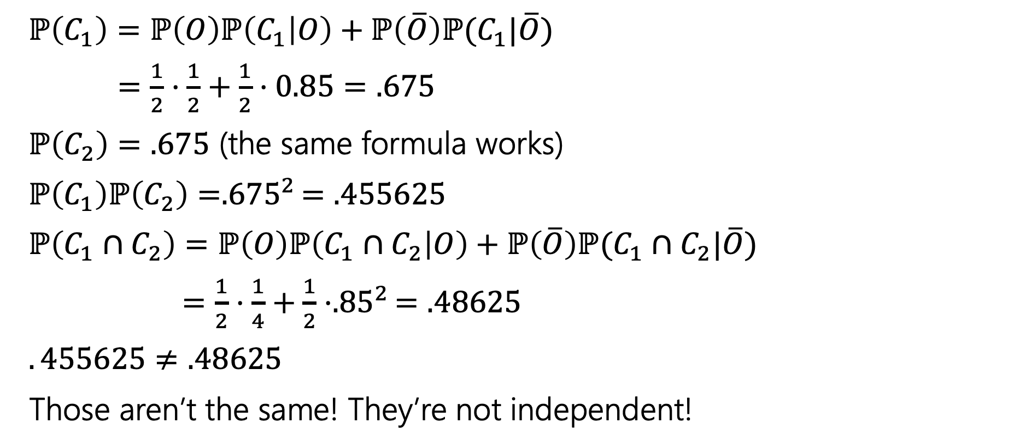
(Unconditioned) Independence
$ℙ\left(C_{1}\right)=ℙ\left(O\right)ℙ\left(C_{1} | O\right)+ℙ\left(\overline{O}\right)ℙ(C_{1}|\overline{O})$
$=\frac{1}{2}⋅\frac{1}{2}+\frac{1}{2}⋅0.85=.675$
$ℙ\left(C_{2}\right)=.675$ (the same formula works)
$ℙ\left(C_{1}\right)ℙ\left(C_{2}\right)={.675}^{2}=.455625$
$ℙ\left(C_{1}∩C_{2}\right)=ℙ\left(O\right)ℙ\left(C_{1}∩C_{2} | O\right)+ℙ\left(\overline{O}\right)ℙ(C_{1}∩C_{2}|\overline{O})$
$=\frac{1}{2}⋅\frac{1}{4}+\frac{1}{2}⋅{.85}^{2}=.48625$
$.455625≠.48625$
Those aren’t the same! They’re not independent!
Notes:
Intuition: seeing a head gives you information – information that it’s more likely you got the biased coin and so the next head is more likely.

Slide 24

Conditional Independence
$ℙ\left(C_{1} | O\right)=1/2$
$ℙ\left(C_{2} | O\right)=1/2$
$ℙ\left(C_{1}∩C_{2} | O\right)=\frac{1}{2}⋅\frac{1}{2}=1/4$
$ℙ\left(C_{1} | O\right)ℙ\left(C_{2} | O\right)=ℙ(C_{1}∩C_{2}|O)$
Yes! $C_{1}$ and $C_{2}$ are conditionally independent, conditioned on $O$.

Slide 25
Takeaway
Read a problem carefully – when we say “these steps are independent of each other” about some part of a sequential process, it’s usually “conditioned on all prior steps, these steps are conditionally independent of each other.”
Those conditional steps are usually dependent (without conditioning) because they might give you information about which branch you took.

Slide 26
More Independence

Slide 27
Independence of events
Recall the definition of independence of events:
Two events $A,B$ are independent if
$$ℙ\left(A∩B\right)=ℙ\left(A\right)⋅ℙ(B)$$
Independence

Slide 28

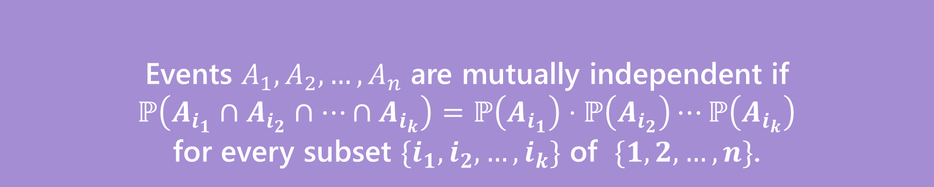
Independence for 3 or more events
For three or more events, we need two kinds of independence
Events $A_{1},A_{2},…,A_{n}$ are pairwise independent if
$ℙ\left(A_{i}∩A_{j}\right)=ℙ\left(A_{i}\right)⋅ℙ\left(A_{j}\right)$ for all $i,j$
Pairwise Independence
Events $A_{1},A_{2},…,A_{n}$ are mutually independent if
$ℙ\left(A_{i_{1}}∩A_{i_{2}}∩…∩A_{i_{k}}\right)=ℙ\left(A_{i_{1}}\right)⋅ℙ\left(A_{i_{2}}\right)⋯ℙ\left(A_{i_{k}}\right)$
for every subset $\{i_{1},i_{2},…,i_{k}\}$ of $\{1,2,…,n\}$.
Mutual Independence

Slide 29

Pairwise Independence vs. Mutual Independence
Roll two fair dice (one red, one blue) independently
$R=$“red die is $3$”
$B=$“blue die is 5”
$S=$“sum is $7$”

Slide 30
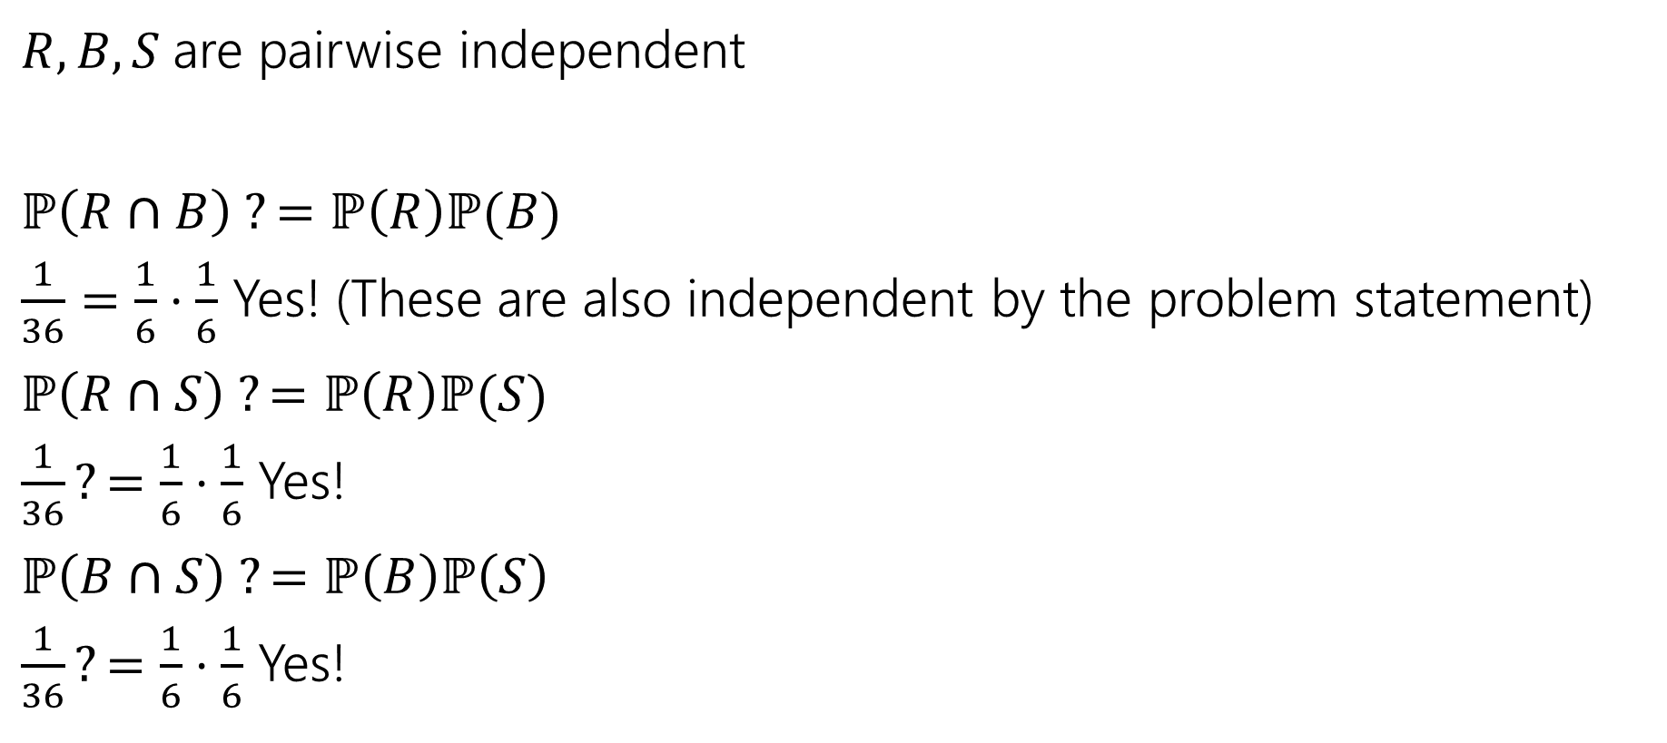
Pairwise Independence
$R,B,S$are pairwise independent
$ℙ\left(R∩B\right) ?=ℙ\left(R\right)ℙ(B)$
$\frac{1}{36}=\frac{1}{6}⋅\frac{1}{6}$ Yes! (These are also independent by the problem statement)
$ℙ\left(R∩S\right) ?=ℙ\left(R\right)ℙ(S)$
$\frac{1}{36}?=\frac{1}{6}⋅\frac{1}{6}$ Yes!
$ℙ\left(B∩S\right) ?=ℙ\left(B\right)ℙ\left(S\right)$
$\frac{1}{36}?=\frac{1}{6}⋅\frac{1}{6}$ Yes!

Slide 31

Mutual Independence
$R,B,S$ are not mutually independent.
$ℙ\left(R∩B∩S\right)=0;$if the red die is 3, and blue die is 5 then the sum is 8 (so it can’t be 7)
$ℙ\left(R\right)ℙ\left(B\right)ℙ\left(S\right)={\left(\frac{1}{6}\right)}^{3}=\frac{1}{216}≠0$
Notes:
Once a subset does not meet the condition then the events are not mutually independent.
When checking for mutual independence you might be tempted to just check the intersection for all the events and stop there, but that is not enough for mutual indepence

Slide 32
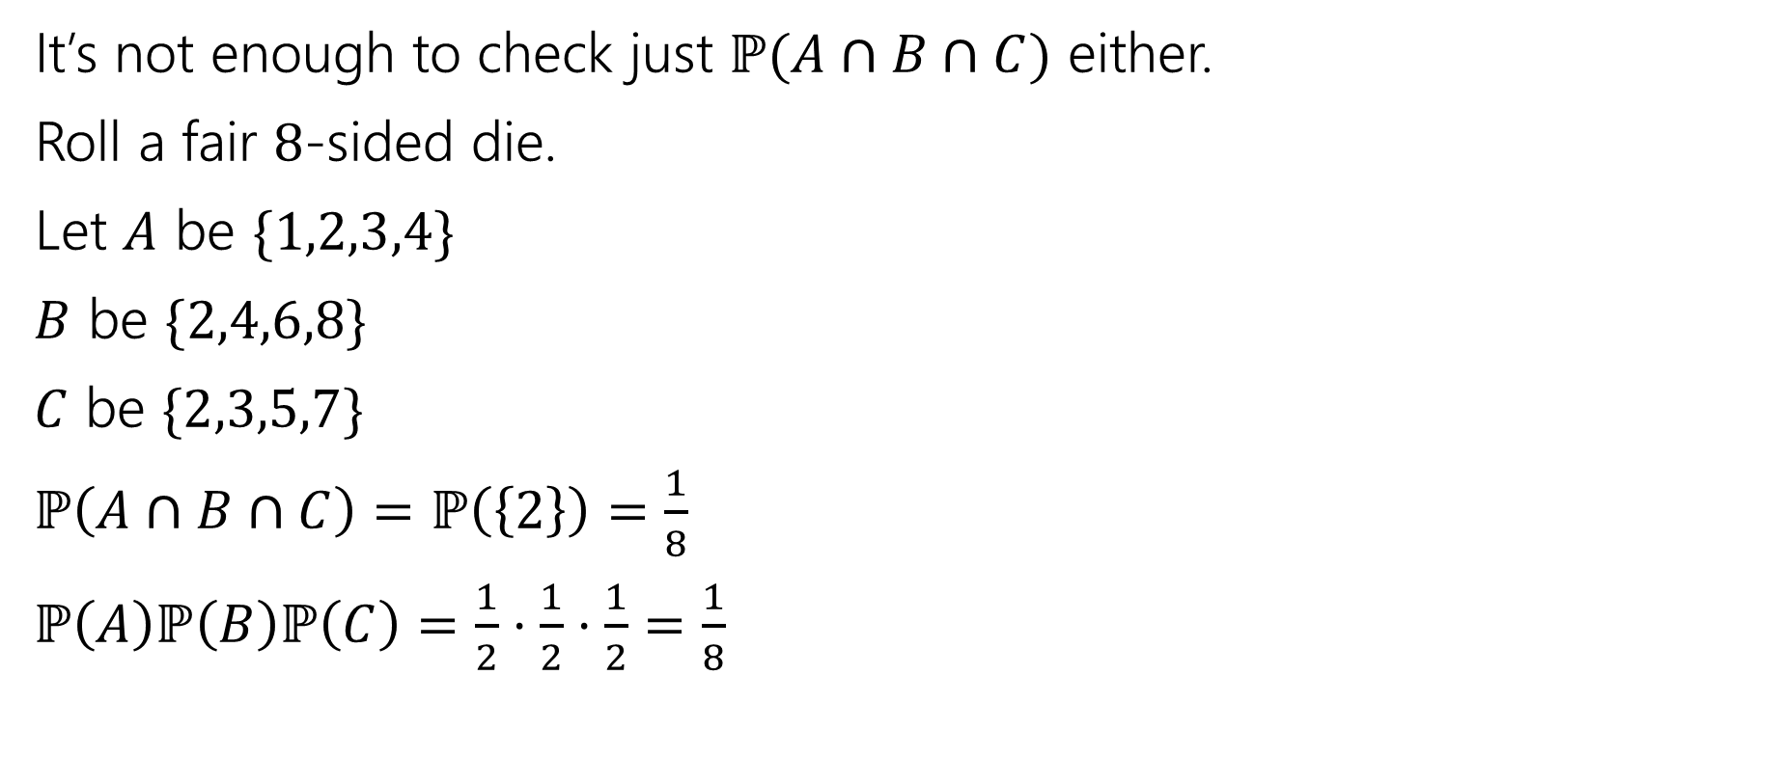
Checking Mutual Independence
It’s not enough to check just $ℙ(A∩B∩C)$ either.
Roll a fair $8$-sided die.
Let $A$ be $\{1,2,3,4\}$
$B$ be $\{2,4,6,8\}$
$C$ be $\{2,3,5,7\}$
$ℙ\left(A∩B∩C\right)=ℙ\left(\left\{2\right\}\right)=\frac{1}{8}$
$ℙ\left(A\right)ℙ\left(B\right)ℙ\left(C\right)=\frac{1}{2}⋅\frac{1}{2}⋅\frac{1}{2}=\frac{1}{8}$

Slide 33
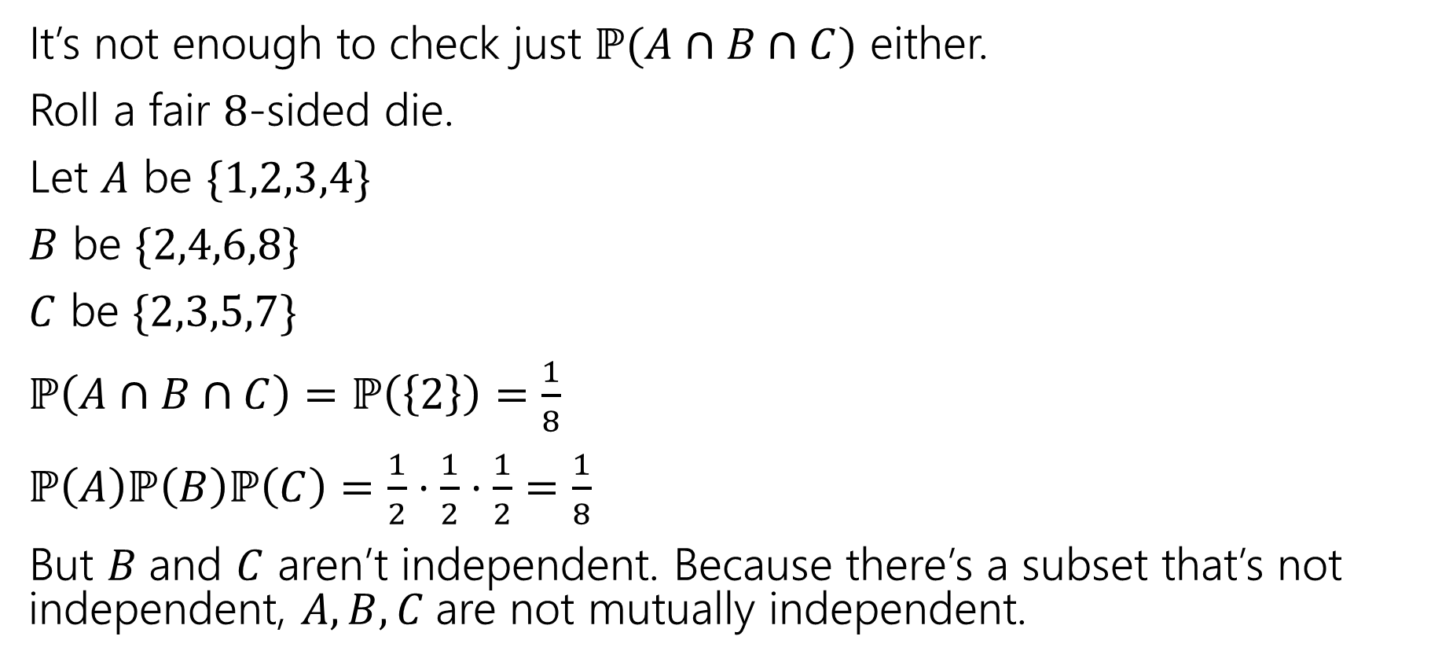
Checking Mutual Independence
It’s not enough to check just $ℙ(A∩B∩C)$ either.
Roll a fair $8$-sided die.
Let $A$ be $\{1,2,3,4\}$
$B$ be $\{2,4,6,8\}$
$C$ be $\{2,3,5,7\}$
$ℙ\left(A∩B∩C\right)=ℙ\left(\left\{2\right\}\right)=\frac{1}{8}$
$ℙ\left(A\right)ℙ\left(B\right)ℙ\left(C\right)=\frac{1}{2}⋅\frac{1}{2}⋅\frac{1}{2}=\frac{1}{8}$
But $B$and $C$ aren’t independent. Because there’s a subset that’s not independent, $A,B,C$are not mutually independent.

Slide 34
Checking Mutual Independence
To check mutual independence of events:
Check every subset.
To check pairwise independence of events:
Check every subset of size two.

Slide 35
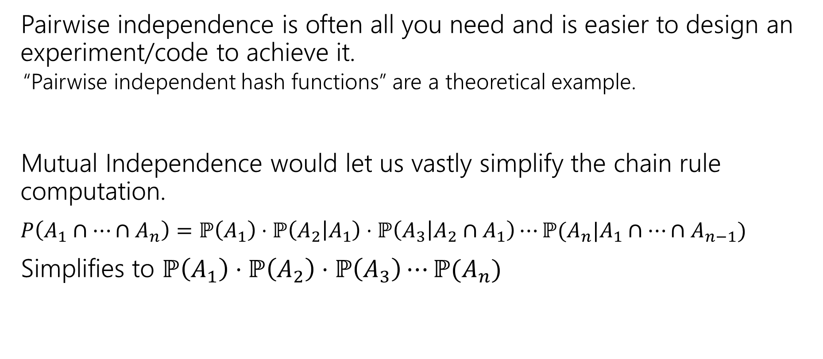
Why Two Versions?
Pairwise independence is often all you need and is easier to design an experiment/code to achieve it.
“Pairwise independent hash functions” are a theoretical example.
Mutual Independence would let us vastly simplify the chain rule computation.
$P\left(A_{1}∩…∩A_{n}\right)=ℙ\left(A_{1}\right)⋅ℙ\left(A_{2} | A_{1}\right)⋅ℙ\left(A_{3} | A_{2}∩A_{1}\right)⋯ℙ(A_{n}|A_{1}∩⋯∩A_{n−1})$
Simplifies to $ℙ\left(A_{1}\right)⋅ℙ\left(A_{2}\right)⋅ℙ\left(A_{3}\right)⋯ℙ(A_{n})$

