Slide 1
Bayes’ Rule
CSE 312 Summer 25
Lecture 6

Slide 2
Announcements
Optional Quiz is available on Ed after lecture.
Quiz 2 will be on Friday.
Homework 1 solutions available after lecture.

Slide 3
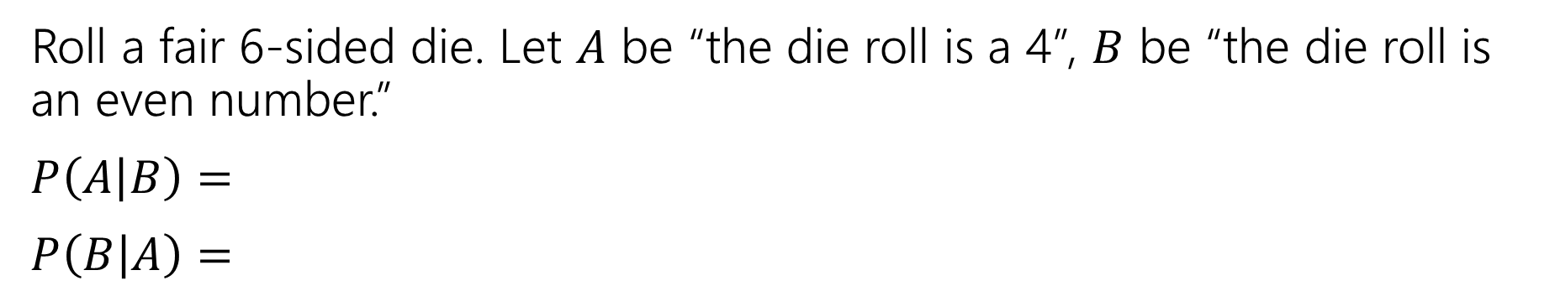

Last Time
For an event $B$, with $ℙ\left(B\right)>0,$
$t$he “Probability of $A$ conditioned on $B$” is
$$ℙ\left(A | B\right)=\frac{ℙ\left(A∩B\right)}{ℙ\left(B\right)}$$
Conditional Probability
Roll a fair 6-sided die. Let $A$ be “the die roll is a 4”, $B$ be “the die roll is an even number.”
$P\left(A | B\right)=$
$P\left(B | A\right)=$
Notes:
What we condition on is “the new (restricted) sample space”
Lets do this warm up

Slide 4
Bayes’ Rule
Notes:
This is going to be our first big rule with conditional probability. We are going to start with an application of this rule first.

Slide 5
Wonka Bars
Willy Wonka has placed golden tickets on 0.1% of his Wonka Bars.
You want to get a golden ticket. You could buy a 1000-or-so of the bars until you find one, but that’s expensive…you’ve got a better idea!
You have a test – a very precise scale you’ve bought.
    If the bar you weigh does have a golden ticket, the scale will alert you 99.9% of the time.
    If the bar you weigh does not have a golden ticket, the scale will (falsely) alert you only 1% of the time.
If you pick up a bar and it alerts, what is the probability you have a golden ticket?
Notes:
This is one where a lot of people’s intuition trips them up. At least it did for me when I first saw problems like this and was surprised by the results.

Slide 6
Willy Wonka
When you have an idea
go to pollev.com/avk5
  Willy Wonka has placed golden tickets on 0.1% of his Wonka Bars.
    If the bar you weigh does have a golden ticket, the scale will alert you 99.9% of the time.
    If the bar you weigh does not have a golden ticket, the scale will (falsely) alert you only 1% of the time.
You pick up a bar and it alerts, what is the probability you have a golden ticket?
Which of these is closest to the right answer?
0.1%
10%
50%
90%
99%
99.9%

Slide 7

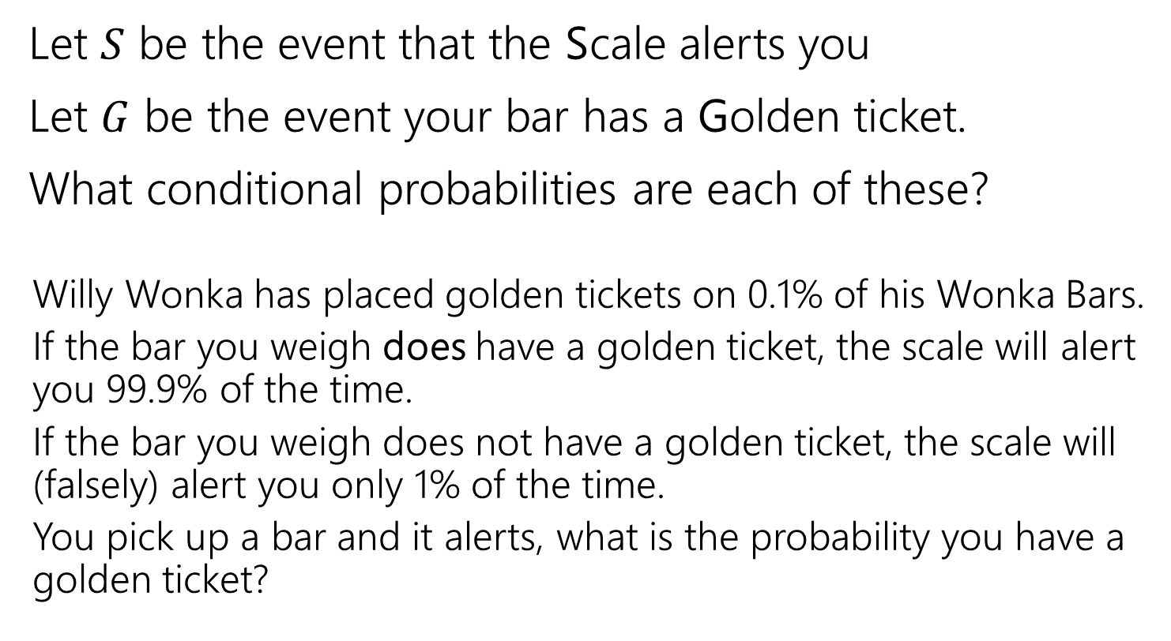



Conditioning
Let $S$ be the event that the Scale alerts you
Let $G$ be the event your bar has a Golden ticket.
What conditional probabilities are each of these?
  Willy Wonka has placed golden tickets on 0.1% of his Wonka Bars.
  If the bar you weigh does have a golden ticket, the scale will alert you 99.9% of the time.
  If the bar you weigh does not have a golden ticket, the scale will (falsely) alert you only 1% of the time.
  You pick up a bar and it alerts, what is the probability you have a golden ticket?
$$ℙ(G)$$
$$ℙ(S|G)$$
$$ℙ\left(S | \overline{G}\right)$$
$$ℙ(G|S)$$

Slide 8
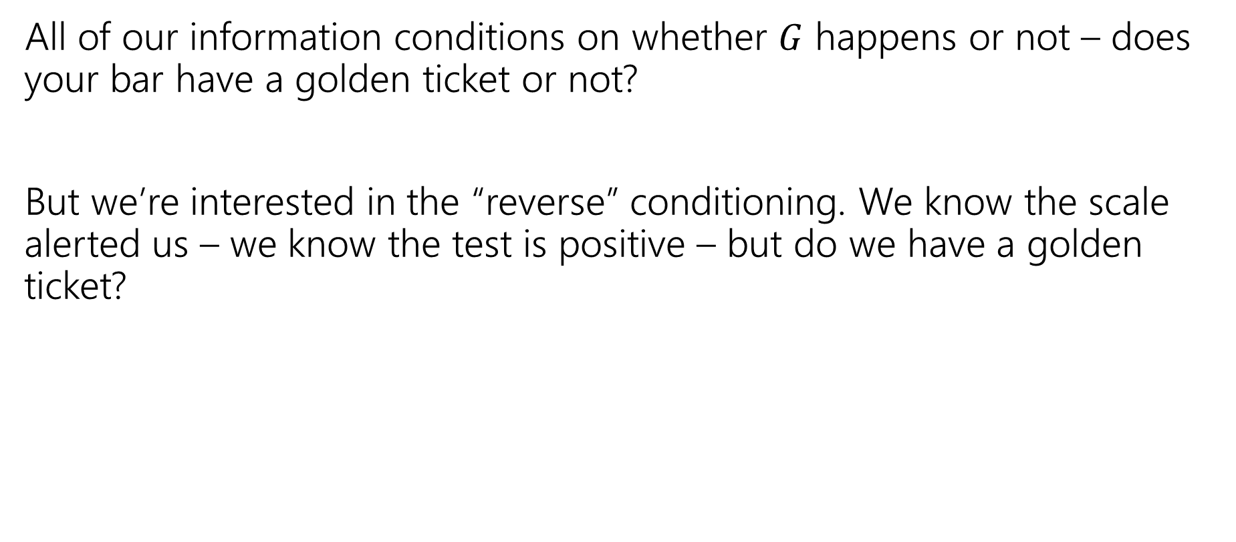
Reversing the Conditioning
All of our information conditions on whether $G$ happens or not – does your bar have a golden ticket or not?
But we’re interested in the “reverse” conditioning. We know the scale alerted us – we know the test is positive – but do we have a golden ticket?

Slide 9
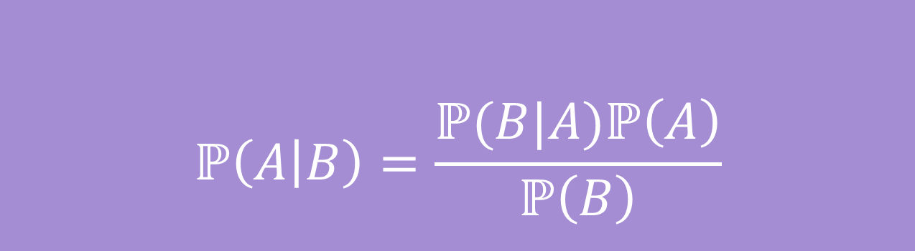
Bayes’ Rule
$$ℙ\left(A | B\right)=\frac{ℙ(B|A)ℙ\left(A\right)}{ℙ\left(B\right)}$$
Bayes’ Rule

Slide 10
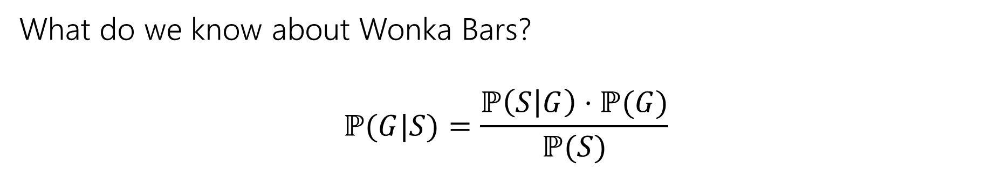
Bayes’ Rule
$$ℙ\left(A | B\right)=\frac{ℙ(B|A)ℙ\left(A\right)}{ℙ\left(B\right)}$$
Bayes’ Rule
What do we know about Wonka Bars?
$$ℙ(G|S)=\frac{ℙ\left(S | G\right)⋅ℙ(G)}{ℙ(S)}$$

Slide 11
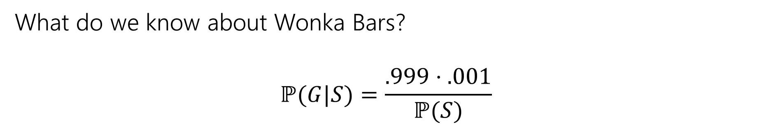
Bayes’ Rule
$$ℙ\left(A | B\right)=\frac{ℙ(B|A)ℙ\left(A\right)}{ℙ\left(B\right)}$$
Bayes’ Rule
What do we know about Wonka Bars?
$$ℙ(G|S)=\frac{.999⋅.001}{ℙ(S)}$$
Notes:
Pause and talk to the people around you. From what we know about the problem, what should the probability of the scale going off be?

Slide 12

Filling In
What’s $ℙ(S)$?
We’ll use a trick called “the law of total probability”:
$ℙ\left(S\right)=ℙ\left(S | G\right)⋅ℙ\left(G\right)+ℙ\left(S | \overline{G}\right)⋅ℙ\left(\overline{G}\right)$
$=0.999⋅.001+.01⋅.999$
$=.010989$
Notes:
The law of total probability is trying to take this intuition about cases and formalize it.
If you can split your sample space or your universe into disjoint pieces, your disjoint cases, there is a golden ticket, there isn’t a golden ticket. And you can answer the question, what is the probability of S conditioned on your first case and the probability of S conditioned on your second case and then you just weight them by how likely you are to be in case 1 or case two then you can add them to get your total probability of S.
Any questions about this intuition? Split into cases and weigh them.

Slide 13
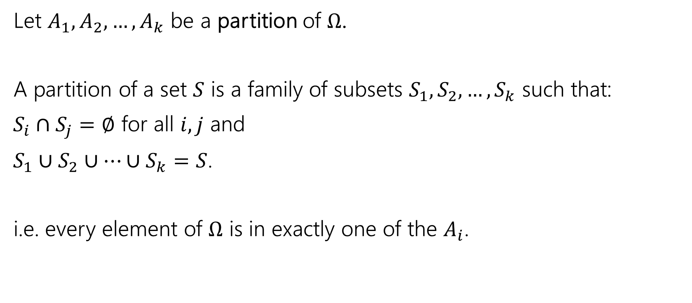
Law of Total Probability
Let $A_{1},A_{2},…,A_{k}$ be a partition of $Ω$.
A partition of a set $S$ is a family of subsets $S_{1},S_{2},…,S_{k}$ such that:
$S_{i}∩S_{j}=∅$ for all $i,j$ and
$S_{1}∪S_{2}∪…∪S_{k}=S$.
i.e. every element of $Ω$ is in exactly one of the $A_{i}$.
Notes:
A partition is a way to divide up a set into subsets such that every element in your set appears in exactly one subset. You are breaking them up into pieces so that they don’t over lap and together they account for the whole sample space.
What we had before was a partition, the bar either has a golden ticket or it doesn’t, so every bar is contained in one of these events.

Slide 14
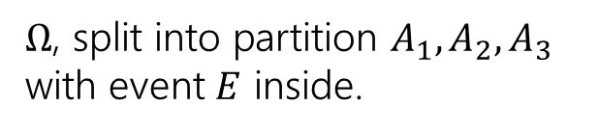





Law of Total Probability
Let $A_{1},A_{2},…,A_{k}$ be a partition of $Ω$.
For any event $E$,
$$ℙ\left(E\right)= \sum_{all i}{ℙ\left(E|A_{i}\right)ℙ(A_{i})}$$
Law of Total Probability
$Ω$, split into partition $A_{1},A_{2},A_{3}$ with event $E$ inside.
$$E$$
$$A_{1}$$
$$A_{2}$$
$$A_{3}$$
Notes:
More than one valid partition is possible.

Slide 15

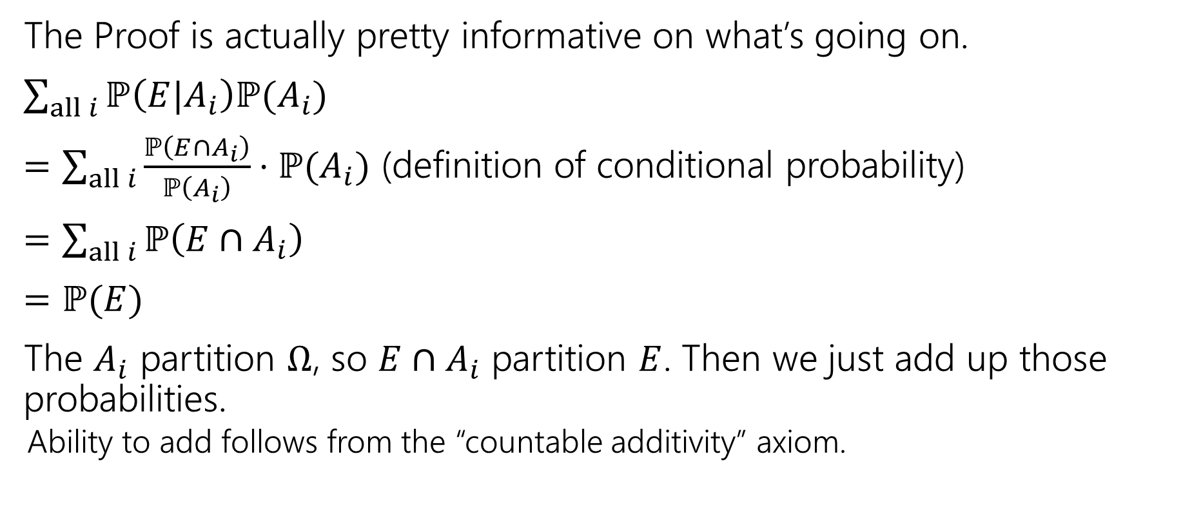



Why?
$$E$$
$$A_{1}$$
$$A_{2}$$
$$A_{3}$$
The Proof is actually pretty informative on what’s going on.
$\sum_{all i}{ℙ\left(E|A_{i}\right)ℙ(A_{i})}$
$=\sum_{all i}{\frac{ℙ\left(E∩A_{i}\right)}{ℙ\left(A_{i}\right)}⋅ℙ(A_{i})}$ (definition of conditional probability)
$=\sum_{all i}{ℙ\left(E∩A_{i}\right)}$
$=ℙ(E)$
The $A_{i}$ partition $Ω$, so $E∩A_{i}$ partition $E$. Then we just add up those probabilities.
  Ability to add follows from the “countable additivity” axiom.

Slide 16
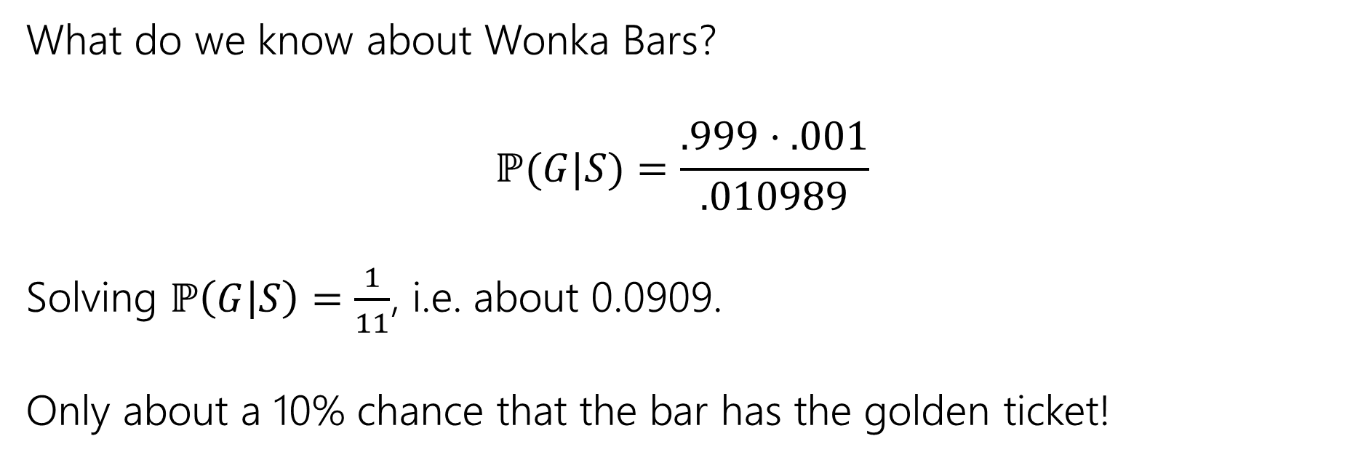
Bayes Rule
What do we know about Wonka Bars?
$$ℙ(G|S)=\frac{.999⋅.001}{.010989}$$
Solving $ℙ\left(G | S\right)=\frac{1}{11}$, i.e. about 0.0909.
Only about a 10% chance that the bar has the golden ticket!

Slide 17
Wait a minute…
  Willy Wonka has placed golden tickets on 0.1% of his Wonka Bars.
  If the bar you weigh does have a golden ticket, the scale will alert you 99.9% of the time.
  If the bar you weigh does not have a golden ticket, the scale will (falsely) alert you only 1% of the time.
That doesn’t fit with many of our guesses. What’s going on?
Instead of saying “we tested one and got a positive” imagine we tested 1000. ABOUT how many bars of each type are there?
(about) 1 with a golden ticket 999 without. Let’s say those are exactly right.
Let’s just say that one golden is truly found.
(about) 1% of the 999 without would be a positive. Let’s say it’s exactly 10.
Notes:
Lets try to refine our intuition.

Slide 18
Visually
Gold bar is the one (true) golden ticket bar.
Purple bars don’t have a ticket and tested negative.
Red bars don’t have a ticket, but tested positive.
The test is, in a sense, doing really well.
It’s almost always right.
The problem is it’s also the case that the correct answer is almost always “no.”
Notes:
Because the case of the golden ticket is so rare, it gets drowned out by false positives.

Slide 19

Updating Your Intuition
Take 1: The test is actually good and has VASTLY increased our belief that there IS a golden ticket when you get a positive result.
If we told you “your job is to find a Wonka Bar with a golden ticket” without the test, you have 1/1000 chance, with the test, you have (about) a 1/11 chance. That’s (almost) 100 times better!
This is actually a huge improvement!

Slide 20
Updating Your Intuition
Take 2: Humans are really bad at intuitively understanding very large or very small numbers.
When I hear “99% chance”, “99.9% chance”, “99.99% chance” they all go into my brain as “well that’s basically guaranteed” And then I forget how many 9’s there actually were.

Slide 21
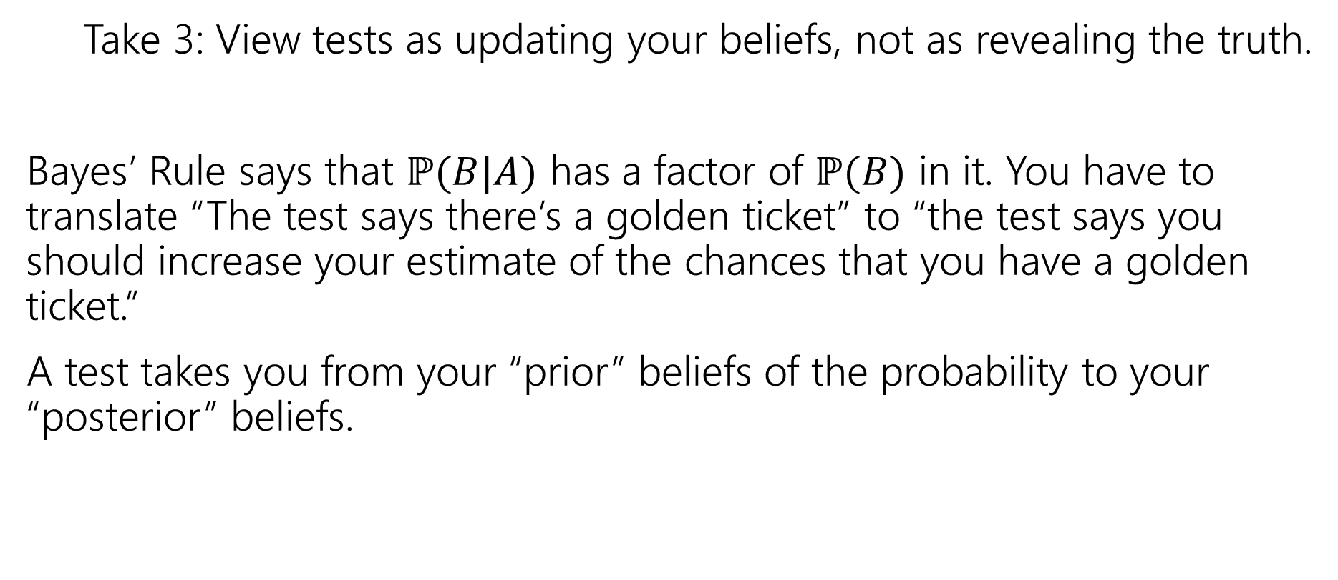
Updating Your Intuition
Take 3: View tests as updating your beliefs, not as revealing the truth.
Bayes’ Rule says that $ℙ(B|A)$ has a factor of $ℙ(B)$ in it. You have to translate “The test says there’s a golden ticket” to “the test says you should increase your estimate of the chances that you have a golden ticket.”
A test takes you from your “prior” beliefs of the probability to your “posterior” beliefs.

Slide 22
More Bayes Practice

Slide 23
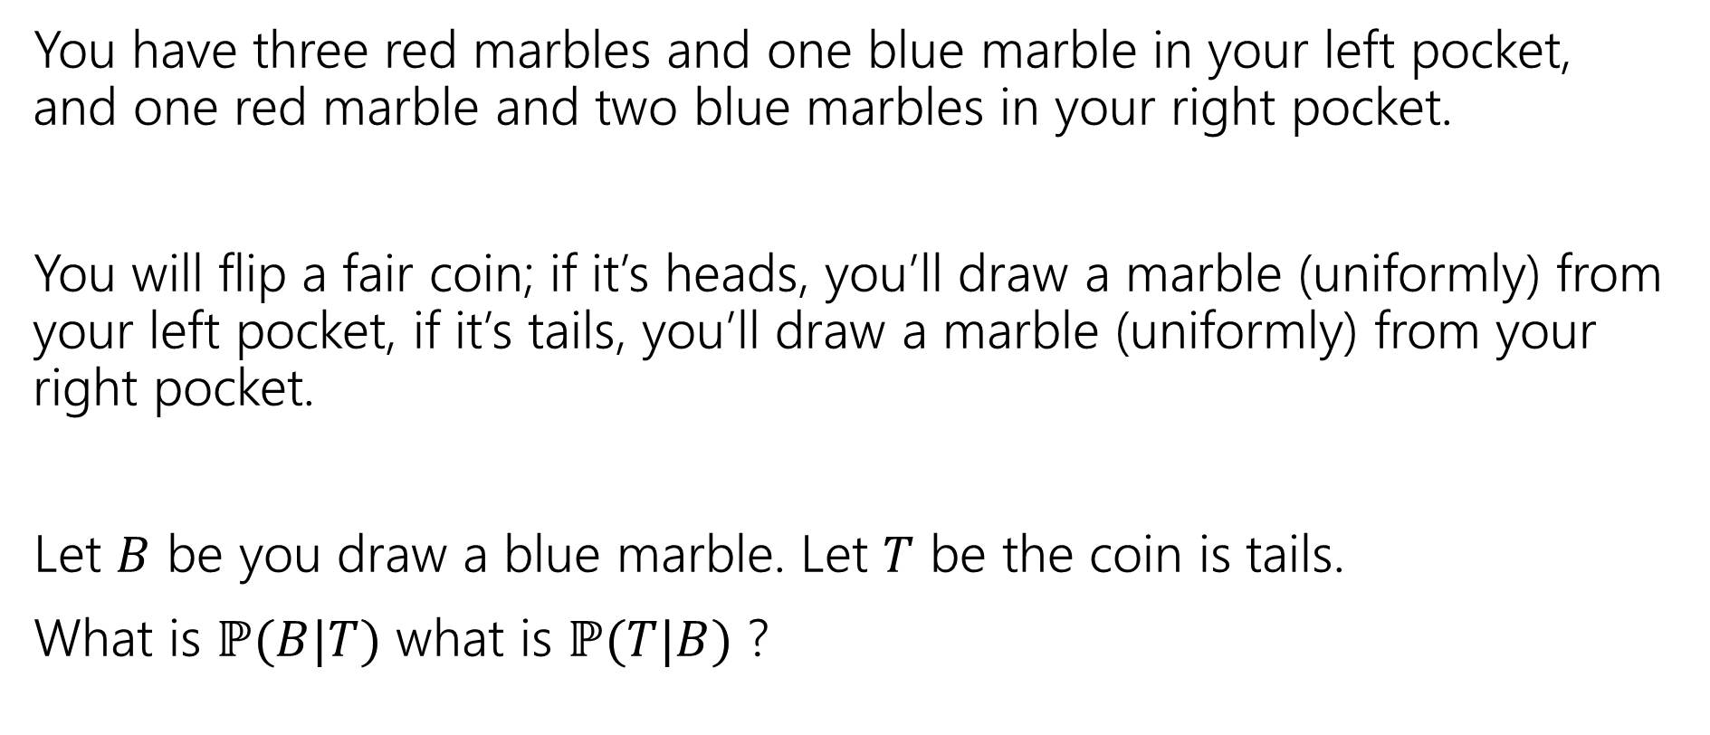
A contrived example
You have three red marbles and one blue marble in your left pocket, and one red marble and two blue marbles in your right pocket.
You will flip a fair coin; if it’s heads, you’ll draw a marble (uniformly) from your left pocket, if it’s tails, you’ll draw a marble (uniformly) from your right pocket.
Let $B$ be you draw a blue marble. Let $T$ be the coin is tails.
What is $ℙ(B|T)$ what is $ℙ(T|B)$ ?

Slide 24

Flipping the conditioning
You have three red marbles and one blue marble in your left pocket, and one red marble and two blue marbles in your right pocket.
if it’s heads, you’ll draw a marble (uniformly) from your left pocket,
if it’s tails, you’ll draw a marble (uniformly) from your right pocket.
What about $ℙ(T|B)$?
Pause, what’s your intuition?
Is this probability
A. less than $½$
B. equal to $½$
C. greater than $½$
The right (tails) pocket is far more likely to produce a blue marble if picked than the left (heads) pocket is. Seems like $ℙ(T|B)$ should be greater than ½.
Notes:
We aren’t reversing the order of events, we are using additional information to update our probability of what happened in the first step

Slide 25

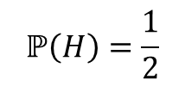






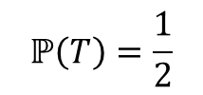

Updated Sequential Processes
You have three red marbles and one blue marble in your left pocket, and one red marble and two blue marbles in your right pocket.
if it’s heads, you’ll draw a marble (uniformly) from your left pocket,
if it’s tails, you’ll draw a marble (uniformly) from your right pocket.
$$ℙ\left(H\right)=\frac{1}{2}$$
$$ℙ\left(T\right)=\frac{1}{2}$$
H
T
$$ℙ\left(R|H\right)=\frac{3}{4}$$
$$ℙ\left(B|H\right)=\frac{1}{4}$$
$$ℙ\left(R|T\right)=\frac{1}{3}$$
$$ℙ\left(B|T\right)=\frac{2}{3}$$
$$ℙ\left(R∩H\right)=3/8$$
$$ℙ\left(R∩T\right)=1/6$$
$$ℙ\left(B∩H\right)=1/8$$
$$ℙ\left(B∩T\right)=1/3$$
Notes:
Draw out the conditional probability rearrangement, on Wednesday we will discuss the formalized rule for a sequential process with more than two steps called the chain rule, but for now this is how we can calculate P(B intersect T).

Slide 26





Updated Sequential Processes
You have three red marbles and one blue marble in your left pocket, and one red marble and two blue marbles in your right pocket.
if it’s heads, you’ll draw a marble (uniformly) from your left pocket,
if it’s tails, you’ll draw a marble (uniformly) from your right pocket.
$$ℙ\left(H\right)=\frac{1}{2}$$
$$ℙ\left(T\right)=\frac{1}{2}$$
H
T
$ℙ\left(B | T\right)=2/3$
$ℙ\left(B\right)=\frac{1}{8}+\frac{1}{3}=\frac{11}{24}$
$$ℙ\left(R|H\right)=\frac{3}{4}$$
$$ℙ\left(B|H\right)=\frac{1}{4}$$
$$ℙ\left(R|T\right)=\frac{1}{3}$$
$$ℙ\left(B|T\right)=\frac{2}{3}$$
$$ℙ\left(R∩H\right)=3/8$$
$$ℙ\left(R∩T\right)=1/6$$
$$ℙ\left(B∩H\right)=1/8$$
$$ℙ\left(B∩T\right)=1/3$$
Notes:
Notice that B intersect H and B intersect T are disjoint, so we can add them, but the sequential process that lead up to it is exactly our law of total probability in action.

Slide 27

Flipping the conditioning
You have three red marbles and one blue marble in your left pocket, and one red marble and two blue marbles in your right pocket.
if it’s heads, you’ll draw a marble (uniformly) from your left pocket,
if it’s tails, you’ll draw a marble (uniformly) from your right pocket.
What about $ℙ(T|B)$?
Bayes’ Rule says:
$ℙ\left(T | B\right)=\frac{ℙ(B|T)ℙ\left(T\right)}{ℙ\left(B\right)}$
$=\frac{\frac{2}{3}⋅\frac{1}{2}}{11/24}$
$=8/11$
Notes:
Show the other way. 8/11 is really more than half.

Slide 28
The Technical Stuff

Slide 29
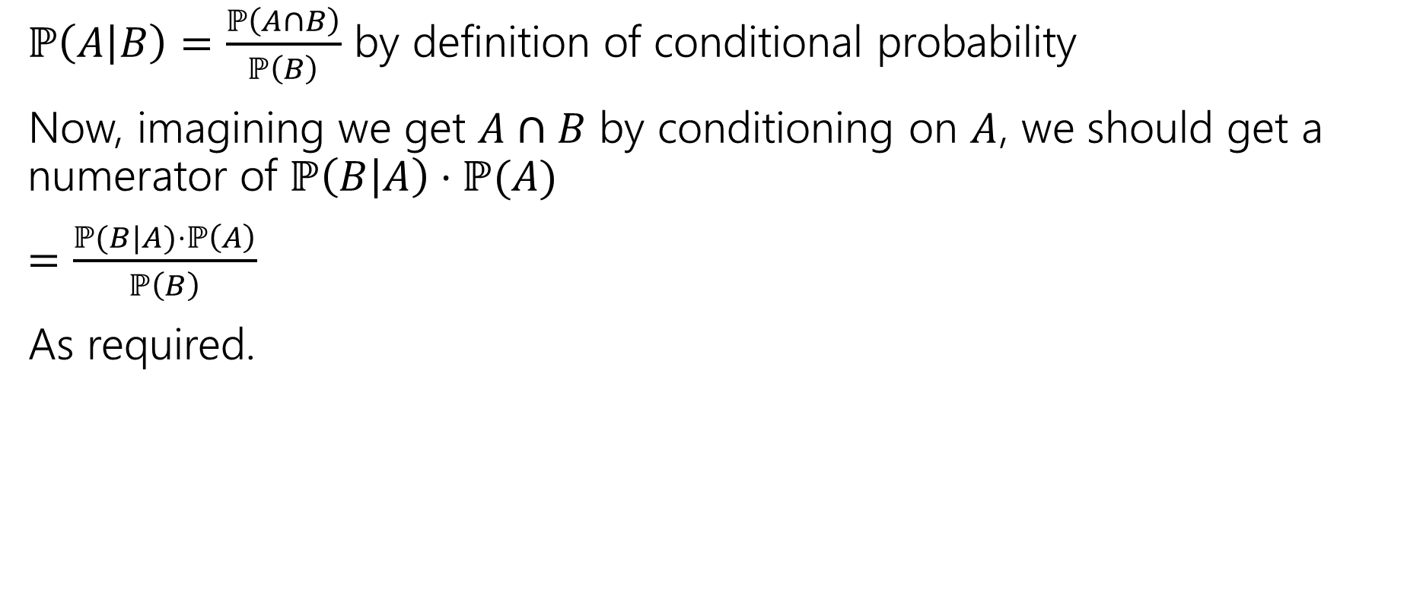
Proof of Bayes’ Rule
$ℙ\left(A | B\right)=\frac{ℙ\left(A∩B\right)}{ℙ\left(B\right)}$ by definition of conditional probability
Now, imagining we get $A∩B$ by conditioning on $A$, we should get a numerator of $ℙ\left(B | A\right)⋅ℙ(A)$
$=\frac{ℙ(B|A)⋅ℙ\left(A\right)}{ℙ\left(B\right)}$
As required.

Slide 30
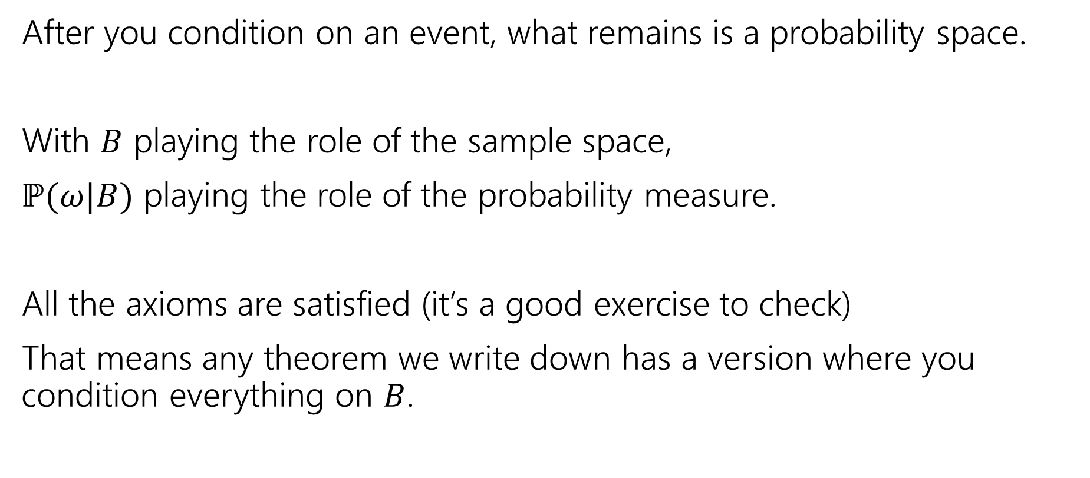
A Technical Note
After you condition on an event, what remains is a probability space.
With $B$ playing the role of the sample space,
$ℙ(ω|B)$ playing the role of the probability measure.
All the axioms are satisfied (it’s a good exercise to check)
That means any theorem we write down has a version where you condition everything on $B$.

Slide 31
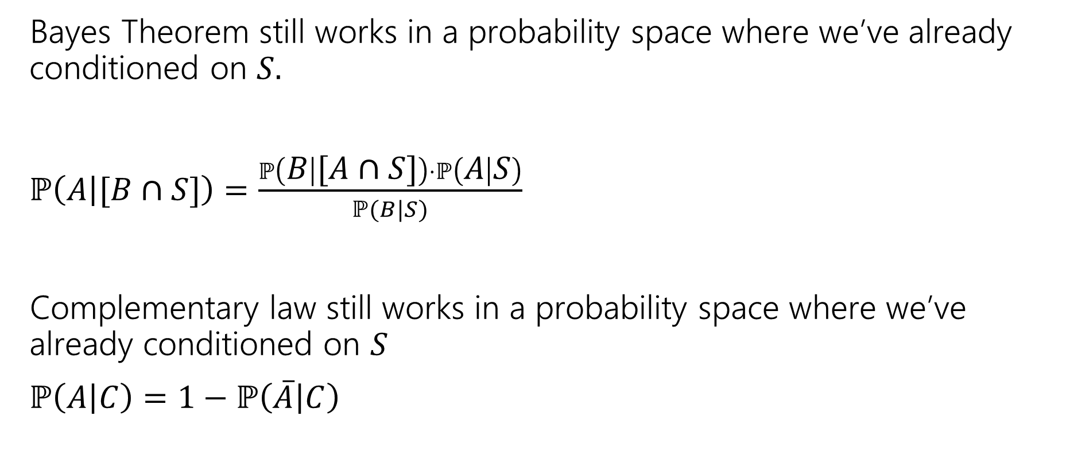
An Example
Bayes Theorem still works in a probability space where we’ve already conditioned on $S.$
$ℙ\left(A | [B∩S]\right)=\frac{ℙ\left(B | [A∩S]\right)⋅ℙ\left(A | S\right)}{ℙ(B|S)}$
Complementary law still works in a probability space where we’ve already conditioned on $S$
$ℙ\left(A | C\right)=1−ℙ\left(\overline{A} | C\right)$
Notes:
These are just examples. EVERY theorem we have that mentions events works this way.

Slide 32
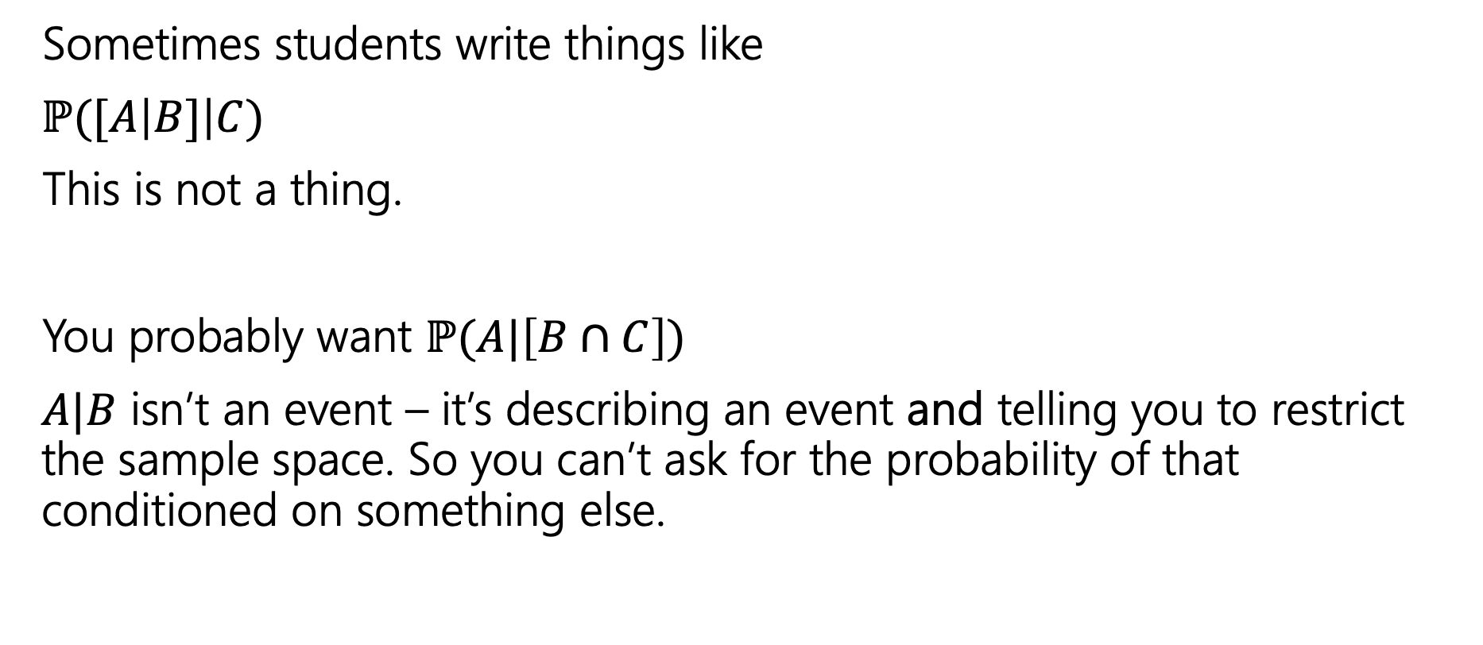
A Quick Technical Remark
Sometimes students write things like
$ℙ([A\left|B]\right|C)$
This is not a thing.
You probably want $ℙ(A|\left[B∩C\right])$
$A|B$ isn’t an event – it’s describing an event and telling you to restrict the sample space. So you can’t ask for the probability of that conditioned on something else.

Slide 33
Bayes in the real world

Slide 34
Application 1: Medical Tests
Helping Doctors and Patients Make Sense of Health Statistics
A researcher posed the following scenario to a group of 160 doctors:
Assume you conduct a disease screening using a standard test in a certain region. You know the following information about the people in this region:
The probability that a person has the disease is 1% (prevalence)
If a person has the disease, the probability that she tests positive is 90% (sensitivity)
If a person does not have the disease, the probability that she nevertheless tests positive is 9% (false-positive rate)
A person tests positive. She wants to know from you whether that means that she has the disease for sure, or what the chances are. What is the best answer?
A. The probability that she has the disease is about 81%.
B. Out of 10 people with a positive test, about 9 have the disease.
C. Out of 10 people with a positive test, about 1 have the disease.
D. The probability that she has the disease is about 1%

Slide 35
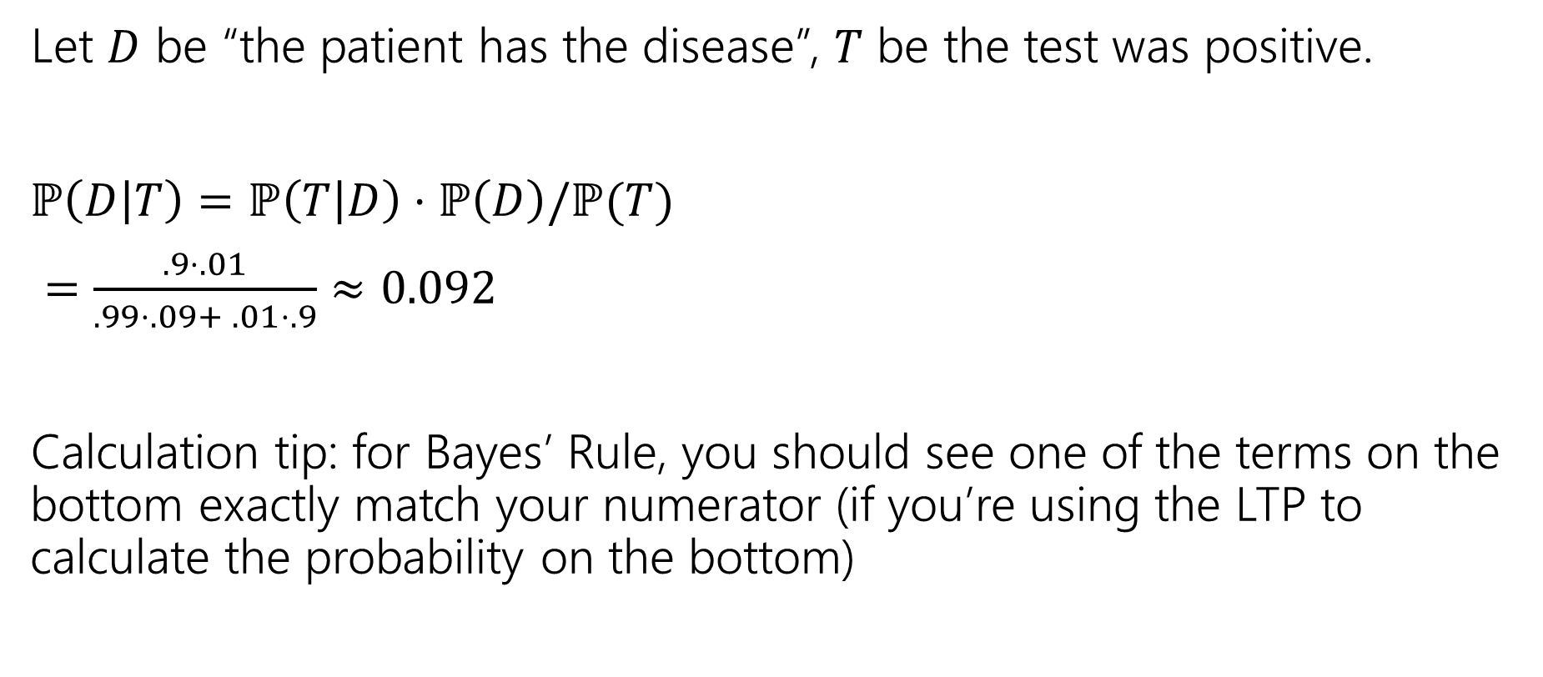
Let’s do the calculation!
Let $D$ be “the patient has the disease”, $T$ be the test was positive.
$ℙ\left(D | T\right)=ℙ\left(T | D\right)⋅ℙ\left(D\right)/ℙ(T)$
$=\frac{.9⋅.01}{.99⋅.09+ .01⋅.9}≈0.092$
Calculation tip: for Bayes’ Rule, you should see one of the terms on the bottom exactly match your numerator (if you’re using the LTP to calculate the probability on the bottom)

Slide 36
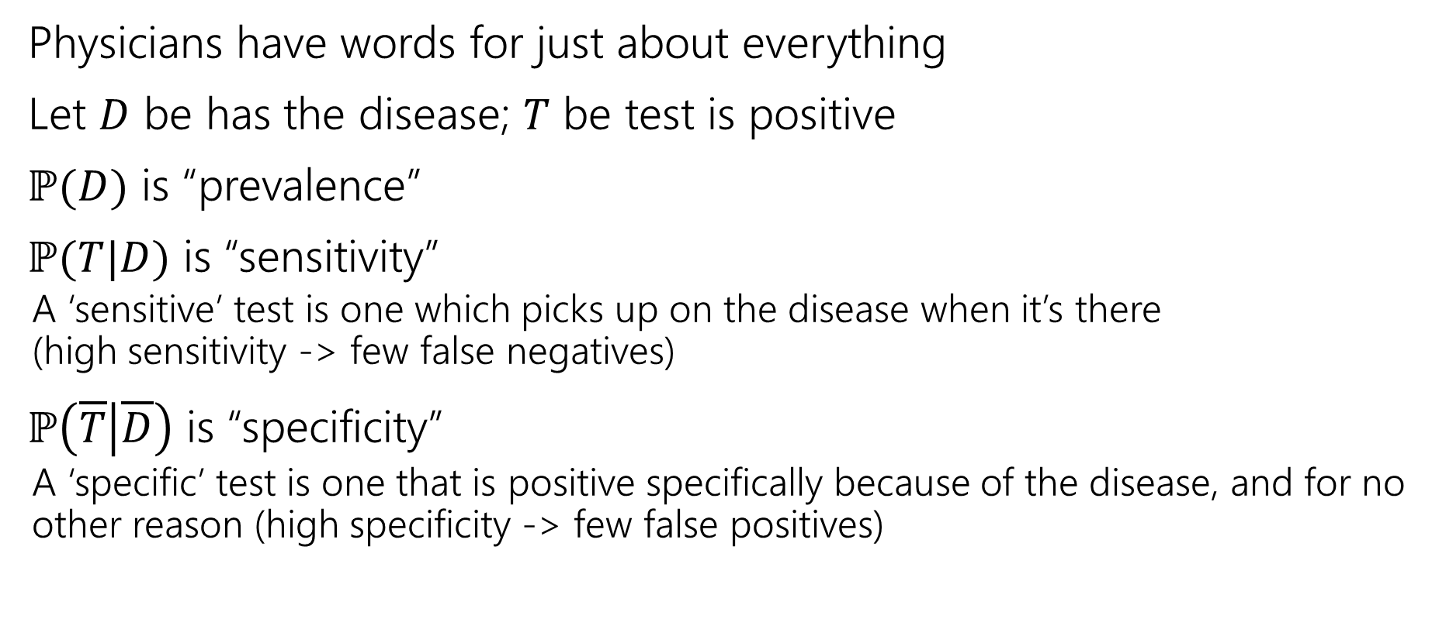
Pause for vocabulary
Physicians have words for just about everything
Let $D$ be has the disease; $T$ be test is positive
$ℙ(D)$ is “prevalence”
$ℙ(T|D)$ is “sensitivity”
  A ‘sensitive’ test is one which picks up on the disease when it’s there
  (high sensitivity -> few false negatives)
$ℙ\left(\overline{T} | \overline{D}\right)$ is “specificity”
  A ‘specific’ test is one that is positive specifically because of the disease, and for no other reason (high specificity -> few false positives)

Slide 37
How did the doctors do
C (about 1 in 10) was the correct answer.
Of the doctors surveyed, less than ¼ got it right (so worse than random guessing).
After the researcher taught them his calculation trick, more than 80% got it right.

Slide 38
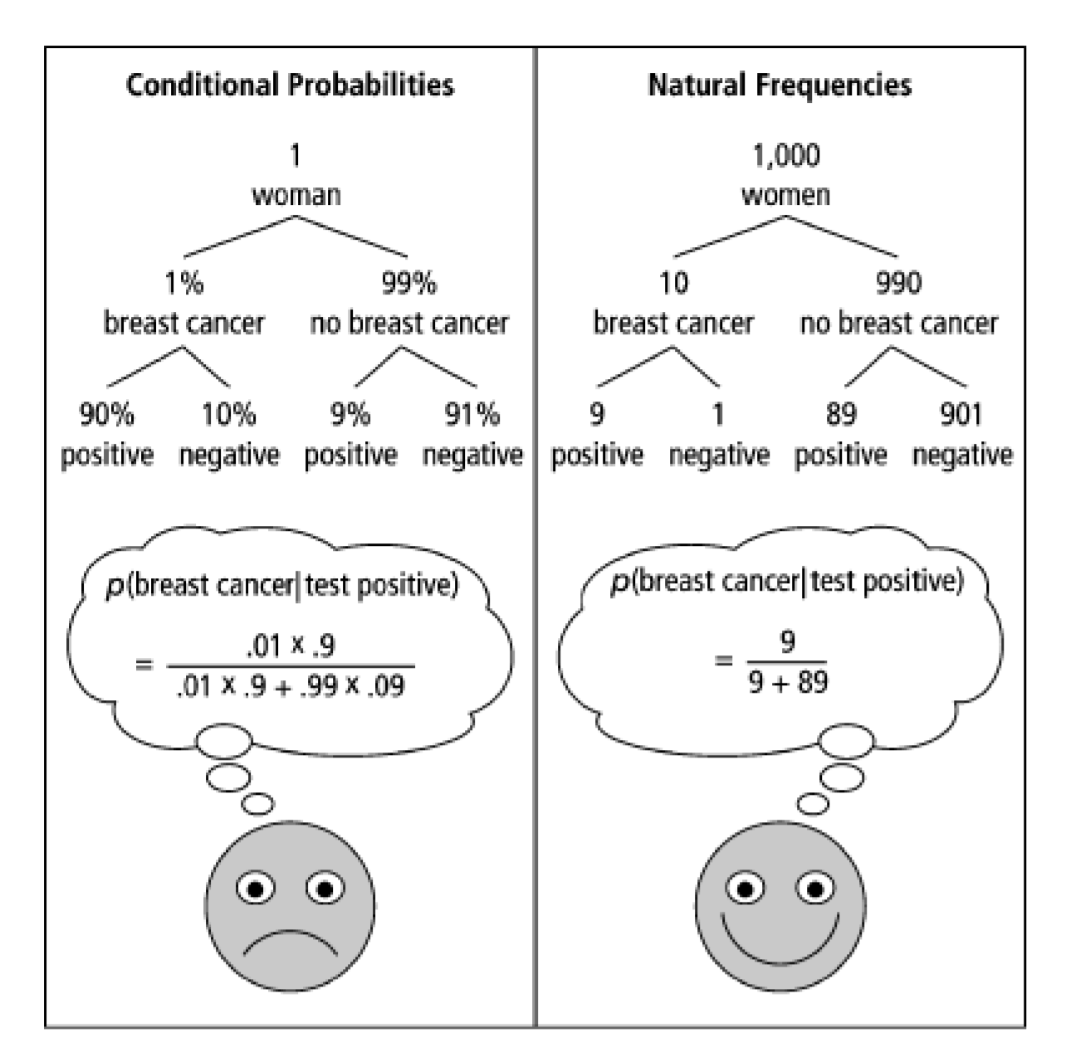
One Weird Trick!
Calculation Trick: imagine you have a large population (not one person) and ask how many there are of false/true positives/negatives.

Slide 39
What about the real world?
When you’re older and have to do more routine medical tests, don’t get concerned (yet) when they ask to run another test.*
It’s usually fine.*
*This is not medical advice, Anna is not a physician.

Slide 40
Optional: Bayes Factor
A way to estimate Bayes calculations quickly

Slide 41
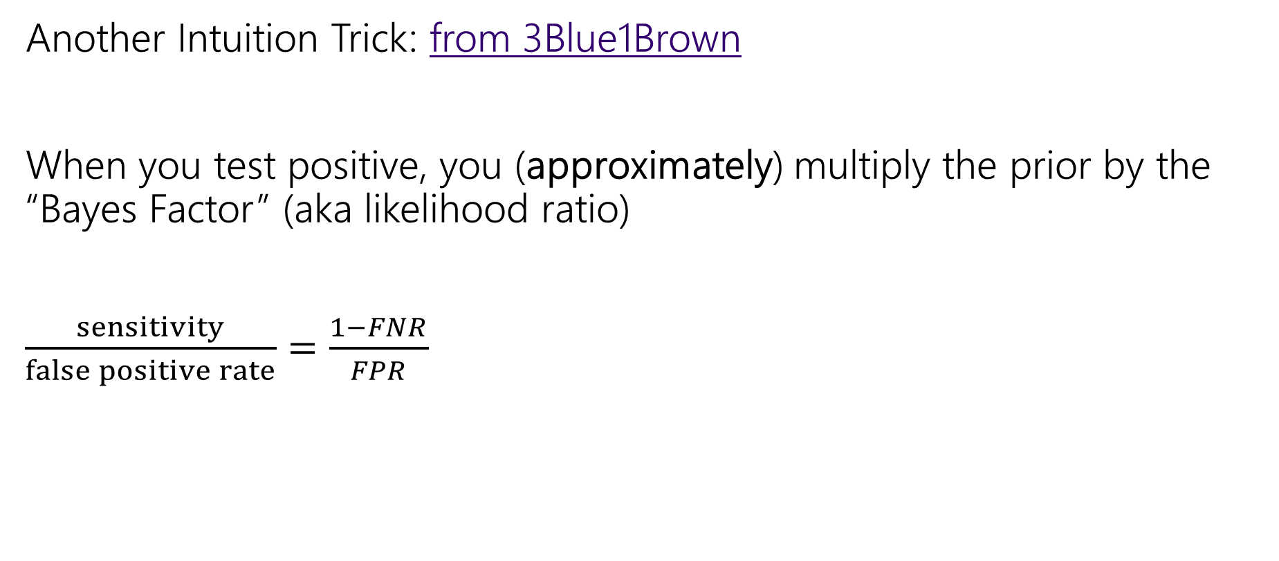
Bayes Factor
Another Intuition Trick: from 3Blue1Brown
When you test positive, you (approximately) multiply the prior by the “Bayes Factor” (aka likelihood ratio)
$\frac{sensitivity}{false positive rate}=\frac{1−FNR}{FPR}$

Slide 42

Bayes Factor
Does it work?
Let’s try it…
Find
$prior⋅\frac{Sensitivity}{FPR}$

Slide 43
Wonka Bars
Willy Wonka has placed golden tickets on 0.1% of his Wonka Bars.
You want to get a golden ticket. You could buy a 1000-or-so of the bars until you find one, but that’s expensive…you’ve got a better idea!
You have a test – a very precise scale you’ve bought.
  If the bar you weigh does have a golden ticket, the scale will alert you 99.9% of the time.
  If the bar you weigh does not have a golden ticket, the scale will (falsely) alert you only 1% of the time.
If you pick up a bar and it alerts, what is the probability you have a golden ticket?

Slide 44

Wonka Bars
Bayes Factor
$\frac{99.9}{1}$
Prior: $.1\%$
Product: $9.99$, so about $10\%$
About what Bayes Rule gets!

Slide 45
Application 1: Medical Tests
Helping Doctors and Patients Make Sense of Health Statistics
A researcher posed the following scenario to a group of 160 doctors:
Assume you conduct a disease screening using a standard test in a certain region. You know the following information about the people in this region:
The probability that a person has the disease is 1% (prevalence)
If a person has the disease, the probability that she tests positive is 90% (sensitivity)
If a person does not have the disease, the probability that she nevertheless tests positive is 9% (false-positive rate)
A person tests positive. She wants to know from you whether that means that she has the disease for sure, or what the chances are. What is the best answer?
A. The probability that she has the disease is about 81%.
B. Out of 10 people with a positive test, about 9 have the disease.
C. Out of 10 people with a positive test, about 1 have the disease.
D. The probability that she has the disease is about 1%

Slide 46

Bayes Factor
What about with the doctors?
$1\%⋅\frac{90\%}{9\%}=10\%$
Again about right!

Slide 47
Caution
Multiplying by the Bayes Factor is an approximation
It gives you the exact numerator for Bayes, but the denominator is
“the number of false positives if the prevalence (/prior) were 0”
When the prior is close to 0, this is a fine approximation!
But plug in a prior of 15% on the last slide, and we get 150% chance.

Slide 48

What about negative tests?
For negative tests, the Bayes Factor is
$\frac{FNR}{specificity }$
Specificity is $(1−false negative rate)$

