Slide 1
Conditional Probability
CSE 312 Summer 25
Lecture 5

Slide 2
Announcements
Homework 1 is due tonight
Homework 2 will be released later today
Section Participation on Gradescope

Slide 3


Last Time
A sample space $Ω$ is the set of all possible outcomes of an experiment.
Sample Space
An event $E⊆Ω$ is a subset of possible outcomes (i.e. a subset of $Ω$)
Event
A probability is a number between 0 and 1 describing how likely a particular outcome is.
Probability

Slide 4

Probability Space
Probability Space
A (discrete) probability space is a pair $(Ω,ℙ)$ where:
$Ω$ is the sample space
$ℙ:Ω→[0,1]$ is the probability measure.
$ℙ$ satisfies:
$ℙ\left(x\right)≥0$ for all $x$
$\sum_{x∈Ω}{ℙ(x)} =1$
If $E,F⊆Ω$ and $E∩F=∅$then $ℙ\left(E∪F\right)=ℙ\left(E\right)+ℙ(F)$

Slide 5
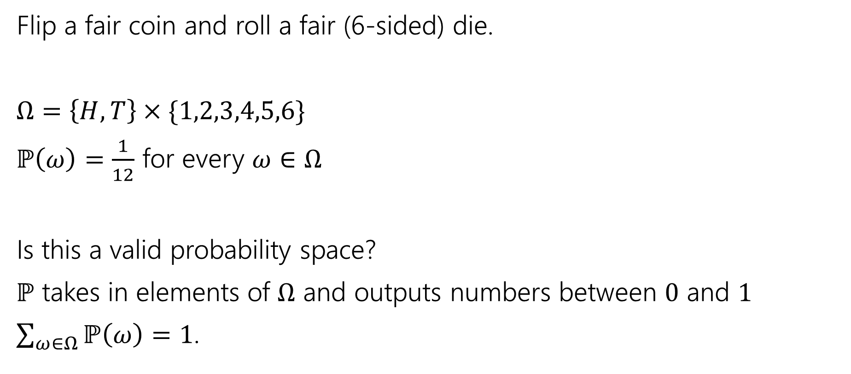
Probability Space
Flip a fair coin and roll a fair (6-sided) die.
$Ω=\left\{H,T\right\}×\{1,2,3,4,5,6\}$
$ℙ\left(ω\right)=\frac{1}{12}$ for every $ω∈Ω$
Is this a valid probability space?
$ℙ$ takes in elements of $Ω$ and outputs numbers between $0$ and $1$
$\sum_{ω∈Ω}{ℙ\left(ω\right)}=1$.
Notes:
But we haven’t said how to handle something like the event, what is the probability of seeing heads and the die roll being greater than 3. Form here on out we are going to assume that the way that we compute this probability is with our additivity condition.

Slide 6
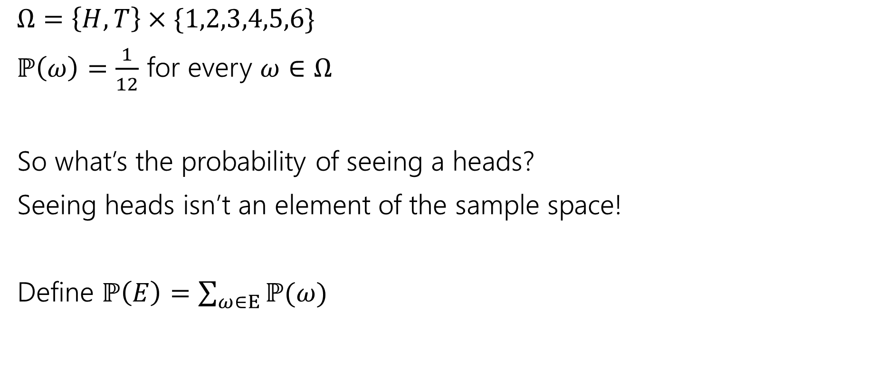
Measure
$Ω=\left\{H,T\right\}×\{1,2,3,4,5,6\}$
$ℙ\left(ω\right)=\frac{1}{12}$ for every $ω∈Ω$
So what’s the probability of seeing a heads?
Seeing heads isn’t an element of the sample space!
Define $ℙ\left(E\right)=\sum_{ω∈E}{ℙ(ω)}$
Notes:
That is,

Slide 7
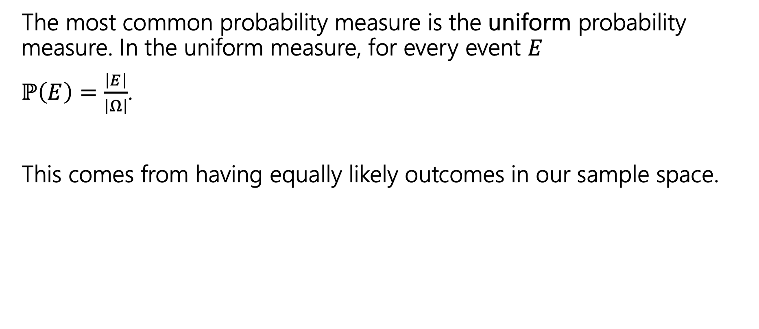
Uniform Probability Space
The most common probability measure is the uniform probability measure. In the uniform measure, for every event $E$
$ℙ\left(E\right)=\frac{\left|E\right|}{\left|Ω\right|}$.
This comes from having equally likely outcomes in our sample space.
Notes:
This next example that we do will show why we prefer working with uniform probability space.

Slide 8
Examples

Slide 9
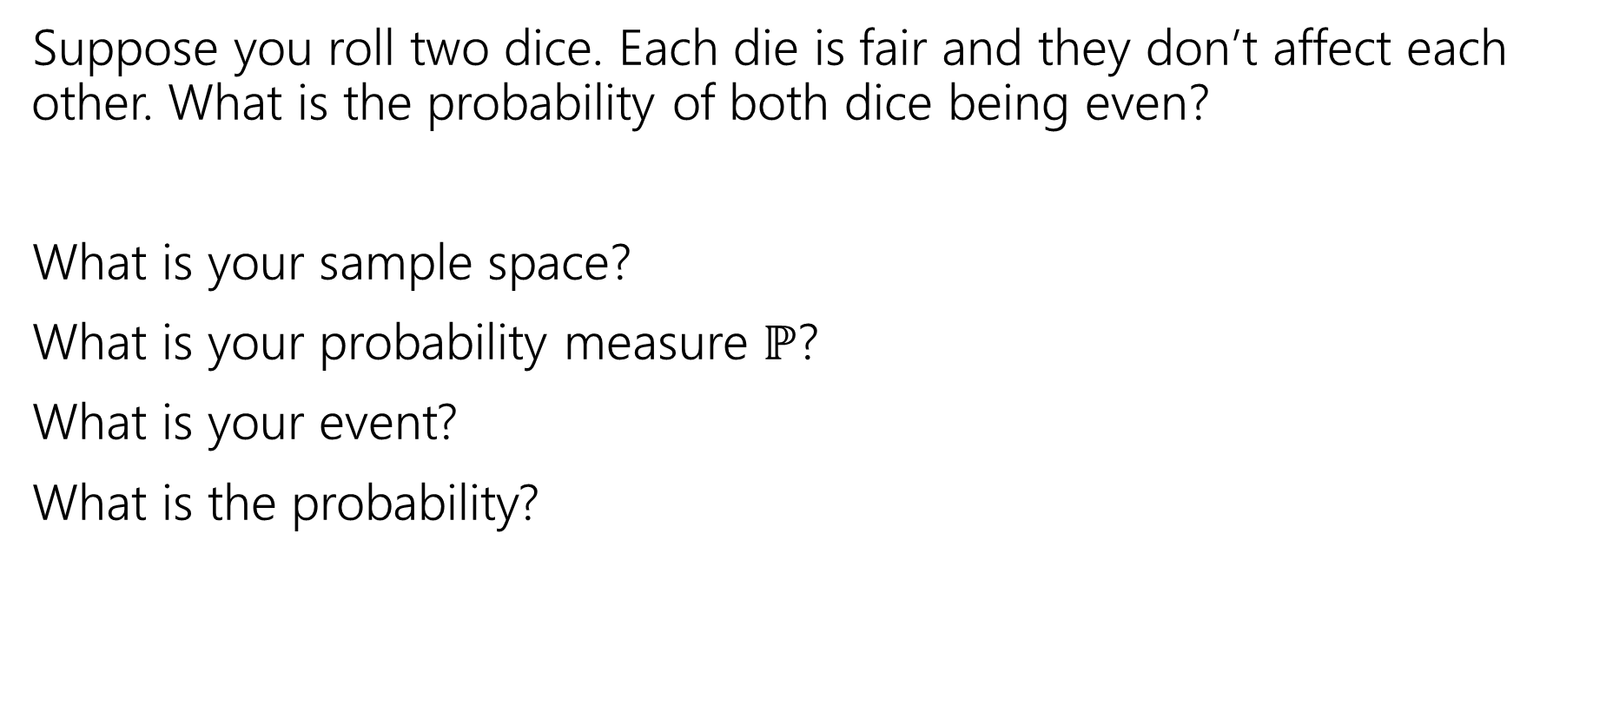
More Examples!
Suppose you roll two dice. Each die is fair and they don’t affect each other. What is the probability of both dice being even?
What is your sample space?
What is your probability measure $ℙ$?
What is your event?
What is the probability?

Slide 10
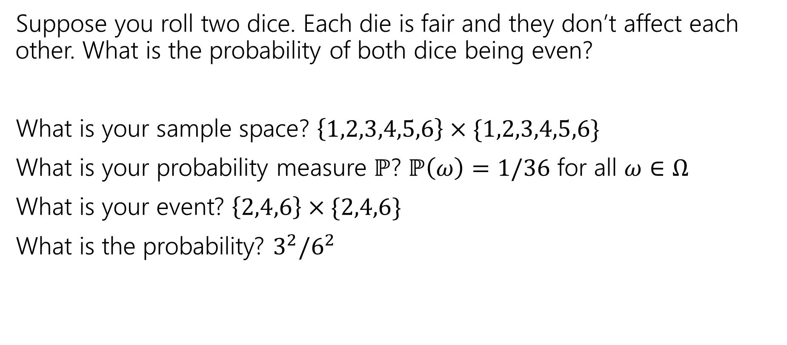
More Examples!
Suppose you roll two dice. Each die is fair and they don’t affect each other. What is the probability of both dice being even?
What is your sample space? $\left\{1,2,3,4,5,6\right\}×\{1,2,3,4,5,6\}$
What is your probability measure $ℙ$? $ℙ\left(ω\right)=1/36$ for all $ω∈Ω$
What is your event? $\left\{2,4,6\right\}×\{2,4,6\}$
What is the probability? $3^{2}/6^{2}$

Slide 11
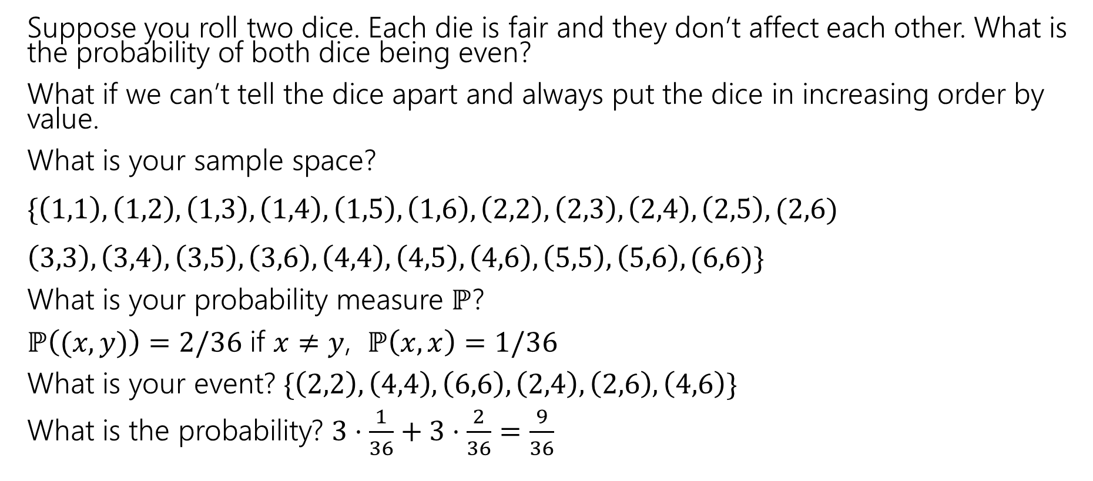
More Examples!
Suppose you roll two dice. Each die is fair and they don’t affect each other. What is the probability of both dice being even?
What if we can’t tell the dice apart and always put the dice in increasing order by value.
What is your sample space?
$\{\left(1,1\right),\left(1,2\right),\left(1,3\right),\left(1,4\right),\left(1,5\right),\left(1,6\right), \left(2,2\right),\left(2,3\right), \left(2,4\right),\left(2,5\right), (2,6)$
$\left(3,3\right),\left(3,4\right),\left(3,5\right),\left(3,6\right),\left(4,4\right),\left(4,5\right),\left(4,6\right),\left(5,5\right),\left(5,6\right), (6,6)\}$
What is your probability measure $ℙ$?
$ℙ\left((x,y)\right)=2/36$ if $x≠y$, $ℙ\left(x,x\right)=1/36$
What is your event? $\{\left(2,2\right),\left(4,4\right),\left(6,6\right), \left(2,4\right),\left(2,6\right),\left(4,6\right)\}$
What is the probability? $3⋅\frac{1}{36}+3⋅\frac{2}{36}=\frac{9}{36}$

Slide 12
Takeaways
There is often more than one sample space possible! But one is probably easier than the others.
Finding a sample space that will make the uniform measure correct will usually make finding the probabilities easier to calculate.

Slide 13
Another Example
Suppose you shuffle a deck of cards so any arrangement is equally likely. What is the probability that the top two cards have the same value?
Sample Space
Probability Measure
Event
Probability

Slide 14
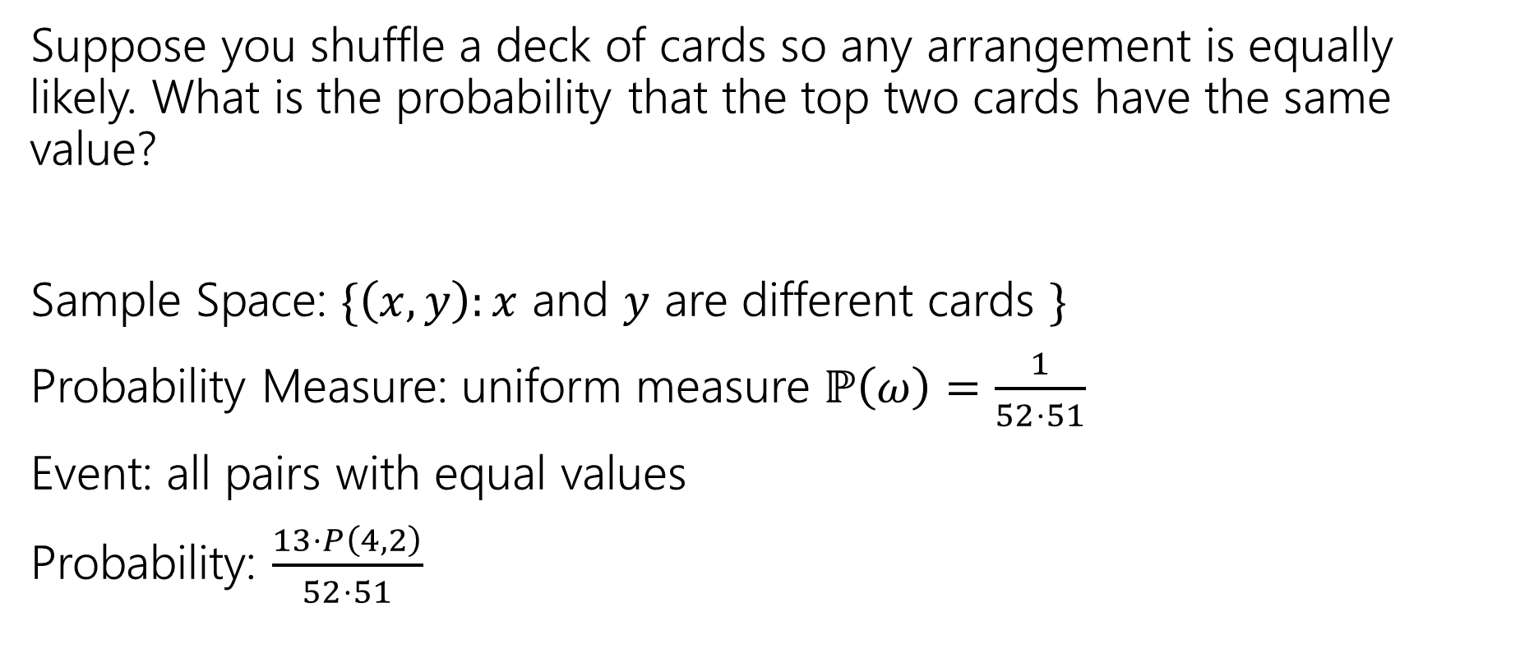
Another Example
Suppose you shuffle a deck of cards so any arrangement is equally likely. What is the probability that the top two cards have the same value?
Sample Space: $\{\left(x,y\right):x$ and $y$ are different cards $\}$
Probability Measure: uniform measure $ℙ\left(ω\right)=\frac{1}{52⋅51}$
Event: all pairs with equal values
Probability: $\frac{13⋅P\left(4,2\right)}{52⋅51}$
Notes:
You can define this with order not mattering, and that will lead to the same answer.

Slide 15
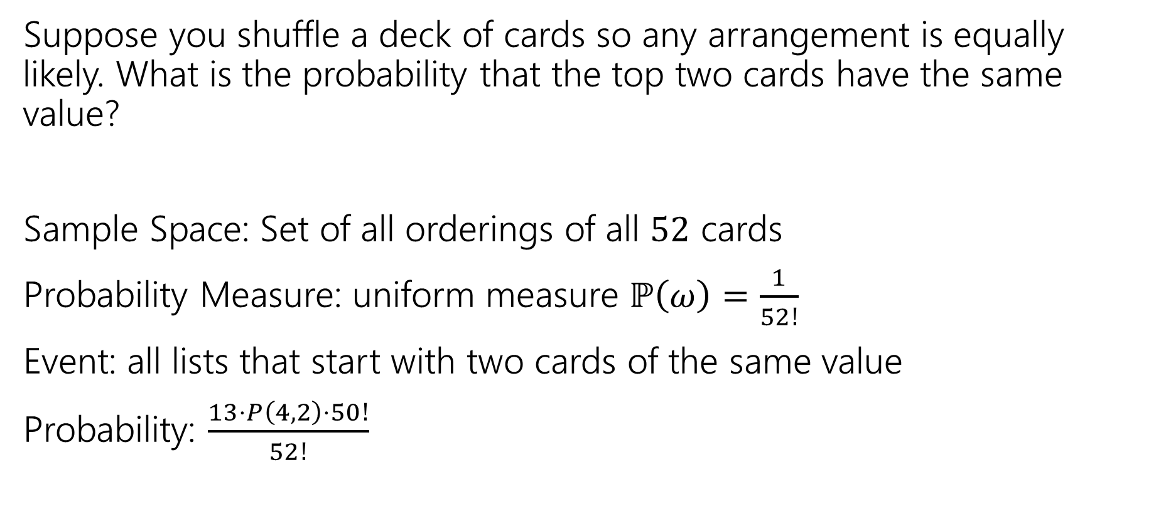
Another Example
Suppose you shuffle a deck of cards so any arrangement is equally likely. What is the probability that the top two cards have the same value?
Sample Space: Set of all orderings of all $52$ cards
Probability Measure: uniform measure $ℙ\left(ω\right)=\frac{1}{52!}$
Event: all lists that start with two cards of the same value
Probability: $\frac{13⋅P\left(4,2\right)⋅50!}{52!}$
Notes:
Here we have to define it with order mattering, because we are using the entire deck of cards.

Slide 16
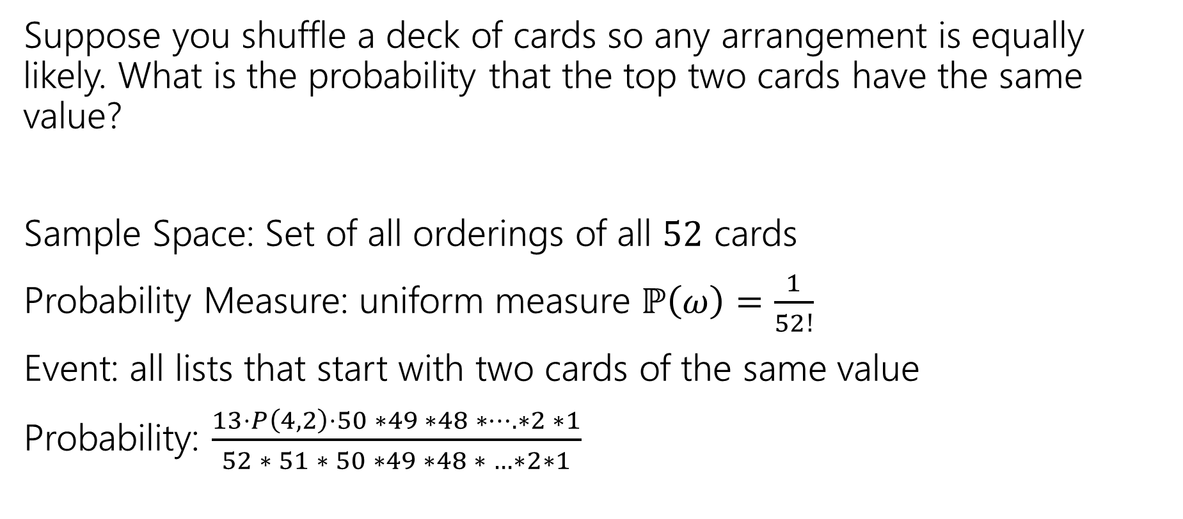
Another Example
Suppose you shuffle a deck of cards so any arrangement is equally likely. What is the probability that the top two cards have the same value?
Sample Space: Set of all orderings of all $52$ cards
Probability Measure: uniform measure $ℙ\left(ω\right)=\frac{1}{52!}$
Event: all lists that start with two cards of the same value
Probability: $\frac{13⋅P\left(4,2\right)⋅50 ∗49 ∗48 ∗…. ∗2 ∗1}{52 ∗ 51 ∗ 50 ∗49 ∗48 ∗ …∗2∗1}$
Notes:
There are multiple valid ways that you can define your sample space, just make sure that however you defined your sample space your elements in the event get counted in the same ways. If order mattered for the sample space, order should mater for the event.

Slide 17
Takeaway
There’s often information you “don’t need” in your sample space.
It won’t give you the wrong answer.
But it sometimes makes for extra work/a harder counting problem,
Good indication: you cancelled A LOT of stuff that was common in the numerator and denominator.

Slide 18
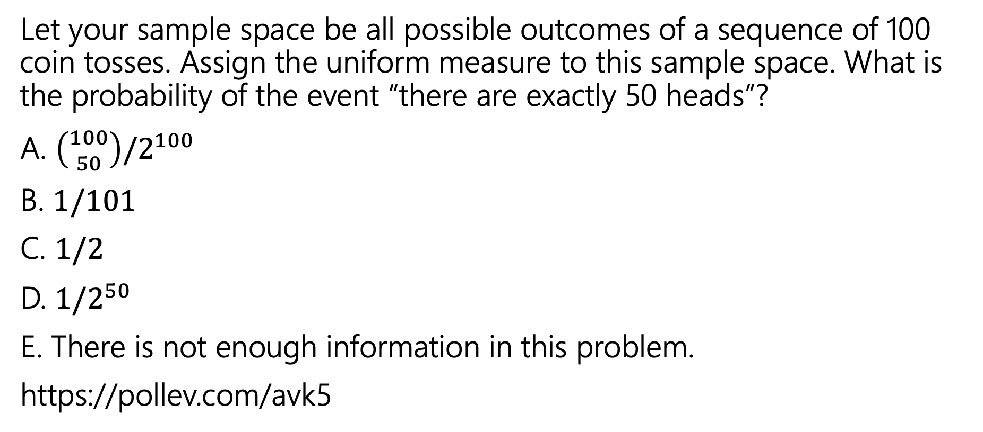
Uniform Probability Space
Let your sample space be all possible outcomes of a sequence of 100 coin tosses. Assign the uniform measure to this sample space. What is the probability of the event “there are exactly 50 heads”?
A. $\left({100 \atop 50}\right)/2^{100}$
B. $1/101$
C. $1/2$
D. $1/2^{50}$
E. There is not enough information in this problem.
https://pollev.com/avk5
Notes:
When we say that we are using the uniform probability measure we are saying that each outcome is equally likely, not every event that we define.

Slide 19
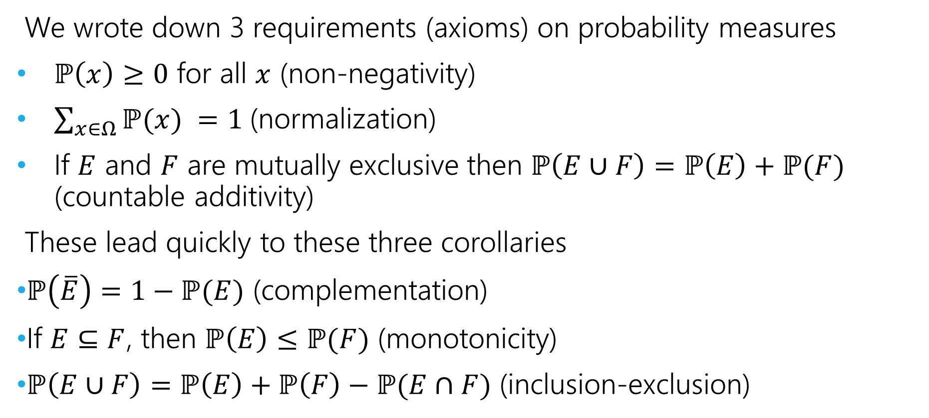
Axioms and Consequences
We wrote down 3 requirements (axioms) on probability measures
$ℙ\left(x\right)≥0$ for all $x$ (non-negativity)
$\sum_{x∈Ω}{ℙ(x)} =1$(normalization)
If $E$ and $F$ are mutually exclusive then $ℙ\left(E∪F\right)=ℙ\left(E\right)+ℙ(F)$ (countable additivity)
These lead quickly to these three corollaries
$ℙ\left(\overline{E}\right)=1−ℙ(E)$ (complementation)
If $E⊆F$, then $ℙ\left(E\right)≤ℙ(F)$ (monotonicity)
$ℙ\left(E∪F\right)=ℙ\left(E\right)+ℙ\left(F\right)−ℙ(E∩F)$ (inclusion-exclusion)
Notes:
Axioms are our starting assumptions. Corollaries or consequences can then be derived from these axioms. We can treat these as facts, and you are welcome to reference them on your homework if they would be helpful.

Slide 20

Some Quick Observations
For discrete probability spaces (the kind we’ve seen so far)
$ℙ\left(E\right)=0$ if and only if ?
$ℙ\left(E\right)=1$ if and only if ?

Slide 21

Some Quick Observations
For discrete probability spaces (the kind we’ve seen so far)
$ℙ\left(E\right)=0$ if and only if an event can’t happen.
$ℙ\left(E\right)=1$ if and only if an event is guaranteed (every outcome outside $E$has probability $0$).

Slide 22
Conditional Probabilities

Slide 23
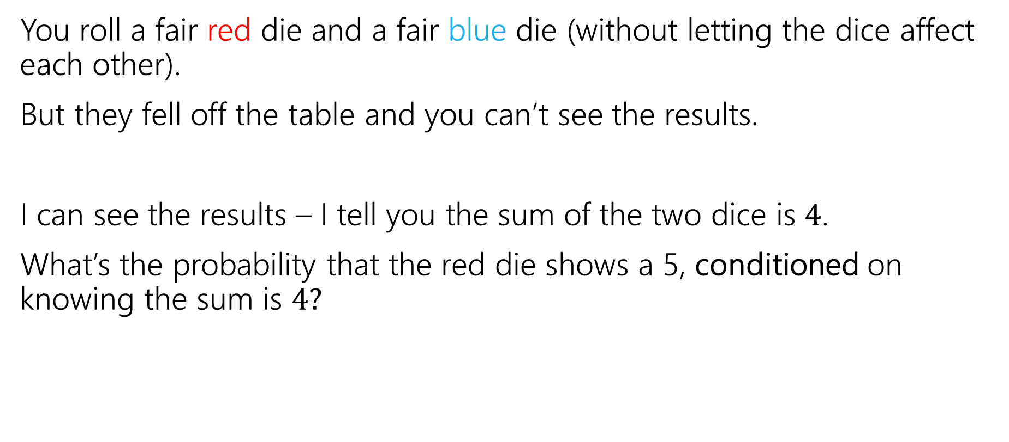
Conditioning
You roll a fair red die and a fair blue die (without letting the dice affect each other).
But they fell off the table and you can’t see the results.
I can see the results – I tell you the sum of the two dice is $4$.
What’s the probability that the red die shows a 5, conditioned on knowing the sum is $4?$
Notes:
Conditional probability is when we were given access to more information than we had originally.

Slide 24
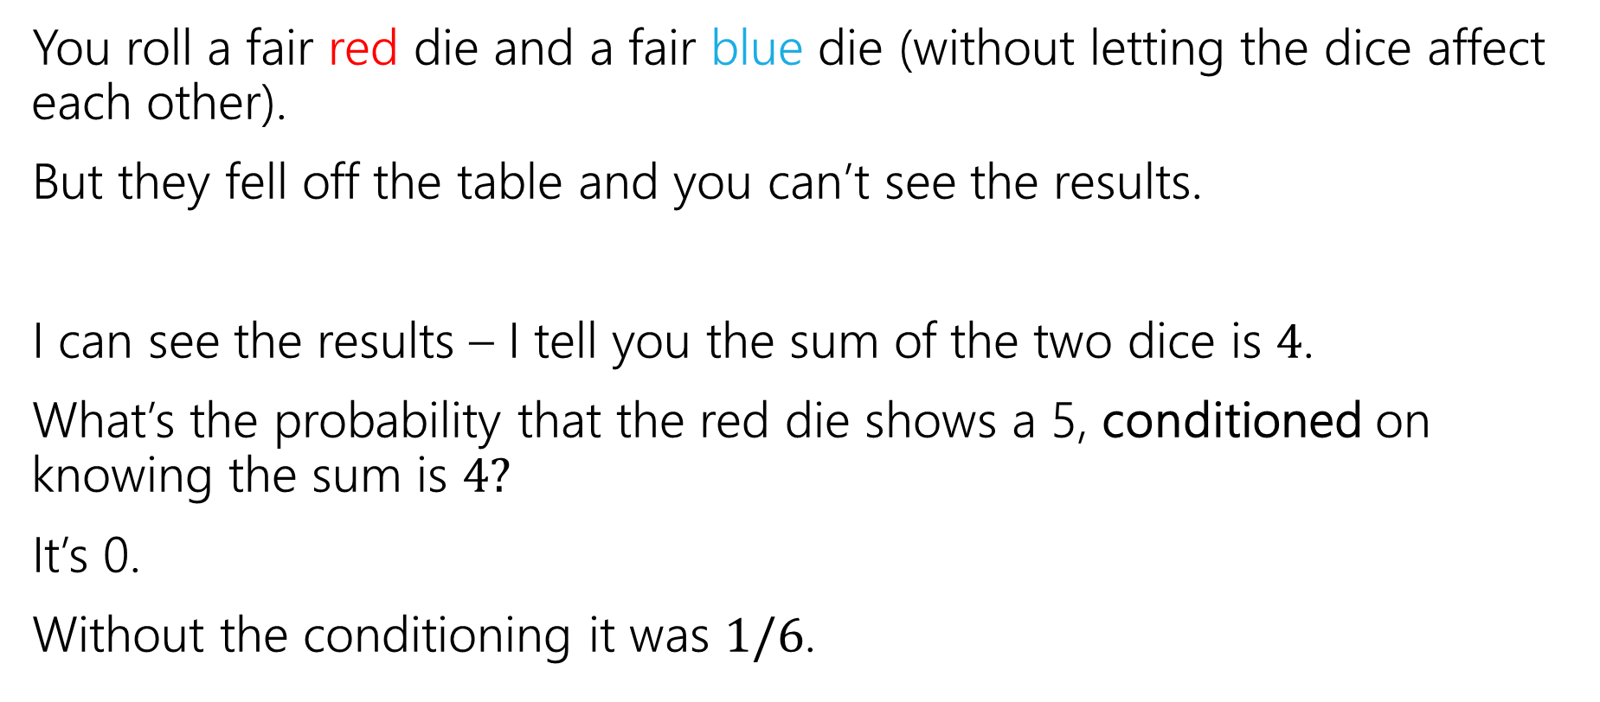
Conditioning
You roll a fair red die and a fair blue die (without letting the dice affect each other).
But they fell off the table and you can’t see the results.
I can see the results – I tell you the sum of the two dice is $4$.
What’s the probability that the red die shows a 5, conditioned on knowing the sum is $4?$
It’s 0.
Without the conditioning it was $1/6$.

Slide 25
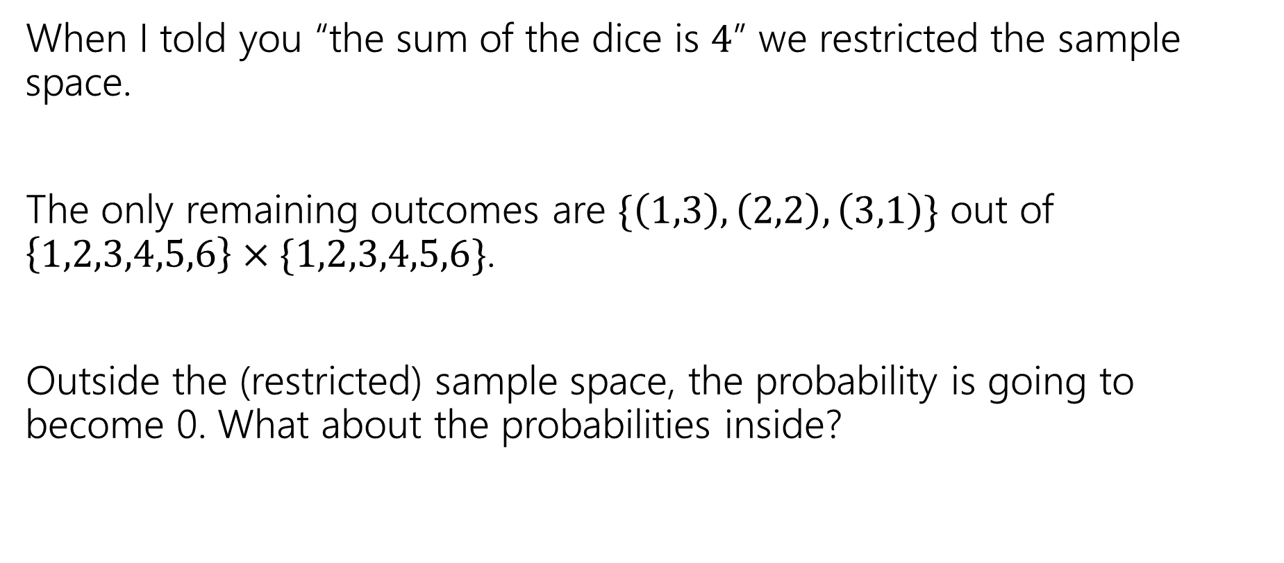
Conditioning
When I told you “the sum of the dice is $4$” we restricted the sample space.
The only remaining outcomes are $\{\left(1,3\right), \left(2,2\right), \left(3,1\right)\}$ out of $\left\{1,2,3,4,5,6\right\}×\{1,2,3,4,5,6\}$.
Outside the (restricted) sample space, the probability is going to become 0. What about the probabilities inside?

Slide 26
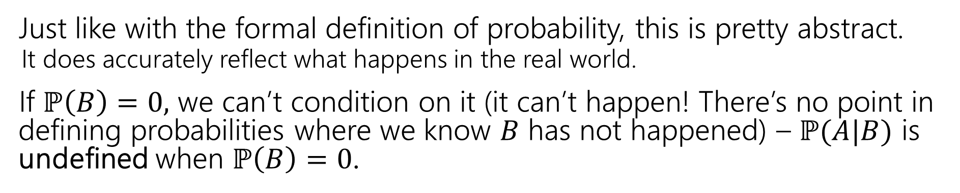

Conditional Probability
For an event $B$, with $ℙ\left(B\right)>0,$
$t$he “Probability of $A$ conditioned on $B$” is
$$ℙ\left(A | B\right)=\frac{ℙ\left(A∩B\right)}{ℙ\left(B\right)}$$
Conditional Probability
Just like with the formal definition of probability, this is pretty abstract.
It does accurately reflect what happens in the real world.
If $ℙ\left(B\right)=0,$ we can’t condition on it (it can’t happen! There’s no point in defining probabilities where we know $B$ has not happened) – $ℙ(A|B)$ is undefined when $ℙ\left(B\right)=0$.
Notes:
Some intuition for this formula. We are restricting out sample space, it is no longer our full sample space it is just outcomes in B, so we are in a way renormalizing by divining by the probability of B. Then the question is what is the probability of A happening in this new universe. For A to happen B must also happen, so we look for the probability of A intersect B.

Slide 27
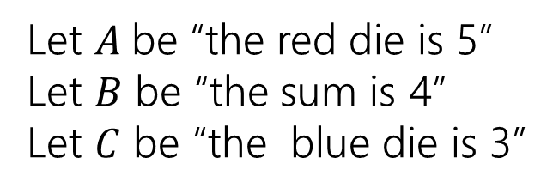
Conditioning…
 | D2=1 | D2=2 | D2=3 | D2=4 | D2=5 | D2=6
D1=1 | (1,1) | (1,2) | (1,3) | (1,4) | (1,5) | (1.6)
D1=2 | (2,1) | (2,2) | (2,3) | (2,4) | (2,5) | (2,6)
D1=3 | (3,1) | (3,2) | (3,3) | (3,4) | (3,5) | (3,6)
D1=4 | (4,1) | (4,2) | (4,3) | (4,4) | (4,5) | (4,6)
D1=5 | (5,1) | (5,2) | (5,3) | (5,4) | (5,5) | (5,6)
D1=6 | (6,1) | (6,2) | (6,3) | (6,4) | (6,5) | (6,6)
Let $A$be “the red die is 5”
Let $B$ be “the sum is 4”
Let $C$ be “the blue die is 3”

Slide 28
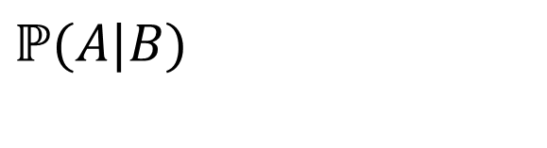
Conditioning…
 | D2=1 | D2=2 | D2=3 | D2=4 | D2=5 | D2=6
D1=1 | (1,1) | (1,2) | (1,3) | (1,4) | (1,5) | (1.6)
D1=2 | (2,1) | (2,2) | (2,3) | (2,4) | (2,5) | (2,6)
D1=3 | (3,1) | (3,2) | (3,3) | (3,4) | (3,5) | (3,6)
D1=4 | (4,1) | (4,2) | (4,3) | (4,4) | (4,5) | (4,6)
D1=5 | (5,1) | (5,2) | (5,3) | (5,4) | (5,5) | (5,6)
D1=6 | (6,1) | (6,2) | (6,3) | (6,4) | (6,5) | (6,6)
Let $A$be “the red die is 5”
Let $B$ be “the sum is 4”
Let $C$ be “the blue die is 3”
$$ℙ(A|B)$$

Slide 29
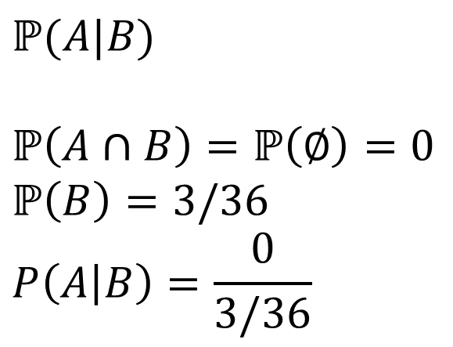
Conditioning…
 | D2=1 | D2=2 | D2=3 | D2=4 | D2=5 | D2=6
D1=1 | (1,1) | (1,2) | (1,3) | (1,4) | (1,5) | (1.6)
D1=2 | (2,1) | (2,2) | (2,3) | (2,4) | (2,5) | (2,6)
D1=3 | (3,1) | (3,2) | (3,3) | (3,4) | (3,5) | (3,6)
D1=4 | (4,1) | (4,2) | (4,3) | (4,4) | (4,5) | (4,6)
D1=5 | (5,1) | (5,2) | (5,3) | (5,4) | (5,5) | (5,6)
D1=6 | (6,1) | (6,2) | (6,3) | (6,4) | (6,5) | (6,6)
Let $A$be “the red die is 5”
Let $B$ be “the sum is 4”
Let $C$ be “the blue die is 3”
$$ℙ(A|B)$$
$$ℙ\left(A∩B\right)=ℙ\left(∅\right)=0$$
$$ℙ\left(B\right)=3/36$$
$$P\left(A | B\right)=\frac{0}{3/36}$$

Slide 30
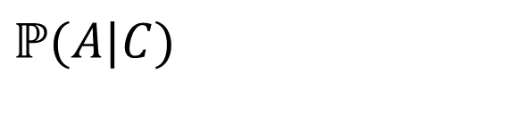
Conditioning…
 | D2=1 | D2=2 | D2=3 | D2=4 | D2=5 | D2=6
D1=1 | (1,1) | (1,2) | (1,3) | (1,4) | (1,5) | (1.6)
D1=2 | (2,1) | (2,2) | (2,3) | (2,4) | (2,5) | (2,6)
D1=3 | (3,1) | (3,2) | (3,3) | (3,4) | (3,5) | (3,6)
D1=4 | (4,1) | (4,2) | (4,3) | (4,4) | (4,5) | (4,6)
D1=5 | (5,1) | (5,2) | (5,3) | (5,4) | (5,5) | (5,6)
D1=6 | (6,1) | (6,2) | (6,3) | (6,4) | (6,5) | (6,6)
Let $A$be “the red die is 5”
Let $B$ be “the sum is 4”
Let $C$ be “the blue die is 3”
$$ℙ(A|C)$$

Slide 31
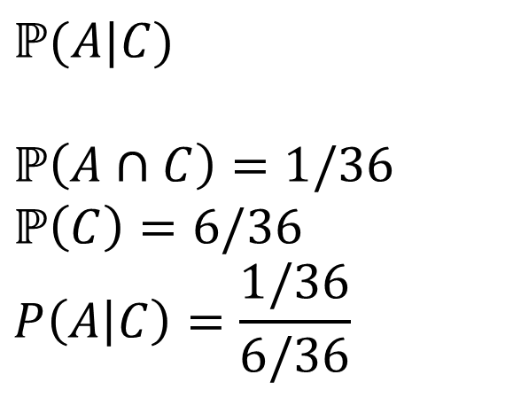
Conditioning…
 | D2=1 | D2=2 | D2=3 | D2=4 | D2=5 | D2=6
D1=1 | (1,1) | (1,2) | (1,3) | (1,4) | (1,5) | (1.6)
D1=2 | (2,1) | (2,2) | (2,3) | (2,4) | (2,5) | (2,6)
D1=3 | (3,1) | (3,2) | (3,3) | (3,4) | (3,5) | (3,6)
D1=4 | (4,1) | (4,2) | (4,3) | (4,4) | (4,5) | (4,6)
D1=5 | (5,1) | (5,2) | (5,3) | (5,4) | (5,5) | (5,6)
D1=6 | (6,1) | (6,2) | (6,3) | (6,4) | (6,5) | (6,6)
Let $A$be “the red die is 5”
Let $B$ be “the sum is 4”
Let $C$ be “the blue die is 3”
$$ℙ(A|C)$$
$$ℙ\left(A∩C\right)=1/36$$
$$ℙ\left(C\right)=6/36$$
$$P\left(A | C\right)=\frac{1/36}{6/36}$$

Slide 32
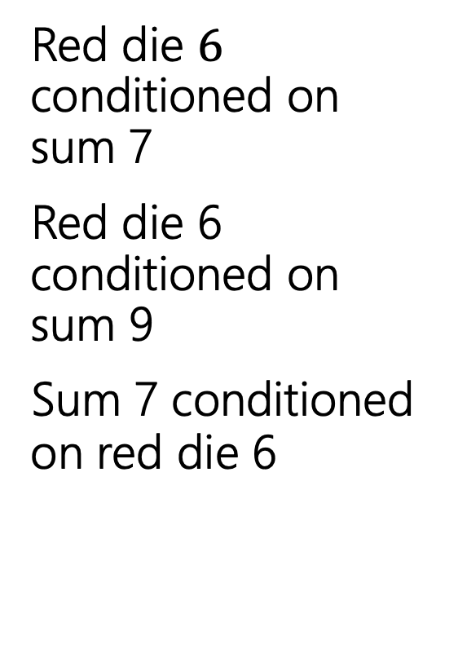
Conditioning Practice
Red die $6$ conditioned on sum 7
Red die 6 conditioned on sum 9
Sum 7 conditioned on red die 6
 | D2=1 | D2=2 | D2=3 | D2=4 | D2=5 | D2=6
D1=1 | (1,1) | (1,2) | (1,3) | (1,4) | (1,5) | (1.6)
D1=2 | (2,1) | (2,2) | (2,3) | (2,4) | (2,5) | (2,6)
D1=3 | (3,1) | (3,2) | (3,3) | (3,4) | (3,5) | (3,6)
D1=4 | (4,1) | (4,2) | (4,3) | (4,4) | (4,5) | (4,6)
D1=5 | (5,1) | (5,2) | (5,3) | (5,4) | (5,5) | (5,6)
D1=6 | (6,1) | (6,2) | (6,3) | (6,4) | (6,5) | (6,6)

Slide 33
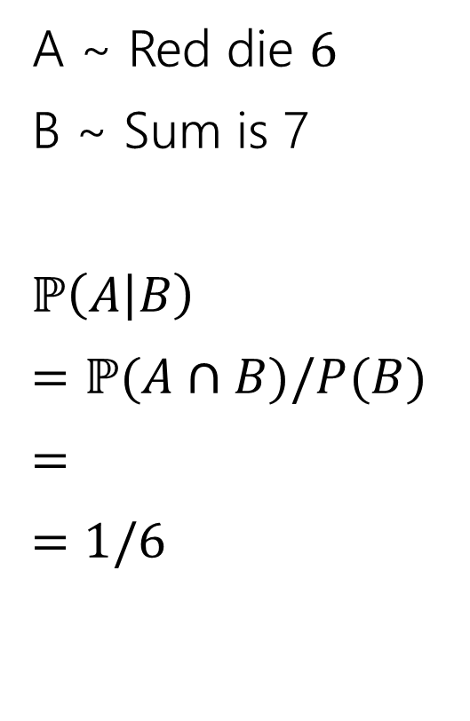
Conditioning Practice
A ~ Red die $6$
B ~ Sum is 7
$ℙ\left(A | B\right)$
$=ℙ(A∩B)/P(B)$
$=$
$=$ $1/6$
 | D2=1 | D2=2 | D2=3 | D2=4 | D2=5 | D2=6
D1=1 | (1,1) | (1,2) | (1,3) | (1,4) | (1,5) | (1.6)
D1=2 | (2,1) | (2,2) | (2,3) | (2,4) | (2,5) | (2,6)
D1=3 | (3,1) | (3,2) | (3,3) | (3,4) | (3,5) | (3,6)
D1=4 | (4,1) | (4,2) | (4,3) | (4,4) | (4,5) | (4,6)
D1=5 | (5,1) | (5,2) | (5,3) | (5,4) | (5,5) | (5,6)
D1=6 | (6,1) | (6,2) | (6,3) | (6,4) | (6,5) | (6,6)

Slide 34
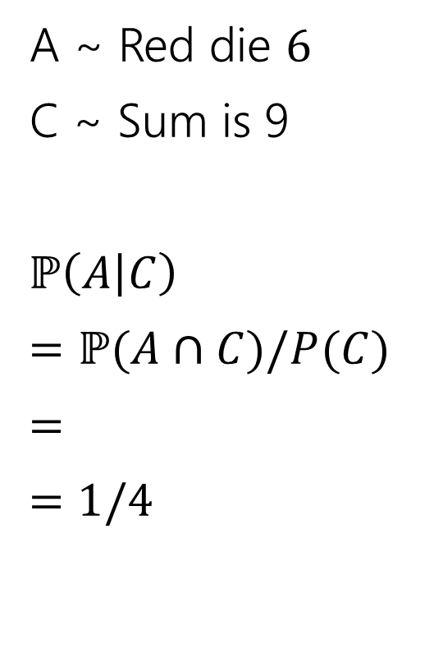
Conditioning Practice
A ~ Red die $6$
C ~ Sum is 9
$ℙ\left(A | C\right)$
$=ℙ(A∩C)/P(C)$
$=$
$=$ $1/4$
 | D2=1 | D2=2 | D2=3 | D2=4 | D2=5 | D2=6
D1=1 | (1,1) | (1,2) | (1,3) | (1,4) | (1,5) | (1.6)
D1=2 | (2,1) | (2,2) | (2,3) | (2,4) | (2,5) | (2,6)
D1=3 | (3,1) | (3,2) | (3,3) | (3,4) | (3,5) | (3,6)
D1=4 | (4,1) | (4,2) | (4,3) | (4,4) | (4,5) | (4,6)
D1=5 | (5,1) | (5,2) | (5,3) | (5,4) | (5,5) | (5,6)
D1=6 | (6,1) | (6,2) | (6,3) | (6,4) | (6,5) | (6,6)

Slide 35
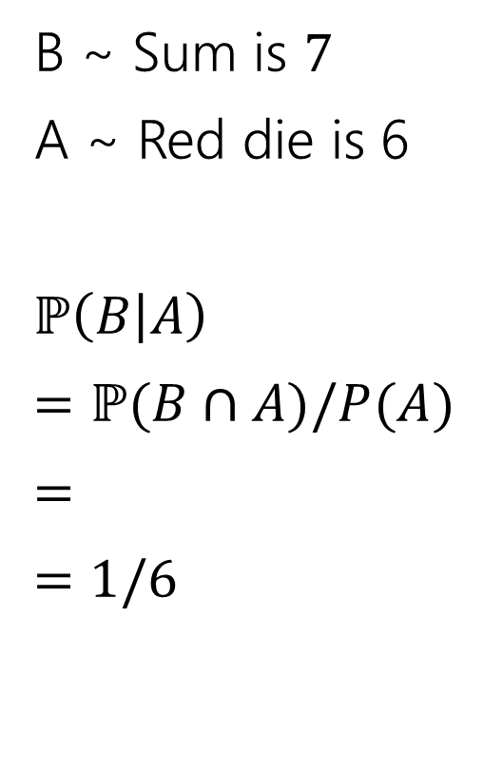
Conditioning Practice
B ~ Sum is $7$
A ~ Red die is 6
$ℙ\left(B | A\right)$
$=ℙ(B∩A)/P(A)$
$=$
$=$ $1/6$
 | D2=1 | D2=2 | D2=3 | D2=4 | D2=5 | D2=6
D1=1 | (1,1) | (1,2) | (1,3) | (1,4) | (1,5) | (1.6)
D1=2 | (2,1) | (2,2) | (2,3) | (2,4) | (2,5) | (2,6)
D1=3 | (3,1) | (3,2) | (3,3) | (3,4) | (3,5) | (3,6)
D1=4 | (4,1) | (4,2) | (4,3) | (4,4) | (4,5) | (4,6)
D1=5 | (5,1) | (5,2) | (5,3) | (5,4) | (5,5) | (5,6)
D1=6 | (6,1) | (6,2) | (6,3) | (6,4) | (6,5) | (6,6)

Slide 36
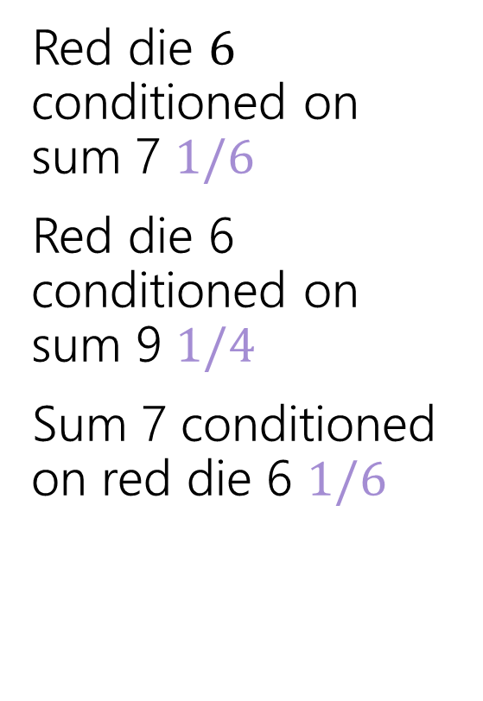
Conditioning Practice
Red die $6$ conditioned on sum 7 $1/6$
Red die 6 conditioned on sum 9 $1/4$
Sum 7 conditioned on red die 6 $1/6$
 | D2=1 | D2=2 | D2=3 | D2=4 | D2=5 | D2=6
D1=1 | (1,1) | (1,2) | (1,3) | (1,4) | (1,5) | (1.6)
D1=2 | (2,1) | (2,2) | (2,3) | (2,4) | (2,5) | (2,6)
D1=3 | (3,1) | (3,2) | (3,3) | (3,4) | (3,5) | (3,6)
D1=4 | (4,1) | (4,2) | (4,3) | (4,4) | (4,5) | (4,6)
D1=5 | (5,1) | (5,2) | (5,3) | (5,4) | (5,5) | (5,6)
D1=6 | (6,1) | (6,2) | (6,3) | (6,4) | (6,5) | (6,6)

Slide 37

Direction Matters
Are $ℙ(A|B)$ and $ℙ(B|A)$ the same?

Slide 38
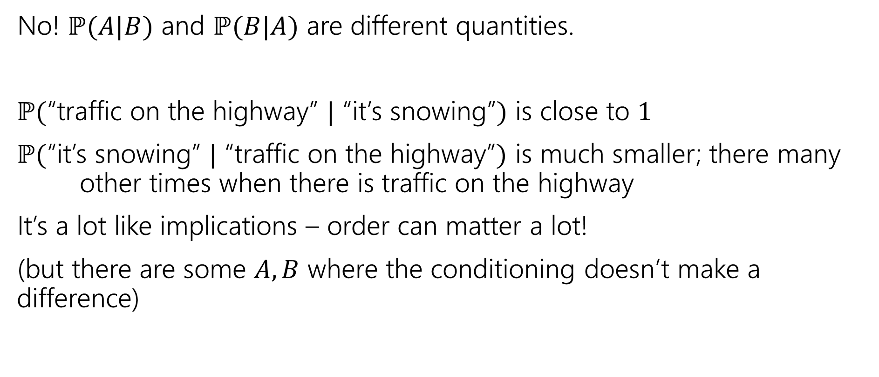
Direction Matters
No! $ℙ(A|B)$ and $ℙ(B|A)$ are different quantities.
$ℙ($“traffic on the highway” $|$ “it’s snowing”$)$ is close to $1$
$ℙ($“it’s snowing” $|$ “traffic on the highway”$)$ is much smaller; there many other times when there is traffic on the highway
It’s a lot like implications – order can matter a lot!
(but there are some $A,B$ where the conditioning doesn’t make a difference)

