Slide 1
Wrap Up Counting
Probability Definitions
CSE 312 Summer 25
Lecture 4

Slide 2
Outline
Today
Counting Practice
Formal Definitions of Probability

Slide 3
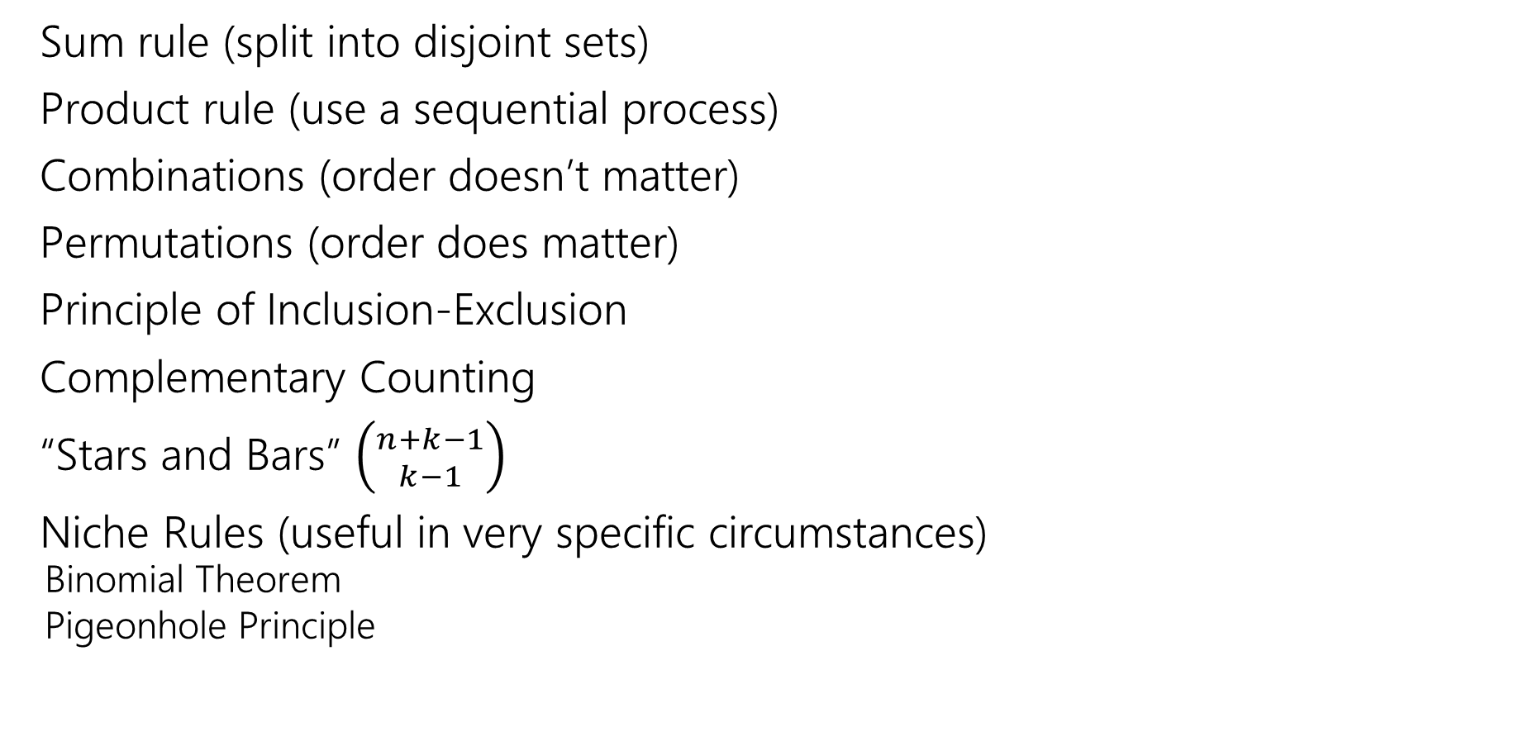
We’ve seen lots of ways to count
Sum rule (split into disjoint sets)
Product rule (use a sequential process)
Combinations (order doesn’t matter)
Permutations (order does matter)
Principle of Inclusion-Exclusion
Complementary Counting
“Stars and Bars” $\left({n+k−1 \atop k−1}\right)$
Niche Rules (useful in very specific circumstances)
  Binomial Theorem
  Pigeonhole Principle

Slide 4
Extra Practice

Slide 5
Cards
A “standard” deck of cards has 52 cards. Each card has a suit
  diamonds ️♦,
  hearts ♥️,
  clubs ♧,
  spades ♠️
and a value (Ace,2,3,4,5,6,7,8,9,10,Jack,Queen, King).
A “5-card-hand” is a set of 5 cards
How many five-card “flushes” are there? – a flush is a hand of cards all of the same suit.
Notes:
Value is sometimes referred to as rank.

Slide 6

Cards
How many five-card “flushes” are there? – a flush is a hand of cards all of the same suit.
Way 1: How can I describe a flush? Which suit it is, and which values:
$\left({4 \atop 1}\right)⋅\left({13 \atop 5}\right)$

Slide 7
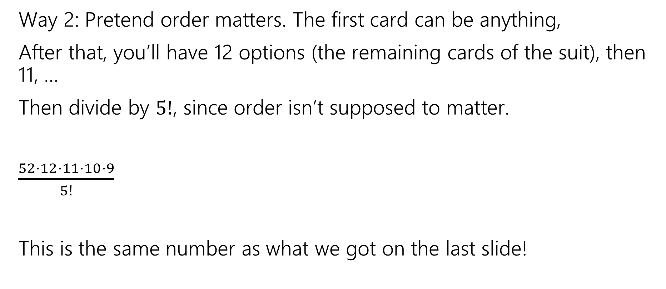
Cards
Way 2: Pretend order matters. The first card can be anything,
After that, you’ll have 12 options (the remaining cards of the suit), then 11, …
Then divide by $5!$, since order isn’t supposed to matter.
$\frac{52⋅12⋅11⋅10⋅9}{5!}$
This is the same number as what we got on the last slide!

Slide 8
Fixing The Overcounting

Slide 9
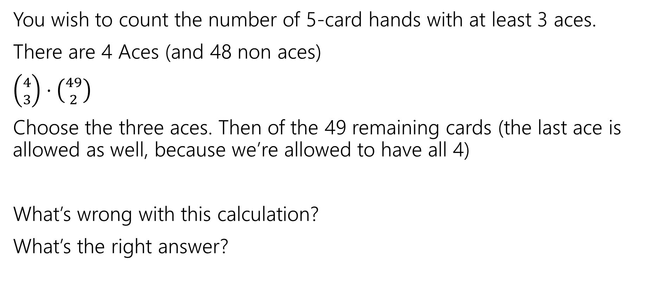
A Solution with a Problem
You wish to count the number of 5-card hands with at least 3 aces.
There are 4 Aces (and 48 non aces)
$\left({4 \atop 3}\right)⋅\left({49 \atop 2}\right)$
Choose the three aces. Then of the 49 remaining cards (the last ace is allowed as well, because we’re allowed to have all 4)
What’s wrong with this calculation?
What’s the right answer?

Slide 10
A Solution with a Problem
For a hand, there should be exactly one set of choices in the sequential process that gets us there.
{A♧, A♠️, A♦️} {A♥️, K ♠️}
And
{A♧, A♠️, A♥️}, {A♦️, K ♠️}
Are two different choices of the process, but they lead to the same hand!

Slide 11
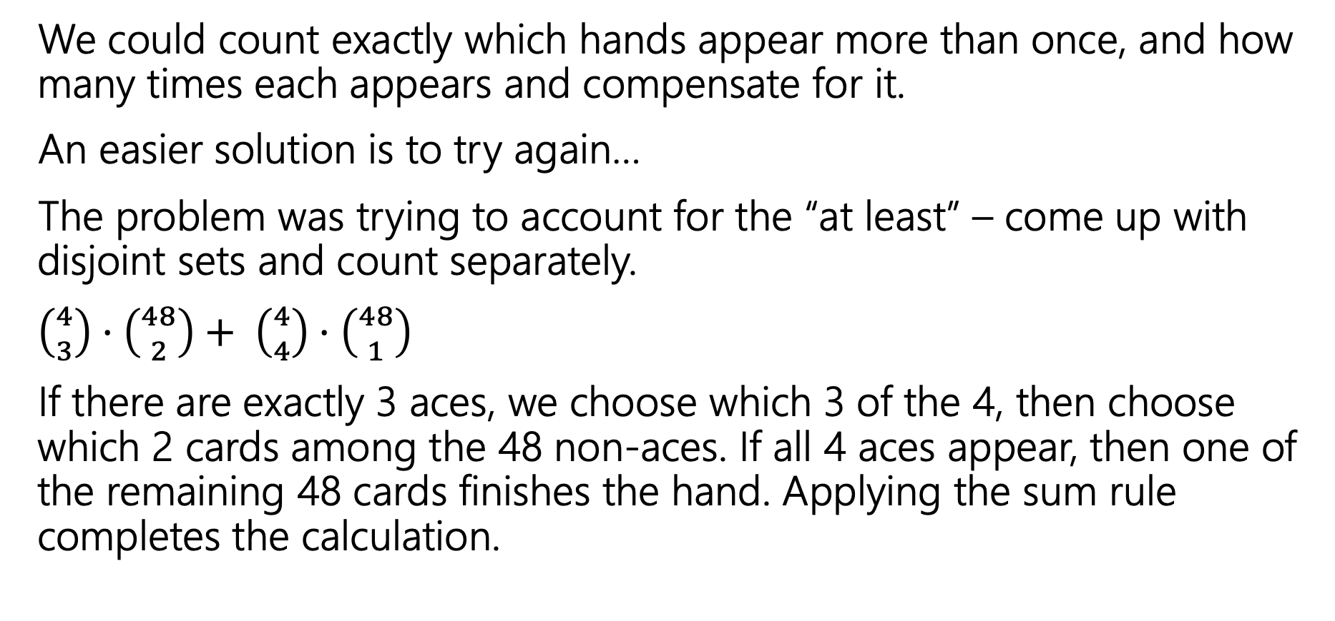
A Solution with a Problem
We could count exactly which hands appear more than once, and how many times each appears and compensate for it.
An easier solution is to try again…
The problem was trying to account for the “at least” – come up with disjoint sets and count separately.
$\left({4 \atop 3}\right)⋅\left({48 \atop 2}\right)+ \left({4 \atop 4}\right)⋅\left({48 \atop 1}\right)$
If there are exactly 3 aces, we choose which 3 of the 4, then choose which 2 cards among the 48 non-aces. If all 4 aces appear, then one of the remaining 48 cards finishes the hand. Applying the sum rule completes the calculation.
Notes:
When you have a problem like this, you want to avoid allowing yourself to have multiple attempts of the same card, You don’t want to have an ace be part of the 4 and then also part of the 49.

Slide 12
When do we overcount?
If there are exactly 4 Aces in the hand, then we count the hand 4 different times (once for each ace as an “extra” one:
{A♧, A♠️, A♦️}, {A♥️, ?}
{A♧, A♠️, A♥️}, {A♦️, ?}
{A♧, A♥️, A♦️}, {A♠️, ?}
{A♥️, A♠️, A♦️}, {A♧, ?}
Notes:
We cant just divide out the over counting since some hands are counted exactly once, but others are counted 4 times.

Slide 13
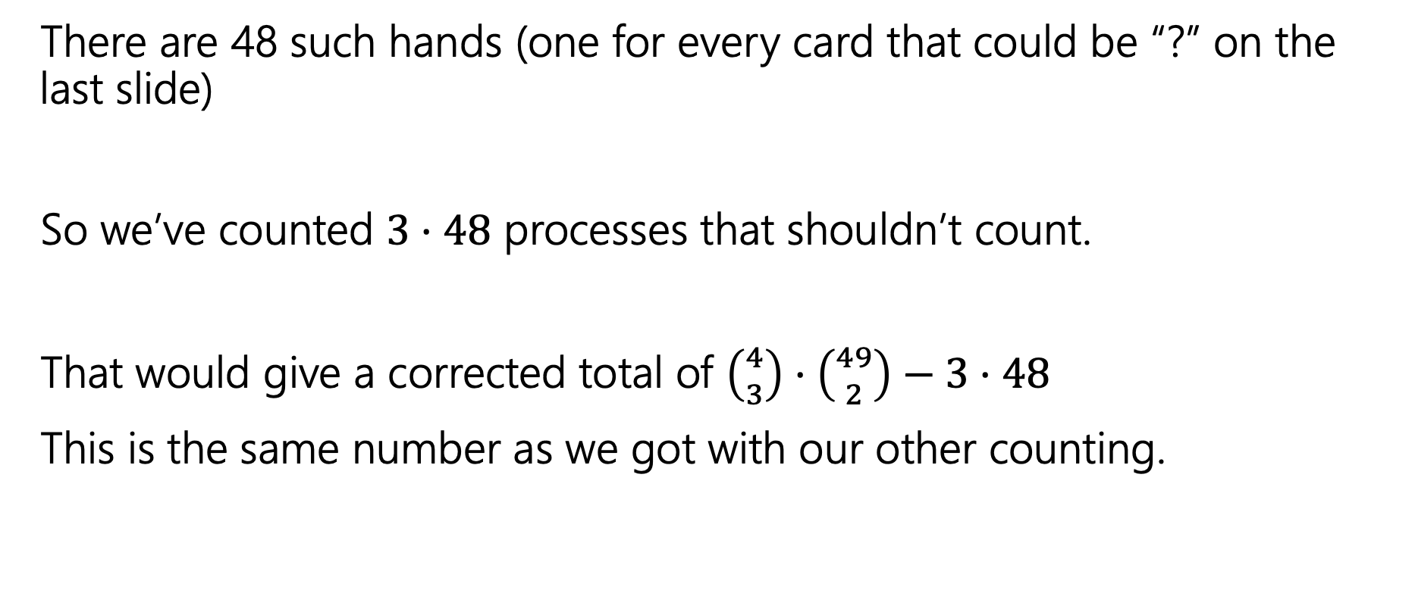
How much do we overcount?
There are 48 such hands (one for every card that could be “?” on the last slide)
So we’ve counted $3⋅48$ processes that shouldn’t count.
That would give a corrected total of $\left({4 \atop 3}\right)⋅\left({49 \atop 2}\right)−3⋅48$
This is the same number as we got with our other counting.

Slide 14
Takeaway
It’s hard to count sets where one of the conditions is “at least X”
You usually need to break those conditions up into disjoint sets and use the sum rule.

Slide 15
Another Problem
You have to choose 8 pieces of fruit. There are apples, oranges, and bananas.
You need to pick at most 2 apples and at least 1 banana. How many sets of fruit can you choose?

Slide 16
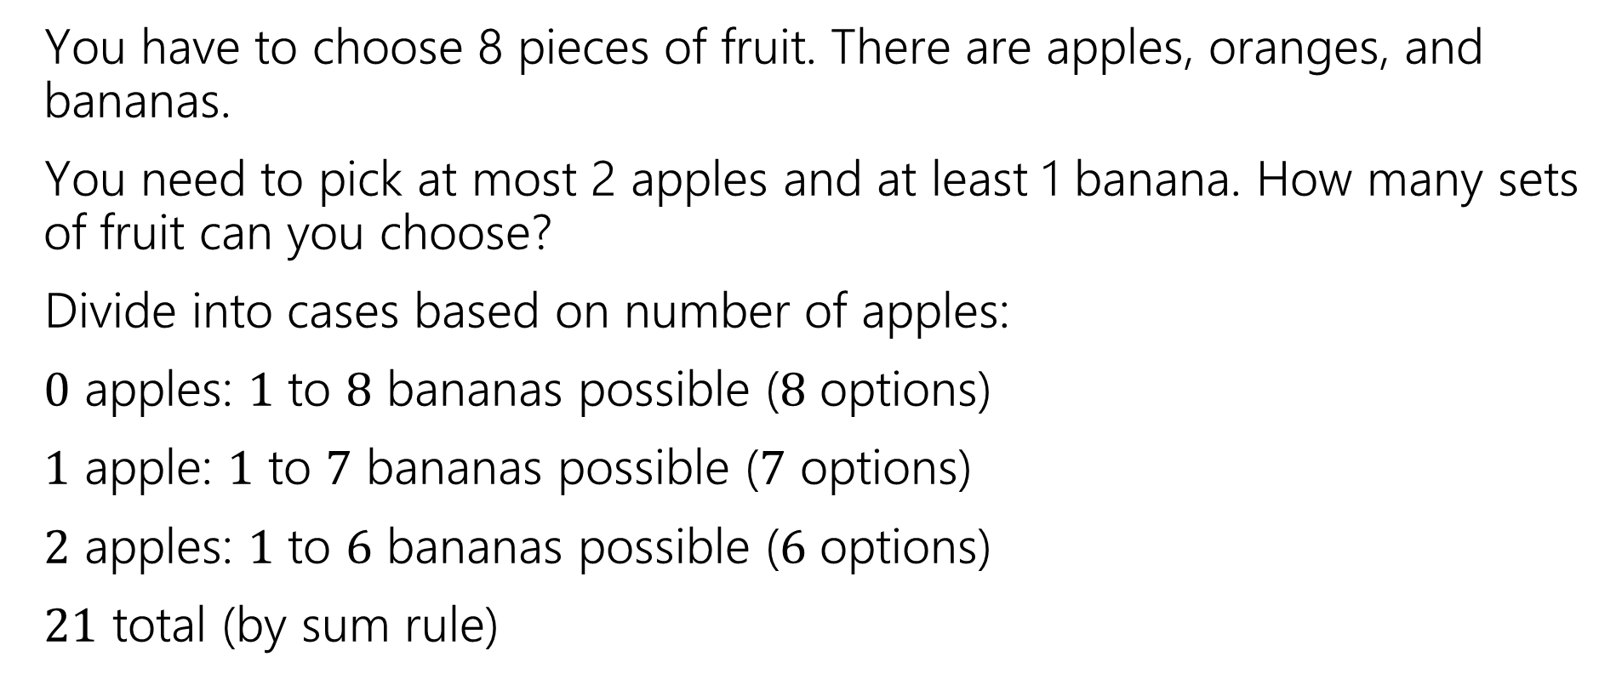
Another Problem
You have to choose 8 pieces of fruit. There are apples, oranges, and bananas.
You need to pick at most 2 apples and at least 1 banana. How many sets of fruit can you choose?
Divide into cases based on number of apples:
$0$ apples: $1$ to $8$ bananas possible ($8$ options)
$1$ apple: $1$ to $7$ bananas possible ($7$ options)
$2$ apples: $1$ to $6$ bananas possible ($6$ options)
$21$ total (by sum rule)
Notes:
If we don’t look at the extra condition, what tool might we want to use?

Slide 17
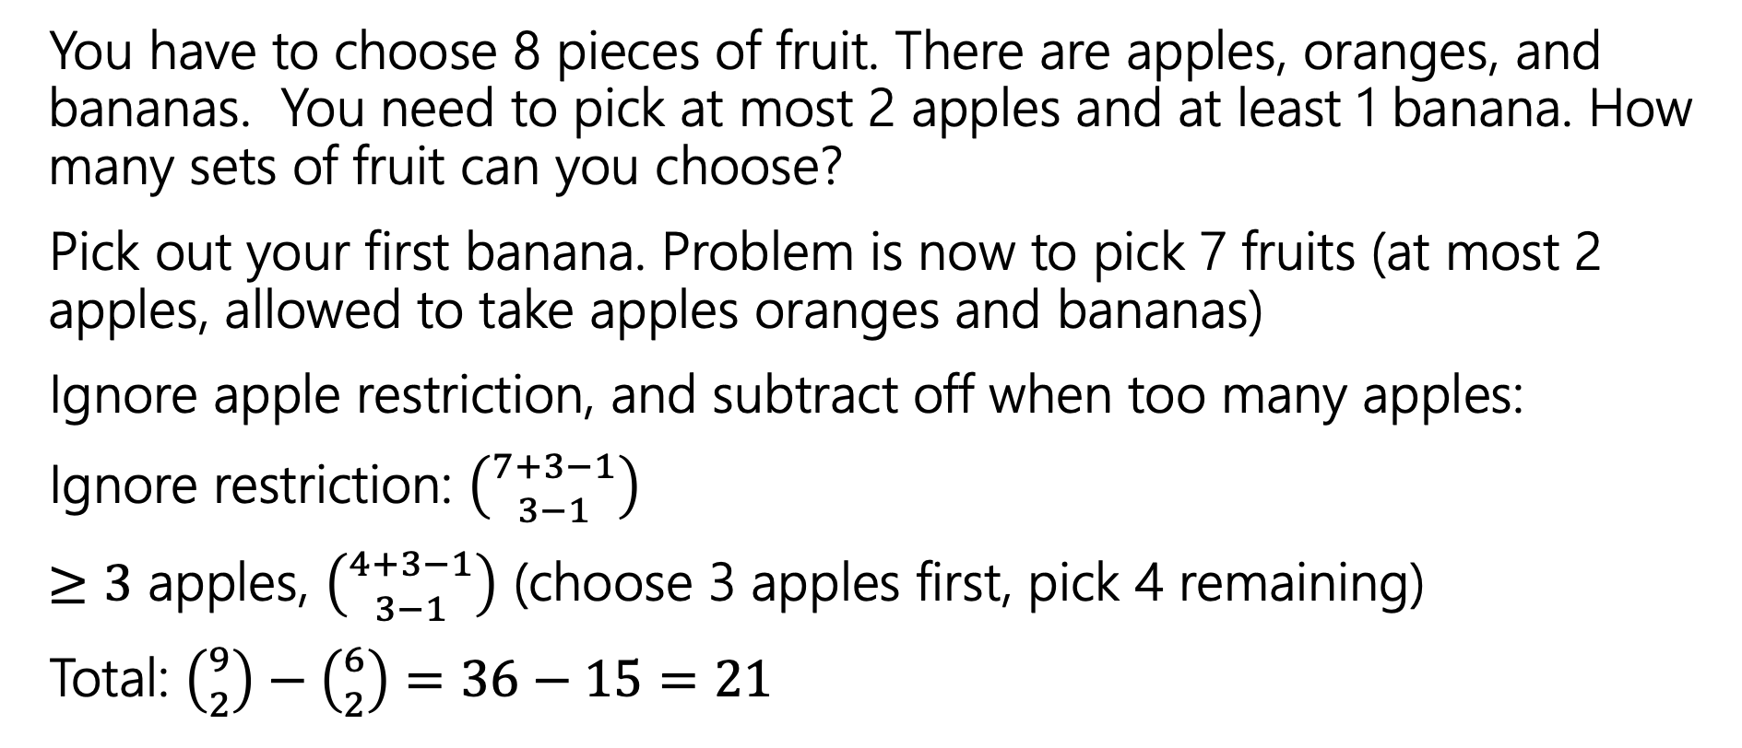
Another Problem
You have to choose 8 pieces of fruit. There are apples, oranges, and bananas. You need to pick at most 2 apples and at least 1 banana. How many sets of fruit can you choose?
Pick out your first banana. Problem is now to pick 7 fruits (at most 2 apples, allowed to take apples oranges and bananas)
Ignore apple restriction, and subtract off when too many apples:
Ignore restriction: $\left({7+3−1 \atop 3−1}\right)$
$≥3$ apples, $\left({4+3−1 \atop 3−1}\right)$ (choose 3 apples first, pick 4 remaining)
Total: $\left({9 \atop 2}\right)−\left({6 \atop 2}\right)=36−15=21$
Notes:
This approach works better for larger numbers because the number of cases would be too large.

Slide 18
Takeaways
For stars and bars style problems with “twists”, it sometimes helps to “just throw the first few in the box” to get a problem that is exactly in the stars and bars framework.
When you can do a problem two very different ways and get the same answer, you get much more confident in the answer.

Slide 19
Practice
How do we know which rule to apply?
With practice you can pick out patterns for which ones might be plausible.
But if as you’re working you realize things are getting out of control, put it aside and try something different.

Slide 20
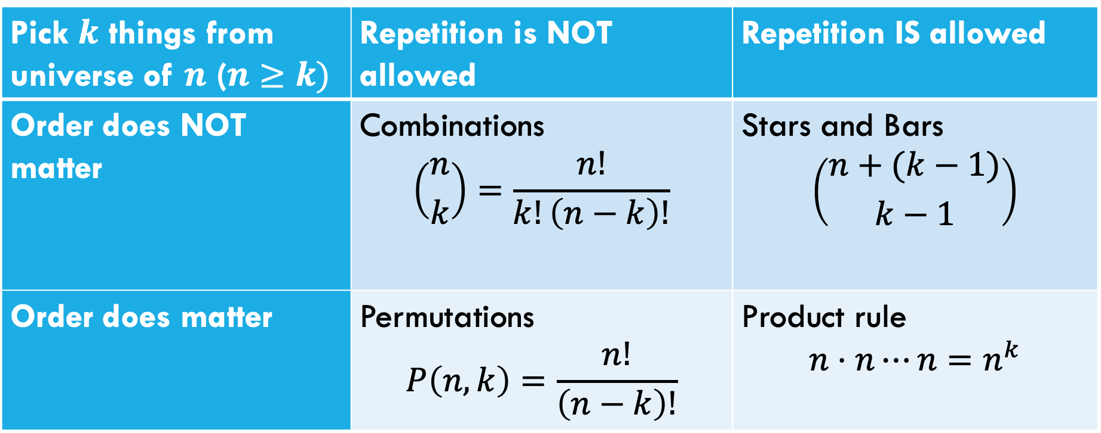
Which Tool Do I Use?
Pick $k$ things from universe of $n$ ($n≥k)$ | Repetition is NOT allowed | Repetition IS allowed
Order does NOT matter | Combinations $$\left({n \atop k}\right)=\frac{n!}{k!\left(n−k\right)!}$$ | Stars and Bars $$\left({n+(k−1) \atop k−1}\right)$$
Order does matter | Permutations $$P\left(n,k\right)=\frac{n!}{\left(n−k\right)!}$$ | Product rule $$n⋅n⋯n=n^{k}$$
This is NOT foolproof! Sometimes you need a twist on the formula; sometimes it’s a completely different tool. But a sign where to start.
Notes:
This isn’t the only tool you can use, but this I here to help you get started.

Slide 21
Probability

Slide 22
Probability
Probability is a way of quantifying our uncertainty.
When more than one outcome is possible,
To have “real-world” examples, we’ll need to start with some foundational processes that we’re going to assert exist
  We can flip a coin, and each face is equally likely to come up
  We can roll a die, and every number is equally likely to come up
  We can shuffle a deck of cards so that every ordering is equally likely.
Notes:
Uncertainty -> more than one outcome is possible
Quantifying -> Assign a number to these outcomes
This next part will be a little definitions heavy, but it will set us up in order to have a common language to use when talking about these problems.

Slide 23
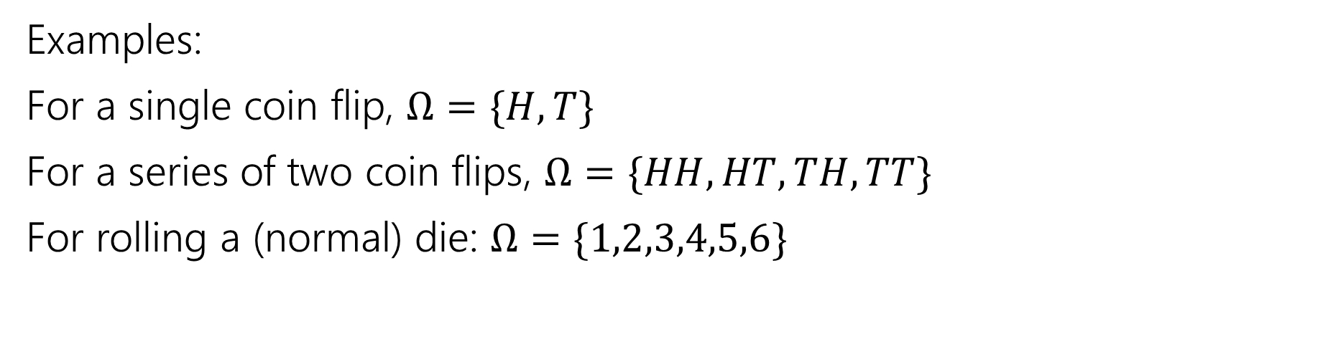
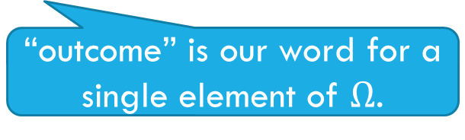

Sample Space
A sample space $Ω$ is the set of all possible outcomes of an experiment.
Sample Space
“outcome” is our word for a single element of $Ω$.
Examples:
For a single coin flip, $Ω=\{H,T\}$
For a series of two coin flips, $Ω=\{HH,HT,TH,TT\}$
For rolling a (normal) die: $Ω=\{1,2,3,4,5,6\}$
Notes:
Capital omega
An experiment here means doing something where we don’t know what will happen, like flipping a coin. Not like a biology experiment.
Rolling an even number would not be a single outcome, that is a set of multiple outcomes.

Slide 24
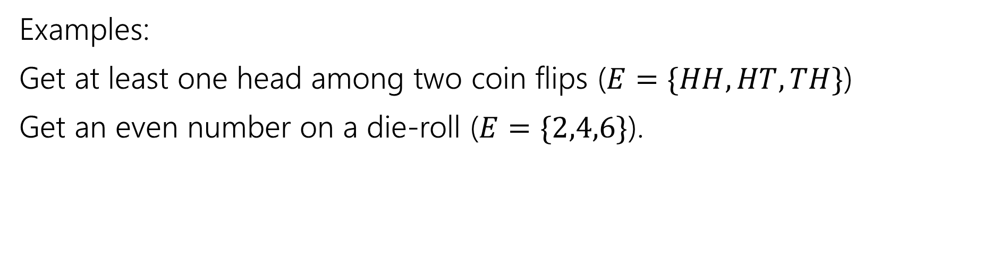

Events
An event $E⊆Ω$ is a subset of possible outcomes (i.e. a subset of $Ω$)
Event
Examples:
Get at least one head among two coin flips ($E=\{HH,HT,TH\}$)
Get an even number on a die-roll ($E=\{2,4,6\}$).
Notes:
If we want to refer to multiple outcomes from our sample space or a subset of our sample space, we will call that an event.

Slide 25
Examples
 | D2=1 | D2=2 | D2=3 | D2=4
D1=1 | (1,1) | (1,2) | (1,3) | (1,4)
D1=2 | (2,1) | (2,2) | (2,3) | (2,4)
D1=3 | (3,1) | (3,2) | (3,3) | (3,4)
D1=4 | (4,1) | (4,2) | (4,3) | (4,4)
I roll a blue 4-sided die and a red 4-sided die.
The table contains the sample space.
The event “the sum of the dice is even” is in gold
The event “the blue die is 1” is in green
Notes:
This table is the sample space of this experiment.
It is perfectly valid to define an event that only contains one outcome

Slide 26
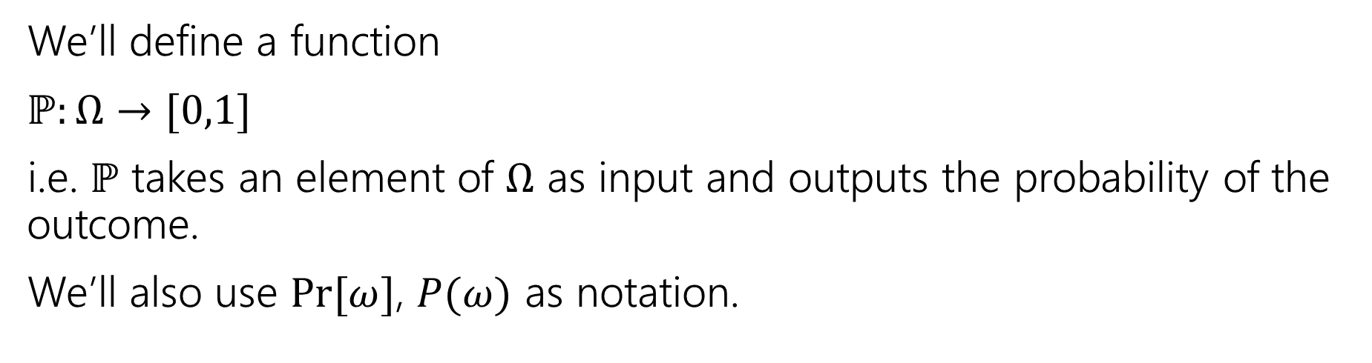
Probability
A probability is a number between 0 and 1 describing how likely a particular outcome is.
Probability
We’ll define a function
$ℙ:Ω→[0,1]$
i.e. $ℙ$ takes an element of $Ω$ as input and outputs the probability of the outcome.
We’ll also use $Pr⁡[ω]$, $P(ω)$ as notation.
Notes:
We’ll start with our informal definition here.
A little more formally, we will define a function that we will call out probability measure. The domain or the input to the function is outcomes from our sample space and it gives you back the probability.

Slide 27

Example
Imagine we toss one coin.
Our sample space $Ω=\{H,T\}$
What do you want $ℙ$ to be?

Slide 28
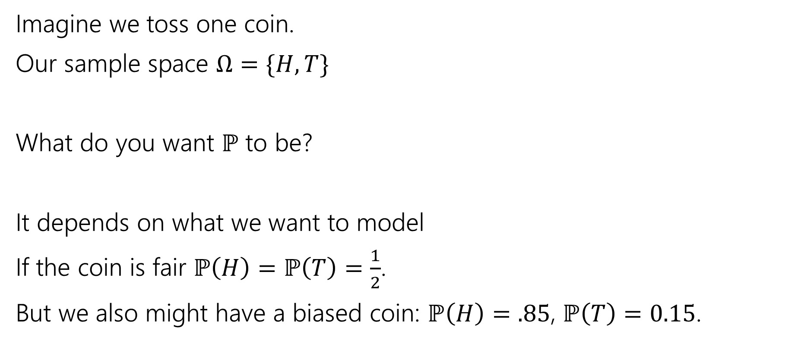
Example
Imagine we toss one coin.
Our sample space $Ω=\{H,T\}$
What do you want $ℙ$ to be?
It depends on what we want to model
If the coin is fair $ℙ\left(H\right)=ℙ\left(T\right)=\frac{1}{2}$.
But we also might have a biased coin: $ℙ\left(H\right)=.85$, $ℙ\left(T\right)=0.15$.
Notes:
When defining an experiment, its not enough to just define the sample space, though that is important, we also need to define our probability measure function.
Both of these functions could describe an experiment accurately, it just depends on what coin is being used for that particular experiment.

Slide 29
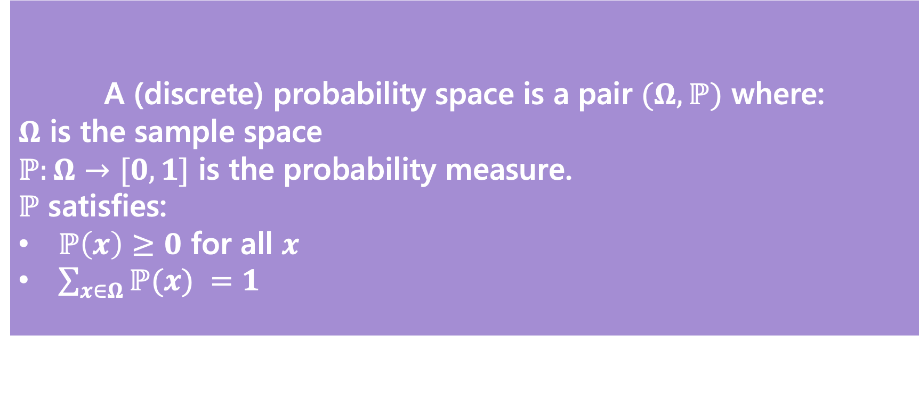
Probability Space
Probability Space
A (discrete) probability space is a pair $(Ω,ℙ)$ where:
$Ω$ is the sample space
$ℙ:Ω→[0,1]$ is the probability measure.
$ℙ$ satisfies:
$ℙ\left(x\right)≥0$ for all $x$
$\sum_{x∈Ω}{ℙ(x)} =1$
If $E,F⊆Ω$ and $E∩F=∅$then $ℙ\left(E∪F\right)=ℙ\left(E\right)+ℙ(F)$
Notes:
This last one is our additivity condition. This is probably something that you are thinking about intuitively and if we don’t have this property then we will not really be properly describing our experiments
If you have these properties, then you are a valid probability space that is describing at least in principle some valid experiment.

Slide 30
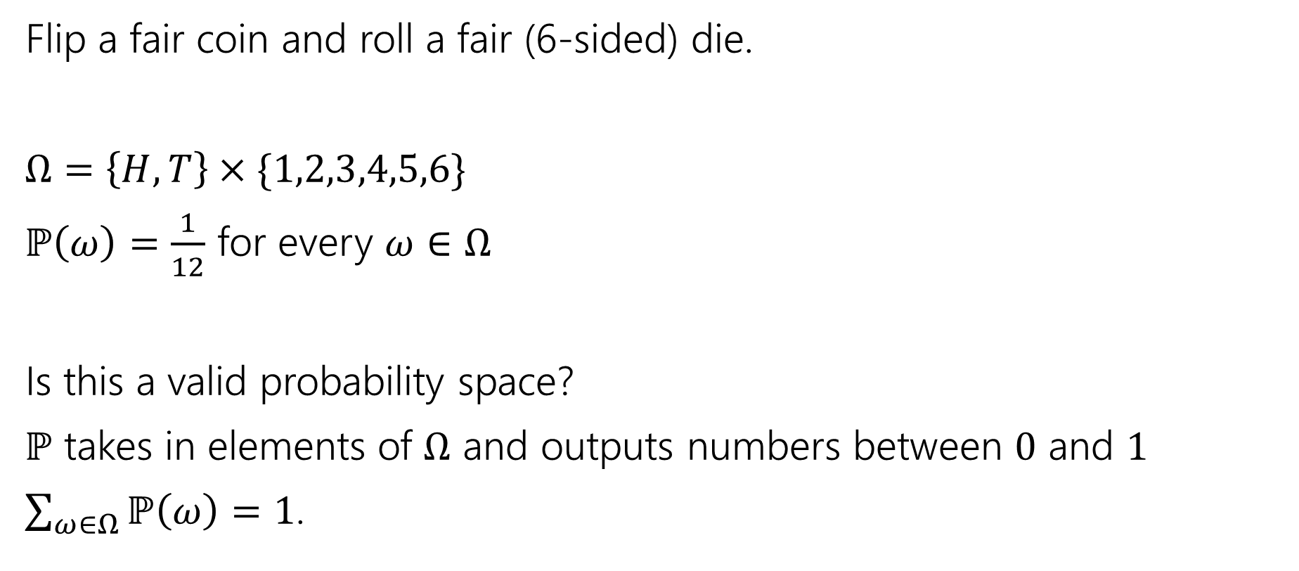
Probability Space
Flip a fair coin and roll a fair (6-sided) die.
$Ω=\left\{H,T\right\}×\{1,2,3,4,5,6\}$
$ℙ\left(ω\right)=\frac{1}{12}$ for every $ω∈Ω$
Is this a valid probability space?
$ℙ$ takes in elements of $Ω$ and outputs numbers between $0$ and $1$
$\sum_{ω∈Ω}{ℙ\left(ω\right)}=1$.
Notes:
But we haven’t said how to handle something like the event, what is the probability of seeing heads and the die roll being greater than 3. Form here on out we are going to assume that the way that we compute this probability is with our additivity condition.

Slide 31
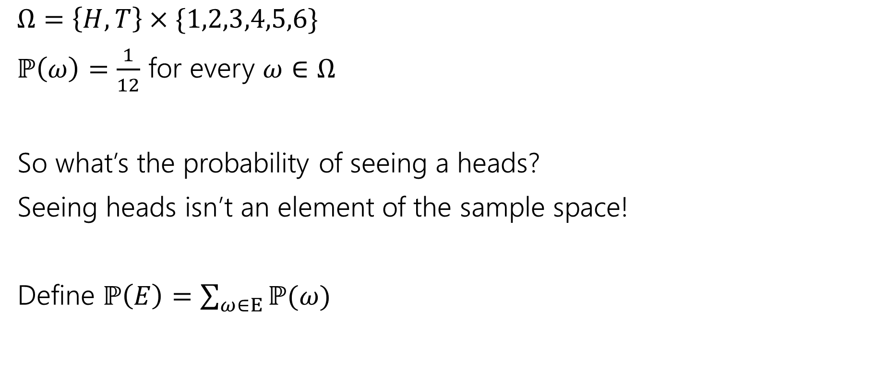
Measure
$Ω=\left\{H,T\right\}×\{1,2,3,4,5,6\}$
$ℙ\left(ω\right)=\frac{1}{12}$ for every $ω∈Ω$
So what’s the probability of seeing a heads?
Seeing heads isn’t an element of the sample space!
Define $ℙ\left(E\right)=\sum_{ω∈E}{ℙ(ω)}$
Notes:
That is,

Slide 32
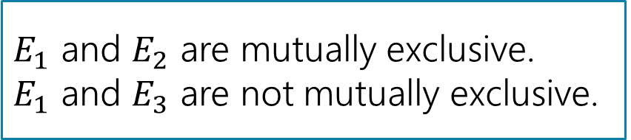
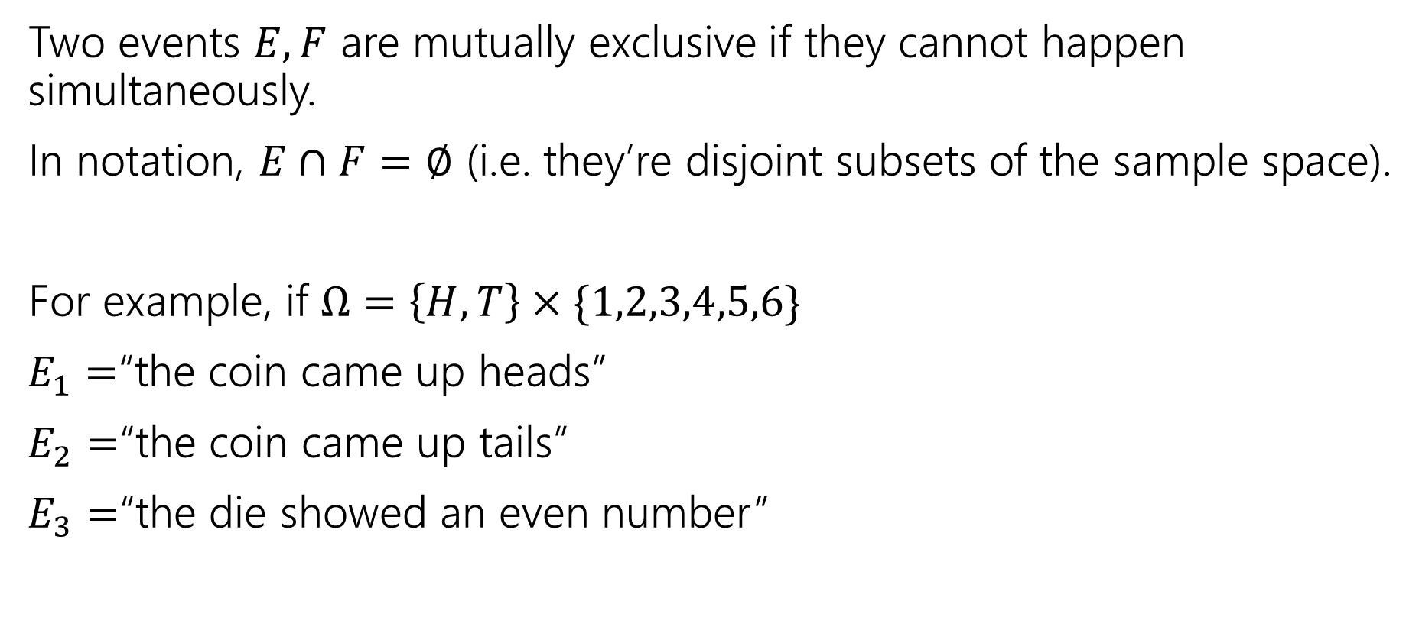
Mutually Exclusive Events
Two events $E,F$ are mutually exclusive if they cannot happen simultaneously.
In notation, $E∩F=∅$ (i.e. they’re disjoint subsets of the sample space).
For example, if $Ω=\left\{H,T\right\}×\{1,2,3,4,5,6\}$
$E_{1}=$“the coin came up heads”
$E_{2}=$“the coin came up tails”
$E_{3}=$“the die showed an even number”
$E_{1}$ and $E_{2}$ are mutually exclusive.
$E_{1}$ and $E_{3}$ are not mutually exclusive.

Slide 33
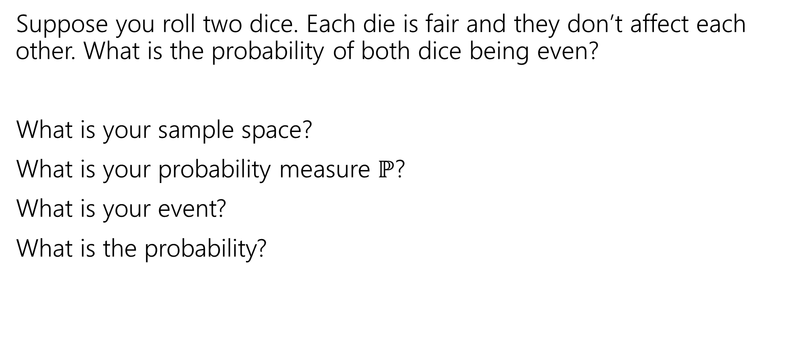
More Examples!
Suppose you roll two dice. Each die is fair and they don’t affect each other. What is the probability of both dice being even?
What is your sample space?
What is your probability measure $ℙ$?
What is your event?
What is the probability?

Slide 34
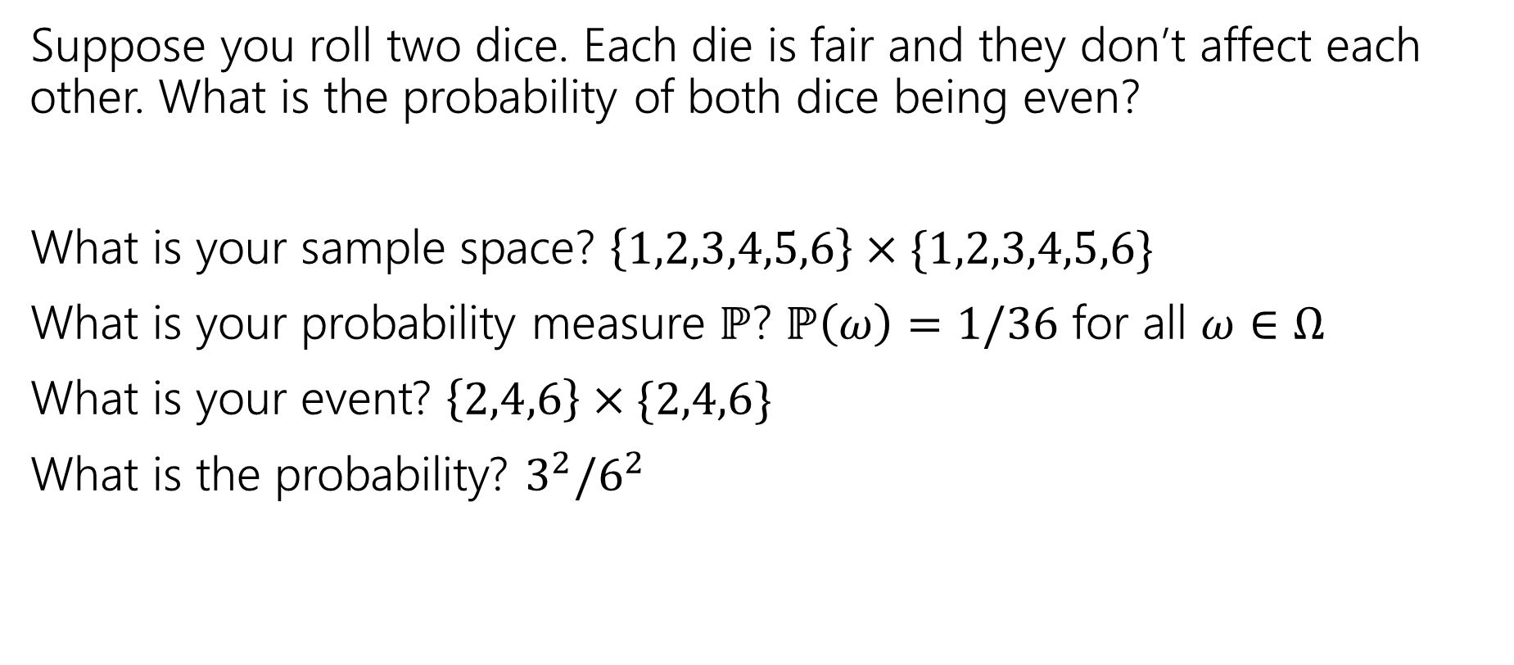
More Examples!
Suppose you roll two dice. Each die is fair and they don’t affect each other. What is the probability of both dice being even?
What is your sample space? $\left\{1,2,3,4,5,6\right\}×\{1,2,3,4,5,6\}$
What is your probability measure $ℙ$? $ℙ\left(ω\right)=1/36$ for all $ω∈Ω$
What is your event? $\left\{2,4,6\right\}×\{2,4,6\}$
What is the probability? $3^{2}/6^{2}$

Slide 35
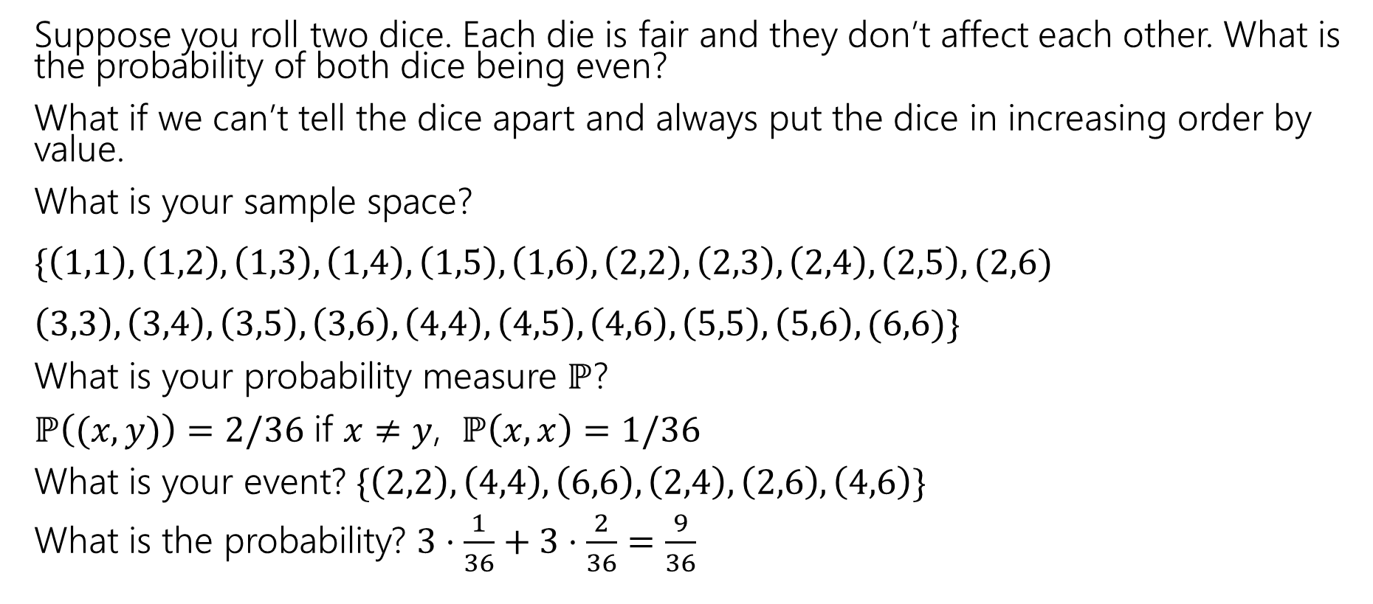
More Examples!
Suppose you roll two dice. Each die is fair and they don’t affect each other. What is the probability of both dice being even?
What if we can’t tell the dice apart and always put the dice in increasing order by value.
What is your sample space?
$\{\left(1,1\right),\left(1,2\right),\left(1,3\right),\left(1,4\right),\left(1,5\right),\left(1,6\right), \left(2,2\right),\left(2,3\right), \left(2,4\right),\left(2,5\right), (2,6)$
$\left(3,3\right),\left(3,4\right),\left(3,5\right),\left(3,6\right),\left(4,4\right),\left(4,5\right),\left(4,6\right),\left(5,5\right),\left(5,6\right), (6,6)\}$
What is your probability measure $ℙ$?
$ℙ\left((x,y)\right)=2/36$ if $x≠y$, $ℙ\left(x,x\right)=1/36$
What is your event? $\{\left(2,2\right),\left(4,4\right),\left(6,6\right), \left(2,4\right),\left(2,6\right),\left(4,6\right)\}$
What is the probability? $3⋅\frac{1}{36}+3⋅\frac{2}{36}=\frac{9}{36}$

Slide 36
Takeaways
There is often more than one sample space possible! But one is probably easier than the others.
Finding a sample space that will make the uniform measure correct will usually make finding the probabilities easier to calculate.

Slide 37
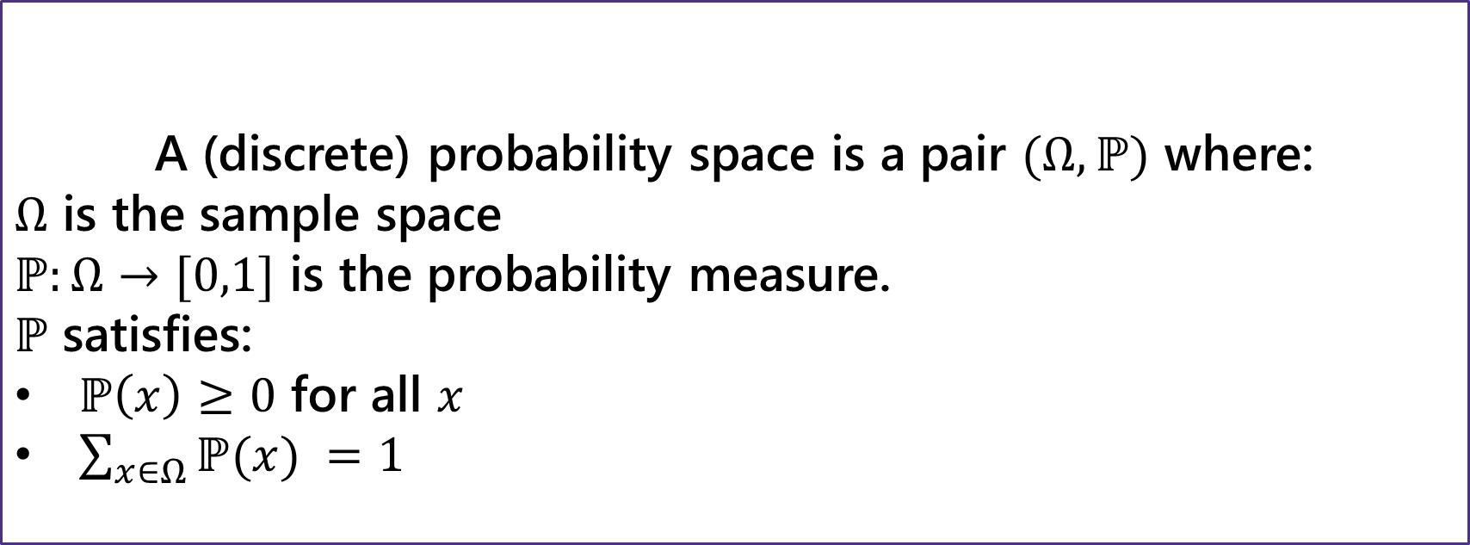
Probability Space
Probability Space
A (discrete) probability space is a pair $(Ω,ℙ)$ where:
$Ω$ is the sample space
$ℙ:Ω→[0,1]$ is the probability measure.
$ℙ$ satisfies:
$ℙ\left(x\right)≥0$ for all $x$
$\sum_{x∈Ω}{ℙ(x)} =1$
If $E,F⊆Ω$ and $E∩F=∅$then $ℙ\left(E∪F\right)=ℙ\left(E\right)+ℙ(F)$

