Slide 1
Even More Counting
CSE 312 Summer 25
Lecture 3

Slide 2
Quiz 1

Slide 3
Announcements
HW 1 is out! Due Wednesday.
Office hours started yesterday! Visit now before others start on the homework.
Also, please start on the homework early. Remember you need to have a meaningful attempt to utilize the penalty free late days.

Slide 4
Outline
So Far
  Sum and Product Rules
  Combinations (order doesn’t matter) and Permutations (order does matter)
  Introduce ordering and remove it to make calculations easier
  Some Proofs by counting two ways
  Binomial Theorem
This Time
  Principle of Inclusion-Exclusion
  Pigeonhole Principle
  Stars and Bars

Slide 5
Principle of Inclusion-Exclusion
Notes:
Usually a last resort approach

Slide 6
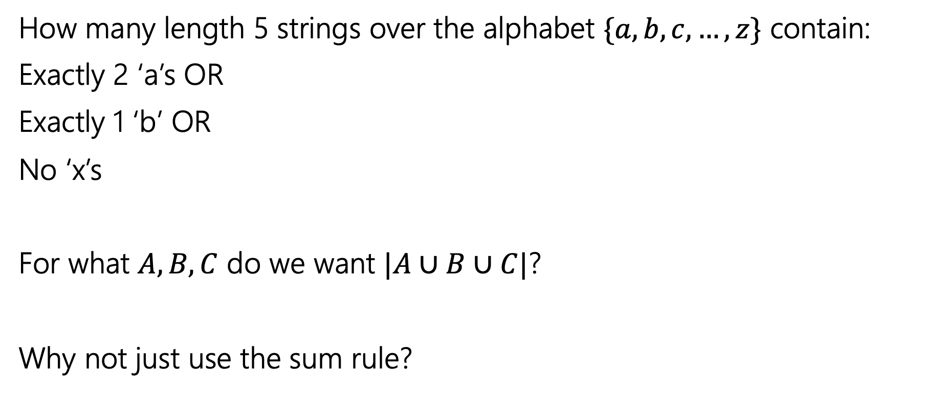
Example
How many length 5 strings over the alphabet $\{a,b,c,…,z\}$ contain:
Exactly 2 ‘a’s OR
Exactly 1 ‘b’ OR
No ‘x’s
For what $A,B,C$ do we want $|A∪B∪C|$?
Why not just use the sum rule?
Notes:
This is an inclusive or
Or sounds like a union and before when we were talking about unions we were using the sum rule
Why does the sum rule not apply?
The principle of inclusion-exclusion allows us to generalize the sum rule when we have overlap.

Slide 7




Principle of Inclusion-Exclusion
The sum rule says when $A$and $B$ are disjoint (no intersection), then $\left|A∪B\right|=\left|A\right|+|B|$.
What about when $A$ and $B$ aren’t disjoint?
For two sets:
$\left|A∪B\right|=\left|A\right|+\left|B\right|−|A∩B|$
$$A$$
$$A∩B$$
$$B$$

Slide 8
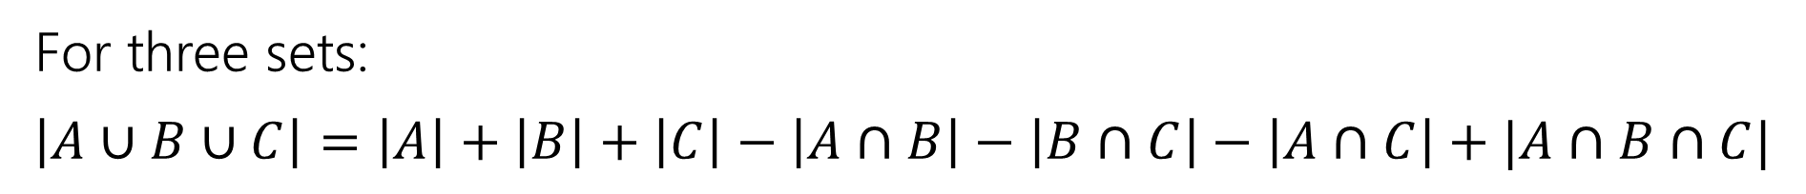
Principle of Inclusion-Exclusion
For three sets:
$\left|A∪B∪C\right|=\left|A\right|+\left|B\right|+\left|C\right|−\left|A∩B\right|−\left|B∩C\right|−\left|A∩C\right|+|A∩B∩C|$

Slide 9
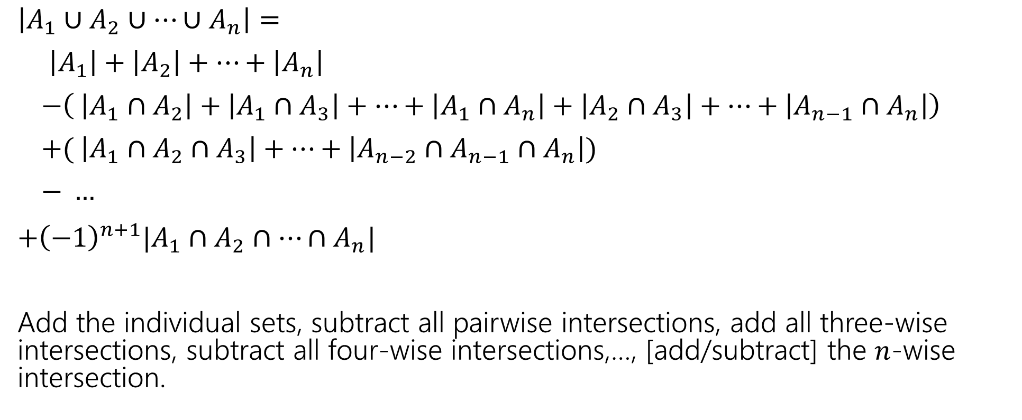
In general:
$\left|A_{1}∪A_{2}∪⋯∪A_{n}\right|=$
$\left|A_{1}\right|+\left|A_{2}\right|+⋯+\left|A_{n}\right|$
$−\left( \left|A_{1}∩A_{2}\right|+\left|A_{1}∩A_{3}\right|+…+\left|A_{1}∩A_{n}\right|+\left|A_{2}∩A_{3}\right|+…+\left|A_{n−1}∩A_{n}\right|\right)$
$+( \left|A_{1}∩A_{2}∩A_{3}\right|+…+\left|A_{n−2}∩A_{n−1}∩A_{n}\right|)$
$− …$
$+{\left(−1\right)}^{n+1}|A_{1}∩A_{2}∩…∩A_{n}|$
Add the individual sets, subtract all pairwise intersections, add all three-wise intersections, subtract all four-wise intersections,…, [add/subtract] the $n$-wise intersection.
Notes:
This is why this approach should be viewed as a last resort. If you have two sets its not too bad, if you have 3 sets that’s manageable, if you have 8 sets this is not going to be fun.

Slide 10

Example
How many length 5 strings over the alphabet $\{a,b,c,…,z\}$ contain:
Exactly 2 ‘a’s OR
Exactly 1 ‘b’ OR
No ‘x’s
For what $A,B,C$ do we want $|A∪B∪C|$?

Slide 11
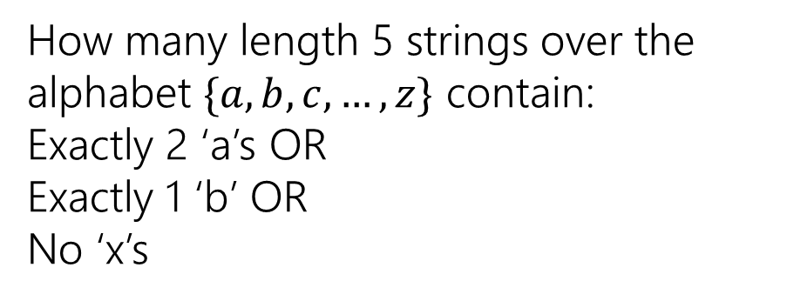
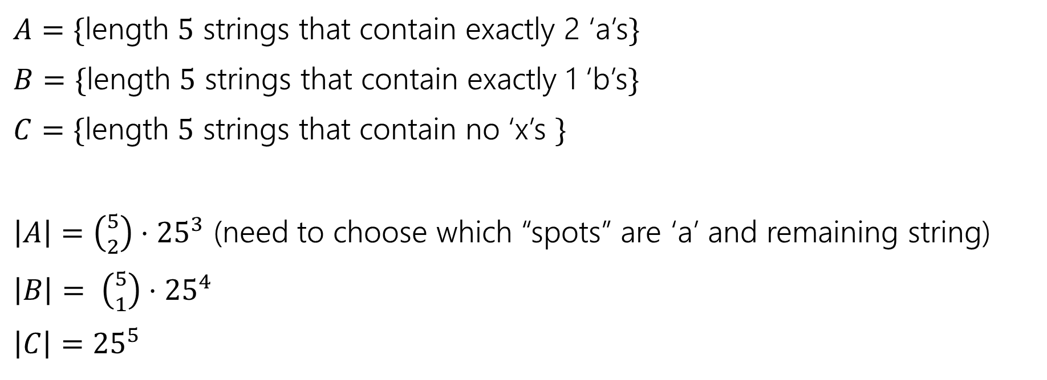
Example
How many length 5 strings over the alphabet $\{a,b,c,…,z\}$ contain:
Exactly 2 ‘a’s OR
Exactly 1 ‘b’ OR
No ‘x’s
$A=\{$length $5$ strings that contain exactly 2 ‘a’s$\}$
$B=\{$length $5$ strings that contain exactly 1 ‘b’s$\}$
$C=\{$length $5$ strings that contain no ‘x’s $\}$
$\left|A\right|=\left({5 \atop 2}\right)⋅{25}^{3}$ (need to choose which “spots” are ‘a’ and remaining string)
$\left|B\right|= \left({5 \atop 1}\right)⋅{25}^{4}$
$\left|C\right|={25}^{5}$

Slide 12

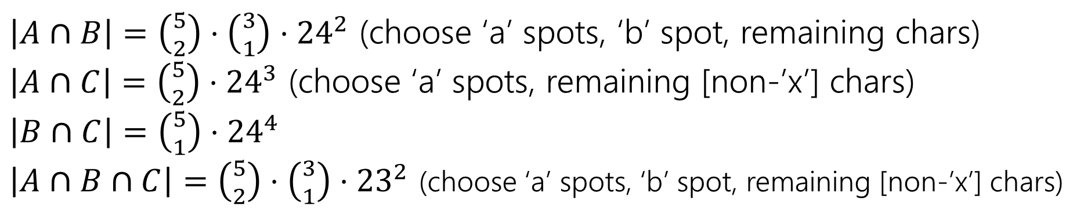

Example
How many length 5 strings over the alphabet $\{a,b,c,…,z\}$ contain:
Exactly 2 ‘a’s OR
Exactly 1 ‘b’ OR
No ‘x’s
$\left|A\right|=\left({5 \atop 2}\right)⋅{25}^{3}$
$\left|B\right|= \left({5 \atop 1}\right)⋅{25}^{3}$
$\left|C\right|={25}^{5}$
$A=\{$length $5$ strings that contain exactly 2 ‘a’s$\}$
$B=\{$length $5$ strings that contain exactly 1 ‘b’s$\}$
$C=\{$length $5$ strings that contain no ‘x’s $\}$
$\left|A∩B\right|=\left({5 \atop 2}\right)⋅\left({3 \atop 1}\right)⋅{24}^{2}$ (choose ‘a’ spots, ‘b’ spot, remaining chars)
$\left|A∩C\right|=\left({5 \atop 2}\right)⋅{24}^{3}$ (choose ‘a’ spots, remaining [non-’x’] chars)
$\left|B∩C\right|=\left({5 \atop 1}\right)⋅{24}^{4}$
$\left|A∩B∩C\right|=\left({5 \atop 2}\right)⋅\left({3 \atop 1}\right)⋅{23}^{2}$ (choose ‘a’ spots, ‘b’ spot, remaining [non-’x’] chars)

Slide 13
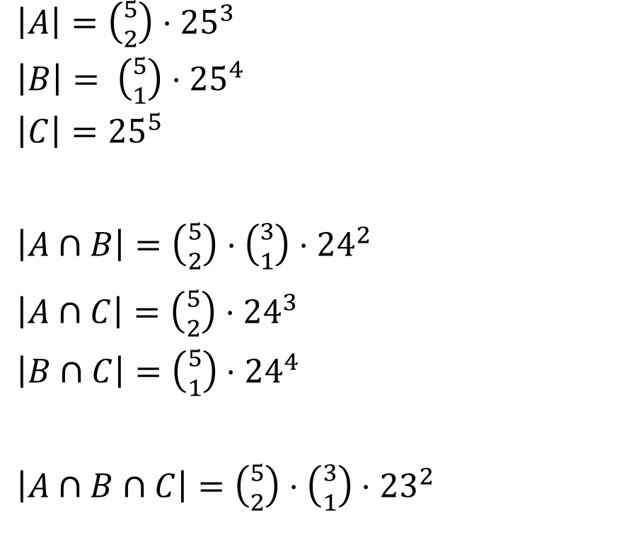
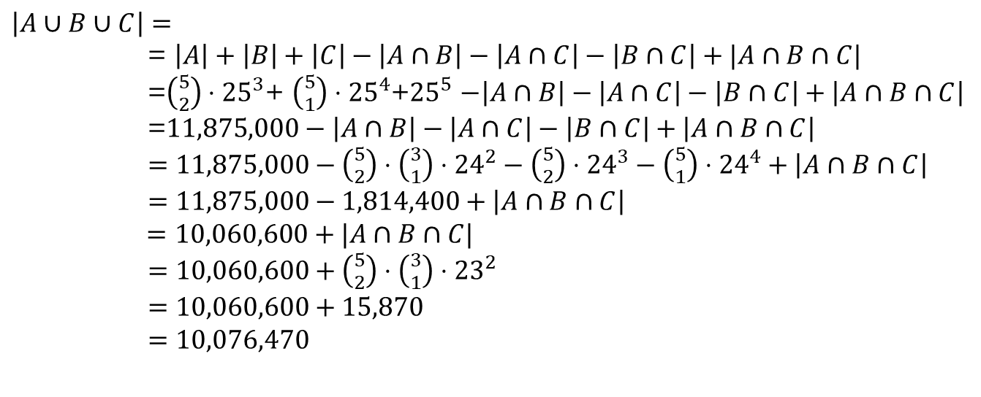
Example
How many length 5 strings over the alphabet $\{a,b,c,…,z\}$ contain:
Exactly 2 ‘a’s OR
Exactly 1 ‘b’ OR
No ‘x’s
$\left|A\right|=\left({5 \atop 2}\right)⋅{25}^{3}$
$\left|B\right|= \left({5 \atop 1}\right)⋅{25}^{4}$
$\left|C\right|={25}^{5}$
$\left|A∩B\right|=\left({5 \atop 2}\right)⋅\left({3 \atop 1}\right)⋅{24}^{2}$
$\left|A∩C\right|=\left({5 \atop 2}\right)⋅{24}^{3}$
$\left|B∩C\right|=\left({5 \atop 1}\right)⋅{24}^{4}$
$\left|A∩B∩C\right|=\left({5 \atop 2}\right)⋅\left({3 \atop 1}\right)⋅{23}^{2}$
$\left|A∪B∪C\right|=$
= $\left|A\right|+\left|B\right|+\left|C\right|−\left|A∩B\right|−\left|A∩C\right|−\left|B∩C\right|+|A∩B∩C|$
=$\left({5 \atop 2}\right)⋅{25}^{3}$+ $\left({5 \atop 1}\right)⋅{25}^{4}$+${25}^{5}$ $−\left|A∩B\right|−\left|A∩C\right|−\left|B∩C\right|+\left|A∩B∩C\right|$
=$11,875,000−\left|A∩B\right|−\left|A∩C\right|−\left|B∩C\right|+\left|A∩B∩C\right|$
$=11,875,000−\left({5 \atop 2}\right)⋅\left({3 \atop 1}\right)⋅{24}^{2}−\left({5 \atop 2}\right)⋅{24}^{3}−\left({5 \atop 1}\right)⋅{24}^{4}+\left|A∩B∩C\right|$
$=11,875,000−1,814,400+\left|A∩B∩C\right|$
$=10,060,600+|A∩B∩C|$
$=10,060,600+\left({5 \atop 2}\right)⋅\left({3 \atop 1}\right)⋅{23}^{2}$
$=10,060,600+15,870$
$=10,076,470$

Slide 14
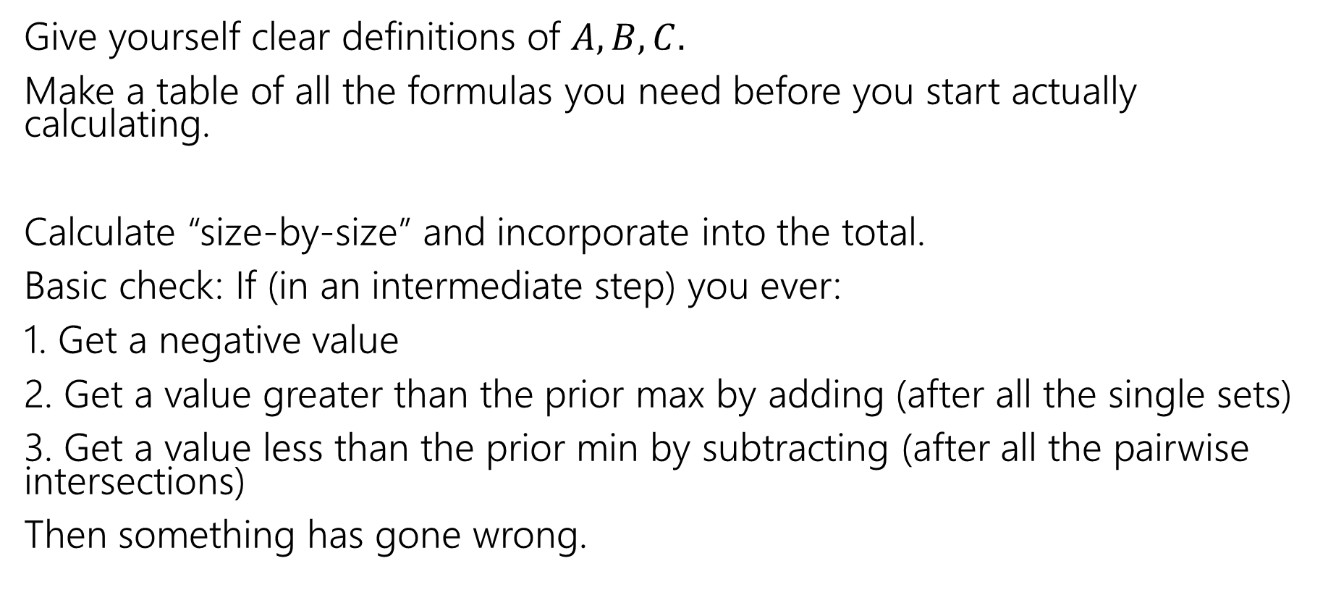
Practical tips
Give yourself clear definitions of $A,B,C.$
Make a table of all the formulas you need before you start actually calculating.
Calculate “size-by-size” and incorporate into the total.
Basic check: If (in an intermediate step) you ever:
1. Get a negative value
2. Get a value greater than the prior max by adding (after all the single sets)
3. Get a value less than the prior min by subtracting (after all the pairwise intersections)
Then something has gone wrong.

Slide 15
Pigeonhole Principle

Slide 16


Pigeonhole Principle
If you have $5$ pigeons, and place them into $4$ holes, then…
At least two pigeons are in the same hole.

Slide 17

Pigeonhole Principle
If you have $5$ pigeons, and place them into $4$ holes, then…
At least two pigeons are in the same hole.
It might be more than two.

Slide 18

Strong Pigeonhole Principle
If you have $n$ pigeons and $k$ pigeonholes, then there is at least one pigeonhole that has at least $\left\lceil \frac{n}{k}\right\rceil$ pigeons.
$\left\lceil a\right\rceil$ is the “ceiling” of $a$ (it means always round up, $\left\lceil 1.1\right\rceil =2$, $\left\lceil 1\right\rceil =1$).

Slide 19













An example
If you have to grow 10 crops, and you have 3 seasons to grow them in, then…

Slide 20
An example
If you have to grow 10 crops, and you have 3 seasons to grow them in, then…
Pigeons: The crops
Pigeonholes: The seasons
Mapping: Which crop you grow in which season.

Slide 21
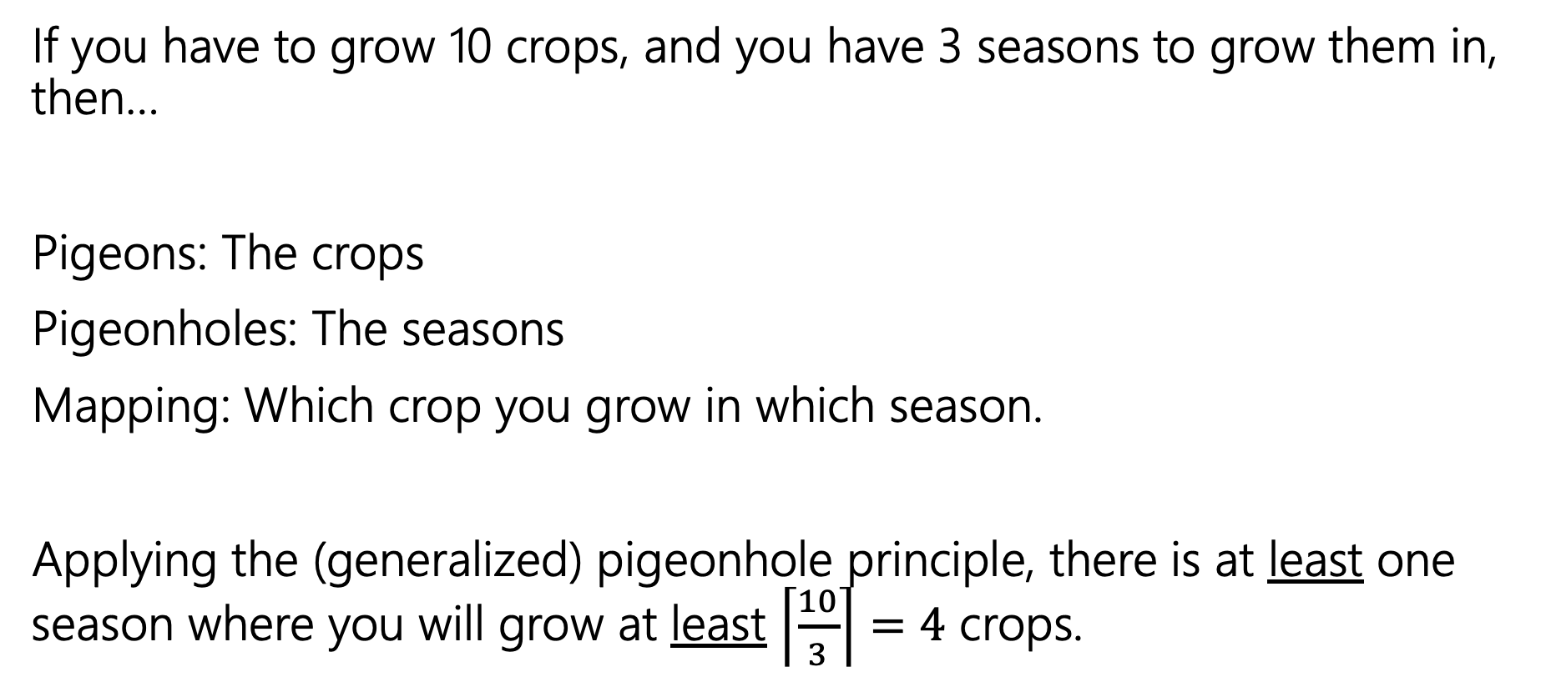
An example
If you have to grow 10 crops, and you have 3 seasons to grow them in, then…
Pigeons: The crops
Pigeonholes: The seasons
Mapping: Which crop you grow in which season.
Applying the (generalized) pigeonhole principle, there is at least one season where you will grow at least $\left\lceil \frac{10}{3}\right\rceil =4$ crops.
Notes:
No matter how you do the assignment, there will be at least one season that will have at least four crops grown during

Slide 22
Practical Tips
When the pigeonhole principle is the right tool, it’s usually the first thing you’d think of or the absolute last thing you’d think of.
For really tricky ones, we’ll warn you in advance that it’s the right method (you’ll see one in the section handout).
When applying the principle, say:
  What are the pigeons
  What are the pigeonholes
  How do you map from pigeons to pigeonholes
Look for – a set you’re trying to divide into groups, where collisions would help you somehow.

Slide 23
Stars and Bars
Notes:
This is going to end up with a formula like combinations or permutations, but we’ll use it a little less often

Slide 24

One More Counting Rule
It’s the start of spring and you want to plant a 3x4 plot on your farm.
You’re going to go to Pierre's General Store to buy twelve seeds.
There are parsnip, cauliflower, potato, kale, and garlic seeds (i.e. five types of seeds)
How many different 12 seed orders can you make?
Consider two orders the same if they contain the same number of every type of seed (order doesn’t matter).
Notes:
Seeds are indistinguishable
Order doesn’t matter
The types matter, but the order doesn’t
There are enough seeds of each kind for you to create any 12 seed order that youd like
It will be easier for us to do this in order, so assume that once I get an order I always order it with parsnips first, then cauliflower, and so on

Slide 25





One More Counting Rule
You’re going to go to Pierre's General Store to buy twelve seeds.
There are parsnip, cauliflower, potato, kale, and garlic seeds (i.e. five types of seeds)
Put seeds in order by type, then put dividers between the types.
Notes:
If I tell you where I’m putting the dividers you can tell me the seed order or if I tell you the seed order you can tell me where to put the dividers. The number of diagrams like this that I can make is exactly the number of different seeds that I can buy.

Slide 26
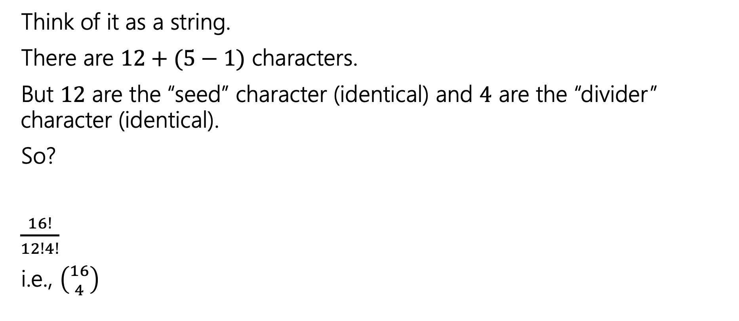
Explanation 1
Think of it as a string.
There are $12+(5−1)$ characters.
But $12$ are the “seed” character (identical) and $4$ are the “divider” character (identical).
So?
$\frac{16!}{12!4!}$
i.e., $\left({16 \atop 4}\right)$

Slide 27
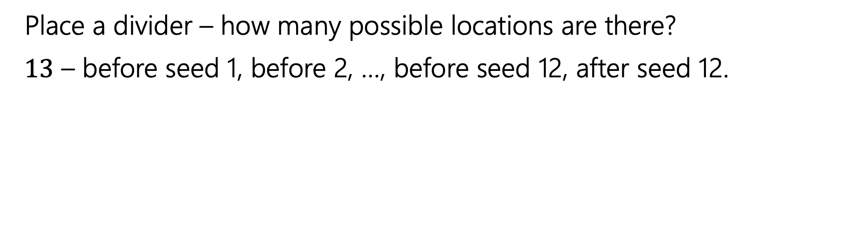
Placing Dividers
Place a divider – how many possible locations are there?
$13$ – before seed 1, before 2, …, before seed 12, after seed 12.
Notes:
Another way we can think about it is by placing the dividers. We’ll start with our 12 seeds and then we will go in and place the dividers on by one. The dividers are indistinguishable, but we will treat them as distinguishable for now and then divide out the over counting

Slide 28
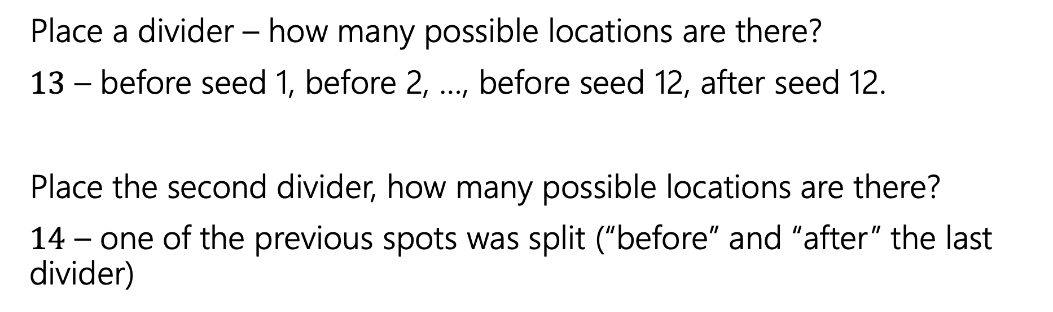
Placing Dividers
Place a divider – how many possible locations are there?
$13$ – before seed 1, before 2, …, before seed 12, after seed 12.
Place the second divider, how many possible locations are there?
$14$ – one of the previous spots was split (“before” and “after” the last divider)

Slide 29
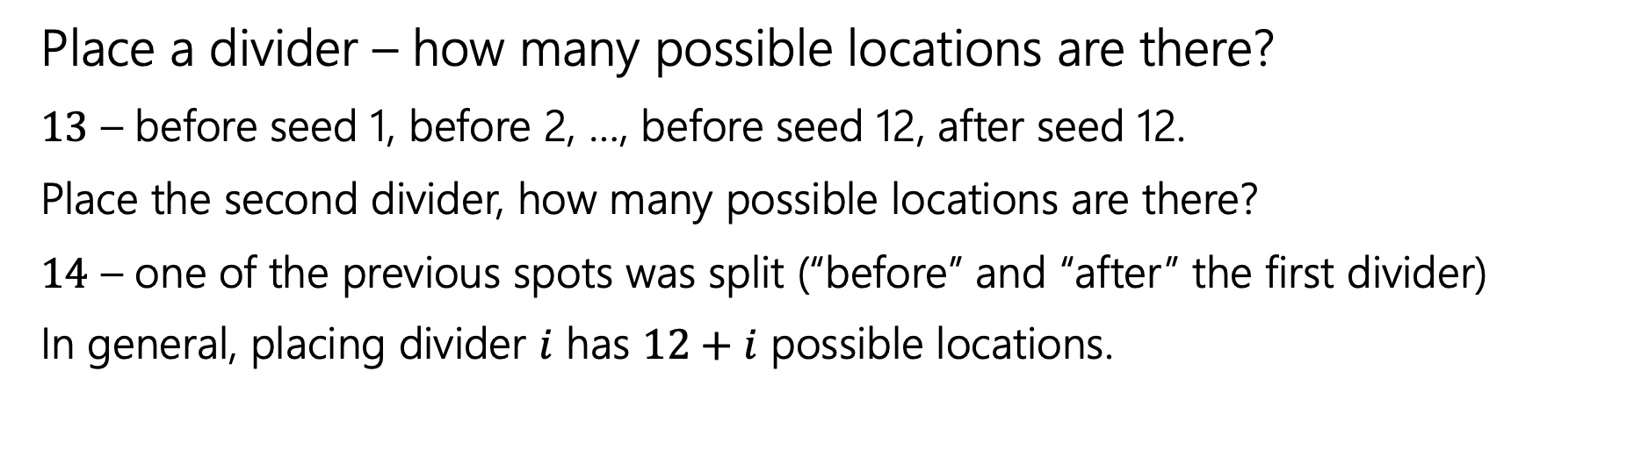
Placing Dividers
Place a divider – how many possible locations are there?
$13$ – before seed 1, before 2, …, before seed 12, after seed 12.
Place the second divider, how many possible locations are there?
$14$ – one of the previous spots was split (“before” and “after” the first divider)
In general, placing divider $i$ has $12+i$ possible locations.

Slide 30
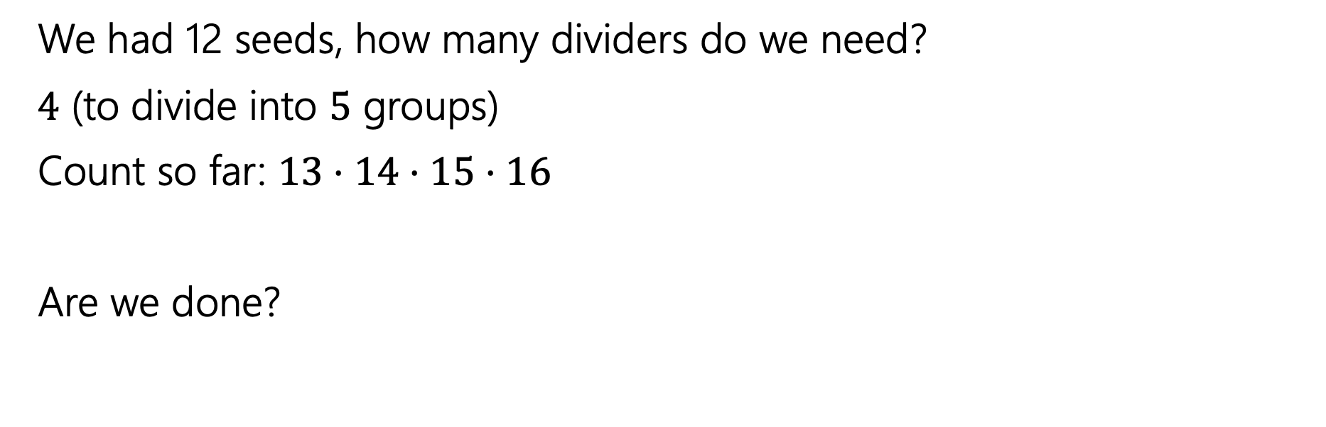
Wrapping Up
We had 12 seeds, how many dividers do we need?
$4$ (to divide into $5$ groups)
Count so far: $13⋅14⋅15⋅16$
Are we done?

Slide 31
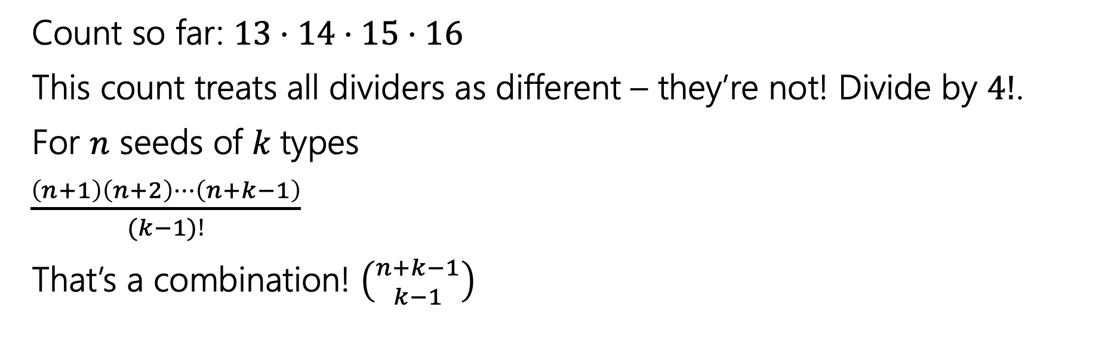
Wrapping Up
Count so far: $13⋅14⋅15⋅16$
This count treats all dividers as different – they’re not! Divide by $4!$.
For $n$ seeds of $k$types
$\frac{\left(n+1\right)\left(n+2\right)⋯\left(n+k−1\right)}{(k−1)!}$
That’s a combination! $\left({n+k−1 \atop k−1}\right)$

Slide 32
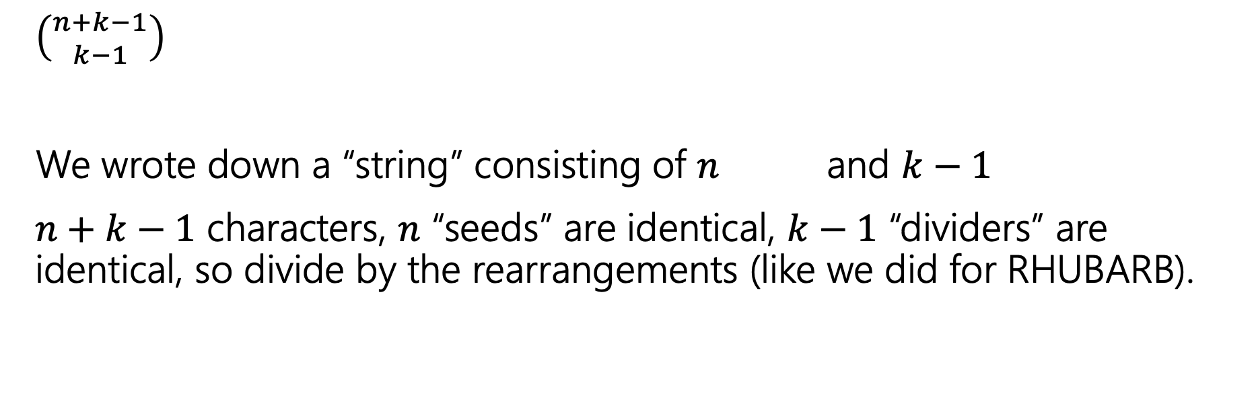
Wrapping Up
$\left({n+k−1 \atop k−1}\right)$
We wrote down a “string” consisting of $n$ and $k−1$
$n+k−1$ characters, $n$ “seeds” are identical, $k−1$ “dividers” are identical, so divide by the rearrangements (like we did for RHUBARB).

Slide 33
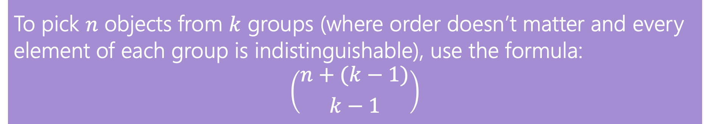
In General
The counting technique we did is often called “stars and bars”
  using a “star” instead of a seed shape, and calling the dividers “bars”
To pick $n$ objects from $k$ groups (where order doesn’t matter and every element of each group is indistinguishable), use the formula:
$$\left({n+(k−1) \atop k−1}\right)$$

