Slide 1
More Counting
CSE 312 Summer 25
Lecture 2

Slide 2
Announcements
Homework 1 will come out tonight, due Wed July 2nd.
Mostly written problems.
Every written problem requires a justification.
Not a proof (unless we say to prove something). But enough explanation that someone who followed lecture but hasn’t seen the problem would fully understand where your answer came from (and believe it’s correct)
There’s also one programming question – submission on gradescope, but it will be easiest to do the questions on Ed (Ed has a python interpreter built in, you could set up your own python environment, but Ed will be sufficient for this quarter).

Slide 3
Announcements
You’ll have 2 late days to use per HW assignment (except the last one) if you submit a meaningful attempt by the original deadline. Failure to submit a meaningful attempt will result in 25% penalty per day.
This policy is intended for “normal” things during the quarter.
If you have an unusual or extended or extreme issue, please let us know.
The sooner you let us know, the more options we have for accommodations.

Slide 4
Announcements
Please read the collaboration policy, in particular:
on homeworks you are encouraged to collaborate, but the writeup must be your own.
  If you’re working with others, don’t take notes from your discussions
  And take a 30 minute break between discussions and your writeup
The goal of these rules is to make sure you’ve learned how to do the problems.
ChatGPT (or any other AI system) is not a valid collaborator.
  Our goal is that you learn how to do the problems, not that ChatGPT learns how to do the problems.

Slide 5
Announcements
Office hours will start tomorrow.
Check the course website of times and locations.

Slide 6
Where Are We?
Last time:
  Sum and Product Rules
  Sequential Processes
  Different ways of thinking lead to different formulas
Today:
  A few more rules: Combinations and Permutations.
  Proof by double counting
  Binomial Theorem

Slide 7

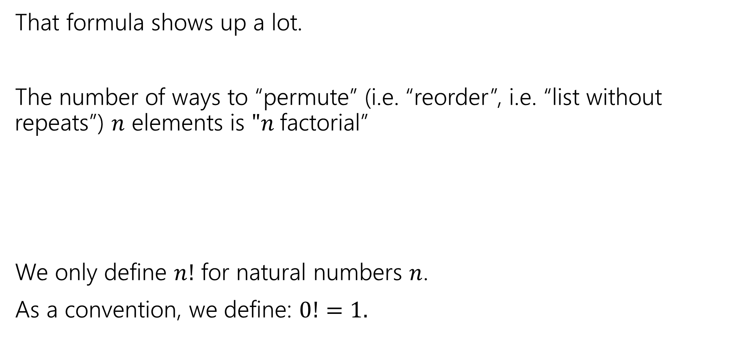

Factorial
That formula shows up a lot.
The number of ways to “permute” (i.e. “reorder”, i.e. “list without repeats”) $n$ elements is $"n$factorial”
We only define $n!$ for natural numbers $n$.
As a convention, we define: $0!=1.$
$$n!=n⋅\left(n−1\right)⋅\left(n−2\right)⋯1$$
$n$ factorial

Slide 8
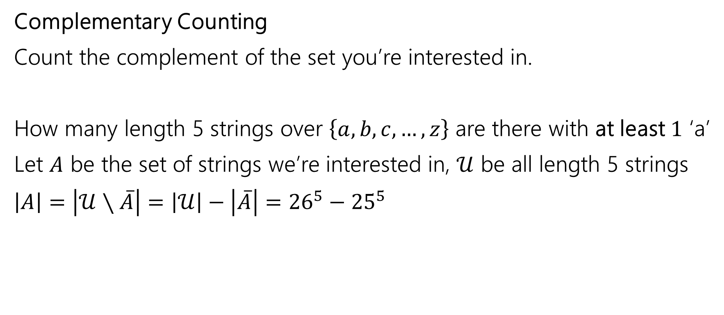
One More Counting Technique
Complementary Counting
Count the complement of the set you’re interested in.
How many length 5 strings over $\left\{a,b,c,…,z\right\}$ are there with at least $1$ ‘a’
Let $A$ be the set of strings we’re interested in, $𝒰$ be all length 5 strings
$\left|A\right|=\left|𝒰∖\overline{A}\right|=\left|𝒰\right|−\left|\overline{A}\right|={26}^{5}−{25}^{5}$

Slide 9




Distinct Letters
How many length $5$ strings are there over the alphabet $\{a,b,…,z\}$ where each string does not repeat a letter.
E.g. “morel” is an allowed string, but “berry” is not, nor is “crocus”
$26⋅25⋅24⋅23⋅22$
Notes:
No repeats, we have 26 letters, string implies order matters.
Looks kind of like a factorial, but we stopped after we picked 5 characters because we want a 5 letter string.
This is a common pattern as well, so well give it a name

Slide 10
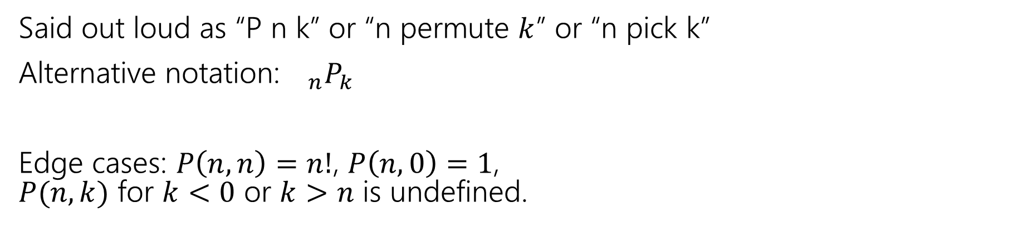
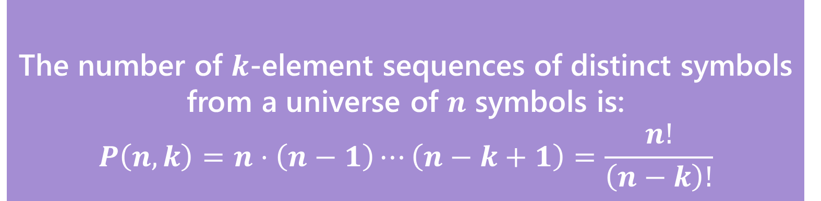
In General
The number of $k$-element sequences of distinct symbols from a universe of $n$ symbols is:
$$P\left(n,k\right)=n⋅\left(n−1\right)⋯\left(n−k+1\right)=\frac{n!}{\left(n−k\right)!}$$
$k$-permutation
Said out loud as “P n k” or “n permute $k$” or “n pick k”
Alternative notation:${}_{n}P_{k}$
Edge cases: $P\left(n,n\right)=n!$, $P\left(n,0\right)=1$,
$P(n,k)$ for $k<0$ or $k>n$ is undefined.
Notes:
P(26, 5), last slide
It can get frustrating to write it out as the string of multiplications up to (n-k+1), so instead we use this formula
Show a little example with P(5,3)

Slide 11
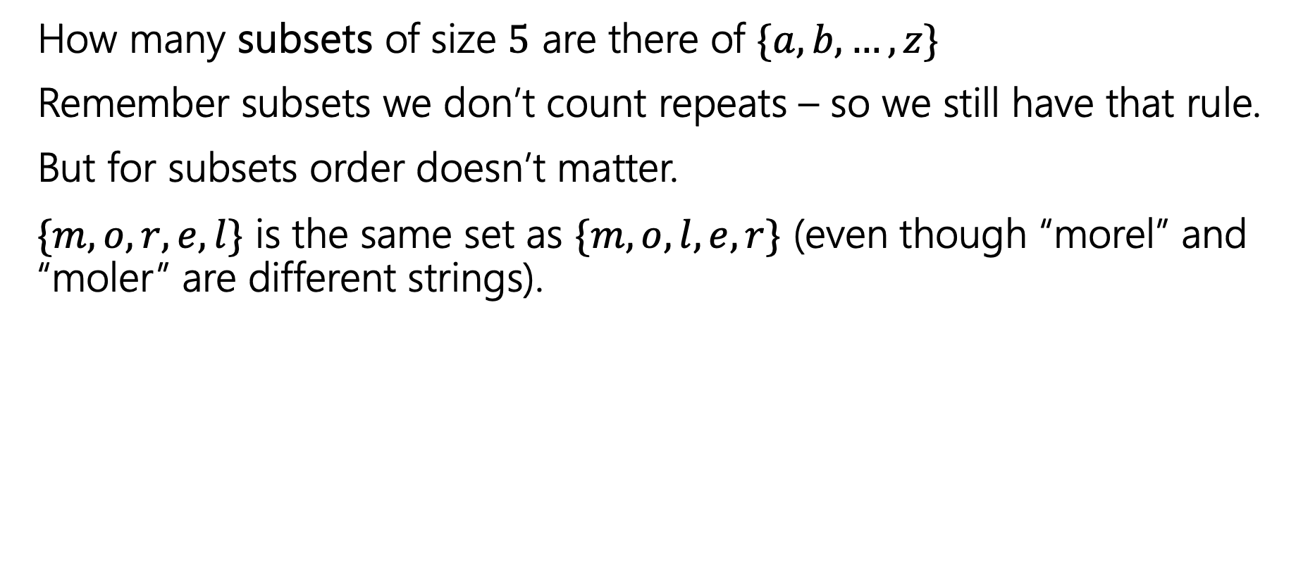
Change it slightly
How many subsets of size $5$ are there of $\{a,b,…,z\}$
Remember subsets we don’t count repeats – so we still have that rule.
But for subsets order doesn’t matter.
$\{m, o, r, e, l\}$ is the same set as $\{m, o, l, e, r\}$ (even though “morel” and “moler” are different strings).
Notes:
Now order doesn’t matter, but we are still not repeating characters.

Slide 12
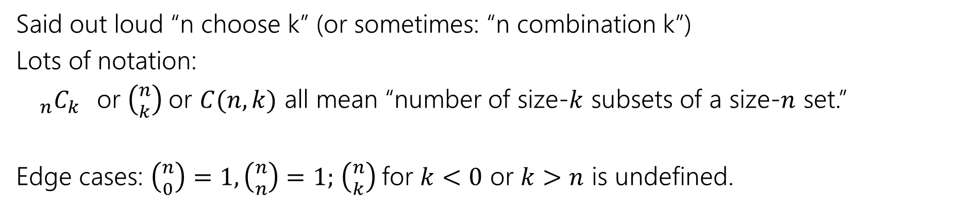
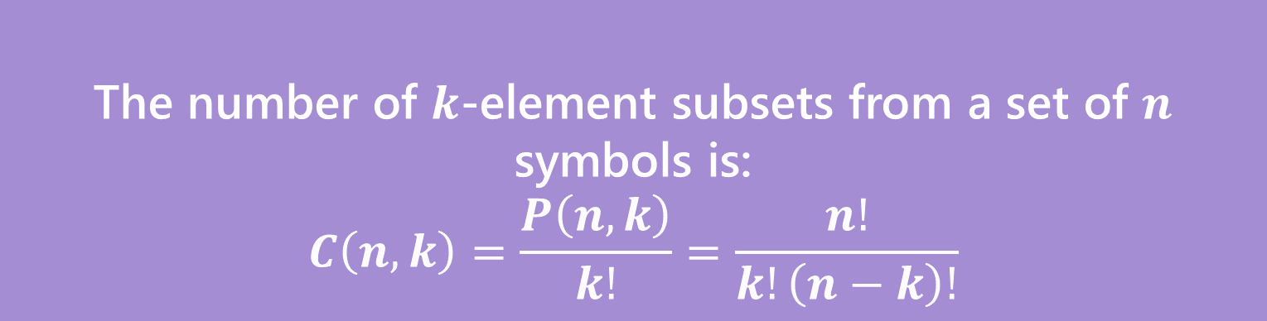
Number of Subsets
The number of $k$-element subsets from a set of $n$ symbols is:
$$C\left(n,k\right)=\frac{P\left(n,k\right)}{k!}=\frac{n!}{k!\left(n−k\right)!}$$
$k$-combination
Said out loud “n choose k” (or sometimes: “n combination k”)
Lots of notation:
${}_{n}C_{k}$or $\left({n \atop k}\right)$or $C(n,k)$ all mean “number of size-$k$ subsets of a size-$n$ set.”
Edge cases: $\left({n \atop 0}\right)=1,\left({n \atop n}\right)=1;$ $\left({n \atop k}\right)$for $k<0$ or $k>n$ is undefined.
Notes:
Lets take a look at the formula before we talk about where it comes from.
Order doesnt matter
This formula shows up a lot, so there are many ways that it gets denoted. Most common is the binomial coefficient notation.
It is like a permutation, but smaller, form the k!, which would make sense because now order doesn’t matter, so we should end up with fewer elements.

Slide 13
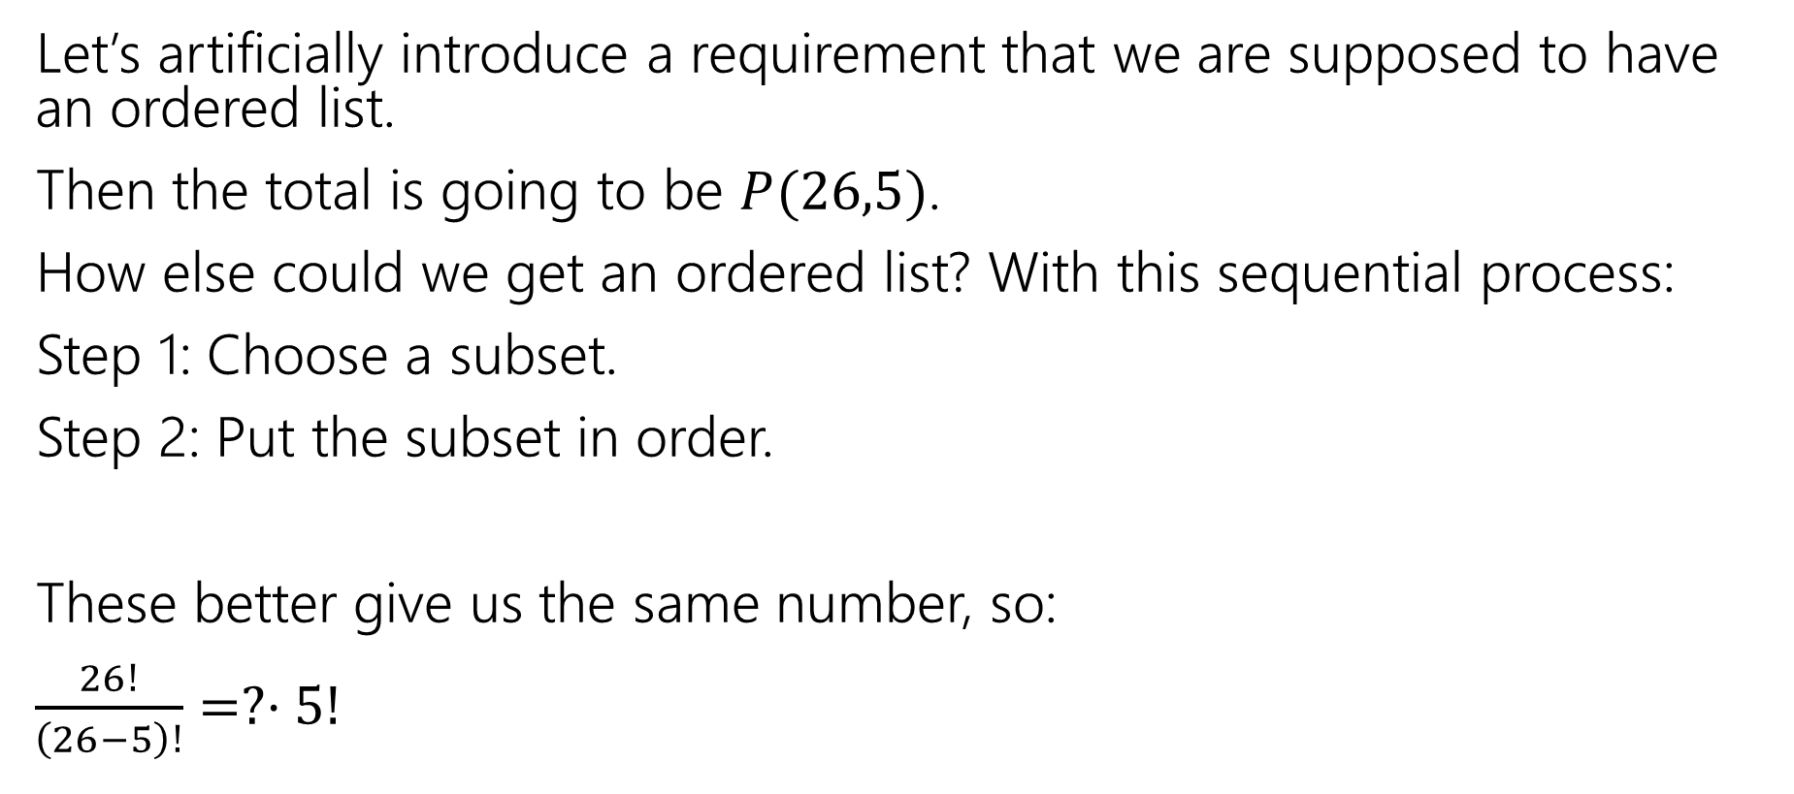
Clever approach – count two ways
Let’s artificially introduce a requirement that we are supposed to have an ordered list.
Then the total is going to be $P(26,5)$.
How else could we get an ordered list? With this sequential process:
Step 1: Choose a subset.
Step 2: Put the subset in order.
These better give us the same number, so:
$\frac{26!}{\left(26−5\right)!}=?⋅5!$
Notes:
How could we get this formula?
Here is a clever way to solve for it. We are going to do a combinatorial proof. This is where we will count the same thing in two different ways and since we are counting the same set then the two ways much be equal.

Slide 14
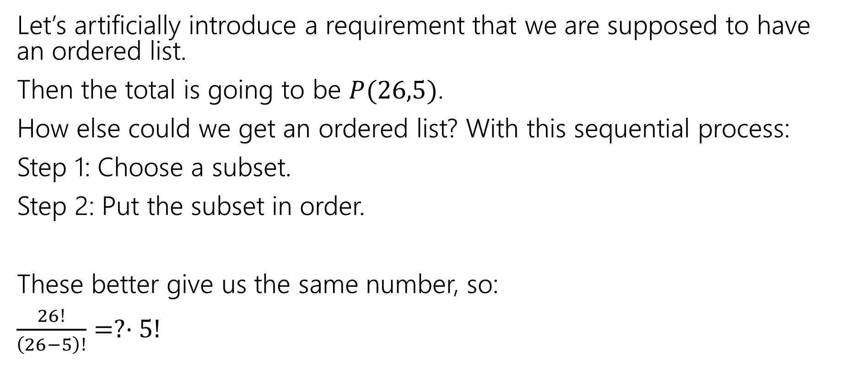
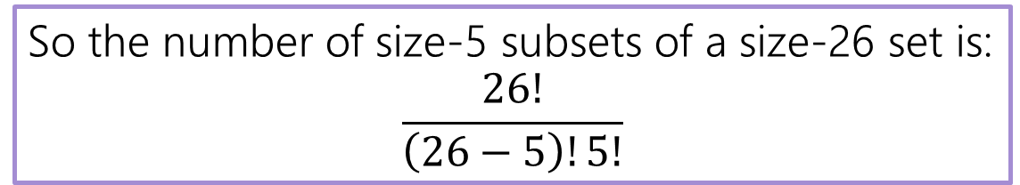
Clever approach – count two ways
Let’s artificially introduce a requirement that we are supposed to have an ordered list.
Then the total is going to be $P(26,5)$.
How else could we get an ordered list? With this sequential process:
Step 1: Choose a subset.
Step 2: Put the subset in order.
These better give us the same number, so:
$\frac{26!}{\left(26−5\right)!}=?⋅5!$
So the number of size-5 subsets of a size-26 set is:
$$\frac{26!}{\left(26−5\right)!5!}$$
Notes:
Once we rearrange for that subset piece we get exactly our combination formula.
This is a little bit of a round about way of getting to the answer, what questions do you have about ither permutations or combinations.

Slide 15
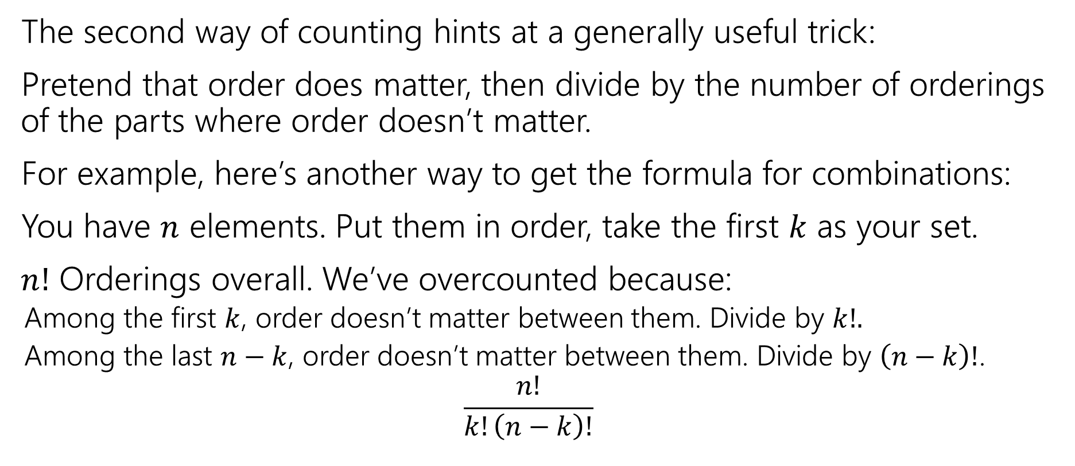
Second Takeaway
The second way of counting hints at a generally useful trick:
Pretend that order does matter, then divide by the number of orderings of the parts where order doesn’t matter.
For example, here’s another way to get the formula for combinations:
You have $n$ elements. Put them in order, take the first $k$ as your set.
$n!$ Orderings overall. We’ve overcounted because:
  Among the first $k$, order doesn’t matter between them. Divide by $k!.$
  Among the last $n−k$, order doesn’t matter between them. Divide by $\left(n−k\right)!$.
  $$\frac{n!}{k!\left(n−k\right)!}$$
Notes:
This approach hints at a really helpful way to sometimes solve these problems. Sometimes its easier to say that order matters and then divide by the number of orderings to remove out overcounting or it can be easier to solve it by saying order doenst matter and then ordering them.

Slide 16
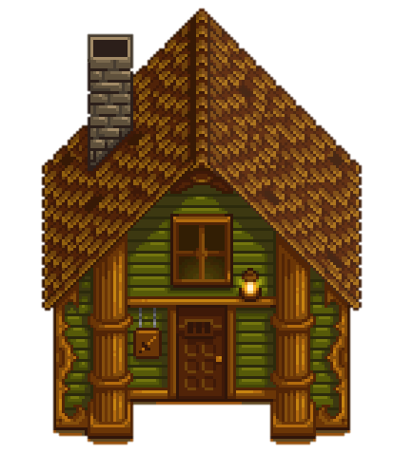
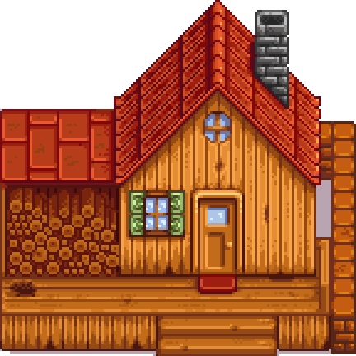

Path Counting
We’re at our farm in the lower-left corner and want to get to the Adventure’s Guild in the upper-right corner.
We’re only going to go right and up.
How many different paths are there?
$2^{8}$
$P\left(8,4\right)$
$\left({8 \atop 4}\right)$
Something else
https://pollev.com/avk5
Notes:
This will be our activity. Take some time to work with the people around you.
You might be thinking that at each step you get to pick right or up and you make 8 steps, so 2^8, but this isn’t quite right because that will count paths that go up 8 and never get to the adventurer’s guild.
Lets take a look at two ways we could think about this problem to figure out if we need to use permutation or combination.

Slide 17
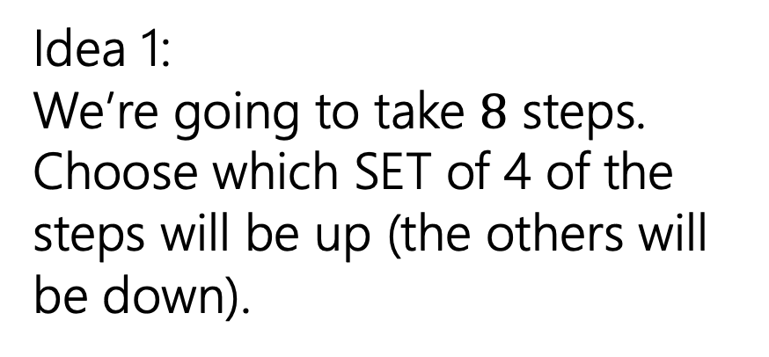
Path Counting
We’re at our farm in the lower-left corner and want to get to the Adventure’s Guild in the upper-right corner.
We’re only going to go right and up.
How many different paths are there?
Idea 1:
We’re going to take $8$ steps. Choose which SET of 4 of the steps will be up (the others will be down).
Notes:
Draw out the steps

Slide 18
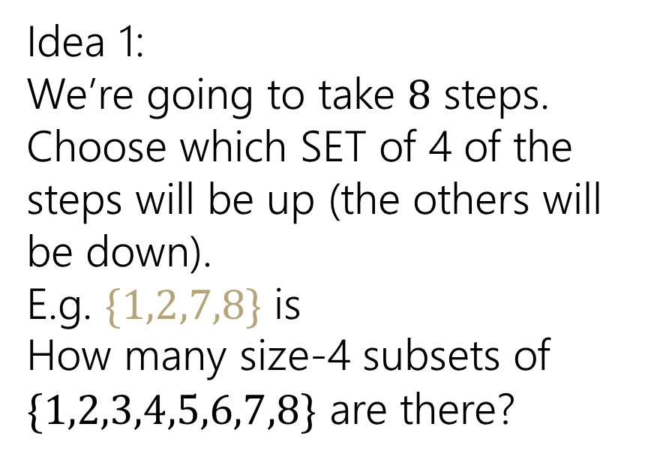
Path Counting
We’re at our farm in the lower-left corner and want to get to the Adventure’s Guild in the upper-right corner.
We’re only going to go right and up.
How many different paths are there?
Idea 1:
We’re going to take $8$ steps. Choose which SET of 4 of the steps will be up (the others will be down).
E.g. $\{1,2,7,8\}$ is
How many size-4 subsets of $\{1,2,3,4,5,6,7,8\}$ are there?

Slide 19
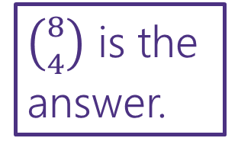
Path Counting
We’re at our farm in the lower-left corner and want to get to the Adventure’s Guild in the upper-right corner.
We’re only going to go right and up.
How many different paths are there?
Idea 1:
We’re going to take $8$ steps. Choose which SET of 4 of the steps will be up (the others will be down).
E.g. $\{1,2,7,8\}$ is
How many size-4 subsets of $\{1,2,3,4,5,6,7,8\}$ are there?
$\left({8 \atop 4}\right)$ is the answer.

Slide 20
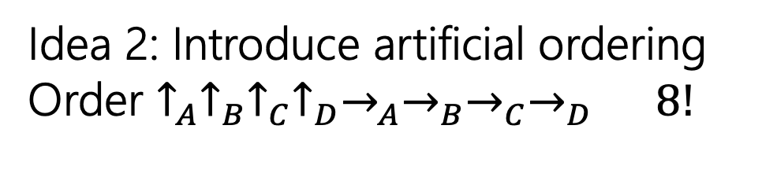
Path Counting
We’re at our farm in the lower-left corner and want to get to the Adventure’s Guild in the upper-right corner.
We’re only going to go right and up.
How many different paths are there?
Idea 2: Introduce artificial ordering
Order $↑_{A}↑_{B}↑_{C}↑_{D}→_{A}→_{B}→_{C}→_{D}$ $8!$
Notes:
We are going to use that trick we learned and intentionally overcount and then correct it.

Slide 21

Path Counting
We’re at our farm in the lower-left corner and want to get to the Adventure’s Guild in the upper-right corner.
We’re only going to go right and up.
How many different paths are there?
Idea 2: Introduce artificial ordering
Order $↑_{A}↑_{B}↑_{C}↑_{D}→_{A}→_{B}→_{C}→_{D}$ $8!$
Remove the overcounting
Those $4$ $↑$ are really the same,
divide by $4!$
The $4→$ are really the same,
divide by $4!$
Total: $\frac{8!}{4!⋅4!}$
$\left({8 \atop 4}\right)$ is the answer.
Notes:
On the HW you will have a path problem and you’ll know that you need to start with combinations and go from there to solve the problem.
You’ll also notice that permutations and combinations will show up in problems that aren’t always clearly presented as I have a set of n elements and I need to pick/choose k of them.

Slide 22

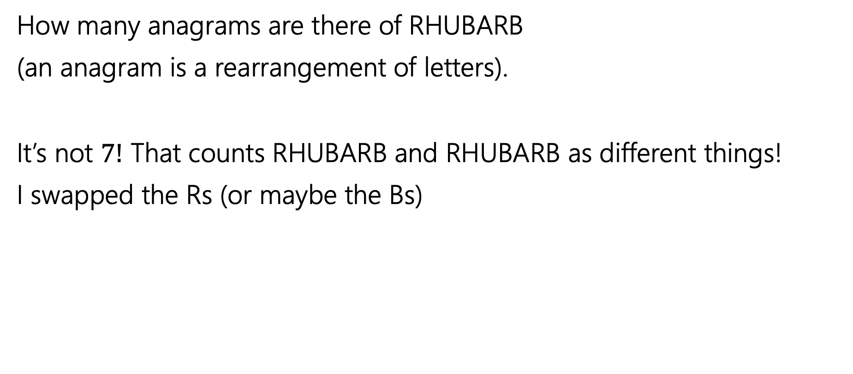
Overcounting
How many anagrams are there of RHUBARB
(an anagram is a rearrangement of letters).
It’s not $7!$ That counts RHUBARB and RHUBARB as different things!
I swapped the Rs (or maybe the Bs)

Slide 23
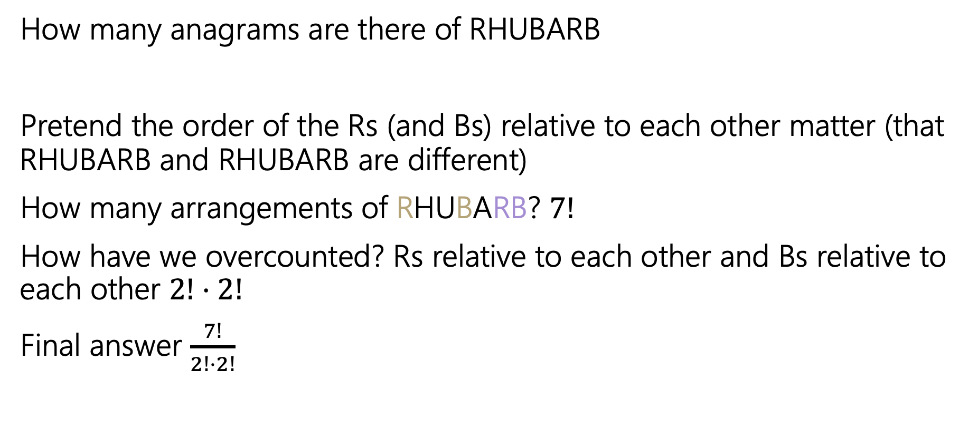
Overcounting
How many anagrams are there of RHUBARB
Pretend the order of the Rs (and Bs) relative to each other matter (that RHUBARB and RHUBARB are different)
How many arrangements of RHUBARB? $7!$
How have we overcounted? Rs relative to each other and Bs relative to each other $2!⋅2!$
Final answer $\frac{7!}{2!⋅2!}$

Slide 24
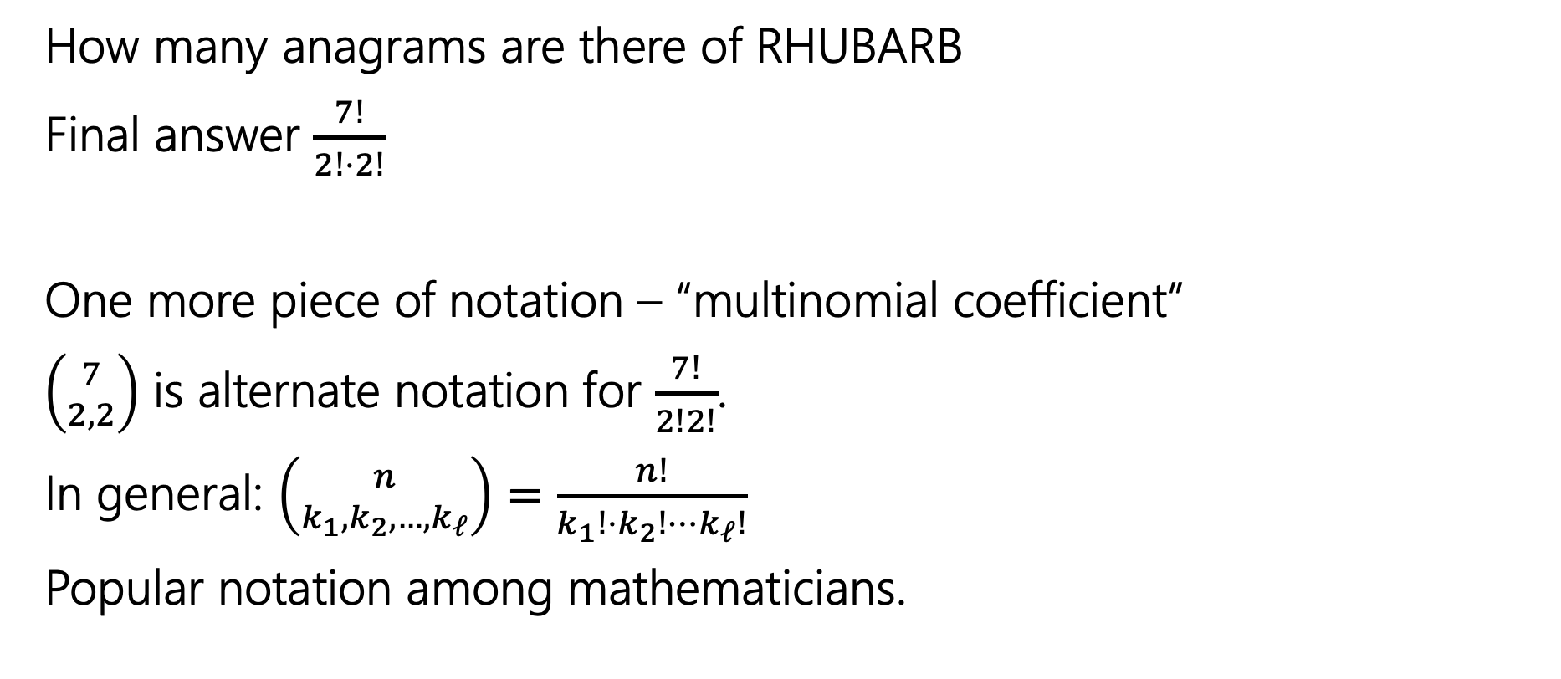
Overcounting
How many anagrams are there of RHUBARB
Final answer $\frac{7!}{2!⋅2!}$
One more piece of notation – “multinomial coefficient”
$\left({7 \atop 2,2}\right)$ is alternate notation for $\frac{7!}{2!2!}$.
In general: $\left({n \atop k_{1},k_{2},…,k_{ℓ}}\right)=\frac{n!}{k_{1}!{⋅k}_{2}!⋯k_{ℓ}!}$
Popular notation among mathematicians.
Notes:
This can be a little confusing notation with the binomial coeffitient notation

Slide 25
Combination Facts
Notes:
Helpful cause it will give us some facts that will be helpful, but hopefully some intuition about them, not just the formulas themselves.

Slide 26

Some Facts about combinations
Symmetry of combinations: $\left({n \atop k}\right)=\left({n \atop n−k}\right)$
Pascal’s Rule: $\left({n \atop k}\right)=\left({n−1 \atop k−1}\right)+\left({n−1 \atop k}\right)$

Slide 27

Two Proofs of Symmetry
Proof 1: By algebra
$\left({n \atop k}\right)=\frac{n!}{k!\left(n−k\right)!}$
$=\frac{n!}{\left(n−k\right)!k!}$
$=\left({n \atop n−k}\right)$
Definition of Combination
Algebra (commutativity of multiplication)
Definition of Combination

Slide 28
Two Proofs of Symmetry
Wasn’t that a great proof.
Airtight. No disputing it.
Got to say “commutativity of multiplication.”
But…do you know why? Can you feel why it’s true?

Slide 29
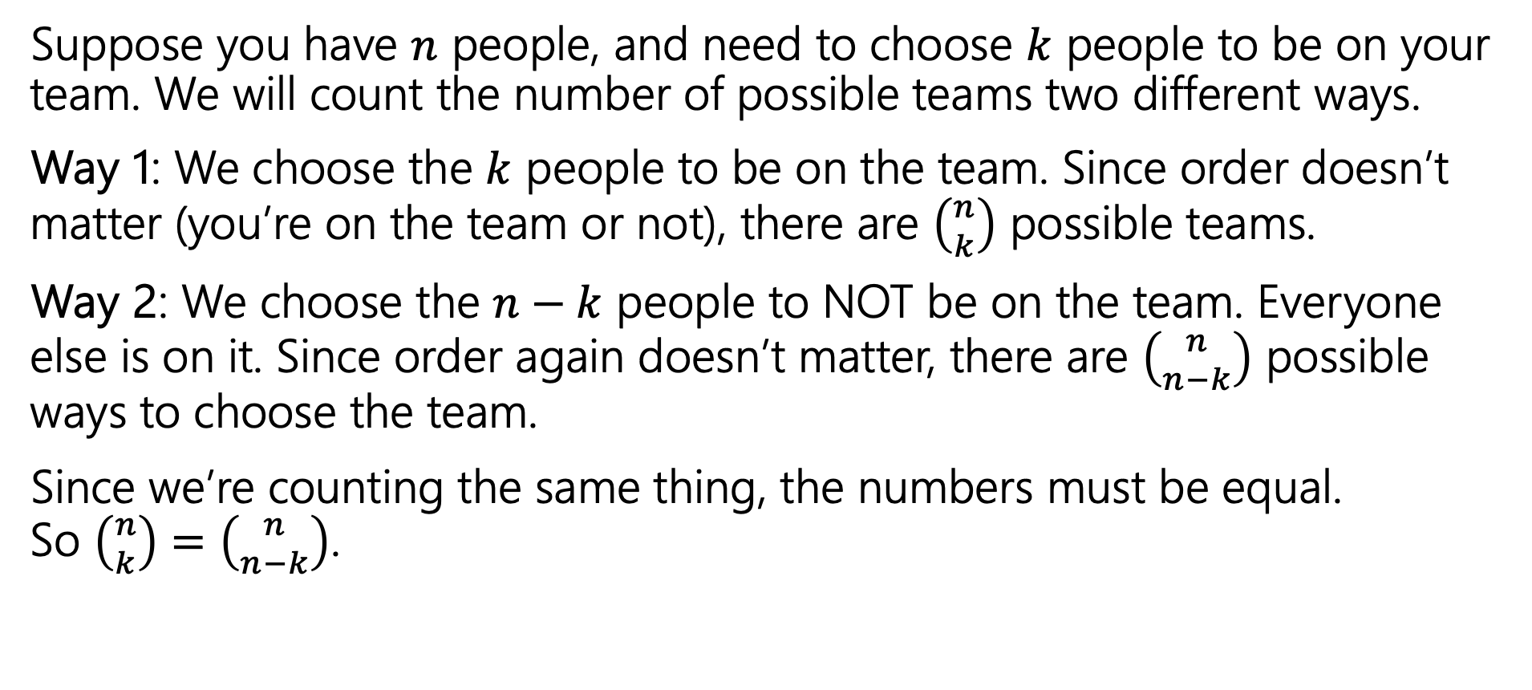
Two Proofs of Symmetry
Suppose you have $n$ people, and need to choose $k$ people to be on your team. We will count the number of possible teams two different ways.
Way 1: We choose the $k$ people to be on the team. Since order doesn’t matter (you’re on the team or not), there are $\left({n \atop k}\right)$ possible teams.
Way 2: We choose the $n−k$ people to NOT be on the team. Everyone else is on it. Since order again doesn’t matter, there are $\left({n \atop n−k}\right)$ possible ways to choose the team.
Since we’re counting the same thing, the numbers must be equal.
So $\left({n \atop k}\right)=\left({n \atop n−k}\right)$.
Notes:
Why does this work? When you choosing a subset you can either count the things that are going into the subset or the things that are not going into the subset, and you will get to the same count.
Any questions?

Slide 30
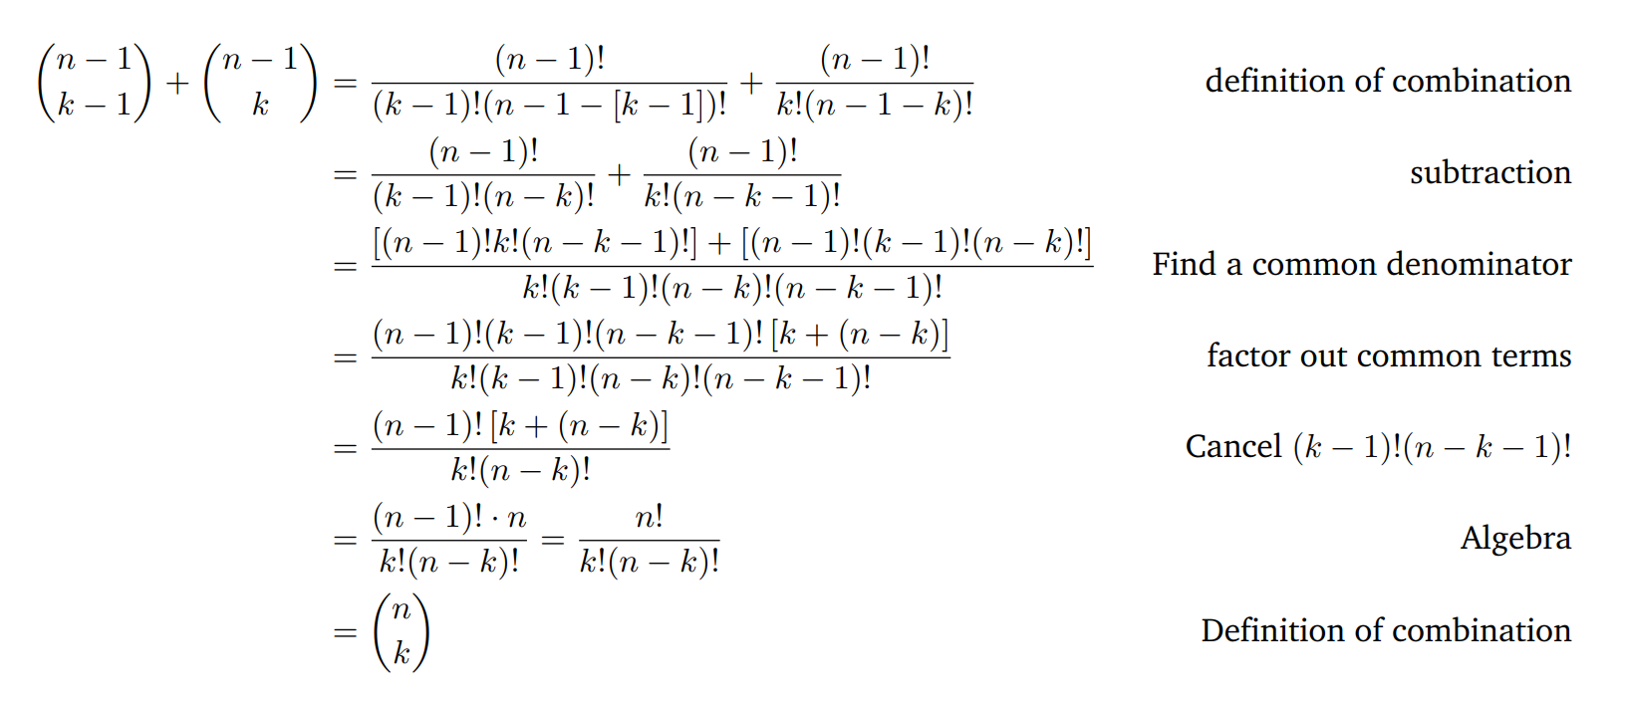

Pascal’s Rule: $\left({n \atop k}\right)=\left({n−1 \atop k−1}\right)+\left({n−1 \atop k}\right)$
Notes:
This is hard to memorize without thinking about the combinatorial proof that comes with it. There are a lot of -1’s on the right hand side

Slide 31
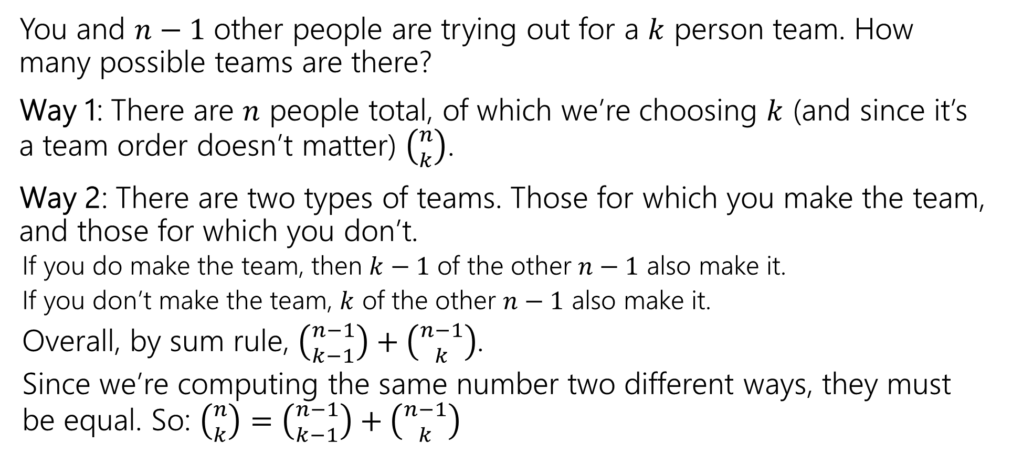
Pascal’s Rule: $\left({n \atop k}\right)=\left({n−1 \atop k−1}\right)+\left({n−1 \atop k}\right)$
You and $n−1$ other people are trying out for a $k$ person team. How many possible teams are there?
Way 1: There are $n$ people total, of which we’re choosing $k$ (and since it’s a team order doesn’t matter) $\left({n \atop k}\right)$.
Way 2: There are two types of teams. Those for which you make the team, and those for which you don’t.
  If you do make the team, then $k−1$ of the other $n−1$ also make it.
  If you don’t make the team, $k$ of the other $n−1$ also make it.
  Overall, by sum rule, $\left({n−1 \atop k−1}\right)+\left({n−1 \atop k}\right)$.
  Since we’re computing the same number two different ways, they must be equal. So: $\left({n \atop k}\right)=\left({n−1 \atop k−1}\right)+\left({n−1 \atop k}\right)$
Notes:
Take some time to think about this set up and what we are counting to see if you can figure out what the right hand side is doing.

Slide 32
Takeaways
Formulas for factorial, permutations, combinations.
A useful trick for counting is to pretend order matters, then account for the overcounting at the end (by dividing out repetitions)
When trying to prove facts about counting, try to have each side of the equation count the same thing.
  Much more fun and much more informative than just churning through algebra.

Slide 33
Binomial Theorem

Slide 34
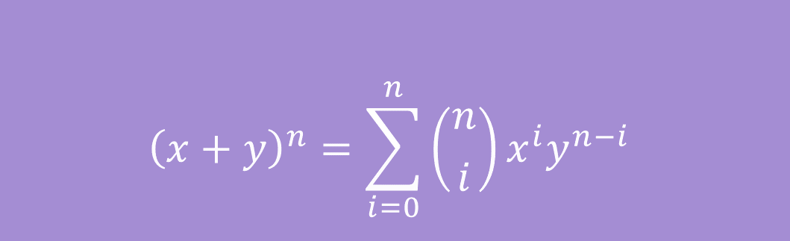

Binomial Theorem
In high school you probably memorized
${\left(x+y\right)}^{2}=x^{2}+2xy+y^{2}$
And ${\left(x+y\right)}^{3}=x^{3}+3x^{2}y+3xy^{2}+y^{3}$
The Binomial Theorem tells us what happens for every $n$:
$${\left(x+y\right)}^{n}=\sum_{i=0}^{n}{\left({n \atop i}\right)x^{i}y^{n−i}}$$
The Binomial Theorem

Slide 35
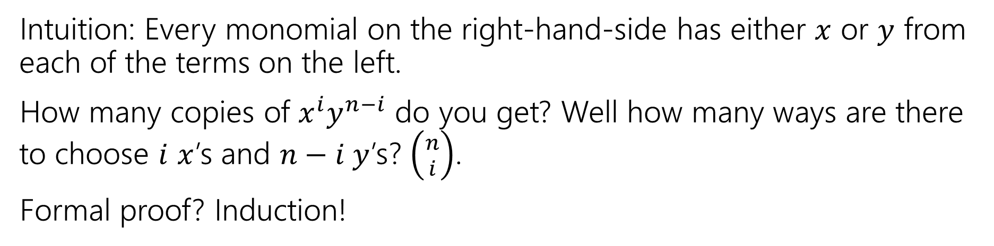
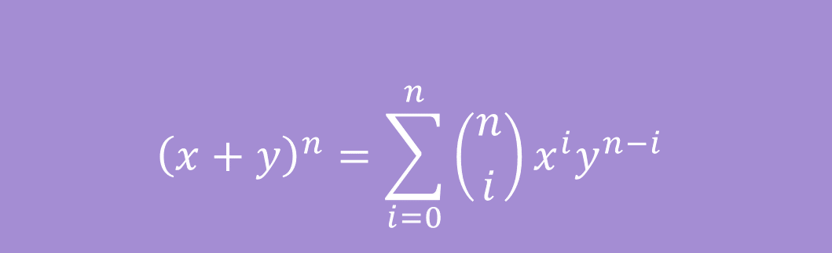
Some intuition
$${\left(x+y\right)}^{n}=\sum_{i=0}^{n}{\left({n \atop i}\right)x^{i}y^{n−i}}$$
The Binomial Theorem
Intuition: Every monomial on the right-hand-side has either $x$ or $y$ from each of the terms on the left.
How many copies of $x^{i}y^{n−i}$ do you get? Well how many ways are there to choose $i$ $x$’s and $n−i y$’s? $\left({n \atop i}\right)$.
Formal proof? Induction!
Notes:
The proof uses pascals rule that we talked about.

Slide 36
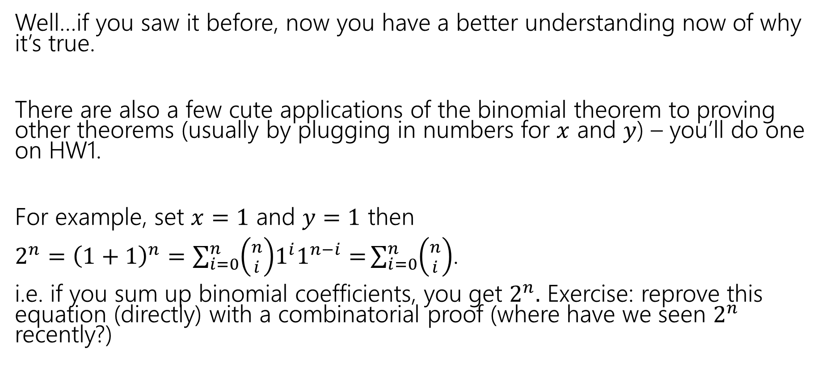
So What?
Well…if you saw it before, now you have a better understanding now of why it’s true.
There are also a few cute applications of the binomial theorem to proving other theorems (usually by plugging in numbers for $x$ and $y$) – you’ll do one on HW1.
For example, set $x=1$ and $y=1$ then
$2^{n}={\left(1+1\right)}^{n}=\sum_{i=0}^{n}{\left({n \atop i}\right)1^{i}1^{n−i}=}\sum_{i=0}^{n}{\left({n \atop i}\right)}$.
i.e. if you sum up binomial coefficients, you get $2^{n}.$ Exercise: reprove this equation (directly) with a combinatorial proof (where have we seen $2^{n}$ recently?)

Slide 37
Extra Practice

Slide 38
Books, revisited
Remember the books problem from lecture 1? Books 1,2,3,4,5 need to be assigned to Leo, Jas, and Vincent (each book to exactly one person).
Now that we know combinations, try a sequential process approach. It won’t be as nice as the change of perspective, but we can make it work.
Break into cases based on how many books Leo gets, use the sum rule to combine.

Slide 39
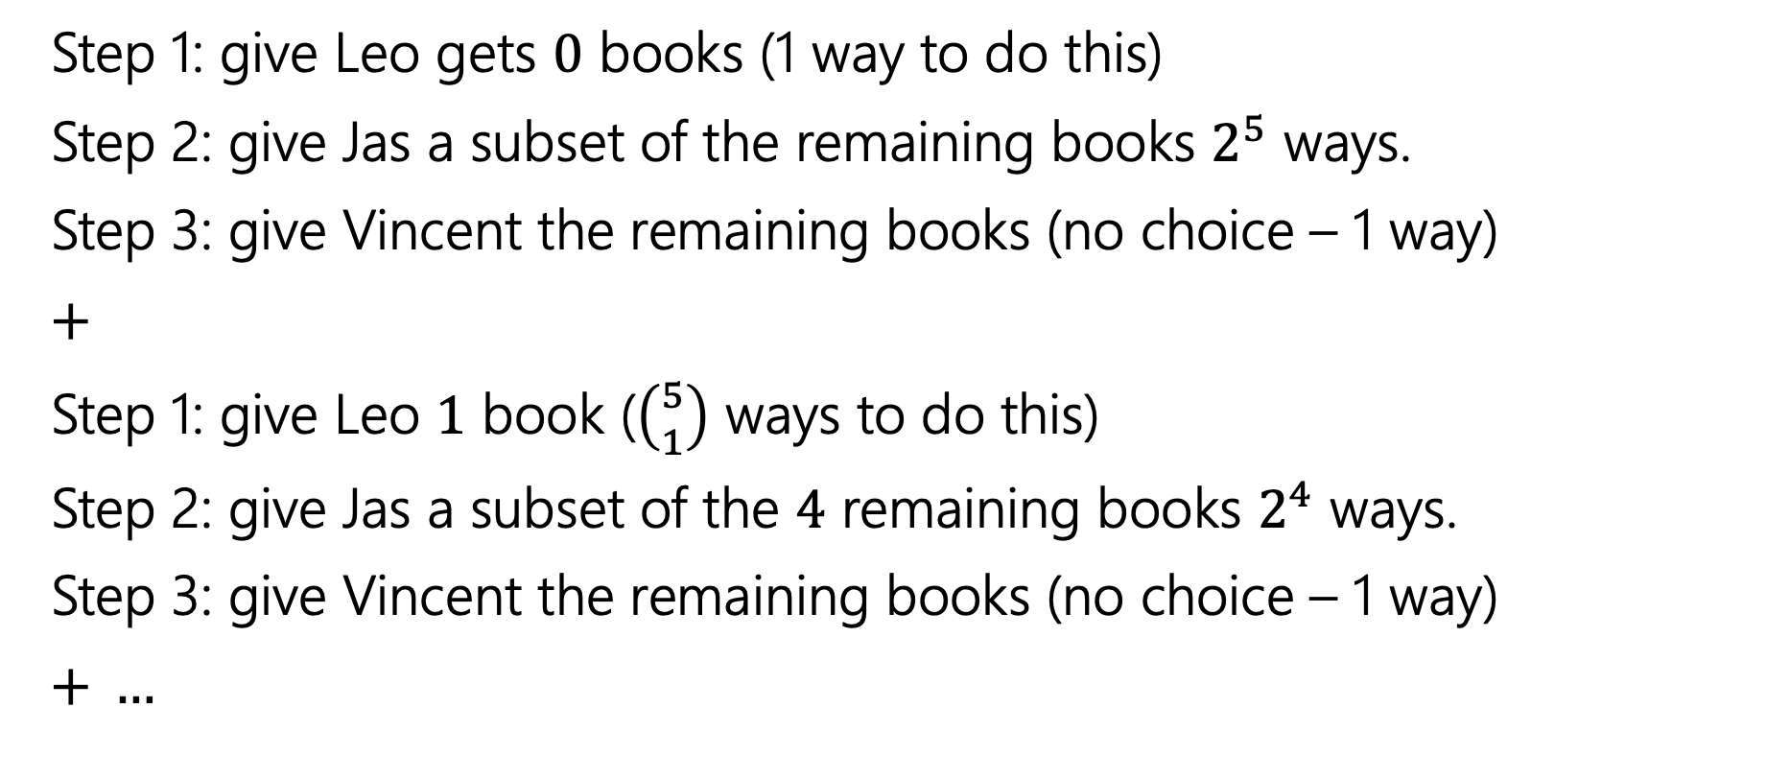
Books, revisited
Step 1: give Leo gets $0$ books (1 way to do this)
Step 2: give Jas a subset of the remaining books $2^{5}$ ways.
Step 3: give Vincent the remaining books (no choice – 1 way)
$+$
Step 1: give Leo $1$ book ($\left({5 \atop 1}\right)$ ways to do this)
Step 2: give Jas a subset of the $4$ remaining books $2^{4}$ ways.
Step 3: give Vincent the remaining books (no choice – 1 way)
$+ …$

Slide 40

Books, revisited
Add all the options together
$1⋅2^{5}⋅1+\left({5 \atop 1}\right)⋅2^{4}⋅1+\left({5 \atop 2}\right)⋅2^{3}⋅1+\left({5 \atop 3}\right)⋅2^{2}⋅1+\left({5 \atop 4}\right)⋅2^{1}⋅1+\left({5 \atop 5}\right)⋅2^{0}⋅1$
If you plug and chug, you’ll get the number we got last time. It took quite a bit of work, but we got there!

