Slide 1
Here Early?
Here for CSE 312?
Welcome! You’re early!
Want a copy of these slides to take notes?
You can download them from the webpage cse.uw.edu/312

Slide 2
Introduction and Counting
CSE 312 Summer 25
Lecture 1

Slide 3

Staff
Instructor: Anna Kuznetsova
Graduate Student in Computer Science at UW
Email: avk5@uw.edu
TAs
Caleb Hsu | Kieran Rullman
Jewoo Park | Krisha Khandelwal
Thakrit (Jai) Wongcharoensangsiri

Slide 4
Logistics – Lectures
There is one lecture, MWF
12:00 – 1:00pm in DEM 104
Lectures will be recorded, with recordings posted when possible.
Notes:
Note on laptop use
Looking at slides will likely not be sufficient, so if you miss lecture please make sure to watch the recording

Slide 5
Logistics – Sections
Sections meet on Thursdays (starting this week)
Please go to your assigned section.
Both sections are at 12pm in ECE.
Sections will not be recorded – we want you to be able to ask questions and give feedback without worrying about being recorded.
Handouts and solutions will be posted.
Your participation, whether in person or async will be recorded.

Slide 6
Materials
When in doubt, it’s on the webpage:
Full URL: https://courses.cs.washington.edu/courses/cse312/25su/
Short URL: http://cse.uw.edu/312
Notes:
Not using canvas, most things you need will be on the web page

Slide 7
Work
Approximately 7 Homeworks (20%)
Mostly written problems, but a few programming questions.
Concept Checks (10%)
Short assignment for each lecture on gradescope; identify misconceptions right away.
Due the morning of the next lecture. First due date Friday.
Section Participation (10%)
Go to section and work on problems there or (if you can’t make it) do the corresponding problems on your own and email them to your TA by Sunday at 11:59pm.
7 In-Lecture Quizzes (10%)
Tentative topics are posted on the calendar. First quiz this Friday.
Two quizzes will be dropped to account for sicknesses and other things that come up during the quarter.
Midterm (20%)
In lecture on Wednesday July 23rd at 12pm.
Final exam (30%)
Part 1 in your assigned section Thursday August 21st at 12pm.
Part 2 in lecture, Friday August 22nd at 12pm.
Final is cumulative but will focus on the latter part of the course.
Notes:
CCs: an explanation will appear when you got the answer correct. If you don’t see an explanation you can attempt as many times as needed.
Section Participation: Tricker problems with the concepts covered in lecture. A great place to attempt problems and ask questions as you are preparing for quizzes and working on that weeks homework.
Quizzes are meant to give you an indicator about how you are doing with the concepts on a more regular basis as they very quickly build on each other. You’ll be able to catch misconceptions earlier and have a more manageable way to catch up on a topic if needed.
Note: these percentage breakdowns are subject to change.

Slide 8
Communication
Ed Discussion board will be our primary means of communication.
Please check frequently.
We’ll send announcement emails via Ed.
If you want to contact us:
Private post on Ed (seen by TAs and Anna, but not other students)
Email Anna
Anonymous Feedback form on webpage
Notes:
Make sure ed emails aren’t going to your junk.

Slide 9
Resources
Office Hours
Will start this Friday. Check the calendar for times and locations.
1:1 Office Hours
See course website for more details.
Ed Discussion
Ask general questions in the mega threads.
Ask specific questions as private posts.
Resources page
List of theorems and definitions
Optional Textbook

Slide 10
Academic Integrity
Be sure that you are able to explain and/or re-derive anything that you submit. If we have doubts about whether you did the work on your own, we may ask you to come in and explain your solution to us verbally.
Collaboration
Resources outside of the course
Generative AI (ChatGPT, LLMs, etc.)
Notes:
Collaboration is really helpful in this class because there are often multiple ways to approach a problem, and some end up being much easier than others.
Rising number of academic integrity cases.

Slide 11
What is This Class?
We’re going to learn fundamentals of probability theory.
A beautiful and useful branch of mathematics.
Applications in:
Machine Learning
Natural Language Processing
Cryptography
Error-Correcting Codes
Data Structures
Data Compression
Complexity Theory
Algorithm Design
…
Notes:
We will be learning the basics of probability theory that have many many applications both in CS and the real world
ML responses are different for the same prompt because of randomness

Slide 12
Content
Combinatorics (fancy counting)
Permutations, combinations, inclusion-exclusion, pigeonhole principle
Formal definitions for Probability
Probability space, events, conditional probability, independence, expectation, variance
Common patterns in probability
Equations and inequalities, “zoo” of common random variables, tail bounds
Continuous Probability
pdf, cdf, sample distributions, central limit theorem, estimating probabilities
Applications
Across CS, but with some focus on ML.
Notes:
Fancy ways of counting finite sets that are finite, but too big for us to write out each element of.
First half of the course will deal with discrete probabilities, like rolling a die or flipping a coin. The second half of the course will be dealing with continuous probabilities like instead of rolling a die I want to generate a real number from 0 to 1. Some things are similar between these two, but some are different.

Slide 13
Themes
Precise mathematical communication
Both reading and writing dense statements.
Probability in the “real world”
A mix of CS applications
And some actual “real life” ones.
Refine your intuition
Most people have some base level feeling of what the chances of some event are.
We’re going to train you to have better gut feelings.
Notes:
You’ve had a lot of practice with this in 311, and we will continue this approach. You wont really be writing many proofs but will be carefully explaining how you calculated something on the HWs. You’ll see that in this class one word can really change what experiment you are referring to, so we want to continue practicing precise communication.

Slide 14
Counting

Slide 15
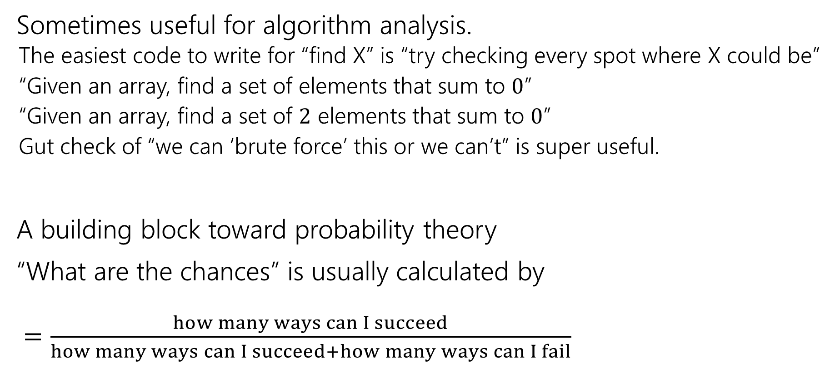
Why Counting?
Sometimes useful for algorithm analysis.
The easiest code to write for “find X” is “try checking every spot where X could be”
“Given an array, find a set of elements that sum to $0$”
“Given an array, find a set of $2$ elements that sum to $0$”
Gut check of “we can ‘brute force’ this or we can’t” is super useful.
A building block toward probability theory
“What are the chances” is usually calculated by $=\frac{how many ways can I succeed}{how many ways can I succeed+how many ways can I fail}$

Slide 16
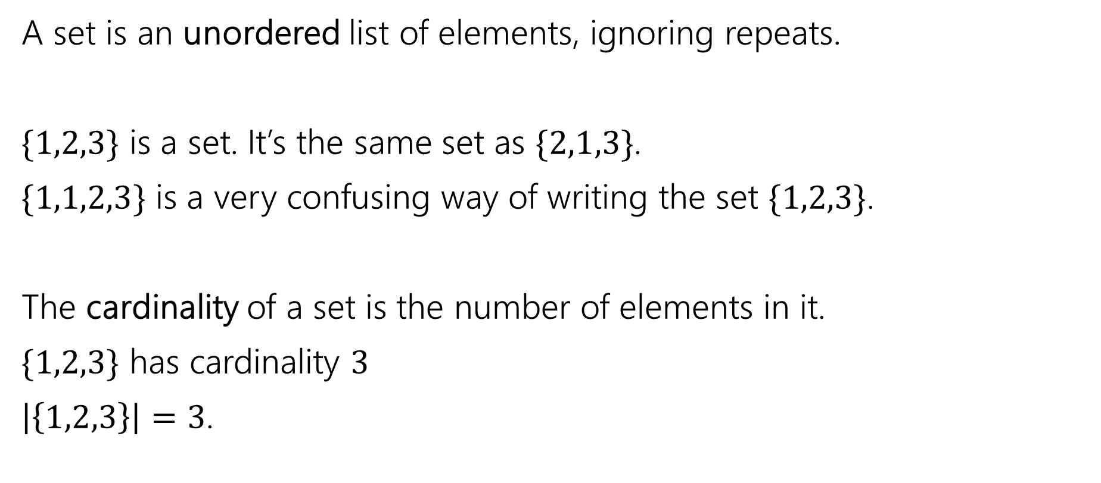
Remember sets?
A set is an unordered list of elements, ignoring repeats.
$\{1,2,3\}$ is a set. It’s the same set as $\{2,1,3\}$.
$\{1,1,2,3\}$ is a very confusing way of writing the set $\{1,2,3\}$.
The cardinality of a set is the number of elements in it.
$\{1,2,3\}$ has cardinality $3$
$\left|\left\{1,2,3\right\}\right|=3$.

Slide 17









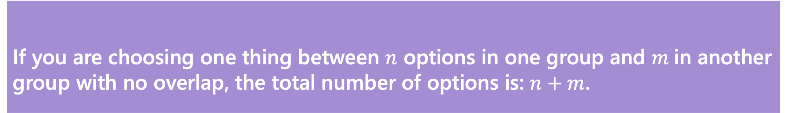
Counting Rules
How many options do I have for dinner in Pelican Town?
I could go to Pierre's General Store where there are $3$ meals I choose from, or I could go to The Stardrop Saloon where there are $5$ meals I choose from (and none of them are the same between the two).
How many total choices?
$3+5=8$
If you are choosing one thing between $n$ options in one group and $m$in another group with no overlap, the total number of options is: $n+m$.
Sum Rule
Notes:
I had one set and another set. I made sure there was no over lap in the sets and unioned them to get my final set of options.

Slide 18
Counting Rules
I’m still hungry…
I decide to cook a meal myself. My meals are always:
One of three types of root vegetable (potato, yam, or taro root).
One of two leafy vegetables (kale or bok choy)
One of four fish (tuna, sardine, salmon, or tilapia)
How many meals can I make?
Notes:
Take a minute to think about this one.

Slide 19









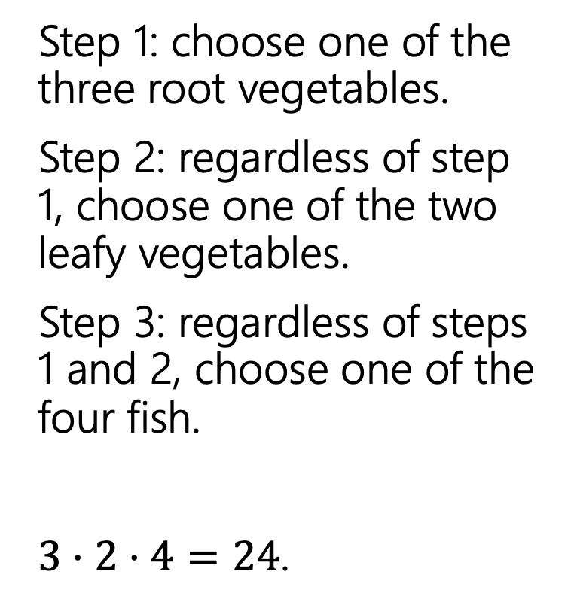
Meals
Step 1: choose one of the three root vegetables.
Step 2: regardless of step 1, choose one of the two leafy vegetables.
Step 3: regardless of steps 1 and 2, choose one of the four fish.
$3⋅2⋅4=24$.

Slide 20
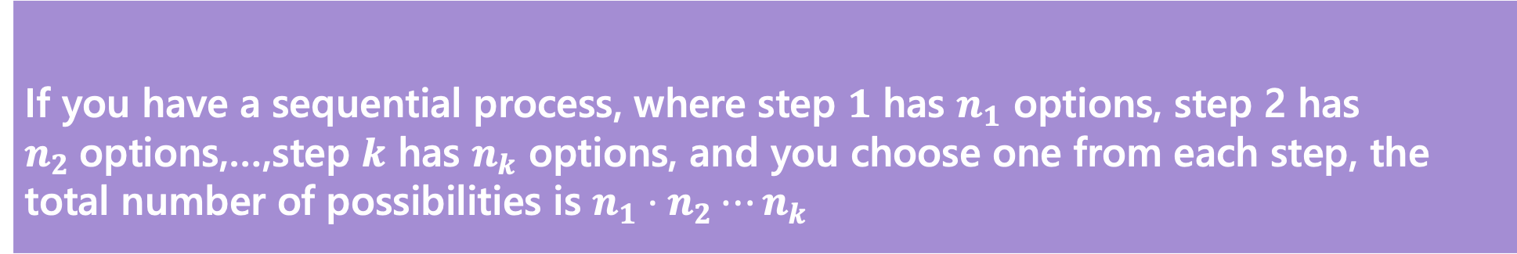
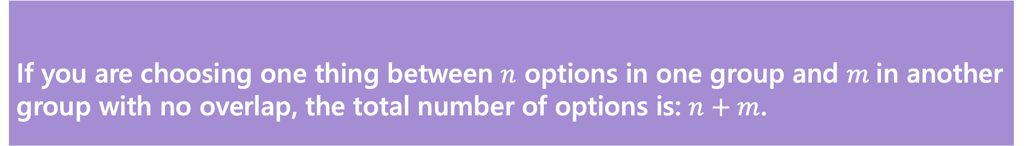
Counting Rules
If you are choosing one thing between $n$ options in one group and $m$in another group with no overlap, the total number of options is: $n+m$.
Sum Rule
If you have a sequential process, where step $1$ has $n_{1}$ options, step 2 has $n_{2}$options,…,step $k$ has $n_{k}$ options, and you choose one from each step, the total number of possibilities is $n_{1}⋅n_{2}⋯n_{k}$
Product Rule
Notes:
Add note about or’s vs and

Slide 21
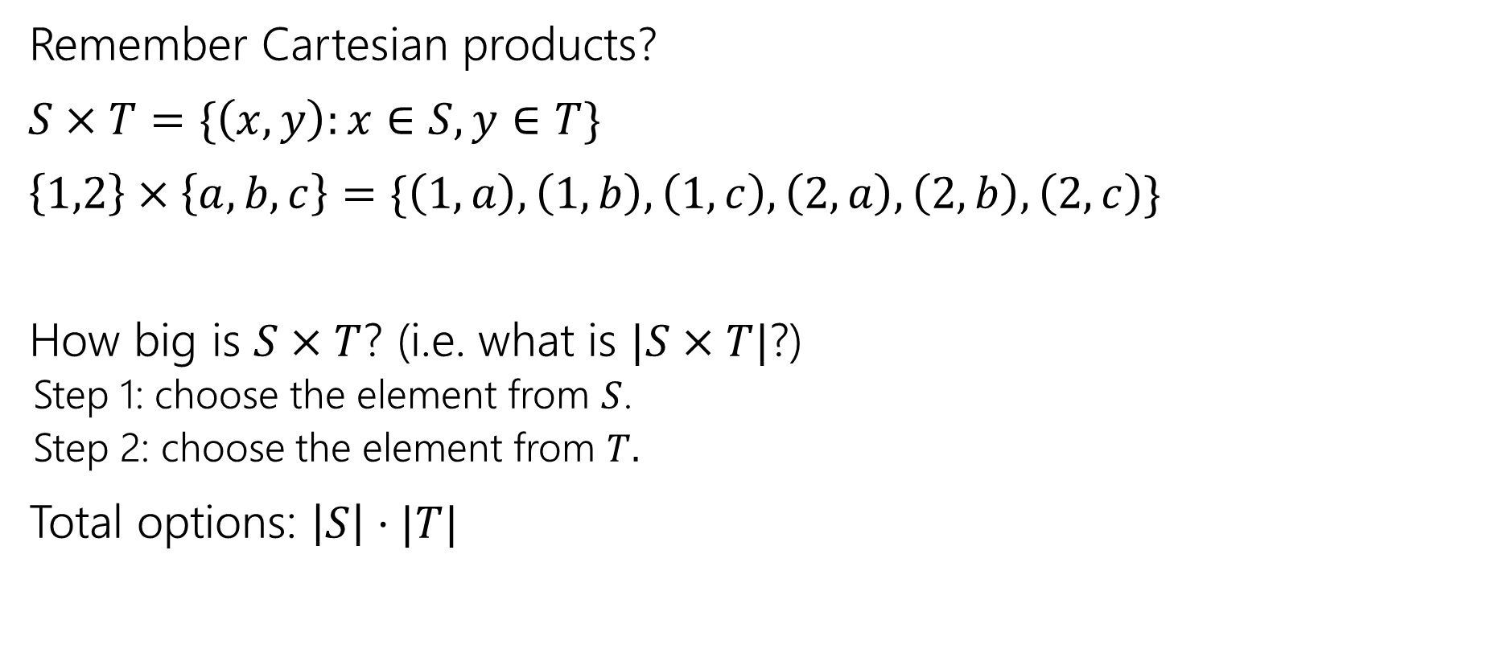
Applications of the product rule
Remember Cartesian products?
$S×T=\{\left(x,y\right):x∈S, y∈T\}$
$\left\{1,2\right\}×\left\{a,b,c\right\}=\{\left(1,a\right),\left(1,b\right),\left(1,c\right),\left(2,a\right),\left(2,b\right),\left(2,c\right)\}$
How big is $S×T$? (i.e. what is $|S×T|$?)
Step 1: choose the element from $S$.
Step 2: choose the element from $T.$
Total options: $\left|S\right|⋅|T|$
Notes:
The resulting set is a set of ordered pairs.

Slide 22

Power Sets
$𝒫\left(S\right)=\{X:X⊆S\}$
$𝒫\left(\left\{1,2,3\right\}\right)=\{ ∅, \left\{1\right\},\left\{2\right\},\left\{3\right\}, \left\{1,2\right\},\left\{1,3\right\},\left\{2,3\right\}, \left\{1,2,3\right\} \}$
How many subsets are there of $S$, i.e. what is $\left|𝒫\left(S\right)\right|$?
Notes:
Take a moment to remember from 311 or try to rederive it from one of the two rules that we introduced

Slide 23
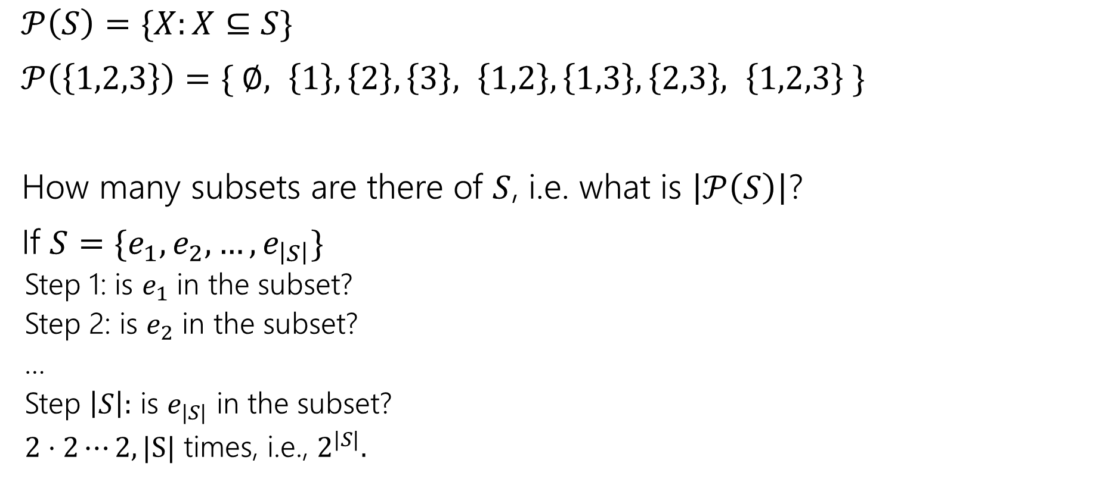
Power Sets
$𝒫\left(S\right)=\{X:X⊆S\}$
$𝒫\left(\left\{1,2,3\right\}\right)=\{ ∅, \left\{1\right\},\left\{2\right\},\left\{3\right\}, \left\{1,2\right\},\left\{1,3\right\},\left\{2,3\right\}, \left\{1,2,3\right\} \}$
How many subsets are there of $S$, i.e. what is $\left|𝒫\left(S\right)\right|$?
If $S=\{e_{1},e_{2},…,e_{\left|S\right|}\}$
Step 1: is $e_{1}$ in the subset?
Step 2: is $e_{2}$ in the subset?
…
Step $\left|S\right|:$ is $e_{|S|}$ in the subset?
$2⋅2⋯2, |S|$ times, i.e., $2^{|S|}.$

Slide 24









Farming Outfits
The farmer has three hats (cowboy, straw, mushroom)
Three shirts (classic overalls, night sky, light blue)
And three pairs of pants (farmer, dinosaur, relaxed fit)
How many outfits are there (consisting of one hat, shirt, and pair of pants) if
the classic overalls shirt cannot be worn with dinosaur pants,
the night sky shirt cannot be worn with relaxed fit pants,
and the light blue shirt cannot be worn with farmer pants.
Notes:
Before the condition it sounded similar to the previous problem

Slide 25
Farming Outfits
Step 1: 3 choices for hats.
Step 2: 3 choices for shirts
Step 3:…
Notes:
But then what do we do with the pants. Take a moment to discuss with you partner. Go back to the other slide

Slide 26
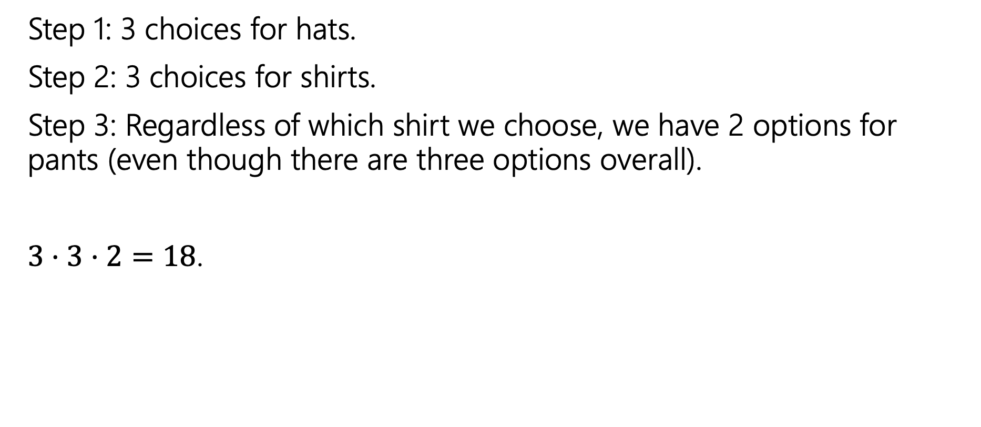
Farming Outfits
Step 1: 3 choices for hats.
Step 2: 3 choices for shirts.
Step 3: Regardless of which shirt we choose, we have 2 options for pants (even though there are three options overall).
$3⋅3⋅2=18$.
Notes:
Two approaches,
count all ways and remove the invalid options of which there are 9
or notice that no matter what shirt you pick there we always be two pant options to pick

Slide 27








Assigning Books
We have 5 books to split to 3 people (Leo, Jas, and Vincent)
Every book goes to exactly one person, but each person could end up with no books (or all of them, or something in between).
1
Leo
2
Jas
3
4
Vincent
5

Slide 28
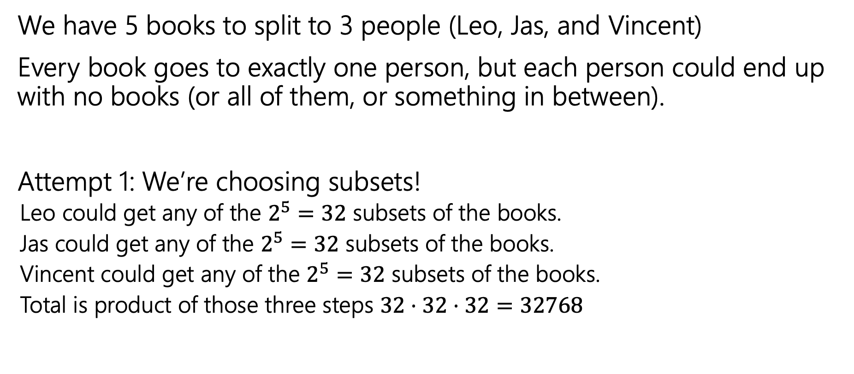
Assigning Books
We have 5 books to split to 3 people (Leo, Jas, and Vincent)
Every book goes to exactly one person, but each person could end up with no books (or all of them, or something in between).
Attempt 1: We’re choosing subsets!
Leo could get any of the $2^{5}=32$ subsets of the books.
Jas could get any of the $2^{5}=32$ subsets of the books.
Vincent could get any of the $2^{5}=32$ subsets of the books.
Total is product of those three steps $32⋅32⋅32=32768$
Notes:
Do you believe this computation? If not, what should we be doing instead? Discuss with your neighbor.

Slide 29

Activity
Attempt 1: We’re choosing subsets!
Leo could get any of the $2^{5}=32$ subsets of the books.
Jas could get any of the $2^{5}=32$ subsets of the books.
Vincent could get any of the $2^{5}=32$ subsets of the books.
Total is product of those three steps $32⋅32⋅32=32768$

Slide 30
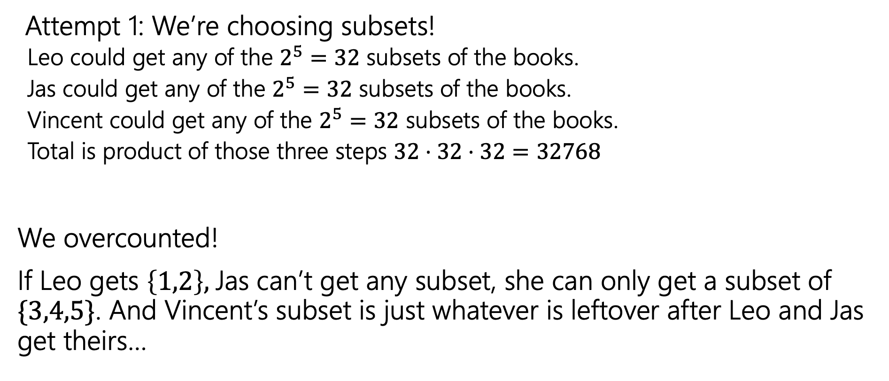
Activity
Attempt 1: We’re choosing subsets!
Leo could get any of the $2^{5}=32$ subsets of the books.
Jas could get any of the $2^{5}=32$ subsets of the books.
Vincent could get any of the $2^{5}=32$ subsets of the books.
Total is product of those three steps $32⋅32⋅32=32768$
We overcounted!
If Leo gets $\left\{1,2\right\},$Jas can’t get any subset, she can only get a subset of $\{3,4,5\}$. And Vincent’s subset is just whatever is leftover after Leo and Jas get theirs…

Slide 31
Fixing All The Books
You could
List out all the options for Leo.
For each of those (separately), list all the possible options for Jas and Vincent.
Use the Summation rule to combine.
~OR~ you could come at the problem from a different angle.

Slide 32
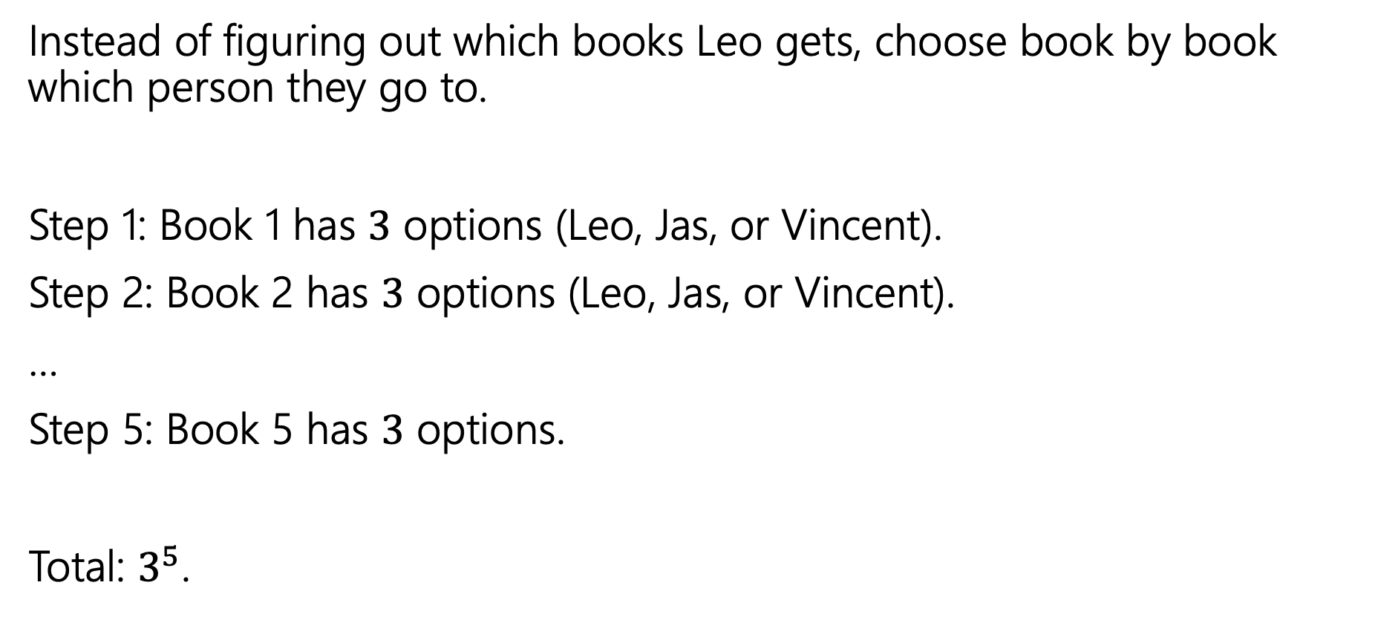
Fixing All the Books
Instead of figuring out which books Leo gets, choose book by book which person they go to.
Step 1: Book 1 has $3$ options (Leo, Jas, or Vincent).
Step 2: Book 2 has $3$ options (Leo, Jas, or Vincent).
…
Step 5: Book 5 has $3$ options.
Total: $3^{5}$.

Slide 33

More sequence practice
How many length 3 sequences are there consisting of distinct elements of $\{1,2,3\}$.

Slide 34
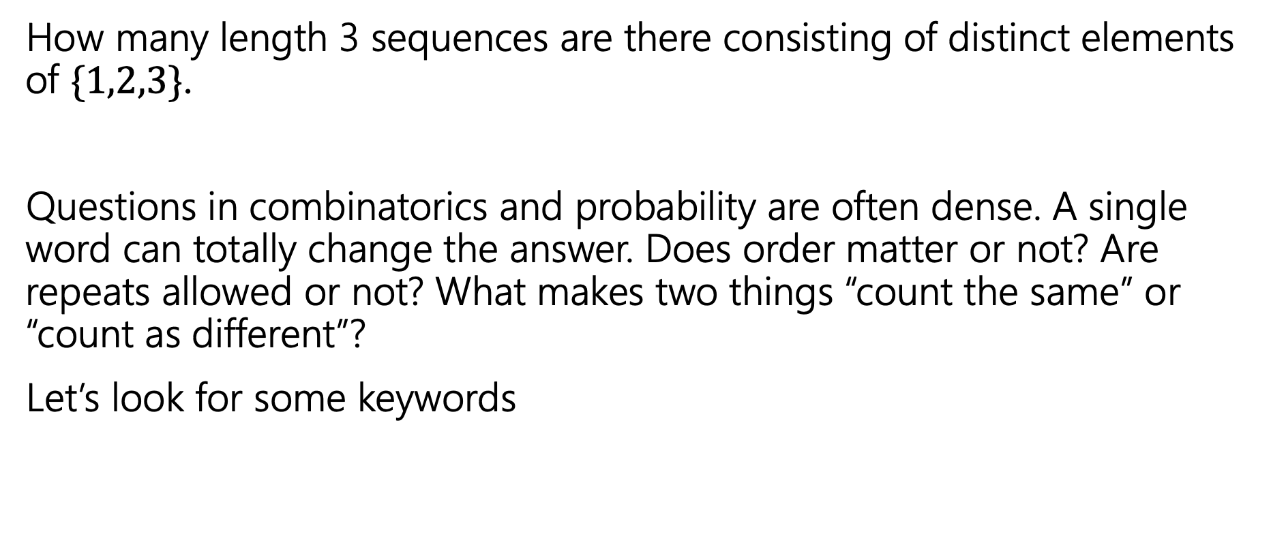
Pause
How many length 3 sequences are there consisting of distinct elements of $\{1,2,3\}$.
Questions in combinatorics and probability are often dense. A single word can totally change the answer. Does order matter or not? Are repeats allowed or not? What makes two things “count the same” or “count as different”?
Let’s look for some keywords

Slide 35

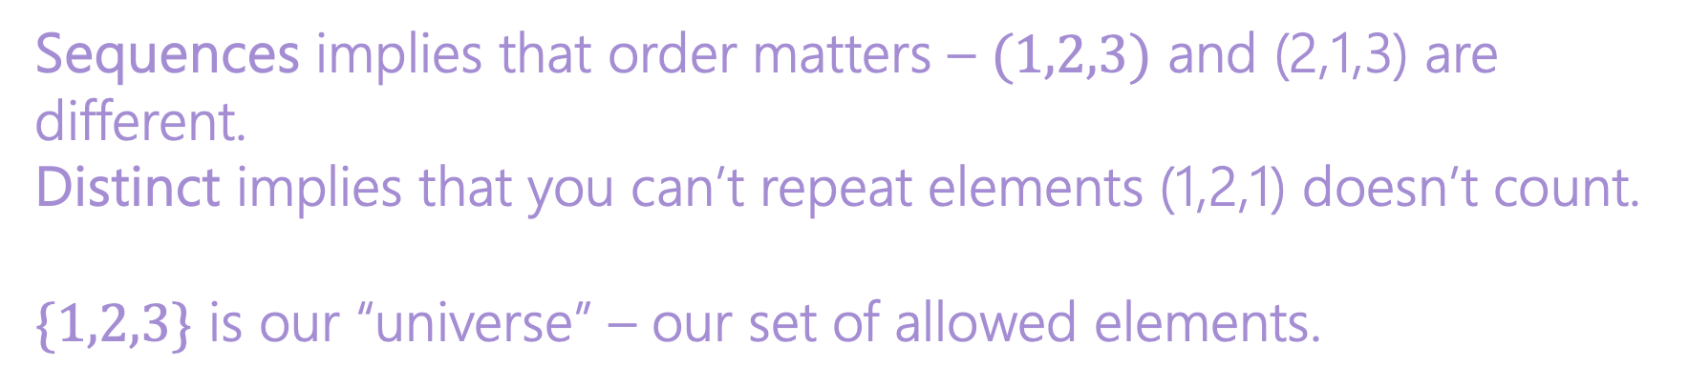
More sequence practice
How many length 3 sequences are there consisting of distinct elements of $\{1,2,3\}$.
Sequences implies that order matters – $(1,2,3)$ and (2,1,3) are different.
Distinct implies that you can’t repeat elements (1,2,1) doesn’t count.
$\{1,2,3\}$ is our “universe” – our set of allowed elements.

Slide 36
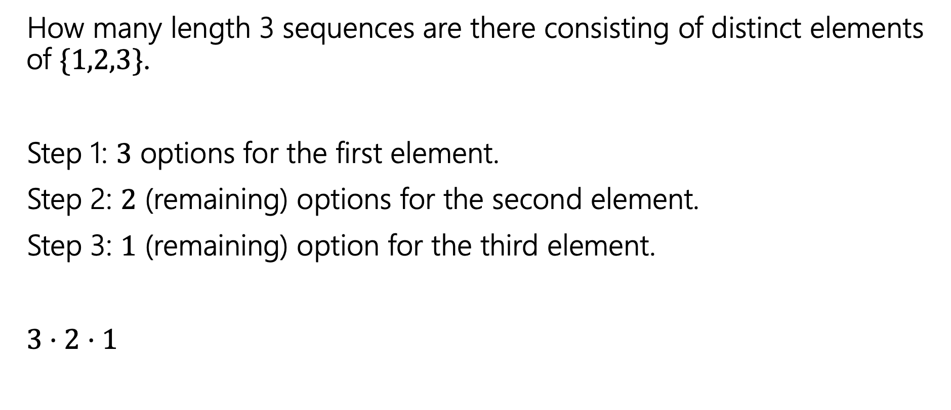
More sequence practice
How many length 3 sequences are there consisting of distinct elements of $\{1,2,3\}$.
Step 1: $3$ options for the first element.
Step 2: $2$ (remaining) options for the second element.
Step 3: $1$ (remaining) option for the third element.
$3⋅2⋅1$

Slide 37

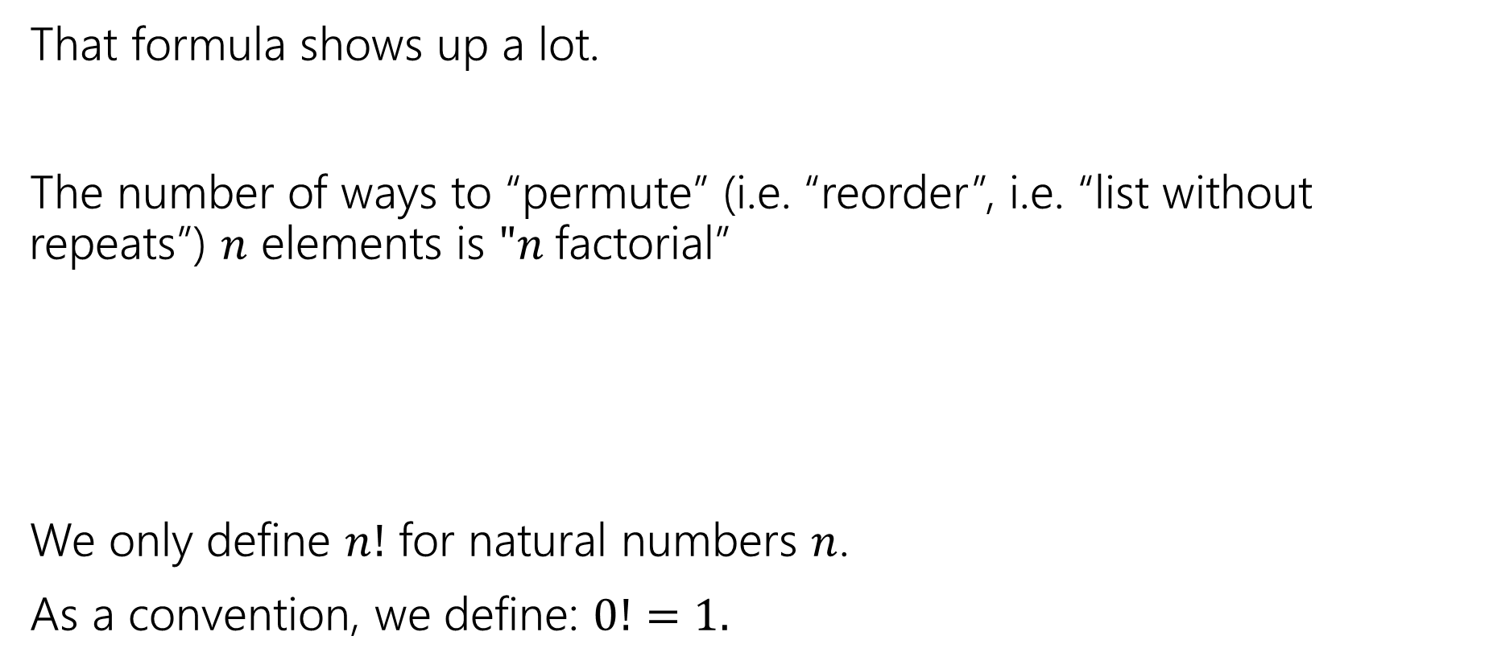

Factorial
That formula shows up a lot.
The number of ways to “permute” (i.e. “reorder”, i.e. “list without repeats”) $n$ elements is $"n$factorial”
We only define $n!$ for natural numbers $n$.
As a convention, we define: $0!=1.$
$$n!=n⋅\left(n−1\right)⋅\left(n−2\right)⋯1$$
$n$ factorial

Slide 38
More Practice

Slide 39

Strings
How many strings of length $5$ are there over the alphabet $\{A,B,C,…,Z\}$? (repeated characters allowed)
How many binary strings of length $n$ are there?

Slide 40

Strings
How many strings of length $5$ are there over the alphabet $\{A,B,C,…,Z\}$? (repeated characters allowed)
${26}^{5}$
How many binary strings of length $n$ are there?
$2^{n}$

