Slide 1
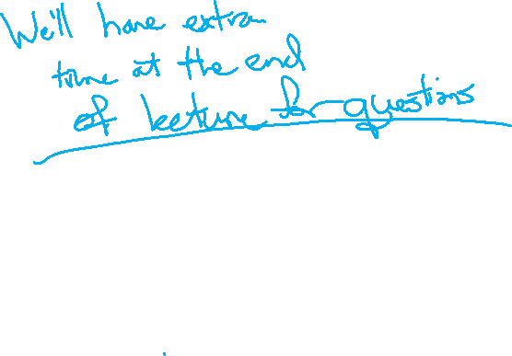
Victory Lap
CSE 312 Autumn 25
Lecture 30

Slide 2
Announcements
We’ll have assigned seating for final exam---if you want to request a left-handed or wright-handed desk, fill out this form (also on webpage).
Use the same form for scheduling conflicts (but we expect those to be rare).
Deadline for the form is Monday at noon.

Slide 3
Victory Lap

Slide 4
What Have We Done?
Well let’s look back…

Slide 5
Content
Combinatorics (fancy counting)
Permutations, combinations, inclusion-exclusion, pigeonhole principle
Formal definitions for Probability
Probability space, events, conditional probability, independence, expectation, variance
Common patterns in probability
Equations and inequalities, “zoo” of common random variables, tail bounds
Continuous Probability
pdf, cdf, sample distributions, central limit theorem, estimating probabilities
Applications
Across CS, but with some focus on ML.

Slide 6
Themes
Precise mathematical communication
Both reading and writing dense statements.
Probability in the “real world”
A mix of CS applications
And some actual “real life” ones.
Refine your intuition
Most people have some base level feeling of what the chances of some event are.
We’re going to train you to have better gut feelings.

Slide 7
Use Your Powers Wisely
We’ve seen probability can be used in the real world!
But also that it:
Can be counter-intuitive/hard to explain (Bayes Rule/Real World)
Probability estimates can depend on the model you’re using (Real World)

Slide 8
How (not to) lie with statistics
You now know a lot of the tools that people use to lie with statistics. (See also: INFO 270)
Some patterns to watch out for:
My smoke alarm is going off, please pay for my new house! (analogy from Matt Parker)
Make a model, find that an event that occurred had small probability/fails some statistical test, claim that the only explanation is something nefarious occurred.
Better response: could the model be wrong? Is this statistical test appropriate? Once in 100 year events do happen…about once in every hundred years, is this just the one?

Slide 9
How (not to) lie with statistics
See a story about testing?
Remember from Bayes’ Rule that you need three numbers to understand a test. (3 of prior, posterior, false positive rate, false negative rate).
Headlines usually give you one number, that often isn’t even one of the ones you need for Bayes (“this test is less accurate than a coin flip!”).
The article itself, if you’re lucky, might give you one or two of the numbers for Bayes – don’t forget the prior!

Slide 10
How (not to) lie with statistics
Before being impressed with a number, make sure you understand what it means.
Recent example for Robbie:
In baseball umpires decide whether a pitch is a strike or a ball (whether it goes through an (invisible) rectangle when thrown to the hitter)
There are camera systems built into stadiums that track the ball, and figure out where it went
In an infamous game an umpire missed 12% of the calls, according to an unofficial analysis of the data. Or possibly 4% of the calls, according to the official analysis of the data.
Notes:
It turns out the official analysis says “the systems have error of up to about an inch” if the estimate of where the ball is, is within 1 inch of the correct call, then assume it was correct. The unofficial analysis says “the computer said it was there, that was a wrong call” Which analysis is right? Well they both have benefits and drawbacks And is either of these numbers good or bad? That was a bad game, but what counts as bad depends on which evaluation system you’re using. https://www.youtube.com/watch?v=9o4weN6AkPY

Slide 11
How (not to) lie with statistics
We can apply our knowledge to the real world!
But if you’re applying in a new domain, get information from domain experts, don’t instantly assume because you know Bayes’ Rule that you know better than domain experts.
Don’t hesitate to use these tools to understand new domains better!
But do keep in mind some things can’t be quantified and just because we can use an algorithm doesn’t mean we always should.

Slide 12
What to take next?
ML (CSE 446) using probability, linear algebra, and other techniques to extract patterns from data and make predictions.
CSE 421 designing algorithms – very little direct probability, but the combinatorics we did at the beginning will be useful.
We also have a graduate level course in randomized algorithms, but it has a few more prereqs
CSE 447 Natural Language Processing
CSE 426 Cryptography
CSE 422 Modern Algorithms
Other things!

