Slide 1
Applications: N-Grams Slides adapted from Yulia Tsvetkov’s 25au offering of CSE 447 with many figures from Jurafsky and Martin ch. 3
CSE 312 Autumn 2025
Lecture 29

Slide 2
Announcements
Quiz retakes are happening in your assigned section tomorrow
You must fill out the quiz retake form on Ed by noon today if you want to be able to retake any of the quizzes
HW8 is due tonight!
Our Final is next Wednesday (12/10) at 8:30 am
Final exam logistics and practice exams are posted under the “Exams” tab on the course website
There will be a Final Review Session this Sunday (12/7) on Zoom. More logistics will be posted on Ed.

Slide 3
The Language Modeling Problem

Slide 4
The Language Modeling problem
Assign a probability to every sentence (or any string of words)
Finite vocabulary (e.g. words or characters) ----------------------
Infinite set of sequences

Slide 5
The Language Modeling problem
Assign a probability to every sentence (or any string of words)
Finite vocabulary (e.g. words or characters) {the, a, telescope, …}
Infinite set of sequences
a telescope STOP
a STOP
the the the STOP
I saw a woman with a telescope STOP
STOP
...

Slide 6

Equivalent Definition
Language Modeling is the task of predicting what word comes next

Slide 7
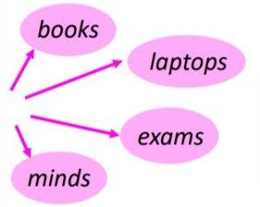
Equivalent Definition
Language Modeling is the task of predicting what word comes next
Notes:
Update notation

Slide 8
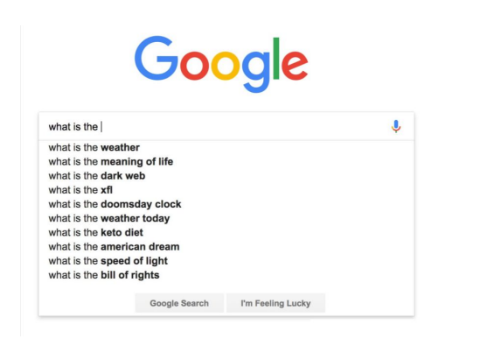
Motivation: Autocorrect

Slide 9

Motivation: Text Generation

Slide 10
Motivation: Text Generation
My current quest is for the Radiant Lexicon, a book that keeps being called the shiny one because that is easier for everyone’s mouths to manage.

Slide 11
Motivation: Text Generation
My current quest is for the Radiant Lexicon, a book that keeps being called the shiny one because that is easier for everyone’s mouths to manage. Elminster once named it the sort of volume you truly should not approach, which only tilted my curiosity upward.

Slide 12
Motivation: Text Generation
My current quest is for the Radiant Lexicon, a book that keeps being called the shiny one because that is easier for everyone’s mouths to manage. Elminster once named it the sort of volume you truly should not approach, which only tilted my curiosity upward. You might wonder why I chase it, and honestly it feels more like it chases me, ever since the orb near my heart began attracting magic the way lanterns attract lost insects. The Lexicon sits in a ruin that cannot keep its hallways agreeing with themselves, shifting forward, then sideways, like the place is rehearsing its own confusion. Troublesome, yes, but so am I, and I imagine the ruin knows this already.

Slide 13
Even More Motivation
Machine translation
p(strong winds) > p(large winds)
Spelling correction
The office is about fifteen minuets from my house
p(about fifteen minutes from) > p(about fifteen minuets from)
Speech recognition
p(I saw a van) >> p(eyes awe of an)
Summarization, question-answering, handwriting recognition, OCR, etc.

Slide 14
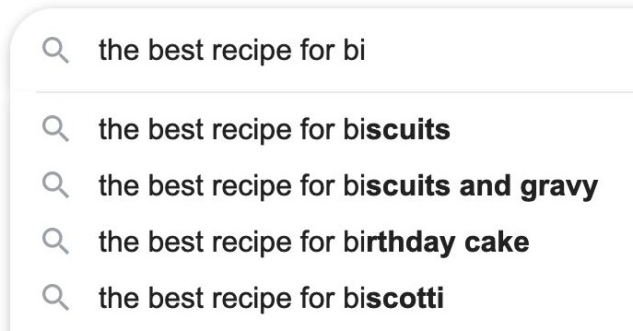
Language Models
A language model is a machine learning model that predicts upcoming words based on the words that came before
a very large corpus
language model

Slide 15
Formal Definition of Language Modeling

Slide 16
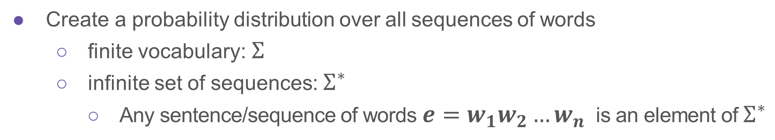
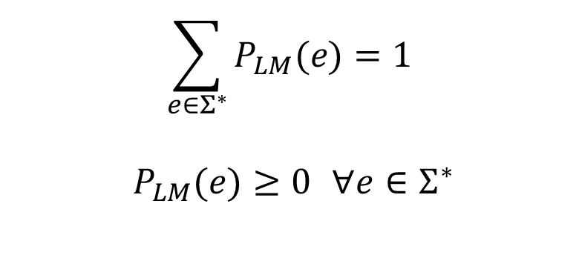
The Language Modeling problem
Create a probability distribution over all sequences of words
finite vocabulary: $Σ$
infinite set of sequences: $Σ^{∗}$
Any sentence/sequence of words $e=w_{1}w_{2}…w_{n}$ is an element of $Σ^{∗}$
$$\sum_{e∈Σ^{∗}}{P_{LM}(e)}=1$$
$P_{LM}(e)≥0$ $∀e∈Σ^{∗}$

Slide 17
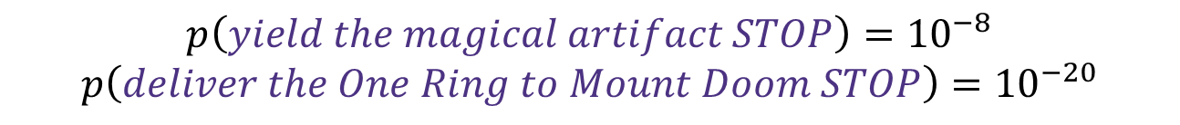
The Language Modeling Problem
$$p\left(yield the magical artifact STOP\right)={10}^{−8}$$
$$p\left(deliver the One Ring to Mount Doom STOP\right)={10}^{−20}$$

Slide 18
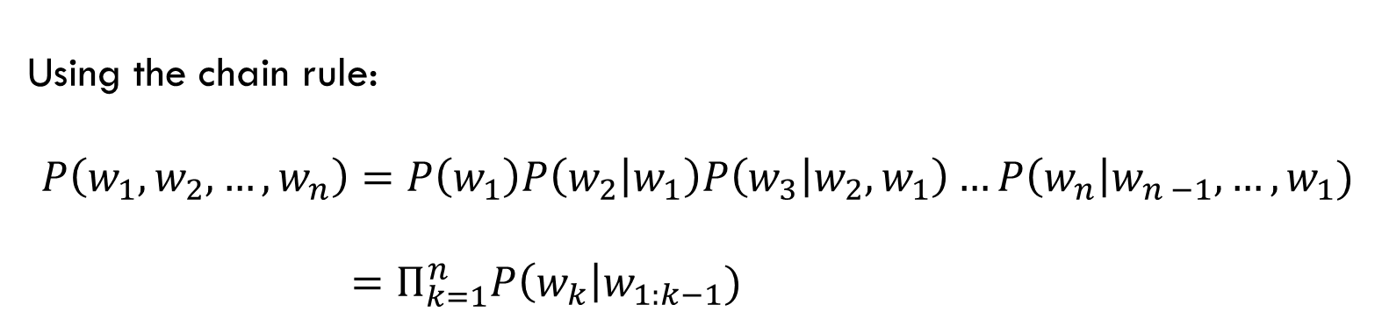
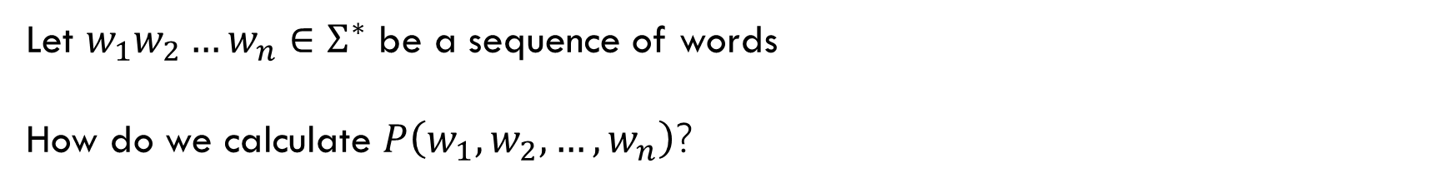
The Language Modeling problem
Let $w_{1}w_{2}…w_{n}∈Σ^{∗}$ be a sequence of words
How do we calculate $P\left(w_{1}, w_{2},…, w_{n}\right)$?
Using the chain rule:
$$P\left(w_{1}, w_{2},…, w_{n}\right)=P\left(w_{1}\right)P\left(w_{2} | w_{1}\right)P\left(w_{3} | w_{2}, w_{1}\right)…P\left(w_{n}\right|w_{n −1}, …, w_{1})$$
$=Π_{k=1}^{n}P\left(w_{k}\right|w_{1:k−1})$

Slide 19
The Language Modeling problem
Let $w_{1}w_{2}…w_{n}∈Σ^{∗}$ be a sequence of words
How do we calculate $P\left(w_{1}, w_{2},…, w_{n}\right)$?
Using the chain rule:
$$P\left(w_{1}, w_{2},…, w_{n}\right)=P\left(w_{1}\right)P\left(w_{2} | w_{1}\right)P\left(w_{3} | w_{2}, w_{1}\right)…P\left(w_{n}\right|w_{n −1}, …, w_{1})$$
$=Π_{k=1}^{n}P\left(w_{k}\right|w_{1:k−1})$
To solve the language modeling problem, all a language model needs to do is calculate the probability of the next word given the previous words (for each word in the sequence).

Slide 20


Equivalent Definition
For any sequence of words $w_{1}w_{2}…w_{n−1}∈Σ^{∗}$, compute the probability distribution of the next word $w_{n}$, where $w_{n}$ can be any word in our vocabulary $Σ$.
$$\sum_{w_{n}∈Σ}{P_{LM}(w_{n}|w_{1:n−1})}=1$$
$P_{LM}\left(w_{n} | w_{1:n−1}\right)≥0$ $∀w_{n }∈Σ$

Slide 21
Our First Language Model

Slide 22
Learning a Language Model
Question: How do we learn a Language Model?
(i.e. an algorithm or formula to produce $P\left(w_{1}, …, w_{n}\right)$ or $P\left(w_{n} | w_{1:n−1}\right)$ for any sequence $w_{1}w_{2}…w_{n}∈Σ^{∗}$)

Slide 23
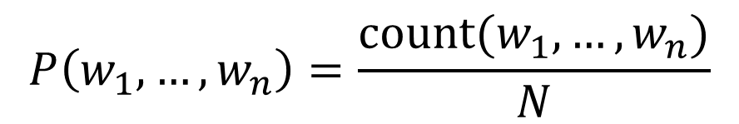
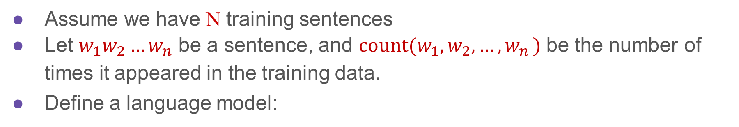
Our First Attempt
Assume we have N training sentences
Let $w_{1}w_{2}…w_{n}$ be a sentence, and ${count(w}_{1}, w_{2}, …{, w}_{n})$ be the number of times it appeared in the training data.
Define a language model:
$$P\left(w_{1},…, w_{n}\right)=\frac{count(w_{1},…, w_{n})}{N}$$

Slide 24
Our First Attempt
Assume we have N training sentences
Let $w_{1}w_{2}…w_{n}$ be a sentence, and ${count(w}_{1}, w_{2}, …{, w}_{n})$ be the number of times it appeared in the training data.
Define a language model:
$$P\left(w_{1},…, w_{n}\right)=\frac{count(w_{1},…, w_{n})}{N}$$
Discuss: What are the drawbacks of this model?

Slide 25
Our First Attempt
Assume we have N training sentences
Let $w_{1}w_{2}…w_{n}$ be a sentence, and ${count(w}_{1}, w_{2}, …{, w}_{n})$ be the number of times it appeared in the training data.
Define a language model:
$$P\left(w_{1},…, w_{n}\right)=\frac{count(w_{1},…, w_{n})}{N}$$
No generalization!

Slide 26
Our Second Attempt: N-grams
A solution that’s similar but more robust than the first approach
Question: How to learn a language model?
Answer (pre-Deep Learning): learn an n-gram language model!

Slide 27
N-gram Language Models

Slide 28
N-grams
“I have a dog whose name is Lucy. I have two cats, they like playing with Lucy.”
Definition: An n-gram is a chunk of n consecutive words.

Slide 29
N-grams
“I have a dog whose name is Lucy. I have two cats, they like playing with Lucy.”
Definition: An n-gram is a chunk of n consecutive words.
unigrams: {I, have, a, dog, whose, name, is, Lucy, two, cats, they, like, playing, with}

Slide 30
N-grams
“I have a dog whose name is Lucy. I have two cats, they like playing with Lucy.”
Definition: An n-gram is a chunk of n consecutive words.
unigrams: {I, have, a, dog, whose, name, is, Lucy, two, cats, they, like, playing, with}
bigrams: {I have, have a, a dog, dog whose, … , with Lucy}

Slide 31
N-grams
“I have a dog whose name is Lucy. I have two cats, they like playing with Lucy.”
Definition: An n-gram is a chunk of n consecutive words.
unigrams: {I, have, a, dog, whose, name, is, Lucy, two, cats, they, like, playing, with}
bigrams: {I have, have a, a dog, dog whose, … , with Lucy}
trigrams: {I have a, have a dog, a dog whose, … , playing with Lucy}

Slide 32
N-grams
“I have a dog whose name is Lucy. I have two cats, they like playing with Lucy.”
Definition: An n-gram is a chunk of n consecutive words.
unigrams: {I, have, a, dog, whose, name, is, Lucy, two, cats, they, like, playing, with}
bigrams: {I have, have a, a dog, dog whose, … , with Lucy}
trigrams: {I have a, have a dog, a dog whose, … , playing with Lucy}
four-grams: {I have a dog, … , like playing with Lucy}
…

Slide 33
N-grams
“I have a dog whose name is Lucy. I have two cats, they like playing with Lucy.”
w₁ – a unigram
w₁ w₂ – a bigram
w₁ w₂ w₃ – a trigram
w₁w₂ …w_{n} – an n-gram

Slide 34

N-gram Language Models
A solution that’s similar but more robust than the first approach
Question: How to learn a language model?
Answer (pre-Deep Learning): learn an n-gram language model!
Idea: Collect statistics about how frequent different n-grams are and use these to predict next words.
For a given $n$ and sequence $w_{1}…w_{k}$, we approximate $P\left(w_{k} | w_{k−1}, …, w_{1}\right)≈P(w_{k}|w_{k−1}…w_{k−n})$
The relative n-gram frequencies are MLE estimates of the probabilities of n-grams appearing $P(w_{k}|w_{k−n:k−1})$

Slide 35
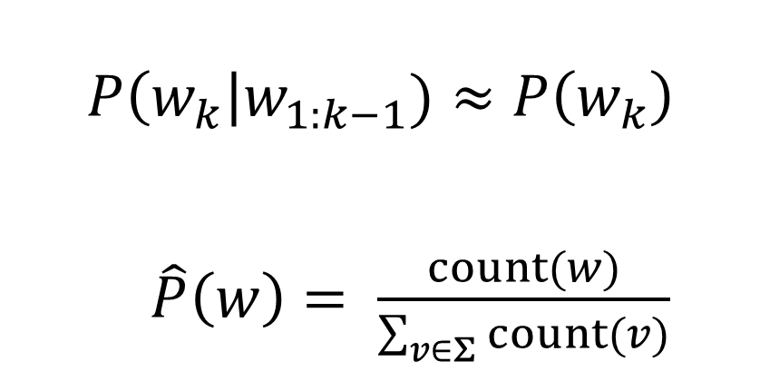
Unigram Language Model
$$P\left(w_{k}\right|w_{1:k−1})≈P\left(w_{k}\right)$$
$\hat{P}\left(w\right)= \frac{count(w)}{\sum_{v∈Σ}{count(v)}}$

Slide 36
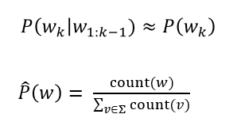
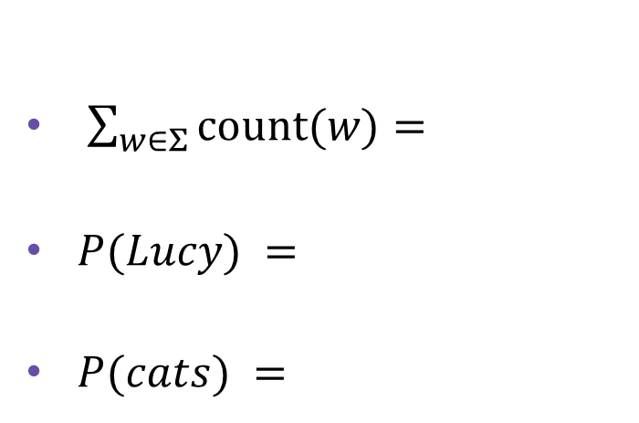
Unigram Language Model
“I have a dog whose name is Lucy. I have two cats, they like playing with Lucy.”
$\sum_{w∈Σ}{count(w)}=$
$P(Lucy) =$
$P(cats) =$

Slide 37
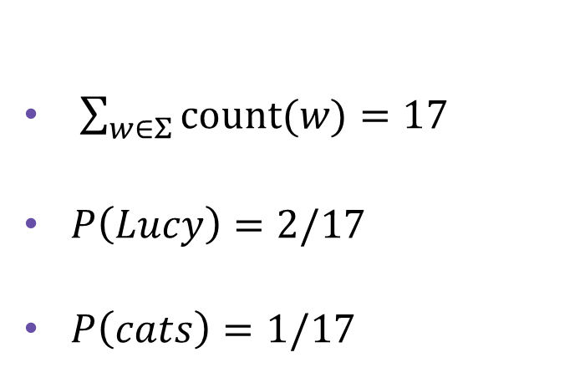
Unigram Language Model
“I have a dog whose name is Lucy. I have two cats, they like playing with Lucy.”
$\sum_{w∈Σ}{count(w)}=17$
$P\left(Lucy\right)=2/17$
$P\left(cats\right)=1/17$

Slide 38
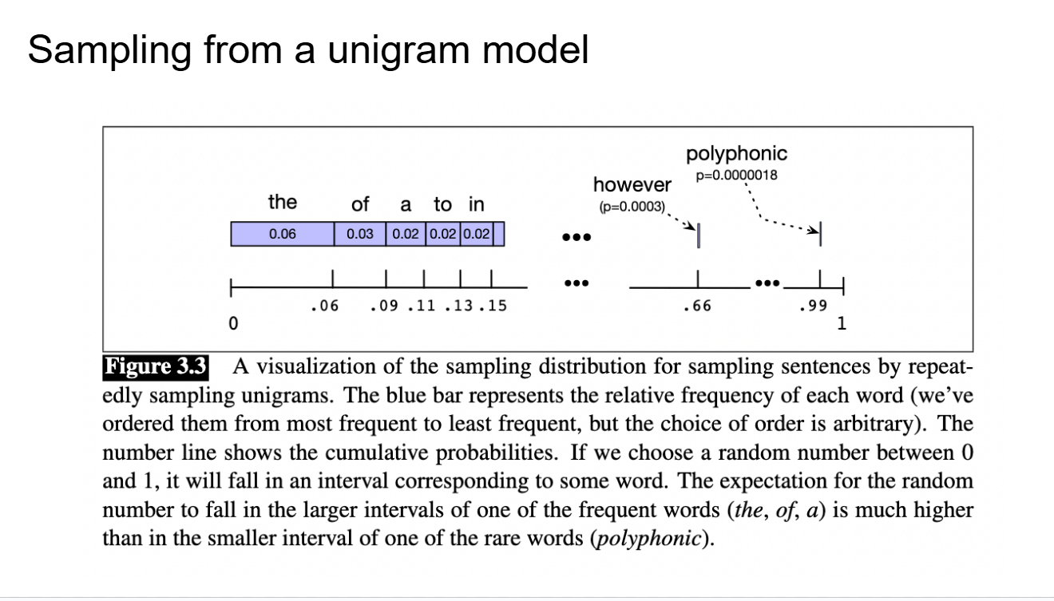
Unigram probability

Slide 39
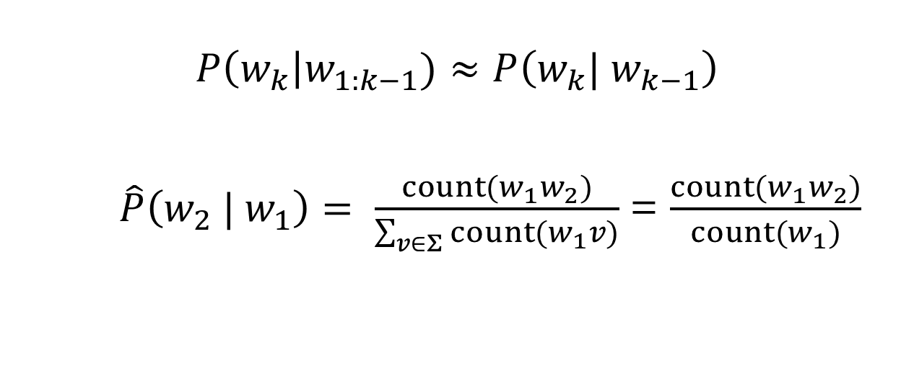
Bigram Language Model
$$P\left(w_{k}\right|w_{1:k−1})≈P\left(w_{k}| w_{k−1}\right)$$
$\hat{P}\left(w_{2} | w_{1}\right)= \frac{count(w_{1}w_{2})}{\sum_{v∈Σ}{count(w_{1}v)}}$ = $\frac{count(w_{1}w_{2})}{count(w_{1})}$
We’re now defining a separate conditional probability distribution for each word

Slide 40
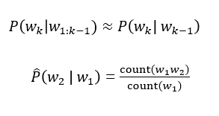
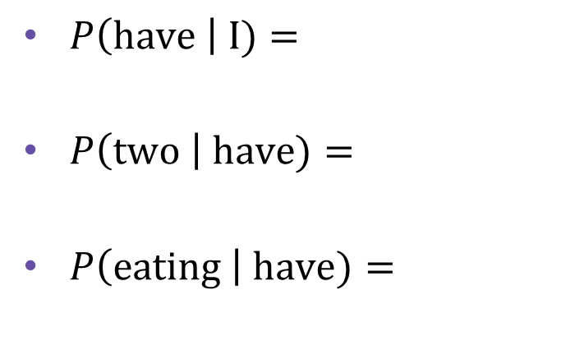
Bigram Language Model
“I have a dog whose name is Lucy. I have two cats, they like playing with Lucy.”
$P\left(have \right| I)=$
$P\left(two \right| have)=$
$P\left(eating \right| have)=$

Slide 41
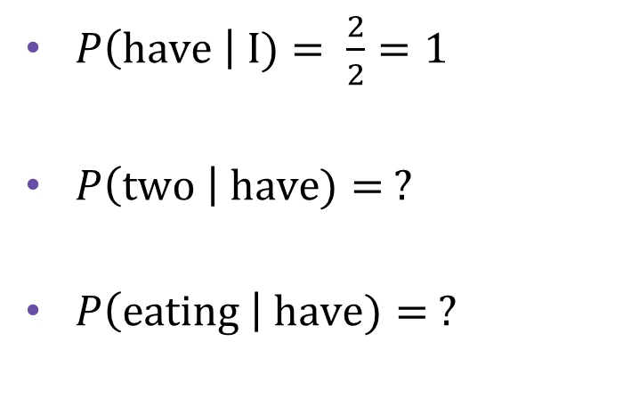
Bigram Language Model
“I have a dog whose name is Lucy. I have two cats, they like playing with Lucy.”
$P\left(have \right| I)= \frac{2}{2}=1$
$P\left(two \right| have)= ?$
$P\left(eating \right| have)= ?$

Slide 42
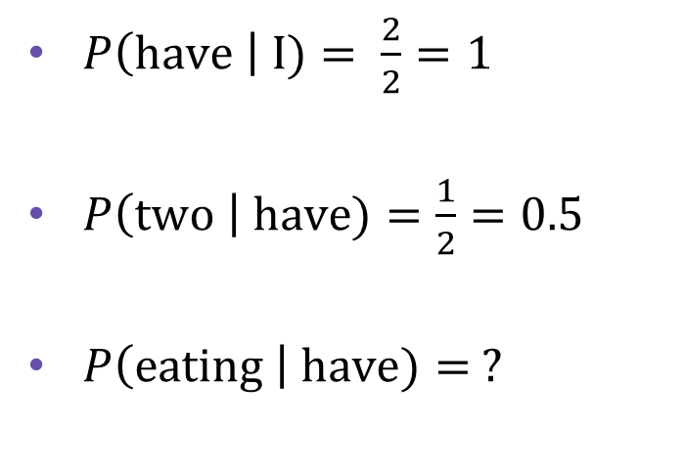
Bigram Language Model
“I have a dog whose name is Lucy. I have two cats, they like playing with Lucy.”
$P\left(have \right| I)= \frac{2}{2}=1$
$P\left(two \right| have)=\frac{1}{2}=0.5$
$P\left(eating \right| have)= ?$

Slide 43
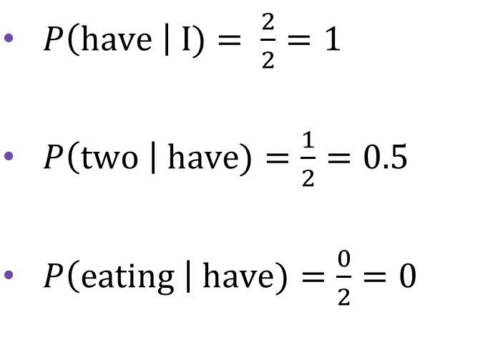
Bigram Language Model
“I have a dog whose name is Lucy. I have two cats, they like playing with Lucy.”
$P\left(have \right| I)= \frac{2}{2}=1$
$P\left(two \right| have)=\frac{1}{2}=0.5$
$P\left(eating \right| have)=\frac{0}{2}=0$

Slide 44

Trigram Language Model
$$P\left(w_{k}\right|w_{1:k−1})≈P\left(w_{k}| w_{k−2}, w_{k−1}\right)$$
$\hat{P}\left(w_{3} | w_{2}, w_{1}\right)= \frac{count(w_{1}w_{2 }w_{3})}{\sum_{v∈Σ}{count(w_{1}w_{2}v)}}$ = $\frac{count(w_{1}w_{2 }w_{3})}{count(w_{1}w_{2})}$
We’re now defining a separate conditional probability distribution over each possible word pair (bigrams)

Slide 45
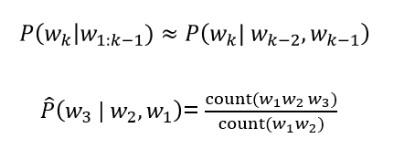
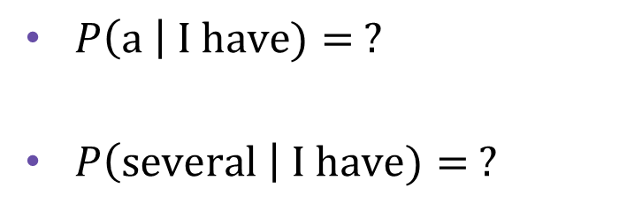
Trigram Language Model
“I have a dog whose name is Lucy. I have two cats, they like playing with Lucy.”
$P\left(a \right| I have)= ?$
$P\left(several \right| I have)= ?$

Slide 46
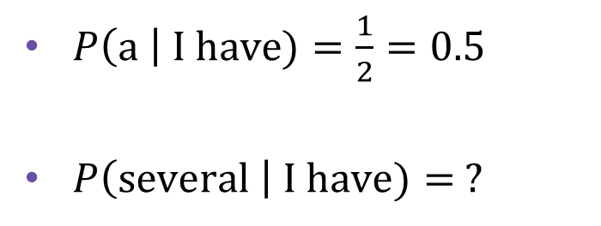
Trigram Language Model
“I have a dog whose name is Lucy. I have two cats, they like playing with Lucy.”
$P\left(a \right| I have)=\frac{1}{2}=0.5$
$P\left(several \right| I have)= ?$

Slide 47
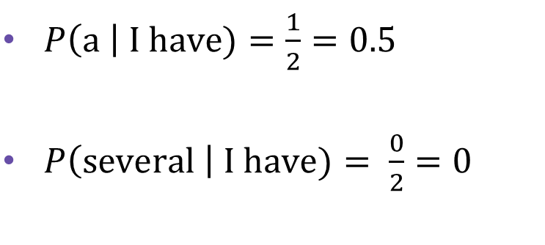
Trigram Language Model
“I have a dog whose name is Lucy. I have two cats, they like playing with Lucy.”
$P\left(a \right| I have)=\frac{1}{2}=0.5$
$P\left(several \right| I have)= \frac{0}{2}=0$

Slide 48
Trigram Language Model
$$P\left(the dog barks STOP\right)=$$

Slide 49
Trigram Language Model
$$P\left(the dog barks STOP\right)=P\left(the \right|∗, ∗)×$$

Slide 50
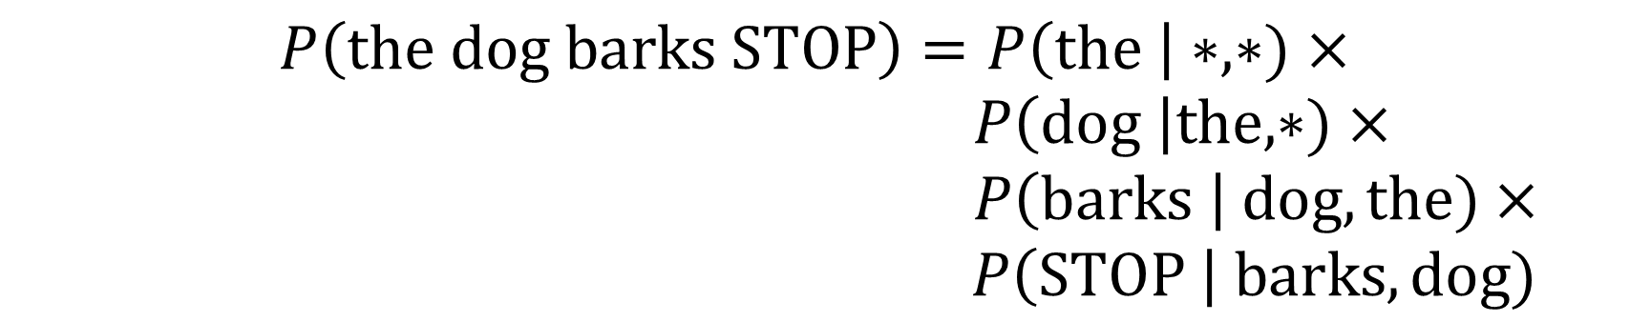
Trigram Language Model
$$P\left(the dog barks STOP\right)=P\left(the \right|∗, ∗)×$$
$P\left(dog \right|the, ∗)×$
$P\left(barks \right| dog, the)×$
$$P\left(STOP \right| barks, dog)$$

Slide 51
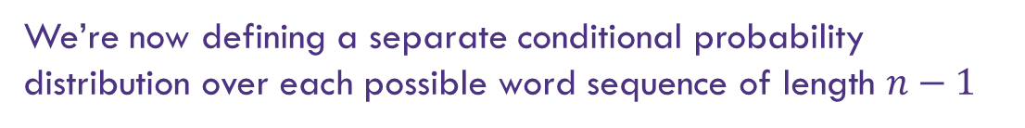
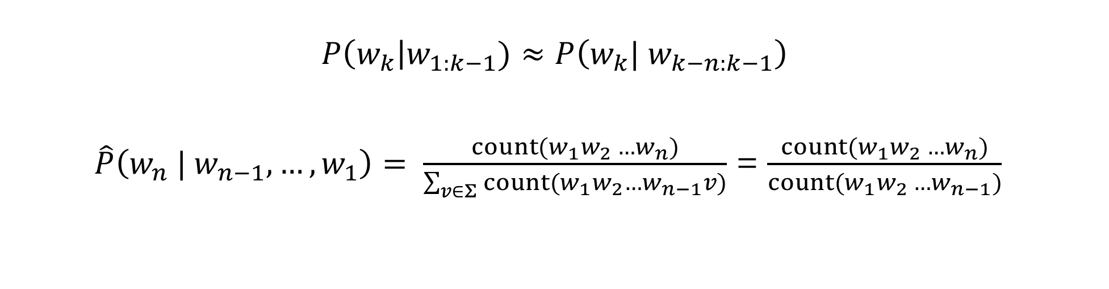
General N-gram model
$$P\left(w_{k}\right|w_{1:k−1})≈P\left(w_{k}| w_{k−n:k−1}\right)$$
$\hat{P}\left(w_{n} | w_{n−1}, …, w_{1}\right)= \frac{count(w_{1}w_{2 }…w_{n})}{\sum_{v∈Σ}{count(w_{1}w_{2}…w_{n−1}v)}}$ = $\frac{count(w_{1}w_{2 }…w_{n})}{count(w_{1}w_{2 }…w_{n−1})}$
We’re now defining a separate conditional probability distribution over each possible word sequence of length $n−1$

Slide 52
N-grams in action

Slide 53
Berkeley restaurant project sentences
can you tell me about any good cantonese restaurants close by
mid priced that food is what i’m looking for
tell me about chez pansies
can you give me a listing of the kinds of food that are available
i’m looking for a good place to eat breakfast
when is caffe venezia open during the day

Slide 54
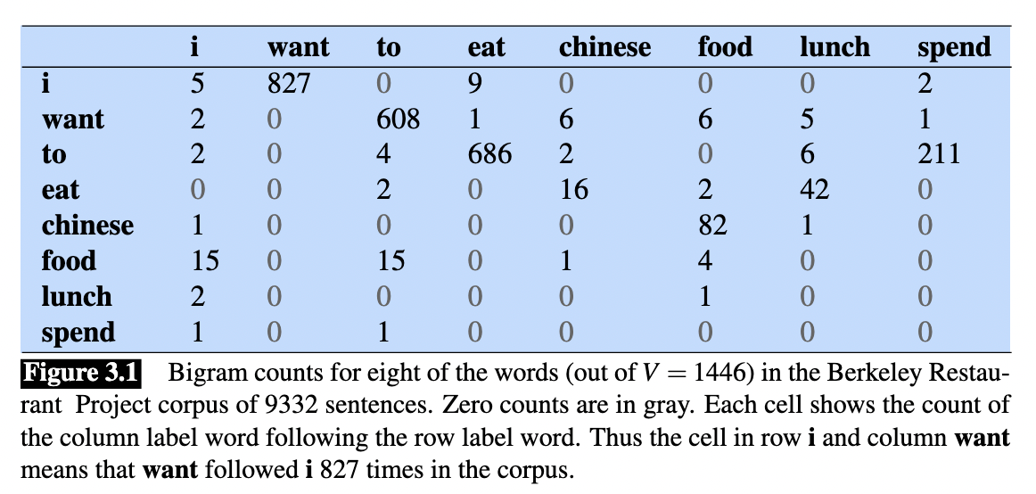
Raw bigram counts

Slide 55
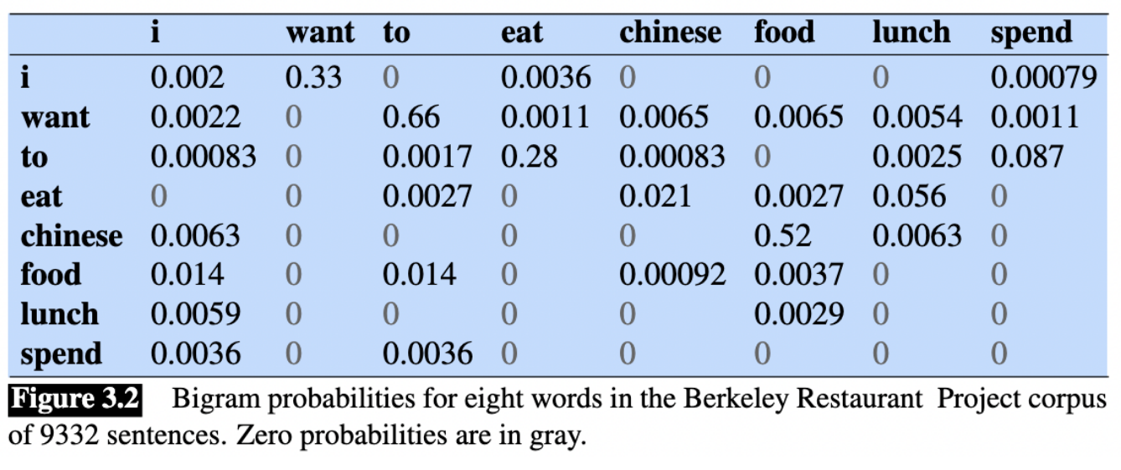
Bigram probabilities

Slide 56
Bigram estimates of sentence probability
P(<s> i want chinese food </s>) = P(i|<s>)
× P(want|i)
× P(chinese|want)
× P(food|chinese)
× P(</s>|food)
= …

Slide 57
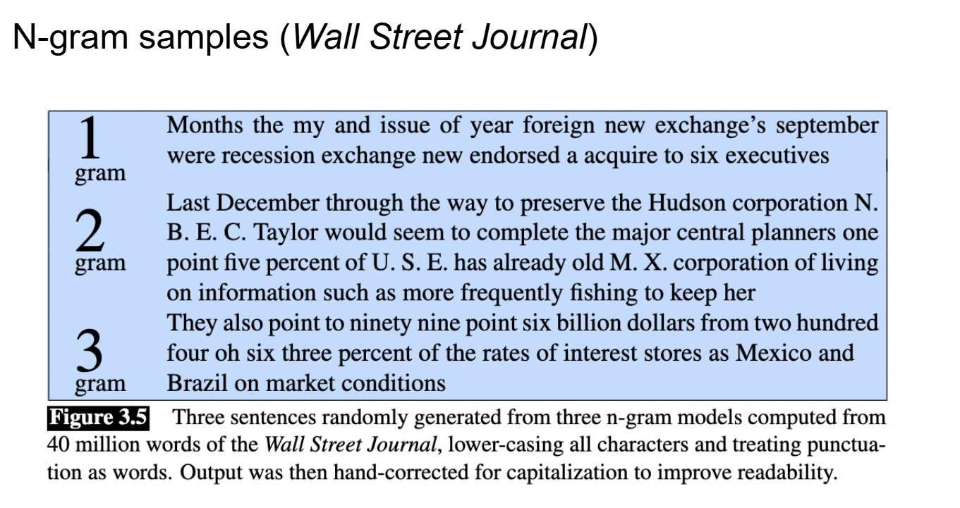
Sampling from N-grams

Slide 58
Sampling from N-grams

Slide 59
Sampling from N-grams

Slide 60
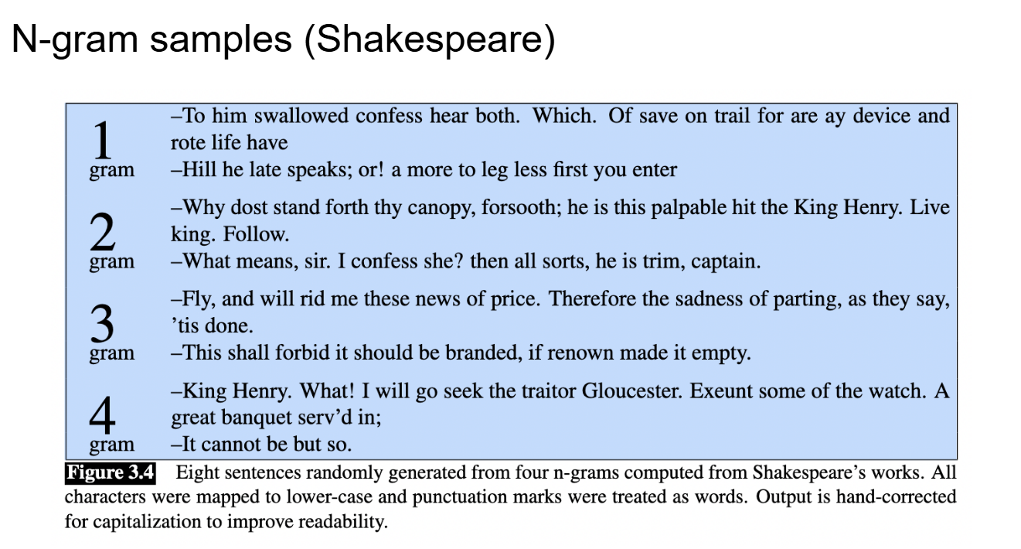
Sampling from N-grams

Slide 61
Sampling from N-grams

Slide 62
Sampling from N-grams

Slide 63
Sampling from N-grams

Slide 64
Laplace Smoothing

Slide 65
Bigram Counts
Redo slide

Slide 66
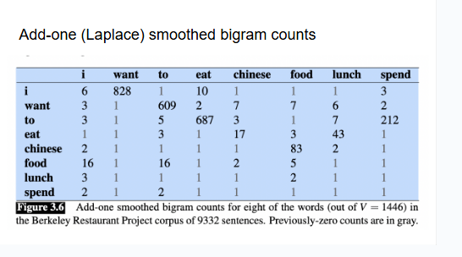
Bigram Counts with Laplace Smoothing

Slide 67

N-gram model with Laplace Smoothing
$$P\left(w_{k}\right|w_{1:k−1})≈P\left(w_{k}| w_{k−n:k−1}\right)$$
$\hat{P}\left(w_{n} | w_{n−1}, …, w_{1}\right)= \frac{count(w_{1}w_{2 }…w_{n})}{\sum_{v∈Σ}{count(w_{1}w_{2}…w_{n−1}v)}}$ = $\frac{count(w_{1}w_{2 }…w_{n})}{count(w_{1}w_{2 }…w_{n−1})}$
${\hat{P}}_{Laplace}\left(w_{n} | w_{n−1}, …, w_{1}\right)= \frac{1+ count(w_{1}w_{2 }…w_{n})}{\left|Σ\right| + \sum_{v∈Σ}{count(w_{1}w_{2}…w_{n−1}v)}}$ = $\frac{1+ count(w_{1}w_{2 }…w_{n})}{\left|Σ\right| +count(w_{1}w_{2 }…w_{n−1})}$

Slide 68
That’s all folks!
TODOs:
Fill out the quiz retake form ASAP if you haven’t already
Finish HW8
Study for the final!

