Slide 1
Joint Distributions
CSE 312 Autumn 25
Lecture 26-27

Slide 2
Announcements
This deck is for both today and Wednesday.
Wednesday’s CC (CC27) is released already if you want to work ahead.
Midterm Second Chance is next Monday; we’ll have a form you need to fill out (so we know how many copies to make).

Slide 3
Multiple Random Variables

Slide 4
This lecture and next lecture
Somewhat out-of-place content.
When we introduced multiple random variables, we’ve always had them be independent.
Because it’s hard to deal with non-independent random variables.
Today and Wednesday are a crash-course in the toolkit for when you have multiple random variables and they aren’t independent.
Going to focus on discrete RVs, we’ll talk about continuous at the end.

Slide 5
Why
Independent random variables are easier to interact with.
But sometimes you want to interact with the dependence
ML/Data science takes advantage of dependence: Netflix knows you like movie A; people liking movie A is dependent on people liking movie B, and so recommends you movie B
  Random variables might be indicators for specific individual people liking movies, or “if we select a person at random, will they like this movie”
Our examples are artificial/simple; we’re just hoping to get the tools down.
Notes:
The kind of dependence matters---we’d want positive covariance (or something like that)

Slide 6

Joint PMF, support
For two (discrete) random variables $X,Y$their joint pmf
$p_{X,Y}\left(x,y\right)=ℙ(X=x∩Y=y)$
When $X,Y$ are independent then $p_{X,Y}\left(x,y\right)=p_{X}\left(x\right)p_{Y}(y)$.

Slide 7
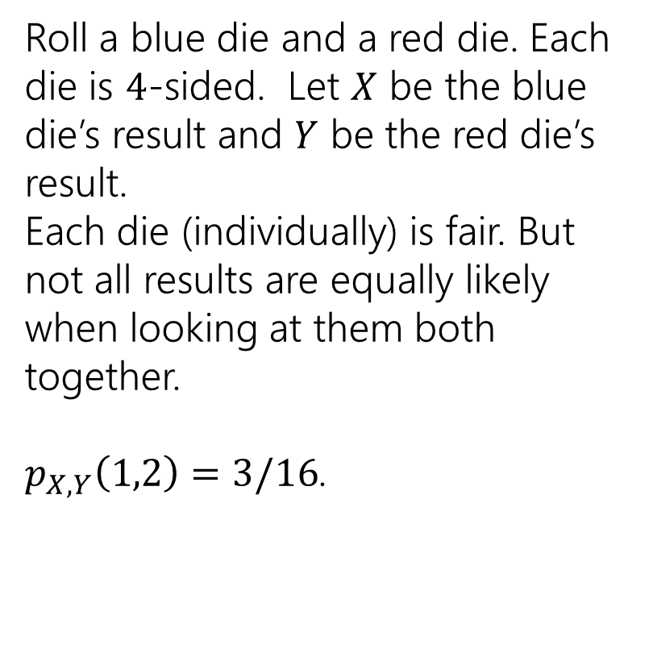
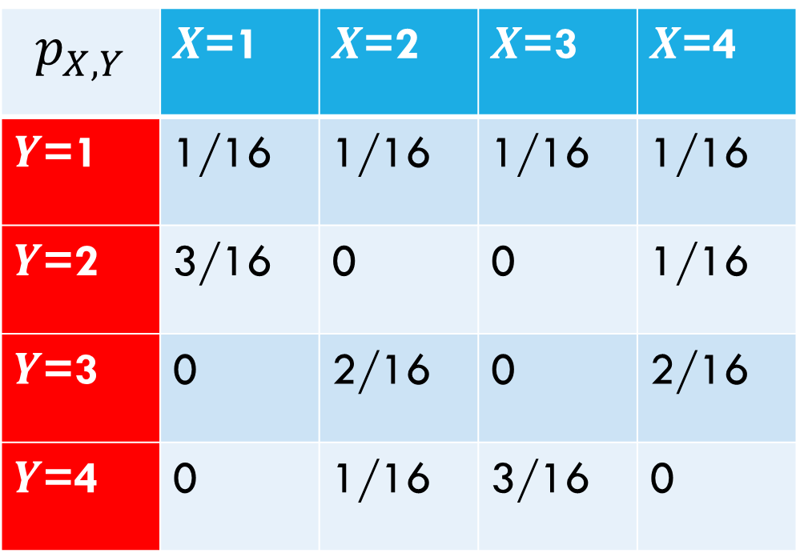
Examples
$$p_{X,Y}$$ | $X$=1 | $X$=2 | $X$=3 | $X$=4
$Y$=1 | 1/16 | 1/16 | 1/16 | 1/16
$Y$=2 | 3/16 | 0 | 0 | 1/16
$Y$=3 | 0 | 2/16 | 0 | 2/16
$Y$=4 | 0 | 1/16 | 3/16 | 0
Roll a blue die and a red die. Each die is $4$-sided. Let $X$ be the blue die’s result and $Y$ be the red die’s result.
Each die (individually) is fair. But not all results are equally likely when looking at them both together.
$p_{X,Y}\left(1,2\right)=3/16$.

Slide 8
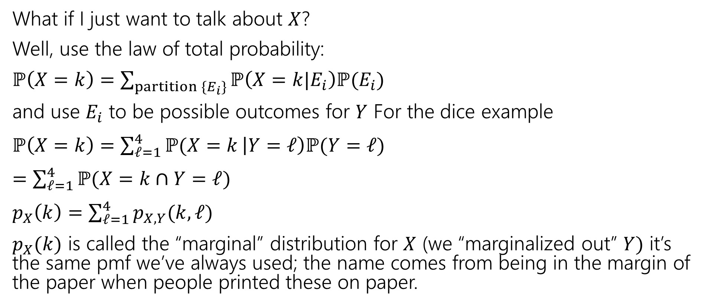
Marginals
What if I just want to talk about $X$?
Well, use the law of total probability:
$ℙ\left(X=k\right)=\sum_{partition \{E_{i}\}}{ℙ\left(X=k|E_{i}\right)ℙ(E_{i})}$
and use $E_{i}$ to be possible outcomes for $Y$ For the dice example
$ℙ\left(X=k\right)=\sum_{ℓ=1}^{4}{ℙ(X=k}\left|Y=ℓ\right)ℙ(Y=ℓ)$
$=\sum_{ℓ=1}^{4}{ℙ(X=k}∩Y=ℓ)$
$p_{X}\left(k\right)=\sum_{ℓ=1}^{4}{p_{X,Y}(k,ℓ)}$
$p_{X}(k)$ is called the “marginal” distribution for $X$ (we “marginalized out” $Y)$ it’s the same pmf we’ve always used; the name comes from being in the margin of the paper when people printed these on paper.

Slide 9
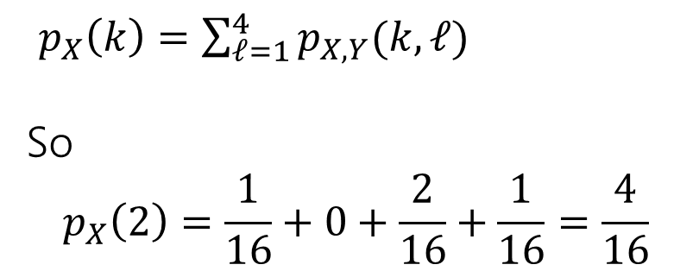
Marginals
$$p_{X,Y}$$ | $X$=1 | $X$=2 | $X$=3 | $X$=4
$Y$=1 | 1/16 | 1/16 | 1/16 | 1/16
$Y$=2 | 3/16 | 0 | 0 | 1/16
$Y$=3 | 0 | 2/16 | 0 | 2/16
$Y$=4 | 0 | 1/16 | 3/16 | 0
$p_{X}\left(k\right)=\sum_{ℓ=1}^{4}{p_{X,Y}(k,ℓ)}$
So
$$p_{X}\left(2\right)=\frac{1}{16}+0+\frac{2}{16}+\frac{1}{16}=\frac{4}{16}$$

Slide 10
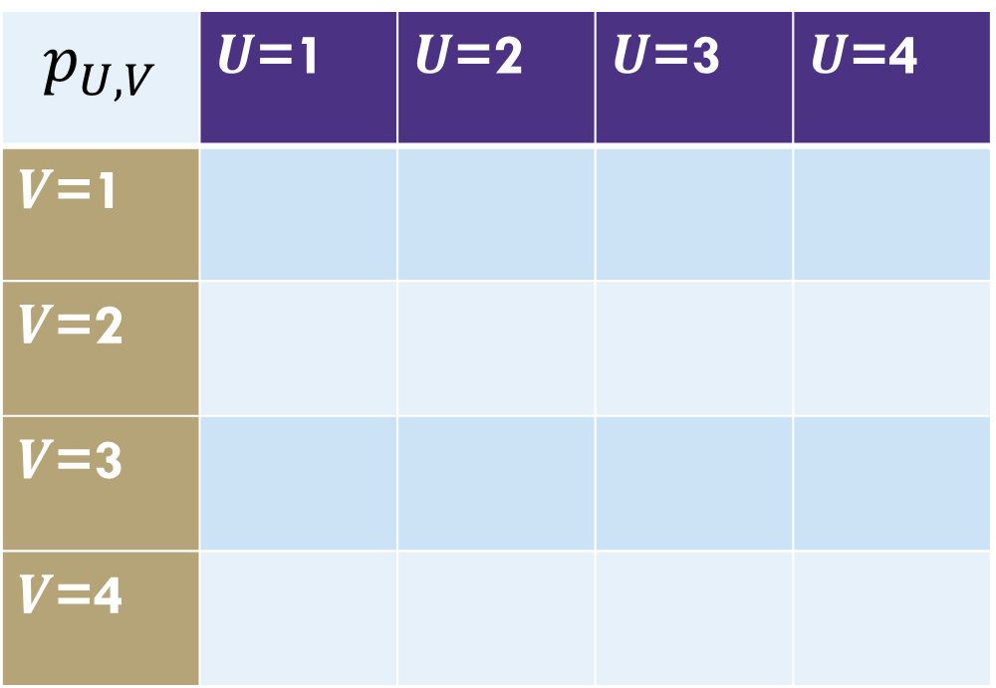
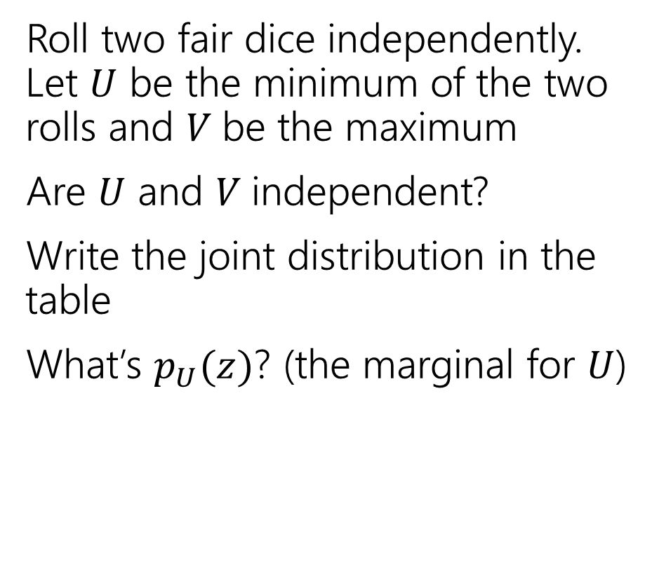
Different dice
Roll two fair dice independently. Let $U$ be the minimum of the two rolls and $V$be the maximum
Are $U$ and $V$independent?
Write the joint distribution in the table
What’s $p_{U}(z)$? (the marginal for $U$)
$$p_{U,V}$$ | $U$=1 | $U$=2 | $U$=3 | $U$=4
$V$=1
$V$=2
$V$=3
$V$=4

Slide 11
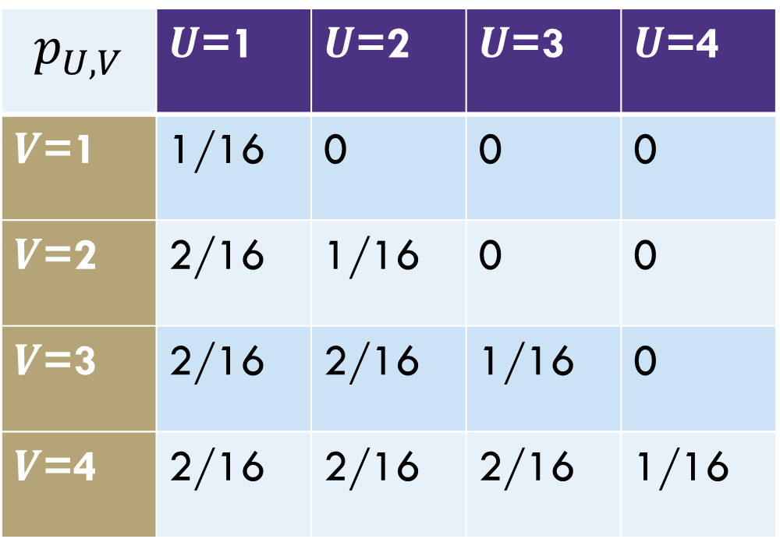
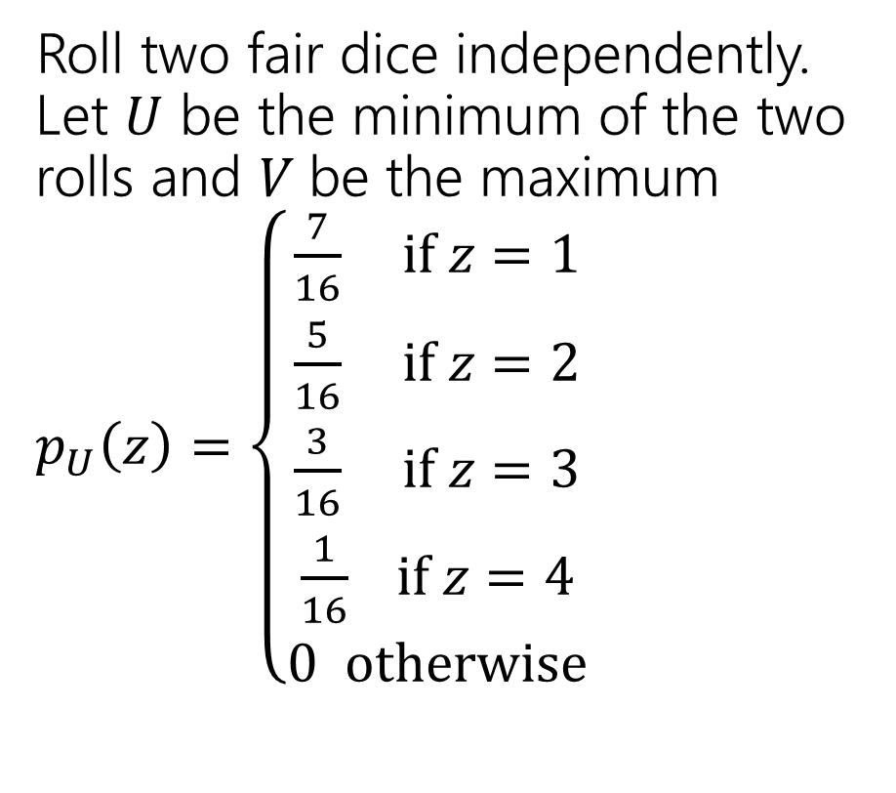
Different dice
Roll two fair dice independently. Let $U$ be the minimum of the two rolls and $V$be the maximum
$p_{U}\left(z\right)=\left\{\begin{aligned}\frac{7}{16} if z=1 \\ \frac{5}{16} if z=2 \\ \frac{3}{16} if z=3 \\ \frac{1}{16} if z=4 \\ 0 otherwise\end{aligned}\right.$
$$p_{U,V}$$ | $U$=1 | $U$=2 | $U$=3 | $U$=4
$V$=1 | 1/16 | 0 | 0 | 0
$V$=2 | 2/16 | 1/16 | 0 | 0
$V$=3 | 2/16 | 2/16 | 1/16 | 0
$V$=4 | 2/16 | 2/16 | 2/16 | 1/16

Slide 12
Expectations and LTE

Slide 13
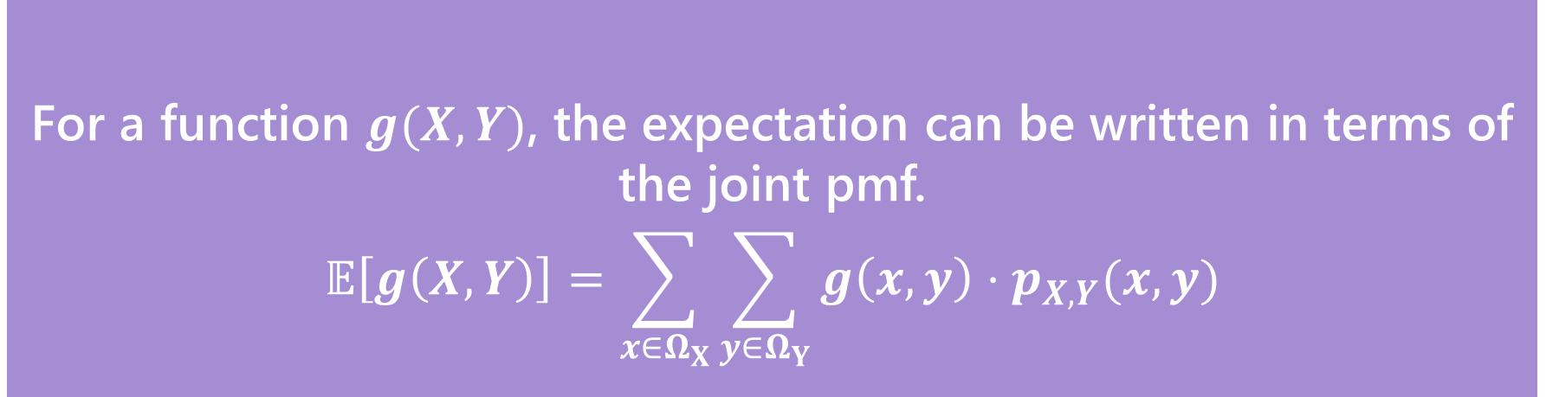

Joint Expectation
For a function $g(X,Y)$, the expectation can be written in terms of the joint pmf.
$$𝔼\left[g\left(X,Y\right)\right]=\sum_{x∈Ω_{X}}{\sum_{y∈Ω_{Y}}{g\left(x,y\right)⋅p_{X,Y}(x,y)}}$$
Expectations of joint functions
This definition hopefully isn’t surprising at this point (it’s the value of $g$ times the probability $g$ takes on that value), but it’s good to see.

Slide 14

Expectation of a function of two RVs
What’s $𝔼[UV]$ for $U,V$ from the last slide?

Slide 15

Expectation of a function of two RVs
What’s $𝔼[UV]$ for $U,V$ from the last slide?
$\sum_{u∈Ω_{U}}{\sum_{v∈ΩV}{uv⋅p_{U,V}(u,v)}}$
$=1⋅1⋅\frac{1}{16}+1⋅2⋅\frac{2}{16}+1⋅3⋅\frac{2}{16}+2⋅2⋅\frac{1}{16}+2⋅3⋅\frac{2}{16}+2⋅4⋅\frac{2}{16}+$
$3⋅3⋅\frac{1}{16}+3⋅4⋅\frac{2}{16}+4⋅4⋅\frac{1}{16}$
$=\frac{92}{16}=\frac{23}{4}=5.75$.

Slide 16


Conditional Expectation
Waaaaaay back when, we said conditioning on an event creates a new probability space, with all the laws holding.
So we can define things like “conditional expectations” which is the expectation of a random variable in that new probability space.
$$𝔼\left[X | E\right]=\sum_{x∈Ω_{X}}{x⋅ℙ(X=x|E)}$$
$$𝔼\left[X | Y=y\right]=\sum_{x∈Ω_{X}}{x⋅ℙ\left(X=x | Y=y\right)}$$

Slide 17

Conditional Expectations
All your favorite theorems are still true.
For example, linearity of expectation still holds
$$𝔼\left[(aX+bY+c) \right|E]=a𝔼\left[X | E\right]+b𝔼\left[Y | E\right]+c$$

Slide 18


Law of Total Expectation
Let $A_{1},A_{2},…,A_{k}$ be a partition of the sample space, then
$$𝔼[X]=\sum_{i=1}^{n}{𝔼\left[X | A_{i}\right]ℙ(A_{i})}$$
Let $X,Y$be discrete random variables, then
$$𝔼[X]=\sum_{y∈Ω_{Y}}{𝔼\left[X | Y=y\right]ℙ(Y=y)}$$
Similar in form to law of total probability, and the proof goes that way as well.

Slide 19

LTE
You will flip $2$ (independent, fair coins). Call the number of heads $X$. Then (independently of the coin flips) draw an exponential random variable $Y$from the distribution $Exp(X+1)$.
What is $𝔼[Y]$?
Notes:
This is a conditional independence, once we know the number of coin flips; certainly the value of $X$ impacts $Y$ since it changes the distribution!
Y has a very strange distribution! We can find it in principle, but if we just want the expectation, we can avoid that work.

Slide 20
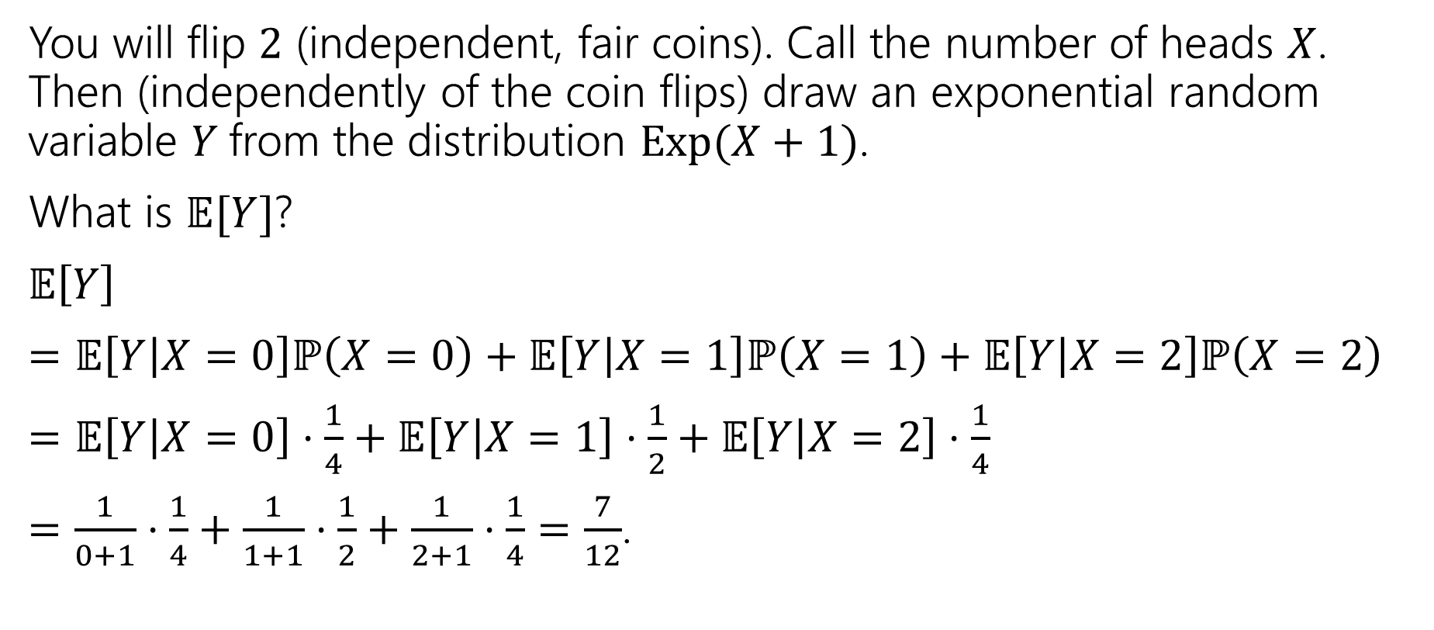
LTE
You will flip $2$ (independent, fair coins). Call the number of heads $X$. Then (independently of the coin flips) draw an exponential random variable $Y$from the distribution $Exp(X+1)$.
What is $𝔼[Y]$?
$𝔼\left[Y\right]$
$=𝔼\left[Y | X=0\right]ℙ\left(X=0\right)+𝔼\left[Y | X=1\right]ℙ\left(X=1\right)+𝔼\left[Y | X=2\right]ℙ\left(X=2\right)$
$=𝔼\left[Y | X=0\right]⋅\frac{1}{4}+𝔼\left[Y | X=1\right]⋅\frac{1}{2}+𝔼\left[Y | X=2\right]⋅\frac{1}{4}$
$=\frac{1}{0+1}⋅\frac{1}{4}+\frac{1}{1+1}⋅\frac{1}{2}+\frac{1}{2+1}⋅\frac{1}{4}=\frac{7}{12}$.

Slide 21
Covariance

Slide 22
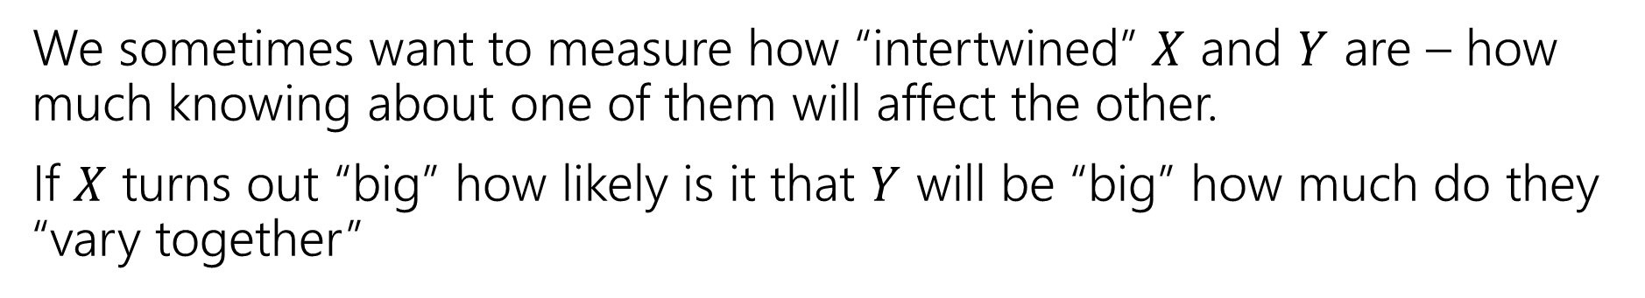
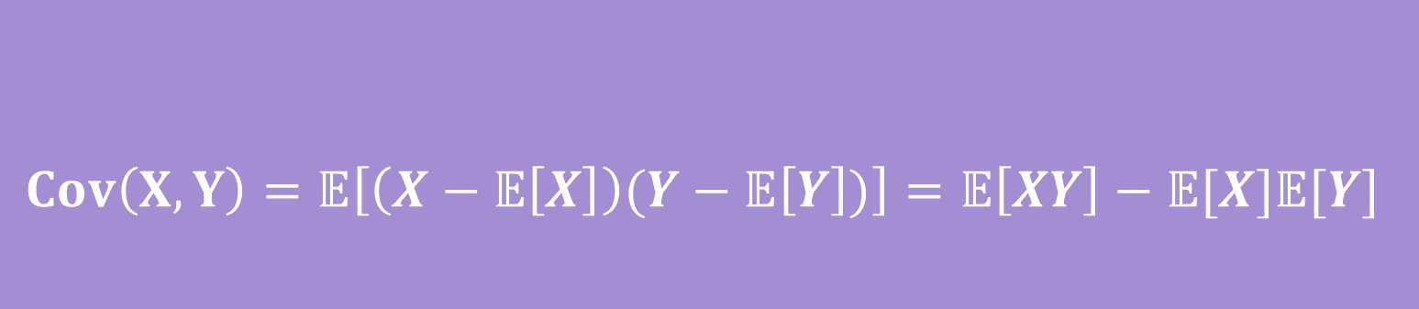
Covariance
We sometimes want to measure how “intertwined” $X$ and $Y$ are – how much knowing about one of them will affect the other.
If $X$ turns out “big” how likely is it that $Y$ will be “big” how much do they “vary together”
$$Cov\left(X,Y\right)=𝔼\left[\left(X−𝔼\left[X\right]\right)(Y−𝔼\left[Y\right])\right]=𝔼\left[XY\right]−𝔼[X]𝔼[Y]$$
Covariance
Notes:
Covariance can be positive or negative! Positive covariance means (linearly) vary together---X bigger than expectation predicts Y bigger than expectation
If covariance is negative than X bigger than expectation predicts Y less than expectation

Slide 23


$$Cov\left(X,Y\right)=𝔼\left[\left(X−𝔼\left[X\right]\right)(Y−𝔼\left[Y\right])\right]=𝔼\left[XY\right]−𝔼[X]𝔼[Y]$$
Covariance
If $X,Y$ go in the same direction
If $X,Y$ go in the opposite directions

Slide 24
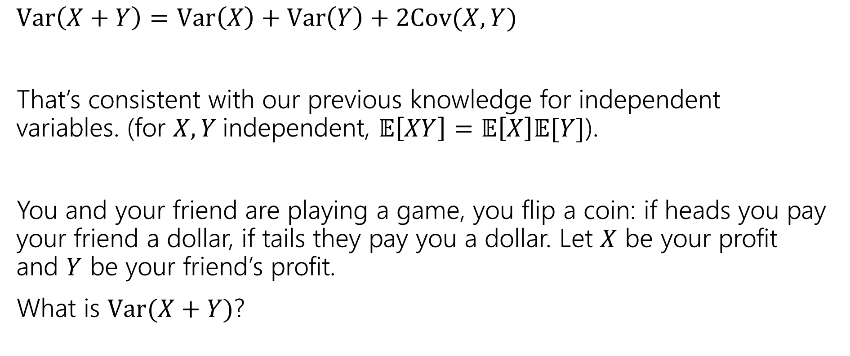
Covariance
$Var\left(X+Y\right)=Var\left(X\right)+Var\left(Y\right)+2Cov(X,Y)$
That’s consistent with our previous knowledge for independent variables. (for $X,Y$independent, $𝔼\left[XY\right]=𝔼\left[X\right]𝔼[Y]$).
You and your friend are playing a game, you flip a coin: if heads you pay your friend a dollar, if tails they pay you a dollar. Let $X$ be your profit and $Y$ be your friend’s profit.
What is $Var(X+Y)$?
Before you calculate, make a prediction. What should it be?

Slide 25
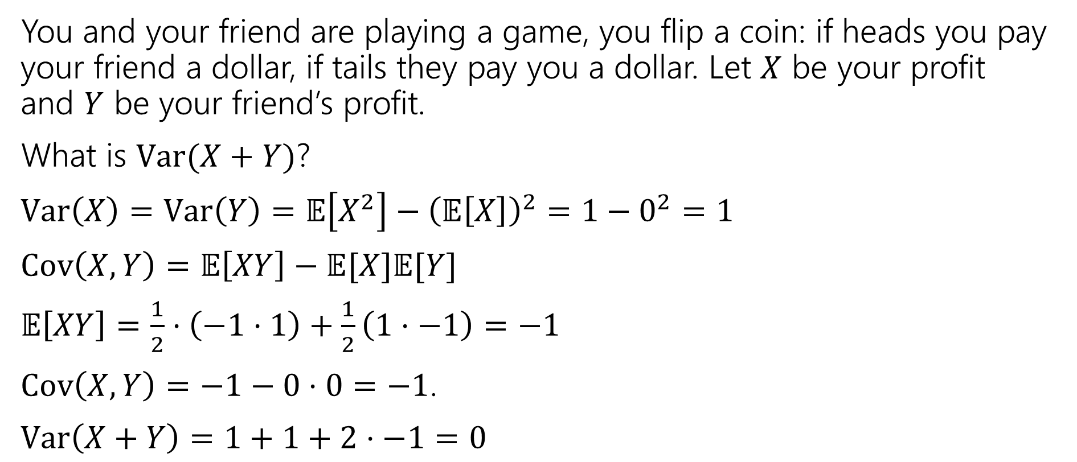
Covariance
You and your friend are playing a game, you flip a coin: if heads you pay your friend a dollar, if tails they pay you a dollar. Let $X$ be your profit and $Y$ be your friend’s profit.
What is $Var(X+Y)$?
$Var\left(X\right)=Var\left(Y\right)=𝔼\left[X^{2}\right]−{\left(𝔼\left[X\right]\right)}^{2}=1−0^{2}=1$
$Cov\left(X,Y\right)=𝔼\left[XY\right]−𝔼[X]𝔼[Y]$
$𝔼\left[XY\right]=\frac{1}{2}⋅\left(−1⋅1\right)+\frac{1}{2}\left(1⋅−1\right)=−1$
$Cov\left(X,Y\right)=−1−0⋅0=−1$.
$Var\left(X+Y\right)=1+1+2⋅−1=0$

Slide 26
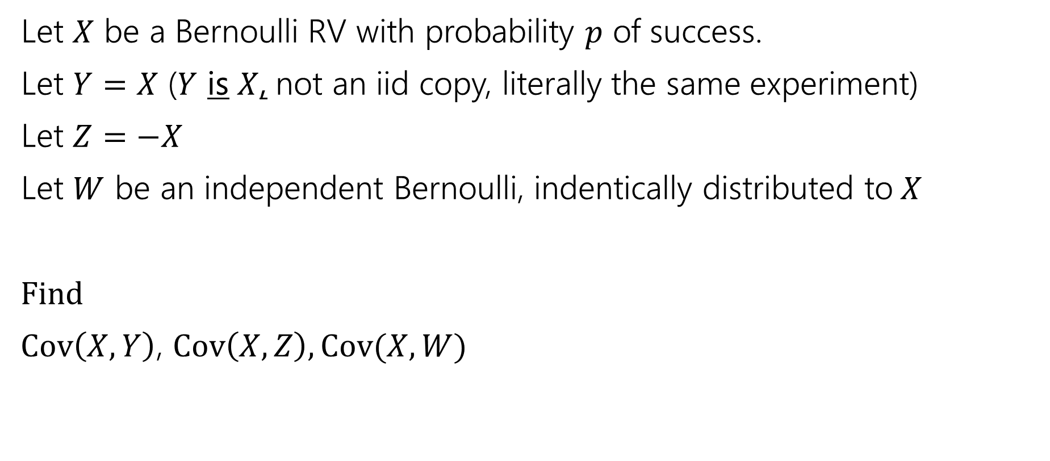
Covariance, Another example
Let $X$ be a Bernoulli RV with probability $p$ of success.
Let $Y=X$ ($Y$ is $X$, not an iid copy, literally the same experiment)
Let $Z=−X$
Let $W$ be an independent Bernoulli, indentically distributed to$X$
Find
$Cov\left(X,Y\right)$, $Cov\left(X,Z\right), Cov(X,W)$

Slide 27
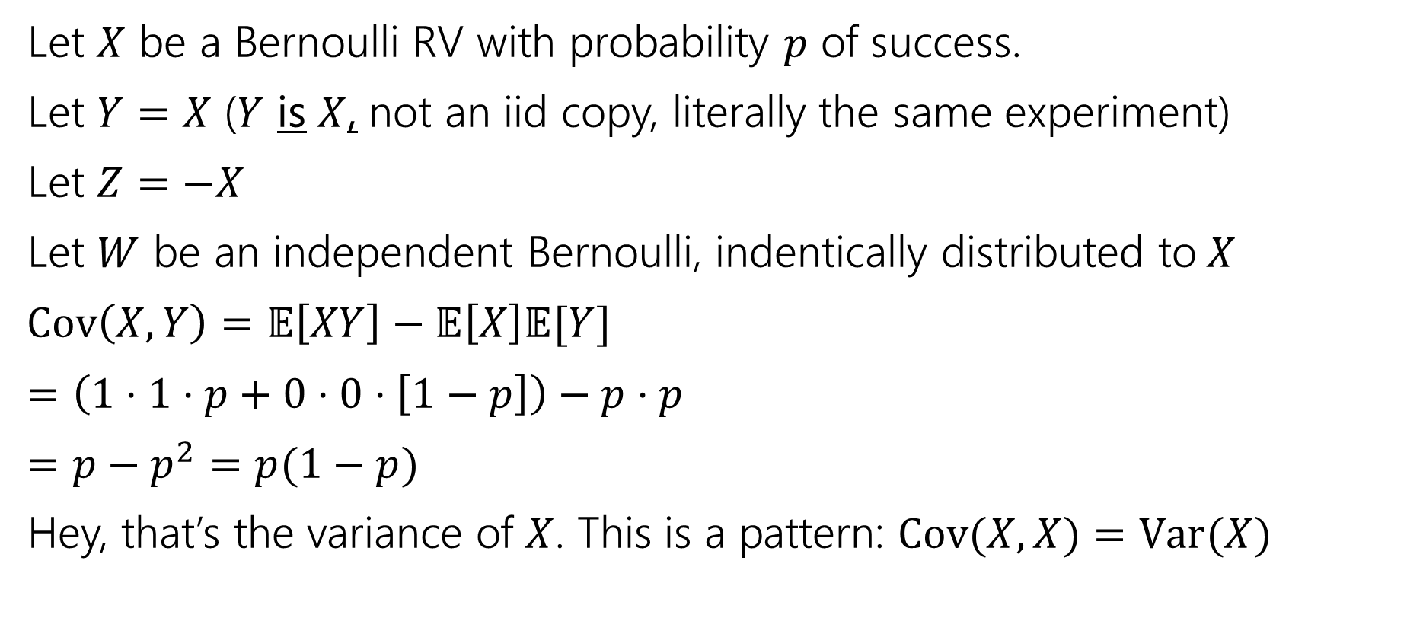
Covariance, Another example
Let $X$ be a Bernoulli RV with probability $p$ of success.
Let $Y=X$ ($Y$ is $X$, not an iid copy, literally the same experiment)
Let $Z=−X$
Let $W$ be an independent Bernoulli, indentically distributed to$X$
$Cov\left(X,Y\right)=𝔼\left[XY\right]−𝔼\left[X\right]𝔼[Y]$
$=\left(1⋅1⋅p+0⋅0⋅\left[1−p\right]\right)−p⋅p$
$=p−p^{2}=p(1−p)$
Hey, that’s the variance of $X$. This is a pattern: $Cov(X,X)=Var(X)$

Slide 28
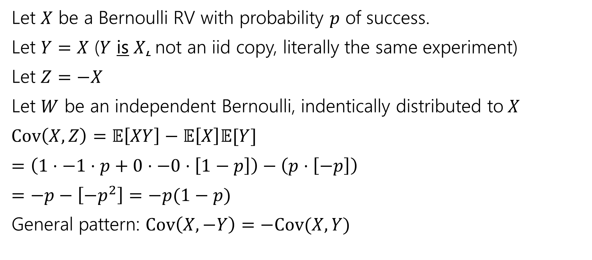
Covariance, Another example
Let $X$ be a Bernoulli RV with probability $p$ of success.
Let $Y=X$ ($Y$ is $X$, not an iid copy, literally the same experiment)
Let $Z=−X$
Let $W$ be an independent Bernoulli, indentically distributed to$X$
$Cov\left(X,Z\right)=𝔼\left[XY\right]−𝔼\left[X\right]𝔼[Y]$
$=\left(1⋅−1⋅p+0⋅−0⋅\left[1−p\right]\right)−\left(p⋅\left[−p\right]\right)$
$=−p−\left[−p^{2}\right]=−p(1−p)$
General pattern: $Cov\left(X,−Y\right)=−Cov(X,Y)$

Slide 29
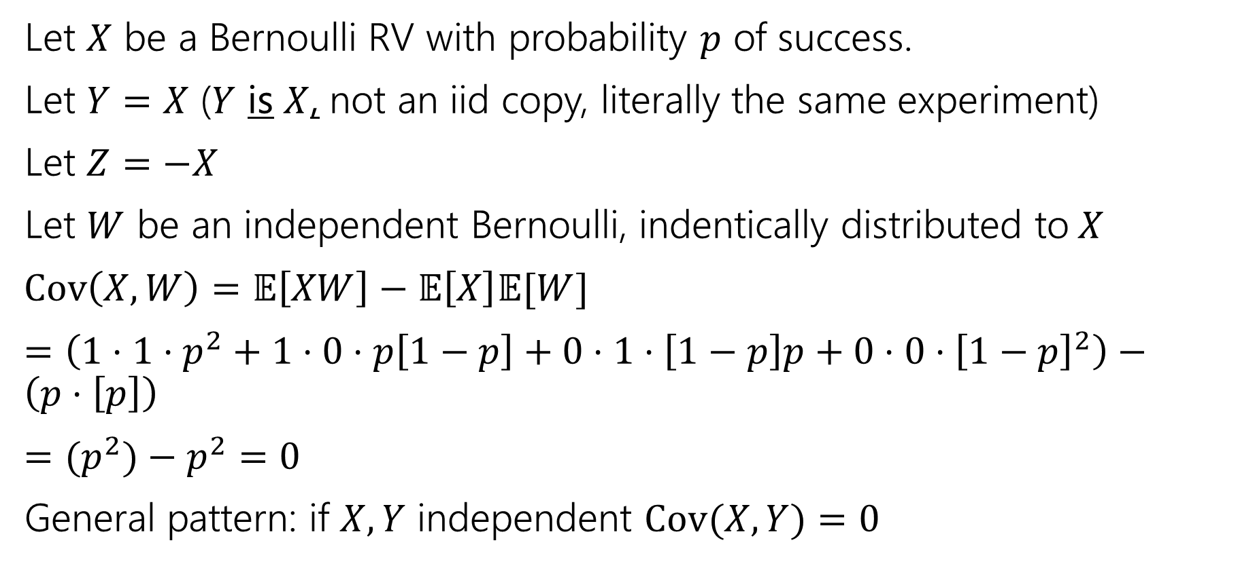
Covariance, Another example
Let $X$ be a Bernoulli RV with probability $p$ of success.
Let $Y=X$ ($Y$ is $X$, not an iid copy, literally the same experiment)
Let $Z=−X$
Let $W$ be an independent Bernoulli, indentically distributed to$X$
$Cov\left(X,W\right)=𝔼\left[XW\right]−𝔼\left[X\right]𝔼[W]$
$=\left(1⋅1⋅p^{2}+1⋅0⋅p\left[1−p\right]+0⋅1⋅\left[1−p\right]p+0⋅0⋅{\left[1−p\right]}^{2}\right)−\left(p⋅\left[p\right]\right)$
$={(p}^{2})−p^{2}=0$
General pattern: if $X,Y$ independent $Cov(X,Y)=0$
Notes:
Converse is not a general pattern; there are “uncorrelated” random variables which are dependent but have covariance 0.
Covariance only measures “linear” relationship; sometimes higher dimensional relationships are hidden. Taking $X\sim N\left(0,1\right), Y=X^2$ is a standard example, but not worth the effort to compute here.

Slide 30
Conditional Distributions

Slide 31
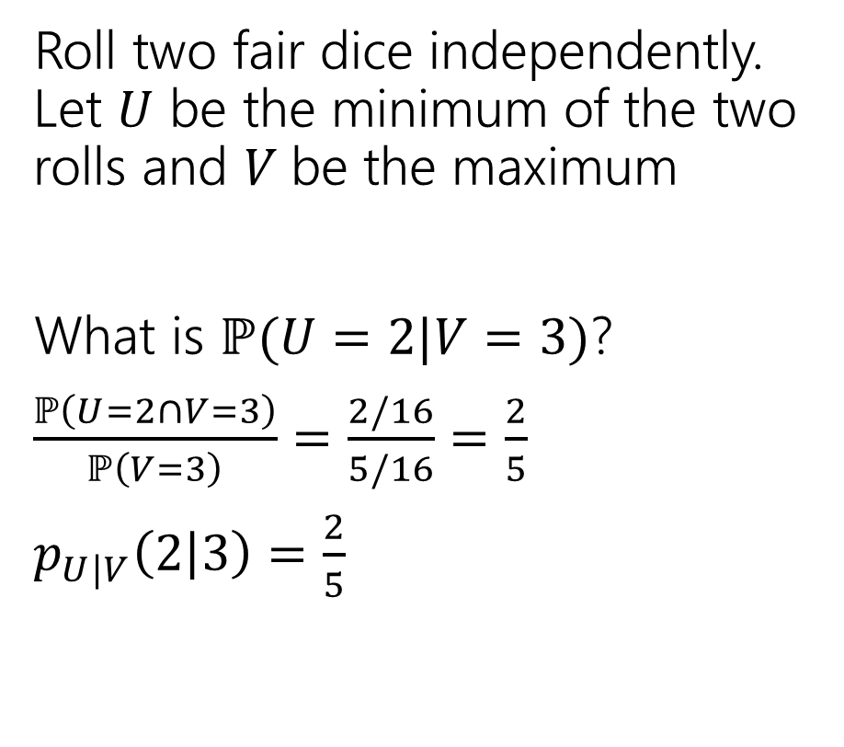
Different dice
Roll two fair dice independently. Let $U$ be the minimum of the two rolls and $V$be the maximum
What is $ℙ(U=2|V=3)$?
$\frac{ℙ\left(U=2∩V=3\right)}{ℙ\left(V=3\right)}=\frac{2/16}{5/16}=\frac{2}{5}$
$p_{U|V}\left(2 | 3\right)=\frac{2}{5}$
$$p_{U,V}$$ | $U$=1 | $U$=2 | $U$=3 | $U$=4
$V$=1 | 1/16 | 0 | 0 | 0
$V$=2 | 2/16 | 1/16 | 0 | 0
$V$=3 | 2/16 | 2/16 | 1/16 | 0
$V$=4 | 2/16 | 2/16 | 2/16 | 1/16

Slide 32

Different dice
Find these values
$p_{V|U}\left(2|1\right)=$
$p_{U|V}\left(1 | 2\right)=$
$p_{U|V}\left(4 | 1\right)=$
$$p_{U,V}$$ | $U$=1 | $U$=2 | $U$=3 | $U$=4
$V$=1 | 1/16 | 0 | 0 | 0
$V$=2 | 2/16 | 1/16 | 0 | 0
$V$=3 | 2/16 | 2/16 | 1/16 | 0
$V$=4 | 2/16 | 2/16 | 2/16 | 1/16

Slide 33
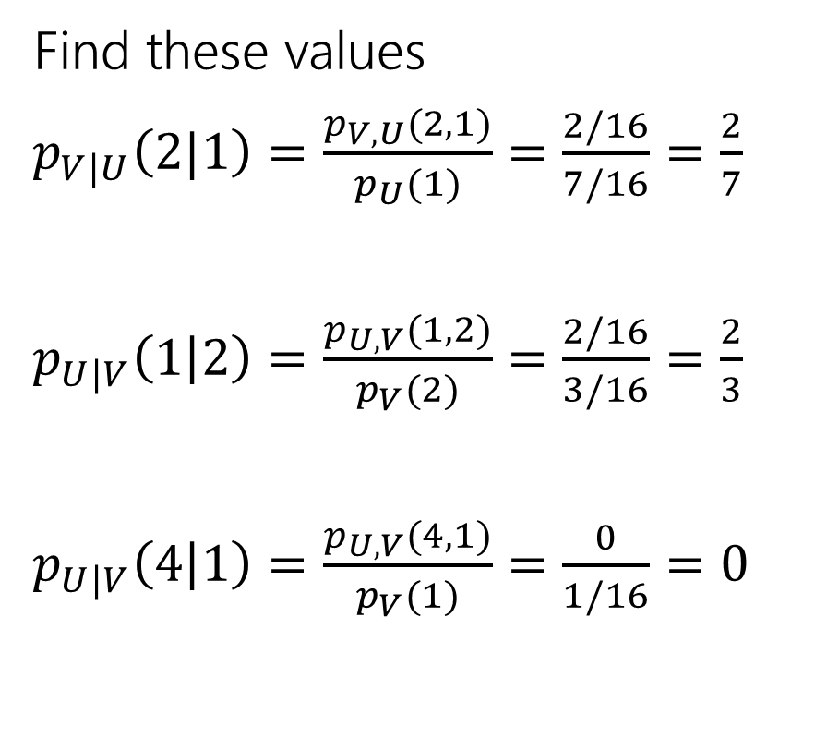
Different dice
Find these values
$p_{V|U}\left(2|1\right)=\frac{p_{V,U}(2,1)}{p_{U}(1)}=\frac{2/16}{7/16}=\frac{2}{7}$
$p_{U|V}\left(1 | 2\right)=\frac{p_{U,V}(1,2)}{p_{V}(2)}=\frac{2/16}{3/16}=\frac{2}{3}$
$p_{U|V}\left(4 | 1\right)=\frac{p_{U,V}(4,1)}{p_{V}(1)}=\frac{0}{1/16}=0$
$$p_{U,V}$$ | $U$=1 | $U$=2 | $U$=3 | $U$=4
$V$=1 | 1/16 | 0 | 0 | 0
$V$=2 | 2/16 | 1/16 | 0 | 0
$V$=3 | 2/16 | 2/16 | 1/16 | 0
$V$=4 | 2/16 | 2/16 | 2/16 | 1/16

Slide 34
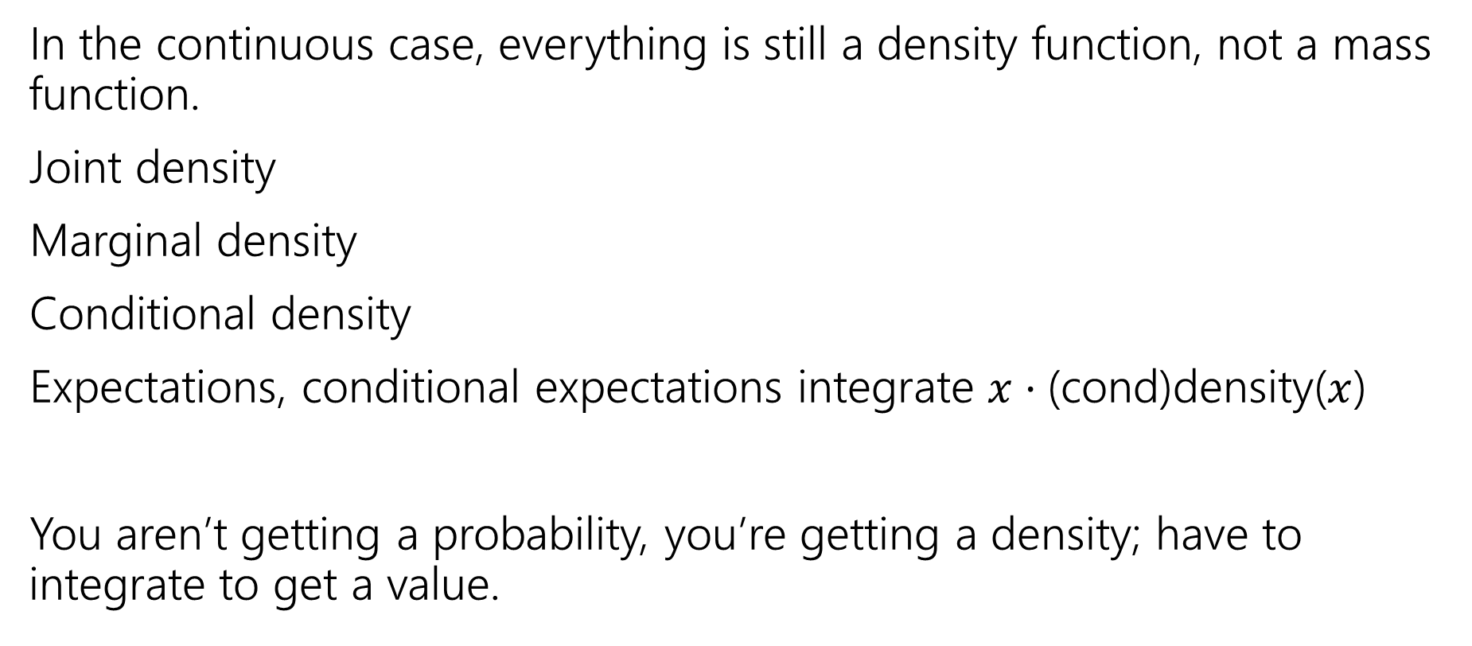
What about the continuous versions?
In the continuous case, everything is still a density function, not a mass function.
Joint density
Marginal density
Conditional density
Expectations, conditional expectations integrate $x⋅$(cond)density($x$)
You aren’t getting a probability, you’re getting a density; have to integrate to get a value.

Slide 35
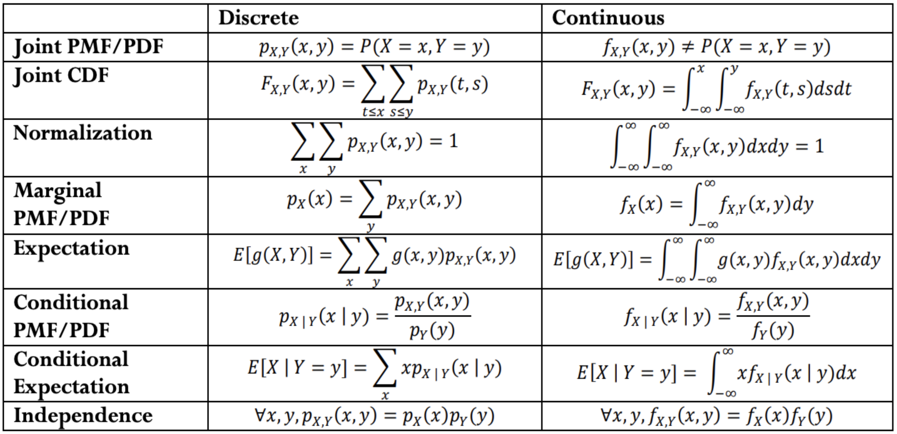
Analogues for continuous
Everything we saw today has a continuous version.
There are “no surprises”– replace pmf with pdf and sums with integrals.

Slide 36
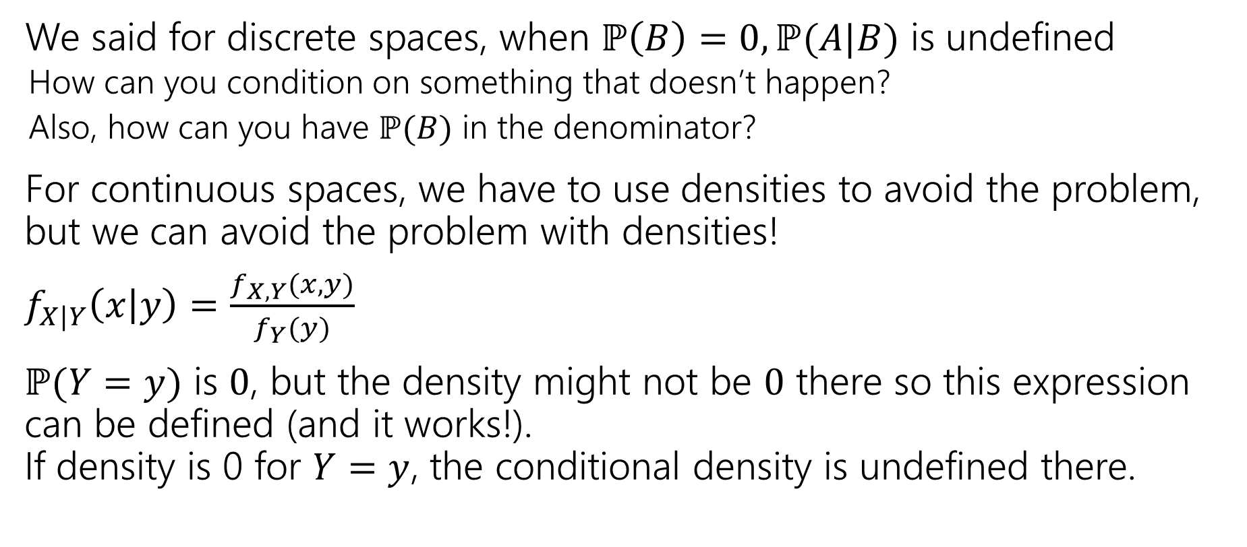
Conditioning on probability 0
We said for discrete spaces, when $ℙ\left(B\right)=0, ℙ(A|B)$ is undefined
  How can you condition on something that doesn’t happen?
  Also, how can you have $ℙ(B)$ in the denominator?
For continuous spaces, we have to use densities to avoid the problem, but we can avoid the problem with densities!
$f_{X|Y}\left(x | y\right)=\frac{f_{X,Y}(x,y)}{f_{Y}(y)}$
$ℙ(Y=y)$ is $0$, but the density might not be $0$ there so this expression can be defined (and it works!).
If density is 0 for $Y=y$, the conditional density is undefined there.

Slide 37
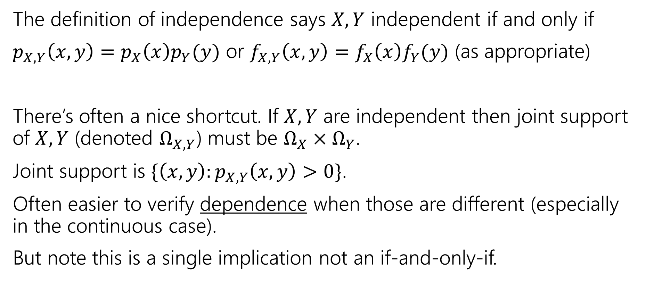
A note on independence
The definition of independence says $X,Y$ independent if and only if
$p_{X,Y}\left(x,y\right)=p_{X}\left(x\right)p_{Y}(y)$ or $f_{X,Y}\left(x,y\right)=f_{X}\left(x\right)f_{Y}(y)$ (as appropriate)
There’s often a nice shortcut. If $X,Y$ are independent then joint support of $X,Y$ (denoted $Ω_{X,Y}$) must be $Ω_{X}×Ω_{Y}$.
Joint support is $\{\left(x,y\right):p_{X,Y}\left(x,y\right)>0\}$.
Often easier to verify dependence when those are different (especially in the continuous case).
But note this is a single implication not an if-and-only-if.
Notes:
$U,V$ from last example can have their dependence verified this way.

Slide 38
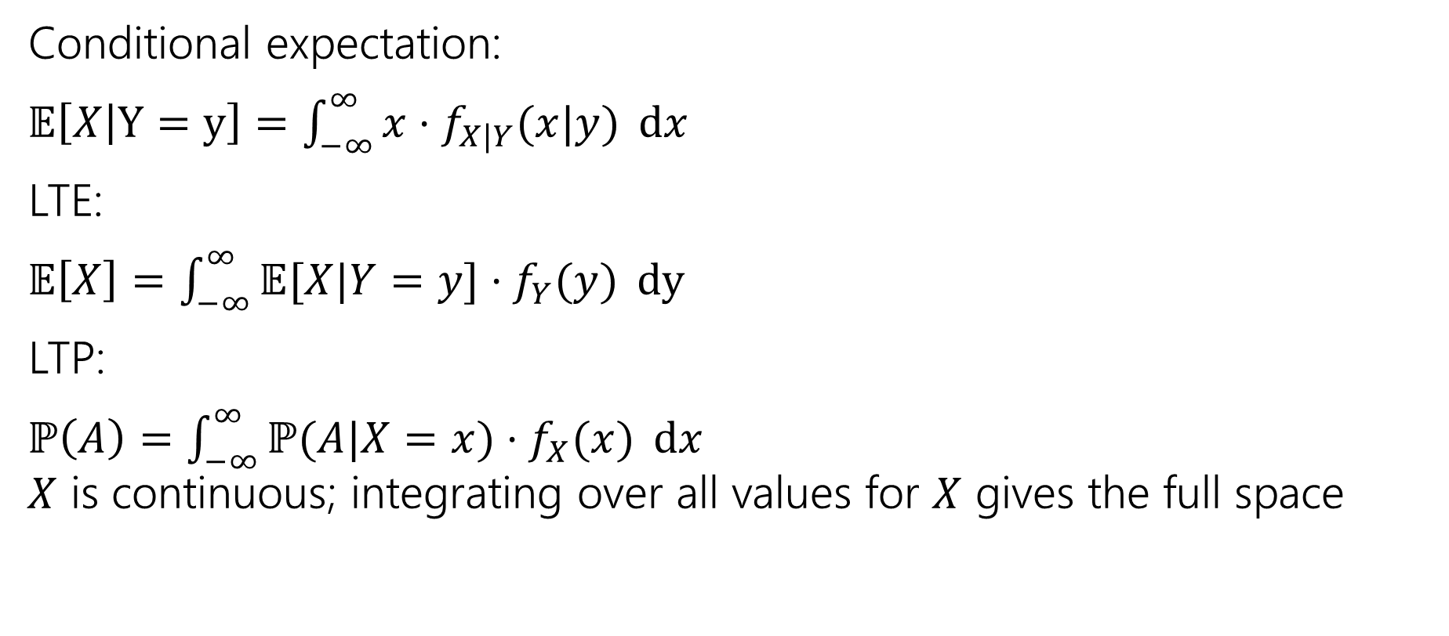
Continuous definitions and theorems
Conditional expectation:
$𝔼\left[X | Y=y\right]=\int_{−∞}^{∞}{x⋅f_{X|Y}(x|y)} dx$
LTE:
$𝔼\left[X\right]=\int_{−∞}^{∞}{𝔼[X|Y=y]⋅f_{Y}(y)} dy$
LTP:
$ℙ\left(A\right)=\int_{−∞}^{∞}{ℙ(A|X=x)⋅f_{X}(x)} dx$
$X$ is continuous; integrating over all values for $X$ gives the full space
Notes:
Common use of conditional density is a conditional expectation

Slide 39


Conditional Expectation
Waaaaaay back when, we said conditioning on an event creates a new probability space, with all the laws holding.
So we can define things like “conditional expectations” which is the expectation of a random variable in that new probability space.
$$𝔼\left[X | E\right]=\sum_{x∈Ω}{x⋅ℙ(X=x|E)}$$
$$𝔼\left[X | Y=y\right]=\sum_{x∈Ω_{X}}{x⋅ℙ\left(X=x | Y=y\right)}$$

Slide 40
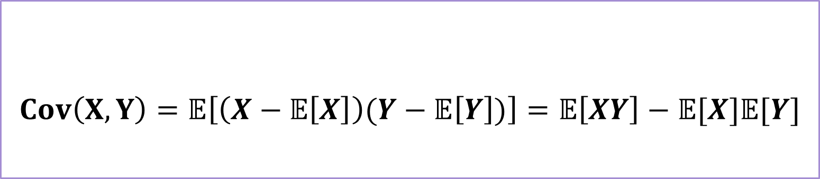
Covariance
We sometimes want to measure how “intertwined” $X$ and $Y$ are – how much knowing about one of them will affect the other.
If $X$ turns out “big” how likely is it that $Y$ will be “big” how much do they “vary together”
$$Cov\left(X,Y\right)=𝔼\left[\left(X−𝔼\left[X\right]\right)(Y−𝔼\left[Y\right])\right]=𝔼\left[XY\right]−𝔼[X]𝔼[Y]$$
Covariance
Notes:
Covariance can be positive or negative! Positive covariance means

