Slide 1
Variance
CSE 312 Autumn 25
Lecture 12

Slide 2
Variance

Slide 3
Where are we?
A random variable is a way to summarize what outcome you saw.
The Expectation of a random variable is its average value.
A way to summarize a random variable

Slide 4
Variance
Another one number summary of a random variable.
But wait, we already have expectation, what’s this for?

Slide 5
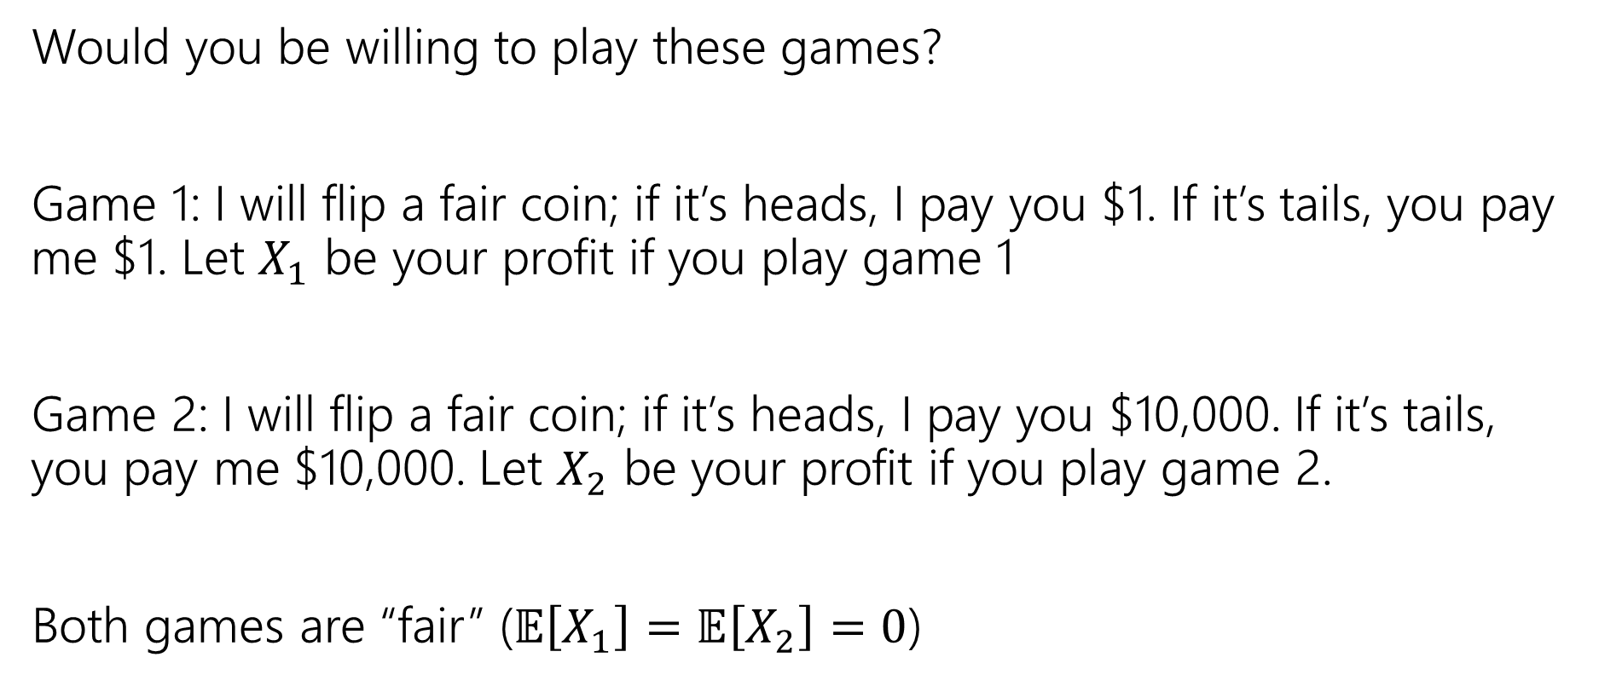
Consider these two games
Would you be willing to play these games?
Game 1: I will flip a fair coin; if it’s heads, I pay you $1. If it’s tails, you pay me $1. Let $X_{1}$ be your profit if you play game 1
Game 2: I will flip a fair coin; if it’s heads, I pay you $10,000. If it’s tails, you pay me $10,000. Let $X_{2}$ be your profit if you play game 2.
Both games are “fair” ($𝔼\left[X_{1}\right]=𝔼\left[X_{2}\right]=0$)

Slide 6
What’s the difference
Expectation tells you what the average will be…
But it doesn’t tell you how “extreme” your results could be.
Nor how likely those extreme results are.
Game 2 has many (well, only) very extreme results.
In expectation they “cancel out” but if you can only play once…
…it would be nice to measure that.

Slide 7
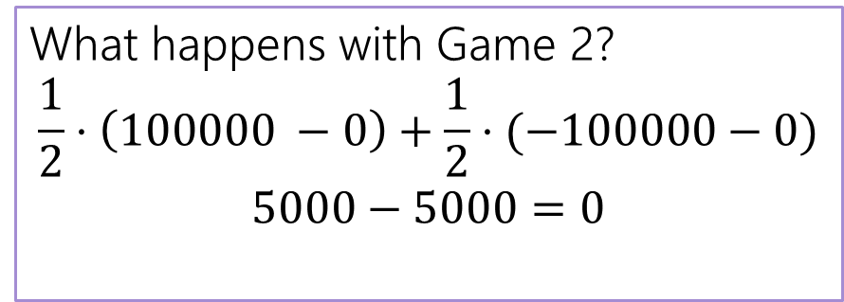
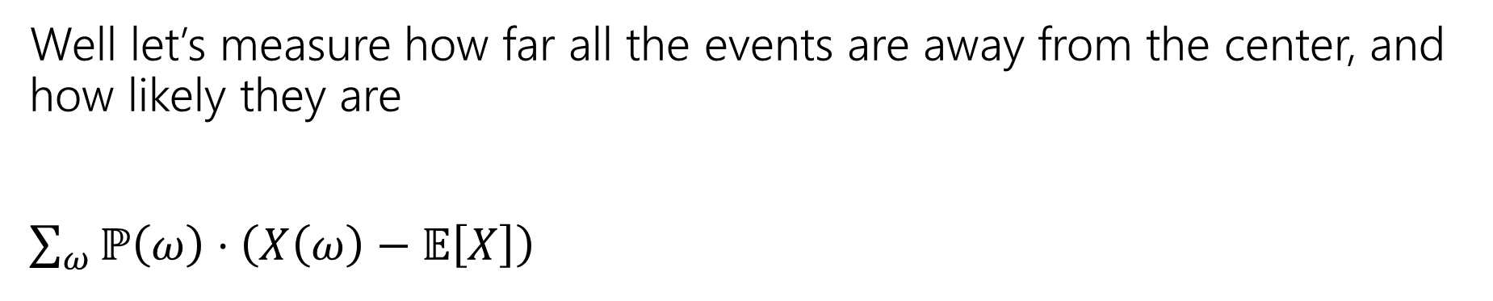
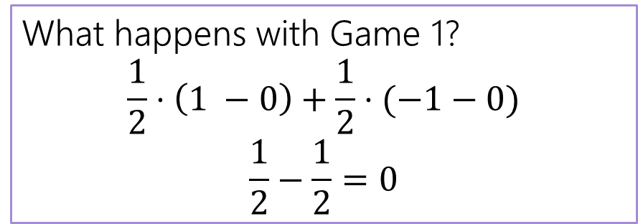
Designing a Measure – Try 1
Well let’s measure how far all the events are away from the center, and how likely they are
$\sum_{ω}{ℙ\left(ω\right)⋅\left(X\left(ω\right)−𝔼\left[X\right]\right) }$
What happens with Game 1?
$$\frac{1}{2}⋅\left(1 −0\right)+\frac{1}{2}⋅(−1−0)$$
$$\frac{1}{2}−\frac{1}{2}=0$$
What happens with Game 2?
$$\frac{1}{2}⋅\left(100000 −0\right)+\frac{1}{2}⋅(−100000−0)$$
$$5000−5000=0$$

Slide 8
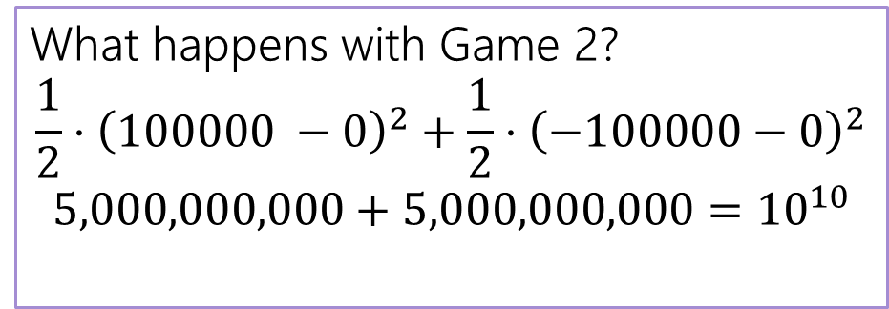
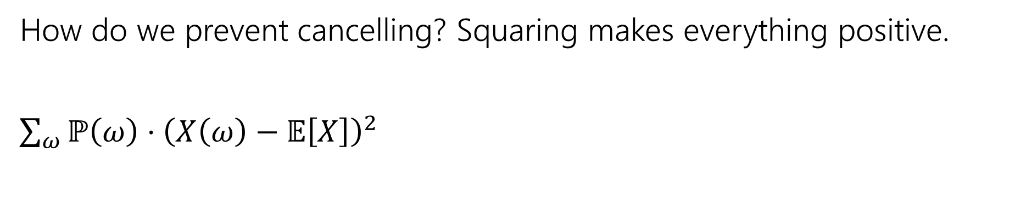

Designing a Measure – Try 2
How do we prevent cancelling? Squaring makes everything positive.
$\sum_{ω}{ℙ\left(ω\right)⋅{\left(X\left(ω\right)−𝔼\left[X\right]\right)}^{2} }$
What happens with Game 1?
$$\frac{1}{2}⋅{\left(1 −0\right)}^{2}+\frac{1}{2}⋅{\left(−1−0\right)}^{2}$$
$$\frac{1}{2}+\frac{1}{2}=1$$
What happens with Game 2?
$$\frac{1}{2}⋅{\left(100000 −0\right)}^{2}+\frac{1}{2}⋅{\left(−100000−0\right)}^{2}$$
$$5,000,000,000+5,000,000,000={10}^{10}$$

Slide 9
Why Squaring
Why not absolute value? Or Fourth power?
Squaring is nicer algebraically.
Our goal with variance was to talk about the spread of results. Squaring makes extreme results even more extreme.
Fourth power over-emphasizes the extreme results (for our purposes).

Slide 10
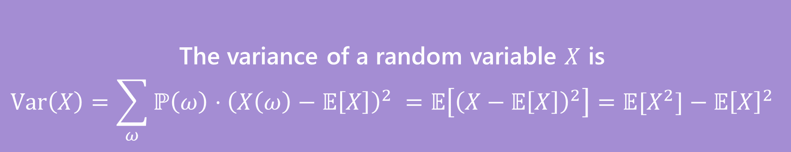
Variance
The first two forms are the definition. The last one is an algebra trick.
The variance of a random variable $X$ is
$$Var\left(X\right)=\sum_{ω}{ℙ\left(ω\right)⋅{\left(X\left(ω\right)−𝔼\left[X\right]\right)}^{2} }=𝔼\left[{\left(X−𝔼\left[X\right]\right)}^{2}\right]=𝔼[X^{2}]−𝔼{\left[X\right]}^{2}$$
Variance

Slide 11
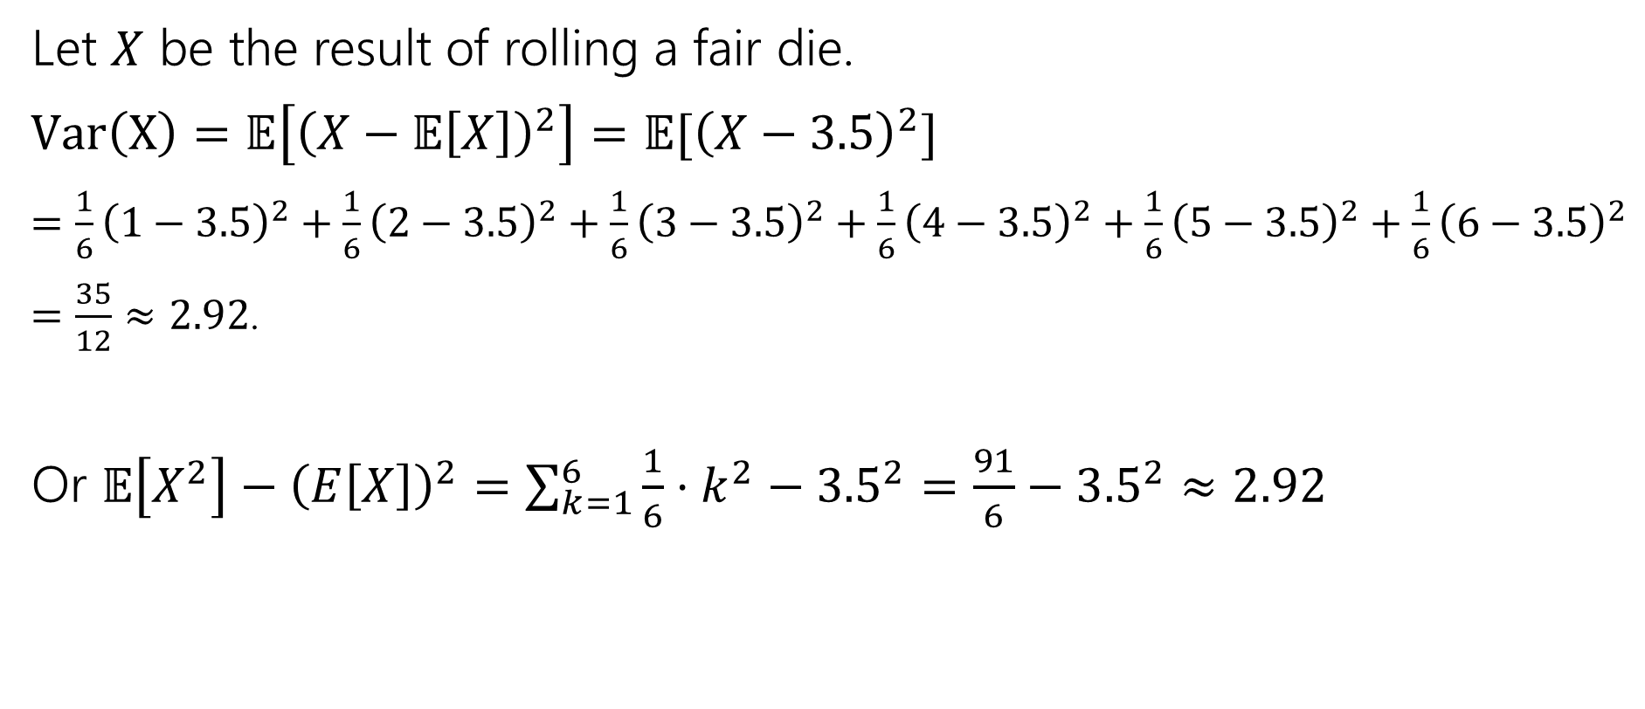
Variance of a die
Let $X$ be the result of rolling a fair die.
$Var\left(X\right)=𝔼\left[{\left(X−𝔼\left[X\right]\right)}^{2}\right]=𝔼[{\left(X−3.5\right)}^{2}]$
$=\frac{1}{6}{\left(1−3.5\right)}^{2}+\frac{1}{6}{\left(2−3.5\right)}^{2}+\frac{1}{6}{\left(3−3.5\right)}^{2}+\frac{1}{6}{\left(4−3.5\right)}^{2}+\frac{1}{6}{\left(5−3.5\right)}^{2}+\frac{1}{6}{\left(6−3.5\right)}^{2}$
$=\frac{35}{12}≈2.92$.
Or $𝔼\left[X^{2}\right]−{\left(E\left[X\right]\right)}^{2}=\sum_{k=1}^{6}{\frac{1}{6}⋅k^{2}−{3.5}^{2}}=\frac{91}{6}−{3.5}^{2}≈2.92$

Slide 12
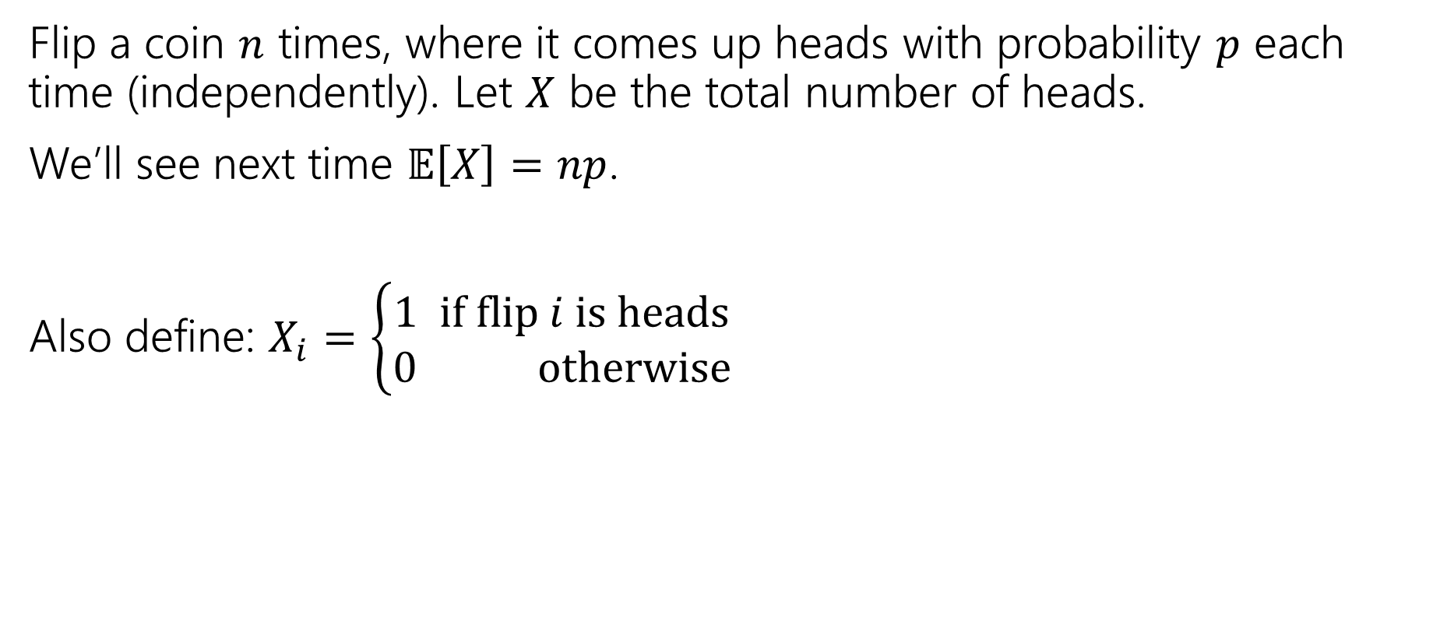

Variance of $n$ Coin Flips
Flip a coin $n$ times, where it comes up heads with probability $p$ each time (independently). Let $X$ be the total number of heads.
We’ll see next time $𝔼\left[X\right]=np$.
Also define: $X_{i}=\left\{\begin{aligned}1 if flip i is heads \\ 0 otherwise\end{aligned}\right.$

Slide 13
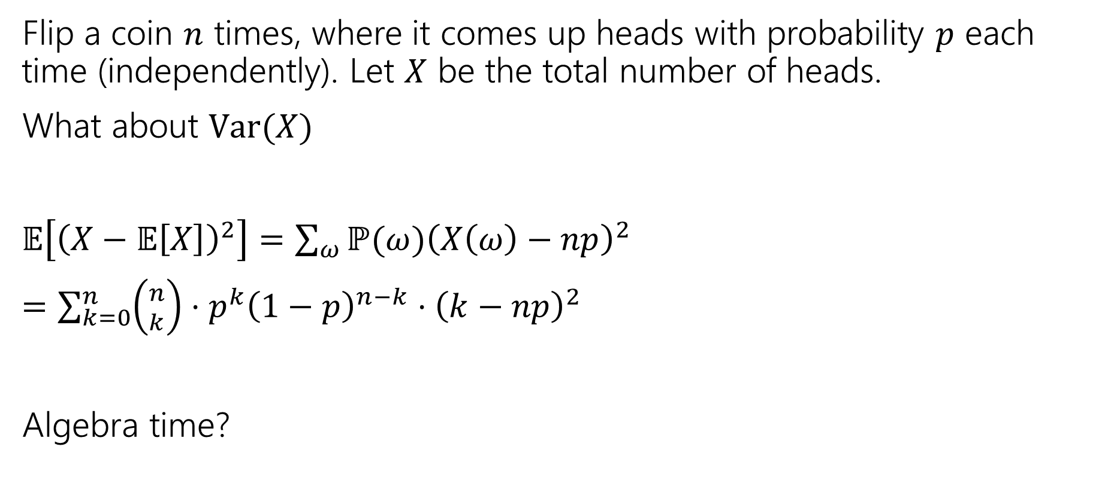
Variance of $n$ Coin Flips
Flip a coin $n$ times, where it comes up heads with probability $p$ each time (independently). Let $X$ be the total number of heads.
What about $Var(X)$
$𝔼\left[{\left(X−𝔼\left[X\right]\right)}^{2}\right]=\sum_{ω}{ℙ(ω){\left(X\left(ω\right)−np\right)}^{2}}$
$=\sum_{k=0}^{n}{\left({n \atop k}\right)⋅p^{k}{\left(1−p\right)}^{n−k}⋅{\left(k−np\right)}^{2}}$
Algebra time?

Slide 14

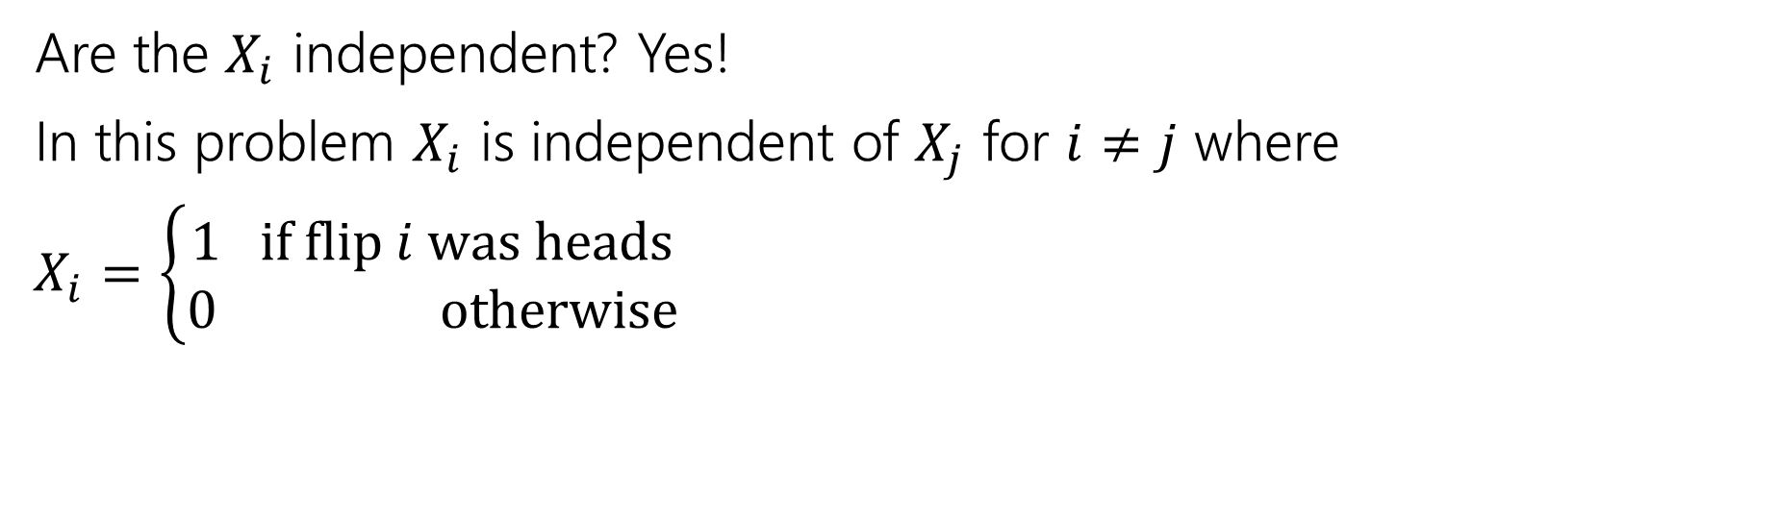
Variance
If $X$ and $Y$ are independent then
$$Var\left(X+Y\right)=Var\left(X\right)+Var(Y)$$
Are the $X_{i}$ independent? Yes!
In this problem $X_{i}$ is independent of $X_{j}$ for $i≠j$ where
$X_{i}=\left\{\begin{aligned}1 if flip i was heads \\ 0 otherwise\end{aligned}\right.$

Slide 15
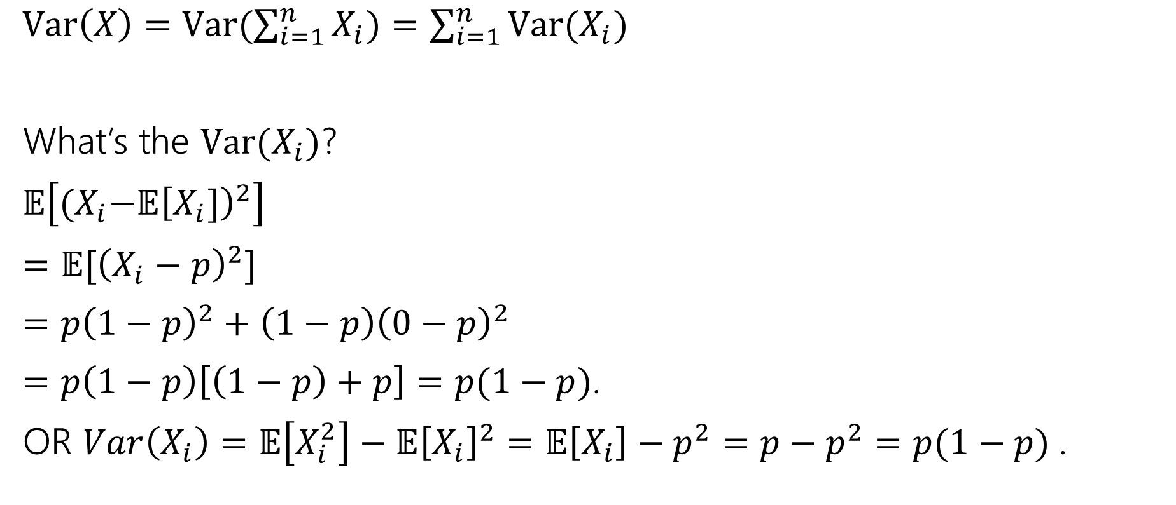
Variance
$Var\left(X\right)=Var(\sum_{i=1}^{n}{X_{i})=\sum_{i=1}^{n}{Var(X_{i})}}$
What’s the $Var(X_{i})$?
$𝔼\left[{(X}_{i}−𝔼{\left[X_{i}]\right)}^{2}\right]$
$=𝔼[{\left(X_{i}−p\right)}^{2}]$
$=p{\left(1−p\right)}^{2}+\left(1−p\right){\left(0−p\right)}^{2}$
$=p\left(1−p\right)\left[\left(1−p\right)+p\right]=p(1−p)$.
OR $Var\left(X_{i}\right)=𝔼\left[X_{i}^{2}\right]−𝔼{\left[X_{i}\right]}^{2}=𝔼\left[X_{i}\right]−p^{2}=p−p^{2}=p(1−p)$.

Slide 16

Plugging In
$Var\left(X\right)=Var(\sum_{i=1}^{n}{X_{i})=\sum_{i=1}^{n}{Var(X_{i})}}$
What’s the $Var(X_{i})$?
$p(1−p)$.
$Var\left(X\right)=\sum_{i=1}^{n}{p\left(1−p\right)=}np(1−p)$.

Slide 17
Expectation and Variance aren’t everything
Alright, so expectation and variance is everything right?
No!
A PMF or CDF *does* fully describe a random variable.
Flip a fair coin 3 times indep. Count heads.
Flip a biased coin (prob heads=2/3) until heads. Count flips.
…

Slide 18
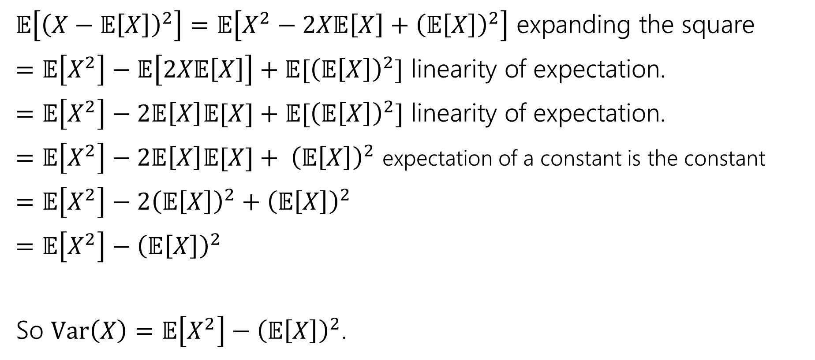
Proof of Calculation Trick
$𝔼\left[{\left(X−𝔼\left[X\right]\right)}^{2}\right]=𝔼\left[X^{2}−2X𝔼\left[X\right]+{\left(𝔼\left[X\right]\right)}^{2}\right]$ expanding the square
$=𝔼\left[X^{2}\right]−𝔼\left[2X𝔼\left[X\right]\right]+𝔼[{\left(𝔼\left[X\right]\right)}^{2}]$ linearity of expectation.
$=𝔼\left[X^{2}\right]−2𝔼\left[X\right]𝔼[X]+𝔼[{\left(𝔼\left[X\right]\right)}^{2}]$ linearity of expectation.
$=𝔼\left[X^{2}\right]−2𝔼\left[X\right]𝔼[X]+ {\left(𝔼\left[X\right]\right)}^{2}$ expectation of a constant is the constant
$=𝔼\left[X^{2}\right]−2{\left(𝔼\left[X\right]\right)}^{2}+{\left(𝔼\left[X\right]\right)}^{2}$
$=𝔼\left[X^{2}\right]−{\left(𝔼\left[X\right]\right)}^{2}$
So $Var\left(X\right)=𝔼\left[X^{2}\right]−{\left(𝔼\left[X\right]\right)}^{2}$.

Slide 19
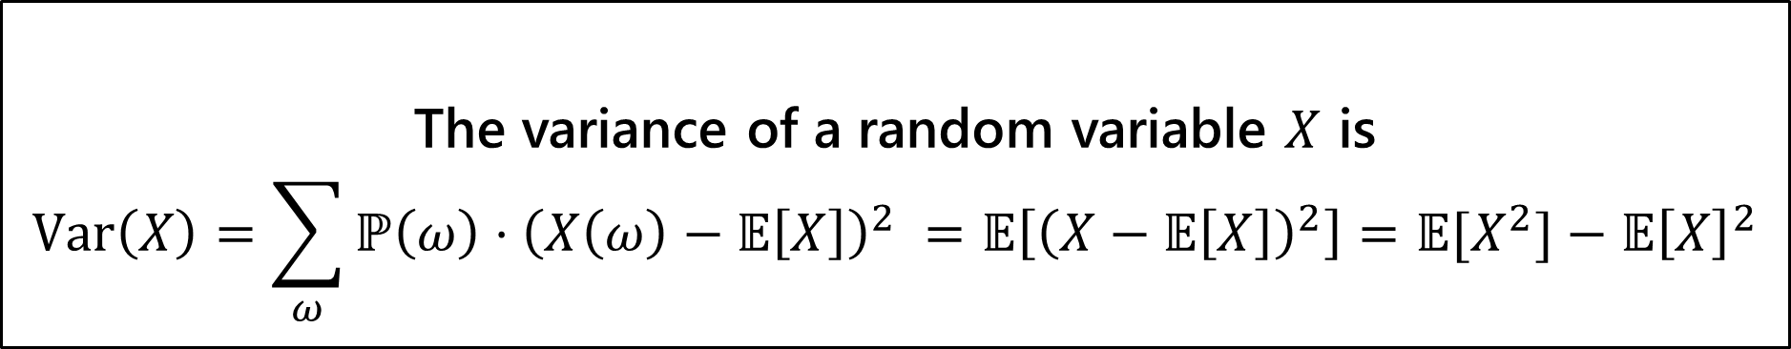

Variance
The first two forms are the definition. The last one is an algebra trick.
The variance of a random variable $X$ is
$$Var\left(X\right)=\sum_{ω}{ℙ\left(ω\right)⋅{\left(X\left(ω\right)−𝔼\left[X\right]\right)}^{2} }=𝔼\left[{\left(X−𝔼\left[X\right]\right)}^{2}\right]=𝔼[X^{2}]−𝔼{\left[X\right]}^{2}$$
Variance
If $X$ and $Y$ are independent, then
$$Var\left(X+Y\right)=Var\left(X\right)+Var(Y)$$

