Slide 1
More Random Variables Expectation, Independence
CSE 312 Autumn 25
Lecture 10

Slide 2
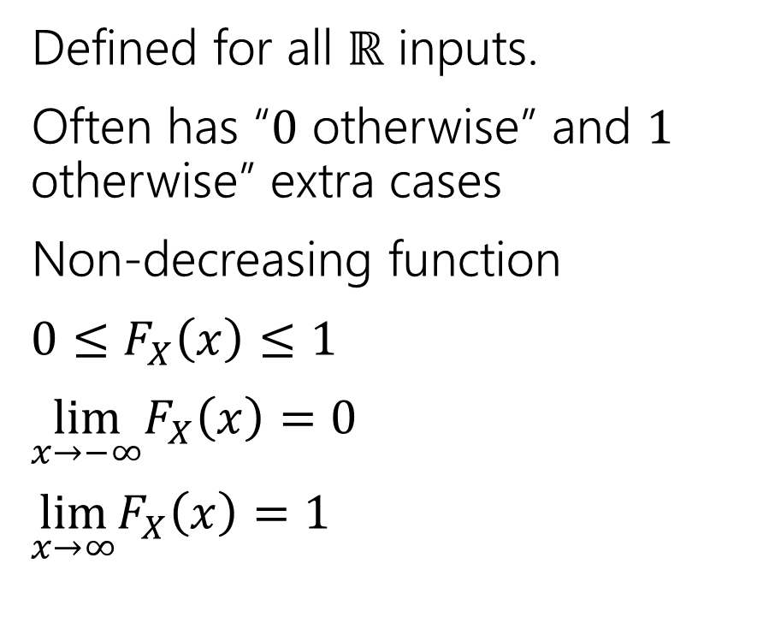
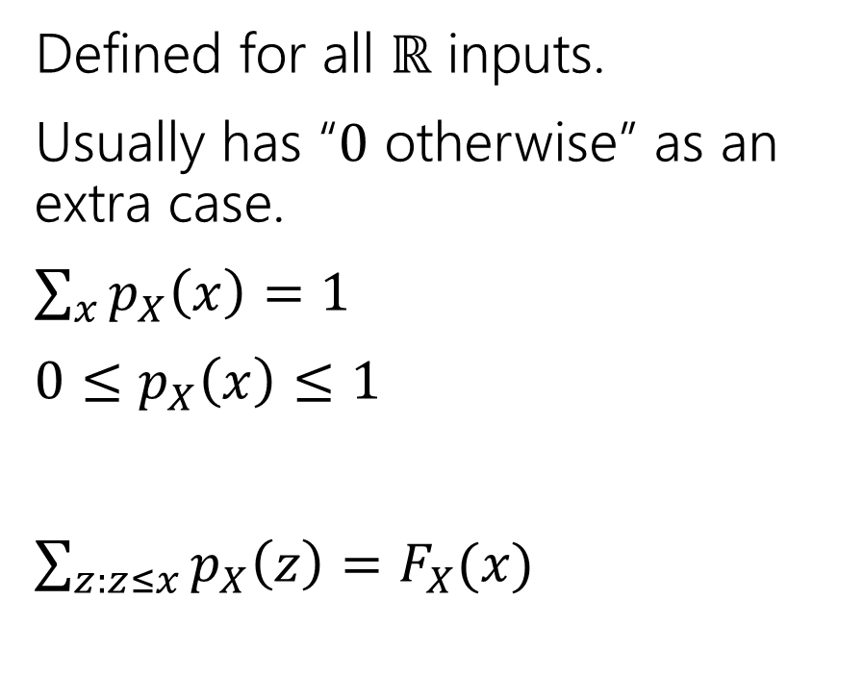
Two descriptions
Probability mass function
Cumulative Distribution function
Defined for all $ℝ$ inputs.
Usually has “$0$ otherwise” as an extra case.
$\sum_{x}{p_{X}\left(x\right)=1}$
$0≤p_{X}\left(x\right)≤1$
$\sum_{z:z≤x}{p_{X}\left(z\right)=F_{X}(x)}$
Defined for all $ℝ$ inputs.
Often has “$0$ otherwise” and $1$ otherwise” extra cases
Non-decreasing function
$0≤F_{X}\left(x\right)≤1$
$\lim_{x→−∞}F_{X}\left(x\right)=0$
$\lim_{x→∞}F_{X}\left(x\right)=1⁡$

Slide 3
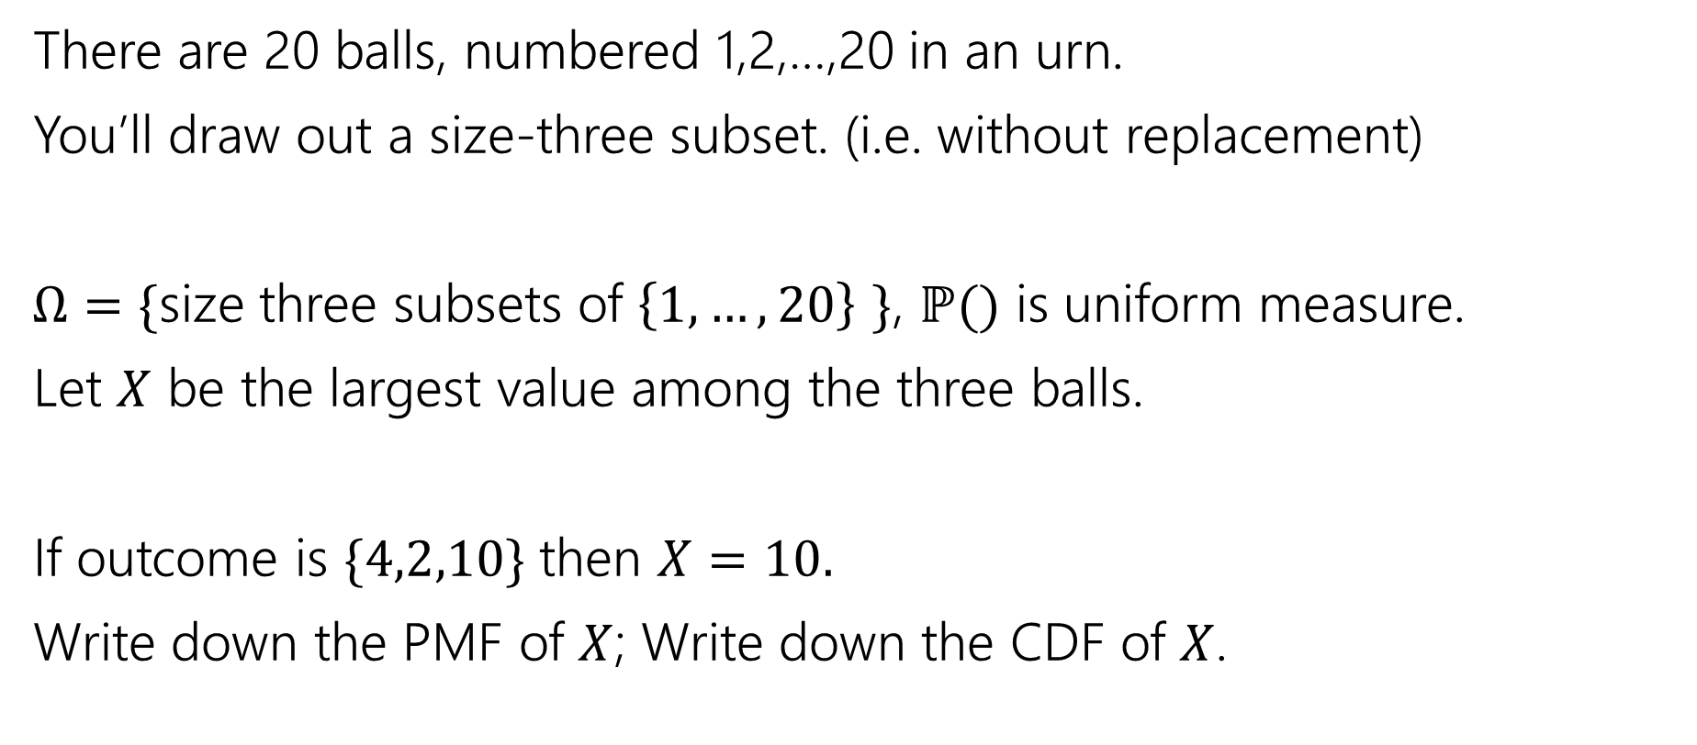
Try It Yourself
There are 20 balls, numbered 1,2,…,20 in an urn.
You’ll draw out a size-three subset. (i.e. without replacement)
$Ω=\{$size three subsets of $\left\{1,…,20\right\}$ $\}$, $ℙ()$ is uniform measure.
Let $X$ be the largest value among the three balls.
If outcome is $\{4,2,10\}$ then $X=10.$
Write down the PMF of $X$; Write down the CDF of $X$.

Slide 4
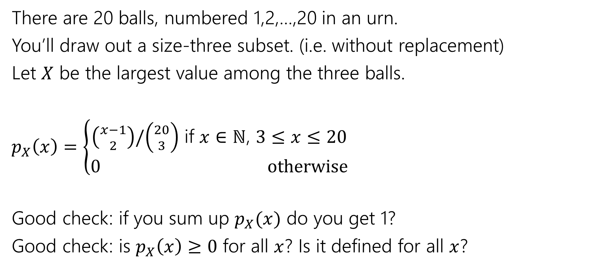
Try It Yourself
There are 20 balls, numbered 1,2,…,20 in an urn.
You’ll draw out a size-three subset. (i.e. without replacement)
Let $X$ be the largest value among the three balls.
$p_{X}\left(x\right)=\left\{\begin{aligned}\left({x−1 \atop 2}\right)/\left({20 \atop 3}\right) \text{if} x∈ℕ\text{, }3≤x≤20 \\ 0 otherwise\end{aligned}\right.$
Good check: if you sum up $p_{X}(x)$ do you get 1?
Good check: is $p_{X}\left(x\right)≥0$ for all $x$? Is it defined for all $x$?

Slide 5
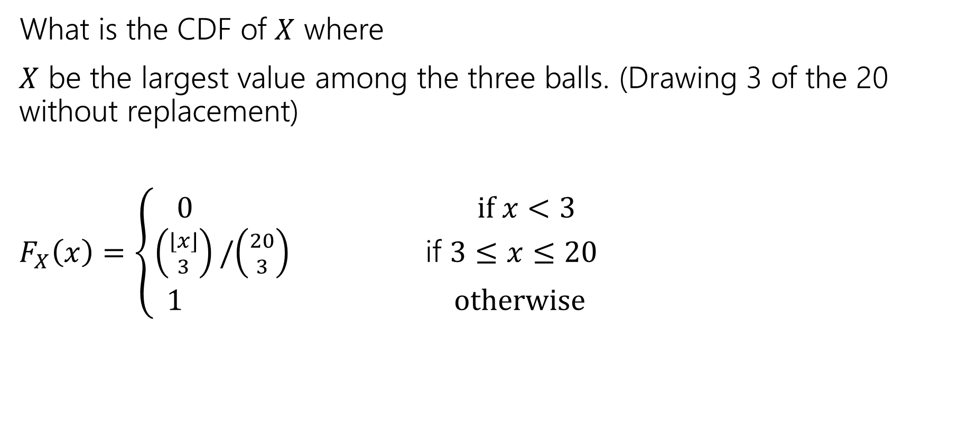
Try it yourself
What is the CDF of $X$ where
$X$ be the largest value among the three balls. (Drawing 3 of the 20 without replacement)
$F_{X}\left(x\right)=\left\{\begin{aligned}\begin{aligned}0 if x<3 \\ \left({⌊x⌋ \atop 3}\right)/\left({20 \atop 3}\right) \text{if} 3≤x≤20\end{aligned} \\ 1 otherwise\end{aligned}\right.$

Slide 6
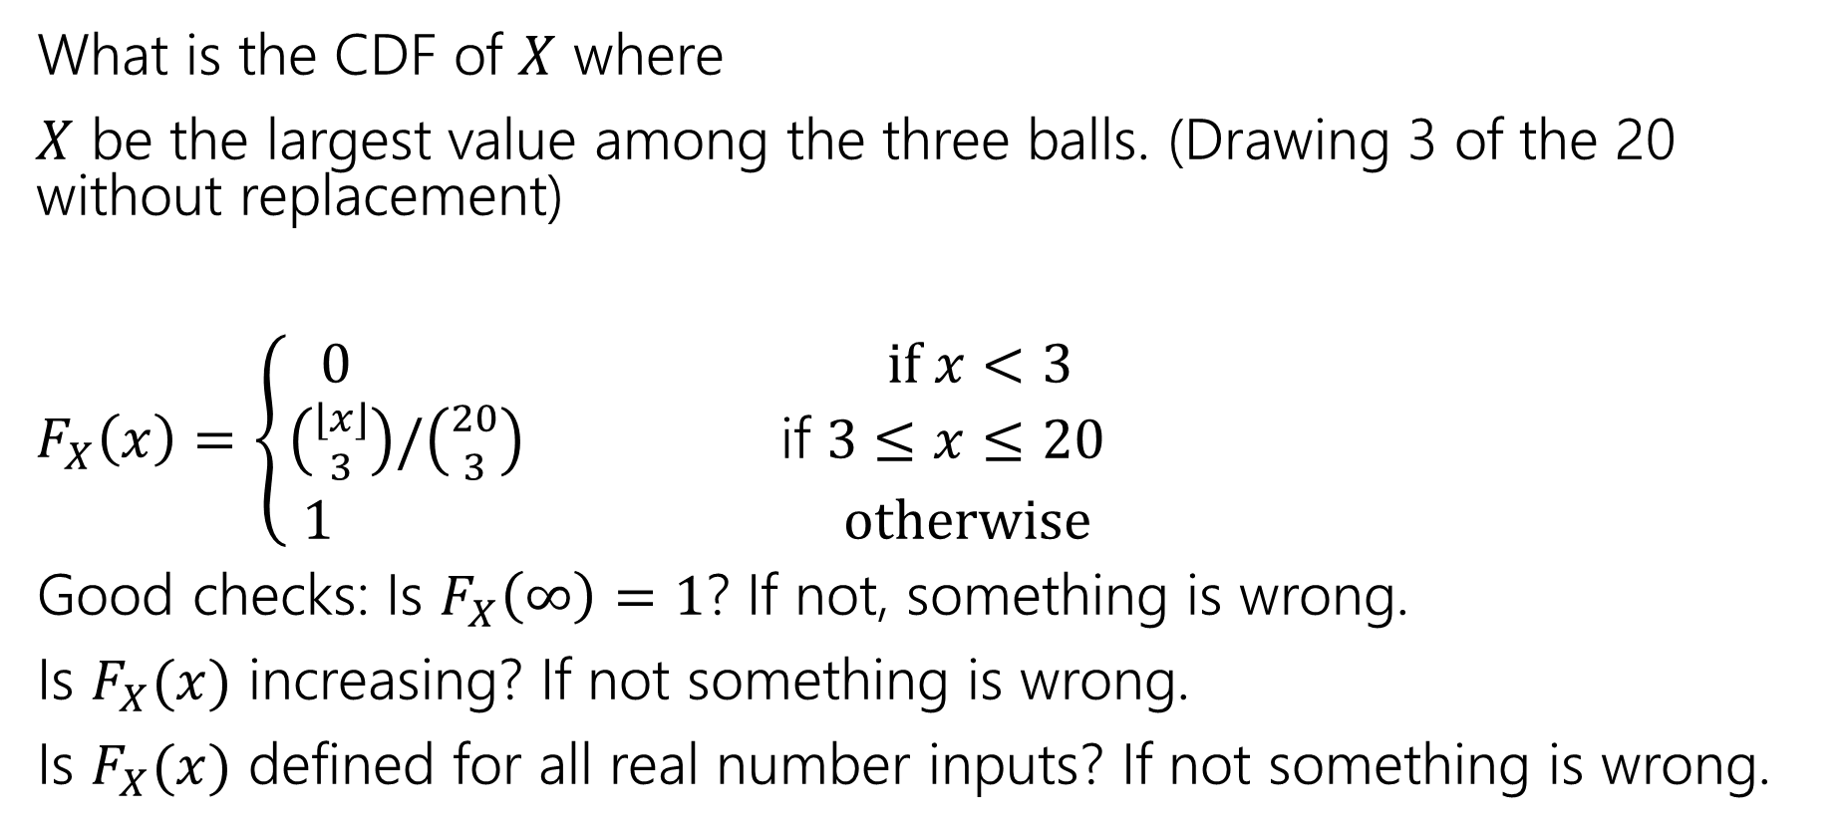
Try it yourself
What is the CDF of $X$ where
$X$ be the largest value among the three balls. (Drawing 3 of the 20 without replacement)
$F_{X}\left(x\right)=\left\{\begin{aligned}\begin{aligned}0 if x<3 \\ \left({⌊x⌋ \atop 3}\right)/\left({20 \atop 3}\right) \text{if} 3≤x≤20\end{aligned} \\ 1 otherwise\end{aligned}\right.$
Good checks: Is $F_{X}\left(∞\right)=1$? If not, something is wrong.
Is $F_{X}(x)$ increasing? If not something is wrong.
Is $F_{X}(x)$ defined for all real number inputs? If not something is wrong.

Slide 7

More Random Variable Practice
Roll a fair die $n$ times. Let $Z$ be the number of rolls that are $5s$ or $6s$.
What is the pmf?
Don’t try to write the CDF…it’s a mess…
Or try for a few minutes to realize it isn’t nice.

Slide 8
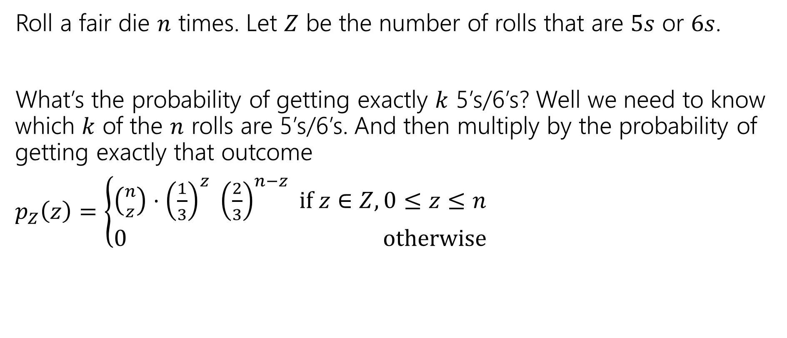
More Random Variable Practice
Roll a fair die $n$ times. Let $Z$ be the number of rolls that are $5s$ or $6s$.
What’s the probability of getting exactly $k$ 5’s/6’s? Well we need to know which $k$ of the $n$ rolls are 5’s/6’s. And then multiply by the probability of getting exactly that outcome
$p_{Z}\left(z\right)=\left\{\begin{aligned}\left({n \atop z}\right)⋅{\left(\frac{1}{3}\right)}^{z} {\left(\frac{2}{3}\right)}^{n−z} if z∈Z,0≤z≤n \\ 0 otherwise\end{aligned}\right.$

Slide 9


Expectation
The “expectation” (or “expected value”) of a random variable $X$ is:
$$𝔼\left[X\right]=\sum_{k}{k⋅ℙ(X=k)}$$
Expectation
Intuition: The weighted average of values $X$ could take on.
Weighted by the probability you actually see them.

Slide 10

Example 1
Flip a fair coin twice (independently)
Let $X$be the number of heads.
$Ω=\{TT,TH,HT,HH\}$, $ℙ()$ is uniform measure.
$𝔼\left[X\right]=\frac{1}{4}⋅0+\frac{1}{2}⋅1+\frac{1}{4}⋅2=0+\frac{1}{2}+\frac{1}{2}=1$.

Slide 11
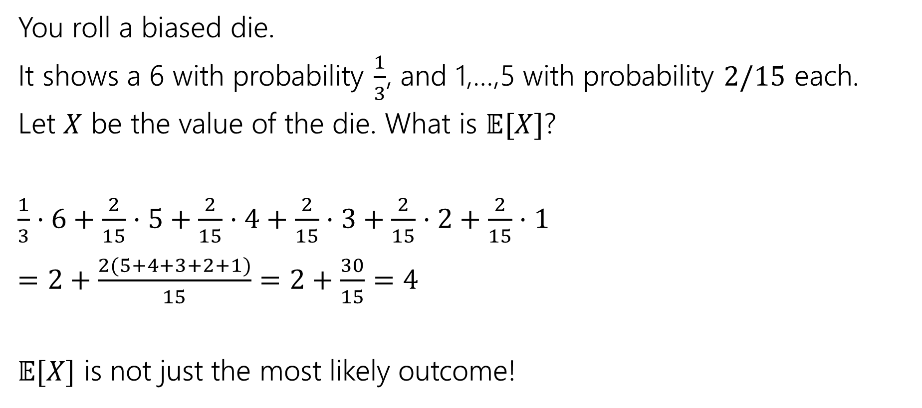
Example 2
You roll a biased die.
It shows a 6 with probability $\frac{1}{3}$, and 1,…,5 with probability $2/15$ each.
Let $X$ be the value of the die. What is $𝔼[X]$?
$\frac{1}{3}⋅6+\frac{2}{15}⋅5+\frac{2}{15}⋅4+\frac{2}{15}⋅3+\frac{2}{15}⋅2+\frac{2}{15}⋅1$
$=2+\frac{2(5+4+3+2+1)}{15}=2+\frac{30}{15}=4$
$𝔼[X]$ is not just the most likely outcome!

Slide 12

Try it yourself
Let $X$ be the result shown on a fair die. What is $𝔼[X]$?
Let $Y$ be the sum of two (independent) fair die rolls. What is $𝔼[Y]$?

Slide 13

Try it yourself
Let $X$ be the result shown on a fair die. What is $𝔼[X]$
$6⋅\frac{1}{6}+5⋅\frac{1}{6}+4⋅\frac{1}{6}+3⋅\frac{1}{6}+2⋅\frac{1}{6}+1⋅\frac{1}{6}$
$=\frac{21}{6}=3.5$
$𝔼[X]$ is not necessarily a possible outcome!
That’s ok, it’s an average!

Slide 14

Try it yourself
$𝔼\left[Y\right]=$
$\frac{1}{36}⋅2+\frac{2}{36}⋅3+\frac{3}{36}⋅4+\frac{4}{36}⋅5+\frac{5}{36}⋅6+\frac{6}{36}⋅7+\frac{5}{36}⋅8+\frac{4}{36}⋅9+\frac{3}{36}⋅10+\frac{2}{36}⋅11+\frac{1}{36}⋅12$
$=7$
$𝔼\left[Y\right]=2𝔼[X]$. That’s not a coincidence…we’ll talk about why on Friday.

Slide 15

Subtle but Important
$X$ is random. You don’t know what it is (at least until you run the experiment).
$𝔼[X]$ is not random. It’s a number.
You don’t need to run the experiment to know what it is.

Slide 16
More Independence

Slide 17
Independence of Random Variables
That’s for events…what about random variables?
$X$ and $Y$ are independent if for all $k,ℓ$
$$ℙ\left(X=k, Y=ℓ\right)=ℙ\left(X=k\right)ℙ(Y=ℓ)$$
Independence (of random variables)
We’ll often use commas instead of $∩$ symbol.

Slide 18

Independence of Random Variables
The “for all values” is important.
We say that the event “the sum is 7” is independent of “the red die is 5”
What about $S=$“the sum of two dice” and $R=$“the value of the red die”

Slide 19
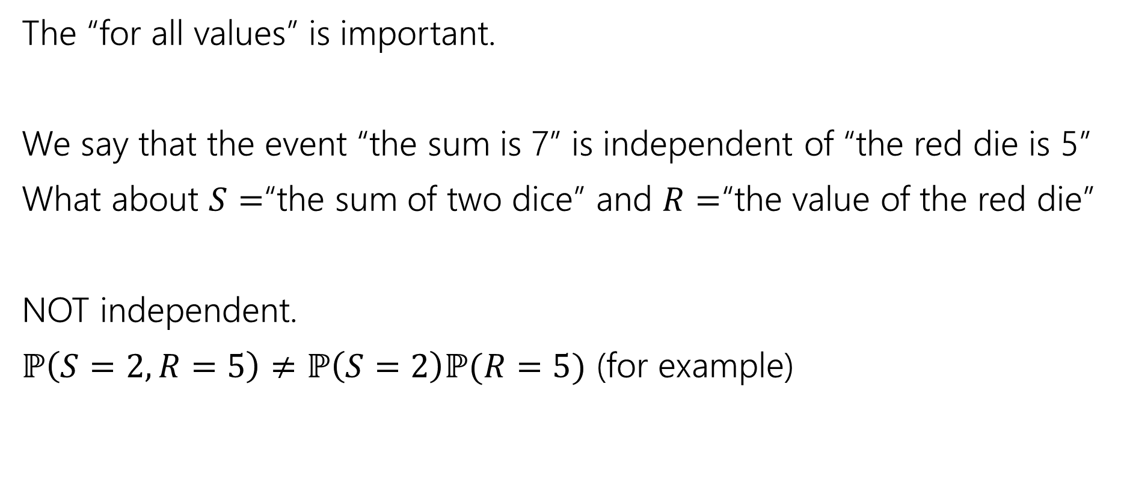
Independence of Random Variables
The “for all values” is important.
We say that the event “the sum is 7” is independent of “the red die is 5”
What about $S=$“the sum of two dice” and $R=$“the value of the red die”
NOT independent.
$ℙ\left(S=2, R=5\right)≠ℙ\left(S=2\right)ℙ(R=5)$ (for example)

Slide 20

Independence of Random Variables
Flip a coin independently $2n$ times.
Let $X$ be “the number of heads in the first $n$ flips.”
Let $Y$ be “the number of heads in the last $n$ flips.”
$X$ and $Y$ are independent.

Slide 21
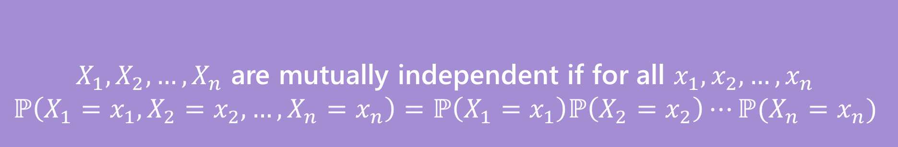

Mutual Independence for RVs
A little simpler to write down than for events
DON’T need to check all subsets for random variables…
But you do need to check all values (all possible $x_{i}$) still.
$X_{1},X_{2},…,X_{n}$ are mutually independent if for all $x_{1},x_{2},…,x_{n}$
$$ℙ\left(X_{1}=x_{1}, X_{2}=x_{2},…,X_{n}=x_{n}\right)=ℙ\left(X_{1}=x_{1}\right)ℙ\left(X_{2}=x_{2}\right)⋯ℙ(X_{n}=x_{n})$$
Mutual Independence (of random variables)

Slide 22
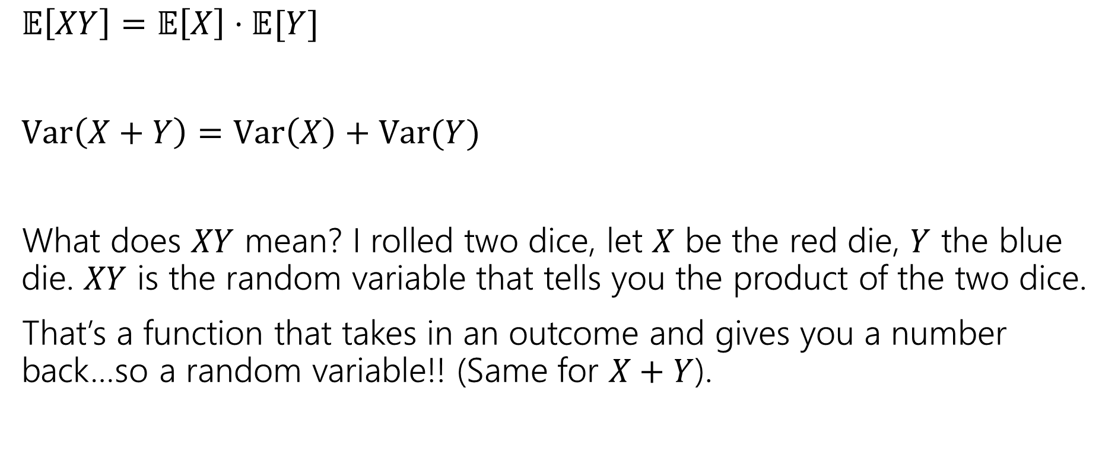
What does Independence give you?
$𝔼\left[XY\right]=𝔼\left[X\right]⋅𝔼[Y]$
$Var\left(X+Y\right)=Var\left(X\right)+Var(Y)$
What does $XY$ mean? I rolled two dice, let $X$ be the red die, $Y$ the blue die. $XY$ is the random variable that tells you the product of the two dice.
That’s a function that takes in an outcome and gives you a number back…so a random variable!! (Same for $X+Y$).

Slide 23
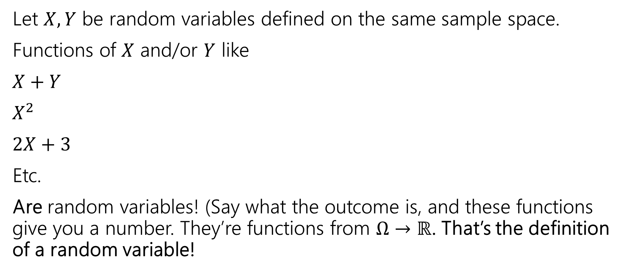
Functions of a random variable
Let $X,Y$ be random variables defined on the same sample space.
Functions of $X$ and/or $Y$ like
$X+Y$
$X^{2}$
$2X+3$
Etc.
Are random variables! (Say what the outcome is, and these functions give you a number. They’re functions from $Ω→ℝ$. That’s the definition of a random variable!

Slide 24
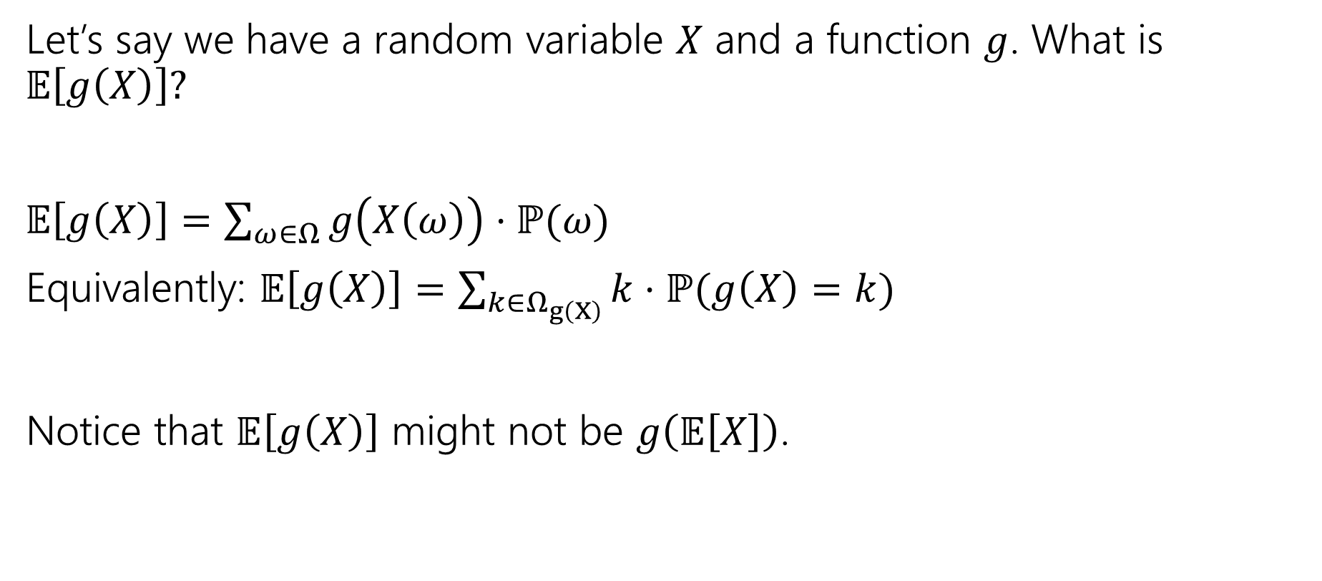
Expectations of functions of random variables
Let’s say we have a random variable $X$ and a function $g$. What is $𝔼\left[g\left(X\right)\right]?$
$𝔼\left[g\left(X\right)\right]=\sum_{ω∈Ω}{g\left(X\left(ω\right)\right)⋅ℙ(ω)}$
Equivalently: $𝔼\left[g\left(X\right)\right]=\sum_{k∈Ω_{g\left(X\right)}}{k⋅ℙ(g\left(X\right)=k)}$
Notice that $𝔼\left[g\left(X\right)\right]$ might not be $g\left(𝔼\left[X\right]\right)$.

Slide 25
Extra Practice

Slide 26

More Practice
Suppose you flip a coin until you see a heads for the first time.
Let $X$ be the number of trials (including the heads)
What is the pmf of $X$?
The cdf of $X$?
$𝔼[X]$?

Slide 27
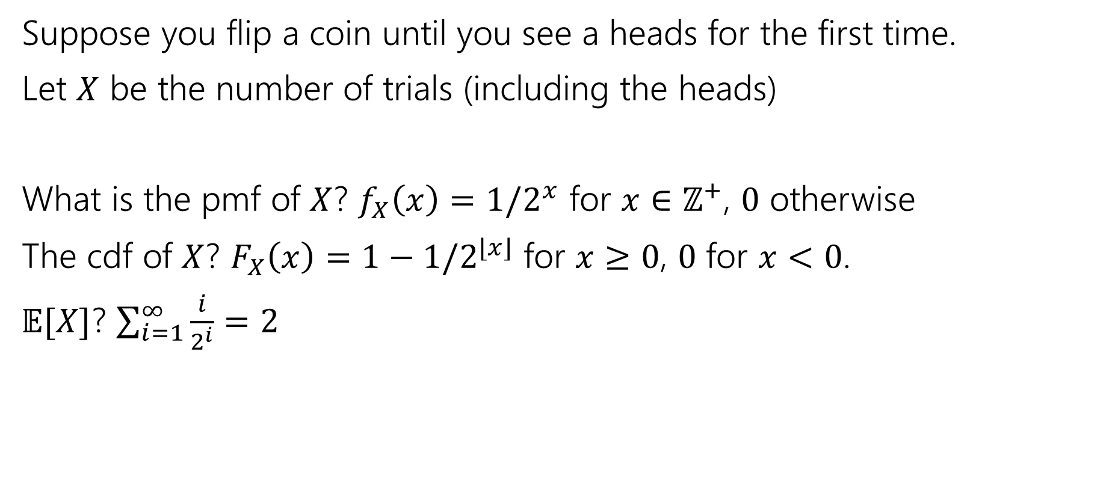
More Practice
Suppose you flip a coin until you see a heads for the first time.
Let $X$ be the number of trials (including the heads)
What is the pmf of $X$? $f_{X}\left(x\right)=1/2^{x}$ for $x∈ℤ^{+}$, $0$ otherwise
The cdf of $X$? $F_{X}\left(x\right)=1−1/2^{⌊x⌋}$ for $x≥0$, $0$ for $x<0$.
$𝔼[X]$? $\sum_{i=1}^{∞}{\frac{i}{2^{i}}}=2$

Slide 28
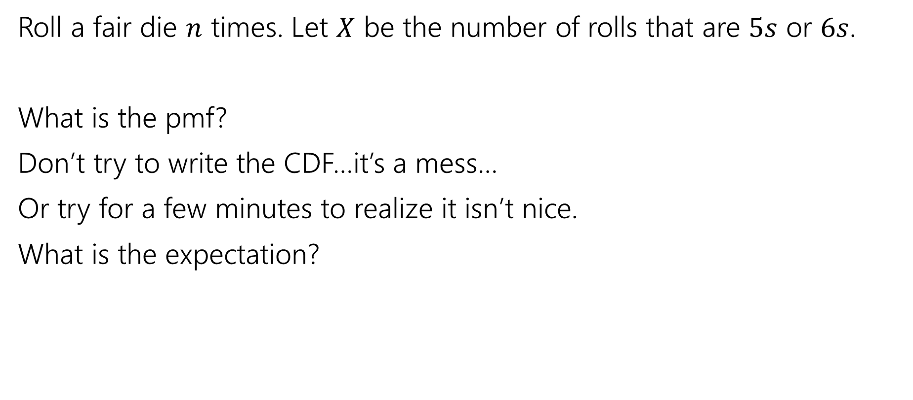
More Random Variable Practice
Roll a fair die $n$ times. Let $X$ be the number of rolls that are $5s$ or $6s$.
What is the pmf?
Don’t try to write the CDF…it’s a mess…
Or try for a few minutes to realize it isn’t nice.
What is the expectation?

Slide 29
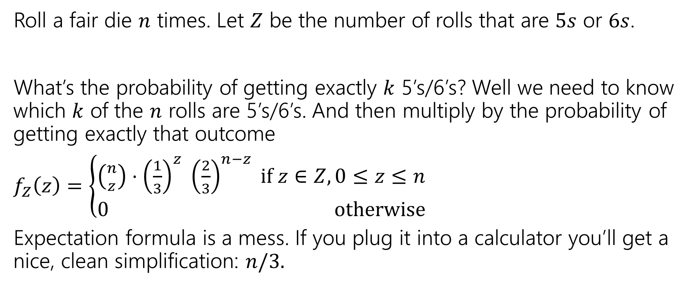
More Random Variable Practice
Roll a fair die $n$ times. Let $Z$ be the number of rolls that are $5s$ or $6s$.
What’s the probability of getting exactly $k$ 5’s/6’s? Well we need to know which $k$ of the $n$ rolls are 5’s/6’s. And then multiply by the probability of getting exactly that outcome
$f_{Z}\left(z\right)=\left\{\begin{aligned}\left({n \atop z}\right)⋅{\left(\frac{1}{3}\right)}^{z} {\left(\frac{2}{3}\right)}^{n−z} if z∈Z,0≤z≤n \\ 0 otherwise\end{aligned}\right.$
Expectation formula is a mess. If you plug it into a calculator you’ll get a nice, clean simplification: $n/3.$

Slide 30
More Practice: Infinite sequential processes

Slide 31
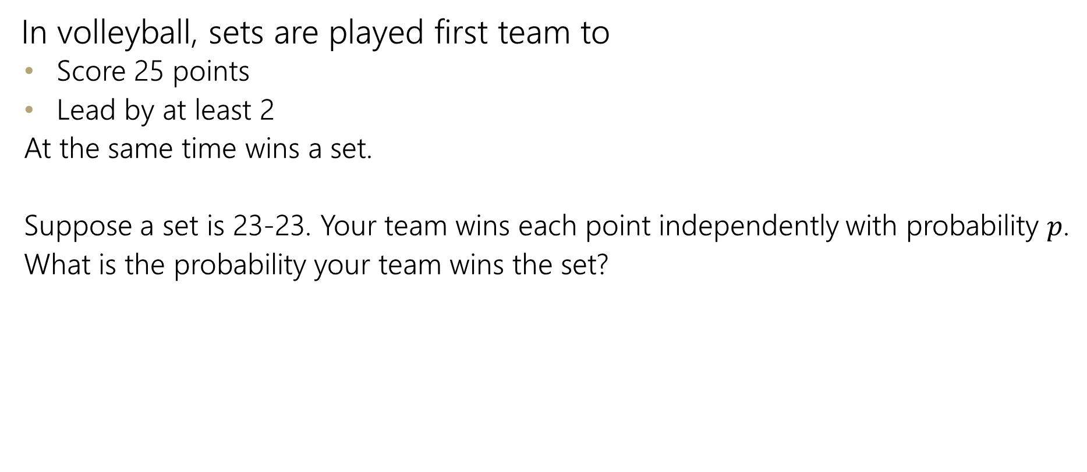
Infinite sequential process
In volleyball, sets are played first team to
Score 25 points
Lead by at least 2
At the same time wins a set.
Suppose a set is 23-23. Your team wins each point independently with probability $p$.
What is the probability your team wins the set?

Slide 32
Sequential Process
0
$$ℙ\left(win from even\right)=p^{2}+2p\left(1−p\right)ℙ(win from even)$$
+
-
W
0
L
+
-
W
0
L
+
-
…

Slide 33
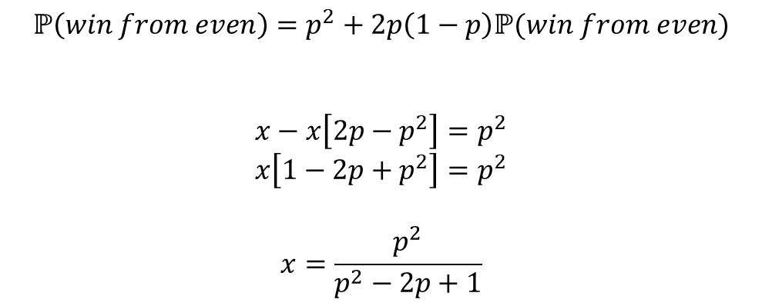
Sequential Process
0
$$ℙ\left(win from even\right)=p^{2}+2p\left(1−p\right)ℙ(win from even)$$
$$x−x\left[2p−p^{2}\right]=p^{2}$$
$$x\left[1−2p+p^{2}\right]=p^{2}$$
$$x=\frac{p^{2}}{p^{2}−2p+1}$$
+
-
W
0
L
+
-
W
0
L
+
-
…

Slide 34

Independence of Random Variables
That’s for events…what about random variables?
$X$ and $Y$ are independent if for all $k,ℓ$
$$ℙ\left(X=k, Y=ℓ\right)=ℙ\left(X=k\right)ℙ(Y=ℓ)$$
Independence (of random variables)
We’ll often use commas instead of $∩$ symbol.

