Slide 1
Wrap Counting
Probability Definitions
CSE 312 Autumn 25
Lecture 4

Slide 2
Outline
Today
Two More Rules
Formal Definitions of Probability

Slide 3

Principle of Inclusion-Exclusion
For three sets:
$\left|A∪B∪C\right|=\left|A\right|+\left|B\right|+\left|C\right|−\left|A∩B\right|−\left|B∩C\right|−\left|A∩C\right|+|A∩B∩C|$

Slide 4

Example
How many length 5 strings over the alphabet $\{a,b,c,…,z\}$ contain:
Exactly 2 ‘a’s OR
Exactly 1 ‘b’ OR
No ‘x’s
For what $A,B,C$ do we want $|A∪B∪C|$?

Slide 5
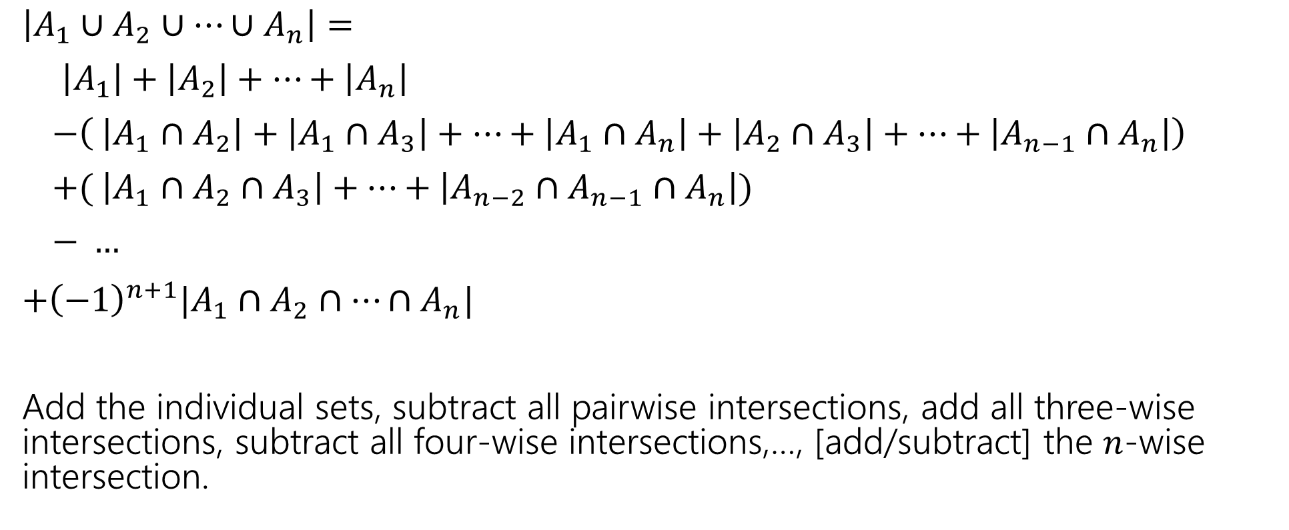
In general:
$\left|A_{1}∪A_{2}∪⋯∪A_{n}\right|=$
$\left|A_{1}\right|+\left|A_{2}\right|+⋯+\left|A_{n}\right|$
$−\left( \left|A_{1}∩A_{2}\right|+\left|A_{1}∩A_{3}\right|+…+\left|A_{1}∩A_{n}\right|+\left|A_{2}∩A_{3}\right|+…+\left|A_{n−1}∩A_{n}\right|\right)$
$+( \left|A_{1}∩A_{2}∩A_{3}\right|+…+\left|A_{n−2}∩A_{n−1}∩A_{n}\right|)$
$− …$
$+{\left(−1\right)}^{n+1}|A_{1}∩A_{2}∩…∩A_{n}|$
Add the individual sets, subtract all pairwise intersections, add all three-wise intersections, subtract all four-wise intersections,…, [add/subtract] the $n$-wise intersection.

Slide 6
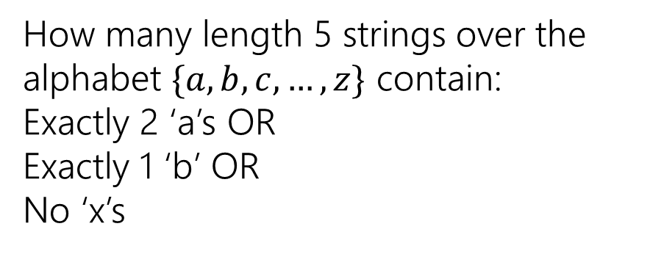
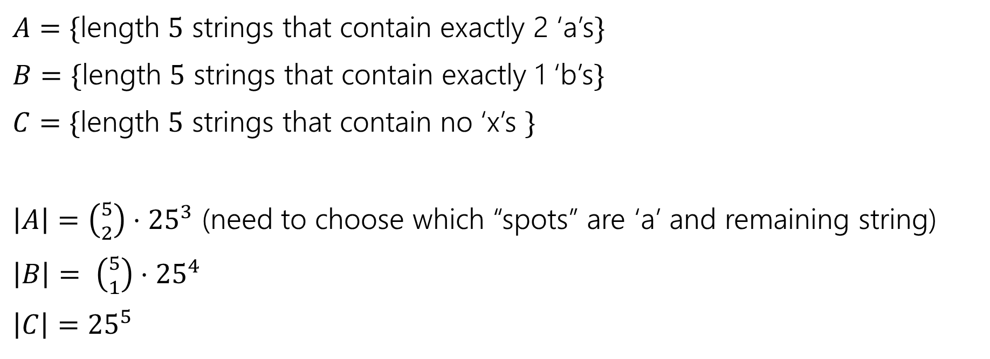
Example
How many length 5 strings over the alphabet $\{a,b,c,…,z\}$ contain:
Exactly 2 ‘a’s OR
Exactly 1 ‘b’ OR
No ‘x’s
$A=\{$length $5$ strings that contain exactly 2 ‘a’s$\}$
$B=\{$length $5$ strings that contain exactly 1 ‘b’s$\}$
$C=\{$length $5$ strings that contain no ‘x’s $\}$
$\left|A\right|=\left({5 \atop 2}\right)⋅{25}^{3}$ (need to choose which “spots” are ‘a’ and remaining string)
$\left|B\right|= \left({5 \atop 1}\right)⋅{25}^{4}$
$\left|C\right|={25}^{5}$

Slide 7

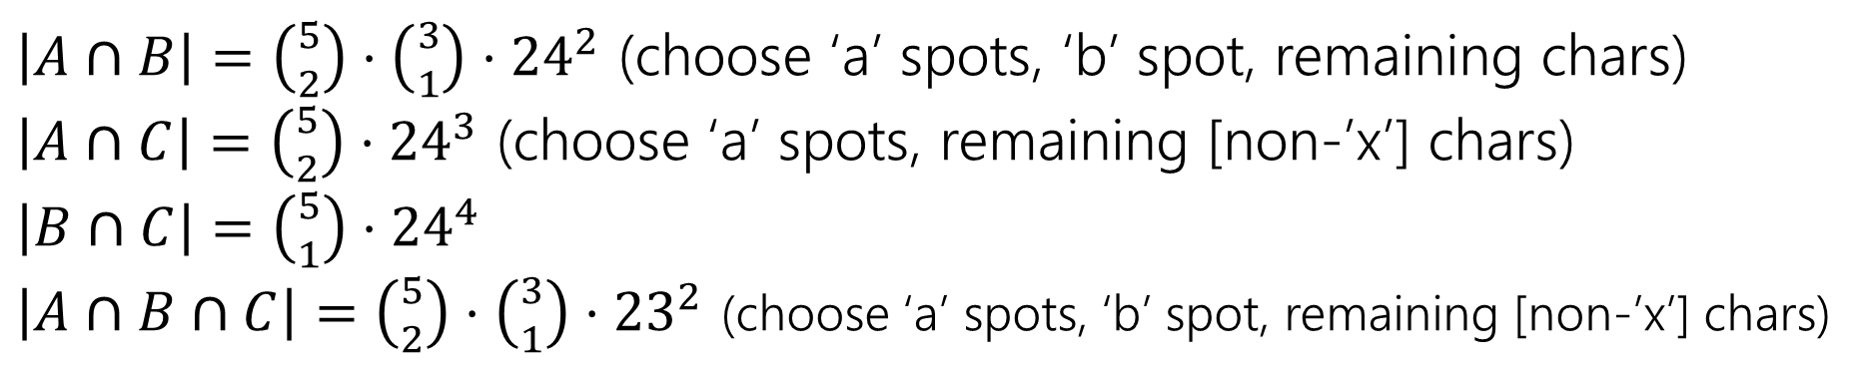

Example
How many length 5 strings over the alphabet $\{a,b,c,…,z\}$ contain:
Exactly 2 ‘a’s OR
Exactly 1 ‘b’ OR
No ‘x’s
$\left|A\right|=\left({5 \atop 2}\right)⋅{25}^{3}$
$\left|B\right|= \left({5 \atop 1}\right)⋅{25}^{3}$
$\left|C\right|={25}^{5}$
$A=\{$length $5$ strings that contain exactly 2 ‘a’s$\}$
$B=\{$length $5$ strings that contain exactly 1 ‘b’s$\}$
$C=\{$length $5$ strings that contain no ‘x’s $\}$
$\left|A∩B\right|=\left({5 \atop 2}\right)⋅\left({3 \atop 1}\right)⋅{24}^{2}$ (choose ‘a’ spots, ‘b’ spot, remaining chars)
$\left|A∩C\right|=\left({5 \atop 2}\right)⋅{24}^{3}$ (choose ‘a’ spots, remaining [non-’x’] chars)
$\left|B∩C\right|=\left({5 \atop 1}\right)⋅{24}^{4}$
$\left|A∩B∩C\right|=\left({5 \atop 2}\right)⋅\left({3 \atop 1}\right)⋅{23}^{2}$ (choose ‘a’ spots, ‘b’ spot, remaining [non-’x’] chars)

Slide 8
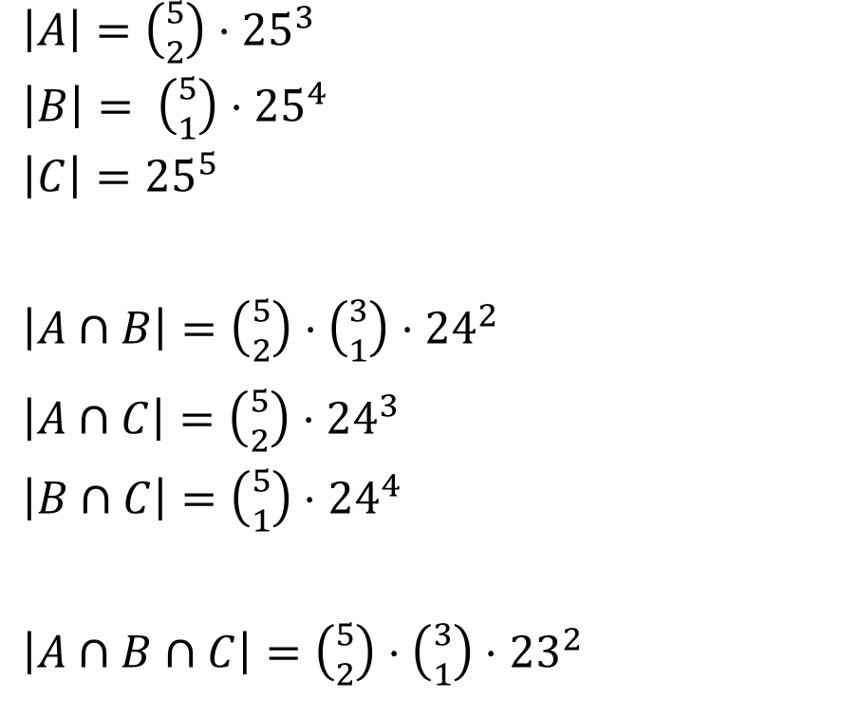
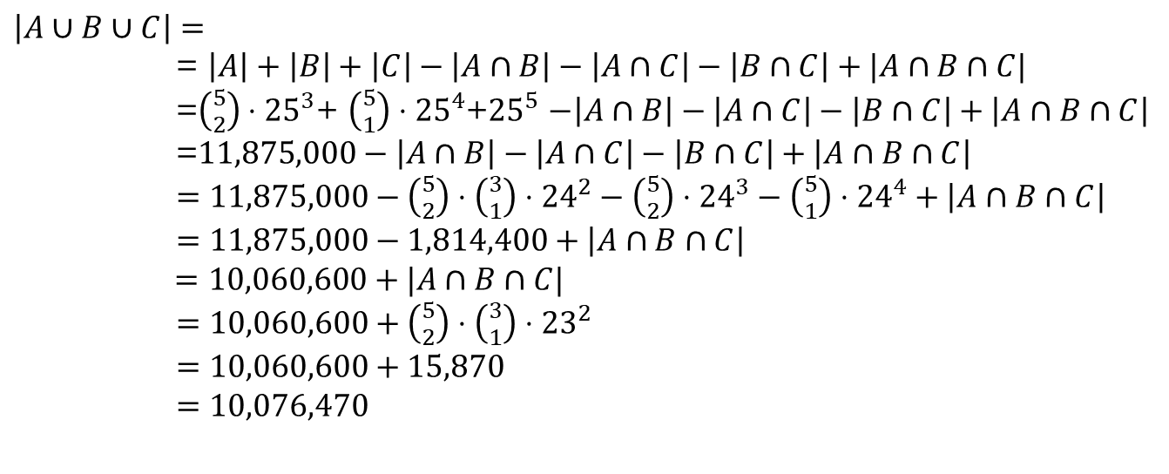
Example
How many length 5 strings over the alphabet $\{a,b,c,…,z\}$ contain:
Exactly 2 ‘a’s OR
Exactly 1 ‘b’ OR
No ‘x’s
$\left|A\right|=\left({5 \atop 2}\right)⋅{25}^{3}$
$\left|B\right|= \left({5 \atop 1}\right)⋅{25}^{4}$
$\left|C\right|={25}^{5}$
$\left|A∩B\right|=\left({5 \atop 2}\right)⋅\left({3 \atop 1}\right)⋅{24}^{2}$
$\left|A∩C\right|=\left({5 \atop 2}\right)⋅{24}^{3}$
$\left|B∩C\right|=\left({5 \atop 1}\right)⋅{24}^{4}$
$\left|A∩B∩C\right|=\left({5 \atop 2}\right)⋅\left({3 \atop 1}\right)⋅{23}^{2}$
$\left|A∪B∪C\right|=$
= $\left|A\right|+\left|B\right|+\left|C\right|−\left|A∩B\right|−\left|A∩C\right|−\left|B∩C\right|+|A∩B∩C|$
=$\left({5 \atop 2}\right)⋅{25}^{3}$+ $\left({5 \atop 1}\right)⋅{25}^{4}$+${25}^{5}$ $−\left|A∩B\right|−\left|A∩C\right|−\left|B∩C\right|+\left|A∩B∩C\right|$
=$11,875,000−\left|A∩B\right|−\left|A∩C\right|−\left|B∩C\right|+\left|A∩B∩C\right|$
$=11,875,000−\left({5 \atop 2}\right)⋅\left({3 \atop 1}\right)⋅{24}^{2}−\left({5 \atop 2}\right)⋅{24}^{3}−\left({5 \atop 1}\right)⋅{24}^{4}+\left|A∩B∩C\right|$
$=11,875,000−1,814,400+\left|A∩B∩C\right|$
$=10,060,600+|A∩B∩C|$
$=10,060,600+\left({5 \atop 2}\right)⋅\left({3 \atop 1}\right)⋅{23}^{2}$
$=10,060,600+15,870$
$=10,076,470$

Slide 9
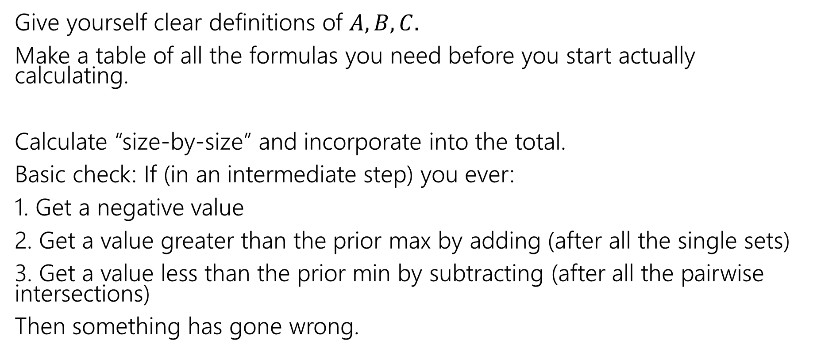
Practical tips
Give yourself clear definitions of $A,B,C.$
Make a table of all the formulas you need before you start actually calculating.
Calculate “size-by-size” and incorporate into the total.
Basic check: If (in an intermediate step) you ever:
1. Get a negative value
2. Get a value greater than the prior max by adding (after all the single sets)
3. Get a value less than the prior min by subtracting (after all the pairwise intersections)
Then something has gone wrong.

Slide 10
Pigeonhole Principle

Slide 11


Pigeonhole Principle
If you have $5$ pigeons, and place them into $4$ holes, then…
At least two pigeons are in the same hole.

Slide 12

Pigeonhole Principle
If you have $5$ pigeons, and place them into $4$ holes, then…
At least two pigeons are in the same hole.
It might be more than two.

Slide 13

Strong Pigeonhole Principle
If you have $n$ pigeons and $k$ pigeonholes, then there is at least one pigeonhole that has at least $\left\lceil \frac{n}{k}\right\rceil$ pigeons.
$\left\lceil a\right\rceil$ is the “ceiling” of $a$ (it means always round up, $\left\lceil 1.1\right\rceil =2$, $\left\lceil 1\right\rceil =1$).

Slide 14
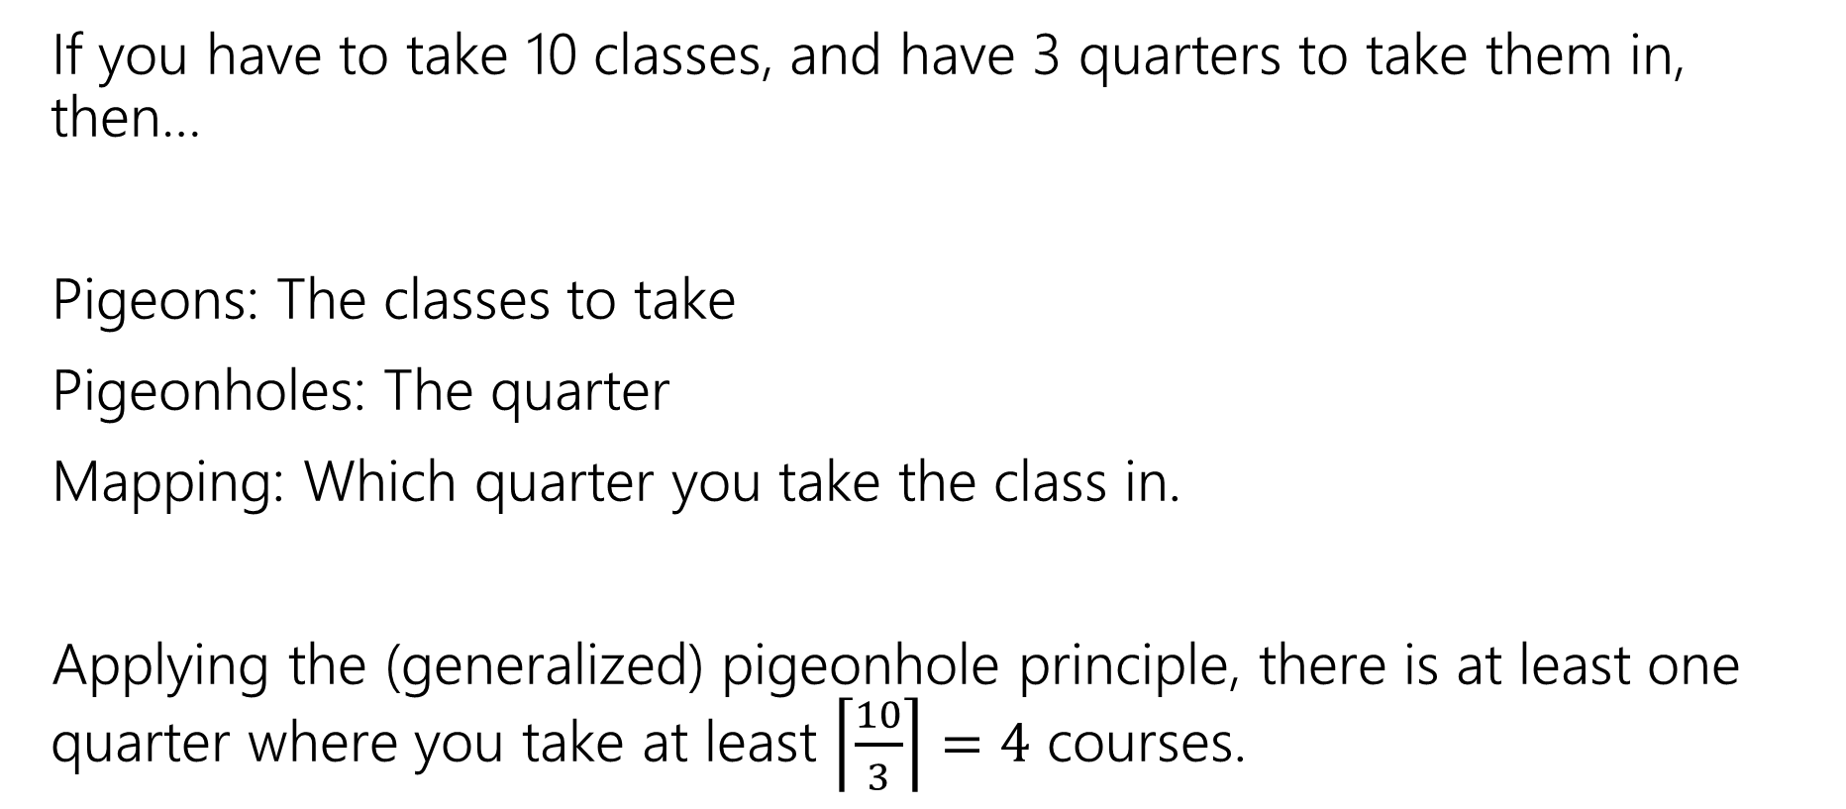
An example
If you have to take 10 classes, and have 3 quarters to take them in, then…
Pigeons: The classes to take
Pigeonholes: The quarter
Mapping: Which quarter you take the class in.
Applying the (generalized) pigeonhole principle, there is at least one quarter where you take at least $\left\lceil \frac{10}{3}\right\rceil =4$ courses.

Slide 15
Practical Tips
When the pigeonhole principle is the right tool, it’s usually the first thing you’d think of or the absolute last thing you’d think of.
For really tricky ones, we’ll warn you in advance that it’s the right method (you’ll see one in the section handout).
When applying the principle, say:
  What are the pigeons
  What are the pigeonholes
  How do you map from pigeons to pigeonholes
Look for – a set you’re trying to divide into groups, where collisions would help you somehow.

Slide 16
Our last counting rule

Slide 17
One More Counting Rule
You’re going to buy one-dozen donuts (i.e., 12 donuts)
There are chocolate, strawberry, coconut, blueberry, and lemon (i.e. five types)
How many different donut boxes can you buy?
Consider two boxes the same if they contain the same number of every kind of donut (order doesn’t matter)

Slide 18
One More Counting Rule
You’re going to buy one-dozen donuts (i.e., 12 donuts)
There are chocolate, strawberry, coconut, blueberry, and lemon (i.e. five types)
Put donuts in order by type, then put dividers between the types.
Counting the number of ways to place dividers instead.

Slide 19

Explanation 1
Think of it as a string.
There are $12+(5−1)$ characters.
But $12$ are the “donut” character (identical) and $4$ are the “divider” character (identical).
So?
$\frac{16!}{12!4!}$
i.e., $\left({16 \atop 4}\right)$

Slide 20
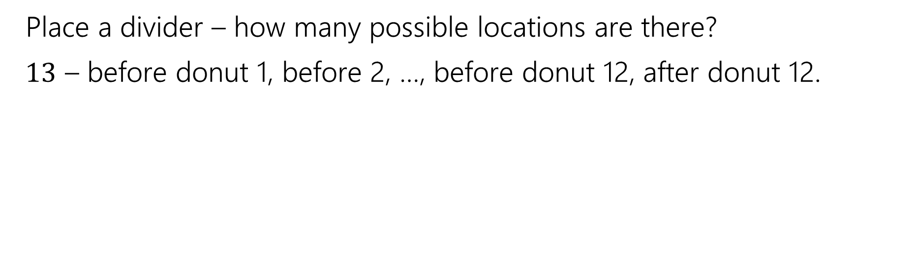
Placing Dividers
Place a divider – how many possible locations are there?
$13$ – before donut 1, before 2, …, before donut 12, after donut 12.

Slide 21
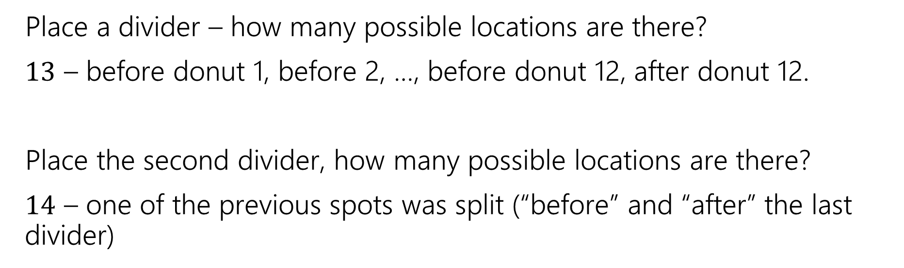
Placing Dividers
Place a divider – how many possible locations are there?
$13$ – before donut 1, before 2, …, before donut 12, after donut 12.
Place the second divider, how many possible locations are there?
$14$ – one of the previous spots was split (“before” and “after” the last divider)

Slide 22
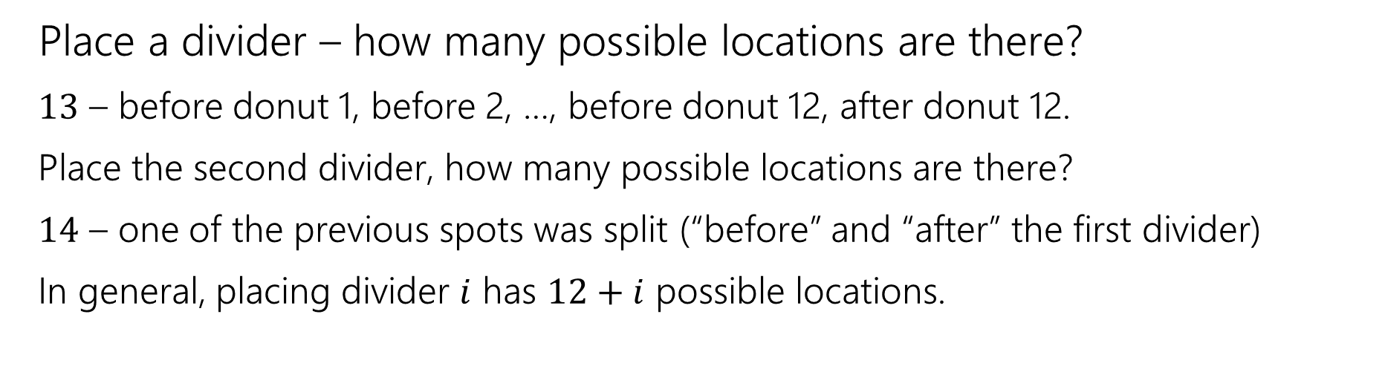
Placing Dividers
Place a divider – how many possible locations are there?
$13$ – before donut 1, before 2, …, before donut 12, after donut 12.
Place the second divider, how many possible locations are there?
$14$ – one of the previous spots was split (“before” and “after” the first divider)
In general, placing divider $i$ has $12+i$ possible locations.

Slide 23
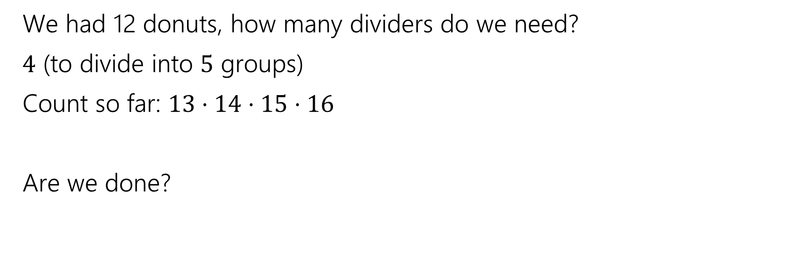
Wrapping Up
We had 12 donuts, how many dividers do we need?
$4$ (to divide into $5$ groups)
Count so far: $13⋅14⋅15⋅16$
Are we done?

Slide 24
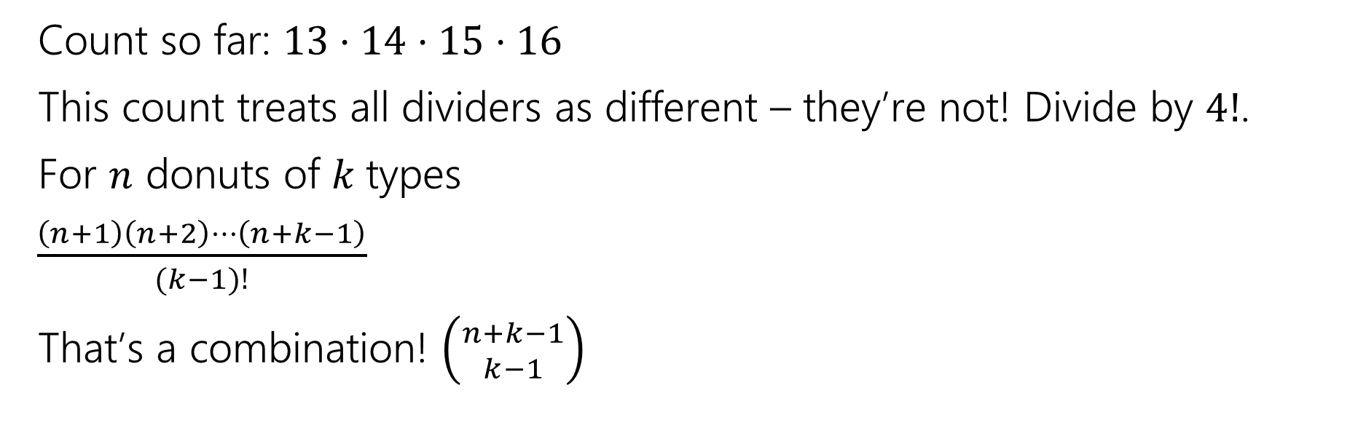
Wrapping Up
Count so far: $13⋅14⋅15⋅16$
This count treats all dividers as different – they’re not! Divide by $4!$.
For $n$ donuts of $k$types
$\frac{\left(n+1\right)\left(n+2\right)⋯\left(n+k−1\right)}{(k−1)!}$
That’s a combination! $\left({n+k−1 \atop k−1}\right)$

Slide 25
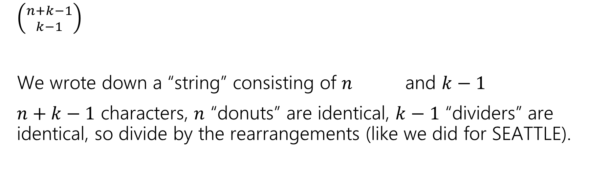
Wrapping Up
$\left({n+k−1 \atop k−1}\right)$
We wrote down a “string” consisting of $n$ and $k−1$
$n+k−1$ characters, $n$ “donuts” are identical, $k−1$ “dividers” are identical, so divide by the rearrangements (like we did for SEATTLE).

Slide 26
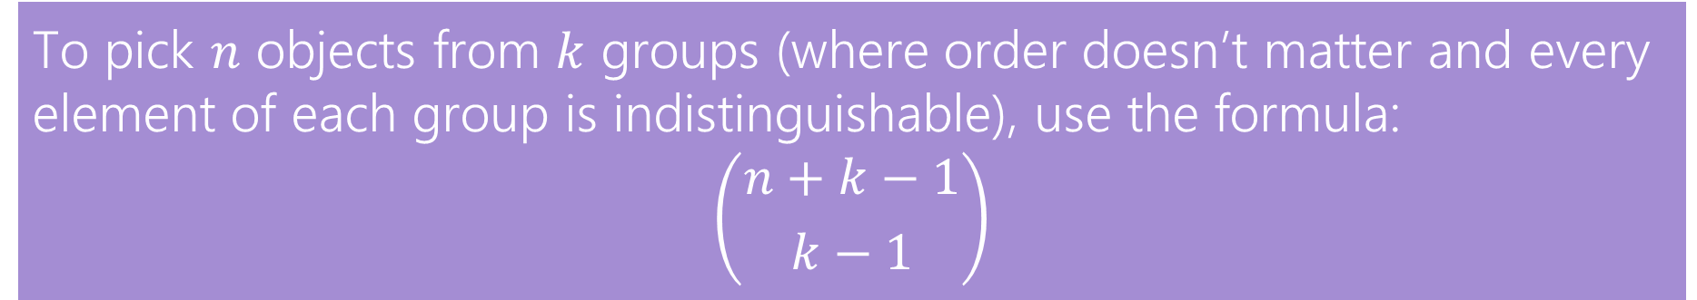
In General
The counting technique we did is often called “stars and bars”
  using a “star” instead of a donut shape, and calling the dividers “bars”
To pick $n$ objects from $k$ groups (where order doesn’t matter and every element of each group is indistinguishable), use the formula:
$$\left({n+k−1 \atop k−1}\right)$$

Slide 27
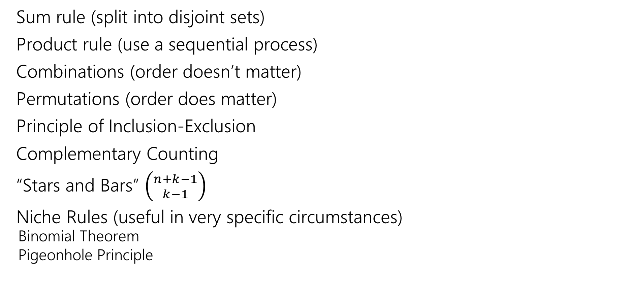
We’ve seen lots of ways to count
Sum rule (split into disjoint sets)
Product rule (use a sequential process)
Combinations (order doesn’t matter)
Permutations (order does matter)
Principle of Inclusion-Exclusion
Complementary Counting
“Stars and Bars” $\left({n+k−1 \atop k−1}\right)$
Niche Rules (useful in very specific circumstances)
  Binomial Theorem
  Pigeonhole Principle

Slide 28
Extra Practice
We’ll discuss Friday or post an extra video.

Slide 29
Practice
How do we know which rule to apply?
With practice you can pick out patterns for which ones might be plausible.
But if as you’re working you realize things are getting out of control, put it aside and try something different.

Slide 30
Cards
A “standard” deck of cards has 52 cards. Each card has a suit
  diamonds ️♦,
  hearts ♥️,
  clubs ♧,
  spades ♠️
and a value (Ace,2,3,4,5,6,7,8,9,10,Jack,Queen, King).
A “5-card-hand” is a set of 5 cards
How many five-card “flushes” are there? – a flush is a hand of cards all of the same suit.

Slide 31

Cards
How many five-card “flushes” are there? – a flush is a hand of cards all of the same suit.
Way 1: How can I describe a flush? Which suit it is, and which values:
$\left({4 \atop 1}\right)⋅\left({13 \atop 5}\right)$

Slide 32
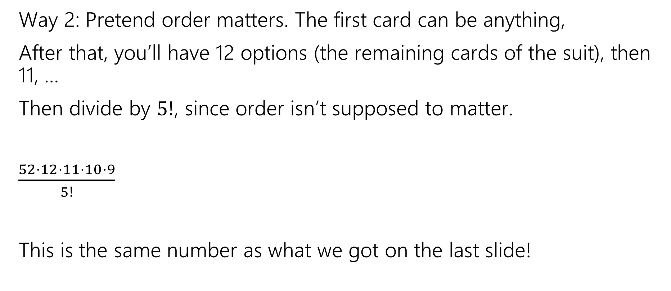
Cards
Way 2: Pretend order matters. The first card can be anything,
After that, you’ll have 12 options (the remaining cards of the suit), then 11, …
Then divide by $5!$, since order isn’t supposed to matter.
$\frac{52⋅12⋅11⋅10⋅9}{5!}$
This is the same number as what we got on the last slide!

Slide 33
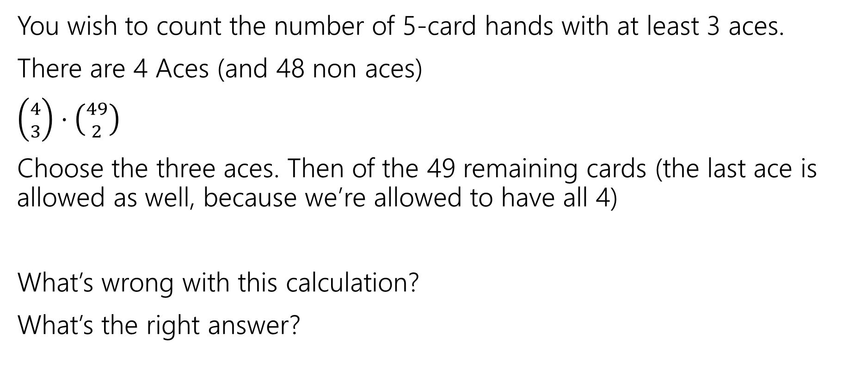
A Solution with a Problem
You wish to count the number of 5-card hands with at least 3 aces.
There are 4 Aces (and 48 non aces)
$\left({4 \atop 3}\right)⋅\left({49 \atop 2}\right)$
Choose the three aces. Then of the 49 remaining cards (the last ace is allowed as well, because we’re allowed to have all 4)
What’s wrong with this calculation?
What’s the right answer?

Slide 34
A Solution with a Problem
For a hand, there should be exactly one set of choices in the sequential process that gets us there.
{A♧, A♠️, A♦️} {A♥️, K ♠️}
And
{A♧, A♠️, A♥️}, {A♦️, K ♠️}
Are two different choices of the process, but they lead to the same hand!

Slide 35
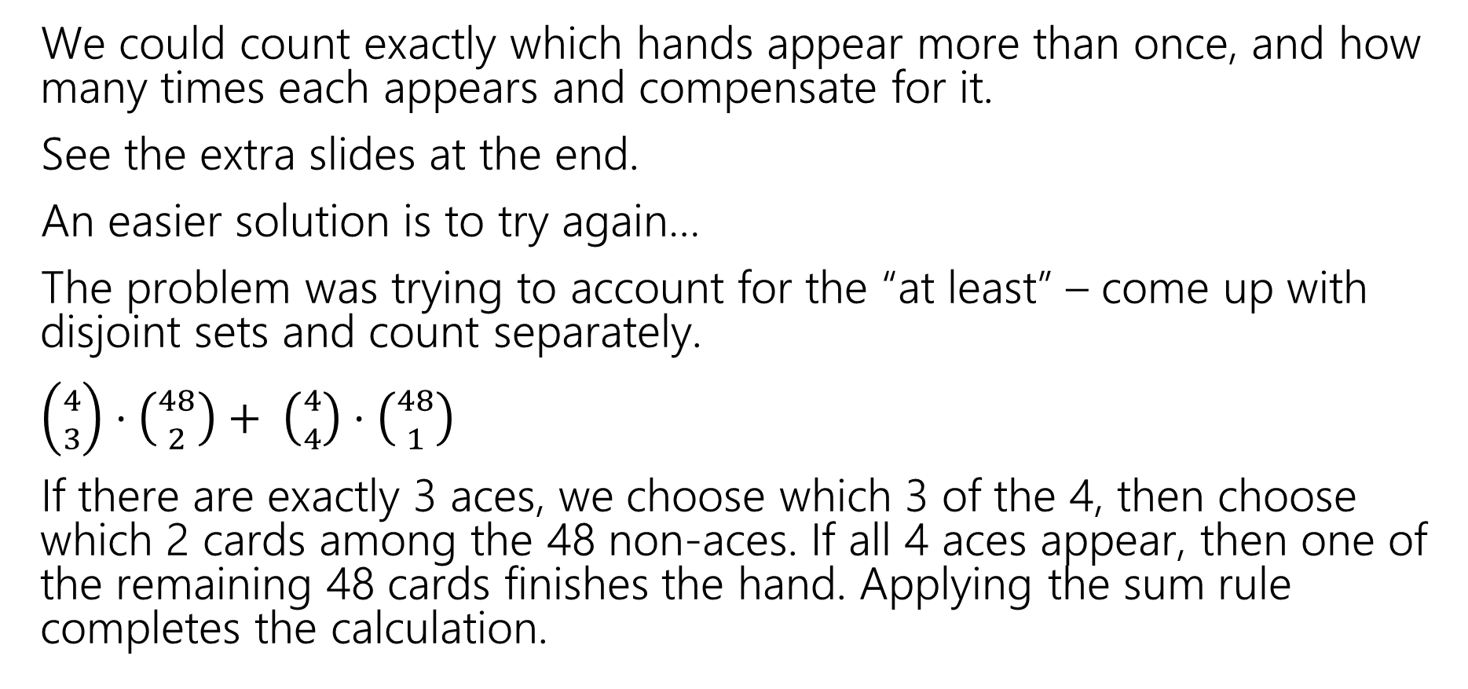
A Solution with a Problem
We could count exactly which hands appear more than once, and how many times each appears and compensate for it.
See the extra slides at the end.
An easier solution is to try again…
The problem was trying to account for the “at least” – come up with disjoint sets and count separately.
$\left({4 \atop 3}\right)⋅\left({48 \atop 2}\right)+ \left({4 \atop 4}\right)⋅\left({48 \atop 1}\right)$
If there are exactly 3 aces, we choose which 3 of the 4, then choose which 2 cards among the 48 non-aces. If all 4 aces appear, then one of the remaining 48 cards finishes the hand. Applying the sum rule completes the calculation.

Slide 36
Takeaway
It’s hard to count sets where one of the conditions is “at least X”
You usually need to break those conditions up into disjoint sets and use the sum rule.

Slide 37
Another Problem
You have to choose 8 pieces of fruit. There are apples, oranges, and bananas.
You need to pick at most 2 apples and at least 1 banana. How many sets of fruit can you choose?

Slide 38
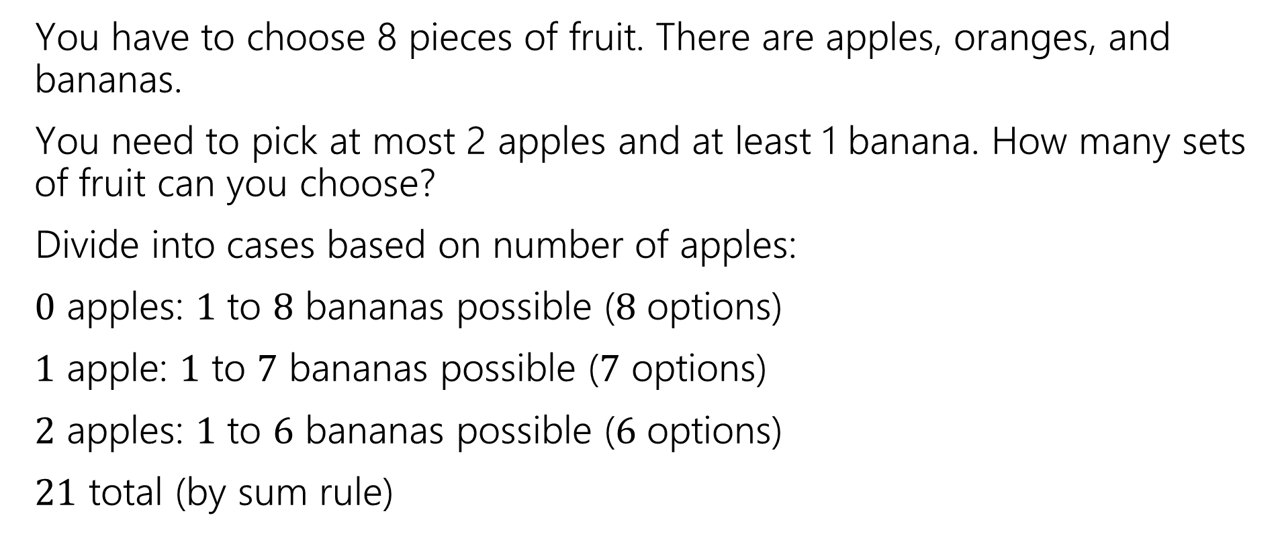
Another Problem
You have to choose 8 pieces of fruit. There are apples, oranges, and bananas.
You need to pick at most 2 apples and at least 1 banana. How many sets of fruit can you choose?
Divide into cases based on number of apples:
$0$ apples: $1$ to $8$ bananas possible ($8$ options)
$1$ apple: $1$ to $7$ bananas possible ($7$ options)
$2$ apples: $1$ to $6$ bananas possible ($6$ options)
$21$ total (by sum rule)

Slide 39
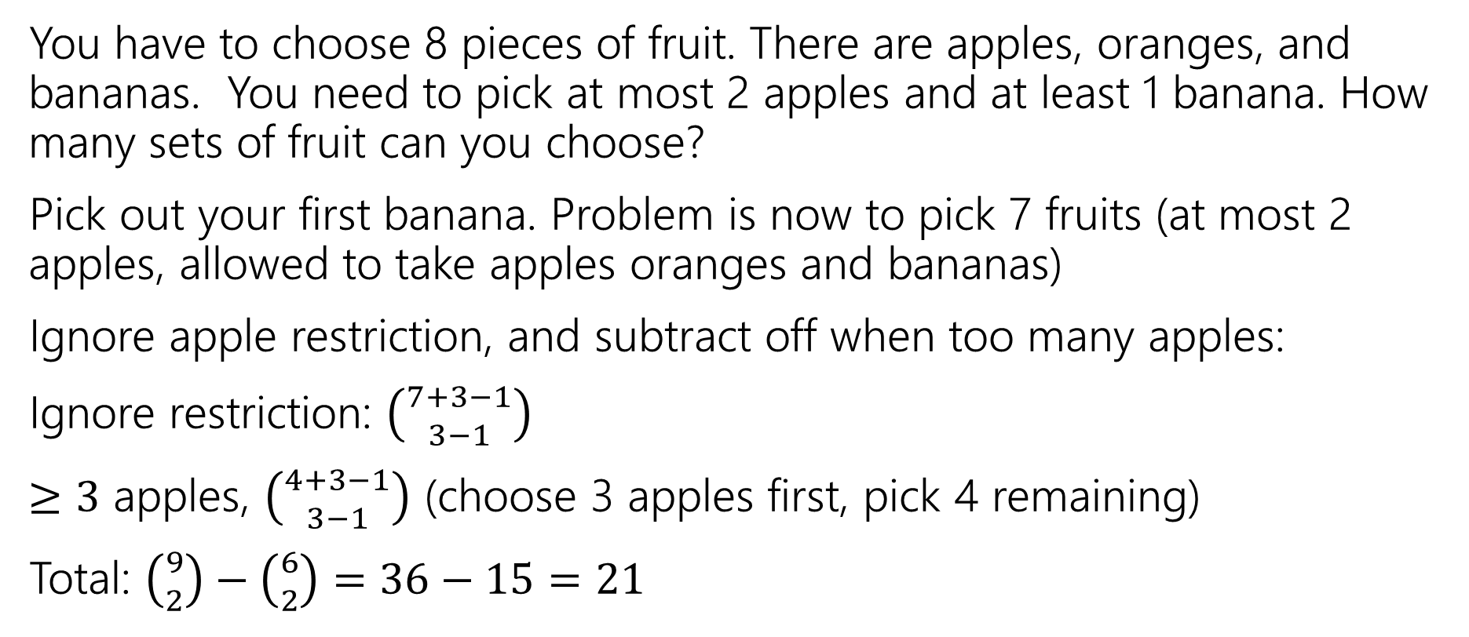
Another Problem
You have to choose 8 pieces of fruit. There are apples, oranges, and bananas. You need to pick at most 2 apples and at least 1 banana. How many sets of fruit can you choose?
Pick out your first banana. Problem is now to pick 7 fruits (at most 2 apples, allowed to take apples oranges and bananas)
Ignore apple restriction, and subtract off when too many apples:
Ignore restriction: $\left({7+3−1 \atop 3−1}\right)$
$≥3$ apples, $\left({4+3−1 \atop 3−1}\right)$ (choose 3 apples first, pick 4 remaining)
Total: $\left({9 \atop 2}\right)−\left({6 \atop 2}\right)=36−15=21$

Slide 40
Takeaways
For donut-counting style problems with “twists”, it sometimes helps to “just throw the first few in the box” to get a problem that is exactly in the donut-counting framework.
When you can do a problem two very different ways and get the same answer, you get much more confident in the answer.

Slide 41
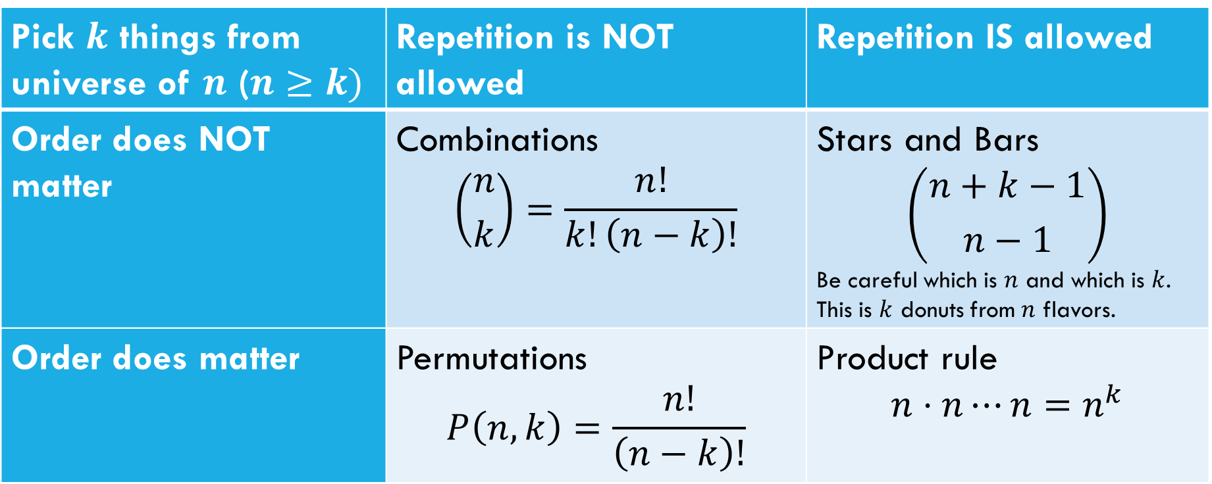
Which Tool Do I Use?
Pick $k$ things from universe of $n$ ($n≥k)$ | Repetition is NOT allowed | Repetition IS allowed
Order does NOT matter | Combinations $$\left({n \atop k}\right)=\frac{n!}{k!\left(n−k\right)!}$$ | Stars and Bars $$\left({n+k−1 \atop n−1}\right)$$ Be careful which is $n$ and which is $k$. This is $k$ donuts from $n$ flavors.
Order does matter | Permutations $$P\left(n,k\right)=\frac{n!}{\left(n−k\right)!}$$ | Product rule $$n⋅n⋯n=n^{k}$$
This is NOT foolproof! Sometimes you need a twist on the formula; sometimes it’s a completely different tool. But a sign where to start.

Slide 42
Fixing The Overcounting

Slide 43
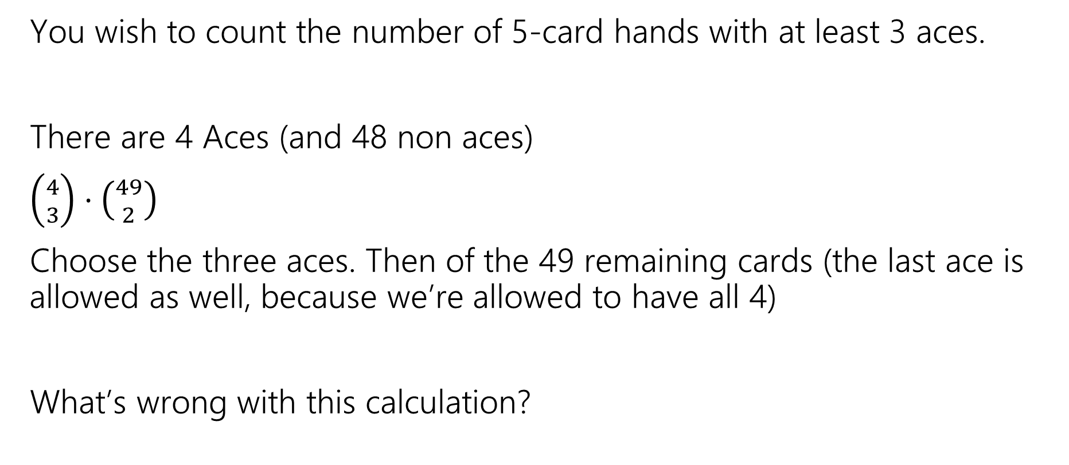
A Solution with a Problem
You wish to count the number of 5-card hands with at least 3 aces.
There are 4 Aces (and 48 non aces)
$\left({4 \atop 3}\right)⋅\left({49 \atop 2}\right)$
Choose the three aces. Then of the 49 remaining cards (the last ace is allowed as well, because we’re allowed to have all 4)
What’s wrong with this calculation?

Slide 44
When do we overcount?
If there are exactly 4 Aces in the hand, then we count the hand 4 different times (once for each ace as an “extra” one:
{A♧, A♠️, A♦️}, {A♥️, ?}
{A♧, A♠️, A♥️}, {A♦️, ?}
{A♧, A♥️, A♦️}, {A♠️, ?}
{A♥️, A♠️, A♦️}, {A♧, ?}

Slide 45
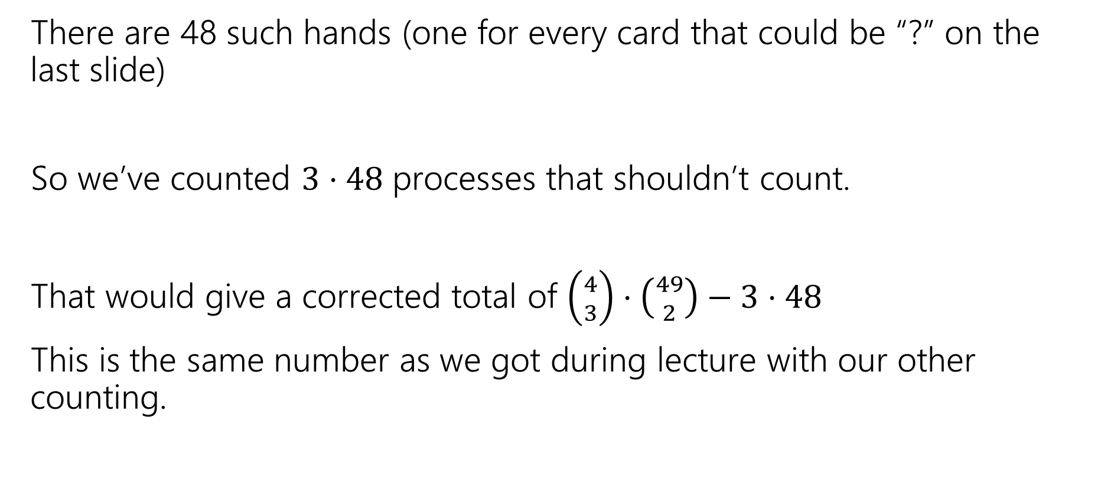
How much do we overcount?
There are 48 such hands (one for every card that could be “?” on the last slide)
So we’ve counted $3⋅48$ processes that shouldn’t count.
That would give a corrected total of $\left({4 \atop 3}\right)⋅\left({49 \atop 2}\right)−3⋅48$
This is the same number as we got during lecture with our other counting.

Slide 46
Probability

Slide 47
Probability
Probability is a way of quantifying our uncertainty.
When more than one outcome is possible,
To have “real-world” examples, we’ll need to start with some foundational processes that we’re going to assert exist
  We can flip a coin, and each face is equally likely to come up
  We can roll a die, and every number is equally likely to come up
  We can shuffle a deck of cards so that every ordering is equally likely.

Slide 48

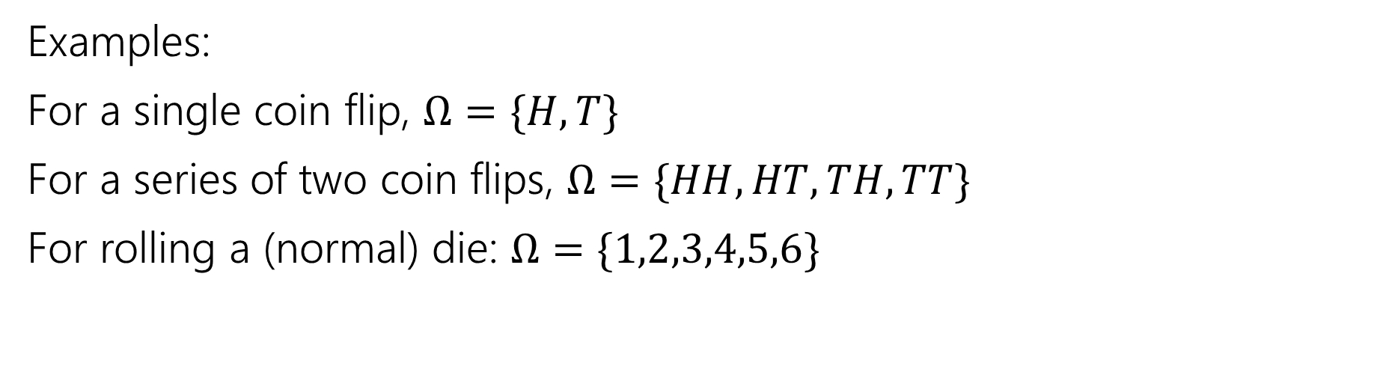
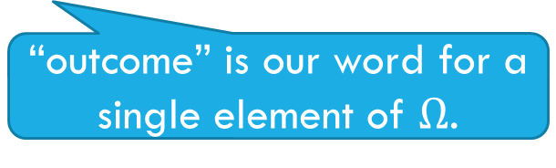
Sample Space
A sample space $Ω$ is the set of all possible outcomes of an experiment.
Sample Space
“outcome” is our word for a single element of $Ω$.
Examples:
For a single coin flip, $Ω=\{H,T\}$
For a series of two coin flips, $Ω=\{HH,HT,TH,TT\}$
For rolling a (normal) die: $Ω=\{1,2,3,4,5,6\}$

Slide 49
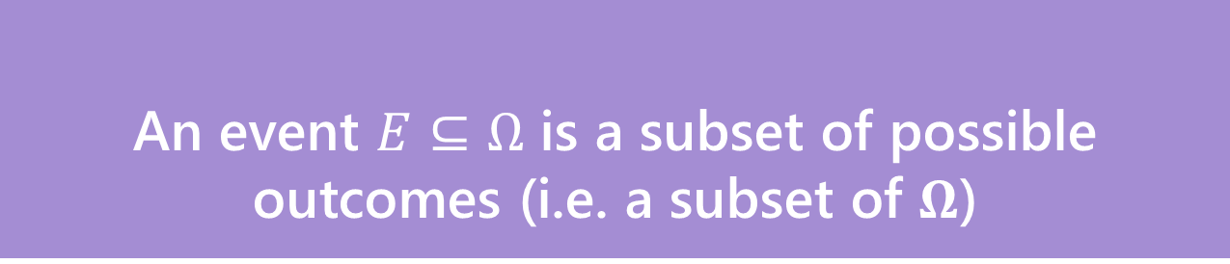
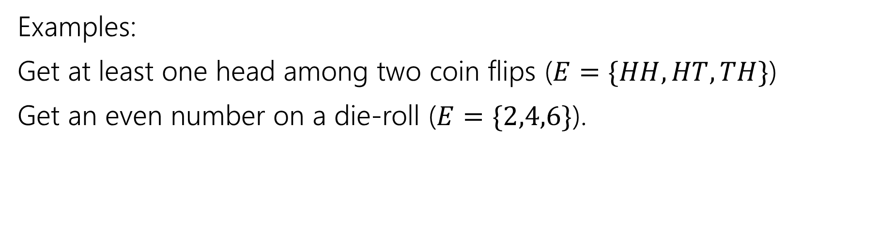
Events
An event $E⊆Ω$ is a subset of possible outcomes (i.e. a subset of $Ω$)
Event
Examples:
Get at least one head among two coin flips ($E=\{HH,HT,TH\}$)
Get an even number on a die-roll ($E=\{2,4,6\}$).

Slide 50
Examples
 | D2=1 | D2=2 | D2=3 | D2=4
D1=1 | (1,1) | (1,2) | (1,3) | (1,4)
D1=2 | (2,1) | (2,2) | (2,3) | (2,4)
D1=3 | (3,1) | (3,2) | (3,3) | (3,4)
D1=4 | (4,1) | (4,2) | (4,3) | (4,4)
I roll a blue 4-sided die and a red 4-sided die.
The table contains the sample space.
The event “the sum of the dice is even” is in gold
The event “the blue die is 1” is in green

Slide 51
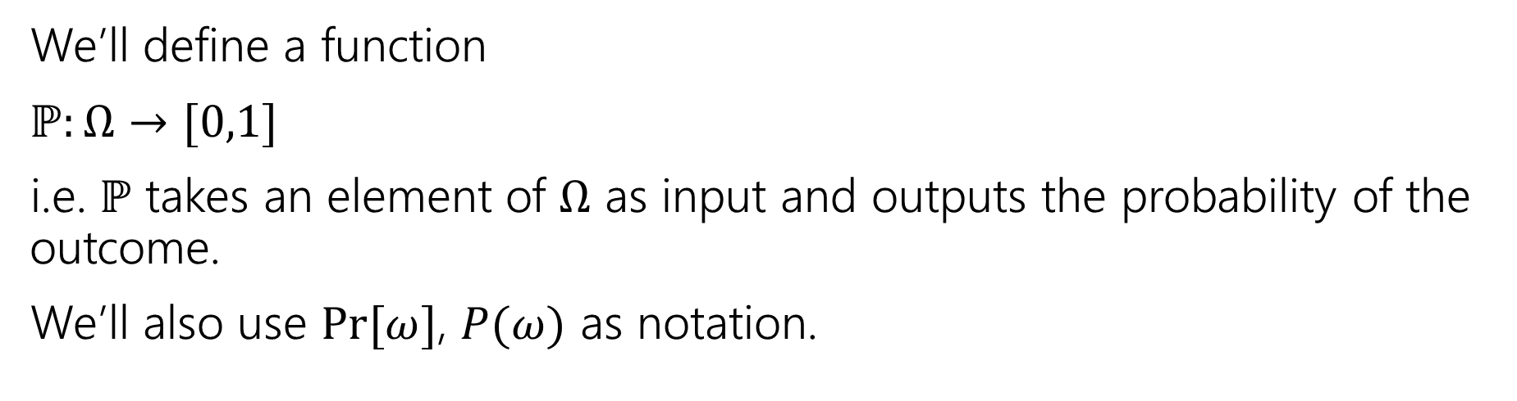
Probability
A probability is a number between 0 and 1 describing how likely a particular outcome is.
Probability
We’ll define a function
$ℙ:Ω→[0,1]$
i.e. $ℙ$ takes an element of $Ω$ as input and outputs the probability of the outcome.
We’ll also use $Pr⁡[ω]$, $P(ω)$ as notation.

Slide 52

Example
Imagine we toss one coin.
Our sample space $Ω=\{H,T\}$
What do you want $ℙ$ to be?

Slide 53
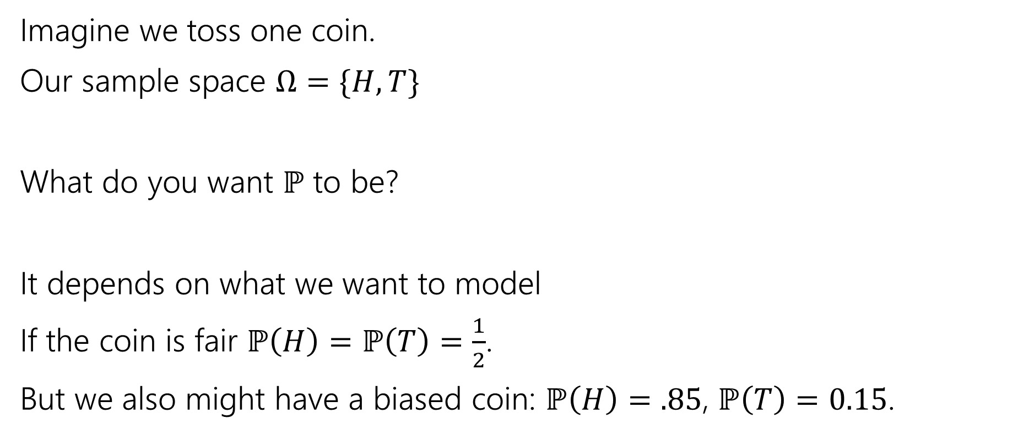
Example
Imagine we toss one coin.
Our sample space $Ω=\{H,T\}$
What do you want $ℙ$ to be?
It depends on what we want to model
If the coin is fair $ℙ\left(H\right)=ℙ\left(T\right)=\frac{1}{2}$.
But we also might have a biased coin: $ℙ\left(H\right)=.85$, $ℙ\left(T\right)=0.15$.

Slide 54

Probability Space
Probability Space
A (discrete) probability space is a pair $(Ω,ℙ)$ where:
$Ω$ is the sample space
$ℙ:Ω→[0,1]$ is the probability measure.
$ℙ$ satisfies:
$ℙ\left(x\right)≥0$ for all $x$
$\sum_{x∈Ω}{ℙ(x)} =1$
If $E,F⊆Ω$ and $E∩F=∅$then $ℙ\left(E∪F\right)=ℙ\left(E\right)+ℙ(F)$

Slide 55
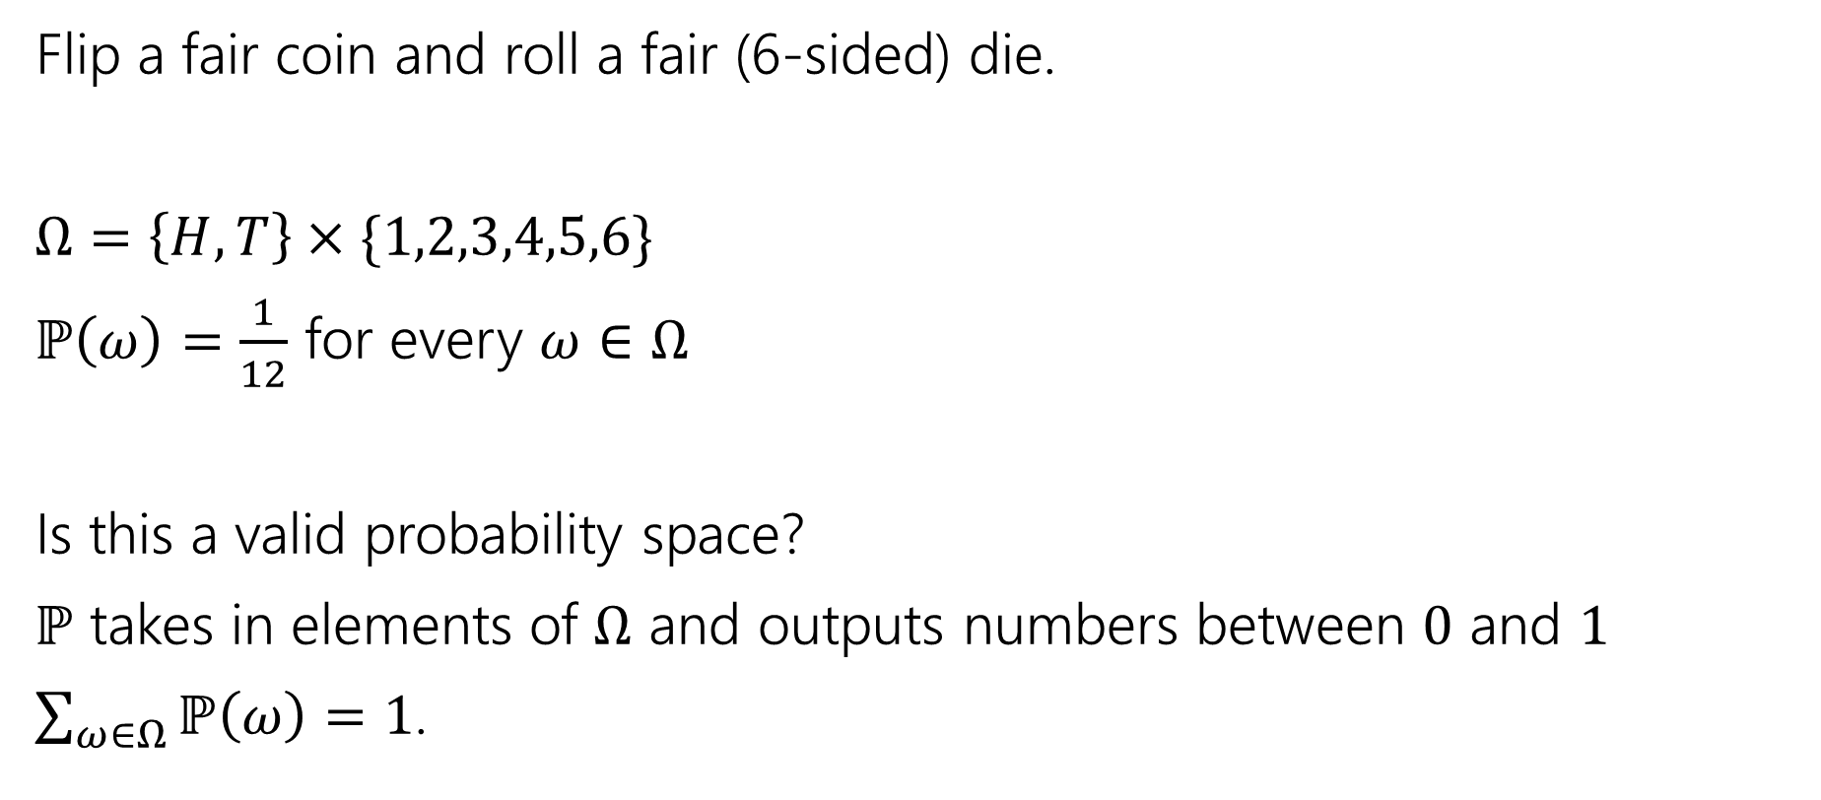
Probability Space
Flip a fair coin and roll a fair (6-sided) die.
$Ω=\left\{H,T\right\}×\{1,2,3,4,5,6\}$
$ℙ\left(ω\right)=\frac{1}{12}$ for every $ω∈Ω$
Is this a valid probability space?
$ℙ$ takes in elements of $Ω$ and outputs numbers between $0$ and $1$
$\sum_{ω∈Ω}{ℙ\left(ω\right)}=1$.

Slide 56
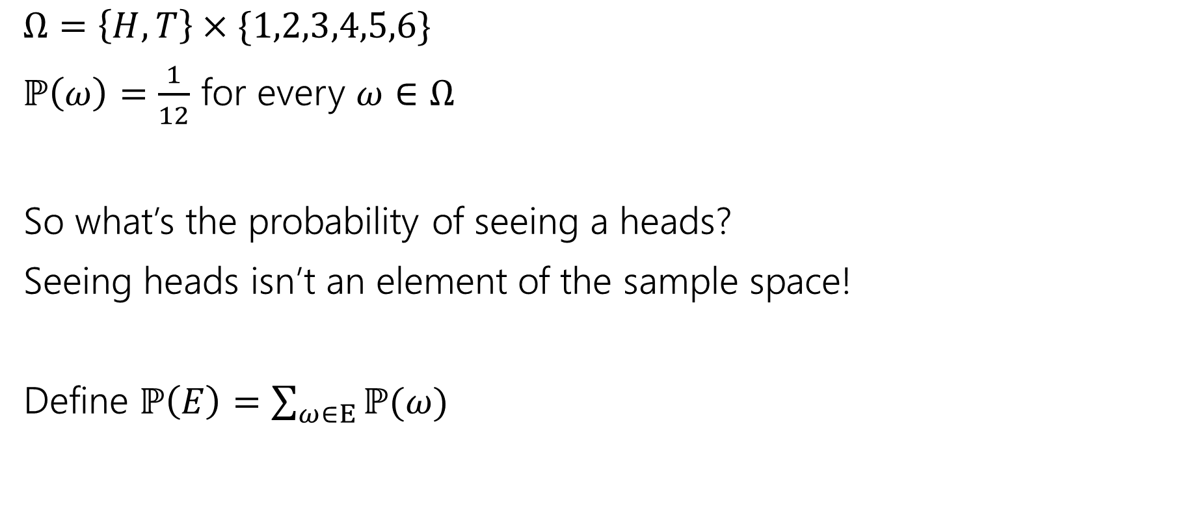
Measure
$Ω=\left\{H,T\right\}×\{1,2,3,4,5,6\}$
$ℙ\left(ω\right)=\frac{1}{12}$ for every $ω∈Ω$
So what’s the probability of seeing a heads?
Seeing heads isn’t an element of the sample space!
Define $ℙ\left(E\right)=\sum_{ω∈E}{ℙ(ω)}$

Slide 57
Probability Space
Probability Space
A (discrete) probability space is a pair $(Ω,ℙ)$ where:
$Ω$ is the sample space
$ℙ:Ω→[0,1]$ is the probability measure.
$ℙ$ satisfies:
$ℙ\left(x\right)≥0$ for all $x$
$\sum_{x∈Ω}{ℙ(x)} =1$
If $E,F⊆Ω$ and $E∩F=∅$then $ℙ\left(E∪F\right)=ℙ\left(E\right)+ℙ(F)$

Slide 58
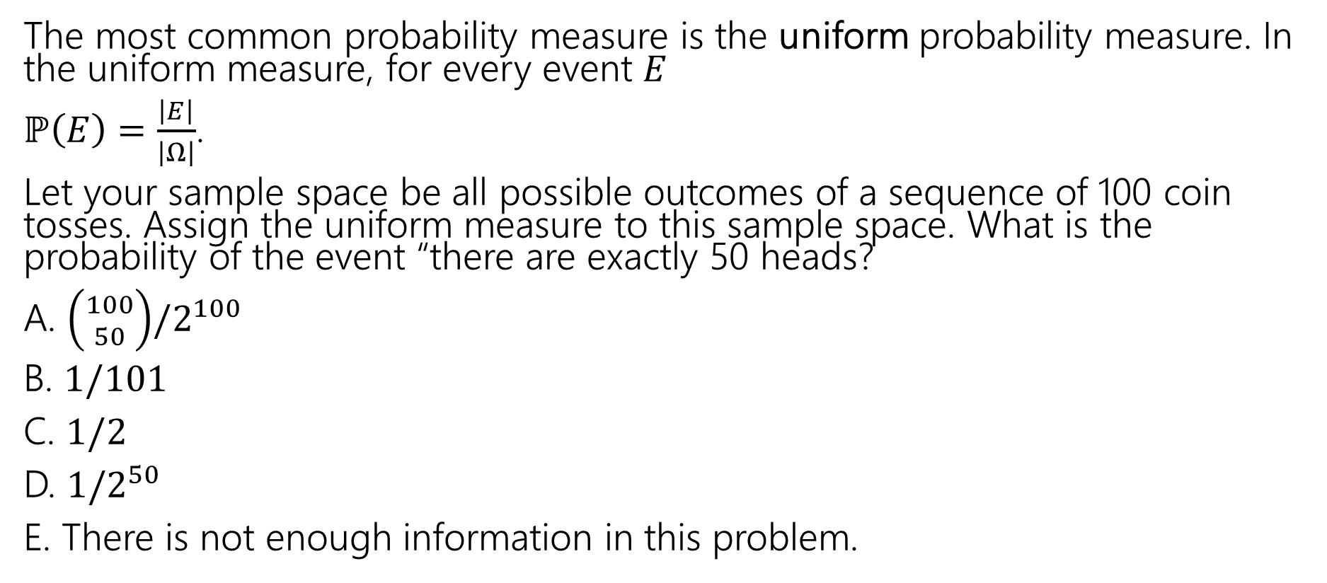
Uniform Probability Space
The most common probability measure is the uniform probability measure. In the uniform measure, for every event $E$
$ℙ\left(E\right)=\frac{\left|E\right|}{\left|Ω\right|}$.
Let your sample space be all possible outcomes of a sequence of 100 coin tosses. Assign the uniform measure to this sample space. What is the probability of the event “there are exactly 50 heads?
A. $\left({100 \atop 50}\right)/2^{100}$
B. $1/101$
C. $1/2$
D. $1/2^{50}$
E. There is not enough information in this problem.

Slide 59
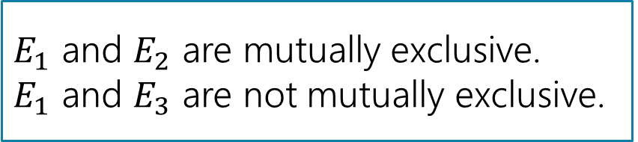
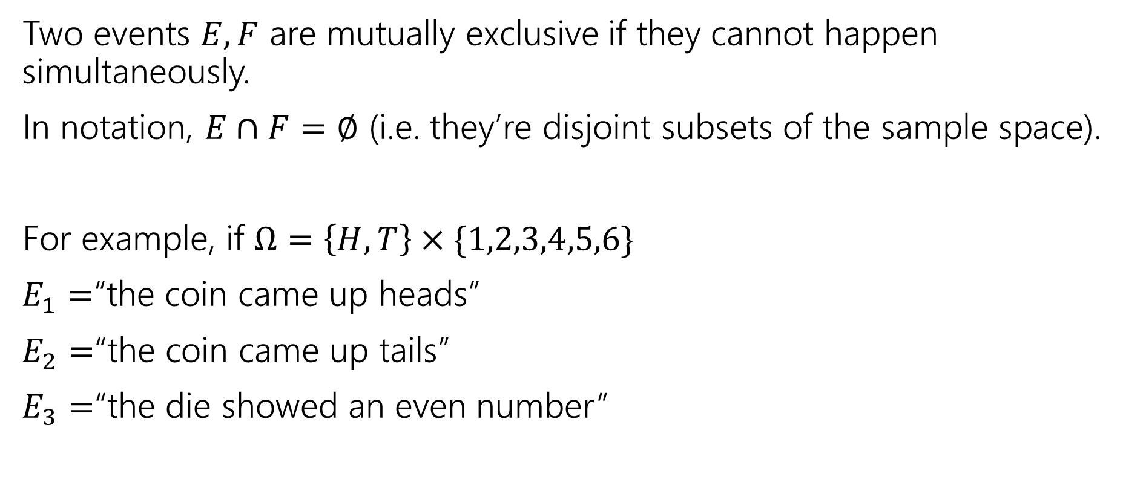
Mutually Exclusive Events
Two events $E,F$ are mutually exclusive if they cannot happen simultaneously.
In notation, $E∩F=∅$ (i.e. they’re disjoint subsets of the sample space).
For example, if $Ω=\left\{H,T\right\}×\{1,2,3,4,5,6\}$
$E_{1}=$“the coin came up heads”
$E_{2}=$“the coin came up tails”
$E_{3}=$“the die showed an even number”
$E_{1}$ and $E_{2}$ are mutually exclusive.
$E_{1}$ and $E_{3}$ are not mutually exclusive.

Slide 60
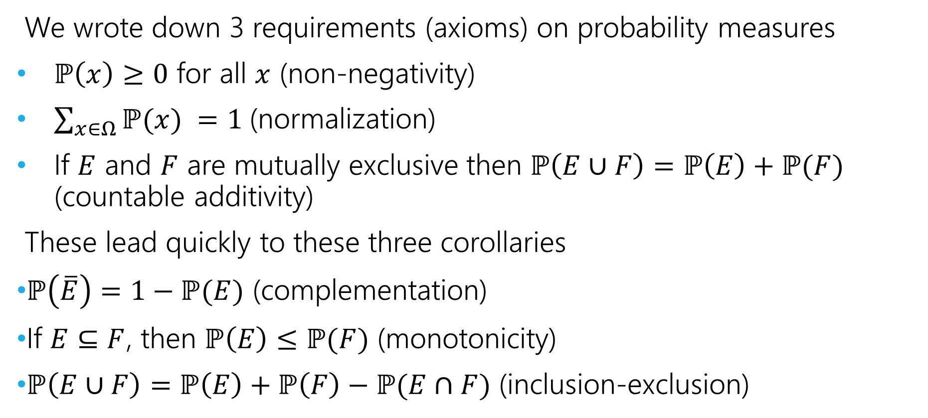
Axioms and Consequences
We wrote down 3 requirements (axioms) on probability measures
$ℙ\left(x\right)≥0$ for all $x$ (non-negativity)
$\sum_{x∈Ω}{ℙ(x)} =1$(normalization)
If $E$ and $F$ are mutually exclusive then $ℙ\left(E∪F\right)=ℙ\left(E\right)+ℙ(F)$ (countable additivity)
These lead quickly to these three corollaries
$ℙ\left(\overline{E}\right)=1−ℙ(E)$ (complementation)
If $E⊆F$, then $ℙ\left(E\right)≤ℙ(F)$ (monotonicity)
$ℙ\left(E∪F\right)=ℙ\left(E\right)+ℙ\left(F\right)−ℙ(E∩F)$ (inclusion-exclusion)

Slide 61
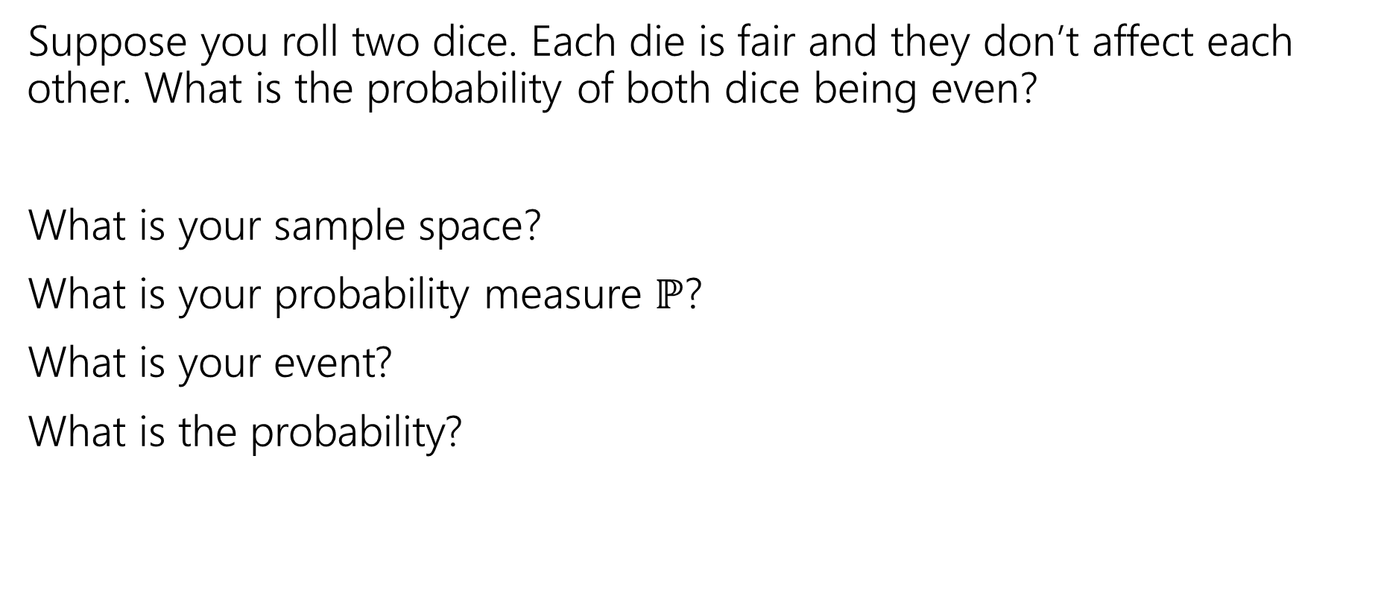
More Examples!
Suppose you roll two dice. Each die is fair and they don’t affect each other. What is the probability of both dice being even?
What is your sample space?
What is your probability measure $ℙ$?
What is your event?
What is the probability?

Slide 62
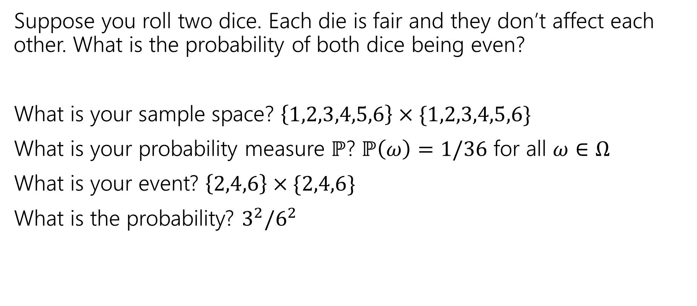
More Examples!
Suppose you roll two dice. Each die is fair and they don’t affect each other. What is the probability of both dice being even?
What is your sample space? $\left\{1,2,3,4,5,6\right\}×\{1,2,3,4,5,6\}$
What is your probability measure $ℙ$? $ℙ\left(ω\right)=1/36$ for all $ω∈Ω$
What is your event? $\left\{2,4,6\right\}×\{2,4,6\}$
What is the probability? $3^{2}/6^{2}$

Slide 63
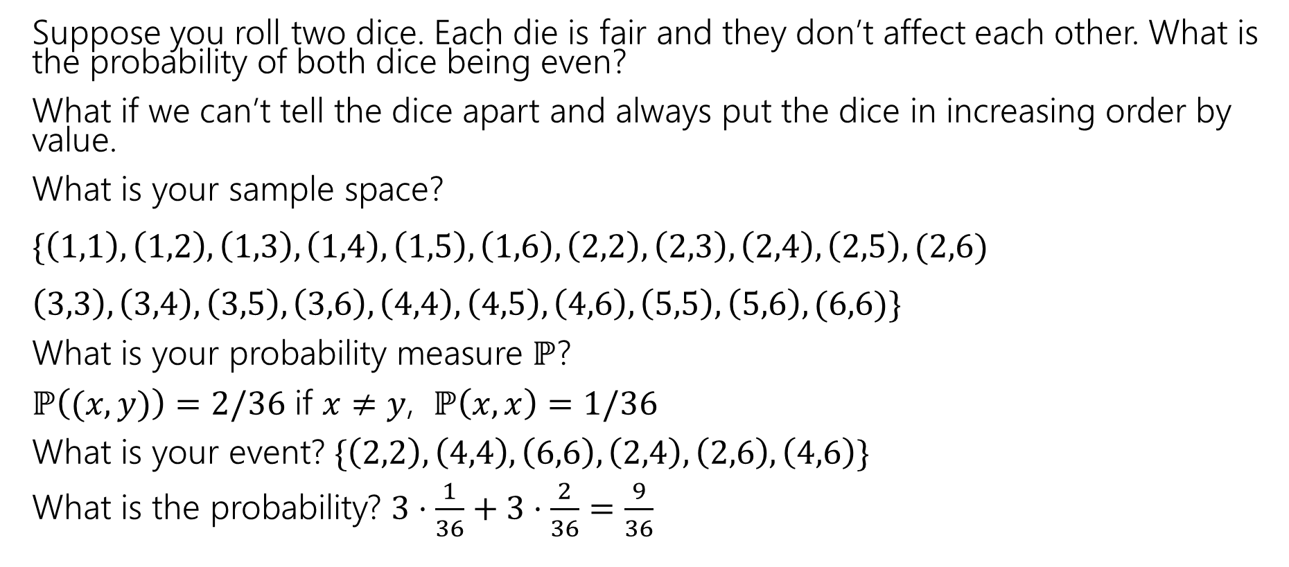
More Examples!
Suppose you roll two dice. Each die is fair and they don’t affect each other. What is the probability of both dice being even?
What if we can’t tell the dice apart and always put the dice in increasing order by value.
What is your sample space?
$\{\left(1,1\right),\left(1,2\right),\left(1,3\right),\left(1,4\right),\left(1,5\right),\left(1,6\right), \left(2,2\right),\left(2,3\right), \left(2,4\right),\left(2,5\right), (2,6)$
$\left(3,3\right),\left(3,4\right),\left(3,5\right),\left(3,6\right),\left(4,4\right),\left(4,5\right),\left(4,6\right),\left(5,5\right),\left(5,6\right), (6,6)\}$
What is your probability measure $ℙ$?
$ℙ\left((x,y)\right)=2/36$ if $x≠y$, $ℙ\left(x,x\right)=1/36$
What is your event? $\{\left(2,2\right),\left(4,4\right),\left(6,6\right), \left(2,4\right),\left(2,6\right),\left(4,6\right)\}$
What is the probability? $3⋅\frac{1}{36}+3⋅\frac{2}{36}=\frac{9}{36}$

Slide 64
Takeaways
There is often more than one sample space possible! But one is probably easier than the others.
Finding a sample space that will make the uniform measure correct will usually make finding the probabilities easier to calculate.

Slide 65
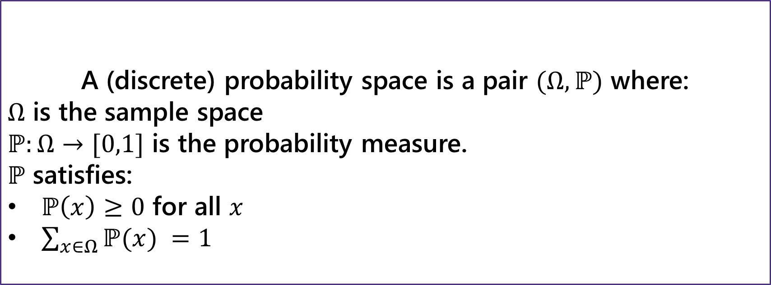
Probability Space
Probability Space
A (discrete) probability space is a pair $(Ω,ℙ)$ where:
$Ω$ is the sample space
$ℙ:Ω→[0,1]$ is the probability measure.
$ℙ$ satisfies:
$ℙ\left(x\right)≥0$ for all $x$
$\sum_{x∈Ω}{ℙ(x)} =1$
If $E,F⊆Ω$ and $E∩F=∅$then $ℙ\left(E∪F\right)=ℙ\left(E\right)+ℙ(F)$

