Slide 1
Here Early?
Here for CSE 312?
Welcome! You’re early!
Want a copy of these slides to take notes?
You can download them from the webpage cs.uw.edu/312

Slide 2
Introduction and Counting
CSE 312 25AU
Lecture 1

Slide 3

Staff
TAs
Advait Bhargav
Parker Gustafson
Emma Huang
Krisha Khandelwal
Lucas Ng
Jeffrey Tappen
Michael Whitmeyer
Jai Wongcharoensangsiri
Anthony Chu
Instructor: Robbie Weber
Ph.D. from UW CSE in theory
Sixth year as teaching faculty
Email: rtweber2@cs.washington.edu Office: CSE2 311

Slide 4
Logistics
Lecture is MWF at 9:30 AM in
Lecture will be recorded, with recordings posted to Panopto.
Recordings are provided “as-is”---if there’s a tech malfunction, we won’t re-record a lecture (but there might be an old similar video we can share).

Slide 5
Logistics
Sections meet on Thursdays (starting this week)
Please go to your assigned section.
If you can’t make your assigned section occasionally, you can ask the TA(s) in charge of another for permission to join.
Section participation is required.
The course is designed to give you high-level ideas here and practice in section.
Get participation credit by doing problems; either in section or emailed to your TA.
Details on Syllabus and Ed (including what to do if you can’t attend section).
Sections aren’t recorded, but resources are available.
Sections will not be recorded – we want you to be able to ask questions and give feedback without worrying about being recorded.
Handouts and solutions will be posted.

Slide 6
Concept Checks
Each Lecture will have a “concept check” associated with it.
Idea: Make sure you’ve understood today’s topic before we build on it 2 days later.
Available on gradescope at 10:30 (after lecture). Due the day of the next lecture at 9:30 (start of lecture).
You can submit as many times as you want.
When you get an answer correct the explanation will appear.
Worth a small amount of your grade, and an 80% average for the quarter is all you need for full credit.
Details in the syllabus.
You can (and should!) submit until you get full credit!

Slide 7
Exam Dates
We’re going to have 4 in-lecture quizzes (20 minutes each)
Oct 13, Oct 20, Nov 17, Nov 24
One midterm November 3rd (6 PM)
“Second chance exams”; optional chances to retake the midterm and two of your quizzes to improve scores
Midterm retake: Monday Dec 1st (6 PM)
Quiz retake: Thursday Dec 4th (in your section)
Final Exam: Wed Dec 10, 8:30-10:20

Slide 8
Syllabus
When in doubt, it’s on the webpage:
(or it will be soon ☺ )
https://courses.cs.washington.edu/courses/cse312/25au/

Slide 9
Work
Concept Checks (7.5%)
Short “quiz” for each lecture on gradescope; identify misconceptions right away.
Due the morning of the next lecture. First due date Monday.
Section Participation (5%)
Go to section and work on problems there or (if you can’t make it) do the corresponding problems on your own and email them to your TA.
Approximately 8 Homeworks (35%)
Mostly written problems, but a few programming questions.
Quizzes (your best 3 of 4) (15%)
20 min in lecture (dates on calendar); topics will be announced well in-advance.
Midterm (15%)
Evening exam Monday November 3rd
Final exam (22.5%)
Wednesday Dec 10, 8:30-10:20 AM
Second Chance exams: (Optional) chance to re-take the midterm and two quizzes last week of the quarter to improve your score; Mon Dec 1 and Thurs Dec 4; details in syllabus.

Slide 10
Communication
Ed Discussion board will be our primary means of communication.
Please check frequently.
We’ll send announcement emails via Ed.
If you want to contact us:
Private post on Ed (seen by TAs and Robbie, but not other students)
Email Robbie
Anonymous Feedback form on webpage

Slide 11
Collaboration Policy
PLEASE collaborate! Please talk to each other and work with each other.
(subject to the policy – details on webpage)
But don’t (except in very specific circumstances) use generative AI systems (e.g., chat-GPT).
Details in syllabus, but in-short: ok only for conceptual questions and for practice after you’ve turned in the relevant homework.

Slide 12
What is This Class?
We’re going to learn fundamentals of probability theory.
A beautiful and useful branch of mathematics.
Applications in:
Machine Learning
Natural Language Processing
Cryptography
Error-Correcting Codes
Data Structures
Data Compression
Complexity Theory
Algorithm Design
…

Slide 13
Content
Combinatorics (fancy counting)
Permutations, combinations, inclusion-exclusion, pigeonhole principle
Formal definitions for Probability
Probability space, events, conditional probability, independence, expectation, variance
Common patterns in probability
Equations and inequalities, “zoo” of common random variables, tail bounds
Continuous Probability
pdf, cdf, sample distributions, central limit theorem, estimating probabilities
Applications
Across CS, but with some focus on ML.

Slide 14
Themes
Precise mathematical communication
Both reading and writing dense statements.
Probability in the “real world”
A mix of CS applications
And some actual “real life” ones.
Refine your intuition
Most people have some base level feeling of what the chances of some event are.
We’re going to train you to have better gut feelings.

Slide 15
Counting

Slide 16
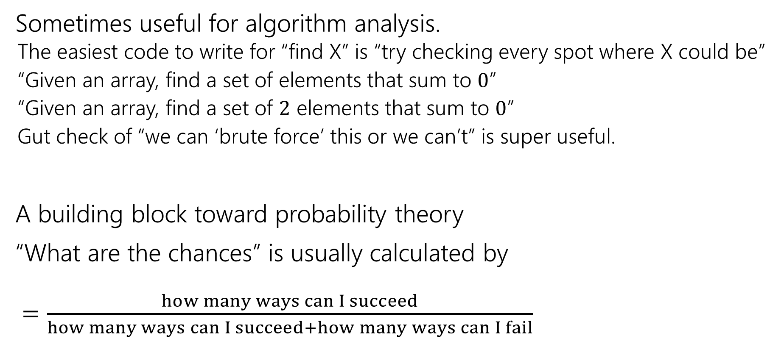
Why Counting?
Sometimes useful for algorithm analysis.
The easiest code to write for “find X” is “try checking every spot where X could be”
“Given an array, find a set of elements that sum to $0$”
“Given an array, find a set of $2$ elements that sum to $0$”
Gut check of “we can ‘brute force’ this or we can’t” is super useful.
A building block toward probability theory
“What are the chances” is usually calculated by $=\frac{how many ways can I succeed}{how many ways can I succeed+how many ways can I fail}$

Slide 17
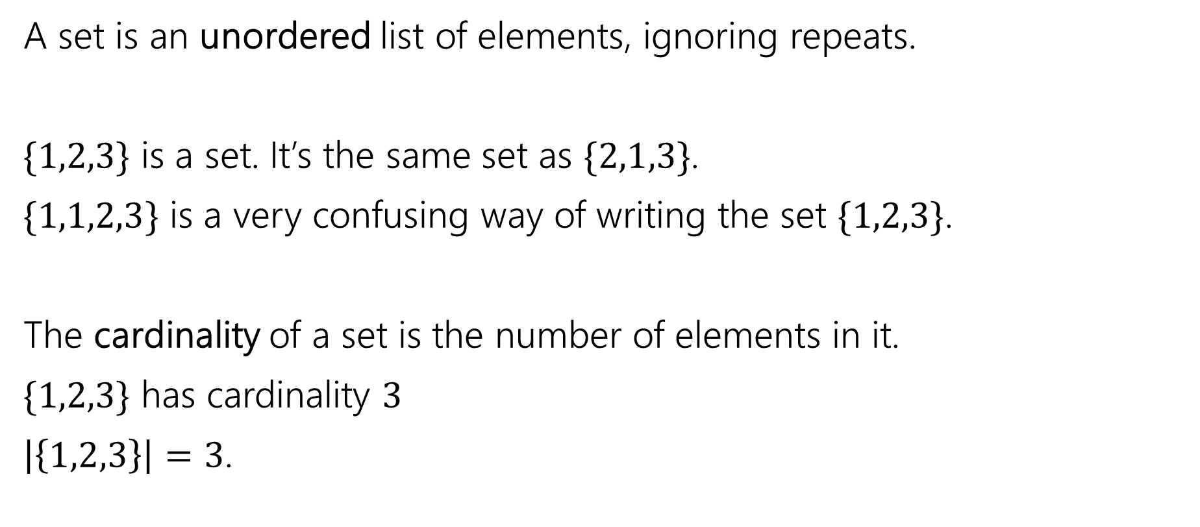
Remember sets?
A set is an unordered list of elements, ignoring repeats.
$\{1,2,3\}$ is a set. It’s the same set as $\{2,1,3\}$.
$\{1,1,2,3\}$ is a very confusing way of writing the set $\{1,2,3\}$.
The cardinality of a set is the number of elements in it.
$\{1,2,3\}$ has cardinality $3$
$\left|\left\{1,2,3\right\}\right|=3$.

Slide 18
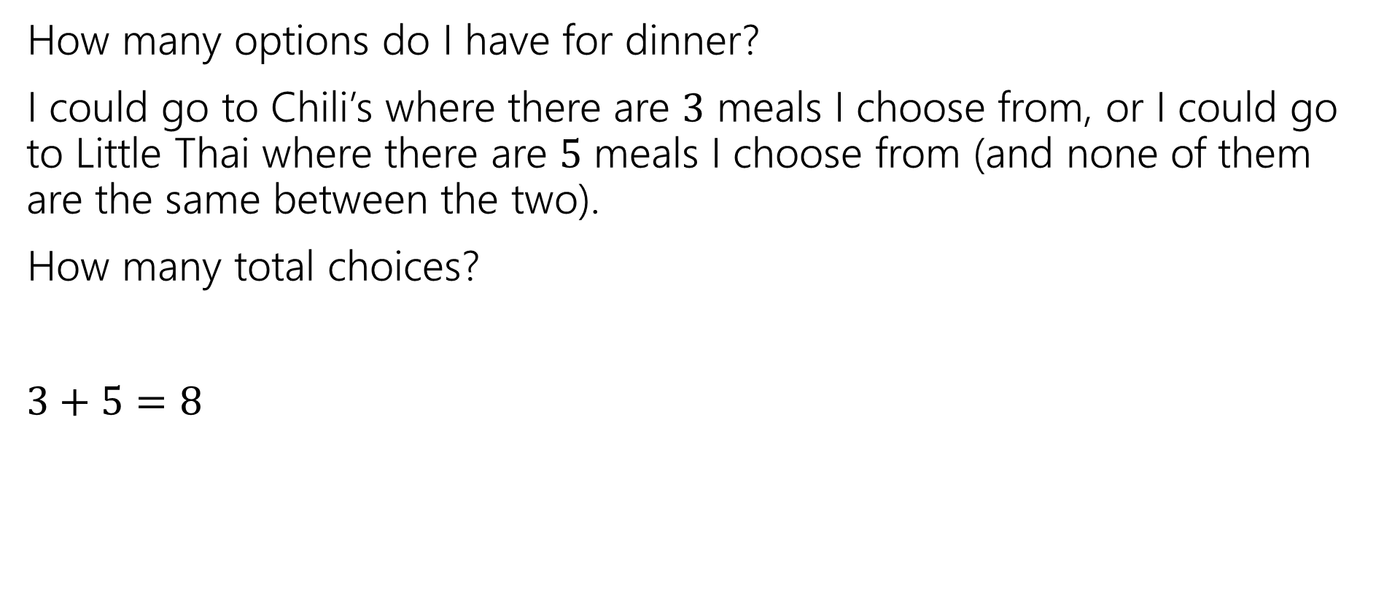
Counting Rules
How many options do I have for dinner?
I could go to Chili’s where there are $3$ meals I choose from, or I could go to Little Thai where there are $5$ meals I choose from (and none of them are the same between the two).
How many total choices?
$3+5=8$
Sum Rule: If you are choosing one thing between $n$ options in one group and $m$in another group with no overlap, the total number of options is: $n+m$.

Slide 19
Counting Rules
I’m still hungry…
I decide to make a sandwich. My sandwiches are always:
One of three types of bread (white, wheat, or sourdough).
One of two spreads (mayo or mustard)
One of four cheeses (American, cheddar, swiss, or Havarti)
How many sandwiches can I make?

Slide 20
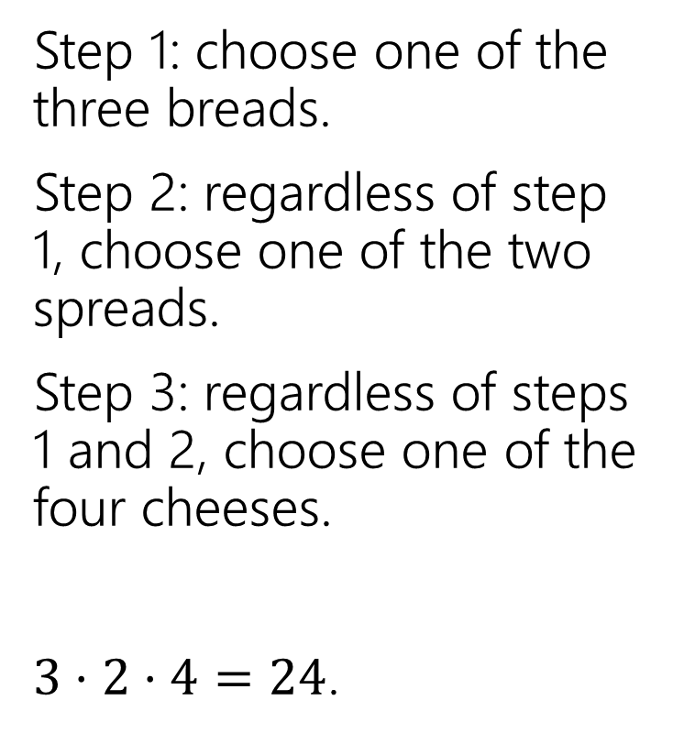
Sandwiches
Step 1: choose one of the three breads.
Step 2: regardless of step 1, choose one of the two spreads.
Step 3: regardless of steps 1 and 2, choose one of the four cheeses.
$3⋅2⋅4=24$.
White
Sourdough
Wheat
Mayo
Mustard
A
C
S
H

Slide 21
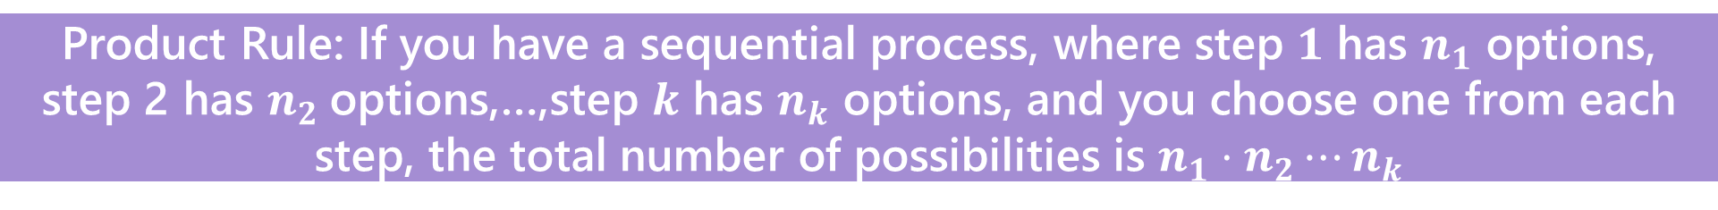
Counting Rules
Sum Rule: If you are choosing one thing between $n$ options in one group and $m$in another group with no overlap, the total number of options is: $n+m$.
Product Rule: If you have a sequential process, where step $1$ has $n_{1}$ options, step 2 has $n_{2}$options,…,step $k$ has $n_{k}$ options, and you choose one from each step, the total number of possibilities is $n_{1}⋅n_{2}⋯n_{k}$

Slide 22
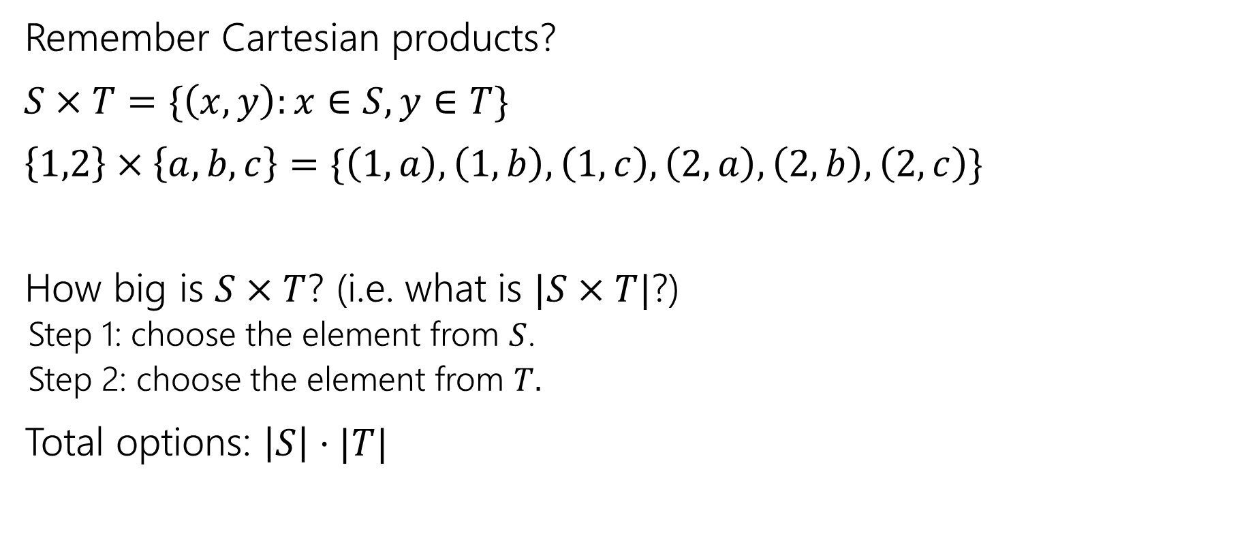
Applications of the product rule
Remember Cartesian products?
$S×T=\{\left(x,y\right):x∈S, y∈T\}$
$\left\{1,2\right\}×\left\{a,b,c\right\}=\{\left(1,a\right),\left(1,b\right),\left(1,c\right),\left(2,a\right),\left(2,b\right),\left(2,c\right)\}$
How big is $S×T$? (i.e. what is $|S×T|$?)
Step 1: choose the element from $S$.
Step 2: choose the element from $T.$
Total options: $\left|S\right|⋅|T|$

Slide 23

Power Sets
$𝒫\left(S\right)=\{X:X⊆S\}$
$𝒫\left(\left\{1,2,3\right\}\right)=\{ ∅, \left\{1\right\},\left\{2\right\},\left\{3\right\}, \left\{1,2\right\},\left\{1,3\right\},\left\{2,3\right\}, \left\{1,2,3\right\} \}$
How many subsets are there of $S$, i.e. what is $\left|𝒫\left(S\right)\right|$?

Slide 24
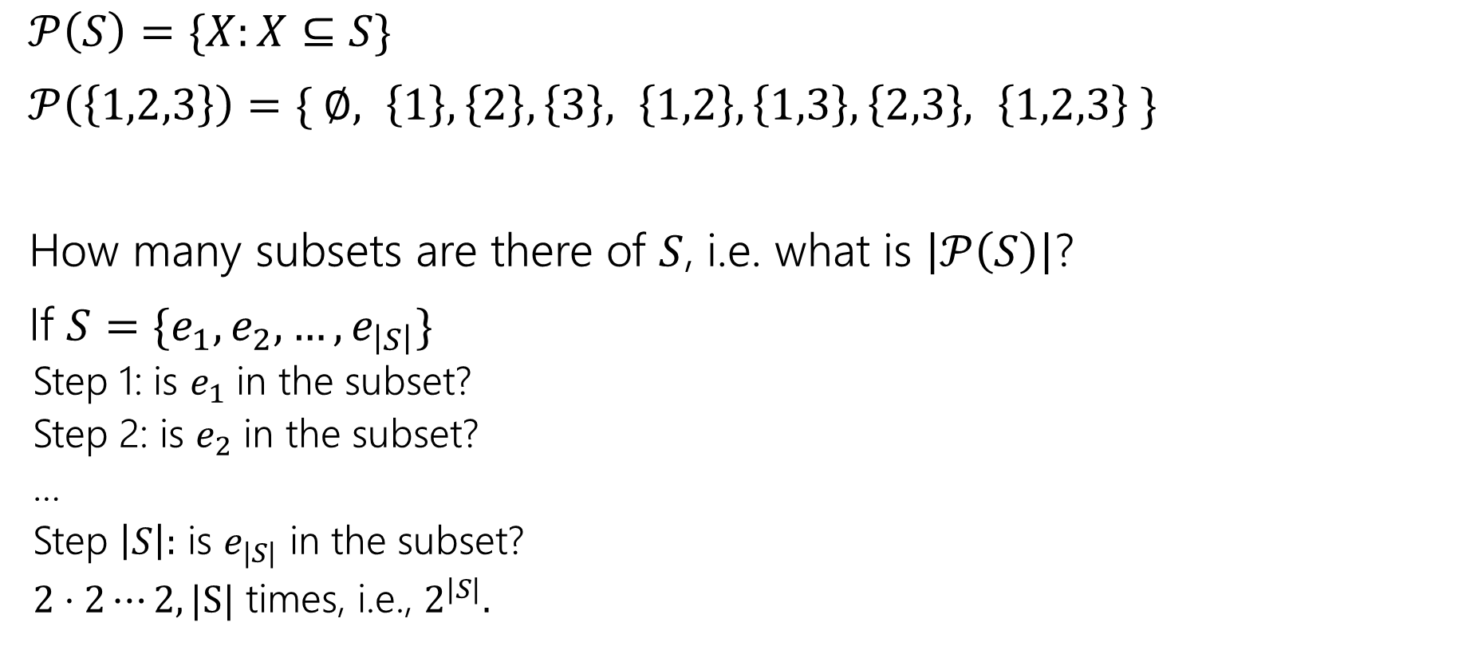
Power Sets
$𝒫\left(S\right)=\{X:X⊆S\}$
$𝒫\left(\left\{1,2,3\right\}\right)=\{ ∅, \left\{1\right\},\left\{2\right\},\left\{3\right\}, \left\{1,2\right\},\left\{1,3\right\},\left\{2,3\right\}, \left\{1,2,3\right\} \}$
How many subsets are there of $S$, i.e. what is $\left|𝒫\left(S\right)\right|$?
If $S=\{e_{1},e_{2},…,e_{\left|S\right|}\}$
Step 1: is $e_{1}$ in the subset?
Step 2: is $e_{2}$ in the subset?
…
Step $\left|S\right|:$ is $e_{|S|}$ in the subset?
$2⋅2⋯2, |S|$ times, i.e., $2^{|S|}.$

Slide 25
Baseball Outfits
The Husky baseball team has three hats (purple, black, gray)
Three jerseys (pinstripe, purple, gold)
And three pairs of pants (gray, white, black)
How many outfits are there (consisting of one hat, jersey, and pair of pants) if
the pinstripe jersey cannot be worn with gray pants,
the purple jersey cannot be worn with white pants,
and the gold jersey cannot be worn with black pants.

Slide 26
Baseball Outfits
Step 1: 3 choices for hats.
Step 2: 3 choices for jerseys
Step 3:…

Slide 27
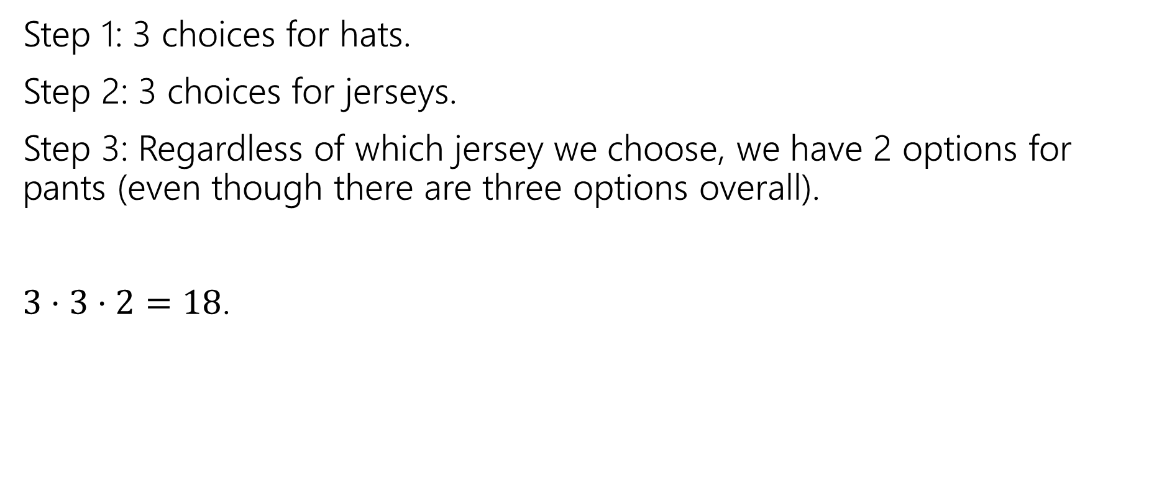
Baseball Outfits
Step 1: 3 choices for hats.
Step 2: 3 choices for jerseys.
Step 3: Regardless of which jersey we choose, we have 2 options for pants (even though there are three options overall).
$3⋅3⋅2=18$.

Slide 28








Assigning Books
We have 5 books to split to 3 people (Alice, Bob, and Charlie)
Every book goes to exactly one person, but each person could end up with no books (or all of them, or something in between).
1
Alice
2
Bob
3
4
Charlie
5

Slide 29
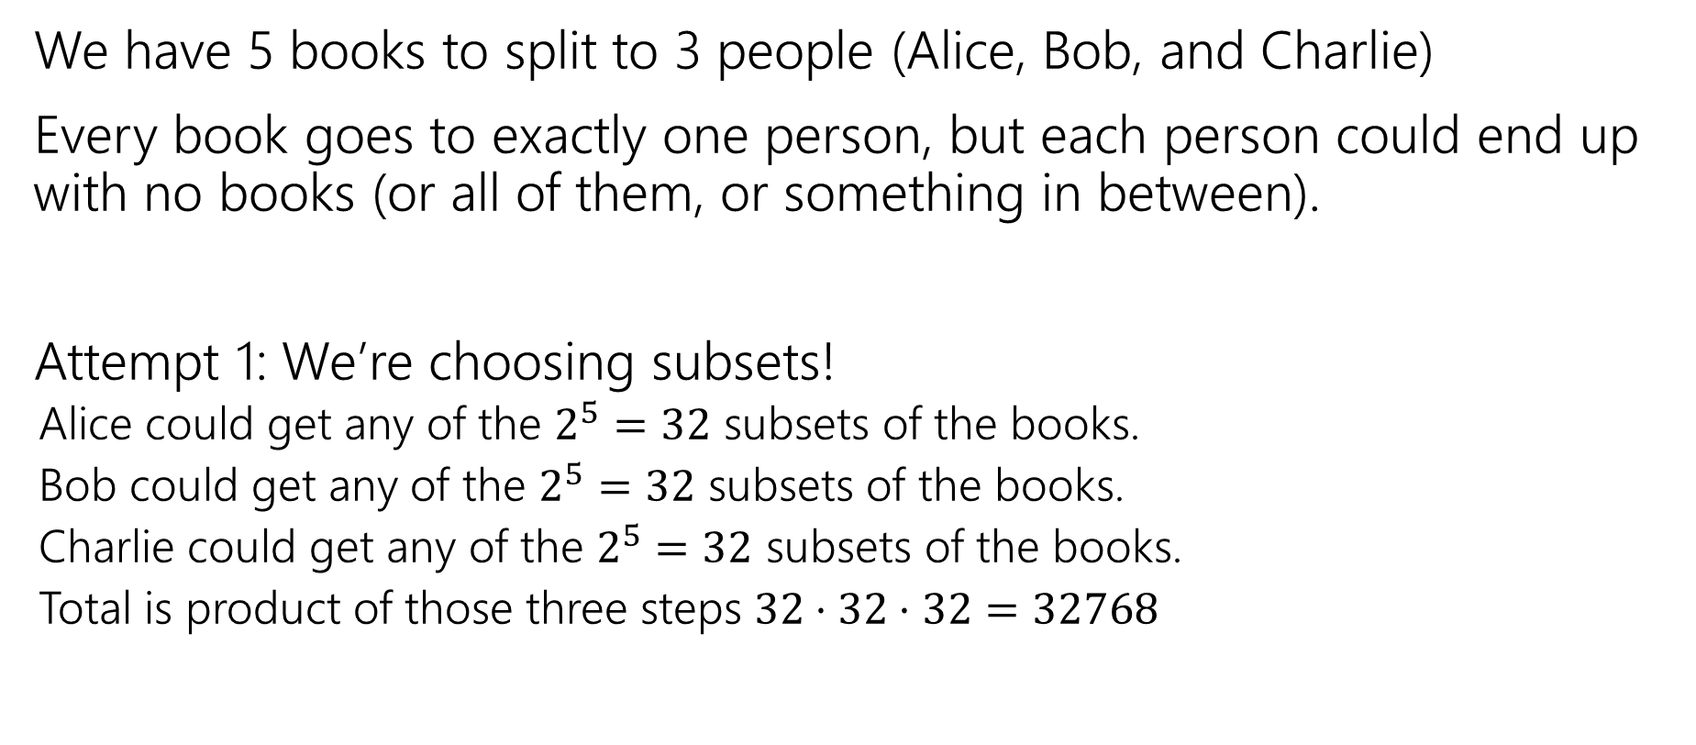
Assigning Books
We have 5 books to split to 3 people (Alice, Bob, and Charlie)
Every book goes to exactly one person, but each person could end up with no books (or all of them, or something in between).
Attempt 1: We’re choosing subsets!
Alice could get any of the $2^{5}=32$ subsets of the books.
Bob could get any of the $2^{5}=32$ subsets of the books.
Charlie could get any of the $2^{5}=32$ subsets of the books.
Total is product of those three steps $32⋅32⋅32=32768$

Slide 30

Activity
Attempt 1: We’re choosing subsets!
Alice could get any of the $2^{5}=32$ subsets of the books.
Bob could get any of the $2^{5}=32$ subsets of the books.
Charlie could get any of the $2^{5}=32$ subsets of the books.
Total is product of those three steps $32⋅32⋅32=32768$

Slide 31
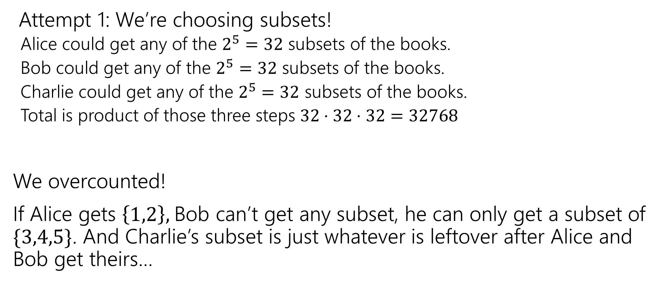
Activity
Attempt 1: We’re choosing subsets!
Alice could get any of the $2^{5}=32$ subsets of the books.
Bob could get any of the $2^{5}=32$ subsets of the books.
Charlie could get any of the $2^{5}=32$ subsets of the books.
Total is product of those three steps $32⋅32⋅32=32768$
We overcounted!
If Alice gets $\left\{1,2\right\},$Bob can’t get any subset, he can only get a subset of $\{3,4,5\}$. And Charlie’s subset is just whatever is leftover after Alice and Bob get theirs…

Slide 32
Fixing All The Books
You could
List out all the options for Alice.
For each of those (separately), list all the possible options for Bob and Charlie.
Use the Summation rule to combine.
~OR~ you could come at the problem from a different angle.

Slide 33
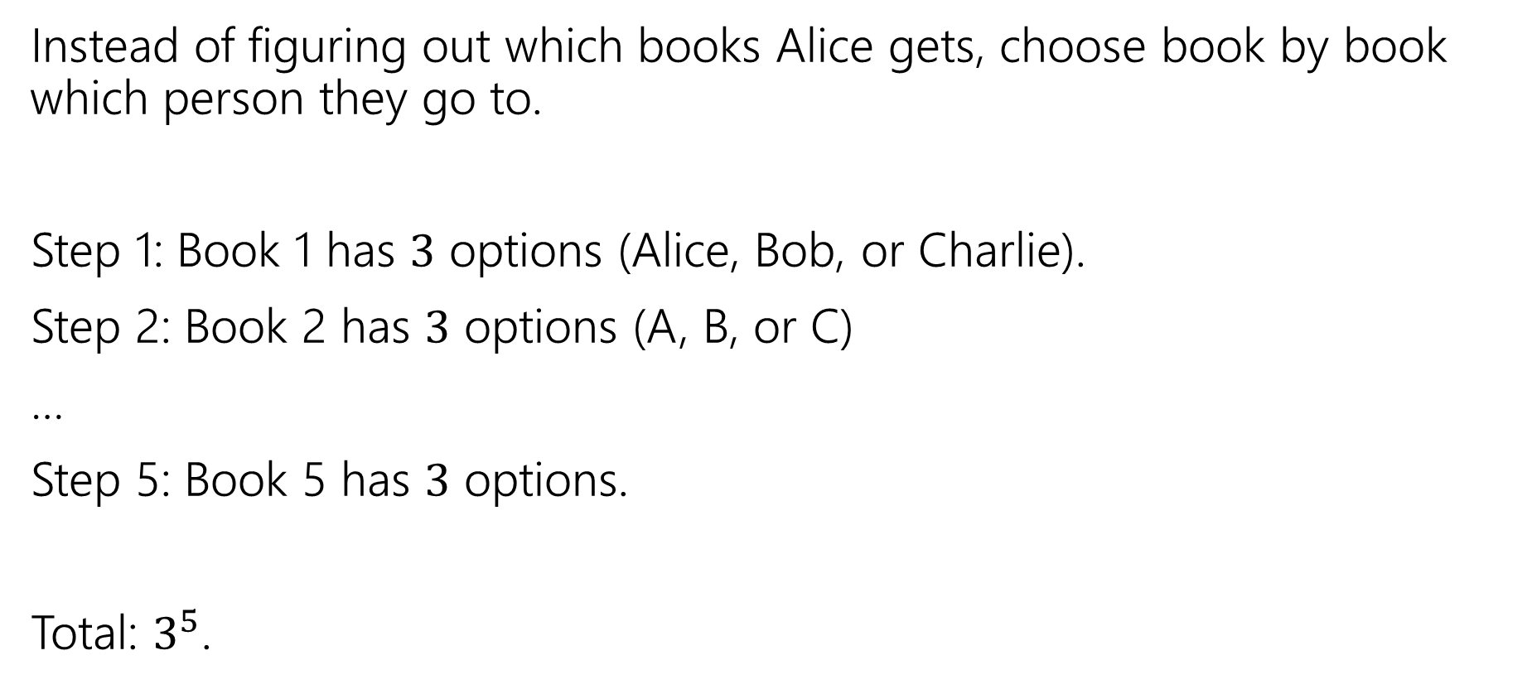
Fixing All the Books
Instead of figuring out which books Alice gets, choose book by book which person they go to.
Step 1: Book 1 has $3$ options (Alice, Bob, or Charlie).
Step 2: Book 2 has $3$ options (A, B, or C)
…
Step 5: Book 5 has $3$ options.
Total: $3^{5}$.

Slide 34

More sequence practice
How many length 3 sequences are there consisting of distinct elements of $\{1,2,3\}$.

Slide 35
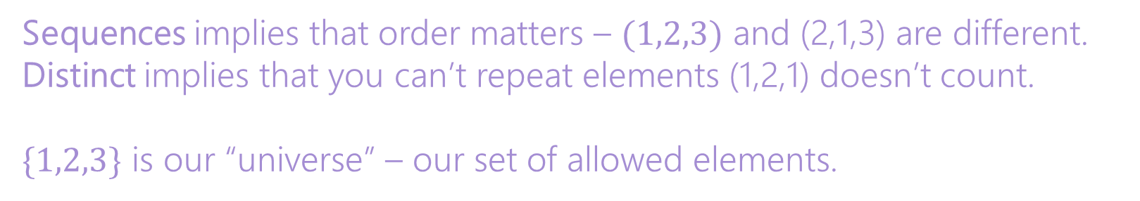
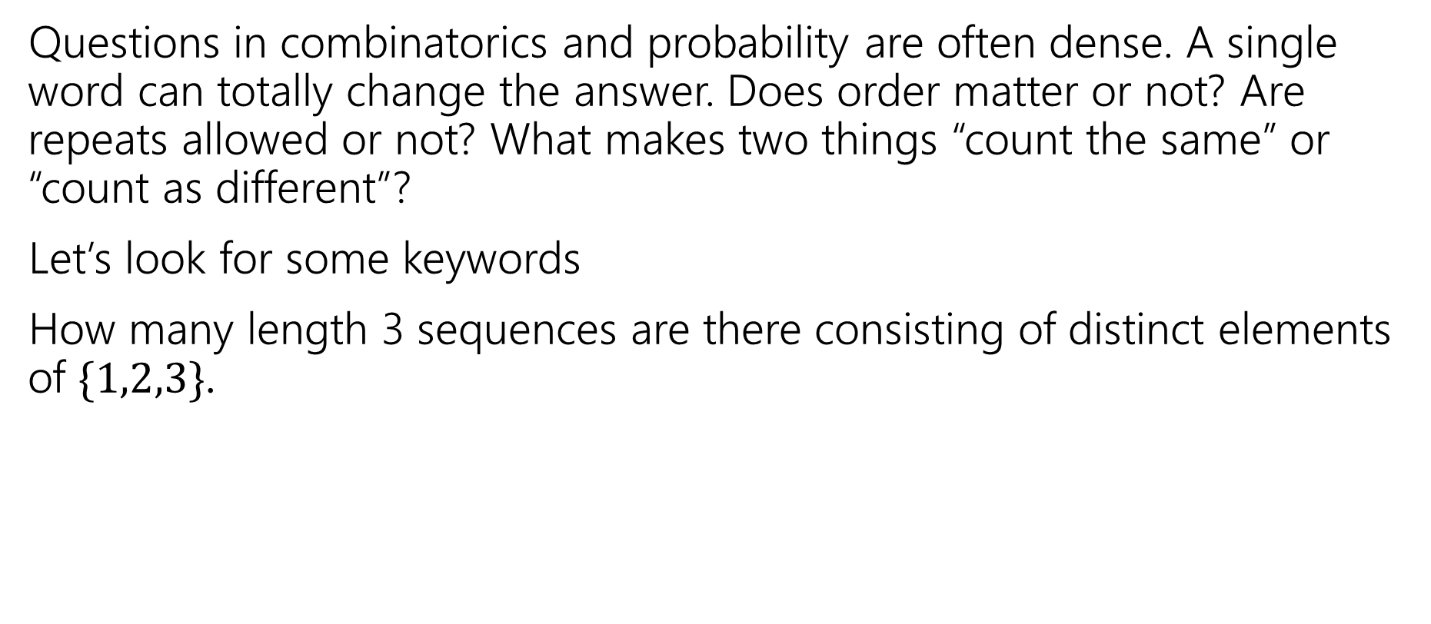
Pause
Questions in combinatorics and probability are often dense. A single word can totally change the answer. Does order matter or not? Are repeats allowed or not? What makes two things “count the same” or “count as different”?
Let’s look for some keywords
How many length 3 sequences are there consisting of distinct elements of $\{1,2,3\}$.
Sequences implies that order matters – $(1,2,3)$ and (2,1,3) are different.
Distinct implies that you can’t repeat elements (1,2,1) doesn’t count.
$\{1,2,3\}$ is our “universe” – our set of allowed elements.

Slide 36
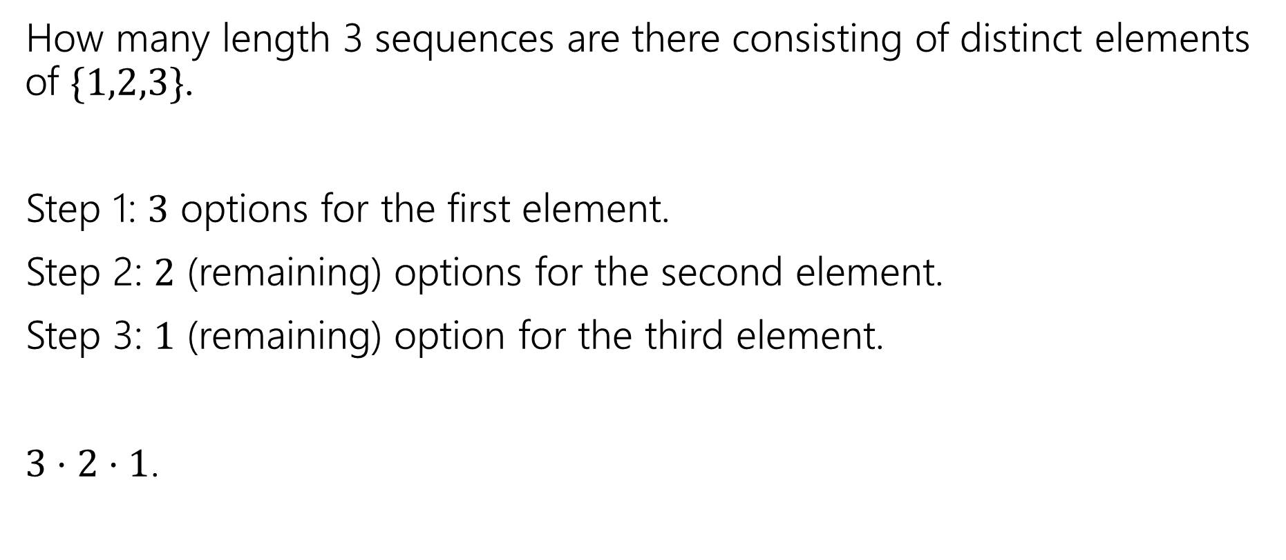
More sequence practice
How many length 3 sequences are there consisting of distinct elements of $\{1,2,3\}$.
Step 1: $3$ options for the first element.
Step 2: $2$ (remaining) options for the second element.
Step 3: $1$ (remaining) option for the third element.
$3⋅2⋅1$.

Slide 37

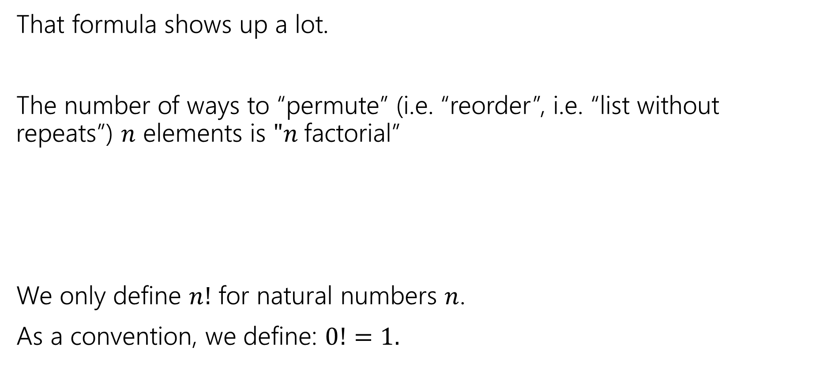

Factorial
That formula shows up a lot.
The number of ways to “permute” (i.e. “reorder”, i.e. “list without repeats”) $n$ elements is $"n$factorial”
We only define $n!$ for natural numbers $n$.
As a convention, we define: $0!=1.$
$$n!=n⋅\left(n−1\right)⋅\left(n−2\right)⋯1$$
$n$ factorial

Slide 38
More Practice

Slide 39

Strings
How many strings of length $5$ are there over the alphabet $\{A,B,C,…,Z\}$? (repeated characters allowed)
How many binary strings of length $n$ are there?

Slide 40

Strings
How many strings of length $5$ are there over the alphabet $\{A,B,C,…,Z\}$? (repeated characters allowed)
${26}^{5}$
How many binary strings of length $n$ are there?
$2^{n}$

