Slide 1
etherpad.wikimedia.org/p/312 for (anonymous) questions/comments!
Random Variables
CSE 312 24Su
Lecture 8

Slide 2
Outline
Today we will talk about random variables!
> Introduce motivation and idea of random variables
> How to describe random variables and their properties
  Support, probability mass function, cumulative distribution function, expectation

Slide 3
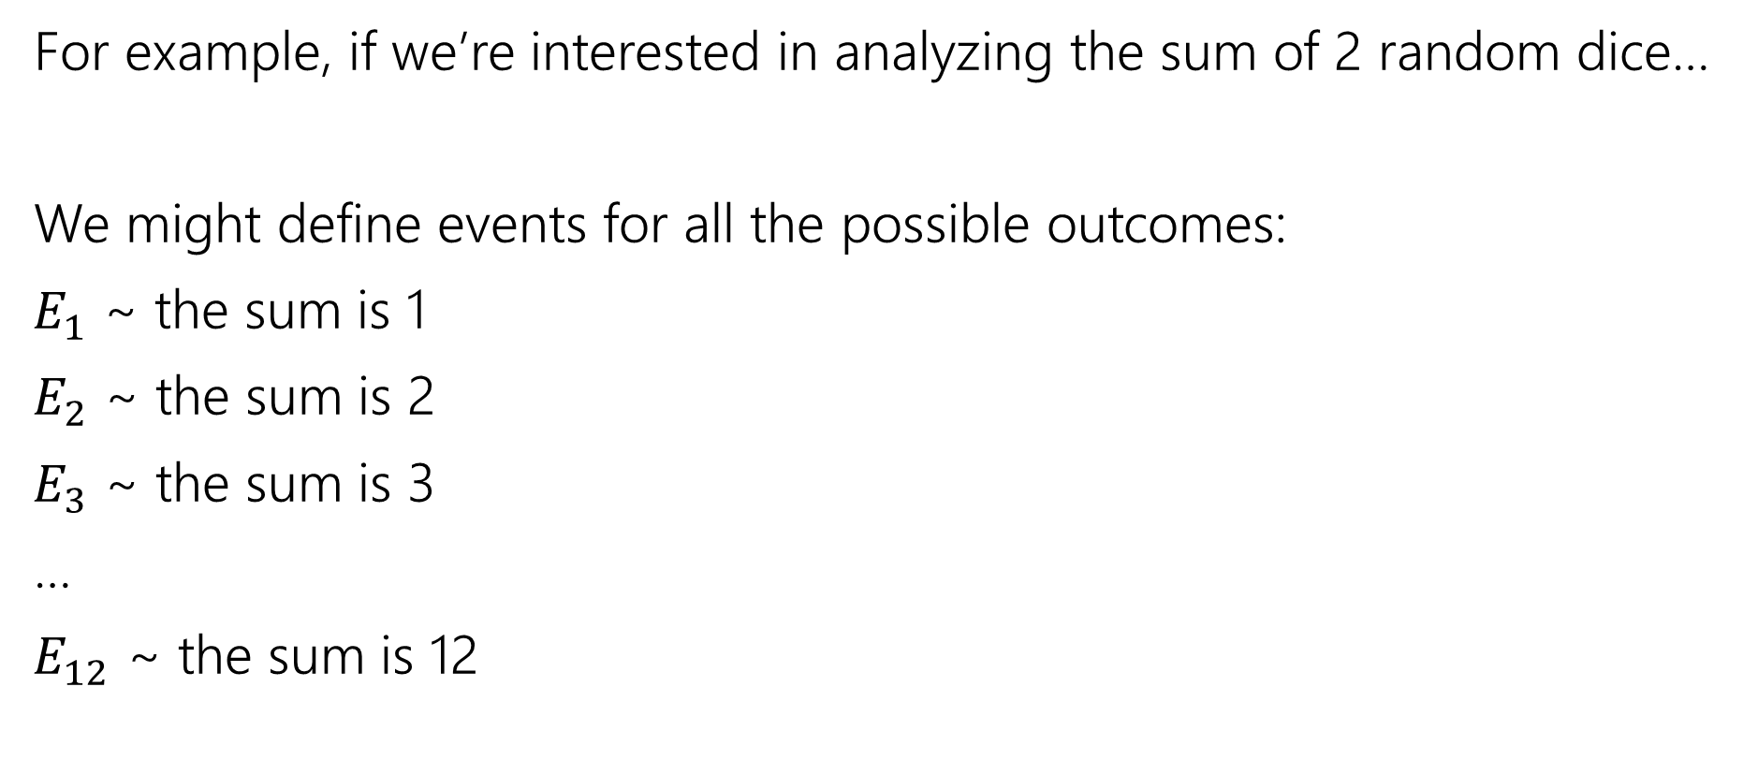
Defining Events Can Be Tedious
For example, if we’re interested in analyzing the sum of 2 random dice…
We might define events for all the possible outcomes:
$E_{1}$ ~ the sum is 1
$E_{2}$ ~ the sum is 2
$E_{3}$ ~ the sum is 3
…
$E_{12}$ ~ the sum is 12

Slide 4
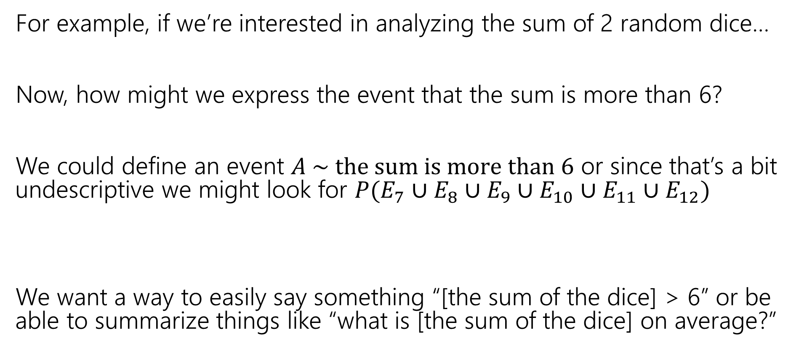
Defining and Using Events Can Be Tedious
For example, if we’re interested in analyzing the sum of 2 random dice…
Now, how might we express the event that the sum is more than 6?
We could define an event $A \sim the sum is more than 6$ or since that’s a bit undescriptive we might look for $P(E_{7}∪E_{8}∪E_{9}∪E_{10}∪E_{11}∪E_{12})$
We want a way to easily say something “[the sum of the dice] > 6” or be able to summarize things like “what is [the sum of the dice] on average?”

Slide 5
Random Variables

Slide 6
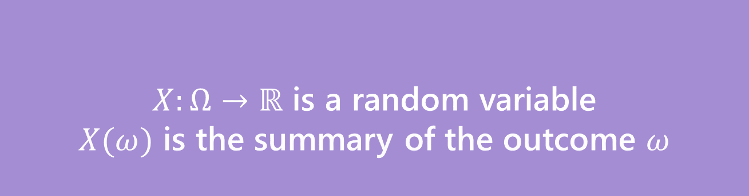
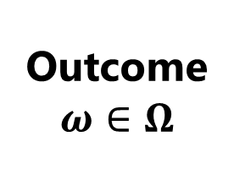


Random Variable
Informally: A random variable is a way to summarize the important (numerical) information from your outcome.
Formally: Function assigning a value to outcomes of a random experiment
$X:Ω→ℝ$ is a random variable
$X(ω)$ is the summary of the outcome $ω$
Random Variable
$Ω$ is set of possible outcomes
Outcome
$$ω∈Ω$$
Quantitative value
$$X$$

Slide 7
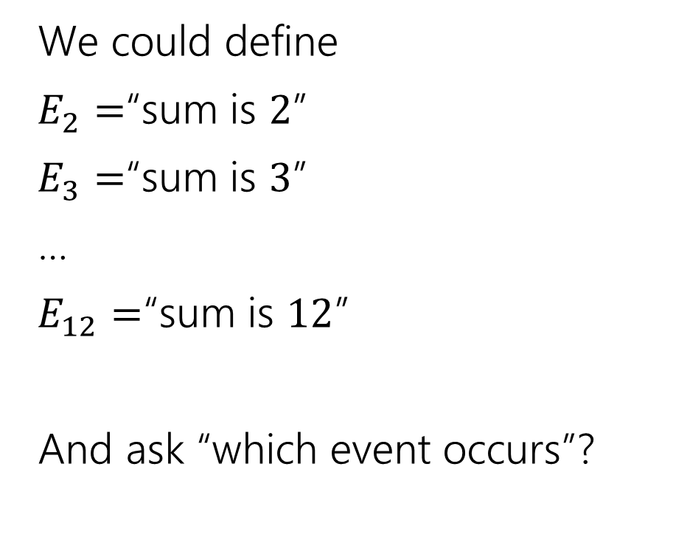

The sum of two dice
Events
Random variable
We could define
$E_{2}=$“sum is $2$”
$E_{3}=$“sum is $3$”
…
$E_{12}=$“sum is $12$”
And ask “which event occurs”?
$X:Ω→ℝ$
$X$is the sum of the two dice.

Slide 8

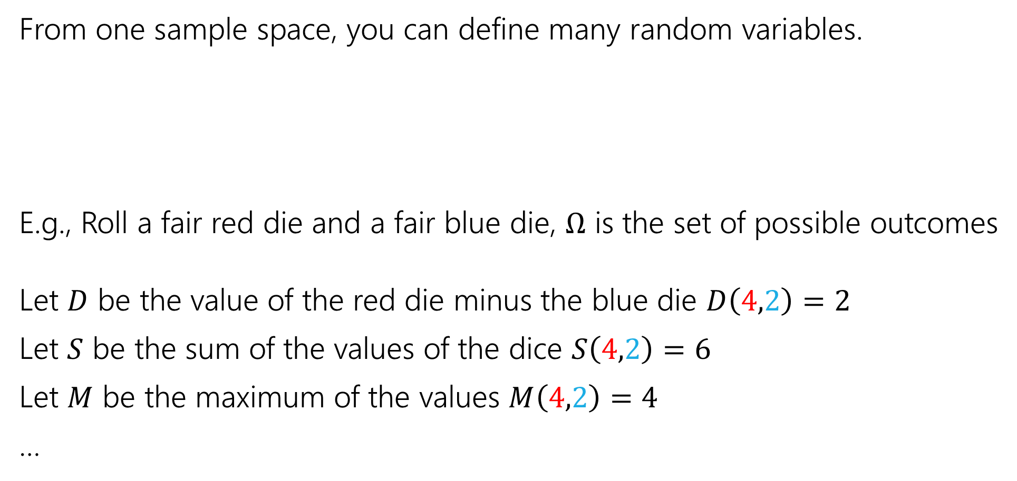

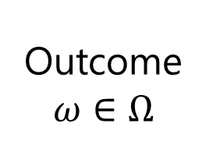


More random variables
From one sample space, you can define many random variables.
E.g., Roll a fair red die and a fair blue die, $Ω$ is the set of possible outcomes
Let $D$ be the value of the red die minus the blue die $D\left(4,2\right)=2$
Let $S$ be the sum of the values of the dice $S\left(4,2\right)=6$
Let $M$ be the maximum of the values $M\left(4,2\right)=4$
…
$Ω$ is set of possible outcomes
Outcome
$$ω∈Ω$$
$$X$$
Quantitative value
$$Y$$
Quantitative value
$$Z$$
Quantitative value

Slide 9
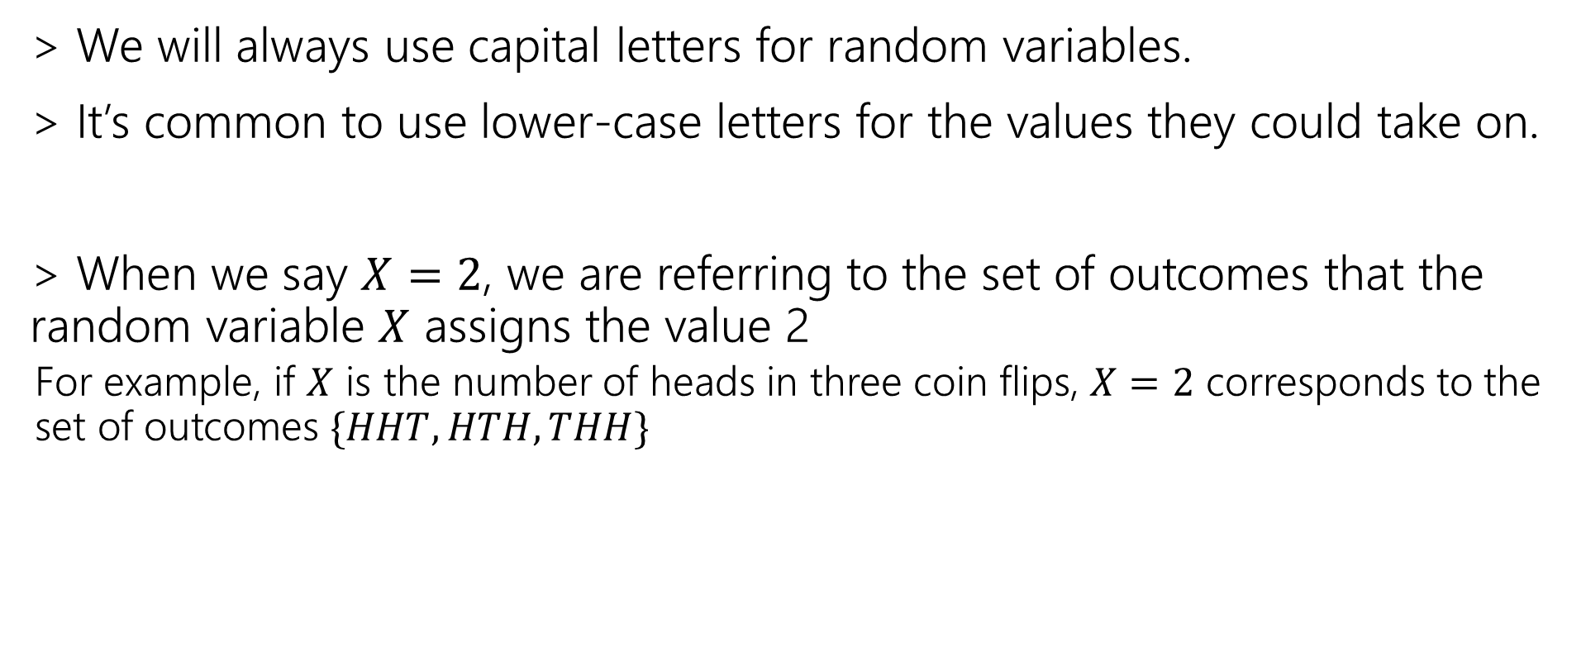
Notational Notes
> We will always use capital letters for random variables.
> It’s common to use lower-case letters for the values they could take on.
> When we say $X=2$, we are referring to the set of outcomes that the random variable $X$ assigns the value 2
  For example, if $X$ is the number of heads in three coin flips, $X=2$ corresponds to the set of outcomes $\{HHT, HTH, THH\}$

Slide 10
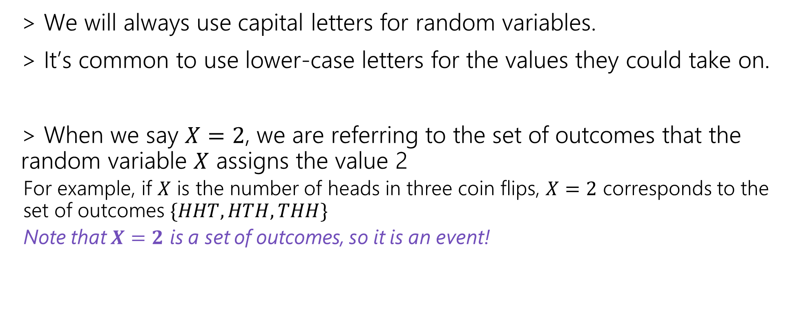
Notational Notes
> We will always use capital letters for random variables.
> It’s common to use lower-case letters for the values they could take on.
> When we say $X=2$, we are referring to the set of outcomes that the random variable $X$ assigns the value 2
  For example, if $X$ is the number of heads in three coin flips, $X=2$ corresponds to the set of outcomes $\{HHT, HTH, THH\}$
  Note that $X=2$ is a set of outcomes, so it is an event!

Slide 11
How do we describe random variables?
Random variable gives a quantitative property of an outcome in a random experiment.
  e.g., the number of coin flips till the first head, or the sum of two dice rolls
  > Support
  e.g., what are the possible “number of coin flips” it could possibly take?
  > Probability Mass Function
  e.g., what’s the probability it takes 3 coin flips till the 1st head? what about 5 flips?
  > Cumulative Distribution Function
  e.g., what’s the probability it takes less than 3 coin flips till the 1st head?
  > Expectation
  e.g., how many coin flips can we expect it to take till the first head on average?
  > Variance
  e.g., on average, how much does the “number of coin flips” deviate from the expectation?

Slide 12
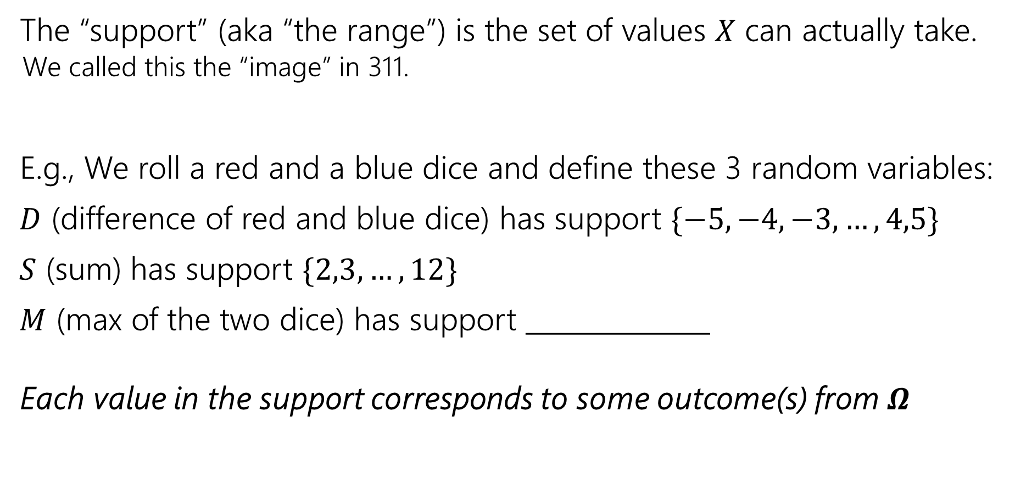
Support
The “support” (aka “the range”) is the set of values $X$ can actually take.
  We called this the “image” in 311.
E.g., We roll a red and a blue dice and define these 3 random variables:
$D$ (difference of red and blue dice) has support $\{−5,−4,−3,…,4,5\}$
$S$ (sum) has support $\{2,3,…,12\}$
$M$ (max of the two dice) has support ______________
Each value in the support corresponds to some outcome(s) from $Ω$

Slide 13
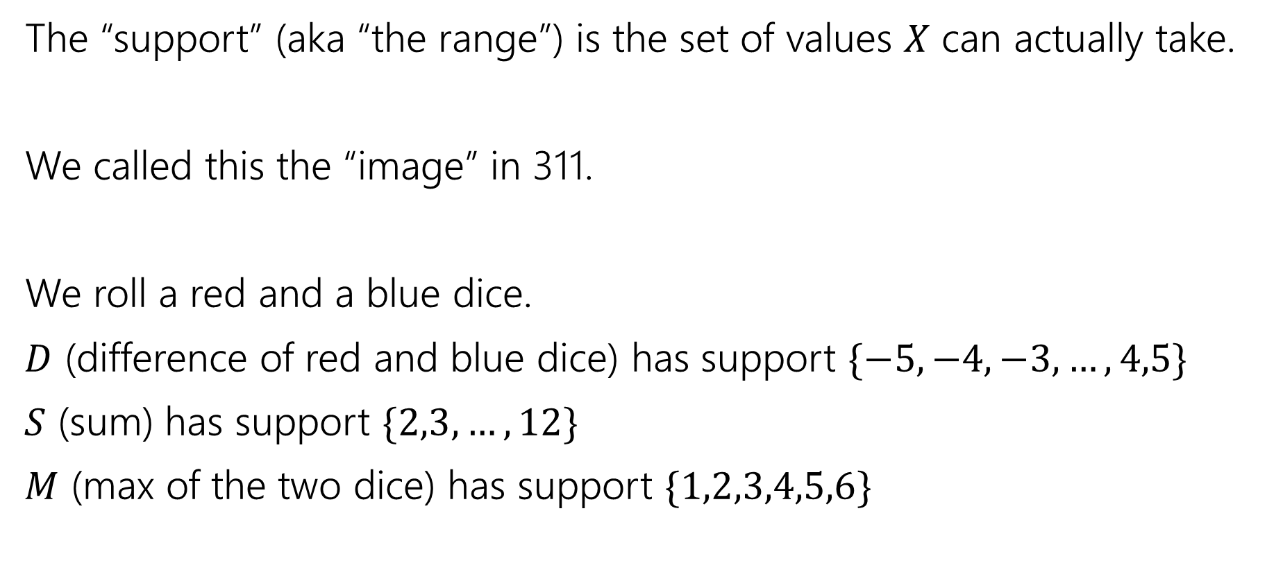
Support
The “support” (aka “the range”) is the set of values $X$ can actually take.
We called this the “image” in 311.
We roll a red and a blue dice.
$D$ (difference of red and blue dice) has support $\{−5,−4,−3,…,4,5\}$
$S$ (sum) has support $\{2,3,…,12\}$
$M$ (max of the two dice) has support $\{1,2,3,4,5,6\}$

Slide 14
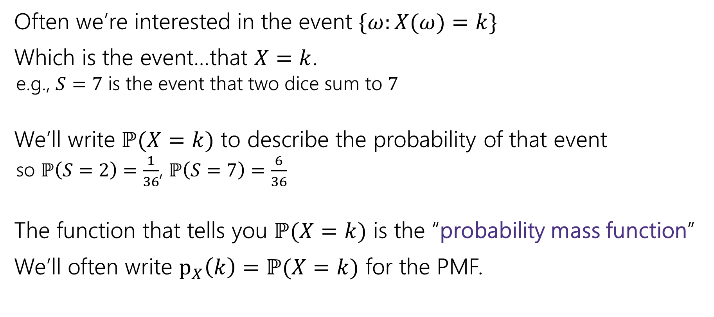

Probability Mass Function
⚠️A random variable $X$ is not an event.
But, $X=2$ is an event – it’s the event/set of outcomes where the random variable takes on the value $2$
Often we’re interested in the event $\{ω:X(ω)=k\}$
Which is the event…that $X=k$.
  e.g., $S=7$ is the event that two dice sum to $7$
We’ll write $ℙ(X=k)$ to describe the probability of that event
  so $ℙ\left(S=2\right)=\frac{1}{36}$, $ℙ\left(S=7\right)=\frac{6}{36}$
The function that tells you $ℙ(X=k)$ is the “probability mass function”
We’ll often write $p_{X}\left(k\right)=ℙ(X=k)$ for the PMF.

Slide 15


Probability Mass Function
Let $T$ be the number of 2’s rolling a (fair) red and blue die.
What is the range of $T$? $Ω_{T}=\{0,1,2\}$
What is the PMF of $T$?
$p_{T}\left(0\right)=25/36$, $p_{T}\left(1\right)=10/36$, $p_{T}\left(2\right)=1/36$
$$p_{T}\left(k\right)=\left\{\begin{aligned}25/36 k=0 \\ 10/36 k=1 \\ 1/36 k=2 \\ 0 otherwise\end{aligned}\right.$$
> Often use piecewise function to give probabilities for different values of k
> This is a function, so include otherwise case, so it is defined for all values

Slide 16
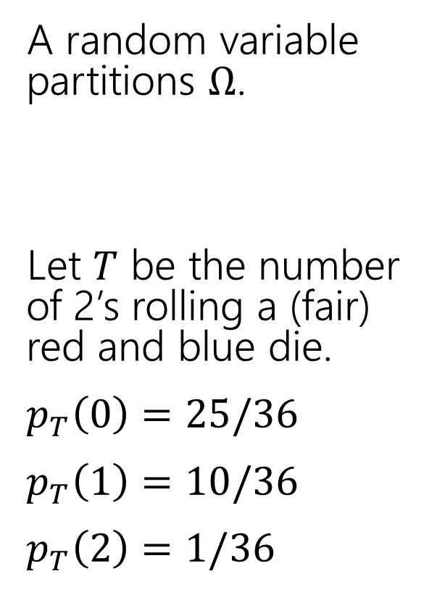
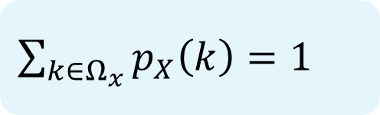
Partition
A random variable partitions $Ω$.
Let $T$ be the number of 2’s rolling a (fair) red and blue die.
$p_{T}\left(0\right)=25/36$
$p_{T}\left(1\right)=10/36$
$p_{T}\left(2\right)=1/36$
 | D2=1 | D2=2 | D2=3 | D2=4 | D2=5 | D2=6
D1=1 | (1,1) | (1,2) | (1,3) | (1,4) | (1,5) | (1.6)
D1=2 | (2,1) | (2,2) | (2,3) | (2,4) | (2,5) | (2,6)
D1=3 | (3,1) | (3,2) | (3,3) | (3,4) | (3,5) | (3,6)
D1=4 | (4,1) | (4,2) | (4,3) | (4,4) | (4,5) | (4,6)
D1=5 | (5,1) | (5,2) | (5,3) | (5,4) | (5,5) | (5,6)
D1=6 | (6,1) | (6,2) | (6,3) | (6,4) | (6,5) | (6,6)
$\sum_{k∈Ω_{x}}{p_{X}\left(k\right)=1}$

Slide 17
Partition
A random variable partitions $Ω$.
Let $T$ be the number of 2’s rolling a (fair) red and blue die.
$p_{T}\left(0\right)=25/36$
$p_{T}\left(1\right)=10/36$
$p_{T}\left(2\right)=1/36$
 | D2=1 | D2=2 | D2=3 | D2=4 | D2=5 | D2=6
D1=1 | (1,1) | (1,2) | (1,3) | (1,4) | (1,5) | (1.6)
D1=2 | (2,1) | (2,2) | (2,3) | (2,4) | (2,5) | (2,6)
D1=3 | (3,1) | (3,2) | (3,3) | (3,4) | (3,5) | (3,6)
D1=4 | (4,1) | (4,2) | (4,3) | (4,4) | (4,5) | (4,6)
D1=5 | (5,1) | (5,2) | (5,3) | (5,4) | (5,5) | (5,6)
D1=6 | (6,1) | (6,2) | (6,3) | (6,4) | (6,5) | (6,6)
$\sum_{k∈Ω_{x}}{p_{X}\left(k\right)=1}$

Slide 18
Partition
A random variable partitions $Ω$.
Let $T$ be the number of 2’s rolling a (fair) red and blue die.
$p_{T}\left(0\right)=25/36$
$p_{T}\left(1\right)=10/36$
$p_{T}\left(2\right)=1/36$
 | D2=1 | D2=2 | D2=3 | D2=4 | D2=5 | D2=6
D1=1 | (1,1) | (1,2) | (1,3) | (1,4) | (1,5) | (1.6)
D1=2 | (2,1) | (2,2) | (2,3) | (2,4) | (2,5) | (2,6)
D1=3 | (3,1) | (3,2) | (3,3) | (3,4) | (3,5) | (3,6)
D1=4 | (4,1) | (4,2) | (4,3) | (4,4) | (4,5) | (4,6)
D1=5 | (5,1) | (5,2) | (5,3) | (5,4) | (5,5) | (5,6)
D1=6 | (6,1) | (6,2) | (6,3) | (6,4) | (6,5) | (6,6)
$\sum_{k∈Ω_{x}}{p_{X}\left(k\right)=1}$

Slide 19
Partition
A random variable partitions $Ω$.
Let $T$ be the number of 2’s rolling a (fair) red and blue die.
$p_{T}\left(0\right)=25/36$
$p_{T}\left(1\right)=10/36$
$p_{T}\left(2\right)=1/36$
 | D2=1 | D2=2 | D2=3 | D2=4 | D2=5 | D2=6
D1=1 | (1,1) | (1,2) | (1,3) | (1,4) | (1,5) | (1.6)
D1=2 | (2,1) | (2,2) | (2,3) | (2,4) | (2,5) | (2,6)
D1=3 | (3,1) | (3,2) | (3,3) | (3,4) | (3,5) | (3,6)
D1=4 | (4,1) | (4,2) | (4,3) | (4,4) | (4,5) | (4,6)
D1=5 | (5,1) | (5,2) | (5,3) | (5,4) | (5,5) | (5,6)
D1=6 | (6,1) | (6,2) | (6,3) | (6,4) | (6,5) | (6,6)
$\sum_{k∈Ω_{x}}{p_{X}\left(k\right)=1}$

Slide 20
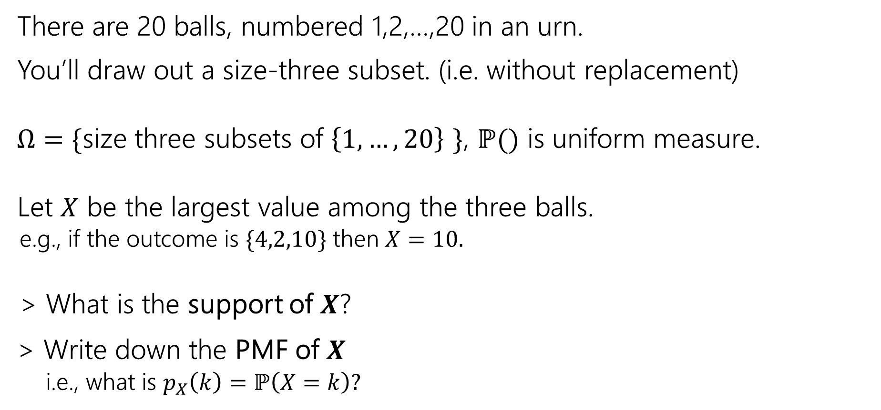
Try It Yourself
There are 20 balls, numbered 1,2,…,20 in an urn.
You’ll draw out a size-three subset. (i.e. without replacement)
$Ω=\{$size three subsets of $\left\{1,…,20\right\}$ $\}$, $ℙ()$ is uniform measure.
Let $X$ be the largest value among the three balls.
  e.g., if the outcome is $\{4,2,10\}$ then $X=10.$
  > What is the support of $X$?
> Write down the PMF of $X$
  i.e., what is $p_{X}\left(k\right)=ℙ\left(X=k\right)?$
Fill out the poll everywhere so Claris knows how long to explain
Go to pollev.com/cse312

Slide 21
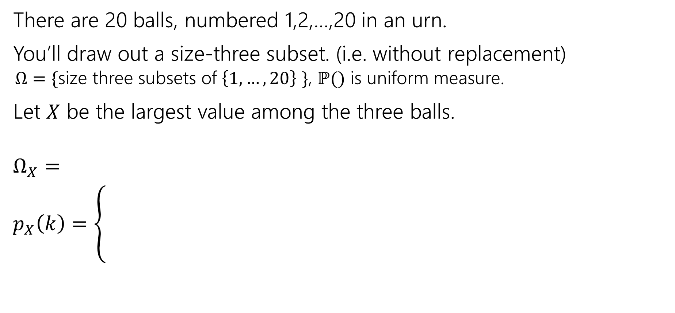
Try It Yourself
There are 20 balls, numbered 1,2,…,20 in an urn.
You’ll draw out a size-three subset. (i.e. without replacement)
  $Ω=\{$size three subsets of $\left\{1,…,20\right\}$ $\}$, $ℙ()$ is uniform measure.
Let $X$ be the largest value among the three balls.
$Ω_{X}=$
$p_{X}\left(k\right)=\left\{\begin{aligned} \\ \\ \end{aligned}\right.$

Slide 22
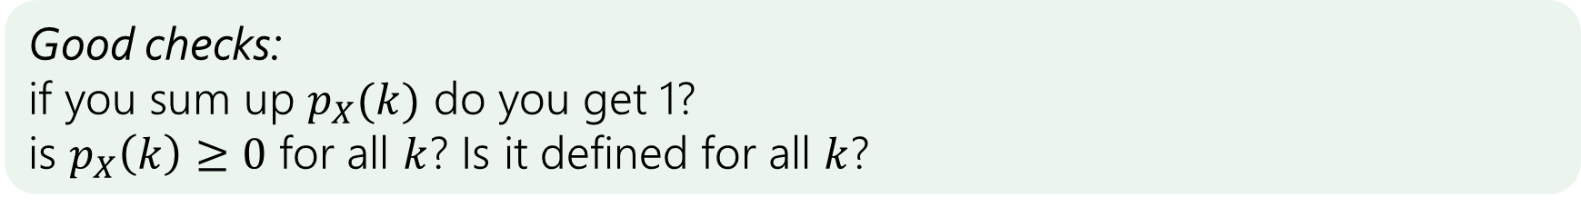
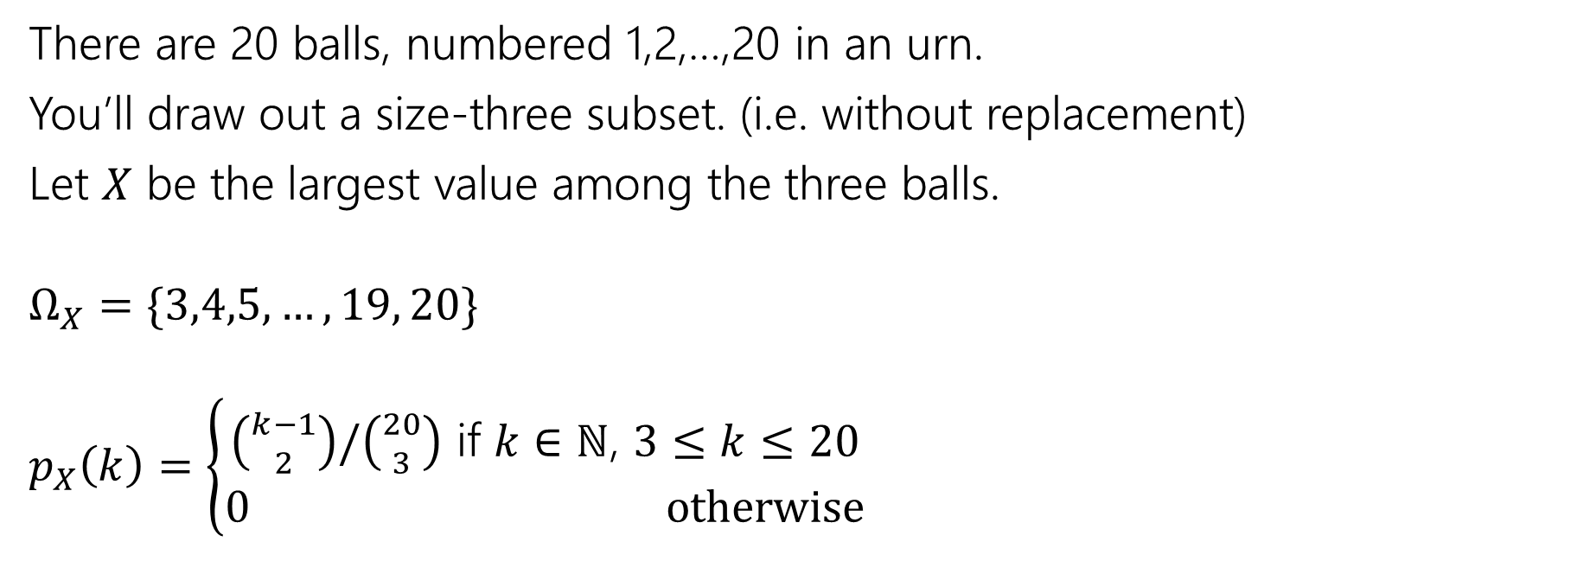
Try It Yourself
There are 20 balls, numbered 1,2,…,20 in an urn.
You’ll draw out a size-three subset. (i.e. without replacement)
Let $X$ be the largest value among the three balls.
$Ω_{X}=\{3,4,5,…,19, 20\}$
$p_{X}\left(k\right)=\left\{\begin{aligned}\left({k−1 \atop 2}\right)/\left({20 \atop 3}\right) \text{if} k∈ℕ\text{, }3≤k≤20 \\ 0 otherwise\end{aligned}\right.$
Good checks:
if you sum up $p_{X}(k)$ do you get 1?
is $p_{X}\left(k\right)≥0$ for all $k$? Is it defined for all $k$?

Slide 23
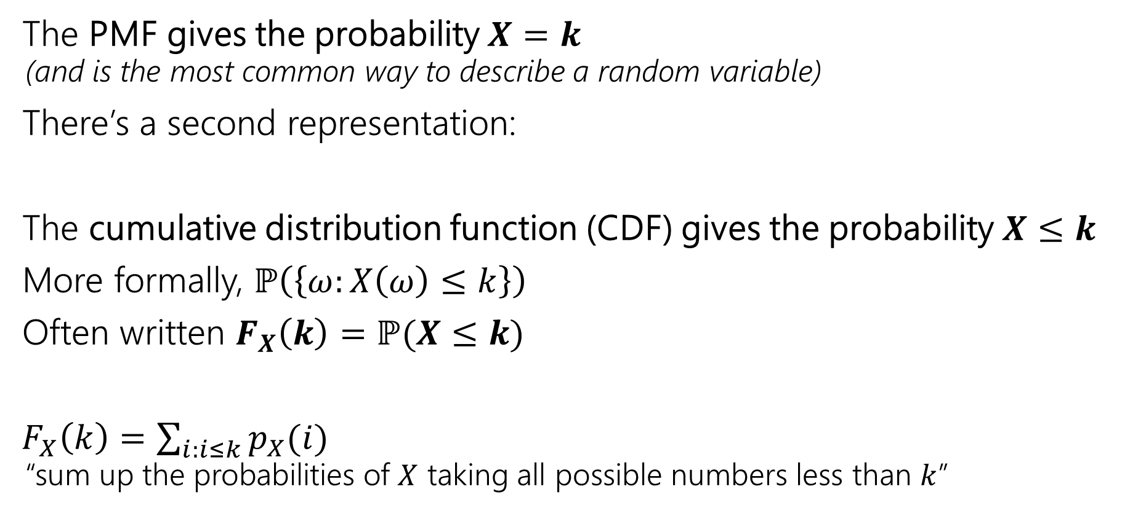
Cumulative Distribution Function (CDF)
The PMF gives the probability $X=k$
  (and is the most common way to describe a random variable)
There’s a second representation:
The cumulative distribution function (CDF) gives the probability $X≤k$
More formally, $ℙ\left(\left\{ω:X\left(ω\right)≤k\right\}\right)$
Often written $F_{X}\left(k\right)=ℙ(X≤k)$
$F_{X}\left(k\right)=\sum_{i:i≤k}{p_{X}(i)}$
  “sum up the probabilities of $X$ taking all possible numbers less than $k$”

Slide 24
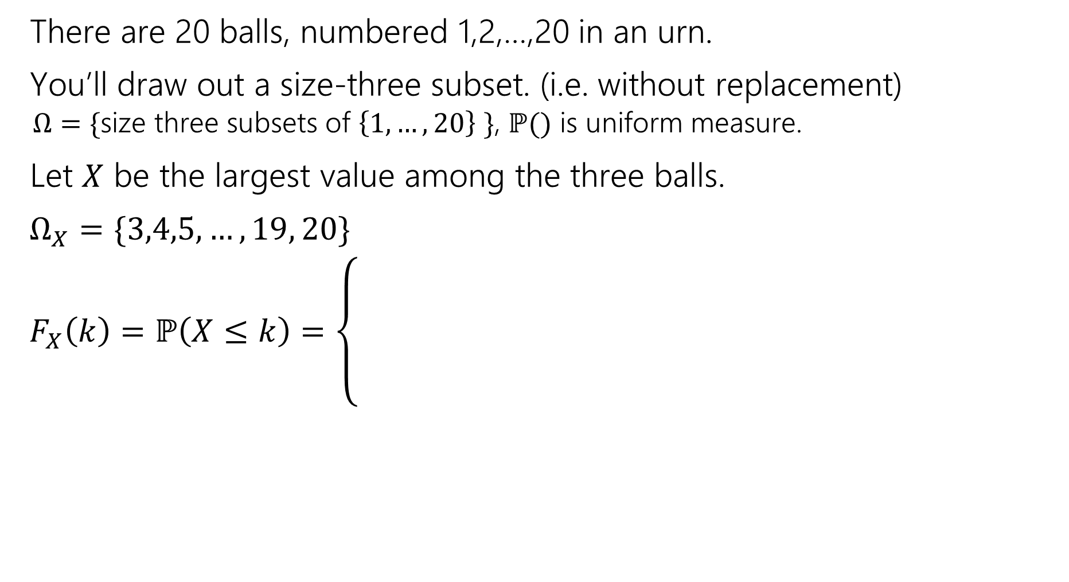
Try it yourself
There are 20 balls, numbered 1,2,…,20 in an urn.
You’ll draw out a size-three subset. (i.e. without replacement)
  $Ω=\{$size three subsets of $\left\{1,…,20\right\}$ $\}$, $ℙ()$ is uniform measure.
Let $X$ be the largest value among the three balls.
$Ω_{X}=\{3,4,5,…,19, 20\}$
$F_{X}\left(k\right)=ℙ\left(X≤k\right)=\left\{\begin{aligned} \\ \\ \\ \end{aligned}\right.$
Think “what is the probability the largest value is less than or equal to $10$?”

Slide 25
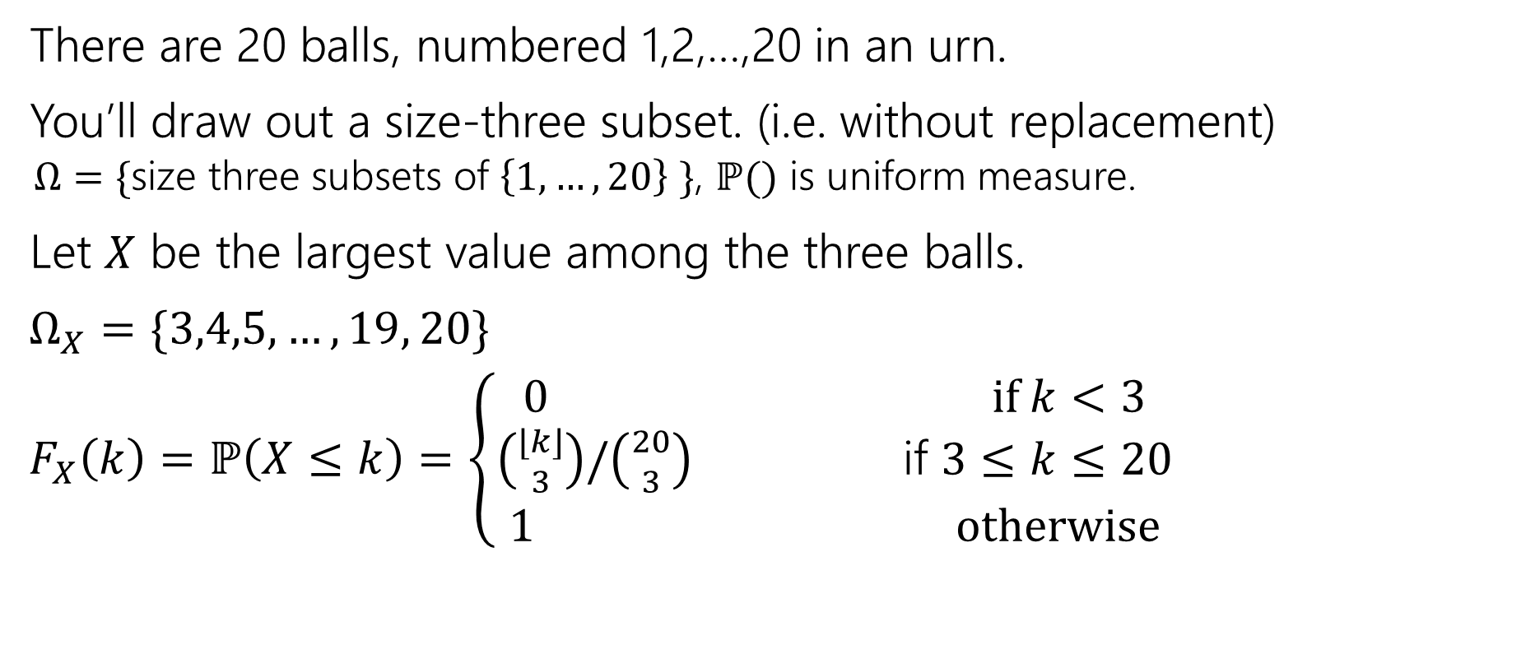
Try it yourself
There are 20 balls, numbered 1,2,…,20 in an urn.
You’ll draw out a size-three subset. (i.e. without replacement)
  $Ω=\{$size three subsets of $\left\{1,…,20\right\}$ $\}$, $ℙ()$ is uniform measure.
Let $X$ be the largest value among the three balls.
$Ω_{X}=\{3,4,5,…,19, 20\}$
$F_{X}\left(k\right)=ℙ\left(X≤k\right)=\left\{\begin{aligned}\begin{aligned}0 if k<3 \\ \left({⌊k⌋ \atop 3}\right)/\left({20 \atop 3}\right) \text{if} 3≤k≤20\end{aligned} \\ 1 otherwise\end{aligned}\right.$
Think “what is the probability the largest value is less than or equal to $k$?”

Slide 26
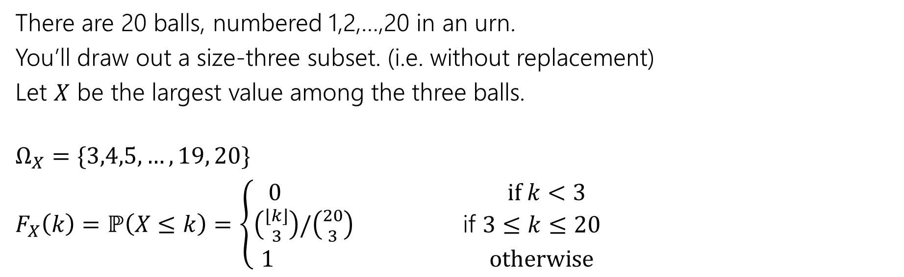
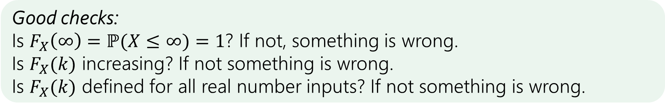
Try it yourself
There are 20 balls, numbered 1,2,…,20 in an urn.
You’ll draw out a size-three subset. (i.e. without replacement)
Let $X$ be the largest value among the three balls.
$Ω_{X}=\{3,4,5,…,19, 20\}$
$F_{X}\left(k\right)=ℙ\left(X≤k\right)=\left\{\begin{aligned}\begin{aligned}0 if k<3 \\ \left({⌊k⌋ \atop 3}\right)/\left({20 \atop 3}\right) \text{if} 3≤k≤20\end{aligned} \\ 1 otherwise\end{aligned}\right.$
Good checks:
Is $F_{X}\left(∞\right)=ℙ(X≤∞)=1$? If not, something is wrong.
Is $F_{X}(k)$ increasing? If not something is wrong.
Is $F_{X}(k)$ defined for all real number inputs? If not something is wrong.

Slide 27
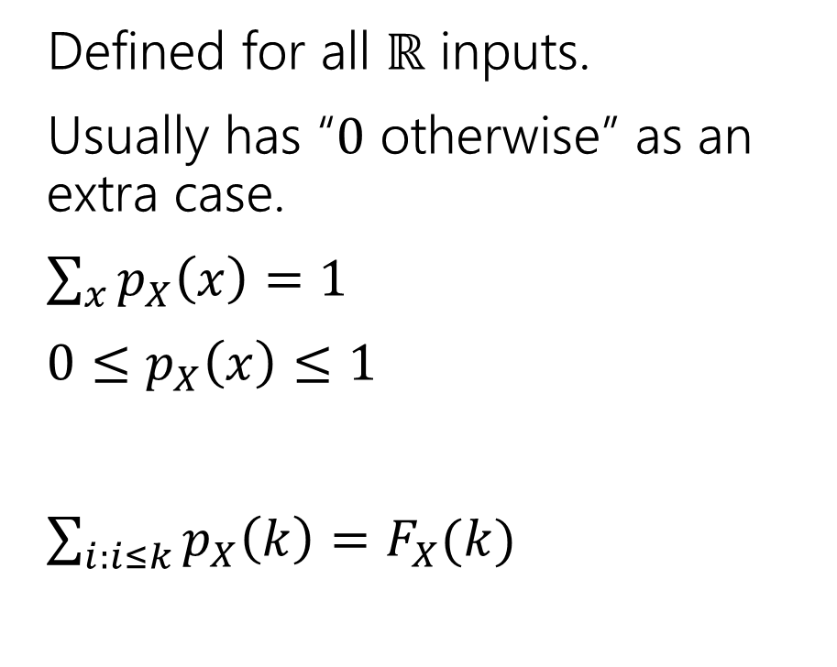
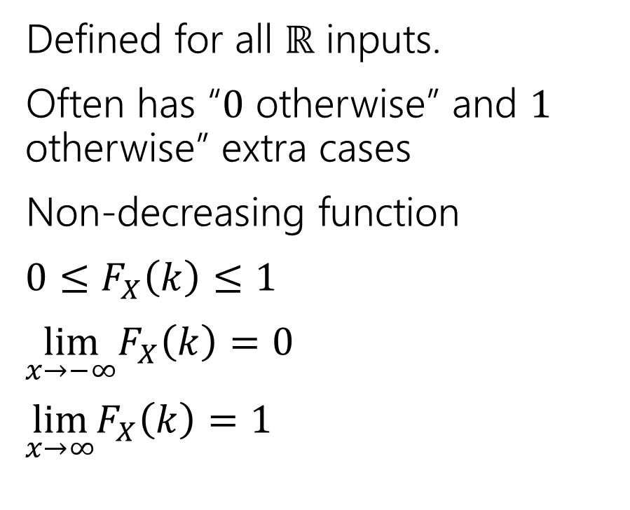
Summary (PMF and CDF)
Probability mass function
Cumulative Distribution function
Defined for all $ℝ$ inputs.
Usually has “$0$ otherwise” as an extra case.
$\sum_{x}{p_{X}\left(x\right)=1}$
$0≤p_{X}\left(x\right)≤1$
$\sum_{i:i≤k}{p_{X}\left(k\right)=F_{X}(k)}$
Defined for all $ℝ$ inputs.
Often has “$0$ otherwise” and $1$ otherwise” extra cases
Non-decreasing function
$0≤F_{X}\left(k\right)≤1$
$\lim_{x→−∞}F_{X}\left(k\right)=0$
$\lim_{x→∞}F_{X}\left(k\right)=1⁡$

Slide 28
Expectation

Slide 29
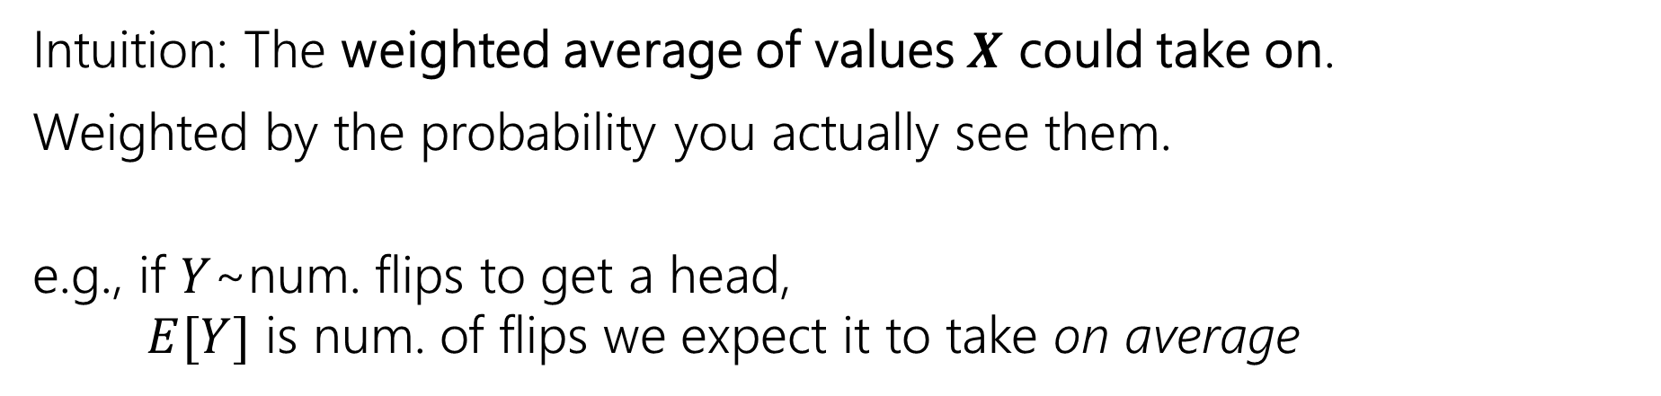

Expectation
The “expectation” (or “expected value”) of a random variable $X$ is:
$$𝔼\left[X\right]=\sum_{k∈Ω_{X}}{k⋅ℙ(X=k)}$$
Expectation
Intuition: The weighted average of values $X$ could take on.
Weighted by the probability you actually see them.
e.g., if $Y$~num. flips to get a head,
$E[Y]$ is num. of flips we expect it to take on average

Slide 30

Example 1
Flip a fair coin twice (independently).
What is the expected number of heads we see?
Let $X$be the number of heads.

Slide 31
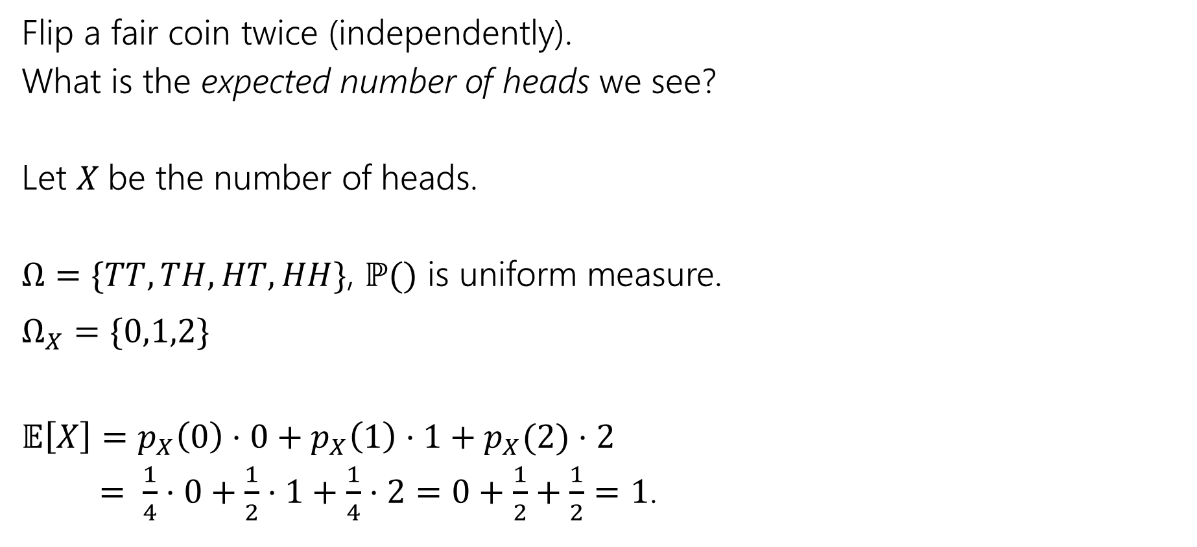
Example 1
Flip a fair coin twice (independently).
What is the expected number of heads we see?
Let $X$be the number of heads.
$Ω=\{TT,TH,HT,HH\}$, $ℙ()$ is uniform measure.
$Ω_{X}=\{0,1,2\}$
$𝔼\left[X\right]=p_{X}\left(0\right)⋅0+p_{X}\left(1\right)⋅1+p_{X}(2)⋅2$
$= \frac{1}{4}⋅0+\frac{1}{2}⋅1+\frac{1}{4}⋅2=0+\frac{1}{2}+\frac{1}{2}=1$.

Slide 32
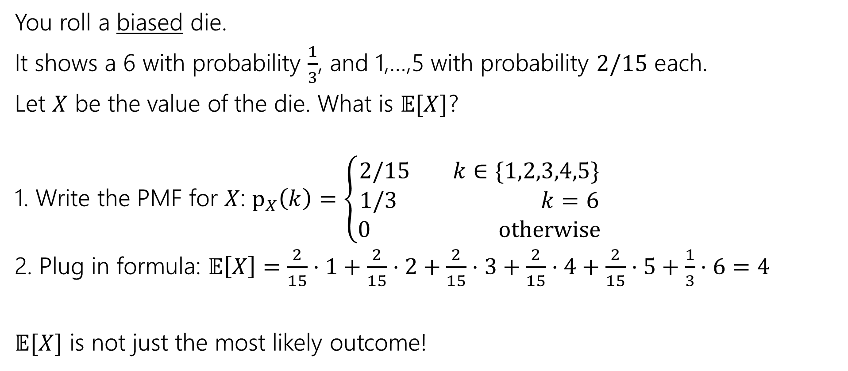
Example 2
You roll a biased die.
It shows a 6 with probability $\frac{1}{3}$, and 1,…,5 with probability $2/15$ each.
Let $X$ be the value of the die. What is $𝔼[X]$?
1. Write the PMF for $X$: $p_{X}\left(k\right)=\left\{\begin{aligned}2/15 k∈\{1,2,3,4,5\} \\ 1/3 k=6 \\ 0 otherwise\end{aligned}\right.$
2. Plug in formula: $𝔼\left[X\right]=\frac{2}{15}⋅1+\frac{2}{15}⋅2+\frac{2}{15}⋅3+\frac{2}{15}⋅4+\frac{2}{15}⋅5+\frac{1}{3}⋅6=4$
$𝔼[X]$ is not just the most likely outcome!

Slide 33

Try it yourself
> Let $X$ be the result shown on a fair die. What is $𝔼[X]$?
> Let $Y$ be the sum of two (independent) fair die rolls. What is $𝔼[Y]$?
Fill out the poll everywhere so Claris knows how long to explain
Go to pollev.com/cse312

Slide 34
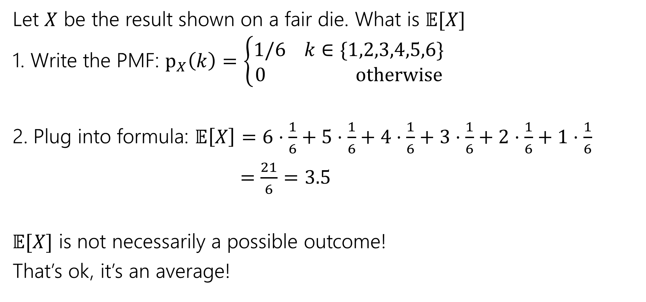
Try it yourself
Let $X$ be the result shown on a fair die. What is $𝔼[X]$
1. Write the PMF: $p_{X}\left(k\right)=\left\{\begin{aligned}1/6 k∈\{1,2,3,4,5,6\} \\ 0 otherwise\end{aligned}\right.$
2. Plug into formula: $𝔼\left[X\right]=6⋅\frac{1}{6}+5⋅\frac{1}{6}+4⋅\frac{1}{6}+3⋅\frac{1}{6}+2⋅\frac{1}{6}+1⋅\frac{1}{6}$
$=\frac{21}{6}=3.5$
$𝔼[X]$ is not necessarily a possible outcome!
That’s ok, it’s an average!

Slide 35
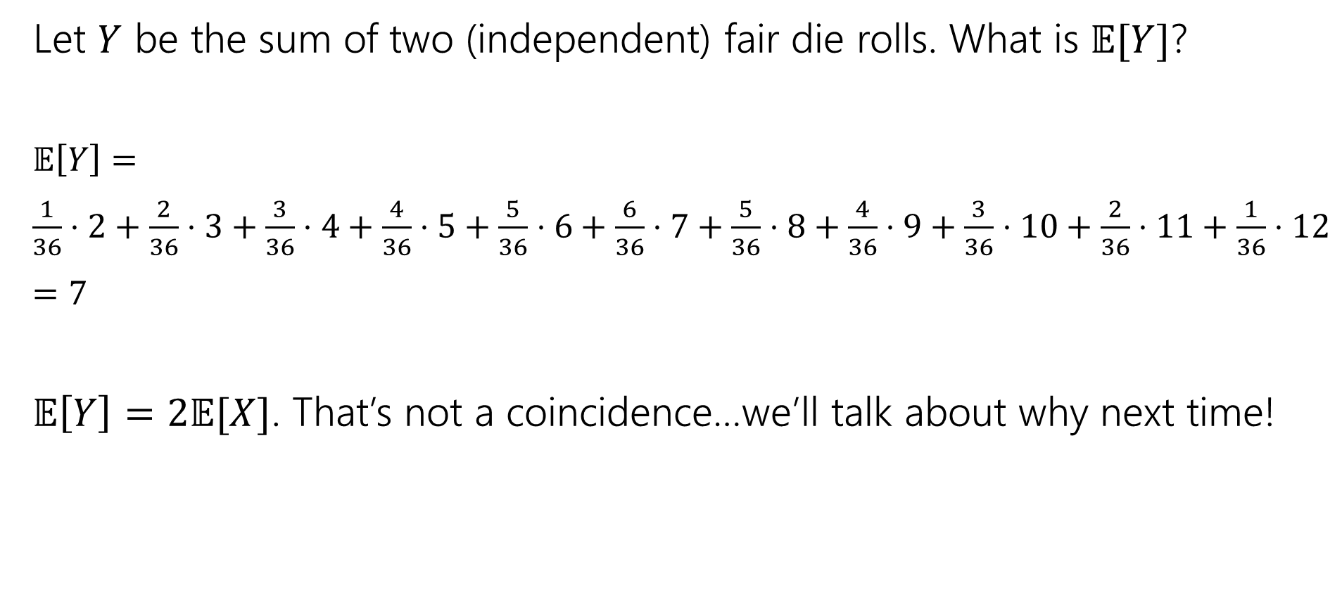
Try it yourself
Let $Y$ be the sum of two (independent) fair die rolls. What is $𝔼[Y]$?
$𝔼\left[Y\right]=$
$\frac{1}{36}⋅2+\frac{2}{36}⋅3+\frac{3}{36}⋅4+\frac{4}{36}⋅5+\frac{5}{36}⋅6+\frac{6}{36}⋅7+\frac{5}{36}⋅8+\frac{4}{36}⋅9+\frac{3}{36}⋅10+\frac{2}{36}⋅11+\frac{1}{36}⋅12$
$=7$
$𝔼\left[Y\right]=2𝔼[X]$. That’s not a coincidence…we’ll talk about why next time!

Slide 36

Subtle but Important
$X$ is random. You don’t know what it is (at least until you run the experiment).
$𝔼[X]$ is not random. It’s a number.
You don’t need to run the experiment to know what it is.

Slide 37
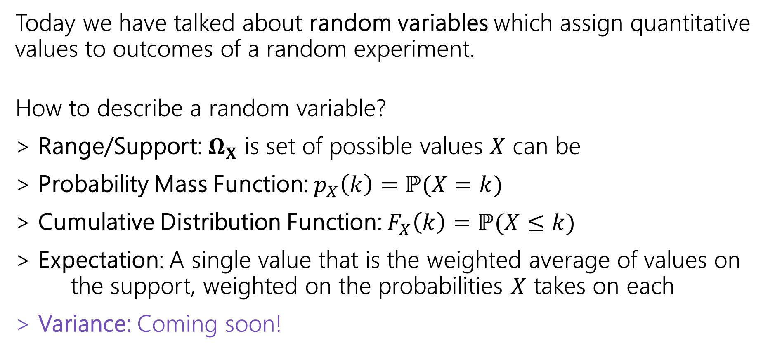
Summary
Today we have talked about random variables which assign quantitative values to outcomes of a random experiment.
How to describe a random variable?
> Range/Support: $Ω_{X}$ is set of possible values $X$ can be
> Probability Mass Function: $p_{X}\left(k\right)=ℙ(X=k)$
> Cumulative Distribution Function: $F_{X}\left(k\right)=ℙ(X≤k)$
> Expectation: A single value that is the weighted average of values on the support, weighted on the probabilities $X$ takes on each
> Variance: Coming soon!

Slide 38
More Practice: Infinite sequential processes

Slide 39
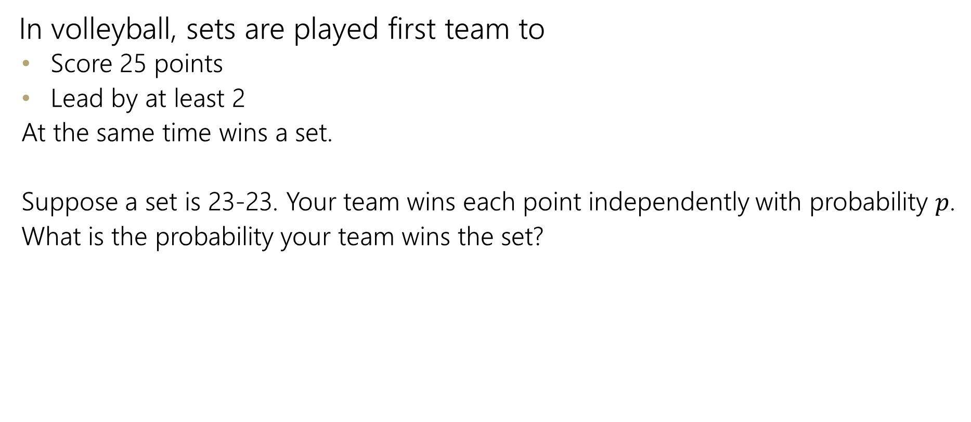
Infinite sequential process
In volleyball, sets are played first team to
  Score 25 points
  Lead by at least 2
  At the same time wins a set.
  Suppose a set is 23-23. Your team wins each point independently with probability $p$.
  What is the probability your team wins the set?

Slide 40
Sequential Process
0
$$ℙ\left(win from even\right)=p^{2}+2p\left(1−p\right)ℙ(win from even)$$
+
-
W
0
L
+
-
W
0
L
+
-
…

Slide 41
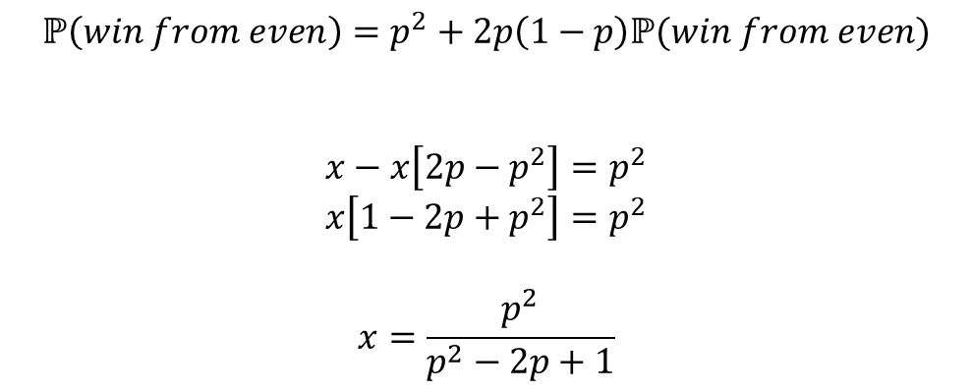
Sequential Process
0
$$ℙ\left(win from even\right)=p^{2}+2p\left(1−p\right)ℙ(win from even)$$
$$x−x\left[2p−p^{2}\right]=p^{2}$$
$$x\left[1−2p+p^{2}\right]=p^{2}$$
$$x=\frac{p^{2}}{p^{2}−2p+1}$$
+
-
W
0
L
+
-
W
0
L
+
-
…

Slide 42

More Random Variable Practice
Roll a fair die $n$ times. Let $Z$ be the number of rolls that are $5s$ or $6s$.
What is the pmf?
Don’t try to write the CDF…it’s a mess…
Or try for a few minutes to realize it isn’t nice.

Slide 43
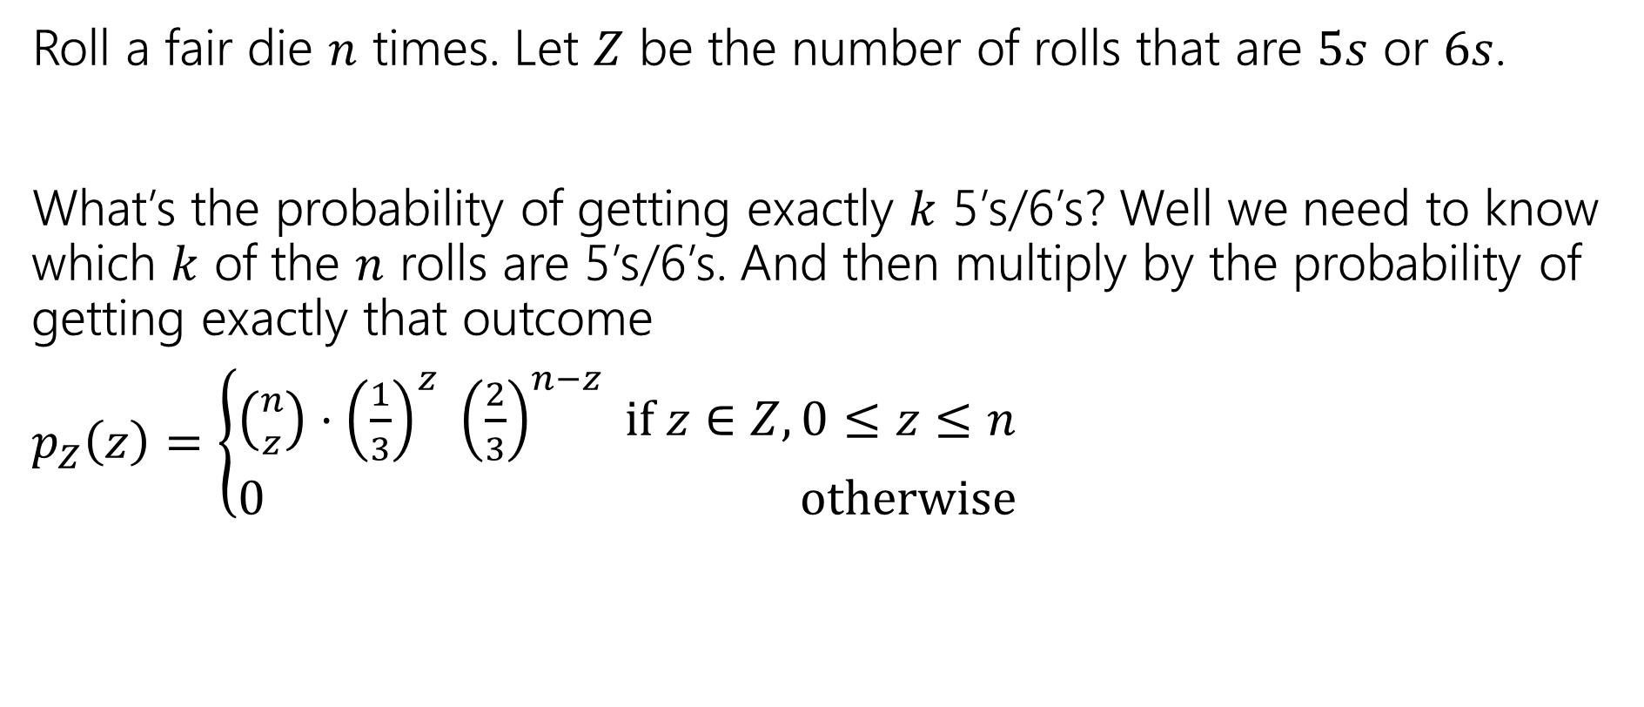
More Random Variable Practice
Roll a fair die $n$ times. Let $Z$ be the number of rolls that are $5s$ or $6s$.
What’s the probability of getting exactly $k$ 5’s/6’s? Well we need to know which $k$ of the $n$ rolls are 5’s/6’s. And then multiply by the probability of getting exactly that outcome
$p_{Z}\left(z\right)=\left\{\begin{aligned}\left({n \atop z}\right)⋅{\left(\frac{1}{3}\right)}^{z} {\left(\frac{2}{3}\right)}^{n−z} if z∈Z,0≤z≤n \\ 0 otherwise\end{aligned}\right.$

