Slide 1
Zoo of Continuous Random Variables
etherpad.wikimedia.org/p/312 for (anonymous) questions/comments!
CSE 312 24Su
Lecture 14

Slide 2
Outline for Today
Review concepts for continuous random variables
Zoo of continuous random variables 🐻
Continuous uniform distribution
Exponential distribution
Normal distribution

Slide 3
Discrete Random Variables
The support has finite or countably infinite values
e.g., number of successes, number of trials till success, attendance at a class are all discrete because they take on a set of finite or countably infinite values
Continuous Random Variables
Random variables with a support of uncountably-infinite values
> e.g., RVs that take on any real number in some interval(s) like distance, height, time, etc.
Some random experiments have uncountably-infinite sample spaces
> How long until the next bus shows up?
> Throwing a dart on a board (what location does the dart land?)
Notes:
Random variables describe quantitative properties of outcomes in a random experiment.
Up till now, we’ve been working with discrete random variables. Thse are random variables that have a support with finite or countably finite values. That could include things like integers… if I asked you what are the values the random variable can take on between 0 and 10. we can list out those specific values.. Examples of this are numbers of successes, attendance in a class, trials till success… discrete random variables…
sometimes, we’re dealing with random experiments, where there is an uncountably infinite sample space. the quantitative properties we’re interested in are continuous. The possible values of these quantitative
Sometimes we’re dealing with random experiments that have uncountably infinite sample spaces. We can’t list out the specific possible outcomes that could occur. For example, if we’re waiting for the next bus, we really can’t ilst out all the possible options for when that bus shows up. It could sho up at 12pm, 12pm and 1 section.. 1.5 seconds. Etc.similarly, if we throw a dart on a board. It could land here or here… anywhere! There are infinite possible and listing them out in some order is impossible.
Because these random experiments have uncountably infinite sample spaces, the quantitative properties or the random variables that we use to describe outcomes in this sample space are usually going to have a support of uncountably infinite values. We call these random variables that have a support of unc… continuous random variables. Uncountabl… standard example is real numbers. For example, …
So in discrete random variables if we’re asked ot list out the values X could take on between 0 and 5, we could list those out, maybe it’s 0,1,2,3,4,5. but in conntinous, we can’t list it out. There’s infinite values in that range – 0, 0.1, 0.001, 0.000001. 0.012.. Infintie. Vlaues.
Small note, random experiments could have both discrete and continuous random variables that we could defin. For example, we could define a discrete rv that saying whether or not the dart hits the target….or we could …both are looking at the same random experiment looking at different quantitiave properties..
Any question about what the difference between these two is.
Ok! So to work with these continuos random variables, work with these continuous probability spaces. I want to first convince you that we’re going to need to use some new techniques.

Slide 4
Discrete RVs
Continuous RVs

Slide 5
Discrete RVs
Continuous RVs
Support is finite/countably infinite (e.g. integers)
Support is uncountably infinite (e.g., real numbers)

Slide 6
Discrete RVs
Continuous RVs
Support is finite/countably infinite (e.g. integers)
Support is uncountably infinite (e.g., real numbers)
$ℙ\left(X=k\right)=\frac{1}{∞}=0$ so we don’t use PMF. instead...

Slide 7
Discrete RVs
Continuous RVs
Support is finite/countably infinite (e.g. integers)
Probability mass function $p_{X}\left(k\right)$ gives probability of each value in support
Support is uncountably infinite (e.g., real numbers)
$ℙ\left(X=k\right)=\frac{1}{∞}=0$ so we don’t use PMF. instead...
Probability density function $f_{X}(k)$ describes relative chances of taking values around $k$
$$\sum_{k∈Ω_{X}}{p_{X}(k)}=1$$
$$0≤p_{X}\left(k\right)≤1$$
$$\int_{−∞}^{∞}{f_{X}(k)} dk=1$$
$$f_{X}\left(k\right)≥0$$

Slide 8
Discrete RVs
Continuous RVs
Support is finite/countably infinite (e.g. integers)
Probability mass function $p_{X}\left(k\right)$ gives probability of each value in support
Support is uncountably infinite (e.g., real numbers)
$ℙ\left(X=k\right)=\frac{1}{∞}=0$ so we don’t use PMF. instead...
Probability density function $f_{X}(k)$ describes relative chances of taking values around $k$
$$\sum_{k∈Ω_{X}}{p_{X}(k)}=1$$
$$0≤p_{X}\left(k\right)≤1$$
$$\int_{−∞}^{∞}{f_{X}(k)} dk=1$$
$$f_{X}\left(k\right)≥0$$
Cumulative Distribution Function (CDF) is the function $F_{X}\left(k\right)=ℙ(X≤k)$

Slide 9
Discrete RVs
Continuous RVs
Support is finite/countably infinite (e.g. integers)
Probability mass function $p_{X}\left(k\right)$ gives probability of each value in support
Support is uncountably infinite (e.g., real numbers)
$ℙ\left(X=k\right)=\frac{1}{∞}=0$ so we don’t use PMF. instead...
Probability density function $f_{X}(k)$ describes relative chances of taking values around $k$
$$\sum_{k∈Ω_{X}}{p_{X}(k)}=1$$
$$0≤p_{X}\left(k\right)≤1$$
$$\int_{−∞}^{∞}{f_{X}(k)} dk=1$$
$$f_{X}\left(k\right)≥0$$
Cumulative Distribution Function (CDF) is the function $F_{X}\left(k\right)=ℙ(X≤k)$
Sum up the probabilities of values $≤k$
Integrate over values $≤k$: $F_{X}\left(k\right)=\int_{−∞}^{k}{f_{X}\left(z\right)dz}$

Slide 10
Discrete RVs
Continuous RVs
Support is finite/countably infinite (e.g. integers)
Probability mass function $p_{X}\left(k\right)$ gives probability of each value in support
Expectation: $𝔼\left[X\right]=\sum_{k∈Ω_{X}}{(k⋅p_{X}\left(k\right))}$
$𝔼\left[g(X)\right]=\sum_{k∈Ω_{X}}{(g(k)⋅p_{X}\left(k\right))}$
Support is uncountably infinite (e.g., real numbers)
$ℙ\left(X=k\right)=\frac{1}{∞}=0$ so we don’t use PMF. instead...
Probability density function $f_{X}(k)$ describes relative chances of taking values around $k$
Expectation: $𝔼\left[X\right]=\int_{−∞}^{∞}{z⋅f_{X}\left(z\right) dz}$
$𝔼\left[g(X)\right]=\int_{−∞}^{∞}{g(z)⋅f_{X}\left(z\right) dz}$
$$\sum_{k∈Ω_{X}}{p_{X}(k)}=1$$
$$0≤p_{X}\left(k\right)≤1$$
$$\int_{−∞}^{∞}{f_{X}(k)} dk=1$$
$$f_{X}\left(k\right)≥0$$
Cumulative Distribution Function (CDF) is the function $F_{X}\left(k\right)=ℙ(X≤k)$
Sum up the probabilities of values $≤k$
Integrate over values $≤k$: $F_{X}\left(k\right)=\int_{−∞}^{k}{f_{X}\left(z\right)dz}$

Slide 11
Discrete RVs
Continuous RVs
Support is finite/countably infinite (e.g. integers)
Probability mass function $p_{X}\left(k\right)$ gives probability of each value in support
Expectation: $𝔼\left[X\right]=\sum_{k∈Ω_{X}}{(k⋅p_{X}\left(k\right))}$
$𝔼\left[g(X)\right]=\sum_{k∈Ω_{X}}{(g(k)⋅p_{X}\left(k\right))}$
Support is uncountably infinite (e.g., real numbers)
$ℙ\left(X=k\right)=\frac{1}{∞}=0$ so we don’t use PMF. instead...
Probability density function $f_{X}(k)$ describes relative chances of taking values around $k$
Expectation: $𝔼\left[X\right]=\int_{−∞}^{∞}{z⋅f_{X}\left(z\right) dz}$
$𝔼\left[g(X)\right]=\int_{−∞}^{∞}{g(z)⋅f_{X}\left(z\right) dz}$
$$\sum_{k∈Ω_{X}}{p_{X}(k)}=1$$
$$0≤p_{X}\left(k\right)≤1$$
$$\int_{−∞}^{∞}{f_{X}(k)} dk=1$$
$$f_{X}\left(k\right)≥0$$
Cumulative Distribution Function (CDF) is the function $F_{X}\left(k\right)=ℙ(X≤k)$
Sum up the probabilities of values $≤k$
Integrate over values $≤k$: $F_{X}\left(k\right)=\int_{−∞}^{k}{f_{X}\left(z\right)dz}$
Variance is $Var\left(X\right)=𝔼\left[X^{2}\right]−{\left(𝔼\left[X\right]\right)}^{2}$

Slide 12
Discrete RVs
Continuous RVs
Support is finite/countably infinite (e.g. integers)
Probability mass function $p_{X}\left(k\right)$ gives probability of each value in support
Expectation: $𝔼\left[X\right]=\sum_{k∈Ω_{X}}{(k⋅p_{X}\left(k\right))}$
$𝔼\left[g(X)\right]=\sum_{k∈Ω_{X}}{(g(k)⋅p_{X}\left(k\right))}$
Support is uncountably infinite (e.g., real numbers)
$ℙ\left(X=k\right)=\frac{1}{∞}=0$ so we don’t use PMF. instead...
Probability density function $f_{X}(k)$ describes relative chances of taking values around $k$
Expectation: $𝔼\left[X\right]=\int_{−∞}^{∞}{z⋅f_{X}\left(z\right) dz}$
$𝔼\left[g(X)\right]=\int_{−∞}^{∞}{g(z)⋅f_{X}\left(z\right) dz}$
$$\sum_{k∈Ω_{X}}{p_{X}(k)}=1$$
$$0≤p_{X}\left(k\right)≤1$$
$$\int_{−∞}^{∞}{f_{X}(k)} dk=1$$
$$f_{X}\left(k\right)≥0$$
Cumulative Distribution Function (CDF) is the function $F_{X}\left(k\right)=ℙ(X≤k)$
Sum up the probabilities of values $≤k$
Integrate over values $≤k$: $F_{X}\left(k\right)=\int_{−∞}^{k}{f_{X}\left(z\right)dz}$
Variance is $Var\left(X\right)=𝔼\left[X^{2}\right]−{\left(𝔼\left[X\right]\right)}^{2}$
Linearity of expectation and properties of expectation and variance applies in both!

Slide 13
Zoo of Continuous Random variables
and get practice with working with continuous random variables!
Notes:
So for continuous random variables, we’re going to try to do things as similarly to the discrete random variables. The first thing we’re going to talk about is probability density function. Abbreviated as the pdf.. We’re going to s

Slide 14
Continuous Zoo
This zoo defines common patterns for continuous random variables and gives us the PDF, CDF, expectation, and variance, so we don’t have to compute it every time!
$$X\sim Unif(a,b)$$
$$X\sim Exp(λ)$$
$$X\sim 𝒩(μ,σ^{2})$$
$f_{X}\left(k\right)=\frac{1}{b−a}$ for $a≤k≤b$
$F_{X}\left(k\right)=\frac{x−a}{b−a}$ if $a≤k<b$
$$𝔼\left[X\right]=\frac{a+b}{2}$$
$$Var\left(X\right)=\frac{{\left(b−a\right)}^{2}}{12}$$
$f_{X}\left(k\right)=λe^{−λk}$ for $k≥0$
$F_{X}\left(k\right)=1−e^{−λk}$ if $k≥0$
$$𝔼\left[X\right]=\frac{1}{λ}$$
$$Var\left(X\right)=\frac{1}{λ^{2}}$$
$$f_{X}\left(k\right)=\frac{1}{σ\sqrt{2π}}exp\left(−\frac{{\left(x−μ\right)}^{2}}{2σ^{2}}\right)$$
$F_{X}\left(k\right)=Φ\left(\frac{k−μ}{σ}\right)$
$$𝔼\left[X\right]=μ$$
$$Var\left(X\right)=σ^{2}$$
It’s a smaller zoo, but it’s just as much fun! :D

Slide 15
Continuous Uniform Distribution
Scenario: Pick a random real number between $a$ and $b$. $X$ is our choice. > $X$ is a uniform random real number between $a$ and $b$ -> $X∼Unif(a,b)$
We saw the discrete uniform distribution before – it took on an integer between $a$ and $b$
This is the continuous uniform distribution – it takes on a real number between $a$ and $b$

Slide 16
Continuous Uniform Distribution - PDF
> $X$ is a uniform random real number between $a$ and $b$ -> $X∼Unif\left(a,b\right)$
What is the PDF, $f_{X}\left(k\right)$?
Draw a picture and think about the properties the PDF must have!
$$f_{X}(k)$$
Fill out the poll everywhere: pollev.com/cse312
$$a$$
$$b$$
$$k$$

Slide 17
Continuous Uniform Distribution - PDF
> $X$ is a uniform random real number between $a$ and $b$ -> $X∼Unif\left(a,b\right)$
What is the PDF, $f_{X}\left(k\right)$?
Draw a picture and think about the properties the PDF must have!
$$b−a$$
$$f_{X}(k)$$
$$1/(b−a)$$
For the area of this rectangle to be 1, the height must be $\frac{1}{b−a}$
$$f_{X}\left(k\right)=\left\{\begin{aligned}\frac{1}{b−a} if a≤k≤b \\ 0 otherwise\end{aligned}\right.$$
$$a$$
$$b$$
$$k$$
The area under a PDF must be 1. $\int_{−∞}^{∞}{f_{X}\left(z\right)ⅆz}=1$

Slide 18
Continuous Uniform Distribution – CDF(Visual)
> $X$ is a uniform random real number between $a$ and $b$ -> $X∼Unif\left(a,b\right)$
What is the CDF, $F_{X}\left(k\right)$? Let’s compute this “visually”….
$$b−a$$
$$f_{X}(z)$$
$$F_{X}\left(k\right)=\left\{ \begin{aligned} \\ \\ \\ \\ \end{aligned}\right.$$
$$1/(b−a)$$
$\frac{1}{b−a}$
$$a$$
$$k$$
$$b$$
$$z$$

Slide 19
Continuous Uniform Distribution – CDF(Visual)
> $X$ is a uniform random real number between $a$ and $b$ -> $X∼Unif\left(a,b\right)$
What is the CDF, $F_{X}\left(k\right)$? Let’s compute this “visually”….
$F_{X}\left(k\right)=P(X≤k)$ is the area of the green region below: $\frac{k−a}{b−a}$ if $a≤k<b$
$$b−a$$
$$f_{X}(z)$$
$$F_{X}\left(k\right)=\left\{\begin{aligned} \\ \\ \frac{k−a}{b−a} if a≤k≤b \\ \\ \end{aligned}\right.$$
$$1/(b−a)$$
$\frac{1}{b−a}$
$$a$$
$$k$$
$$b$$
$$z$$

Slide 20
Continuous Uniform Distribution – CDF(Visual)
> $X$ is a uniform random real number between $a$ and $b$ -> $X∼Unif\left(a,b\right)$
What is the CDF, $F_{X}\left(k\right)$? Let’s compute this “visually”….
$F_{X}\left(k\right)=P(X≤k)$ is the area of the green region below: $\frac{k−a}{b−a}$ if $a≤k<b$
$$b−a$$
$$f_{X}(z)$$
$$F_{X}\left(k\right)=\left\{\begin{aligned} \\ 0 if k<a \\ \frac{k−a}{b−a} if a≤k≤b \\ \\ \end{aligned}\right.$$
$$1/(b−a)$$
$\frac{1}{b−a}$
$$k$$
$$a$$
$$b$$
$$z$$

Slide 21
Continuous Uniform Distribution – CDF(Visual)
> $X$ is a uniform random real number between $a$ and $b$ -> $X∼Unif\left(a,b\right)$
What is the CDF, $F_{X}\left(k\right)$? Let’s compute this “visually”….
$F_{X}\left(k\right)=P(X≤k)$ is the area of the green region below: $\frac{k−a}{b−a}$ if $a≤k<b$
$$b−a$$
$$f_{X}(z)$$
$$F_{X}\left(k\right)=\left\{\begin{aligned} \\ 0 if k<a \\ \frac{k−a}{b−a} if a≤k≤b \\ \\ 1 if k≥b\end{aligned}\right.$$
$$1/(b−a)$$
$\frac{1}{b−a}$
$$a$$
$$b$$
$$k$$
$$z$$

Slide 22
Continuous Uniform Distribution – CDF(Integral)
> $X$ is a uniform random real number between $a$ and $b$ -> $X∼Unif\left(a,b\right)$
What is the CDF, $F_{X}\left(k\right)$? Let’s compute this “algebraically”….
The CDF is: $F_{X}\left(k\right)= \int_{−∞}^{k}{f_{X}\left(z\right)dz}$
We can compute this for the ranges based on what $k$ is and what $f_{X}\left(z\right)$ is for the values of $z$ less than $k$
Case when $k≤a$: $F_{X}\left(k\right)= \int_{−∞}^{k}{f_{X}\left(z\right)dz}=\int_{−∞}^{k}{0 dz=0}$
Case when $a≤k≤b$: $F_{X}\left(k\right)= \int_{−∞}^{k}{f_{X}\left(z\right)dz}$ = $\int_{−∞}^{a}{0 dz}+\int_{a}^{k}{\frac{1}{b−a}dz}=\frac{k−a}{b−a}$
Case when $k>b$: $F_{X}\left(k\right)= \int_{−∞}^{k}{f_{X}\left(z\right)dz}$ = $\int_{a}^{b}{\frac{1}{b−a}dz}+\int_{b}^{k}{ 0dz}=1$
$$F_{X}\left(k\right)=\left\{\begin{aligned} \\ 0 if k<a \\ \frac{k−a}{b−a} if a≤k≤b \\ \\ 1 if k≥b\end{aligned}\right.$$

Slide 23
Continuous Uniform Distribution – Expectation
> $X$ is a uniform random real number between $a$ and $b$ -> $X∼Unif\left(a,b\right)$
Using the formula for expectation….
$𝔼\left[X\right]=\int_{−∞}^{∞}{z⋅f_{X}\left(z\right) dz}$
$=\int_{−∞}^{a}{z⋅0 dz}+\int_{a}^{b}{z⋅\frac{1}{b−a}dz}+\int_{b}^{∞}{z⋅0}dz$
$=0+\int_{a}^{b}{\frac{z}{b−a} dz+0}$
$={{\left.\frac{z^{2}}{2(b−a)}\right|}^{b}}_{z=a}=\frac{b^{2}}{2(b−a)}−\frac{a^{2}}{2\left(b−a\right)}=\frac{b^{2}−a^{2}}{2\left(b−a\right)}=\frac{\left(b+a\right)\left(b−a\right)}{2\left(b−a\right)}$
$=\frac{a+b}{2}$
$$f_{X}(z)$$
$$1/(b−a)$$
$$a$$
$$b$$
Notes:
This is the formula fore xpectaion. The value of this PDF dependes on what the value of z… because the pdf if positive if z is in this range and 0 otherwise… so, we’re going to break up this integral.. This first part is summing over the values of z in this range…. (highlight)
Note we’re taking this integral with respect to z. these are just constanct… we’re going to end up with this expression.. Remember we’re evaluating this integral from a to b.

Slide 24
Continuous Uniform Distribution – Variance
> $X$ is a uniform random real number between $a$ and $b$ -> $X∼Unif\left(a,b\right)$
$Var\left(X\right)=𝔼\left[X^{2}\right]−(𝔼{\left[X\right])}^{2}$
Computing $𝔼\left[X^{2}\right]$
$𝔼\left[X^{2}\right]=\int_{−∞}^{∞}{z^{2}f_{X}\left(z\right)dz}=\int_{−∞}^{a}{z^{2}⋅0 dz+\int_{a}^{b}{z^{2}⋅\frac{1}{b−a}dz}+\int_{b}^{∞}{z^{2}⋅0 dz}}$
$=0+\int_{a}^{b}{z^{2}⋅\frac{1}{b−a}dz}+0$
$=\frac{1}{b−a}⋅{{\left.\frac{z^{3}}{3}\right|}^{b}}_{z=a}=\frac{1}{b−a}\left(\frac{b^{3}}{3}−\frac{a^{3}}{3}\right)=\frac{1}{3\left(b−a\right)}⋅\left(b−a\right)\left(a^{2}+ab+b^{2}\right)$
$=\frac{a^{2}+ab+b^{2}}{3}$
$$f_{X}(z)$$
$$1/(b−a)$$
$$a$$
$$b$$
Notes:
This is the formula fore xpectaion. The value of this PDF dependes on what the value of z… because the pdf if positive if z is in this range and 0 otherwise… so, we’re going to break up this integral.. This first part is summing over the values of z in this range…. (highlight)
Note we’re taking this integral with respect to z. these are just constanct… we’re going to end up with this expression.. Remember we’re evaluating this integral from a to b.

Slide 25
Continuous Uniform Distribution – Variance
> $X$ is a uniform random real number between $a$ and $b$ -> $X∼Unif\left(a,b\right)$
$Var\left(X\right)=𝔼\left[X^{2}\right]−(𝔼{\left[X\right])}^{2}$
$𝔼\left[X^{2}\right]=\frac{a^{2}+ab+b^{2}}{3}$
Plug into the formula:
$Var\left(X\right)=𝔼\left[X^{2}\right]−{\left(𝔼\left[X\right]\right)}^{2}$
$=\frac{a^{2}+ab+b^{2}}{3}−{\left(\frac{a+b}{2}\right)}^{2} =\frac{{\left(b−a\right)}^{2}}{12}$
$$f_{X}(z)$$
$$1/(b−a)$$
$$a$$
$$b$$
Notes:
This is the formula fore xpectaion. The value of this PDF dependes on what the value of z… because the pdf if positive if z is in this range and 0 otherwise… so, we’re going to break up this integral.. This first part is summing over the values of z in this range…. (highlight)
Note we’re taking this integral with respect to z. these are just constanct… we’re going to end up with this expression.. Remember we’re evaluating this integral from a to b.

Slide 26
Continuous Uniform Distribution
$X\sim Unif(a,b)$ (uniform real number between $a$ and $b$)
PDF: $f_{X}\left(k\right)=\left\{\begin{aligned}\frac{1}{b−a} if a≤k≤b \\ 0 otherwise\end{aligned}\right.$
CDF: $F_{X}\left(k\right)=\left\{\begin{aligned}0 if k<a \\ \frac{k−a}{b−a} if a≤k≤b \\ 1 if k≥b\end{aligned}\right.$
Expectation: $𝔼\left[X\right]=\frac{a+b}{2}$
Variance: $Var\left(X\right)=\frac{{\left(b−a\right)}^{2}}{12}$

Slide 27
Exponential Distribution
How much time till an event occurs?
e.g., seconds till thunder, time till the first customer
With the geometric distribution, we said trials must be independent ->
“If the flip 1 is tails, the coin doesn’t remember it was tails, you’ve made no progress”
Here, waiting must not make the event happen any sooner ->
“If we don’t get success in the first 3.87sec, chances of seeing success doesn’t change”
This sounds very similar to a geometric distribution!
> Geometric random variable is the number of trials till success (discrete).
> Exponential random variable is time (a real number, continuous) till success
This means memorylessness! $ℙ\left(X≥k+1 \right|X≥1)=ℙ(Y≥k)$

Slide 28
Exponential Distribution- CDF
$X\sim Exp(λ)$ is time till the first event. Average of $λ$ events per time unit.
It would be hard to come up with the PDF directly here, so start with CDF.
We want $F_{X}\left(t\right)=$ $ℙ\left(X≤t\right)=1−ℙ(X>t)$

Slide 29
Exponential Distribution- CDF
$X\sim Exp(λ)$ is time till the first event. Average of $λ$ events per time unit.
It would be hard to come up with the PDF directly here, so start with CDF.
We want $F_{X}\left(t\right)=$ $ℙ\left(X≤t\right)=1−ℙ(X>t)$
What distribution do we know about the also deals with time?

Slide 30
Exponential Distribution- CDF
$X\sim Exp(λ)$ is time till the first event. Average of $λ$ events per time unit.
It would be hard to come up with the PDF directly here, so start with CDF.
We want $F_{X}\left(t\right)=$ $ℙ\left(X≤t\right)=1−ℙ(X>t)$
What distribution do we know about the also deals with time…Poisson!
Poisson random variable gives us the number of events in a unit of time

Slide 31
Exponential Distribution- CDF
$X\sim Exp(λ)$ is time till the first event. Average of $λ$ events per time unit.
It would be hard to come up with the PDF directly here, so start with CDF.
We want $F_{X}\left(t\right)=$ $ℙ\left(X≤t\right)=1−ℙ(X>t)$
What Poisson are we waiting on, and what event for it tells you that $X>t$?
what must be true about the number of successes in a certain time interval?
What distribution do we know about the also deals with time…Poisson!
Poisson random variable gives us the number of events in a unit of time
Notes:
Draw picture

Slide 32
Exponential Distribution- CDF
$X\sim Exp(λ)$ is time till the first event. Average of $λ$ events per time unit.
It would be hard to come up with the PDF directly here, so start with CDF.
We want $F_{X}\left(t\right)=$ $ℙ\left(X≤t\right)=1−ℙ(X>t)$
What Poisson are we waiting on, and what event for it tells you that $X>t$?
there must be 0 events in the first $t$ time units
$Y\sim Poi(λt)$ (average $λt$events in $t$ time units). Then, $ℙ\left(X>t\right)=ℙ\left(Y=0\right)$
What distribution do we know about the also deals with time…Poisson!
Poisson random variable gives us the number of events in a unit of time

Slide 33
Exponential Distribution- CDF
$X\sim Exp(λ)$ is time till the first event. Average of $λ$ events per time unit.
We want $F_{X}\left(t\right)=$ $ℙ\left(X≤t\right)=1−ℙ(X>t)$
Let $Y\sim Poi(λt)$ (average $λt$events in $t$ time units). Then, $ℙ\left(X>t\right)=ℙ\left(Y=0\right)$
“its take more than $t$ time units for first event” = “0 successes in the first $t$ time units”
Putting it all together…
$F_{X}\left(t\right)=$ $1−ℙ\left(X>t\right)$
$=1−ℙ\left(Y=0\right)$
$=1−e^{−λt}\frac{{\left(λt\right)}^{0}}{0!}$
$=$ $1−e^{−λt}$
$$F_{X}\left(k\right)=\left\{\begin{aligned}1−e^{−λk} if k≥0 \\ 0 otherwise\end{aligned}\right.$$

Slide 34
Exponential Distribution- PDF
Now we know the CDF: $F_{X}\left(k\right)=\left\{\begin{aligned}1−e^{−λk} if k≥0 \\ 0 otherwise\end{aligned}\right.$
What’s the PDF (probability density function)?
$f_{Y}\left(t\right)=$

Slide 35
Exponential Distribution- PDF
Now we know the CDF: $F_{X}\left(k\right)=\left\{\begin{aligned}1−e^{−λk} if k≥0 \\ 0 otherwise\end{aligned}\right.$
What’s the PDF (probability density function)?
$f_{Y}\left(t\right)=\frac{d}{dt}\left(1−e^{−λt}\right)=0−\frac{d}{dt}\left(e^{−λt}\right)=λe^{−λt}$.
For $t≥0$ it’s that expression
For $t<0$ it’s just $0.$

Slide 36
Exponential Distribution- PDF
Red: $λ=5$
Blue: $λ=2$
Purple: $λ=0.5$
Notes:
Lambda is the rate, expected number of successes in a time unit.. If we have a higher rathe of success, density decreases a lot faster.. Highest density at the start

Slide 37
Memorylessness
$ℙ\left(X≥k+1 | X≥1\right)=\frac{ℙ(X≥k+1∩X≥1)}{ℙ(X≥1)}=\frac{ℙ(X≥k+1)}{1−(1−e^{−λ⋅1})}$
$=\frac{e^{−λ(k+1)}}{e^{−λ}}=e^{−λk}$
What about $ℙ(X≥k)$ (without conditioning on the first step)?
${1−(1−e}^{−λk})=e^{−λk}$
It’s the same!!!
More generally, for an exponential rv $X,$ $ℙ\left(X≥s+t | X≥s\right)=ℙ(X≥t)$

Slide 38
Side note
I hid a trick in that algebra,
$ℙ\left(X≥1\right)=1−ℙ\left(X<1\right)=1−ℙ(X≤1)$
The first step is the complementary law.
The second step is using that $\int_{1}^{1}{f_{X}\left(z\right)dz}=0$
In general, for continuous random variables we can switch out $≤$ and $<$without anything changing.
We can’t make those switches for discrete random variables.

Slide 39
Exponential Distribution- Expectation
$X\sim Exp(λ)$ is time till the first event. Average of $λ$ events per time unit.
$𝔼\left[X\right]=\int_{−∞}^{∞}{{z⋅f}_{X}\left(z\right)dz}$
$=\int_{0}^{∞}{z⋅λe^{−λz}}dz$
Let $u=z; dv=λe^{−λz}dz$ ($v=−e^{−λz}$)
Integrate by parts:$−ze^{−λz}−\int{−e^{−λz}}dz=−ze^{−λz}−\frac{1}{λ}e^{−λz}$
Definite Integral:$−ze^{−λz}−\frac{1}{λ}e^{−λz}{\left.​\right|}_{z=0}^{∞}=(\lim_{z→∞}{−ze^{−λz}−\frac{1}{λ}e^{−λz}) −(0−\frac{1}{λ})}$
By L’Hopital’s Rule $(\lim_{z→∞}{−\frac{z}{e^{λz}}−\frac{1}{λe^{λz}}) −(0−\frac{1}{λ})}=\left(\lim_{z→∞}−\frac{1}{λe^{λz}}\right)+\frac{1}{λ}=\frac{1}{λ}$
Don’t worry about the derivation (it’s here if you’re interested; you’re not responsible for the derivation. Just the value.
Notes:
This Is more complicated calculus than you need to know for this calss.

Slide 40
Exponential Distribution- Variance
$X\sim Exp(λ)$ is time till the first event. Average of $λ$ events per time unit.
$Var\left(X\right)=E\left[X^{2}\right]−{\left(E\left[X\right]\right)}^{2}$
$=$ $\int_{−∞}^{∞}{{z^{2}⋅f}_{X}\left(z\right)dz} −{\left(\frac{1}{λ}\right)}^{2}$
$= …$after a bunch of calculus
$=\frac{1}{λ^{2}}$
Don’t worry about the actual calculus here as well ☺
Notes:
For the variance,

Slide 41
Exponential Distribution
$X\sim Exp(λ)$
Parameter $λ≥0$ is the average number of events in a unit of time.
PDF: $f_{X}\left(k\right)=\left\{\begin{aligned}λe^{−λk} if k≥0 \\ 0 otherwise\end{aligned}\right.$
CDF: $F_{X}\left(k\right)=\left\{\begin{aligned}1−e^{−λk} if k≥0 \\ 0 otherwise\end{aligned}\right.$
Expectation: $𝔼\left[X\right]=\frac{1}{λ}$
Variance: $Var\left(X\right)=\frac{1}{λ^{2}}$

Slide 42
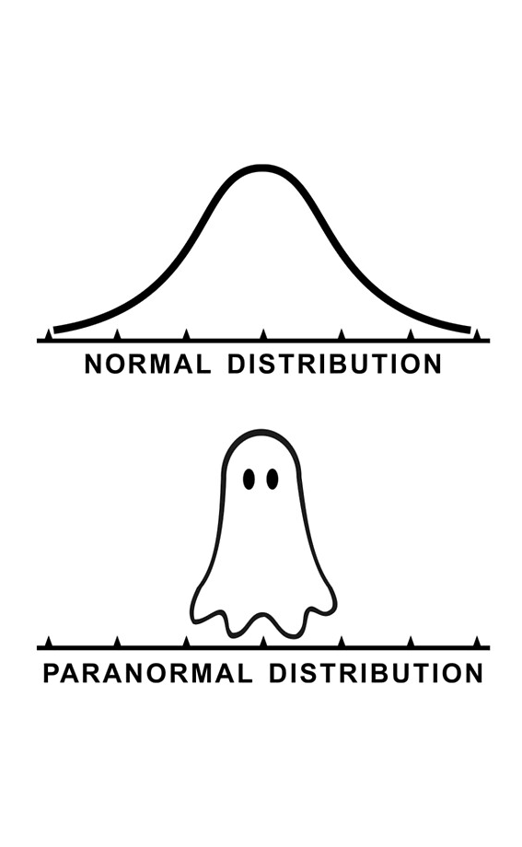
Normal Distribution

Slide 43
Normal Random Variable (AKA Gaussian)
There’s not a single scenario that follows a normal distribution… But we’re going to see that it shows up in a lot of real world situations!
A normal random variable $X\sim 𝒩(μ,σ^{2})$ has two parameters:
$μ=𝔼\left[X\right]$ is the mean
$σ^{2}=Var(X)$ is the variance ($σ=\sqrt{Var\left(X\right)}$ is standard deviation)
and follows this probability density function (a bell curve!):
$f_{X}\left(k\right)=\frac{1}{σ\sqrt{2π}}e^{−\frac{{\left(k−μ\right)}^{2}}{2σ^{2}}}$
Notes:
Today, we’re going to focus on talingabout this distribution.. And then on Monday, we’re going to see how this distribution shows up in a lot of real world scenarios.

Slide 44
Let’s take a closer look at that PDF…
$X\sim 𝒩(μ,σ^{2})$ iff $X$ follows the following PDF:
symmetric around the mean
constant for normalization
$f_{X}\left(k\right)=\frac{1}{σ\sqrt{2π}}e^{−\frac{{\left(k−μ\right)}^{2}}{2σ^{2}}}$
variance to control spread
exponential term for tails
Notes:
Today, we’re going to focus on talking about this distribution.. And then on Monday, we’re going to see how this distribution shows up in a lot of real world scenarios.
Normalization constant.. So that when we integrate over all values, that will be 1. this part here is the more interesting part, it’s where the k is. We have e raised to some negative power. This is some kind of exponential decay… it’s going to get exponentially smaller with really big or really small values of k.. X minus mu is how far you are away from the mean. We’re looking at that squared deviation, keep everything positive.. This might look a little similar to the formula for variance. We don’t want to just look at that in absolute terms, we want to compare it to the variance, which is why we’re dividieing… if the variance Is high, having a large distance is not that impressive it’s more likely to occur. But if the variance is low, having a large distance is more impressive, we’re less likely to see that.

Slide 45
Changing the variance
Green: $σ^{2}=.7$
Red $σ^{2}=1$
Blue: $σ^{2}=2$
Notes:
Angint eh

Slide 46
Changing the mean
Green: $σ^{2}=.7, μ=0$
Purple $σ^{2}=.7, μ=−1$

Slide 47
Closure of Normals Under Scale and Shift
When we scale a normal (multiplying by a constant) or shift it (adding a constant) we get a normal random variable back!
If $X\sim 𝒩\left(μ,σ^{2}\right)$
Then for $Y=aX+b$, $Y\sim 𝒩\left(aμ+b, a^{2}σ^{2}\right)$
intuitively: we are just stretching and squishing the distribution – it’s symmetric without major disruptions it still follows the same general shape
Normals are unique in that you get a NORMAL back.
If you multiply a binomial by $3/2$ you don’t get a binomial (it’s support isn’t even integers!)
Notes:
A property of normal random variables. Epxected value and variance are not surprising. Using linearity of expectation, and properties of variance … key thing to realize is that this random variable is still normal it still has the same pdf that we talked about, jstu with different parameters.
This is not something that is always true. Fore xample if we have a binaiomal random variables… range (0, 1, …n),

Slide 48
Closure of Normals Under Addition
When we add two independent normal random variables, you get another normal random variable.
If $X\sim 𝒩\left(μ_{X},σ_{X}^{2}\right)$ and $Y\sim 𝒩\left(μ_{Y},σ_{Y}^{2}\right)$ and $X$ and $Y$ are independent,
Then, for $Z=aX+bY+c$, $Z\sim 𝒩\left(aμ_{X}+bμ_{Y}+c,{a^{2}σ}_{X}^{2}+{b^{2}σ}_{Y}^{2}\right)$
Normals are unique in that you get a NORMAL back.
The sum of two dice rolls (sum of two uniform distributions) does not follow a uniform distribution
Notes:
A property of normal random variables. Epxected value and variance are not surprising. Using linearity of expectation, and properties of variance … key thing to realize is that this random variable is still normal it still has the same pdf that we talked about, jstu with different parameters.
This is not something that is always true. Fore xample if we have a binaiomal random variables… range (0, 1, …n),

Slide 49
Ok…what about the CDF?
There is no closed form for the CDF ☹
So how can we find the values $F_{X}\left(k\right)=ℙ(X≤k)$?
And for finding the probability of $X$ being in other ranges, we certainly don’t want to bother integrating over that PDF…

Slide 50
We have a table with precomputed values!
AKA the “z-table”, “phi-table”
We have a table containing values for the CDF of the standard normal random variable $Z\sim 𝒩(0,1)$
Yes, we’re going to use a table in 2024 🤩 Mainly for consistency in this class.
(In the real world, we have programming libraries like Python’s scipy: stats.norm.cdf)
Notes:
Many years ago, someone decided to compute the values in the CDF for a bunch of r values for a normal random variable with mean 0 and variance 1. we have this talbe to look up those values.. Instead of having a formula we have this beautifyl thing. Somsone when through each of these values and computed the cdf for it\\maybeyou’re thinking… it’s 1014 .. Why are we just ..

Slide 51
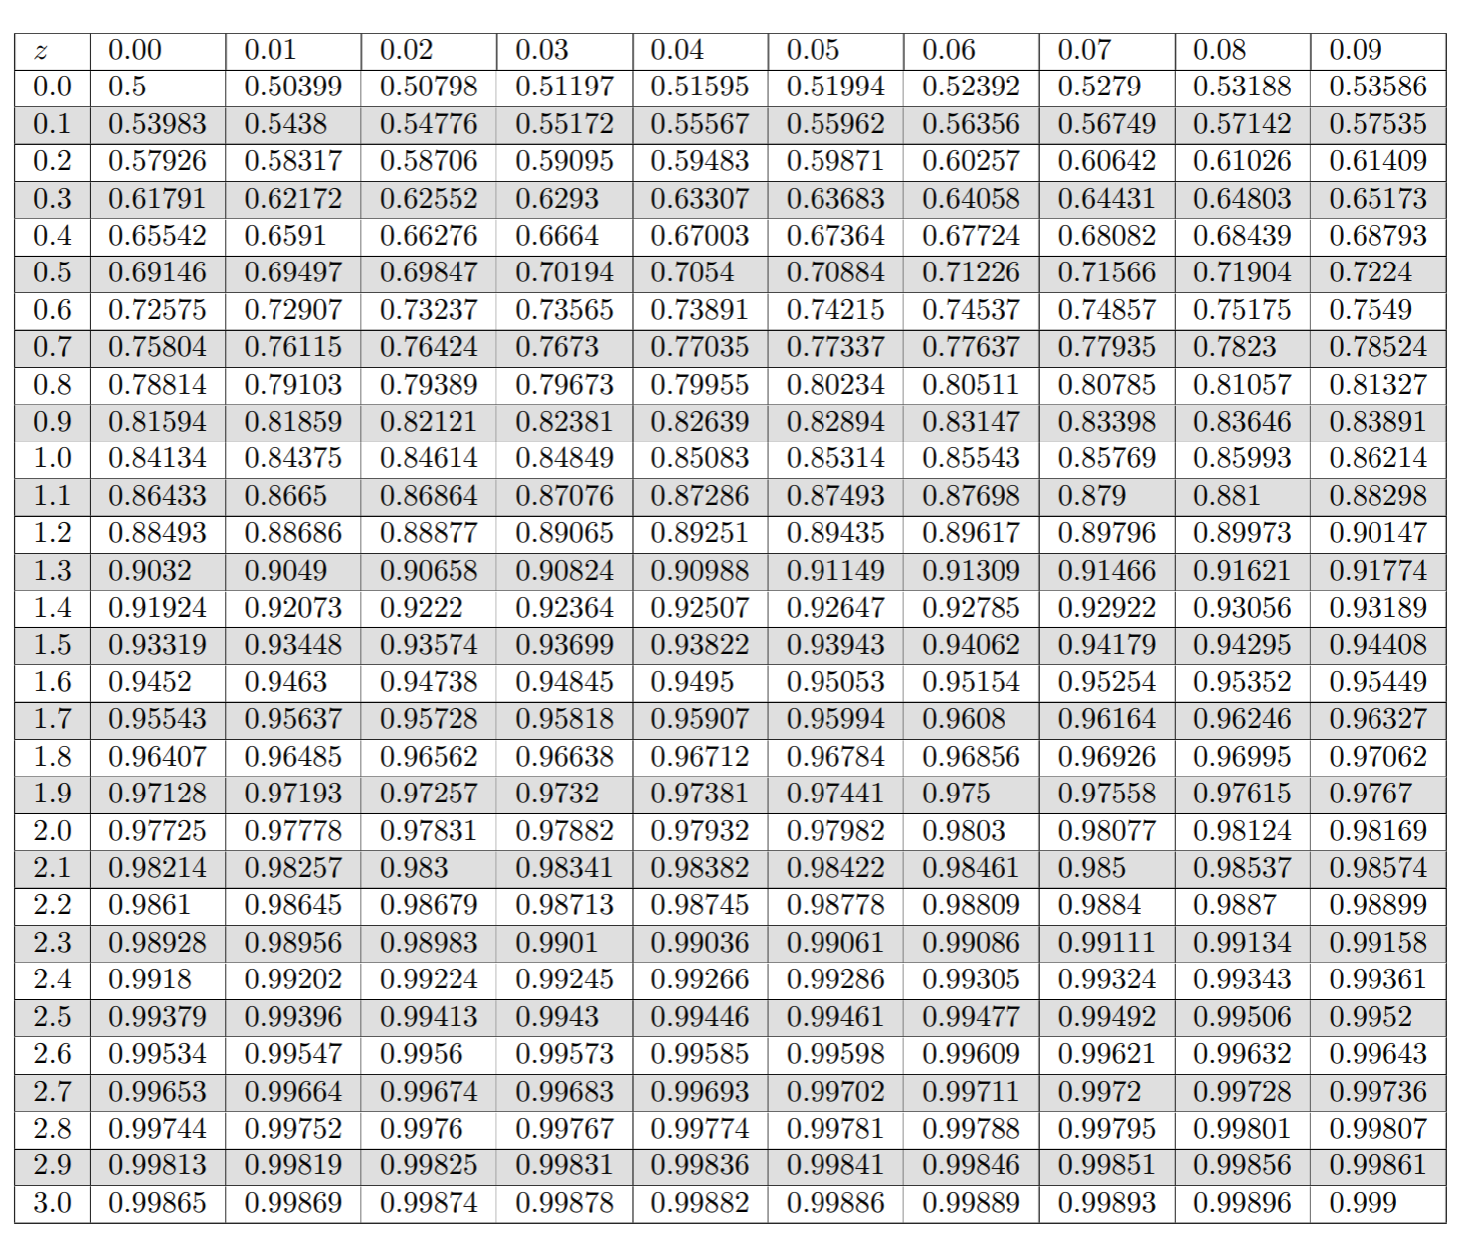
We have a table with precomputed values!
AKA the “z-table”, “phi-table”
We have a table containing values for the CDF of the standard normal random variable $Z\sim 𝒩(0,1)$
> $Φ$ is a function for CDF of $𝒩(0,1)$
> $Φ\left(z\right)=F_{Z}\left(z\right)=ℙ(Z≤z)$
Notes:
As a short hand we’re going to use this function, called Phi, Greek leteter for the CDF of a nomal distribution with mean 0 and variance 1. If we write something like this… We’re looking at …

Slide 52
We have a table with precomputed values!
AKA the “z-table”, “phi-table”
We have a table containing values for the CDF of the standard normal random variable $Z\sim 𝒩(0,1)$
> $Φ$ is a function for CDF of $𝒩(0,1)$
> $Φ\left(z\right)=F_{Z}\left(z\right)=ℙ(Z≤z)$
Notes:
Example here P(Z <= 0.34)=

Slide 53
But how to go from $𝒩\left(μ,σ^{2}\right)$ to $𝒩(0,1)$?
We have a table for the values of $𝒩(0,1)$. How to use this for $𝒩\left(μ,σ^{2}\right)$?
We will standardize $X$! If we have $X\sim 𝒩(μ,σ^{2})$
1. Subtract $μ$ to shift the distribution to have mean of 0
$𝔼\left[X−μ\right]=𝔼\left[X\right]−μ=μ−μ=0$
2. Divide by $σ$ to squish/stretch the distribution to have variance of 1
$Var\left(\frac{X−μ}{σ}\right)=\frac{1}{σ^{2}}Var\left(X−μ\right)=\frac{1}{σ^{2}}Var\left(X\right)=\frac{1}{σ^{2}}σ^{2}=1$
$Z=\frac{X−μ}{σ}$ is a standard normal random variable: $Z\sim 𝒩(0,1)$
Notes:
The table gives us values for a normal raviarable with mean 0 and std 1. butwhat about other random variables that have a different mean and variance? We are going to standardize it, to get a normal random variable that has mean and variable 1. …
We have a random variable with mean …. The first thing we’re going to want to do, if shift it, and get it centered around 0. subtract mean to have mean of. 0
Now, we are
Remember divided by s

Slide 54
Computing Probabilities of Normal RVs
1. Write the probability we’re interested in in terms of the CDF
2. Standardize the normal random variable: $Z=\frac{X−μ}{σ}$
2. Round the “z-score”(s) to the hundredths place.
3. Look up the value(s) in the table

Slide 55
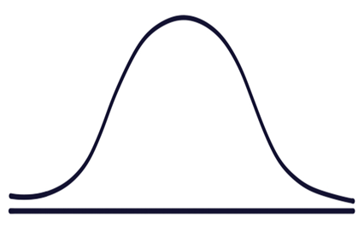
Practice!
We use $Φ(z)$ to mean $F_{Z}(z)$ where $Z\sim 𝒩(0,1)$.
Let $X\sim 𝒩(5,4)$. What is $ℙ\left(X≤9\right)?$
$ℙ\left(X≤9\right)$
$=ℙ\left(\frac{Y−5}{2}≤\frac{9−5}{2}\right)$ standardize (algebra on both sides)
$=ℙ(Z≤\frac{9−5}{2})$ where $Z\sim N(0,1)$.
$=ℙ\left(Z≤\frac{9−5}{2}\right)=Φ\left(2.00\right)=0.97725$
$$5$$
$$9$$

Slide 56
Practice!
We use $Φ(z)$ to mean $F_{Z}(z)$ where $Z\sim 𝒩(0,1)$.
Let $X\sim 𝒩(5,4)$. What is $ℙ\left(X>9\right)?$
$ℙ\left(X>9\right)=1−ℙ(X≤9)$
$=1−ℙ\left(\frac{Y−5}{2}≤\frac{9−5}{2}\right)$ standardize (algebra on both sides)
$=1−ℙ(Z≤\frac{9−5}{2})$ where $Z\sim N(0,1)$.
$=1−ℙ\left(Z≤\frac{9−5}{2}\right)=1−Φ\left(2.00\right)$
$=1−0.97725=0.02275$
$$5$$
$$9$$

Slide 58
More practice
Let $X\sim 𝒩(3, 2)$.
What is the probability that $1≤X≤4$?
$ℙ\left(1≤X≤4\right)$
$$1$$
$$3$$
$$4$$

Slide 59
More practice
Let $X\sim 𝒩(3, 2)$.
What is the probability that $1≤X≤4$?
$ℙ\left(1≤X≤4\right)$
$=ℙ\left(X≤4\right)−ℙ\left(X≤1\right)$
$= ℙ\left(\frac{X−3}{\sqrt{2}}≤\frac{4−3}{\sqrt{2}}\right)−ℙ\left(\frac{X−3}{\sqrt{2}}≤\frac{1−3}{\sqrt{2}}\right)=$
$=ℙ\left(Z≤\frac{4−3}{\sqrt{2}}\right)−ℙ\left(Z≤\frac{1−3}{\sqrt{2}}\right)$ where $Z\sim 𝒩(0,1)$
$=Φ\left(.71\right)−Φ\left(−1.41\right)$
$$1$$
$$3$$
$$4$$

Slide 60
More practice
How do we find $Φ\left(−1.41\right)=ℙ\left(Z≤−1.41\right)$? Our table only has CDF values for positive numbers! 😱
Recall: the normal distribution is symmetric
$ℙ\left(Z≤−1.41\right)=$
$$−1.41$$
$$1$$
$$1.41$$

Slide 61
More practice
How do we find $Φ\left(−1.41\right)=ℙ\left(Z≤−1.41\right)$? Our table only has CDF values for positive numbers! 😱
Recall: the normal distribution is symmetric
$ℙ\left(Z≤−1.41\right)=ℙ\left(Z≥1.41\right)$
$=1−ℙ\left(Z≤1.41\right)$
$=1−Φ(1.41)$ this is something we can do…
$$−1.41$$
$$1$$
$$0.71$$

Slide 62
More practice
Let $X\sim 𝒩(3, 2)$.
What is the probability that $1≤X≤4$?
$ℙ\left(1≤X≤4\right)$
$=ℙ\left(X≤4\right)−ℙ\left(X≤1\right)$
$= ℙ\left(\frac{X−3}{\sqrt{2}}≤\frac{4−3}{\sqrt{2}}\right)−ℙ\left(\frac{X−3}{\sqrt{2}}≤\frac{1−3}{\sqrt{2}}\right)=$
$=ℙ\left(Z≤\frac{4−3}{\sqrt{2}}\right)−ℙ\left(Z≤\frac{1−3}{\sqrt{2}}\right)$ where $Z\sim 𝒩(0,1)$
$=Φ\left(.71\right)−Φ\left(−1.41\right)=Φ\left(.71\right)−(1−Φ\left(1.41))\right)$
$=0.76115 −\left(1−0.92073\right)=0.68188$
$$1$$
$$3$$
$$4$$

Slide 63
“within __ standard deviations from the mean”
What’s the probability of being within two standard deviations from the mean?
$ℙ\left(μ−2σ≤X≤μ+2σ\right)$
$=ℙ\left(X≤μ+2σ\right)−ℙ\left(X≤μ−2σ\right)=ℙ\left(Z≤\frac{μ+2σ−μ}{σ}\right)−ℙ\left(Z≤\frac{μ−2σ−μ}{σ}\right)$
$=Φ\left(2\right)−Φ\left(−2\right)$
$=Φ\left(2\right)−\left(1−Φ\left(2\right)\right)$
$=.97725−\left(1−.97725\right)=.9545$
You’ll sometimes hear statisticians refer to the “68-95-99.7 rule” which is the probability of being within 1,2, or 3 standard deviations of the mean.

Slide 64
Normal (aka Guassian)
When finding the probability of a normal random variable, draw a picture!! It can help reasoning about how we can use the CDF and the z-table to compute the desired region.
1. Write the probability we’re interested in in terms of the CDF
2. Standardize the normal random variable: $Z=\frac{X−μ}{σ}$
2. Round the “z-score”(s) to the hundredths place.
3. Look up the value(s) in the table

Slide 65
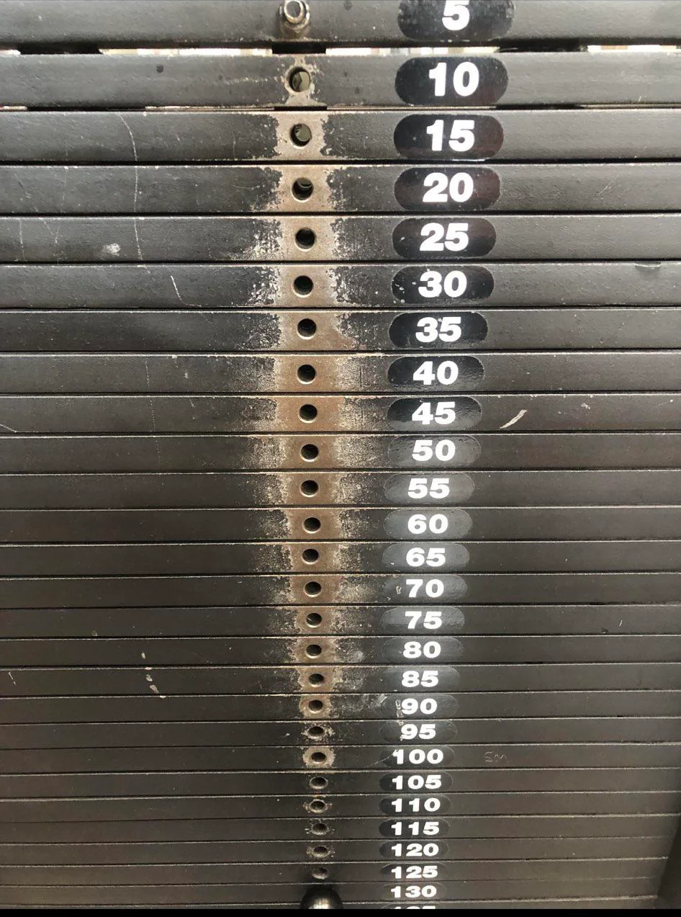
Can you spot the normal distribution?
It turns out the normal distribution appear a LOT in the real world. Like…in the gym!
On Monday, we will talk about how and why!
Picture from reddit

