Slide 1
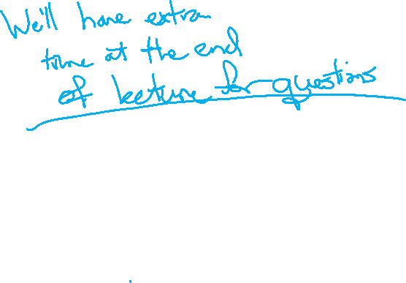
Victory Lap
CSE 312 Spring 24
Lecture 28

Slide 2
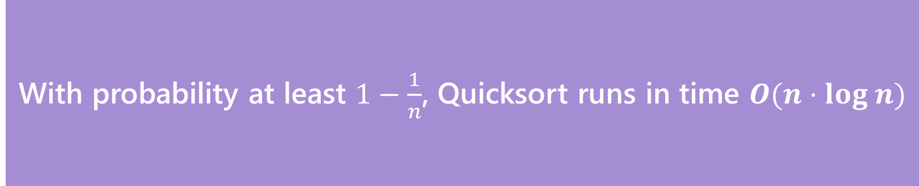
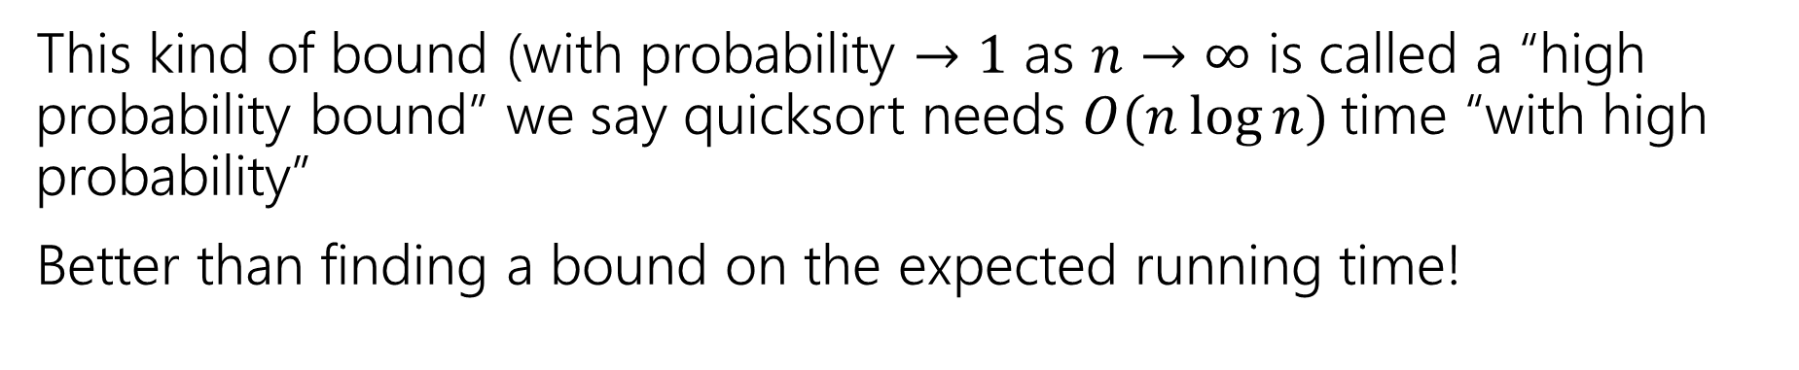
The Theorem
With probability at least $1−\frac{1}{n}$, Quicksort runs in time $O(n⋅log n)$
Quicksort
This kind of bound (with probability $→1$ as $n→∞$ is called a “high probability bound” we say quicksort needs $O(n\log{n)}$time “with high probability”
Better than finding a bound on the expected running time!

Slide 3
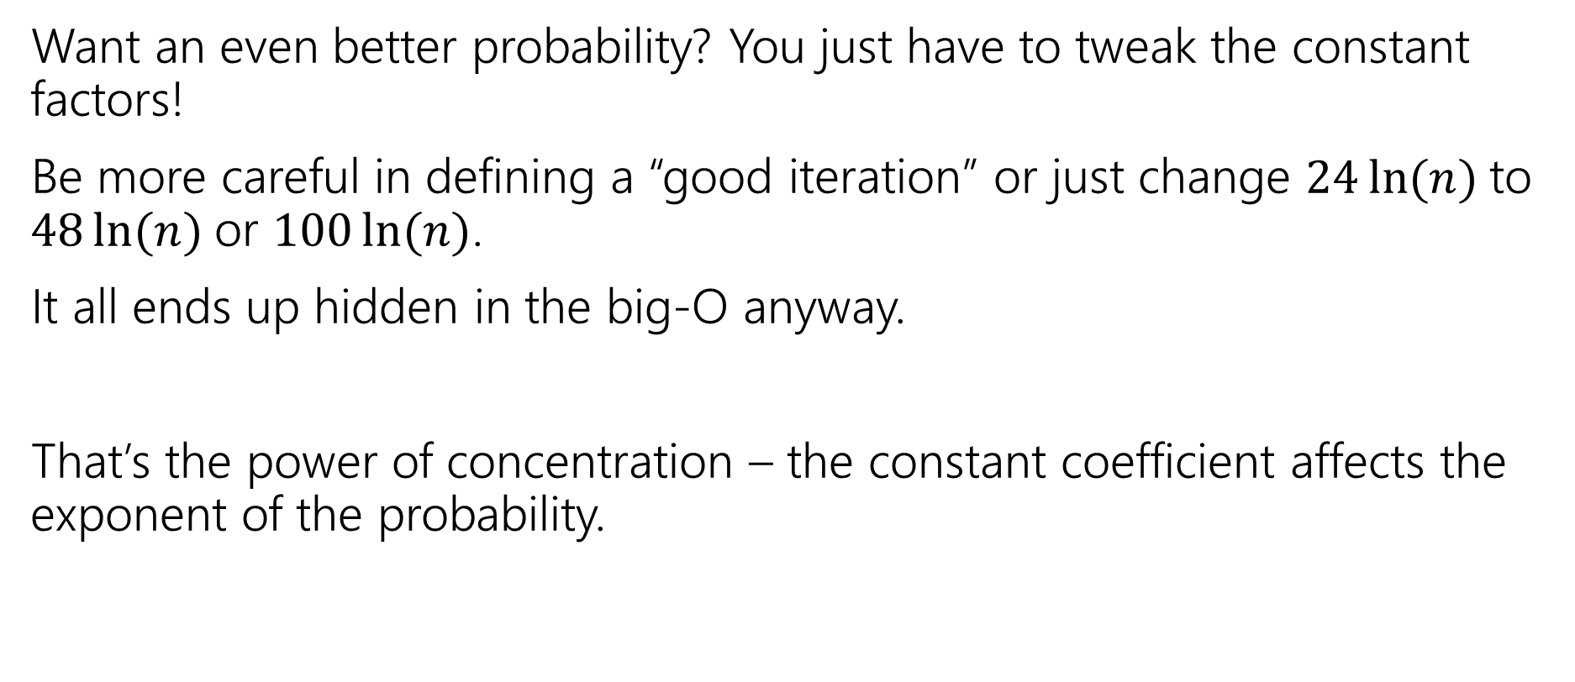
Want a different bound?
Want an even better probability? You just have to tweak the constant factors!
Be more careful in defining a “good iteration” or just change $24\ln{(n)}$to $48\ln{(n)}$or $100\ln{(n)}$.
It all ends up hidden in the big-O anyway.
That’s the power of concentration – the constant coefficient affects the exponent of the probability.

Slide 4
Common Quicksort Implementations
A common strategy in practice is the “median of three” rule.
Choose three elements (either at random or from specific spots). Take the median of those for your pivot
Guarantees you don’t have the worst possible pivot.
Only a small constant number of extra steps beyond the fixed pivot (find the median of three numbers is just a few comparisons).
Another strategy: find the true median (very fancy, very impractical: take 421)

Slide 5
Monte Carlo Algorithms
Just some intuition

Slide 6
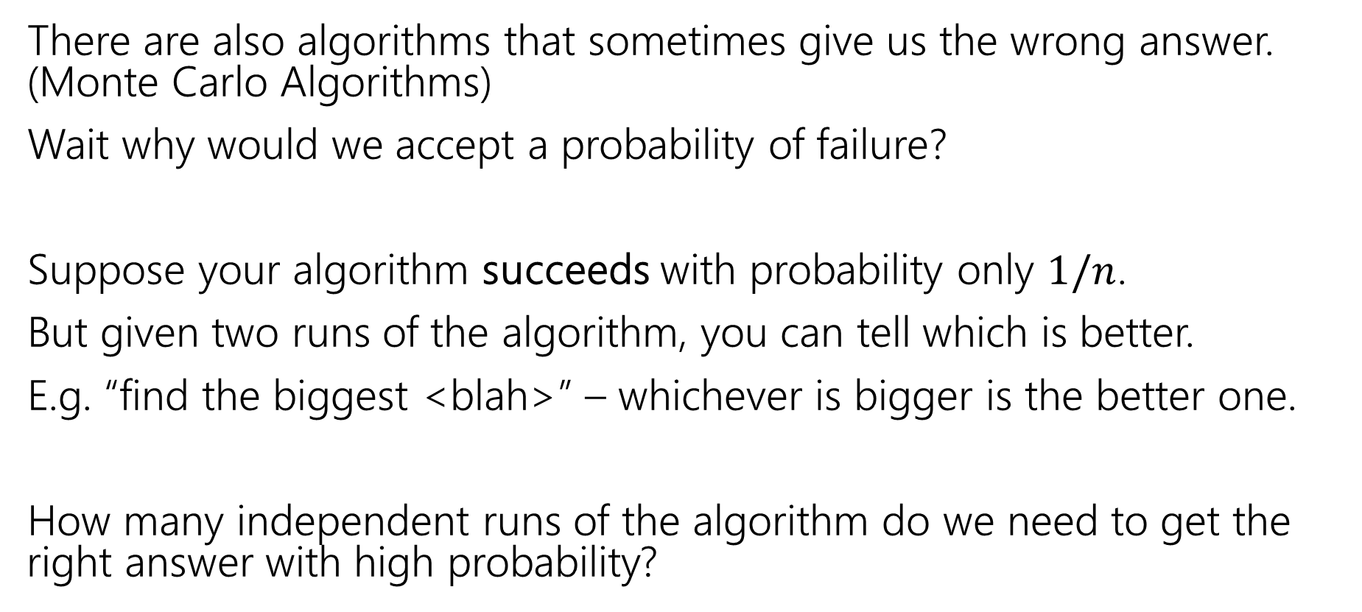
Algorithms with some probability of failure
There are also algorithms that sometimes give us the wrong answer. (Monte Carlo Algorithms)
Wait why would we accept a probability of failure?
Suppose your algorithm succeeds with probability only $1/n$.
But given two runs of the algorithm, you can tell which is better.
E.g. “find the biggest <blah>” – whichever is bigger is the better one.
How many independent runs of the algorithm do we need to get the right answer with high probability?

Slide 7
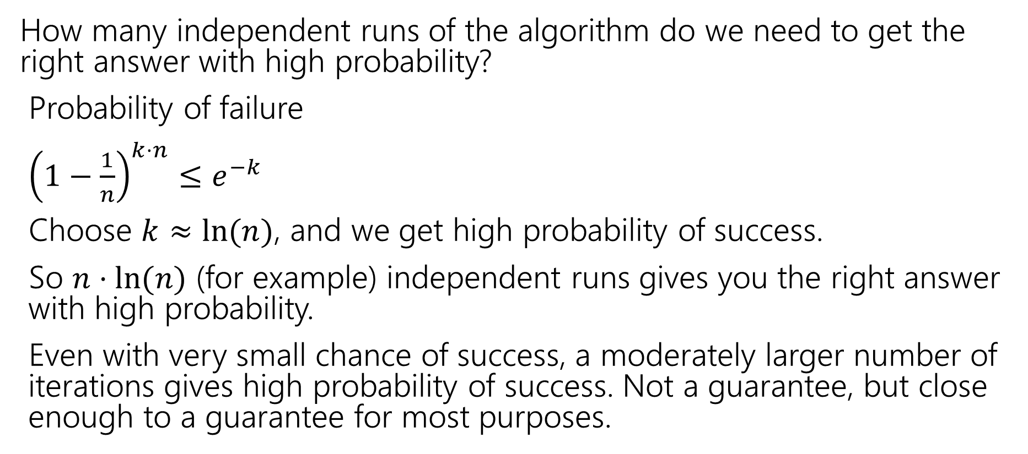
Small Probability of Failure
How many independent runs of the algorithm do we need to get the right answer with high probability?
Probability of failure
${\left(1−\frac{1}{n}\right)}^{k⋅n}≤e^{−k}$
Choose $k≈ln⁡(n)$, and we get high probability of success.
So $n⋅ln⁡(n)$ (for example) independent runs gives you the right answer with high probability.
Even with very small chance of success, a moderately larger number of iterations gives high probability of success. Not a guarantee, but close enough to a guarantee for most purposes.

Slide 8
Victory Lap

Slide 9
What Have We Done?
Well let’s look back…

Slide 10
Content
Combinatorics (fancy counting)
  Permutations, combinations, inclusion-exclusion, pigeonhole principle
Formal definitions for Probability
  Probability space, events, conditional probability, independence, expectation, variance
Common patterns in probability
  Equations and inequalities, “zoo” of common random variables, tail bounds
Continuous Probability
  pdf, cdf, sample distributions, central limit theorem, estimating probabilities
Applications
  Across CS, but with some focus on ML.

Slide 11
Themes
Precise mathematical communication
  Both reading and writing dense statements.
Probability in the “real world”
  A mix of CS applications
  And some actual “real life” ones.
Refine your intuition
  Most people have some base level feeling of what the chances of some event are.
  We’re going to train you to have better gut feelings.

Slide 12
Use Your Powers Wisely
We’ve seen probability can be used in the real world!
But also that it:
Can be counter-intuitive/hard to explain (Bayes Rule/Real World)
Probability estimates can depend on the model you’re using (Real World)

Slide 13
How (not to) lie with statistics
You now know a lot of the tools that people use to lie with statistics. (See also: INFO 270)
Some patterns to watch out for:
My smoke alarm is going off, please pay for my new house! (analogy from Matt Parker)
Make a model, find that an event that occurred had small probability/fails some statistical test, claim that the only explanation is something nefarious occurred.
Better response: could the model be wrong? Is this statistical test appropriate? Once in 100 year events do happen…about once in every hundred years, is this just the one?

Slide 14
How (not to) lie with statistics
See a story about testing?
Remember from Bayes’ Rule that you need three numbers to understand a test. (3 of prior, posterior, false positive rate, false negative rate).
Headlines usually give you one number, that often isn’t even one of the ones you need for Bayes (“this test is less accurate than a coin flip!”).
The article itself, if you’re lucky, might give you one or two of the numbers for Bayes – don’t forget the prior!

Slide 15
How (not to) lie with statistics
Before being impressed with a number, make sure you understand what it means.
Recent example for Robbie:
In baseball umpires decide whether a pitch is a strike or a ball (whether it goes through an (invisible) rectangle when thrown to the hitter)
There are camera systems built into stadiums that track the ball, and figure out where it went
In an infamous game an umpire missed 12% of the calls, according to an unofficial analysis of the data.
Or possibly 4% of the calls, according to the official analysis of the data.
Notes:
It turns out the official analysis says “the systems have error of up to about an inch” if the estimate of where the ball is, is within 1 inch of the correct call, then assume it was correct.
The unofficial analysis says “the computer said it was there, that was a wrong call”
Which analysis is right? Well they both have benefits and drawbacks
And is either of these numbers good or bad? That was a bad game, but what counts as bad depends on which evaluation system you’re using.
https://www.youtube.com/watch?v=9o4weN6AkPY

Slide 16
How (not to) lie with statistics
We can apply our knowledge to the real world!
But if you’re applying in a new domain, get information from domain experts, don’t instantly assume because you know Bayes’ Rule that you know better than domain experts.
Don’t hesitate to use these tools to understand new domains better!
But do keep in mind some things can’t be quantified and just because we can use an algorithm doesn’t mean we always should.

Slide 17
What to take next?
ML (CSE 446) using probability, linear algebra, and other techniques to extract patterns from data and make predictions.
CSE 421 designing algorithms – very little direct probability, but the combinatorics we did at the beginning will be useful.
  We also have a graduate level course in randomized algorithms, but it has a few more prereqs
CSE 447 Natural Language Processing
CSE 426 Cryptography
CSE 422 Modern Algorithms
Other things!

Slide 18
Conditional Expectation Practice

Slide 19
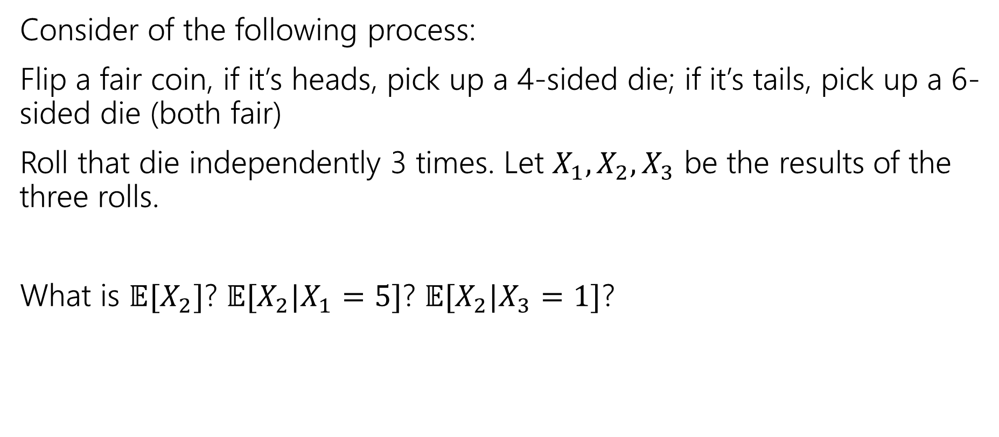
Practice with conditional expectations
Consider of the following process:
Flip a fair coin, if it’s heads, pick up a 4-sided die; if it’s tails, pick up a 6-sided die (both fair)
Roll that die independently 3 times. Let $X_{1},X_{2},X_{3}$ be the results of the three rolls.
What is $𝔼[X_{2}]$? $𝔼[X_{2}|X_{1}=5]$? $𝔼[X_{2}|X_{3}=1]$?

Slide 20
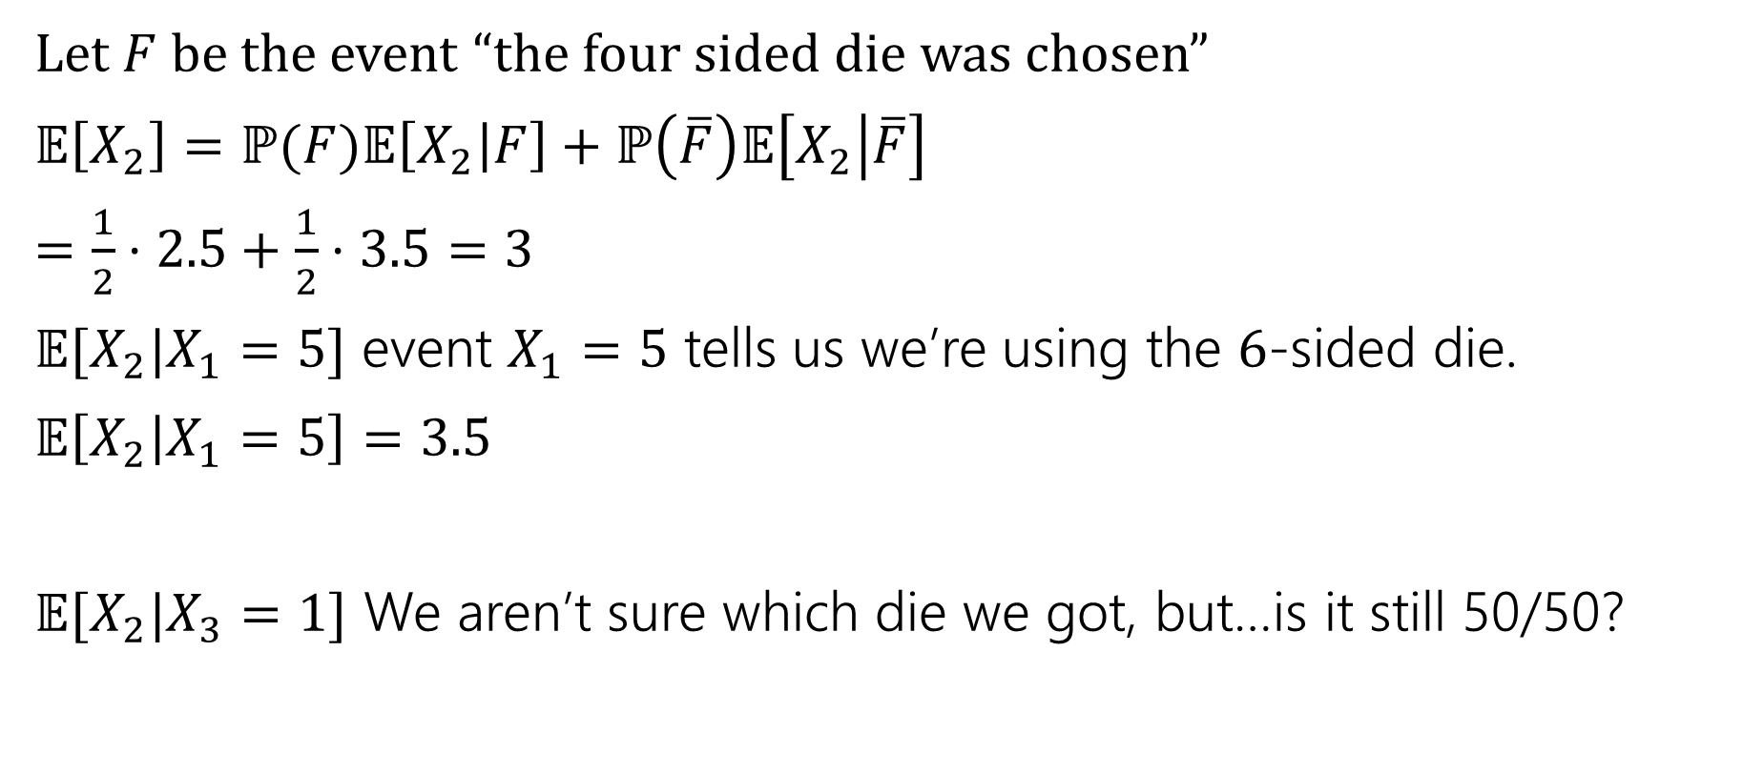
Using conditional expectations
Let $F$ be the event “the four sided die was chosen”
$𝔼\left[X_{2}\right]=ℙ(F)𝔼\left[X_{2} | F\right]+ℙ\left(\overline{F}\right)𝔼\left[X_{2} | \overline{F}\right]$
$=\frac{1}{2}⋅2.5+\frac{1}{2}⋅3.5=3$
$𝔼[X_{2}|X_{1}=5]$ event $X_{1}=5$ tells us we’re using the $6$-sided die.
$𝔼\left[X_{2} | X_{1}=5\right]=3.5$
$𝔼[X_{2}|X_{3}=1]$ We aren’t sure which die we got, but…is it still 50/50?

Slide 21
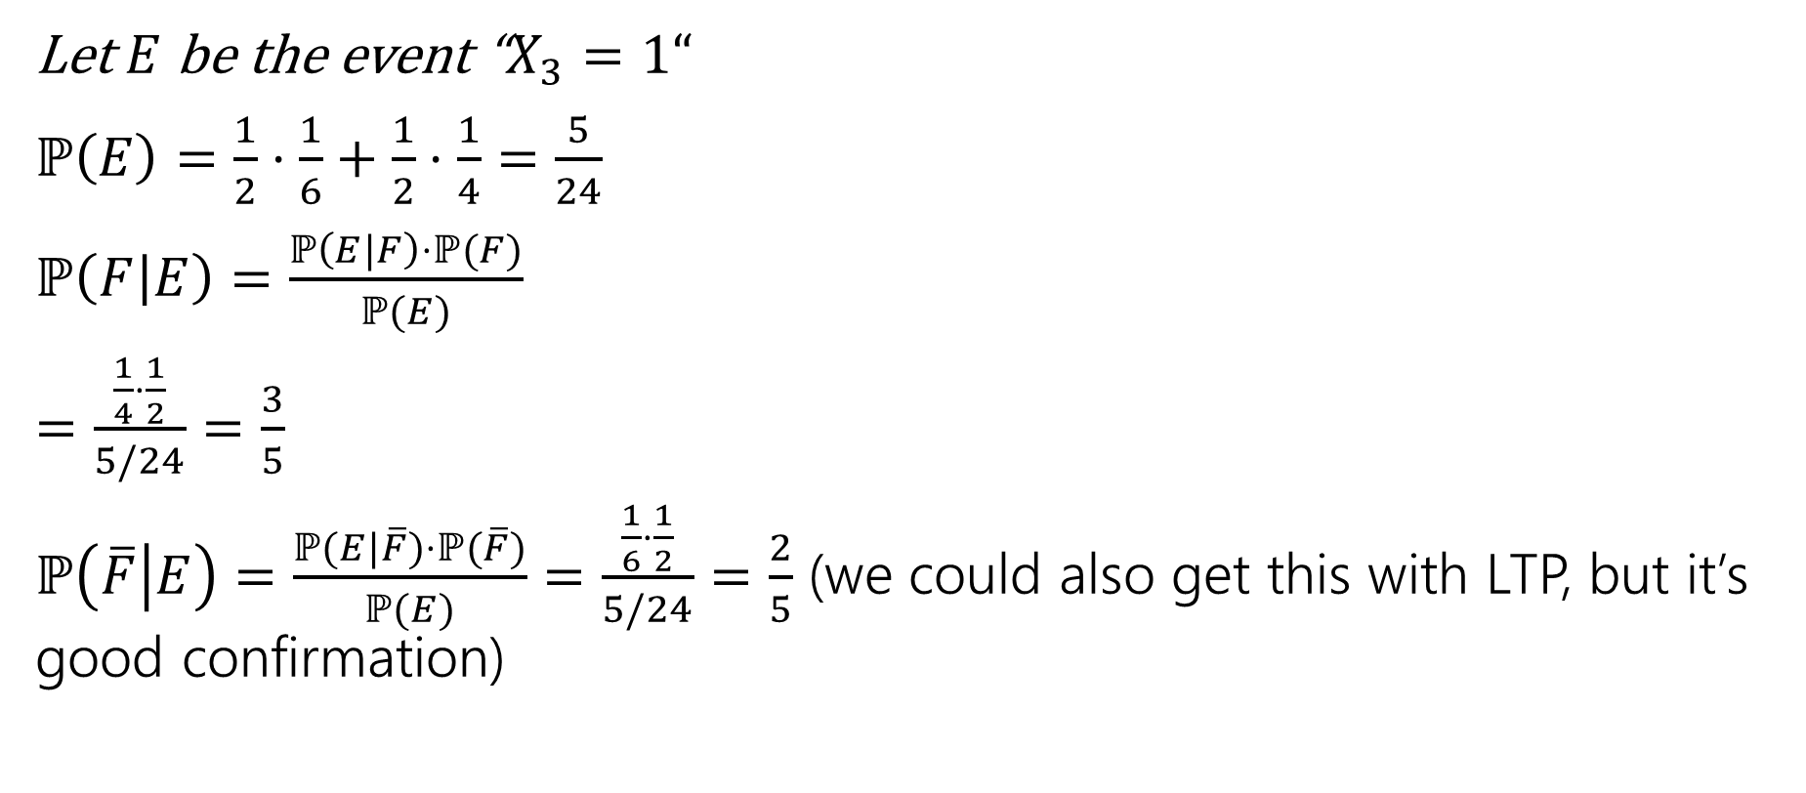
Setup
Let $E$ be the event “$X_{3}=1“$
$ℙ\left(E\right)=\frac{1}{2}⋅\frac{1}{6}+\frac{1}{2}⋅\frac{1}{4}=\frac{5}{24}$
$ℙ\left(F | E\right)=\frac{ℙ\left(E|F\right)⋅ℙ(F)}{ℙ(E)}$
$=\frac{\frac{1}{4}⋅\frac{1}{2}}{5/24}=\frac{3}{5}$
$ℙ\left(\overline{F} | E\right)=\frac{ℙ(E|\overline{F})⋅ℙ(\overline{F})}{ℙ(E)}$ $=\frac{\frac{1}{6}⋅\frac{1}{2}}{5/24}=\frac{2}{5}$ (we could also get this with LTP, but it’s good confirmation)

Slide 22
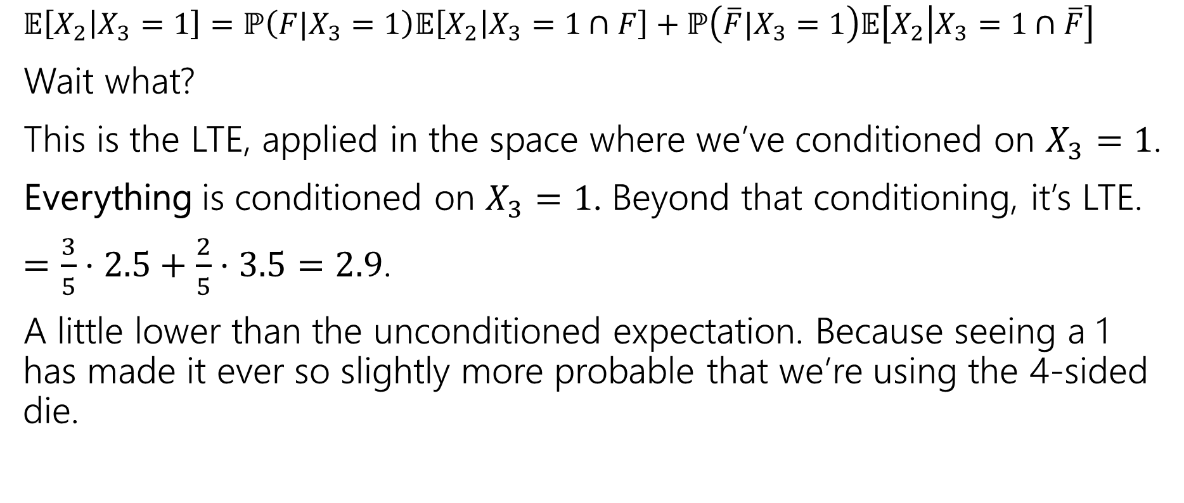
Analysis
$𝔼\left[X_{2} | X_{3}=1\right]=ℙ\left(F|X_{3}=1\right)𝔼\left[X_{2} | X_{3}=1∩F\right]+ℙ\left(\overline{F}|X_{3}=1\right)𝔼\left[X_{2} | X_{3}=1∩\overline{F}\right]$
Wait what?
This is the LTE, applied in the space where we’ve conditioned on $X_{3}=1$.
Everything is conditioned on $X_{3}=1$. Beyond that conditioning, it’s LTE.
$=\frac{3}{5}⋅2.5+\frac{2}{5}⋅3.5=2.9$.
A little lower than the unconditioned expectation. Because seeing a 1 has made it ever so slightly more probable that we’re using the 4-sided die.

