Slide 1
Hodgepodge
CSE 312 Spring 24
Lecture 26

Slide 2
Biased
One property we might want from an estimator is for it to be unbiased.
The expectation is taken over the randomness in the samples we drew.
The formula is fixed, the data we draw to evaluate the formula becomes the source of the randomness.
So we’re not consistently overestimating or underestimating.
If an estimator isn’t unbiased then it’s biased.
An estimator $\hat{θ}$is “unbiased” if
$$𝔼\left[\hat{θ}\right]=θ$$

Slide 3
Not Unbiased
$𝔼\left[\hat{θ_{σ^{2}}}\right]=𝔼[\frac{1}{n}\sum_{i=1}^{n}{{\left(x_{i}−\hat{θ_{μ}}\right)}^{2}]}$
$=\frac{n−1}{n}σ^{2}$
Which is not what we wanted. This is a biased estimator. But it’s not too biased…
The MLE is consistent (under some very mild assumptions), but it can be biased or unbiased.
An estimator $\hat{θ}$is “consistent” if
$$\lim_{n→∞}{𝔼\left[\hat{θ}\right]}=θ$$
Notes:
See, e.g., https://stats.stackexchange.com/questions/323873/assumptions-of-mle

Slide 4
Correction
The MLE slightly underestimates the true variance.
You could correct for this! Just multiply by $\frac{n}{n−1}.$
This would give you a formula of:
$\frac{n}{n−1}⋅\frac{1}{n}\sum_{i=1}^{n}{{\left(x_{i}−\hat{θ_{μ}}\right)}^{2}}$
$=\frac{1}{n−1}\sum_{i=1}^{n}{{\left(x_{i}−\hat{θ_{μ}}\right)}^{2}}$ where $\hat{θ_{μ}}$ is the sample mean.
Called the “sample variance” because it’s the variance you estimate if you want an (unbiased) estimate of the variance given only a sample.
If you took a statistics course, you probably learned the square root of this as the definition of standard deviation.

Slide 5
Fun Facts

Slide 6
What’s with the $n−1$?
Soooooooooo, why is the MLE for variance off?
Intuition 1: when we’re comparing to the real mean, $x_{1}$ doesn’t affect the real mean (the mean is what the mean is regardless of what you draw).
But when you compare to the sample mean, $x_{1}$ pulls the sample mean toward it, decreasing the variance a tiny bit.
Intuition 2: We only have $n−1$ “degrees of freedom” with the mean and $n−1$ of the data points, you know the final data point. Only $n−1$ of the data points have “information” the last is fixed by the sample mean.

Slide 7
Why does it matter?
When statisticians are estimating a variance from a sample, they usually divide by $n−1$ instead of $n$.
They also (with unknown variance) generally don’t use the CLT to estimate probabilities.
A “t-test” is used when scientists/statisticians think their data is approximately normal, but they don’t know the variance.
They aren’t using the $Φ()$ table, they’re using a different table based on the altered variance estimates.

Slide 8
Why use MLEs? Are there other estimators?
If you have a prior distribution over what values of $θ$ are likely, combining the idea of Bayes rule with the idea of an MLE will give you
Maximum a posteriori probability estimation (MAP)
You pick the maximum value of $ℙ(θ|E)$ starting from a known prior over possible values of $θ.$
$argmax_{θ}\frac{ℙ(E|θ)⋅ℙ(θ)}{ℙ(E)}=argmax_{θ}ℙ(E|θ)⋅ℙ(θ)$
$ℙ(E)$ is a constant, so the argmax is unchanged if you ignore it.
Note when prior is constant, you get MLE!

Slide 9
What about $X$ and $Y$ from last Friday?
We polled $n$ people and said, Flip a coin:
If coin is heads OR you have cheated on a partner, tell me “heads”
If coin is tails AND you have never cheated on a partner, tell me “tails”
$X$ was the number of people polled who said “heads”
$Y$ was the number of people polled who cheated on a partner.
We’re trying to find an estimator for $Y$.

Slide 10
What about $X$ and $Y$ from last Friday?
We polled $n$ people and said, Flip a coin:
If coin is heads OR you have cheated on a partner, tell me “heads”
If coin is tails AND you have never cheated on a partner, tell me “tails”
$X$ was the number of people polled who said “heads”
$Y$ was the number of people polled who cheated on a partner.
We’re trying to find an estimator for $Y$.
We picked the estimator “$\hat{Y}=2\left(X−\frac{n}{2}\right)$”
$𝔼\left[\hat{Y}\right]=2\left(𝔼\left[X\right]−\frac{n}{2}\right)=2\left(\left[\frac{n}{2}+\frac{np}{2}\right]−\frac{n}{2}\right)=np$ where $p$ is fraction of people who cheated. I.e., $Y$ This was an unbiased estimator!

Slide 11
What about $X$ and $Y$ from last Friday?
$X$ was the number of people polled who said “heads”
$Y$ was the number of people polled who cheated on a spouse.
We’re trying to find an estimator for.
$ℒ\left(X=k;Y\right)=\left({n−Y \atop k−Y}\right).5^{k−Y}.5^{n−k}=\left({n−Y \atop k−Y}\right).5^{n−Y}$
$k−Y=\frac{n−Y}{2}⇒k−\frac{n}{2}=\frac{Y}{2}⇒Y=2\left(k−\frac{n}{2}\right)$
So this is also an MLE! This estimator is only handling the randomness in the coin flips, not the randomness in who was selected. You get the same answer if you back up that far.
The binomial coefficient is maximized when it’s $\left({m \atop m/2}\right)$
Analysis is more complicated because we can’t use calculus (defined only on integers)
Notes:
This is VEEEEEERY hand-wavy; to make this rigorous we have to also deal with Y increasing causing the exponent of .5 to decrease (and therefore the likelihood to go up)

Slide 12
Are our MLE’s accurate?

Slide 13
Confidence for MLEs
We said our MLE for “probability of heads on a flip” is $\hat{p }=\frac{num heads}{num flips}$
And $𝔼\left[\hat{p}\right]=p$. (where $p$ is the true probability of heads).
But how close is it to the true value? What if on-average it’s correct, but it’s often very far away.
If only we had a tool…one that would describe the probability of being far from your expectation…

Slide 14
Confidence for MLEs
By Hoeffding’s Inequality
$ℙ\left(\left|\hat{p}−p\right|≥t\right)≤2\exp\left(−2t^{2}n\right)$
For $n=100$ and $p=.1$ we’d get $ℙ\left(\left|\hat{p}−p\right|≥.1\right)≤2\exp\left(−2⋅{\left(.1\right)}^{2}⋅100\right)≈.14$
We can do that computation even with $p$ unknown!

Slide 15
Multidimensional Gaussians

Slide 16
Preliminary: Random Vectors
In ML, our data points are often multidimensional.
For example:
To predict housing prices, each data point might have: number of rooms, number of bathrooms, square footage, zip code, year built, …
To make movie recommendations, each data point might have: ratings of existing movies, whether you started a movie and stopped after 10 minutes,…
A single data point is a full vector

Slide 17
Preliminary: Random Vectors
A random vector $X$ is a vector where each entry is a random variable.
$𝔼[X]$ is a vector, where each entry is the expectation of that entry.
For example, if $X$ is a uniform vector from the sample space
$\left\{\left[\begin{matrix}1 \\ 2 \\ 3\end{matrix}\right],\left[\begin{matrix}−1 \\ 2 \\ 3\end{matrix}\right],\left[\begin{matrix}0 \\ 2 \\ 6\end{matrix}\right]\right\}$
$𝔼\left[X\right]={\left[0,2,4\right]}^{T}$

Slide 18
Covariance Matrix
Remember Covariance?
$Cov\left(X,Y\right)=𝔼\left[(X−𝔼[X])(Y−𝔼\left[Y\right])\right]=𝔼\left[XY\right]−𝔼[X]𝔼[Y]$
We’ll want to talk about covariance between entries:
Define the “covariance matrix”
$Σ=\left[\begin{matrix}Cov(X_{1},X_{1}) & ⋯ & Cov(X_{1},X_{n}) \\ ⋮ & Cov(X_{i},X_{j}) & ⋮ \\ Cov(X_{n},X_{1}) & ⋯ & Cov(X_{n},X_{n})\end{matrix}\right]$

Slide 19
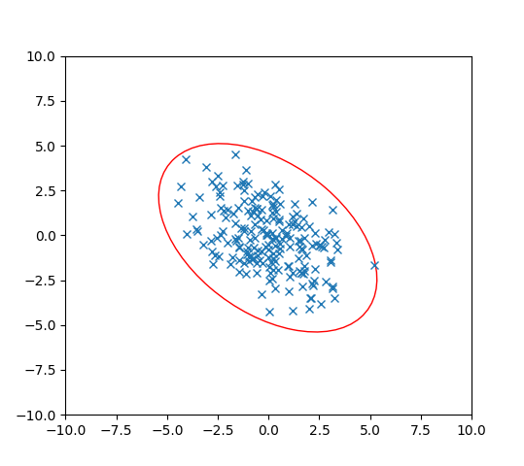
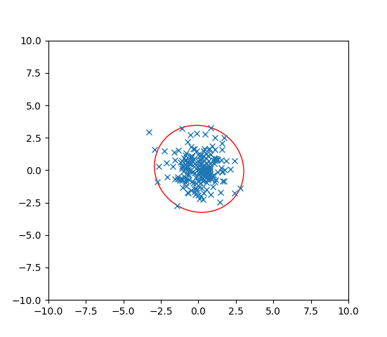
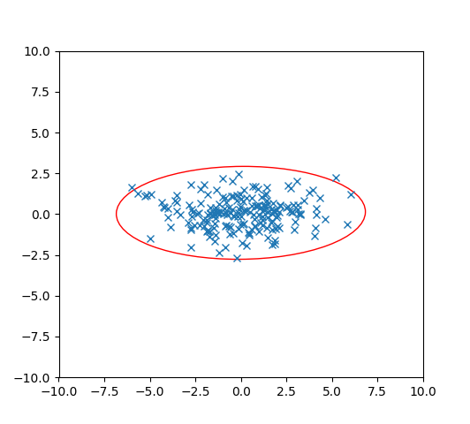
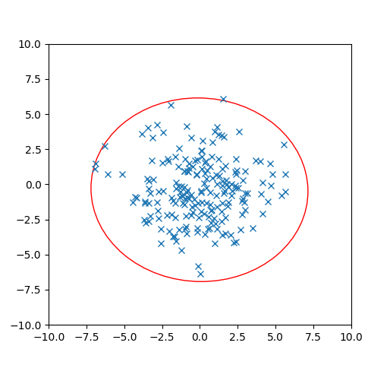
Covariance
Let’s think about 2 dimensions.
Let $X={\left[X_{1},X_{2}\right]}^{T}$ where $X_{i}\sim 𝒩(0,1)$ and $X_{1}$ and $X_{2}$ are independent.
What is $Σ$? Which of these pictures are 200 i.i.d. samples of $X$?

Slide 20
Covariance
Let’s think about 2 dimensions.
Let $X={\left[X_{1},X_{2}\right]}^{T}$ where $X_{i}\sim 𝒩(0,1)$ and $X_{1}$ and $X_{2}$ are independent.
What is $Σ$? Which of these pictures are 200 i.i.d. samples of $X$?
$$Σ=\left[\begin{matrix}1 & 0 \\ 0 & 1\end{matrix}\right]$$

Slide 21
Unequal Variances, Still Independent
Let’s think about 2 dimensions.
Let $X={\left[X_{1},X_{2}\right]}^{T}$ where $X_{1}\sim 𝒩(0,5)$, $X_{2}\sim 𝒩(0,1)$ and $X_{1}$ and $X_{2}$ are independent.
What is $Σ$? Which of these pictures are i.i.d. samples of $X$?

Slide 22
Unequal Variances, Still Independent
Let’s think about 2 dimensions.
Let $X={\left[X_{1},X_{2}\right]}^{T}$ where $X_{1}\sim 𝒩(0,5)$, $X_{2}\sim 𝒩(0,1)$ and $X_{1}$ and $X_{2}$ are independent.
What is $Σ$? Which of these pictures are i.i.d. samples of $X$?
$$Σ=\left[\begin{matrix}5 & 0 \\ 0 & 1\end{matrix}\right]$$

Slide 23
What about dependence.
When we introduce dependence, we need to know the mean vector and the covariance matrix to define the distribution
(instead of just the mean and the variance).
Let’s see a few examples…

Slide 24
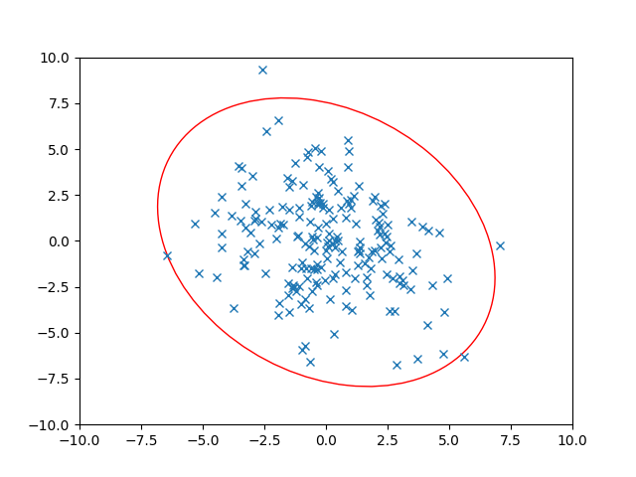
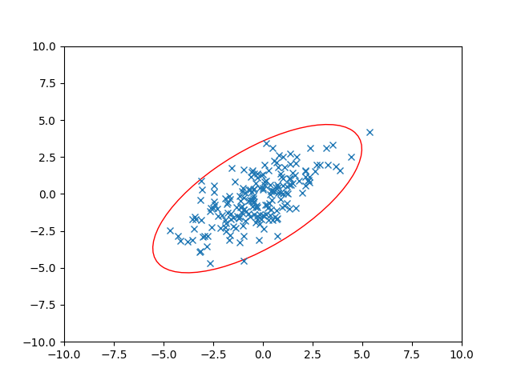
Dependence
Let’s think about 2 dimensions.
Let $X={\left[X_{1},X_{2}\right]}^{T}$ where $Var\left(X_{1}\right)=3$, $Var\left(X_{2}\right)=3$ BUT$X_{1}$ and $X_{2}$ are dependent. $Cov\left(X_{1},X_{2}\right)=2$
What is $Σ$? Which of these pictures are i.i.d. samples of $X$?

Slide 25
Dependence
Let’s think about 2 dimensions.
Let $X={\left[X_{1},X_{2}\right]}^{T}$ where $Var\left(X_{1}\right)=3$, $Var\left(X_{2}\right)=3$ BUT$X_{1}$ and $X_{2}$ are dependent. $Cov\left(X_{1},X_{2}\right)=2$
What is $Σ$? Which of these pictures are i.i.d. samples of $X$?
$$Σ=\left[\begin{matrix}3 & 2 \\ 2 & 3\end{matrix}\right]$$

Slide 26
Dependence
Let’s think about 2 dimensions.
Let $X={\left[X_{1},X_{2}\right]}^{T}$ where ${Var(X}_{1})=5$, $Var\left(X_{2}\right)=7$ BUT$X_{1}$ and $X_{2}$ are dependent. $Cov\left(X_{1},X_{2}\right)=−2$
What is $Σ$? Which of these pictures are i.i.d. samples of $X$?

Slide 27
Dependence
Let’s think about 2 dimensions.
Let $X={\left[X_{1},X_{2}\right]}^{T}$ where ${Var(X}_{1})=5$, $Var\left(X_{2}\right)=7$ BUT$X_{1}$ and $X_{2}$ are dependent. $Cov\left(X_{1},X_{2}\right)=−2$
What is $Σ$? Which of these pictures are i.i.d. samples of $X$?
$$Σ=\left[\begin{matrix}5 & −2 \\ −2 & 7\end{matrix}\right]$$

Slide 28
Using the Covariance Matrix
What were those ellipses in those datasets?
How do we know how many standard deviations from the mean a 2D point is, for the independent, variance $1$ ones
Well $(x_{1}−𝔼\left[X_{1}\right])$ is the distance from $x$ to the center in the $x$-direction.
And $(x_{2}−𝔼\left[x_{2}\right])$ is the distance from $x$ to the center in the $y$-direction.
So the number of standard deviations is $\sqrt{{\left(x_{1}−𝔼\left[X_{1}\right]\right)}^{2}+{\left(x_{2}−𝔼\left[x_{2}\right]\right)}^{2}}$
That’s just the distance!
In general, the major/minor axes of those ellipses were the eigenvectors of the covariance matrix. And the associated eigenvalues tell you how the directions should be weighted.

Slide 29
Probability and ML
Many problems in ML: Given a bunch of data points, you’ll find a function $f$ that you hope will predict future points well.
We usually assume there is some true distribution $𝒟$ of data points (e.g. all theoretical possible houses and their prices).
You get a dataset $S$ that you assume was sampled from $𝒟$ to find $f_{S}$
$f_{S}$ depends on the data (just like our MLEs depended on the data), so before you knew what $S$ was, $f$ was a random variable. You then want to figure out what the true error is if you knew $𝒟$.

Slide 30
Probability and ML
But $𝒟$ is a theoretical construct. I can’t calculate probabilities. What can we do instead? Get a second dataset $T$drawn from $𝒟$ (drawn independently of $S$)
(or actually save part of your database before you start).
Then $𝔼_{𝒟}\left[error of f\right]=𝔼_{T}\left[error of f_{S} | S\right]$
But how confident can you be? You can make confidence intervals
(statements like the true error is within 5% of our estimate with probability at least $.9$) using concentration inequalities.

Slide 31
One more ML preview

Slide 32
Experiments with the correct expectation
Gradient Descent
How did I “train” the model in the first place?
Lots of options…one is “gradient descent”
Think of the “error on the data-set” as a function we’re minimizing.
Take the gradient (derivative of the error with respect to every coefficient in your function), and move in the direction of lower error.
But finding the gradient is expensive…what if we could just estimate the gradient…like with a subset of the data.

Slide 33
Experiments with the correct expectation
We could find an unbiased estimator of the true gradient!
An experiment where the expectation of the vector we get is the true gradient (but might not be the true gradient itself).
Looking at a random subset of the full data-set would let us do that!
For many optimizations it’s faster to approximate the gradient. You’ll be less accurate in each step (since your gradient is less accurate), but each step is much faster, and that tradeoff can be worth it.

Slide 34
Conditional Expectation Practice

Slide 35
Practice with conditional expectations
Consider of the following process:
Flip a fair coin, if it’s heads, pick up a 4-sided die; if it’s tails, pick up a 6-sided die (both fair)
Roll that die independently 3 times. Let $X_{1},X_{2},X_{3}$ be the results of the three rolls.
What is $𝔼[X_{2}]$? $𝔼[X_{2}|X_{1}=5]$? $𝔼[X_{2}|X_{3}=1]$?

Slide 36
Using conditional expectations
Let $F$ be the event “the four sided die was chosen”
$𝔼\left[X_{2}\right]=ℙ(F)𝔼\left[X_{2} | F\right]+ℙ\left(\overline{F}\right)𝔼\left[X_{2} | \overline{F}\right]$
$=\frac{1}{2}⋅2.5+\frac{1}{2}⋅3.5=3$
$𝔼[X_{2}|X_{1}=5]$ event $X_{1}=5$ tells us we’re using the $6$-sided die.
$𝔼\left[X_{2} | X_{1}=5\right]=3.5$
$𝔼[X_{2}|X_{3}=1]$ We aren’t sure which die we got, but…is it still 50/50?

Slide 37
Setup
Let $E$ be the event “$X_{3}=1“$
$ℙ\left(E\right)=\frac{1}{2}⋅\frac{1}{6}+\frac{1}{2}⋅\frac{1}{4}=\frac{5}{24}$
$ℙ\left(F | E\right)=\frac{ℙ\left(E|F\right)⋅ℙ(F)}{ℙ(E)}$
$=\frac{\frac{1}{4}⋅\frac{1}{2}}{5/24}=\frac{3}{5}$
$ℙ\left(\overline{F} | E\right)=\frac{ℙ(E|\overline{F})⋅ℙ(\overline{F})}{ℙ(E)}$ $=\frac{\frac{1}{6}⋅\frac{1}{2}}{5/24}=\frac{2}{5}$ (we could also get this with LTP, but it’s good confirmation)

Slide 38
Analysis
$𝔼\left[X_{2} | X_{3}=1\right]=ℙ\left(F|X_{3}=1\right)𝔼\left[X_{2} | X_{3}=1∩F\right]+ℙ\left(\overline{F}|X_{3}=1\right)𝔼\left[X_{2} | X_{3}=1∩\overline{F}\right]$
Wait what?
This is the LTE, applied in the space where we’ve conditioned on $X_{3}=1$.
Everything is conditioned on $X_{3}=1$. Beyond that conditioning, it’s LTE.
$=\frac{3}{5}⋅2.5+\frac{2}{5}⋅3.5=2.9$.
A little lower than the unconditioned expectation. Because seeing a 1 has made it ever so slightly more probable that we’re using the 4-sided die.

