Slide 1
Normal RVs
CSE 312 Spring 24
Lecture 17

Slide 2
Announcements
Remember that HW5 is out!
  Due on Wednesday (the “normal” schedule)
  New version posted this morning (added the feedback question).
We’re still waiting for a few folks who were sick to get makeup exams. Please don’t discuss the exam publicly yet.
  And don’t discuss with those who haven’t taken it at all until they do.

Slide 3
Continuous Zoo
$$X\sim Unif(a,b)$$
$$X\sim Exp(λ)$$
$$X\sim 𝒩(μ,σ^{2})$$
$$f_{X}\left(k\right)=\frac{1}{b−a}$$
$$𝔼\left[X\right]=\frac{a+b}{2}$$
$$Var\left(X\right)=\frac{{\left(b−a\right)}^{2}}{12}$$
$f_{X}\left(k\right)=λe^{−λk}$ for $k≥0$
$$𝔼\left[X\right]=\frac{1}{λ}$$
$$Var\left(X\right)=\frac{1}{λ^{2}}$$
$$f_{X}\left(k\right)=\frac{1}{σ\sqrt{2π}}exp\left(−\frac{{\left(x−μ\right)}^{2}}{2σ^{2}}\right)$$
$$𝔼\left[X\right]=μ$$
$$Var\left(X\right)=σ^{2}$$
It’s a smaller zoo, but it’s just as much fun!

Slide 4
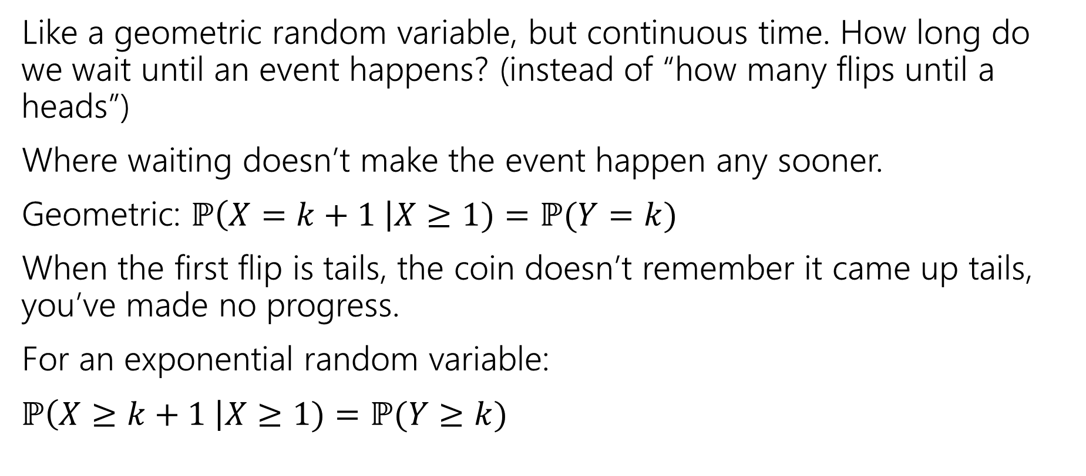
Exponential Random Variable
Like a geometric random variable, but continuous time. How long do we wait until an event happens? (instead of “how many flips until a heads”)
Where waiting doesn’t make the event happen any sooner.
Geometric: $ℙ\left(X=k+1 \right|X≥1)=ℙ(Y=k)$
When the first flip is tails, the coin doesn’t remember it came up tails, you’ve made no progress.
For an exponential random variable:
$ℙ\left(X≥k+1 \right|X≥1)=ℙ(Y≥k)$

Slide 5
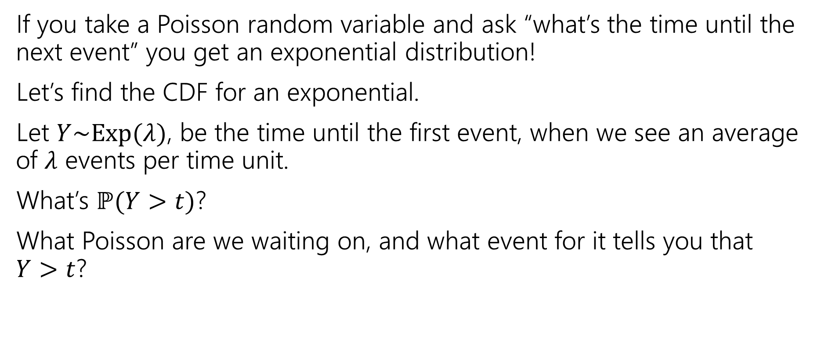
Exponential random variable
If you take a Poisson random variable and ask “what’s the time until the next event” you get an exponential distribution!
Let’s find the CDF for an exponential.
Let $Y\sim Exp(λ)$, be the time until the first event, when we see an average of $λ$ events per time unit.
What’s $ℙ(Y>t)$?
What Poisson are we waiting on, and what event for it tells you that
$Y>t$?

Slide 6
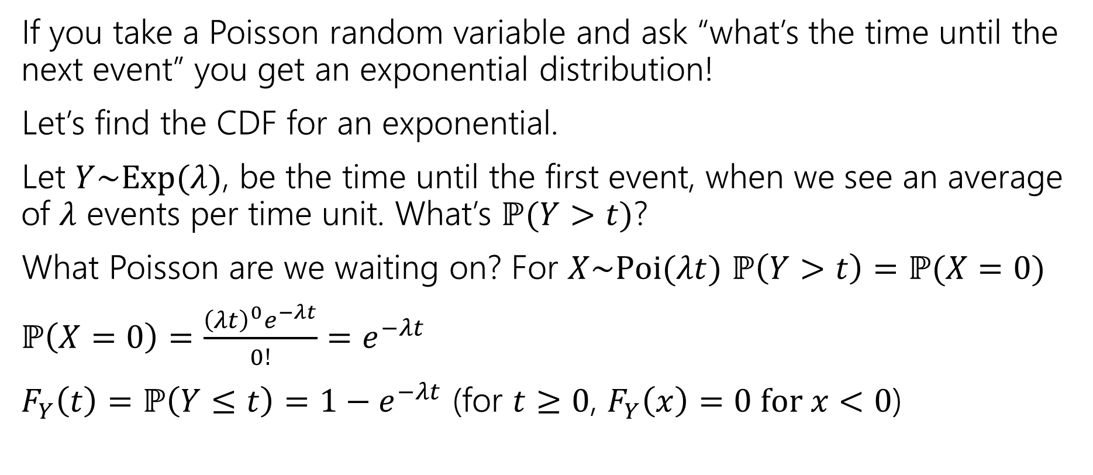
Exponential random variable
If you take a Poisson random variable and ask “what’s the time until the next event” you get an exponential distribution!
Let’s find the CDF for an exponential.
Let $Y\sim Exp(λ)$, be the time until the first event, when we see an average of $λ$ events per time unit. What’s $ℙ(Y>t)$?
What Poisson are we waiting on? For $X\sim Poi(λt)$ $ℙ\left(Y>t\right)=ℙ(X=0)$
$ℙ\left(X=0\right)=\frac{{\left(λt\right)}^{0}e^{−λt}}{0!}=e^{−λt}$
$F_{Y}\left(t\right)=ℙ\left(Y≤t\right)=1−e^{−λt}$ (for $t≥0$, $F_{Y}\left(x\right)=0 for x<0$)

Slide 7
Find the density
We know the CDF, $F_{Y}\left(t\right)=ℙ\left(Y≤t\right)=1−e^{−λt}$
What’s the density?
$f_{Y}\left(t\right)=$

Slide 8
Find the density
We know the CDF, $F_{Y}\left(t\right)=ℙ\left(Y≤t\right)=1−e^{−λt}$
What’s the density?
$f_{Y}\left(t\right)=\frac{d}{dt}\left(1−e^{−λt}\right)=0−\frac{d}{dt}\left(e^{−λt}\right)=λe^{−λt}$.
For $t≥0$ it’s that expression
For $t<0$ it’s just $0.$

Slide 9
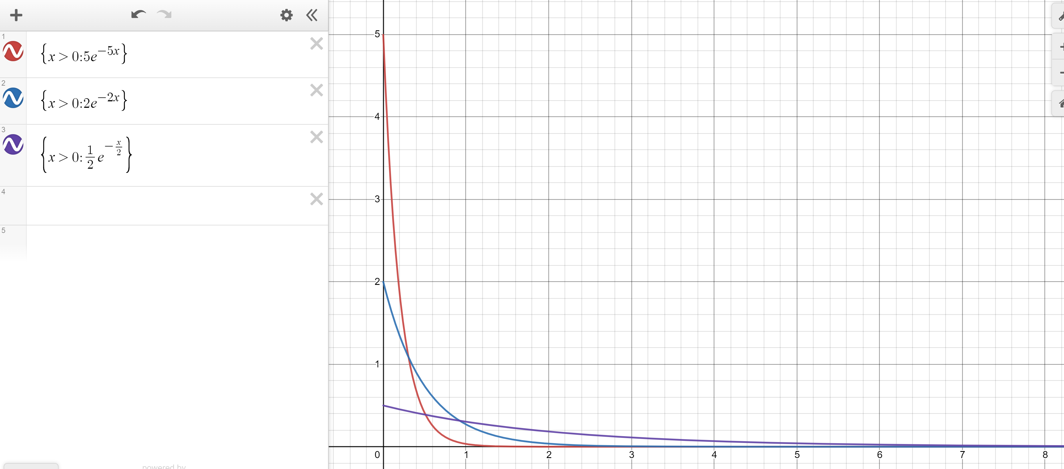
Exponential PDF
Red: $λ=5$
Blue: $λ=2$
Purple: $λ=0.5$

Slide 10
Memorylessness
$ℙ\left(X≥k+1 | X≥1\right)=\frac{ℙ(X≥k+1∩X≥1)}{ℙ(X≥1)}=\frac{ℙ(X≥k+1)}{1−(1−e^{−λ⋅1})}$
$=\frac{e^{−λ(k+1)}}{e^{−λ}}=e^{−λk}$
What about $ℙ(X≥k)$ (without conditioning on the first step)?
${1−(1−e}^{−λk})=e^{−λk}$
It’s the same!!!
More generally, for an exponential rv $X,$ $ℙ\left(X≥s+t | X≥s\right)=ℙ(X≥t)$

Slide 11
Side note
I hid a trick in that algebra,
$ℙ\left(X≥1\right)=1−ℙ\left(X<1\right)=1−ℙ(X≤1)$
The first step is the complementary law.
The second step is using that $\int_{1}^{1}{f_{X}\left(z\right)dz}=0$
In general, for continuous random variables we can switch out $≤$ and $<$without anything changing.
  We can’t make those switches for discrete random variables.

Slide 12
Expectation of an exponential
Don’t worry about the derivation (it’s here if you’re interested; you’re not responsible for the derivation. Just the value.
Let $X\sim Exp(λ)$
$𝔼\left[X\right]=\int_{−∞}^{∞}{{z⋅f}_{X}\left(z\right)dz}$
$=\int_{0}^{∞}{z⋅λe^{−λz}}dz$
Let $u=z; dv=λe^{−λz}dz$ ($v=−e^{−λz}$)
Integrate by parts:$−ze^{−λz}−\int{−e^{−λz}}dz=−ze^{−λz}−\frac{1}{λ}e^{−λz}$
Definite Integral:$−ze^{−λz}−\frac{1}{λ}e^{−λz}{\left.​\right|}_{z=0}^{∞}=(\lim_{z→∞}{−ze^{−λz}−\frac{1}{λ}e^{−λz}) −(0−\frac{1}{λ})}$
By L’Hopital’s Rule $(\lim_{z→∞}{−\frac{z}{e^{λz}}−\frac{1}{λe^{λz}}) −(0−\frac{1}{λ})}=\left(\lim_{z→∞}−\frac{1}{λe^{λz}}\right)+\frac{1}{λ}=\frac{1}{λ}$

Slide 13
Variance of an exponential
If $X\sim Exp\left(λ\right)then Var\left(X\right)=\frac{1}{λ^{2}}$
Similar calculus tricks will get you there.

Slide 14
Exponential
$X\sim Exp(λ)$
Parameter $λ≥0$ is the average number of events in a unit of time.
$f_{X}\left(k\right)=\left\{\begin{aligned}λe^{−λk} if k≥0 \\ 0 otherwise\end{aligned}\right.$
$F_{X}\left(k\right)=\left\{\begin{aligned}1−e^{−λk} if k≥0 \\ 0 otherwise\end{aligned}\right.$
$𝔼\left[X\right]=\frac{1}{λ}$
$Var\left(X\right)=\frac{1}{λ^{2}}$

Slide 15
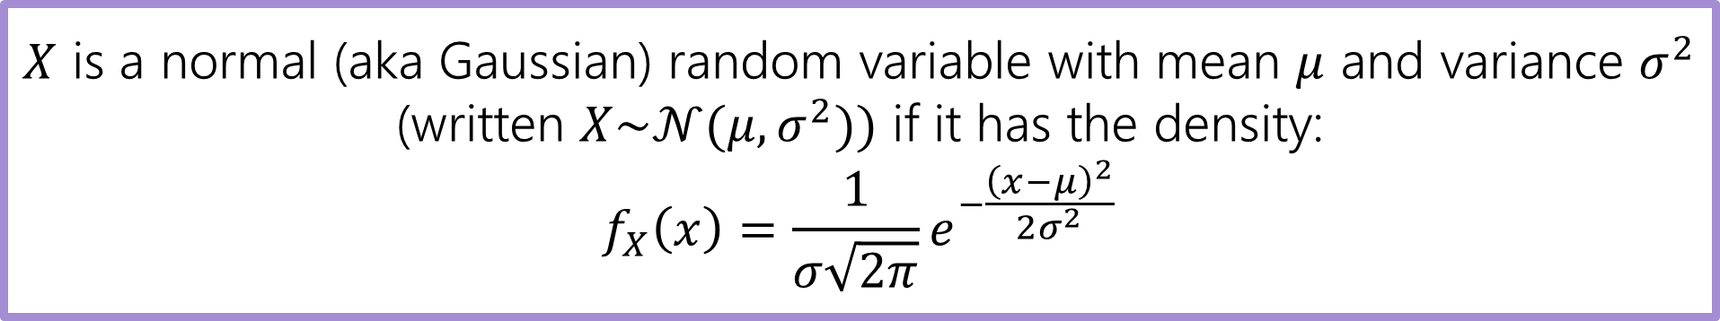
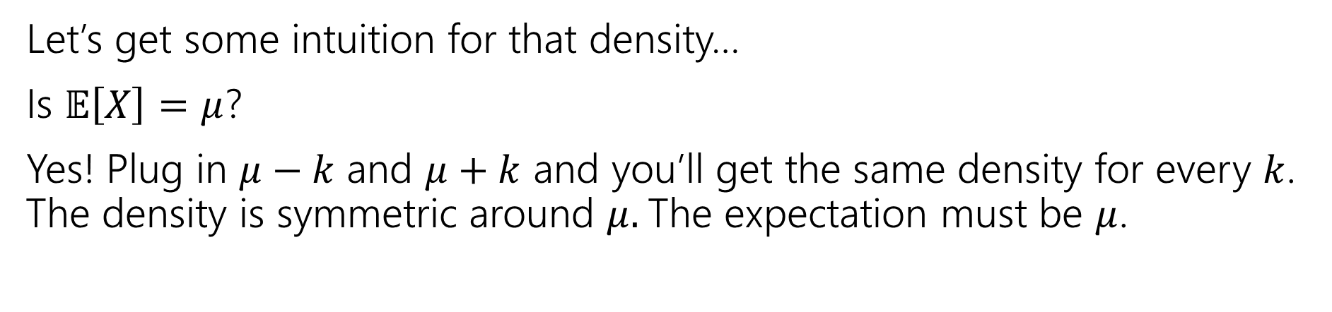
Normal Random Variable
$X$ is a normal (aka Gaussian) random variable with mean $μ$ and variance $σ^{2}$ (written $X\sim 𝒩(μ,σ^{2}))$ if it has the density:
$$f_{X}\left(x\right)=\frac{1}{σ\sqrt{2π}}e^{−\frac{{\left(x−μ\right)}^{2}}{2σ^{2}}}$$
Let’s get some intuition for that density…
Is $𝔼\left[X\right]=μ$?
Yes! Plug in $μ−k$ and $μ+k$ and you’ll get the same density for every $k$. The density is symmetric around $μ.$The expectation must be $μ$.

Slide 16
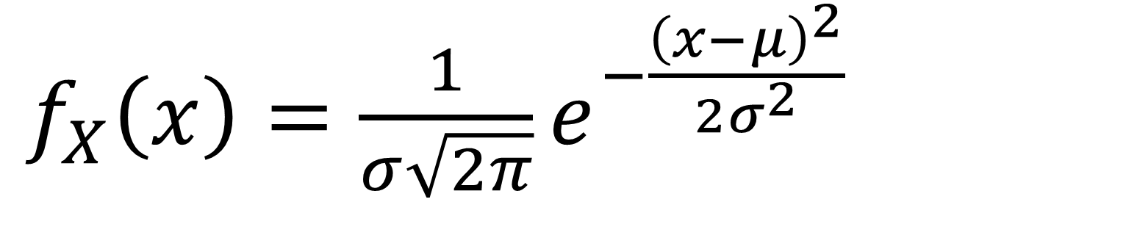
Breaking down the density
$f_{X}\left(x\right)=\frac{1}{σ\sqrt{2π}}e^{−\frac{{\left(x−μ\right)}^{2}}{2σ^{2}}}$

Slide 17
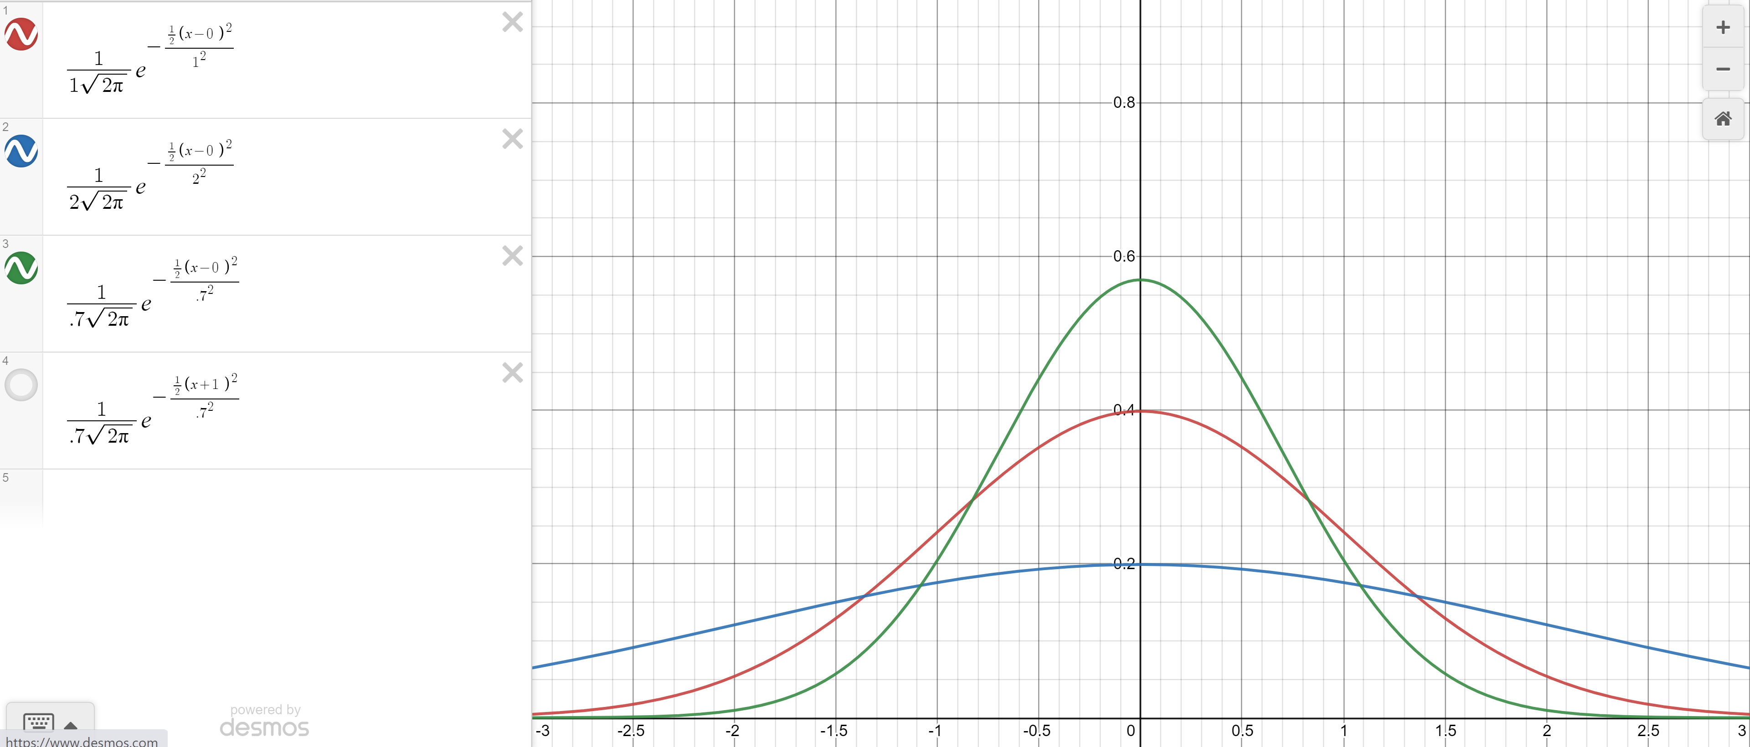

Changing the variance
Green: $σ^{2}=.7$
Red $σ^{2}=1$
Blue: $σ^{2}=2$

Slide 18
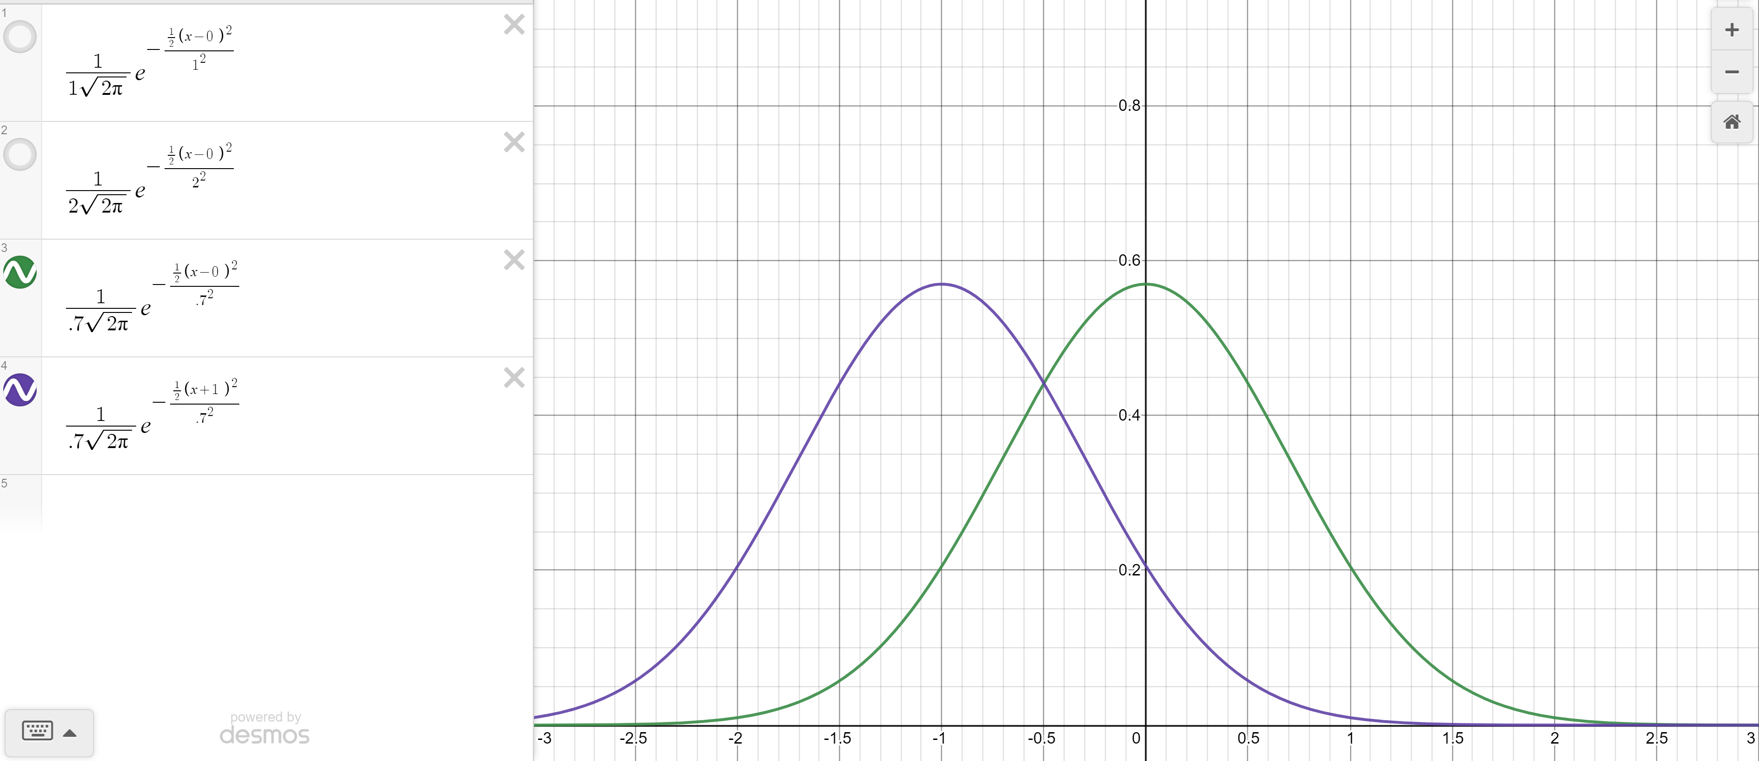

Changing the mean
Green: $σ^{2}=.7, μ=0$
Purple $σ^{2}=.7, μ=−1$

Slide 19
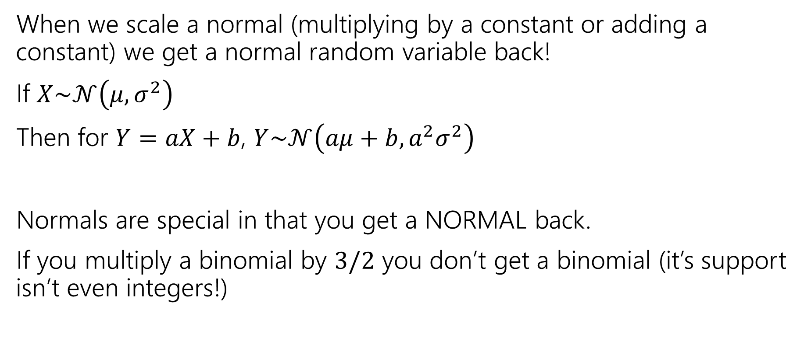
Scaling Normals
When we scale a normal (multiplying by a constant or adding a constant) we get a normal random variable back!
If $X\sim 𝒩\left(μ,σ^{2}\right)$
Then for $Y=aX+b$, $Y\sim 𝒩\left(aμ+b, a^{2}σ^{2}\right)$
Normals are special in that you get a NORMAL back.
If you multiply a binomial by $3/2$ you don’t get a binomial (it’s support isn’t even integers!)

Slide 20
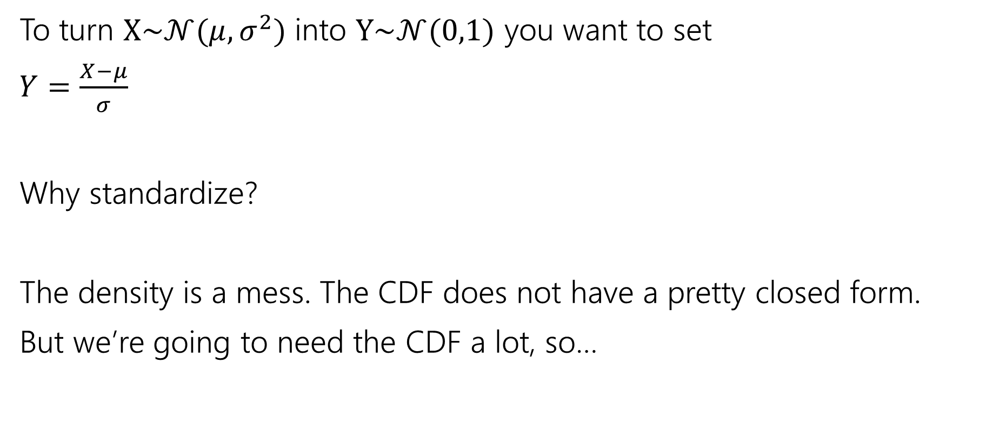
Standardize
To turn $X\sim 𝒩(μ,σ^{2})$ into $Y\sim 𝒩(0,1)$ you want to set
$Y=\frac{X−μ}{σ}$
Why standardize?
The density is a mess. The CDF does not have a pretty closed form.
But we’re going to need the CDF a lot, so…

Slide 21
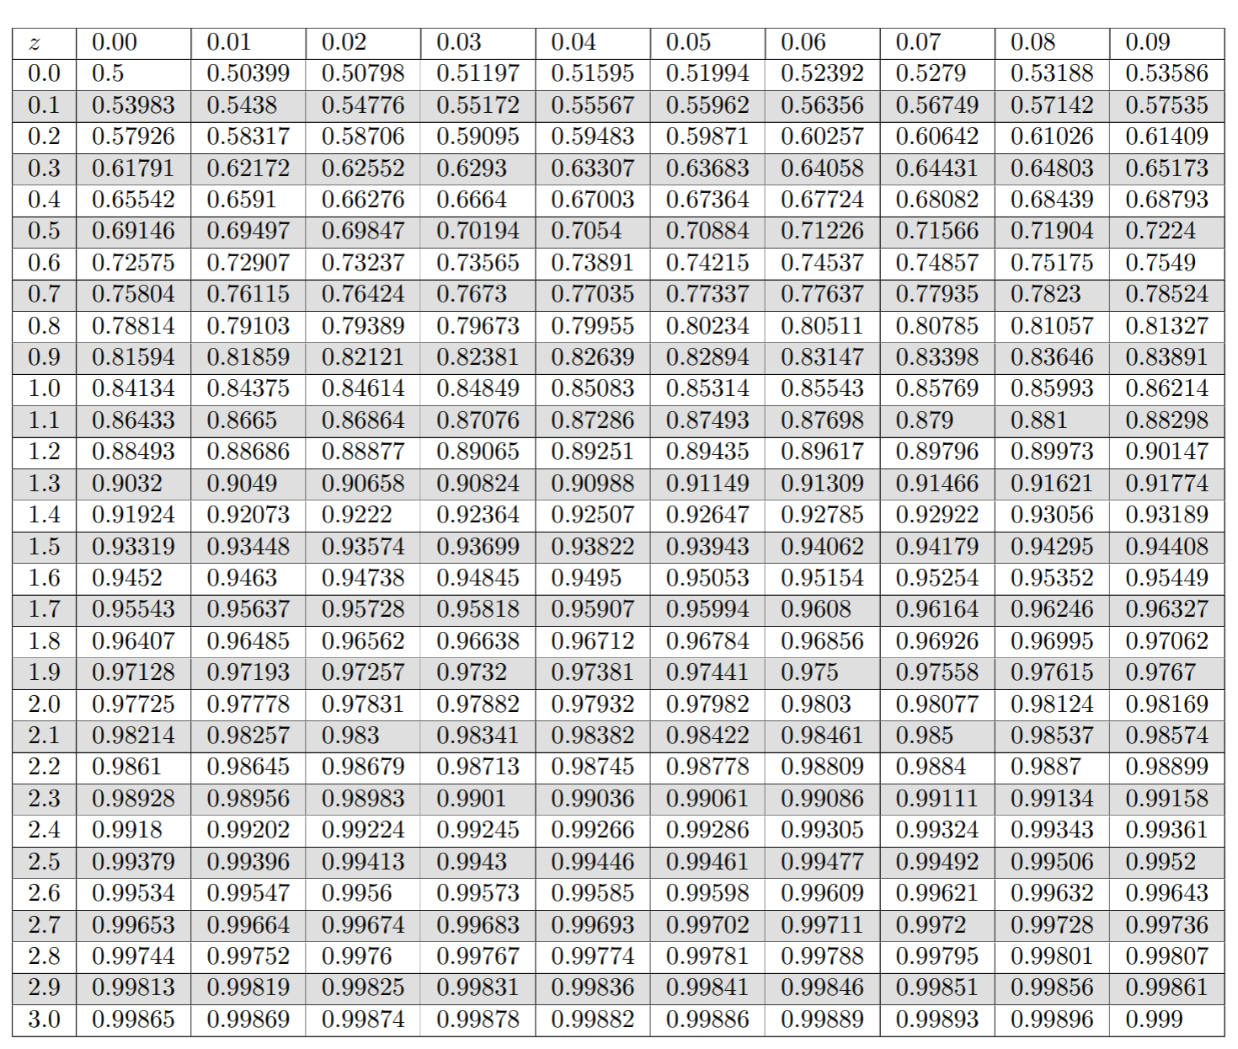
Table of Standard Normal CDF
The way we’ll evaluate the CDF of a normal is to:
1. convert to a standard normal
2. Round the “z-score” to the hundredths place.
3. Look up the value in the table.
It’s 2024, we’re using a table?
The table makes sure we have consistent rounding rules (makes it easier for us to debug with you).
You can’t evaluate this by hand – the “z-score” can give you intuition right away.

Slide 22
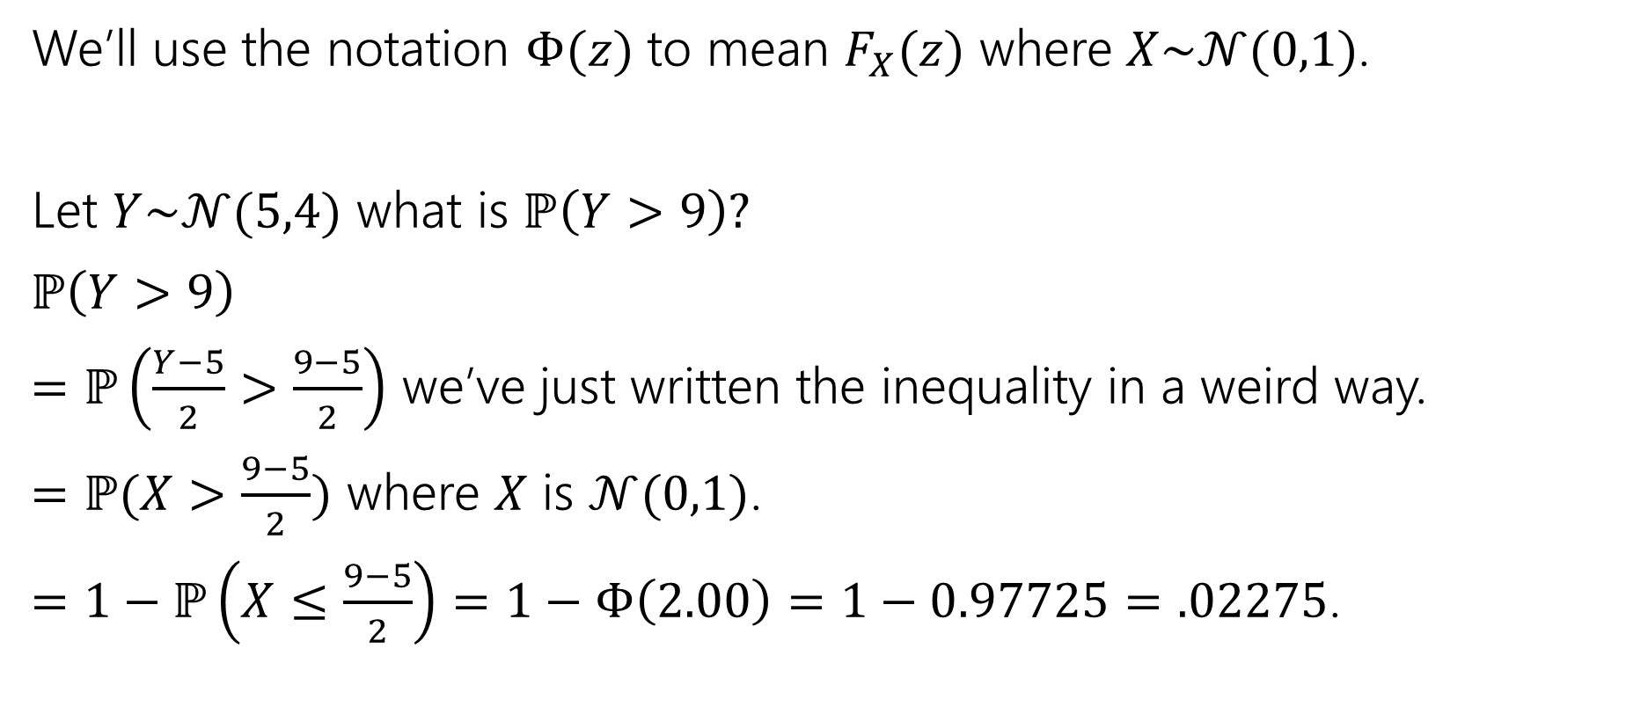
Use the table!
We’ll use the notation $Φ(z)$ to mean $F_{X}(z)$ where $X\sim 𝒩(0,1)$.
Let $Y\sim 𝒩(5,4)$ what is $ℙ\left(Y>9\right)?$
$ℙ\left(Y>9\right)$
$=ℙ\left(\frac{Y−5}{2}>\frac{9−5}{2}\right)$ we’ve just written the inequality in a weird way.
$=ℙ(X>\frac{9−5}{2})$ where $X$ is $𝒩(0,1)$.
$=1−ℙ\left(X≤\frac{9−5}{2}\right)=1−Φ\left(2.00\right)=1−0.97725=.02275$.

Slide 23

Normal (aka Guassian)
$X\sim 𝒩(μ,σ^{2})$
Parameter $μ$ is the expectation; $σ^{2}$ is the variance.
$f_{X}\left(x\right)=\frac{1}{σ\sqrt{2π}}e^{−\frac{{\left(x−μ\right)}^{2}}{2σ^{2}}}$
$F_{X}\left(k\right)$ has no nice closed form. Use the table.
$𝔼\left[X\right]=μ$
$Var\left(X\right)=σ^{2}$

Slide 24

More practice
Let $X\sim 𝒩(3, 2)$.
What is the probability that $1≤X≤4$

Slide 25
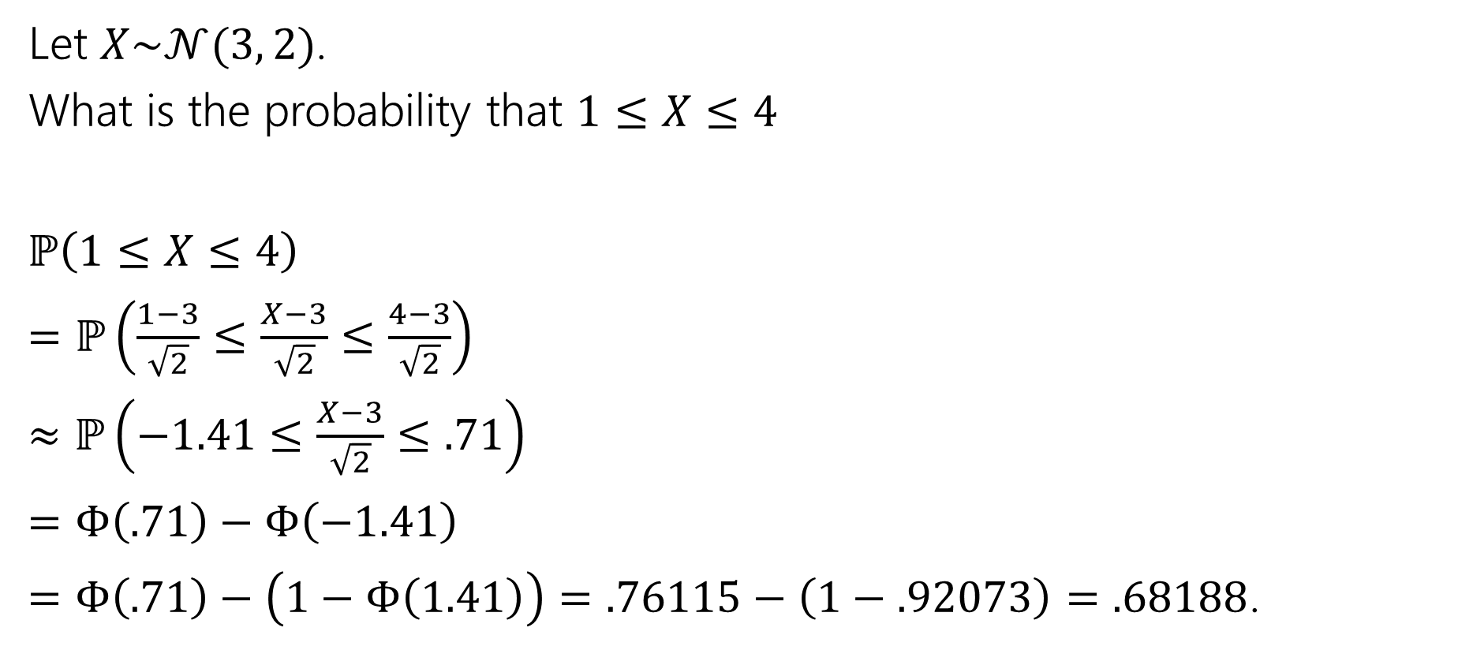
More practice
Let $X\sim 𝒩(3, 2)$.
What is the probability that $1≤X≤4$
$ℙ\left(1≤X≤4\right)$
$=ℙ\left(\frac{1−3}{\sqrt{2}}≤\frac{X−3}{\sqrt{2}}≤\frac{4−3}{\sqrt{2}}\right)$
$≈ℙ\left(−1.41≤\frac{X−3}{\sqrt{2}}≤.71\right)$
$=Φ\left(.71\right)−Φ\left(−1.41\right)$
$=Φ\left(.71\right)−\left(1−Φ\left(1.41\right)\right)=.76115−\left(1−.92073\right)=.68188$.

Slide 26
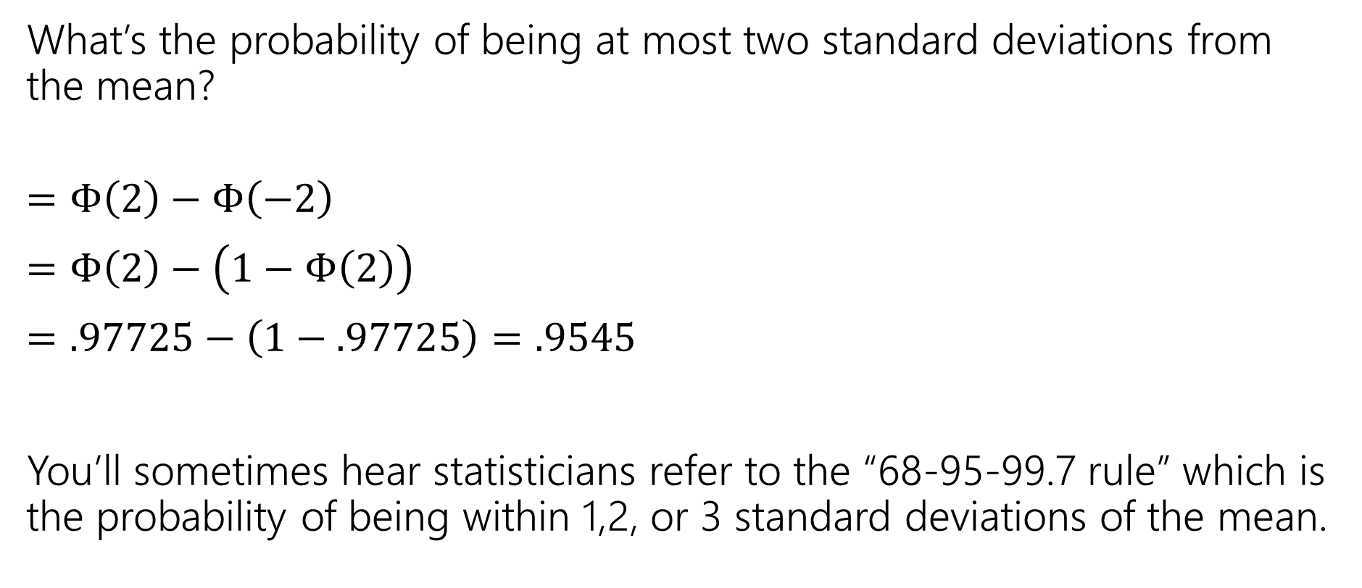
In real life
What’s the probability of being at most two standard deviations from the mean?
$=Φ\left(2\right)−Φ\left(−2\right)$
$=Φ\left(2\right)−\left(1−Φ\left(2\right)\right)$
$=.97725−\left(1−.97725\right)=.9545$
You’ll sometimes hear statisticians refer to the “68-95-99.7 rule” which is the probability of being within 1,2, or 3 standard deviations of the mean.

