Slide 1
Continuous Zoo
CSE 312 Spring 24
Lecture 16

Slide 2
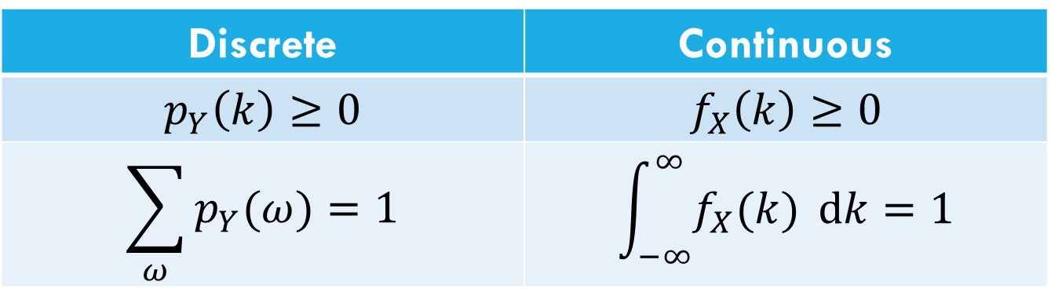
Let’s start with the pmf
For discrete random variables, we defined the pmf: $p_{Y}\left(k\right)=ℙ(Y=k)$.
We can’t have a pmf quite like we did for discrete random variables. Let $X$be a random real number between $0$ and $1$.
$ℙ\left(X=.1\right)=\frac{1}{∞}$??
Let’s try to maintain as many rules as we can…
Discrete | Continuous
$$p_{Y}\left(k\right)≥0$$ | $$f_{X}\left(k\right)≥0$$
$$\sum_{ω}{p_{Y}(ω)}=1$$ | $$\int_{−∞}^{∞}{f_{X}(k)} dk=1$$
Use $f_{X}$ instead of $p_{X}$ to remember it’s different .

Slide 3
The probability density function
For Continuous random variables, the analogous object is the
“probability density function” we write $f_{X}\left(k\right)$ instead of $p_{X}(k)$
Idea: Make it “work right” for events since single outcomes don’t make sense.
$ℙ\left(a≤X≤b\right)=c$
$$\int_{a}^{b}{f_{X}\left(z\right) dz}=c$$
integrating is analogous to sum.

Slide 4
The probability density function
For Continuous random variables, the analogous object is the
“probability density function” we write $f_{X}\left(k\right)$ instead of $p_{X}(k)$
Idea: Make it “work right” for events since single outcomes don’t make sense.
$ℙ\left(a≤X≤b\right)=c$
$$\int_{a}^{b}{f_{X}\left(z\right) dz}=c$$
integrating is analogous to sum.

Slide 5
PDF for uniform
Let $X$ be a uniform real number between $0$ and $1$.
What should $f_{X}(k)$ be to make all those events integrate to the right values?
$f_{X}\left(k\right)=\left\{\begin{aligned}0 if k<0 or k>1 \\ 1 if 0≤k≤1\end{aligned}\right.$

Slide 6
Probability Density Function
So $ℙ\left(X=.1\right)=??$
$f_{X}\left(.1\right)=1$
The number that best represents $ℙ(X=.1)$ is $0$.
This is different from $f_{X}(x)$
So…what is $f_{X}(x)$???
For continuous probability spaces:
Impossible events have probability $0$,
but some probability $0$ events might be possible.

Slide 7
Using the PDF
Let’s look at a different pdf…
Compare the events: $X≈.2$ and $X≈.5$
$ℙ(.2−ε/2≤X≤.2+ε/2)$
What will the pdf give? $\int_{.2−ε/2}^{−2+ε/2}{f_{X}\left(z\right) dz}$
$f_{X}\left(.2\right)⋅ε$
What happens if we look at the ratio
$\frac{ℙ(X≈.2)}{ℙ(X≈.5)}$
.2
.5

Slide 8
Using the PDF
Let’s look at a different pdf…
Compare the events: $X≈.2$ and $X≈.5$
$ℙ(.2−ε/2≤X≤.2+ε/2)$
What will the pdf give? $\int_{.2−ε/2}^{−2+ε/2}{f_{X}\left(z\right) dz}$
$f_{X}\left(.2\right)⋅ε$
What happens if we look at the ratio
$\frac{ℙ(X≈.2)}{ℙ(X≈.5)}=\frac{ℙ\left(.2−\frac{ε}{2}≤X≤.2+\frac{ε}{2}\right)}{ℙ\left(.5−\frac{ε}{2}≤X≤.5+\frac{ε}{2}\right)}=\frac{εf_{X}(.2)}{εf_{X}(.5)}=\frac{f_{X}\left(.2\right)}{f_{X}(.5)}$
.2
.5

Slide 9
So what’s the pdf?
It’s the number that when integrated over gives the probability of an event.
Equivalently, it’s number such that:
-integrating over all real numbers gives 1.
-comparing $f_{X}\left(k\right)$ and $f_{X}(ℓ)$ gives the relative chances of $X$ being near $k$ or $ℓ$.

Slide 10
CDFs

Slide 11
What’s a CDF?
The Cumulative Distribution Function $F_{X}\left(k\right)=ℙ(X≤k)$
analogous to the CDF for discrete variables.
$F_{X}\left(k\right)=ℙ\left(X≤k\right)=\int_{−∞}^{k}{f_{X}\left(z\right) dz}$
So how do I get from CDF to PDF? Taking the derivative!
$\frac{d}{dk}F_{X}(k)=\frac{d}{dk}\left(\int_{−∞}^{k}{f_{X}\left(z\right) dz}\right)=f_{X}(k)$

Slide 12
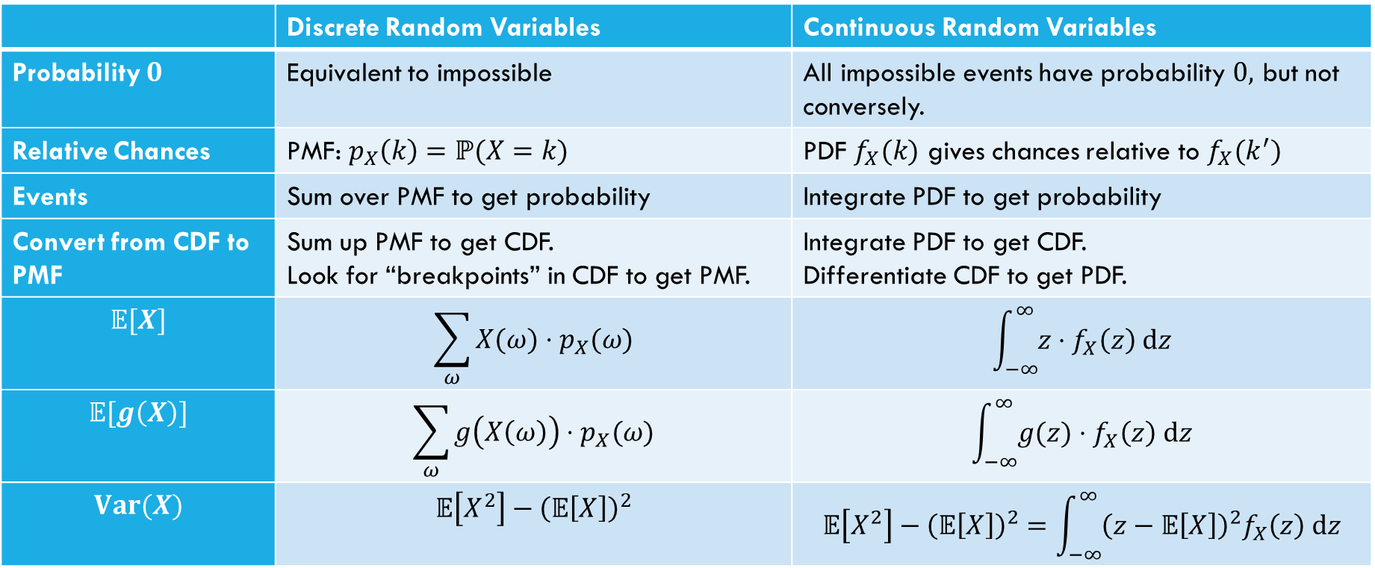
Comparing Discrete and Continuous
 | Discrete Random Variables | Continuous Random Variables
Probability $0$ | Equivalent to impossible | All impossible events have probability $0,$ but not conversely.
Relative Chances | PMF: $p_{X}\left(k\right)=ℙ(X=k)$ | PDF $f_{X}(k)$ gives chances relative to $f_{X}(k^{′})$
Events | Sum over PMF to get probability | Integrate PDF to get probability
Convert from CDF to PMF | Sum up PMF to get CDF. Look for “breakpoints” in CDF to get PMF. | Integrate PDF to get CDF. Differentiate CDF to get PDF.
$$𝔼[X]$$ | $$\sum_{ω}{X(ω)⋅p_{X}(ω)}$$ | $$\int_{−∞}^{∞}{z⋅f_{X}\left(z\right) dz}$$
$$𝔼[g\left(X\right)]$$ | $$\sum_{ω}{g\left(X\left(ω\right)\right)⋅p_{X}(ω)}$$ | $$\int_{−∞}^{∞}{g(z)⋅f_{X}\left(z\right) dz}$$
$$Var(X)$$ | $$𝔼\left[X^{2}\right]−{\left(𝔼\left[X\right]\right)}^{2}$$ | $$𝔼\left[X^{2}\right]−{\left(𝔼\left[X\right]\right)}^{2}=\int_{−∞}^{∞}{{\left(z−𝔼\left[X\right]\right)}^{2}f_{X}\left(z\right) dz}$$

Slide 13
What about expectation?
For a random variable $X$, we define:
$𝔼\left[X\right]=\int_{−∞}^{∞}{{X(z)⋅f}_{X}\left(z\right) dz}$
Just replace summing over the pmf with integrating the pdf.
It still represents the average value of $X$.

Slide 14
Expectation of a function
For any function $g$ and any continuous random variable, $X:$
$𝔼\left[g\left(X\right)\right]=\int_{−∞}^{∞}{g\left(X(z)\right)⋅f_{X}\left(z\right) dz}$
Again, analogous to the discrete case; just replace summation with integration and pmf with the pdf.
We’re going to treat this as a definition.
Technically, this is really a theorem; since $f()$ is the pdf of $X$ and it only gives relative likelihoods for $X$, we need a proof to guarantee it “works” for $g(X)$.
Sometimes called “Law of the Unconscious Statistician.”

Slide 15
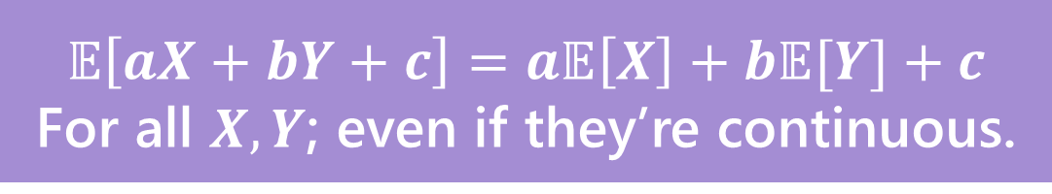
Linearity of Expectation
Still true!
Won’t show you the proof – for just $𝔼[aX+b]$, it’s
$𝔼\left[aX+b\right]=\int_{−∞}^{∞}{\left[aX\left(k\right)+b\right]f_{X}(k) dk}$
$=\int_{−∞}^{∞}{aX\left(k\right)f_{X}\left(k\right)dk}+\int_{−∞}^{∞}{bf_{X}\left(k\right)dk}$
$=a\int_{−∞}^{∞}{X\left(k\right)f_{X}\left(k\right)dk}+b\int_{−∞}^{∞}{f_{X}\left(k\right)dk}$
$=a𝔼\left[X\right]+b$
$$𝔼\left[aX+bY+c\right]=a𝔼\left[X\right]+b𝔼[Y]+c$$
For all $X,Y$; even if they’re continuous.

Slide 16
Variance
No surprises here
$$Var\left(X\right)=𝔼\left[X^{2}\right]−{\left(𝔼\left[X\right]\right)}^{2}=\int_{−∞}^{∞}{{f_{X}(k)\left(X\left(k\right)−𝔼\left[X\right]\right)}^{2} dk}$$

Slide 17
Let’s calculate an expectation
Let $X$ be a uniform random number between $a$ and$b$.
$𝔼\left[X\right]=\int_{−∞}^{∞}{z⋅f_{X}\left(z\right) dz}$
$=\int_{−∞}^{a}{z⋅0 dz}+\int_{a}^{b}{z⋅\frac{1}{b−a}dz}+\int_{b}^{∞}{z⋅0}dz$
$=0+\int_{a}^{b}{\frac{z}{b−a} dz+0}$
$={{\left.\frac{z^{2}}{2(b−a)}\right|}^{b}}_{z=a}=\frac{b^{2}}{2(b−a)}−\frac{a^{2}}{2\left(b−a\right)}=\frac{b^{2}−a^{2}}{2\left(b−a\right)}=\frac{\left(b+a\right)\left(b−a\right)}{2\left(b−a\right)}=\frac{a+b}{2}$

Slide 18
What about $𝔼\left[g\left(X\right)\right]$
Let $X\sim Unif(a,b)$, what about $𝔼\left[X^{2}\right]$?
$𝔼\left[X^{2}\right]=\int_{−∞}^{∞}{z^{2}f_{X}\left(z\right)dz}$
$=\int_{−∞}^{a}{z^{2}⋅0 dz+\int_{a}^{b}{z^{2}⋅\frac{1}{b−a}dz}+\int_{b}^{∞}{z^{2}⋅0 dz}}$
$=0+\int_{a}^{b}{z^{2}⋅\frac{1}{b−a}dz}+0$
$=\frac{1}{b−a}⋅{{\left.\frac{z^{3}}{3}\right|}^{b}}_{z=a}=\frac{1}{b−a}\left(\frac{b^{3}}{3}−\frac{a^{3}}{3}\right)=\frac{1}{3\left(b−a\right)}⋅\left(b−a\right)\left(a^{2}+ab+b^{2}\right)$
$=\frac{a^{2}+ab+b^{2}}{3}$

Slide 19
Let’s assemble the variance
$Var\left(X\right)=𝔼\left[X^{2}\right]−{\left(𝔼\left[X\right]\right)}^{2}$
$=\frac{a^{2}+ab+b^{2}}{3}−{\left(\frac{a+b}{2}\right)}^{2}$
$=\frac{4(a^{2}+ab+b^{2})}{12}−\frac{{3(a}^{2}+2ab+b^{2})}{12}$
$=\frac{a^{2}−2ab+b^{2}}{12}$
$=\frac{{\left(a−b\right)}^{2}}{12}$

Slide 20
Continuous Uniform Distribution
$X\sim Unif(a,b)$ (uniform real number between $a$ and $b$)
PDF: $f_{X}\left(k\right)=\left\{\begin{aligned}\frac{1}{b−a} if a≤k≤b \\ 0 otherwise\end{aligned}\right.$
CDF: $F_{X}\left(k\right)=\left\{\begin{aligned}0 if k<a \\ \frac{k−a}{b−a} if a≤k≤b \\ 1 if k≥b\end{aligned}\right.$
$𝔼\left[X\right]=\frac{a+b}{2}$
$Var\left(X\right)=\frac{{\left(b−a\right)}^{2}}{12}$

Slide 21
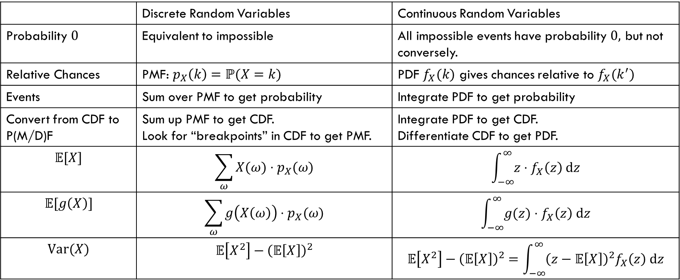
Comparing Discrete and Continuous
 | Discrete Random Variables | Continuous Random Variables
Probability $0$ | Equivalent to impossible | All impossible events have probability $0,$ but not conversely.
Relative Chances | PMF: $p_{X}\left(k\right)=ℙ(X=k)$ | PDF $f_{X}(k)$ gives chances relative to $f_{X}(k^{′})$
Events | Sum over PMF to get probability | Integrate PDF to get probability
Convert from CDF to P(M/D)F | Sum up PMF to get CDF. Look for “breakpoints” in CDF to get PMF. | Integrate PDF to get CDF. Differentiate CDF to get PDF.
$$𝔼[X]$$ | $$\sum_{ω}{X(ω)⋅p_{X}(ω)}$$ | $$\int_{−∞}^{∞}{z⋅f_{X}\left(z\right) dz}$$
$$𝔼[g\left(X\right)]$$ | $$\sum_{ω}{g\left(X\left(ω\right)\right)⋅p_{X}(ω)}$$ | $$\int_{−∞}^{∞}{g(z)⋅f_{X}\left(z\right) dz}$$
$$Var(X)$$ | $$𝔼\left[X^{2}\right]−{\left(𝔼\left[X\right]\right)}^{2}$$ | $$𝔼\left[X^{2}\right]−{\left(𝔼\left[X\right]\right)}^{2}=\int_{−∞}^{∞}{{\left(z−𝔼\left[X\right]\right)}^{2}f_{X}\left(z\right) dz}$$

Slide 22
Continuous Zoo
$$X\sim Unif(a,b)$$
$$X\sim Exp(λ)$$
$$X\sim 𝒩(μ,σ^{2})$$
$$f_{X}\left(k\right)=\frac{1}{b−a}$$
$$𝔼\left[X\right]=\frac{a+b}{2}$$
$$Var\left(X\right)=\frac{{\left(b−a\right)}^{2}}{12}$$
$f_{X}\left(k\right)=λe^{−λk}$ for $k≥0$
$$𝔼\left[X\right]=\frac{1}{λ}$$
$$Var\left(X\right)=\frac{1}{λ^{2}}$$
$$f_{X}\left(k\right)=\frac{1}{σ\sqrt{2π}}exp\left(−\frac{{\left(x−μ\right)}^{2}}{2σ^{2}}\right)$$
$$𝔼\left[X\right]=μ$$
$$Var\left(X\right)=σ^{2}$$
It’s a smaller zoo, but it’s just as much fun!

Slide 23
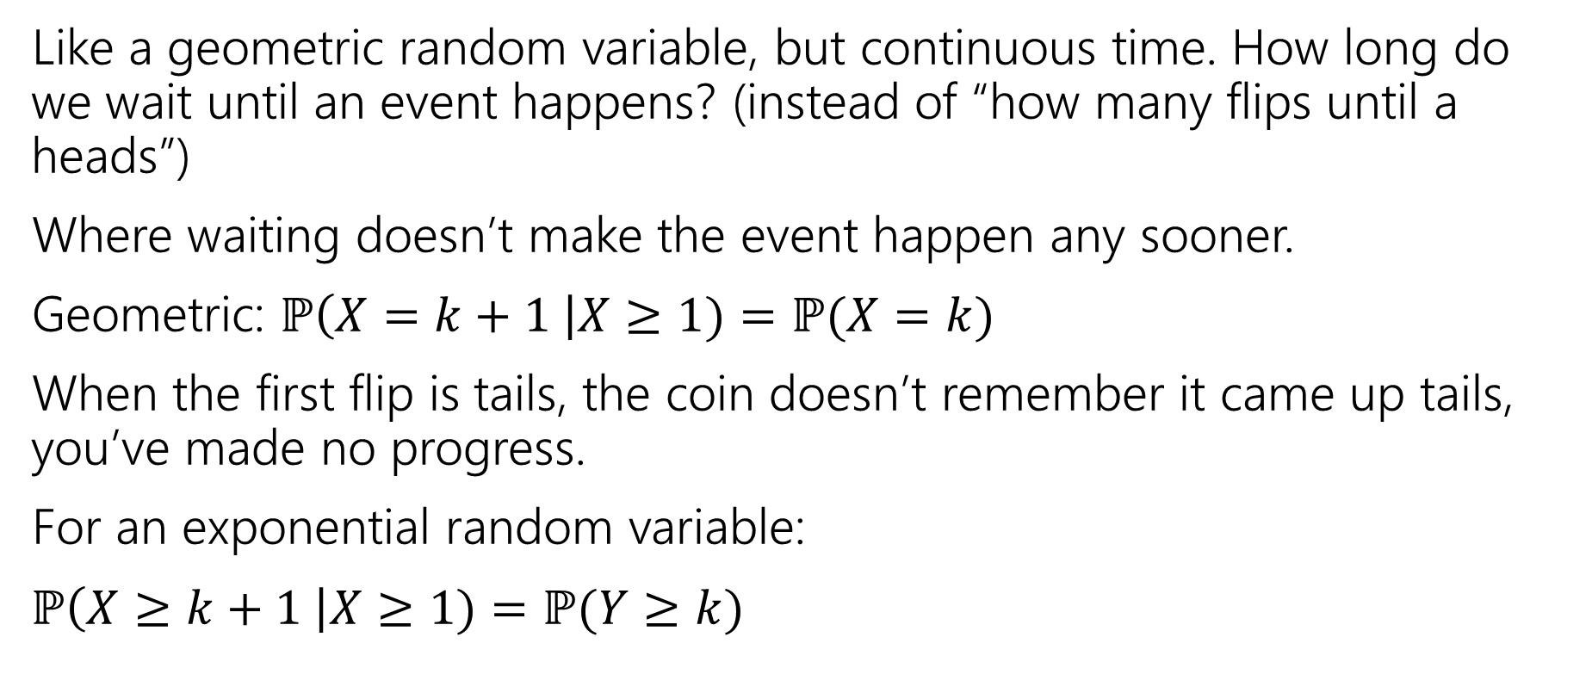
Exponential Random Variable
Like a geometric random variable, but continuous time. How long do we wait until an event happens? (instead of “how many flips until a heads”)
Where waiting doesn’t make the event happen any sooner.
Geometric: $ℙ\left(X=k+1 \right|X≥1)=ℙ(X=k)$
When the first flip is tails, the coin doesn’t remember it came up tails, you’ve made no progress.
For an exponential random variable:
$ℙ\left(X≥k+1 \right|X≥1)=ℙ(Y≥k)$

Slide 24
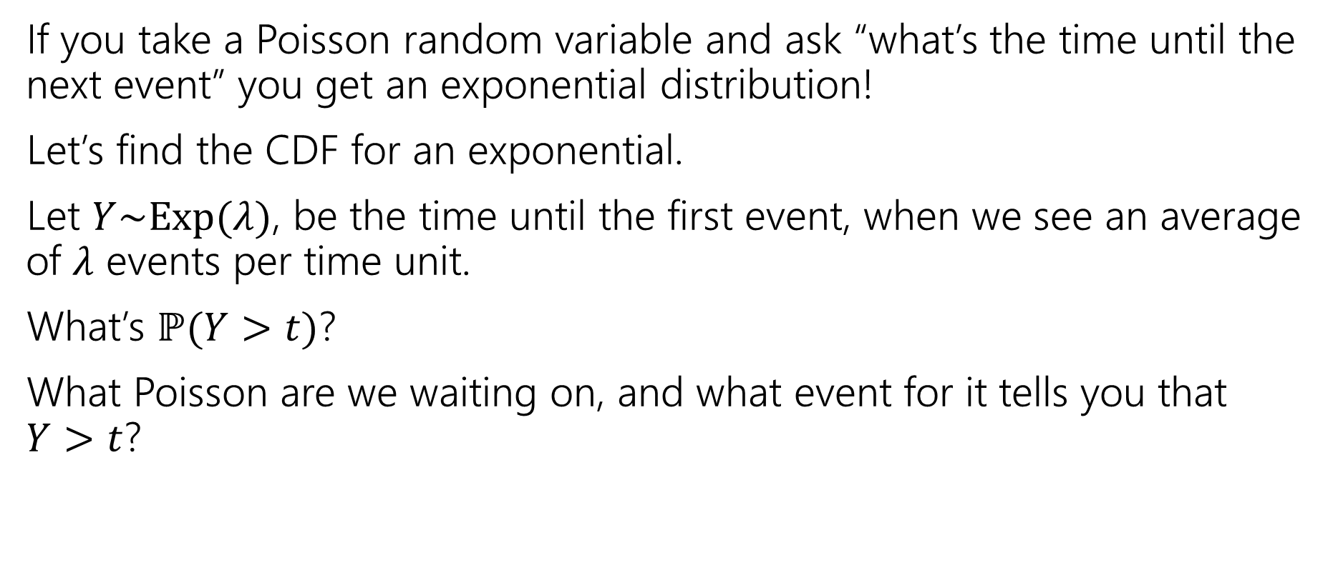
Exponential random variable
If you take a Poisson random variable and ask “what’s the time until the next event” you get an exponential distribution!
Let’s find the CDF for an exponential.
Let $Y\sim Exp(λ)$, be the time until the first event, when we see an average of $λ$ events per time unit.
What’s $ℙ(Y>t)$?
What Poisson are we waiting on, and what event for it tells you that
$Y>t$?

Slide 25
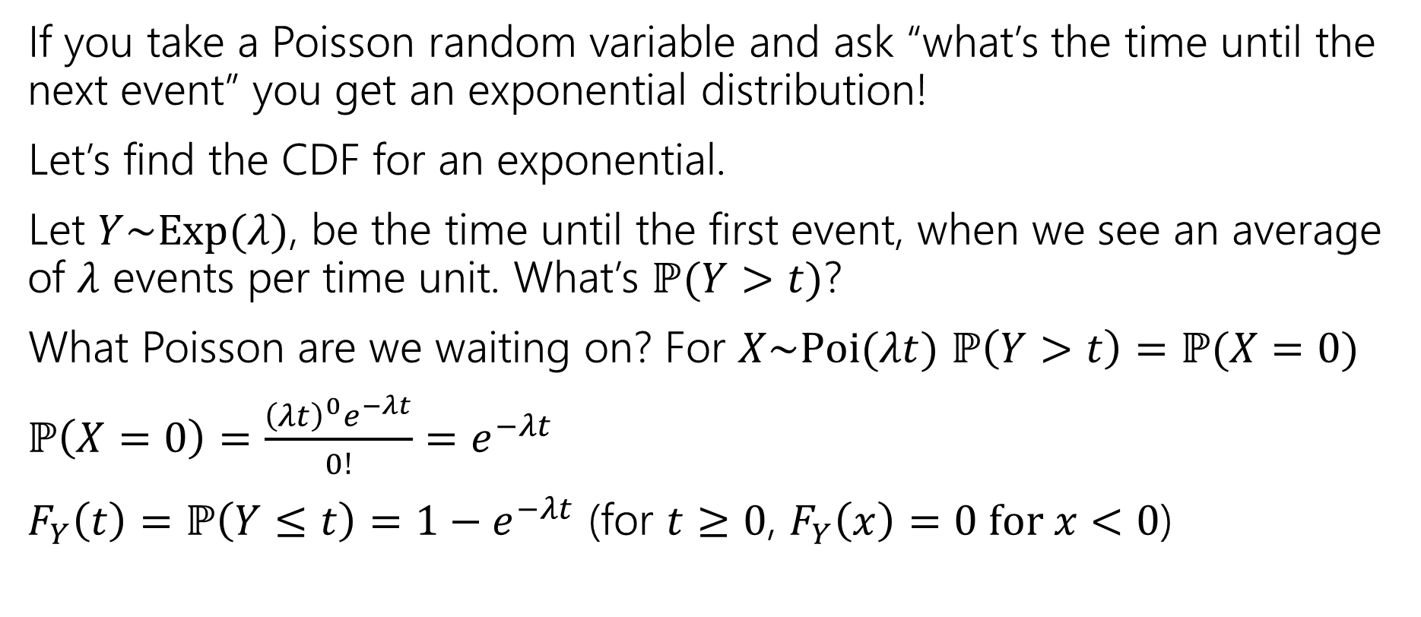
Exponential random variable
If you take a Poisson random variable and ask “what’s the time until the next event” you get an exponential distribution!
Let’s find the CDF for an exponential.
Let $Y\sim Exp(λ)$, be the time until the first event, when we see an average of $λ$ events per time unit. What’s $ℙ(Y>t)$?
What Poisson are we waiting on? For $X\sim Poi(λt)$ $ℙ\left(Y>t\right)=ℙ(X=0)$
$ℙ\left(X=0\right)=\frac{{\left(λt\right)}^{0}e^{−λt}}{0!}=e^{−λt}$
$F_{Y}\left(t\right)=ℙ\left(Y≤t\right)=1−e^{−λt}$ (for $t≥0$, $F_{Y}\left(x\right)=0 for x<0$)

Slide 26
Find the density
We know the CDF, $F_{Y}\left(t\right)=ℙ\left(Y≤t\right)=1−e^{−λt}$
What’s the density?
$f_{Y}\left(t\right)=$

Slide 27
Find the density
We know the CDF, $F_{Y}\left(t\right)=ℙ\left(Y≤t\right)=1−e^{−λt}$
What’s the density?
$f_{Y}\left(t\right)=\frac{d}{dt}\left(1−e^{−λt}\right)=0−\frac{d}{dt}\left(e^{−λt}\right)=λe^{−λt}$.
For $t≥0$ it’s that expression
For $t<0$ it’s just $0.$

Slide 28
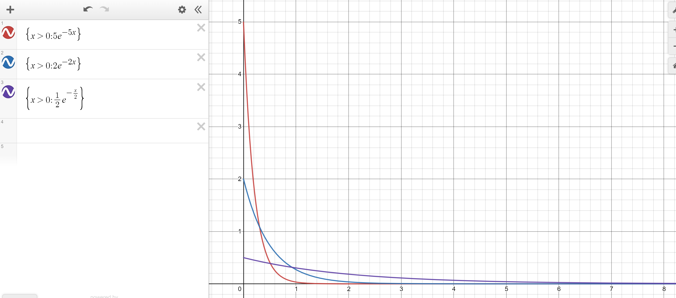
Exponential PDF
Red: $λ=5$
Blue: $λ=2$
Purple: $λ=0.5$

Slide 29
Memorylessness
$ℙ\left(X≥k+1 | X≥1\right)=\frac{ℙ(X≥k+1∩X≥1)}{ℙ(X≥1)}=\frac{ℙ(X≥k+1)}{1−(1−e^{−λ⋅1})}$
$=\frac{e^{−λ(k+1)}}{e^{−λ}}=e^{−λk}$
What about $ℙ(X≥k)$ (without conditioning on the first step)?
${1−(1−e}^{−λk})=e^{−λk}$
It’s the same!!!
More generally, for an exponential rv $X,$ $ℙ\left(X≥s+t | X≥s\right)=ℙ(X≥t)$

Slide 30
Side note
I hid a trick in that algebra,
$ℙ\left(X≥1\right)=1−ℙ\left(X<1\right)=1−ℙ(X≤1)$
The first step is the complementary law.
The second step is using that $\int_{1}^{1}{f_{X}\left(z\right)dz}=0$
In general, for continuous random variables we can switch out $≤$ and $<$without anything changing.
  We can’t make those switches for discrete random variables.

Slide 31
Expectation of an exponential
Don’t worry about the derivation (it’s here if you’re interested; you’re not responsible for the derivation. Just the value.
Let $X\sim Exp(λ)$
$𝔼\left[X\right]=\int_{−∞}^{∞}{{z⋅f}_{X}\left(z\right)dz}$
$=\int_{0}^{∞}{z⋅λe^{−λz}}dz$
Let $u=z; dv=λe^{−λz}dz$ ($v=−e^{−λz}$)
Integrate by parts:$−ze^{−λz}−\int{−e^{−λz}}dz=−ze^{−λz}−\frac{1}{λ}e^{−λz}$
Definite Integral:$−ze^{−λz}−\frac{1}{λ}e^{−λz}{\left.​\right|}_{z=0}^{∞}=(\lim_{z→∞}{−ze^{−λz}−\frac{1}{λ}e^{−λz}) −(0−\frac{1}{λ})}$
By L’Hopital’s Rule $(\lim_{z→∞}{−\frac{z}{e^{λz}}−\frac{1}{λe^{λz}}) −(0−\frac{1}{λ})}=\left(\lim_{z→∞}−\frac{1}{λe^{λz}}\right)+\frac{1}{λ}=\frac{1}{λ}$

Slide 32
Variance of an exponential
If $X\sim Exp\left(λ\right)then Var\left(X\right)=\frac{1}{λ^{2}}$
Similar calculus tricks will get you there.

Slide 33
Exponential
$X\sim Exp(λ)$
Parameter $λ≥0$ is the average number of events in a unit of time.
$f_{X}\left(k\right)=\left\{\begin{aligned}λe^{−λk} if k≥0 \\ 0 otherwise\end{aligned}\right.$
$F_{X}\left(k\right)=\left\{\begin{aligned}1−e^{−λk} if k≥0 \\ 0 otherwise\end{aligned}\right.$
$𝔼\left[X\right]=\frac{1}{λ}$
$Var\left(X\right)=\frac{1}{λ^{2}}$

Slide 34

What about $𝔼\left[g\left(X\right)\right]$
Let $X\sim Unif(a,b)$, what about $𝔼\left[X^{2}\right]$?
$𝔼\left[X^{2}\right]=$

Slide 35


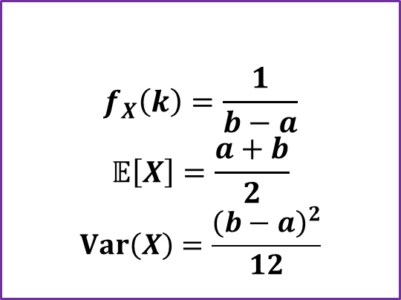
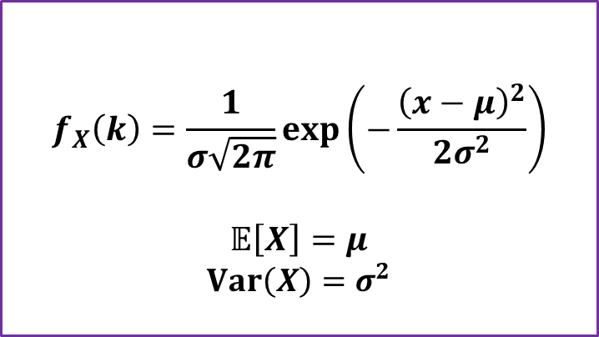

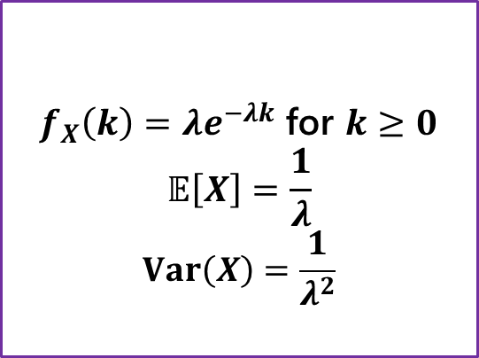
Continuous Zoo
$$X\sim Unif(a,b)$$
$$X\sim Exp(λ)$$
$$X\sim 𝒩(μ,σ^{2})$$
$$f_{X}\left(k\right)=\frac{1}{b−a}$$
$$𝔼\left[X\right]=\frac{a+b}{2}$$
$$Var\left(X\right)=\frac{{\left(b−a\right)}^{2}}{12}$$
$f_{X}\left(k\right)=λe^{−λk}$ for $k≥0$
$$𝔼\left[X\right]=\frac{1}{λ}$$
$$Var\left(X\right)=\frac{1}{λ^{2}}$$
$$f_{X}\left(k\right)=\frac{1}{σ\sqrt{2π}}exp\left(−\frac{{\left(x−μ\right)}^{2}}{2σ^{2}}\right)$$
$$𝔼\left[X\right]=μ$$
$$Var\left(X\right)=σ^{2}$$
It’s a smaller zoo, but it’s just as much fun!

