Slide 1
More Independence; Variance
CSE 312 Spring 24
Lecture 11

Slide 2
More Independence

Slide 3
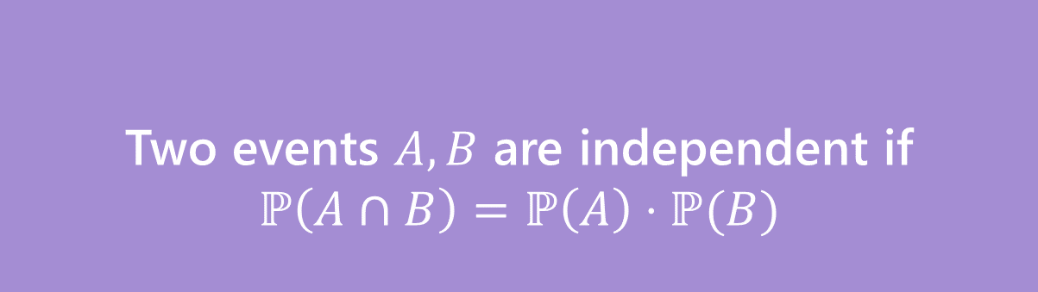
Independence of events
Recall the definition of independence of events:
Two events $A,B$ are independent if
$$ℙ\left(A∩B\right)=ℙ\left(A\right)⋅ℙ(B)$$
Independence

Slide 4

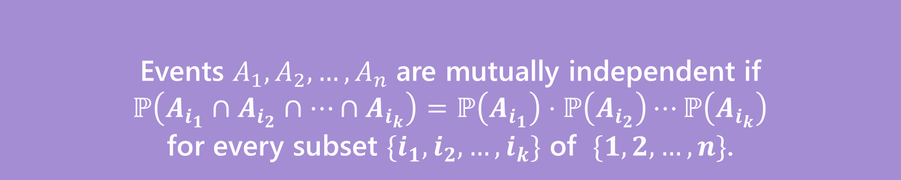
Independence for 3 or more events
For three or more events, we need two kinds of independence
Events $A_{1},A_{2},…,A_{n}$ are pairwise independent if
$ℙ\left(A_{i}∩A_{j}\right)=ℙ\left(A_{i}\right)⋅ℙ\left(A_{j}\right)$ for all $i,j$
Pairwise Independence
Events $A_{1},A_{2},…,A_{n}$ are mutually independent if
$ℙ\left(A_{i_{1}}∩A_{i_{2}}∩…∩A_{i_{k}}\right)=ℙ\left(A_{i_{1}}\right)⋅ℙ\left(A_{i_{2}}\right)⋯ℙ\left(A_{i_{k}}\right)$
for every subset $\{i_{1},i_{2},…,i_{k}\}$ of $\{1,2,…,n\}$.
Mutual Independence

Slide 5

Independence of Random Variables
That’s for events…what about random variables?
$X$ and $Y$ are independent if for all $k,ℓ$
$$ℙ\left(X=k, Y=ℓ\right)=ℙ\left(X=k\right)ℙ(Y=ℓ)$$
Independence (of random variables)
We’ll often use commas instead of $∩$ symbol.

Slide 6

Independence of Random Variables
The “for all values” is important.
We say that the event “the sum is 7” is independent of “the red die is 5”
What about $S=$“the sum of two dice” and $R=$“the value of the red die”

Slide 7
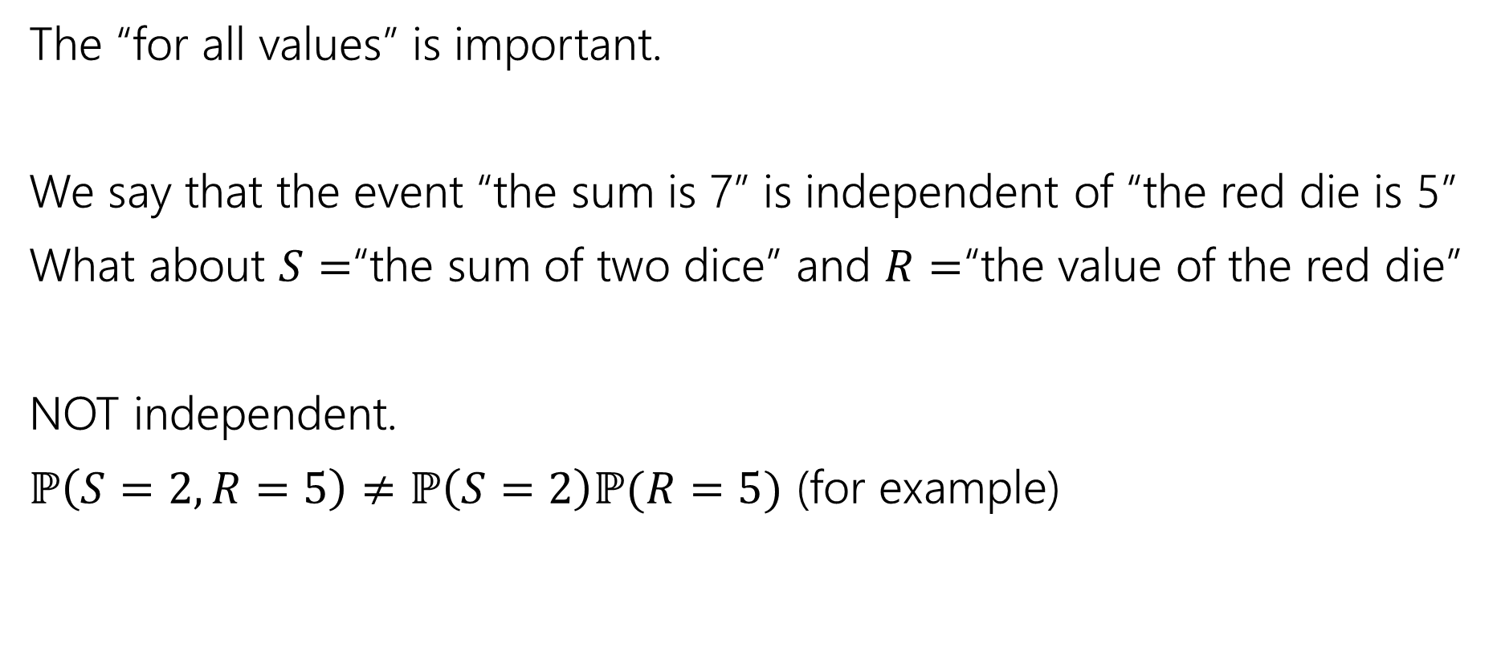
Independence of Random Variables
The “for all values” is important.
We say that the event “the sum is 7” is independent of “the red die is 5”
What about $S=$“the sum of two dice” and $R=$“the value of the red die”
NOT independent.
$ℙ\left(S=2, R=5\right)≠ℙ\left(S=2\right)ℙ(R=5)$ (for example)

Slide 8

Independence of Random Variables
Flip a coin independently $2n$ times.
Let $X$ be “the number of heads in the first $n$ flips.”
Let $Y$ be “the number of heads in the last $n$ flips.”
$X$ and $Y$ are independent.

Slide 9

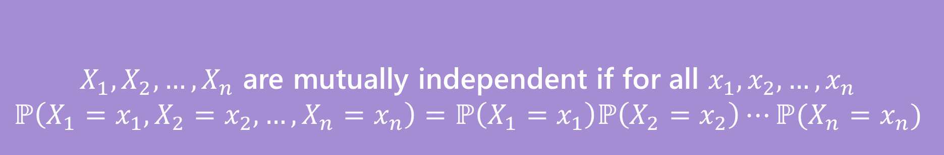
Mutual Independence for RVs
A little simpler to write down than for events
DON’T need to check all subsets for random variables…
But you do need to check all values (all possible $x_{i}$) still.
$X_{1},X_{2},…,X_{n}$ are mutually independent if for all $x_{1},x_{2},…,x_{n}$
$$ℙ\left(X_{1}=x_{1}, X_{2}=x_{2},…,X_{n}=x_{n}\right)=ℙ\left(X_{1}=x_{1}\right)ℙ\left(X_{2}=x_{2}\right)⋯ℙ(X_{n}=x_{n})$$
Mutual Independence (of random variables)
Notes:
Wait but why don’t we need different kinds of independence? It turns out for RVs that it doesn’t make a difference. The intuition here is that it comes from the “for all x_i” condition. Any random variable that *isn’t* mentioned just “factors out” when you evaluate either the left or right hand-side. That’s because you must handle *all* values, the same doesn’t happen for events.

Slide 10
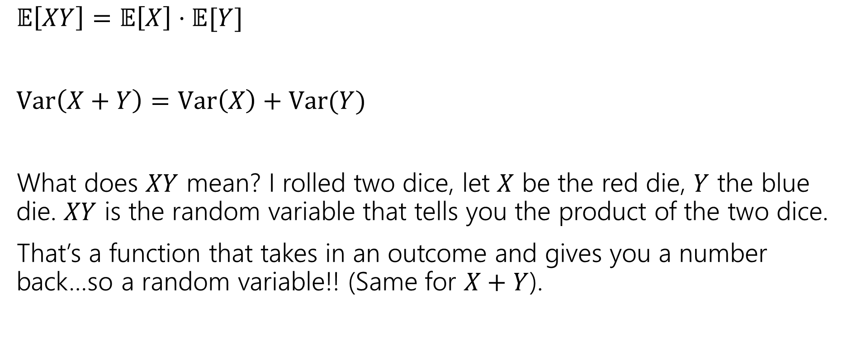
What does Independence give you?
$𝔼\left[XY\right]=𝔼\left[X\right]⋅𝔼[Y]$
$Var\left(X+Y\right)=Var\left(X\right)+Var(Y)$
What does $XY$ mean? I rolled two dice, let $X$ be the red die, $Y$ the blue die. $XY$ is the random variable that tells you the product of the two dice.
That’s a function that takes in an outcome and gives you a number back…so a random variable!! (Same for $X+Y$).

Slide 11
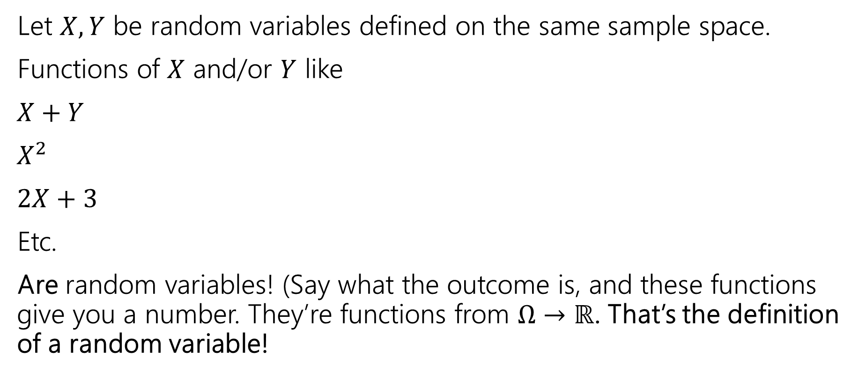
Functions of a random variable
Let $X,Y$ be random variables defined on the same sample space.
Functions of $X$ and/or $Y$ like
$X+Y$
$X^{2}$
$2X+3$
Etc.
Are random variables! (Say what the outcome is, and these functions give you a number. They’re functions from $Ω→ℝ$. That’s the definition of a random variable!

Slide 12
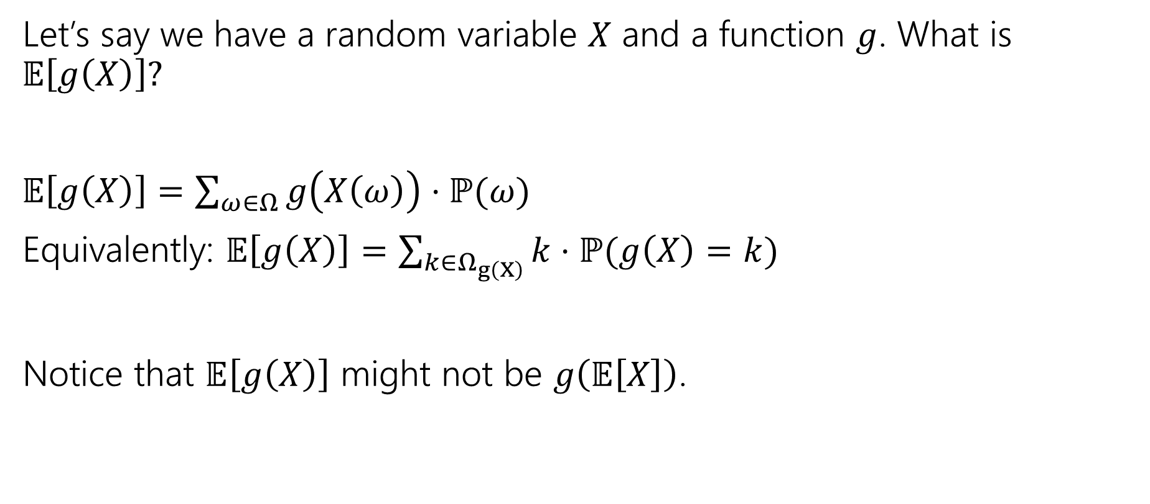
Expectations of functions of random variables
Let’s say we have a random variable $X$ and a function $g$. What is $𝔼\left[g\left(X\right)\right]?$
$𝔼\left[g\left(X\right)\right]=\sum_{ω∈Ω}{g\left(X\left(ω\right)\right)⋅ℙ(ω)}$
Equivalently: $𝔼\left[g\left(X\right)\right]=\sum_{k∈Ω_{g\left(X\right)}}{k⋅ℙ(g\left(X\right)=k)}$
Notice that $𝔼\left[g\left(X\right)\right]$ might not be $g\left(𝔼\left[X\right]\right)$.

Slide 13
Variance

Slide 14
Where are we?
A random variable is a way to summarize what outcome you saw.
The Expectation of a random variable is its average value.
A way to summarize a random variable

Slide 15
Variance
Another one number summary of a random variable.
But wait, we already have expectation, what’s this for?

Slide 16
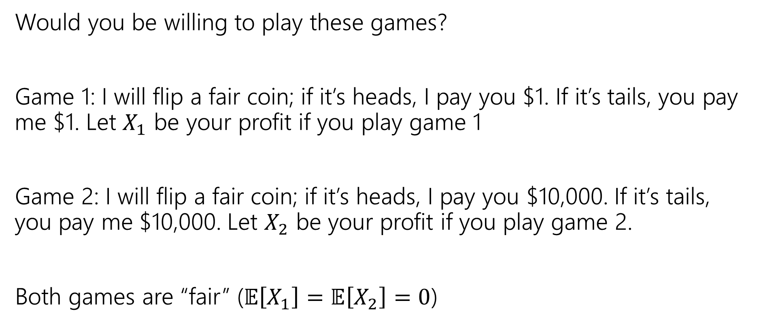
Consider these two games
Would you be willing to play these games?
Game 1: I will flip a fair coin; if it’s heads, I pay you $1. If it’s tails, you pay me $1. Let $X_{1}$ be your profit if you play game 1
Game 2: I will flip a fair coin; if it’s heads, I pay you $10,000. If it’s tails, you pay me $10,000. Let $X_{2}$ be your profit if you play game 2.
Both games are “fair” ($𝔼\left[X_{1}\right]=𝔼\left[X_{2}\right]=0$)

Slide 17
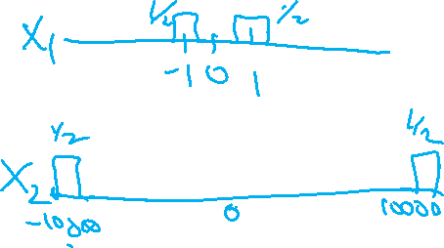
Consider these two games
Would you be willing to play these games?
Game 1: I will flip a fair coin; if it’s heads, I pay you $1. If it’s tails, you pay me $1. Let $X_{1}$ be your profit if you play game 1
Game 2: I will flip a fair coin; if it’s heads, I pay you $10,000. If it’s tails, you pay me $10,000. Let $X_{2}$ be your profit if you play game 2.
Both games are “fair” ($𝔼\left[X_{1}\right]=𝔼\left[X_{2}\right]=0$)

Slide 18
What’s the difference
Expectation tells you what the average will be…
But it doesn’t tell you how “extreme” your results could be.
Nor how likely those extreme results are.
Game 2 has many (well, only) very extreme results.
In expectation they “cancel out” but if you can only play once…
…it would be nice to measure that.

Slide 19
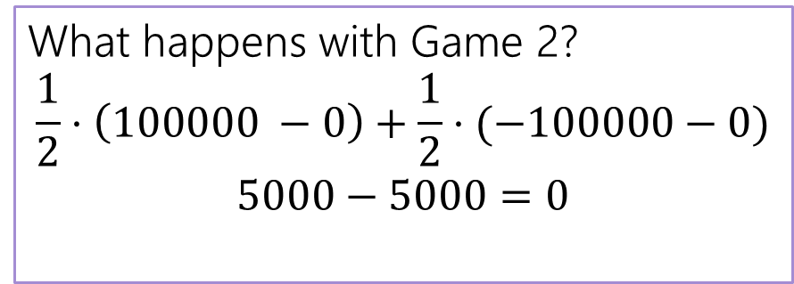
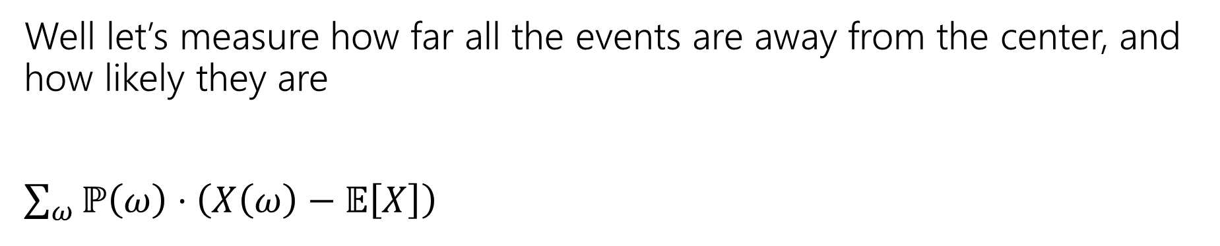
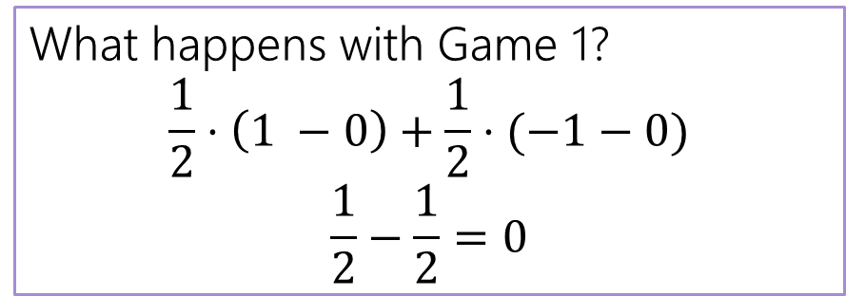
Designing a Measure – Try 1
Well let’s measure how far all the events are away from the center, and how likely they are
$\sum_{ω}{ℙ\left(ω\right)⋅\left(X\left(ω\right)−𝔼\left[X\right]\right) }$
What happens with Game 1?
$$\frac{1}{2}⋅\left(1 −0\right)+\frac{1}{2}⋅(−1−0)$$
$$\frac{1}{2}−\frac{1}{2}=0$$
What happens with Game 2?
$$\frac{1}{2}⋅\left(100000 −0\right)+\frac{1}{2}⋅(−100000−0)$$
$$5000−5000=0$$

Slide 20
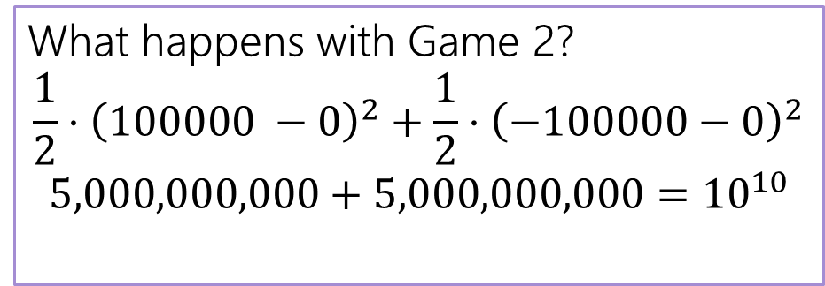
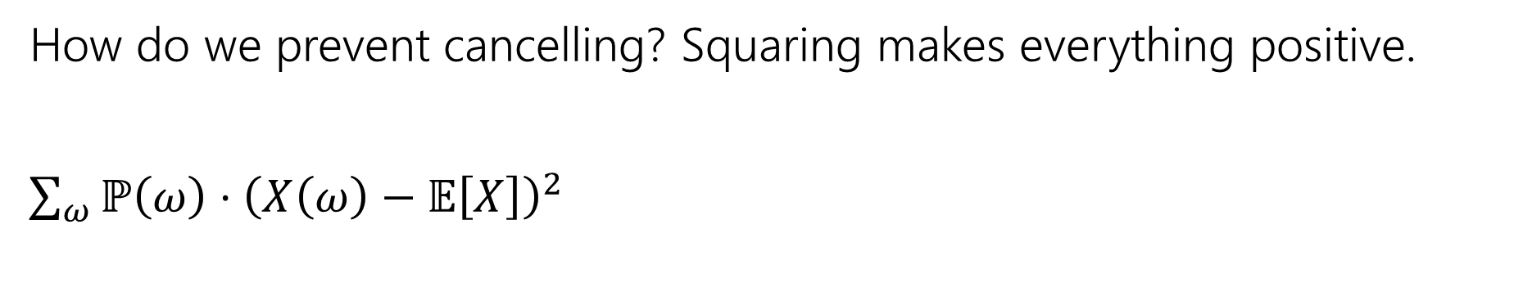

Designing a Measure – Try 2
How do we prevent cancelling? Squaring makes everything positive.
$\sum_{ω}{ℙ\left(ω\right)⋅{\left(X\left(ω\right)−𝔼\left[X\right]\right)}^{2} }$
What happens with Game 1?
$$\frac{1}{2}⋅{\left(1 −0\right)}^{2}+\frac{1}{2}⋅{\left(−1−0\right)}^{2}$$
$$\frac{1}{2}+\frac{1}{2}=1$$
What happens with Game 2?
$$\frac{1}{2}⋅{\left(100000 −0\right)}^{2}+\frac{1}{2}⋅{\left(−100000−0\right)}^{2}$$
$$5,000,000,000+5,000,000,000={10}^{10}$$

Slide 21
Why Squaring
Why not absolute value? Or Fourth power?
Squaring is nicer algebraically.
Our goal with variance was to talk about the spread of results. Squaring makes extreme results even more extreme.
Fourth power over-emphasizes the extreme results (for our purposes).

Slide 22
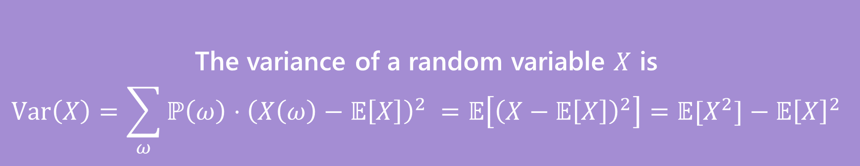
Variance
The first two forms are the definition. The last one is an algebra trick.
The variance of a random variable $X$ is
$$Var\left(X\right)=\sum_{ω}{ℙ\left(ω\right)⋅{\left(X\left(ω\right)−𝔼\left[X\right]\right)}^{2} }=𝔼\left[{\left(X−𝔼\left[X\right]\right)}^{2}\right]=𝔼[X^{2}]−𝔼{\left[X\right]}^{2}$$
Variance

Slide 23
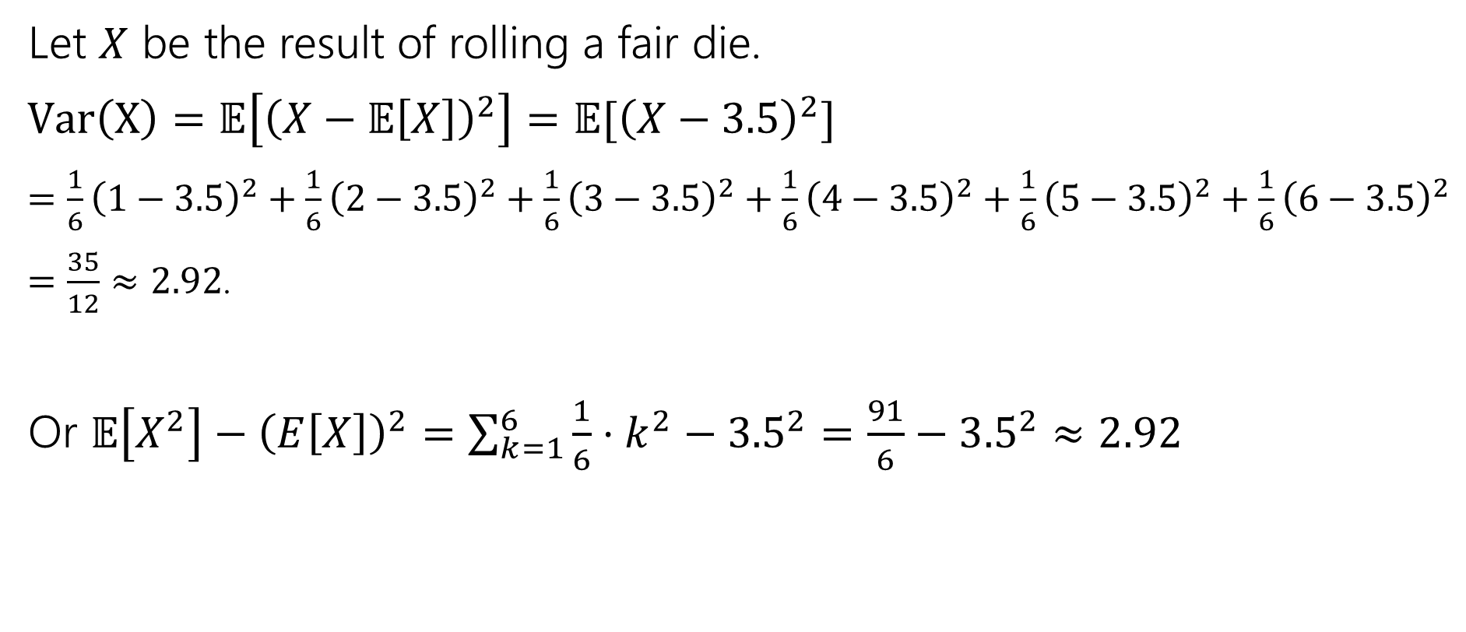
Variance of a die
Let $X$ be the result of rolling a fair die.
$Var\left(X\right)=𝔼\left[{\left(X−𝔼\left[X\right]\right)}^{2}\right]=𝔼[{\left(X−3.5\right)}^{2}]$
$=\frac{1}{6}{\left(1−3.5\right)}^{2}+\frac{1}{6}{\left(2−3.5\right)}^{2}+\frac{1}{6}{\left(3−3.5\right)}^{2}+\frac{1}{6}{\left(4−3.5\right)}^{2}+\frac{1}{6}{\left(5−3.5\right)}^{2}+\frac{1}{6}{\left(6−3.5\right)}^{2}$
$=\frac{35}{12}≈2.92$.
Or $𝔼\left[X^{2}\right]−{\left(E\left[X\right]\right)}^{2}=\sum_{k=1}^{6}{\frac{1}{6}⋅k^{2}−{3.5}^{2}}=\frac{91}{6}−{3.5}^{2}≈2.92$

Slide 24
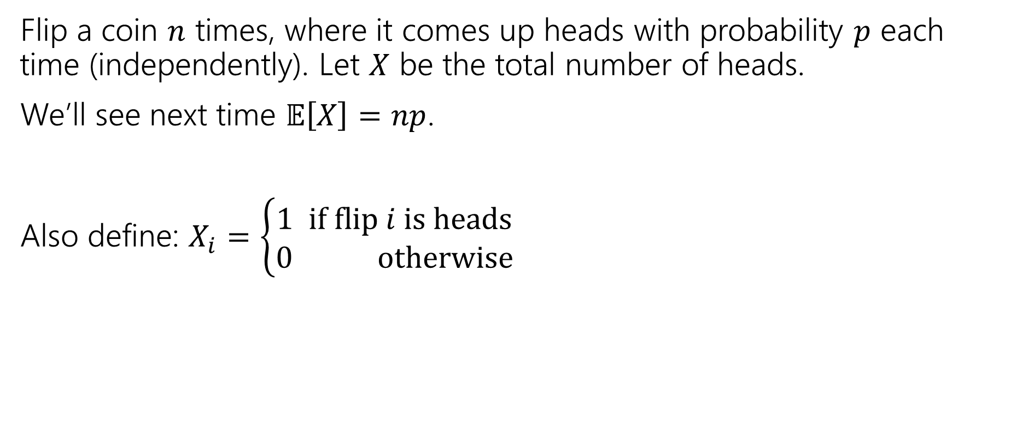

Variance of $n$ Coin Flips
Flip a coin $n$ times, where it comes up heads with probability $p$ each time (independently). Let $X$ be the total number of heads.
We’ll see next time $𝔼\left[X\right]=np$.
Also define: $X_{i}=\left\{\begin{aligned}1 if flip i is heads \\ 0 otherwise\end{aligned}\right.$

Slide 25
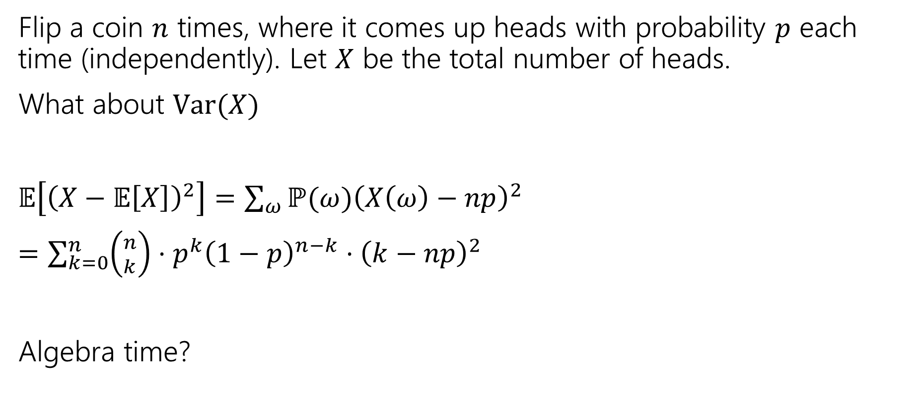
Variance of $n$ Coin Flips
Flip a coin $n$ times, where it comes up heads with probability $p$ each time (independently). Let $X$ be the total number of heads.
What about $Var(X)$
$𝔼\left[{\left(X−𝔼\left[X\right]\right)}^{2}\right]=\sum_{ω}{ℙ(ω){\left(X\left(ω\right)−np\right)}^{2}}$
$=\sum_{k=0}^{n}{\left({n \atop k}\right)⋅p^{k}{\left(1−p\right)}^{n−k}⋅{\left(k−np\right)}^{2}}$
Algebra time?

Slide 26

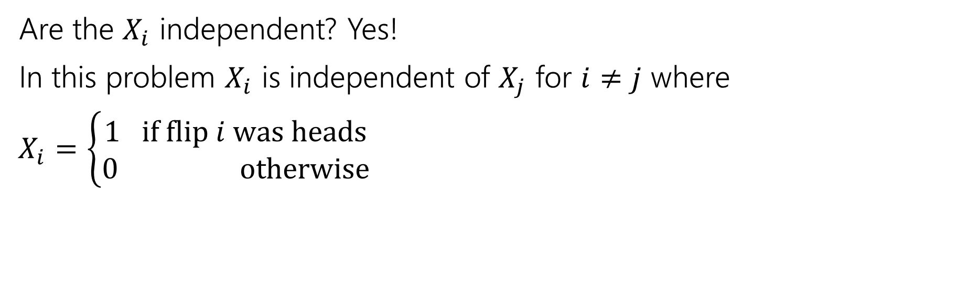
Variance
If $X$ and $Y$ are independent then
$$Var\left(X+Y\right)=Var\left(X\right)+Var(Y)$$
Are the $X_{i}$ independent? Yes!
In this problem $X_{i}$ is independent of $X_{j}$ for $i≠j$ where
$X_{i}=\left\{\begin{aligned}1 if flip i was heads \\ 0 otherwise\end{aligned}\right.$

Slide 27
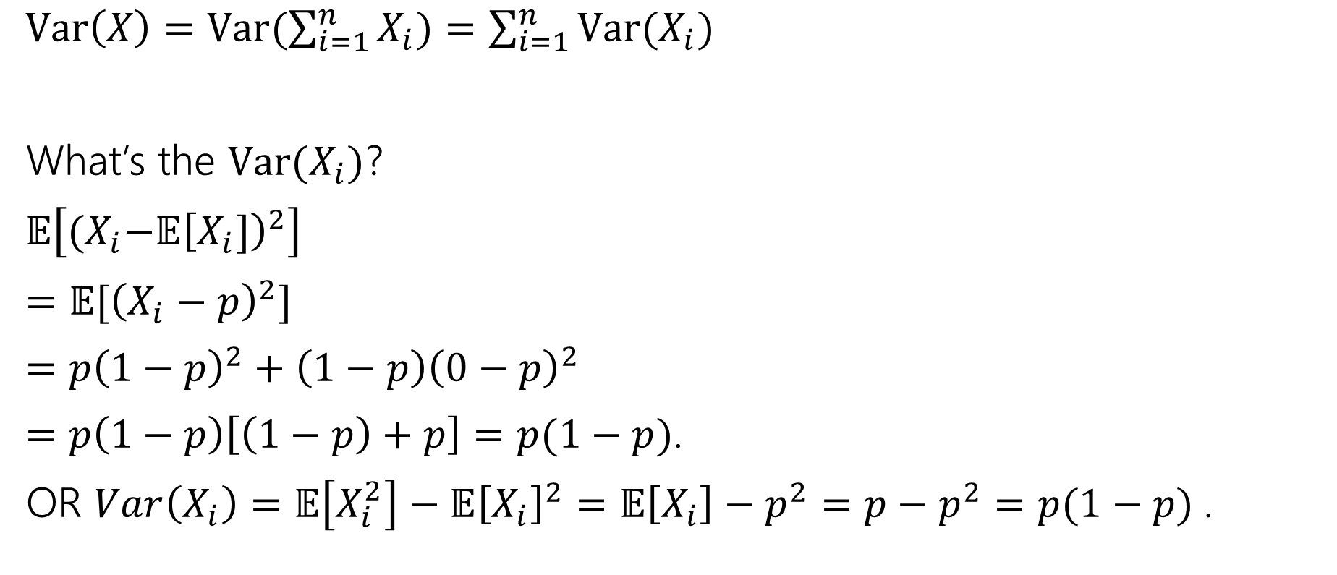
Variance
$Var\left(X\right)=Var(\sum_{i=1}^{n}{X_{i})=\sum_{i=1}^{n}{Var(X_{i})}}$
What’s the $Var(X_{i})$?
$𝔼\left[{(X}_{i}−𝔼{\left[X_{i}]\right)}^{2}\right]$
$=𝔼[{\left(X_{i}−p\right)}^{2}]$
$=p{\left(1−p\right)}^{2}+\left(1−p\right){\left(0−p\right)}^{2}$
$=p\left(1−p\right)\left[\left(1−p\right)+p\right]=p(1−p)$.
OR $Var\left(X_{i}\right)=𝔼\left[X_{i}^{2}\right]−𝔼{\left[X_{i}\right]}^{2}=𝔼\left[X_{i}\right]−p^{2}=p−p^{2}=p(1−p)$.

Slide 28

Plugging In
$Var\left(X\right)=Var(\sum_{i=1}^{n}{X_{i})=\sum_{i=1}^{n}{Var(X_{i})}}$
What’s the $Var(X_{i})$?
$p(1−p)$.
$Var\left(X\right)=\sum_{i=1}^{n}{p\left(1−p\right)=}np(1−p)$.

Slide 29
Expectation and Variance aren’t everything
Alright, so expectation and variance is everything right?
No!
A PMF or CDF *does* fully describe a random variable.
Flip a fair coin 3 times indep. Count heads.
Flip a biased coin (prob heads=2/3) until heads. Count flips.
…

Slide 30
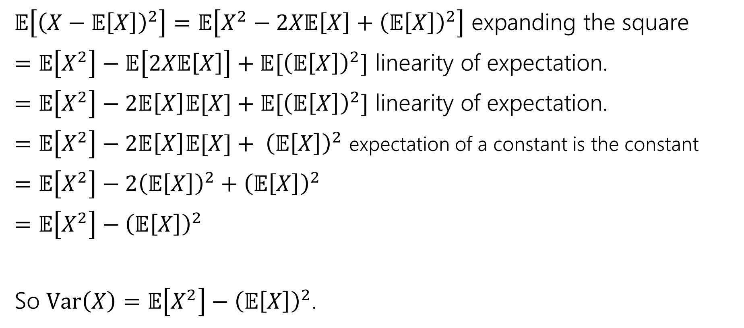
Proof of Calculation Trick
$𝔼\left[{\left(X−𝔼\left[X\right]\right)}^{2}\right]=𝔼\left[X^{2}−2X𝔼\left[X\right]+{\left(𝔼\left[X\right]\right)}^{2}\right]$ expanding the square
$=𝔼\left[X^{2}\right]−𝔼\left[2X𝔼\left[X\right]\right]+𝔼[{\left(𝔼\left[X\right]\right)}^{2}]$ linearity of expectation.
$=𝔼\left[X^{2}\right]−2𝔼\left[X\right]𝔼[X]+𝔼[{\left(𝔼\left[X\right]\right)}^{2}]$ linearity of expectation.
$=𝔼\left[X^{2}\right]−2𝔼\left[X\right]𝔼[X]+ {\left(𝔼\left[X\right]\right)}^{2}$ expectation of a constant is the constant
$=𝔼\left[X^{2}\right]−2{\left(𝔼\left[X\right]\right)}^{2}+{\left(𝔼\left[X\right]\right)}^{2}$
$=𝔼\left[X^{2}\right]−{\left(𝔼\left[X\right]\right)}^{2}$
So $Var\left(X\right)=𝔼\left[X^{2}\right]−{\left(𝔼\left[X\right]\right)}^{2}$.

Slide 31
Useful Facts

Slide 32

Make a prediction
How should $Var\left(X+c\right)$ relate to $Var(X)$ if $c$ is a constant?
How should $Var(aX)$ relate to $Var(X)$ is $a$ is a constant?

Slide 33

Make a prediction
How should $Var\left(X+c\right)$ relate to $Var(X)$ if $c$ is a constant?
How should $Var(aX)$ relate to $Var(X)$ is $a$ is a constant?
$Var\left(X+c\right)=Var\left(X\right)$
$Var\left(aX\right)=a^{2}Var(X)$

Slide 34
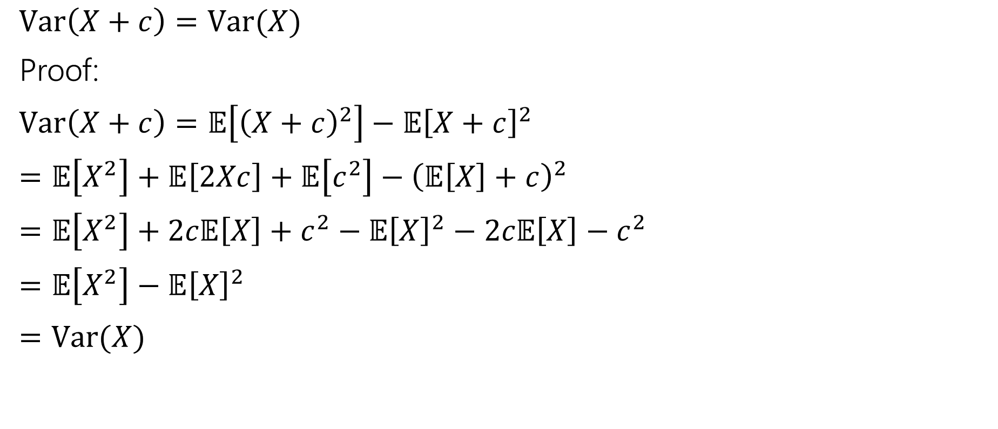
Facts About Variance
$Var\left(X+c\right)=Var(X)$
Proof:
$Var\left(X+c\right)=𝔼\left[{\left(X+c\right)}^{2}\right]−𝔼{\left[X+c\right]}^{2}$
$=𝔼\left[X^{2}\right]+𝔼\left[2Xc\right]+𝔼\left[c^{2}\right]−{\left(𝔼\left[X\right]+c\right)}^{2}$
$=𝔼\left[X^{2}\right]+2c𝔼\left[X\right]+c^{2}−𝔼{\left[X\right]}^{2}−2c𝔼\left[X\right]−c^{2}$
$=𝔼\left[X^{2}\right]−𝔼{\left[X\right]}^{2}$
$=Var(X)$

Slide 35

Facts about Variance
$Var\left(aX\right)=a^{2}Var(X)$
$=𝔼\left[{\left(aX\right)}^{2}\right]−(𝔼{\left[aX\right])}^{2}$
$=a^{2}𝔼\left[X^{2}\right]−{\left(a𝔼\left[X\right]\right)}^{2}$
$=a^{2}𝔼\left[X^{2}\right]−a^{2}𝔼{\left[X\right]}^{2}$
$=a^{2}\left(𝔼\left[X^{2}\right]−𝔼{\left[X\right]}^{2}\right)$

Slide 36
Extra Practice

Slide 37

More Practice
Suppose you flip a coin until you see a heads for the first time.
Let $X$ be the number of trials (including the heads)
What is the pmf of $X$?
The cdf of $X$?
$𝔼[X]$?

Slide 38
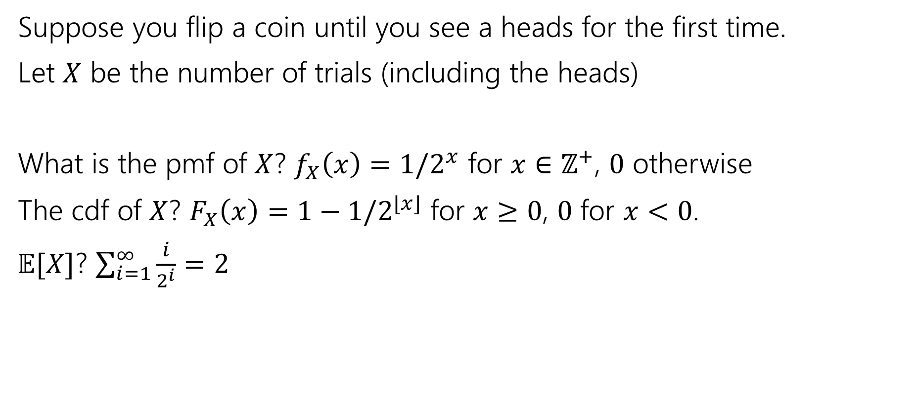
More Practice
Suppose you flip a coin until you see a heads for the first time.
Let $X$ be the number of trials (including the heads)
What is the pmf of $X$? $f_{X}\left(x\right)=1/2^{x}$ for $x∈ℤ^{+}$, $0$ otherwise
The cdf of $X$? $F_{X}\left(x\right)=1−1/2^{⌊x⌋}$ for $x≥0$, $0$ for $x<0$.
$𝔼[X]$? $\sum_{i=1}^{∞}{\frac{i}{2^{i}}}=2$

Slide 39
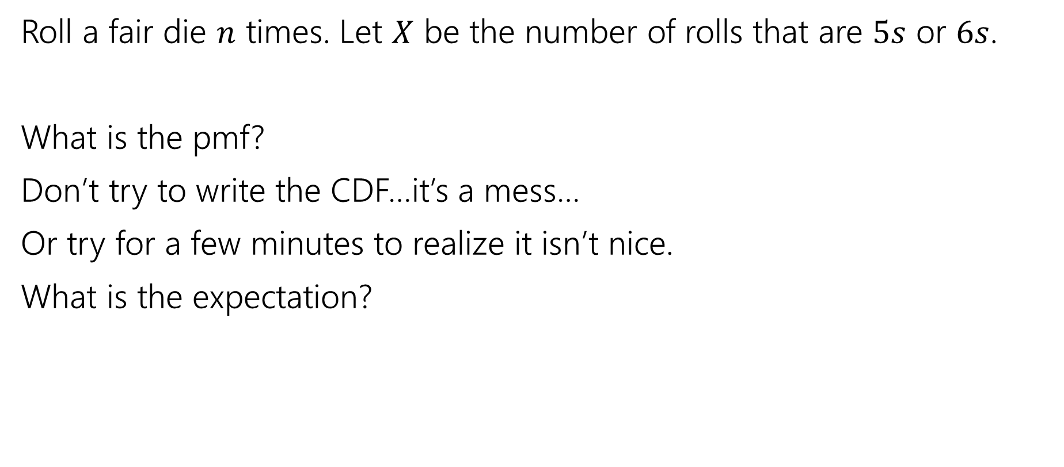
More Random Variable Practice
Roll a fair die $n$ times. Let $X$ be the number of rolls that are $5s$ or $6s$.
What is the pmf?
Don’t try to write the CDF…it’s a mess…
Or try for a few minutes to realize it isn’t nice.
What is the expectation?

Slide 40
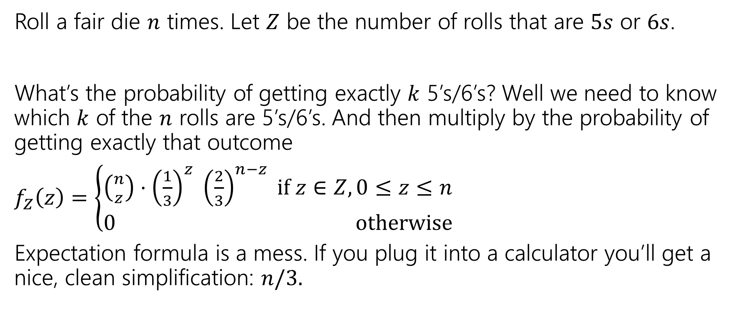
More Random Variable Practice
Roll a fair die $n$ times. Let $Z$ be the number of rolls that are $5s$ or $6s$.
What’s the probability of getting exactly $k$ 5’s/6’s? Well we need to know which $k$ of the $n$ rolls are 5’s/6’s. And then multiply by the probability of getting exactly that outcome
$f_{Z}\left(z\right)=\left\{\begin{aligned}\left({n \atop z}\right)⋅{\left(\frac{1}{3}\right)}^{z} {\left(\frac{2}{3}\right)}^{n−z} if z∈Z,0≤z≤n \\ 0 otherwise\end{aligned}\right.$
Expectation formula is a mess. If you plug it into a calculator you’ll get a nice, clean simplification: $n/3.$

Slide 41

Independence of Random Variables
That’s for events…what about random variables?
$X$ and $Y$ are independent if for all $k,ℓ$
$$ℙ\left(X=k, Y=ℓ\right)=ℙ\left(X=k\right)ℙ(Y=ℓ)$$
Independence (of random variables)
We’ll often use commas instead of $∩$ symbol.

Slide 42
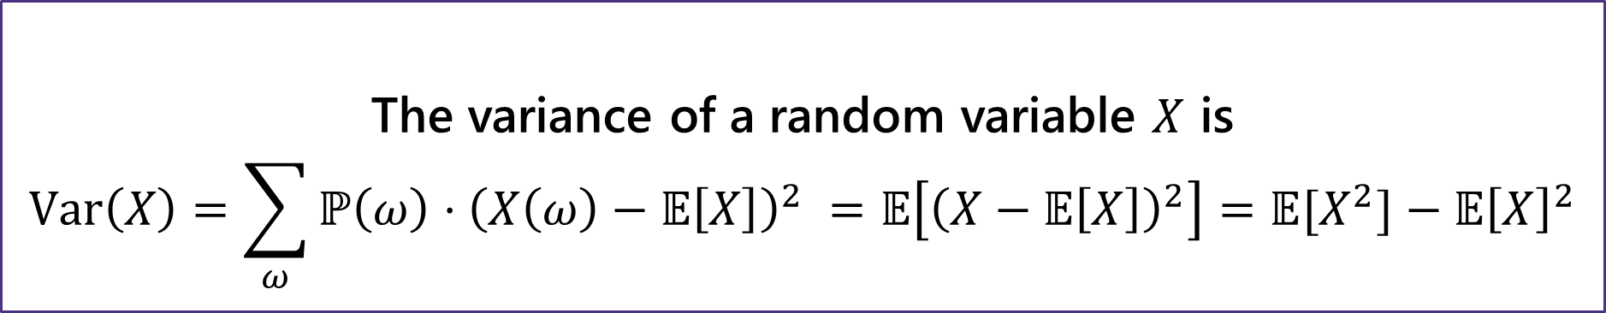
Variance
The first two forms are the definition. The last one is an algebra trick.
The variance of a random variable $X$ is
$$Var\left(X\right)=\sum_{ω}{ℙ\left(ω\right)⋅{\left(X\left(ω\right)−𝔼\left[X\right]\right)}^{2} }=𝔼\left[{\left(X−𝔼\left[X\right]\right)}^{2}\right]=𝔼[X^{2}]−𝔼{\left[X\right]}^{2}$$
Variance

