Slide 1
Random Variables
CSE 312 Spring 24
Lecture 10

Slide 2
Random Variables

Slide 3

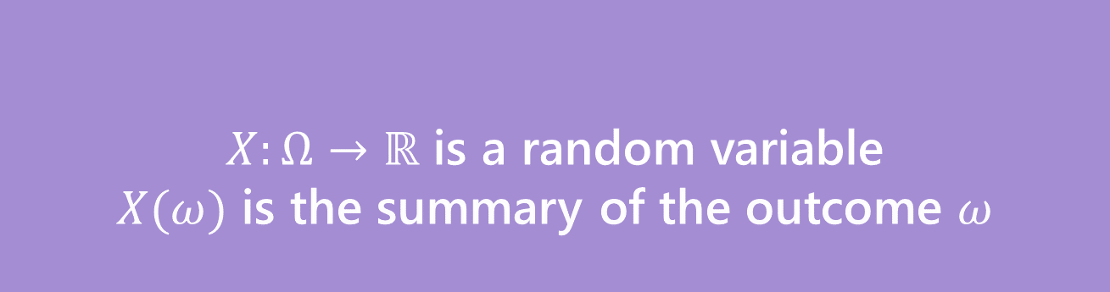
Random Variable
Support $Ω_{X}$
the set of values $X$ can take.
Probability Mass Function
(pmf $p_{X}(x)$)
on input $x,$tells you $ℙ\left(X=x\right).$
What’s a random variable?
Formally
Informally: A random variable is a way to summarize the important (numerical) information from your outcome.
$X:Ω→ℝ$ is a random variable
$X(ω)$ is the summary of the outcome $ω$
Random Variable

Slide 4
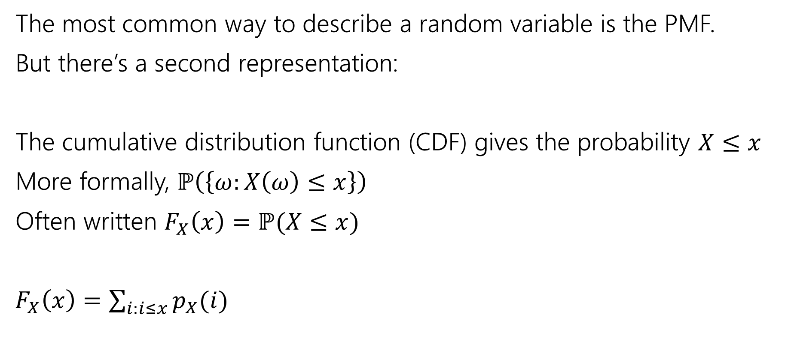
Describing a Random Variable
The most common way to describe a random variable is the PMF.
But there’s a second representation:
The cumulative distribution function (CDF) gives the probability $X≤x$
More formally, $ℙ\left(\left\{ω:X\left(ω\right)≤x\right\}\right)$
Often written $F_{X}\left(x\right)=ℙ(X≤x)$
$F_{X}\left(x\right)=\sum_{i:i≤x}{p_{X}(i)}$

Slide 5

Try it yourself
What is the CDF of $X$ where
$X$ be the largest value among the three balls. (Drawing 3 of the 20 without replacement)

Slide 6
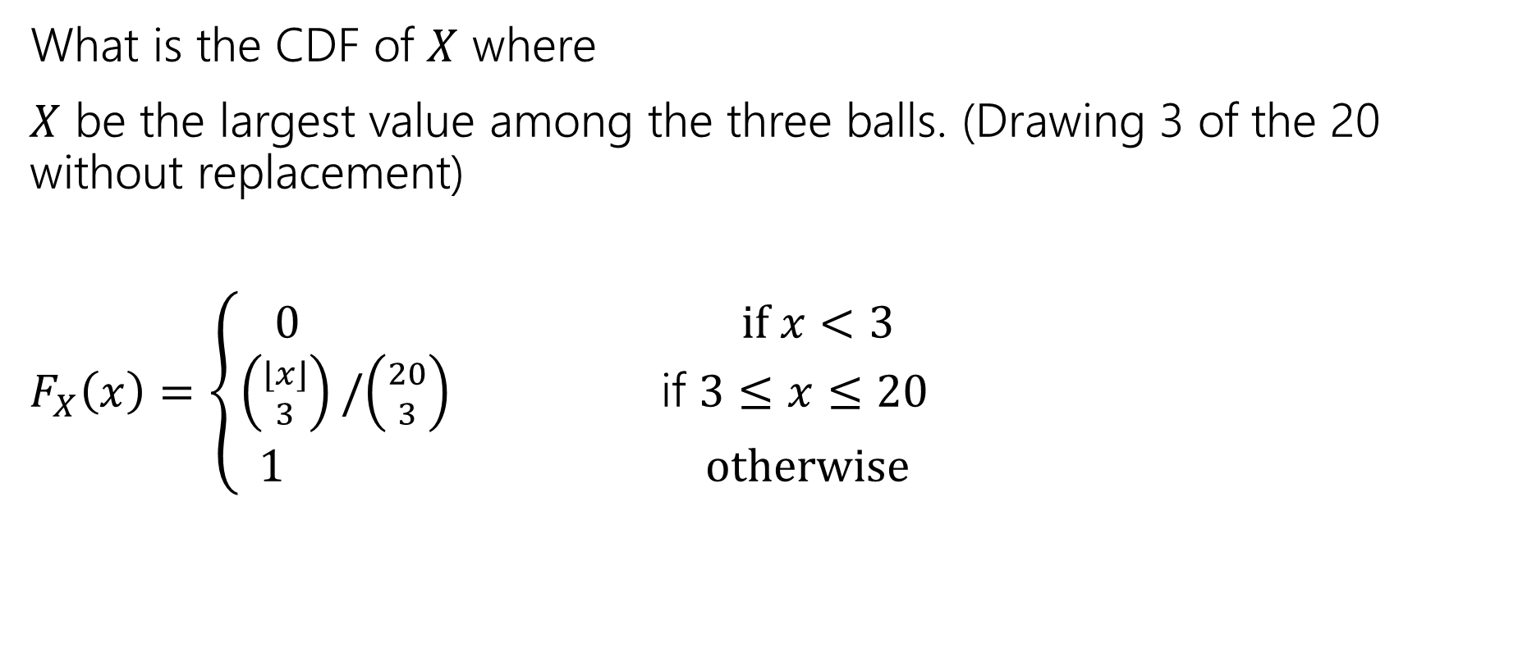
Try it yourself
What is the CDF of $X$ where
$X$ be the largest value among the three balls. (Drawing 3 of the 20 without replacement)
$F_{X}\left(x\right)=\left\{\begin{aligned}\begin{aligned}0 if x<3 \\ \left({⌊x⌋ \atop 3}\right)/\left({20 \atop 3}\right) \text{if} 3≤x≤20\end{aligned} \\ 1 otherwise\end{aligned}\right.$

Slide 7
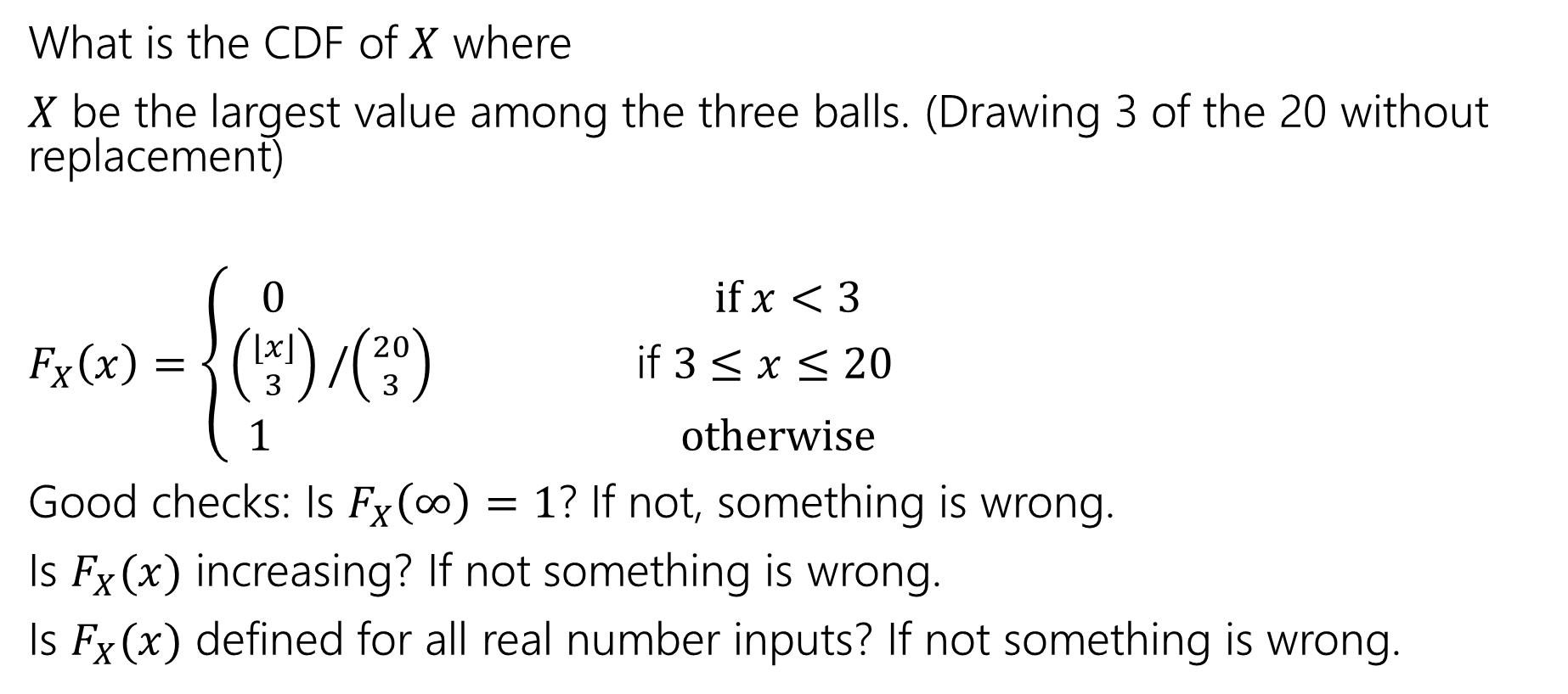
Try it yourself
What is the CDF of $X$ where
$X$ be the largest value among the three balls. (Drawing 3 of the 20 without replacement)
$F_{X}\left(x\right)=\left\{\begin{aligned}\begin{aligned}0 if x<3 \\ \left({⌊x⌋ \atop 3}\right)/\left({20 \atop 3}\right) \text{if} 3≤x≤20\end{aligned} \\ 1 otherwise\end{aligned}\right.$
Good checks: Is $F_{X}\left(∞\right)=1$? If not, something is wrong.
Is $F_{X}(x)$ increasing? If not something is wrong.
Is $F_{X}(x)$ defined for all real number inputs? If not something is wrong.

Slide 8
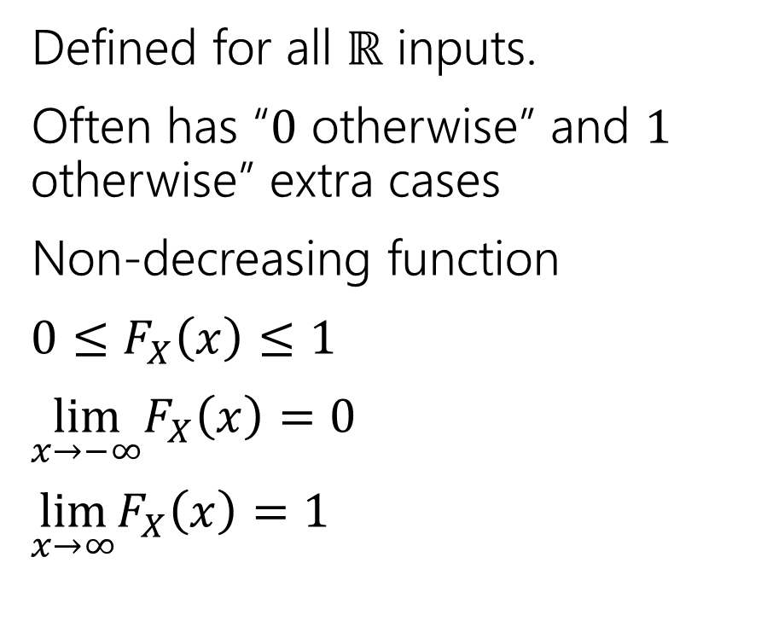
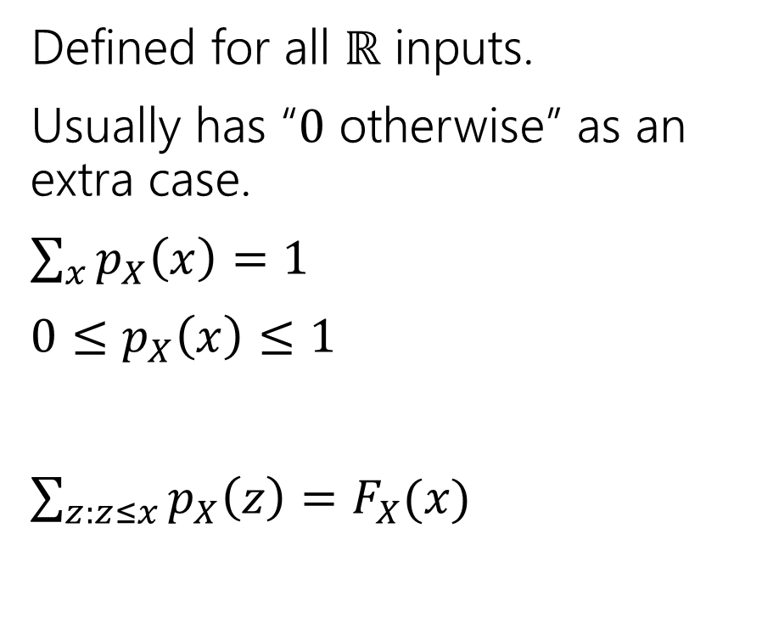
Two descriptions
Probability mass function
Cumulative Distribution function
Defined for all $ℝ$ inputs.
Usually has “$0$ otherwise” as an extra case.
$\sum_{x}{p_{X}\left(x\right)=1}$
$0≤p_{X}\left(x\right)≤1$
$\sum_{z:z≤x}{p_{X}\left(z\right)=F_{X}(x)}$
Defined for all $ℝ$ inputs.
Often has “$0$ otherwise” and $1$ otherwise” extra cases
Non-decreasing function
$0≤F_{X}\left(x\right)≤1$
$\lim_{x→−∞}F_{X}\left(x\right)=0$
$\lim_{x→∞}F_{X}\left(x\right)=1⁡$

Slide 9

More Random Variable Practice
Roll a fair die $n$ times. Let $Z$ be the number of rolls that are $5s$ or $6s$.
What is the pmf?
Don’t try to write the CDF…it’s a mess…
Or try for a few minutes to realize it isn’t nice.

Slide 10
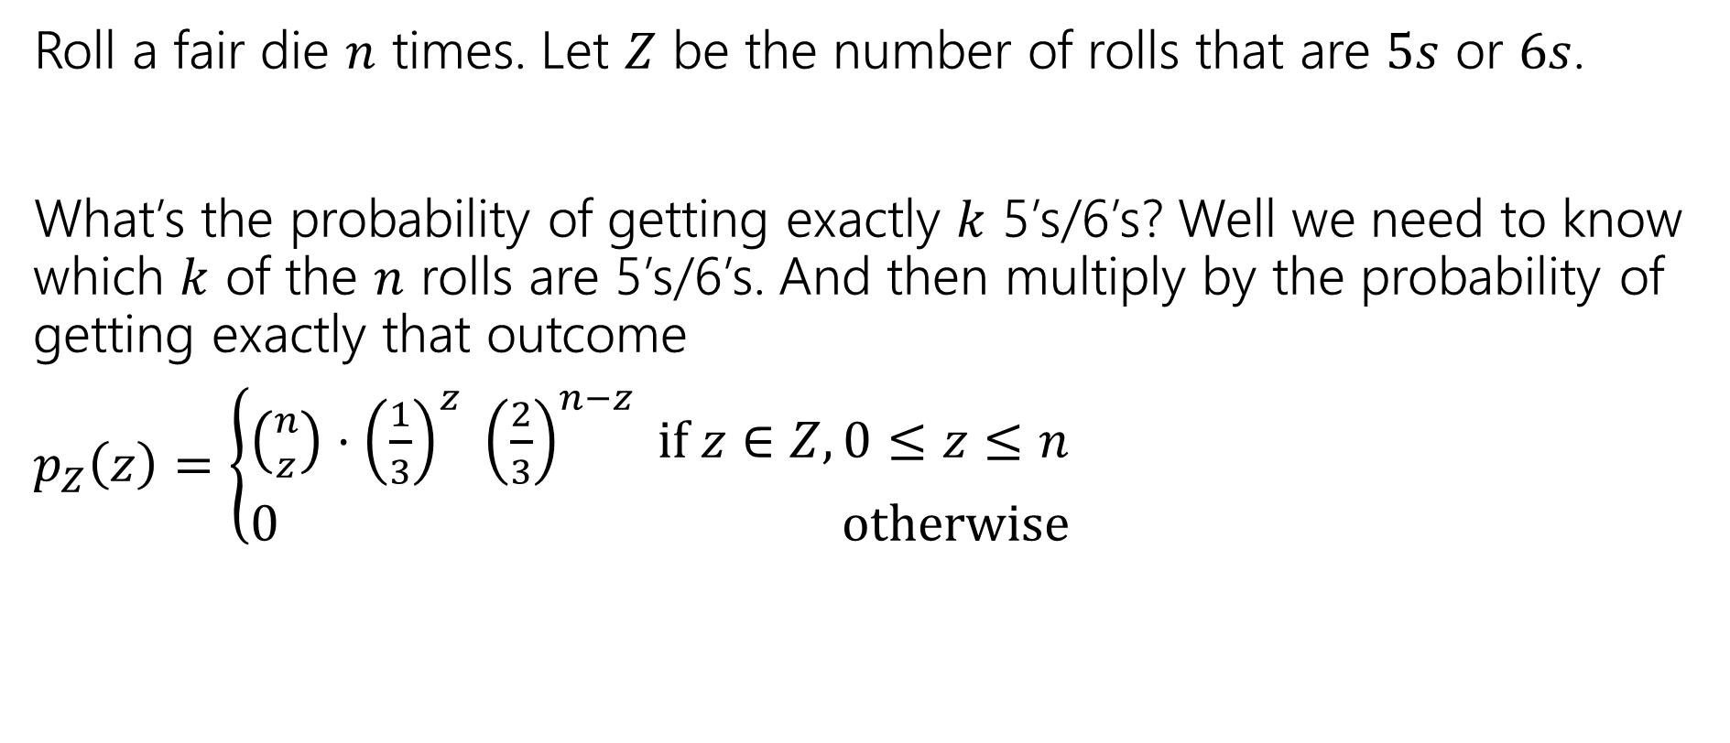
More Random Variable Practice
Roll a fair die $n$ times. Let $Z$ be the number of rolls that are $5s$ or $6s$.
What’s the probability of getting exactly $k$ 5’s/6’s? Well we need to know which $k$ of the $n$ rolls are 5’s/6’s. And then multiply by the probability of getting exactly that outcome
$p_{Z}\left(z\right)=\left\{\begin{aligned}\left({n \atop z}\right)⋅{\left(\frac{1}{3}\right)}^{z} {\left(\frac{2}{3}\right)}^{n−z} if z∈Z,0≤z≤n \\ 0 otherwise\end{aligned}\right.$

Slide 11
Expectation

Slide 12


Expectation
The “expectation” (or “expected value”) of a random variable $X$ is:
$$𝔼\left[X\right]=\sum_{k}{k⋅ℙ(X=k)}$$
Expectation
Intuition: The weighted average of values $X$ could take on.
Weighted by the probability you actually see them.

Slide 13

Example 1
Flip a fair coin twice (independently)
Let $X$be the number of heads.
$Ω=\{TT,TH,HT,HH\}$, $ℙ()$ is uniform measure.
$𝔼\left[X\right]=\frac{1}{4}⋅0+\frac{1}{2}⋅1+\frac{1}{4}⋅2=0+\frac{1}{2}+\frac{1}{2}=1$.

Slide 14
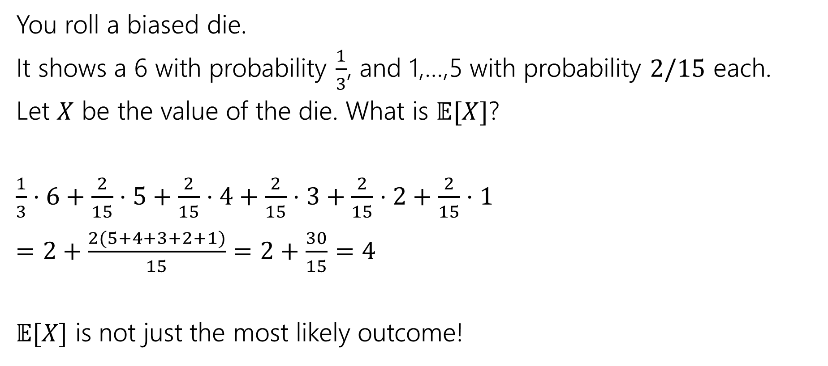
Example 2
You roll a biased die.
It shows a 6 with probability $\frac{1}{3}$, and 1,…,5 with probability $2/15$ each.
Let $X$ be the value of the die. What is $𝔼[X]$?
$\frac{1}{3}⋅6+\frac{2}{15}⋅5+\frac{2}{15}⋅4+\frac{2}{15}⋅3+\frac{2}{15}⋅2+\frac{2}{15}⋅1$
$=2+\frac{2(5+4+3+2+1)}{15}=2+\frac{30}{15}=4$
$𝔼[X]$ is not just the most likely outcome!

Slide 15

Try it yourself
Let $X$ be the result shown on a fair die. What is $𝔼[X]$?
Let $Y$ be the sum of two (independent) fair die rolls. What is $𝔼[Y]$?
Fill out the poll everywhere so Robbie knows how long to explain
Go to pollev.com/robbie

Slide 16

Try it yourself
Let $X$ be the result shown on a fair die. What is $𝔼[X]$
$6⋅\frac{1}{6}+5⋅\frac{1}{6}+4⋅\frac{1}{6}+3⋅\frac{1}{6}+2⋅\frac{1}{6}+1⋅\frac{1}{6}$
$=\frac{21}{6}=3.5$
$𝔼[X]$ is not necessarily a possible outcome!
That’s ok, it’s an average!

Slide 17

Try it yourself
$𝔼\left[Y\right]=$
$\frac{1}{36}⋅2+\frac{2}{36}⋅3+\frac{3}{36}⋅4+\frac{4}{36}⋅5+\frac{5}{36}⋅6+\frac{6}{36}⋅7+\frac{5}{36}⋅8+\frac{4}{36}⋅9+\frac{3}{36}⋅10+\frac{2}{36}⋅11+\frac{1}{36}⋅12$
$=7$
$𝔼\left[Y\right]=2𝔼[X]$. That’s not a coincidence…we’ll talk about why on Friday.

Slide 18

Subtle but Important
$X$ is random. You don’t know what it is (at least until you run the experiment).
$𝔼[X]$ is not random. It’s a number.
You don’t need to run the experiment to know what it is.

Slide 19
More Independence

Slide 20
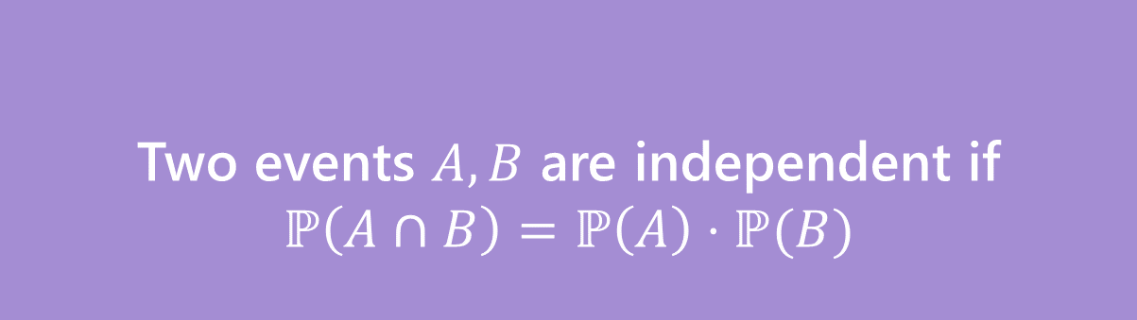
Independence of events
Recall the definition of independence of events:
Two events $A,B$ are independent if
$$ℙ\left(A∩B\right)=ℙ\left(A\right)⋅ℙ(B)$$
Independence

Slide 21

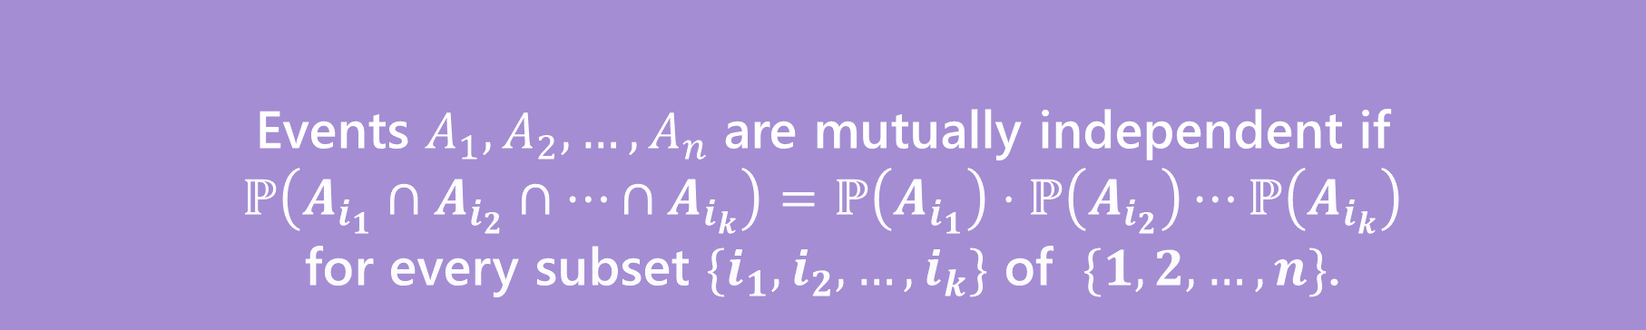
Independence for 3 or more events
For three or more events, we need two kinds of independence
Events $A_{1},A_{2},…,A_{n}$ are pairwise independent if
$ℙ\left(A_{i}∩A_{j}\right)=ℙ\left(A_{i}\right)⋅ℙ\left(A_{j}\right)$ for all $i,j$
Pairwise Independence
Events $A_{1},A_{2},…,A_{n}$ are mutually independent if
$ℙ\left(A_{i_{1}}∩A_{i_{2}}∩…∩A_{i_{k}}\right)=ℙ\left(A_{i_{1}}\right)⋅ℙ\left(A_{i_{2}}\right)⋯ℙ\left(A_{i_{k}}\right)$
for every subset $\{i_{1},i_{2},…,i_{k}\}$ of $\{1,2,…,n\}$.
Mutual Independence

Slide 22

Pairwise Independence vs. Mutual Independence
Roll two fair dice (one red one blue) independently
$R=$“red die is $3$”
$B=$“blue die is 5”
$S=$“sum is $7$”
How should we describe these events?

Slide 23
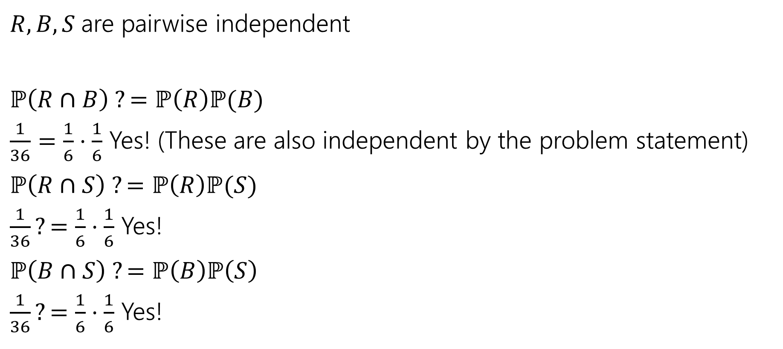
Pairwise Independence
$R,B,S$are pairwise independent
$ℙ\left(R∩B\right) ?=ℙ\left(R\right)ℙ(B)$
$\frac{1}{36}=\frac{1}{6}⋅\frac{1}{6}$ Yes! (These are also independent by the problem statement)
$ℙ\left(R∩S\right) ?=ℙ\left(R\right)ℙ(S)$
$\frac{1}{36}?=\frac{1}{6}⋅\frac{1}{6}$ Yes!
$ℙ\left(B∩S\right) ?=ℙ\left(B\right)ℙ\left(S\right)$
$\frac{1}{36}?=\frac{1}{6}⋅\frac{1}{6}$ Yes!
Since all three pairs are independent, we say the random variables are pairwise independent.

Slide 24

Mutual Independence
$R,B,S$ are not mutually independent.
$ℙ\left(R∩B∩S\right)=0;$if the red die is 3, and blue die is 5 then the sum is 8 (so it can’t be 7)
$ℙ\left(R\right)ℙ\left(B\right)ℙ\left(S\right)={\left(\frac{1}{6}\right)}^{3}=\frac{1}{216}≠0$

Slide 25
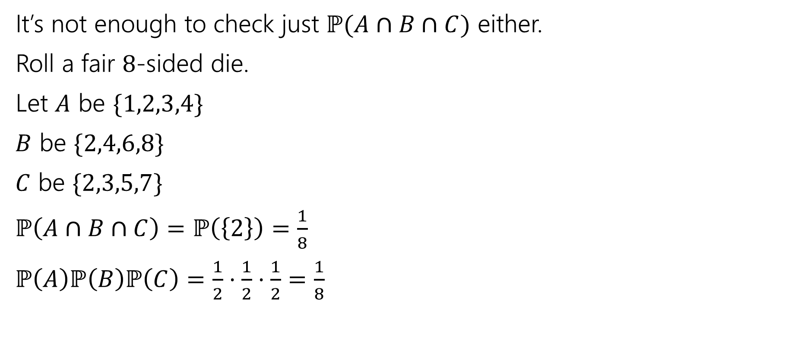
Checking Mutual Independence
It’s not enough to check just $ℙ(A∩B∩C)$ either.
Roll a fair $8$-sided die.
Let $A$ be $\{1,2,3,4\}$
$B$ be $\{2,4,6,8\}$
$C$ be $\{2,3,5,7\}$
$ℙ\left(A∩B∩C\right)=ℙ\left(\left\{2\right\}\right)=\frac{1}{8}$
$ℙ\left(A\right)ℙ\left(B\right)ℙ\left(C\right)=\frac{1}{2}⋅\frac{1}{2}⋅\frac{1}{2}=\frac{1}{8}$

Slide 26
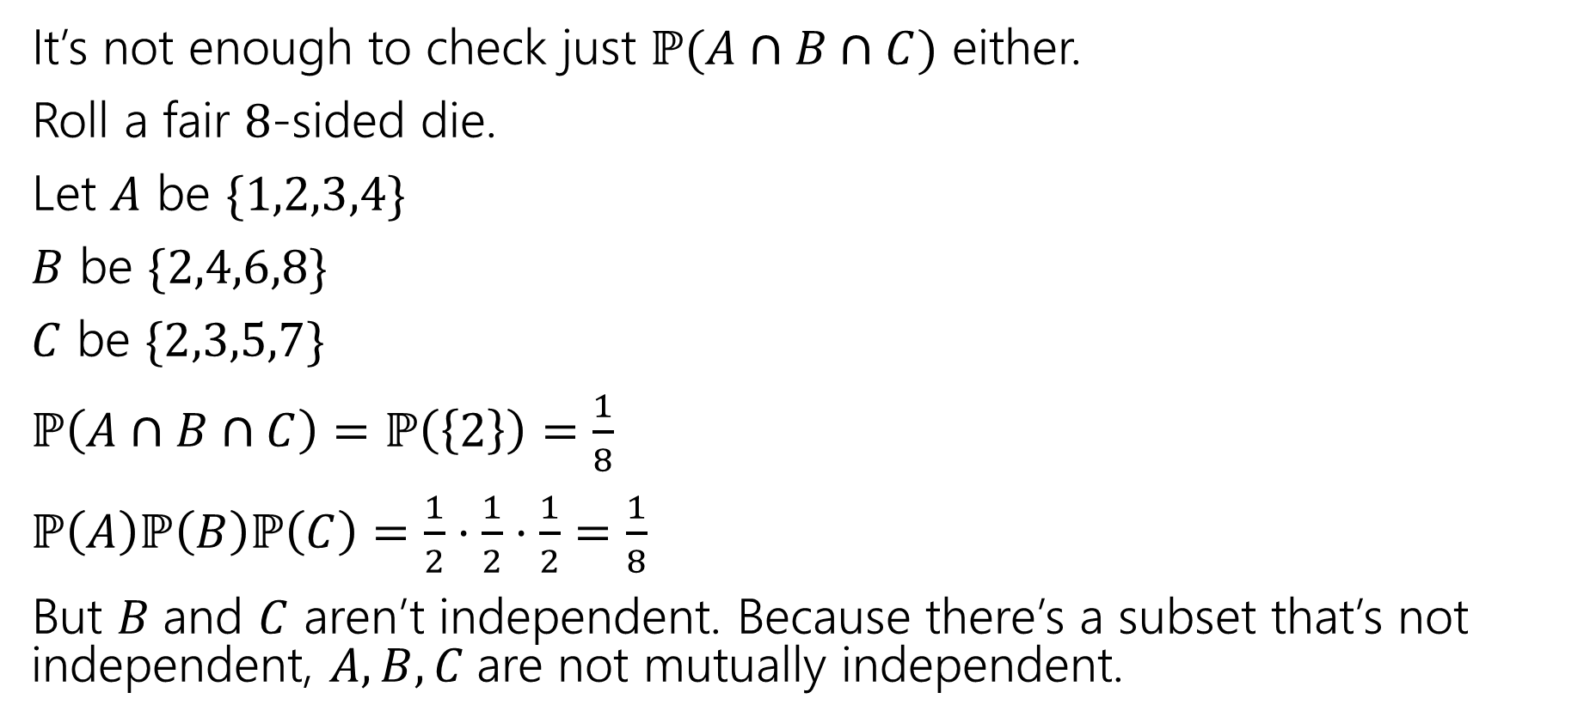
Checking Mutual Independence
It’s not enough to check just $ℙ(A∩B∩C)$ either.
Roll a fair $8$-sided die.
Let $A$ be $\{1,2,3,4\}$
$B$ be $\{2,4,6,8\}$
$C$ be $\{2,3,5,7\}$
$ℙ\left(A∩B∩C\right)=ℙ\left(\left\{2\right\}\right)=\frac{1}{8}$
$ℙ\left(A\right)ℙ\left(B\right)ℙ\left(C\right)=\frac{1}{2}⋅\frac{1}{2}⋅\frac{1}{2}=\frac{1}{8}$
But $B$and $C$ aren’t independent. Because there’s a subset that’s not independent, $A,B,C$are not mutually independent.

Slide 27
Checking Mutual Independence
To check mutual independence of events:
Check every subset.
To check pairwise independence of events:
Check every subset of size two.

Slide 28

Independence of Random Variables
That’s for events…what about random variables?
$X$ and $Y$ are independent if for all $k,ℓ$
$$ℙ\left(X=k, Y=ℓ\right)=ℙ\left(X=k\right)ℙ(Y=ℓ)$$
Independence (of random variables)
We’ll often use commas instead of $∩$ symbol.

Slide 29

Independence of Random Variables
The “for all values” is important.
We say that the event “the sum is 7” is independent of “the red die is 5”
What about $S=$“the sum of two dice” and $R=$“the value of the red die”

Slide 30
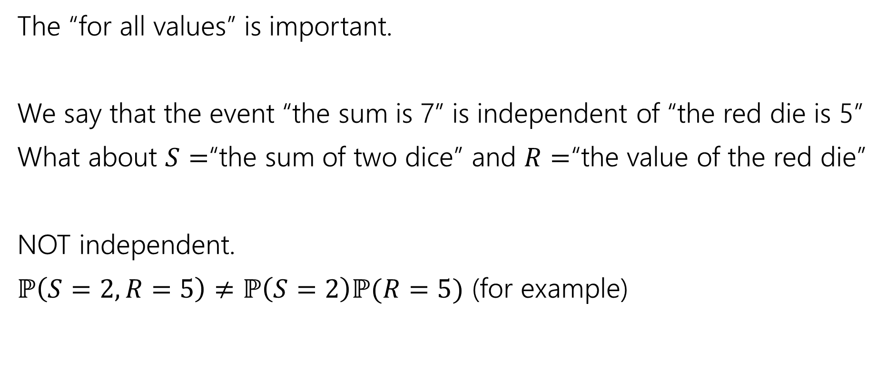
Independence of Random Variables
The “for all values” is important.
We say that the event “the sum is 7” is independent of “the red die is 5”
What about $S=$“the sum of two dice” and $R=$“the value of the red die”
NOT independent.
$ℙ\left(S=2, R=5\right)≠ℙ\left(S=2\right)ℙ(R=5)$ (for example)

Slide 31

Independence of Random Variables
Flip a coin independently $2n$ times.
Let $X$ be “the number of heads in the first $n$ flips.”
Let $Y$ be “the number of heads in the last $n$ flips.”
$X$ and $Y$ are independent.

Slide 32
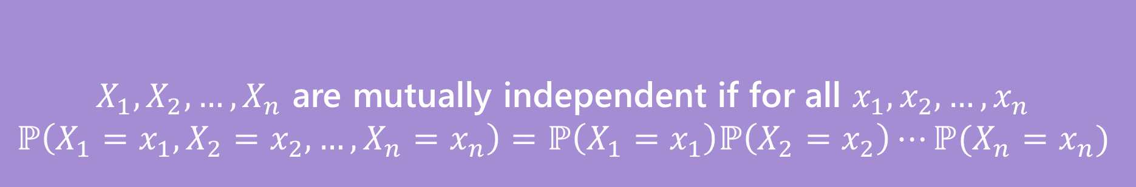

Mutual Independence for RVs
A little simpler to write down than for events
DON’T need to check all subsets for random variables…
But you do need to check all values (all possible $x_{i}$) still.
$X_{1},X_{2},…,X_{n}$ are mutually independent if for all $x_{1},x_{2},…,x_{n}$
$$ℙ\left(X_{1}=x_{1}, X_{2}=x_{2},…,X_{n}=x_{n}\right)=ℙ\left(X_{1}=x_{1}\right)ℙ\left(X_{2}=x_{2}\right)⋯ℙ(X_{n}=x_{n})$$
Mutual Independence (of random variables)

Slide 33

What does Independence give you?
$𝔼\left[XY\right]=𝔼\left[X\right]⋅𝔼[Y]$
$Var\left(X+Y\right)=Var\left(X\right)+Var(Y)$

Slide 34
More Practice: Infinite sequential processes

Slide 35
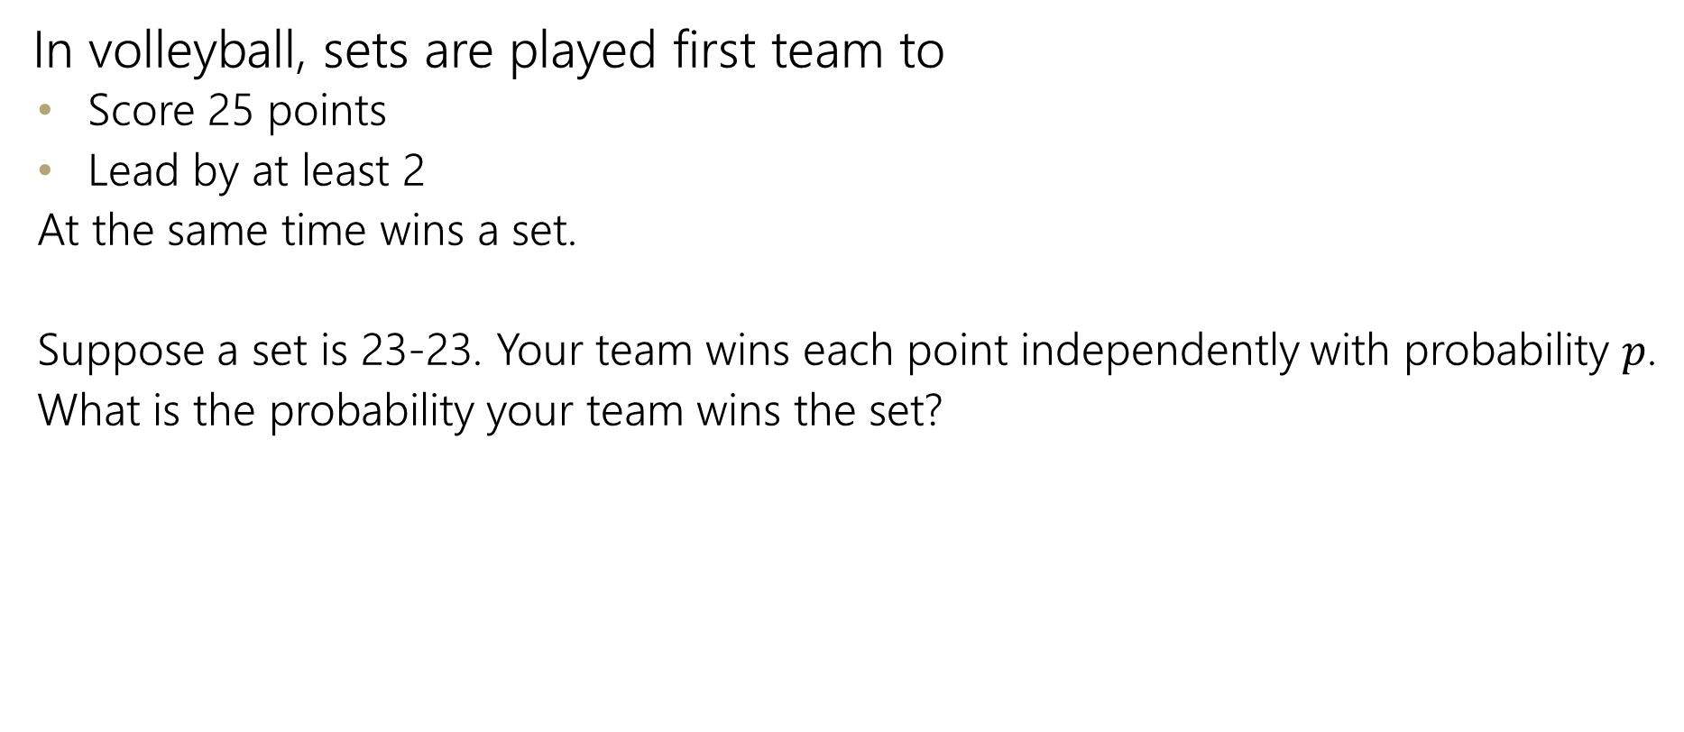
Infinite sequential process
In volleyball, sets are played first team to
  Score 25 points
  Lead by at least 2
  At the same time wins a set.
  Suppose a set is 23-23. Your team wins each point independently with probability $p$.
  What is the probability your team wins the set?

Slide 36
Sequential Process
0
$$ℙ\left(win from even\right)=p^{2}+2p\left(1−p\right)ℙ(win from even)$$
+
-
W
0
L
+
-
W
0
L
+
-
…

Slide 37
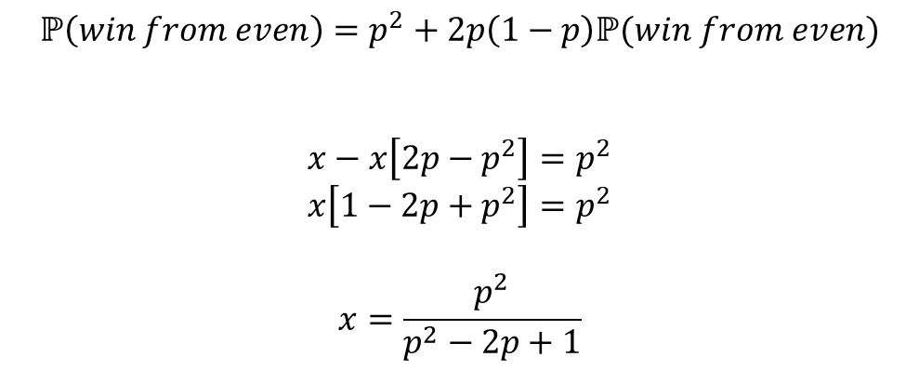
Sequential Process
0
$$ℙ\left(win from even\right)=p^{2}+2p\left(1−p\right)ℙ(win from even)$$
$$x−x\left[2p−p^{2}\right]=p^{2}$$
$$x\left[1−2p+p^{2}\right]=p^{2}$$
$$x=\frac{p^{2}}{p^{2}−2p+1}$$
+
-
W
0
L
+
-
W
0
L
+
-
…

