Slide 1
Random Variables Bayes Rule Applications
CSE 312 Spring 24
Lecture 9

Slide 2
Today
A convenient representation: random variables
Bayes’ Rule in the real world!

Slide 3
Implicitly defining $Ω$
We’ve often skipped an explicit definition of $Ω.$
Often $|Ω|$ is infinite, so we really couldn’t write it out (even in principle).
How would that happen?
Flip a fair coin (independently each time) until you see your first tails. what is the probability that you see at least 3 heads?

Slide 4
An infinite process.
$Ω$ is infinite.
A sequential process is also going to be infinite…
But the tree is “self-similar”
To know what the next step looks like, you only need to look back a finite number of steps.
From every node, the children look identical (H with probability ½, continue pattern; T to a leaf with probability ½)
$$ℙ\left(H\right)=\frac{1}{2}$$
$$ℙ\left(T\right)=\frac{1}{2}$$
H
$$ℙ\left(T\right)=1/2$$
$$ℙ\left(HH|H\right)=\frac{1}{2}$$
$$ℙ\left(HT|H\right)=\frac{1}{2}$$
H
$$ℙ\left(HT\right)=1/4$$
$$ℙ\left(HHH|HH\right)=\frac{1}{2}$$
$$ℙ\left(HHT|HH\right)=\frac{1}{2}$$
H
$$ℙ\left(HHT\right)=1/8$$
…

Slide 5
Finding $ℙ($at least $3$ heads)
Method 1: infinite sum.
$Ω$ includes $H^{i}T$ for every $i$. Every such outcome has probability $1/2^{i+1}$
What outcomes are in our event?
$\sum_{i=3}^{∞}{1/2^{i+1}}=$ $\frac{\frac{1}{2^{4}}}{1−1/2}=\frac{1}{8}$
Infinite geometric series, where common ratio is between $−1$ and $1$ has closed form $\frac{first term}{1−ratio}$

Slide 6
Finding $ℙ($at least $3$ heads)
Method 2:
Calculate the complement
$ℙ($at most 2 heads) = $\frac{1}{2}+\frac{1}{4}+\frac{1}{8}$
$ℙ($at least 3 heads)= $1−\left(\frac{1}{2}+\frac{1}{4}+\frac{1}{8}\right)=\frac{1}{8}$

Slide 7
Random Variables

Slide 8
Random Variable
What’s a random variable?
Formally
Informally: A random variable is a way to summarize the important (numerical) information from your outcome.
$X:Ω→ℝ$ is a random variable
$X(ω)$ is the summary of the outcome $ω$
Random Variable

Slide 9
The sum of two dice
Events
Random variable
We could define
$E_{2}=$“sum is $2$”
$E_{3}=$“sum is $3$”
…
$E_{12}=$“sum is $12$”
And ask “which event occurs”?
$X:Ω→ℝ$
$X$is the sum of the two dice.

Slide 10
More random variables
From one sample space, you can define many random variables.
Roll a fair red die and a fair blue die
Let $D$ be the value of the red die minus the blue die $D\left(4,2\right)=2$
Let $S$ be the sum of the values of the dice $S\left(4,2\right)=6$
Let $M$ be the maximum of the values $M\left(4,2\right)=4$
…

Slide 11
Notational Notes
We will always use capital letters for random variables.
It’s common to use lower-case letters for the values they could take on.
Formally random variables are functions, so you’d think we’d write
$X\left(H,H,T\right)=2$
But we nearly never do. We just write $X=2$

Slide 12
Support ($Ω_{X})$
The “support” (aka “the range”) is the set of values $X$ can actually take.
We called this the “image” in 311.
$D$ (difference of red and blue) has support $\{−5,−4,−3,…,4,5\}$
$S$ (sum) has support $\{2,3,…,12\}$
What is the support of $M$ (max of the two dice)

Slide 13
Probability Mass Function
Often we’re interested in the event $\{ω:X(ω)=x\}$
Which is the event…that $X=x$.
We’ll write $ℙ(X=x)$ to describe the probability of that event
So $ℙ\left(S=2\right)=\frac{1}{36}$, $ℙ\left(S=7\right)=\frac{1}{6}$
The function that tells you $ℙ(X=x)$ is the “probability mass function”
We’ll often write $p_{X}\left(x\right)$ for the pmf.

Slide 14
Partition
A random variable partitions $Ω$.
Let $T$ be the number of twos in rolling a (fair) red and blue die.
$p_{T}\left(0\right)=25/36$
$p_{T}\left(1\right)=10/36$
$p_{T}\left(2\right)=1/36$
 | D2=1 | D2=2 | D2=3 | D2=4 | D2=5 | D2=6
D1=1 | (1,1) | (1,2) | (1,3) | (1,4) | (1,5) | (1.6)
D1=2 | (2,1) | (2,2) | (2,3) | (2,4) | (2,5) | (2,6)
D1=3 | (3,1) | (3,2) | (3,3) | (3,4) | (3,5) | (3,6)
D1=4 | (4,1) | (4,2) | (4,3) | (4,4) | (4,5) | (4,6)
D1=5 | (5,1) | (5,2) | (5,3) | (5,4) | (5,5) | (5,6)
D1=6 | (6,1) | (6,2) | (6,3) | (6,4) | (6,5) | (6,6)

Slide 15
Try It Yourself
There are 20 balls, numbered 1,2,…,20 in an urn.
You’ll draw out a size-three subset. (i.e. without replacement)
$Ω=\{$size three subsets of $\left\{1,…,20\right\}$ $\}$, $ℙ()$ is uniform measure.
Let $X$ be the largest value among the three balls.
If outcome is $\{4,2,10\}$ then $X=10.$
Write down the pmf of $X$
Fill out the poll everywhere so Robbie knows how long to explain
Go to pollev.com/robbie

Slide 16
Try It Yourself
There are 20 balls, numbered 1,2,…,20 in an urn.
You’ll draw out a size-three subset. (i.e. without replacement)
Let $X$ be the largest value among the three balls.
$p_{X}\left(x\right)=\left\{\begin{aligned}\left({x−1 \atop 2}\right)/\left({20 \atop 3}\right) \text{if} x∈ℕ\text{, }3≤x≤20 \\ 0 otherwise\end{aligned}\right.$
Good check: if you sum up $p_{X}(x)$ do you get 1?
Good check: is $p_{X}\left(x\right)≥0$ for all $x$? Is it defined for all $x$?

Slide 17
Bayes in the real world

Slide 18
Application 1: Medical Tests
Helping Doctors and Patients Make Sense of Health Statistics
A researcher posed the following scenario to a group of 160 doctors:
Assume you conduct a disease screening using a standard test in a certain region. You know the following information about the people in this region:
The probability that a person has the disease is 1% (prevalence)
If a person has the disease, the probability that she tests positive is 90% (sensitivity)
If a person does not have the disease, the probability that she nevertheless tests positive is 9% (false-positive rate)
A person tests positive. She wants to know from you whether that means that she has the disease for sure, or what the chances are. What is the best answer?
A. The probability that she has the disease is about 81%.
B. Out of 10 people with a positive test, about 9 have the disease.
C. Out of 10 people with a positive test, about 1 have the disease.
D. The probability that she has the disease is about 1%

Slide 19
Let’s do the calculation!
Let $D$ be “the patient has the disease”, $T$ be the test was positive.
$ℙ\left(D | T\right)=ℙ\left(T | D\right)⋅ℙ\left(D\right)/ℙ(T)$
$=\frac{.9⋅.01}{.99⋅.09+ .01⋅.9}≈0.092$
Calculation tip: for Bayes’ Rule, you should see one of the terms on the bottom exactly match your numerator (if you’re using the LTP to calculate the probability on the bottom)

Slide 20
Pause for vocabulary
Physicians have words for just about everything
Let $D$ be has the disease; $T$ be test is positive
$ℙ(D)$ is “prevalence”
$ℙ(T|D)$ is “sensitivity”
A ‘sensitive’ test is one which picks up on the disease when it’s there (high sensitivity -> few false negatives)
$ℙ\left(\overline{T} | \overline{D}\right)$ is “specificity”
A ‘specific’ test is one that is positive specifically because of the disease, and for no other reason (high specificity -> few false positives)

Slide 21
How did the doctors do
C (about 1 in 10) was the correct answer.
Of the doctors surveyed, less than ¼ got it right (so worse than random guessing).
After the researcher taught them his calculation trick, more than 80% got it right.

Slide 22
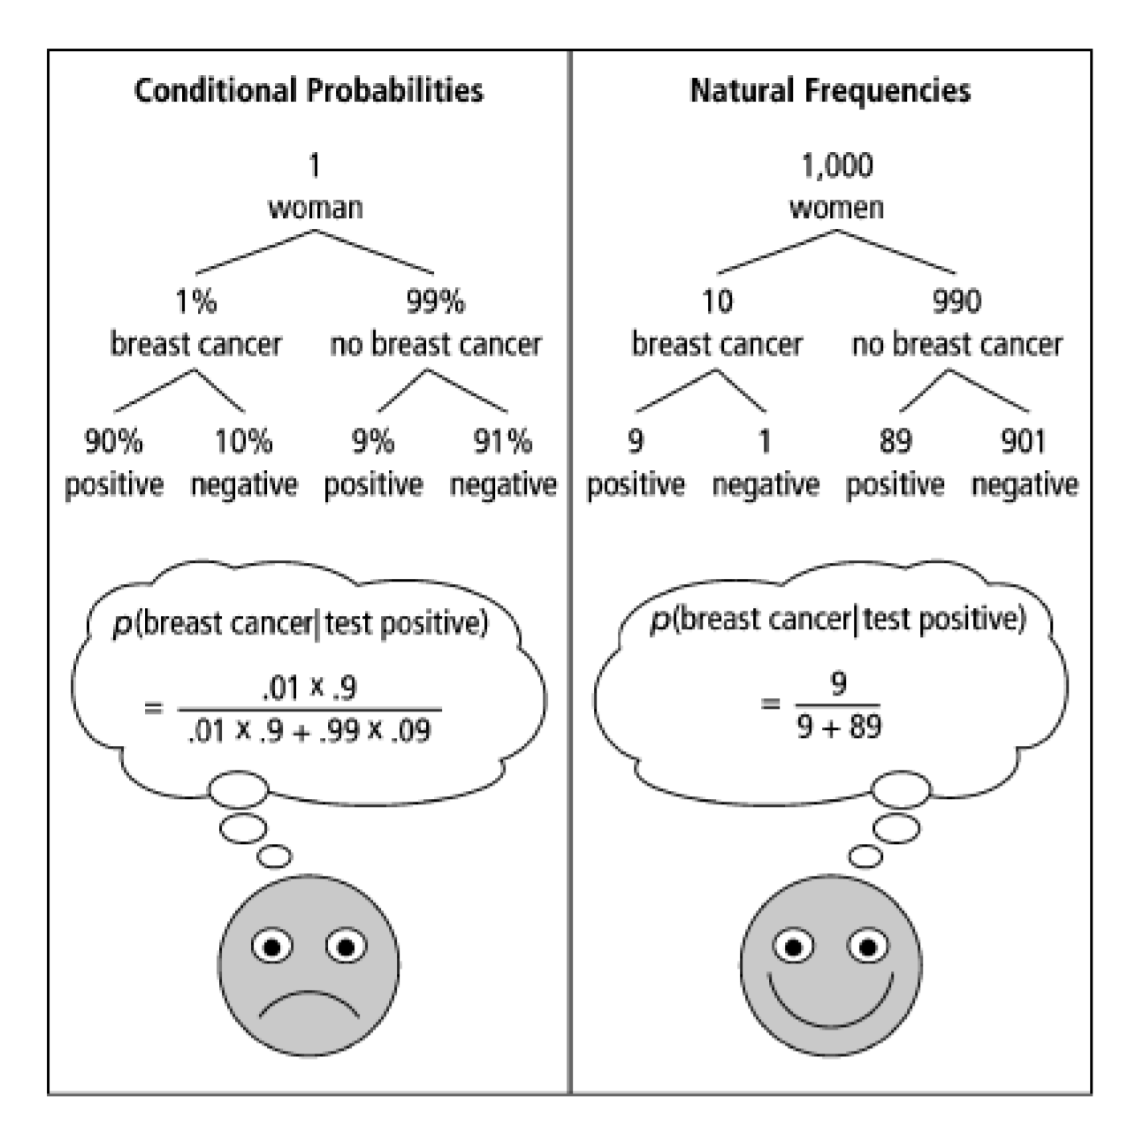
One Weird Trick!
Calculation Trick: imagine you have a large population (not one person) and ask how many there are of false/true positives/negatives.

Slide 23
What about the real world?
When you’re older and have to do more routine medical tests, don’t get concerned (yet) when they ask to run another test.*
It’s usually fine.*
*This is not medical advice, Robbie is not a physician.

Slide 24
Careful Surveys

Slide 25
Application 2: An Imbalanced Survey
In 2014, a paper was published
“Do non-citizens vote in U.S. elections?”
This is a real paper (peer-reviewed). It claims that
1. In a survey, about 4% (of a few hundred) of non-U.S.-citizens surveyed said they voted in the 2008 federal election (which isn’t allowed).
2. Those non-citizen voters voted heavily (estimate 80+%) for democrats.
3. “It is likely though by no means certain that John McCain would have won North Carolina were it not for the votes for Obama cast by non-citizens”

Slide 26
Application 2: What is this survey?
The “Cooperative Congressional Election Study” was run in 2008 and 2010.
It interviews about 20,000 people about how/whether they voted in federal elections.
Two strange observations:
1. The noncitizens are a very small portion of those surveyed. Feels a little strange.
2. Those people…maybe accidentally admitted to a crime?

Slide 27
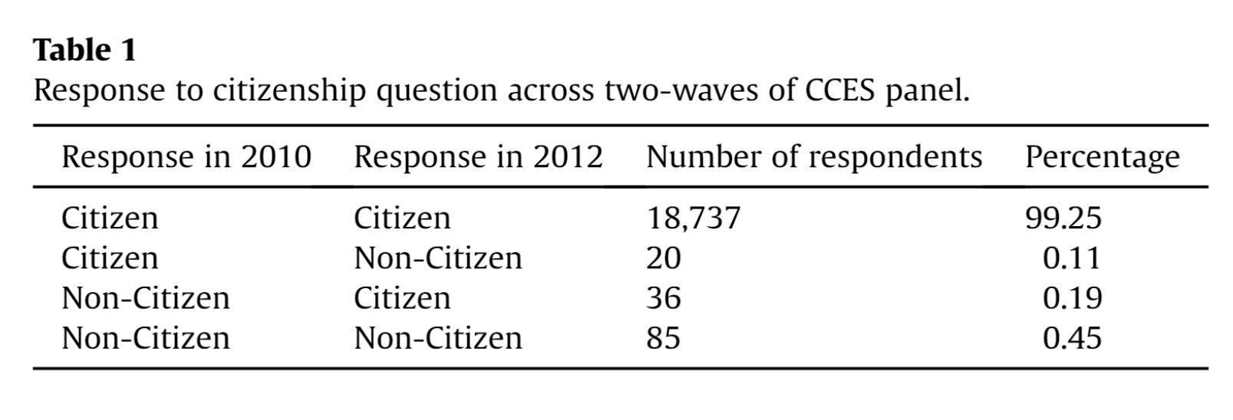
Application 2: Another Red Flag
A response paper (by different authors)
“The perils of cherry picking low frequency events in large sample surveys”
Notes:
A few thousand people per year renounce US citizenship (usually for tax reasons); number varies substantially over time (news source, but lacking exact data: https://www.forbes.com/sites/kathleenpeddicord/2022/07/28/does-renouncing-us-citizenship-make-sense-for-the-average-american-abroad/?sh=105ab80823ca) , but we’d generally expect closer to 1-2 people not 20 that lose citizenship.

Slide 28
An Explanation
Suppose $0.1\%$of people check the wrong check-box on any individual question (independently)
Suppose you really interviewed $20,000$ people, of whom $300$ are really non-citizens (none of whom voted), and the rest are citizens, of whom $70\%$voted. What is the probability someone appears to have voted
$ℙ\left(say V | say NC\right)=\frac{ℙ\left(say NC | say V\right)⋅ℙ(say V)}{ℙ(say NC)}=\frac{.001⋅.7}{.999⋅(\frac{300}{20000})+.001⋅(\frac{19700}{20000})}≈4.38\%$

Slide 29
Conclusion
The authors of the original paper did know about response error…
…and they have an appendix that argues the population of “non-citizen” voters isn’t distributed exactly like you’d expect.
But with it being such a small number of people, this isn’t surprising.
And even they admit response bias played more of a role than they initially thought.
Though they still think they found some evidence of non-citizens voting (but not enough to flip North Carolina anymore).
Notes:
A possibility (Robbie’s hot take): it might be that question was misinterpreted as “would you vote if allowed/who would you vote for” by some number of people, along with more traditional response error.

Slide 30
Takeaways
When talking about rare events (rare diseases, rare prize-winning-golden-tickets), think carefully about whether a test is really as informative as you think.
Do the explicit calculation
Intuition is easier if thinking about a large population of repeated tests, not just one.
Be careful of small subparts of large datasets
People from a large majority group (accidentally) clicking the wrong demographic information can “drown out” signal of a very small group.

Slide 31
Optional: Bayes Factor
A way to estimate Bayes calculations quickly

Slide 32
Bayes Factor
Another Intuition Trick: from 3Blue1Brown
When you test positive, you (approximately) multiply the prior by the “Bayes Factor” (aka likelihood ratio)
$\frac{sensitivity}{false positive rate}=\frac{1−FNR}{FPR}$

Slide 33
Bayes Factor
Does it work?
Let’s try it…
Find
$prior⋅\frac{Sensitivity}{FPR}$

Slide 34
Wonka Bars
Willy Wonka has placed golden tickets on 0.1% of his Wonka Bars.
You want to get a golden ticket. You could buy a 1000-or-so of the bars until you find one, but that’s expensive…you’ve got a better idea!
You have a test – a very precise scale you’ve bought.
If the bar you weigh does have a golden ticket, the scale will alert you 99.9% of the time.
If the bar you weigh does not have a golden ticket, the scale will (falsely) alert you only 1% of the time.
If you pick up a bar and it alerts, what is the probability you have a golden ticket?

Slide 35
Wonka Bars
Bayes Factor
$\frac{99.9}{1}$
Prior: $.1\%$
Product: $9.99$, so about $10\%$
About what Bayes Rule gets!

Slide 36
Application 1: Medical Tests
Helping Doctors and Patients Make Sense of Health Statistics
A researcher posed the following scenario to a group of 160 doctors:
Assume you conduct a disease screening using a standard test in a certain region. You know the following information about the people in this region:
The probability that a person has the disease is 1% (prevalence)
If a person has the disease, the probability that she tests positive is 90% (sensitivity)
If a person does not have the disease, the probability that she nevertheless tests positive is 9% (false-positive rate)
A person tests positive. She wants to know from you whether that means that she has the disease for sure, or what the chances are. What is the best answer?
A. The probability that she has the disease is about 81%.
B. Out of 10 people with a positive test, about 9 have the disease.
C. Out of 10 people with a positive test, about 1 have the disease.
D. The probability that she has the disease is about 1%

Slide 37
Bayes Factor
What about with the doctors?
$1\%⋅\frac{90\%}{9\%}=10\%$
Again about right!

Slide 38
Caution
Multiplying by the Bayes Factor is an approximation
It gives you the exact numerator for Bayes, but the denominator is “the number of false positives if the prevalence (/prior) were 0”
When the prior is close to 0, this is a fine approximation!
But plug in a prior of 15% on the last slide, and we get 150% chance.

Slide 39
What about negative tests?
For negative tests, the Bayes Factor is
$\frac{FNR}{specificity }$
Specificity is $(1−false negative rate)$

Slide 40
Random Variable
What’s a random variable?
Formally
Informally: A random variable is a way to summarize the important (numerical) information from your outcome.
$X:Ω→ℝ$ is a random variable
$X(ω)$ is the summary of the outcome $ω$
Random Variable

