Slide 1
More Bayes’ Rule and Independence
CSE 312 Spring 24
Lecture 7

Slide 2
Wonka Bars
Willy Wonka has placed golden tickets on 0.1% of his Wonka Bars.
You want to get a golden ticket. You could buy a 1000-or-so of the bars until you find one, but that’s expensive…you’ve got a better idea!
You have a test – a very precise scale you’ve bought.
If the bar you weigh does have a golden ticket, the scale will alert you 99.9% of the time.
If the bar you weigh does not have a golden ticket, the scale will (falsely) alert you only 1% of the time.
If you pick up a bar and it alerts, what is the probability you have a golden ticket?

Slide 3
Willy Wonka
Fill out the poll everywhere so Robbie knows how long to explain
Go to pollev.com/cse312
Willy Wonka has placed golden tickets on 0.1% of his Wonka Bars.
If the bar you weigh does have a golden ticket, the scale will alert you 99.9% of the time.
If the bar you weigh does not have a golden ticket, the scale will (falsely) alert you only 1% of the time.
You pick up a bar and it alerts, what is the probability you have a golden ticket?
Which of these is closest to the right answer?
0.1%
10%
50%
90%
99%
99.9%

Slide 4
Conditioning
Let $S$ be the event that the Scale alerts you
Let $G$ be the event your bar has a Golden ticket.
What conditional probabilities are each of these?
Willy Wonka has placed golden tickets on 0.1% of his Wonka Bars.
If the bar you weigh does have a golden ticket, the scale will alert you 99.9% of the time.
If the bar you weigh does not have a golden ticket, the scale will (falsely) alert you only 1% of the time.
If you pick up a bar and it alerts, what is the probability you have a golden ticket?

Slide 5
Conditioning
Let $S$ be the event that the Scale alerts you
Let $G$ be the event your bar has a Golden ticket.
What conditional probabilities are each of these?
Willy Wonka has placed golden tickets on 0.1% of his Wonka Bars.
If the bar you weigh does have a golden ticket, the scale will alert you 99.9% of the time.
If the bar you weigh does not have a golden ticket, the scale will (falsely) alert you only 1% of the time.
You pick up a bar and it alerts, what is the probability you have a golden ticket?
$$ℙ(G)$$
$$ℙ(S|G)$$
$$ℙ\left(S | \overline{G}\right)$$
$$ℙ(G|S)$$

Slide 6
Reversing the Conditioning
All of our information conditions on whether $G$ happens or not – does your bar have a golden ticket or not?
But we’re interested in the “reverse” conditioning. We know the scale alerted us – we know the test is positive – but do we have a golden ticket?

Slide 7
Bayes Rule
$$ℙ\left(A | B\right)=\frac{ℙ(B|A)ℙ\left(A\right)}{ℙ\left(B\right)}$$

Slide 8
Bayes Rule
$$ℙ\left(A | B\right)=\frac{ℙ(B|A)ℙ\left(A\right)}{ℙ\left(B\right)}$$
What do we know about Wonka Bars?
$$ℙ(G|S)=\frac{ℙ\left(S | G\right)⋅ℙ(G)}{ℙ(S)}$$

Slide 9
Bayes Rule
$$ℙ\left(A | B\right)=\frac{ℙ(B|A)ℙ\left(A\right)}{ℙ\left(B\right)}$$
What do we know about Wonka Bars?
$$ℙ(G|S)=\frac{.999⋅.001}{ℙ(S)}$$

Slide 10
Filling In
What’s $ℙ(S)$?
We’ll use a trick called “the law of total probability”:
$ℙ\left(S\right)=ℙ\left(S | G\right)⋅ℙ\left(G\right)+ℙ\left(S | \overline{G}\right)⋅ℙ\left(\overline{G}\right)$
$=0.999⋅.001+.01⋅.999$
$=.010989$

Slide 11
Law of Total Probability
Let $A_{1},A_{2},…,A_{k}$ be a partition of $Ω$.
A partition of a set $S$ is a family of subsets $S_{1},S_{2},…,S_{k}$ such that:
$S_{i}∩S_{j}=∅$ for all $i,j$ and
$S_{1}∪S_{2}∪…∪S_{k}=S$.
i.e. every element of $Ω$ is in exactly one of the $A_{i}$.

Slide 12
Law of Total Probability
Let $A_{1},A_{2},…,A_{k}$ be a partition of $Ω$.
For any event $E$,
$$ℙ\left(E\right)= \sum_{all i}{ℙ\left(E|A_{i}\right)ℙ(A_{i})}$$
Law of Total Probability

Slide 13
Why?
$$E$$
$$A_{1}$$
$$A_{2}$$
$$A_{3}$$
The Proof is actually pretty informative on what’s going on.
$\sum_{all i}{ℙ\left(E|A_{i}\right)ℙ(A_{i})}$
$=\sum_{all i}{\frac{ℙ\left(E∩A_{i}\right)}{ℙ\left(A_{i}\right)}⋅ℙ(A_{i})}$ (definition of conditional probability)
$=\sum_{all i}{ℙ\left(E∩A_{i}\right)}$
$=ℙ(E)$
The $A_{i}$ partition $Ω$, so $E∩A_{i}$ partition $E$. Then we just add up those probabilities.
Ability to add follows from the “countable additivity” axiom.

Slide 14
Bayes Rule
What do we know about Wonka Bars?
$$ℙ(G|S)=\frac{.999⋅.001}{.010989}$$
Solving $ℙ\left(G | S\right)=\frac{1}{11}$, i.e. about 0.0909.
Only about a 10% chance that the bar has the golden ticket!

Slide 15
Wait a minute…
Willy Wonka has placed golden tickets on 0.1% of his Wonka Bars.
If the bar you weigh does have a golden ticket, the scale will alert you 99.9% of the time.
If the bar you weigh does not have a golden ticket, the scale will (falsely) alert you only 1% of the time.
That doesn’t fit with many of our guesses. What’s going on?
Instead of saying “we tested one and got a positive” imagine we tested 1000. ABOUT how many bars of each type are there?
(about) 1 with a golden ticket 999 without. Lets say those are exactly right.
Lets just say that one golden is truly found
(about) 1% of the 999 without would be a positive. Lets say it’s exactly 10.

Slide 16
Visually
Gold bar is the one (true) golden ticket bar.
Purple bars don’t have a ticket and tested negative.
Red bars don’t have a ticket, but tested positive.
The test is, in a sense, doing really well.
It’s almost always right.
The problem is it’s also the case that the correct answer is almost always “no.”

Slide 17
Updating Your Intuition
Take 1: The test is actually good and has VASTLY increased our belief that there IS a golden ticket when you get a positive result.
If we told you “your job is to find a Wonka Bar with a golden ticket” without the test, you have 1/1000 chance, with the test, you have (about) a 1/11 chance. That’s (almost) 100 times better!
This is actually a huge improvement!

Slide 18
Updating Your Intuition
Take 2: Humans are really bad at intuitively understanding very large or very small numbers.
When I hear “99% chance”, “99.9% chance”, “99.99% chance” they all go into my brain as “well that’s basically guaranteed” And then I forget how many 9’s there actually were.
But the number of 9s matters because they end up “cancelling” with the “number of 9’s” in the population that’s truly negative. We’ll talk about this a little more on Friday in the applications.

Slide 19
Updating Your Intuition
Take 3: View tests as updating your beliefs, not as revealing the truth.
Bayes’ Rule says that $ℙ(B|A)$ has a factor of $ℙ(B)$ in it. You have to translate “The test says there’s a golden ticket” to “the test says you should increase your estimate of the chances that you have a golden ticket.”
A test takes you from your “prior” beliefs of the probability to your “posterior” beliefs.

Slide 20
More Bayes Practice

Slide 21
A contrived example
You have three red marbles and one blue marble in your left pocket, and one red marble and two blue marbles in your right pocket.
You will flip a fair coin; if it’s heads, you’ll draw a marble (uniformly) from your left pocket, if it’s tails, you’ll draw a marble (uniformly) from your right pocket.
Let $B$ be you draw a blue marble. Let $T$ be the coin is tails.
What is $ℙ(B|T)$ what is $ℙ(T|B)$ ?

Slide 22
Updated Sequential Processes
You have three red marbles and one blue marble in your left pocket, and one red marble and two blue marbles in your right pocket.
if it’s heads, you’ll draw a marble (uniformly) from your left pocket,
if it’s tails, you’ll draw a marble (uniformly) from your right pocket.
$$ℙ\left(H\right)=\frac{1}{2}$$
$$ℙ\left(T\right)=\frac{1}{2}$$
H
T
For sequential processes with probability, at each step multiply by $ℙ\left(next step \right|all∩prior∩steps)$
$$ℙ\left(R|H\right)=\frac{3}{4}$$
$$ℙ\left(R|T\right)=\frac{1}{3}$$
$$ℙ\left(B|T\right)=\frac{2}{3}$$
$$ℙ\left(B|H\right)=\frac{1}{4}$$
$$ℙ\left(R∩H\right)=3/8$$
$$ℙ\left(R∩T\right)=1/6$$
$$ℙ\left(B∩H\right)=1/8$$
$$ℙ\left(B∩T\right)=1/3$$

Slide 23
Updated Sequential Processes
You have three red marbles and one blue marble in your left pocket, and one red marble and two blue marbles in your right pocket.
if it’s heads, you’ll draw a marble (uniformly) from your left pocket,
if it’s tails, you’ll draw a marble (uniformly) from your right pocket.
$$ℙ\left(H\right)=\frac{1}{2}$$
$$ℙ\left(T\right)=\frac{1}{2}$$
H
T
For sequential processes with probability, at each step multiply by $ℙ\left(next step \right|all∩prior∩steps)$
$ℙ\left(B | T\right)=2/3$; $ℙ\left(B\right)=\frac{1}{8}+\frac{1}{3}=\frac{11}{24}$
$$ℙ\left(R|H\right)=\frac{3}{4}$$
$$ℙ\left(R|T\right)=\frac{1}{3}$$
$$ℙ\left(B|T\right)=\frac{2}{3}$$
$$ℙ\left(B|H\right)=\frac{1}{4}$$
$$ℙ\left(R∩H\right)=3/8$$
$$ℙ\left(R∩T\right)=1/6$$
$$ℙ\left(B∩H\right)=1/8$$
$$ℙ\left(B∩T\right)=1/3$$

Slide 24
Flipping the conditioning
You have three red marbles and one blue marble in your left pocket, and one red marble and two blue marbles in your right pocket.
if it’s heads, you’ll draw a marble (uniformly) from your left pocket,
if it’s tails, you’ll draw a marble (uniformly) from your right pocket.
What about $ℙ(T|B)$?
Pause, what’s your intuition?
Is this probability
A. less than $½$
B. equal to $½$
C. greater than $½$

Slide 25
Flipping the conditioning
You have three red marbles and one blue marble in your left pocket, and one red marble and two blue marbles in your right pocket.
if it’s heads, you’ll draw a marble (uniformly) from your left pocket,
if it’s tails, you’ll draw a marble (uniformly) from your right pocket.
What about $ℙ(T|B)$?
Pause, what’s your intuition?
Is this probability
A. less than $½$
B. equal to $½$
C. greater than $½$
The right (tails) pocket is far more likely to produce a blue marble if picked than the left (heads) pocket is. Seems like $ℙ(T|B)$ should be greater than ½.

Slide 26
Flipping the conditioning
You have three red marbles and one blue marble in your left pocket, and one red marble and two blue marbles in your right pocket.
if it’s heads, you’ll draw a marble (uniformly) from your left pocket,
if it’s tails, you’ll draw a marble (uniformly) from your right pocket.
What about $ℙ(T|B)$?
Bayes’ Rule says:
$ℙ\left(T | B\right)=\frac{ℙ(B|T)ℙ\left(T\right)}{ℙ\left(B\right)}$
$=\frac{\frac{2}{3}⋅\frac{1}{2}}{11/24}=8/11$

Slide 27
The Technical Stuff

Slide 28
Proof of Bayes’ Rule
$ℙ\left(A | B\right)=\frac{ℙ\left(A∩B\right)}{ℙ\left(B\right)}$ by definition of conditional probability
Now, imagining we get $A∩B$ by conditioning on $A$, we should get a numerator of $ℙ\left(B | A\right)⋅ℙ(A)$
$=\frac{ℙ(B|A)⋅ℙ\left(A\right)}{ℙ\left(B\right)}$
As required.

Slide 29
A Technical Note
After you condition on an event, what remains is a probability space.
With $B$ playing the role of the sample space,
$ℙ(ω|B)$ playing the role of the probability measure.
All the axioms are satisfied (it’s a good exercise to check)
That means any theorem we write down has a version where you condition everything on $B$.

Slide 30
An Example
Bayes Theorem still works in a probability space where we’ve already conditioned on $S.$
$ℙ\left(A | [B∩S]\right)=\frac{ℙ\left(B | [A∩S]\right)⋅ℙ\left(A | S\right)}{ℙ(B|S)}$

Slide 31
A Quick Technical Remark
I often see students write things like
$ℙ([A\left|B]\right|C)$
This is not a thing.
You probably want $ℙ(A|\left[B∩C\right])$
$A|B$ isn’t an event – it’s describing an event and telling you to restrict the sample space. So you can’t ask for the probability of that conditioned on something else.

Slide 32
Real-World Bayes Example

Slide 33
Application 1: Medical Tests
Helping Doctors and Patients Make Sense of Health Statistics
A researcher posed the following scenario to a group of 160 doctors:
Assume you conduct a disease screening using a standard test in a certain region. You know the following information about the people in this region:
The probability that a person has the disease is 1% (prevalence)
If a person has the disease, the probability that she tests positive is 90% (sensitivity)
If a person does not have the disease, the probability that she nevertheless tests positive is 9% (false-positive rate)
A person tests positive. She wants to know from you whether that means that she has the disease for sure, or what the chances are. What is the best answer?
A. The probability that she has the disease is about 81%.
B. Out of 10 people with a positive test, about 9 have the disease.
C. Out of 10 people with a positive test, about 1 have the disease.
D. The probability that she has the disease is about 1%

Slide 34
Let’s do the calculation!
Let $D$ be “the patient has the disease”, $T$ be the test was positive.
$ℙ\left(D | T\right)=ℙ\left(T | D\right)⋅ℙ\left(D\right)/ℙ(T)$
$=\frac{.9⋅.01}{.99⋅.09+ .01⋅.9}≈0.092$
Calculation tip: for Bayes’ Rule, you should see one of the terms on the bottom exactly match your numerator (if you’re using the LTP to calculate the probability on the bottom)

Slide 35
Pause for vocabulary
Physicians have words for just about everything
Let $D$ be has the disease; $T$ be test is positive
$ℙ(D)$ is “prevalence”
$ℙ(T|D)$ is “sensitivity”
A ‘sensitive’ test is one which picks up on the disease when it’s there (high sensitivity -> few false negatives)
$ℙ\left(\overline{T} | \overline{D}\right)$ is “specificity”
A ‘specific’ test is one that is positive specifically because of the disease, and for no other reason (high specificity -> few false positives)

Slide 36
How did the doctors do
C (about 1 in 10) was the correct answer.
Of the doctors surveyed, less than ¼ got it right (so worse than random guessing).
After the researcher taught them his calculation trick, more than 80% got it right.

Slide 37
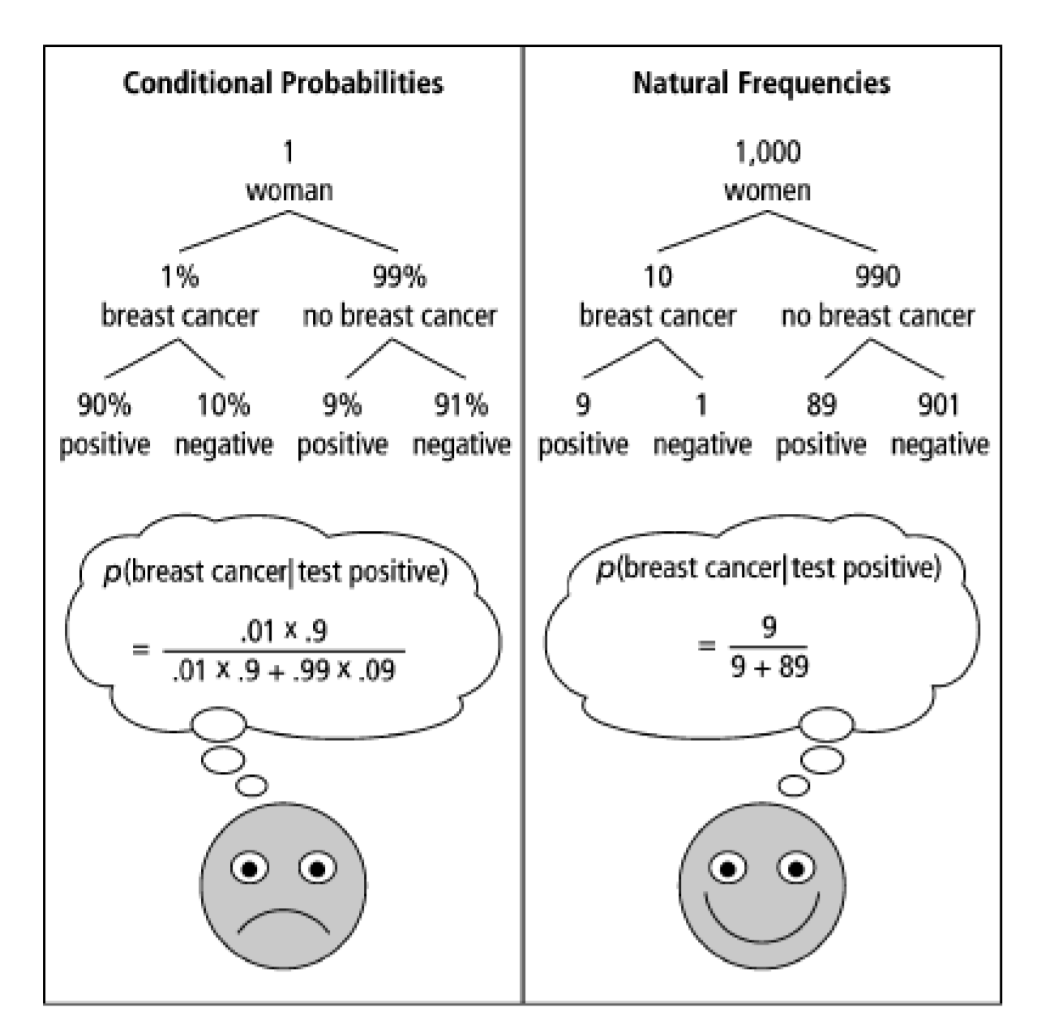
One Weird Trick!
Calculation Trick: imagine you have a large population (not one person) and ask how many there are of false/true positives/negatives.

Slide 38
What about the real world?
When you’re older and have to do more routine medical tests, don’t get concerned (yet) when they ask to run another test.*
It’s usually fine.*
*This is not medical advice, Robbie is not a physician.

Slide 39
Independence

Slide 40
Definition of Independence
We’ve calculated conditional probabilities.
Sometimes conditioning – getting some partial information about the outcome – doesn’t actually change the probability.
We already saw an example like this…

Slide 41
Conditioning Practice
Red die $6$ conditioned on sum 7 $1/6$
Red die 6 conditioned on sum 9 $1/4$
Sum 7 conditioned on red die 6 $1/6$
 | D2=1 | D2=2 | D2=3 | D2=4 | D2=5 | D2=6
D1=1 | (1,1) | (1,2) | (1,3) | (1,4) | (1,5) | (1.6)
D1=2 | (2,1) | (2,2) | (2,3) | (2,4) | (2,5) | (2,6)
D1=3 | (3,1) | (3,2) | (3,3) | (3,4) | (3,5) | (3,6)
D1=4 | (4,1) | (4,2) | (4,3) | (4,4) | (4,5) | (4,6)
D1=5 | (5,1) | (5,2) | (5,3) | (5,4) | (5,5) | (5,6)
D1=6 | (6,1) | (6,2) | (6,3) | (6,4) | (6,5) | (6,6)
Red die 6 has probability 1/6 before or after conditioning on sum 7.

Slide 42
Independence
Two events $A,B$ are independent if
$$ℙ\left(A∩B\right)=ℙ\left(A\right)⋅ℙ(B)$$
Independence
You’ll sometimes see this called “statistical independence” to emphasize that we’re talking about probabilities (not, say, physical interactions).
If $A,B$ both have non-zero probability then
$ℙ\left(A∩B\right)=ℙ(A)ℙ(B)$ $⇔$ $ℙ\left(A | B\right)=ℙ(A)$ $⇔ℙ\left(B | A\right)=ℙ(B)$

Slide 43
Examples
We flip a fair coin three times. Each flip is independent. (both in the statistical independence sense and in the “doesn’t affect the next one” sense).
Is $E=\{HHH\}$ independent of $F=$“at most two heads”?
Are $A=$“the first flip is heads” and $B=$“the second flip is tails” independent?

Slide 44
Examples
Is $E=\{HHH\}$ independent of $F=$“at most two heads”?
$ℙ\left(E∩F\right)=0$ (can’t have all three heads and at most two heads).
$ℙ\left(E\right)=1/8$, $ℙ\left(F\right)=7/8$, $ℙ\left(E∩F\right)≠ℙ\left(E\right)ℙ(F)$.
Are $A=$“the first flip is heads” and $B=$“the second flip is tails” independent?
$ℙ\left(A∩B\right)=2/8$ (uniform measure, and two of eight outcomes meet both $A$ and $B$.
$ℙ\left(A\right)=1/2$, $ℙ\left(B\right)=1/2$ $\frac{2}{8}=\frac{1}{2}⋅\frac{1}{2}$. These are independent!

Slide 45
Hey Wait
I said “the flips are independent” why aren’t $E,F$ independent?
“the flips are independent” means events like <the first flip is blah>” is independent of events like <the second flip is blah>
But if you have an event that involves both flip one and two that might not be independent of an event involving flip one or two.

