Slide 1
Here Early?
Here for CSE 312?
Welcome! You’re early!
Want a copy of these slides to take notes?
  You can download them from the webpage cs.uw.edu/312
  Want to be ready for the end of the lecture?
  Download the Activity slide from the same place
  Go to pollev.com/robbie and login with your at-uw email (not at-cs!)
  You should see a question that doesn’t make sense yet.

Slide 2
Introduction and Counting
CSE 312 24Sp
Lecture 1

Slide 3

Staff
TAs
Ameya Agrawal
Ariel Fu
Anna Kuznetsova
Zhi Yang Lim
Allie Pfleger
Edward Qin
Emily Robinson
Alicia Stepin
Claris Winston
Ben Zhang
Muru Zhang
Jolie Zhou
Instructor: Robbie Weber
Ph.D. from UW CSE in theory
Fourth year as teaching faculty
Email: rtweber2@cs.washington.edu

Slide 4
Logistics
There are two lectures, MWF
A lecture 9:30-10:20, B lecture 1:30-2:20
Both will be recorded, with recordings posted when possible.
Try to attend your officially registered lecture, but you don’t need permission to occasionally attend the other.
The lectures should be nearly identical, but there will be small differences (e.g. more/fewer/different questions)

Slide 5
Logistics
Sections meet on Thursdays (starting this week)
Please go to your assigned section.
If you can’t make your assigned section one week, you can ask the TA(s) in charge of another for permission to join.
Sections will not be recorded – we want you to be able to ask questions and give feedback without worrying about being recorded.
Handouts and solutions will be posted.

Slide 6
Syllabus
When in doubt, it’s on the webpage:
(or it will be soon ☺ )
https://courses.cs.washington.edu/courses/cse312/24sp/

Slide 7
Work
Concept Checks (7.5%)
  Short “quiz” for each lecture on gradescope; identify misconceptions right away.
  Due the morning of the next lecture. First due date Friday
  Section Participation (5%)
  Go to section and work on problems there or (if you can’t make it) do the corresponding problems on your own and email them to your TA.
Approximately 8 Homeworks (50%)
  Mostly written problems, but a few programming questions.
Midterm (12.5%)
  Evening exam Monday April 29
Final exam (25%)
  Monday June 3 12:30-2:20 Combined exam for both sections

Slide 8
Communication
Ed Discussion board will be our primary means of communication.
  Please check frequently.
  We’ll send announcement emails via Ed.
  If you want to contact us:
  Private post on Ed (seen by TAs and Robbie, but not other students)
  Email Robbie
  Anonymous Feedback form on webpage

Slide 9
Collaboration Policy
PLEASE collaborate! Please talk to each other and work with each other.
(subject to the policy – details on webpage)

Slide 10
What is This Class?
We’re going to learn fundamentals of probability theory.
A beautiful and useful branch of mathematics.
Applications in:
Machine Learning
Natural Language Processing
Cryptography
Error-Correcting Codes
Data Structures
Data Compression
Complexity Theory
Algorithm Design
…

Slide 11
Content
Combinatorics (fancy counting)
  Permutations, combinations, inclusion-exclusion, pigeonhole principle
Formal definitions for Probability
  Probability space, events, conditional probability, independence, expectation, variance
Common patterns in probability
  Equations and inequalities, “zoo” of common random variables, tail bounds
Continuous Probability
  pdf, cdf, sample distributions, central limit theorem, estimating probabilities
Applications
  Across CS, but with some focus on ML.

Slide 12
Themes
Precise mathematical communication
  Both reading and writing dense statements.
Probability in the “real world”
  A mix of CS applications
  And some actual “real life” ones.
Refine your intuition
  Most people have some base level feeling of what the chances of some event are.
  We’re going to train you to have better gut feelings.

Slide 13
Counting

Slide 14
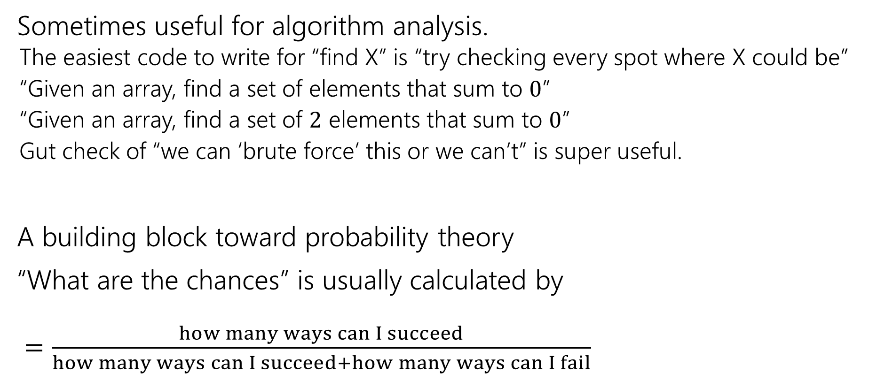
Why Counting?
Sometimes useful for algorithm analysis.
  The easiest code to write for “find X” is “try checking every spot where X could be”
  “Given an array, find a set of elements that sum to $0$”
  “Given an array, find a set of $2$ elements that sum to $0$”
  Gut check of “we can ‘brute force’ this or we can’t” is super useful.
A building block toward probability theory
“What are the chances” is usually calculated by
$=\frac{how many ways can I succeed}{how many ways can I succeed+how many ways can I fail}$

Slide 15
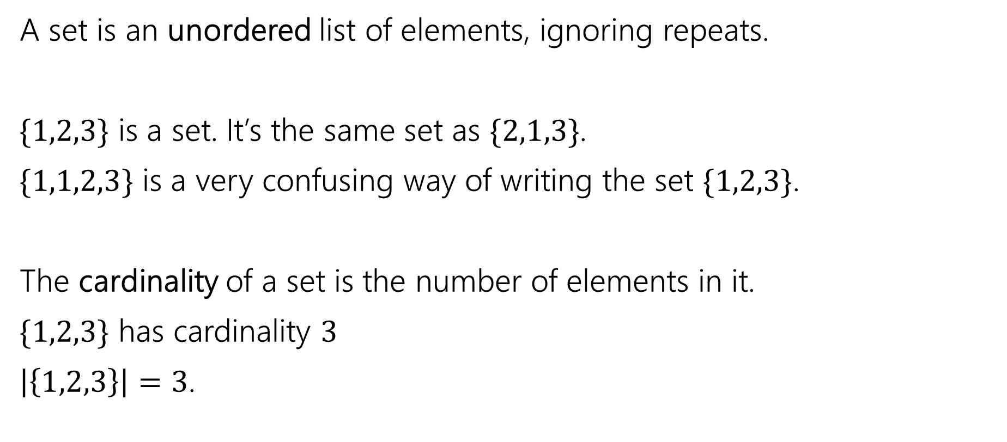
Remember sets?
A set is an unordered list of elements, ignoring repeats.
$\{1,2,3\}$ is a set. It’s the same set as $\{2,1,3\}$.
$\{1,1,2,3\}$ is a very confusing way of writing the set $\{1,2,3\}$.
The cardinality of a set is the number of elements in it.
$\{1,2,3\}$ has cardinality $3$
$\left|\left\{1,2,3\right\}\right|=3$.

Slide 16
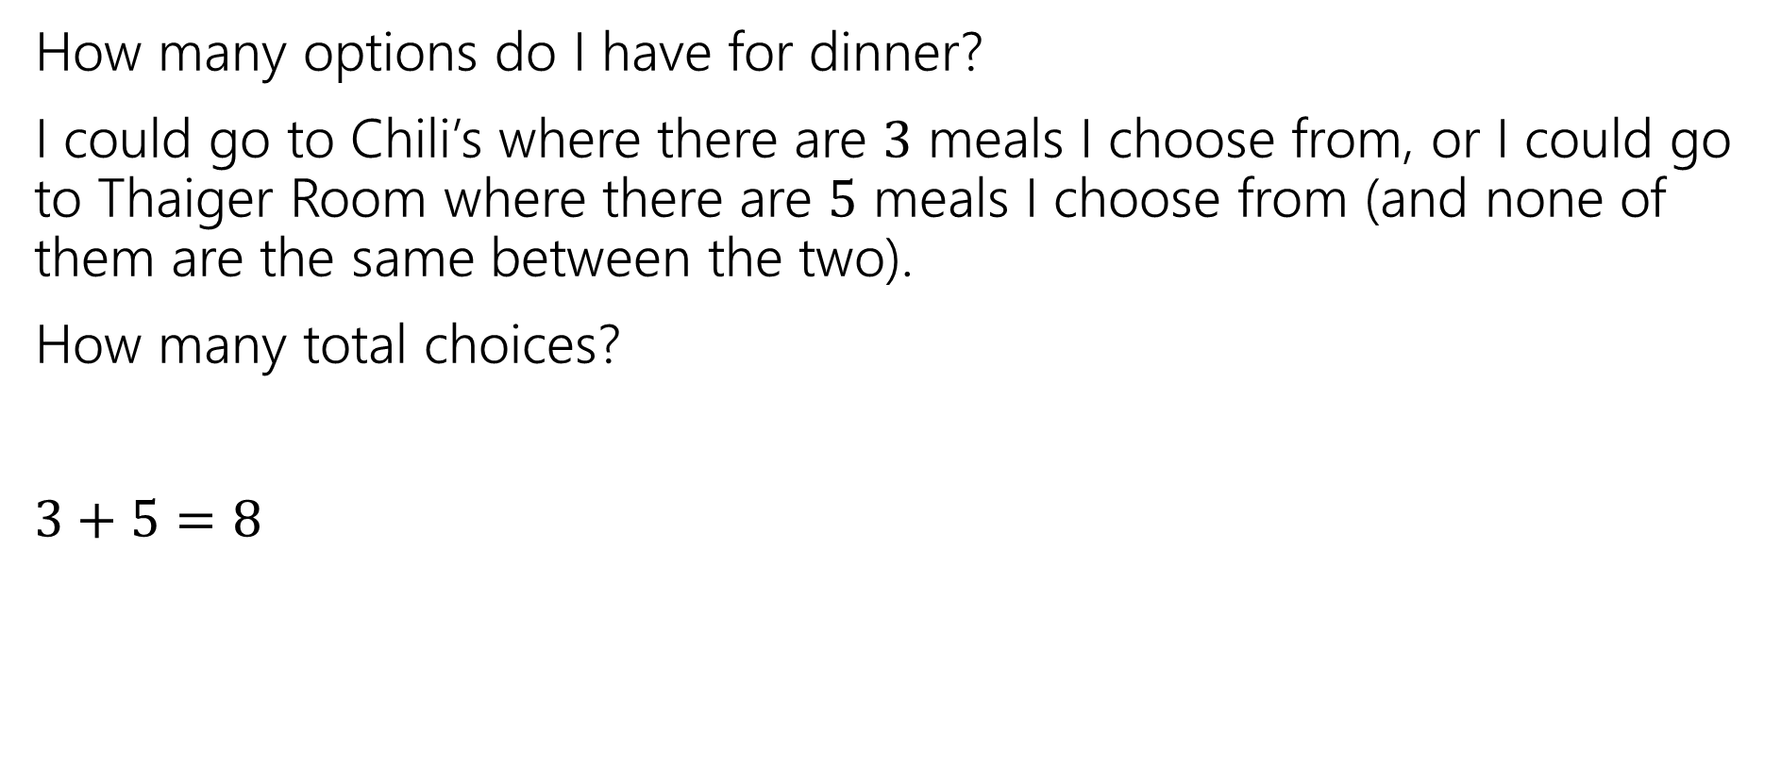
Counting Rules
How many options do I have for dinner?
I could go to Chili’s where there are $3$ meals I choose from, or I could go to Thaiger Room where there are $5$ meals I choose from (and none of them are the same between the two).
How many total choices?
$3+5=8$
Sum Rule: If you are choosing one thing between $n$ options in one group and $m$in another group with no overlap, the total number of options is: $n+m$.

Slide 17
Counting Rules
I’m still hungry…
I decide to make a sandwich. My sandwiches are always:
  One of three types of bread (white, wheat, or sourdough).
  One of two spreads (mayo or mustard)
  One of four cheeses (American, cheddar, swiss, or Havarti)
How many sandwiches can I make?

Slide 18
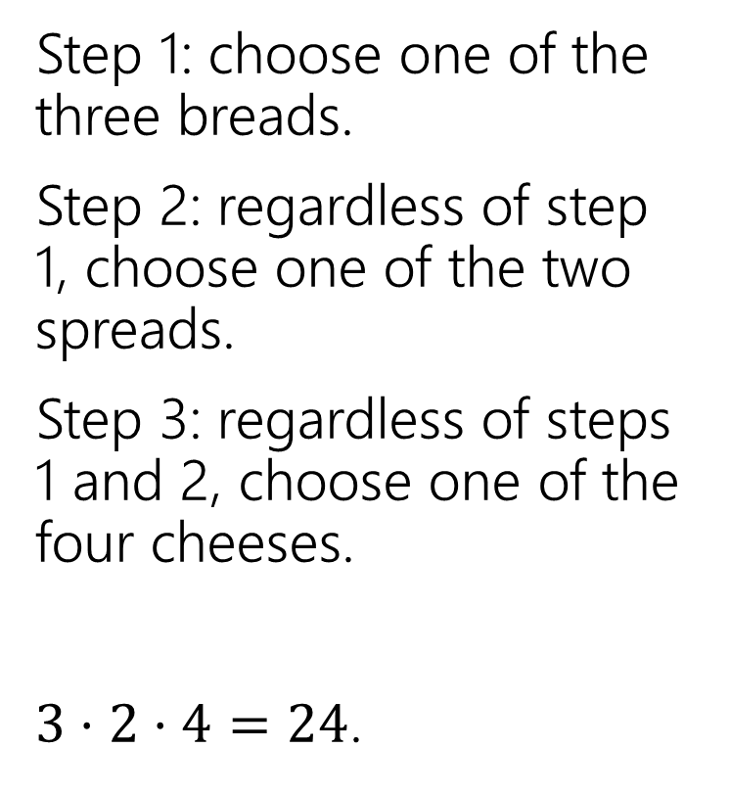
Sandwiches
Step 1: choose one of the three breads.
Step 2: regardless of step 1, choose one of the two spreads.
Step 3: regardless of steps 1 and 2, choose one of the four cheeses.
$3⋅2⋅4=24$.
White
Sourdough
Wheat
Mayo
Mustard
A
C
S
H

Slide 19
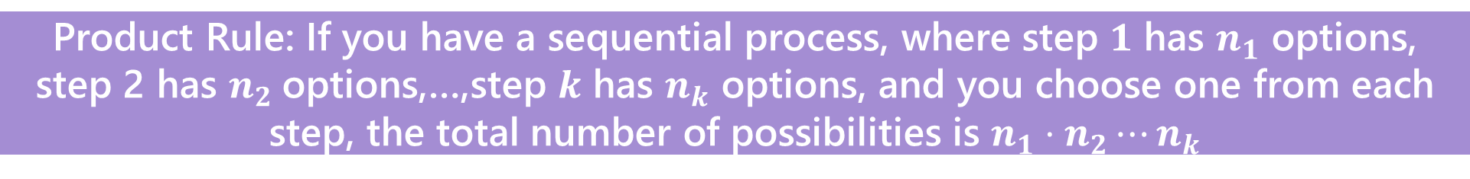
Counting Rules
Sum Rule: If you are choosing one thing between $n$ options in one group and $m$in another group with no overlap, the total number of options is: $n+m$.
Product Rule: If you have a sequential process, where step $1$ has $n_{1}$ options, step 2 has $n_{2}$options,…,step $k$ has $n_{k}$ options, and you choose one from each step, the total number of possibilities is $n_{1}⋅n_{2}⋯n_{k}$

Slide 20
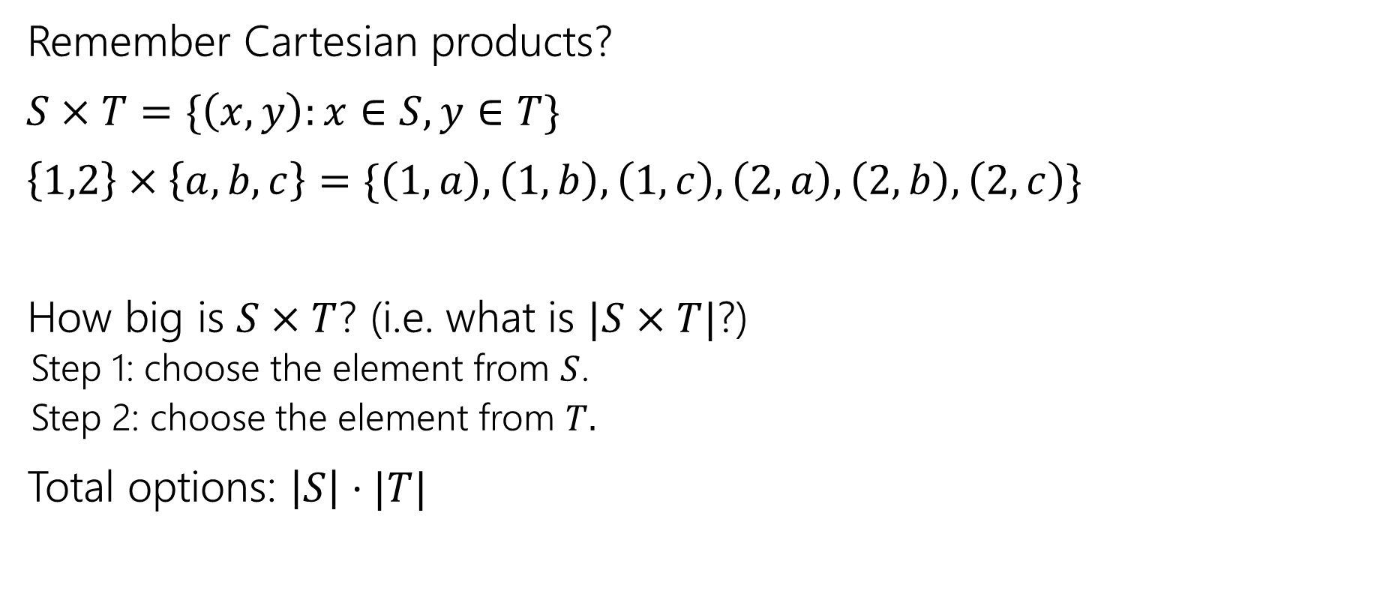
Applications of the product rule
Remember Cartesian products?
$S×T=\{\left(x,y\right):x∈S, y∈T\}$
$\left\{1,2\right\}×\left\{a,b,c\right\}=\{\left(1,a\right),\left(1,b\right),\left(1,c\right),\left(2,a\right),\left(2,b\right),\left(2,c\right)\}$
How big is $S×T$? (i.e. what is $|S×T|$?)
  Step 1: choose the element from $S$.
  Step 2: choose the element from $T.$
Total options: $\left|S\right|⋅|T|$

Slide 21

Power Sets
$𝒫\left(S\right)=\{X:X⊆S\}$
$𝒫\left(\left\{1,2,3\right\}\right)=\{ ∅, \left\{1\right\},\left\{2\right\},\left\{3\right\}, \left\{1,2\right\},\left\{1,3\right\},\left\{2,3\right\}, \left\{1,2,3\right\} \}$
How many subsets are there of $S$, i.e. what is $\left|𝒫\left(S\right)\right|$?

Slide 22
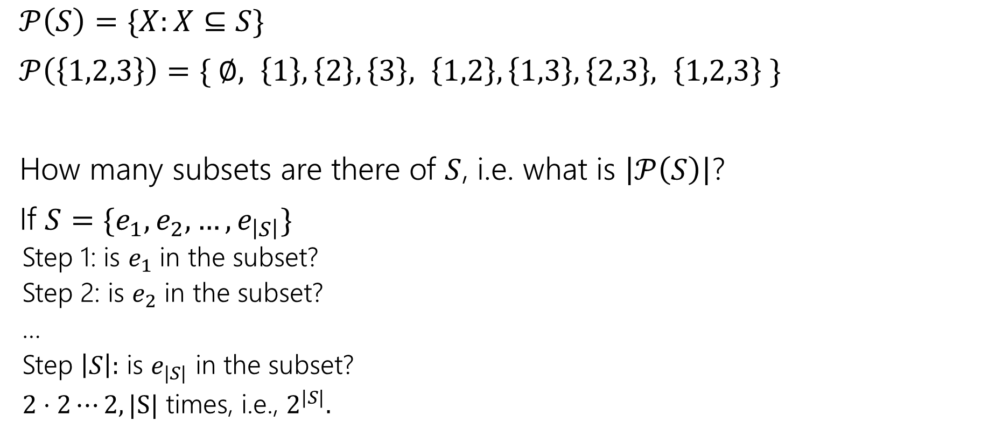
Power Sets
$𝒫\left(S\right)=\{X:X⊆S\}$
$𝒫\left(\left\{1,2,3\right\}\right)=\{ ∅, \left\{1\right\},\left\{2\right\},\left\{3\right\}, \left\{1,2\right\},\left\{1,3\right\},\left\{2,3\right\}, \left\{1,2,3\right\} \}$
How many subsets are there of $S$, i.e. what is $\left|𝒫\left(S\right)\right|$?
If $S=\{e_{1},e_{2},…,e_{\left|S\right|}\}$
  Step 1: is $e_{1}$ in the subset?
  Step 2: is $e_{2}$ in the subset?
  …
  Step $\left|S\right|:$ is $e_{|S|}$ in the subset?
  $2⋅2⋯2, |S|$ times, i.e., $2^{|S|}.$

Slide 23
Baseball Outfits
The Husky baseball team has three hats (purple, black, gray)
Three jerseys (pinstripe, purple, gold)
And three pairs of pants (gray, white, black)
How many outfits are there (consisting of one hat, jersey, and pair of pants) if
  the pinstripe jersey cannot be worn with gray pants,
  the purple jersey cannot be worn with white pants,
  and the gold jersey cannot be worn with black pants.

Slide 24
Baseball Outfits
Step 1: 3 choices for hats.
Step 2: 3 choices for jerseys
Step 3:…

Slide 25
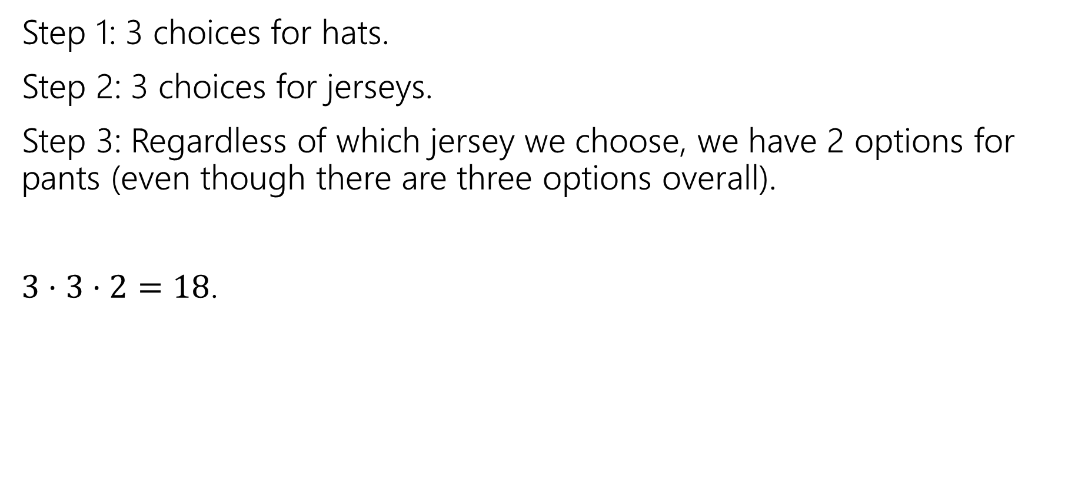
Baseball Outfits
Step 1: 3 choices for hats.
Step 2: 3 choices for jerseys.
Step 3: Regardless of which jersey we choose, we have 2 options for pants (even though there are three options overall).
$3⋅3⋅2=18$.

Slide 26








Assigning Books
We have 5 books to split to 3 people (Alice, Bob, and Charlie)
Every book goes to exactly one person, but each person could end up with no books (or all of them, or something in between).
1
Alice
2
Bob
3
4
Charlie
5

Slide 27
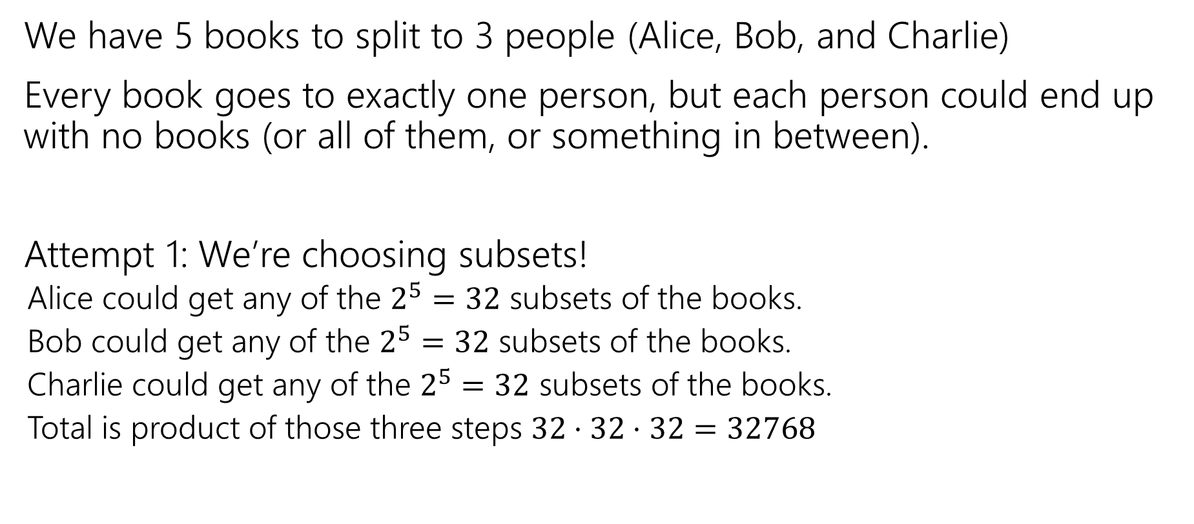
Assigning Books
We have 5 books to split to 3 people (Alice, Bob, and Charlie)
Every book goes to exactly one person, but each person could end up with no books (or all of them, or something in between).
Attempt 1: We’re choosing subsets!
  Alice could get any of the $2^{5}=32$ subsets of the books.
  Bob could get any of the $2^{5}=32$ subsets of the books.
  Charlie could get any of the $2^{5}=32$ subsets of the books.
  Total is product of those three steps $32⋅32⋅32=32768$

Slide 28

Activity
Attempt 1: We’re choosing subsets!
  Alice could get any of the $2^{5}=32$ subsets of the books.
  Bob could get any of the $2^{5}=32$ subsets of the books.
  Charlie could get any of the $2^{5}=32$ subsets of the books.
  Total is product of those three steps $32⋅32⋅32=32768$
Fill out the poll everywhere so Robbie can adjust his explanation
Go to pollev.com/robbie and login with your UW identity

Slide 29
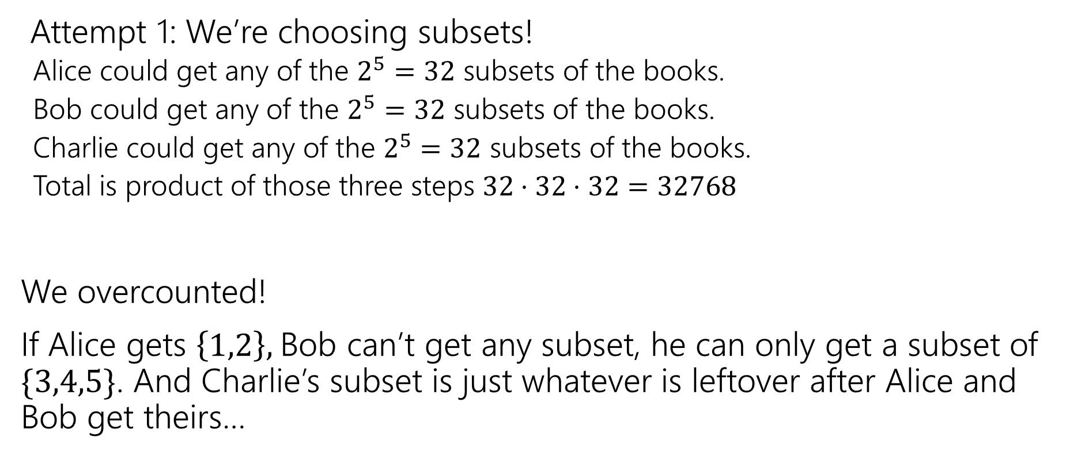
Activity
Attempt 1: We’re choosing subsets!
  Alice could get any of the $2^{5}=32$ subsets of the books.
  Bob could get any of the $2^{5}=32$ subsets of the books.
  Charlie could get any of the $2^{5}=32$ subsets of the books.
  Total is product of those three steps $32⋅32⋅32=32768$
We overcounted!
If Alice gets $\left\{1,2\right\},$Bob can’t get any subset, he can only get a subset of $\{3,4,5\}$. And Charlie’s subset is just whatever is leftover after Alice and Bob get theirs…

Slide 30
Fixing All The Books
You could
List out all the options for Alice.
For each of those (separately), list all the possible options for Bob and Charlie.
Use the Summation rule to combine.
~OR~ you could come at the problem from a different angle.

Slide 31
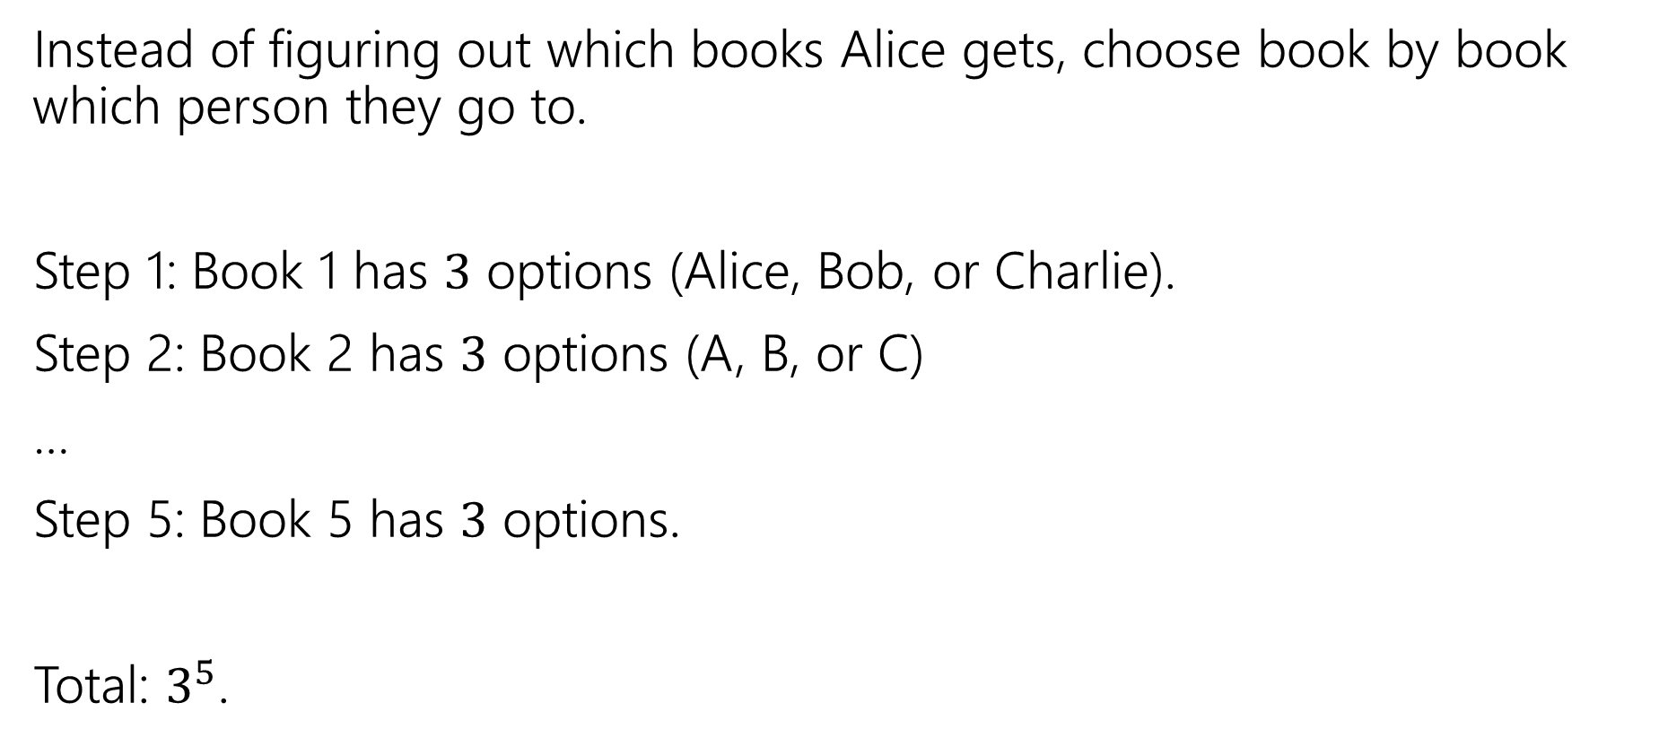
Fixing All the Books
Instead of figuring out which books Alice gets, choose book by book which person they go to.
Step 1: Book 1 has $3$ options (Alice, Bob, or Charlie).
Step 2: Book 2 has $3$ options (A, B, or C)
…
Step 5: Book 5 has $3$ options.
Total: $3^{5}$.

Slide 32

More sequence practice
How many length 3 sequences are there consisting of distinct elements of $\{1,2,3\}$.

Slide 33
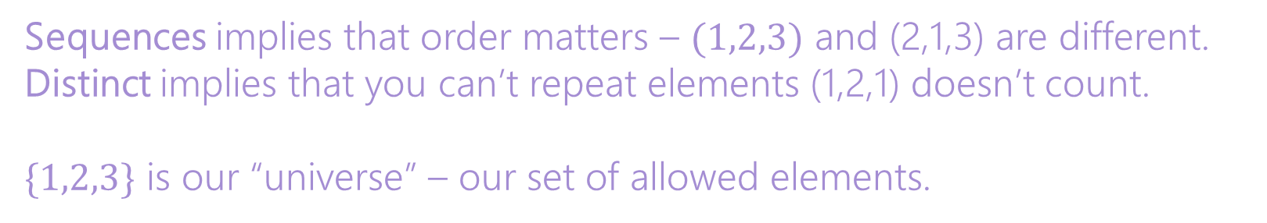
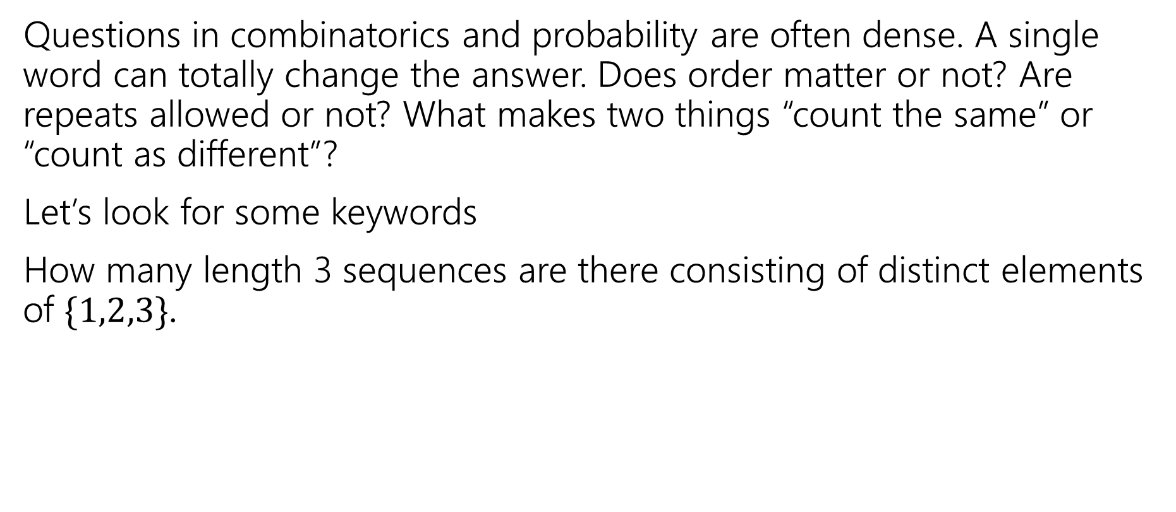
Pause
Questions in combinatorics and probability are often dense. A single word can totally change the answer. Does order matter or not? Are repeats allowed or not? What makes two things “count the same” or “count as different”?
Let’s look for some keywords
How many length 3 sequences are there consisting of distinct elements of $\{1,2,3\}$.
Sequences implies that order matters – $(1,2,3)$ and (2,1,3) are different.
Distinct implies that you can’t repeat elements (1,2,1) doesn’t count.
$\{1,2,3\}$ is our “universe” – our set of allowed elements.

Slide 34
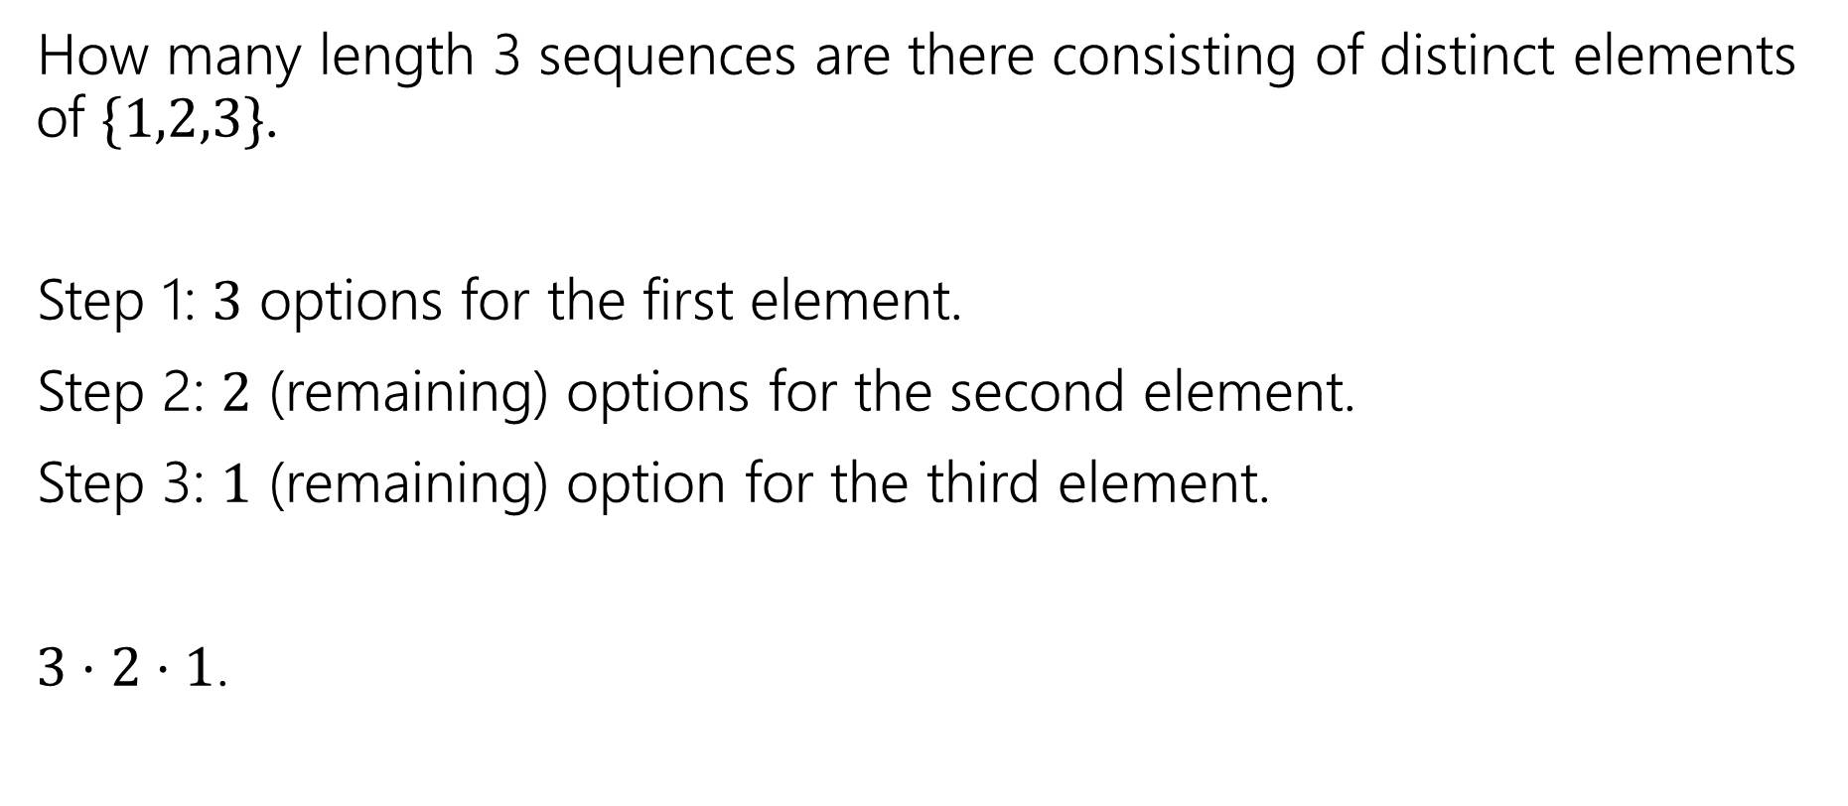
More sequence practice
How many length 3 sequences are there consisting of distinct elements of $\{1,2,3\}$.
Step 1: $3$ options for the first element.
Step 2: $2$ (remaining) options for the second element.
Step 3: $1$ (remaining) option for the third element.
$3⋅2⋅1$.

Slide 35

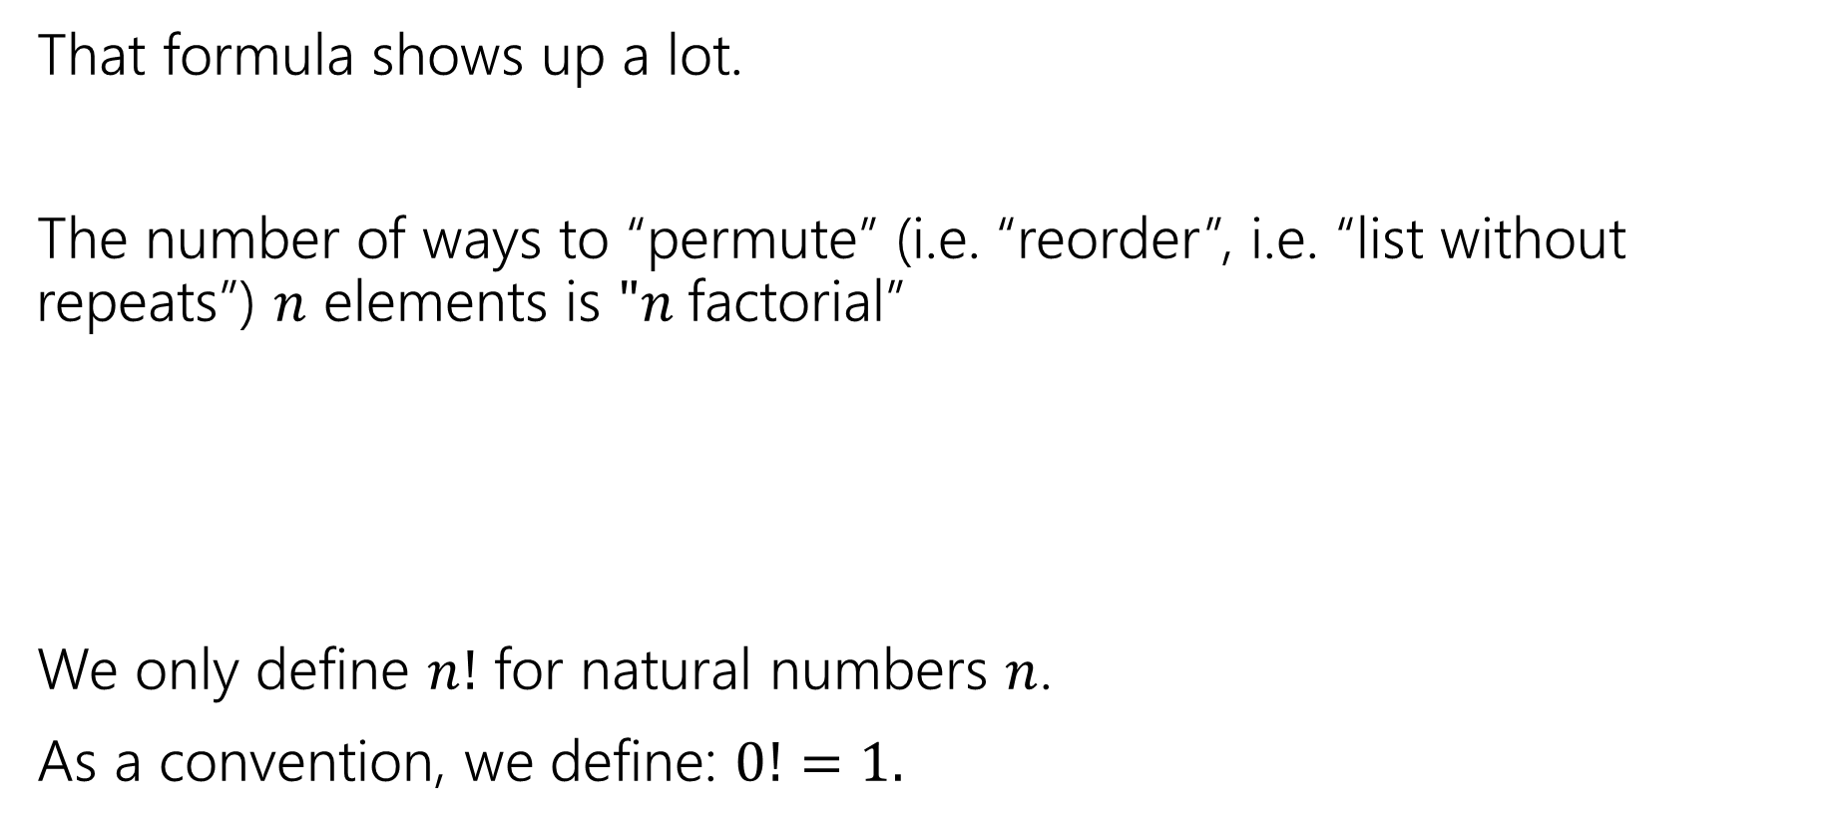

Factorial
That formula shows up a lot.
The number of ways to “permute” (i.e. “reorder”, i.e. “list without repeats”) $n$ elements is $"n$factorial”
We only define $n!$ for natural numbers $n$.
As a convention, we define: $0!=1.$
$$n!=n⋅\left(n−1\right)⋅\left(n−2\right)⋯1$$
$n$ factorial

Slide 36
More Practice

Slide 37

Strings
How many strings of length $5$ are there over the alphabet $\{A,B,C,…,Z\}$? (repeated characters allowed)
How many binary strings of length $n$ are there?

Slide 38

Strings
How many strings of length $5$ are there over the alphabet $\{A,B,C,…,Z\}$? (repeated characters allowed)
${26}^{5}$
How many binary strings of length $n$ are there?
$2^{n}$

