Slide 1
Continuous Random Variables Continued
CSE 312 Summer 21
Lecture 15

Slide 2
Announcements
Only 1 person signed up for extra OH! 😢
Extending the sign up for OH.
Please sign up by tonight.

Slide 3
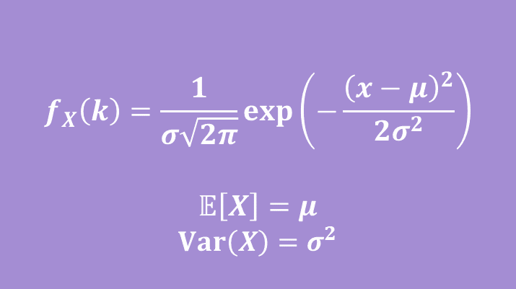

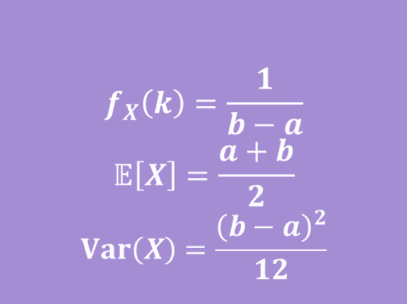
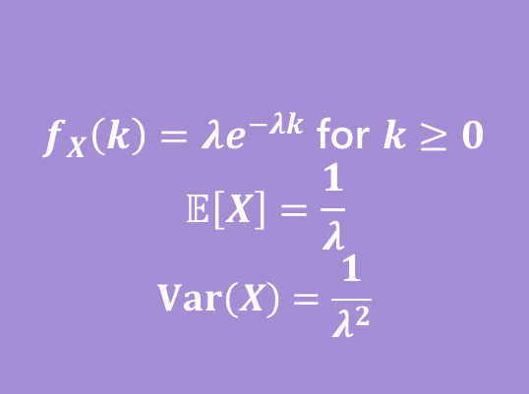


Continuous Zoo
$$X\sim Unif(a,b)$$
$$X\sim Exp(λ)$$
$$X\sim 𝒩(μ,σ^{2})$$
$$f_{X}\left(k\right)=\frac{1}{b−a}$$
$$𝔼\left[X\right]=\frac{a+b}{2}$$
$$Var\left(X\right)=\frac{{\left(b−a\right)}^{2}}{12}$$
$f_{X}\left(k\right)=λe^{−λk}$ for $k≥0$
$$𝔼\left[X\right]=\frac{1}{λ}$$
$$Var\left(X\right)=\frac{1}{λ^{2}}$$
$$f_{X}\left(k\right)=\frac{1}{σ\sqrt{2π}}exp\left(−\frac{{\left(x−μ\right)}^{2}}{2σ^{2}}\right)$$
$$𝔼\left[X\right]=μ$$
$$Var\left(X\right)=σ^{2}$$

Slide 4
Uniform Distribution (Continuous)

Slide 5
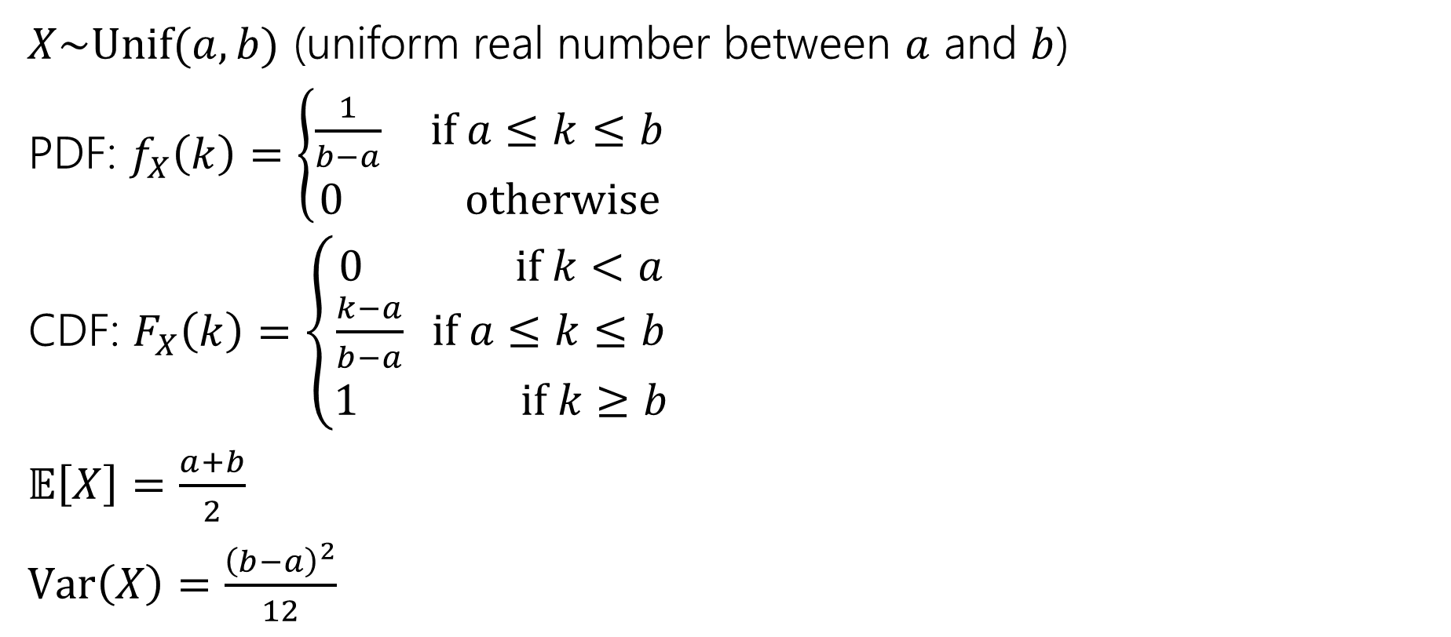
Continuous Uniform Distribution
$X\sim Unif(a,b)$ (uniform real number between $a$ and $b$)
PDF: $f_{X}\left(k\right)=\left\{\begin{aligned}\frac{1}{b−a} if a≤k≤b \\ 0 otherwise\end{aligned}\right.$
CDF: $F_{X}\left(k\right)=\left\{\begin{aligned}0 if k<a \\ \frac{k−a}{b−a} if a≤k≤b \\ 1 if k≥b\end{aligned}\right.$
$𝔼\left[X\right]=\frac{a+b}{2}$
$Var\left(X\right)=\frac{{\left(b−a\right)}^{2}}{12}$

Slide 6
Exponential Distribution

Slide 7
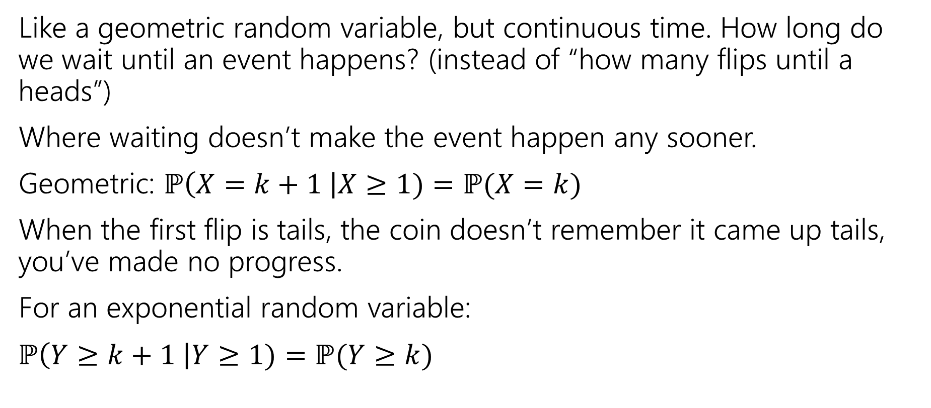
Exponential Random Variable
Like a geometric random variable, but continuous time. How long do we wait until an event happens? (instead of “how many flips until a heads”)
Where waiting doesn’t make the event happen any sooner.
Geometric: $ℙ\left(X=k+1 \right|X≥1)=ℙ(X=k)$
When the first flip is tails, the coin doesn’t remember it came up tails, you’ve made no progress.
For an exponential random variable:
$ℙ\left(Y≥k+1 \right|Y≥1)=ℙ(Y≥k)$

Slide 8
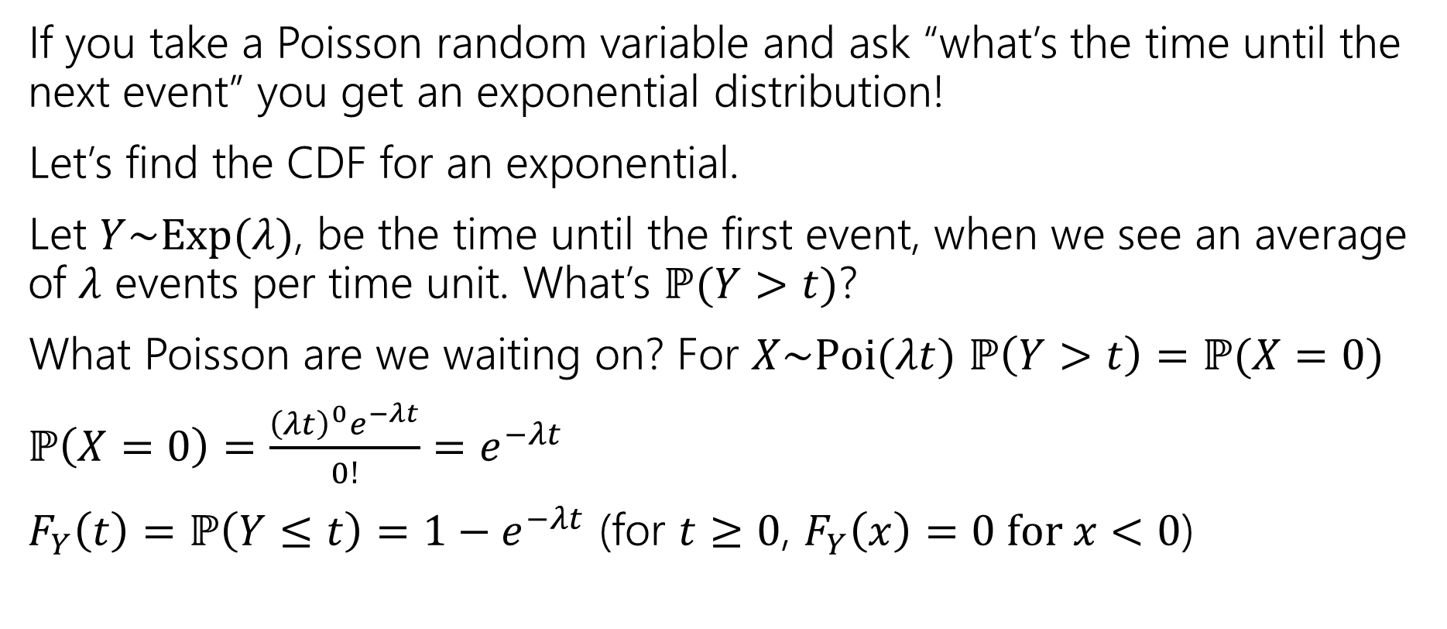
Exponential Random Variable
If you take a Poisson random variable and ask “what’s the time until the next event” you get an exponential distribution!
Let’s find the CDF for an exponential.
Let $Y\sim Exp(λ)$, be the time until the first event, when we see an average of $λ$ events per time unit. What’s $ℙ(Y>t)$?
What Poisson are we waiting on? For $X\sim Poi(λt)$ $ℙ\left(Y>t\right)=ℙ(X=0)$
$ℙ\left(X=0\right)=\frac{{\left(λt\right)}^{0}e^{−λt}}{0!}=e^{−λt}$
$F_{Y}\left(t\right)=ℙ\left(Y≤t\right)=1−e^{−λt}$ (for $t≥0$, $F_{Y}\left(x\right)=0 for x<0$)

Slide 9

Find the density
We know the CDF, $F_{Y}\left(t\right)=ℙ\left(Y≤t\right)=1−e^{−λt}$
What’s the density?
$f_{Y}\left(t\right)=$

Slide 10

Find the density
We know the CDF, $F_{Y}\left(t\right)=ℙ\left(Y≤t\right)=1−e^{−λt}$
What’s the density?
$f_{Y}\left(t\right)=\frac{d}{dt}\left(1−e^{−λt}\right)=0−\frac{d}{dt}\left(e^{−λt}\right)=λe^{−λt}$.
For $t≥0$ it’s that expression
For $t<0$ it’s just $0.$

Slide 11
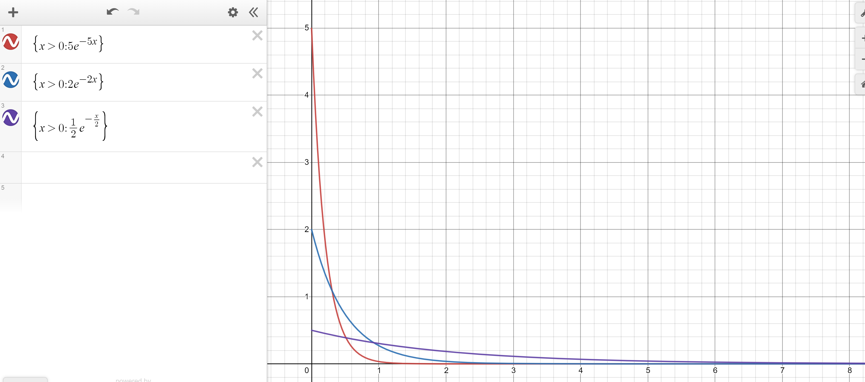
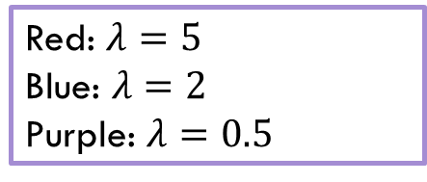
Exponential PDF
Red: $λ=5$
Blue: $λ=2$
Purple: $λ=0.5$

Slide 12
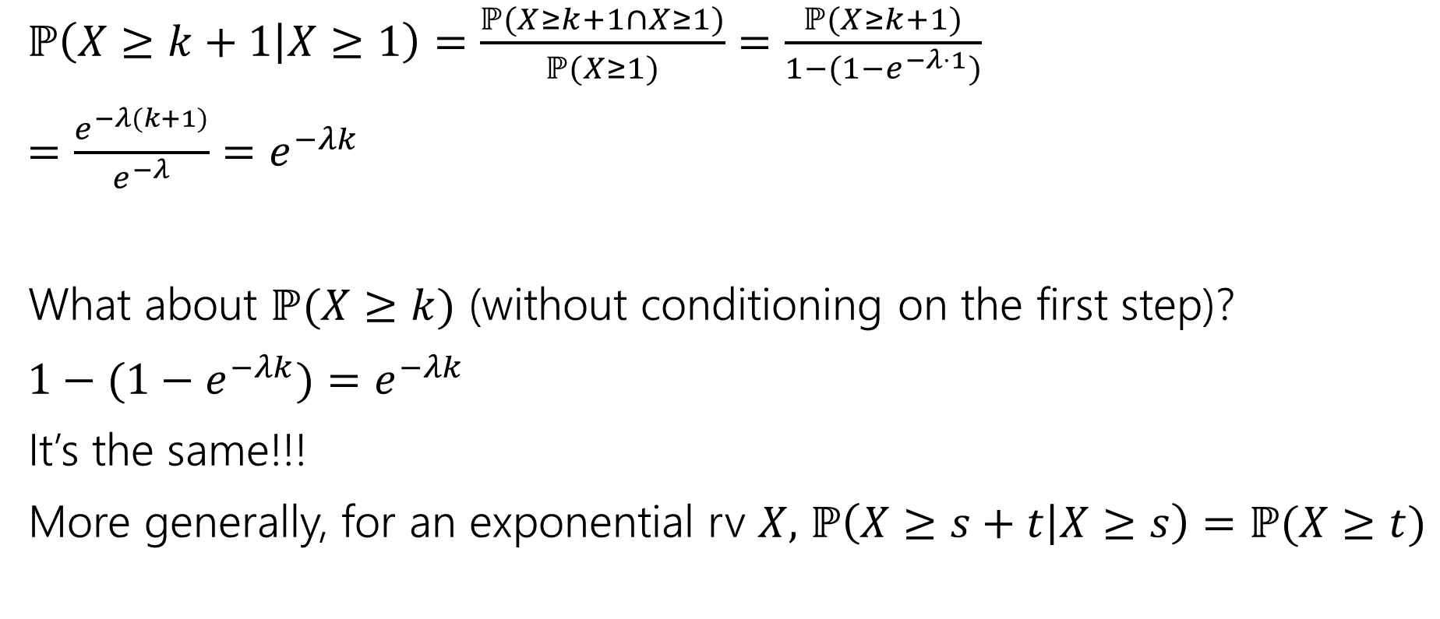
Memorylessness
$ℙ\left(X≥k+1 | X≥1\right)=\frac{ℙ(X≥k+1∩X≥1)}{ℙ(X≥1)}=\frac{ℙ(X≥k+1)}{1−(1−e^{−λ⋅1})}$
$=\frac{e^{−λ(k+1)}}{e^{−λ}}=e^{−λk}$
What about $ℙ(X≥k)$ (without conditioning on the first step)?
${1−(1−e}^{−λk})=e^{−λk}$
It’s the same!!!
More generally, for an exponential rv $X,$ $ℙ\left(X≥s+t | X≥s\right)=ℙ(X≥t)$

Slide 13
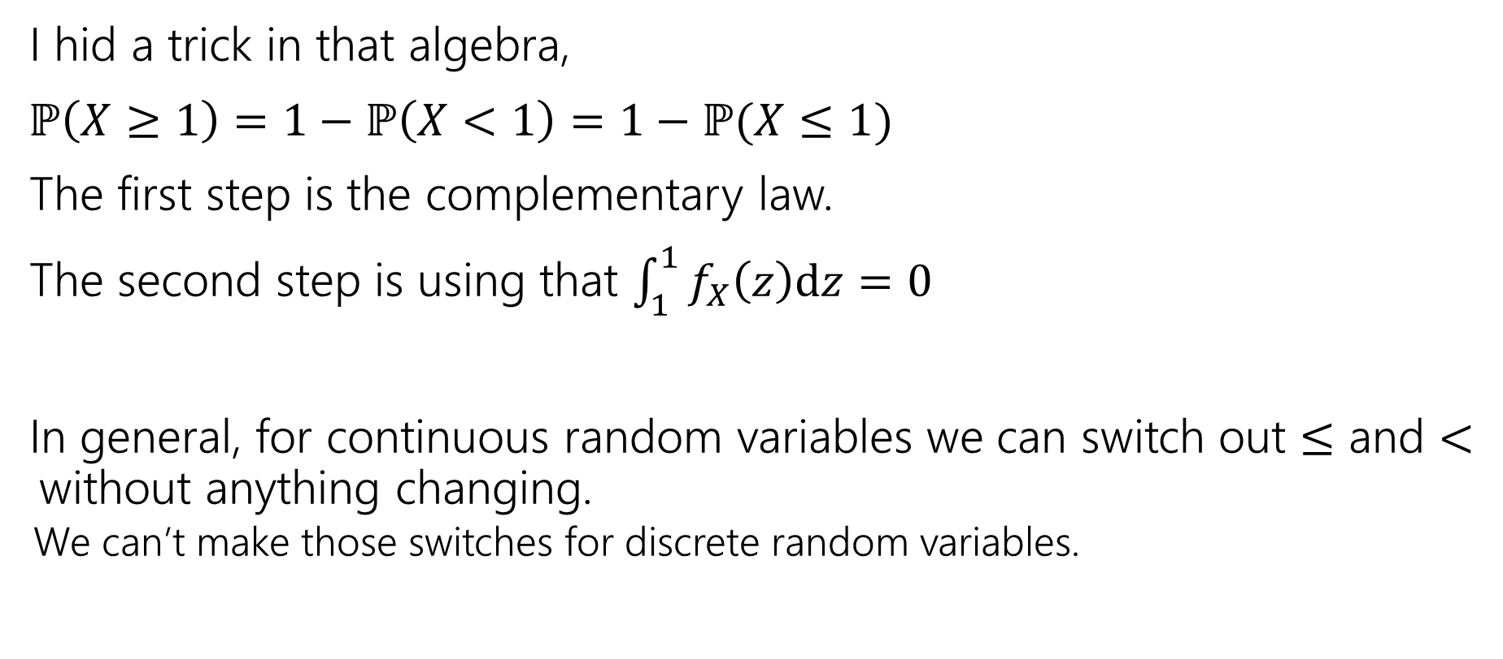
Side note
I hid a trick in that algebra,
$ℙ\left(X≥1\right)=1−ℙ\left(X<1\right)=1−ℙ(X≤1)$
The first step is the complementary law.
The second step is using that $\int_{1}^{1}{f_{X}\left(z\right)dz}=0$
In general, for continuous random variables we can switch out $≤$ and $<$without anything changing.
  We can’t make those switches for discrete random variables.

Slide 14
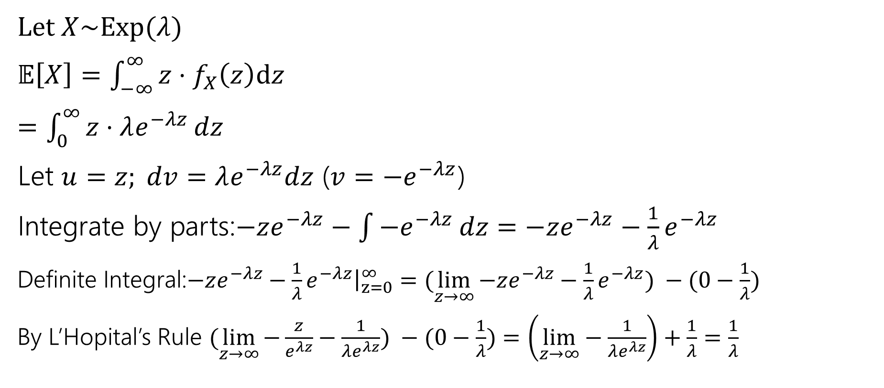
Expectation of an exponential
Don’t worry about the derivation (it’s here if you’re interested; you’re not responsible for the derivation. Just the value.
Let $X\sim Exp(λ)$
$𝔼\left[X\right]=\int_{−∞}^{∞}{{z⋅f}_{X}\left(z\right)dz}$
$=\int_{0}^{∞}{z⋅λe^{−λz}}dz$
Let $u=z; dv=λe^{−λz}dz$ ($v=−e^{−λz}$)
Integrate by parts:$−ze^{−λz}−\int{−e^{−λz}}dz=−ze^{−λz}−\frac{1}{λ}e^{−λz}$
Definite Integral:$−ze^{−λz}−\frac{1}{λ}e^{−λz}{\left.​\right|}_{z=0}^{∞}=(\lim_{z→∞}{−ze^{−λz}−\frac{1}{λ}e^{−λz}) −(0−\frac{1}{λ})}$
By L’Hopital’s Rule $(\lim_{z→∞}{−\frac{z}{e^{λz}}−\frac{1}{λe^{λz}}) −(0−\frac{1}{λ})}=\left(\lim_{z→∞}−\frac{1}{λe^{λz}}\right)+\frac{1}{λ}=\frac{1}{λ}$

Slide 15

Variance of an exponential
If $X\sim Exp\left(λ\right) then Var\left(X\right)=\frac{1}{λ^{2}}$
Similar calculus tricks will get you there.

Slide 16
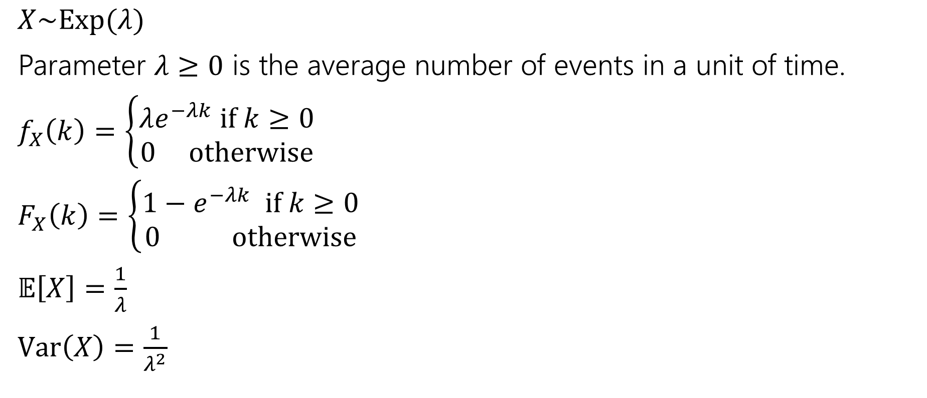
Exponential
$X\sim Exp(λ)$
Parameter $λ≥0$ is the average number of events in a unit of time.
$f_{X}\left(k\right)=\left\{\begin{aligned}λe^{−λk} if k≥0 \\ 0 otherwise\end{aligned}\right.$
$F_{X}\left(k\right)=\left\{\begin{aligned}1−e^{−λk} if k≥0 \\ 0 otherwise\end{aligned}\right.$
$𝔼\left[X\right]=\frac{1}{λ}$
$Var\left(X\right)=\frac{1}{λ^{2}}$

Slide 17
Normal Distribution

Slide 18
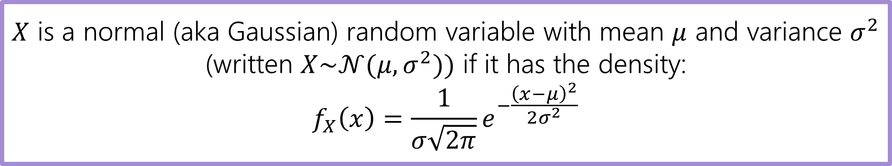
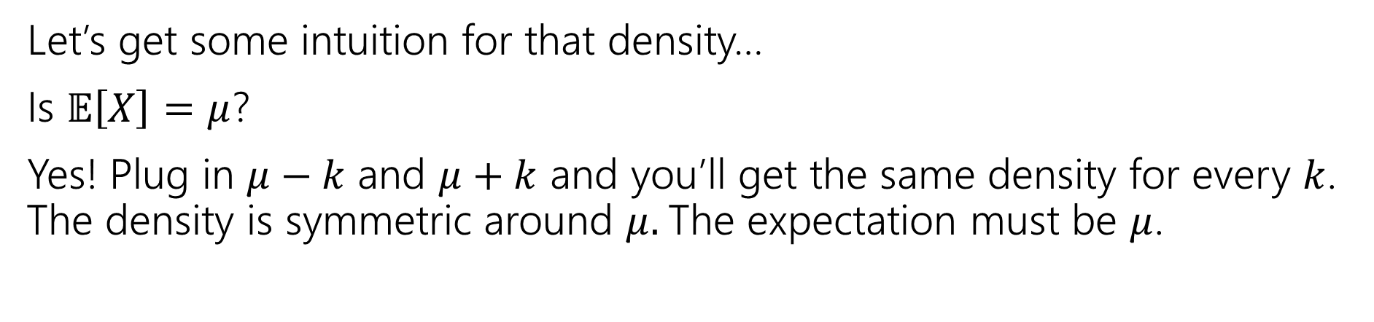
Normal Random Variable
$X$ is a normal (aka Gaussian) random variable with mean $μ$ and variance $σ^{2}$ (written $X\sim 𝒩(μ,σ^{2}))$ if it has the density:
$$f_{X}\left(x\right)=\frac{1}{σ\sqrt{2π}}e^{−\frac{{\left(x−μ\right)}^{2}}{2σ^{2}}}$$
Let’s get some intuition for that density…
Is $𝔼\left[X\right]=μ$?
Yes! Plug in $μ−k$ and $μ+k$ and you’ll get the same density for every $k$. The density is symmetric around $μ.$The expectation must be $μ$.

Slide 19
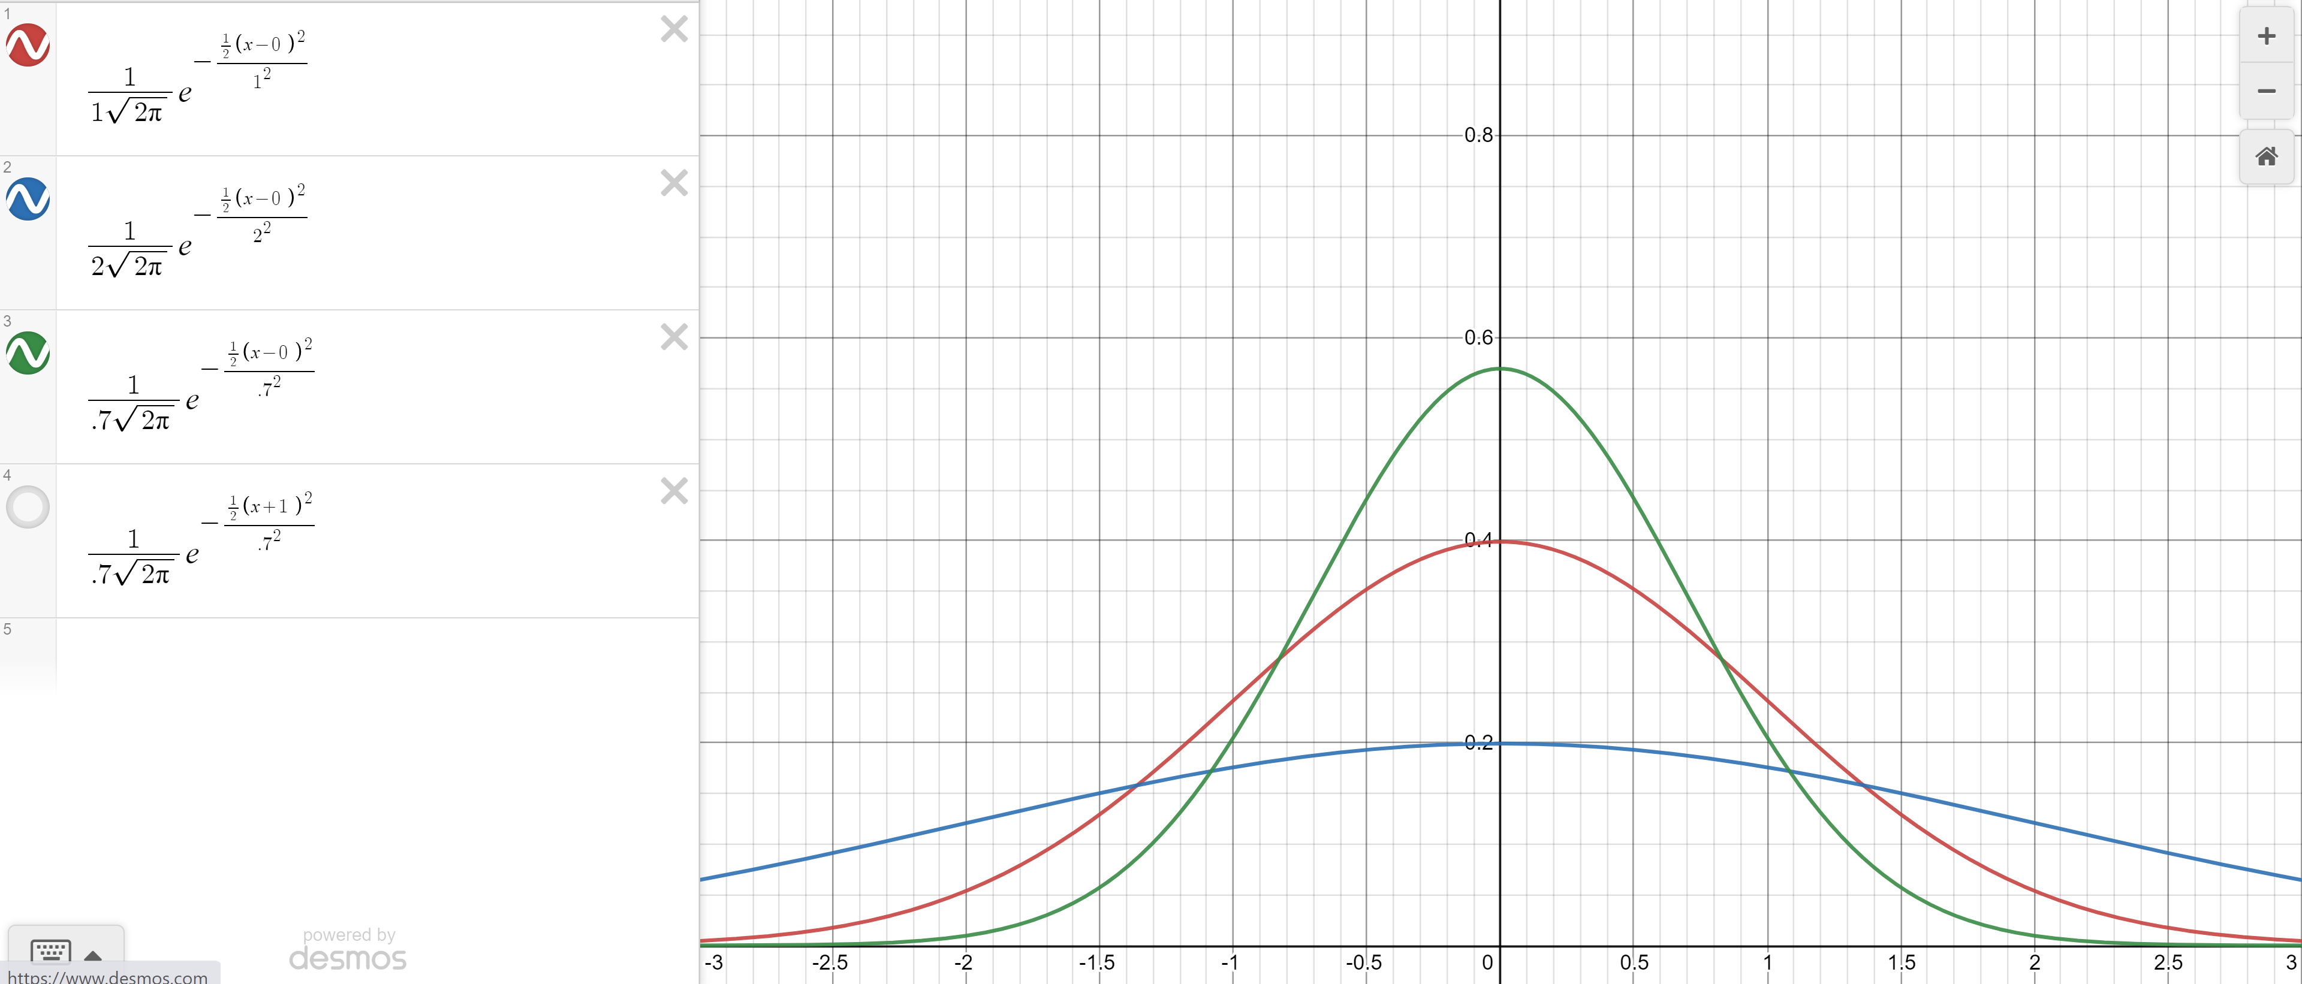

Changing the variance
Green: $σ^{2}=.7$
Red $σ^{2}=1$
Blue: $σ^{2}=2$

Slide 20
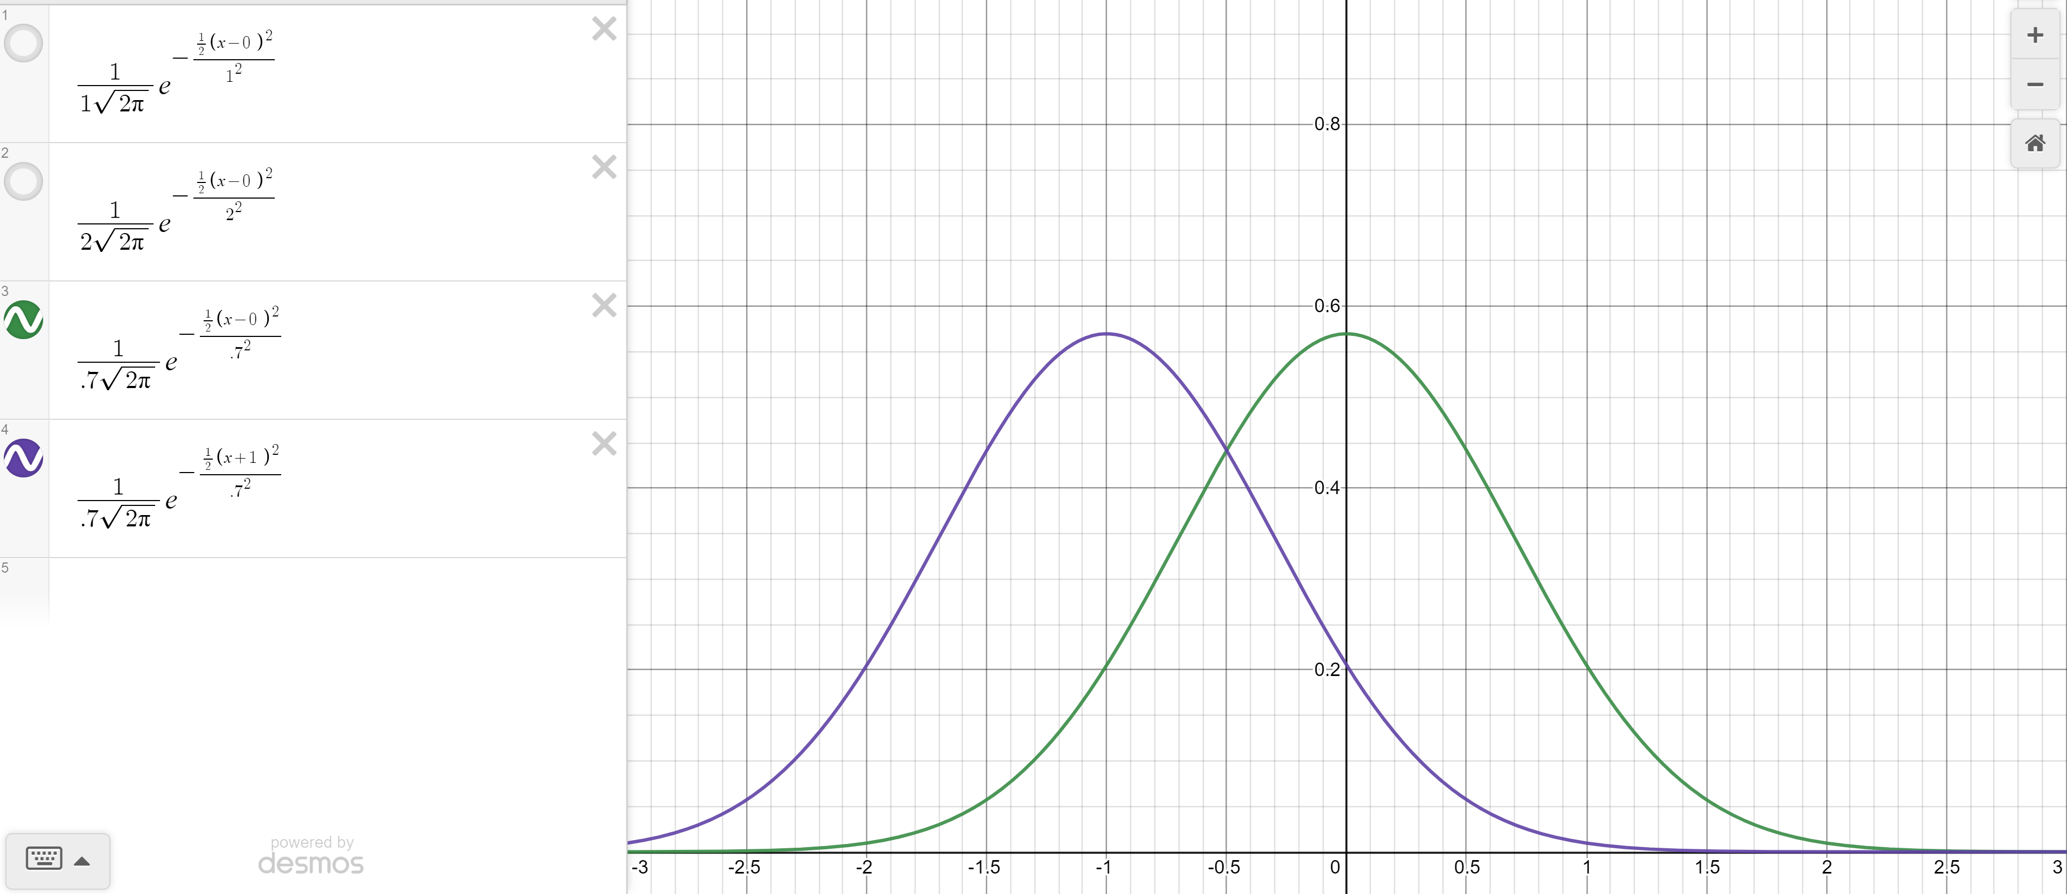

Changing the mean
Green: $σ^{2}=.7, μ=0$
Purple $σ^{2}=.7, μ=−1$

Slide 21
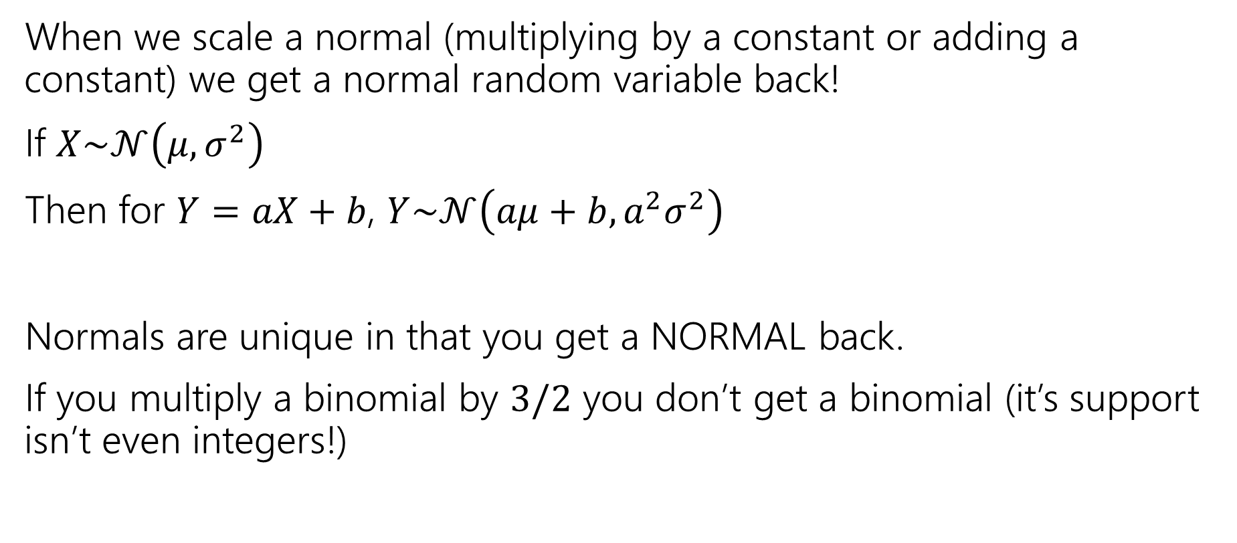
Scaling Normals
When we scale a normal (multiplying by a constant or adding a constant) we get a normal random variable back!
If $X\sim 𝒩\left(μ,σ^{2}\right)$
Then for $Y=aX+b$, $Y\sim 𝒩\left(aμ+b, a^{2}σ^{2}\right)$
Normals are unique in that you get a NORMAL back.
If you multiply a binomial by $3/2$ you don’t get a binomial (it’s support isn’t even integers!)

Slide 22
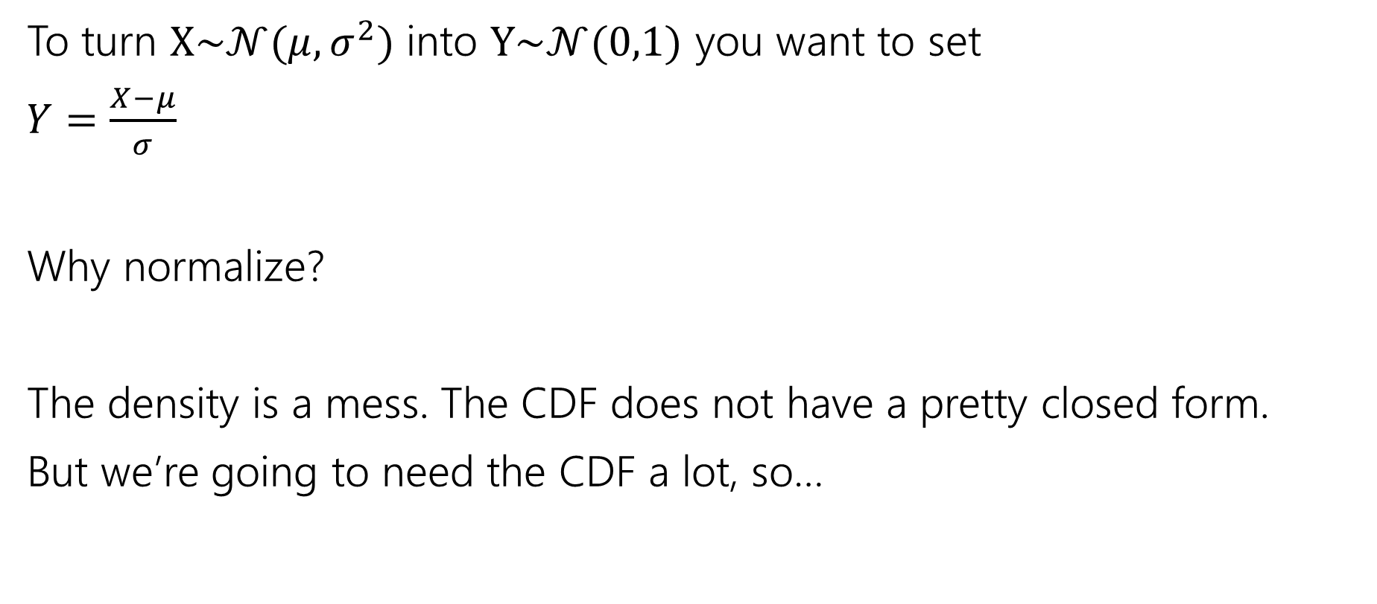
Normalize
To turn $X\sim 𝒩(μ,σ^{2})$ into $Y\sim 𝒩(0,1)$ you want to set
$Y=\frac{X−μ}{σ}$
Why normalize?
The density is a mess. The CDF does not have a pretty closed form.
But we’re going to need the CDF a lot, so…

Slide 23
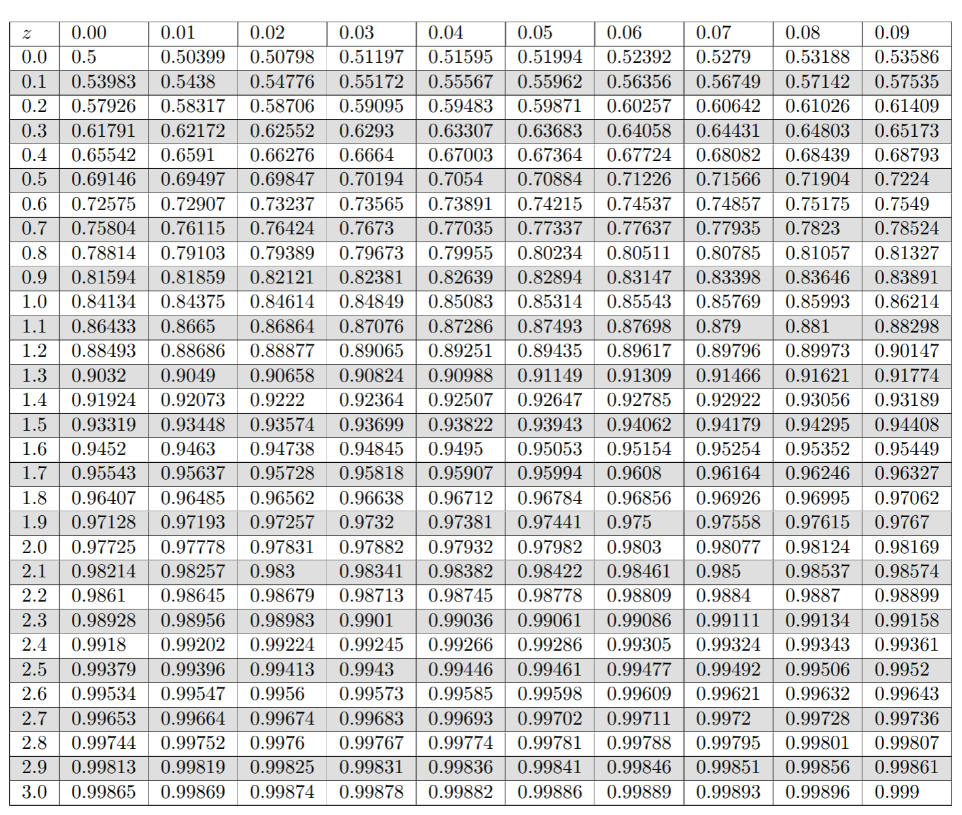
Table of Standard Normal CDF
The way we’ll evaluate the CDF of a normal is to:
1. convert to a standard normal
2. Round the “z-score” to the hundredths place.
3. Look up the value in the table.
It’s 2021, we’re using a table?
The table makes sure we have consistent rounding rules (makes it easier for us to debug with you).
You can’t evaluate this by hand – the “z-score” can give you intuition right away.

Slide 24
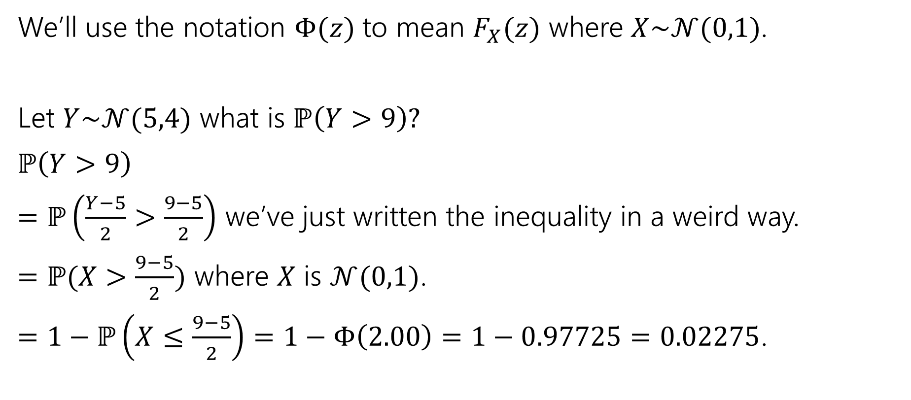
Use the table!
We’ll use the notation $Φ(z)$ to mean $F_{X}(z)$ where $X\sim 𝒩(0,1)$.
Let $Y\sim 𝒩(5,4)$ what is $ℙ\left(Y>9\right)?$
$ℙ\left(Y>9\right)$
$=ℙ\left(\frac{Y−5}{2}>\frac{9−5}{2}\right)$ we’ve just written the inequality in a weird way.
$=ℙ(X>\frac{9−5}{2})$ where $X$ is $𝒩(0,1)$.
$=1−ℙ\left(X≤\frac{9−5}{2}\right)=1−Φ\left(2.00\right)=1−0.97725=0.02275$.

Slide 25

More Practice
Let $X\sim 𝒩(3, 2)$
What is the probability of $1≤X≤4 ?$

Slide 26
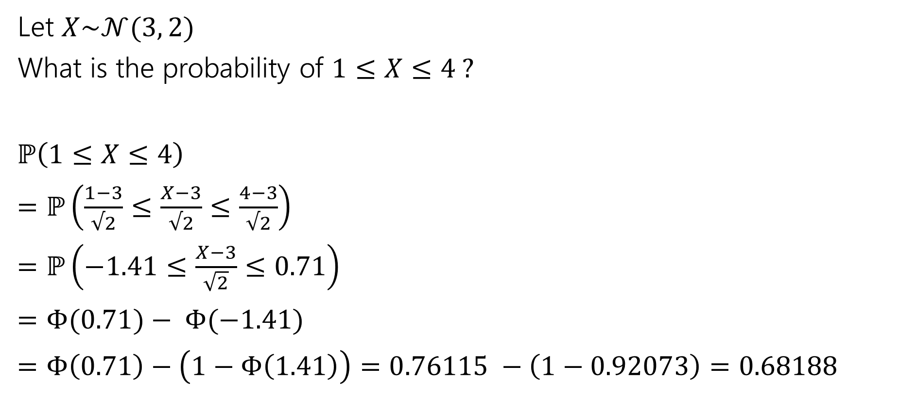
More Practice
Let $X\sim 𝒩(3, 2)$
What is the probability of $1≤X≤4 ?$
$ℙ\left(1≤X≤4\right)$
$=ℙ\left(\frac{1−3}{√2}≤\frac{X−3}{√2}≤\frac{4−3}{√2}\right)$
$=ℙ\left(−1.41≤\frac{X−3}{\sqrt{2}}≤0.71\right)$
$=Φ(0.71)− Φ(−1.41)$
$=Φ\left(0.71\right)−\left(1−Φ\left(1.41\right)\right)=0.76115 −\left(1−0.92073\right)=0.68188$

Slide 27
In real life
What’s the probability of being at most two standard deviations from the mean?

Slide 28
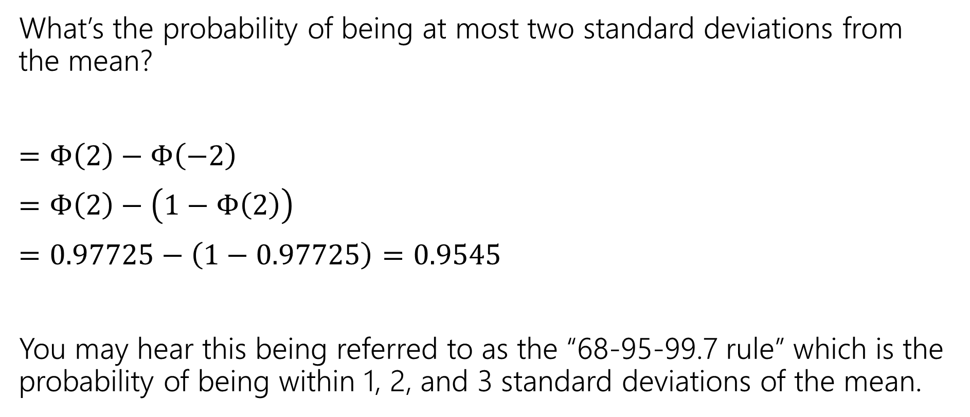
In real life
What’s the probability of being at most two standard deviations from the mean?
$=Φ\left(2\right)−Φ\left(−2\right)$
$=Φ\left(2\right)−\left(1−Φ\left(2\right)\right)$
$=0.97725−\left(1−0.97725\right)=0.9545$
You may hear this being referred to as the “68-95-99.7 rule” which is the probability of being within 1, 2, and 3 standard deviations of the mean.

