Slide 1
Independence
CSE 312 Summer 21
Lecture 7

Slide 2
Announcements
Problem Set 1 grades have been released.
Please submit a regrade request (if needed) on Gradescope within a week.
Problem Set 2 due tomorrow.
Review Summary 1 due on Friday.
Real World Mini-project out tonight.
Problem Set 3 out tomorrow.

Slide 3
Announcements
Problem Set 3 out tomorrow evening.
Problem Set 3 includes a programming project – using Bayes rule to do some machine learning – detecting whether emails are spam or “ham” (legitimate emails).
Longer than the programming on Problem Set1 – please get started early!
Extra resources with common difficulties on the programming project will be linked in the Problem Set 3 pdf.

Slide 4
Today
Chain Rule
Independence
Conditional Independence

Slide 5
Chain Rule

Slide 6
A word of caution from last lecture
I often see students write things like
$ℙ([A\left|B]\right|C)$
This is not a thing.
You probably want $ℙ(A|\left[B∩C\right])$
$A|B$ isn’t an event – it’s describing an event and telling you to restrict the sample space. So, you can’t ask for the probability of that conditioned on something else.

Slide 7
Chain Rule
We defined conditional probability as: $ℙ\left(A | B\right)=\frac{ℙ\left(A∩B\right)}{ℙ\left(B\right)}$
Which means $ℙ\left(A∩B\right)=ℙ(A|B)ℙ(B)$
$$ℙ\left(A_{1}∩A_{2}∩…∩A_{n}\right)=ℙ\left(A_{n} | A_{1}∩…∩A_{n−1}\right)⋅ℙ\left(A_{n−1} | A_{1}∩…∩A_{n−2}\right)⋯ℙ\left(A_{2} | A_{1}\right)⋅ℙ(A_{1})$$
Chain Rule

Slide 8
Chain Rule Example
Shuffle a standard deck of 52 cards (so every ordering is equally likely).
Let $A$ be the event “The top card is a K♦”
Let $B$ be the event “the second card is a Q♥”
Let $C$ be the event “the third card is an A♠️”
What is $ℙ(A∩B∩C)$?
Use the chain rule!
$ℙ\left(A\right)⋅ℙ\left(B | A\right)⋅ℙ(C|A∩B)$
$\frac{1}{52}⋅\frac{1}{51}⋅\frac{1}{50}$

Slide 9
Independence

Slide 10
Definition of Independence
We’ve calculated conditional probabilities.
Sometimes conditioning – getting some partial information about the outcome and restricting the sample space – doesn’t change the probability.
We already saw an example like this…

Slide 11
Revisiting Conditioning Practice
Red die $6$ conditioned on sum 7 $1/6$
Red die 6 conditioned on sum 9 $1/4$
Sum 7 conditioned on red die 6 $1/6$
 | D2=1 | D2=2 | D2=3 | D2=4 | D2=5 | D2=6
D1=1 | (1,1) | (1,2) | (1,3) | (1,4) | (1,5) | (1.6)
D1=2 | (2,1) | (2,2) | (2,3) | (2,4) | (2,5) | (2,6)
D1=3 | (3,1) | (3,2) | (3,3) | (3,4) | (3,5) | (3,6)
D1=4 | (4,1) | (4,2) | (4,3) | (4,4) | (4,5) | (4,6)
D1=5 | (5,1) | (5,2) | (5,3) | (5,4) | (5,5) | (5,6)
D1=6 | (6,1) | (6,2) | (6,3) | (6,4) | (6,5) | (6,6)
Red die 6 has probability 1/6 before or after conditioning on sum 7.

Slide 12
Independence
Two events $A,B$ are (statistically) independent if
$$ℙ\left(A∩B\right)=ℙ\left(A\right)⋅ℙ(B)$$
Independence
You’ll sometimes see this called “statistical independence” to emphasize that we’re talking about probabilities (not, say, physical interactions).
If $A,B$ both have non-zero probability then
$ℙ\left(A∩B\right)=ℙ(A)ℙ(B)$ $⇔$ $ℙ\left(A | B\right)=ℙ(A)$ $⇔ℙ\left(B | A\right)=ℙ(B)$

Slide 13
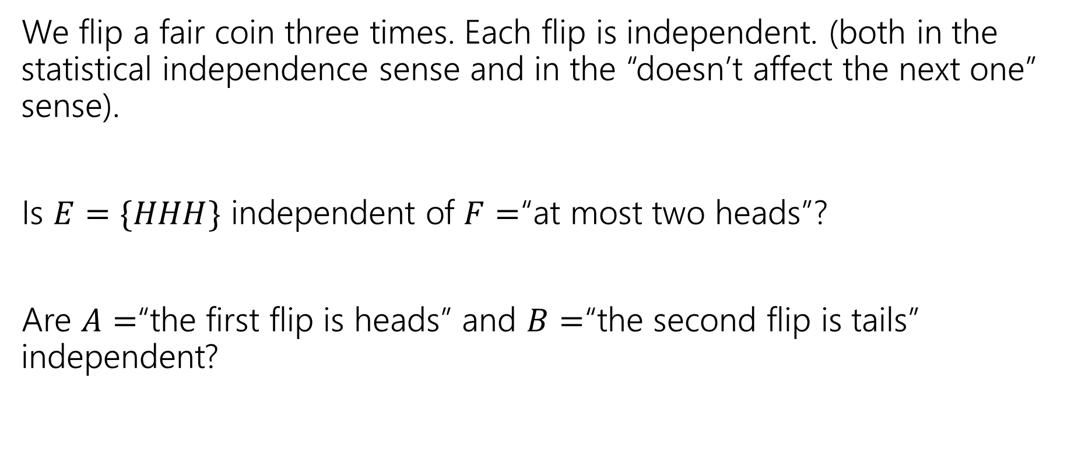
Examples
We flip a fair coin three times. Each flip is independent. (both in the statistical independence sense and in the “doesn’t affect the next one” sense).
Is $E=\{HHH\}$ independent of $F=$“at most two heads”?
Are $A=$“the first flip is heads” and $B=$“the second flip is tails” independent?
Fill out the poll everywhere so Kushal knows how long to explain
Go to pollev.com/cse312su21

Slide 14
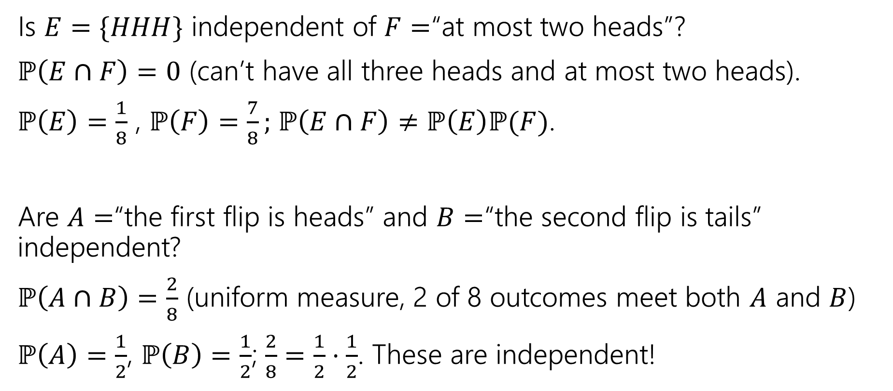
Examples
Is $E=\{HHH\}$ independent of $F=$“at most two heads”?
$ℙ\left(E∩F\right)=0$ (can’t have all three heads and at most two heads).
$ℙ\left(E\right)=\frac{1}{8}$ , $ℙ\left(F\right)=\frac{7}{8};$ $ℙ\left(E∩F\right)≠ℙ\left(E\right)ℙ(F)$.
Are $A=$“the first flip is heads” and $B=$“the second flip is tails” independent?
$ℙ\left(A∩B\right)=\frac{2}{8}$ (uniform measure, 2 of 8 outcomes meet both $A$ and $B$)
$ℙ\left(A\right)=\frac{1}{2}$, $ℙ\left(B\right)=\frac{1}{2}$; $\frac{2}{8}=\frac{1}{2}⋅\frac{1}{2}$. These are independent!

Slide 15
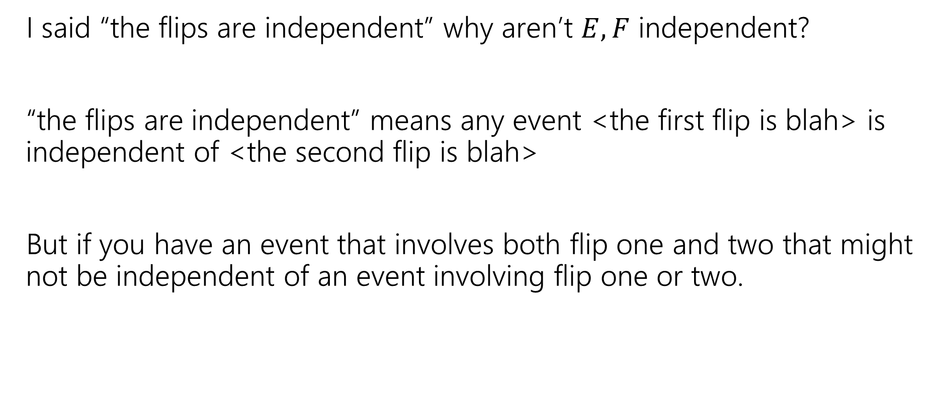
Hey Wait
I said “the flips are independent” why aren’t $E,F$ independent?
“the flips are independent” means any event <the first flip is blah> is independent of <the second flip is blah>
But if you have an event that involves both flip one and two that might not be independent of an event involving flip one or two.

Slide 16
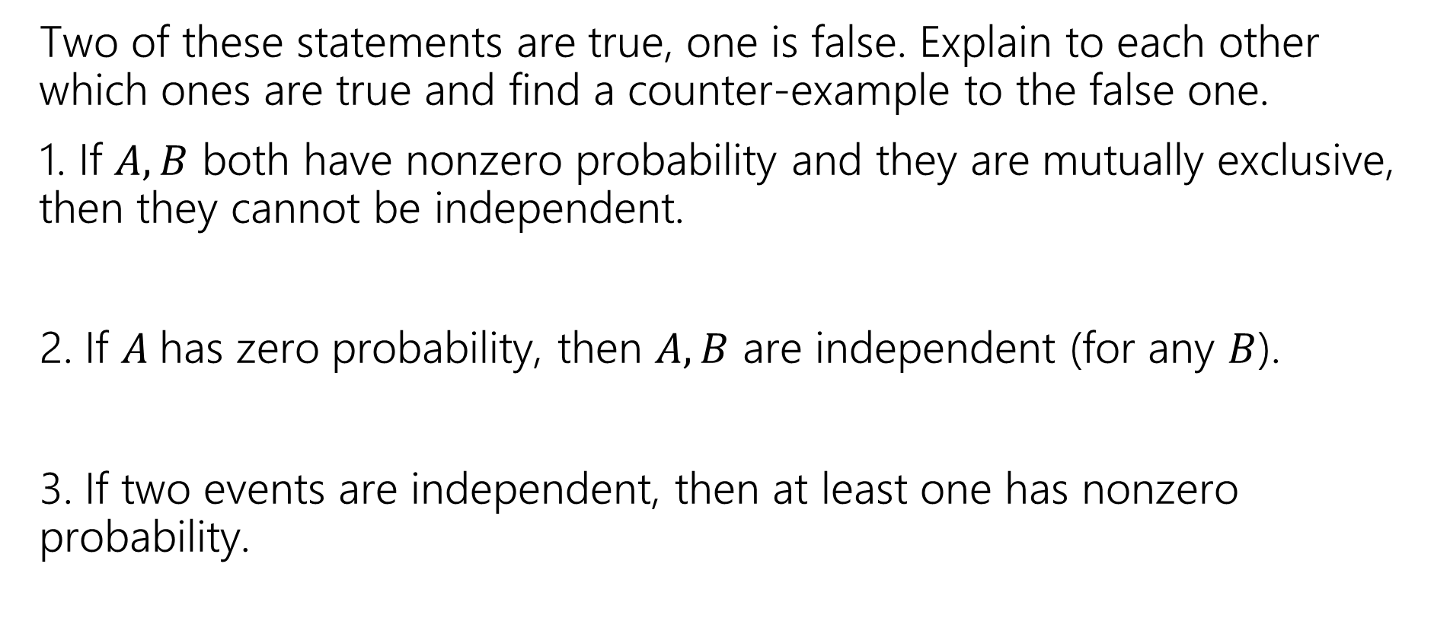
Mutual Exclusion and Independence
Two of these statements are true, one is false. Explain to each other which ones are true and find a counter-example to the false one.
1. If $A,B$ both have nonzero probability and they are mutually exclusive, then they cannot be independent.
2. If $A$has zero probability, then $A,B$ are independent (for any $B$).
3. If two events are independent, then at least one has nonzero probability.
Fill out the poll everywhere so Kushal knows how long to explain
Go to pollev.com/cse312su21

Slide 17
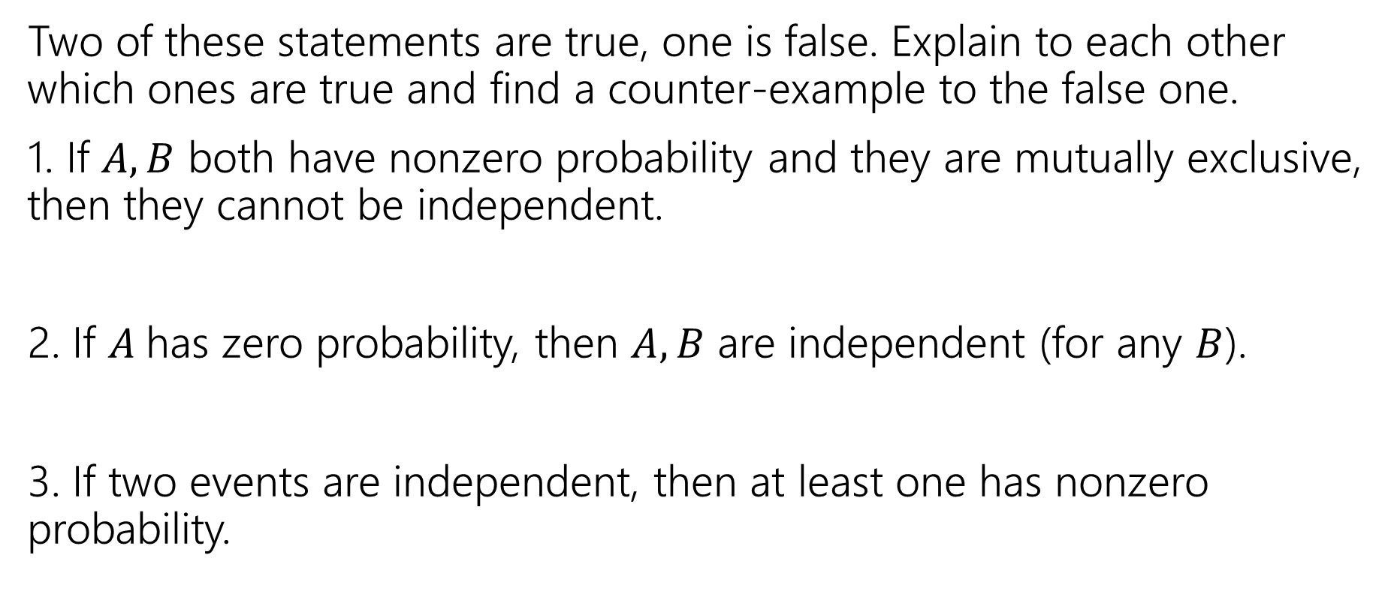
Mutual Exclusion and Independence
Two of these statements are true, one is false. Explain to each other which ones are true and find a counter-example to the false one.
1. If $A,B$ both have nonzero probability and they are mutually exclusive, then they cannot be independent.
2. If $A$has zero probability, then $A,B$ are independent (for any $B$).
3. If two events are independent, then at least one has nonzero probability.

Slide 18
Conditional Independence

Slide 19

Conditional Independence
We say $A$ and $B$ are conditionally independent on $C$ if
$ℙ\left(A∩B | C\right)=ℙ\left(A | C\right)⋅ℙ(B|C)$
i.e. if you condition on $C$, they are independent.
Two events $A,B$ are independent conditioned on $C$ if $ℙ\left(C\right)≠0$ and
$$ℙ\left(A∩B∣C\right)=ℙ\left(A∣C\right)⋅ℙ(B∣C)$$
Conditional Independence

Slide 20
Conditional Independence Example
You have two coins. Coin $A$ is fair, coin $B$ comes up heads with probability $0.85$.
You will roll a (fair) die, if the result is odd flip coin $A$ twice (independently); if the result is even flip coin $B$ twice (independently)
Let $C_{1}$ be the event “the first flip is heads”, $C_{2}$ be the event “the second flip is heads”, $O$ be the event “the die was odd”
Are $C_{1}$ and $C_{2}$ independent? Are they independent conditioned on $O$?

Slide 21
(Unconditioned) Independence
$ℙ\left(C_{1}\right)=ℙ\left(O\right)ℙ\left(C_{1} | O\right)+ℙ\left(\overline{O}\right)ℙ(C_{1}|\overline{O})$
$=\frac{1}{2}⋅\frac{1}{2}+\frac{1}{2}⋅0.85=.675$
$ℙ\left(C_{2}\right)=.675$ (the same formula works)
$ℙ\left(C_{1}\right)ℙ\left(C_{2}\right)={.675}^{2}=.455625$
$ℙ\left(C_{1}∩C_{2}\right)=ℙ\left(O\right)ℙ\left(C_{1}∩C_{2} | O\right)+ℙ\left(\overline{O}\right)ℙ(C_{1}∩C_{2}|\overline{O})$
$=\frac{1}{2}⋅\frac{1}{4}+\frac{1}{2}⋅{.85}^{2}=.48625$
Those aren’t the same! They’re not independent!
Intuition: seeing a head gives you information – information that it’s more likely you got the biased coin and so the next head is more likely.

Slide 22

Conditional Independence
$ℙ\left(C_{1} | O\right)=1/2$
$ℙ\left(C_{2} | O\right)=1/2$
$ℙ\left(C_{1}∩C_{2} | O\right)=\frac{1}{2}⋅\frac{1}{2}=1/4$
$ℙ\left(C_{1} | O\right)ℙ\left(C_{2} | O\right)=ℙ(C_{1}∩C_{2}|O)$
Yes! $C_{1}$ and $C_{2}$ are conditionally independent, conditioned on $O$.

Slide 23
Takeaway
Read a problem carefully – when we say “these steps are independent of each other” about some part of a sequential process, it’s usually “conditioned on all prior steps, these steps are conditionally independent of each other.”
Those conditional steps are usually dependent (without conditioning) because they might give you information about which branch you took.

