Slide 1
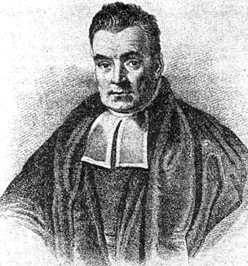
Naïve Bayes Classifiers
Jonathan Lee and Varun Mahadevan

Slide 2
Independence
Recap:
Definition: Two events X and Y are independent if and only if
$P\left(XY\right)=P\left(X\right)P\left(Y\right).$
Equivalently, if $P\left(Y\right)>0$, then$P\left(X | Y\right)=P(X)$.

Slide 3
Conditional Independence
Definition: Two events A and B are conditionally independent given C if and only if
$P\left(A∩B | C\right)=P\left(A | C\right)P\left(B | C\right).$
Equivalently, if P(B) > 0 and P(C) > 0, then $P\left(A | BC\right)=P\left(A | C\right)$.

Slide 4
Example:
Randomly choose a day of the week
A = { It is not a Monday }
B = { It is a Saturday }
C = { It is the weekend }
A and B are dependent events
P(A) = 6/7, P(B) = 1/7, P(AB) = 1/7
Now condition both A and B on C:
P(A|C) = 1, P(B|C) = ½, P(AB|C) = ½
P(AB|C) = P(A|C)P(B|C) => A|C and B|C are independent

Slide 5
Conditional Independence
Conditional Independence does not imply Independence.
Suppose X and Y are conditionally independent given Z, and X
and Y are conditionally independent given Z^{C}.
Are X and Y independent?

Slide 6
Conditional Independence
Conditional Independence does not imply Independence.
We have two coins, one fair and one 2-headed.
Let X be the event that the first flip is a Head.
Let Y be the event that the second flip is a Head.
Let Z be the event that we choose the fair coin.

Slide 7
Conditional Independence
Conditional Independence does not imply Independence.
P(X | Z) = ½, P(Y | Z) = ½, P(XY | Z) = ¼
Since P(X | Z)P(Y | Z) = P(XY|Z),
X and Y are conditionally independent given Z.
You can convince yourself that X and Y are conditionally
independent given Z^{C} using a similar argument.

Slide 8
Conditional Independence
Conditional Independence does not imply Independence.
P(X) = ¾ , and P(Y) = ¾
P(XY) = P(XY|Z)P(Z) + P(XY|Z^{C})P(Z^{C})
= ¼ x ½ + 1 x ½ = 5/8
P(XY) ≠ P(X)P(Y), so X and Y are not independent.

Slide 9
Programming Project: Spam Filter
Implement a Naive Bayes classifier for classifying emails as either spam or ham (= nonspam).
You may use Java or Python 3. We’ve provided starter code in both.
Read Jonathan Lee’s notes on the course web, start early, and ask for help if you get stuck!

Slide 10
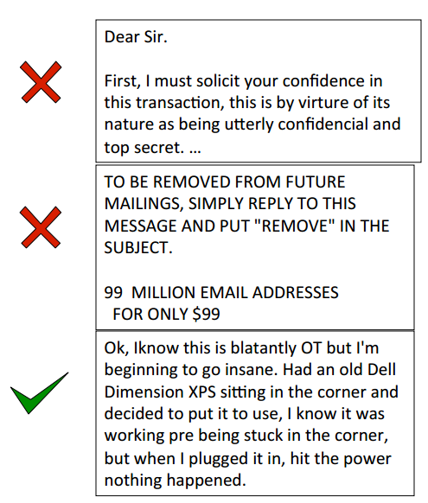
Spam vs. Ham
In the past, the bane of any email user’s existence
Less of a problem for consumers now, because spam filters have gotten really good
Easy for humans to identify spam, but not necessarily easy for computers

Slide 11
The spam classification problem
Input: collection of emails, already labeled spam or ham
Someone has to label these by hand
Called the training data
Use this data to train a model that “understands” what makes an email spam or ham
We’re using a Naïve Bayes classifier, but there are other approaches
This is a Machine Learning problem (take CSE 446 for more)
Test your model on emails whose label isn’t provided, and see how well it does
Called the test data

Slide 12
Naïve Bayes in the real world
One of the oldest, simplest methods for classification
Powerful and still used in the real world/industry
Identifying credit card fraud
Identifying fake Amazon reviews
Identifying vandalism on Wikipedia
Still used (with modifications) by Gmail to prevent spam
Facial recognition
Categorizing Google News articles
Even used for medical diagnosis!

Slide 13
Naïve Bayes in theory
We will use what we’ve learned in the past few weeks. Specifically:
Conditional Probability
$P\left(A|B\right)=\frac{P\left(A∩B\right)}{P(B)}$
Bayes’ Theorem
$P\left(A | B\right)=\frac{P\left(B|A\right)P\left(A\right)}{P(B)}$
Law of Total Probability
$P(A)=\sum_{n}{P\left(A | B_{n}\right)P(B_{n})}$
Chain Rule
$$P\left(A_{1},…,A_{n}\right)=P\left(A_{1}\right) P\left(A_{2} | A_{1}\right)…P\left(A_{n} | A_{n−1}…A_{1}\right)$$
Conditional Independence of A and B, given C
$P\left(A∩B | C\right)=P\left(A | C\right)P(B|C)$
$$P\left(A | B∩C\right)=P\left(A | C\right)$$

Slide 14
How do we represent an email?
There are characteristics of emails that might give a computer a hint about whether it’s spam
Possible features: words in body, subject line, sender, message header, time sent
For this assignment, we choose to represent an email as the set $\{x_{1}, x_{2},…, x_{n}\}$of distinct words in the subject and body
SUBJECT: Top Secret Business Venture
Dear Sir.
First, I must solicit your confidence in this transaction, this is by virture of its nature as being utterly confidencial and top secret…
{top, secret, business, venture, dear, sir, first, I, must, solicit, your, confidence, in, this, transaction, is, by, virture, of, its, nature, as, being, utterly, confidencial, and}
Notice that there are no duplicate words

Slide 15
Programming Project
Take the set $\{x_{1}, x_{2},…, x_{n}\}$ of distinct words to represent the email.
We are trying to compute
$$P\left(Spam | x_{1}, x_{2},…, x_{n}\right)= ???$$
Apply Bayes’ Theorem. It’s easier to find the probability of a word appearing in a spam email than the reverse.
$P\left(Spam | x_{1}, x_{2},…, x_{n}\right)=$
$$\frac{P\left(x_{1}, x_{2},…x_{n} | Spam\right)P(Spam)}{P\left(x_{1}, x_{2},…x_{n} | Spam\right)P\left(Spam\right)+P\left(x_{1}, x_{2},…x_{n} | Ham\right)P(Ham)}$$

Slide 16
Programming Project
Apply the chain rule to the numerator:
$$P\left(x_{1}, x_{2},…x_{n} | Spam\right)P\left(Spam\right)=P(x_{1},x_{2},…,x_{n},Spam)$$
Apply the Chain Rule again to decompose this:
$$P\left(x_{1},x_{2},…,x_{n},Spam\right)=P\left(x_{1} | x_{2},…,x_{n},Spam\right)P(x_{2}|x_{3},…,x_{n},Spam)…P\left(x_{n} | Spam\right)P(Spam)$$
But this is still hard to compute.
How could you compute $P\left(x_{1} | x_{2},…,x_{n},Spam\right)?$

Slide 17
Let’s simplify the problem with an assumption.
We will assume that the words in the email are conditionally independent of each other, given that we know whether or not the email is spam.
This is why we call this Naïve Bayes: conditional independence isn’t true.
So how does this help?
$$P\left(x_{1},x_{2},…,x_{n},Spam\right)=P\left(x_{1} | x_{2},…,x_{n},Spam\right)P(x_{2}|x_{3},…,x_{n},Spam)…P\left(x_{n} | Spam\right)P(Spam)≈P\left(x_{1} | Spam\right)P(x_{2}|Spam)…P\left(x_{n} | Spam\right)P(Spam)$$
$$P(x_{1},x_{2},…,x_{n},Spam)≈P(Spam)\prod_{i=1}^{n}{P(x_{i}|Spam)}$$

Slide 18
Programming Project
$P(x_{1},x_{2},…,x_{n},Spam)≈P(Spam)\prod_{i=1}^{n}{P(x_{i}|Spam)}$
Similarly, $P(x_{1},x_{2},…,x_{n},Ham)≈P(Ham)\prod_{i=1}^{n}{P(x_{i}|Ham)}$
Putting it all together
$$P\left(Spam | x_{1}, x_{2},…, x_{n}\right)≈\frac{P(Spam)\prod_{i=1}^{n}{P(x_{i}|Spam)}}{P\left(Spam\right)\prod_{i=1}^{n}{P\left(x_{i} | Spam\right)}+P(Ham)\prod_{i=1}^{n}{P(x_{i}|Ham)}}$$
$P\left(Spam\right)$ and $P(Ham)$ are just the fraction of training emails that are spam and ham
What about $P\left(x_{i} | Spam\right)$?

Slide 19
How spammy is a word?
What is $P(viagra|Spam)$ asking?
Would be easy to count how many spam emails contain this word:
$P\left(w | Spam\right)= \frac{number of spam emails containing w}{total number of spam emails}$
This seems reasonable, but there’s a problem…

Slide 20
Suppose the word Pokemon only appears in ham in the training data, never in spam
$$P\left(Pokemon | Spam\right)=0$$
Since the overall spam probability is the product of such individual probabilities, if any of those is 0, the whole product is 0
Any email with the word Pokemon would be assigned a spam probability of 0
What can we do?
SUBJECT: Get out of debt!
Cheap prescription pills! Earn fast cash using this one weird trick! Meet singles near you and get preapproved for a low interest credit card! Pokemon
definitely not spam, right?

Slide 21
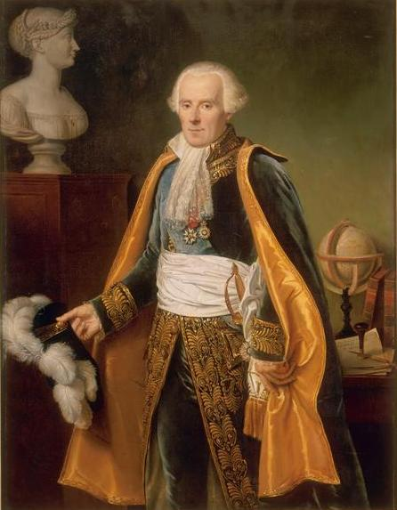
Laplace smoothing
Crazy idea: what if we pretend we’ve seen every outcome once already?
Pretend we’ve seen one more spam email with $w$, one more without $w$
$$P\left(w | Spam\right)= \frac{|\left.spam emails containing w|\right.+1}{|\left.spam emails|\right.+2}$$
Then, $P\left(Pokemon | Spam\right)>0$
No one word will bias the overall probability too much
General technique to avoid assuming that unseen events will never happen

Slide 22
Naïve Bayes Overview
For each word w in the spam training set, count how many spam emails contain w:
$$P\left(w | Spam\right)= \frac{|\left.spam emails containing w|\right.+1}{|\left.spam emails|\right.+2}$$
Compute $P\left(w | Ham\right)$ analogously
$P(Spam)= \frac{|\left.spam emails|\right.}{|\left.spam emails|\right.+|\left.ham emails|\right.}$ ,$P(Ham)=1−P(Spam)$
For each test email with words $\{x_{1}, x_{2},…, x_{n}\}$,
$$P\left(Spam | x_{1}, x_{2},…, x_{n}\right)≈\frac{P(Spam)\prod_{i=1}^{n}{P(x_{i}|Spam)}}{P\left(Spam\right)\prod_{i=1}^{n}{P\left(x_{i} | Spam\right)}+P(Ham)\prod_{i=1}^{n}{P(x_{i}|Ham)}}$$
Output “spam” iff $P\left(Spam | x_{1}, x_{2},…, x_{n}\right)$ > 1/2

Slide 23
Read the Notes!
Before starting, read Jonathan Lee’s Naïve Bayes Notes on the course web for precise technical details.
Describes how to avoid floating point underflow in formulas such as $\prod_{i=1}^{n}{P\left(x_{i} | Spam\right)}$

