Slide 1
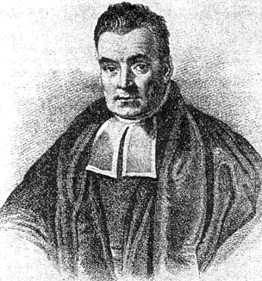
Naïve Bayes Classifiers
Jonathan Lee and Varun Mahadevan

Slide 2
Programming Project: Spam Filter
Due: Check the Calendar
Implement a Naive Bayes classifier for classifying emails as either spam or ham.
You may use C, Java, Python, or R; ask if you have a different preference. We’ve provided starter code in Java, Python and R.
Read Jonathan’s notes on the website, start early, and ask for help if you get stuck!

Slide 3
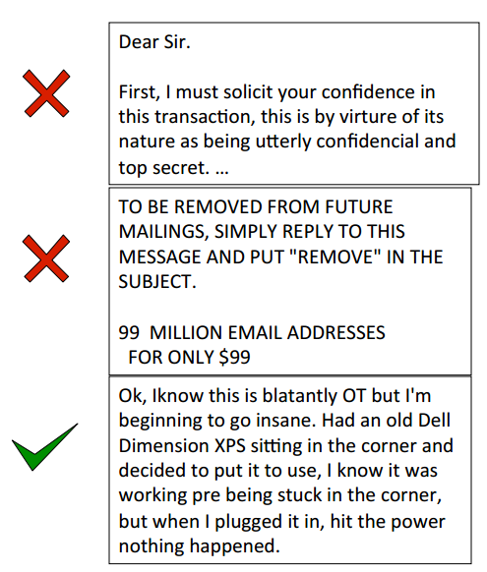
Spam vs. Ham
(at least in the past) the bane of any email user’s existence
You know it when you see it!
Easy for humans to identify, but not necessarily easy for computers
Less of a problem for consumers now, because spam filters have gotten really good…

Slide 4
The spam classification problem
Input: collection of emails, already labelled spam or ham
Someone has to label these by hand!
Usually called the training data
Use this data to train a model that “understands” what makes an email spam or ham
We’re using a Naïve Bayes classifier, but there are other approaches
This is a Machine Learning problem (take 446 for more!)
Test your model on emails whose label isn’t known to the model, and see how well it does
Usually called the test data

Slide 5
Naïve Bayes in the real world
One of the oldest, simplest models for classification
Still, very powerful and used all the time in the real world/industry
Identifying credit card fraud
Identifying fake Amazon reviews
Identifying vandalism on Wikipedia
Still used (with modifications) by Gmail to prevent spam
Facial recognition
Categorizing Google News articles
Even used for medical diagnosis!

Slide 6
Independence
Recap:
Definition: Two events X and Y are independent if
$P(XY)=P(X)P(Y)$,
and if $P\left(Y\right)>0$, then$P\left(X | Y\right)=P(X)$

Slide 7
Conditional Independence
Conditional Independence tells us that: Two events A and B are conditionally independent given C if
$P\left(A∩B | C\right)=P\left(A | C\right)P(B|C)$,
and if P(B) > 0 and P(C) > 0, then $P\left(A | BC\right)=P\left(A | C\right)$

Slide 8
Example:
Randomly choose a day of the week
A = { It is not a Monday }
B = { It is a Saturday }
C = { It is the weekend }
A and B are dependent events
P(A) = 6/7, P(B) = 1/7, P(AB) = 1/7
Now condition both A and B on C:
P(A|C) = 1, P(B|C) = ½, P(AB|C) = ½
P(AB|C) = P(A|C)P(B|C) => A|C and B|C are independent

Slide 9
Conditional Independence
Conditional Independence does not imply Independence!!!!!!!!
If X and Y are conditionally independent given Z, and X and
Y are conditionally independent given Z^{C}.
Are X and Y independent?

Slide 10
Conditional Independence
Conditional Independence does not imply Independence!!!!!!!!
We have two coins – {H, T} and {H, H}
Let X be the event that the first flip is a Head.
Let Y be the event that the second flip is a Head.
Let Z be the event that we choose the fair coin.

Slide 11
Conditional Independence
Conditional Independence does not imply Independence!!!!!!!!
P(X | Z) = ½, P(Y | Z) = ½, P(XY | Z) = ¼
Since P(X | Z)P(Y | Z) = P(XY|Z),
X and Y are conditionally independent given Z.
You can convince yourself that X and Y are conditionally
independent given Z^{C} using a similar argument.

Slide 12
Conditional Independence
Conditional Independence does not imply Independence!!!!!!!!
P(X) = ¾ , and P(Y) = ¾
P(XY) = P(XY|Z)P(Z) + P(XY|Z^{C})P(Z^{C})
= ¼ x ½ + 1 x ½ = 5/8
P(XY) ≠ P(X)P(Y), X and Y are not independent.

Slide 13
Naïve Bayes in theory
The concepts behind Naïve Bayes are nothing new to you -- we’ll be using what we’ve learned in the past few weeks.
Specifically
Bayes Theorem
$P\left(A | B\right)=\frac{P\left(B|A\right)P\left(A\right)}{P(B)}$
Law of Total Probability
$P(A)=\sum_{n}{P\left(A | B_{n}\right)P(B_{n})}$
Chain Rule
$P\left(A_{1},…,A_{n}\right)=P\left(A_{1}\right) P\left(A_{2} | A_{1}\right)…P\left(A_{n} | A_{n−1}…A_{1}\right)$
Conditional Independence
$P\left(A∩B | C\right)=P\left(A | C\right)P(B|C)$
Conditional Probability
$P\left(A|B\right)=\frac{P\left(A∩B\right)}{P(B)}$

Slide 14
How do we represent an email?
There’s a lot of different things about emails that might give a computer a hint about whether or not it’s spam
Possible features: words in body, subject line, sender, message header, time sent…
For this assignment, we choose to represent an email just as the set of distinct words $(x_{1}, x_{2},…, x_{n})$ in the subject and body
SUBJECT: Top Secret Business Venture
Dear Sir.
First, I must solicit your confidence in this transaction, this is by virture of its nature as being utterly confidencial and top secret…
(top, secret, business, venture, dear, sir, first, I, must, solicit, your, confidence, in, this, transaction, is, by, virture, of, its, nature, as, being, utterly, confidencial, and)
Notice that there are no duplicate words!

Slide 15
Programming Project
Take the set of distinct words $(x_{1}, x_{2},…, x_{n})$ to represent the text in an email.
We are trying to compute
$$P\left(Spam | x_{1}, x_{2},…, x_{n}\right)= ???$$
By applying Bayes Theorem, we can reverse the conditioning. It’s easier to find the probability of a word appearing in a spam email than the reverse.
$$P\left(Spam | x_{1}, x_{2},…, x_{n}\right)=\frac{P\left(x_{1}, x_{2},…x_{n} | Spam\right)P(Spam)}{P(x_{1},x_{2},…,x_{n})}$$
$$=\frac{P\left(x_{1}, x_{2},…x_{n} | Spam\right)P(Spam)}{P\left(x_{1}, x_{2},…x_{n} | Spam\right)P\left(Spam\right)+P\left(x_{1}, x_{2},…x_{n} | Ham\right)P(Ham)}$$

Slide 16
Programming Project
Let’s take a look at the numerator and apply the rule for Conditional Probability
$$P\left(x_{1}, x_{2},…x_{n} | Spam\right)P\left(Spam\right)=P(x_{1},x_{2},…,x_{n},Spam)$$
And now let’s use the Chain Rule to decompose this
$$P\left(x_{1},x_{2},…,x_{n},Spam\right)=P\left(x_{1} | x_{2},…,x_{n},Spam\right)P(x_{2},…,x_{n},Spam)$$
$$=P\left(x_{1} | x_{2},…,x_{n},Spam\right)P(x_{2}|x_{3},…,x_{n},Spam)P(x_{3},…,x_{n},Spam)$$
$=…$
$$=P\left(x_{1} | x_{2},…,x_{n},Spam\right)…P\left(x_{n−1} | x_{n},Spam\right)P\left(x_{n} | Spam\right)P(Spam)$$
But this is still hard to compute.

Slide 17
Let’s simplify the problem with an assumption.
We will assume that the words in the email are conditionally independent of each other, given that we know whether or not the email is spam.
This is why we call this Naïve Bayes. This isn’t true irl!
So how does this help?
$$P\left(x_{1},x_{2},…,x_{n},Spam\right)=P\left(x_{1} | x_{2},…,x_{n},Spam\right)…P\left(x_{n−1} | x_{n},Spam\right)P\left(x_{n} | Spam\right)P(Spam)$$
$$≈P\left(x_{1} | Spam\right)P(x_{2}|Spam)…P\left(x_{n−1} | Spam\right)P\left(x_{n} | Spam\right)P(Spam)$$
$$P(x_{1},x_{2},…,x_{n},Spam)≈P(Spam)\prod_{i=1}^{n}{P(x_{i}|Spam)}$$

Slide 18
Programming Project
So we know that
$$P(x_{1},x_{2},…,x_{n},Spam)≈P(Spam)\prod_{i=1}^{n}{P(x_{i}|Spam)}$$
Similarly
$$P(x_{1},x_{2},…,x_{n},Ham)≈P(Ham)\prod_{i=1}^{n}{P(x_{i}|Ham)}$$
Putting it all together
$$P\left(Spam | x_{1}, x_{2},…, x_{n}\right)≈\frac{P(Spam)\prod_{i=1}^{n}{P(x_{i}|Spam)}}{P\left(Spam\right)\prod_{i=1}^{n}{P\left(x_{i} | Spam\right)}+P(Ham)\prod_{i=1}^{n}{P(x_{i}|Ham)}}$$

Slide 19
How spammy is a word?
Have a nice formula for email spam probability, using conditional probabilities of words given ham/spam
$P\left(Spam\right)$ and $P(Ham)$ are just the proportion of total emails that are spam and ham
What is $P(viagra|Spam)$ asking?
Would be easy to just count up how many spam emails have this word in them, so
$P\left(w | Spam\right)= \frac{number of spam emails containing w}{total number of spam emails}$ (maybe)
This seems reasonable, but there’s a problem…

Slide 20
Suppose the word Pokemon only ever showed up in ham emails in the training data, never in spam
$$P\left(Pokemon | Spam\right)=0$$
Since the overall spam probability is the product of a bunch of individual probabilities, if any of those is 0, the whole thing is 0
Any email with the word Pokemon would be assigned a spam probability of 0
What can we do?
SUBJECT: Get out of debt!
Cheap prescription pills! Earn fast cash using this one weird trick! Meet singles near you and get preapproved for a low interest credit card! Pokemon
definitely not spam, right?

Slide 21
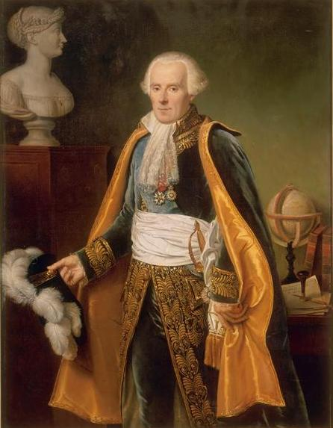
Laplace smoothing
Crazy idea: what if we pretend we’ve seen every outcome once already?
Pretend we’ve seen one more spam email with $w$, one more without $w$
$$P\left(w | Spam\right)= \frac{\left[number of spam emails containing w\right]+1}{\left[total number of spam emails\right]+2}$$
Then, $P\left(Pokemon | Spam\right)>0$
No one word can “poison” the overall probability too much
General technique to avoid assuming that unseen events will never happen

