Slide 1
Trick Mechanics
Illustrating Schnapsen in the second phase,
when the stock is no longer open.
Notes:
Title: How to Win at Femkort Speaker: Martin Tompa Abstract: We will discuss some two-person, perfect-information, trick-taking card games, generalized to decks of cards containing any number of suits and any number of cards in each suit. The particular focus is on a Swedish card game called Femkort, in which the goal is simply to take the final trick. I will explain a simple winning strategy for Femkort devised by the Swedish mathematician Johan Wästlund. We will then go on to consider the version in which there is a trump suit, because that version is an important aspect of the endgame in the more complex Austrian card game Schnapsen. I will describe my progress in devising a winning strategy for Femkort with trumps, and explain where I am stuck. If you don't know anything about trick-taking card games, I will explain everything you need to know. If you enjoy games, this talk will be fun.

Slide 2
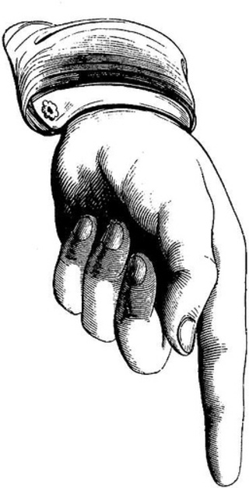
♠ is the Trump Suit
West
East

