Slide 1
Halting Problem
CSE 311 Summer 2025
Lecture 23

Slide 2
Announcements
Midterm retakes are happening today and tomorrow
HW7 is out and due this Friday, 8/15
HW5 solutions are at the front of the class
Final logistics are posted on the Exams page of the course website

Slide 3
Review: Uncomputability

Slide 4
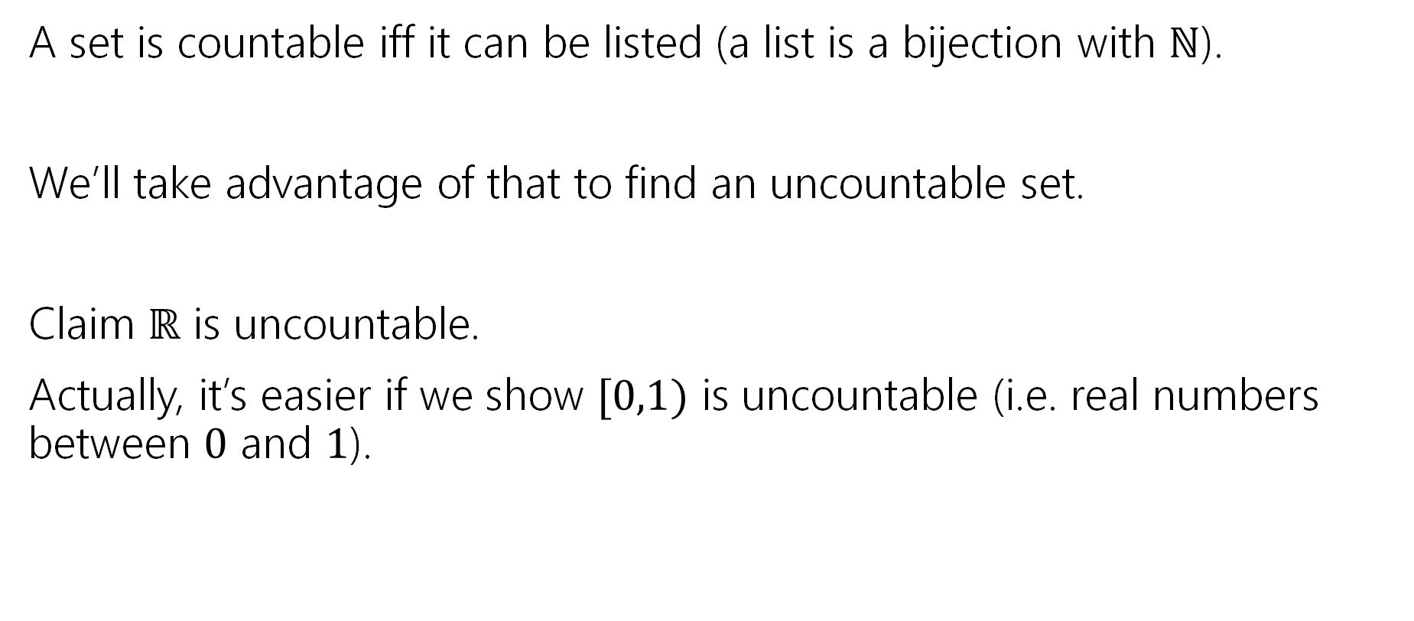

A proof idea
A set is countable iff it can be listed (a list is a bijection with $ℕ$).
We’ll take advantage of that to find an uncountable set.
Claim $ℝ$ is uncountable.
Actually, it’s easier if we show $[0,1)$ is uncountable (i.e. real numbers between $0$ and $1$).

Slide 5

Uncountable
Suppose, for the sake of contradiction, that $[0,1)$ is countable.
Then there is a bijection $f:ℕ→[0,1)$.
Use that bijection to make the following table…

Slide 6
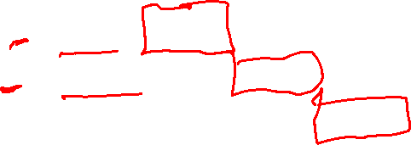


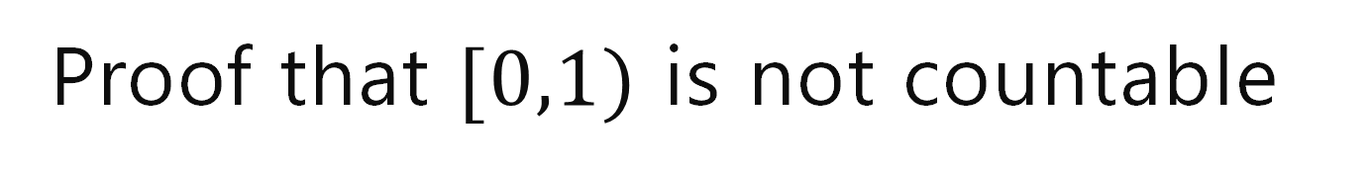
Proof that $[0,1)$ is not countable
Suppose, for the sake of contradiction, that there is a list of them:
Number | Digits after decimal | 0 | 1 | 2 | 3 | 4 | 5 | 6 | 7 | …
$$f(0)$$ | 0. | 3 | 3 | 3 | 3 | 3 | 3 | 3 | 3 | …
$$f(1)$$ | 0. | 2 | 7 | 2 | 7 | 2 | 8 | 5 | 4 | …
$$f(2)$$ | 0. | 1 | 4 | 1 | 5 | 9 | 2 | 6 | 5 | …
$$f(3)$$ | 0. | 2 | 2 | 2 | 2 | 2 | 2 | 2 | 2 | …
$$f(4)$$ | 0. | 1 | 2 | 3 | 4 | 5 | 6 | 7 | 8 | …
$$f(5)$$ | 0. | 9 | 8 | 7 | 6 | 5 | 4 | 3 | 2 | …
$$f(6)$$ | 0. | 8 | 2 | 7 | 6 | 4 | 5 | 7 | 4 | …
$$f(7)$$ | 0. | 5 | 9 | 4 | 2 | 7 | 5 | 1 | 7 | …
… | … | … | … | … | … | … | … | … | … | …
Flipping Rule: let’s set the $i^{th}$ column to:
$7$ if $f(i)$’s $i^{th}$ column is not $7$
$3$if $f{\left(i\right)}^{′}s$ $i^{th}$ column is $7$.
0.73777733…

Slide 7
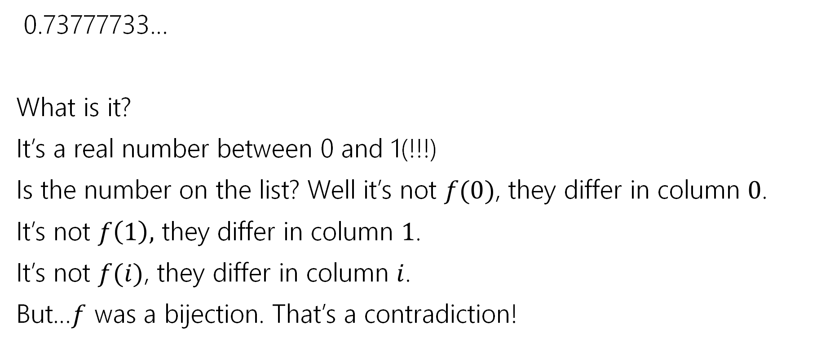
Wrapping Up
0.73777733…
What is it?
It’s a real number between 0 and 1(!!!)
Is the number on the list? Well it’s not $f(0)$, they differ in column $0$.
It’s not $f\left(1\right),$ they differ in column $1$.
It’s not $f(i)$, they differ in column $i$.
But…$f$ was a bijection. That’s a contradiction!

Slide 8
Diagonalization
This proof technique is called diagonalization
Often “Cantor’s Diagonalization” (after Cantor, who developed it).

Slide 9

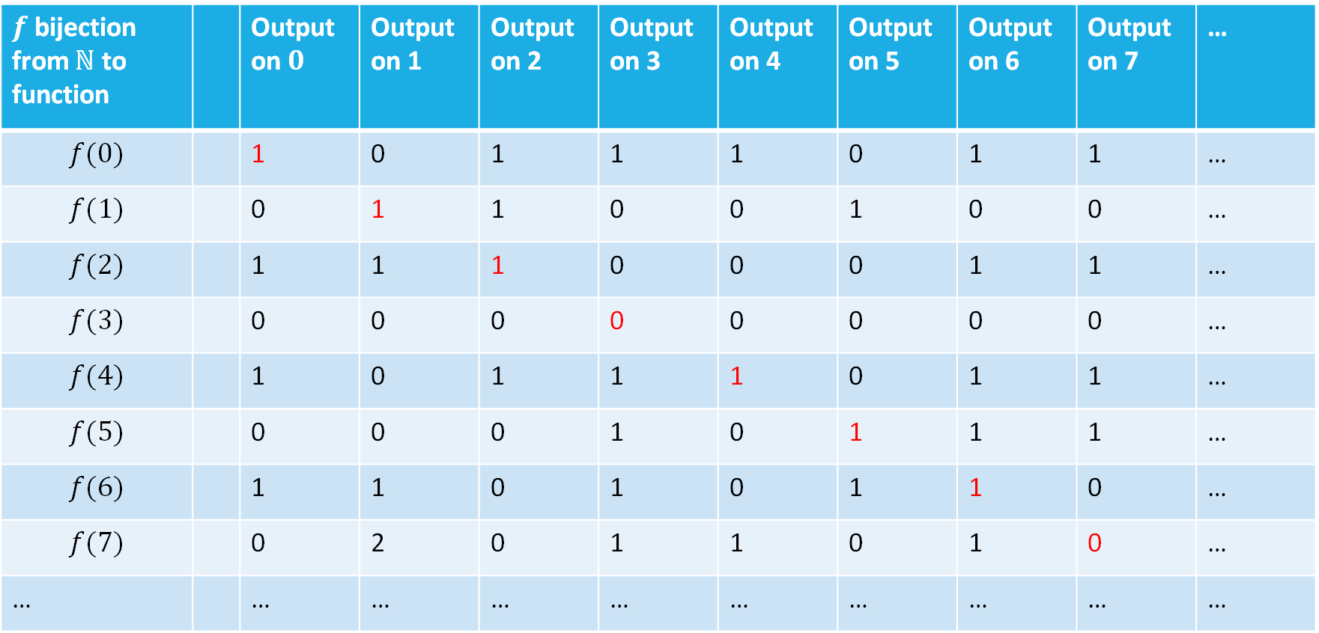
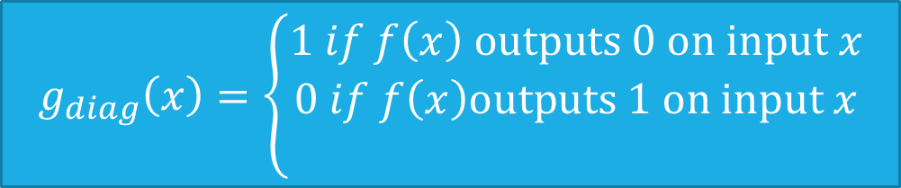


Proof that $[0,1)$ set of binary-valued functions is not countable
Suppose, for the sake of contradiction, that there is a list of them:
$f$ bijection from $ℕ$ to function |  | Output on $0$ | Output on 1 | Output on 2 | Output on 3 | Output on 4 | Output on 5 | Output on 6 | Output on 7 | …
$$f(0)$$ |  | 1 | 0 | 1 | 1 | 1 | 0 | 1 | 1 | …
$$f(1)$$ |  | 0 | 1 | 1 | 0 | 0 | 1 | 0 | 0 | …
$$f(2)$$ |  | 1 | 1 | 1 | 0 | 0 | 0 | 1 | 1 | …
$$f(3)$$ |  | 0 | 0 | 0 | 0 | 0 | 0 | 0 | 0 | …
$$f(4)$$ |  | 1 | 0 | 1 | 1 | 1 | 0 | 1 | 1 | …
$$f(5)$$ |  | 0 | 0 | 0 | 1 | 0 | 1 | 1 | 1 | …
$$f(6)$$ |  | 1 | 1 | 0 | 1 | 0 | 1 | 1 | 0 | …
$$f(7)$$ |  | 0 | 2 | 0 | 1 | 1 | 0 | 1 | 0 | …
… |  | … | … | … | … | … | … | … | … | …
How do we find a function not on our list?
Well to make sure it’s not $f(i)$ (the function in the $i^{th}$ row)
Have $g_{diag}\left(i\right)=1−f\left(i\right)\left(i\right)$
$$g_{diag}\left(x\right)=\left\{\begin{aligned}1 if f\left(x\right) outputs 0 on input x \\ 0 if f\left(x\right)outputs 1 on input x \\ \end{aligned}\right.$$

Slide 10
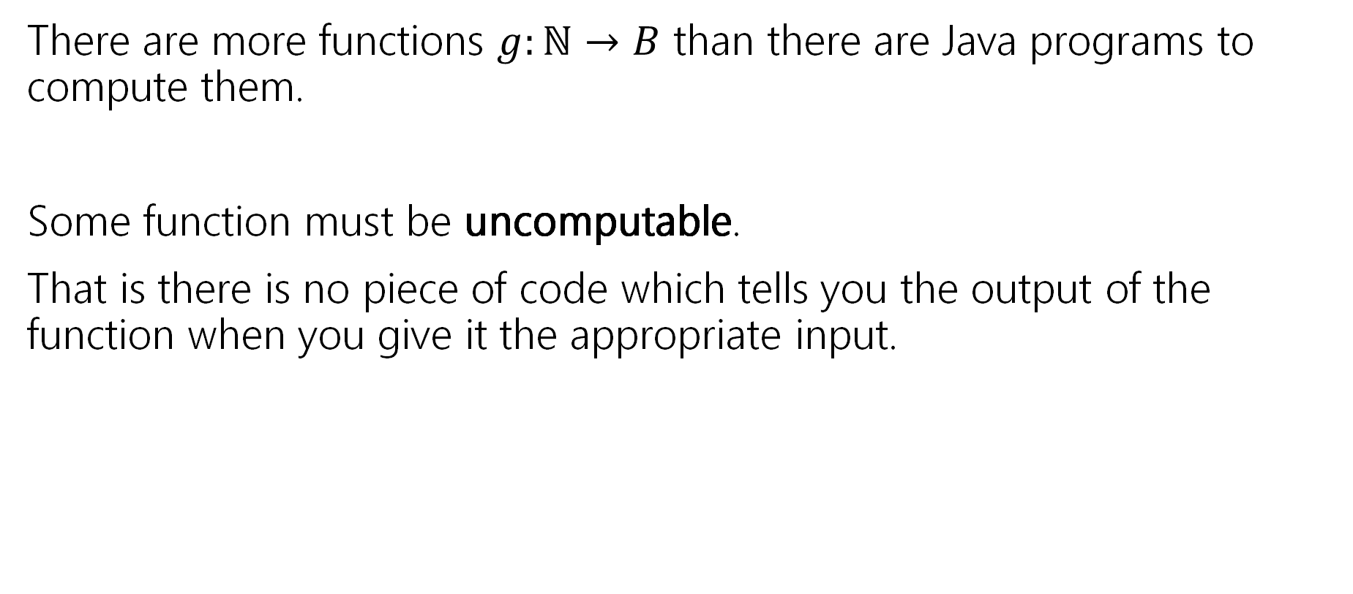
Our Second big takeaway
There are more functions $g:ℕ→B$ than there are Java programs to compute them.
Some function must be uncomputable.
That is there is no piece of code which tells you the output of the function when you give it the appropriate input.

Slide 11
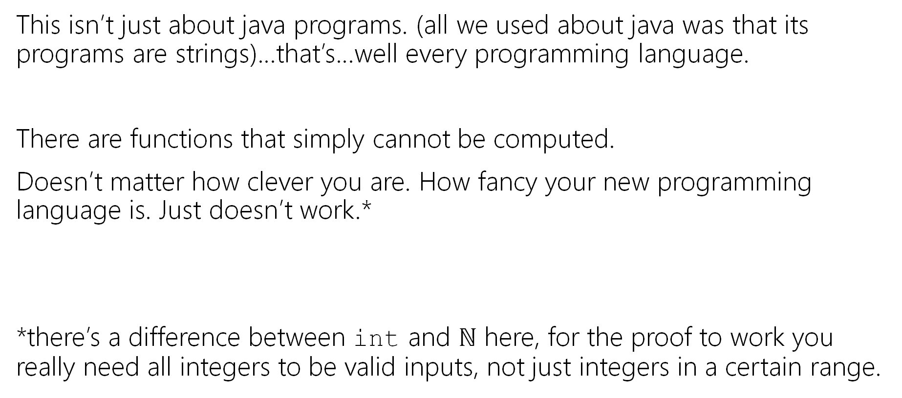
Not just Java
This isn’t just about java programs. (all we used about java was that its programs are strings)…that’s…well every programming language.
There are functions that simply cannot be computed.
Doesn’t matter how clever you are. How fancy your new programming language is. Just doesn’t work.*
*there’s a difference between int and $ℕ$ here, for the proof to work you really need all integers to be valid inputs, not just integers in a certain range.

Slide 12
Does this matter?
It’s even worse than that – almost all functions are not computable.
So…how come this has never happened to you?
This might not be meaningful yet. Almost all functions are also inexpressible in a finite amount of English (English is a language too!)
You’ve probably never decided to write a program that computes a function you couldn’t describe in English…
Are there any problems anyone is interested in solving that aren’t computable?

Slide 13
What’s a computer?

Slide 14

Formal definition of computer
To prove a theorem, we’ll need some kind of definition.
The first theoretical description of a (“normal”) computer is a Turing Machine
Turing Machines have:
A finite control
  think: a DFA-like object to represent program state, what is the program I’m executing, what line number am I on, etc.
As much memory as we need
  Stored on an infinite “tape”
A “focus-of-attention”
  The bit of memory on the tape we’re paying attention to right now. Can read and write at this spot. The finite control can move the focus.
Notes:
“Tape” as in “Casette tape” or “VHS tape”---a storage device---not like a piece of duct tape.

Slide 15
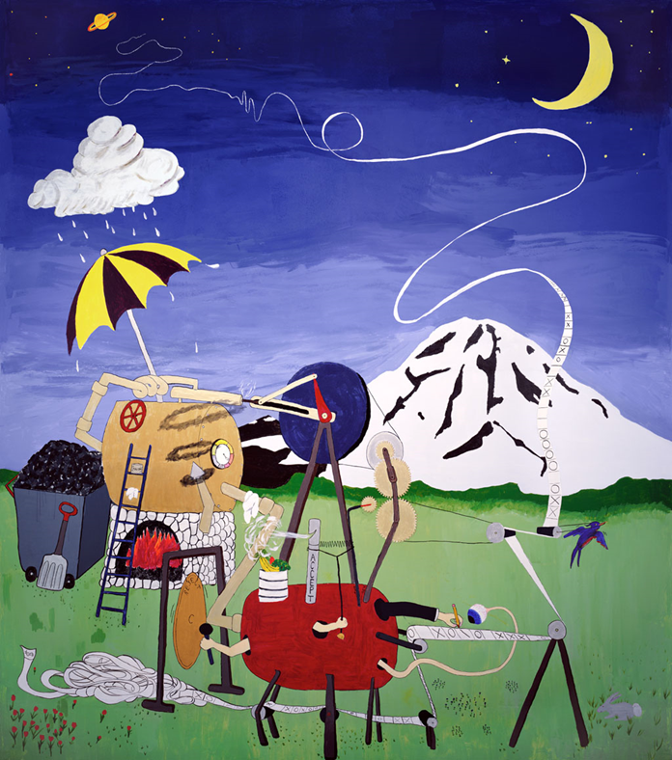


Slide 16

Does that sound like a computer?
Maybe not the first analogy you would have come up with.
But computer scientists still love talking about Turing Machines---take 431 to learn more
But an idea called “Turing-completeness” says we can think about Java programs instead
A computational device is Turing-complete if it can do everything a Turing-machine can do.
Java is Turing-complete, as are C++, Python, and any other general-purpose programming language you know. And moreover, none can really solve problems the others can’t
See 431 for more on these.
Notes:
Just like NFAs, DFAs, Regexes are equivalent in power
The Church-Turing thesis says “this represents everything we care about”

Slide 17
The Halting Problem

Slide 18
A Practical Uncomputable Problem
Ever pressed the run button on your code and have it take a long time?
Like an infinitely long time?
What didn’t your compiler…like, tell you not to push the button yet.
It tells you when your code doesn’t compile before it runs it…why doesn’t it check for infinite loops?

Slide 19
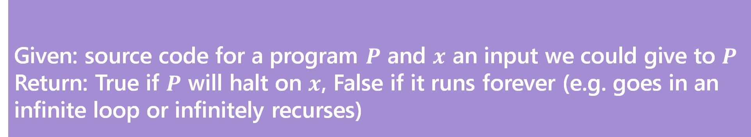
The Halting Problem
Given: source code for a program $P$ and $x$ an input we could give to $P$
Return: True if $P$ will halt on $x$, False if it runs forever (e.g. goes in an infinite loop or infinitely recurses)
The Halting Problem
This would be super useful to solve!
We can’t solve it…let’s find out why.

Slide 20
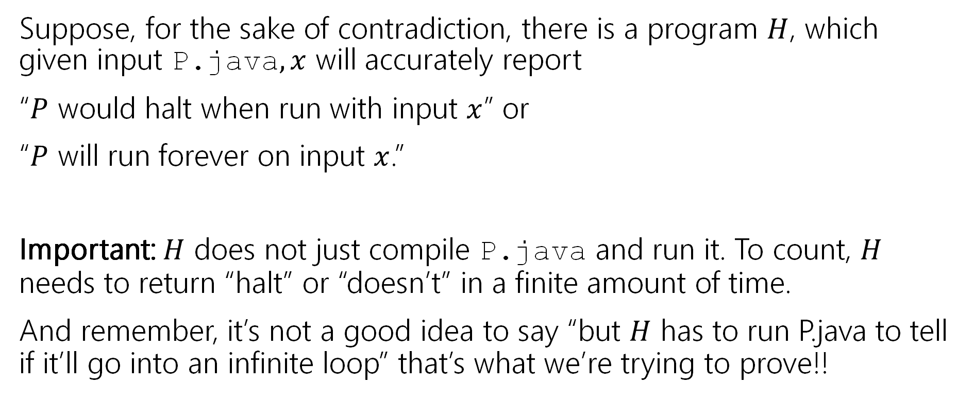

A Proof By Contradiction
Suppose, for the sake of contradiction, there is a program $H$, which given input P.java$,x$ will accurately report
“$P$ would halt when run with input $x$” or
“$P$ will run forever on input $x$.”
Important: $H$ does not just compile P.java and run it. To count, $H$ needs to return “halt” or “doesn’t” in a finite amount of time.
And remember, it’s not a good idea to say “but $H$ has to run P.java to tell if it’ll go into an infinite loop” that’s what we’re trying to prove!!

Slide 21

A Very Tricky Program.
Diagonal.java(String x){
Run H.exe on input <x, x>
if(H.exe says “x halts on x”)
while(true){//Go into an infinite loop
int x=2+2;
}
else //H.exe says “x doesn’t halt on x”
return; //halt.
}

Slide 22
So, uhh that’s a weird program.
What do we do with it?
USE IT TO BREAK STUFF
Does Diagonal.java halt when its input is Diagonal.java?
Let’s assume it does and see what happens…

Slide 23

A Very Tricky Program.
Imagine Diagonal.java halts on Diagonal.java.
Then H better say it halts.
So it goes into an infinite loop.
Wait shoot.
Diagonal.java(String x){
Run H.exe on input <x, x>
if(H.exe says “x halts on x”)
while(true){//Go into an infinite loop
int x=2+2;
}
else //H.exe says “x doesn’t halt on x”
return; //halt.
}

Slide 24
So, uhh that’s a weird program.
What do we do with it?
USE IT TO BREAK STUFF
Does Diagonal.java halt when its input is Diagonal.java?
Let’s assume it does and see what happens…
  That didn’t work.
Let’s assume it doesn’t and see what happens…

Slide 25

A Very Tricky Program.
Imagine Diagonal.java doesn’t halt on Diagonal.java.
Then H better say it doesn’t halt.
So we go into the else branch.
And it halts
Wait shoot.
Diagonal.java(String x){
Run H.exe on input <x, x>
if(H.exe says “x halts on x”)
while(true){//Go into an infinite loop
int x=2+2;
}
else //H.exe says “x doesn’t halt on x”
return; //halt.
}

Slide 26

So, uhh that’s a weird program.
What do we do with it?
USE IT TO BREAK STUFF
Does Diagonal.java halt when its input is Diagonal.java?
Let’s assume it does and see what happens…
  That didn’t work.
Let’s assume it doesn’t and see what happens…
  That didn’t work either.
There’s no third option. It either halts or it doesn’t. And it doesn’t do either. That’s a contradiction! H.exe can’t exist.

Slide 27

So…
So there is no general-purpose algorithm that decides whether any input program halts (on any input string).
The Halting Problem is undecidable (i.e. uncomputable) there is no algorithm that solves every instance of the problem correctly.
Notes:
This is a proof by contradiction---it’s not necessarily _just_ Diagonal.java that we can’t tell whether it halts.
In fact, every attempt at H will fail on _infinitely_ many inputs (else hard-code the finite list into the program first).

Slide 28
What this does and doesn’t mean
Does this code halt?
public static void main(String[] args)
{
  int i=0;
  while(i<100){
  System.out.println(“*”);
  i++;
  }
  }

Slide 29
What this does and doesn’t mean
Does this code halt?
public static void main(String[] args)
{
  int i=0;
  while(i<100){
  System.out.println(“*”);
  i++;
  }
  }
It does halt!

Slide 30
What this does and doesn’t mean
Does this code halt?
public static void main(String[] args)
{
  int i=0;
  while(i<100){
  System.out.println(“*”);
  //i++; //doesn’t seem important.
  }
  }

Slide 31
What this does and doesn’t mean
Does this code halt?
public static void main(String[] args)
{
  int i=0;
  while(i<100){
  System.out.println(“*”);
  //i++; //doesn’t seem important.
  }
  }
It doesn’t halt!

Slide 32
What that does and doesn’t mean
That doesn’t mean that there aren’t algorithms that often get the answer right
  For example, if there’s no loops, no recursion, and no method calls, it definitely halts. No problem with a program that checks that there’s no loops, recursion, or method calls and tells you it’s going to halt if it doesn’t find any.
  This isn’t just a failure of computers – if you think you can do this by hand, well…
  …you can’t either.

Slide 33
Takeaways
Don’t expect that there’s a better IDE/better compiler/better programming language coming that will make it possible to tell if your code is going to hit an infinite loop.
It’s not coming.

Slide 34

More Uncomputable problems
Imagine we gave the following task to 121 students:
Write a program that prints “Hello World”
Can you make an autograder?
Technically…NO!

Slide 35
More Uncomputable problems
Imagine we gave the following task to 121 students:
Write a program that prints “Hello World”
Can you make an autograder?
Technically…NO!
In practice, we declare the program wrong if it runs for 1 minute or so. That’s not right 100% of the time, but it’s good enough for your programming classes.

Slide 36

How Would we prove that?
With a reduction
Suppose, for the sake of contradiction, I can solve the HelloWorld problem. (i.e. on input P.java I can tell whether it eventually prints HelloWorld)
Let W.exe solve that problem.
Consider this program…

Slide 37

A Reduction
Trick(P,x){
Run P on x, //(but only simulate printing if P prints things)
Print “Hello World”
}
This actually prints “hello world” iff P halts on x.
Plug Trick into W and….we solved the Halting Problem!

Slide 38

Reductions in General
The big idea for reductions is “reusing code”
Just like calling a library
But doing it in contrapositive form.
Instead of
“If I have a library, then I can solve a new problem” reductions can do the contrapositive:
“If I can solve a problem I know I shouldn’t be able to, then that library function can’t exist”

Slide 39
Fun (Scary?) Fact
Rice’s Theorem
Says any “non-trivial” input-output behavior of programs cannot be computed (in finite time).

Slide 40
Victory Lap!

Slide 41

We’ve Covered A LOT
Propositional Logic.
Boolean logic and circuits.
Boolean algebra.
Predicates, quantifiers and predicate logic.
Inference rules and formal proofs for propositional and predicate logic.
English proofs.
Set theory.
Modular arithmetic.
Prime numbers.
GCD, Euclid's algorithm and modular inverse
You’ll use quantifiers in 332 to define big-O
431 is basically 10 weeks of fun set proofs.
Interested in crypto? They’ll come back.

Slide 42
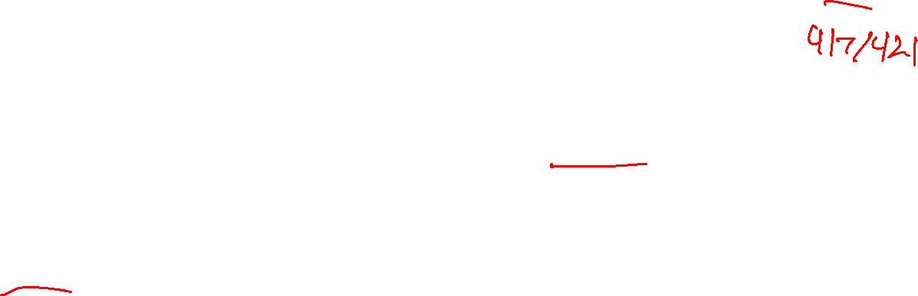
No really. A lot
Induction and Strong Induction.
Recursively defined functions and sets.
Structural induction.
Regular expressions.
Context-free grammars and languages.
One-to-one and Onto
Graphs
Lots of induction proof [sketches] in 332
You’ll see these in compilers
You’ll use graphs at least once a week for the rest of your CS career.

Slide 43

Like A lot a lot.
DFAs, NFAs and language recognition.
Cross Product construction for DFAs.
Finite state machines with outputs at states.
Conversion of regular expressions to NFAs.
Powerset construction to convert NFAs to DFAs.
Equivalence of DFAs, NFAs, Regular Expressions
Method to prove languages not accepted by DFAs.
Cardinality, countability and diagonalization
Undecidability: Halting problem and evaluating properties of programs.
Promise you won’t ever try to solve the Halting Problem? It’s tempting to try to sometimes if you don’t remember it’s undecidable

Slide 44
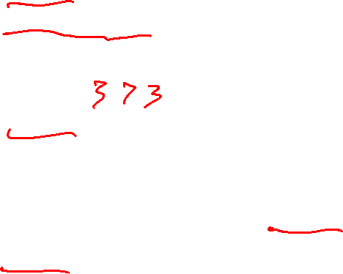
What Comes next?
CSE 312 (foundations II)
  Fewer proofs ☹
  Basics of probability theory (super useful in algorithms, ML, and just everyday life). Fundamental statistics.
CSE 332 (data structures and parallelism)
  Data structures, a few fundamental algorithms, parallelism.
  Graphs. Graphs everywhere.
  Also, induction. [same for 417/421, 422 the algorithms courses]
CSE 431 (complexity theory)
  What can’t you do with computers in a reasonable amount of time.
  Beautiful theorems – more on CFGs, DFAs/NFAs as well.

Slide 45
[If time] Q&A

