Slide 1
NFAs, Relating Models of Computation
CSE 311 Summer 2025
Lecture 20

Slide 2
Announcements
Midterm retakes are happening today and tomorrow
HW7 is out and due this Friday, 8/15
HW5 solutions are at the front of the class
Final logistics are posted on the Exams page of the course website

Slide 3
Review

Slide 4

Deterministic Finite Automaton
Our machine is going to get a string as input.
It will read one character at a time and update “its state.”
At every step, the machine thinks of itself as in one of the (finite number) vertices.
When it reads the character it follows the arrow labeled with that character to its next state.
Start at the “start state” (unlabeled, incoming arrow).
After you’ve read the last character, accept the string if and only if you’re in a “final state” (double circle).

Slide 5
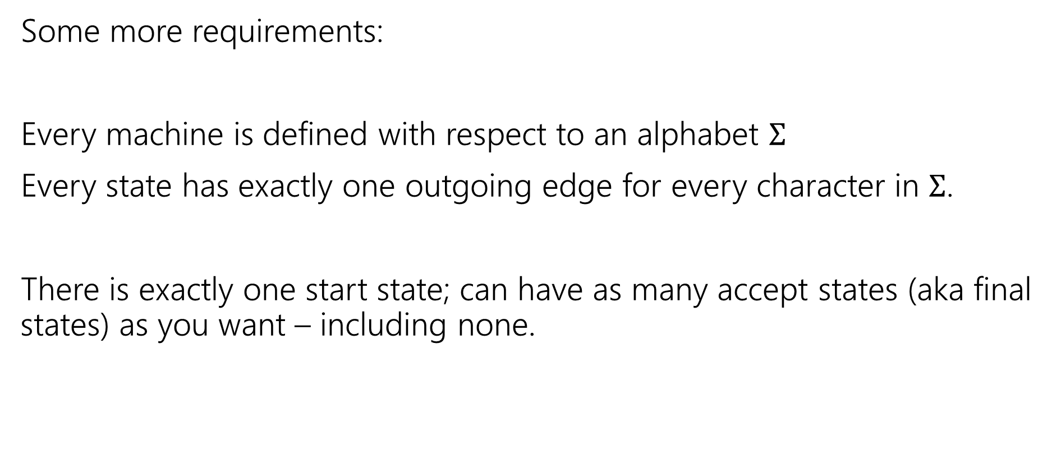
Deterministic Finite Automata
Some more requirements:
Every machine is defined with respect to an alphabet $Σ$
Every state has exactly one outgoing edge for every character in $Σ$.
There is exactly one start state; can have as many accept states (aka final states) as you want – including none.

Slide 6




Design some DFAs
Let $Σ=\{0,1,2\}$
$M_{1}$ should recognize “strings with an even number of 2’s.
$M_{2}$ should recognize “strings where the sum of the digits is congruent to $0$ $(mod 3)"$
2
s₁
s₀
2
0,1
0,1
0
1
$$t_{2}$$
1
2
2
$$t_{1}$$
2
$$t_{0}$$
0
1
0

Slide 7
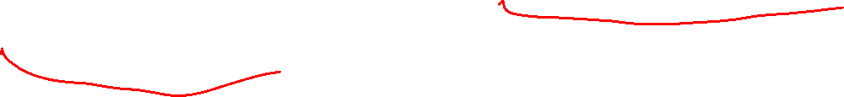
What language does this machine recognize?
1
s₀
s₁
That’s all binary strings of even length.
1
0
0
0,1
0
0
s₀
s₁
1
0,1
s₂
s₃
1

Slide 8
DFA Minimization
We can know!
Fun fact: there is a unique minimum DFA for every language (up to renaming the states)
High level idea – final states and non-final states must be different.
Otherwise, hope that states can be the same, and iteratively separate when they have to go to different spots.
In some quarters, we cover it in detail. But…we ran out of time.

Slide 9
Next Time
What if we give the DFAs a little more power…try to get them to do more things.

Slide 10
DFAs Wrapped

Slide 11
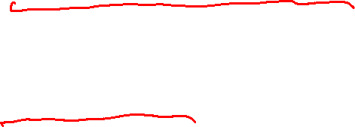
What are FSMs used for?
“Classic” hardware applications:
Anything where you only need to remember a very small amount of information, and have very simple update rules.
Vending machines
Elevators: need to know whether you’re going up or down, where people want to go, where people are waiting, and whether you’re going up or down. Simple rules to transition.
These days…general hardware is cheap, less likely to use custom hardware. BUT the programmer was probably still thinking about FSMs when writing the code.

Slide 12
What are FSMs used for?
Theoretically – still lots of applications.
grep uses FSMs to analyze regular expressions (more on this later).
Useful for modeling situations where you have minimal memory.
Good model for simple AI (say simple NPCs in games).
Technically all of our computers are finite state machines…
  But they’re not usually how we think about them...

Slide 13
NFAs, Power of machines

Slide 14
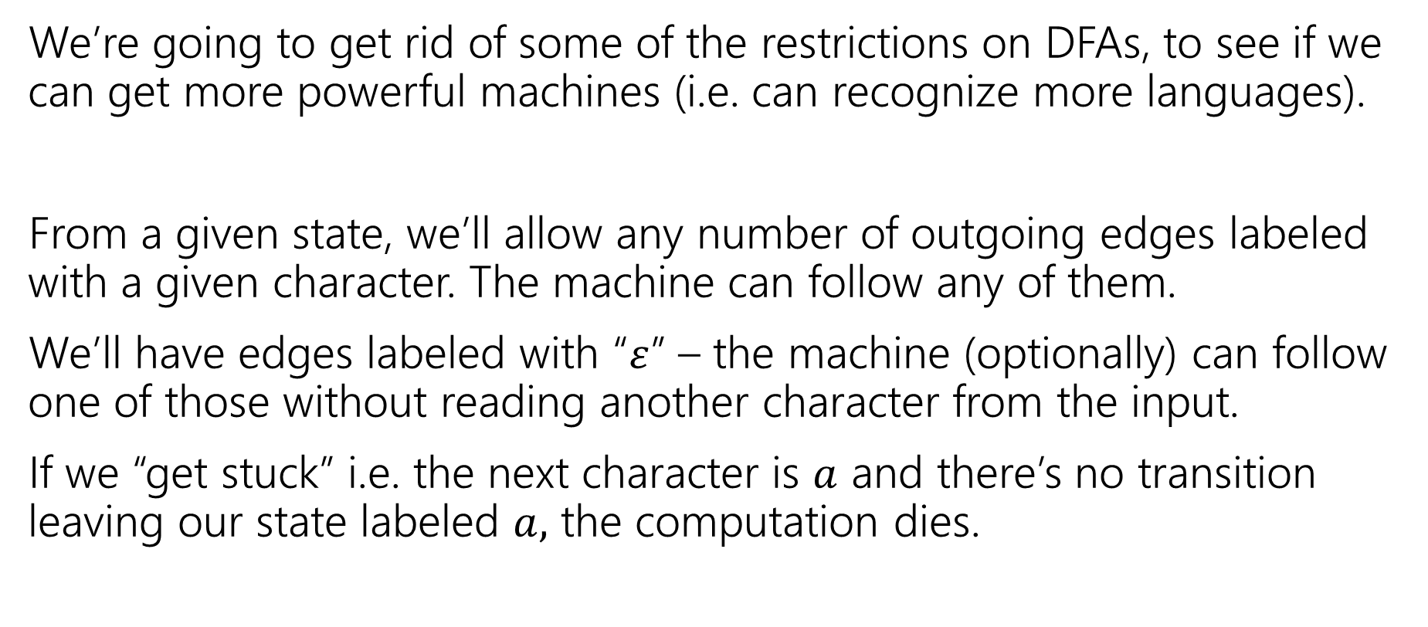

Let’s try to make our more powerful automata
We’re going to get rid of some of the restrictions on DFAs, to see if we can get more powerful machines (i.e. can recognize more languages).
From a given state, we’ll allow any number of outgoing edges labeled with a given character. The machine can follow any of them.
We’ll have edges labeled with “$ε$” – the machine (optionally) can follow one of those without reading another character from the input.
If we “get stuck” i.e. the next character is $a$ and there’s no transition leaving our state labeled $a,$ the computation dies.

Slide 15

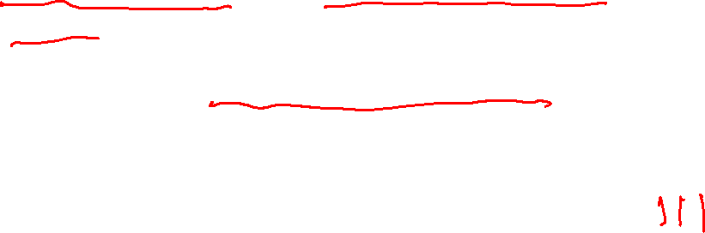
Nondeterministic Finite Automata
An NFA:
  Still has exactly one start state and any number of final states.
  The NFA accepts $x$ if there is some path from a start state to a final state labeled with $x$.
  From a state, you can have 0,1, or many outgoing arrows labeled with a single character. You can choose any of them to build the required path.
s₀
1
s₁
1
s₂
1
s₃
0,1
0,1

Slide 16
Wait a second…
But…how does it know?
Is this realistic?

Slide 17
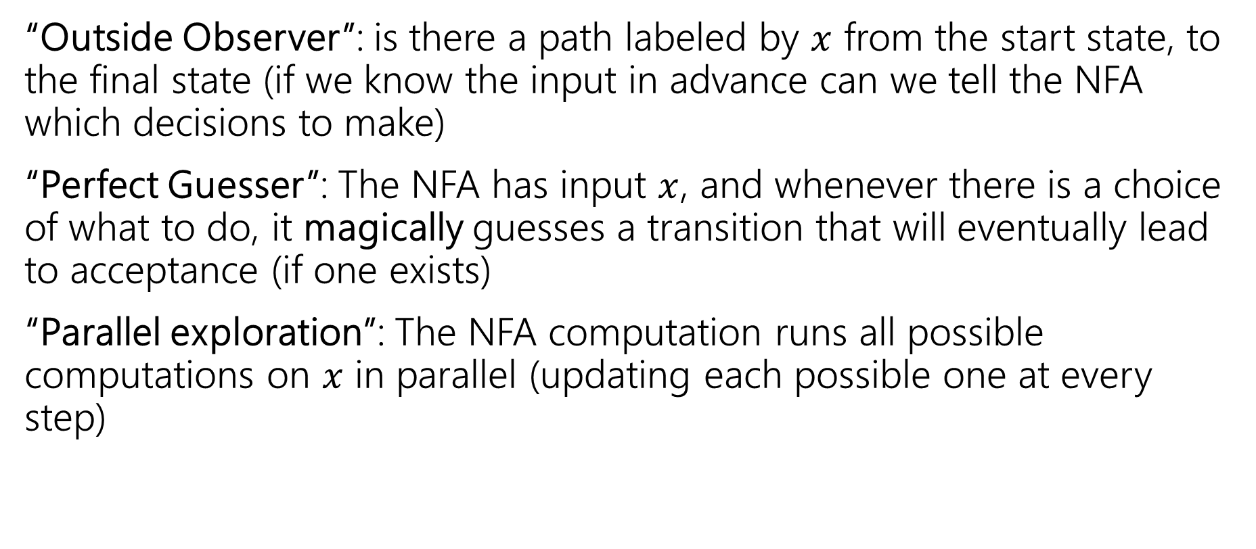

Three ways to think about NFAs
“Outside Observer”: is there a path labeled by $x$ from the start state, to the final state (if we know the input in advance can we tell the NFA which decisions to make)
“Perfect Guesser”: The NFA has input $x$, and whenever there is a choice of what to do, it magically guesses a transition that will eventually lead to acceptance (if one exists)
“Parallel exploration”: The NFA computation runs all possible computations on $x$ in parallel (updating each possible one at every step)

Slide 18
So…magic guessing doesn’t exist
I know.
The parallel computation view is realistic.
Lets us give simpler descriptions of complicated objects.
This notion of “nondeterminism” is also really useful in more advanced CS theory (you’ll see it again in 421 or 431 if not sooner).
Source of the P vs. NP problem.

Slide 19
NFA practice
What is the language of this NFA?
0,1
1
1
s₁
s₂
s₃
1
s₀
0
1
s₅
s₄
1

Slide 20


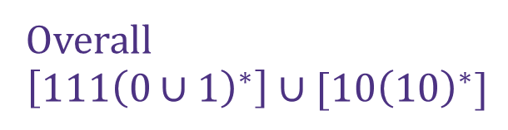
NFA practice
What is the language of this NFA?
0,1
1
1
s₁
s₂
s₃
$$111{\left(0∪1\right)}^{∗}$$
1
s₀
0
1
s₅
Overall
$$\left[111{\left(0∪1\right)}^{∗}\right]∪[10{\left(10\right)}^{∗}]$$
s₄
$$10{\left(10\right)}^{∗}$$
1

Slide 21

What about those $ε$-transitions?
2
0,1
0,1
s₀
s₁
ε
2
q
0
t₁
1
1
0
ε
2
2
0
t₀
2
t₂
1

Slide 22
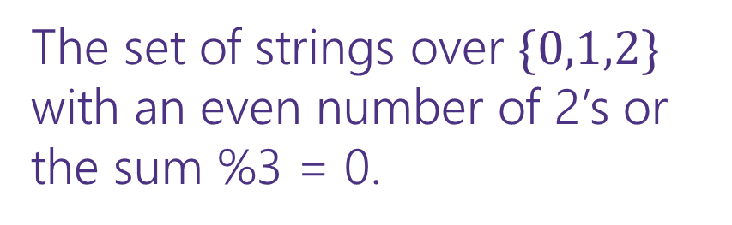
What about those $ε$-transitions?
2
0,1
0,1
s₀
s₁
ε
2
The set of strings over $\{0,1,2\}$ with an even number of 2’s or the sum %3 = 0.
q
0
t₁
1
1
0
ε
2
2
0
t₀
2
t₂
1

Slide 23
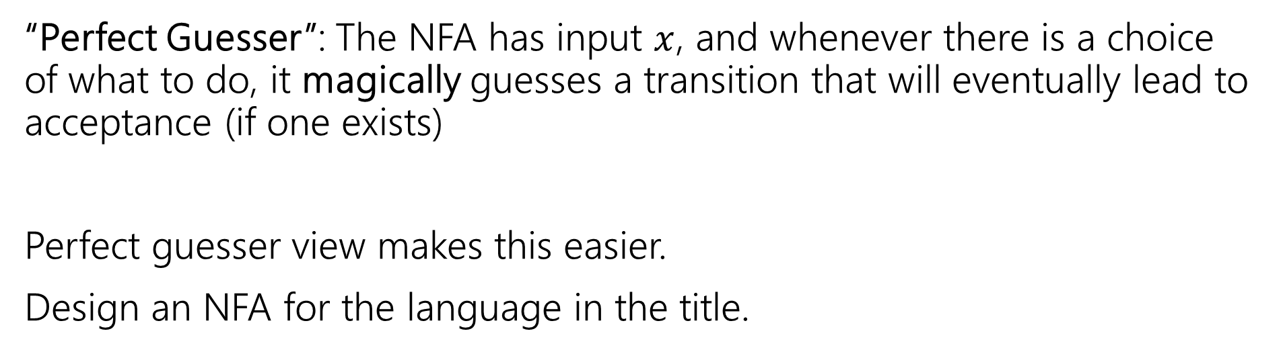
NFA that recognizes “binary strings with a 1 in the third position from the end”
“Perfect Guesser”: The NFA has input $x$, and whenever there is a choice of what to do, it magically guesses a transition that will eventually lead to acceptance (if one exists)
Perfect guesser view makes this easier.
Design an NFA for the language in the title.

Slide 24
NFA that recognizes “binary strings with a 1 in the third position from the end”
0,1
1
0,1
0,1
s₃
s₂
s₁
s₀
That’s WAY easier than the DFA…

Slide 25
Parallel Exploration view of an NFA
0,1
1
0,1
0,1
s₃
s₂
s₁
s₀
Input string 0101100
0
1
0
1
1
0
0
s₃
s₃
s₃
s₃
s₃
s₃
s₃
s₃
s₂
s₁
s₀
s₂
s₁
s₀
X
s₂
s₁
s₀
X

Slide 26
Relating Models of Computation

Slide 27
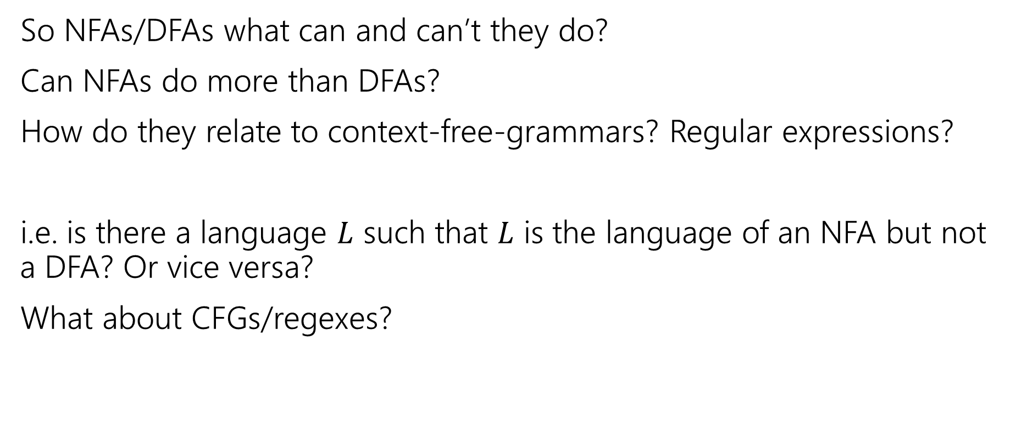
Regularity
So NFAs/DFAs what can and can’t they do?
Can NFAs do more than DFAs?
How do they relate to context-free-grammars? Regular expressions?
i.e. is there a language $L$ such that $L$ is the language of an NFA but not a DFA? Or vice versa?
What about CFGs/regexes?

Slide 28
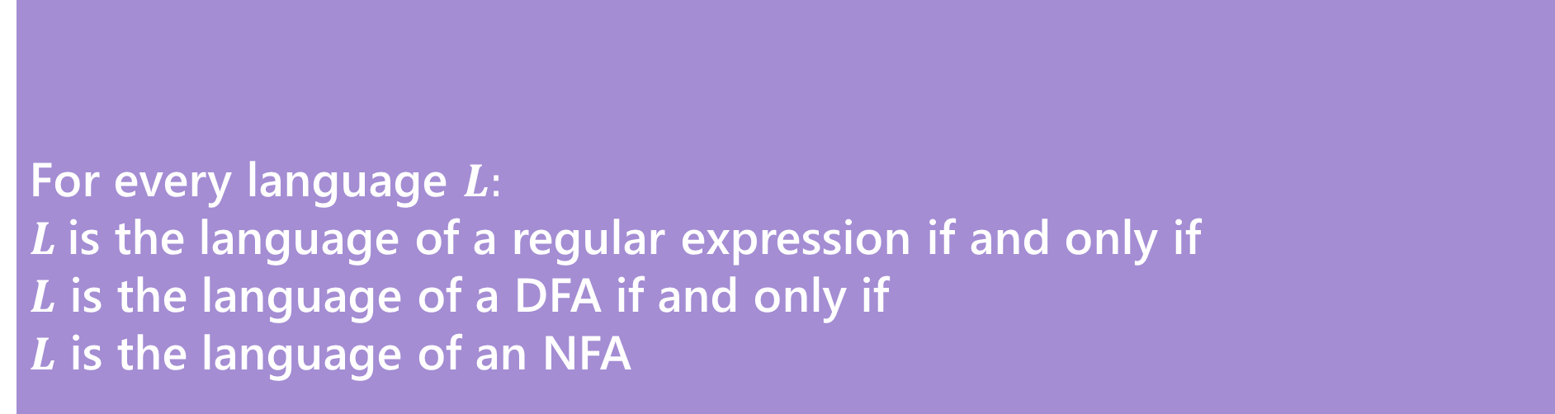
Regularity
So NFAs/DFAs what can and can’t they do?
Can NFAs do more than DFAs?
How do they relate to context-free-grammars? Regular expressions?
For every language $L:$
$L$is the language of a regular expression if and only if
$L$ is the language of a DFA if and only if
$L$ is the language of an NFA
Kleene’s Theorem

Slide 29
Regularity
So NFAs, DFAs, and regular expressions are all “equally powerful”
Every language either can be expressed with any of them or none of them.
A set of strings that is recognized by a DFA (equivalently, recognized by an NFA; equivalently, the language of a regular expression) is called a regular language.
So to show a language is “regular” you just need to show one of these and prove it works. There are some “irregular” languages (that don’t have a corresponding NFA/DFA/regex).
CFGs are “more powerful” (every regular language can also be represented with a CFG, but some languages with CFGs have not NFA/DFA/regex.

Slide 30
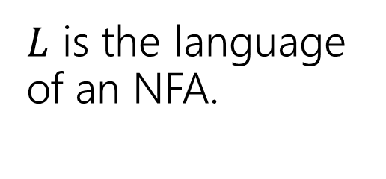
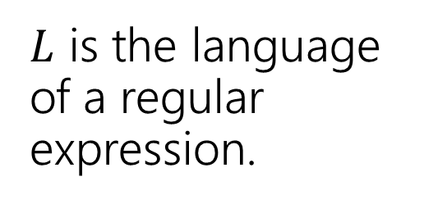
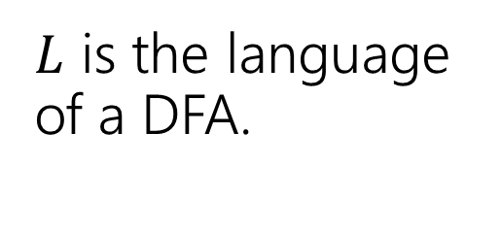
Proof [sketch]
$L$ is the language of an NFA.
$L$ is the language of a regular expression.
This is just a “sketch” of the proof. We want you to get the intuition for why this is true, we’ll go very quickly for some cases.
$L$ is the language of a DFA.

Slide 31
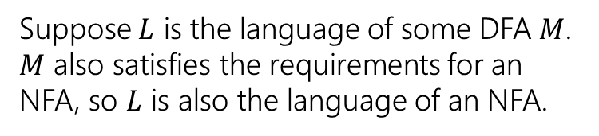
Proof [sketch]
$L$ is the language of an NFA.
Every DFA is a NFA
$L$ is the language of a regular expression.
$L$ is the language of a DFA.
Suppose $L$ is the language of some DFA $M$. $M$ also satisfies the requirements for an NFA, so $L$ is also the language of an NFA.

Slide 32
Proof [sketch]
$L$ is the language of an NFA.
Every DFA is a NFA
$L$ is the language of a regular expression.
$L$ is the language of a DFA.

Slide 33
Can we convert an NFA to a DFA?
NFAs are magic though! DFAs can’t guess…
Parallel exploration: The NFA computation runs all possible computations on x step-by-step at the same time in parallel
At any step, the set of all possible states we could be in is fixed!
And the update steps are deterministic if we just check all possibilities!

Slide 34
Parallel Exploration view of an NFA
0,1
1
0,1
0,1
s₃
s₂
s₁
s₀
Input string 0101100
0
1
0
1
1
0
0
s₃
s₃
s₃
s₃
s₃
s₃
s₃
s₃
s₂
s₁
s₀
s₂
s₁
s₀
X
s₂
s₁
s₀
X

Slide 35
Can we convert an NFA to a DFA?
NFAs are magic though! DFAs can’t guess…
Parallel exploration: The NFA computation runs all possible computations on x step-by-step at the same time in parallel
At any step, the set of all possible states we could be in is fixed!
And the update steps are deterministic if we just check all possibilities!

Slide 36
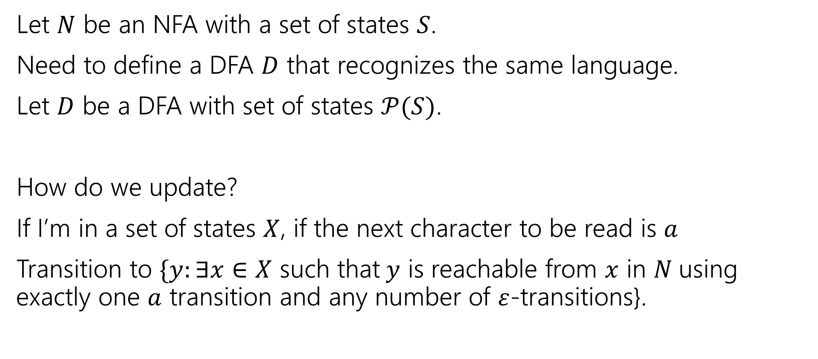
Converting from an NFA to a DFA
Let $N$ be an NFA with a set of states $S$.
Need to define a DFA $D$ that recognizes the same language.
Let $D$ be a DFA with set of states $𝒫(S)$.
How do we update?
If I’m in a set of states $X$, if the next character to be read is $a$
Transition to $\{y:∃x∈X$ such that$y$ is reachable from $x$ in $N$using exactly one $a$ transition and any number of $ε$-transitions}.

Slide 37


An example (starting point)
{a}
{c}
a
ɛ
1
0
0
1
c
b
{a,b}
0
0,1
$$N$$
$$D$$

Slide 38
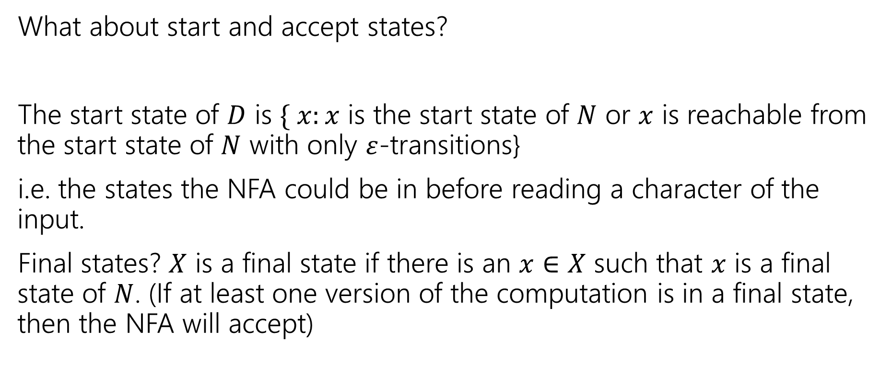
Finishing the DFA
What about start and accept states?
The start state of $D$ is $\{ x:x$ is the start state of $N$ or $x$ is reachable from the start state of $N$ with only $ε$-transitions}
i.e. the states the NFA could be in before reading a character of the input.
Final states? $X$ is a final state if there is an $x∈X$ such that $x$ is a final state of $N$. (If at least one version of the computation is in a final state, then the NFA will accept)

Slide 39

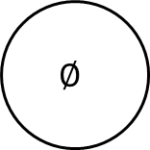
An example
$$D$$
0
{b,c}
{a}
{c}
1
a
0
1
1
1
{a,b,c}
ɛ
1
0
{b}
0
1
0
0
c
b
{a,b}
1
0
0,1
$$∅$$
$$N$$
0
0,1

Slide 40
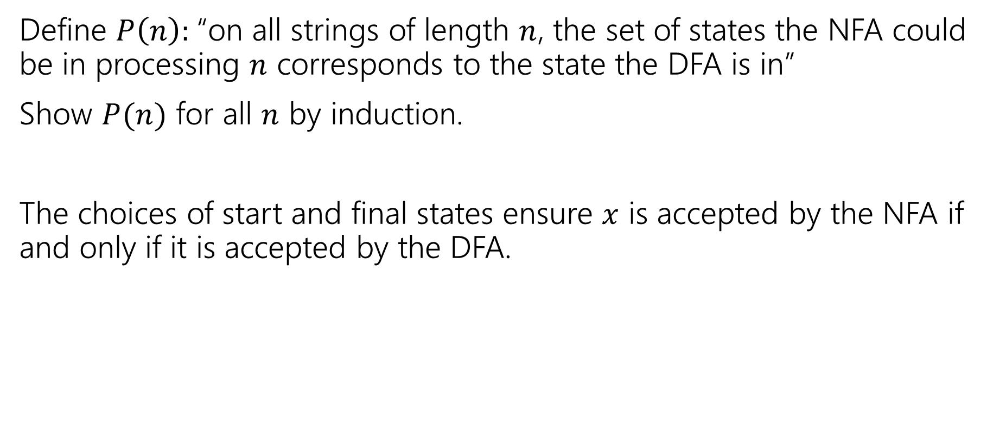
Proof Sketch
Define $P\left(n\right):$“on all strings of length $n$, the set of states the NFA could be in processing $n$ corresponds to the state the DFA is in”
Show $P(n)$ for all $n$ by induction.
The choices of start and final states ensure $x$ is accepted by the NFA if and only if it is accepted by the DFA.

Slide 41
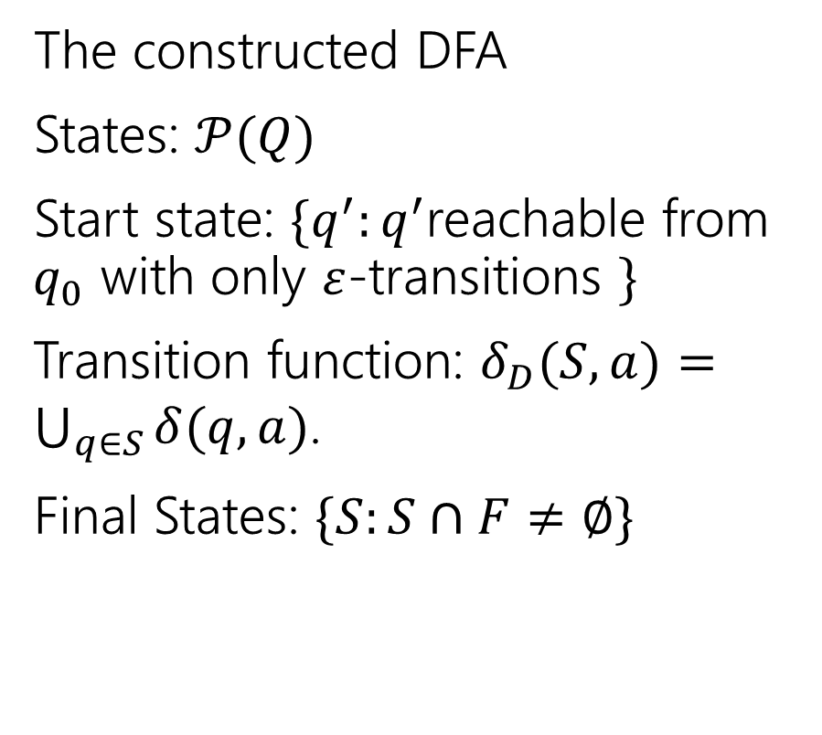
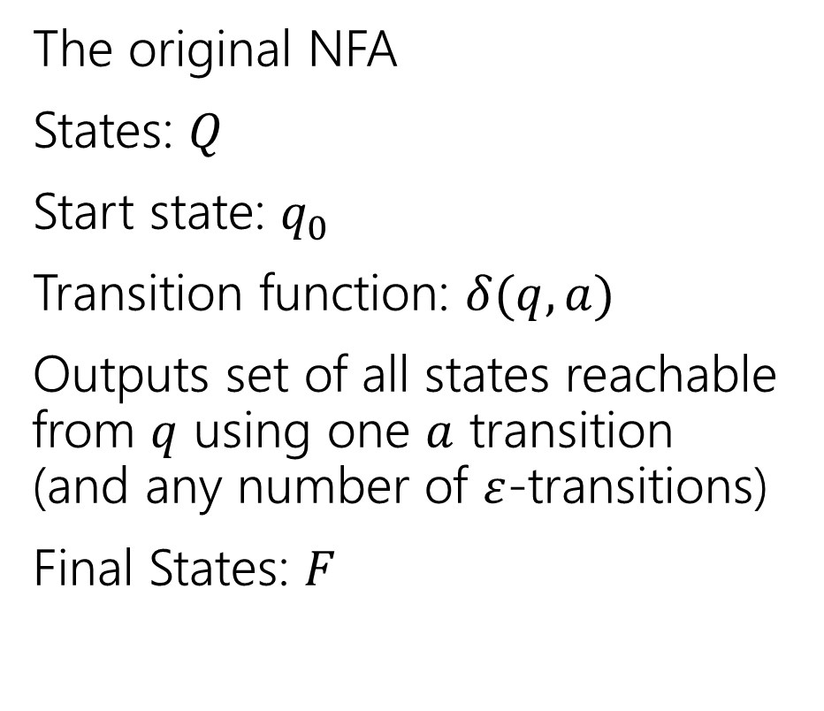
More formally (the “powerset construction”)
The original NFA
States: $Q$
Start state: $q_{0}$
Transition function: $δ(q,a)$
Outputs set of all states reachable from $q$ using one $a$ transition (and any number of $ε$-transitions)
Final States: $F$
The constructed DFA
States: $𝒫(Q)$
Start state: $\{q^{′}:q^{′}$reachable from $q_{0}$ with only $ε$-transitions $\}$
Transition function: $δ_{D}(S,a)=\bigcup_{q∈S}{δ(q,a)}$.
Final States: $\{S:S∩F≠∅\}$

Slide 42
Proof [sketch]
$L$ is the language of an NFA.
Powerset Construction
Every DFA is a NFA
$L$ is the language of a regular expression.
$L$ is the language of a DFA.

Slide 43
Every regular expression has a corresponding NFA.
Proof by…
Structural induction!
Regular expressions are recursively defined, so we can prove something about every regular expression via induction.
What was that definition again…

Slide 44
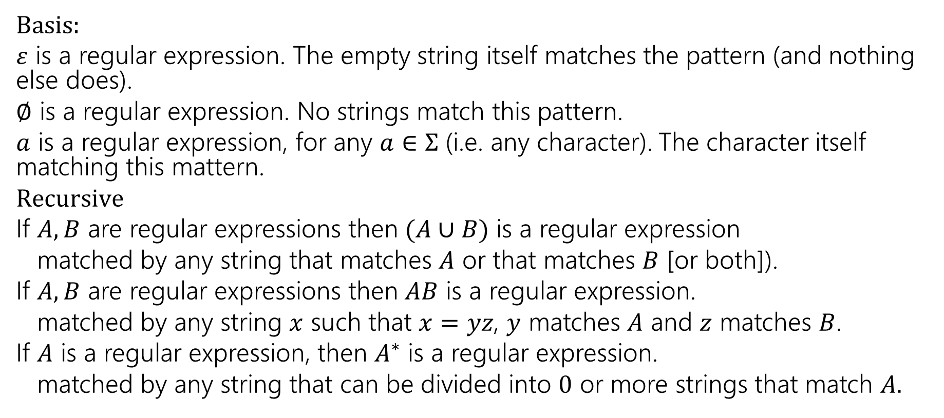
Regular Expressions
  Basis:
  $ε$ is a regular expression. The empty string itself matches the pattern (and nothing else does).
  $∅$ is a regular expression. No strings match this pattern.
  $a$ is a regular expression, for any $a∈Σ$ (i.e. any character). The character itself matching this mattern.
  $Recursive$
  If $A,B$ are regular expressions then $(A∪B)$ is a regular expression
  matched by any string that matches $A$ or that matches $B$ [or both]).
  If $A,B$ are regular expressions then $AB$ is a regular expression.
  matched by any string $x$ such that $x=yz$, $y$ matches $A$ and $z$ matches $B$.
  If $A$ is a regular expression, then $A^{∗}$ is a regular expression.
  matched by any string that can be divided into $0$ or more strings that match $A.$

Slide 45


Let $P(A)$ be “There is an NFA whose language is the same as the language for $A$.”
Base Cases:
$∅$
$ε$
$a$ ($a∈Σ)$

Slide 46
Let $P(A)$ be “There is an NFA whose language is the same as the language for $A$.”
Base Cases:
$∅$
$ε$
$a$ ($a∈Σ)$
a

Slide 47

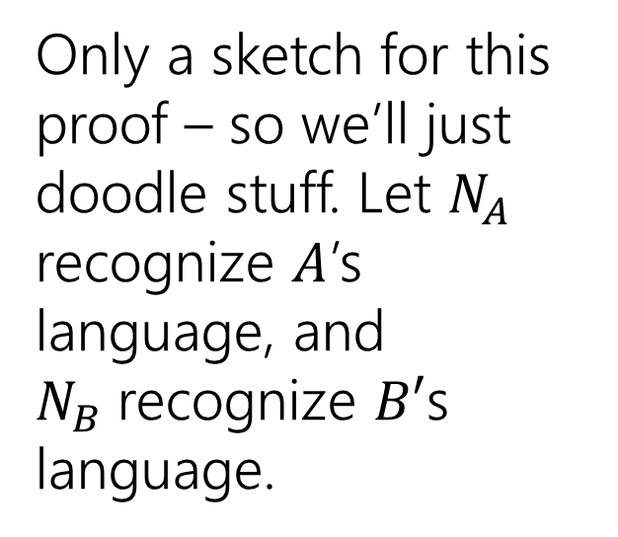
Let $P(A)$ be “There is an NFA whose language is the same as the language for $A$.”
Let $R$ be a regex not covered by the base cases. By the exclusion rule, $R=A∪B$ or $AB$ or $A^{∗}$ from some regexes $A,B$
Inductive Hypothesis: Suppose $P(A)$ and $P\left(B\right).$
Inductive Step: Case 1: $A∪B$
Only a sketch for this proof – so we’ll just doodle stuff. Let $N_{A}$ recognize $A$’s language, and $N_{B}$recognize $B′$s language.
N_{A}
N_{B}

Slide 48
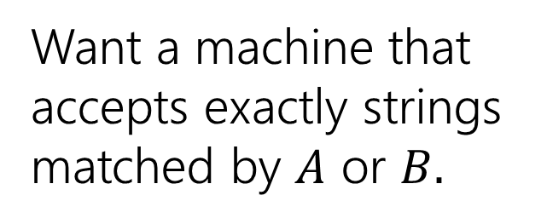
Let $P(A)$ be “There is an NFA whose language is the same as the language for $A$.”
Let $R$ be a regex not covered by the base cases. By the exclusion rule, $R=A∪B$ or $AB$ or $A^{∗}$ from some regexes $A,B$
Inductive Hypothesis: Suppose $P(A)$ and $P\left(B\right).$
Inductive Step: Case 1: $A∪B$
N_{A}
N_{B}
Want a machine that accepts exactly strings matched by $A$ or $B.$

Slide 49
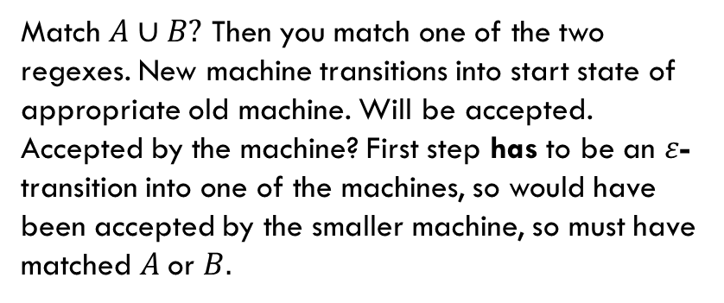
Let $P(A)$ be “There is an NFA whose language is the same as the language for $A$.”
Let $R$ be a regex not covered by the base cases. By the exclusion rule, $R=A∪B$ or $AB$ or $A^{∗}$ from some regexes $A,B$
Inductive Hypothesis: Suppose $P(A)$ and $P\left(B\right).$
Inductive Step: Case 1: $A∪B$
N_{A}
ɛ
Match $A∪B?$ Then you match one of the two regexes. New machine transitions into start state of appropriate old machine. Will be accepted.
Accepted by the machine? First step has to be an $ε$-transition into one of the machines, so would have been accepted by the smaller machine, so must have matched $A$or $B.$
ɛ
N_{B}
Want a machine that accepts exactly strings matched by $A$ or $B.$

Slide 50

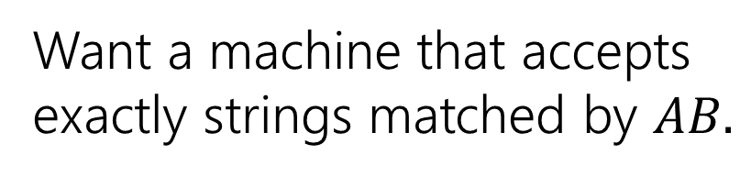
Let $P(A)$ be “There is an NFA whose language is the same as the language for $A$.”
Let $R$ be a regex not covered by the base cases. By the exclusion rule, $R=A∪B$ or $AB$ or $A^{∗}$ from some regexes $A,B$
Inductive Hypothesis: Suppose $P(A)$ and $P\left(B\right).$
Inductive Step: Case 2: $AB$
N_{A}
N_{B}
Want a machine that accepts exactly strings matched by $AB.$

Slide 51

Let $P(A)$ be “There is an NFA whose language is the same as the language for $A$.”
Let $R$ be a regex not covered by the base cases. By the exclusion rule, $R=A∪B$ or $AB$ or $A^{∗}$ from some regexes $A,B$
Inductive Hypothesis: Suppose $P(A)$ and $P\left(B\right).$
Inductive Step: Case 2: $AB$
String $x$ that matches $AB$ can divide into $yz$ where $y$ matches $A$, $z$ matches $B$.
NFA can run as $N_{A}$ would on $y$ take $ε$-transition, then run as $N_{B}$ would on $z$ so accepted by $N$
String $x$ that is accepted?
$N$ must run in $N_{A}$ take $ε$-transition, then run in $N_{B}$until acceptance. Substring read in $N_{A}$ must match $A.$ Substring read in $N_{B}$ must match $B$ (by IH) so string matches $AB.$
ɛ
ɛ
N_{A}
N_{B}
Want a machine that accepts exactly strings matched by $AB.$

Slide 52

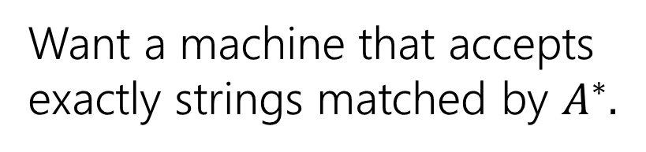
Let $P(A)$ be “There is an NFA whose language is the same as the language for $A$.”
Let $R$ be a regex not covered by the base cases. By the exclusion rule, $R=A∪B$ or $AB$ or $A^{∗}$ from some regexes $A,B$
Inductive Hypothesis: Suppose $P(A)$ and $P\left(B\right).$
Inductive Step: Case 3: $A^{∗}$
N_{A}
Want a machine that accepts exactly strings matched by $A^{∗}.$

Slide 53


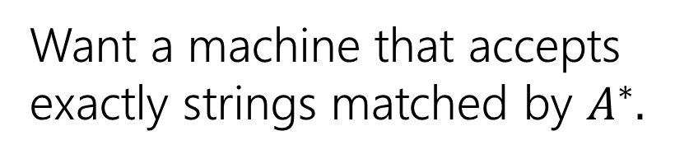
Let $P(A)$ be “There is an NFA whose language is the same as the language for $A$.”
Let $R$ be a regex not covered by the base cases. By the exclusion rule, $R=A∪B$ or $AB$ or $A^{∗}$ from some regexes $A,B$
Inductive Hypothesis: Suppose $P(A)$ and $P\left(B\right).$
Inductive Step: Case 3: $A^{∗}$
If $x$ matches $A^{∗}$, then by def of $∗$ $x=ε$ or $x=x_{1}…x_{k}$ with each $x_{i}$ matching $A$. If $x=ε,$ machine accepts by not transitioning. Otherwise run accepting computation in $N_{A}$ for each $x_{i}$ return to start until $x_{k}$ then end in accept state (all possible by IH)
If accepted by $N$,
Either $ε$ or go from start state of $N_{A}$ to final state and $ε$-transition back to start some number of times. So we can break string into parts accepted by $N_{A}$ by IH we can break string into substrings all matched by $A,$i.e. we match $A^{∗}$.
ɛ
ɛ
N_{A}
ɛ
Want a machine that accepts exactly strings matched by $A^{∗}.$

Slide 54

Let $P(A)$ be “There is an NFA whose language is the same as the language for $A$.”
By principle of structural induction, $P(A)$ holds for all regular expressions $A.$
Thus every regular expression has an equivalent NFA.
Every regex has an equivalent NFA

Slide 55
An example
(01 ∪1)*0
0
ɛ
1
ɛ
ɛ
ɛ
ɛ
0
ɛ
ɛ
ɛ
ɛ
1

Slide 56
Proof [sketch]
$L$ is the language of an NFA.
Regex -> equiv. NFA
Convert NFA to DFA
Every DFA is a NFA
$L$ is the language of a regular expression.
$L$ is the language of a DFA.

Slide 57
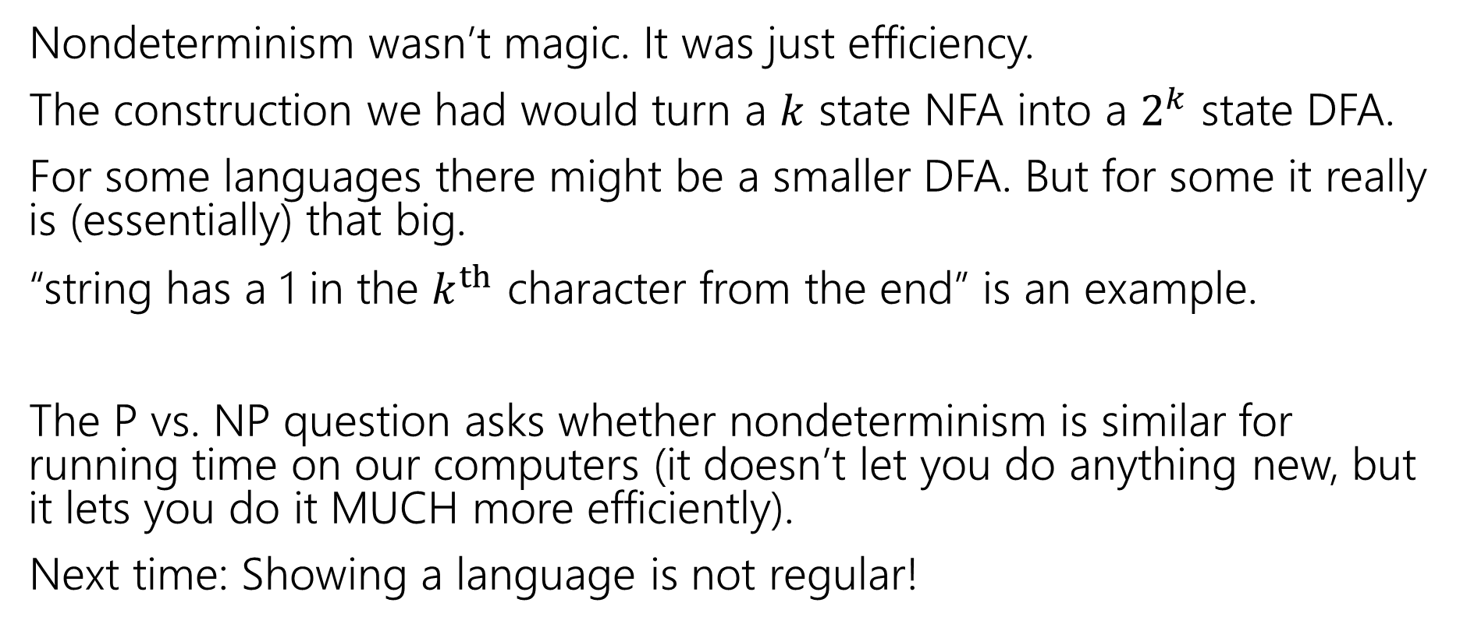
Takeaways
Nondeterminism wasn’t magic. It was just efficiency.
The construction we had would turn a $k$ state NFA into a $2^{k}$ state DFA.
For some languages there might be a smaller DFA. But for some it really is (essentially) that big.
“string has a 1 in the $k^{th}$ character from the end” is an example.
The P vs. NP question asks whether nondeterminism is similar for running time on our computers (it doesn’t let you do anything new, but it lets you do it MUCH more efficiently).
Next time: Showing a language is not regular!

Slide 58
Enrichment Content
(optional) sketch that for every NFA there is an equivalent regular expression.

Slide 59
Every NFA has an equivalent regular expression
Not responsible for this, but if you’re curious:

Slide 60
Generalized NFAs
Like NFAs but allow
  Parallel edges
  Regular Expressions as edge labels
    NFAs already have edges labeled ɛ or a
An edge labeled by A can be followed by reading a string of input chars that is in the language represented by A
Defn: A string x is accepted iff there is a path from start to final state labeled by a regular expression whose language contains x

Slide 61
Starting from an NFA
    Add new start state and final state
ɛ
ɛ
ɛ
    Then eliminate original states one by one, keeping the same language, until it looks like:
    Final regular expression will be A
A

Slide 62
Only two simplification rules
Rule 1: For any two states q₁ and q₂ with parallel edges (possibly q₁=q₂), replace
Rule 2: Eliminate non-start/final state q₃ by replacing all
for every pair of states q₁, q₂ (even if q₁=q₂)
A
A⋃B
q₁
q₂
by
q₁
q₂
B
B
q₁
A
q₃
C
q₂
by
AB*C
q₂
q₁

Slide 63
Converting an NFA to a regular expression
Consider the DFA for the mod 3 sum
  Accept strings from {0,1,2}* where the digits mod 3 sum of the digits is 0
0
t₁
1
1
2
2
0
0
t₀
2
t₂
1

Slide 64
Splicing out a state t₁
Regular expressions to add to edges
t₀→t₁→t₀ : 10*2
t₀→t₁→t₂ : 10*1
t₂→t₁→t₀ : 20*2
t₂→t₁→t₂ : 20*1
0
t₁
s
1
1
ɛ
2
2
0
0
t₀
2
t₂
1
ɛ
f

Slide 65
Splicing out a state t₁
Regular expressions to add to edges
t₀→t₁→t₀ : 10*2
t₀→t₁→t₂ : 10*1
t₂→t₁→t₀ : 20*2
t₂→t₁→t₂ : 20*1
s
ɛ
0 ∪ 20*1
t₀
2 ∪ 10*1
t₂
0 ∪ 10*2
1 ∪ 20*2
ɛ
f

Slide 66
Splicing out state t₂ (and then t₀)
s
R₁: 0 ∪ 10*2
R₂: 2 ∪ 10*1
R₃: 1 ∪ 20*2
R₄: 0 ∪ 20*1
R₅: R₁ ∪ R₂R₄*R₃
ɛ
R₂
R₄
R₁
t₀
t₂
R₃
ɛ
f
s
ɛ
R₅
ɛ
t₀
f
Final regular expression: R₅*=
(0 ∪ 10*2 ∪ (2 ∪ 10*1)(0 ∪ 20*1)*(1 ∪ 20*2))*

Slide 67

Proof [sketch]
$L$ is the language of an NFA.
GNFA simplified to regex
Regex -> equiv. NFA
Convert NFA to DFA
Every DFA is a NFA
$L$ is the language of a regular expression.
$L$ is the language of a DFA.

Slide 68
Todo
Tonight:
CC 20 is out and due Wednesday at noon
Get started on HW7 if you haven’t already

