Slide 1
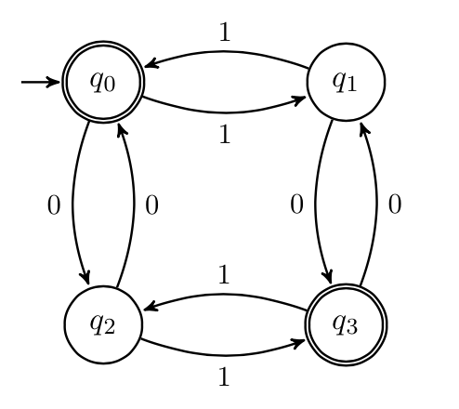
Finite State Machines
CSE 311 Summer 2025
Lecture 19

Slide 2

Announcements
HW6 is due tonight!
- The late due date is still Saturday, 8/9, so you can use at most
one late day for HW6
HW7 will be released today and will be due next Friday, 8/15
The midterm retake exam schedule will be posted on the Ed board later today
- You must take the midterm retake exam during your scheduled time

Slide 3
Review

Slide 4
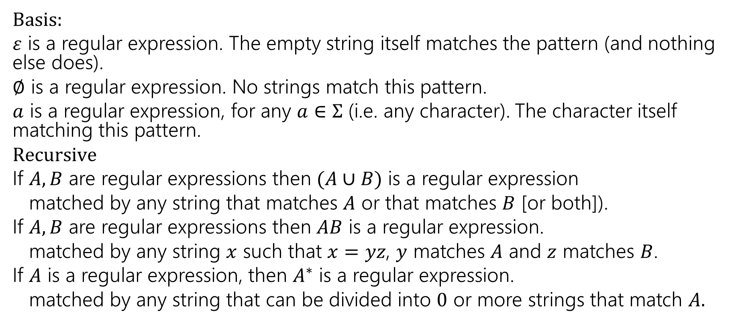
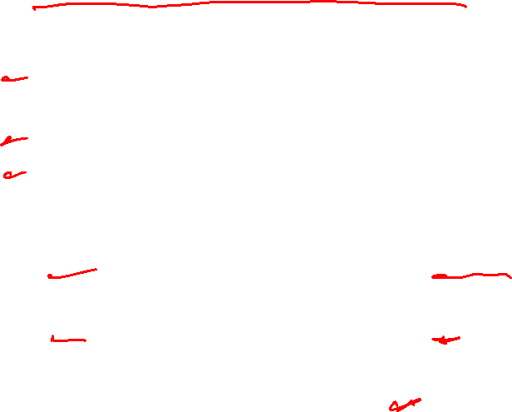
Regular Expressions
  Basis:
  $ε$ is a regular expression. The empty string itself matches the pattern (and nothing else does).
  $∅$ is a regular expression. No strings match this pattern.
  $a$ is a regular expression, for any $a∈Σ$ (i.e. any character). The character itself matching this pattern.
  $Recursive$
  If $A,B$ are regular expressions then $(A∪B)$ is a regular expression
  matched by any string that matches $A$ or that matches $B$ [or both]).
  If $A,B$ are regular expressions then $AB$ is a regular expression.
  matched by any string $x$ such that $x=yz$, $y$ matches $A$ and $z$ matches $B$.
  If $A$ is a regular expression, then $A^{∗}$ is a regular expression.
  matched by any string that can be divided into $0$ or more strings that match $A.$

Slide 5
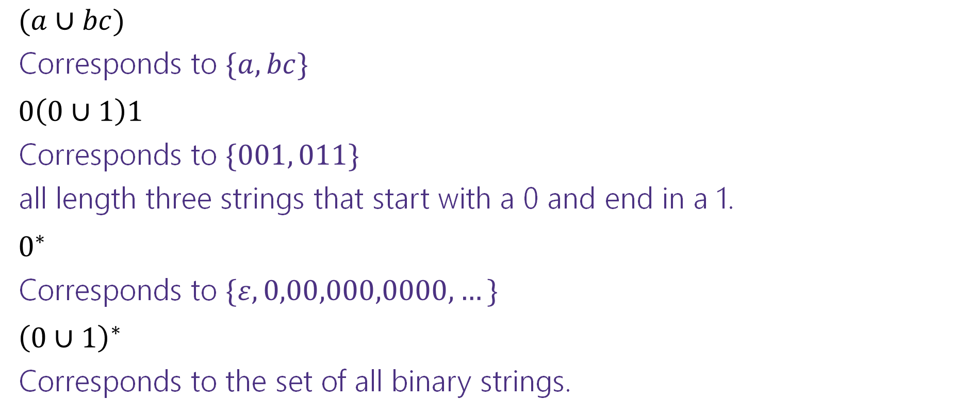
Regular Expressions
$(a∪bc)$
Corresponds to $\{a,bc\}$
$0\left(0∪1\right)1$
Corresponds to $\{001, 011\}$
all length three strings that start with a 0 and end in a 1.
$0^{∗}$
Corresponds to $\{ε,0,00,000,0000,…\}$
${\left(0∪1\right)}^{∗}$
Corresponds to the set of all binary strings.

Slide 6
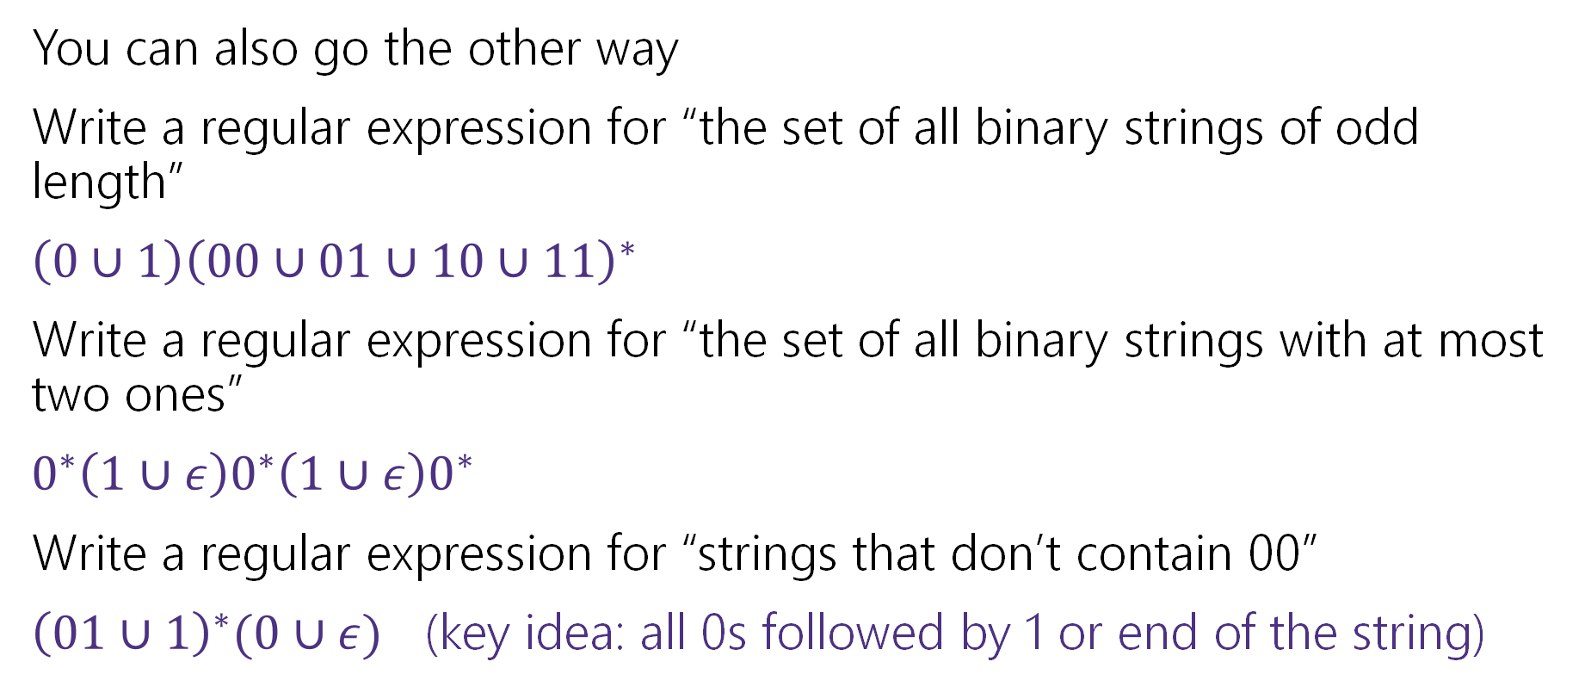
More Practice
You can also go the other way
Write a regular expression for “the set of all binary strings of odd length”
$\left(0∪1\right){\left(00∪01∪10∪11\right)}^{∗}$
Write a regular expression for “the set of all binary strings with at most two ones”
$0^{∗}\left(1∪ε\right)0^{∗}\left(1∪ε\right)0^{∗}$
Write a regular expression for “strings that don’t contain 00”
${\left(01∪1\right)}^{∗}(0∪ε)$ (key idea: all 0s followed by 1 or end of the string)

Slide 7
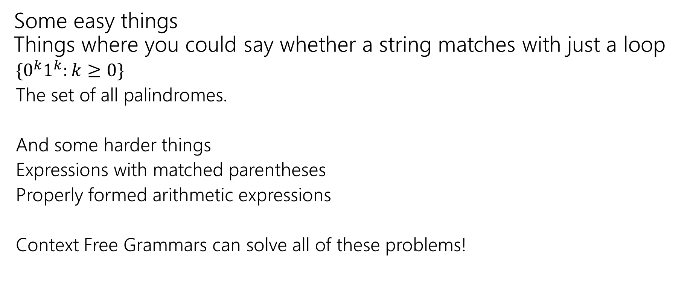
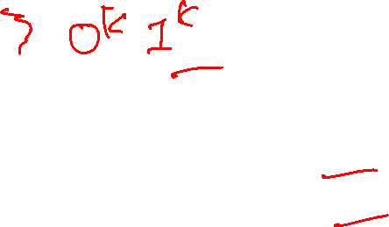
What Can’t Regular Expressions Do?
Some easy things
Things where you could say whether a string matches with just a loop
  $\{0^{k}1^{k}:k≥0\}$
  The set of all palindromes.
  And some harder things
  Expressions with matched parentheses
  Properly formed arithmetic expressions
  Context Free Grammars can solve all of these problems!

Slide 8
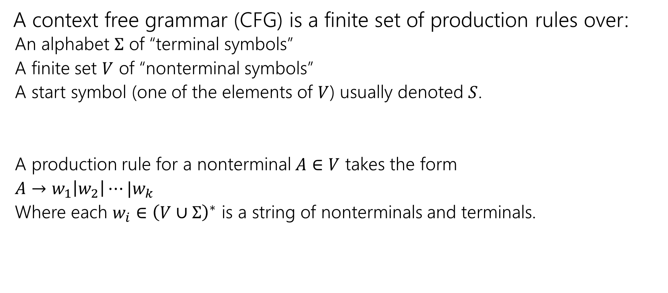

Context Free Grammars
A context free grammar (CFG) is a finite set of production rules over:
  An alphabet $Σ$ of “terminal symbols”
  A finite set $V$ of “nonterminal symbols”
  A start symbol (one of the elements of $V$) usually denoted $S$.
  A production rule for a nonterminal $A∈V$ takes the form
  $A→w_{1}\left|w_{2}\right|⋯|w_{k}$
  Where each $w_{i}∈{\left(V∪Σ\right)}^{∗}$ is a string of nonterminals and terminals.

Slide 9
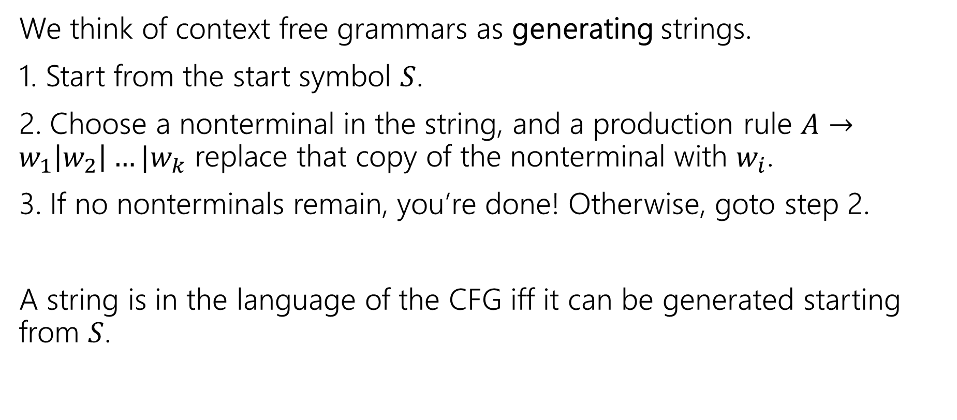

Context Free Grammars
We think of context free grammars as generating strings.
1. Start from the start symbol $S$.
2. Choose a nonterminal in the string, and a production rule $A→w_{1}\left|w_{2}\right|…|w_{k}$ replace that copy of the nonterminal with $w_{i}$.
3. If no nonterminals remain, you’re done! Otherwise, goto step 2.
A string is in the language of the CFG iff it can be generated starting from $S$.

Slide 10
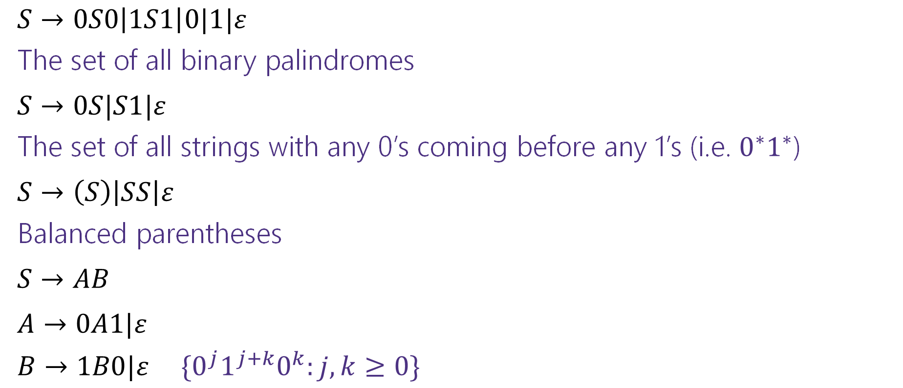
Examples
$S→0S0\left|1S1\right|0|1|ε$
The set of all binary palindromes
$S→0S|S1|ε$
The set of all strings with any 0’s coming before any 1’s (i.e. $0^{∗}1^{∗}$)
$S→\left(S\right)\left|SS\right|ε$
Balanced parentheses
$S→AB$
$A→0A1|ε$
$B→1B0|ε$ $\{0^{j}1^{j+k}0^{k}:j,k≥0\}$

Slide 11
Warm Up: REs and CFGs

Slide 12
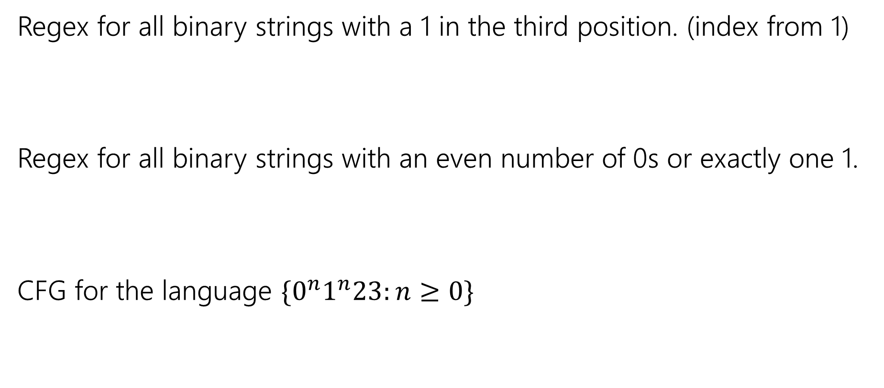
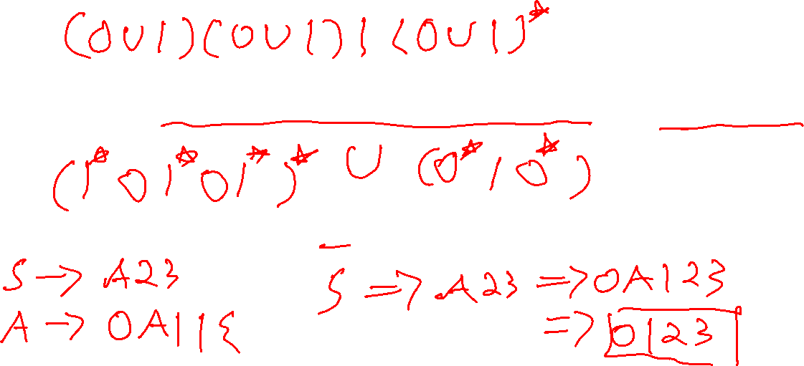
More Practice
Regex for all binary strings with a 1 in the third position. (index from 1)
Regex for all binary strings with an even number of 0s or exactly one 1.
CFG for the language $\{0^{n}1^{n}23:n≥0\}$

Slide 13
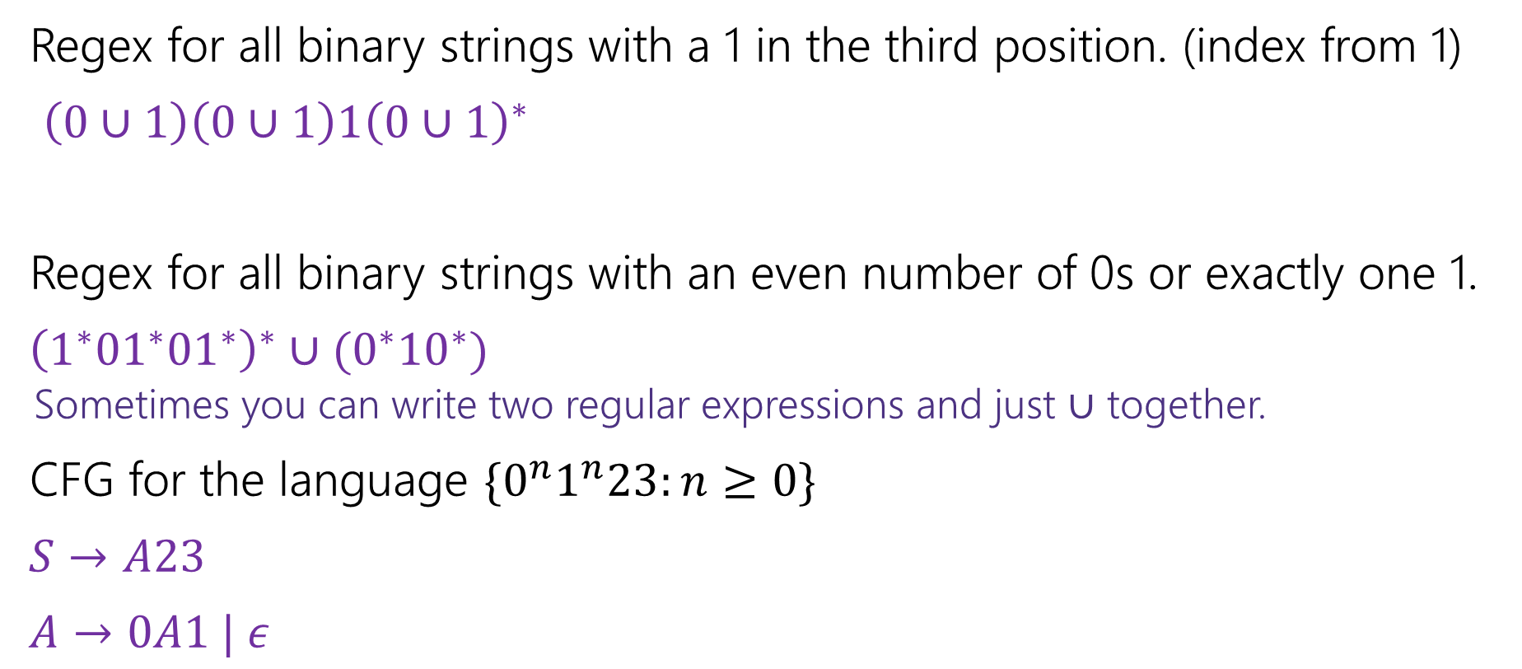
More Practice
Regex for all binary strings with a 1 in the third position. (index from 1)
$\left(0∪1\right)\left(0∪1\right)1{\left(0∪1\right)}^{∗}$
Regex for all binary strings with an even number of 0s or exactly one 1.
${\left(1^{∗}{01}^{∗}{01}^{∗}\right)}^{∗}∪(0^{∗}{10}^{∗})$
  Sometimes you can write two regular expressions and just $∪$ together.
CFG for the language $\{0^{n}1^{n}23:n≥0\}$
$S→A23$
$A→0A1 | ε$

Slide 14
Deterministic Finite Automata

Slide 15
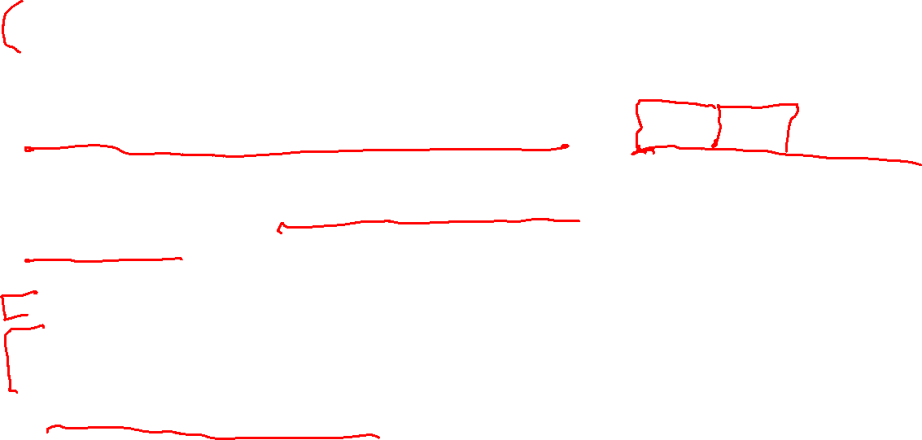
Last Two Weeks
What computers can and can’t do…
  Given any finite amount of time.
We’ll start with a simple model of a computer – finite state machines.
What do we want computers to do? Let’s start very simple.
We’ll give them an input (in a string format), and we want them to say “yes” or “no” for that string on a certain question.
Example questions one might want to answer.
  Does this input java code compile to a valid program?
  Does this input string match a particular regular expression?
  Is this input list sorted?
  Depending on the “computer” some questions might be out of reach.

Slide 16
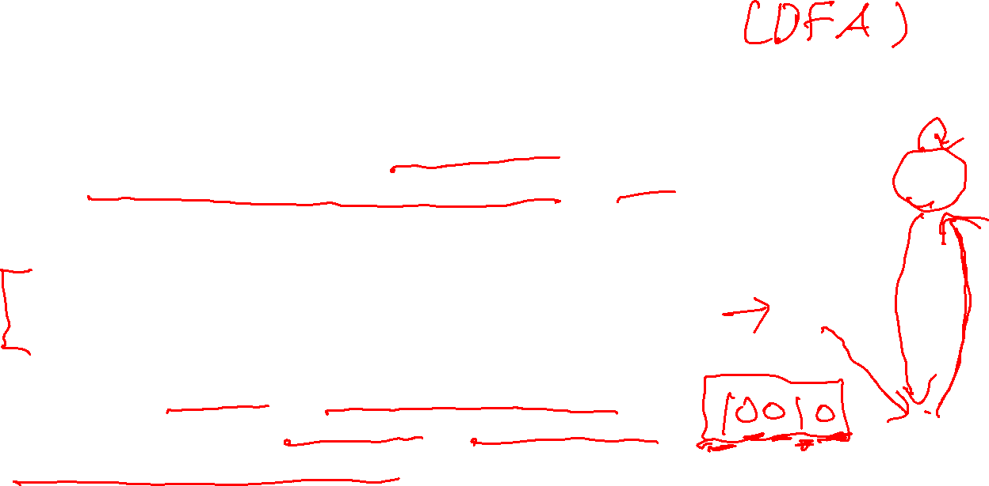
Deterministic Finite Automaton
Our machine is going to get a string as input.
It will read one character at a time and update “its state.”
At every step, the machine thinks of itself as in one of the (finite number) vertices.
When it reads the character it follows the arrow labeled with that character to its next state.
Start at the “start state” (unlabeled, incoming arrow).
After you’ve read the last character, accept the string if and only if you’re in a “final state” (double circle).

Slide 17

Let’s see an example
Input string:
011
1010

Slide 18
Let’s see an example
Input string:
011
1010

Slide 19
Let’s see an example
Input string:
011
1010

Slide 20
Let’s see an example
Input string:
011
1010

Slide 21
Let’s see an example
Input string:
011
1010

Slide 22

Let’s see an example
Input string:
011
1010

Slide 23
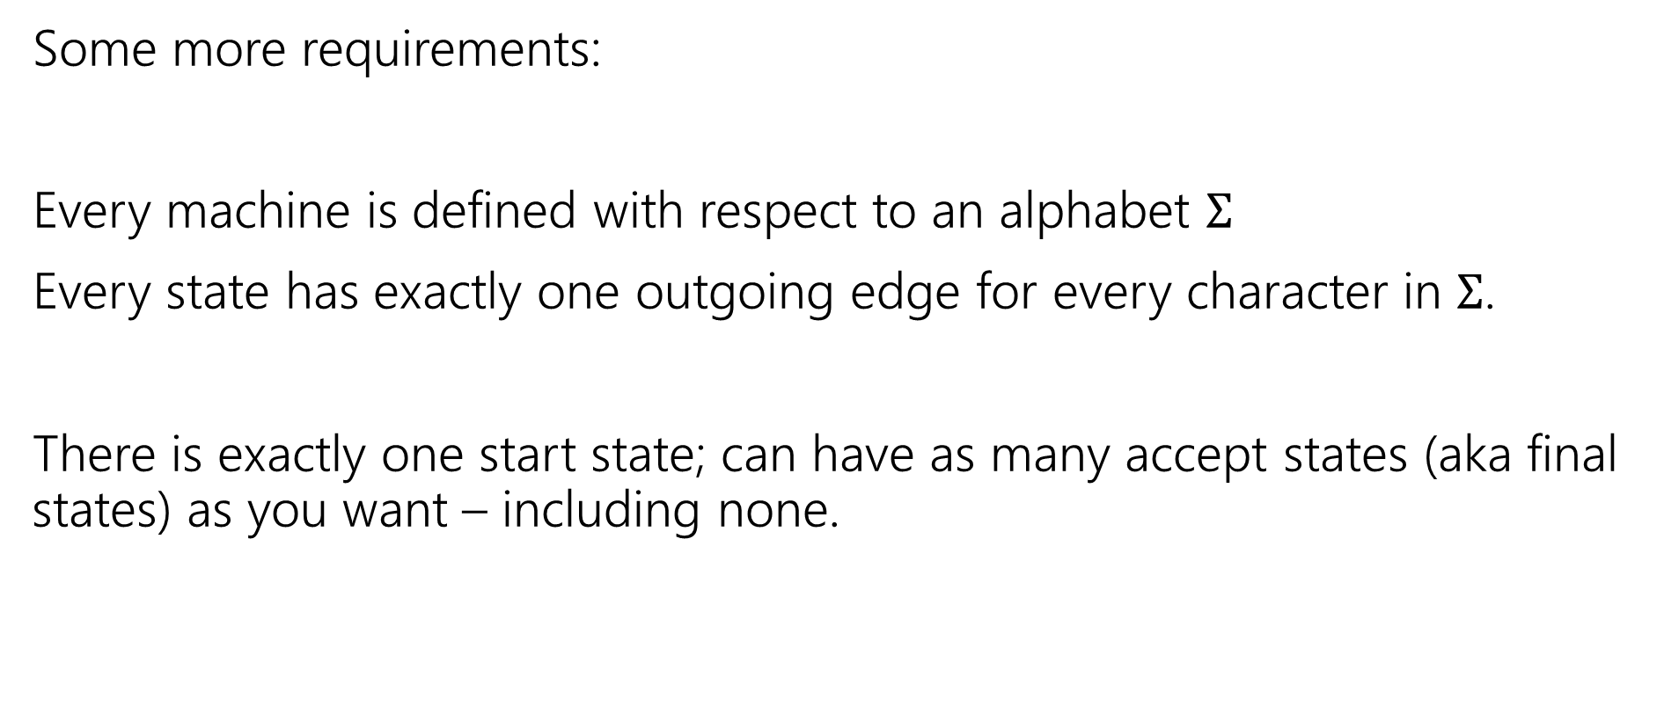
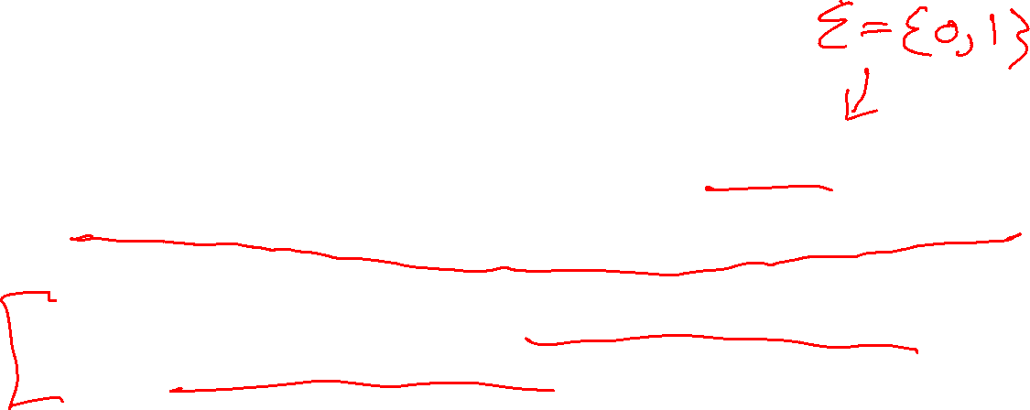
Deterministic Finite Automata
Some more requirements:
Every machine is defined with respect to an alphabet $Σ$
Every state has exactly one outgoing edge for every character in $Σ$.
There is exactly one start state; can have as many accept states (aka final states) as you want – including none.

Slide 24

Deterministic Finite Automata
Can also represent transitions with a table.
Old State | 0 | 1
s₀ | s₀ | s₁
s₁ | s₀ | s₂
s₂ | s₀ | s₃
s₃ | s₃ | s₃
0
0
1
1
1
s₀
s₁
s₂
s₃
0
0,1

Slide 25
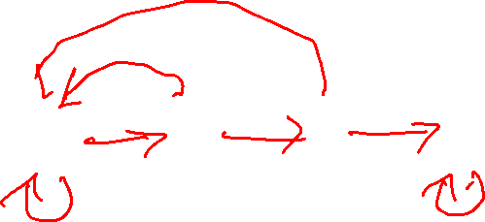
Deterministic Finite Automata
What is the language of this DFA?
I.e. the set of all strings it accepts?
Old State | 0 | 1
s₀ | s₀ | s₁
s₁ | s₀ | s₂
s₂ | s₀ | s₃
s₃ | s₃ | s₃
0
0
1
1
1
s₀
s₁
s₂
s₃
0
0,1

Slide 26


Deterministic Finite Automata
If the string has $111$, then you’ll end up in $s_{3}$ and never leave.
If you end with a $0$ you’re back in $s_{0}$ which also accepts.
And…$ε$ is also accepted
$\left[{\left(0∪1\right)}^{∗}111{\left(0∪1\right)}^{∗}\right]∪{\left[{\left(0∪1\right)}^{∗}0\right]}^{∗}$
Old State | 0 | 1
s₀ | s₀ | s₁
s₁ | s₀ | s₂
s₂ | s₀ | s₃
s₃ | s₃ | s₃
0
0
1
1
1
s₀
s₁
s₂
s₃
0
0,1

Slide 27
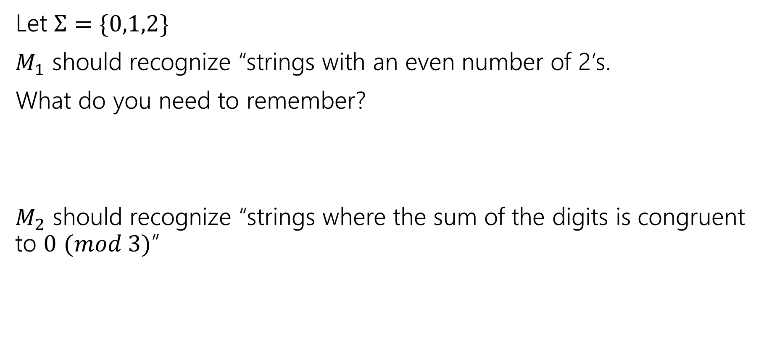
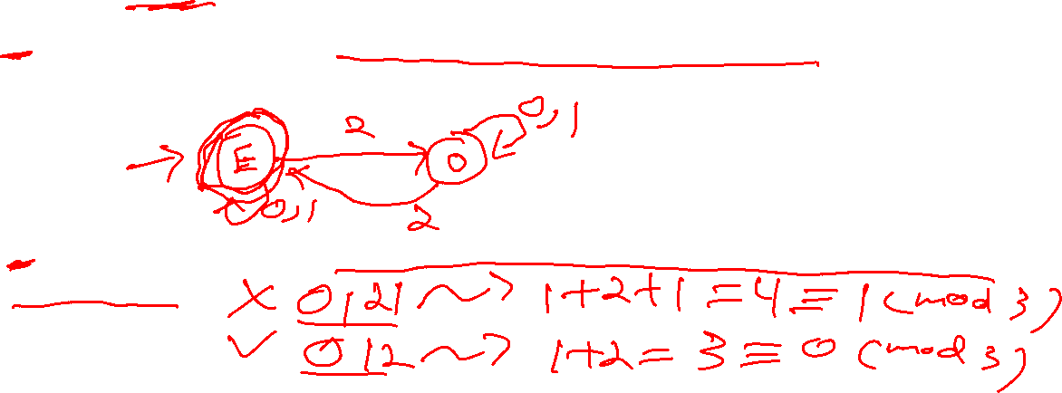
Design some DFAs
Let $Σ=\{0,1,2\}$
$M_{1}$ should recognize “strings with an even number of 2’s.
What do you need to remember?
$M_{2}$ should recognize “strings where the sum of the digits is congruent to $0$ $(mod 3)$”

Slide 28

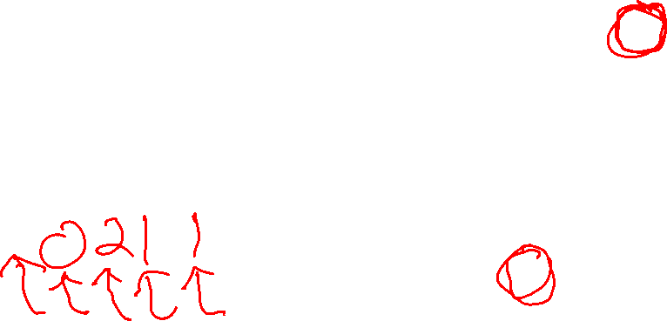



Design some DFAs
Let $Σ=\{0,1,2\}$
$M_{1}$ should recognize “strings with an even number of 2’s.
$M_{2}$ should recognize “strings where the sum of the digits is congruent to $0$ $(mod 3)"$
2
s₁
s₀
2
0,1
0,1
0
1
$$t_{2}$$
1
2
2
$$t_{1}$$
2
$$t_{0}$$
0
1
0

Slide 29
Designing DFAs notes
DFAs can’t “count arbitrarily high”
For example, we could not make a DFA that remembers the overall sum of all the digits (not taken % 3)
That would have infinitely many states! We’re only allowed a finite number.

Slide 30
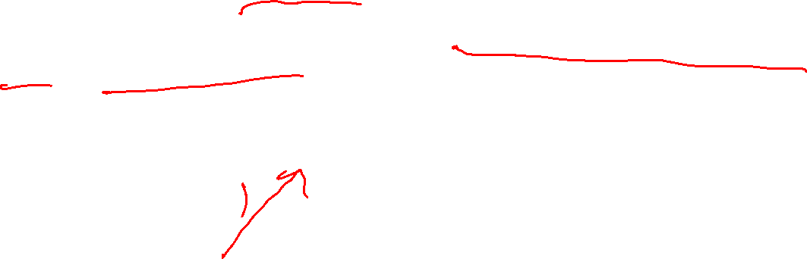
Strings over {0,1,2} w/ even number of 2’s and sum%3=0
s₀t₁
s₁t₂
s₀t₀
s₁t₀
s₀t₂
s₁t₁

Slide 31
Strings over {0,1,2} w/ even number of 2’s and sum%3=0
0
0
s₀t₁
2
s₁t₂
2
1
1
1
0
0
s₀t₀
2
s₁t₀
2
1
1
1
2
s₀t₂
s₁t₁
0
2
0

Slide 32
Strings over {0,1,2} w/ even number of 2’s and sum%3=0
s₀t₀
s₁t₀
s₀t₁
s₁t₁
s₀t₂
s₁t₂

Slide 33
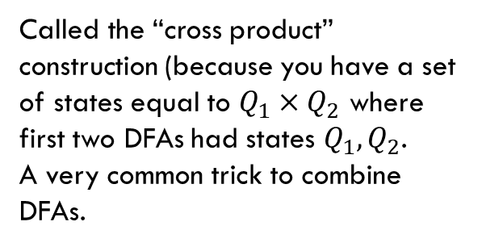
Strings over {0,1,2} w/ even number of 2’s and sum%3=0
Changed notation – final states with bold outlines.
0
0
s₀t₀
s₁t₀
2
2
1
1
0
0
s₀t₁
2
2
s₁t₁
1
1
1
1
Called the “cross product” construction (because you have a set of states equal to $Q_{1}×Q_{2}$ where first two DFAs had states $Q_{1},Q_{2}$.
A very common trick to combine DFAs.
2
2
s₀t₂
s₁t₂
0
0

Slide 34
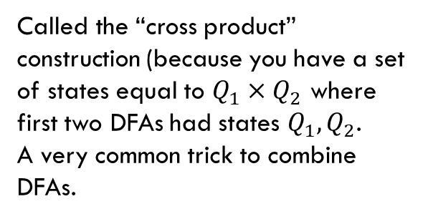

Strings over {0,1,2} w/ even number of 2’s and sum%3=0
Changed notation – final states with bold outlines.
0
0
s₀t₀
s₁t₀
2
2
1
1
0
0
s₀t₁
2
2
s₁t₁
1
1
1
1
Called the “cross product” construction (because you have a set of states equal to $Q_{1}×Q_{2}$ where first two DFAs had states $Q_{1},Q_{2}$.
A very common trick to combine DFAs.
2
2
s₀t₂
s₁t₂
0
0
“even # 2’s”
“odd # 2’s”

Slide 35

Strings over {0,1,2} w/ even number of 2’s and sum%3=0
Changed notation – final states with bold outlines.
0
0
s₀t₀
s₁t₀
2
2
“sum%3 = 0”
1
1
0
0
s₀t₁
2
2
s₁t₁
1
1
“sum%3 = 1”
1
1
Called the “cross product” construction (because you have a set of states equal to $Q_{1}×Q_{2}$ where first two DFAs had states $Q_{1},Q_{2}$.
A very common trick to combine DFAs.
2
2
s₀t₂
s₁t₂
0
0
“sum%3 = 2”

Slide 36
Strings over {0,1,2} w/ even number of 2’s OR sum%3=0
0
0
s₀t₀
s₁t₀
Want to change the and to or – don’t need to change states or transitions…
2
2
1
1
0
0
s₀t₁
2
2
s₁t₁
1
1
1
1
2
2
s₀t₂
s₁t₂
0
0

Slide 37

Strings over {0,1,2} w/ even number of 2’s OR sum%3=0
0
0
s₀t₀
s₁t₀
Want to change the and to or – don’t need to change states or transitions…
Just which accept.
2
2
1
1
0
0
s₀t₁
2
2
s₁t₁
1
1
1
1
2
2
s₀t₂
s₁t₂
0
0

Slide 38
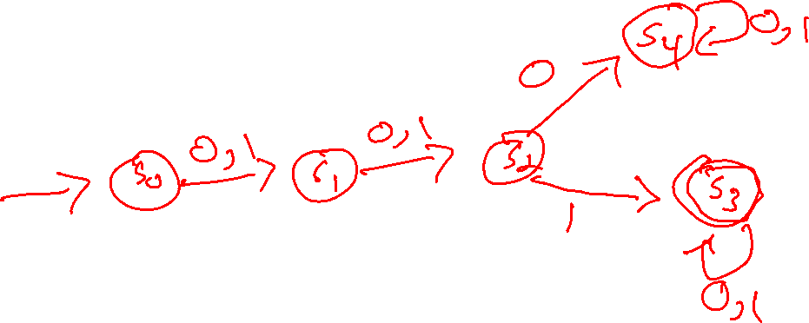
The set of binary strings with a 1 in the 3rd position from the start

Slide 39
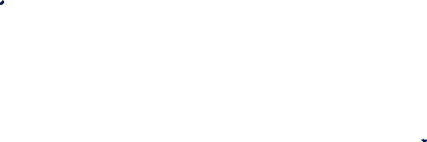
The set of binary strings with a 1 in the 3rd position from the start
R
0,1
0
s₀
0,1
s₁
0,1
s₂
1
A
0,1

Slide 40
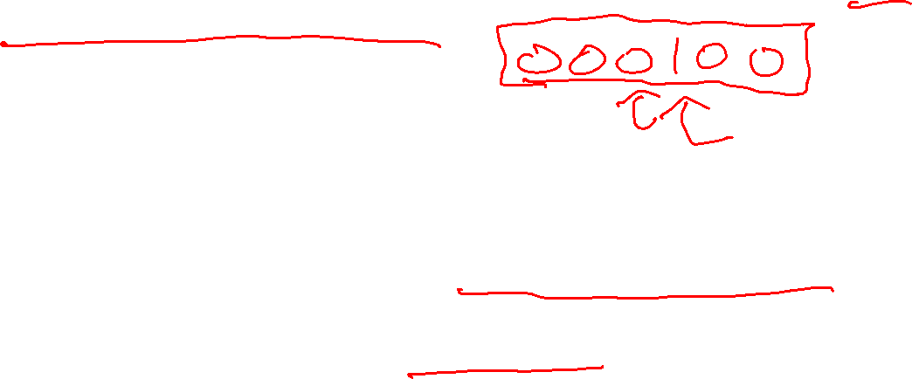
The set of binary strings with a 1 in the 3rd position from the end
What do we need to remember?
We can’t know what string was third from the end until we have read the last character.
So we’ll need to keep track of “the character that was 3 ago” in case this was the end of the string.
But if it’s not…we’ll need the character 2 ago, to update what the character 3 ago becomes. Same with the last character.

Slide 41
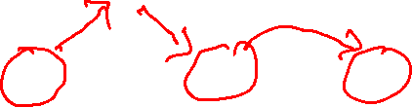
3 bit shift register
1
0
“Remember the last three bits”
001
011
1
0
1
1
1
1
0
0
000
010
101
111
1
0
0
1
0
0
100
110

Slide 42

The set of binary strings with a 1 in the 3rd position from the end
1
0
0
1
0
1
0
1
0
1
00
01
10
11
1
1
1
1
0
0
0
0
001
011
1
0
1
1
1
1
0
0
000
010
101
111
1
0
0
1
0
0
100
110

Slide 43
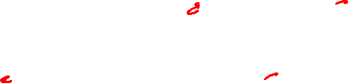
The set of binary strings with a 1 in the 3rd position from the end
1
0
001
011
1
0
1
1
1
1
0
0
000
010
101
111
1
0
0
1
0
0
100
110

Slide 44
The beginning versus the end
R
0
0,1
s₀
0,1
s₁
0,1
s₂
1
A
0,1
001
1
011
1
0
1
1
1
0
000
1
010
101
0
111
1
0
0
0
1
0
100
0
110

Slide 45
From the beginning was “easier” than “from the end”
At least in the sense that we needed fewer states.
That might be surprising since a java program wouldn’t be much different for those two.
Not being able to access the full input at once limits your abilities somewhat and makes some jobs harder than others.

Slide 46
What language does this machine recognize?
1
s₀
s₁
1
0
0
0
0
1
s₂
s₃
1

Slide 47
What language does this machine recognize?
1
s₀
s₁
1
0
0
0
0
1
s₂
s₃
1
#1s even
#1s odd

Slide 48

What language does this machine recognize?
1
s₀
s₁
#0s even
1
0
0
0
0
1
s₂
s₃
#0s odd
1

Slide 49
What language does this machine recognize?
1
s₀
s₁
1
0
0
#0s is congruent to #1s (mod 2)
Wait…there’s an easier way to describe that….
0
0
1
s₂
s₃
1

Slide 50

What language does this machine recognize?
1
s₀
s₁
That’s all binary strings of even length.
1
0
0
0,1
0
0
s₀
s₁
1
0,1
s₂
s₃
1

Slide 51
Takeaways
The first DFA might not be the simplest.
Try to think of other descriptions – you might realize you can keep track of fewer things than you thought.
Boy…it’d be nice if we could know that we have the smallest possible DFA for a given language…

Slide 52
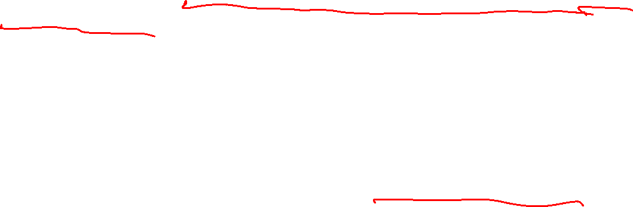
DFA Minimization
We can know!
Fun fact: there is a unique minimum DFA for every language (up to renaming the states)
High level idea – final states and non-final states must be different.
Otherwise, hope that states can be the same, and iteratively separate when they have to go to different spots.
In some quarters, we cover it in detail. But…we ran out of time.

Slide 53
Next Time
What if we give the DFAs a little more power…try to get them to do more things.

Slide 54
Optional Content: Machines with output

Slide 55
What are FSMs used for?
“Classic” hardware applications:
Anything where you only need to remember a very small amount of information, and have very simple update rules.
Vending machines
Elevators: need to know whether you’re going up or down, where people want to go, where people are waiting, and whether you’re going up or down. Simple rules to transition.
These days…general hardware is cheap, less likely to use custom hardware. BUT the programmer was probably still thinking about FSMs when writing the code.

Slide 56
What are FSMs used for?
Theoretically – still lots of applications.
grep uses FSMs to analyze regular expressions (more on this later).
Useful for modeling situations where you have minimal memory.
Good model for simple AI (say simple NPCs in games).
Technically all of our computers are finite state machines…
  But they’re not usually how we think about them…more on this next week.

Slide 57
Adding Output to Finite State Machines
So far we have considered finite state machines that just accept/reject strings
  called “Deterministic Finite Automata” or DFAs
One can also consider finite state machines that with output
  These are often used as controllers

Slide 58
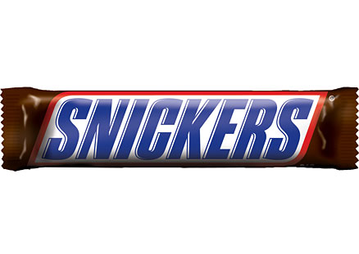

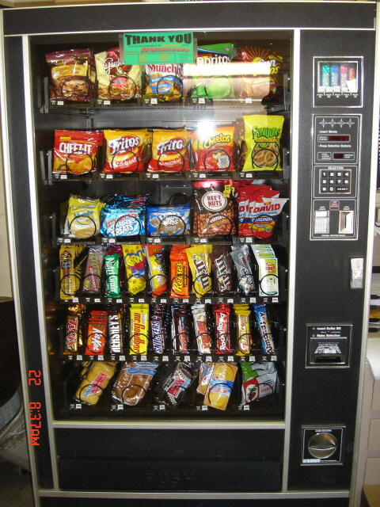
Vending Machine
Enter 15 cents in dimes or nickels
Press S or B for a candy bar

Slide 59
Vending Machine v0.1

Slide 60
Vending Machine, v0.1
D
D
0
N
5
N
10
N, D
15
B, S
Basic transitions on N (nickel), D (dime), B (butterfinger), S (snickers)

Slide 61
Vending Machine v0.2
D
D
0
N
5
N
10
N, D
15
B, S

Slide 62
Vending Machine, v0.2
0
D
N
15
D
D
B
0’ [B]
5
N
S
N
N
10
D
15’ [N]
B
S
N
0” [S]
D
Adding output to states: N – Nickel, S – Snickers, B – Butterfinger

Slide 63
Vending Machine, v1.0
B,S
0
D
N
15
B,S
D
B,S
B
D
B,S
D
N
S
N
0’ [B]
N
5
10
N
D
15’ [N]
B
N
S
D
B,S
N
N
0” [S]
D
B
15” [D]
S
D
Adding additional “unexpected” transitions to cover all symbols for each state

Slide 64
Todo
Tonight:
CC 19 is out and due Monday at noon
HW6 is due tonight!
Take a look at HW7 over the weekend and make sure you can access GRIN
Keep an eye out for the midterm retake schedule that will be posted on the Ed board

