Slide 1
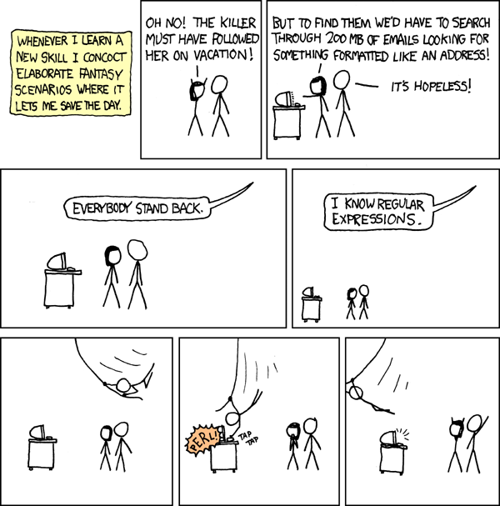
Regular Expressions
CSE 311 Summer 2025
Lecture 18

Slide 2
Announcements
The HW6 due date was pushed back to this Friday, 8/8
- The late due date is still Saturday, 8/9, so you can use at most
one late day for HW6
HW7 will be released on Friday and will be due next Friday, 8/15
HW3, HW4, and midterm solutions are at the front of the class
Fill out the midterm retake scheduling form that’s posted on Ed by this Thursday (8/7) EOD. You will not be able to take the midterm retake exam if you don’t fill out the form.

Slide 3
Review

Slide 4
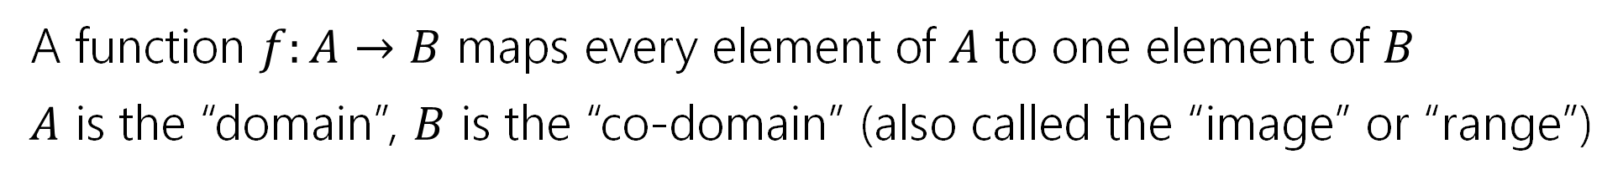
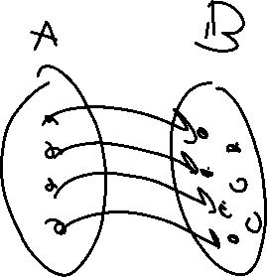
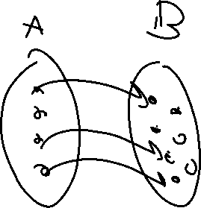
Functions!
A function $f:A→B$ maps every element of $A$ to one element of $B$
$A$ is the “domain”, $B$ is the “co-domain” (also called the “image” or “range”)
Good function
Not a function

Slide 5


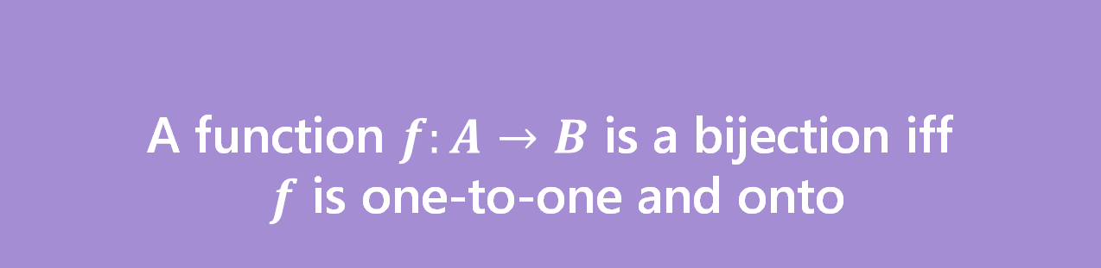
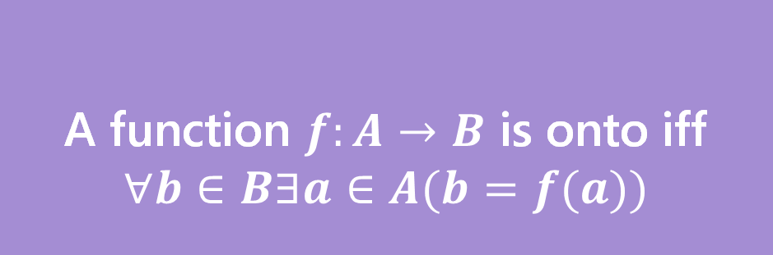
Bijection
A function $f$ is one-to-one iff
$$∀a∀b(f\left(a\right)=f\left(b\right)→a=b)$$
A function $f:A→B$ is onto iff
$$∀b∈B∃a∈A(b=f(a))$$
One-to-one (aka injection)
Onto (aka surjection)
A function $f:A→B$ is a bijection iff
$f$ is one-to-one and onto
Bijection
A bijection maps every element of the domain to exactly one element of the co-domain, and every element of the codomain to exactly one element of the domain.

Slide 6
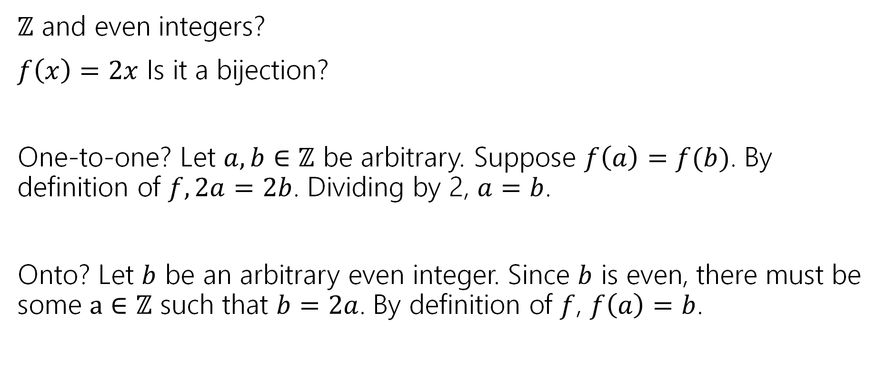

They’re all the same size.
$ℤ$ and even integers?
$f\left(x\right)=2x$ Is it a bijection?
One-to-one? Let $a,b∈ℤ$ be arbitrary. Suppose $f\left(a\right)=f(b)$. By definition of $f, 2a=2b$. Dividing by 2, $a=b$.
Onto? Let $b$ be an arbitrary even integer. Since $b$ is even, there must be some $a∈ℤ$ such that $b=2a$. By definition of $f$, $f\left(a\right)=b$.

Slide 7
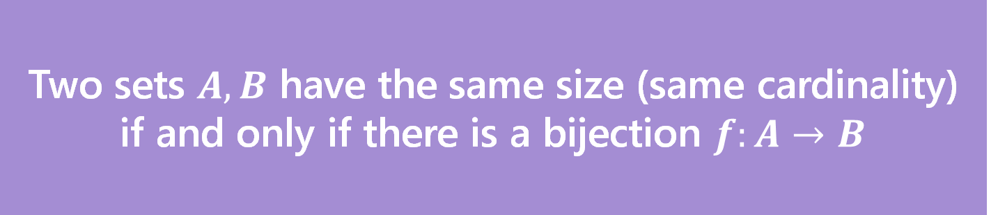
Definition
Two sets $A,B$ have the same size (same cardinality) if and only if there is a bijection $f:A→B$
This matches our intuition on finite sets.
But it also works for infinite sets!
Let’s see just how infinite these sets are.

Slide 8
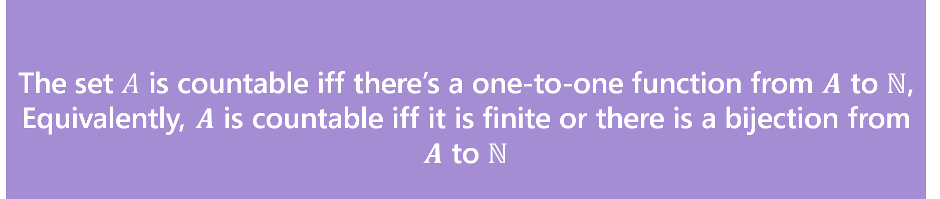
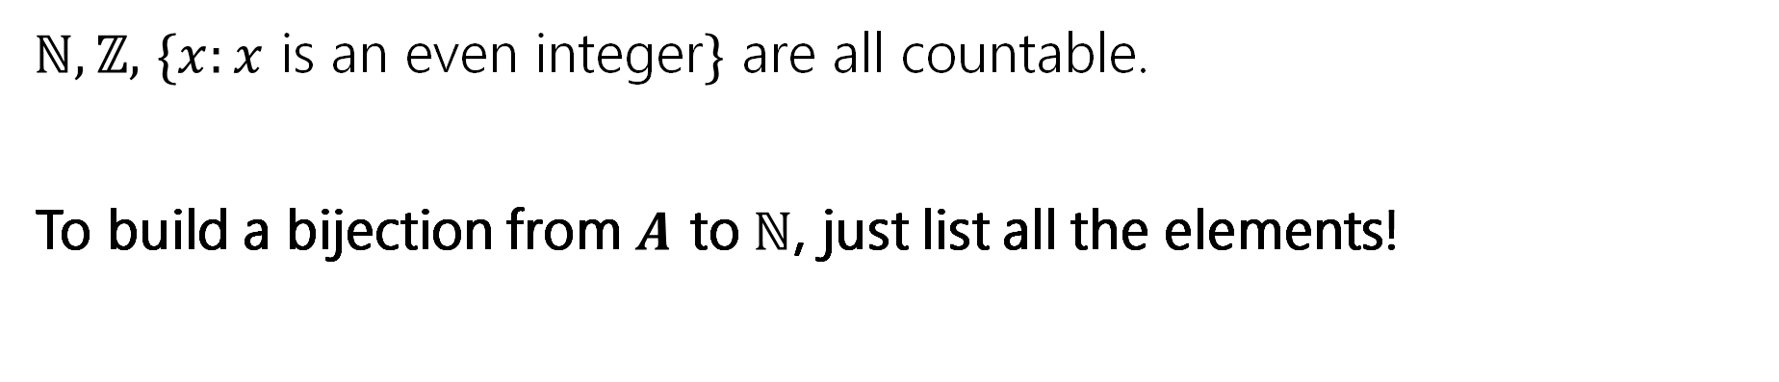
Countable
The set $A$ is countable iff there’s a one-to-one function from $A$ to $ℕ$,
Equivalently, $A$ is countable iff it is finite or there is a bijection from $A$ to $ℕ$
Countable
$ℕ,ℤ,$ $\{x:x$ is an even integer$\}$ are all countable.
To build a bijection from $A$ to $ℕ$, just list all the elements!

Slide 9

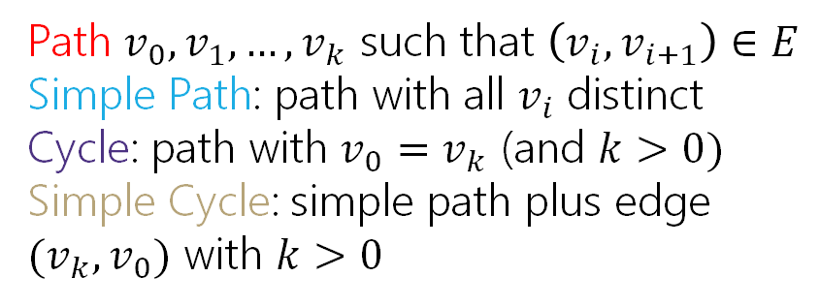
Directed Graphs
$G=(V,E)$
$V$is a set of vertices (an underlying set of elements)
$E$ is a set of edges (ordered pairs of vertices; i.e. connections from one to the next).
Path $v_{0},v_{1},…,v_{k}$ such that $\left(v_{i},v_{i+1}\right)∈E$
Simple Path: path with all $v_{i}$ distinct
Cycle: path with $v_{0}=v_{k}$ (and $k>0)$
Simple Cycle: simple path plus edge ${(v}_{k},v_{0})$ with $k>0$

Slide 10
Part 3 of the course!

Slide 11

Course Outline
Symbolic Logic (training wheels)
Just make arguments in mechanical ways.
Proof Strategies/Set Theory/Number Theory (bike in your backyard)
Models of computation (biking in your neighborhood)
Still make and communicate rigorous arguments
But now with objects you haven’t used before.
A first taste of how we can argue rigorously about computers.
First: regular expressions and context free grammars – understand these “simpler computers”
Soon: what these simple computers can do Then: what simple computers can’t do.
Last week: A problem our computers cannot solve.

Slide 12

The next two weeks
What are we learning?
Today: some theory that’s useful for computer scientists
The topics for this lecture are key parts of building compilers, we’ll use that as motivation—no details on compilers, but hopefully enough that you’ll find it interesting.
They ALSO can be thought of as “underpowered computers.”
We’ll use them to build up to proving what computers can and can’t do.
Fri/Mon: Tiny computers! (what can they do/what can’t they do?)

Slide 13
Regular Expressions

Slide 14
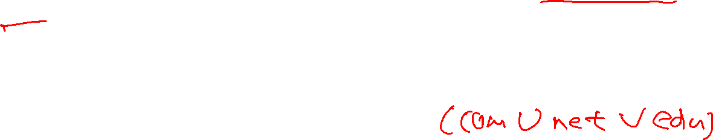
Regular Expressions
I have a giant text document. And I want to find all the email addresses inside. What does an email address look like?
[some letters and numbers] @ [more letters] . [com, net, or edu]
We want to ctrl-f for a pattern of strings rather than a single string

Slide 15
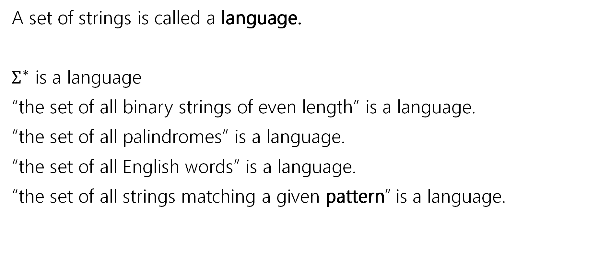

Languages
A set of strings is called a language.
$Σ^{∗}$ is a language
“the set of all binary strings of even length” is a language.
“the set of all palindromes” is a language.
“the set of all English words” is a language.
“the set of all strings matching a given pattern” is a language.

Slide 16
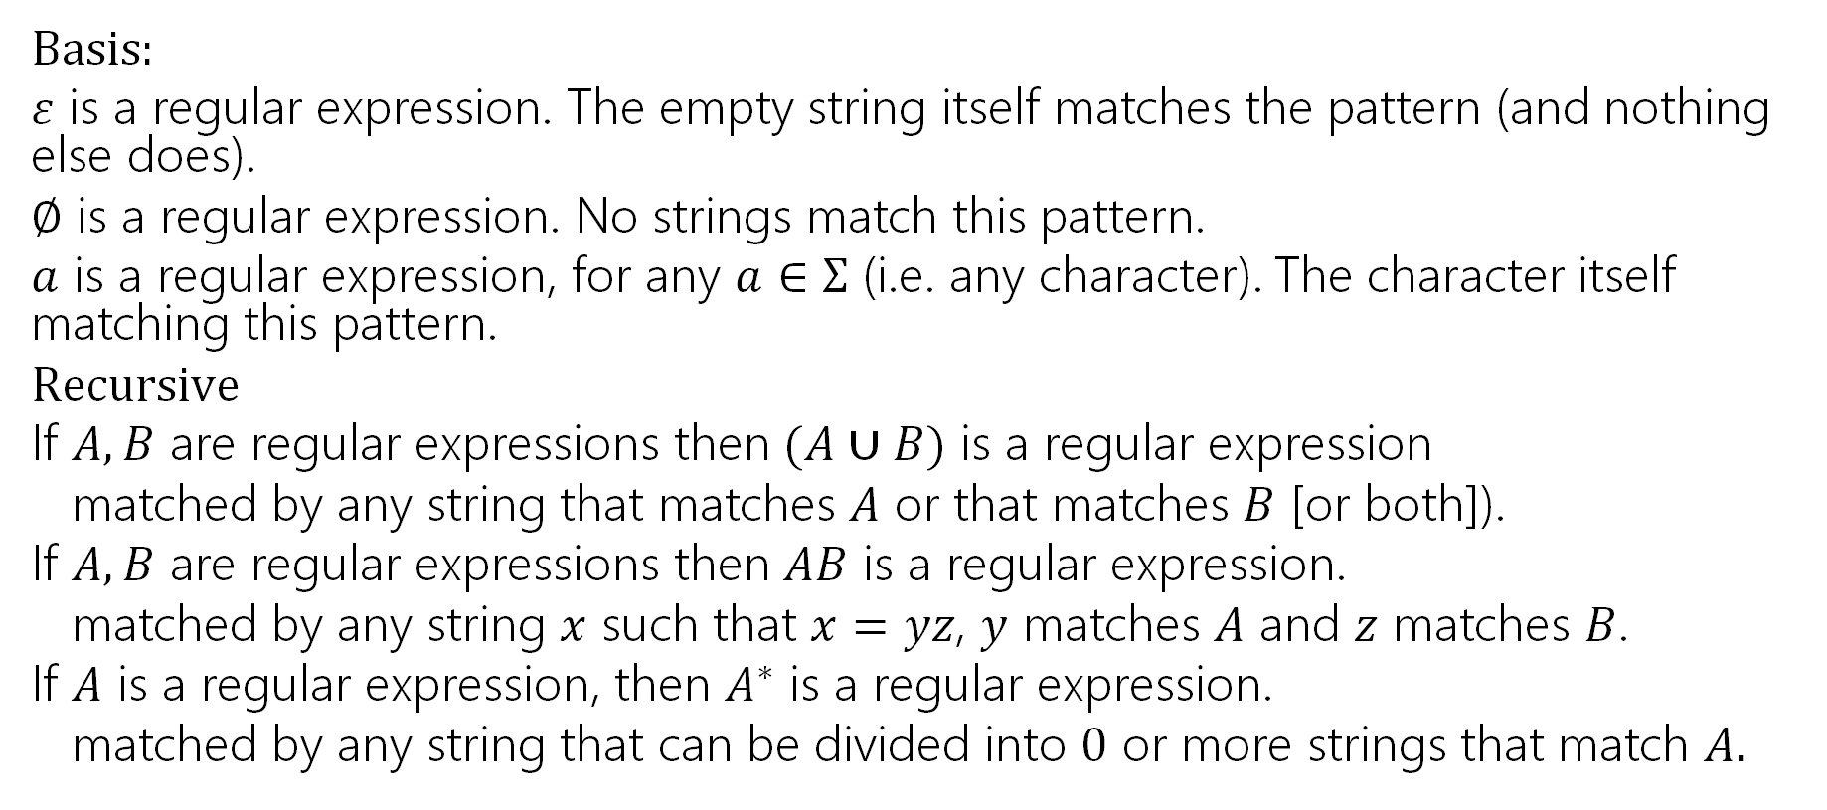
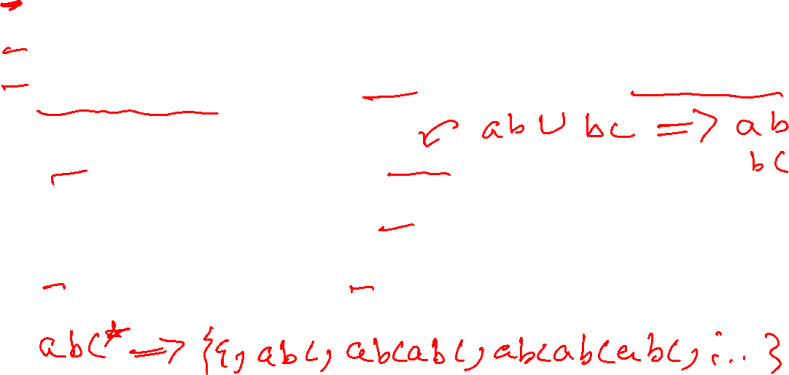
Regular Expressions
Basis:
$ε$ is a regular expression. The empty string itself matches the pattern (and nothing else does).
$∅$ is a regular expression. No strings match this pattern.
$a$ is a regular expression, for any $a∈Σ$ (i.e. any character). The character itself matching this pattern.
$Recursive$
If $A,B$ are regular expressions then $(A∪B)$ is a regular expression
matched by any string that matches $A$ or that matches $B$ [or both]).
If $A,B$ are regular expressions then $AB$ is a regular expression.
matched by any string $x$ such that $x=yz$, $y$ matches $A$ and $z$ matches $B$.
If $A$ is a regular expression, then $A^{∗}$ is a regular expression.
matched by any string that can be divided into $0$ or more strings that match $A.$

Slide 17

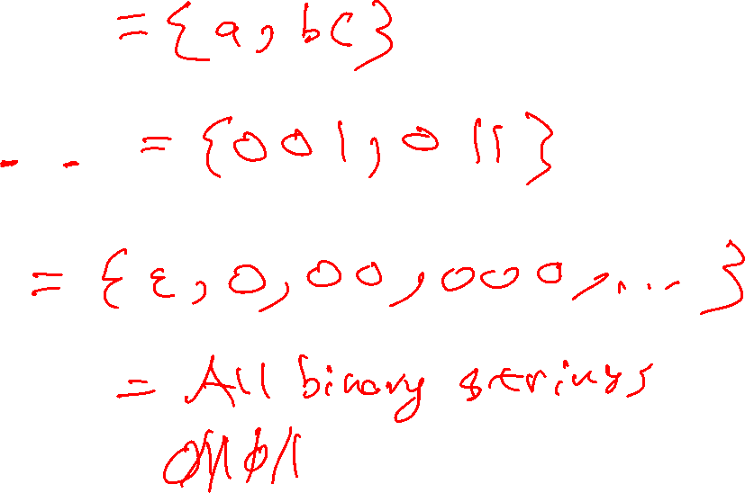
Regular Expressions
$(a∪bc)$
$0\left(0∪1\right)1$
$0^{∗}$
${\left(0∪1\right)}^{∗}$

Slide 18
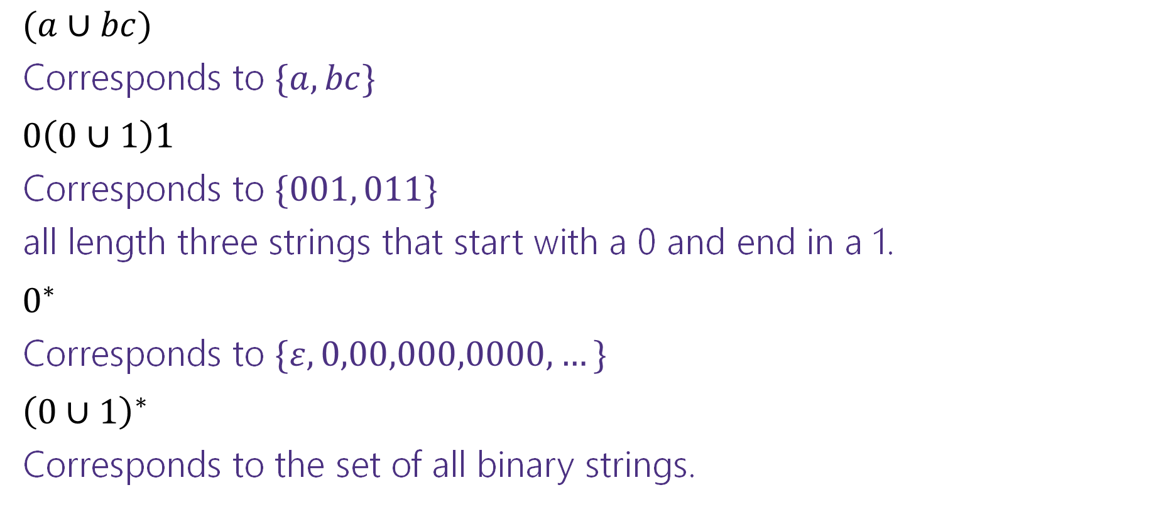
Regular Expressions
$(a∪bc)$
Corresponds to $\{a,bc\}$
$0\left(0∪1\right)1$
Corresponds to $\{001, 011\}$
all length three strings that start with a 0 and end in a 1.
$0^{∗}$
Corresponds to $\{ε,0,00,000,0000,…\}$
${\left(0∪1\right)}^{∗}$
Corresponds to the set of all binary strings.

Slide 19

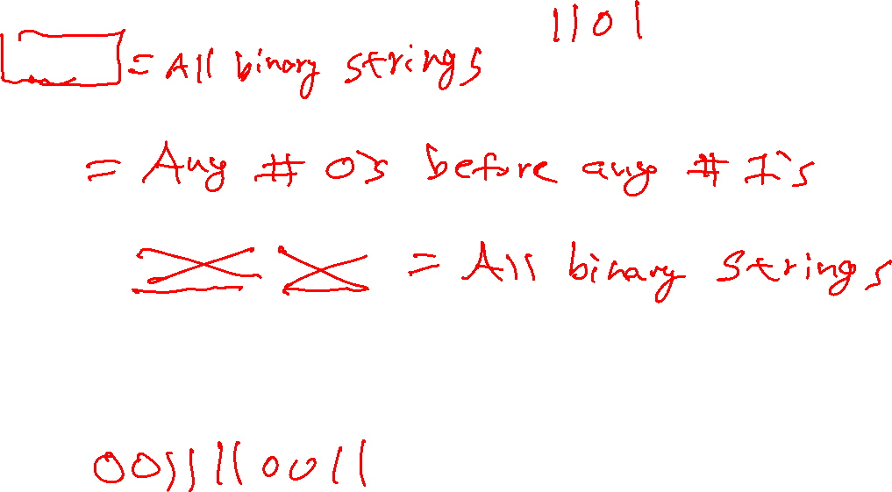
More Examples
${\left(0^{∗}1^{∗}\right)}^{∗}$
$0^{∗}1^{∗}$
${\left(0∪1\right)}^{∗}{\left(00∪11\right)}^{∗}{\left(0∪1\right)}^{∗}$
${\left(00∪11\right)}^{∗}$

Slide 20
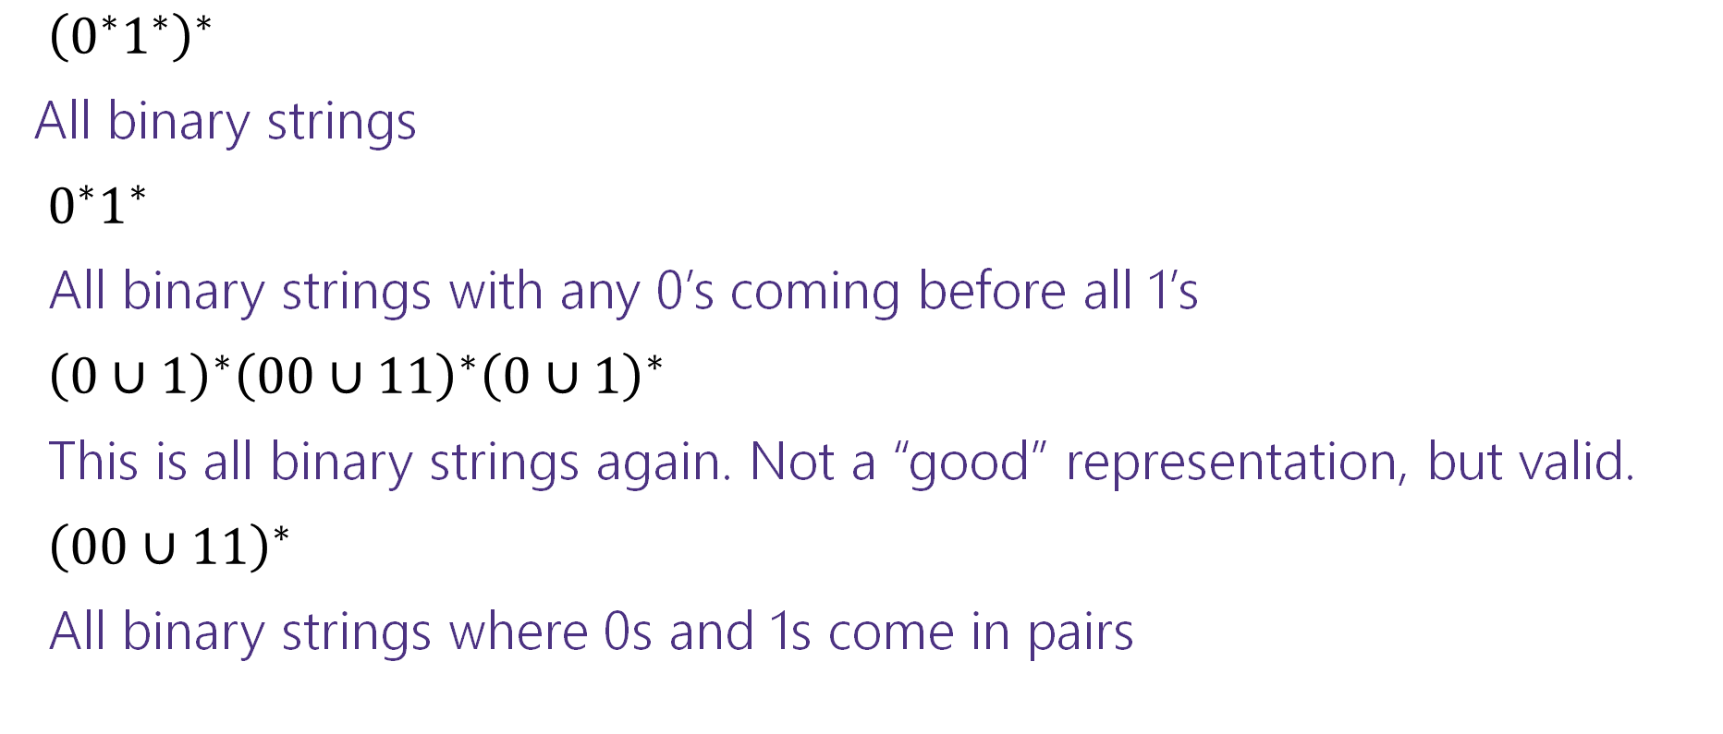
More Examples
${\left(0^{∗}1^{∗}\right)}^{∗}$
All binary strings
$0^{∗}1^{∗}$
All binary strings with any 0’s coming before all 1’s
${\left(0∪1\right)}^{∗}{\left(00∪11\right)}^{∗}{\left(0∪1\right)}^{∗}$
This is all binary strings again. Not a “good” representation, but valid.
${\left(00∪11\right)}^{∗}$
All binary strings where 0s and 1s come in pairs

Slide 21
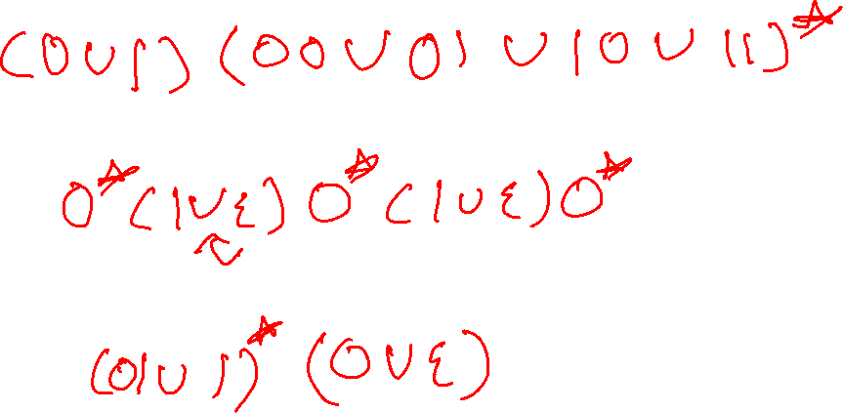
More Practice
You can also go the other way
Write a regular expression for “the set of all binary strings of odd length”
Write a regular expression for “the set of all binary strings with at most two ones”
Write a regular expression for “strings that don’t contain 00”

Slide 22
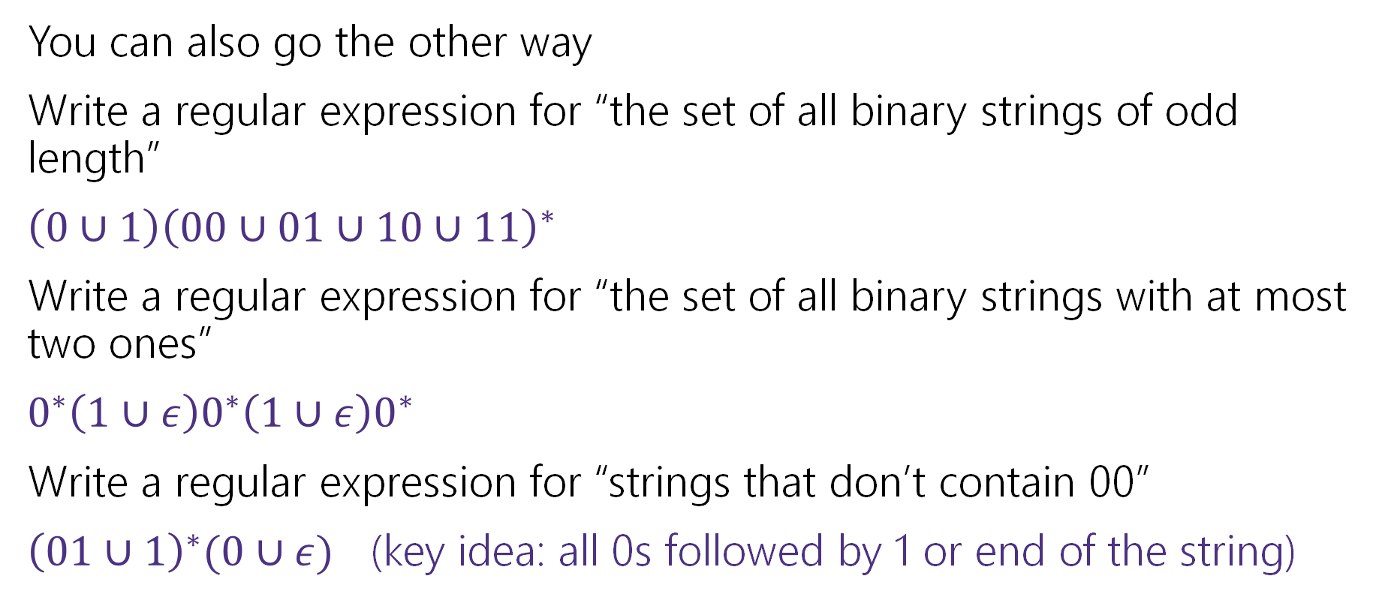

More Practice
You can also go the other way
Write a regular expression for “the set of all binary strings of odd length”
$\left(0∪1\right){\left(00∪01∪10∪11\right)}^{∗}$
Write a regular expression for “the set of all binary strings with at most two ones”
$0^{∗}\left(1∪ε\right)0^{∗}\left(1∪ε\right)0^{∗}$
Write a regular expression for “strings that don’t contain 00”
${\left(01∪1\right)}^{∗}(0∪ε)$ (key idea: all 0s followed by 1 or end of the string)

Slide 23
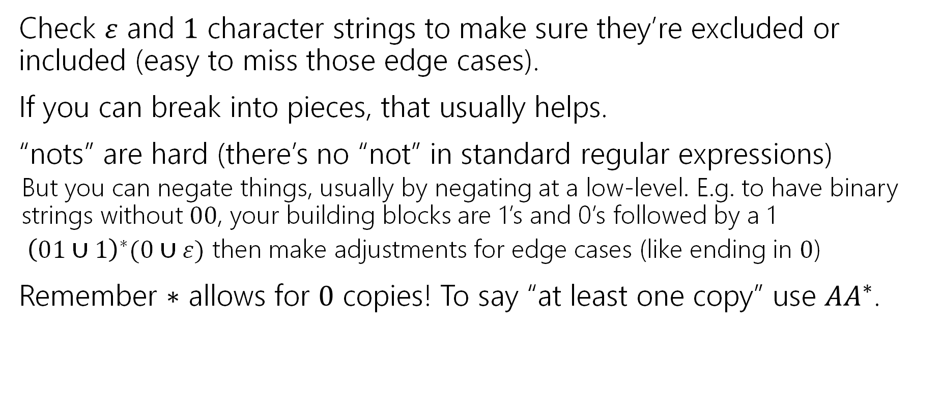

Practical Advice
Check $ε$ and $1$ character strings to make sure they’re excluded or included (easy to miss those edge cases).
If you can break into pieces, that usually helps.
“nots” are hard (there’s no “not” in standard regular expressions)
But you can negate things, usually by negating at a low-level. E.g. to have binary strings without $00$, your building blocks are 1’s and 0’s followed by a 1
${ \left(01∪1\right)}^{∗}(0∪ε)$ then make adjustments for edge cases (like ending in $0$)
Remember $∗$ allows for $0$ copies! To say “at least one copy” use $AA^{∗}$.

Slide 24

Regular Expressions In Practice
EXTREMELY useful. Used to define valid “tokens” (like legal variable names or all known keywords when writing compilers/languages)
Used in grep to actually search through documents.
Pattern p = Pattern.compile("a*b");
Matcher m = p.matcher("aaaaab");
boolean b = m.matches();
^ start of string
$ end of string
[01] a 0 or a 1
[0-9] any single digit
\. period \, comma \- minus
. any single character
ab a followed by b (AB)
(a|b) a or b (A ∪ B) a? zero or one of a (A ∪ ε) a* zero or more of a A*
a+ one or more of a AA*
e.g. ^[\-+]?[0-9]*(\.|\,)?[0-9]+$
General form of decimal number e.g. 9.12 or -9,8 (Europe)
Notes:
You’ll learn this in CSE 391!

Slide 25
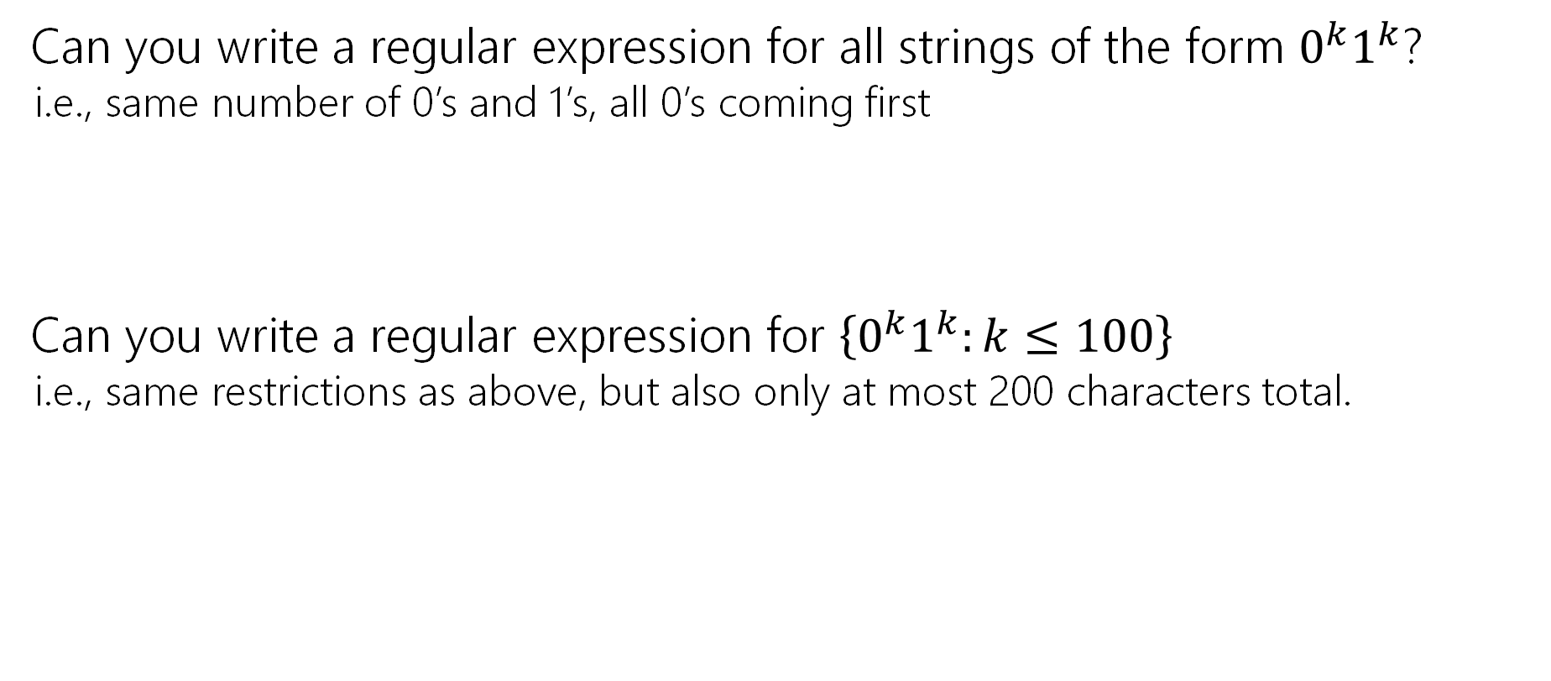
What can’t regular expressions do?
Can you write a regular expression for all strings of the form $0^{k}1^{k}$?
i.e., same number of 0’s and 1’s, all 0’s coming first
Can you write a regular expression for $\left\{0^{k}1^{k}:k≤100\right\}$
i.e., same restrictions as above, but also only at most 200 characters total.

Slide 26
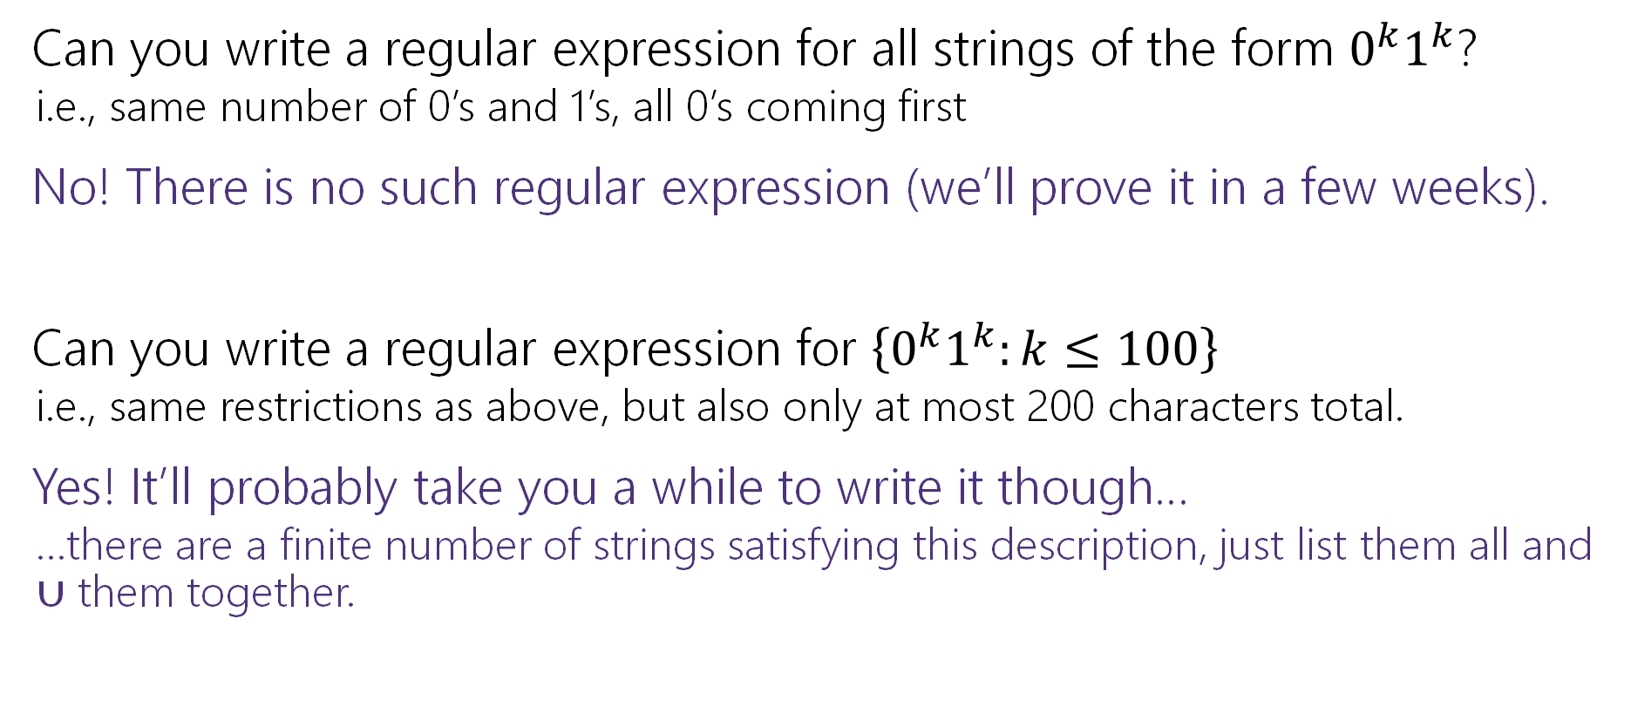
What can’t regular expressions do?
Can you write a regular expression for all strings of the form $0^{k}1^{k}$?
i.e., same number of 0’s and 1’s, all 0’s coming first
No! There is no such regular expression (we’ll prove it in a few weeks).
Can you write a regular expression for $\left\{0^{k}1^{k}:k≤100\right\}$
i.e., same restrictions as above, but also only at most 200 characters total.
Yes! It’ll probably take you a while to write it though…
…there are a finite number of strings satisfying this description, just list them all and $∪$ them together.

Slide 27
A Vocabulary Note
Not everything can be represented as a regular expression.
E.g. “the set of all palindromes” is not the language of any regular expression.
Some programming languages define features in their “regexes” that can’t be represented by our definition of regular expressions.
Things like “match this pattern, then have exactly that substring appear later.
So before you say “ah, you can’t do that with regular expressions, I learned it in 311!” you should make sure you know whether your language is calling a more powerful object “regular expressions”.
But the more “fancy features” beyond regular expressions you use, the slower the checking algorithms run, (and the harder it is to force the expressions to fit into the framework) so this is still very useful theory.

Slide 28
More Practice: Regular Expressions

Slide 29
More Practice
All binary strings with a 1 in the third position. (index from 1)
All binary strings with a 1 in the third position from the end (with length at least three).
All binary strings with an even number of 0s or exactly one 1.

Slide 30
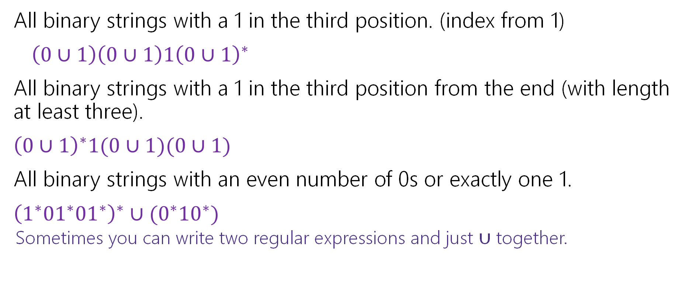
More Practice
All binary strings with a 1 in the third position. (index from 1)
$\left(0∪1\right)\left(0∪1\right)1{\left(0∪1\right)}^{∗}$
All binary strings with a 1 in the third position from the end (with length at least three).
${\left(0∪1\right)}^{∗}1(0∪1)(0∪1)$
All binary strings with an even number of 0s or exactly one 1.
${\left(1^{∗}{01}^{∗}{01}^{∗}\right)}^{∗}∪(0^{∗}{10}^{∗})$
Sometimes you can write two regular expressions and just $∪$ together.

Slide 31

Context Free Grammars
Another way of defining a language

Slide 32
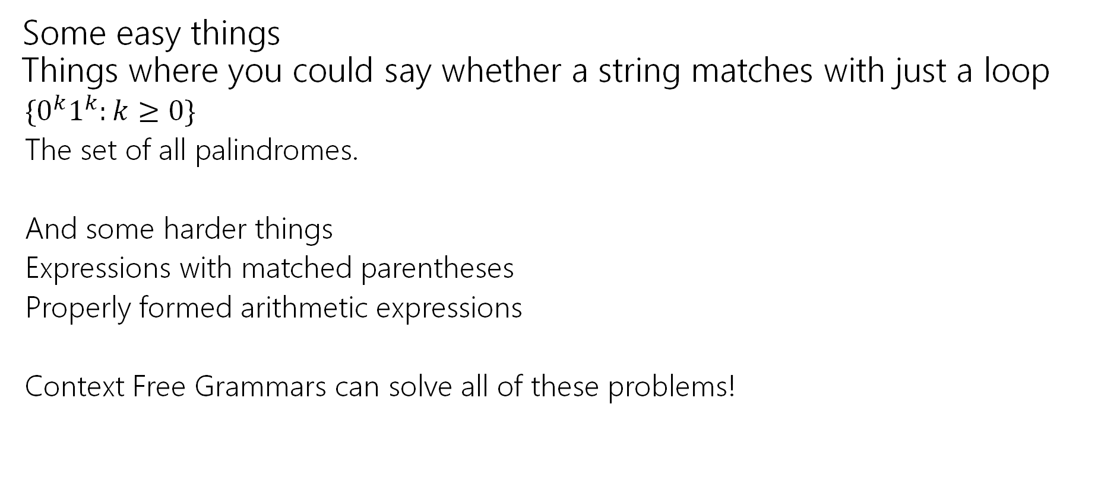

What Can’t Regular Expressions Do?
Some easy things Things where you could say whether a string matches with just a loop
$\{0^{k}1^{k}:k≥0\}$
The set of all palindromes.
And some harder things
Expressions with matched parentheses
Properly formed arithmetic expressions
Context Free Grammars can solve all of these problems!

Slide 33
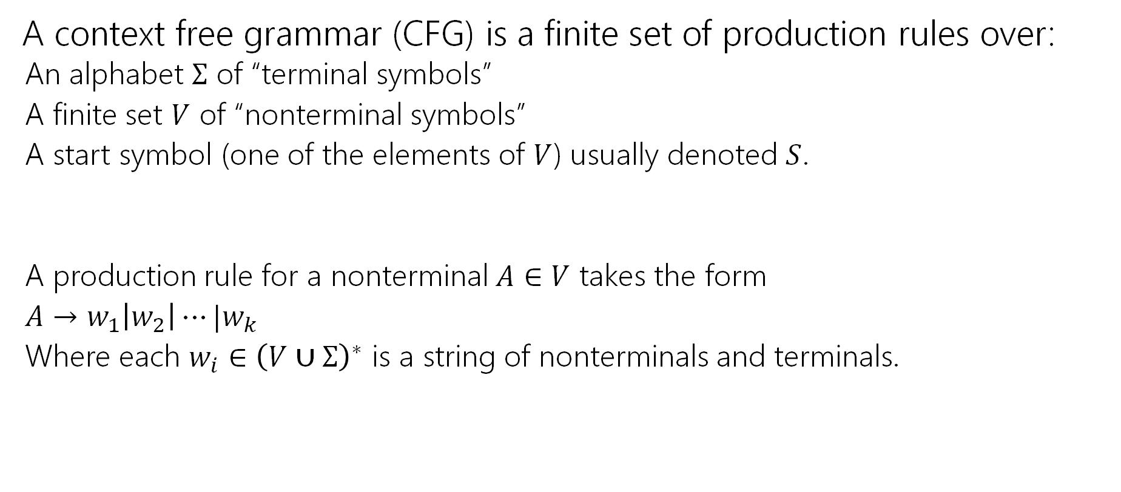

Context Free Grammars
A context free grammar (CFG) is a finite set of production rules over:
An alphabet $Σ$ of “terminal symbols”
A finite set $V$ of “nonterminal symbols”
A start symbol (one of the elements of $V$) usually denoted $S$.
A production rule for a nonterminal $A∈V$ takes the form
$A→w_{1}\left|w_{2}\right|⋯|w_{k}$
Where each $w_{i}∈{\left(V∪Σ\right)}^{∗}$ is a string of nonterminals and terminals.

Slide 34
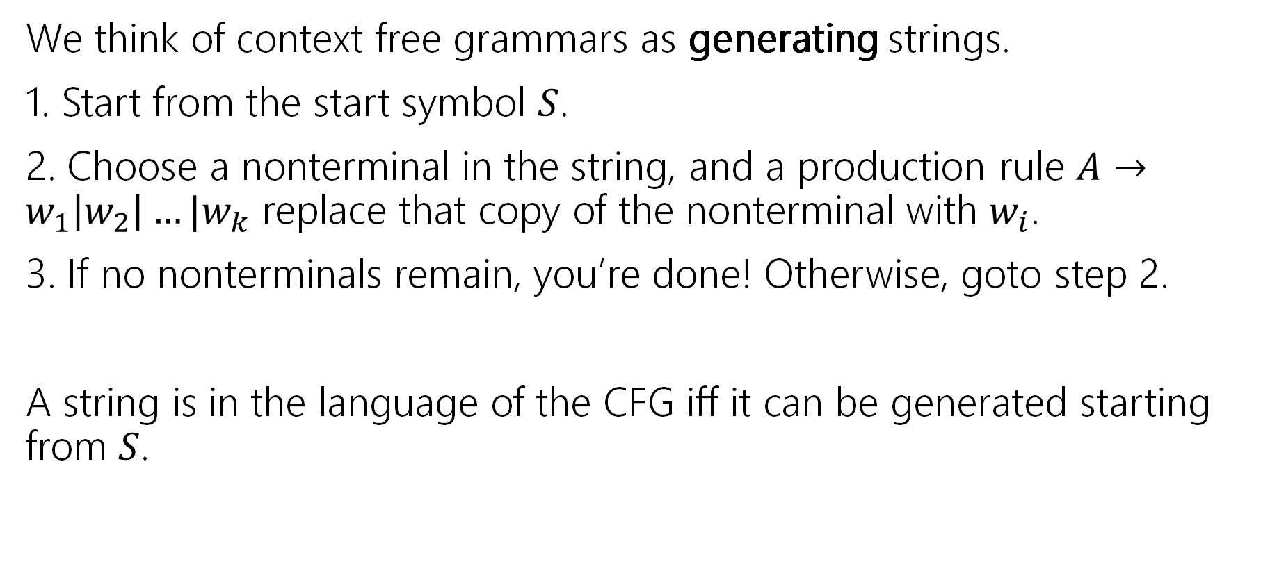

Context Free Grammars
We think of context free grammars as generating strings.
1. Start from the start symbol $S$.
2. Choose a nonterminal in the string, and a production rule $A→w_{1}\left|w_{2}\right|…|w_{k}$ replace that copy of the nonterminal with $w_{i}$.
3. If no nonterminals remain, you’re done! Otherwise, goto step 2.
A string is in the language of the CFG iff it can be generated starting from $S$.

Slide 35

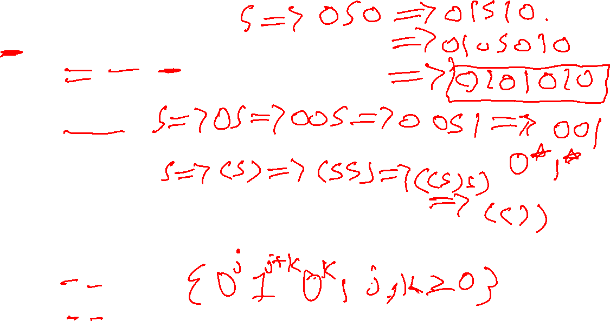
Examples
$S→0S0\left|1S1\right|0|1|ε$
$S→0S|S1|ε$
$S→\left(S\right)\left|SS\right|ε$
$S→AB$
$A→0A1|ε$
$B→1B0|ε$
The alphabet here is {(,)} i.e. parentheses are the characters.

Slide 36
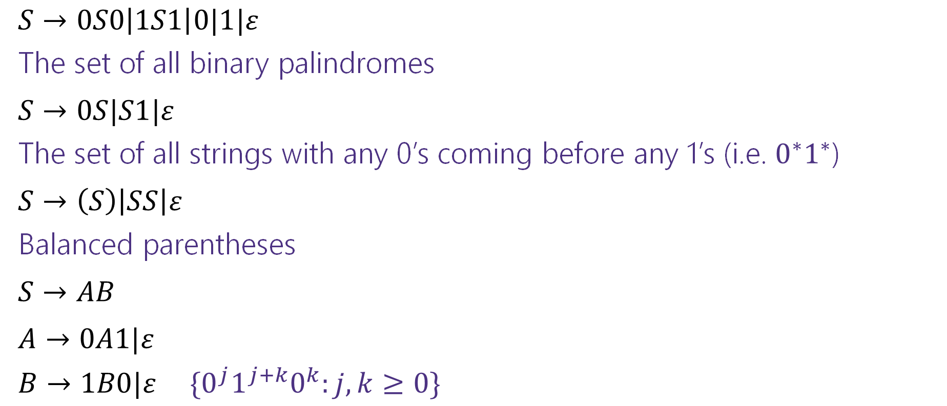
Examples
$S→0S0\left|1S1\right|0|1|ε$
The set of all binary palindromes
$S→0S|S1|ε$
The set of all strings with any 0’s coming before any 1’s (i.e. $0^{∗}1^{∗}$)
$S→\left(S\right)\left|SS\right|ε$
Balanced parentheses
$S→AB$
$A→0A1|ε$
$B→1B0|ε$ $\{0^{j}1^{j+k}0^{k}:j,k≥0\}$

Slide 37

Arithmetic
$E→E+E\left|E∗E\right|\left(E\right)\left|x\right|y\left|z\right|0\left|1\right|2\left|3\right|4\left|5\right|6\left|7\right|8|9$
Generate $\left(2∗x\right)+y$
Generate $2+3∗4$ in two different ways

Slide 38
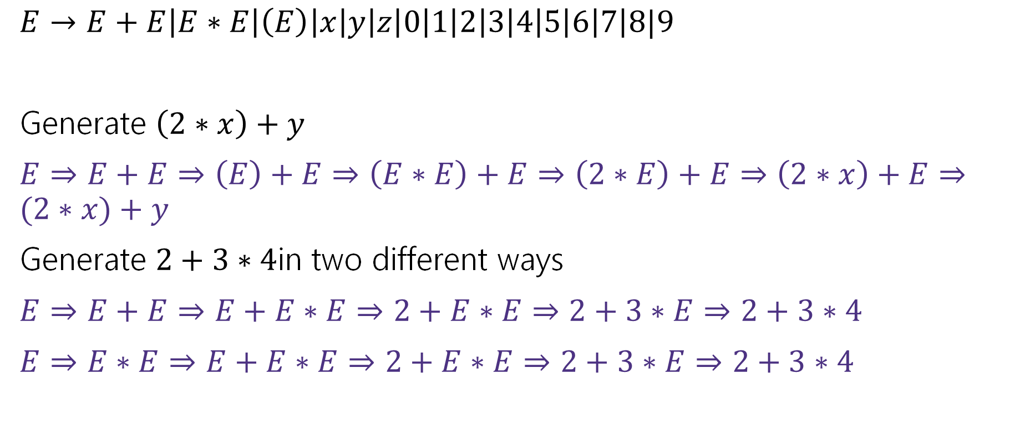

Arithmetic
$E→E+E\left|E∗E\right|\left(E\right)\left|x\right|y\left|z\right|0\left|1\right|2\left|3\right|4\left|5\right|6\left|7\right|8|9$
Generate $\left(2∗x\right)+y$
$E⇒E+E⇒\left(E\right)+E⇒\left(E∗E\right)+E⇒\left(2∗E\right)+E⇒\left(2∗x\right)+E⇒(2∗x)+y$
Generate $2+3∗4$in two different ways
$E⇒E+E⇒E+E∗E⇒2+E∗E⇒2+3∗E⇒2+3∗4$
$E⇒E∗E⇒E+E∗E⇒2+E∗E⇒2+3∗E⇒2+3∗4$

Slide 39
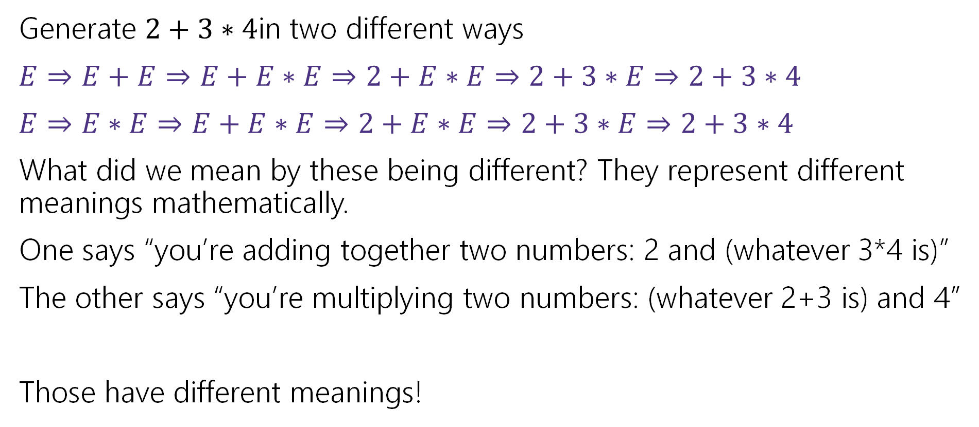
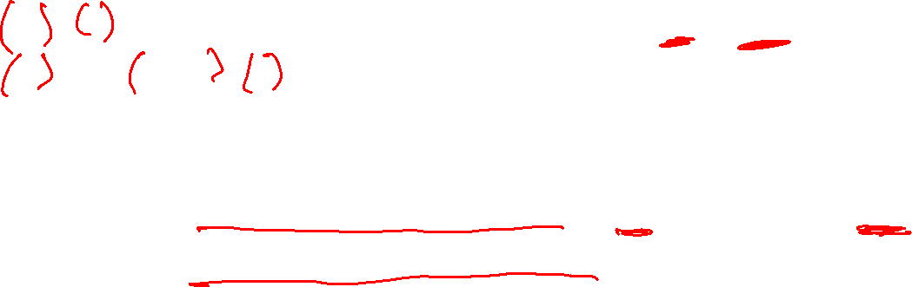
Multiple ways of generating strings
Generate $2+3∗4$in two different ways
$E⇒E+E⇒E+E∗E⇒2+E∗E⇒2+3∗E⇒2+3∗4$
$E⇒E∗E⇒E+E∗E⇒2+E∗E⇒2+3∗E⇒2+3∗4$
What did we mean by these being different? They represent different meanings mathematically.
One says “you’re adding together two numbers: 2 and (whatever 3*4 is)”
The other says “you’re multiplying two numbers: (whatever 2+3 is) and 4”
Those have different meanings!

Slide 40
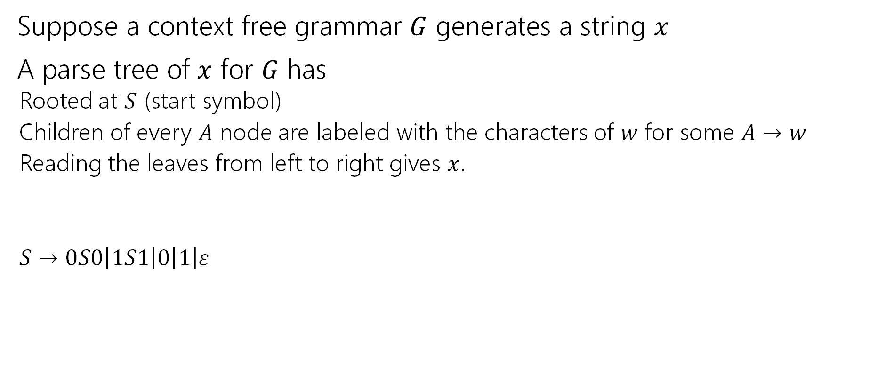

Parse Trees—remember where parentheses go
Suppose a context free grammar $G$ generates a string $x$
A parse tree of $x$ for $G$ has
Rooted at $S$ (start symbol)
Children of every $A$ node are labeled with the characters of $w$ for some $A→w$
Reading the leaves from left to right gives $x$.
$S→0S0\left|1S1\right|0\left|1\right|ε$
S
0
S
0
1
S
1
1

Slide 41



Back to the arithmetic
$E→E+E\left|E∗E\right|\left(E\right)\left|x\right|y\left|z\right|0\left|1\right|2\left|3\right|4\left|5\right|6\left|7\right|8|9$
Two parse trees for $2+3∗4$
E
E
E
+
E
E
$$∗$$
E
E
$$∗$$
E
+
E
4
2
E
3
4
2
3

Slide 42
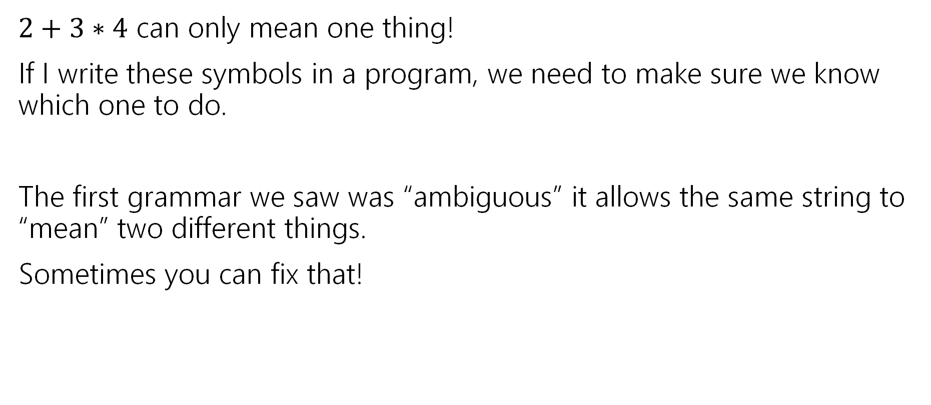
Why do we care about parsing?
$2+3∗4$ can only mean one thing!
If I write these symbols in a program, we need to make sure we know which one to do.
The first grammar we saw was “ambiguous” it allows the same string to “mean” two different things.
Sometimes you can fix that!

Slide 43

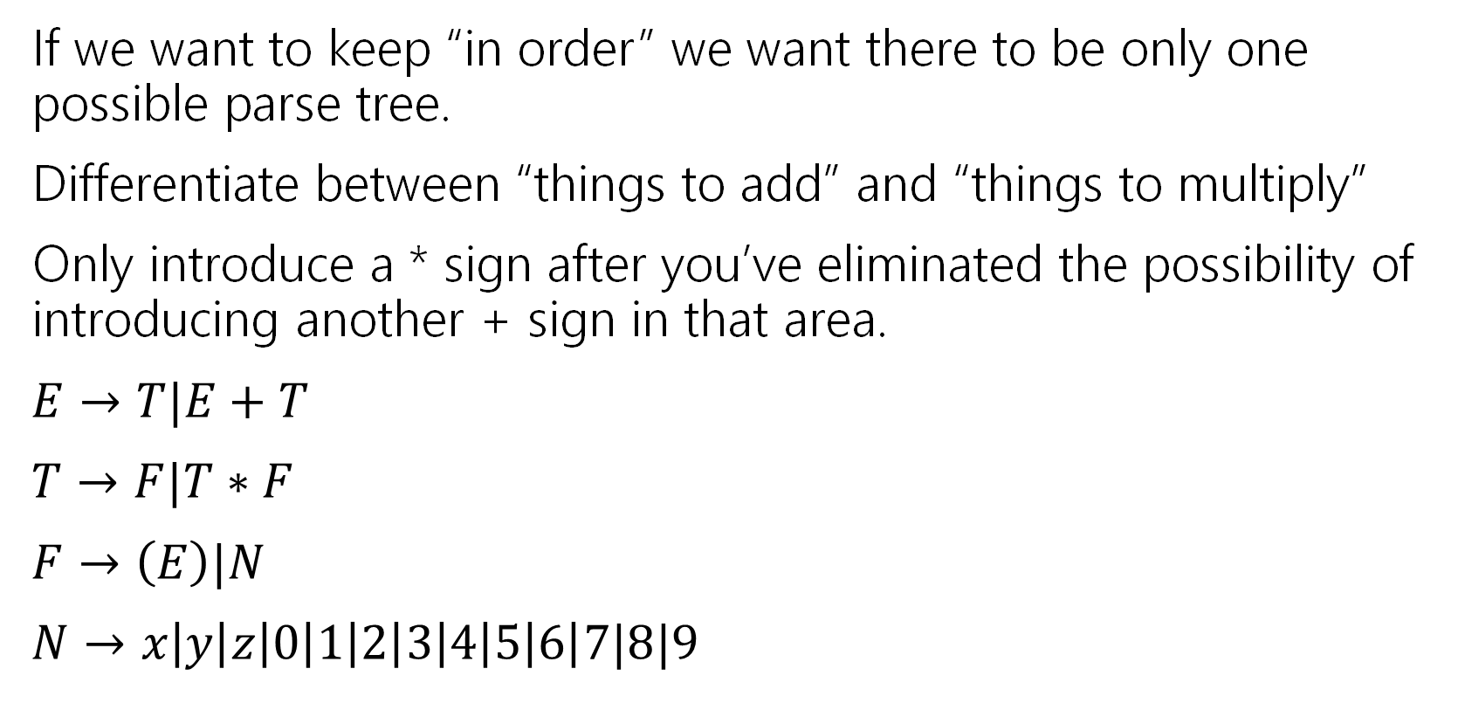
How do we encode order of operations
If we want to keep “in order” we want there to be only one possible parse tree.
Differentiate between “things to add” and “things to multiply”
Only introduce a * sign after you’ve eliminated the possibility of introducing another + sign in that area.
$E→T|E+T$
$T→F|T∗F$
$F→\left(E\right)|N$
$N→x\left|y\right|z\left|0\right|1\left|2\right|3\left|4\right|5\left|6\right|7|8|9$
E
E
+
T
T
T
$$∗$$
F
F
N
F
N
4
N
3
2

Slide 44
How do Computer Scientists use CFGs?
Most programming languages define valid programs as “strings that fit a CFG” That makes sure Java breaks down math expressions correctly! And also code like this:
if(i>0)
if(j>0)
System.out.println(“hi”);
else
System.out.println(“bye”);
if(i>0)
if(j>0)
System.out.println(“hi”);
else
System.out.println(“bye”);
The else could be attached to either “if”! Java needs a rule to decide which it goes with.
Java’s convention makes the one on the left the intuitive whitespace.
(You as a programmer should put braces so the humans reading your code don’t have to wonder!)

Slide 45
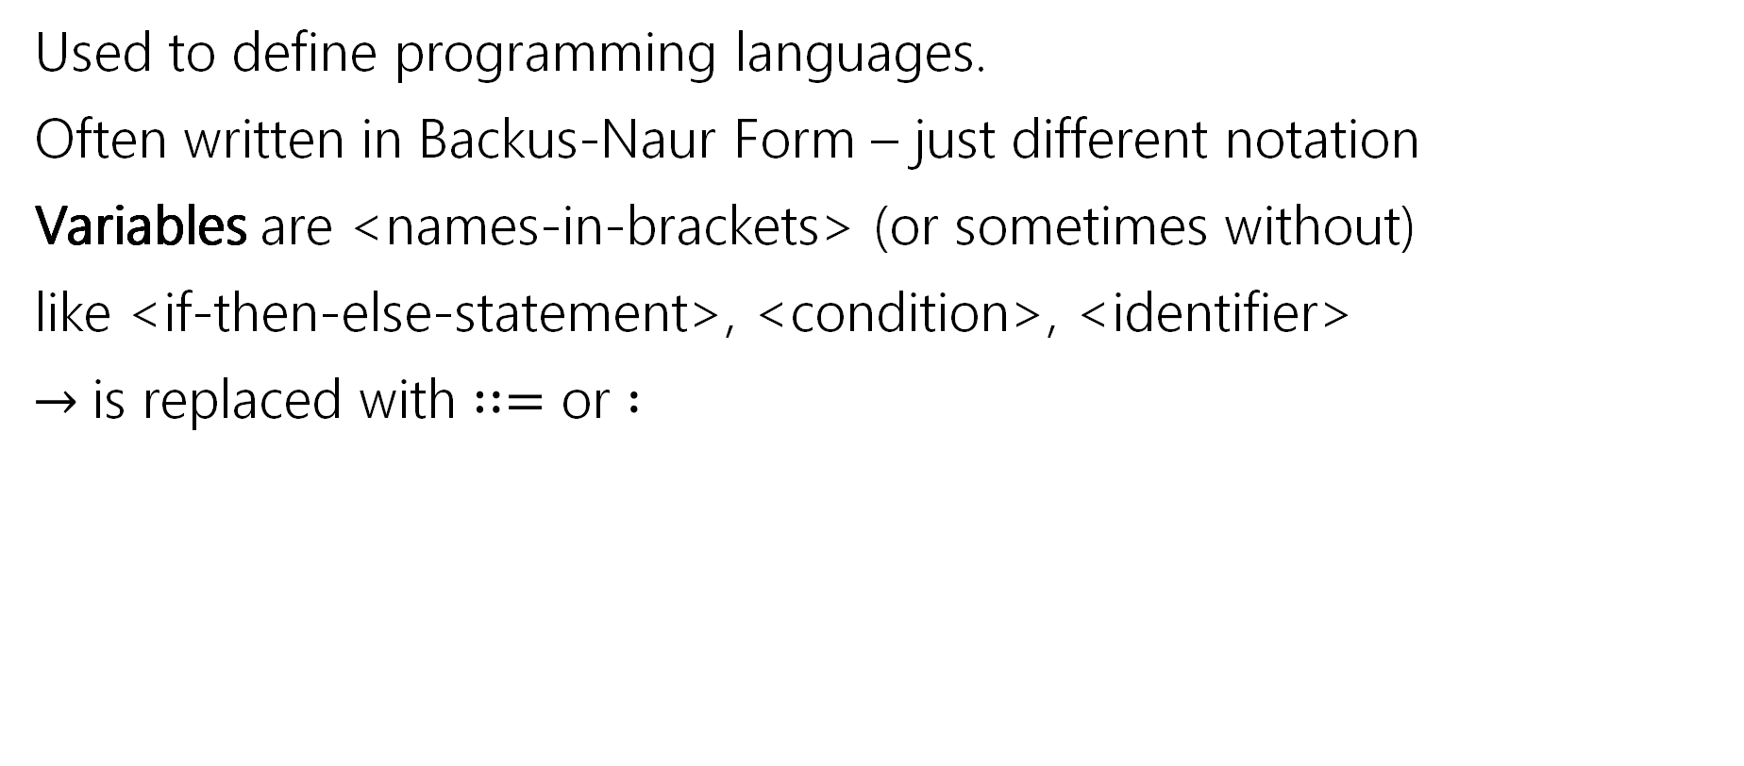

CFGs in practice
Used to define programming languages.
Often written in Backus-Naur Form – just different notation
Variables are <names-in-brackets> (or sometimes without)
like <if-then-else-statement>, <condition>, <identifier>
$→$is replaced with $∷=$ or $:$

Slide 46
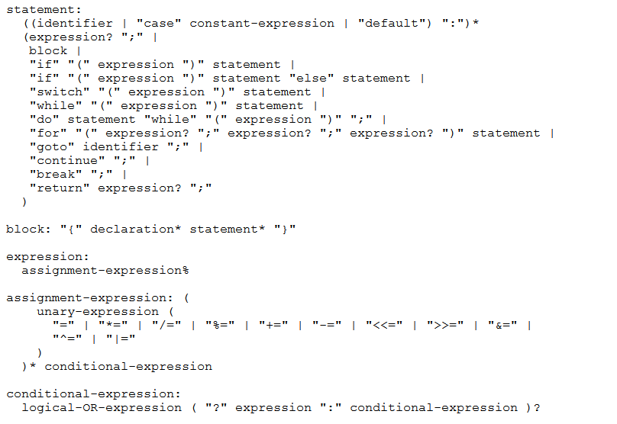
BNF for C (no <...> and uses : instead of ::=)

Slide 47
Some fun CFG applications
If we have time

Slide 48
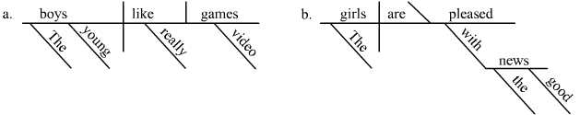
Parse Trees
Remember diagramming sentences in middle school?
<sentence>::=<noun phrase><verb phrase>
<noun phrase>::=<determiner><adjective><noun>
<verb phrase>::=<verb><adverb>|<verb><object>
<object>::=<noun phrase>

Slide 49
Parse Trees
<sentence>::=<noun phrase><verb phrase>
<noun phrase>::=<determiner><adjective><noun>
<verb phrase>::=<verb><adverb>|<verb><object>
<object>::=<noun phrase>
The old man the boat.

Slide 50
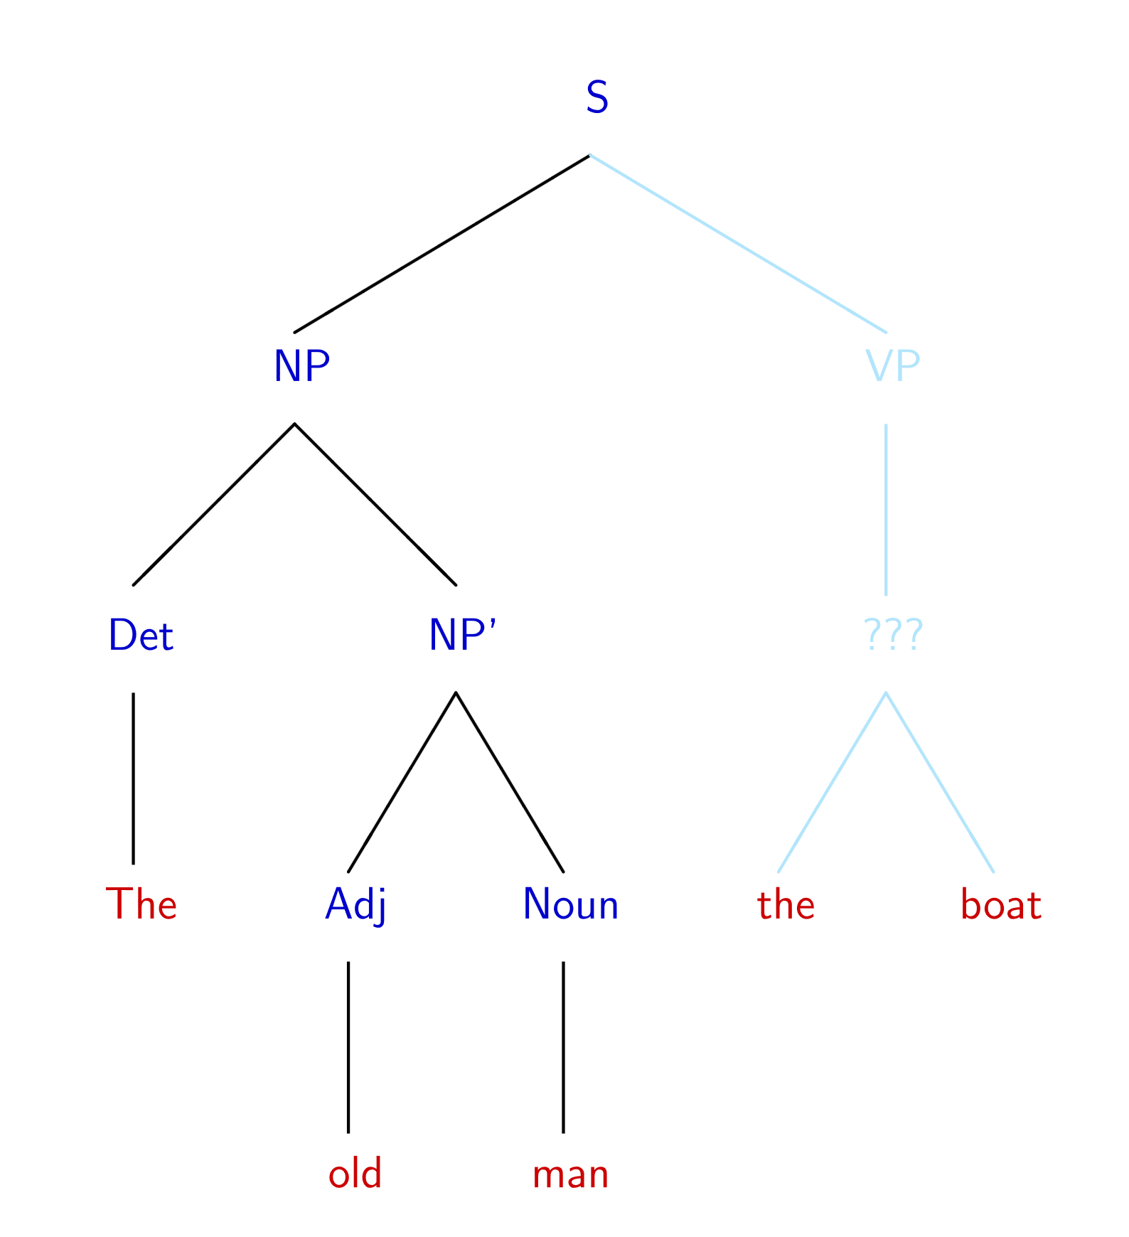
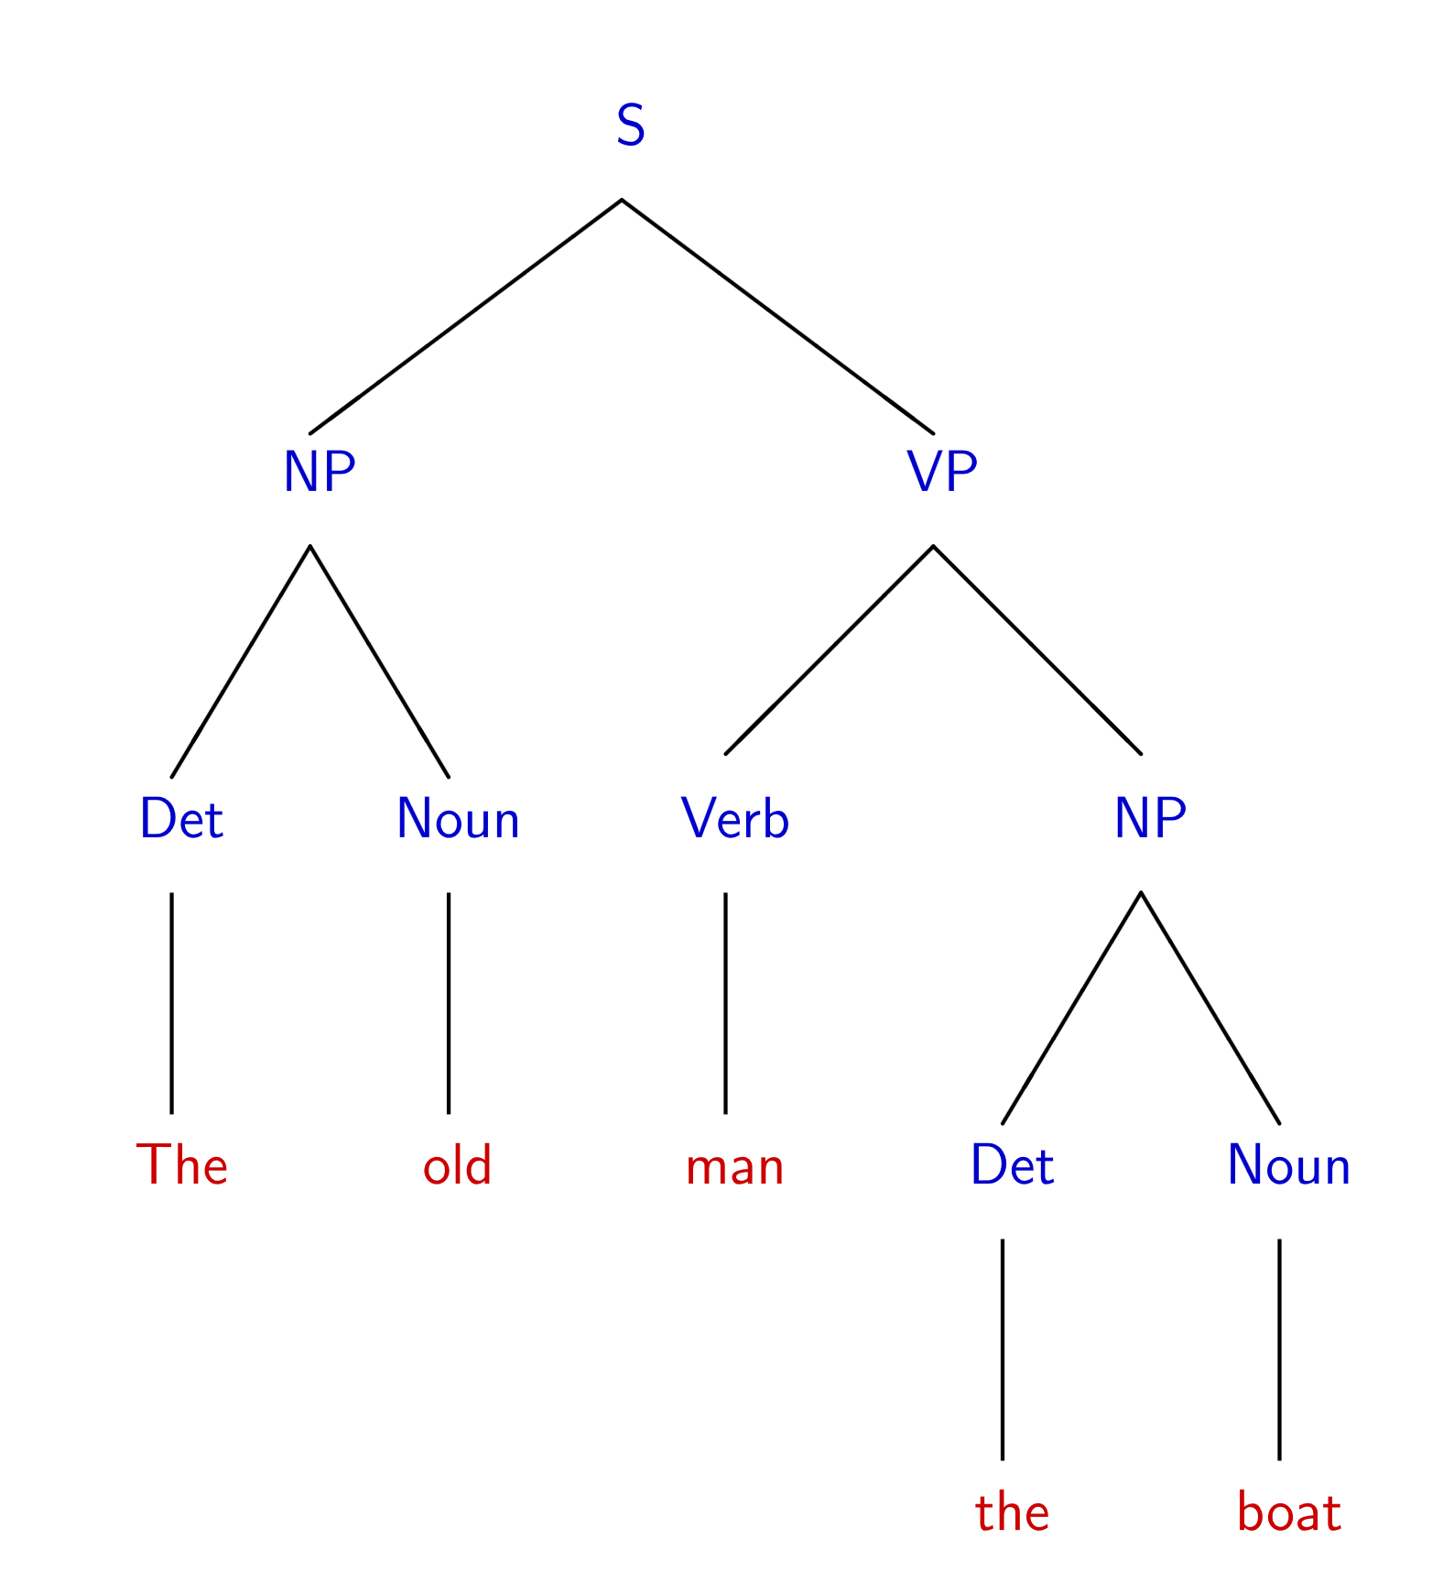
The old man the boat
By Jochen Burghardt - Own work, CC BY-SA 4.0, https://commons.wikimedia.org/w/index.php?curid=92742400

Slide 51
English is ambiguous
(Most of ‘standard’) English can be represented as a context free grammar.
It’s not perfect.
The grammar is ambiguous! That is, there are sentences which have multiple valid parsings (multiple meanings).
Can you find multiple meanings of this sentence: “Place these 3 exercise balls on the mat at the top of the hill.”
See this video

Slide 52
The Important Takeaways

Slide 53
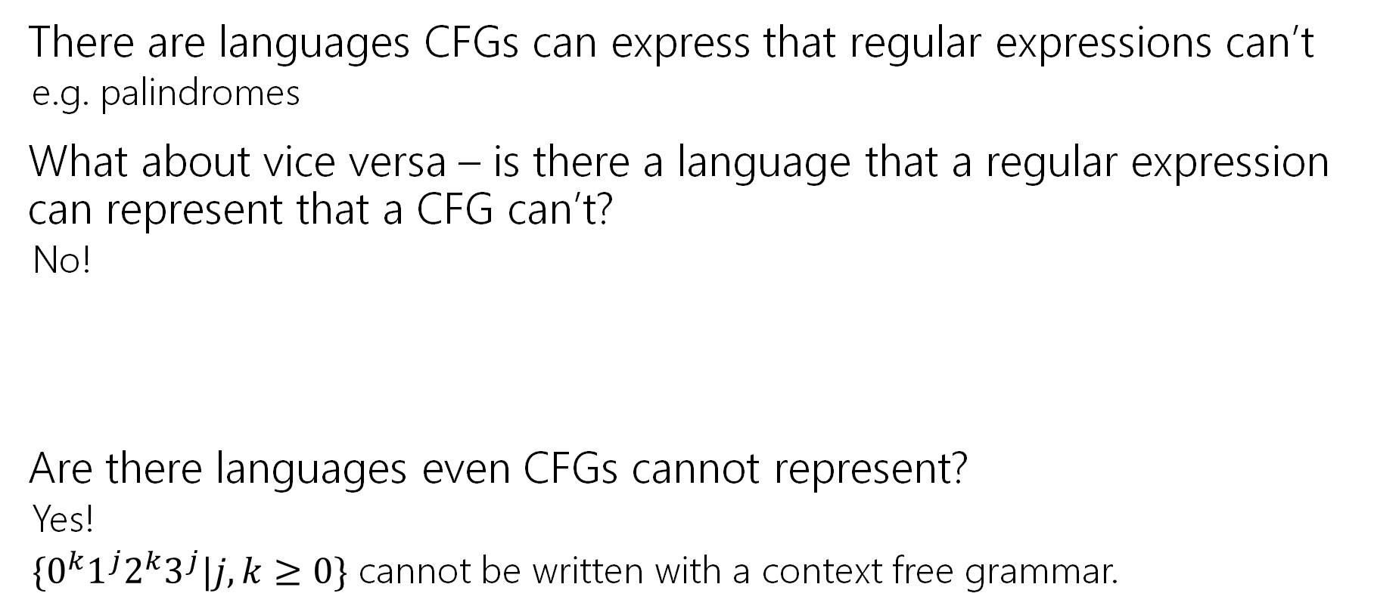
Power of Context Free Languages
There are languages CFGs can express that regular expressions can’t
e.g. palindromes
What about vice versa – is there a language that a regular expression can represent that a CFG can’t?
No!
Are there languages even CFGs cannot represent?
Yes!
$\{0^{k}1^{j}2^{k}3^{j}|j,k≥0\}$ cannot be written with a context free grammar.

Slide 54
Takeaways
CFGs and regular expressions gave us ways of succinctly representing sets of strings
Regular expressions super useful for representing things you need to search for
CFGs represent complicated languages like “java code with valid syntax”
Next: (mathematical representations of) Tiny computers! And how they relate to regular expressions and CFGs.

Slide 55
Todo
Tonight:
CC 18 is out and due Friday at noon
Fill out the midterm retake scheduling form by Thursday EOD
Start working on HW6 after lecture if you haven’t already

